Slide 1
Operational Aspects of SC RF Cavities with Beam
Matthias Liepe
Department of Physics, CLASSE
Cornell University
With Slides provided by S. Belomestnykh

Slide 2

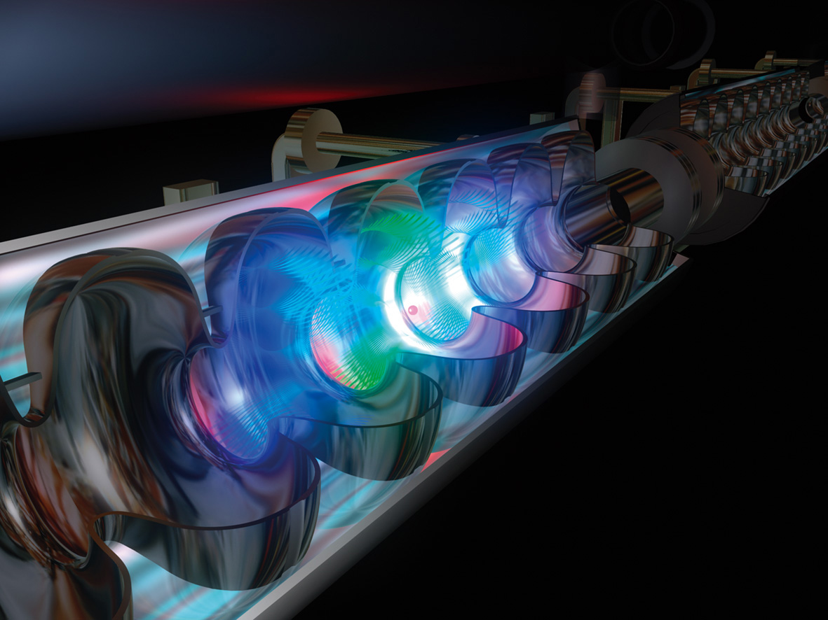
SRF Cavity and Beam: A Love Story?
1970
since ~1970

Slide 3
Outline: SRF and Beam
Introduction: Superconducting RF and beam
Fundamental mode and beam
  Beam induced fields: Single bunch and bunch train
  Beam loading and optimal loaded Q
Higher Order Modes and beam
  HOM excitation by the beam
  HOM issues: heating, beam instability and emittance growth
  Beam based HOM damping measurements
Operational aspects
  Field perturbations and energy stability
  Beam based field calibration
  Cavity performance with beam
Outline

Slide 4

  Introduction: Superconducting RF and beam
Introduction: SRF and Beam

Slide 5
And there was beam…
Two different points of view:
  The SRF cavity’s view:
    I could function so nicely if the beam wouldn't cause such a mess…
  The beam’s view:
    OK, gaining energy is nice, but why do these cavities also have to disturb me so much?
Introduction: SRF and Beam

Slide 6
The Cavity and the Beam…
Impact on the SRF cavity:
Beam loading, field perturbations, increased RF power
HOM power handling and heating issues
Beam induced trips
…
Impact on the Beam:
Energy gain, energy (in)stability
Beam instability and emittance growth
Beam loss due to RF trips
…
Introduction: SRF and Beam

Slide 7
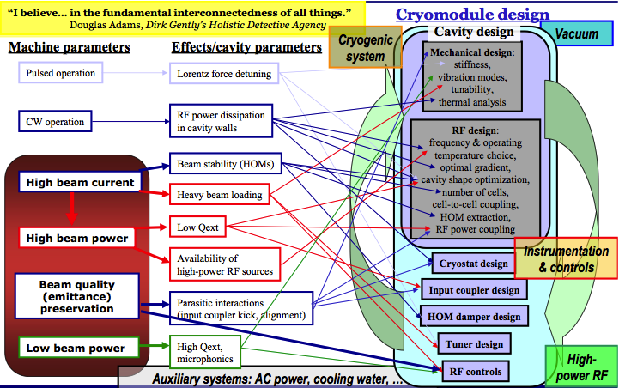
SRF Cavity Design and Beam
Introduction: SRF and Beam

Slide 8
Beam-related Cavity Design Issues
High beam current: ➔ beam instability due to interaction with cavity higher-order modes ➔ cavity and HOM absorber design for strong damping; frequency choice; high HOM power handling and heating issues
High beam power: ➔ heavy beam loading, low Q_{ext} ➔ tuner design to compensate reactive component; RF controls to fight field perturbations; high RF power amplifier availability, input coupler design
Low beam power: ➔ high Q_{ext} ➔ microphonics and compensation, mechanical design, LLRF feedback
Beam quality (emittance) preservation: ➔ minimize parasitic interactions (coupler kick, HOMs) ➔ input coupler and cavity design; frequency choice; cavity alignment; short range wake fields; RF focusing
High energy stability: ➔ high amplitude and phase stability ➔ RF controls (feedback and feedforward loops)
Introduction: SRF and Beam

Slide 9
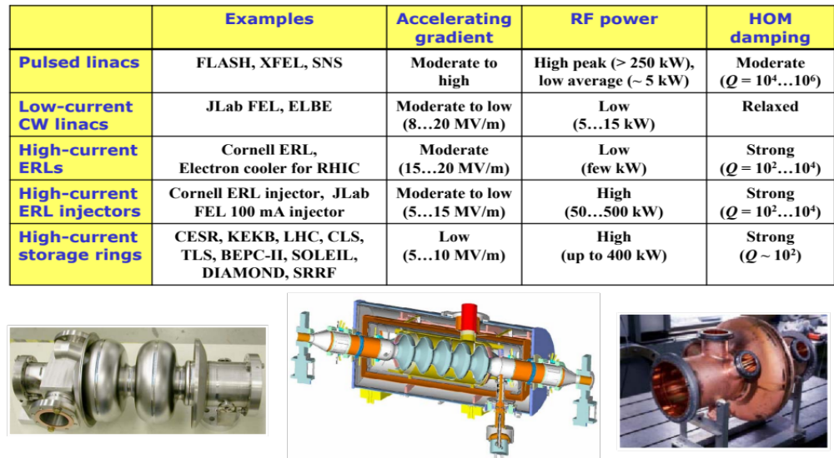
SRF Cavities: Typical Requirements for different Beams
Introduction: SRF and Beam

Slide 10
Different Beams, different SRF Cavities, different Functions
Fundamental RF for beam acceleration
  Provide energy gain
  Secondary functions: bunching, quantum lifetime, energy acceptance
(3rd) Harmonic RF for altering fundamental RF waveform
  Reduce beam energy spread by flattening effective RF wave at crest
  Shorten bunch length by increasing RF wave slope
  Lengthen bunches by flattening RF wave at synchronous phase and thus making wider potential well (often beam induced voltage on passive cavities is used)
Dipole mode RF for beam deflection
  Crab cavities rotate bunches for head-on collisions
SRF guns
  Fast acceleration and RF focusing of the beam (possibly using magnetic field from a HOM)
Introduction: SRF and Beam

Slide 11
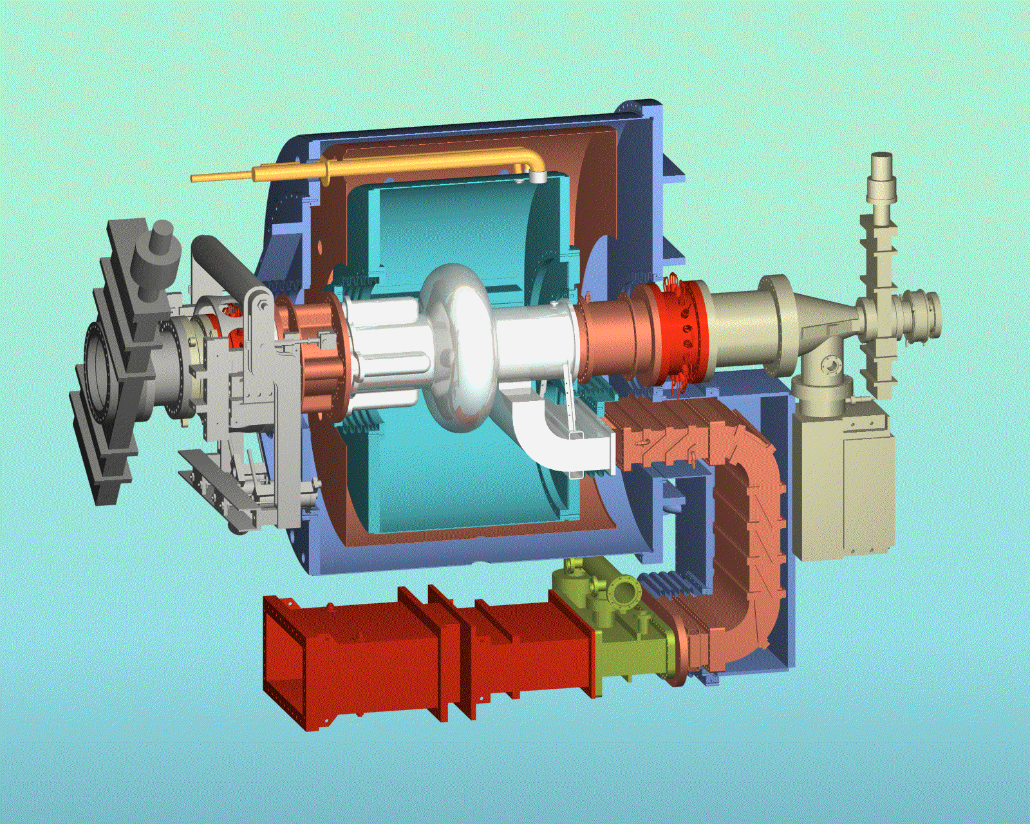
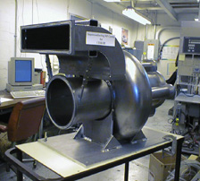
SRF for Storage Rings
Provide energy gain: deliver RF power to a high-current beam(s)
Provide high voltage for high synchrotron tune and short bunch length
Provide enough voltage for good quantum lifetime
Provide voltage for good energy acceptance
Suppress parasitic interaction of a beam with higher-order modes (HOMs) by providing good HOM damping (concept of so-called HOM-damped, HOM-free or single-mode cavity).
Introduction: SRF and Beam

Slide 12
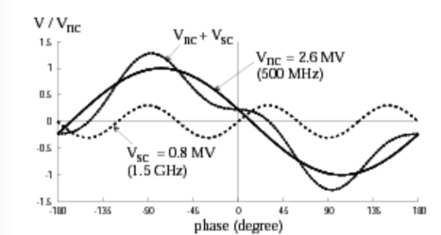

SRF for Bunch Length Manipulation in Rings
Bunch shortening to enhance luminosity (colliders)
Bunch lengthening to improve the Touschek beam lifetime (light sources)
Improved beam stability due to Landau damping
Typically, 3rd harmonic beam- driven (passive) cavities are used
Introduction: SRF and Beam

Slide 13
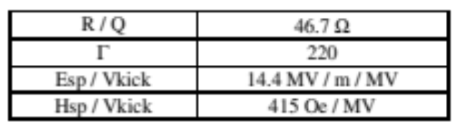
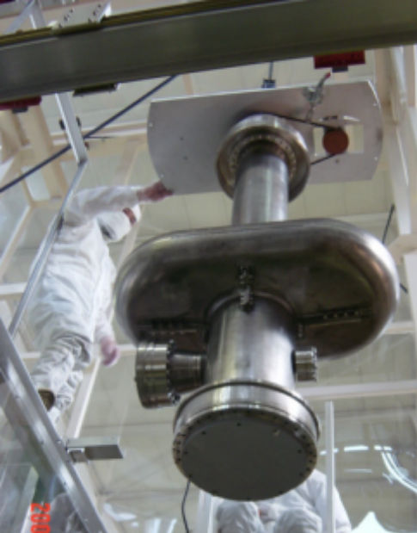
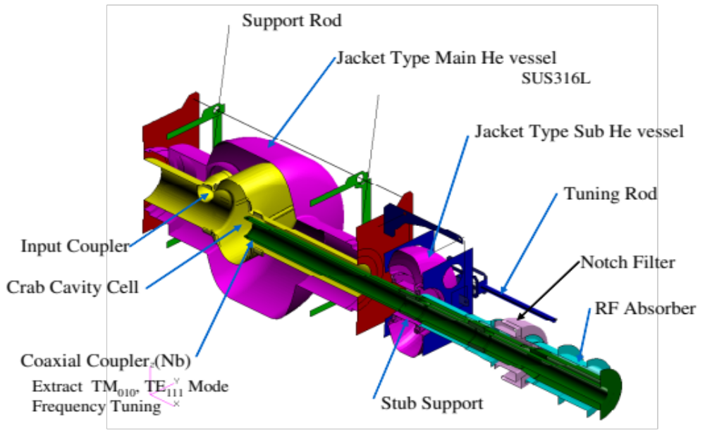
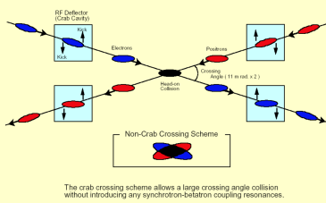
Crab Cavities
These cavities are used in colliders (KEKB) to reduce synchro-betatron oscillations coupling in a scheme with collisions at large crossing angles.
A crab cavity provides a transverse kick to bunches so that they collide head-on.
Its operating mode is TM110 deflecting mode if an elliptical cavity is used .
Introduction: SRF and Beam

Slide 14
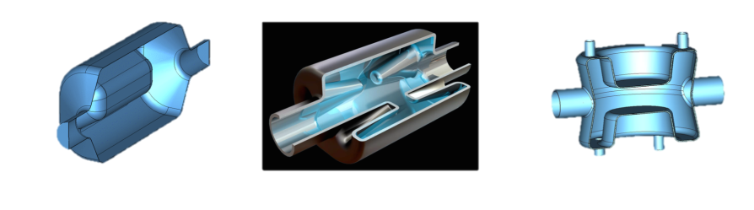
Crab Cavities: Other Types
Other cavity types are being developed for hadron colliders (LHC, eRHIC).
Hadron bunches are longer than electron bunches – lower frequencies are required.
Elliptical cavities become too bulky.
Examples: designs developed for LHC luminosity upgrade:
Introduction: SRF and Beam
RF dipole cavity (ODU) Four-rod cavity (Lancaster University) DQW crab cavity (BNL)

Slide 15
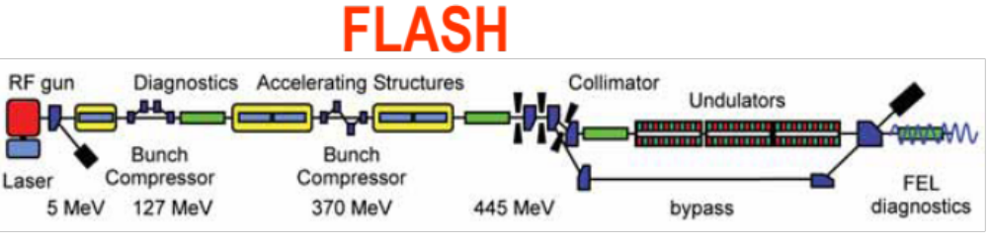
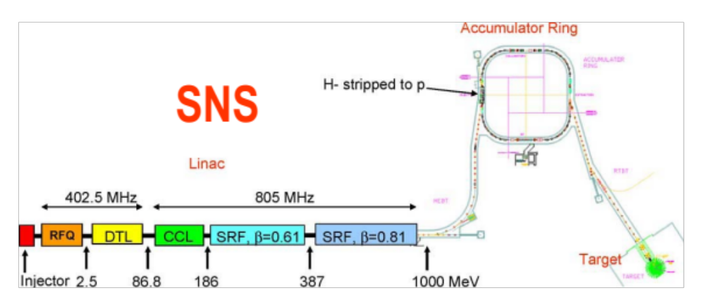
SRF for Straight Linacs
SRF straight linacs operate in pulsed mode if high energies are needed, CW mode for lower energies.
Higher gradients (>25 MV/m) are typically used in pulsed mode, 15 to 20 MV/m in CW mode.
Requirements on HOM damping vary, depending on beam current, but generally relaxed compared to ERLs
Introduction: SRF and Beam

Slide 16
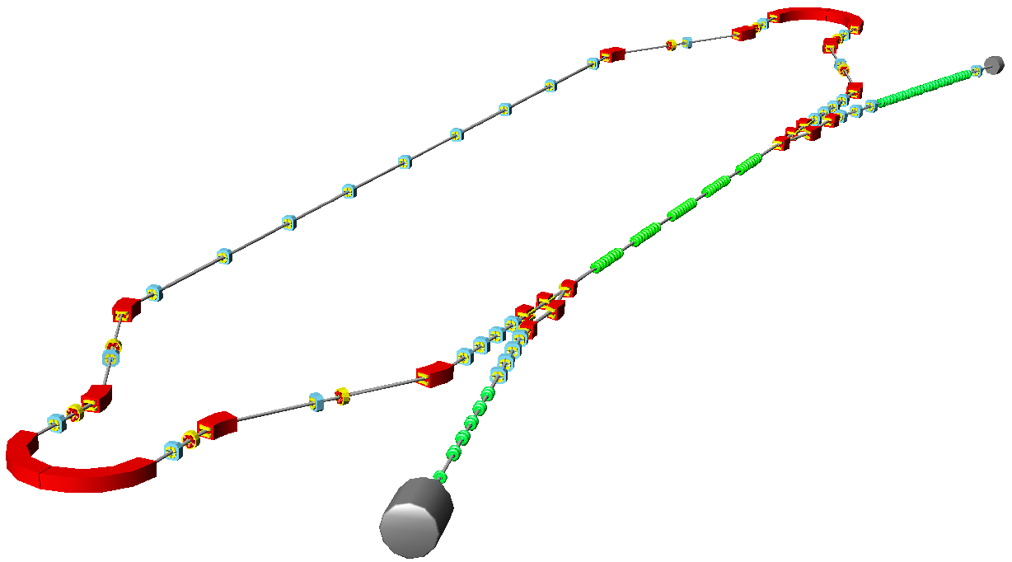
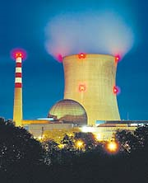
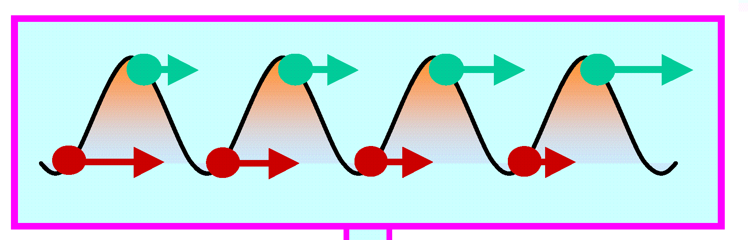
Energy-Recovery Linacs (ERLs)
3. Use beam for science, e.g. x-ray generation
Example: 5 GeV linac, 100 mA
S.C. without energy-recovery: >1 GW
S.C. with energy-recovery: <15 MW
6. dump beam:
low dump energy,
less radioactivity
2. acceleration
4. Recirculate beam
Introduction: SRF and Beam
5. deceleration
to re-use energy
1. Injection
fresh beam

Slide 17
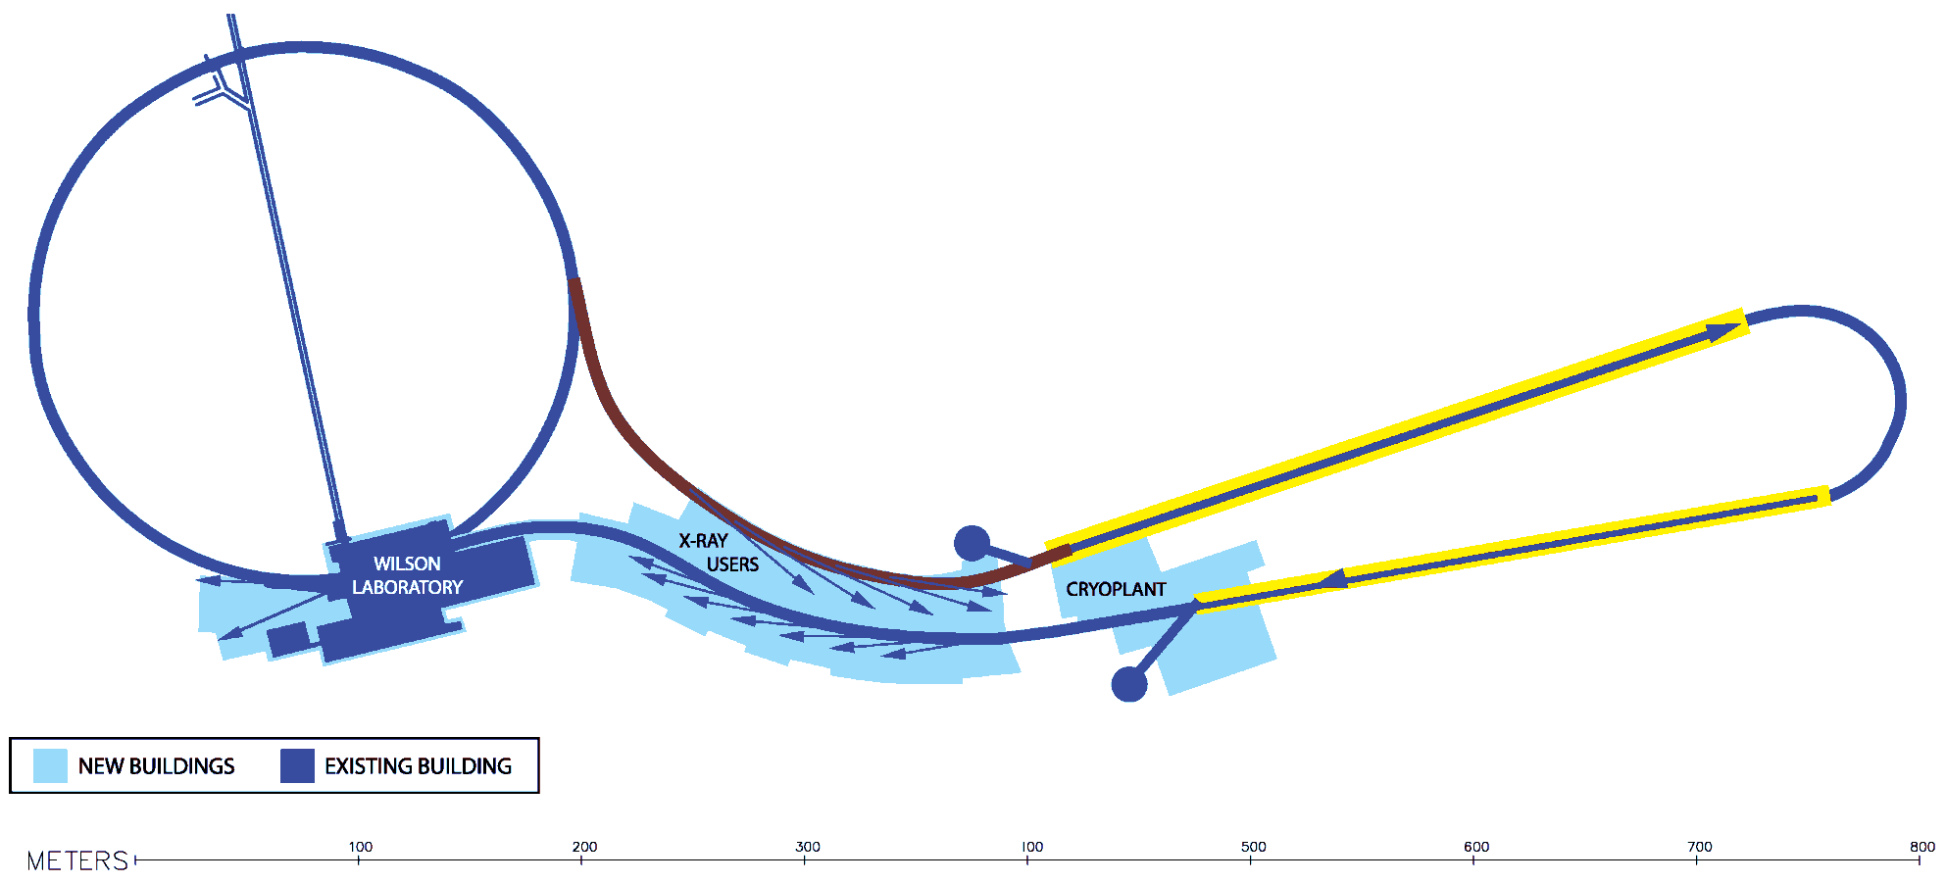
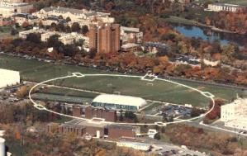
ERLs
5 GeV, 100 mA, hard X-ray light source
ERL main linac: 5 GeV, 100 mA with energy recovery
CESR
ERL injector
Introduction: SRF and Beam
Parameter | Cornell ERL
rms source size(mm) | 2(h) x 2(v)
x-ray beamsize | down to 1 nm
Coherent flux x-rays/s/0.1% bw | 5 x 10¹⁴
rms pulse duration | down to 0.1 ps
CESR
Undulators and X-ray beam lines
Beam Stop

Slide 18
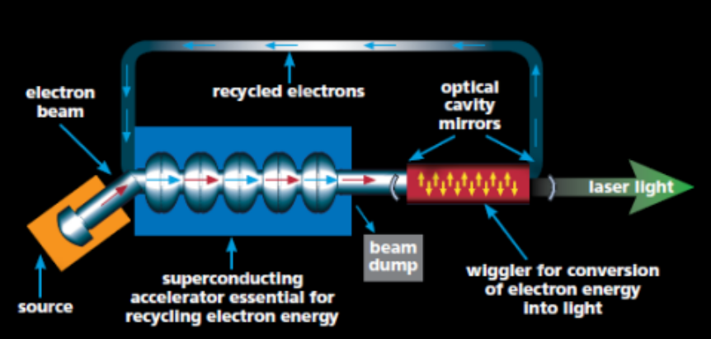


SRF for ERLs
Due to energy recovery, the required RF power is nearly independent of the beam current. Beam loading is zero in an ideal case.
However, small deviations can induce strong effects → hence very tight requirements to RF amplitude and phase stability at high loaded Q
Introduction: SRF and Beam
Multipass Beam Breakup (BBU) due to interaction with dipole HOMs is the major limitation of the beam current in ERLs. Strong damping of HOMs in multi-cell cavities is required.
HOM power dissipation may be high.

Slide 19
Low beta Cavities
Increased needs for reduced-beta ( β < 1) SRF cavities, especially for CW and high duty factor pulsed machines:
  Accelerator driven systems (ADS)
  Nuclear transmutation of long-lived active waste
  Energy production
  Intense spallation neutron sources
  Nuclear physics
  Radioactive ion acceleration
  Defense applications
Introduction: SRF and Beam
High current
Medium/low current
Accelerator driven systems Waste transmutation Energy production | Production of radioactive ions Nuclear structure
Pulsed spallation sources
CW
Pulsed

Slide 20
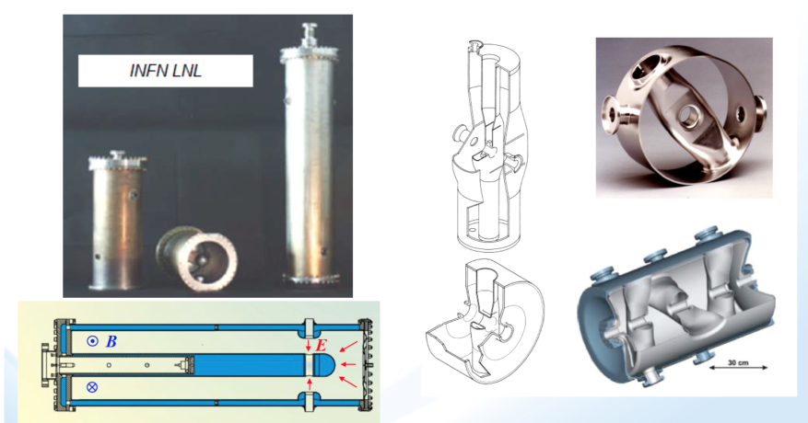
Low beta Cavity Types
Dominating this field are TEM cavities: coaxial quarter wave resonators and half wave resonators (coaxial and spoke).
Introduction: SRF and Beam

Slide 21
SRF Photoemission Electron Guns
SRF has potential advantage over other electron gun technologies in CW mode of operation, where it potentially can provide higher rate of acceleration, generating high-charge bunches and high average beam currents.
In SRF photoinjectors we are merging together such complex technologies as high QE photocathodes, superconducting RF, high repetition rate synchronizable lasers.
Among the challenges imposed by these technologies are maintaining UHV environment for the cathodes, preparing and maintaining cleanliness of the cavity RF surfaces while allowing operation and replacement of the cathodes, designing low RF loss and low heat leak interface between the cold cavities and warmer cathodes…
Introduction: SRF and Beam

Slide 22
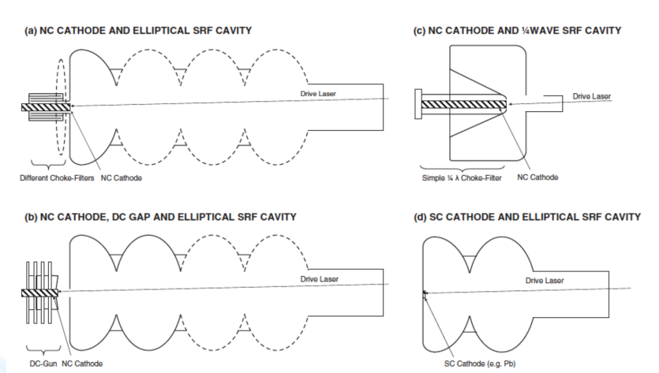

SRF Gun Types
Introduction: SRF and Beam

Slide 23
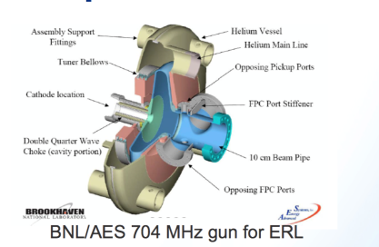


SRF Gun Examples
Introduction: SRF and Beam
Notes:
U of Wisconsin-Madison

Slide 24
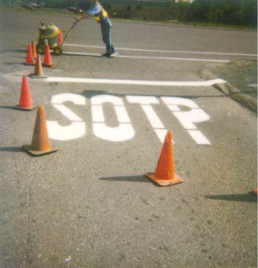
  Fundamental mode and beam
Fundamental Mode and Beam

Slide 25
  Fundamental mode and beam
  Beam induced fields: Single bunch and bunch train
  Beam loading and optimal loaded Q
Fundamental Mode and Beam

Slide 26
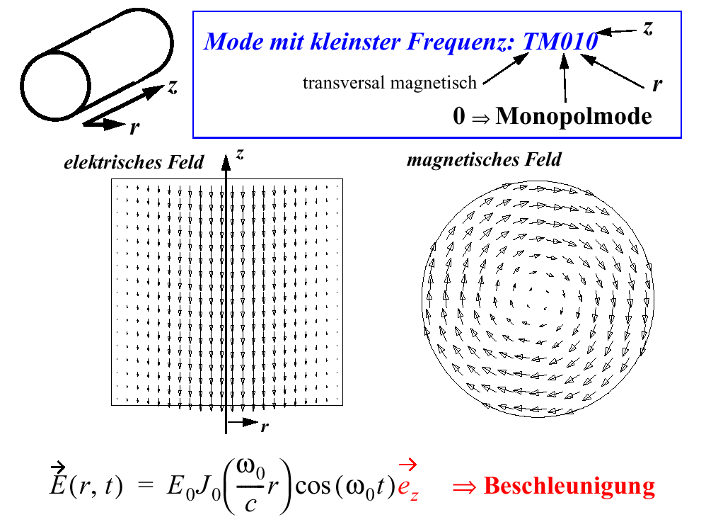
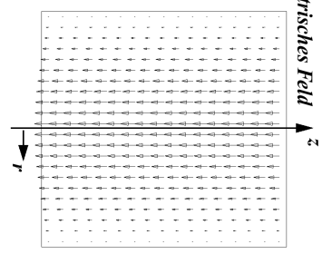
The mode we love so much: TM₀₁₀
lowest frequency mode:
transverse magnetic
0 ⇒ monopole mode
electric field
magnetic field
Fundamental Mode and Beam
z
⇒ acceleration

Slide 27
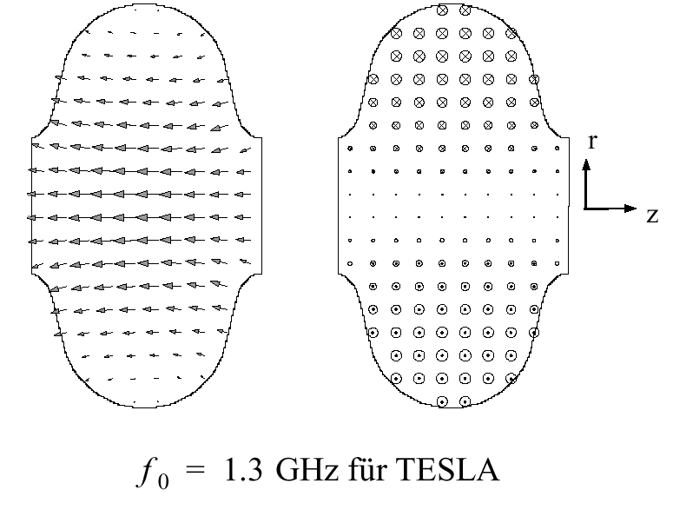
The Accelerating Mode in an
Elliptical RF Cavity
electric field
Fundamental Mode and Beam
magnetic field
for ILC cavities

Slide 28
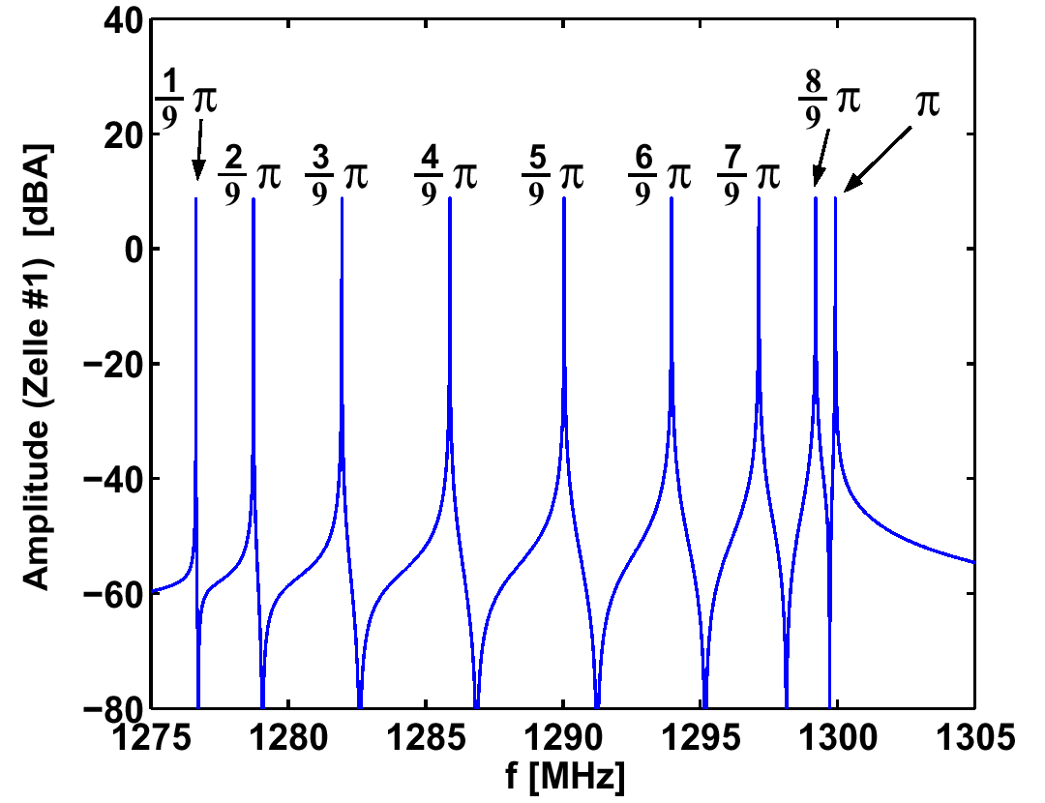
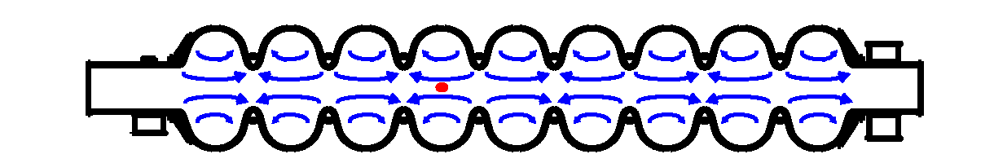
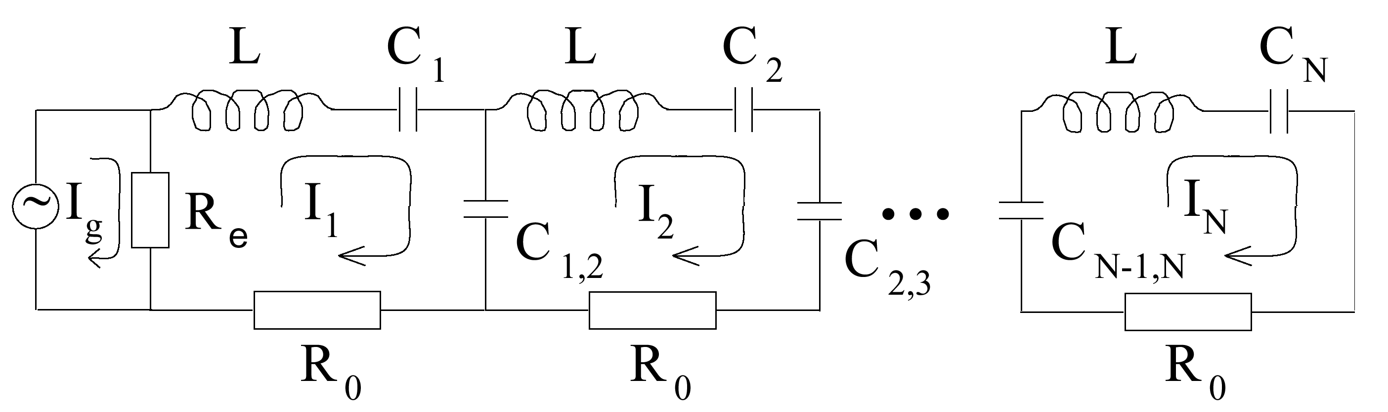
Multi-cell Cavities
N coupled cells ⇒ N TM₀₁₀ modes = TM₀₁₀ passband!
Highest frequency mode (π-mode) is the accelerating mode
Fundamental Mode and Beam

Slide 29
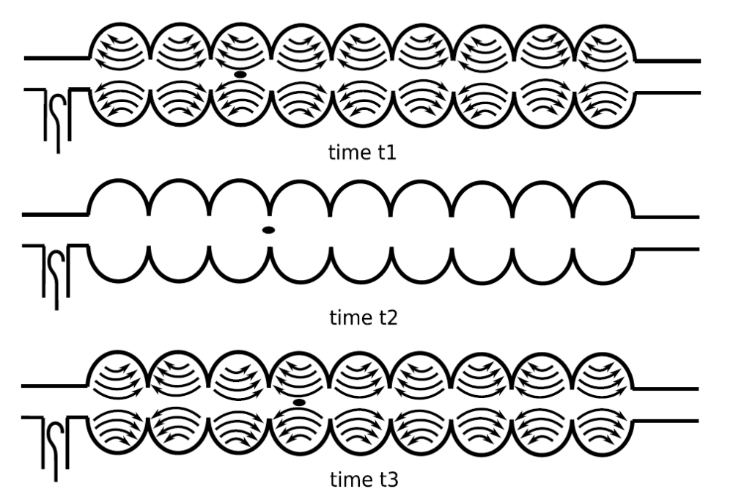
The Accelerating Mode
electron bunch
t=0
Fundamental Mode and Beam
t=T/4
t=T/2

Slide 30
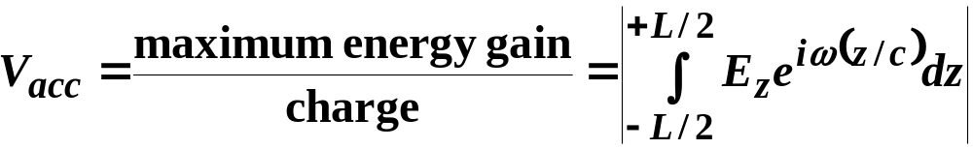
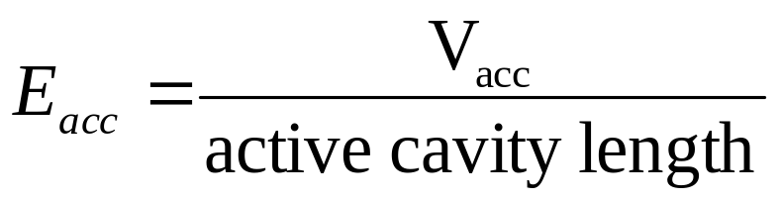
Accelerating Voltage
Accelerating π-mode:
Accelerating voltage:
Fundamental Mode and Beam
Accelerating field gradient:

Slide 31
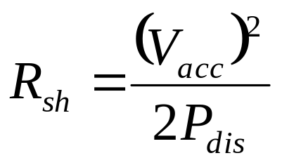
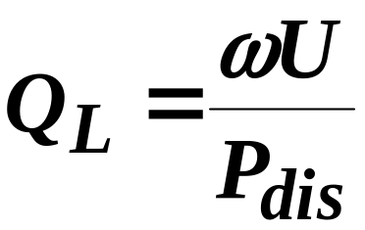
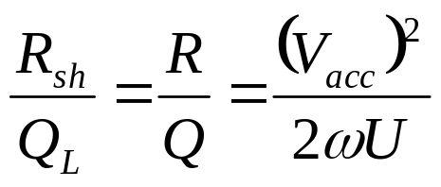
Coupling Strength: R/Q
Shunt-impedance:
Quality factor:
Fundamental Mode and Beam
Note: Here I use the circuit definition of the shunt impedance. The so-called accelerator definition of it is a factor of 2 larger!

Slide 32
Excitation of the Fundamental Mode
Two different sources excite the accel. mode:
RF Generator (power source)
  RF power at the fundamental mode frequency is coupled into the cavity via the input coupler
Beam current
  Bunches / bunch train excites the fund. mode
To obtain the total cavity voltage we need to add the generator-induced voltage and beam-induced voltage (this follows from the principle of linear superposition; consequence of the linearity of Maxwell equations.)
Fundamental Mode and Beam

Slide 33
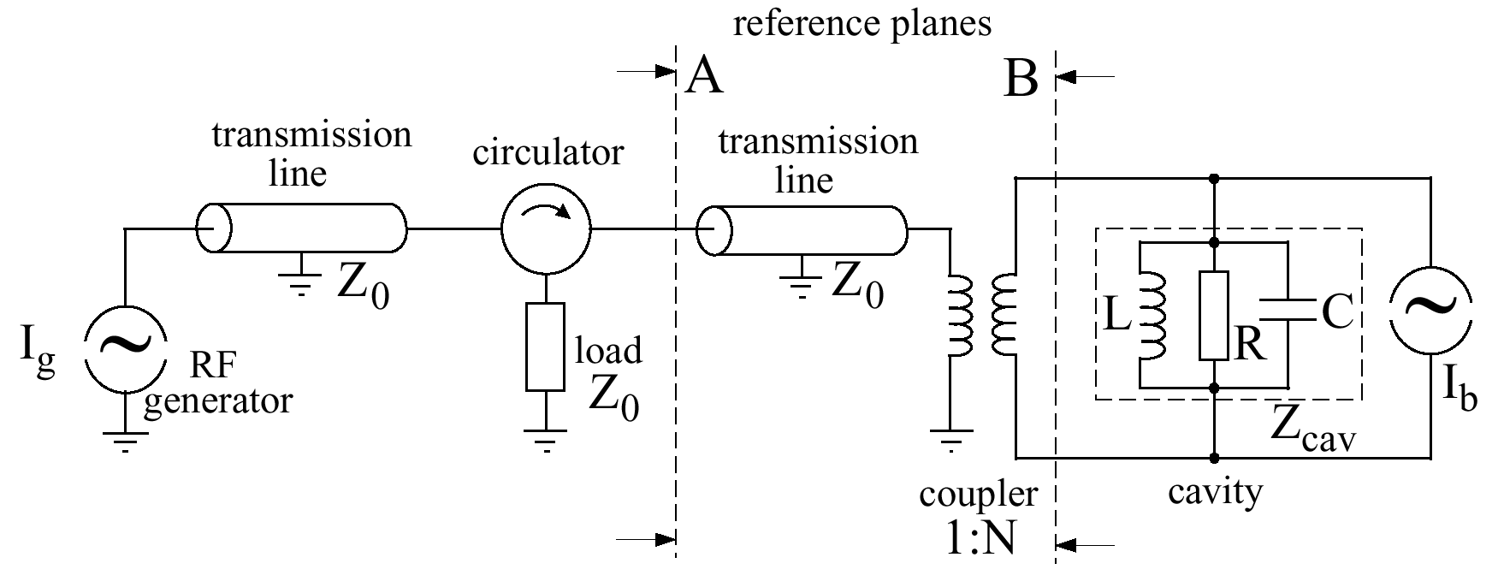
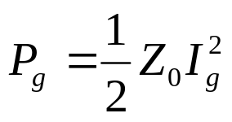
Equivalent Circuit Model
The full picture: generator - transmission line - coupler - cavity
beam current
Fundamental Mode and Beam
generator:
coupler acts like a transformer:
V₂ = N V₁
I₂ = 1/N I₁
cavity modeled as LCR circuit:
Note: R is the shut impedance, not R_{surf}!

Slide 34
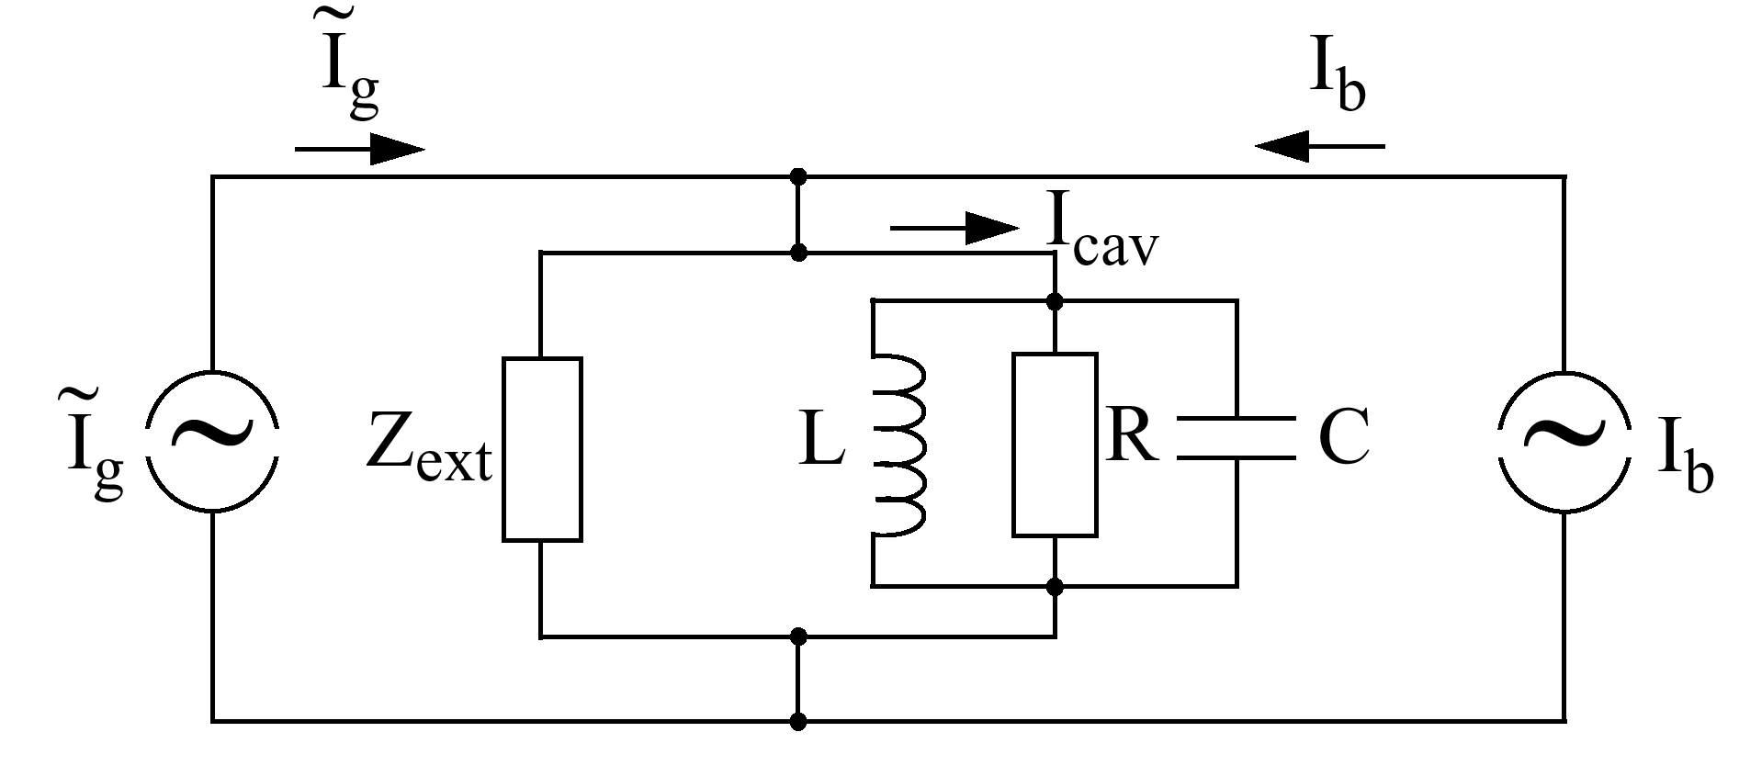
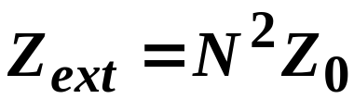
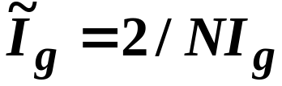
Simplified Circuit Model
Fundamental Mode and Beam
fictitious generator current:
transformed external load:
⇒ Use this model to simulate cavity filling, RF field control, beam loading, …

Slide 35
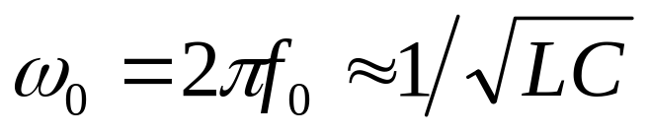
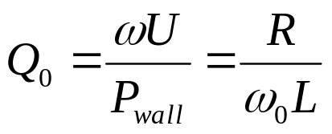
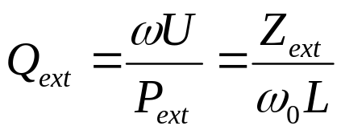
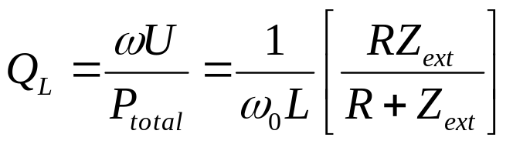
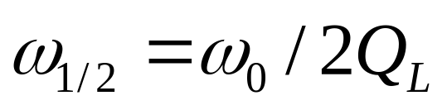
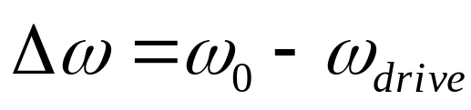
More Figures of Merit…
Resonance frequency:
Intrinsic quality factor:
External quality factor:
Fundamental Mode and Beam
Loaded quality factor:
Bandwidth of mode:
Cavity detuning:

Slide 36
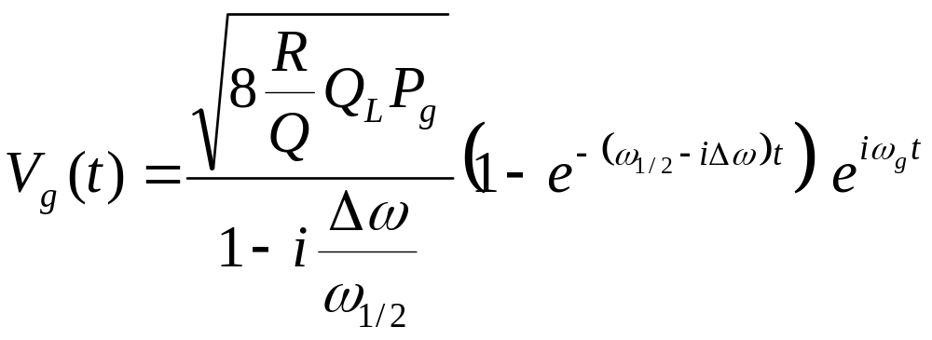
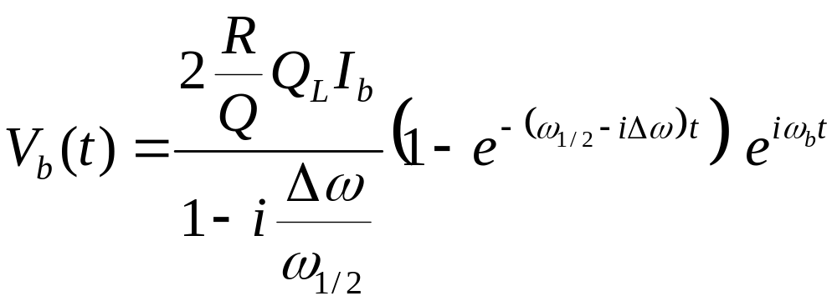
Generator and Beam Induced Voltage
Generator induced voltage (for constant generator power):
Fundamental Mode and Beam
Beam induced voltage (beam starts at t = 0):

Slide 37
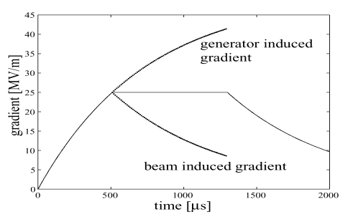
Example: FLASH
The generator and the beam induced voltage compensate each other if Q_{L} is properly adjusted.
Fundamental Mode and Beam
generator power
time

Slide 38
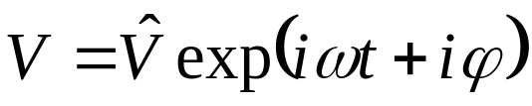



Complex Phasor Diagram
It is convenient to describe the voltages as vectors in the complex plane as:
This vector rotates counterclockwise in the complex plane and is called phasor.
The component of any voltage that contributes to acceleration of the bunch is the projection of the voltage onto the real axis.
Fundamental Mode and Beam
V_{g}
V_{b}
V
V_{b}

Slide 39


Single Bunch
So far: treated beam as an AC current
Reality: bunches!
Accelerating mode voltage induced by a single bunch:
On average, bunch “sees” half of its own induced field:
(fundamental theorem of beam loading)
Fundamental Mode and Beam

Slide 40

Fundamental Theorem of Beam Loading
A point charge crosses a cavity initially empty of energy.
After the charge leaves the cavity, a beam-induced voltage V_{b} remains in a given cavity mode.
By energy conservation the particle must have lost energy equal to the work done by the induced voltage on the charge.
What fraction ( f ) of V_{b} does the charge itself see?
Answer: ½ V_{b}
Fundamental Mode and Beam

Slide 41

Bunch Train
Need to sum individual bunch induced voltages:
Substructure!
Envelope given by previous equation
Example: For first 10 bunches
Fundamental Mode and Beam
beam induced voltage [kV]
time [μs]

Slide 42

Steady State
Sum of beam induced and generator induced voltage is not constant, but shows saw-like shape!
Fundamental Mode and Beam
voltage [MV]
time [μs]

Slide 43

But there are N TM₀₁₀ Modes in a
N-cell Cavity…
Both, the generator and the beam will not only excite the accelerating TM₀₁₀ mode, but with small amplitudes also all other TM₀₁₀ modes:
Example: TTF 2x7-cell superstructure
Fundamental Mode and Beam

Slide 44

Example: TTF 2x7-cell Superstructure
field amplitude
total accelerating voltage
cell #13
Fundamental Mode and Beam
sum over all cells!
cell #1
time [μs]
time [μs]

Slide 45

Example: TTF 2x7-cell Superstructure
Resulting Bunch to Bunch Energy Fluctuation:
Note:
Energy transport from one cell to another requires excitation of more than one mode!
Fundamental Mode and Beam

Slide 46
  Fundamental mode and beam
  Beam induced fields: Single bunch and bunch train
  Beam loading and optimal loaded Q
Fundamental Mode and Beam

Slide 47



RF Power Requirements with Beam
The RF power required to maintain an accelerating voltage V_{acc} is given by ( β = Q_{ext}/Q₀):
beam phase
From this one can calculate, that the minimum RF power is required if:
Fundamental Mode and Beam
All power is transferred to the beam (no reflected power)
optimal loaded Q:
optimal cavity detuning:

Slide 48

RF Power vs. Beam Current at fixed Coupling
For a fixed coupling, chose coupling to match beam at nominal current
  Standing wave pattern in the input coupler and transmission line goes from full reflection (without beam) through matched condition at nominal beam current to partial reflection.
Initially over-coupled input coupler becomes under-coupled
Fundamental Mode and Beam

Slide 49
Example 1: Cornell ERL 2-cell Cavity (on-crest acceleration):
250
1.2 MV, 100 mA
1 MV, 100 mA
200
0.8 MV, 100 mA
optimal Q_{L}
150
Fundamental Mode and Beam
Required power [kW]
Note:
1MV*0.1A=100kW
100
50
0
1
2
3
4
5
6
7
8
9
10
Q_{L}
x 10
4

Slide 50


Example 2: Cornell ERL Main Linac
ERL: ⇒ No effective beam loading in main linac!
(accelerated and decelerated beam compensate each other)
20
Δ
f=0 Hz
15
10 Hz
20 Hz
10
RF drive power [kW]
30 Hz
Fundamental Mode and Beam
5
40 Hz
0
10
6
10
7
loaded Q
10
8
10
9

Slide 51
  Break
Fundamental Mode and Beam

Slide 52

  Higher Order Modes and beam
Fundamental Mode and Beam

Slide 53
Higher Order Modes and beam
  HOM excitation by the beam
  HOM issues: heating, beam instability and emittance growth
  Beam based HOM damping measurements
  HOMS as a diagnostic tool: HOM based BPM
Higher Order Mode and Beam

Slide 54




Higher-Order-Mode Excitation
bunch
bunch
time
Higher Order Mode and Beam
bunch
The bunched beam excites higher-order-modes (HOMs) in the cavity.

Slide 55
Higher-Order-Mode Excitation
As bunch traverses a cavity, it deposits electromagnetic energy, which is described in terms of wakefields.
The wakefields, in turn, can be presented as a sum of cavity eigenmodes (fundamental and HOMs).
If a charge passes a cavity exactly on axis, it excites only monopole modes. For a point charge this excitation depends only on the amount of charge and the cavity shape.
Subsequent bunches may be affected by these fields and at high beam currents one must consider beam instabilities and additional heating of accelerator components.
Higher Order Mode and Beam
bunch

Slide 56


Higher-Order-Mode Excitation
bunch
Short range wake-field: Fields inside the bunch and just behind it
Long range wakes (Higher-Order-Modes)
Higher Order Mode and Beam
  Monopole modes: RF heating and longitudinal emittance dilution
  Dipole modes: transverse emittance dilution and beam break-up
Slide 56

Slide 57

Cavity-Beam Interaction: Time domain
The integrated field seen by a test particle traveling on the same path at a constant distance s behind a point charge q is the longitudinal wake (Green) function w(s). Then the wake potential is a convolution of the linear bunch charge density distribution q(s) and the wake function:
Higher Order Mode and Beam
0
-10
wake potential W [V]
-20
bunch
-30
-5
-4
-3
-2
-1
0
1
2
3
4
5
S [mm]

Slide 58


Time Domain: Longitudinal Loss Factor
Once the longitudinal wake potential is known, the total energy loss of the bunch passing the cavity is given by:
Now we can define a figure of merit, the loss factor: electromagnetic energy a bunch leaves behind in a structure, normalized by bunch charge q:
Higher Order Mode and Beam

Slide 59

Example: Longitudinal Loss Factor of a Pill-Box Cavity
Only for a few simple geometries formulas for the loss factor can be derived analytically. One of such geometries is a pill-box cavity with beam tubes. For a gaussian beam with rms bunch length s interacting with a pill-box cavity with the radius b, accelerating gap g, and beam pipe radius a we get:
This formula is valid for σ << a and g < 2(b-a).
For cases where analytic solution cannot be found, we use computer codes such as ABCI, NOVO, CST Particle Studio, ACE3P…
Higher Order Mode and Beam
$$k\left(σ\right)=\frac{1}{2π^{2}ε_{0}a}\left[\sqrt{\frac{g}{σ}}−1\right]$$

Slide 60

Example: ACE3P
Higher Order Mode and Beam
Visualization by Greg Schussman

Slide 61



Frequency Domain: Beam-Cavity Interaction
Bunch excites E&M cavity eigenmodes (Higher-Order Modes):
In the frequency domain, the loss factor can be represented as a sum of individual loss factors of the cavity modes:
-> for bunch train: average monopole HOM power per cavity
Higher Order Mode and Beam

Slide 62
Example: Cornell ERL
2 x 100 mA ERL beam
σ_{bunch} = 0.6 mm
q = 77 pC bunches
7-cell cavities with loss factor of 13 V/pC
200
Higher Order Mode and Beam
HOM
160
⇒ ~50% of power above 10 GHz
⇒ Short bunches can excite very high frequency modes!
~100 W at f < 10 GHz
120
HOM power loss above f [W]
80
~100 W at f > 10 GHz
40
0
0
20
40
60
80
100
HOM frequency [GHz]

Slide 63


Resonant Monopole Mode Excitation
Resonant Monopole Mode excitation if f_{HOM} ≈ N⋅f_{bunch}
If the wakefields (HOMs) do not decay sufficiently between the bunches, then fields from subsequent bunches can interfere constructively (resonant effect, if f_{HOM} ≈ N/T_{b}) and cause excessive HOM power loss and various instabilities.
=> Most SRF cavities have special devices to damp HOMs
Higher Order Mode and Beam
Need strong HOM damping!

Slide 64


Dipole, Quadrupole…Modes
Accelerating voltage (m = multipole order of mode; r = radial distance from axis): V_{acc} ∝ r^{m}
  m=1 for dipole modes; m=2 for quadrupole modes…
Loss factor (R/Q has units of Ω/m^{m} here):
For dipole modes it is common to define kick factor:
Higher Order Mode and Beam
$$k_{⊥,n}=\frac{k_{||,n}\left(a\right)}{ω_{n}{a^{2}}/c}=\frac{c}{2}{\left(\frac{R}{Q}\right)}_{n}$$

Slide 65
Higher Order Modes and beam
  HOM excitation by the beam
  HOM issues: heating, beam instability and emittance growth
  Beam based HOM damping measurements
  HOMS as a diagnostic tool: HOM based BPM
Higher Order Mode and Beam

Slide 66

Detrimental effects caused by the beam interaction with cavity HOMs
Multi-bunch instabilities (long. and transverse) in storage rings
Single-pass BBU in linacs
Multipass beam break-up (BBU) instabilities (transverse and longitudinal) in re-circulating linacs
Resonant excitation of longitudinal HOMs and heating
Increased beam energy spread
Additional cryogenic losses
This is why most SRF cavities have special devices to damp HOMs (absorb their energy).
Higher Order Mode and Beam

Slide 67



Example 1: HOM Power Heating
Shielded bellows at KEK-B:
  Comb-type RF shield developed to replace RF fingers.
Higher Order Mode and Beam

Slide 68

Example 2: Single Pass BBU from high Q Dipole HOM
Insufficiently damped dipole modes can cause emittance growth and even beam break-up
Higher Order Mode and Beam

Slide 69
Example 3: Transverse BBU in Recirculating Linacs
In a recirculating linac a feedback system formed between cavities and the beam is closed. ⇒ Instability at sufficient high currents (BBU threshold)!
Cavity with dipole higher-order mode
Higher Order Mode and Beam
Simple model for single cavity instability beam current:
ω
For I_{BBU} > 100 mA, need
I
∝
BBU
(
R
/
Q
)
Q
strong HOM damping (Q ≈ 10⁴ to 10⁵ )!

Slide 70

Beam Current and HOM Damping Requirements
High beam current requires high power handling capabilities of HOM damping scheme
Risk of resonant mode excitation and beam stability require strong HOM damping by HOM damping scheme
Project | Beam current [mA] | Average HOM power per cavity [W] | Required monopole Q < | Required dipole Q <
CEBAF 12GeV | 0.10 | 0.05 | 1.40E+09 | 1.50E+09
XFEL | 5 | 1 | 1.00E+05 | 1.00E+05
BERLinPro | 100 | 150 | 1.00E+04 | 1.00E+04
KEK-CERL | 100 | 185 | 1.00E+06 | 1.00E+04
Cornell ERL | 100 | 200 | 5.00E+03 | 1.00E+04
eRHIC | 300 | 7,500 | 1.00E+04 | 4.00E+04
KEKB | 1,400 | 15,000 | 1.00E+02 | 1.00E+02
Higher Order Mode and Beam

Slide 71
Beam Current and HOM Damping Requirements
Project | Bunch length [ps] | 90% HOM power below [GHz]
KEKB | 25 | 9
eRHIC | 7 | 25
BERLinPro | 2 | 45
KEK-CERL | 2 | 52
Cornell ERL | 2 | 50
XFEL | 0.08 | ~500 GHz
Short bunch length requires broadband HOM damping scheme: few GHz to tens of GHz
Higher Order Mode and Beam

Slide 72
HOM Damping Solutions
Depending on the project, the HOM damping scheme must
  Efficiently handle high power up to several kW per cavity
  Provide very strong HOM suppression of monopole, dipole, quadrupole modes with Q=100 - 10,000
  Be broadband (up to >100 GHz)
  Be inexpensive / require little beam line length
Fortunately, usually not all of these are required at the same time
Different requirements ➔ different solutions
Higher Order Mode and Beam

Slide 73




HOM Damping Schemes
Antenna / loop HOM couplers
Waveguide HOM dampers
Higher Order Mode and Beam
RF absorbing materials
Beamline HOM loads

Slide 74


Antenna HOM Dampers: Pros
Require no extra beamline length
  But filter is needed to suppress coupling to fundamental mode, which can be complex
Relatively easy to clean
HOM power can be absorbed at room temperature
Higher Order Mode and Beam
superconducting
pick up antenna
output to
room temp.
load
superconducting
pick up loop
capacitive
coupling
capacitor of the
1.3 GHz notch
filter

Slide 75



Antenna HOM Dampers: Challenges
Performance depends strongly on HOM frequency
  Poor coupling at high frequencies
Coupling depends strongly on mode polarization
Significant coupler kicks
Risk of multipacting (e.g. initial 3.9GHz FNAL/FLASH cavities, SNS cavities )
Potential thermal issues in CW operation
Higher Order Mode and Beam

Slide 76


Waveguide HOM Dampers: Pros
Waveguide is a natural high-pass filter
High power-handling capability with broadband damping
Small beamline length required
Loads can be at higher temperature
Good experience at PEP-II and CEBAF…
Relatively easy to fabricate
Higher Order Mode and Beam
Original CEBAF Cavity
748.5 MHz High Current Cavity

Slide 77


Waveguide HOM Dampers: Challenges
Performance depends on waveguide length
Coupling depends on mode polarization (need multiple waveguide couplers)
Significant coupler kicks
High static heat leak (Order 1 W per waveguide)
Higher Order Mode and Beam
F. Marhauser

Slide 78



Beamline HOM Dampers: Pros
Beampipe is a natural high-pass filter
High power-handling capability
Very broadband
Radial symmetry helps avoid beam kicks
Radial symmetry ensures all HOM polarizations are damped
Can incorporate bellow sections between cavities
Good experience with CESR, KEKB, FLASH
Relatively simple design
Higher Order Mode and Beam
Flange for disassembly
40 to 80K intercept
5K intercept
Flange to cavity
Shielded bellow
SiC absorber ring brazed to metal ring

Slide 79


Beamline HOM Dampers: Challenges
Requires extra beamline length
More difficult to clean; risk of dust from absorber material
RF absorber material availability (need UHV, radiation hard, broadband losses at cryogenic temperatures, sufficient DC conductivity…)
Additional thermal transitions to higher intercept temperatures required, especially at high HOM power
Higher Order Mode and Beam
80 K
Cavity at 1.8 K
80 K
HOM Power

Slide 80
Higher Order Modes and beam
  HOM excitation by the beam
  HOM issues: heating, beam instability and emittance growth
  Beam based HOM damping measurements
  HOMS as a diagnostic tool: HOM based BPM
Higher Order Mode and Beam

Slide 81

Beam Based HOM Damping Measurements
The beam can be used to excite HOMs on purpose to search for weakly damped / trapped HOMs.
  Pass beam off axis through cavities to couple to all modes
  Modulate bunch charge to generate sidebands in beam spectrum drive HOMs resonantly
  Measure HOM spectrum and beam motion vs. charge modulation frequency
Higher Order Mode and Beam

Slide 82

Example: FLASH
TTF/Flash results with current modulated beam reveled several weakly damped modes.
Some of them where initially not predicted by numerical HOM calculations!
Higher Order Mode and Beam

Slide 83
Higher Order Modes and beam
  HOM excitation by the beam
  HOM issues: heating, beam instability and emittance growth
  Beam based HOM damping measurements
  HOMS as a diagnostic tool: HOM based BPM
Higher Order Mode and Beam

Slide 84


Cavity HOMs can be used as a BPM
courtesy N. Baboi,
HOM amplitude [arb. units]
(cf. M. Ross and J. Frisch).
Higher Order Mode and Beam
-1 0 1 2 3
Transverse beam offset [mm]
Beam does not excite dipole modes if it passed cavity on axis: P_{HOM} ∝ (beam offset)²
  Angular resolution < 50 µrad
  Relative position resolution ~ 4 µm

Slide 85

  Operational aspects
Operational aspects

Slide 86
After installation in an accelerator...
Connect cavities to cryogenic system, RF source, instrumentation and control electronics …
Conditioning:
  Cavities and input couplers are usually subjected to the in situ conditioning and/or acceptance testing.
  Quite often the need arises for re-conditioning or conditioning to new operating requirements.
Trips:
  RF trip frequency tolerance depends on the type of accelerator and experiment. HEP and NP experiments rely on integrating statistics and more tolerant to interruptions than user facilities, such as X-ray light sources.
Operational aspects

Slide 87

Typical RF system block diagram
Operational aspects
LLRF controls to maintain the cavity field amplitude and phase
Interlocks (machine protection system) to turn off RF and/or beam
  Fast interlocks can be part of the LLRF system, but there should be redundancy with slower ready chain.
  Multilayer quench protection: LLRF to look for large deviation of the field amplitude from the set point; fast He bath pressure switch; temperature sensors (slow).
  Coupler: Vacuum and arc detector interlocks.

Slide 88
Operational aspects
  Field perturbations and energy stability
  Beam based field calibration
  Cavity performance with beam: Good and bad examples
Operational aspects

Slide 89
Field Stability Requirements
Different accelerators have different requirements on field stability!
approximate RMS requirements:
  1% for amplitude and 1 deg for phase (storage rings, SNS)
  0.1% for amplitude and 0.1 deg for phase (linear collider, …)
  down to 0.01% for amplitude and 0.01 deg for phase (XFEL, ERL light sources)
Operational aspects

Slide 90
Beam induced RF Field Perturbations
From
Beam current modulations
Bunch to bunch charge fluctuations
Pulsed beam transients (FLASH, ILC, SNS)
Return phase fluctuation of the decelerated beam in and ERL
Potential instabilities in storage rings (coupling of energy and path length)
Excitation of other passband modes
Other sources:
Cavity detuning, HV power supply ripple…
⇒ Beam energy fluctuations!
Operational aspects

Slide 91

Example 1: Bunch Charge Fluctuations
Operational aspects

Slide 92

Example 2: Beam Transients
Operational aspects
Gradient [MV/m]
time [μs]

Slide 93

Example 3: ERL with Return Phase Error
Cavity tuners need to adjust the cavity detuning to its optimal value to compensate for the reactive loading
Tom Powers, Chris Tennant; TJNAF FEL
Operational aspects
I_{acc}
I_{dec}
I_{net}

Slide 94
Cavity Microphonics
ERL high Q_{L} cavity without feedback:
10
5
accelerating field [MV/m]
Operational aspects
0
0
0.2
0.4
0.6
0.8
1
time [sec]
100
phase [deg]
0
-100
0
0.2
0.4
0.6
0.8
1
time [sec]

Slide 95





How to control the cavity RF field? LLRF Control Systems
Operational aspects
DSP
Virtex II FPGA

Slide 96

LLRF Control
Frequency tuner
Operational aspects
Measure cavity RF field.
Derive new klystron drive signal to stabilize the cavity RF field.
Derive new frequency control signal to keep cavity at design frequency.

Slide 97
LLRF Control Design Choices
Analog vs. digital control design
Self- excited loop (SEL) vs. generator driven system (GDR)
Amplitude and phase (A&P) vs. in- phase and quadrature (I&Q) detector and controller
Vector-sum (VS) vs. individual cavity control
Operational aspects

Slide 98
Analog vs. Digital
Analog:
+: fast; simple; well suited for small numbers of units
-: less flexible; digital DAQ needed anyway; digital control of analog controller needed anyway (state machine, …)
Digital:
+: provides flexibility; easier vector sum control; extensive diagnostic; advanced controllers; advanced exception handling; integrated state machine; …
-: somewhat more programming; more latency (but difference becomes smaller from year to year and recently became in many cases insignificant)
Operational aspects

Slide 99

Self- excited loop (SEL) vs. generator driven system (GDR)
Generator Driven Resonator
External generator
Well defined and controlled cavity filling
Pulsed operation
Open loop operation
With tracking PLL will behave like SEL
Self Excited Loop
Tracks detuning cavities in CW systems on startup
Start up from noise
Useful for high Q_{L} cavity operation without beam (e.g. during conditioning)
Behaves like GDR when locked to M.O. during beam operation
Operational aspects

Slide 100
Amplitude and Phase (A&P) vs. In- phase and Quadrature (I&Q):
A&P:
  Amplitude detector has very low noise level
  Typically used in analog LLRF
I&Q:
  Better for control of cavity detuning, best for correction of large field errors; control to zero field
  Typically used in digital LLRF
Operational aspects
Imaginary (Q) component
A
ϕ
Real (I) component

Slide 101

Vector-sum (VS) vs. individual cavity control:
Vector-sum control:
Multiple cavities powered by a single power source ⇒ usually lower cost
Vector sum of the cavity voltages is controlled
Spread in cavity parameters or field perturbations ⇒ relative fields in the individual cavities are time dependent
  Does not work for very high loaded Q cavities due to microphonics and Lorentz-force instability
Difficult to operate each cavity at its performance limit
Operational aspects

Slide 102

Digital LLRF System Diagram
Operational aspects

Slide 103

Achieved Energy Stability: TTF/FLASH
Operational aspects

Slide 104
ERL high Q_{L} Cavity Test Operation
With feedback: Very good field stability with 5 mA ERL beam:
Without feedback:
10
12.4
σ_{A}/A ≈ 1·10 ⁻ ⁴
5
accelerating field [MV/m]
12.3
accelerating field [MV/m]
12.2
Operational aspects
0
12.1
0
0.2
0.4
0.6
0.8
1
0
0.2
0.4
time [sec]
0.6
0.8
1
11
time [sec]
100
σ_{ϕ} ≈ 0.02 deg
10.5
phase [deg]
phase [deg]
10
0
9.5
-100
9
0
0.2
0.4
0.6
0.8
1
0
0.2
0.4
0.6
0.8
1
time [sec]
time [sec]

Slide 105
Operational aspects
  Field perturbations and energy stability
  Beam based field calibration
  Cavity performance with beam: Good and bad examples
Operational aspects

Slide 106



Beam Based Calibration at FLASH
Measure beam induced voltage
Gradient calibration to a few %
Phase calibration to <1 deg
Operational aspects

Slide 107




Field Calibration based on Single Bunch Transients
Operational aspects
P. PAWLIK, M. GRECKI, S. SIMROCK

Slide 108

Field Calibration at the Cornell ERL Injector using beam induced fields
Operational aspects
The frequency of an un-powered cavity is scanned.
The data are fitted with a resonance formula to obtain the amplitude and phase calibrations.

Slide 109


Setting the RF Phase at SNS
Beam-based measurements are done to set each cavity RF phase correctly. The beam’s β = v/c < 1
The cavity “s” phase is scanned 360 degrees and the change in Time Of Flight (TOF) between two down-stream detectors is measured.
Operational aspects
Measurements are compared with simulations. This gives beam energy, cavity voltage and beam phase offset calibration.
Each cavity is scanned sequentially

Slide 110
Operational aspects
  Field perturbations and energy stability
  Beam based field calibration
  Cavity performance with beam: Good and bad examples
Operational aspects

Slide 111
Cavity Performance with Beam
After the cryomodule is assembled, its cavities and input couplers are usually conditioned in situ.
However, sometimes the need arises for re-conditioning or conditioning to new operating requirements.
SRF cavity performance can change over time:
  “Dust” can propagate through beam pipe into cavity (beam fields)
  Field emitter can turn on suddenly
  Special events (vacuum leaks…)
  Collective effects …
Not always it is possible to recover initial performance.
Operational aspects

Slide 112


Example 1: KEK-B, Long Term Cavity Operation (I)
Maximum accelerating voltage:
All cavities provided V_{acc} >2 MV after 7 years operation.
Voltage of D11C degraded after the vacuum trouble.
Voltage of D11B degraded after changing the coupling of the input coupler.
Overall, very positive experience.
Operational aspects
T. Furuya, S. Mitsunobu

Slide 113



Example 1: KEK-B, Long Term Cavity Operation (II)
Intrinsic cavity Q:
?
Unloaded Q at 2MV (8MV/m) gradually degraded to 3 - 5x10⁸.
Out-gassing and/or ferrite dust from the HOM dampers?
Operational aspects
T. Furuya, S. Mitsunobu

Slide 114

Example 1: KEK-B: Beam Aborts
Caused by RF
Caused by beam Loss
others
Operational aspects
H. Ikeda
Caused by beam loss (60%), RF (28%), or others (12%).
Average number of beam aborts in two rings caused by any RF reasons is about 1 to 2 /day.

Slide 115

Example 2: RF Trips in Light Source
Light sources are user facilities: require long, uninterrupted X-ray beam. Hence: very low RF trip rate is required
Taiwan Light Source (TLS): trip rate was reduced to ~0.5 per week.
The SRF cavity itself is almost never the cause of the trip as it operates well below its gradient limit.
RF related beam trips per month (2005 – 2007)
Operational aspects

Slide 116

Example 3: Electron-Positron Collider LEP II at maximum Energy
CERN installed the largest SRF system in the 90s to double LEP.
The experience there was dominated by the quest to deliver the highest possible energy beams with the available RF.
The accelerating gradient increase came from optimizing the RF power distribution and high power RF processing to suppress field emission. For stable operation with beam the total gradient was set about 5% lower than the maximum achieved during conditioning.
However, to operate at the maximum beam energy, the experiments had to tolerate a very high frequency of RF trips. The trip rate was about 2 per hour at 98 GeV rising to about 4 per hour at 100 GeV.
Most trips occurred due to field emission -> in-situ processing played a crucial role.
Operational aspects

Slide 117


Example 4: SNS
Designed to operate at 2.1 K (superfluid helium)
Return end can
Helium vessels
Operational aspects
Space frame
Supply end can
Fundamental power couplers

Slide 118

Example 4: Cavity Limitations at SNS (I)
Operational aspects

Slide 119

Example 4: Cavity Limitations at SNS (II)
Operational aspects

Slide 120


Example 5: CEBAF
Saw changes in cavity performance vs. time
Not all of these changes are correlated to external disturbances
1995 vs. 2003
Sudden change in cavity trip rate
Operational aspects
after
before

Slide 121

Example 5: CEBAF Downtime (1999)
Other than the arc trips, the SRF system directly contributed 48 minutes (less than 0.1%) of the 1620 hours of unscheduled downtime.
Operational aspects

Slide 122
Conclusion

Slide 123

Conclusion
SRF Cavity and Beam
What would be one without the other?
A true love story…
…to be continued

Slide 124

Thank you for your attention!

