Slide 1
RF Principles and TM Mode Cavity
Erk Jensen
CERN BE/RF

Slide 2
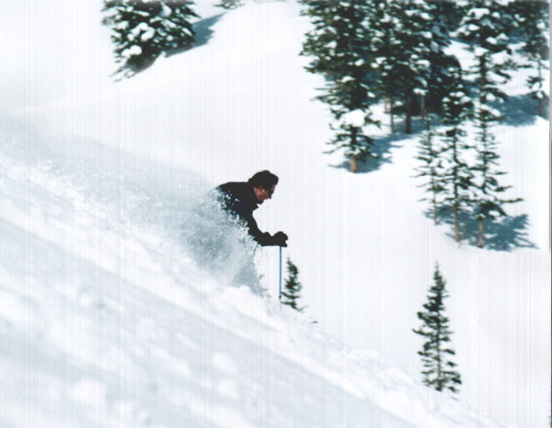
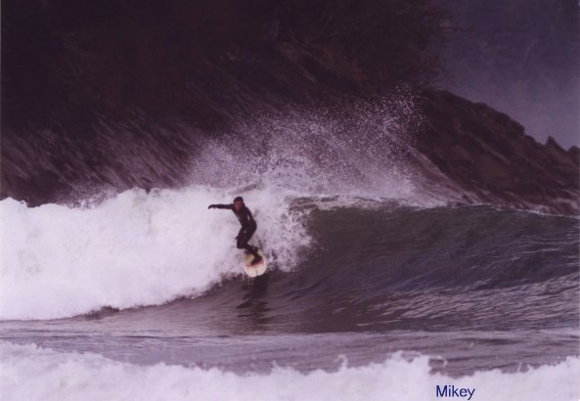
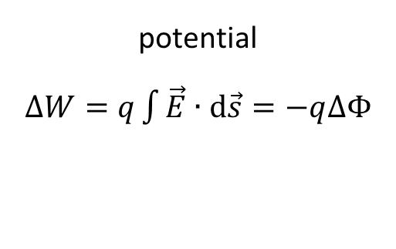
DC versus RF
DC accelerator
potential
$∆W=q\int{\vec{E}∙d\vec{s}}=−q∆Φ$
RF accelerator

Slide 3
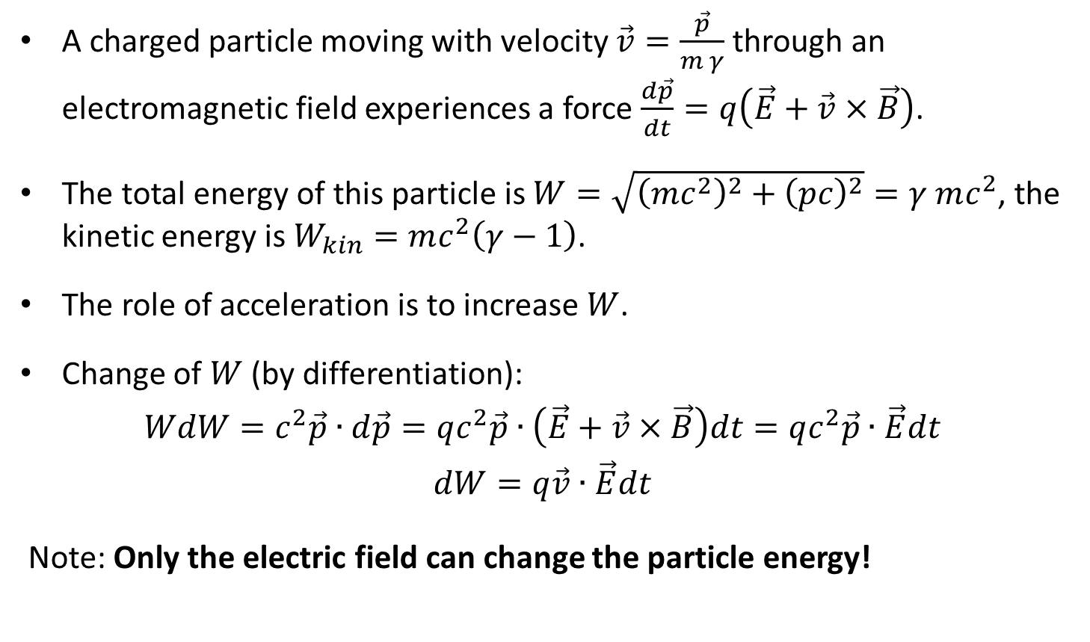
Lorentz force
A charged particle moving with velocity $\vec{v}=\frac{\vec{p}}{m γ}$ through an electromagnetic field experiences a force $\frac{d\vec{p}}{dt}=q\left(\vec{E}+\vec{v}×\vec{B}\right)$.
The total energy of this particle is $W=\sqrt{{\left(mc^{2}\right)}^{2}+{\left(pc\right)}^{2}}=γ mc^{2}$, the kinetic energy is $W_{kin}=mc^{2}\left(γ−1\right)$.
The role of acceleration is to increase $W$.
Change of $W$ (by differentiation):
$$WdW=c^{2}\vec{p}∙d\vec{p}=qc^{2}\vec{p}∙\left(\vec{E}+\vec{v}×\vec{B}\right)dt=qc^{2}\vec{p}∙\vec{E}dt$$
$$dW=q\vec{v}∙\vec{E}dt$$
Note: Only the electric field can change the particle energy!

Slide 4
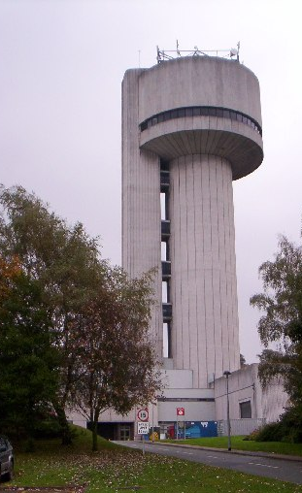
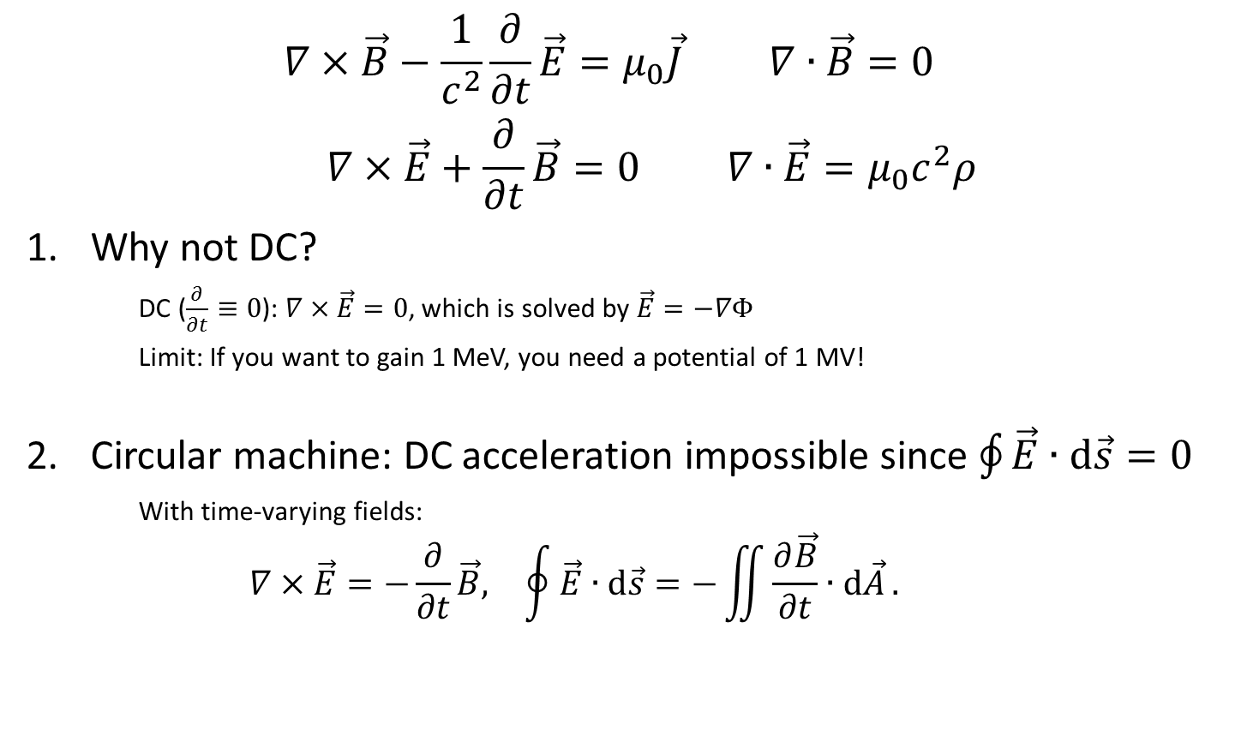
Maxwell’s equations (in vacuum)
$$\begin{matrix}∇×\vec{B}−\frac{1}{c^{2}}\frac{∂}{∂t}\vec{E}=μ_{0}\vec{J} & ∇∙\vec{B}=0 \\ ∇×\vec{E}+\frac{∂}{∂t}\vec{B}=0 & ∇∙\vec{E}=μ_{0}c^{2}ρ\end{matrix}$$
Why not DC?
    DC ($\frac{∂}{∂t}≡0$): $∇×\vec{E}=0$, which is solved by $\vec{E}=−∇Φ$
    Limit: If you want to gain 1 MeV, you need a potential of 1 MV!
Circular machine: DC acceleration impossible since $\oint{\vec{E}∙\text{d}\vec{s}=0}$
    With time-varying fields:
    $$\begin{matrix}∇×\vec{E}=−\frac{∂}{∂t}\vec{B}, & \oint{\vec{E}∙\text{d}\vec{s}=−\iint{\frac{∂\vec{B}}{∂t}∙\text{d}\vec{A}}}.\end{matrix}$$
World’s highest energy Van-de-Graaff Generator on Daresbury Lab campus

Slide 5
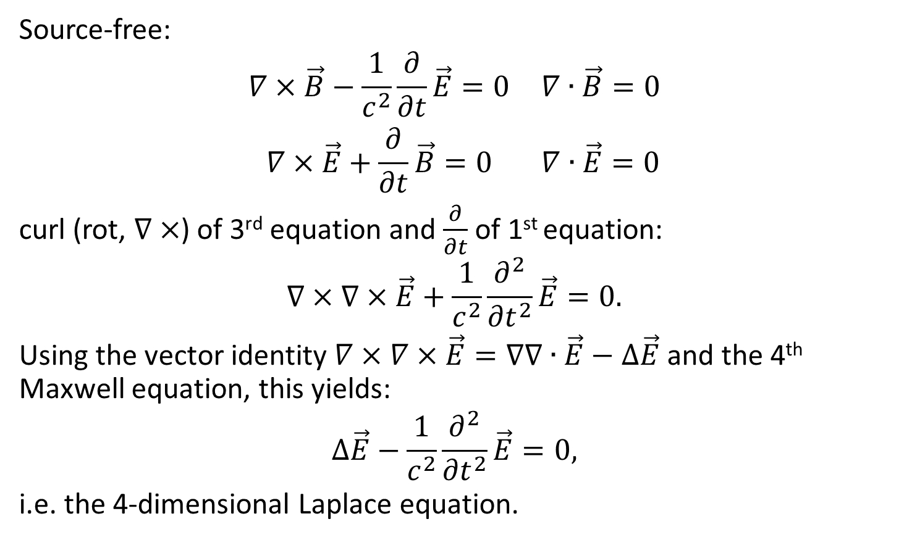
Maxwell’s equations in vacuum (contd.)
Source-free:
$$\begin{matrix}∇×\vec{B}−\frac{1}{c^{2}}\frac{∂}{∂t}\vec{E}=0 & ∇∙\vec{B}=0 \\ ∇×\vec{E}+\frac{∂}{∂t}\vec{B}=0 & ∇∙\vec{E}=0\end{matrix}$$
curl (rot, $∇×$) of 3rd equation and $\frac{∂}{∂t}$ of 1st equation:
$$∇×∇×\vec{E}+\frac{1}{c^{2}}\frac{∂^{2}}{{∂t}^{2}}\vec{E}=0.$$
Using the vector identity $∇×∇×\vec{E}=∇∇∙\vec{E}−∆\vec{E}$ and the 4th Maxwell equation, this yields:
$$∆\vec{E}−\frac{1}{c^{2}}\frac{∂^{2}}{{∂t}^{2}}\vec{E}=0,$$
i.e. the 4-dimensional Laplace equation.

Slide 6
From waveguide to pillbox

Slide 7
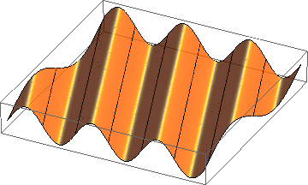
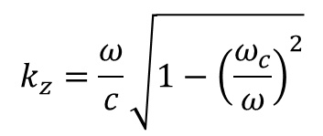
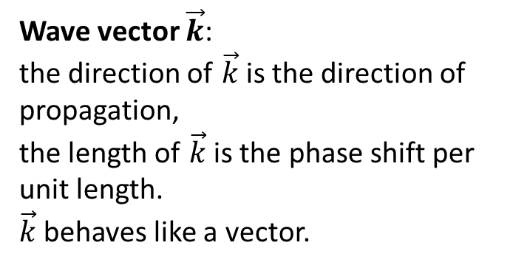

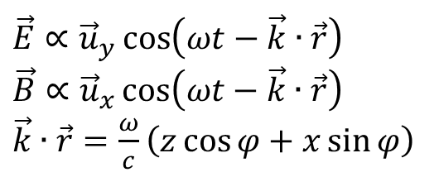

Homogeneous plane wave
$\vec{E}∝{\vec{u}}_{y}\cos\left(ωt−\vec{k}∙\vec{r}\right)$
$\vec{B}∝{\vec{u}}_{x}\cos\left(ωt−\vec{k}∙\vec{r}\right)$
$\vec{k}∙\vec{r}=\frac{ω}{c}\left(z\cos{φ}+x\sin{φ}\right)$
Wave vector $\vec{k}$:
the direction of $\vec{k}$is the direction of propagation,
the length of $\vec{k}$ is the phase shift per unit length.
$\vec{k}$ behaves like a vector.
x
$$k_{⊥}=\frac{ω_{c}}{c}$$
$$k=\frac{ω}{c}$$
E_{y}
φ
$$k_{z}=\frac{ω}{c}\sqrt{1−{\left(\frac{ω_{c}}{ω}\right)}^{2}}$$
z

Slide 8
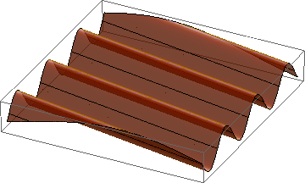

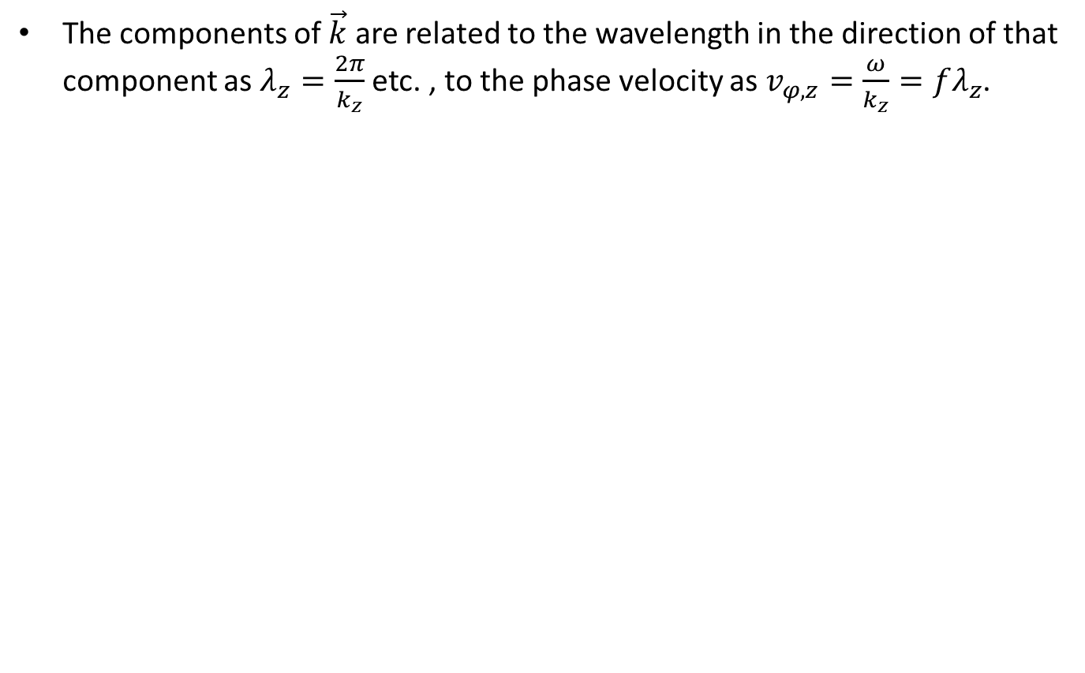
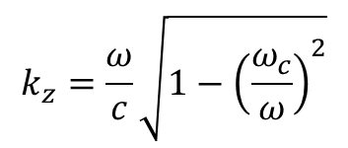


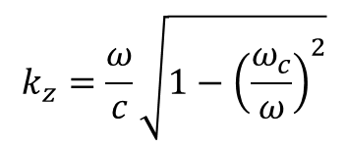

Wave length, phase velocity
The components of $\vec{k}$ are related to the wavelength in the direction of that component as $λ_{z}=\frac{2π}{k_{z}}$ etc. , to the phase velocity as $v_{φ,z}=\frac{ω}{k_{z}}=fλ_{z}$.
$$k=\frac{ω}{c}$$
$$k_{⊥}=\frac{ω_{c}}{c}$$
E_{y}
$$k_{z}=\frac{ω}{c}\sqrt{1−{\left(\frac{ω_{c}}{ω}\right)}^{2}}$$
x
$$k_{⊥}=\frac{ω_{c}}{c}$$
z
$$k=\frac{ω}{c}$$
$$k_{z}=\frac{ω}{c}\sqrt{1−{\left(\frac{ω_{c}}{ω}\right)}^{2}}$$

Slide 9
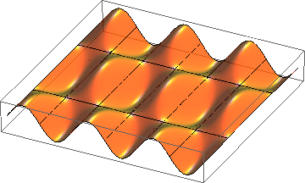
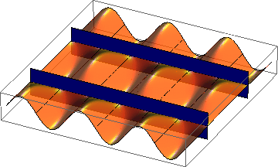
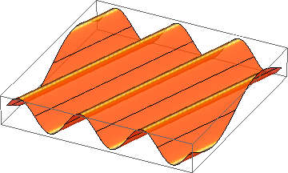

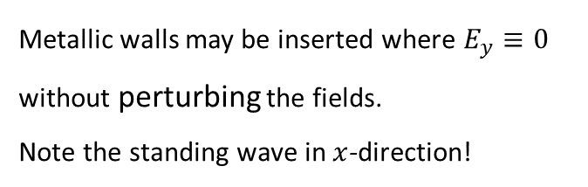


Superposition of 2 homogeneous plane waves
$$E_{y}$$
$$x$$
$$z$$
=
+
Metallic walls may be inserted where $E_{y}≡0$
without perturbing the fields.
Note the standing wave in $x$-direction!
This way one gets a hollow rectangular waveguide

Slide 10
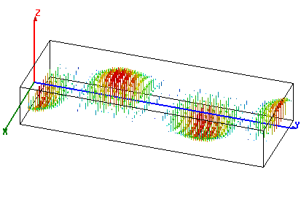
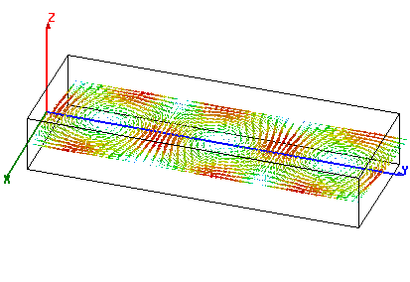
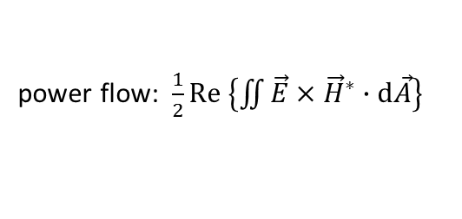
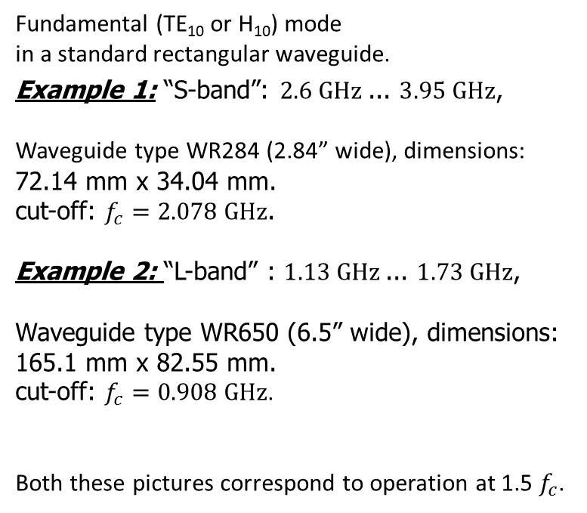
Rectangular waveguide
Fundamental (TE₁₀ or H₁₀) mode
in a standard rectangular waveguide.
Example 1: “S-band”: $2.6 \text{GHz}$... $3.95 \text{GHz}$,
Waveguide type WR284 (2.84” wide), dimensions: 72.14 mm x 34.04 mm.
cut-off: $f_{c}=2.078 \text{GHz}$.
Example 2: “L-band” : $1.13 \text{GHz}$... $1.73 \text{GHz}$,
Waveguide type WR650 (6.5” wide), dimensions: 165.1 mm x 82.55 mm.
cut-off: $f_{c}=0.908 \text{GHz}$.
Both these pictures correspond to operation at 1.5 $f_{c}$.
power flow
electric field
magnetic field
power flow
power flow: $\frac{1}{2}\text{Re} \left\{\iint{\vec{E}}×{\vec{H}}^{∗}∙\text{d}\vec{A}\right\}$

Slide 11
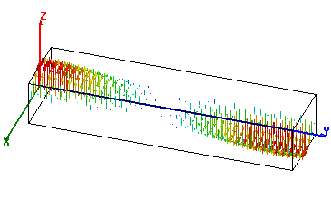
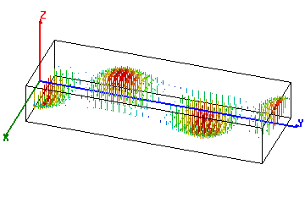

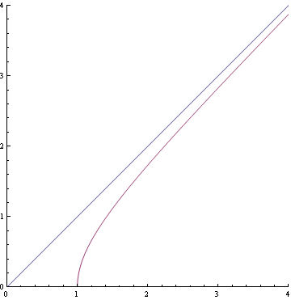


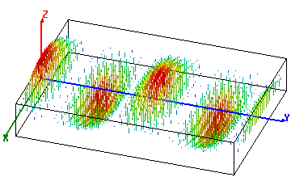


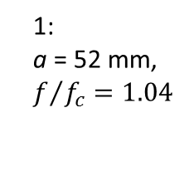

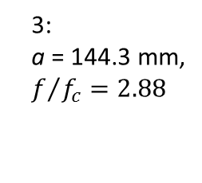
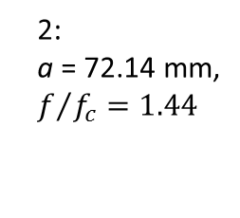
Waveguide dispersion
$$f=3 \text{GHz}$$
What happens with different waveguide dimensions (different width a)?
1:
a = 52 mm,
$f/{f_{c}}=1.04$
2:
a = 72.14 mm,
$f/{f_{c}}=1.44$
3
2
3:
a = 144.3 mm,
$f/{f_{c}}=2.88$
1
cutoff

Slide 12








Phase velocity
The phase velocity is the speed with which the crest or a zero-crossing travels in z-direction.
Note on the three animations on the right that, at constant f, it is .
Note that at , !
With , !
f = 3 GHz
1:
a = 52 mm,
f/f_{c} = 1.04
2:
a = 72.14 mm,
f/f_{c} = 1.44
3
2
3:
a = 144.3 mm,
f/f_{c} = 2.88
1
cutoff

Slide 13
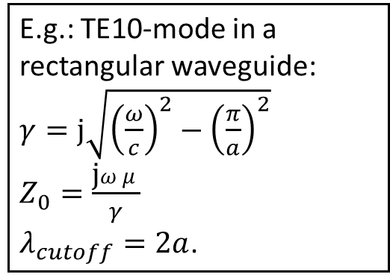
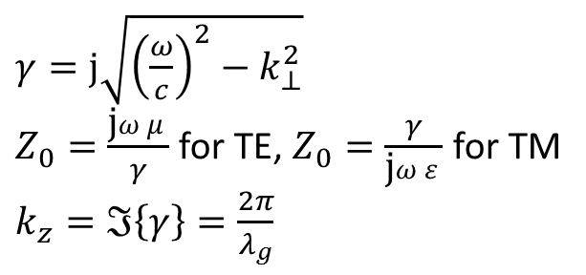
Summary waveguide dispersion and phase velocity:
In a general cylindrical waveguide:
$γ=\text{j}\sqrt{{\left(\frac{ω}{c}\right)}^{2}−k_{⊥}^{2}}$
$Z_{0}=\frac{\text{j}ωμ}{γ}$ for TE, $Z_{0}=\frac{γ}{\text{j}ωε}$ for TM
$k_{z}=ℑ\left\{γ\right\}=\frac{2π}{λ_{g}}$
E.g.: TE10-mode in a rectangular waveguide:
$γ=\text{j}\sqrt{{\left(\frac{ω}{c}\right)}^{2}−{\left(\frac{π}{a}\right)}^{2}}$
$Z_{0}=\frac{\text{j}ωμ}{γ}$
$λ_{cutoff}=2a$.
In a hollow waveguide: phase velocity $v_{φ}>c$, group velocity $v_{gr}<c$, $v_{gr}∙v_{φ}=c^{2}$.

Slide 14
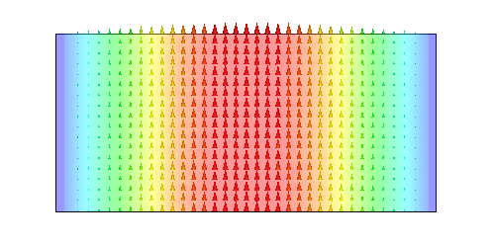
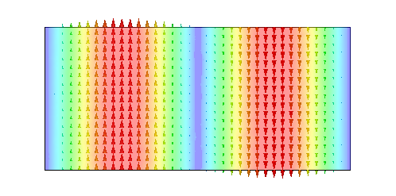
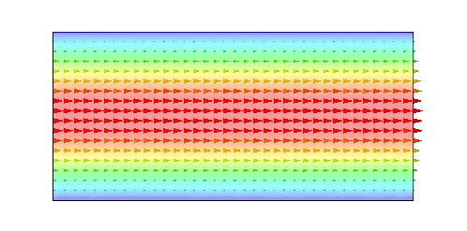
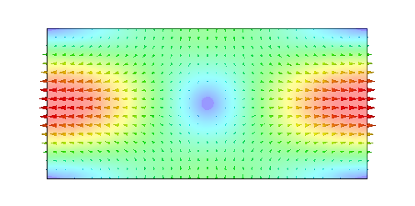
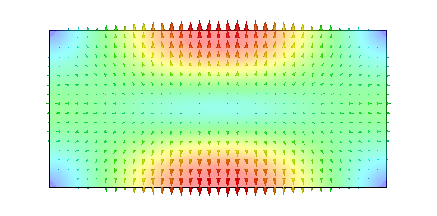
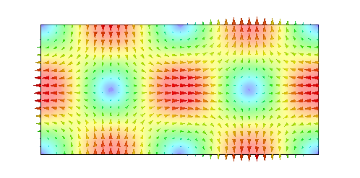
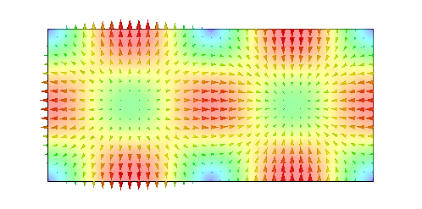
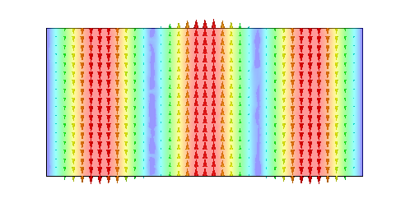
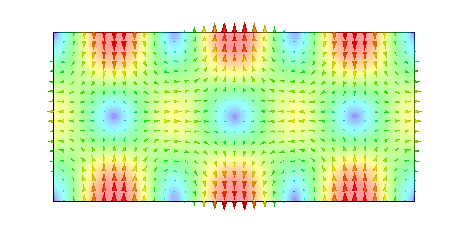
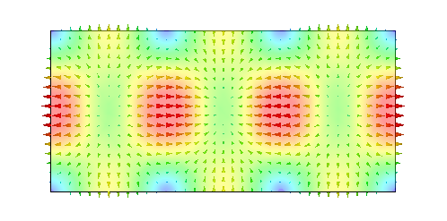
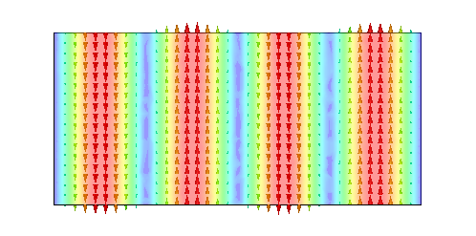
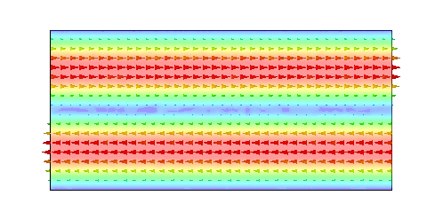
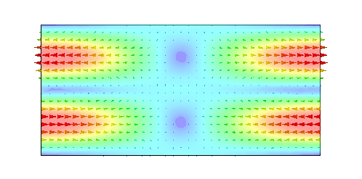
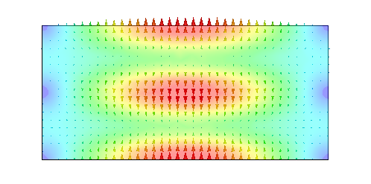
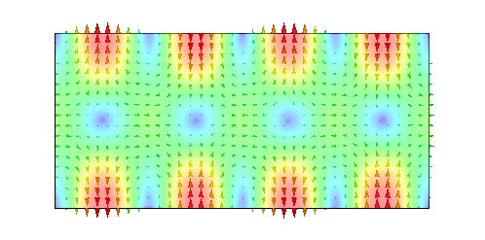
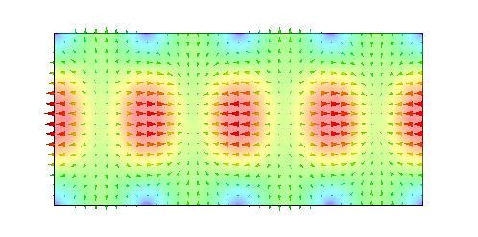
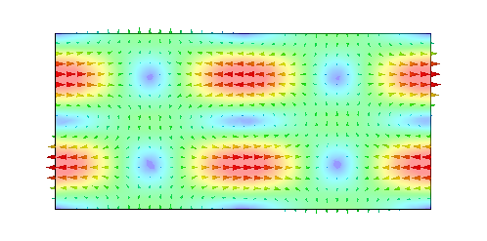
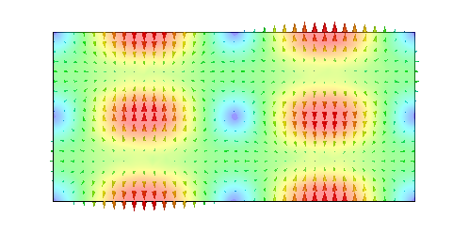


Rectangular waveguide modes
TE₁₀
TE₂₀
TE₀₁
TE₁₁
TM₁₁
TE₂₁
TM₂₁
TE₃₀
TE₃₁
TM₃₁
TE₄₀
TE₀₂
TE₁₂
TM₁₂
TE₄₁
TM₄₁
TE₂₂
TM₂₂
TE₅₀
TE₃₂
plotted: E-field

Slide 15

Some more standard rectangular Waveguides
Waveguide name |  |  | Recommended frequency band of operation (GHz) | Cutoff frequency of lowest order mode (GHz) | Cutoff frequency of next mode (GHz) | Inner dimensions of waveguide opening (inch)
EIA | RCSC | IEC
WR2300 | WG0.0 | R3 | 0.32 — 0.45 | 0.257 | 0.513 | 23.0 × 11.5
WR1150 | WG3 | R8 | 0.63 — 0.97 | 0.513 | 1.026 | 11.50 × 5.75
WR340 | WG9A | R26 | 2.2 — 3.3 | 1.736 | 3.471 | 3.40 × 1.70
WR75 | WG17 | R120 | 10 — 15 | 7.869 | 15.737 | 0.75 × 0.375
WR10 | WG27 | R900 | 75 — 110 | 59.015 | 118.03 | 0.10 × 0.05
WR3 | WG32 | R2600 | 220 — 330 | 173.571 | 347.143 | 0.034 × 0.017
b
a
WR2300
WR2100
WR1800
WR1500
WR1150
WR975
courtesy: Eric Montesinos/CERN

Slide 16





Radial waves
Also radial waves may be interpreted as superposition of plane waves.
The superposition of an outward and an inward radial wave can result in the field of a round hollow waveguide.

Slide 17









Round waveguide
f/f_{c} = 1.44
TE₁₁ – fundamental
TM₀₁ – axial field
TE₀₁ – low loss

Slide 18









Circular waveguide modes
TE₁₁
TE₁₁
TM₀₁
TE₂₁
TE₂₁
TE₃₁
TE₃₁
TE₀₁
TM₁₁
plotted: E-field

Slide 19


General waveguide equations:
Transverse wave equation (membrane equation): $∆T+{\left(\frac{ω_{c}}{c}\right)}^{2}T=0$.
 | TE (or H-) modes | TM (or E-) modes
Boundary condition: | $$\vec{n}∙∇T=0$$ | $$T=0$$
longitudinal wave equations (transmission line equations): | $$\frac{dU\left(z\right)}{dz}+γZ_{0}I\left(z\right)=0 \\ \frac{dI\left(z\right)}{dz}+\frac{γ}{Z_{0}}U\left(z\right)=0$$
Propagation constant: | $$γ=j\frac{ω}{c}\sqrt{1−{\left(\frac{ω_{c}}{ω}\right)}^{2}}$$
Characteristic impedance: | $$Z_{0}=\frac{jωμ}{γ}$$ | $$Z_{0}=\frac{γ}{jωε}$$
Ortho-normal eigenvectors: | $$\vec{e}={\vec{u}}_{z}×∇T$$ | $$\vec{e}=−∇T$$
Transverse fields: | $$\vec{E}=U\left(z\right)\vec{ e} \\ \vec{H}=I\left(z\right){ \vec{u}}_{z}×\vec{e}$$
Longitudinal fields: | $$H_{z}={\left(\frac{ω_{c}}{ω}\right)}^{2}\frac{T U\left(z\right)}{jωμ}$$ | $$E_{z}={\left(\frac{ω_{c}}{ω}\right)}^{2}\frac{T I\left(z\right)}{jωε}$$

Slide 20








Special cases: rectangular and round waveguide
Rectangular waveguide: transverse eigenfunctions
Round waveguide: transverse eigenfunctions
where in both cases $ε_{i}=\left\{\begin{matrix}1 & if & i=0 \\ 2 & if & i≠0\end{matrix}\right.$
TE (H-) modes: | $$T_{mn}^{(H)}=\frac{1}{π}\sqrt{\frac{a b ε_{m}ε_{n}}{{\left(mb\right)}^{2}+{\left(na\right)}^{2}}}\cos\left(\frac{mπ}{a}x\right)\cos\left(\frac{nπ}{b}y\right)$$
TM (E-) modes: | $$T_{mn}^{(E)}=\frac{2}{π}\sqrt{\frac{a b}{{\left(mb\right)}^{2}+{\left(na\right)}^{2}}}\sin\left(\frac{mπ}{a}x\right)\sin\left(\frac{nπ}{b}y\right)$$
$$b$$
$$a$$
$$\frac{ω_{c}}{c}=\sqrt{{\left(\frac{mπ}{a}\right)}^{2}+{\left(\frac{nπ}{b}\right)}^{2}}$$
TE (H-) modes: | $$T_{mn}^{(H)}=\sqrt{\frac{ε_{m}}{π\left(χ_{mn}^{′2}−m^{2}\right)}}\frac{J_{m}\left(χ_{mn}^{′}\frac{ρ}{a}\right)}{J_{m}\left(χ_{mn}^{′}\right)} \left\{\begin{matrix}\cos\left(mφ\right) \\ \sin\left(mφ\right)\end{matrix}\right\}$$
TM (E-) modes: | $$T_{mn}^{(E)}=\sqrt{\frac{ε_{m}}{π}} \frac{J_{m}\left(χ_{mn}\frac{ρ}{a}\right)}{J_{m−1}\left(χ_{mn}\right)} \left\{\begin{matrix}\sin\left(mφ\right) \\ \cos\left(mφ\right)\end{matrix}\right\}$$
$$∅=2a$$
$$\frac{ω_{c}}{c}=\frac{χ_{mn}}{a}$$

Slide 21


Waveguide perturbed by notches
“notches”
Signal flow chart
Reflections from notches lead to a superimposed standing wave pattern.
“Trapped mode”

Slide 22




Short-circuited waveguide
TM₀₁₀ (no axial dependence)
TM₀₁₁
TM₀₁₂

Slide 23







Single WG mode between two shorts
short
circuit
$$a$$
$$e^{−jk_{z}ℓ}$$
short
circuit
$$−1$$
Signal flow chart
$$−1$$
$$e^{−jk_{z}ℓ}$$
$$−ae^{−jk_{z}ℓ}$$
Eigenvalue equation for field amplitude $a$:
$$a=e^{−jk_{z}2ℓ}a$$
Non-vanishing solutions exist for $2k_{z}ℓ=2πm$:
With $k_{z}=\frac{ω}{c}\sqrt{1−{\left(\frac{ω_{c}}{ω}\right)}^{2}}$, this becomes $f_{0}^{2}=f_{c}^{2}+{\left(c\frac{m}{2𝓁}\right)}^{2}$.

Slide 24


Simple pillbox
(only 1/2 shown)
TM₀₁₀-mode
electric field (purely axial)
magnetic field (purely azimuthal)

Slide 25








Pillbox cavity field (w/o beam tube)
h
Ø 2a
The only non-vanishing field components :

Slide 26


Pillbox with beam pipe
TM₀₁₀-mode
(only 1/4 shown)
One needs a hole for the beam pipe – circular waveguide below cutoff
electric field
magnetic field

Slide 27


A more practical pillbox cavity
TM₀₁₀-mode
(only 1/4 shown)
Round of sharp edges (to reduce field enhancement!)
electric field
magnetic field

Slide 28


A (real) elliptical cavity
TM₀₁₀-mode
(only 1/4 shown)
electric field
magnetic field

Slide 29

Choice of frequency
Size:
  Linear dimensions scale as $f^{−1}$, volume as $f^{−3}$.
  amount of material, mass, stiffness, tolerances, …
  Outer radius of elliptical cavity $\sim 0.45 λ$.
Beam interaction:
  $r/Q$ increases with $f$ – but also for HOMs!
  short bunches are easier with higher $f$.
Technology:
  superconducting: BCS resistance $∝f^{2}$.
  Power sources available?
  Max. accelerating voltage?

Slide 30
Characterizing a cavity

Slide 31


Acceleration voltage and $R/Q$
I define
$$V_{acc}=\int_{−∞}^{∞}{E_{z}ⅇ^{ⅉ\frac{ω}{βc }z}ⅆz}.$$
The exponential factor accounts for the variation of the field while particles with velocity $βc$ are traversing the cavity gap.
With this definition, $V_{acc}$ is generally complex – this becomes important with more than one gap (cell).
For the time being we are only interested in $\left|V_{acc}\right|$.
The square of the acceleration voltage is proportional to the stored energy $W;$the proportionality constant defines the quantity called “R-upon-Q”:
$$\frac{R}{Q}=\frac{{\left|V_{acc}\right|}^{2}}{2ω_{0}W}.$$
Attention – different definitions are used in literature!
electric field

Slide 32



Transit time factor
The transit time factor is the ratio of the acceleration voltage to the (non-physical) voltage a particle with infinite velocity would see:
$$TT=\frac{\left|V_{acc}\right|}{\left|∫E_{z}ⅆz\right|}=\frac{\left|\int{\left.E_{z}ⅇ^{ⅉ\frac{ω}{βc}z}ⅆz\right. }\right|}{\left|∫E_{z}ⅆz\right|}.$$
The transit time factor of an ideal pillbox cavity (no axial field dependence) of height (gap length) $h$ is:
$TT=\sin{{\left(\frac{χ_{01}h}{2a}\right)}/{\left(\frac{χ_{01}h}{2a}\right)}}$
Field rotates by 360° during particle passage.
$$TT$$
$$\frac{h}{λ}$$

Slide 33




Stored energy
The energy stored in the electric field is
$$W_{E}=\iiint_{cavity}{\frac{ε}{2}{\left|\vec{E}\right|}^{2}ⅆV.}$$
The energy stored in the magnetic field is
$$W_{M}=\iiint_{cavity}{\frac{μ}{2}{\left|\vec{H}\right|}^{2}ⅆV.}$$
Since $\vec{E}$ and $\vec{H}$ are $90°$ out of phase, the stored energy continuously swaps from electric energy to magnetic energy.
On average, electric and magnetic energy must be equal.
In steady state, the Poynting vector describes this energy flux.
In steady state, the total energy stored (constant) is
$$W=\iiint_{cavity}{\left(\frac{ε}{2}{\left|\vec{E}\right|}^{2}+\frac{μ}{2}{\left|\vec{H}\right|}^{2}\right)ⅆV.}$$
$$W_{E}$$
$$\vec{E}$$
$$W_{M}$$
$$\vec{H}$$

Slide 34



Stored energy and Poynting vector
electric field energy
Poynting vector
magnetic field energy

Slide 35



Wall losses & $Q_{0}$
The losses $P_{loss}$ are proportional to the stored energy $W$.
The tangential $\vec{H}$ on the surface is linked to a surface current ${\vec{J}}_{A}=\vec{n}×\vec{H}$ (flowing in the skin depth $δ$).
This surface current ${\vec{J}}_{A}$ sees a surface resistance $R_{s}$, resulting in a local power density $R_{s}{\left|H_{t}\right|}^{2}$ flowing into the wall.
$R_{s}$ is related to skin depth $δ$ as $δσR_{s}=1$.
  Cu at $300 \text{K}$ has $σ≈5.8∙{{10}^{7}\text{S}}/{\text{m}}$, leading to $R_{s}≈8 \text{mΩ}$ at 1 GHz, scaling with $\sqrt{ω}$.
  Nb at $2 \text{K}$ has a typical $R_{s}≈10 \text{n}\text{Ω}$ at 1 GHz, scaling with $ω^{2}$.
The total wall losses result from $P_{loss}=\underset{wall}{∬}R_{s}{\left|H_{t}\right|}^{2}ⅆA$.
The cavity $Q_{0}$ (caused by wall losses) is defined as $Q_{0}=\frac{ω_{0}W}{P_{loss}}.$
Typical $Q_{0}$values:
  Cu at $300 \text{K}$ (normal-conducting): $𝒪\left({10}^{3}…{10}^{5}\right)$, improves at cryogenic $T$ by a factor $RRR$.
  Nb at $2 \text{K}$ (superconducting): $𝒪\left({10}^{9}…{10}^{11}\right)$
No! Anomalous skin effect!
Only by a factor $≈10$!

Slide 36

Shunt impedance
The square of the acceleration voltage is proportional to the power loss $P_{loss}$.
The proportionality constant defines the “shunt impedance”
$$R=\frac{{\left|V_{acc}\right|}^{2}}{2 P_{loss}}.$$
Attention, also here different definitions are used!
Traditionally, the shunt impedance is the quantity to optimize in order to minimize the power required for a given gap voltage.

Slide 37

Geometric factor
With
$$Q_{0}=\frac{ω_{0}W}{\underset{wall}{∬}R_{s}{\left|H_{t}\right|}^{2}ⅆA},$$
and assuming an average surface resistance $R_{s}$, one can introduce the “geometric factor”$G$ as
$$G=Q_{0}×R_{s}=\frac{ω_{0}W}{\underset{wall}{∬}{\left|H_{t}\right|}^{2}ⅆA}.$$
$G$ has dimension Ohm, depends only on the cavity geometry (as the name suggests) and typically is $𝒪\left(100 \text{Ω}\right)$.
Note that $R_{s}∙R=G∙\left(R/Q\right)$ (dimension ${\text{Ω}}^{2}$, purely geometric)
$G$ is only used for SC cavities.

Slide 38









Cavity resonator – equivalent circuit
Simplification: single mode
$$I_{G}$$
$$V_{acc}$$
$$I_{B}$$
$$P$$
Generator
Z
Beam
$$R/β$$
$$C$$
$$L$$
$$R$$
$β$: coupling factor
$R$: shunt impedance
$\sqrt{L/C}=\frac{R}{Q}$: R-upon-Q
Cavity

Slide 39



Power coupling - Loaded $Q$
Note that the generator inner impedance also loads the cavity – for very large $Q_{0}$ more than the cavity wall losses.
To calculate the loaded $Q$ ($Q_{L}$), losses have to be added:
$$\frac{1}{Q_{L}}=\frac{P_{loss}+P_{ext}+…}{ω_{0} W}=\frac{1}{Q_{0}}+\frac{1}{Q_{ext}}+\frac{1}{…}.$$
The coupling factor $β$ is the ratio ${P_{ext}}/{P_{loss}}$.
With $β$, the loaded $Q$ can be written
$$Q_{L}=\frac{Q_{0}}{1+β}.$$
For NC cavities, often $β=1$ is chosen (power amplifier matched to empty cavity); for SC cavities, $β=𝒪\left({10}^{4}…{10}^{6}\right)$.

Slide 40






Resonance
$$Q_{0}=1000$$
$$Q_{0}=100$$
$Q_{0}=1$0
$$Q_{0}=1$$
While a high $Q_{0}$ results in small wall losses, so less power is needed for the same voltage.
On the other hand the bandwidth becomes very narrow.
Note: a 1 GHz cavity with a $Q_{0}$ of ${10}^{10}$ has a natural bandwidth of 0.1 Hz!
… to make this manageable, $Q_{ext}$ is chosen much smaller!

Slide 41













Loss factor
Impedance seen by the beam
V (induced)
$$I_{B}$$
$$k_{loss}=\frac{ω_{0}}{2}\left(\frac{R}{Q}\right)=\frac{{\left|V_{acc}\right|}^{2}}{4 W}=\frac{1}{2C}$$
Beam
Energy deposited by a single charge $q$: $k_{loss}q^{2}$
$$R/β$$
$$C$$
$$L$$
$$R$$
$$L=R/{\left(Q_{0}{ ω}_{0}\right)}$$
$$C={Q_{0}}/{\left(R ω_{0}\right)}$$
Voltage induced by a single charge $q$:
Cavity
$$ⅇ^{−\frac{ω_{0}}{2Q_{L}}t}$$
$$\frac{V_{acc}}{2 k_{loss} q}$$
$$f_{0}t$$

Slide 42





Summary: relations $V_{acc}$, $W$ and $P_{loss}$
Attention – different definitions are used in literature !
$$V_{acc}$$
acceleration voltage
𝑉_𝑎𝑐𝑐
acceleration voltage
$$P_{wall}$$
wall losses
𝑃_𝑤𝑎𝑙𝑙
wall losses
$$W$$
Energy stored
𝑊
Energy stored
$$\frac{R}{Q}=\frac{{\left|V_{acc}\right|}^{2}}{2ω_{0}W}$$
$$R=\frac{{\left|V_{acc}\right|}^{2}}{2P_{loss}}=\frac{R}{Q}Q_{0}$$
$$k_{loss}=\frac{ω_{0}}{2}\frac{R}{Q}=\frac{{\left|V_{acc}\right|}^{2}}{4W}$$
$$Q_{0}=\frac{ω_{0}W}{P_{loss}}$$

Slide 43


Beam loading
The beam current “loads” the cavity, in the
equivalent circuit this appears as an impedance in
parallel to the shunt impedance.
If the generator is matched to the unloaded cavity
($β=1$), beam loading will (normally) cause the accelerating voltage to decrease.
The power absorbed by the beam is $−\frac{1}{2}ℜ\left\{V_{acc}I_{B}^{∗}\right\}$.
For high power transfer efficiency RF → beam, beam loading must be high!
For SC cavities (very large $β)$, the generator is typically matched to the beam impedance!
Variation in the beam current leads to transient beam loading, which requires special care!
Often the “impedance” the beam presents is strongly reactive – this leads to a detuning of the cavity.

Slide 44


Multipactor
The words “multipactor”, “to multipact” and “multipacting” are artificially composed of “multiple” “impact”.
Multipactor describes a resonant RF phenomenon in vacuum:
  Consider a free electron in a simple cavity – it gets accelerated by the
  electric field towards the wall
  when it impacts the wall, secondary electrons will be emitted, described
  by the secondary emission yield (SEY)
  in certain impact energy ranges, more than one electron is emitted for
  one electron impacting! So the number of electrons can increase
  When the time for an electron from emission to impact takes exactly
  ½ of the RF period, resonance occurs – with the SEY>1, this leads to an
  avalanche increase of electrons, effectively taking all RF power at this
  field level, depleting the stored energy and limiting the field!
For this simple “2-point MP”, this resonance
condition is reached at $\frac{1}{4π}\frac{e}{m}V={\left(fd\right)}^{2}$ or
$\frac{V}{112 \text{V}}={\left(\frac{f}{\text{MHz}}\frac{d}{\text{m}}\right)}^{2}$. There exist other resonant bands.
courtesy: Sarah Aull/CERN

Slide 45


Multipactor (contd.)
Unfortunately, good metallic conductors (Cu, Ag, Nb) all have SEY>1!
1-point MP occurs when the electron impact where they were emitted
Electron trajectories can be complex since both $\vec{E}$ and $\vec{B}$ influence them; computer simulations allow to determine the MP bands (barriers)
To reduce of suppress MP, a combination of the following may be considered:
  Use materials with low SEY
  Optimize the shape of your cavity (→ elliptical cavity)
  Conditioning (surface altered by exposure to RF fields)
  Coating (Ti, TiN, NEG, C …)
  Clearing electrode (for a superimposed DC electric field)
  Rough surfaces

Slide 46
Many gaps

Slide 47











What do you gain with many gaps?
The $R/Q$ of a single gap cavity is limited to some 100 Ω.
Now consider to distribute the available power to $n$ identical cavities: each will receive $P/n$, thus produce an accelerating voltage of . (Attention: phase important!)
The total accelerating voltage thus increased, equivalent to a total equivalent shunt impedance of $nR$.
$$\left|V_{acc}\right|=n\sqrt{2R\frac{P}{n}}=\sqrt{2\left(nR\right)P}$$
$$P/n$$
$$P/n$$
$$P/n$$
$$P/n$$
$$1$$
$$2$$
$$3$$
$$n$$

Slide 48

Standing wave multicell cavity
Instead of distributing the power from the amplifier, one might as well couple the cavities, such that the power automatically distributes, or have a cavity with many gaps (e.g. drift tube linac).
Coupled cavity accelerating structure (side coupled)
The phase relation between gaps is important!

Slide 49





Brillouin diagram;
Travelling wave structure
π
$${ωL}/{c }$$
2π
speed of light line,
ω = β /c
2π/3
π
synchronous
π/2
π/2
0
0
π/2
β L
π

Slide 50





The elliptical cavity
At $1.3 GHz$:
$R_{0}=103.3 mm$,
$2L=115.3 mm$.
The elliptical shape was found as
optimum compromise between
  maximum gradient ($E_{acc}/E_{surf}$)
  suppression of multipactor
  mode purity
  machinability
Operated in $π$-mode, i.e. cell length
is exactly ${βλ}/2$.
It has become de facto standard,
used for ions and leptons! E.g.:
  ILC/X-FEL: 1.3 GHz, 9-cell cavity
  SNS (805 MHz)
  SPL/ESS (704 MHz)
  LHC (400 MHz)
D. Proch, 1993 ^{*)}
*): http://accelconf.web.cern.ch/AccelConf/SRF93/papers/srf93g01.pdf‎

Slide 51













Elliptical cavity – the de facto standard for SRF
FERMI 3.9 GHz
TESLA/ILC 1.3 GHz
LEP 0.352 GHz
S-DALINAC 3 GHz
SNS ß=0.61,0.81, 0.805 GHz
CEBAF 1.5 GHz
HERA 0.5 GHz
cells
HEPL 1.3 GHz
TRISTAN 0.5 GHz
CESR 0.5 GHz
KEK-B 0.5 GHz

Slide 52










Practical RF parameters 1
Average accelerating gradient: $E_{acc}=\frac{\sqrt{ωW\left(R/Q\right)}}{l_{active}}$
$B_{peak}$ on the wall
$E_{peak}$ on the wall
$$\frac{E_{peak}}{E_{acc}}$$
$$\frac{B_{peak}}{E_{acc}}$$
Contour plot of $\left|E\right|$
Contour plot of $\left|B\right|$
$$l_{active}$$
The ratio shows sensitivity of the shape to the field emission of electrons.
The ratio shows limit in E_{acc} due to the break-down of superconductivity (Nb ~190 mT).
courtesy: Jacek Sekutovicz/DESY

Slide 53




Practical RF parameters 2
$$G∙\left(R/Q\right)$$
Both $G$ and $R/Q$ are purely geometric parameters.
Like the shunt impedance $R$, the product $G∙\left(R/Q\right)$ is a measure of the power loss for given acceleration voltage $V_{acc}$ and surface resistance $R_{s}$.
$$P_{loss}=\frac{{\left|V_{acc}\right|}^{2}R_{s}}{2 G∙\left(R/Q\right)}$$
Minimize $R_{s}$:
  operation at lower $T$,
  better surface cleanliness,
  lower residual resistance
Optimize geometry maximizing $G∙\left(R/Q\right)$.
courtesy: Jacek Sekutovicz/DESY

Slide 54
Single-cell versus multi-cell cavities
Advantages of single-cell cavities:
  It is easier to manage HOM damping
  There is no field flatness problem.
  Input coupler transfers less power
  They are easy for cleaning and preparation
Advantages of multi-cell cavities:
  much more acceleration per meter!
  better use of the power
  more cost-effective for most applications
courtesy: Jacek Sekutovicz/DESY

Slide 55








Practical RF parameters 3
Cell-to-cell coupling $k_{cc}$ will determine the width of the passbands in multi-cell cavities.
$$k_{cc}=2\frac{{ω_{π}−ω}_{0}}{ω_{π}+ω_{0}}$$
2π
Brillouin diagram
$${ωL}/c$$
π
$${ω_{π} L}/c$$
π/2
$${ω_{0} L}/c$$
0
π/2
β L
π
courtesy: Jacek Sekutovicz/DESY

Slide 56

Field flatness
Field amplitude variation from cell to cell in a multi-cell structure
Should be small for maximum acceleration.
Field flatness sensitivity factor $a_{ff}$ for a structure made of $N$ cells:
$$\frac{ΔA_{i}}{A_{i}}=a_{ff}\frac{Δf_{i}}{f_{i}}$$
  is related to the cell-to-cell coupling as $a_{ff}=\frac{N^{2}}{k_{cc}}$ and describes the sensitivity of the field flatness on the errors in individual cells.
courtesy: Jacek Sekutovicz/DESY

Slide 57


Criteria for Cavity Design (1)
Here: Inner cells of multi-cell structures
Parameters for optimization:
  Fundamental mode: $\frac{R}{Q}$, $G$, $\frac{E_{peak}}{E_{acc}}$, $\frac{B_{peak}}{E_{acc}}$, $k_{cc}$.
  Higher order modes: $k_{⊥}$, $k_{z}$.
The elliptical cavity design has distinct advantages:
  easy to clean (rinse)
  little susceptible to MP – can be conditioned …
Geometric parameters for optimization:
  iris ellipse half axes: $a$, $b$:
  iris aperture radius: $r_{i}$,
  equator ellipse half axes: $A$, $B$
Problem: 7 parameters to optimize, only 5 to play
with – some compromise has to be found!
courtesy: Jacek Sekutovicz/DESY

Slide 58


Criteria for Cavity Design (2)
Criterion | RF parameter | Improves if | examples
high gradient operation | ${E_{peak}}/{E_{acc}}$ ${B_{peak}}/{E_{acc}}$ | $r_{i}$ | TESLA, CEBAF 12 GeV HG
low cryogenic losses | $$\frac{R}{Q}∙G$$ | $r_{i}$ | CEBAF LL
High $I_{beam}$ | $k_{⊥}$, $k_{z}$ | $r_{i}$ | B-factory RHIC cooling LHeC
We see here that $r_{i}$ is a very “powerful” variable to trim the RF-parameters of a cavity.
Of course it has to fit the aperture required for the beam!
courtesy: Jacek Sekutovicz/DESY

Slide 59





Effect of $r_{i}$
Smaller $r_{i}$ allows to concentrate $E_{z}$ where it is needed for acceleration
r_{i} = 40 mm r_{i} = 20 mm
E_{z} (z) for small and big iris radius
courtesy: Jacek Sekutovicz/DESY

Slide 60

Example: cell optimization at 1.5 GHz
A. Mosnier, E. Haebel, SRF Workshop 1991
courtesy: Jacek Sekutovicz/DESY

Slide 61




Equator shape optimization
${B_{peak}}/{E_{acc}}$ (and $G$) change when changing the equator shape.
courtesy: Jacek Sekutovicz/DESY

Slide 62




Iris shape optimization
${E_{peak}}/{E_{acc}}$ changes with the iris shape
25 mm
20 mm
42 mm
42 mm
Both cells have the same: f, (R/Q) and r_{i}
courtesy: Jacek Sekutovicz/DESY

Slide 63






Minimizing HOM excitation
HOMs loss factors ($k_{⊥}$ , $k_{z}$)
r_{i} = 20mm
r_{i} = 40mm
$\frac{R}{Q}=152 \text{Ω}$
${B_{peak}}/{E_{acc}}=3.5{\text{mT}}/{\left({MV}/m\right)}$
${E_{peak}}/{E_{acc}}=1.9$
$\frac{R}{Q}=86 \text{Ω}$
${B_{peak}}/{E_{acc}}=4.6{\text{mT}}/{\left({MV}/m\right)}$
${E_{peak}}/{E_{acc}}=3.2$
courtesy: Jacek Sekutovicz/DESY

Slide 64


Cell-to-cell coupling $k_{cc}$
r_{i} = 20mm
r_{i} = 40mm
$\frac{R}{Q}=152 \text{Ω}$
${B_{peak}}/{E_{acc}}=3.5{\text{mT}}/{\left({MV}/m\right)}$
${E_{peak}}/{E_{acc}}=1.9$
$\frac{R}{Q}=86 \text{Ω}$
${B_{peak}}/{E_{acc}}=4.6{\text{mT}}/{\left({MV}/m\right)}$
${E_{peak}}/{E_{acc}}=3.2$
courtesy: Jacek Sekutovicz/DESY

Slide 65



Scaling the frequency
x 2 =
f_{π} | [MHz] | 2600
R/Q | [Ω] | 57
r/q=(R/Q)/l | [Ω/m] | 2000
G | [Ω] | 271
f_{π} | [MHz] | 1300
R/Q | [Ω] | 57
r/q=(R/Q)/l | [Ω/m] | 1000
G | [Ω] | 271
$$r/Q={\left(R/Q\right)}/l∝f$$
courtesy: Jacek Sekutovicz/DESY

Slide 66

Operating temperature
At the XFEL gradient, Qo is higher by 80% at 1.8 K
courtesy: Jacek Sekutovicz/DESY

Slide 67



Historic evolution of inner cell geometry
TESLA optimized
E_{peak}/E_{acc}
Re-entrant optimized
B_{peak}/E_{acc}
LL optimized
B_{peak}/E_{acc}
Example: ILC
1992
2002/04
2002/04
r_{i} | [mm] | 35 | 30 | 30
k_{cc} | [%] | 1.9 | 1.56 | 1.52
E_{peak}/E_{acc} | - | 1.98 | 2.30 | 2.36
B_{peak}/E_{acc} | [mT/(MV/m)] | 4.15 | 3.57 | 3.61
R/Q | [Ω] | 113.8 | 135 | 133.7
G | [Ω] | 271 | 284.3 | 284
R/Q*G | [Ω*Ω] | 30840 | 38380 | 37970
k┴ (σ_{z}=1 mm) | [V/pC/cm²] | 0.23 | 0.38 | 0.38
k║ (σ_{z}=1 mm) | [V/pC] | 1.46 | 1.75 | 1.72
courtesy: Jacek Sekutovicz/DESY

Slide 68

Cavity optimization example
courtesy: Frank Marhauser/JLAB

Slide 69
Higher order modes
external dampers
R₁, Q₁,ω₁
R₂, Q₂,ω₂
R₃, Q₃,ω₃
...
...
n₁
n₂
n₃
I_{B}

Slide 70


Pillbox: 1st dipole mode
TM₁₁₀-mode
(only 1/4 shown)
electric field
magnetic field

Slide 71

Panofsky-Wenzel theorem
For particles moving virtually at $v=c$, the integrated transverse force (kick) can be determined from the transverse variation of the integrated longitudinal force!
$$ⅉ\frac{ω}{c}{\vec{F}}_{⊥}=∇_{⊥}F_{z}$$
Pure TE modes: No net transverse force !
Transverse modes are characterized by
the transverse impedance in ω-domain
the transverse loss factor (kick factor) in t-domain !
W.K.H. Panofsky, W.A. Wenzel: “Some Considerations Concerning the Transverse Deflection of Charged Particles in Radio-Frequency Fields”, RSI 27, 1957]

Slide 72



CERN/PS 80 MHz cavity (for LHC)
inductive (loop) coupling,
low self-inductance

Slide 73



Higher order modes
Example shown:
80 MHz cavity PS for LHC.
Color-coded:

Slide 74

Higher order modes (measured spectrum)
without dampers
with dampers

Slide 75


7-cell 1.3 GHz structure for BERLinPro
Galek et al.: IPAC2013
Band diagram (top) and Q-factors (bottom)
Reminder:
0-mode $π$-mode

Slide 76



HOMs: Example 5-cell cavity
First passbands of HOMs typically dangerous
courtesy: Rama Calaga/CERN

Slide 77





HOM dampers
Ferrite absorbers: broadband damper, room temperature
Waveguides: better suited for higher frequencies (size!)
Notch filters: narrow-band; target specific mode
Multi-cell cavities require broadband dampers
More tomorrow by Guillaume Devanz!
ferrite absorber
waveguides
notch filter
bandpass filter
double notch

Slide 78
Tuners

Slide 79



Small boundary perturbation
Perturbation calculation is used to understand the basics for cavity tuning – it is used to analyse the sensitivity to (small) surface geometry perturbations.
  This is relevant to understand the effect of fabrication tolerances.
  Intentional surface deformation or introduced obstacles can be used to tune the cavity.
The basic idea of the perturbation theory is use a known solution (in this case the unperturbed cavity) and assume that the deviation from it is only small. We just used this to calculate the losses (assuming $H_{t}$ would be that without losses).
The result of this calculation leads to a convenient expression for the (de)tuning:
$$\frac{ω−ω_{0}}{ω}=\frac{\iiint_{ΔV}{\left(μ_{0}{\left|H_{0}\right|}^{2}−ε{\left|E_{0}\right|}^{2}\right)ⅆV}}{\iiint_{V}{\left(μ_{0}{\left|H_{0}\right|}^{2}+ε{\left|E_{0}\right|}^{2}\right)ⅆV}}$$
V
ΔV
V
Slater Theorem
unperturbed: $ω_{0}$
perturbed: $ω$

Slide 80


Lorentz force detuning
The presence of electromagnetic fields inside the cavity lead to a mechanical pressure on the cavity.
Radiation pressure: $P=\frac{1}{4}(μ_{0}{\left|H\right|}^{2}−ε_{0}{\left|E\right|}^{2})$
Deformation of the cavity shape:
Frequency shift: $Δf=K L {\left|E_{acc}\right|}^{2}$; typical: $K L≈−{\left(1…10\right)\text{Hz}}/{{\left(\frac{\text{MV}}{\text{m}}\right)}^{2}}$
This requires good stiffness – and the possibility to tune rapidly!

Slide 81

Tuner principle
Slow tuners:
  compensate for mechanical tolerances,
  realized with stepper motor drives
Fast tuners:
  compensate Lorentz-force detuning and reactive beam loading
  realized with piezo crystal (lead zirconate titanate – PZT)
Tuning of SC cavities is often realized by deforming the cavity:
courtesy: Eiji Kako/KEK

Slide 82



Blade tuner
Developed by INFN Milan
Azimuthal motion transferred to longitudinal strain
Zero backlash
CuBe threaded shaft used for a screw nut system
Stepping motor and gear combination driver
Two piezo actuators for fast action
All components in cold location
courtesy: Eiji Kako/KEK

Slide 83




“Saclay” lever-arm tuner
Developed by DESY based on the Saclay design
Double lever system (leverage 1.25)
Cold stepping motor and gear combination
Screw nut system
Two piezo actuators for fast action in a preloaded frame
All components in cold location
courtesy: Eiji Kako/KEK

Slide 84




Slide-jack tuner
Developed by KEK for STF cryomodule
Slide-jack mechanism
Single high voltage piezo actuator for fast action
Warm stepping motor for easy maintenacne
Access port for replacing piezo
courtesy: Eiji Kako/KEK

Slide 85
FPC
(Fundamental Power Coupler)

Slide 86




Magnetic (loop) coupling
The magnetic field of the cavity main mode is intercepted by a coupling loop
The coupling can be adjusted by changing the size or the orientation of the loop.
Coupling: $∝∭\vec{H}∙{\vec{J}}_{m}ⅆV$
coupling loop
$${\vec{J}}_{m}$$
$$\vec{H}$$
courtesy: David Alesini/INFN

Slide 87




Electric (antenna) coupling
The inner conductor of the coaxial feeder line ends in an antenna penetrating into the electric field of the cavity.
The coupling can be adjusted by varying the penetration.
Coupling $∝∭\vec{E}∙\vec{J}ⅆV$
antenna
$$\vec{J}$$
$$\vec{E}$$
courtesy: David Alesini/INFN

Slide 88





Fundamental Power Coupler – FPC
The Fundamental Power Coupler is the connecting part between the RF transmission line and the RF cavity
It is a specific piece of transmission line that also has to provide the cavity vacuum barrier.
FPCs are amongst the most critical parts of the RF cavity system in an accelerator!
A good RF design, a good mechanical design and a high quality fabrication are essential for an efficient and reliable operation.
More tomorrow by Guillaume Devanz!
LHC FPC
SPL FPC
HL-LHC FPC
courtesy: Eric Montesinos/CERN

Slide 89
Cavity Fabrication techniques

Slide 90

Materials
Selection criteria
  Electrical conductivity
  Secondary emission yield (SEY)
  mechanical stiffness/hardness (at cryogenic $T$)
  thermal conductivity, thermal expansion
  machining & joining techniques
  vacuum tight, low outgassing rate
  creep resistance,
  magnetic permeability
  radiation hardness
  fatigue stress
  …
Important: specify what you need and what you can measure/control at reception!

Slide 91


Niobium
Magnets use NbTi or Nb₃Sn, SC Cavities use mainly Nb!
Pure Nb has a high critical magnetic field ($H_{c}=200 mT$)
Nb has a high transition temperature ($T_{c}=9.3 K$).
It is chemically inert (surface covered by oxide layer)
It can be machined and deep-drawn
It is available as bulk and sheet material in any size, fabricated by forging and rolling
Large grain sizes (often favoured) obtained by e-beam melting
Instead of bulk or sheet Nb, Nb can also be coated (e.g. by sputtering) on Cu – CERN has built the LEP, LHC and HIE-Isolde cavities with this technique. Advantages: thermal stability, material cost, optimisation of $R_{BCS}$ possible; disadvantages: difficult technology to master, lower $Q_{0}$.
Nb ingot after EBM at Heraeus (D)

Slide 92

Dielectrics
Aluminium oxide, AL₂O₃, aka Alumina, is
often used in vacuum/RF windows and
vacuum feed-throughs.
Isostatically pressed AL₂O₃ is used for
leak-tightness (LEP power couplers, e.g.).
To reduce multipactor, it is often coated
with titanium or titanium nitride (TiN).
Other window materials: Sapphire, BeO,
quartz, diamond …)
Silicon carbide (SiC), C-loaded AlN have been effectively used as RF absorbers inside vacuum.
Different ferrites are used as absorbers and to use their variable magnetic permeability.
Coax transition through alumina window with traces of breakdown

Slide 93















Fabrication of Nb sheets at
Nb ingot
Forging
Cutting
Pressing
Milling
Annealing
1st EB melting
Rolling
Levering
2nd, 3rd … EB melting
Polishing
Chemical polishing
Separate from base plate
Inspections: (ICP-AES, Gas analysis, RRR, grain size, hardness tensile stress …)
Rolling

Slide 94

Other forming techniques
Forging, pressing, deep drawing, …
Spinning, planing, rolling, …
lapping, polishing, electropolishing, …
Electroforming, hydroforming, explosion forming
Powder metal techniques, additive manufacturing (3-D printing)
Sputtering
seamless cavity: e.g. back extrusion
back-extruded Nb tubes for E-XFEL
courtesy: Waldemar Singer/DESY

Slide 95





Joining techniques
TIG welding
EB welding
Microstructure of the EB welding area
grain size (50 ÷ 2000) μm
double joint:
inner for vacuum,
out for mechanical stability

Slide 96






Established cavity fabrication
Half cells are shaped by deep drawing.
Dumb bells are assemled by electron beam welding.
After proper cleaning eight dumb bells and two end group sections welded by electron beam together
Important: clean conditions on all steps
shape accuracy, preparation and EB welding
courtesy: Waldemar Singer/DESY

Slide 97



Advances in SCRF Technology
Preparing for EP (inserting cathode)
Photos: Rongli Geng
Clean room assembly (JLAB)
Stay tuned for A. Romanenko’s lecture on Sat.!
C. Antoine: CAS SC 2013

Slide 98
Thank you very much!

