Slide 1
Cryogenics & Cryomodules
Part 1: Catching Cold
J. G. Weisend II
Deputy Head of Accelerator Projects
www.europeanspallationsource.se
11 September 2015

Slide 2
Goal
The goal of this tutorial is to provide a background in cryogenics suitable for workers in the field of Superconducting RF along with pointers for further study
  At the end of today, you should understand the basics of cryogenics and cryomodules as they apply to SRF systems
The tutorial is divided into 2 logical parts: one on making things cold i.e. refrigeration systems & He II (Catching Cold) and 1 on maintaining things cold i.e. Cryostats and cryomodules (Keeping Cold)

Slide 3
Outline
Part 1: Catching Cold
  Introduction To Cryogenics
  Basic refrigeration processes
    Isenthalpic (Joule-Thomson)
    Isentropic expansion
  Carnot Cycle, COP and FOM
  Collins Cycle and Modern Refrigeration Plants
  He II (Superfluid Helium)
    Definition and use in SRF systems
    Two-Fluid Model
    Heat Transfer
    Fluid mechanics
    Second Sound
    He II Refrigeration Systems

Slide 4
Outline
Part 2: Keeping Cold
  Cryogenic Safety
    Oxygen Deficiency Hazards
    Pressure safety
    High Level Guidelines
  Cryostats and Cryomodules
    Definitions
    Materials
    Thermal Insulation Systems
      Conduction
      Convection
      Radiation
    Cryomodule Examples

Slide 5
What is Cryogenics ?
Cryogenics is the science & engineering of phenomena that occur at temperatures below 120 K
Cryogenic applications include:
  Air Separation
  MRI Systems
  Cooling of superconducting magnets for research: HEP, Fusion, High Field Labs
  Liquefaction of gases allows transport at high densities and low pressure: LNG, oxygen, nitrogen, argon, hydrogen, helium
  Space Applications: LOX, LH₂, sensor cooling typically below 3 K
  Biomedical: cryosurgery, cell preservation)
  Other physics applications: Dark matter searches, calorimeters, EXO
  Aerospace and military – IR sensing
  SRF Systems
While this tutorial will only cover one of these applications, the basic principles taught apply to all of them

Slide 6
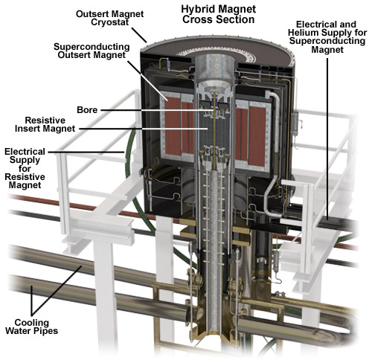
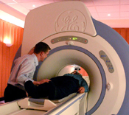
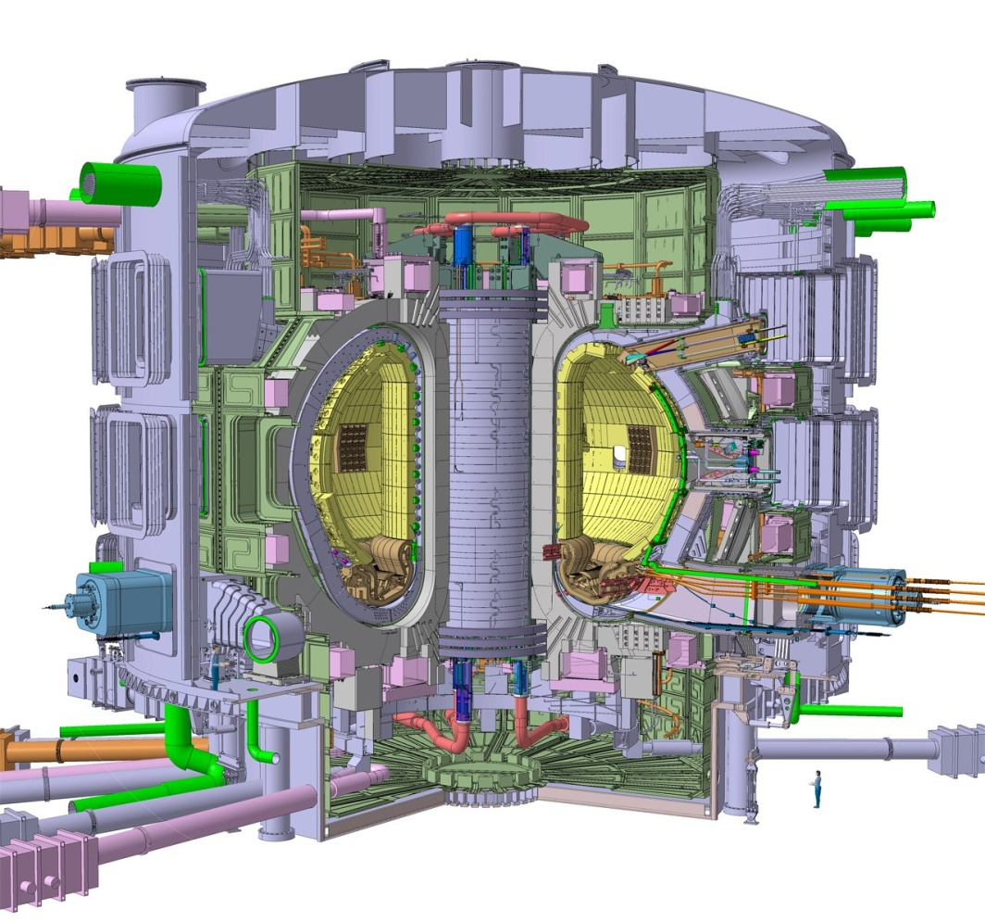
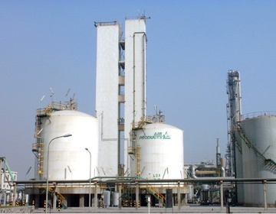
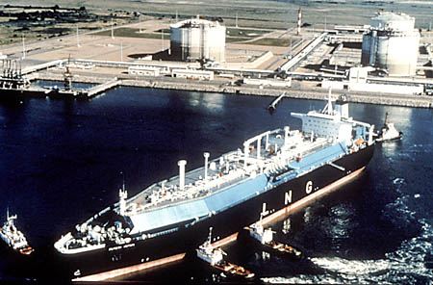
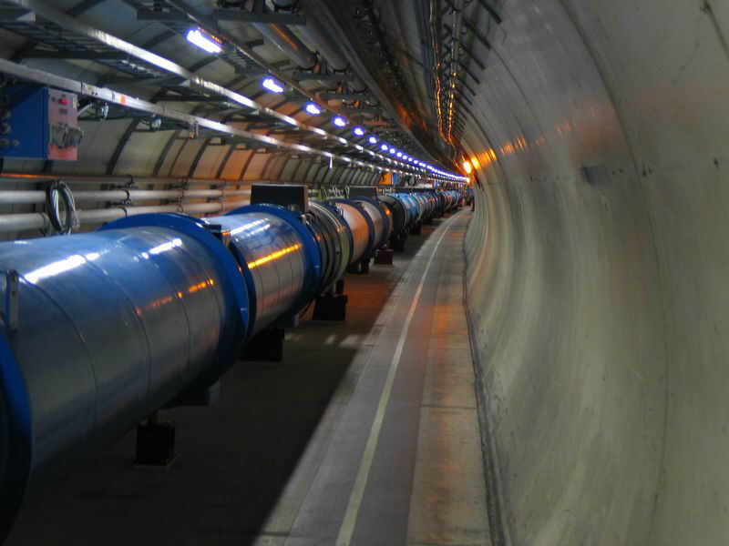
Some Examples

Slide 7
Superconducting RF is Very Popular
Name | Accelerator Type | Lab | T (K) | Refrigeration Capacity | Status
CEBAF | Electron Linac | JLab | 2.1 | 4.2 kW @ 2.1 K | Operating
12 GeV Upgrade | Electron Linac | Jlab | 2.1 | 4.2 kW @ 2.1 K | Operating
ESS | Proton Linac | ESS | 2.0 | 3 kW @ 2 K | Under Construction
SNS | H⁻ Linac | ORNL | 2.1 | 2.4 kW @ 2.1 K | Operating
E Linac | Electron Linac | TRIUMF | 2.0 | 288 L/Hr | Operating
S-DALINAC | Electron Linac | TU Darmstadt | 2.0 | 120 W @ 2.0 K | Operating
ERL | Electron Linac | Cornell | 1.8 | 7.5 kW @ 1.8 K | Proposed
XFEL | Electron Linac | DESY | 2.0 5 -8 40-80 | 2.5 kW @ 2 K 4 kW@ 5 -8 K 26 kW @ 40-80 K | Under construction
ATLAS | Heavy Ion Linac | ANL | 4.7 | 1.2 kW @4.7 | Operating
LCLS II | Accelerator | SLAC | 2.1 K | 4 kW @ 2 K 14 kW @ 35 -55 K 1.2 kW @ 5 – 8 K | Design (2019) TESLA Tech
ISAC - II | Heavy Ion Linac | TRIUMF | 4 |  | Operating
FRIB | Heavy Ion Linac | MSU | 2.1 4.5 33/55 | 3.6 k W @ 2.1 K 4.5 kW @ 4.5 K 20 kW @ 35/55 K | Under Construction

Slide 8
Catching Cold
Before we get involved in thermodynamic cycles, let’s go over the basics
There are really only a few ways in which to make a pure fluid such as helium colder
  Cause the fluid to do work by making it expand against a piston or turbine while keeping it thermally isolated from the outside environment Isentropic Expansion
  Transfer heat from the fluid to a colder surface
  Cause the fluid to do “internal work” by expanding it through a valve while keeping it thermally isolated Isenthalpic Expansion
    Joule-Thomson expansion (more later)
  Once the fluid is a liquid, reduce the pressure above the fluid below atmospheric pressure thus reducing the saturation temperature
All modern cryogenic plants do the first 3. Ones that provide cooling below 4.2 K also do the last item

Slide 9
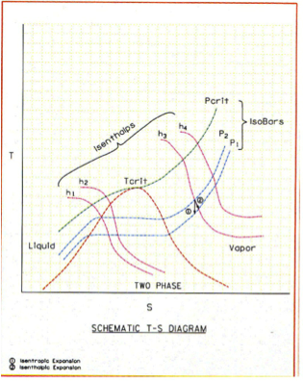
Generic T-S diagram Showing Isenthalps, Isobars and 2 Phase Region
Enthalpy
h = u + pv

Slide 10
Carnot Cycle
This is an ideal cycle: all processes are reversible
  Entropy is only changed by absorbing or removing heat at constant temperature
  2nd law of Thermodynamics, in a reversible process dQ = -TdS
The Carnot Consists of 4 steps
  Compress the working fluid isothermally at T_{H} (1-2)
  Expand the working fluid isentropically from T_{H} to T_{C} (2-3)
  Absorb heat into the working fluid isothermally and reversibly at T_{C} (3-4)
  Compress the working fluid isentropically from T_{C} to T_{H} (4-1)
  Note isentropically = reversibly and adiabatically

Slide 11
Carnot Cycle
T
T_{H}
2
1
T_{C}
3
4
Q
S
s₁
s₂
How do we describe the performance of such a cycle?

Slide 12
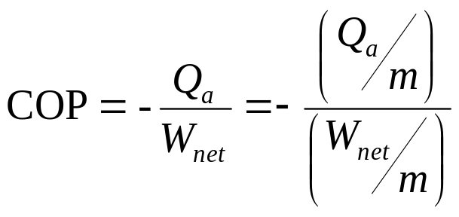
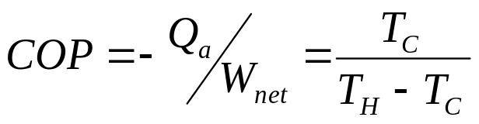
Coefficient of Performance
& the Carnot Cycle
Coefficient of Performance: the heat absorbed from the cold sink divided by the net work required to remove this heat
  Minus sign takes into account that the heat absorbed by the cycle is positive while the work done is negative
  For the ideal (and in practice unachievable) Carnot cycle it can be shown that:

Slide 13
Coefficient of Performance
& the Carnot Cycle
For a plant operating between room 300 K and 4.2 K, the Carnot COP is
4.2/( 300 – 4.2) or 0.0142
The Carnot cycle is the ideal case. It is the best you can do without violating the laws of thermodynamics
Note that the form of the Carnot COP shows that you have a better COP (thus a more efficient process or refrigerator) if T_{C} is large
  It is always thermodynamically more efficient to intercept heat (provide cooling) at higher temperatures
  This fact drives a lot of cryogenic design
In practice, we generally discuss the inverse of the COP because this allows us to describe the number of watts of work required to provide 1 Watt of cooling at a given temperature. For a Carnot cycle providing cooling at 4.2 K. This is 70 W/W
  People will frequently and incorrectly refer to this as a COP as well

Slide 14
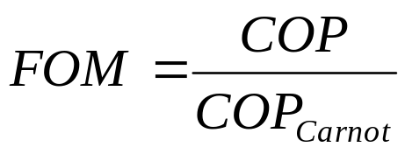
Carnot Cycles & the Real World
Can we build a real machine using a Carnot cycle? In a word NO
Why?
  Compressing a fluid isothermally is very hard to achieve, Normally the fluid is compressed and then cooled back down to 300 K
  Expanding or compressing fluid isentropically is basically impossible
  We can absorb heat into a boiling fluid isothermally but not with out irreversible losses
How close can we get to Carnot? We define the Figure of Merit (FOM) as:
  We also speak in terms of “percent Carnot” i.e. FOM of 0.2 is 20% Carnot

Slide 15
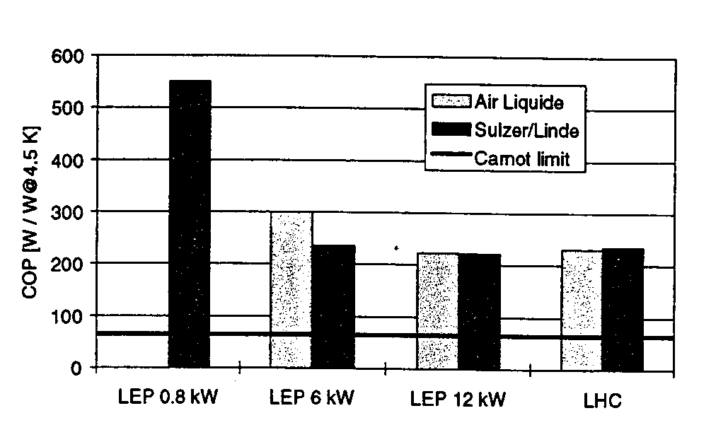
The real world is sometimes not kind to cryogenic engineers
These are state of the art helium refrigerators. Note that the best of them (for LHC) runs at about 220 W/W or a FOM of 0.318 or at 32% Carnot

Slide 16
Practical Impact of Plant Performance
How much power does it take to operate a large cryogenic refrigeration plant?
AT ESS we expect to have a refrigeration plant capable of removing as much as 9.5 kW at 4.5 K. The FOM of the plant is expected to be 0.26
If the plant operates as expected this means we will need:
(66/0.26) x 9500 = 2.4 MW of mechanical power
We are adding some additional margin to the electrical power requirements and have asked for at least 2.6 MW available for powering the compressors

Slide 17
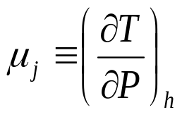
Joule-Thomson Expansion
Isenthalpic (h=constant) expansion
Fluid cools as is it is expanded at constant enthalpy through a valve
However, depending on both the fluid and the temperature, such an expansion can also cause heating.
Define the Joule-Thomson expansion coefficient
μ_{j} must be positive for cooling to occur
Cooling by JT expansion has some advantages
  No moving parts
  Can easily handle two-phase mixtures

Slide 18
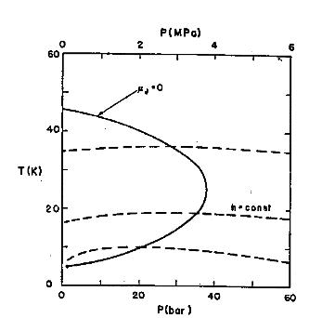
JT Inversion Curve & Maximum
Inversion Temperatures
Fluid | Max Inversion Temperature (K)
Nitrogen | 623
Argon | 723
Hydrogen | 202
He | 43
Maximum inversion temperature for helium is 43 K
Note that below ~ 2 K He again warms on JT expansion
Many fluids, such as N₂ can be liquefied using JT expansion – JT cycle
Inversion curve for Helium

Slide 19
Practical Large Scale Helium Refrigerators
Modern large scale Helium refrigerators/liquefiers use a variation of the Claude cycle known as the Collins cycle
The key difference between these cycles and the JT cycle is the addition of expansion engines (pistons or turbines) that the fluid does work against and thus cools
The process through these expansion engines may be idealized as Isentropic (s = constant) expansion
  Cooling occurs at any temperature
  ΔT for a given ΔP is much larger than for isenthalpic expansion
Claude cycle = 1 expansion engine, Collins cycle = multiple expansion engines
  The post WW II development of the Collins liquefier revolutionized laboratory research in cryogenics

Slide 20
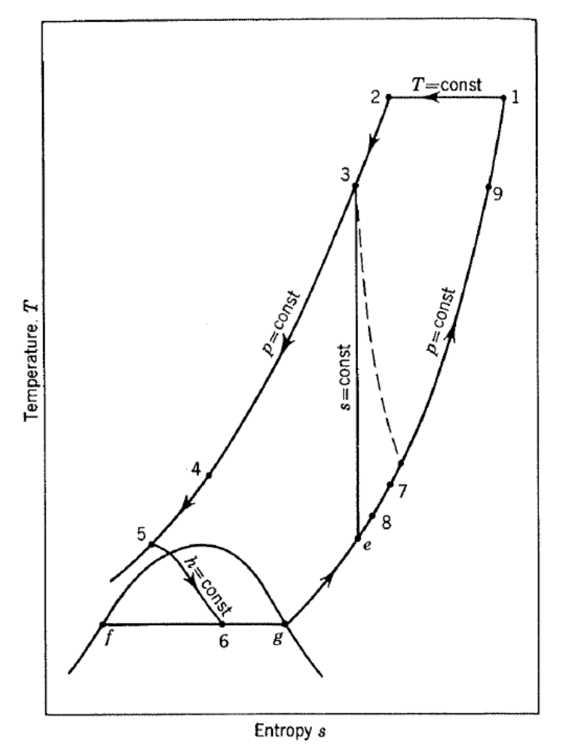
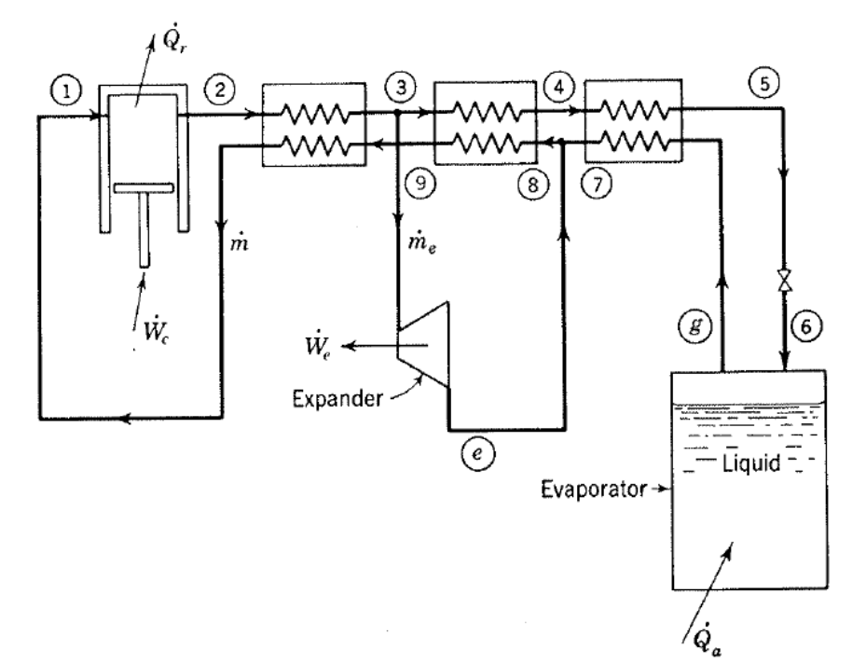
Claude Cycle
From Cryogenic Systems
R. Barron

Slide 21
Collins Cycle
Cycle consists of :
  1) Compression to ~ 16 Bar with cooling back to 300 K + oil removal
  2) Cooling of high pressure gas with LN₂
  3) Isentropic expansion via 2 or more expansion engines
  4) Cooling of high pressure gas by the cold returning low pressure stream
  5) Isenthalpic expansion through JT valve
  6) Return of gas to compressors at just above 1 Bar

Slide 22
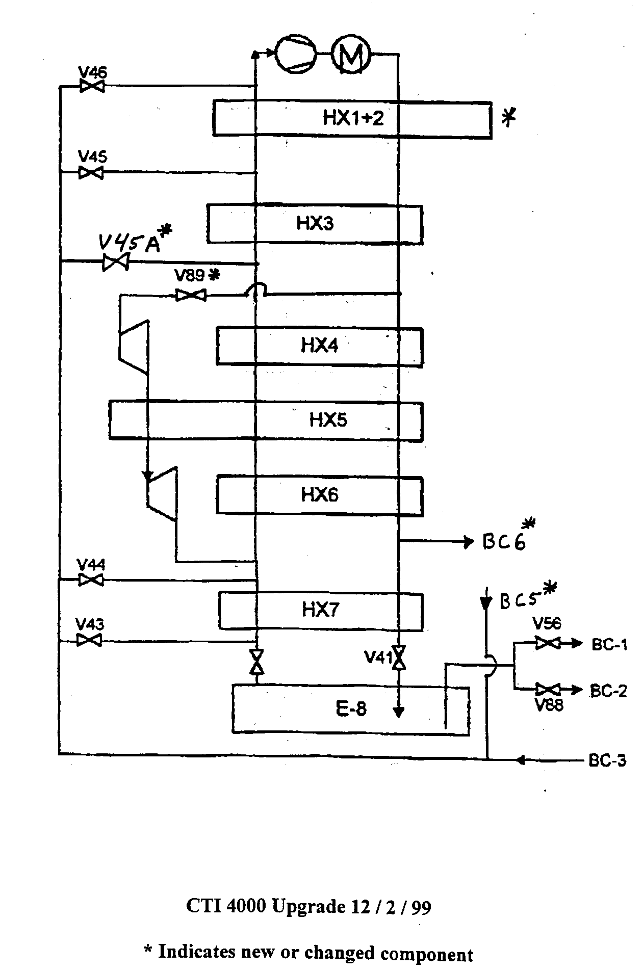
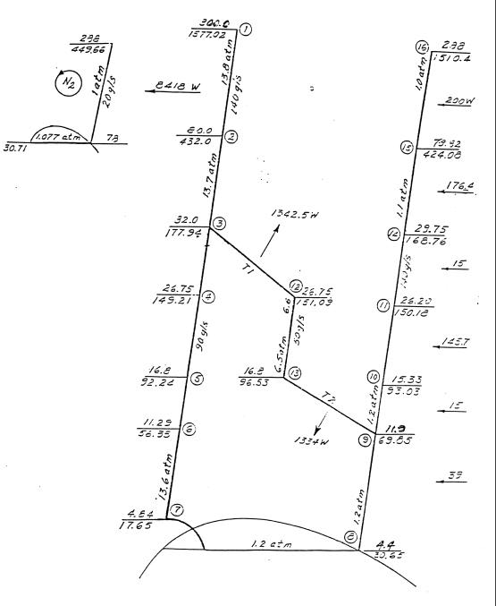
CTI 4000 Refrigerator
(early 80’s vintage ~ 1.2 kW @ 4.5 K)

Slide 23
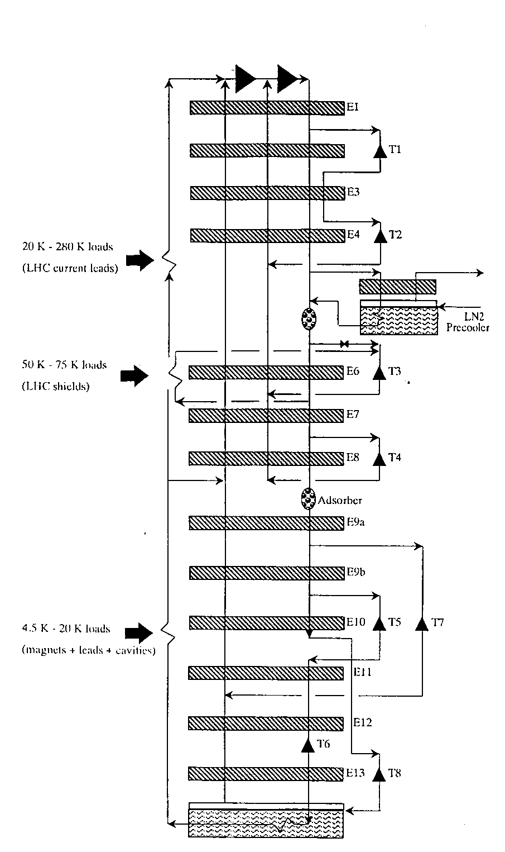
LHC 4.5 K Refrigeration Plant
18 kW @ 4.5 K – produced in ~ 2004
1of 8 required (4 from Linde, 4 from Air Liquide)
Note:
  Large number of expansion turbines – some in series with HP stream
  Medium pressure return
  Heat loads at intermediate temperatures
  Designed to have high % Carnot
  (roughly 30%)

Slide 24
Refrigerators vs. Liquefiers
Refrigerators are closed cycle systems
  They provide cooling and can create liquids but all the mass flow is returned to the start of the cycle
  Such systems are said to have “balanced flow”
Liquefiers are open cycle systems
  They provide a liquid which is then drawn off and used elsewhere
  These have “unbalanced flows” the amount of mass returned to the start of the cycle is less than the amount that started by the mass that was converted to liquid.
  In order to keep the cycle running this mass would have to be added as room temperature gas.

Slide 25
Refrigerators vs. Liquefiers
In practice, this distinction is less clear cut
  Modern cryogenic plants can operate either as refrigerators or liquefiers and in fact, generally operate as a mixture of the two.
  We talk about refrigeration loads & liquefaction loads
  A key issue is at what temperature is the boil off gas from a cryogenic liquid returned to the cycle?
    If brought back at a cryogenic temperature and used to cool incoming warmer gas then this is a refrigeration load
    If brought back warm and not used to cool incoming warmer gas this is a liquefaction load
The thermodynamic rules are the same for refrigerators and liquefiers

Slide 26
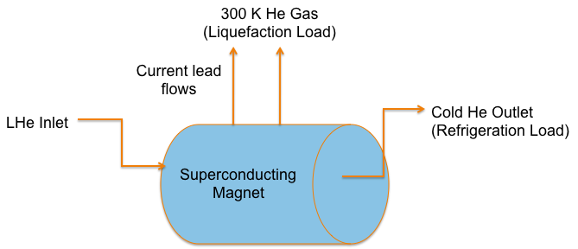
Consider the cooling of a superconducting magnet and its current leads

Slide 27
He II (Superfluid Helium)
2nd liquid phase of helium (hence He II)
Phase transition is 2nd order (no latent heat) but there is a discontinuity in the specific heat (λ transition)
T_{λmax} = 2.2 K
Has unique thermal and fluid properties
  High effective thermal conductivity
  Zero viscosity under certain conditions

Slide 28
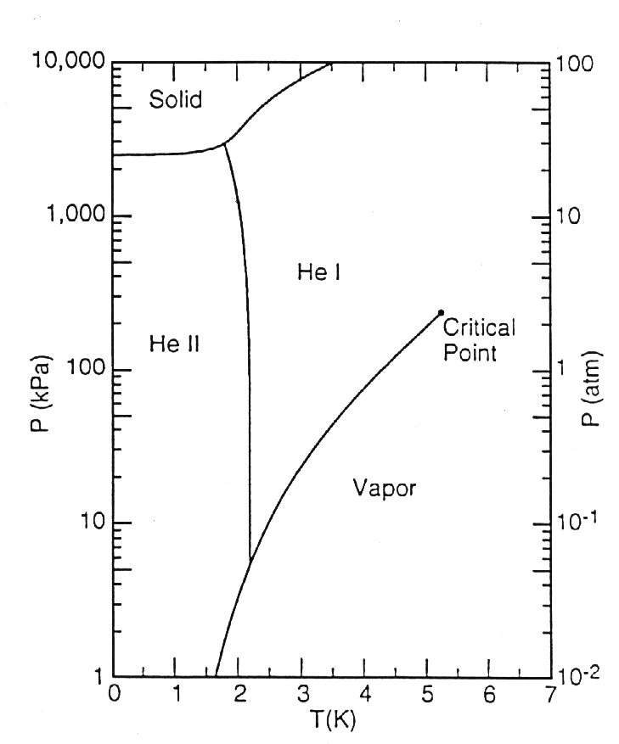
Helium Phase Diagram

Slide 29
Why Use He II in SRF Systems?
The biggest single advantage is the lower temperature (<4.2 K)
  Lower temperature means lower BCS losses in cavities, size of effect is RF frequency dependent
  He II refrigeration is more costly (due to Carnot & machine inefficiencies)
  Generally speaking, removing 1 W at 2 K is the equivalent of removing 3 W at 4.2 K
  There is a point at which the gain from lower BCS losses is better than the additional cost of refrigeration
An additional advantage is the very efficient heat transfer mechanism in He II
  This results in no bulk boiling which reduces microphonics
The majority of new SRF systems operate in the He II regime

Slide 30
What is He II ?
A “Bose – Einstein like” Condensate
  A fraction of atoms in He II have condensed to the quantum ground state
  He II was the first of these condensates discovered
  The only one that has significant industrial applications
The properties of He II can be understood via the two fluid model

Slide 31
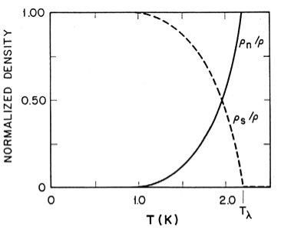
Two Fluid Model
He II can be thought of a fluid with two interpenetrating components:
  Normal fluid component
    Finite viscosity
    Finite entropy
  Superfluid component
    Zero viscosity
    Zero entropy
The interaction of these components can explain He II behavior
Relative Densities of Superfluid and Normal fluid components
(From Helium Cryogenics – Van Sciver)

Slide 32
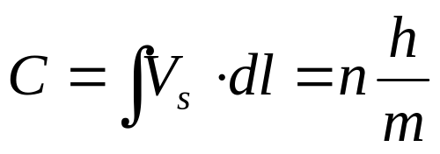
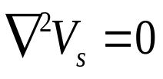

Quantized Vortices
(or does He II at 1 K rotate in a bucket)
At 1 K He II is almost entirely the superfluid component and thus has almost 0 viscosity. This would imply that He at 1 K in a spinning bucket wouldn’t rotate but it does. What’s the answer?
  The vortices are quantized:
Solves rotating bucket problem
  In the body of the fluid:
  At the wall:
This has been experimentally observed
The quantized vortices in the superfluid component are an important part of heat transfer mechanism in He II

Slide 33
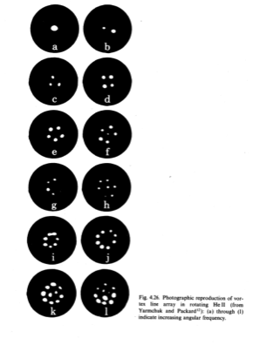
Direct Observation of Quantized Vortices via Electron Trapping

Slide 34
Heat Transfer in He II
The basic mechanism is internal convection:
No net mass flow
Note that this is not conduction or classical convection but an entirely different heat transfer mechanism
This can be extremely efficient (more than 1000x better than conduction through copper)
V _{n}
Q
V_{s}
T_{H}
T_{L}

Slide 35
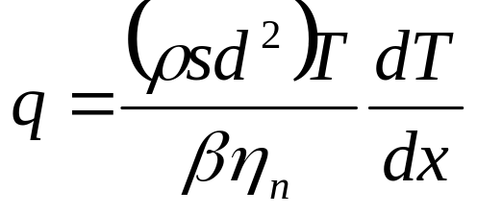
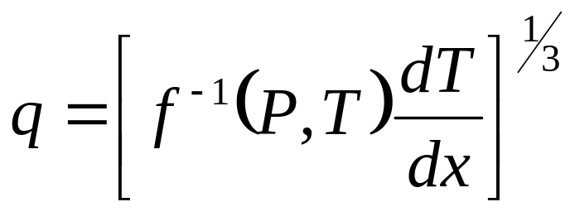
Heat Transfer in He II
There are 2 heat transfer regimes:
  V_{s} < V _{sc}
  V_{s} > V _{sc}
    Mutual Friction Regime (quantized vortices interact with the viscosity of the normal component
As V _{sc} ~ d^{-1/4} (cgs units) the mutual friction regime is most applicable in engineering applications of He II

Slide 36
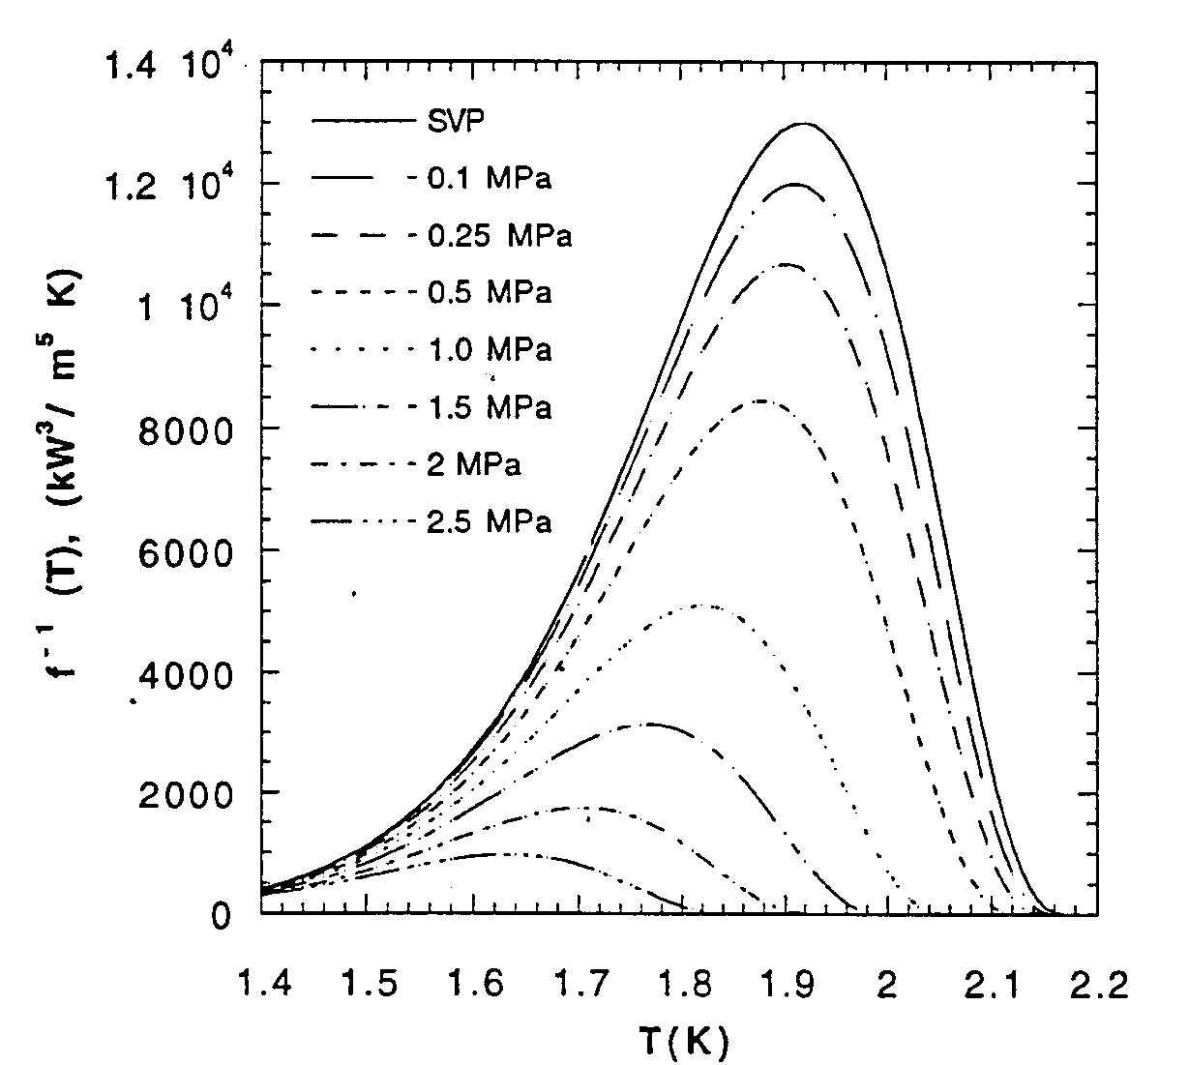
Heat Conductivity Function

Slide 37
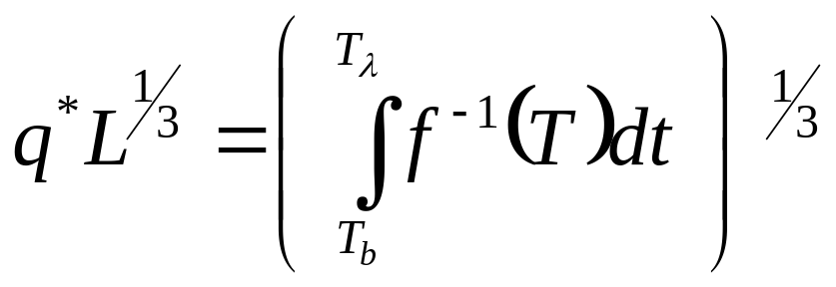
He II Heat Transfer Limits
In pressurized He II: T _{h} must be less than T _{λ}
Thus the peak heat flux q* is:
At 1.9 K and 1 bar :
q*L^{1/3} ~ 15 kW/m^{5/3}

Slide 38
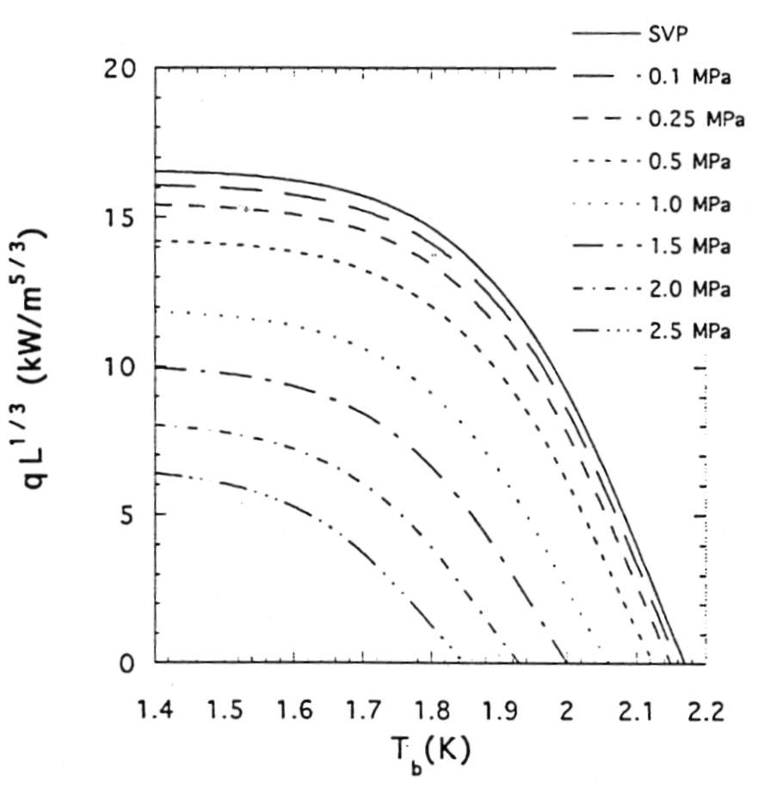
Peak Heat Flux (q*) in Pressurized He II

Slide 39
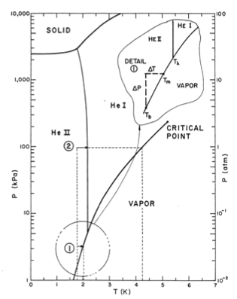
Limits on He II
Heat Transfer
In saturated He II, the limit is given by the local saturation temperature & the degree of local subcooling
In the ILC cavity He vessel this works out to about 1 W/cm² or ~ 30 W total through the connection tube
  More heat than that would require a redesign
Exceeding the heat transfer limits in either the saturated or pressurized case results in conversion to He I and boiling at the heated surface

Slide 40
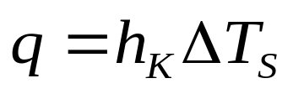
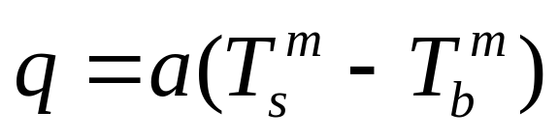
Surface Heat Transfer
Heat transfer from a surface into He II is completely dominated by a fundamental inefficiency in moving energy from the surface to the fluid
This effect exists but is not important in standard convection problems
  Normally we assume T_{w} = T_{fw} but this is not true in the case of He II
This surface heat transfer effect is described by Kapitza Conductance
  For q < 1 kW/m²
  For q > 1 kW/m²
h _{k,} a and m are empirical and dependent on material, temperature and surface condition

Slide 41
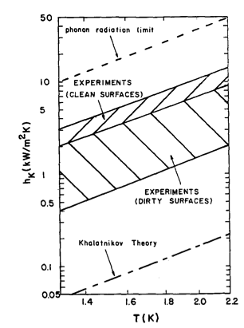
Surface Heat Transfer
m ~ 3
Kapitza conductance is not dependent on helium flow rate

Slide 42
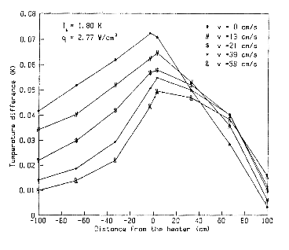
Forced Convection and He II
If Kapitza Conductance is independent of flow rate does forced convection in He II make any sense?
  Yes! Forced convection has the effect of reducing the maximum temperature in the He II and thus allowing more heat to be transferred before reaching the peak heat flux

Slide 43
He II Fluid Dynamics
Despite the presence of the superfluid component, in almost all engineering applications He II behaves as a classical fluid. This includes :
  Pump performance
    Except cavitation in saturated He II
  Pressure drop in tubes, valves, bellows and fittings
  Flow metering techniques
This is likely a result of the quantized vortices in the superfluid component being coupled via mutual friction to the normal fluid viscosity
However, keep in mind that the unique heat transfer properties still exist as described.

Slide 44
He II Fluid Dynamics
He II does behave differently in cases of:
  Film flow
  Porous plugs
  Two – phase flow (liquid/vapor) due to the large density difference between liquid and vapor in the case of He II

Slide 45
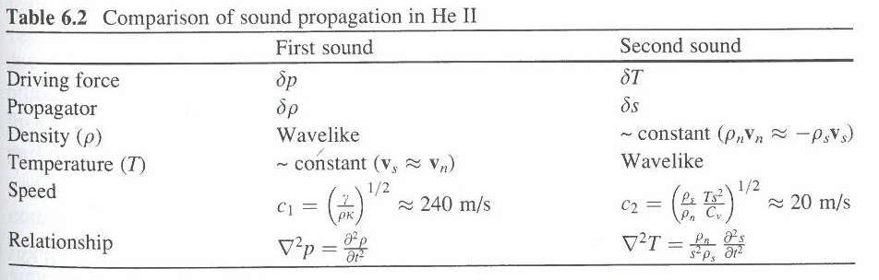
Second Sound
The two-fluid model predicts and experiments show that temperature waves may be established in the He II due to oscillations in the local entropy. These temperature waves are known as second sound as they are analogous to density waves caused by pressure oscillations.
Recall that the superfluid component has zero entropy
From Helium Cryogenics S.W. Van Sciver (2013)

Slide 46
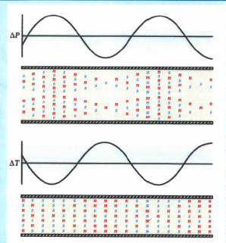
Second Sound
Second sound can be detected via
  thermometry (either time or flight or resonance techniques)
  Oscillating Superleak Transducers
Second sound is attenuated by mutual friction and has been used extensively quantum turbulence
More recently second sound has been used to locate quenches in SRF cavities
From Donnelly Physics Today October 2009

Slide 47
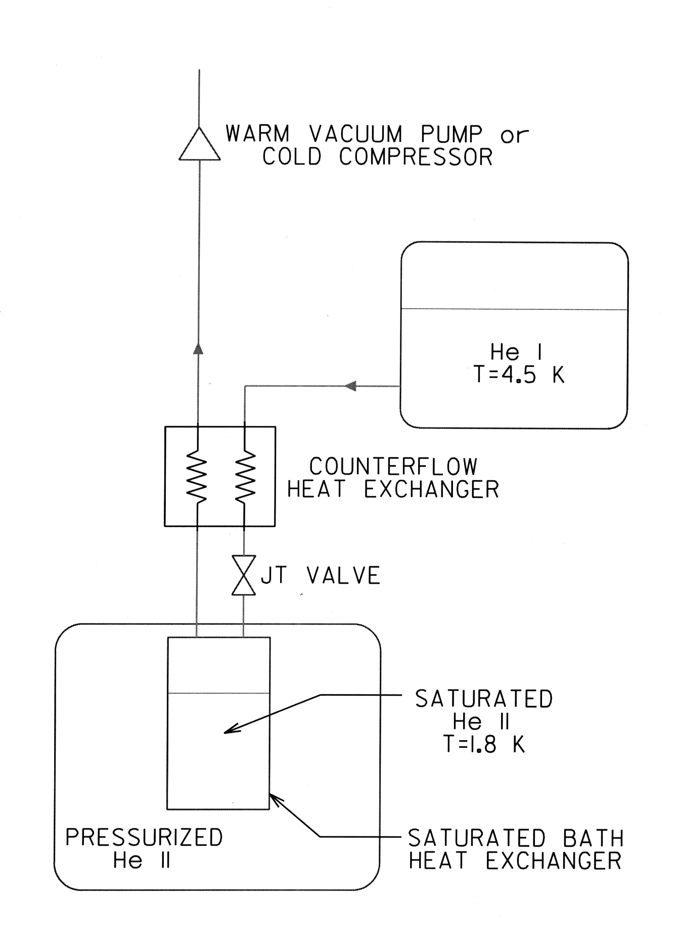
Typical He II Refrigeration System
He II (Superfluid Helium) S. W. Van Sciver,
in Handbook of Cryogenic Engineering,
There 2 approaches to providing He II To SRF systems:
Create the He II for a given string of components and distribute it (LHC, XFEL, CEBAF)
  Less expensive, fewer warm/cold transitions
Create the He II at each cryomodule (12 GeV, SNS, ESS, FRIB)
  Less Heat load to 2 K
  Better flexibility

Slide 48
He II Summary
He II is a unique fluid that displays quantum behavior on a macroscopic scale
He II has significant applications in large scale cryogenics for scientific research
Despite its unique properties, the use of He II in industrial scale engineering applications is well understood and significant experience exists: Tore Supra, LHC, Jlab, NASA

