Slide 1
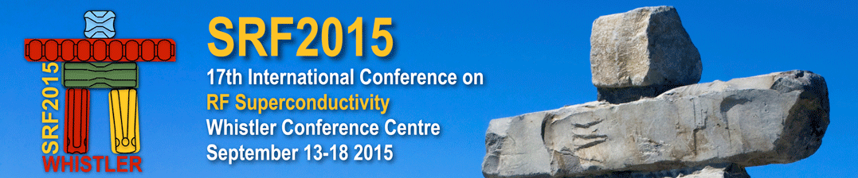
Measurement Techniques
Detlef Reschke
Whistler, September 11, 2015
SRF2015 Tutorial Session

Slide 2
Outline
Some personal remarks
Vertical test (Set-up + Procedure)
Temperature mapping
Second Sound
Radiation + dark current measurement
Interpretation of RF signals
Identification of Quench, Field emission, Multipacting
Processing
Cryomodule testing

Slide 3
Some personal remarks
My presentation will follow the “cavity point-of-view”.
For more technical information + details I try to give some relevant references.
The emphasis is on the vertical test.
Many examples will refer to the work done at DESY on 1.3GHz single- + nine-cell (EU-XFEL) cavities.
Tutorial is based on my CERN accelerator school lecture 2013 in Erice.

Slide 4
Outline
Some personal remarks
Vertical test (Set-up + Procedure)
Temperature mapping
Second Sound
Radiation + dark current measurement
Interpretation of RF signals
Identification of Quench, Field emission, Multipacting
Processing
Cryomodule testing

Slide 5
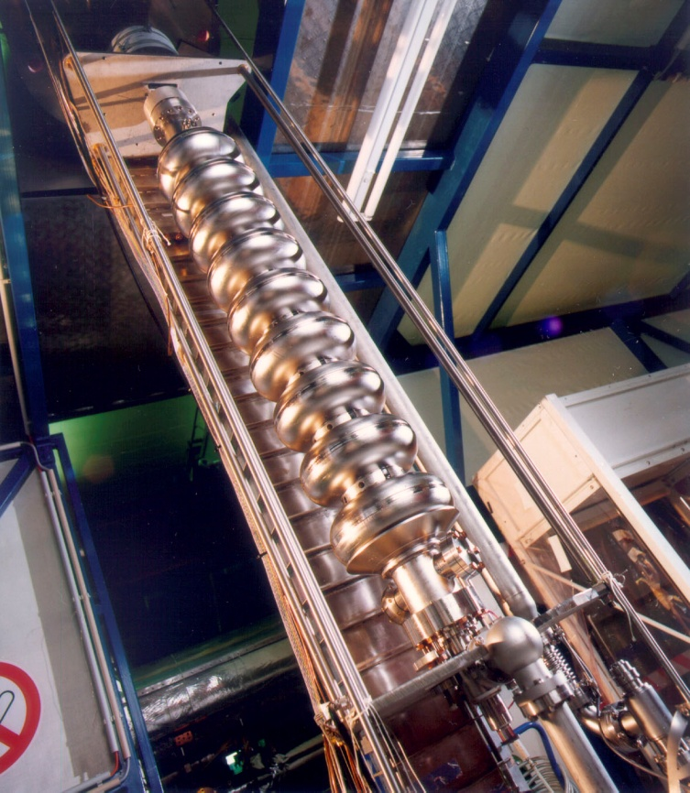
Vertical test of a SRF cavity
Vertical test is
  Acceptance test of the overall cavity performance
  (e.g. EU-XFEL series cavity production)
  => integral check of cavity fabrication
  + cavity surface treatment
  Check of a special treatment
  (e.g. single-cell cavities for special purposes,
  check of new techniques, etc.)
  => integral over all treatments / handlings
  since the vertical test before!

Slide 6
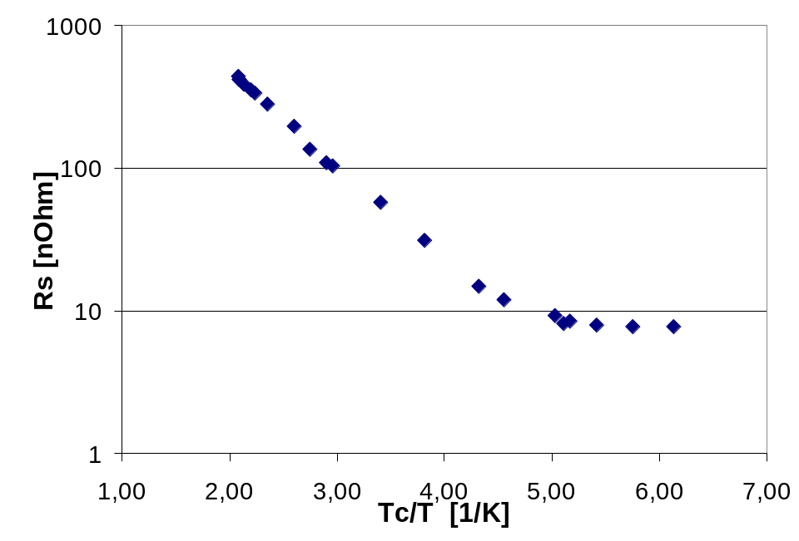
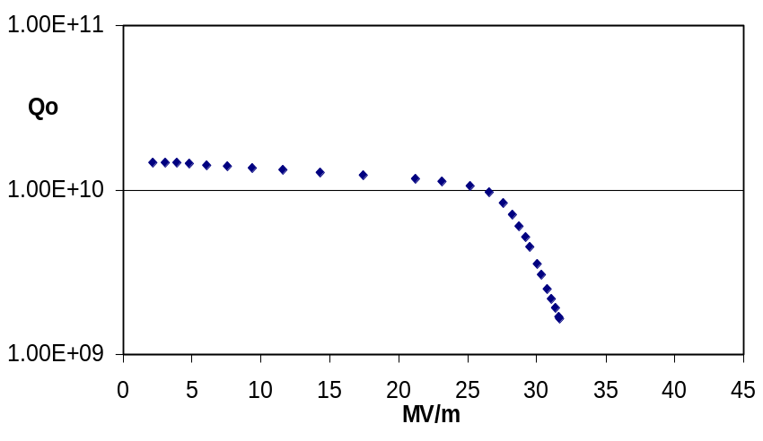
Vertical test of a SRF cavity II
Goal is: Q₀ vs. E_{acc}; Q₀ vs. T
RF measurement gives information of the average behavior
=> power losses are averaged over whole RF surface
Operation in cw or “long” RF pulses (steady state is achieved)
R_{BCS}(T)
R_{RES}
Q₀ (E_{acc})
Q₀ (T) => R_{s} (T_{c}/T)

Slide 7
Preparation of vertical test
Necessary preparation:
  Cavity ready (after cleanroom work)
  Evacuated, leak checked to < 1x10⁻¹⁰ mbar·l/sec, RGA (residual gas analysis) checked
  Mechanical assembly to the test insert
  Vacuum connection, pumping, leak check + RGA
  Connection of rf-cables incl. checks (short circuit, time-domain reflectometer measurement)
  Assembly + check of diagnostics (Second Sound, temperature mapping, x-ray sensors, …)
  Transport to vertical cryostat

Slide 8
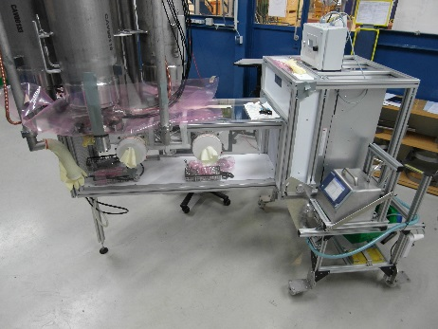
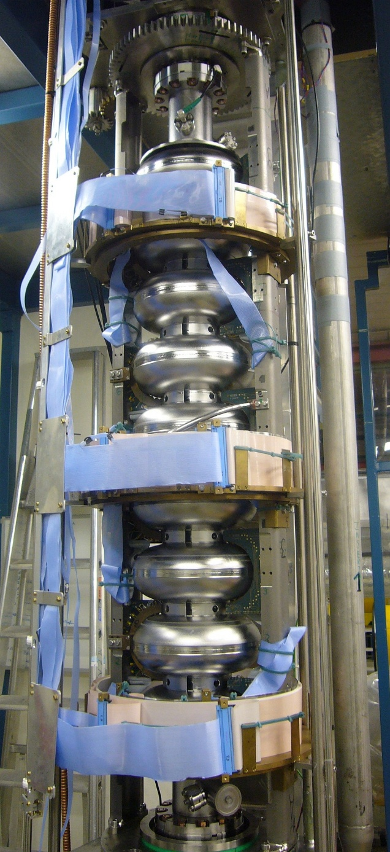
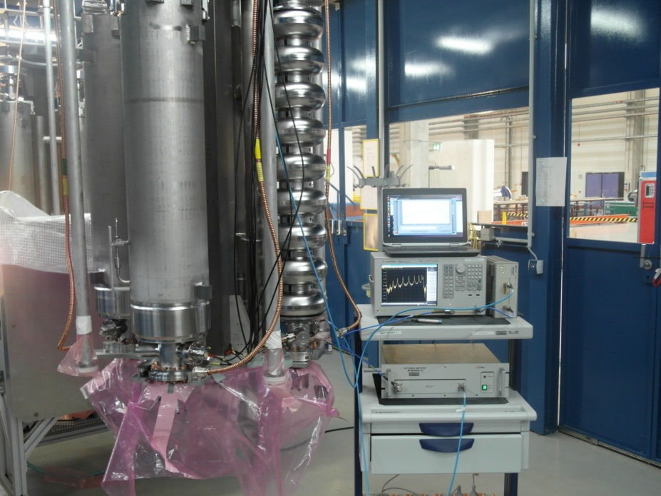
Vertical test insert

Slide 9
Preparation of vertical test II
Preparation in vertical cryostat:
  Mechanical assembly of insert to cryostat
  Vacuum connection, pumping and leak check of connection
  Connection of rf-cables, diagnostics, cryo sensors, etc. incl. check
  Cool down to 4.2 K / 2 K(maybe after holding at 100K)
  Preparation of interlock systems
RF test:
  RF-cable calibration
  Optional: Measurement of Q₀(T) from 4.2K to ≤ 2K
  Measurement of Q₀(E_{acc})
  Optional: Q₀(E_{acc}) at various temperatures
  Q₀(E_{acc}) in passband/higher modes
  Diagnostics: T-mapping, Second Sound, x-ray analysis, …
  f₀(T) from >T_{c} to ≤ 2K

Slide 10
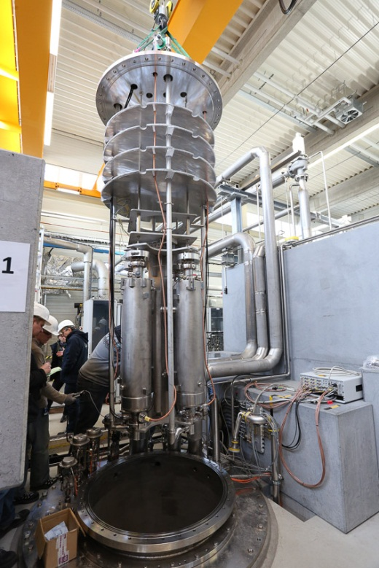
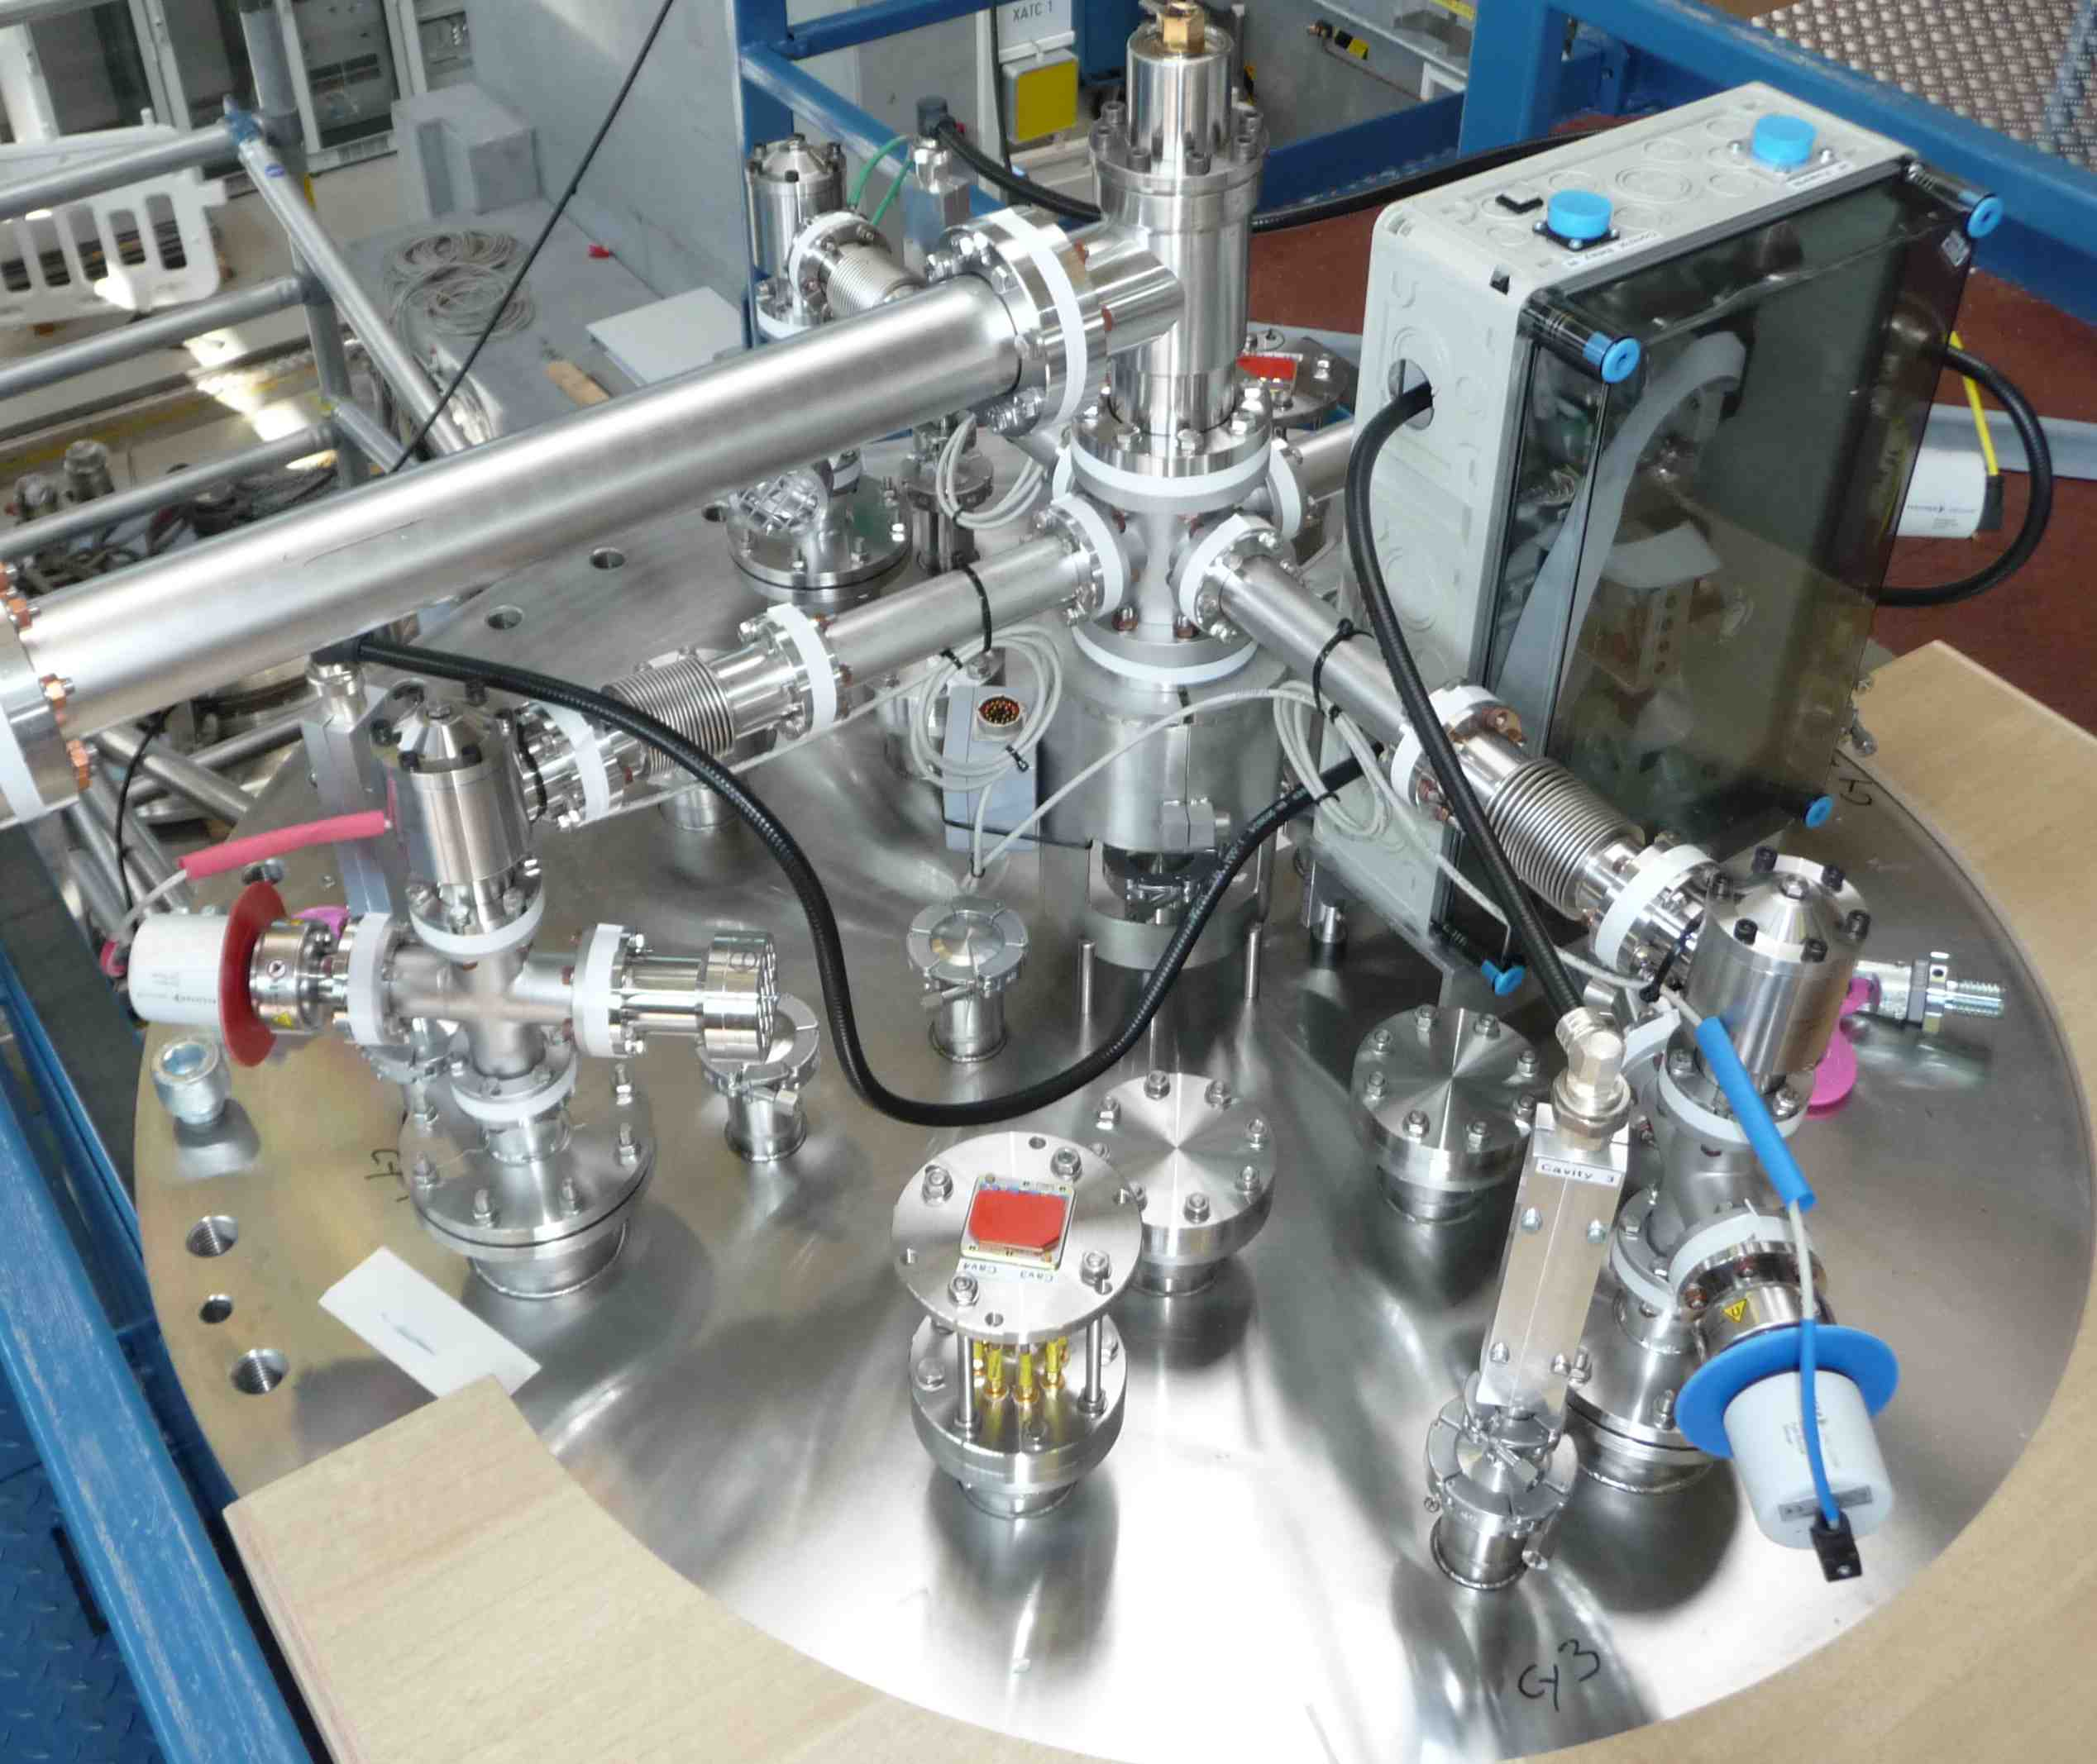
Vertical test insert II

Slide 11
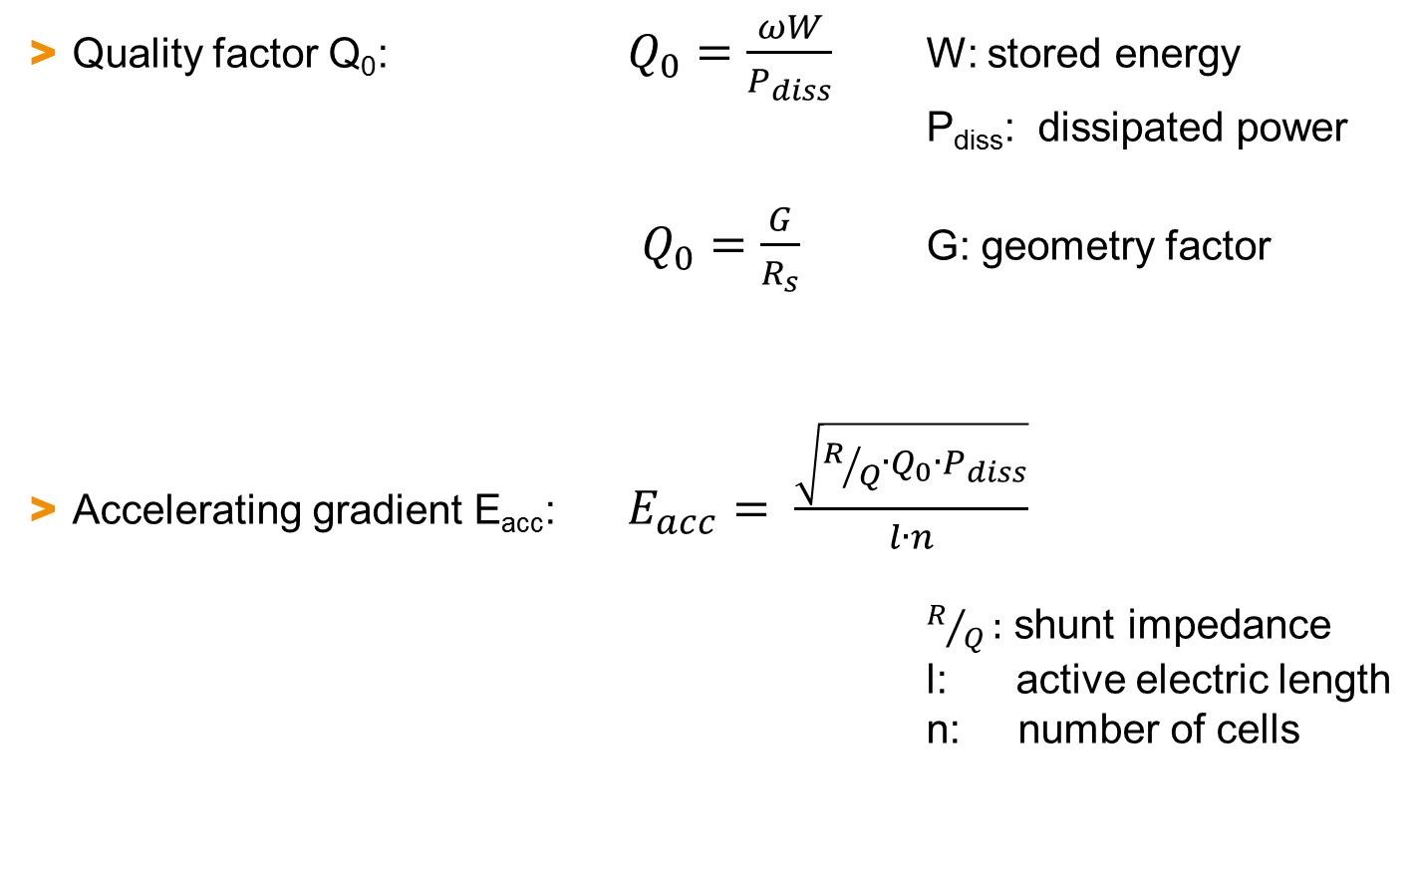
Reminder: Basic Relations
Quality factor Q₀: $Q_{0}=\frac{ωW}{P_{diss}}$ W: stored energy
P_{diss}: dissipated power
$Q_{0}=\frac{G}{R_{s}}$ G: geometry factor
Accelerating gradient E_{acc}: $E_{acc}= \frac{\sqrt{R/Q∙Q_{0}∙P_{diss}}}{l∙n}$
$R/Q:$ shunt impedance
l: active electric length
n: number of cells

Slide 12
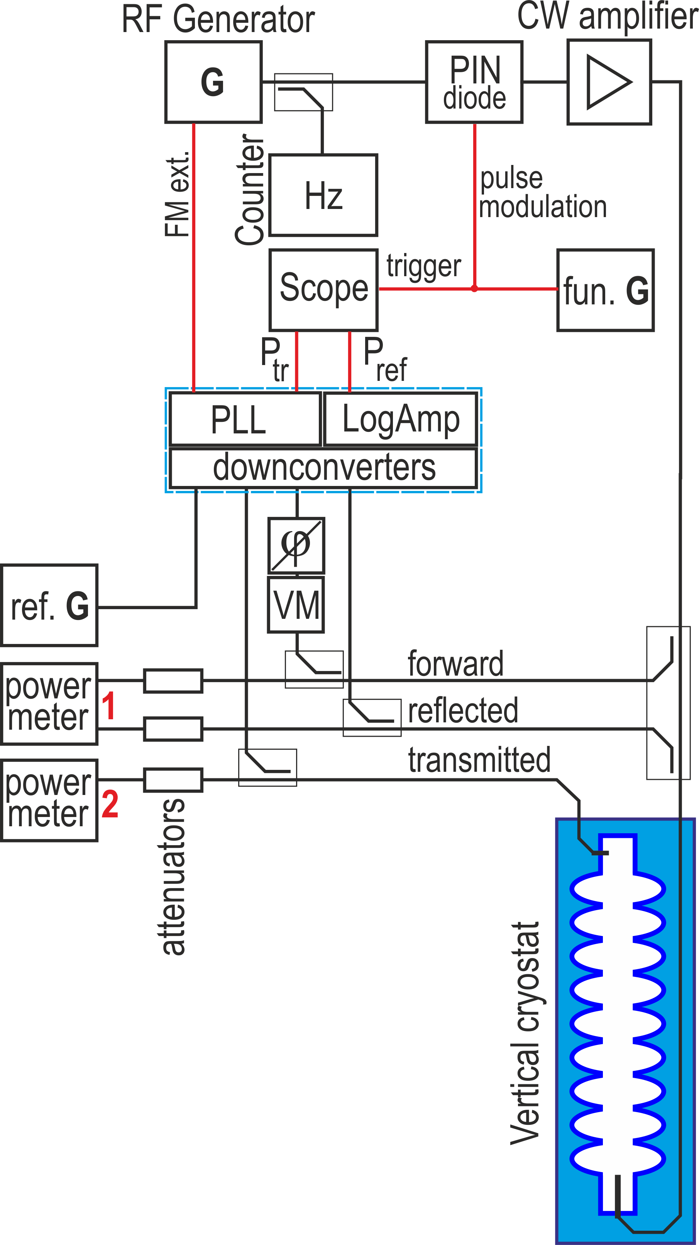
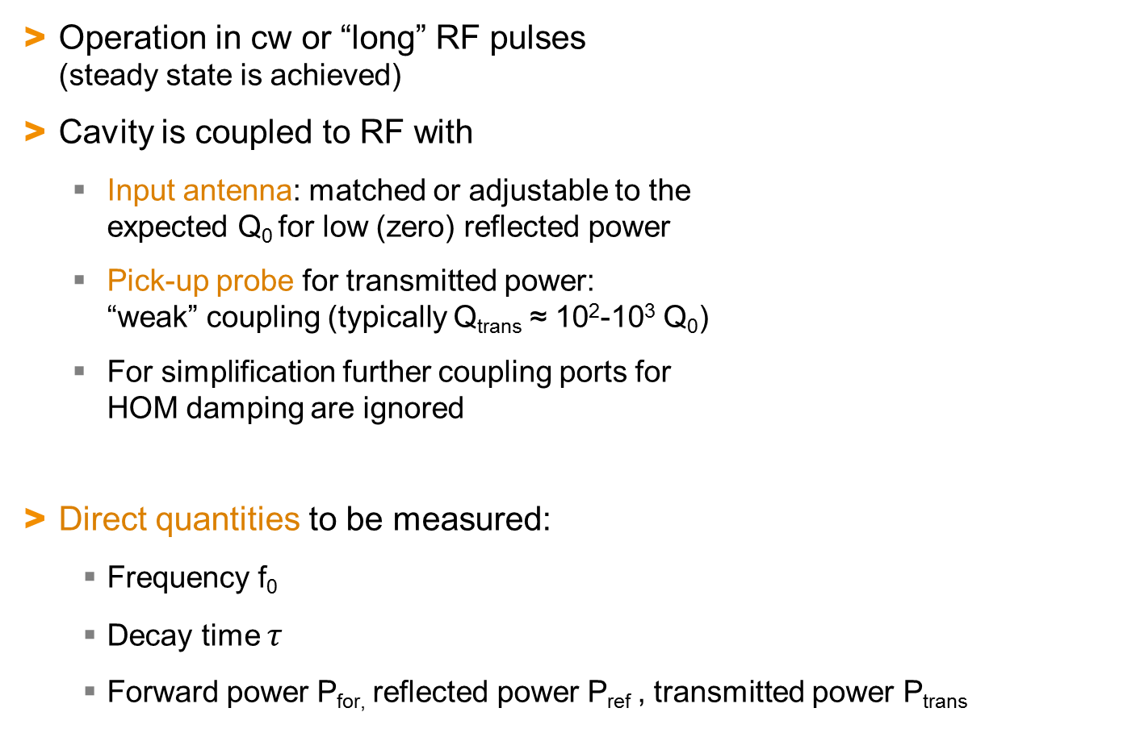
RF set-up for vertical test: Introduction
Operation in cw or “long” RF pulses
(steady state is achieved)
Cavity is coupled to RF with
  Input antenna: matched or adjustable to the
  expected Q₀ for low (zero) reflected power
  Pick-up probe for transmitted power:
  “weak” coupling (typically Q_{trans} ≈ 10²-10³ Q₀)
  For simplification further coupling ports for
  HOM damping are ignored
Direct quantities to be measured:
  Frequency f₀
  Decay time $τ$
  Forward power P_{for,} reflected power P_{ref} , transmitted power P_{trans}

Slide 13
RF set-up for vertical test
Sharp resonance (HWFM can be < 1Hz)
requires “phase locked loop” (PLL)
PLL:
fraction of P_{trans} and P_{f} are fed in a rf mixer,
downconverted and a voltage proportional to the
phase difference between the signals is used to
control the frequency of the RF generator.
Phase shifter for one of the signals is
necessary:
Phase = 0 => Cavity on resonance
RF generator:
  Analog VCO (voltage controlled oscillator)
  “modern” RF generator

Slide 14
RF set-up for vertical test II
Frequency counter
PIN diode + function generator:
  fast switching of the rf signal
  typically a rectangular pulse by function generator
CW amplifier
  typically up to 1 kW
  Solid-state is state-of-the-art
  Water or air cooled
  Important: Circulator
Power measurement in steady state
  Power meter

Slide 15
RF set-up for vertical test III
Power measurement for pulses
  Scope with crystal detectors or logarithmic amplifiers
  ADC’s with logarithmic amplifiers
Passive components:
  Directional couplers
  Attenuators
  Cables

Slide 16
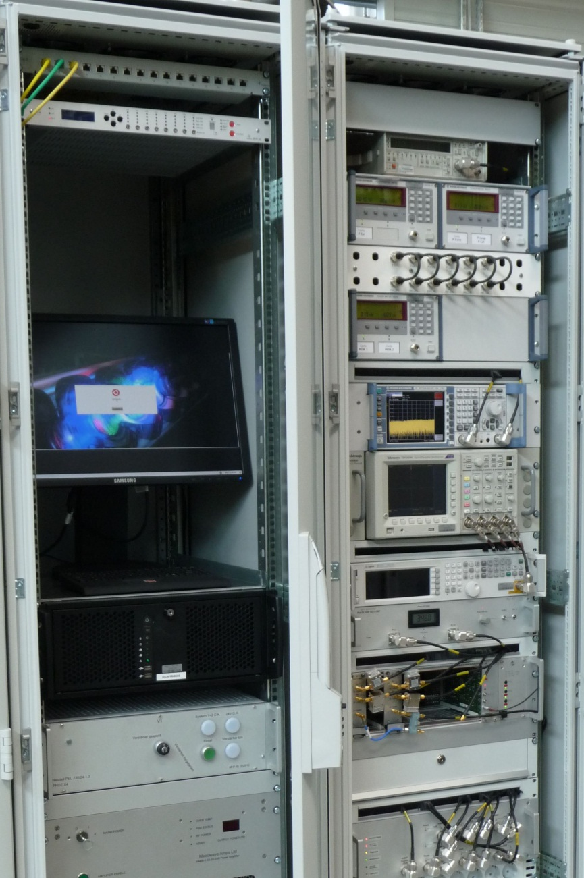
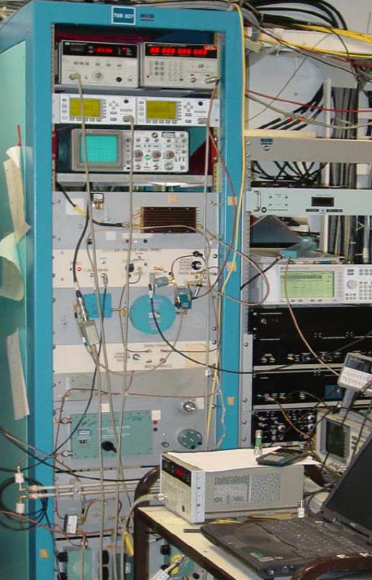
RF set-ups
2005: JLab 0.5-3GHz VCO PLL system for R&D
AMTF DESY 1.3GHz for XFEL cavities

Slide 17
Cable calibration
You need the RF power levels at the cavity,
but you measure in your test rack.
Accurate knowledge of cable attenuation,
attenuation of directional coupler + attenuators at
test frequency mandatory!
Cable calibration:
  outside of the cryostat:
  1-way calibration for all cables
  => easy and low error
  Inside of the cryostat:
  i) 2-way calibration (reflection measurement)
  ii) indirect 1-way calibration
  => use an identical (type + length) reference cable
  inside the cryostat
Several sources of errors possible !!!
(directional coupler, “bad” connections, wrong adjustments, VSWR…)

Slide 18
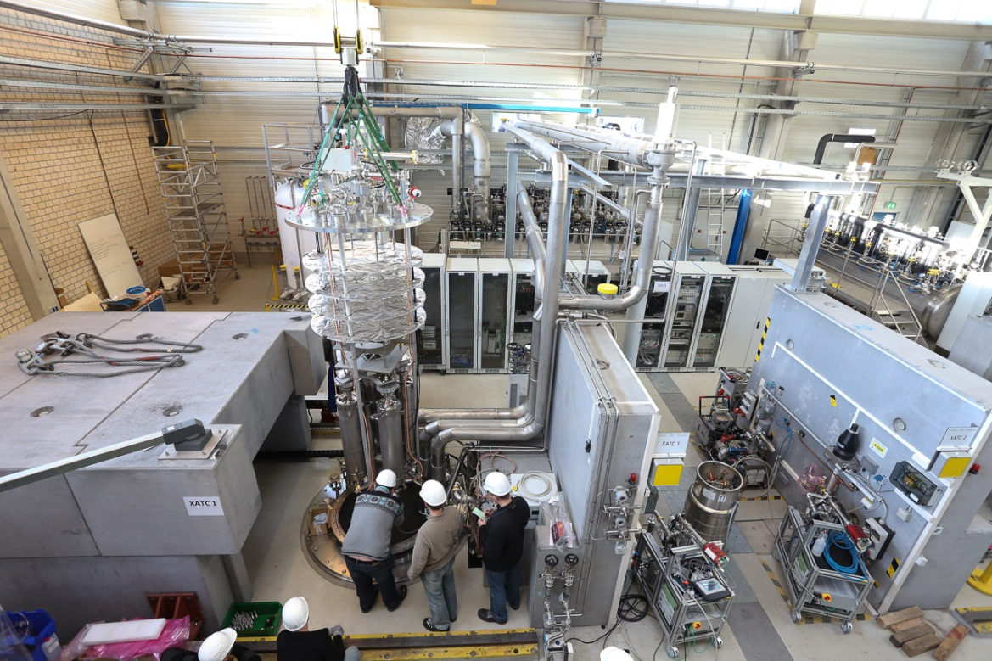
Interlock
SRF cavities can “produce” significant and hazardous x-rays with comparatively low RF power
RF measurements direct at the cryostat require exact rules and limits depending on your local test situation
For high gradient measurements an appropriate shielding and operational interlock system is mandatory

Slide 19
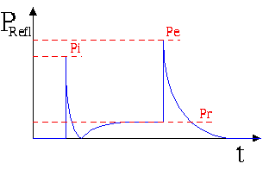

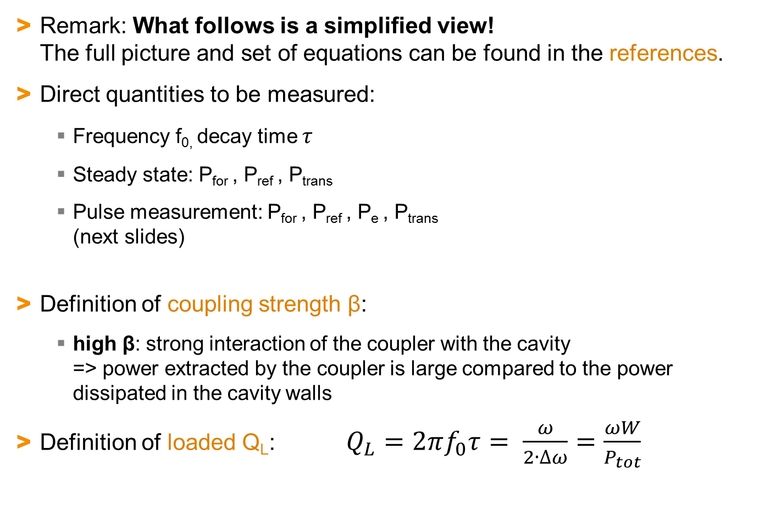
The path to Q₀ and E_{acc}
Remark: What follows is a simplified view!
The full picture and set of equations can be found in the references.
Direct quantities to be measured:
  Frequency f_{0,} decay time $τ$
  Steady state: P_{for} , P_{ref} , P_{trans}
  Pulse measurement: P_{for} , P_{ref} , P_{e} , P_{trans}
  (next slides)
Definition of coupling strength β:
  high β: strong interaction of the coupler with the cavity
  => power extracted by the coupler is large compared to the power dissipated in the cavity walls
Definition of loaded Q_{L}: $Q_{L}=2πf_{0}τ= \frac{ω}{2∙∆ω}=\frac{ωW}{P_{tot}}$
for

Slide 20

The path to Q₀ and E_{acc} II
Step 1:
Calculation of β in steady state:
Note: Steady state measurement is not unique
=> pulse measurement is necessary!
for undercoupling or
β = 1/ β for overcoupling

Slide 21
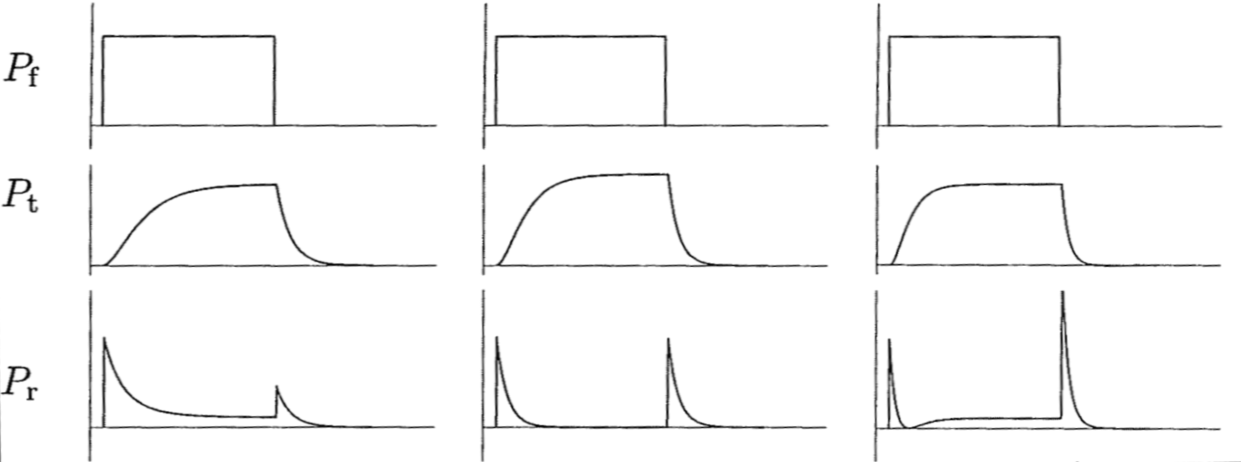
The path to Q₀ and E_{acc} III
Step 2: Response of the cavity to a rectangular RF pulse
  independent calculation of β from P_{for} , P_{ref} , P_{e}
  => 3 more equations for β
  decision about coupling of the cavity:
for
undercoupled β < 1
critical coupled β = 1
overcoupled β > 1
t
t
t

Slide 22
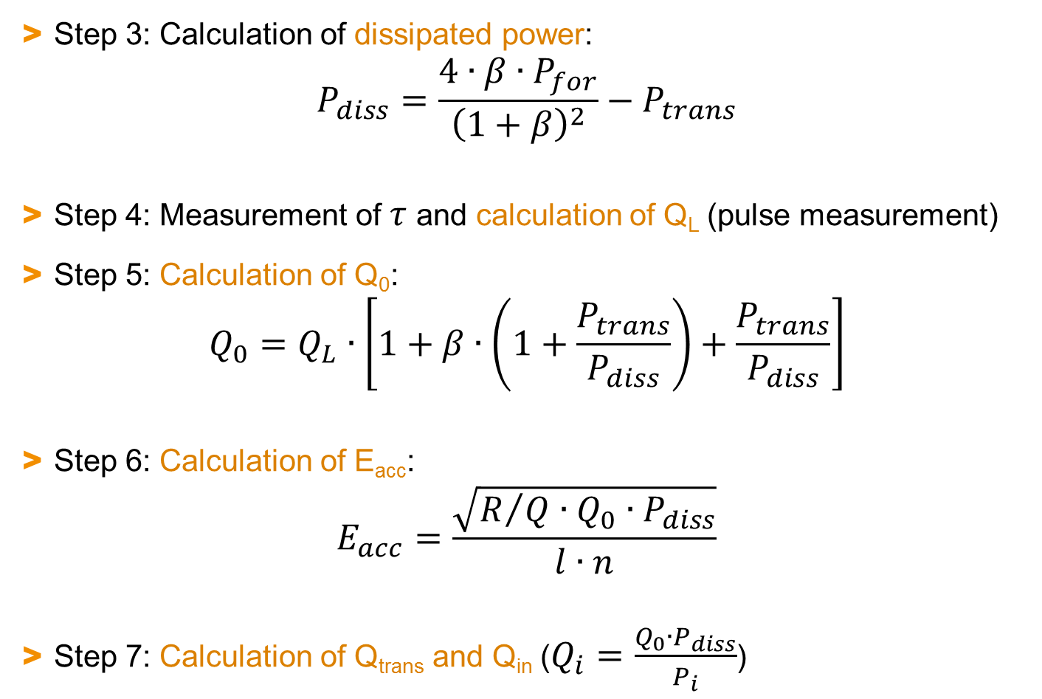
The path to Q₀ and E_{acc} IV
Step 3: Calculation of dissipated power:
$P_{diss}=\frac{4∙β∙P_{for}}{{\left(1+β\right)}^{2}}−P_{trans}$
Step 4: Measurement of $τ$ and calculation of Q_{L} (pulse measurement)
Step 5: Calculation of Q₀:
$Q_{0}=Q_{L}∙\left[1+β∙\left(1+\frac{P_{trans}}{P_{diss}}\right)+\frac{P_{trans}}{P_{diss}}\right]$
Step 6: Calculation of E_{acc}:
$E_{acc}=\frac{\sqrt{R/{Q∙Q_{0}∙P_{diss}}}}{l∙n}$
Step 7: Calculation of Q_{trans} and Q_{in} ($Q_{i}=\frac{Q_{0}∙P_{diss}}{P_{i}}$)

Slide 23
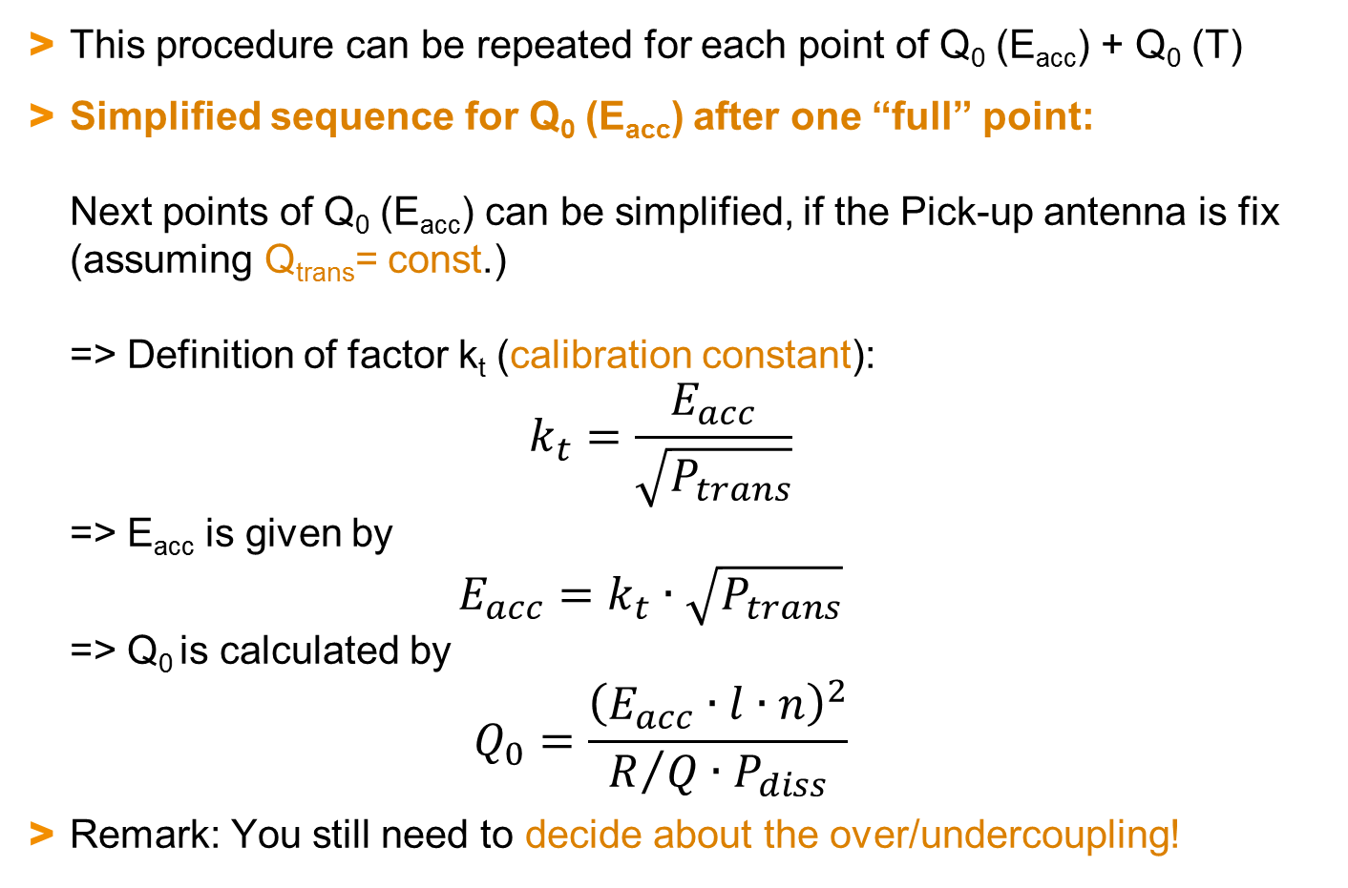
The path to Q₀ and E_{acc} V (Simplified Q(E) points)
This procedure can be repeated for each point of Q₀ (E_{acc}) + Q₀ (T)
Simplified sequence for Q₀ (E_{acc}) after one “full” point:
Next points of Q₀ (E_{acc}) can be simplified, if the Pick-up antenna is fix (assuming Q_{trans}= const.)
=> Definition of factor k_{t} (calibration constant):
$k_{t}=\frac{E_{acc}}{\sqrt{P_{trans}}}$
=> E_{acc} is given by
$E_{acc}=k_{t}∙\sqrt{P_{trans}}$
=> Q₀ is calculated by
$Q_{0}=\frac{{\left(E_{acc}∙l∙n\right)}^{2}}{R/{Q∙P_{diss}}}$
Remark: You still need to decide about the over/undercoupling!

Slide 24
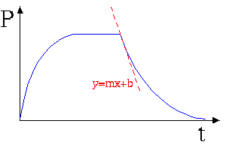
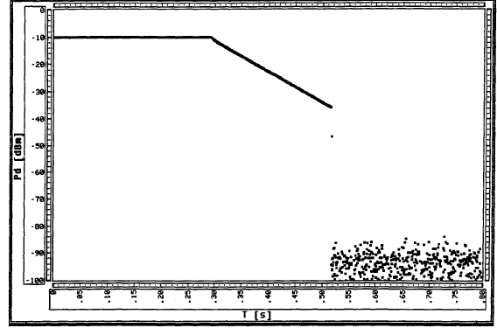
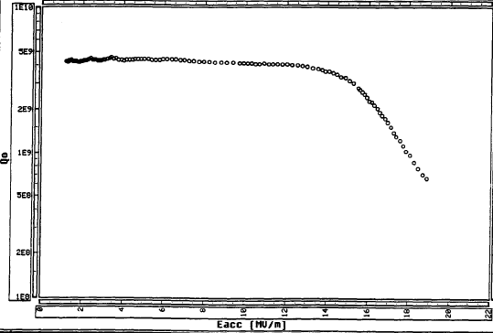
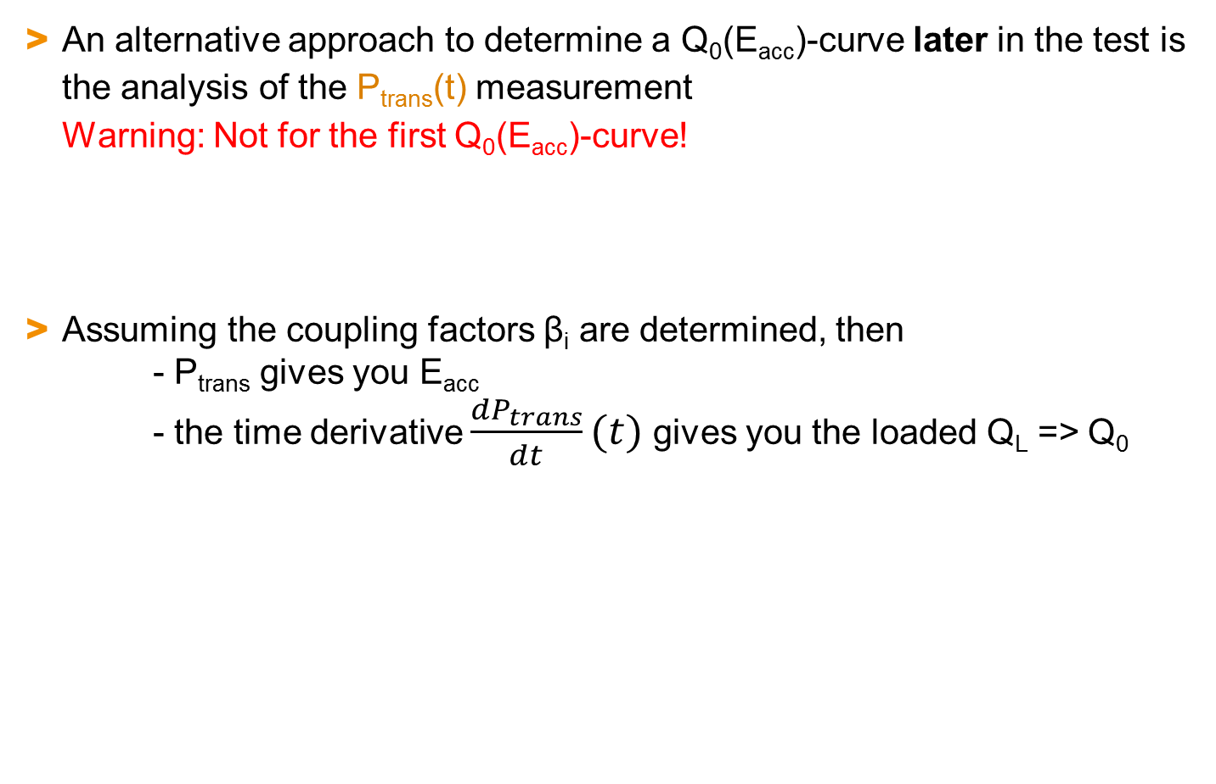
The path to Q₀ and E_{acc} VI: P_{trans}(t) => Q₀(E_{acc})
An alternative approach to determine a Q₀(E_{acc})-curve later in the test is the analysis of the P_{trans}(t) measurement
Warning: Not for the first Q₀(E_{acc})-curve!
Assuming the coupling factors β_{i} are determined, then
- P_{trans} gives you E_{acc}
- the time derivative $\frac{{dP}_{trans}}{dt}(t)$ gives you the loaded Q_{L} => Q₀
P_{trans}(t)
Q₀(E_{acc})

Slide 25
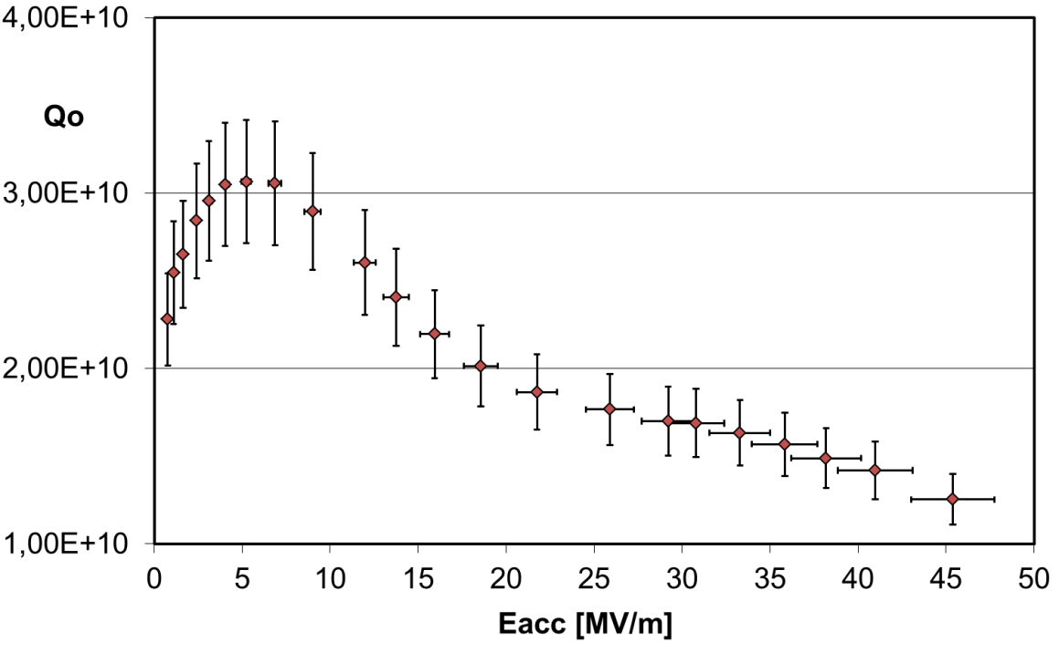
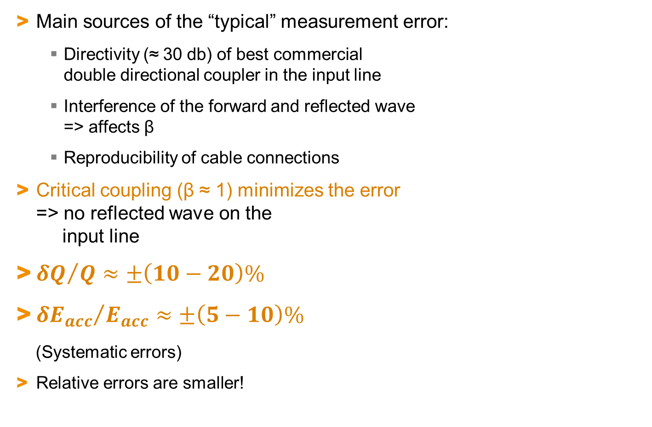
Measurement errors
Main sources of the “typical” measurement error:
  Directivity (≈ 30 db) of best commercial
  double directional coupler in the input line
  Interference of the forward and reflected wave
  => affects β
  Reproducibility of cable connections
Critical coupling (β ≈ 1) minimizes the error
=> no reflected wave on the
input line
${δQ}/Q≈±\left(10−20\right)\%$
${δE_{acc}}/{E_{acc}}≈±\left(5−10\right)\%$
(Systematic errors)
Relative errors are smaller!

Slide 26
Outline
Some personal remarks
Vertical test (Set-up + Procedure)
Temperature mapping
Second Sound
Radiation + dark current measurement
Interpretation of RF signals
Identification of Quench, Field emission, Multipacting
Processing
Cryomodule testing

Slide 27
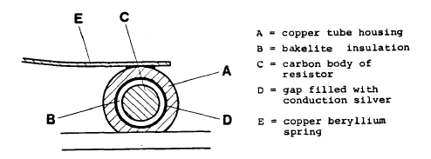
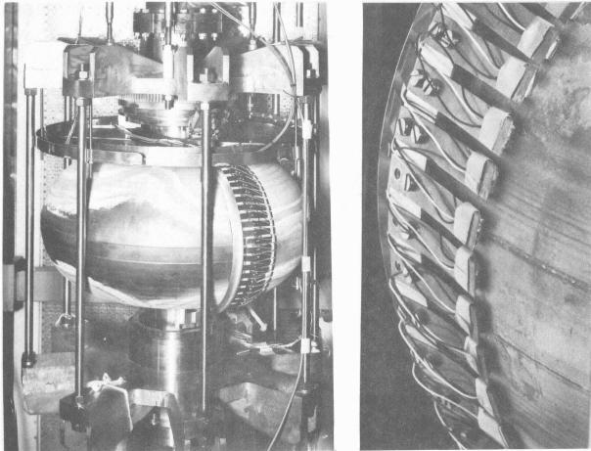
Temperature Mapping
Measure the temperature on the He-side to detect losses on the RF-side
Developed in the 1970es at Stanford + CERN
for normal-fluid / sub-cooled helium
Cross section of the
carbon thermometer
Rotating thermometry system
used at CERN for 352 MHz

Slide 28
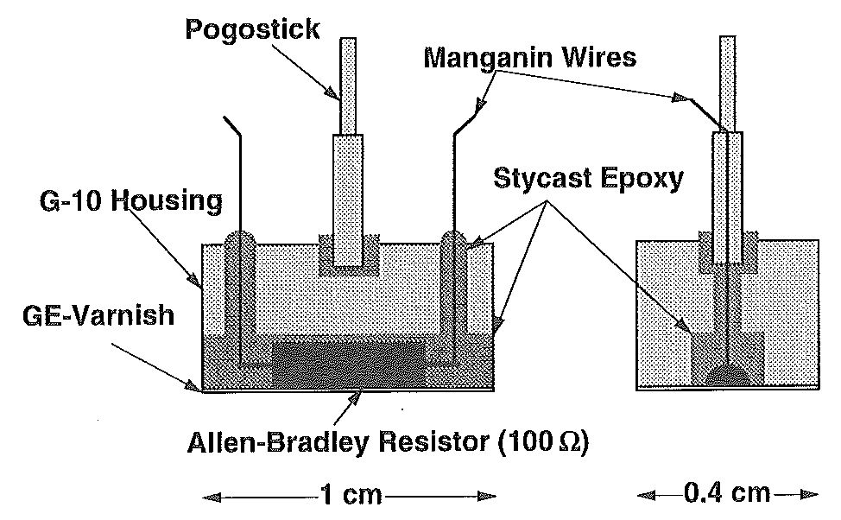
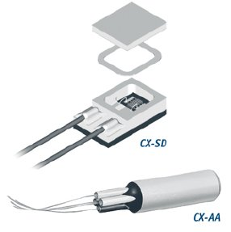
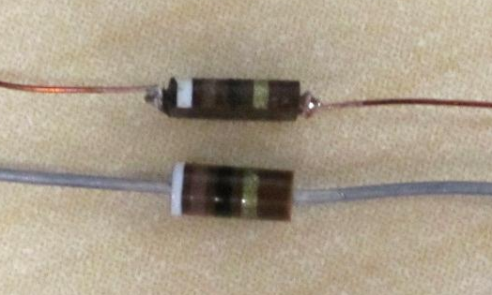
Temperature Mapping in superfluid He
In superfluid He (necessary for high gradients + f₀ > 1 GHz):
  + BCS losses are suppressed
  + spatial resolution is increased
  - “efficiency” of thermometers is reduced due to extremely good cooling
  for fixed thermometers: 20-40% with strong variations
  for movable thermometers: < 3%
Basic component is a heat sensitive element with a strong characteristic line at low temperatures:
mostly carbon resistors
Allen-Bradley carbon resistor 100 Ω, 1/8 W
4.2K: ≈ 1 kΩ
1.8K: > 10 kΩ
Cernox® resistors
“Pogostick” Thermometer (Cornell)

Slide 29
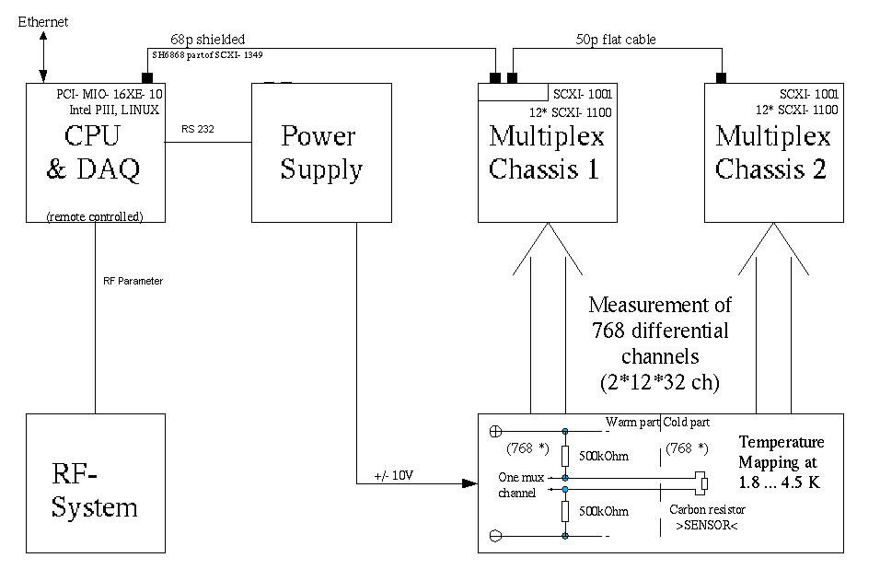
Temperature Mapping: Layout
General layout of T-mapping system (DESY):
Calibration of resistors for individual R_{i} (T_{bath}) between 4.2K and 1.8K
Trigger

Slide 30
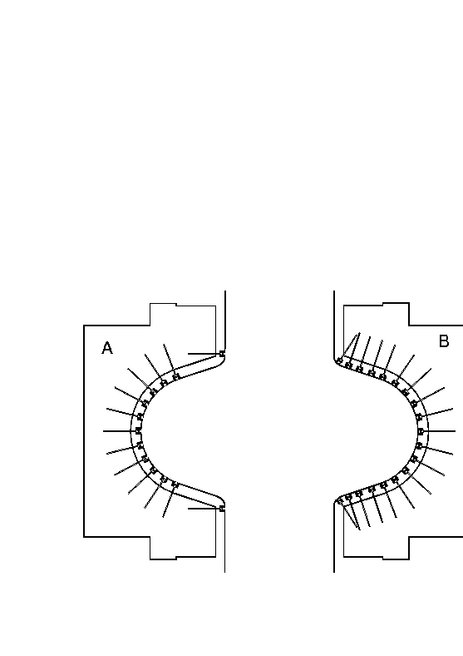
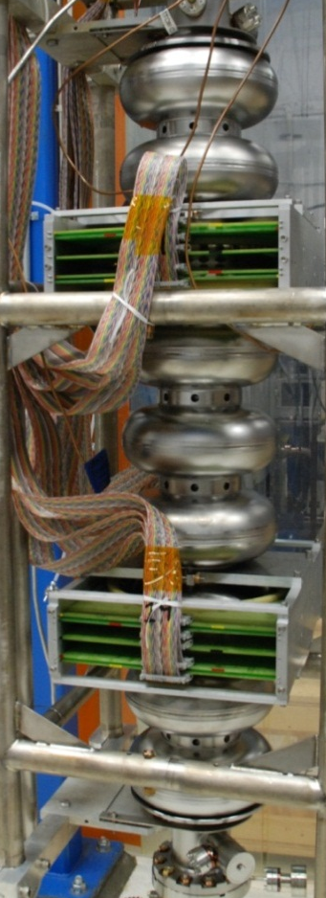
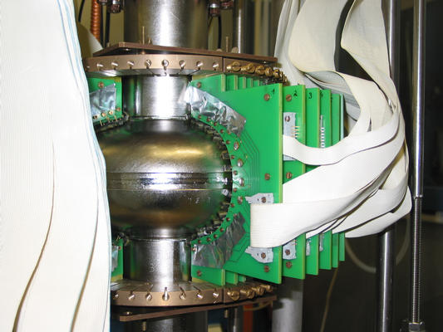
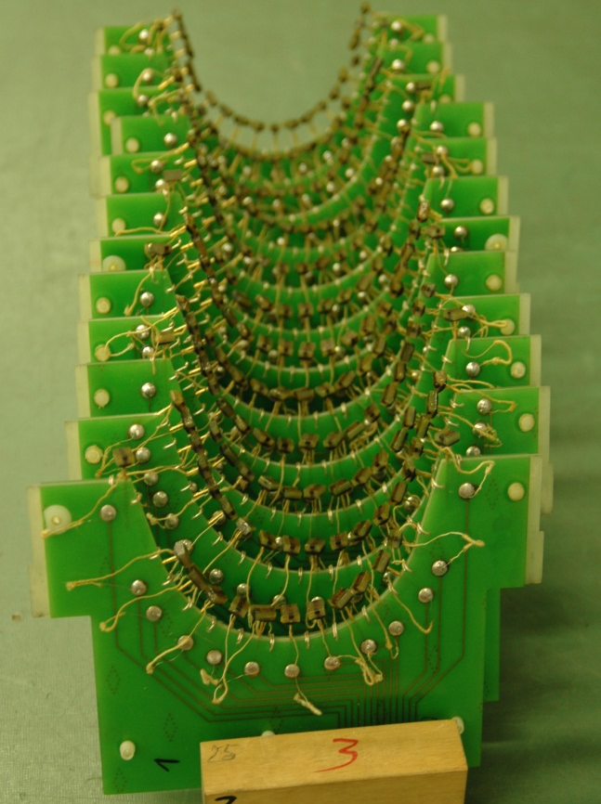
Temperature Mapping: Fixed Systems I
Fixed systems with several hundreds of resistors
  + Fast read-out (≈ sec)
  + Sensitive: ΔT ≈ 0,1 mK can be detected
  - Sensitive cabling
  - Intensive maintenance necessary

Slide 31
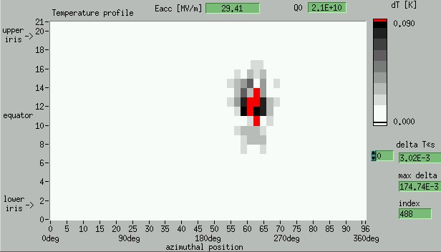
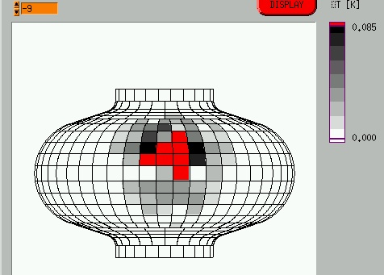
Temperature Mapping: Fixed Systems II
Fixed systems are most complex, but most powerful:
  1) Qualitative analysis => quench location (easy)
  2) Semi-quantitative analysis => ΔT vs. E_{acc}
  3) Quantitative analysis => R_{s,calc} from ΔT (requires additional calibration)
  4) time resolved measurements => temperature (quench) evolution
Example 1: Locating the quench and the temperature distribution
(2D- or 3D-view)

Slide 32
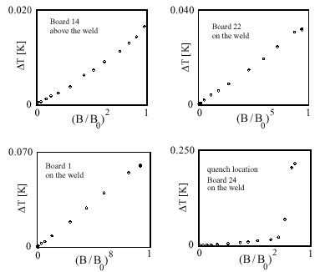
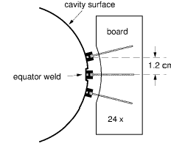
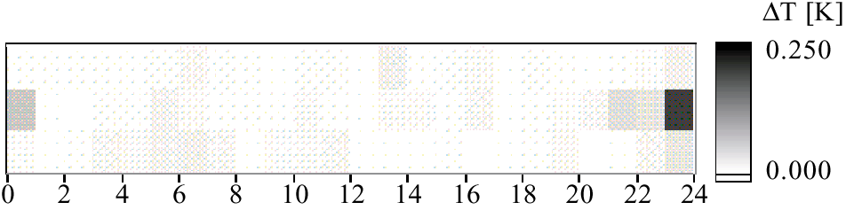
Example 2: Check of ΔT vs. B^{n}
Temperature mapping of the equator region
Thermometer response:
ΔT ~ B² - B⁸
Heating on the equator

Slide 33
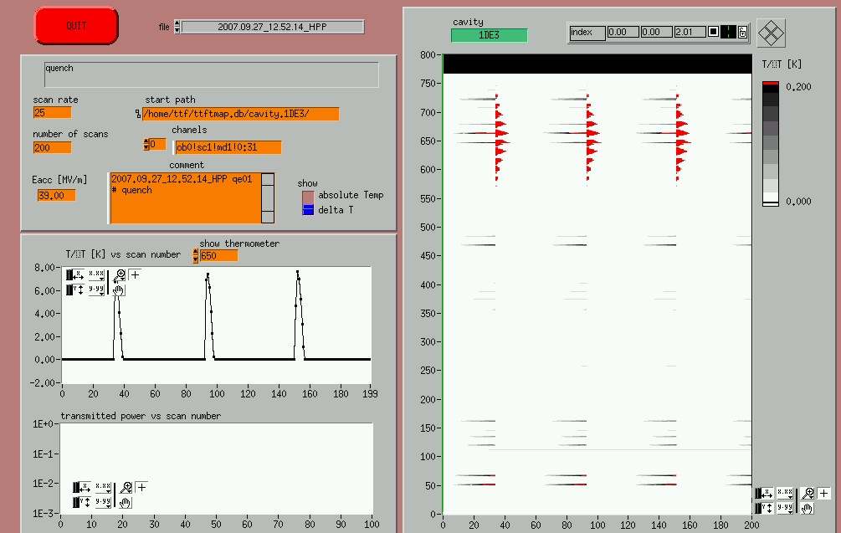
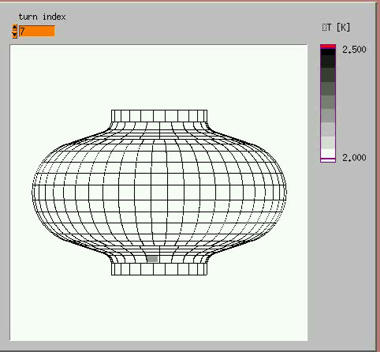
Temperature Mapping: Fixed Systems IV
Example for time resolved T-Mapping
Individual response of each thermometer

Slide 34
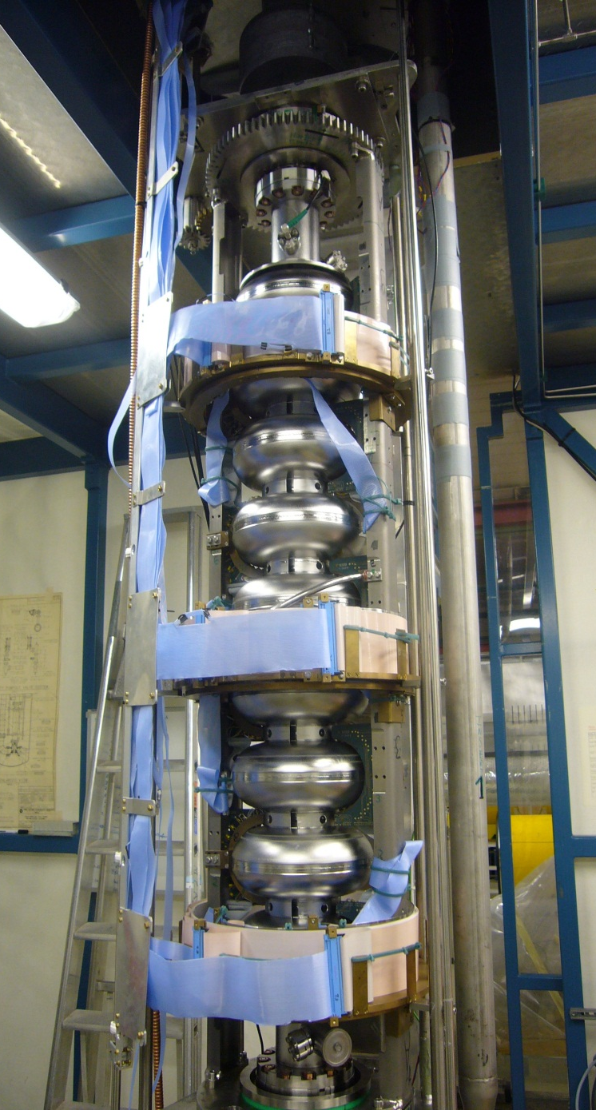
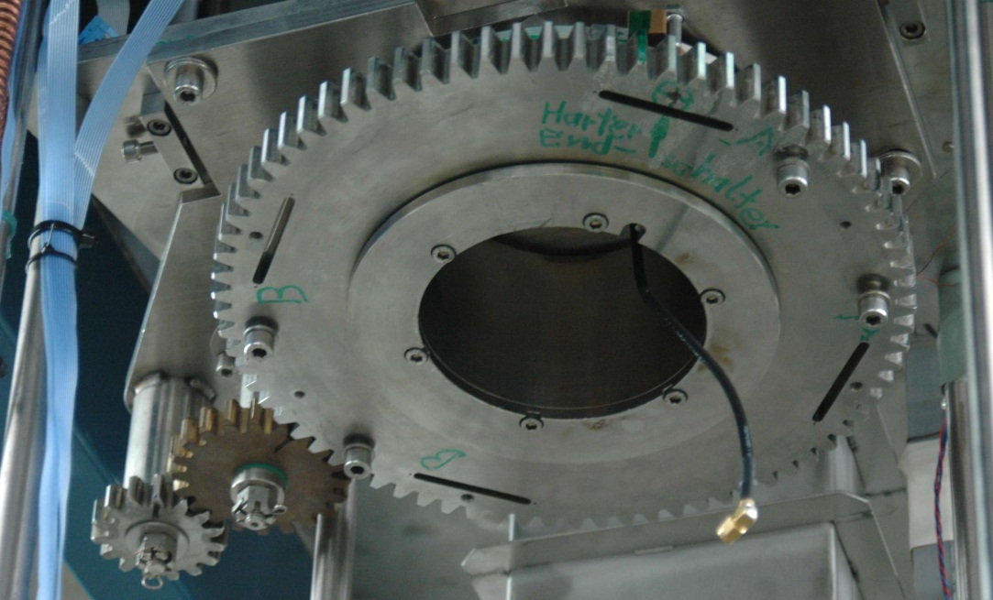
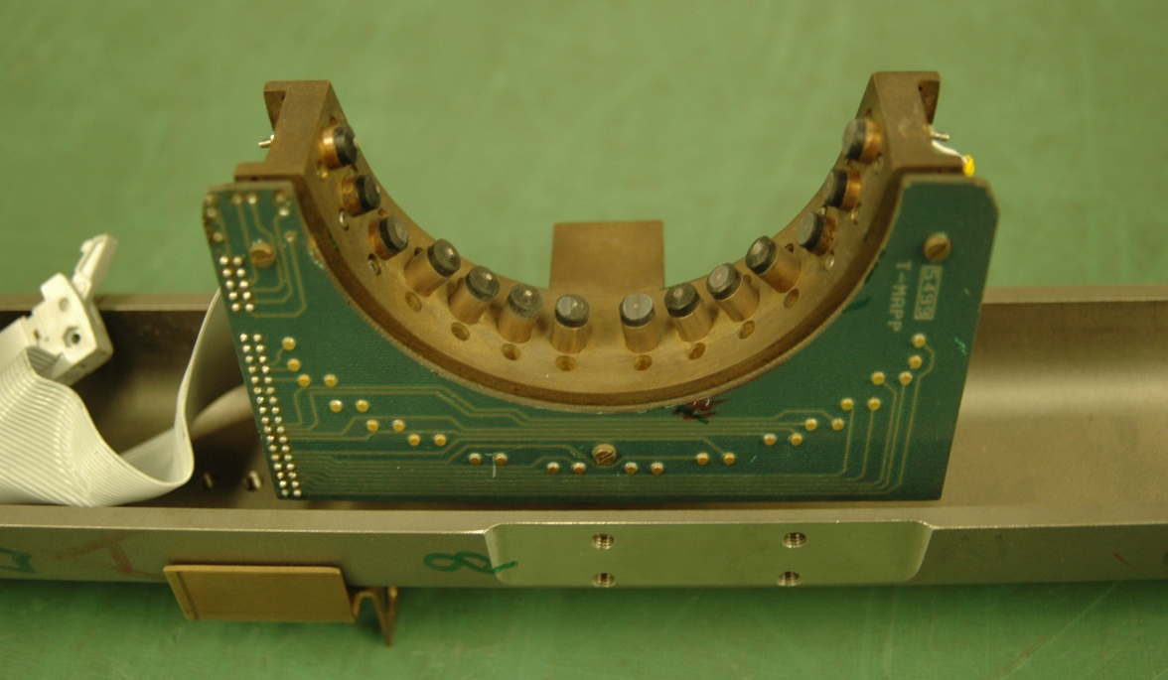
Temperature Mapping: Rotating systems I

Slide 35
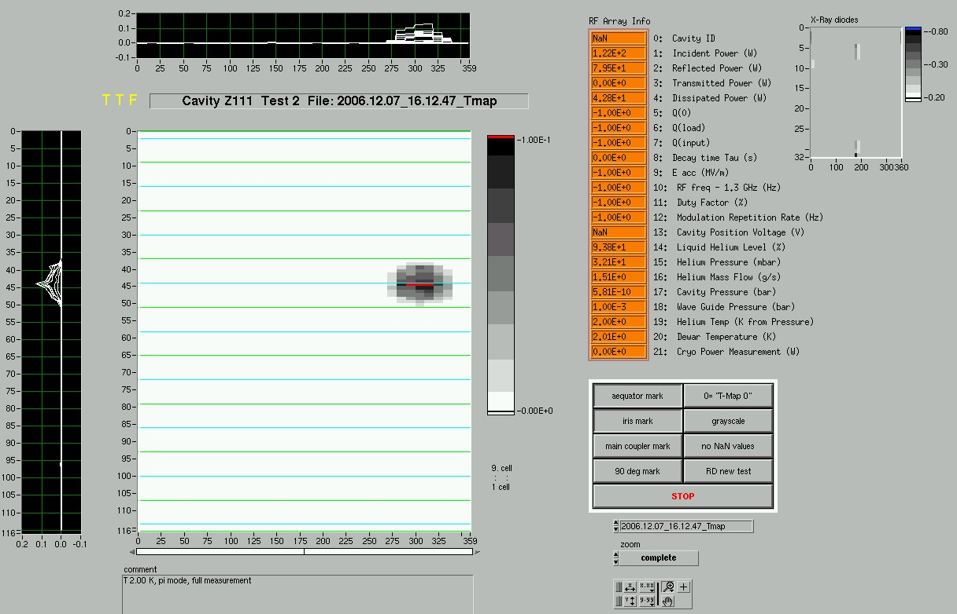
Temperature Mapping: Rotating systems II
Quench detection + time resolved measurements possible
Time consuming (0,5h – 1h)
Less thermometers for multi-cell cavities
X-ray diodes
not existing !!

Slide 36
Outline
Some personal remarks
Vertical test (Set-up + Procedure)
Temperature mapping
Second Sound
Radiation + dark current measurement
Interpretation of RF signals
Identification of Quench, Field emission, Multipacting
Processing
Cryomodule testing

Slide 37
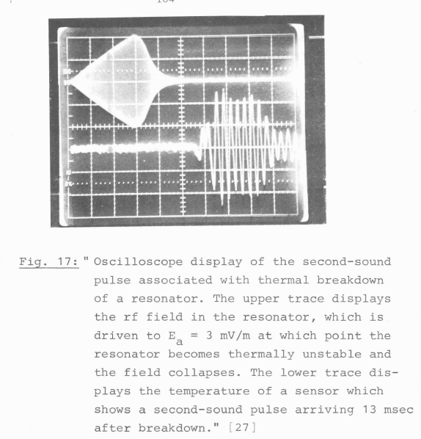
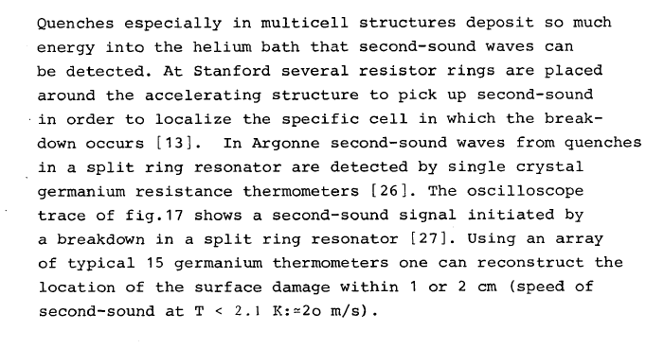
Second Sound
“New” technique?
H. Piel, “Diagnostics Methods of Superconducting Cavities
and Identification of Phenomena“, SRF workshop 1980

Slide 38
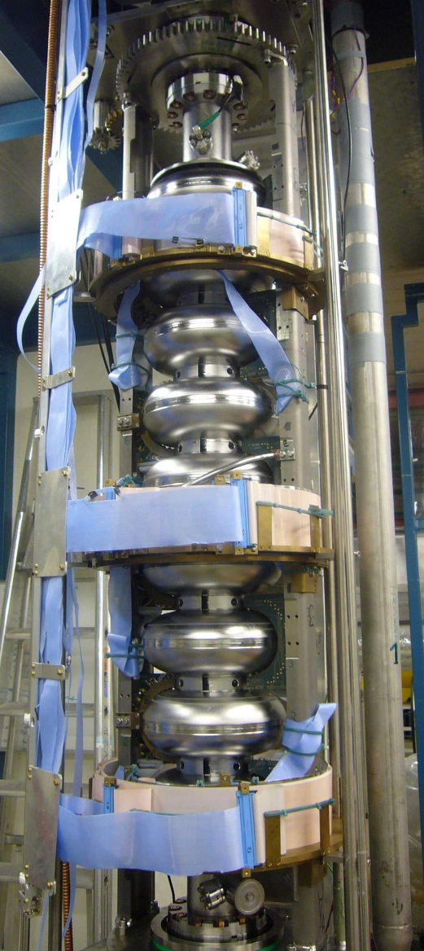

Comparison of Second Sound and Temperature Mapping
Temperature mapping (left)
  Complex assembly for each test
  required
Second Sound (right)
  Simple and one-time assembly
  at the cryostat insert
  Fast measurement
  16 (8) sensors only

Slide 39


Second sound – detection
OST (Oscillating Superleak Transducer) consisting of metal plate and thin diaphragm coated with gold → capacitor
Second sound actuates oscillations of the diaphragm
Measure voltage change
OST (Oscillating Superleak
Transducer) of Cornell Design

Slide 40


Data Processing
OST
Quench localization depending on
Second Sound velocity
=> stable bath temperature

Slide 41



Quench localisation => trilateration / probability calculation
Trilateration:
Sketch of intersecting volume
Probability calculation:
- Color shows the fitting error (mm) for each
single point – not the quench size
- Lines show the sigmas of distribution of
“quenchpoints” – not taken from fitting error (color)
σ_{z}=8.9mm
σ_{ϕ}=9.0°

Slide 42
Quench localisation => summary
Uncertainties:
  Size of the OSTs
  Heat distribution in Nb
  Signal analysis
Measurement uncertainty:
typically ~ cm
Comparison with T-Map:
Agreement with uncertainty of 1-2 cm
With or without boundary condition:
Quench forced on cavity surface?

Slide 43
Outline
Some personal remarks
Vertical test (Set-up + Procedure)
Temperature mapping
Second Sound
Radiation + dark current measurement
Interpretation of RF signals
Identification of Quench, Field emission, Multipacting
Processing
Cryomodule testing

Slide 44





X-ray (+neutron) detection
Detect x-rays + neutrons either outside of cryostat or localization inside the cryostat
Radiation detectors (outside of cryostat):
  Ionization chamber
  => also relevant for personal safety!
  Neutron detectors
  => for personal safety outside of shielding
  Scintillator with Multi-Channel Analyzer
  => energy spectrum
+

Slide 45



X-ray detection inside the cryostat
Radiation detectors (inside of cryostat):
  Photo Diode usable for x-rays (Hamamatsu)
  used in liquid He; typically in the T-mapping set-up
  at and close to the irises
  (example later)
  Current vs. gradient for
  54 photo diodes of a
  3 GHz nine-cell set-up
  X-ray (medical) films

Slide 46

Electron / dark current detection (only 2 examples)
Vertical cw test:
=> Pick-up antenna can be used for e⁻ - detection
=> Separation of RF – and DC signal
=> Direct current measurement with electrometer
Compton diode
or Faraday Cup

Slide 47
Outline
Some personal remarks
Vertical test (Set-up + Procedure)
Temperature mapping
Second Sound
Radiation + dark current measurement
Interpretation of RF signals
Identification of Quench, Field emission, Multipacting
Processing
Cryomodule testing

Slide 48

Interpretation of RF signals
Cavity limiting phenomena show typical RF signals
(“Diagnostics Methods of Superconducting Cavities and Identification of Phenomena”, H. Piel, SRF workshop 1980)
1) Response without any limiting / degrading / ”special” effect:
P_{in}
P_{ref}
P_{trans}

Slide 49


Interpretation of RF signals II
2) Additional losses appear during the built-up time of the field
=> something is warming up!
  Weak-spot in the cavity
  Heating in couplers, antennas
3) Sudden changes in the power relation appearing like a Q-switch (within one rf point or increasing the power to the next point)
=> Maybe a breakdown in your power cable /connector by gas discharge in the low pressure helium (Paschen minimum is close)!
P_{trans}
P_{trans}
log P_{trans}

Slide 50
Outline
Some personal remarks
Vertical test (Set-up + Procedure)
Temperature mapping
Second Sound
Radiation + dark current measurement
Interpretation of RF signals
Identification of Quench, Field emission, Multipacting
Processing
Cryomodule testing

Slide 51

RF-Signals + Symptoms of Quench
RF-signal of a thermal or magnetic breakdown (“Quench”) :
  breakdown of transmitted power within ≈ms (thermal time constant)
  often self-pulsing
No X-rays !!!
=> with x-rays life becomes more complicated (quench with FE present, FE induced quench, multipacting, …)
P_{trans}
P_{trans}

Slide 52


RF-Signals + Symptoms of Quench II
T-Mapping:
  Detection of temperature rise at cavity wall near quench location
  ΔT during quench up to few K
  precursor just below the quench ??

Slide 53






JLab T-mapping and High-Resolution Optical Inspection
Rongli Geng
Precursor T-jump
at quench location
hot spot near equator EBW
Ciovati et al
700 μm dia. defect in AES5
300 μm dia. defect in A15
53

Slide 54


RF-Signals + Symptoms of Field Emission
Typical decrease of Q₀-value
  sometimes not so obvious
Drop of Q₀ accompanied by exponential X-ray increase according to Fowler Nordheim’s law
Field emission electrons can cause a “field emission induced quench”

Slide 55

RF-Signals + Symptoms of Field Emission II
RF-signal of field emission :
  Change of decay slope
  for P_{trans}
  => reflects the change
  of Qo-value
In multi-cell cavities:
Excitation of other passband modes by energy transfer
P_{trans}
log P_{trans}

Slide 56

RF-Signals + Symptoms of Field Emission III
T-Mapping:
field emission gives a “hot trace” on one azimuthal position
T-Mapping necessary to decide between “Quench with FE” and “Field Emission induced Quench”
Electron probe: Exponential increase of current (Fowler Nordheim’s law)
2-D T-map of a
field emission loaded
cavity

Slide 57


RF-Signals + Symptoms of Field Emission IV
X-ray mapping (+ respective T-Map)
Application of X-ray films + X-ray spectroscopy (see above)
Remark:
FE can be caused by strong hydrocarbon contaminations of your vacuum system
=> “Clean” pumping station + RGA at the test insert necessary

Slide 58

RF-signals and symptoms of Multipacting
Multipacting:
Each cavity shape has its individual MP barrier(s)
rf-signal of transmitted power:
  no increase of P_{trans} for enhanced forward power (barrier)
often breakdowns of rf field (like quench) during processing
X-ray detectors and electron pick-ups are also showing activity
(in the moment of breakdown!!!)
P_{trans}

Slide 59



Multipacting: Temperature mapping
“Hot spot“ may move along the equator

Slide 60
Multipacting: Processing
Processing takes seconds to hours
  one-point MP: hard barrier => maybe no processing success
  two-point MP: soft barrier => fast processing (sec to min)
After warming up to room temperature (mostly) re-processing is necessary
Remark:
MP can be caused by surface gas layers esp. hydrocarbon contaminations of your vacuum system
=> “Clean” pumping station + RGA at the test insert necessary

Slide 61


Multipacting in other components
Remark: Multipacting is an issue of interest in higher order mode coupler and fundamental power coupler for cavities
  See references + morning talk
  MP calculations using “MultiPac” for 2 coupler types
1-side 3rd order MP in coaxial coupler
2-side 5th order MP in waveguide coupler
P. Yla ̈-Oijala, TESLA Report, TESLA 97-21, (1997).

Slide 62
Outline
Some personal remarks
Vertical test (Set-up + Procedure)
Temperature mapping
Second Sound
Radiation + dark current measurement
Interpretation of RF signals
Identification of Quench, Field emission, Multipacting
Processing (+ Switch-on effects)
Cryomodule testing

Slide 63
Field emission: Processing and Switch-on
One or several “breakdowns” of the RF signal – often accompanied by loosing the lock for the PLL - resulting in
- drop in radiation
- higher Q₀ , higher E_{acc}
(sometimes low field Q₀-value is degraded)
=> Processing event
  Sometimes slow improvement (degradation) with some instable behavior
Sudden Q₀ and gradient degradation with accompanied increase in radiation
=> “Field emission switch on” event

Slide 64
Field emission: Switch-on
Activation of a field emitter:
Before turn on event
after turn on event

Slide 65

Field emission: Processing
Processing of emitters (“conditioning”) possible
  RF and helium proc. with moderate rf power and cw-like operation
  high peak power processing (HPP) with high rf power and short pulses
Some RF processing you cannot avoid during the first Q₀(E_{acc})-curve in case of field emission (if you like it or not)
Helium processing:
Variation of RF processing
Keep pressure below discharge condition
Run cavity in the field emission regime
Push the gradient as high as the system allows
The process in details is unknown
  Electron spraying from FE → bombard surface → ionization of helium at around surface → destroy field emitter???
  Controlled processing is difficult
Courtesy J. Mammosser

Slide 66


Field emission: HPP
High Peak Power processing (developed in 1990es at Cornell)
=> up to MW with few hundred µsec pulse length
Local melting leads to formation of a plasma and finally to the explosion of the emitter (model by J. Knobloch)
“star bursts” (Lichtenberg figures) caused by the plasma
Notes:
HPP uses very high rf power – typical a few hundert kW up to MW – and short pulses of a few hundred µsec. Basing on the work of R. Campisi most efforts on HPP were undertaken at Cornell.
Preparing this talk I looked to the models describing the processing effects. Though there is a lot of agreement, still different authors vary significantly for example in the description of he processing. I will concentrate on very few main features. More details can be found in Hasan’s textbook and the articles presented at the SRF workshops.
Fundamental for all explanations of processing is a high current density emitted by the emission spot. Most simple argumentation is, that the high current density results in a strong heating of the emitter and its final melting and destruction. Many experimental observations can only be explained, if the adsorbed gases are taken into account. In case of helium processing often a slow modification of the emission behaviour is observed, which can be interpreted as a modification of the adsorbed gases caused by the bombardement with helium ions. Partionally this conditioning effect is reversible after a warm-up and cool-down cycle.
The model for HPP proposed by Jens also starts with a high current density from a nm-scale emission spot, which leads to a local melting. New is the addition of a feedback loop resulting in the formation of a plasma above the emitter, which finally gives the energy to explode the µm-sized particle. The plasma is also the origin of the popular starburst. They are only visible in the e—microscope and can be explained as modification of the surface layer (flourine depletion)
The figures are known since the 18th century as Lichtenberg figures produced by discharging experiments.

Slide 67


Field emission: HPP II
HPP on 5- and 9-cell structures in vertical tests:
improvement from (10-15) MV/m to (20-28) MV/m, but often reduced Q-value
Requires special high power coupler
Typically E_{acc}(during HPP) ≈ 2x E_{acc}(after processing)
Courtesy H. Padamsee

Slide 68

Field emission: Processing in accelerator structures
Processing example at TTF DESY:
Processing of module 2 in linac successful (Feb 1999)
(operation limited by power coupler above 19 MV/m)

Slide 69




Field Emission ?
MP! And then later on Field Emission !
Qo vs. Eacc
Radiation vs. Eacc
MP
FE
If this cavity is limited at this condition, what is the limiting factor?
Field emission?
Courtesy J. Mammosser

Slide 70
Outline
Some personal remarks
Vertical test (Set-up + Procedure)
Temperature mapping
Second Sound
Radiation + dark current measurement
Interpretation of RF signals
Identification of Quench, Field emission, Multipacting
Processing
Cryomodule testing

Slide 71

Horizontal Cavity Tests
Horizontal cavity tests are important in order to a cavity full equipped with its subsystems before a module integration
  Power coupler
  Tuner
  Piezo-Tuners
Check of cooling
conditions + flux
trapping
Horizontal cryostat at DESY for high power pulsed operation (without beam)

Slide 72

Cryomodule testing
Closely follows a presentation by Denis Kostin (DESY)
Cryomodule tests for FLASH + EU-XFEL as example

Slide 73



Module / Cryogenics
12m
He gas return pipe
70K shield
4K shield
Cavity type TESLA
Number of cavities 8
Cavity length 1.038 m
Operating frequency 1.3 GHz
R/Q 1036 Ω
Accelerating Gradient 20..35 MV/m
Quality factor 10¹⁰
Q_{ext} (input coupler) 3×10⁶
Operating temperature 2 K
LHe cooling 2K / 31mbar
HERA cryoplant is used
input coupler
2 phase LHe pipe
Notes:
- European XFEL module with 8x 1.3 GHz nine-cell cavities; 12 m long;
Pulsed operation 10Hz, 1,4msec with average gradient 23,6MV/m
Operating T: 2K
Mechanics: cavity, 2K 2-phase line; He-gas return pipe; 2 two shield with nominal 5K and 70K, power coupler with 2 windows and 2 mechanical parts (cold) and warm

Slide 74

Cryomodule Test Bench (CMTB) RF System
Notes:
Overview of high power RF system
Explain from Klystron to module
WDM: Which circulators / isolators?

Slide 75

CMTB LLRF System
data acquisition
data acquisition
Notes:
LLRF system for pulsed operation!!:
Cavity with 4 couplings
Ignore HOM‘s
Vom klystron zum Cavity weiter zum Probesignal
In addition: Technical interlock for the coupler / frequency tuner
WDM / Andre: Vectormodulator ??? Warum 2x Vectormodulator???

Slide 76

Module Gamma Radiation Measurement
Gamma detector "DUMP"
Gamma detector "GUN"
module
Two gamma detectors are placed near the beam line on both ends of the module (by the end-caps).
Notes:
„Very basic“ instrumentation
Possible in addition more gamma detectors around the module
Dark current measurement

Slide 77
Module Vacuum System
Three vacuum systems:
- Beam vacuum
- Coupler vacuum
- Isolation vacuum of vessel
Beam line
Module
Coupler
Common pumping line
Ti Sublimation Pump
Ion Getter Pump
TSP/IGP connected in parallel and IGP used as a vacuum gauge.

Slide 78

Coupler Technical Interlock
3 times e- (charged particles)
light in coupler vacuum
light in wave guide (air side)
temperature cold ceramic
temperature warm ceramic
vacuum coupler
vacuum cavity
bias voltage
cryogenic OK
low level RF gate on klystron
all thresholds are hardware set
Notes:
- Technical Interlock of the coupler prevents damages to the high power coupler in case of sparks, high e-activities or strong warming.
- Sensors: e- detectors, photo multipliers, T-sensors and Vac
(TTF3 type with more diagnostics )
- Maybe other technical interlocks: Kryo ok

Slide 79

Module Test Procedure (1)

Slide 80

Module Test Procedure (2)

Slide 81

Module Test Procedure (3)

Slide 82
Module Test Data
coupler RF power conditioning 8 couplers
coupler sensors data history 8 couplers
k_{t} (cavity probe calibration) 8 cavities
Q_{load} (at 1.3 GHz) 8 cavities
Q_{ext_probe}, Q_{ext_HOM1/2} (at 1.3 GHz) 8 cavities
frequency / spectra 8 cavities
E_{acc.X.start} (single) 8 cavities
E_{acc.max} (single, no Q_{o}) 8 cavities
X-rays (E_{acc.max}) 8 cavities
Q_{o}(E_{acc}) module
X-rays(Eacc) module
cavity conditioning data 8 cavities
HOM couplers Q_{ext}(Freq_HOM) 8 cavities
coupler / cavity vacuum pressure
e- probes signal (voltage)
light (PM) signal (voltage) – not for the XFEL / AMTF
spark detector (diode) signal (voltage)
cold ceramics temperature (PT1000) T_{70K}
warm ceramics temperature (IR/PT1000) T_{300K}
coupler sensors data
RF power / cavity gradient
gamma radiation (X-rays)
LHe level / pressure

Slide 83

Cryosystem/Cooldown Test
temperature measurement: temperature sensors (cavities/couplers + cryogenics) data are stored.
cavity resonance frequency measurement during the cooldown.
cryogenic losses measurement based on temperature and LHe flow data: 2K, 4K and 70K static (infrastructure) and dynamic (RF power) losses.
Optional: stretch-wire based module dimensional changes measurements.

Slide 84




RF Couplers Conditioning History/Data (1)
20 μs pulses
50,100,200,400,800 μs pulses
Vac
Pfor
e-
light
Light IL events
Light IL events
Notes:
Warum machen wir den Power Sweep???

Slide 85




RF Couplers Conditioning History/Data (2)
TSP saturated
1300 μs pulses
RF power sweep at 1300 μs pulse
TSP fired
cryo works
cryo works
Light IL events
coupler 1,2,6,8 activity

Slide 86




RF Couplers Q_{load} Tests
Input RF Couplers coupling tuning range measured at CMTB
operating value Q_{load}=3×10⁶

Slide 87






RF Calibration / Cavity Test
Cavities gradients for the 1.3 ms rectangular pulse
RF Power Calibration
flat-top RF power pulse
evaluated error margins for accelerating
gradients in this test are about ±10..16%.
R_{sh}/Q=1030Ω, Lcavity=1.035m,
Qload=3×10⁶, f₀=1.3GHz, Pfor≈5kW,
t_{fill}=1300μs (for calibration, 500μs for flat-top)

Slide 88



Example:
Single Cavity Results

Slide 89




Example:
Module Test Results
dynamic cryo-losses
Q₀(E_{acc})
gamma radiation
Flat-top pulse 500+800μs operation at 10 Hz

Slide 90


Cryo Module Test Bench
Notes:
Before you start editing the slides of your talk change to the Master Slide view:
Menu button “View”, Master, Slide Master:
Edit the following 2 items in the 1st slide:
1) 1st row in the violet header:
Delete the existent text and write the title of your talk into this text field
2) The 2 rows in the footer area: Delete the text and write the information
regarding your talk (same as on the Title Slide) into this text field.
If you want to use more partner logos position them left
beside the DESY logo in the footer area
Close Master View

Slide 91



Accelerator Module Test Facility (AMTF)

Slide 92
References
H. Padamsee et al., “RF Superconductivity for Accelerators”
T. Powers, “Theory and Practice of Cavity Test Systems”, Tutorial SRF Workshop 2005
+ “Practical Aspects of SRF Cavity Testing and Operations”, Tutorial SRF Conference 2013
W.-D. Moeller, “Design, Fabrication, and operation of High-Power and HOM- Coupler for SC Cavities”, Tutorial SRF Conference 2011
J. Sekutowicz, “Superconducting Cavities”, CAS 2010
R. Geng, “Limits in Cavity Performance”, Tutorial SRF Conference 2011
H. Piel, “Diagnostics Methods of Superconducting Cavities and Identification of Phenomena”, SRF workshop 1980
Tutorials and Contributions to SRF workshops / conferences

Slide 93
Thank you !
Thanks to all colleagues for their support, transparencies and “stolen” figures especially
T. Büttner, R. Geng, A. Gössel, D. Kostin, R. Laasch, L. Lilje,
J. Mammosser, H. Padamsee, H. Piel, T. Powers,
F. Schlander, J. Sekutowicz, Y. Tamashevich, H. Weise
The end !

