Slide 1

Pushing Nb performance
Alexander Romanenko
SRF’2015 Tutorials
12 Sep 2015

Slide 2
Part I: brief overview of past limitations + progress in fundamental understanding of previously encountered phenomena
Part II: new discoveries

Slide 3
PART I: Brief overview of past limitations + progress in fundamental understanding

Slide 4
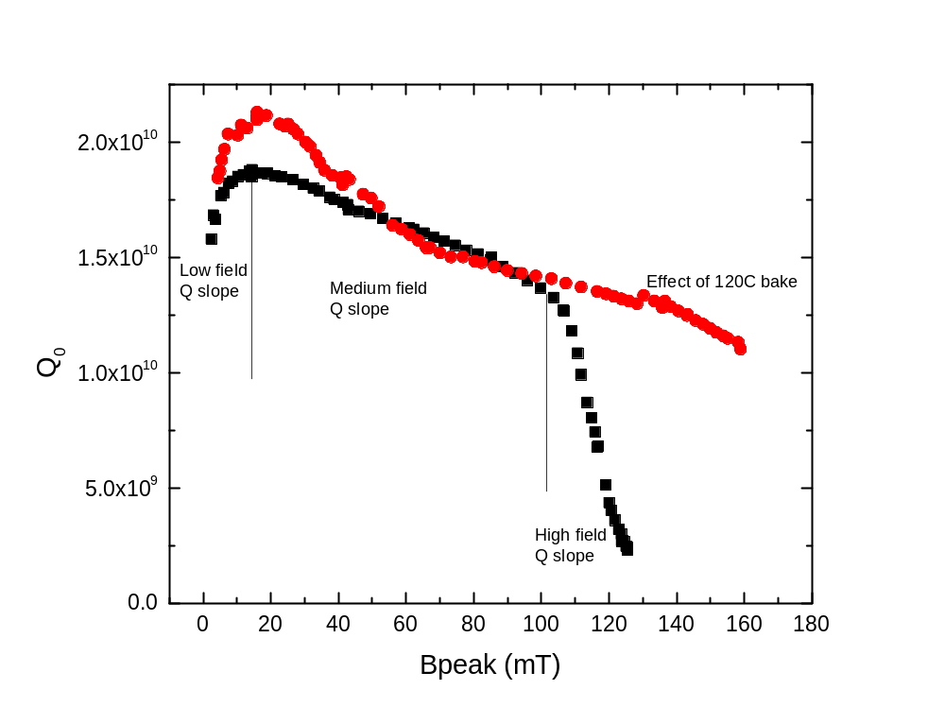
Detailed look at Q(E) curve portions – Q slopes
quench

Slide 5
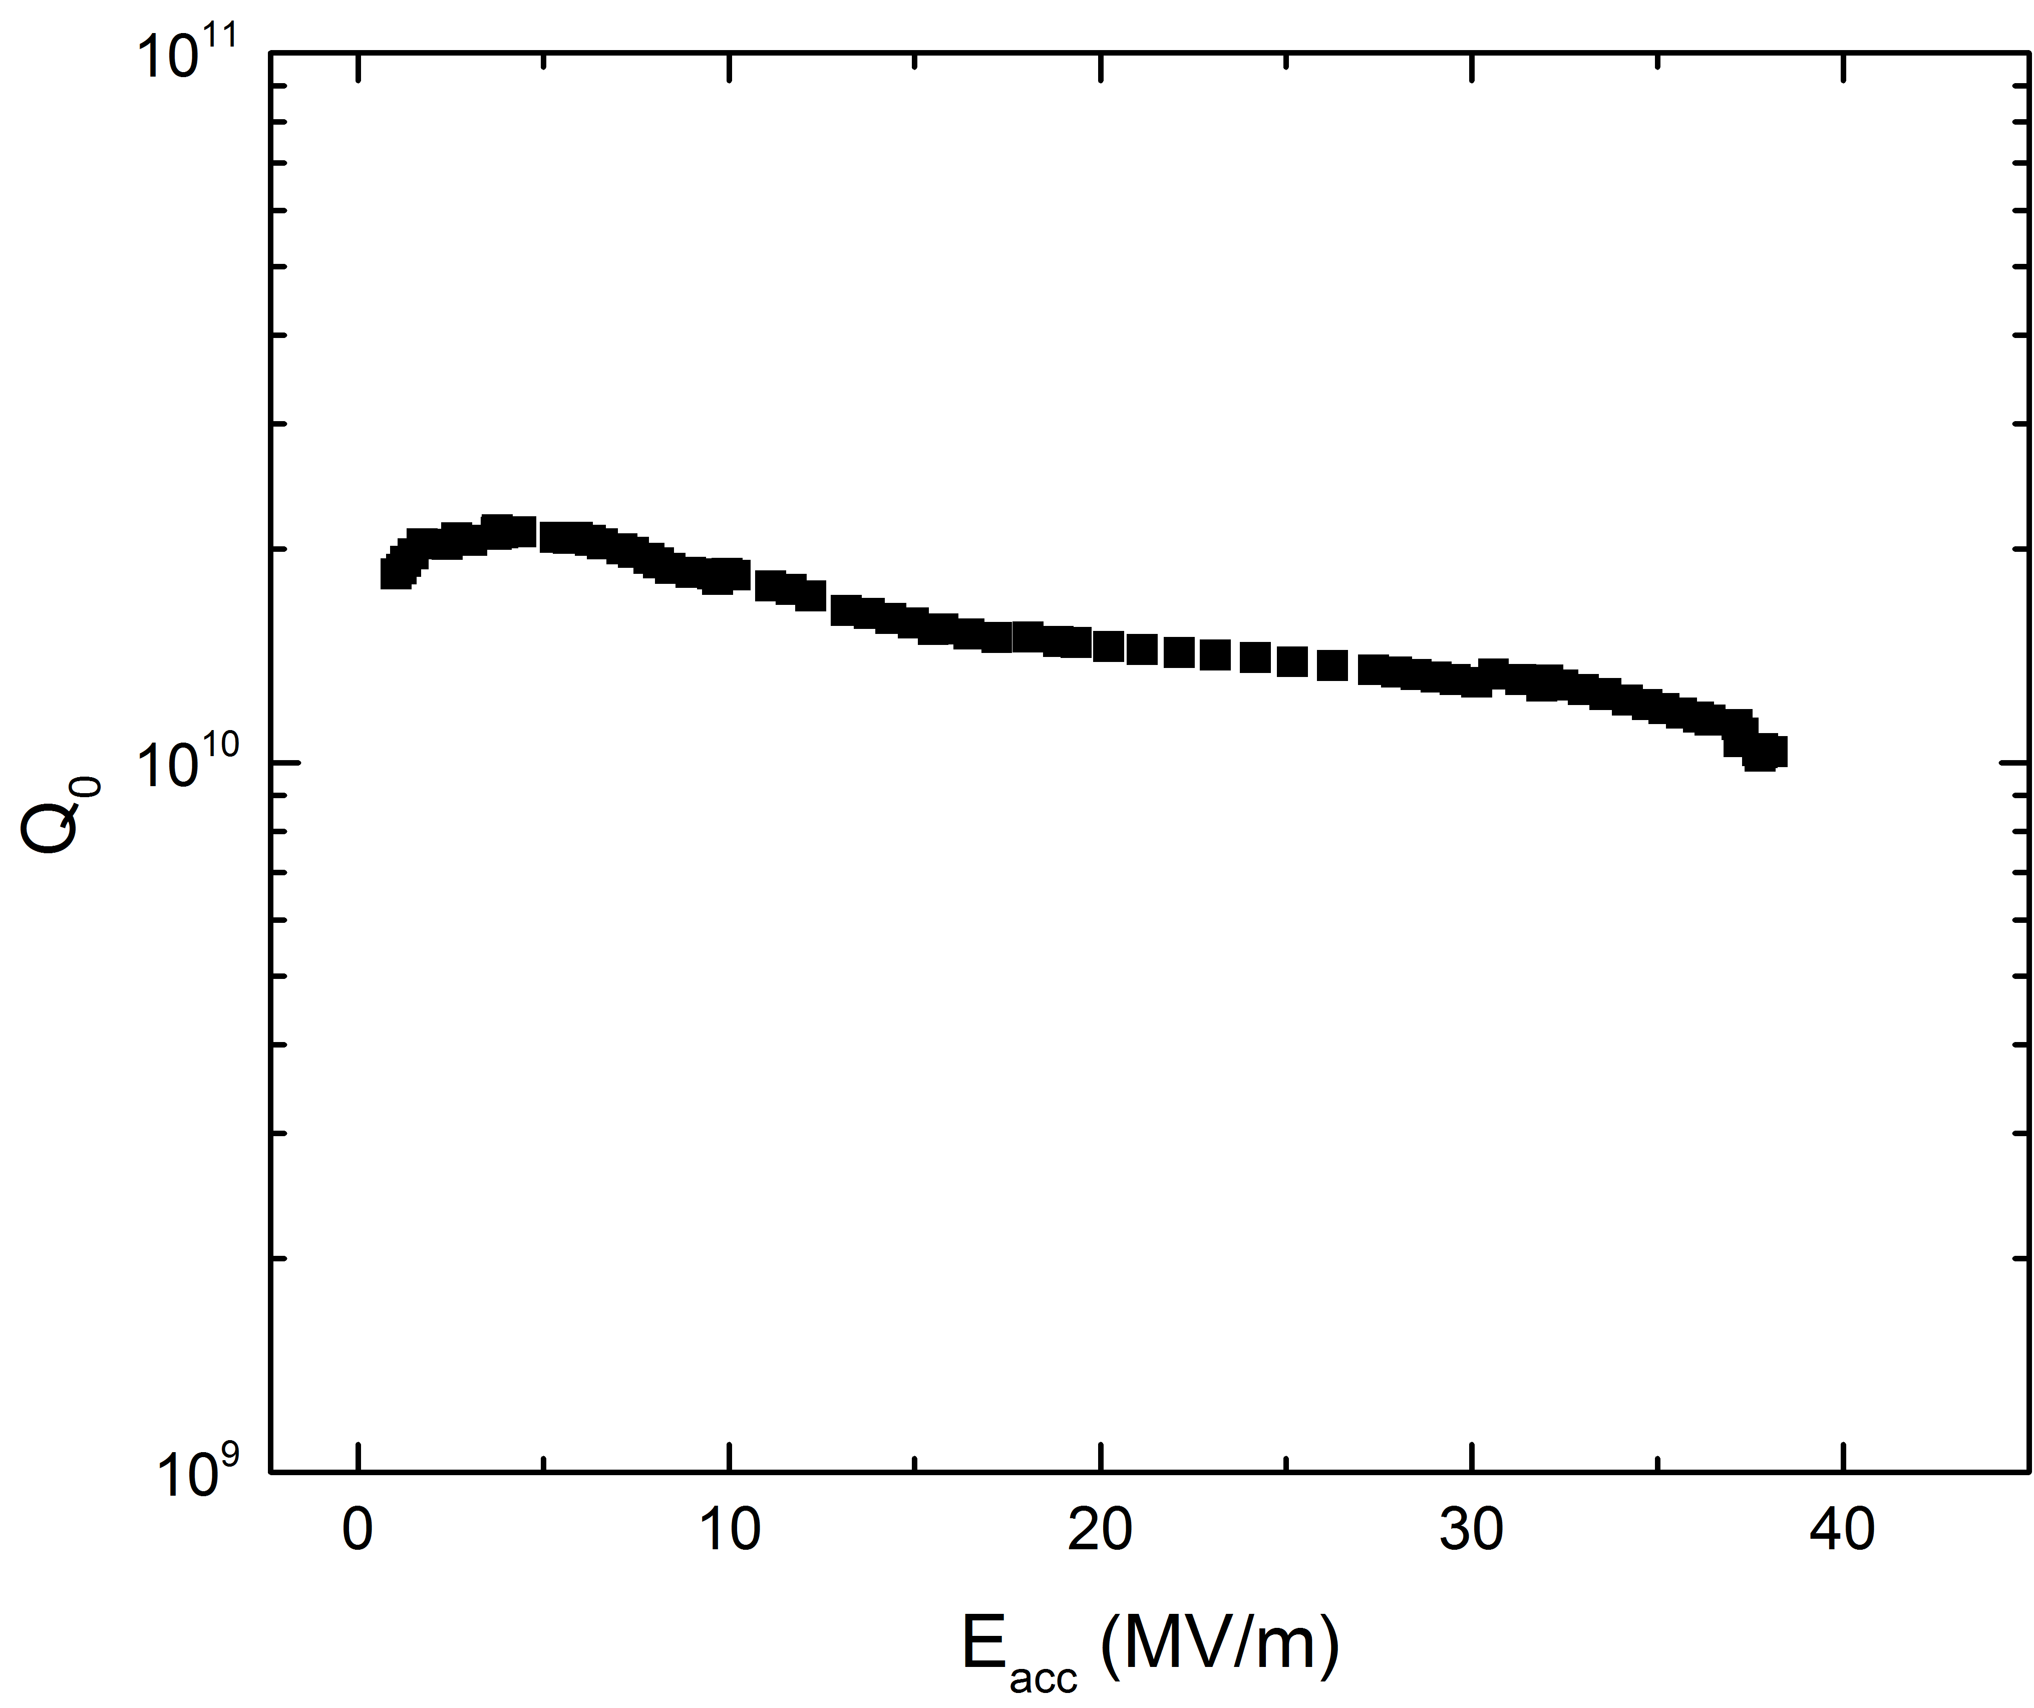
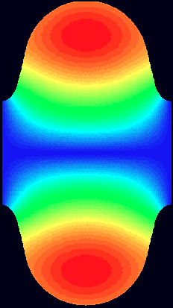
Q(E) curve and goals of SRF research
Increase Q => decrease required power
Where does Q go at very low fields?
Increase max E_{acc} => decrease accelerator length
B_{peak}~160 mT
Q=const/R_{s}
Average surface resistance
Typical ILC-prepared cavity at T=2K
Surface magnetic
field B

Slide 6
Limits to the achievable gradient

Slide 7
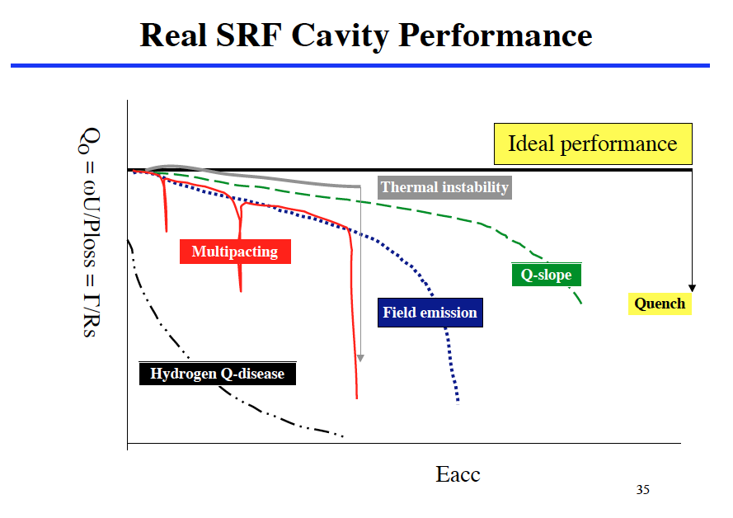
Niobium surface structure
Advancements driven by scientific understanding

Slide 8
High gradient – possible limitations
Multipacting
  Multiple impact electron amplification
Field emission
  Emission and acceleration of electrons by the surface electric fields
Quench
  Localized loss of superconductivity followed by a quickly spreading normal zone consuming all of the available RF power within < 1ms
  Currently still the ultimate limit to gradients

Slide 9
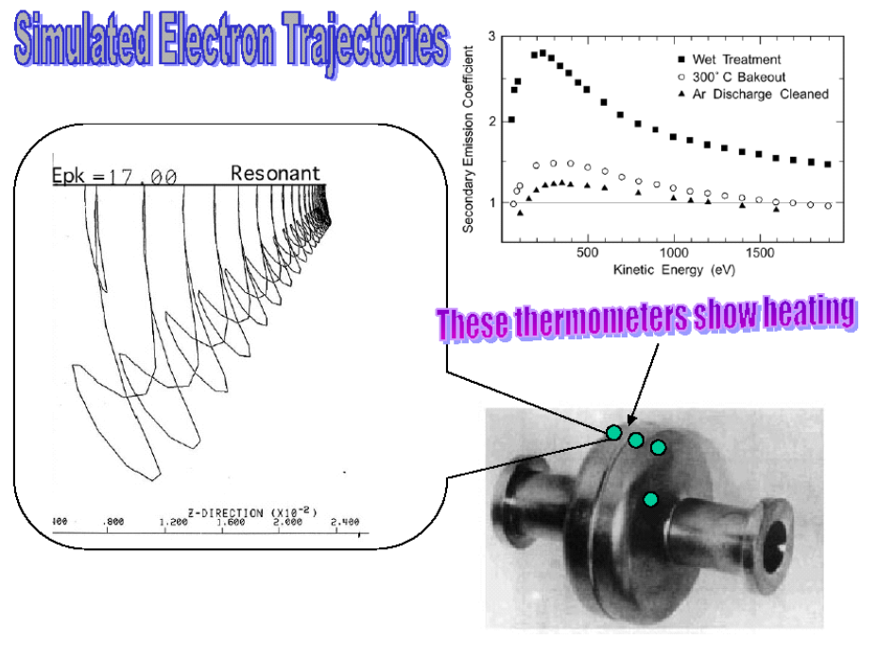
Multipacting
Understood since ~1980s
  Essentially non-issue in elliptical cavities
  Typical long processing times (hours to days) to achieve the required gradient in lower beta cavities of more complicated shapes (quarterwave, spoke, half-wave resonators)
    Still usually can be processed

Slide 10
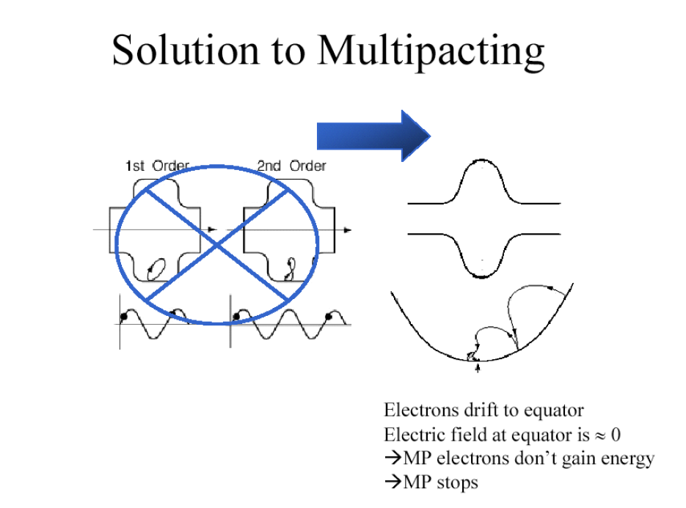

Slide 11
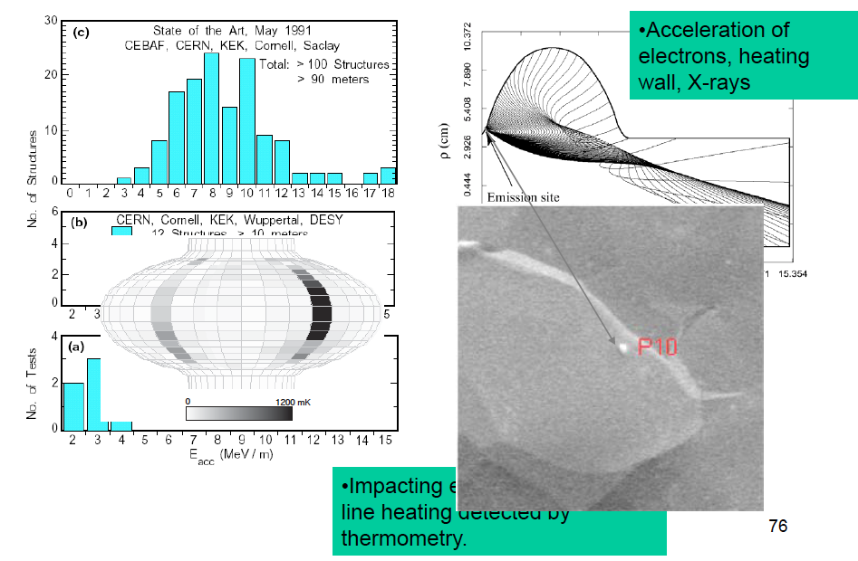
Field emission
Field emission

Slide 12
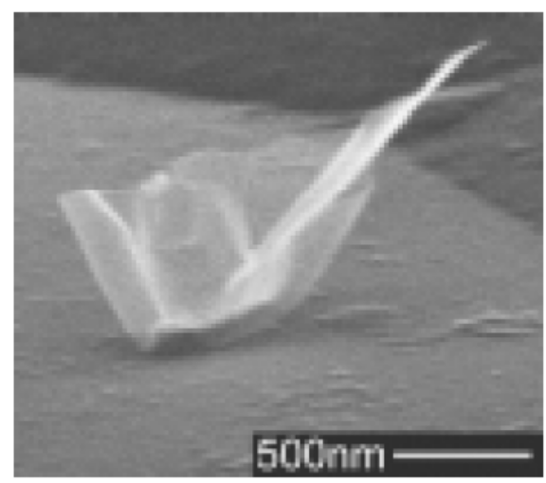
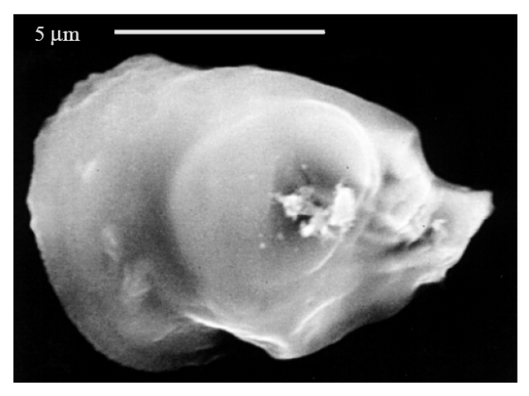
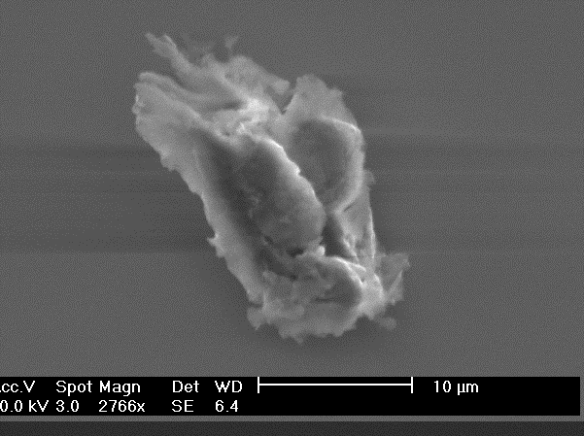
Museum of Known Field Emitters 0.5 to 10 microns
Note the sharp features on the Particles.
(a) Sub-micron field emitting particles found on sample prepared with 9-cell cavity
(b) Al particle found at a field emission site in the dc field emission scanning apparatus and subsequently analyzed with the SEM
(c) Field emitting particle found with thermometry followed by dissection of a 1.5 GHz cavity. Carbon, oxygen, iron, chromium, and nickel were among the foreign elements detected

Slide 13
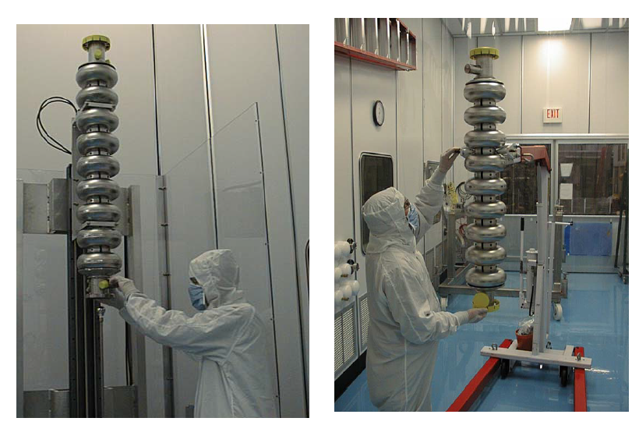
Solution to field emission – high pressure water rinsing (100 atm), and an ultra-clean assembly => remove field emitters and preserve cleanliness

Slide 14
Quench
Currently the hard limit on achievable cavity gradient
Initial “spark” can be thermal (heating above Tc) or magnetic (local critical field exceeded)
  In any case normal spreading zone emerges
Frequently driven by some sort of defect
  High gradient ones remain to be identified/found
  Accompanied by “pre-heating”
    Frequently not the case of N doped => different nature of quench

Slide 15
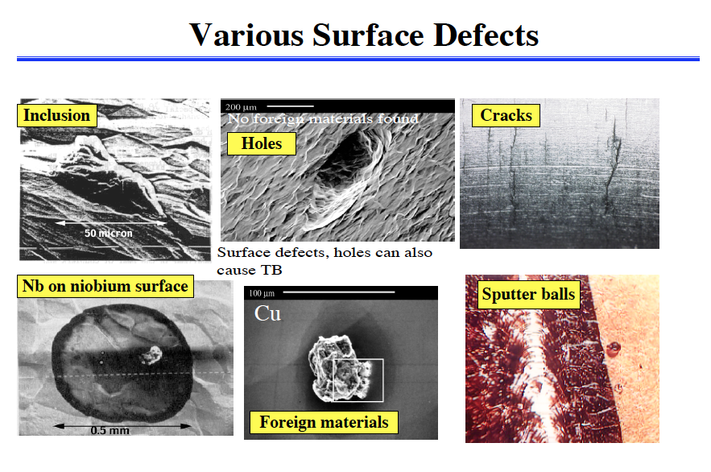
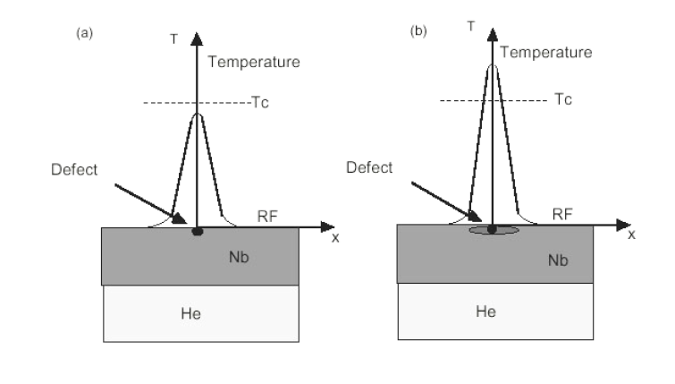
Thermal breakdown
Overheating of the defect area above Tc
Solution -> Raise thermal conductivity -> use high purity niobium

Slide 16
Quench – some new aspects
Decreased quench levels in N doped cavities are not associated with pre-heating
  Interesting fundamental problem to understand
Currently -> PPMS etc suggest decreased field of first penetration for heavier doping

Slide 17
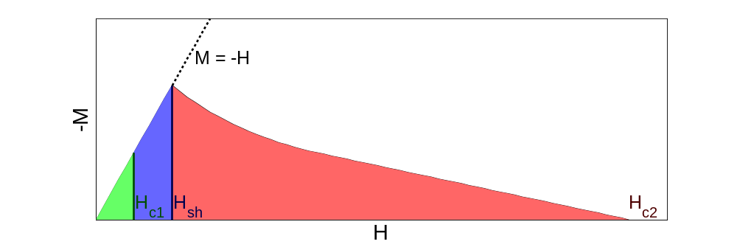
Superheating Field – ultimate limit as perceived now
(Note: Magnetization curve for H increasing only)
Meissner state
Meissner state (metastable)
Vortex state
Flux free Meissner state is stable up to H_{c1}
Favorable for flux to be deep in bulk above H_{c1}
BUT surface energy barrier allows metastable state Ultimate SRF limit: superheating field H_{sh}
Notes:
Flux free Meissner state is stable up to H_{c1}
Favorable for flux to be deep in bulk above H_{c1}
BUT surface energy barrier allows metastable state! Ultimate limit: “superheating” field H_{sh}

Slide 18
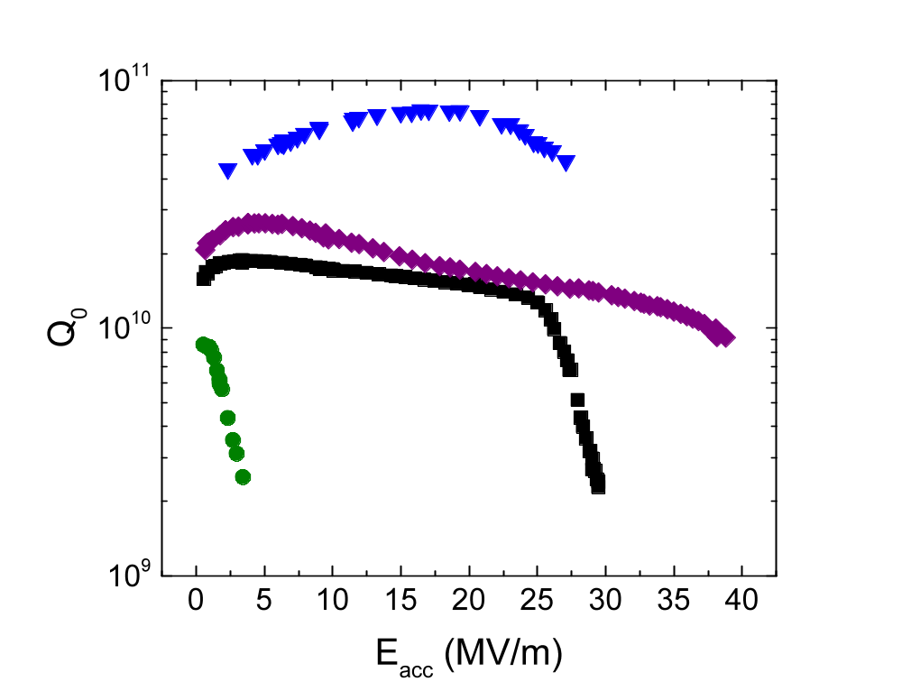
Cavity performance limitations – progress in understanding
#4: N doping to increase Q by a factor of >2
f =1.3 GHz, T = 2K
Electropolished cavity
Too much H absorbed
120C bake
#3: mechanism of the “120C baking”
#1: microscopic mechanism of “Q-disease”
#2: origin of the “high field Q slope”

Slide 19
BUT FIRST
Surface resistance
Q ~ 1/R_{s}
  R_{s}(T) = R_{BCS}(T) + R_{residual}
Fundamental part described by Bardeen-Cooper-Schrieffer (BCS) theory
Residual resistance due to other contributions

Slide 20


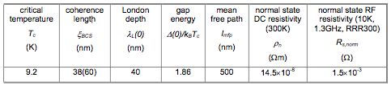
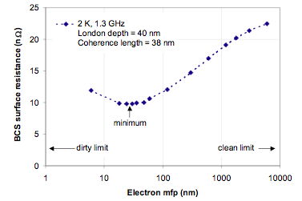
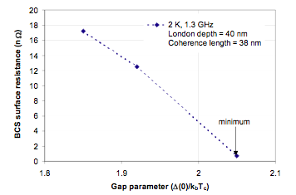
BCS resistance
Bauer- Review of surface resistance models –TD note

Slide 21
Experimental decomposition of Rbcs(H) and Rres(H)

Slide 22
Motivation
Cavity Q₀ is a function of both temperature (T) and surface magnetic field H
  Q slopes
Temperature dependence of Rbcs for all treatments is well-understood -> thermally excited quasiparticles give Rbcs ~ 1/T*exp(-Δ/kT) at all RF fields (gap etc may change though)
Q = G/<Rs>, where <Rs> = Rbcs(T) + Rres
Crucial question – how does Rs(B) emerge from its components Rbcs(B) and Rres (B)?

Slide 23
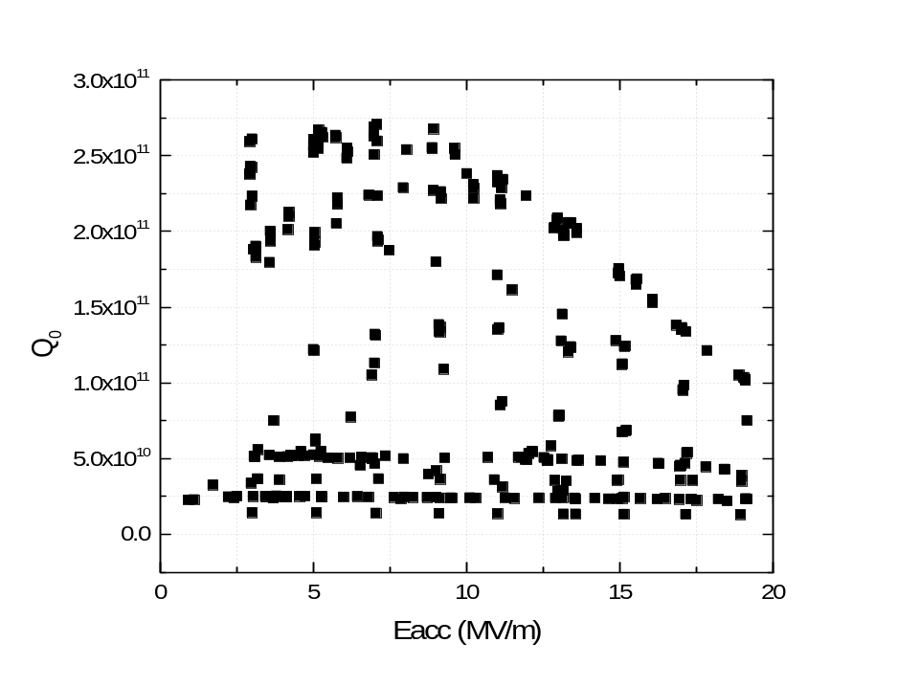
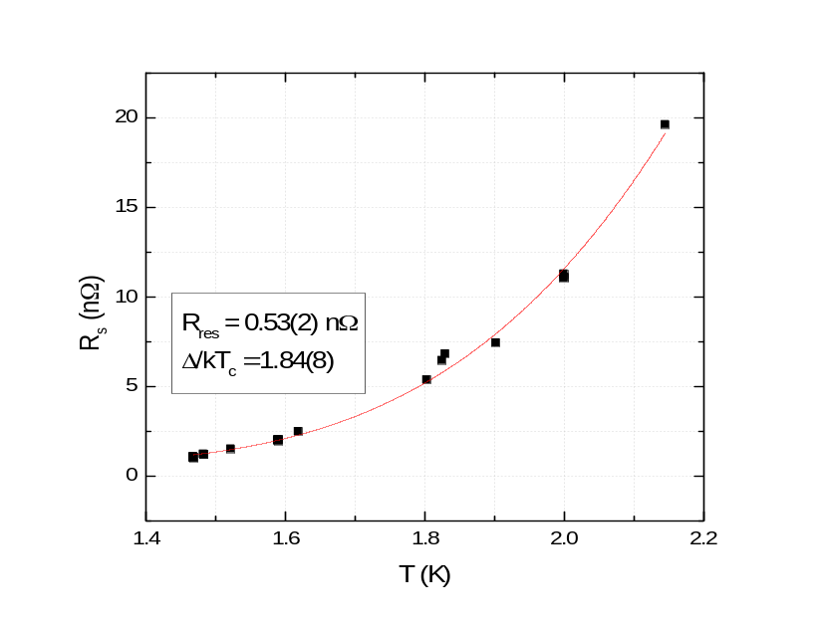
How to decompose the BCS and residual at all fields?
Obtain as many Q(B,T) measurements as practical at ALL fields (not only at a single low field)
At each fixed field fit corresponding Q(T) to extract Rres
  Also gives Rbcs(T) = Rs(T)-Rres
Or simply measure the lowest T Q(E) curve and take it as residual -> frequently an excellent approximation
A. Romanenko and A. Grassellino
Appl. Phys. Lett. 102, 252603 (2013)
Bath temperature

Slide 24
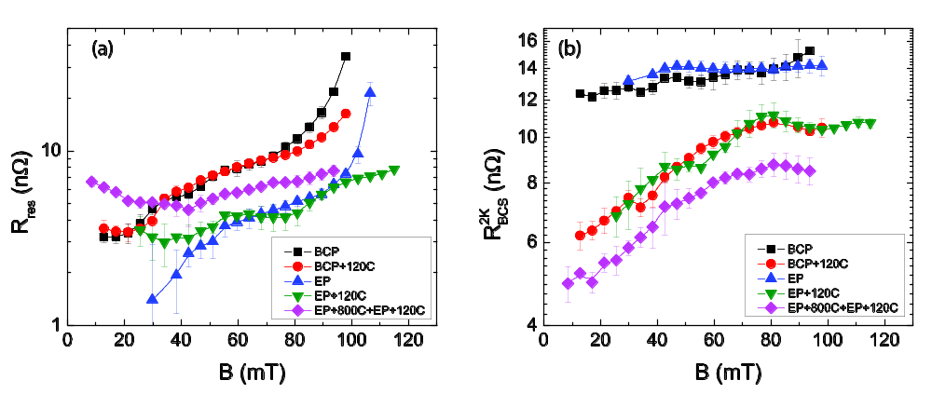
Plethora of insight – standard treatments
A. Romanenko and A. Grassellino, Appl. Phys. Lett. 102, 252603 (2013)
High field Q slope is due to Rres
Medium field Q slope is a combination of both Rres and Rbcs
Low field Q slope is due to Rres
Rbcs decreases but becomes strongly field dependent after 120C

Slide 25
Is RF surface temperature increase significant?
It was suggested that a “thermal feedback” may cause a slope in the Q0(E) curve since Rbcs(T)~1/T*exp(-const/T) – strongly T-dependent
  Trf increasing at higher fields=> Rbcs(Trf) increases => slope
Only thermal simulations based on Rs(H) from RF measurements were reported in the literature
  Kapitza resistance has a big uncertainty
B
Trf
Cavity wall
Heat flux= ½ Rs*H²
Tout
Helium bath @ Tbath
Trf > Tout > Tbath
T_{out} we can measure by T-mapping independently => only thermal conductivity needed to find Trf

Slide 26
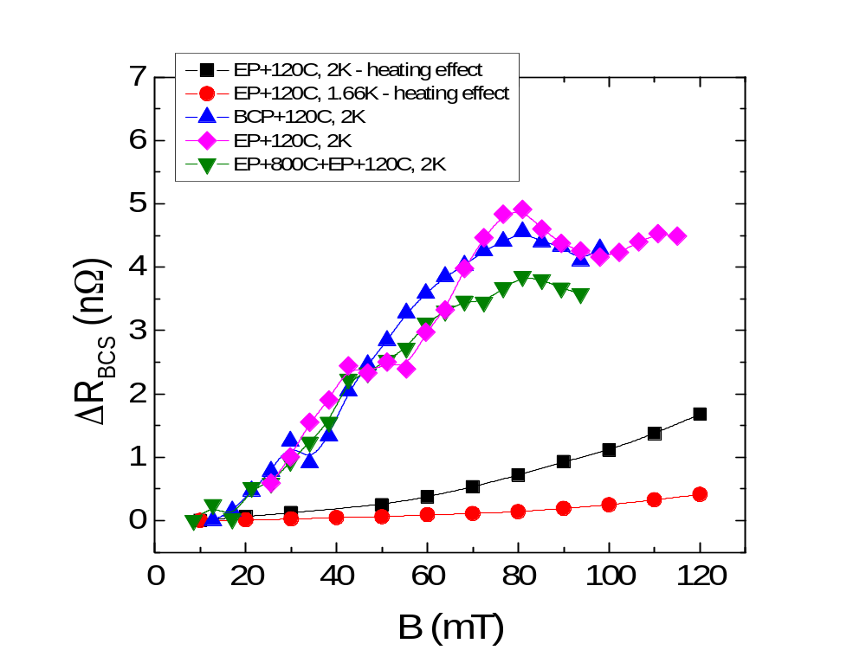
From combined T-map/RF measurements
Heating is negligible, Rbcs increase with field is a genuine effect
Thermal feedback does not explain the medium field Q slope

Slide 27
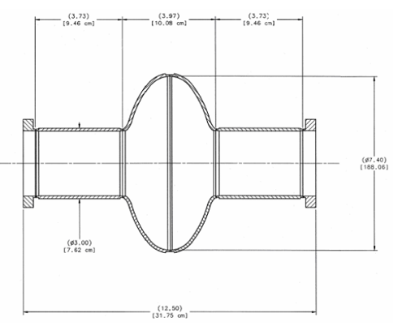
NOW RECALL: Only surface ~40-100 nm matter
Liquid Helium at T=2K
Niobium
3mm
Vacuum with RF fields
B_{a}=B₀e^{iωt}
~10 cm cavity length
B_{in}
λ(0)~40 nm
Inner surface nanostructure within ~ 40-100 nm completely determines RF losses in the cavity
3-5 nm
Nb₂O₅
B_{a}=B₀e^{iωt}
Λ

Slide 28
Progress in fundamental understanding utilizing advanced techniques
Microscopic details of Q-disease
Cause of the “high field Q slope”
Mechanism of 120C baking

Slide 29
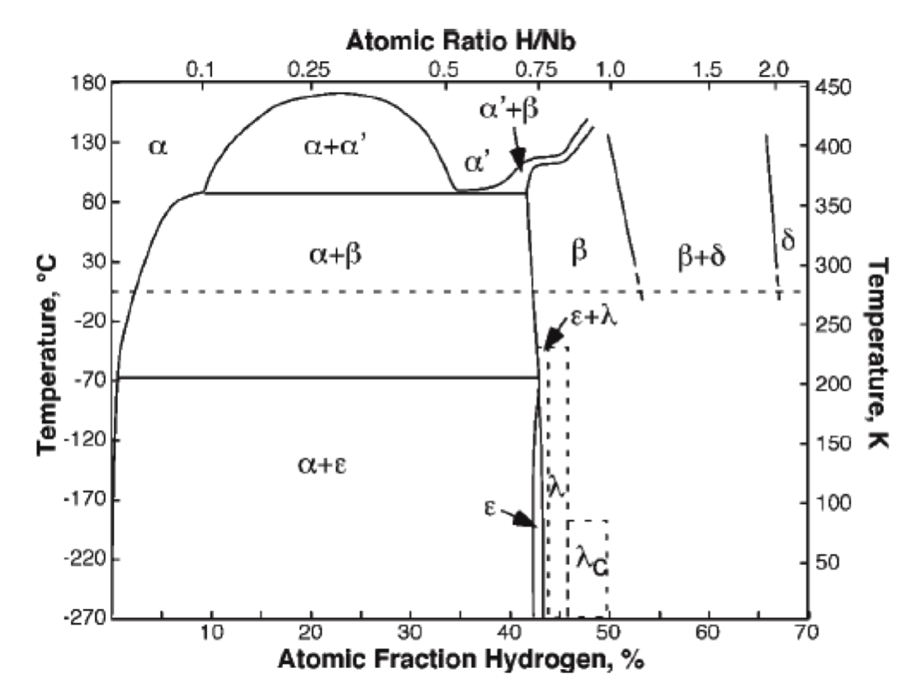
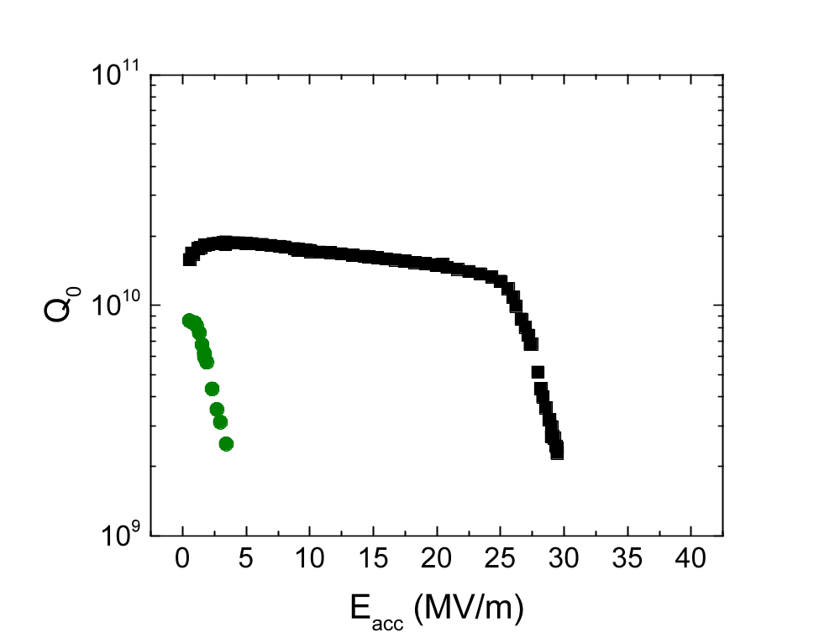
Topic #1: microscopic details of Q disease
#1: microscopic mechanism of “Q-disease”
Q disease
Nb-H phase diagram
Cavity cooling
Q-disease was proposed in the past to be caused by excess hydrogen, which forms non-superconducting niobium hydrides upon cooldown
  Remedy found – 600-800C vacuum anneal to degas hydrogen
  Microscopic details never established

Slide 30
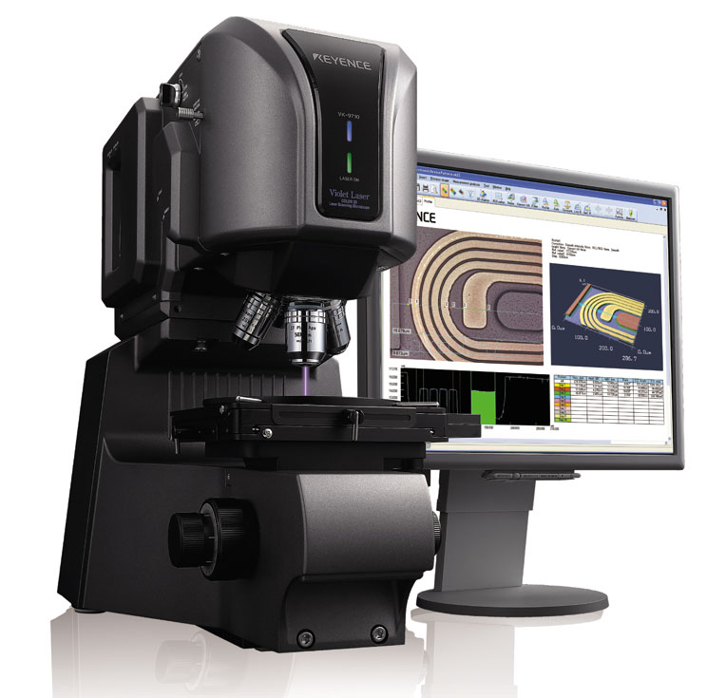
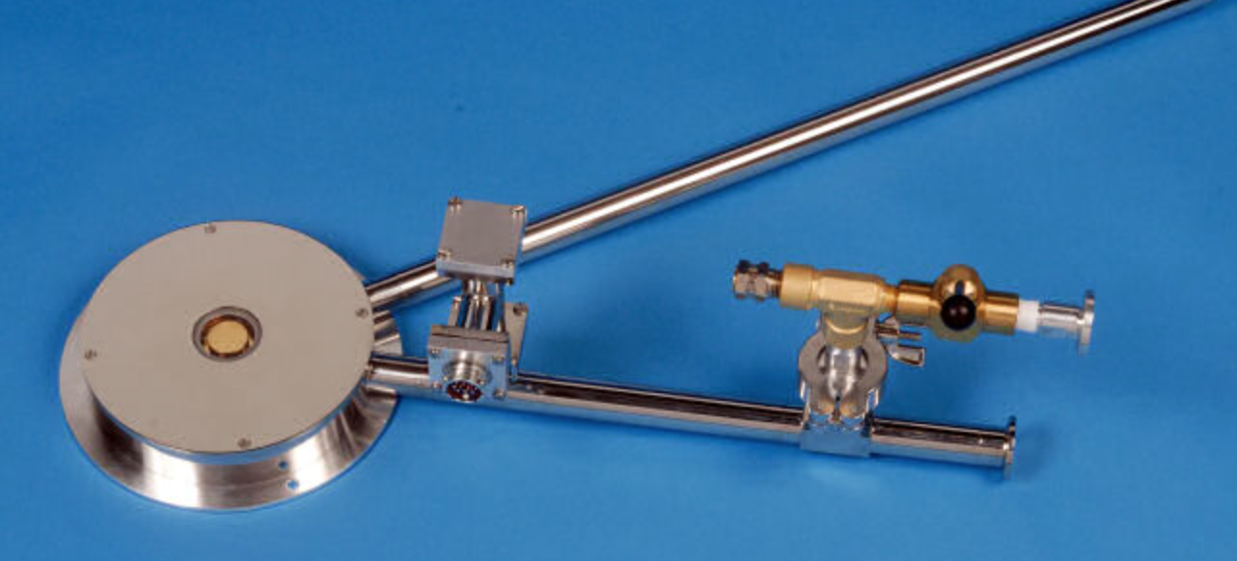
Microscopic mechanism of Q-disease
Possible to observe directly hydride formation in H-reach niobium samples using the cryostage in the laser confocal scanning microscope
F. Barkov et al, Phys. Rev. ST Accel. Beams 15, 122001 (2012)
F. Barkov et al, J. Appl. Phys. 114, 164904 (2013)

Slide 31
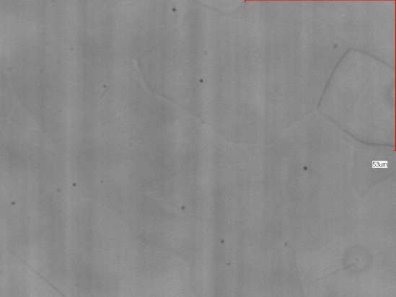
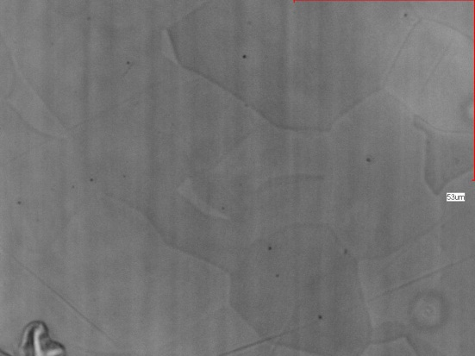
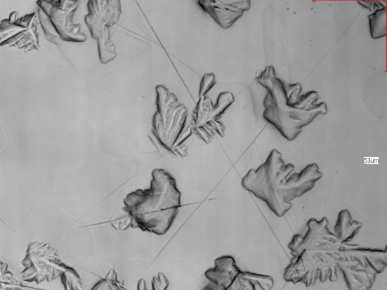
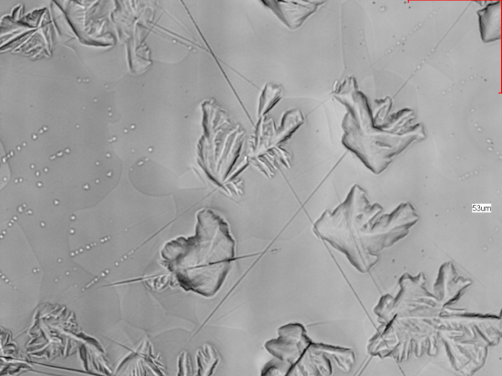
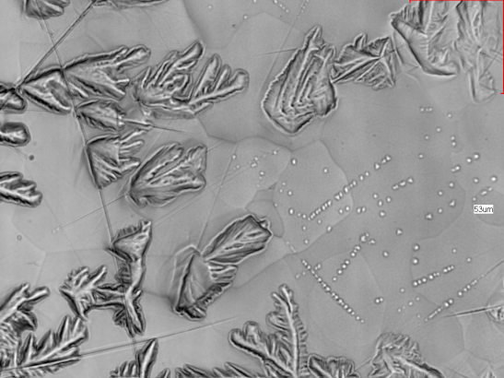
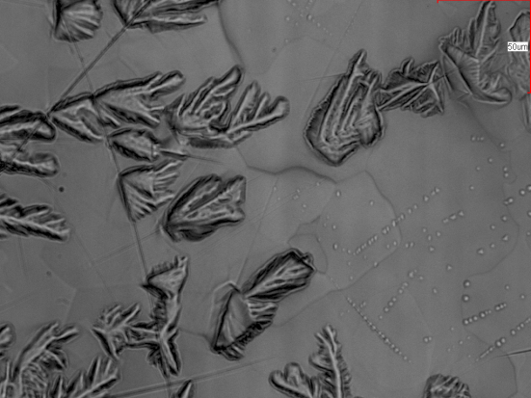
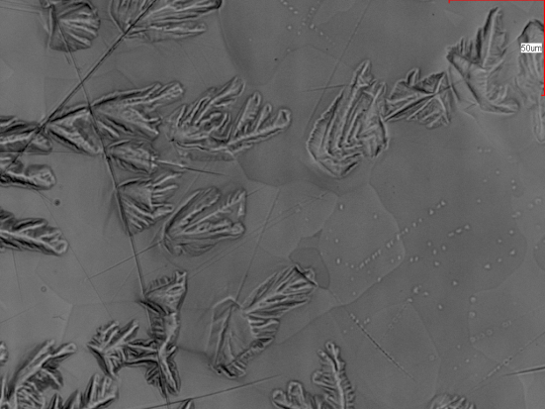
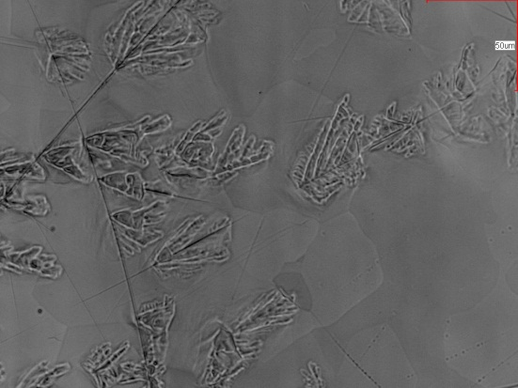
First cooldown
50 um
Hydrides first appear
T=300K
T=160K
T=140K
Second (smaller) phase of hydride forms
T=100K
T=6K
T=180K
Large phase starts to dissolve
Hydrides gone, dislocation skeleton (deformation) remains on the surface
T=210K
T=260K

Slide 32
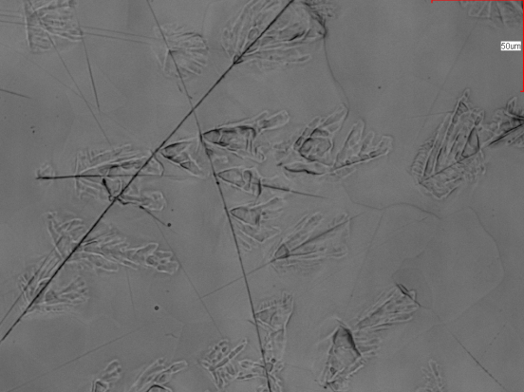
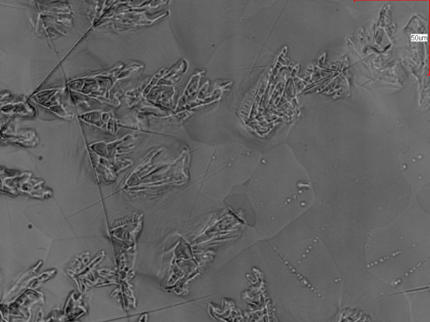
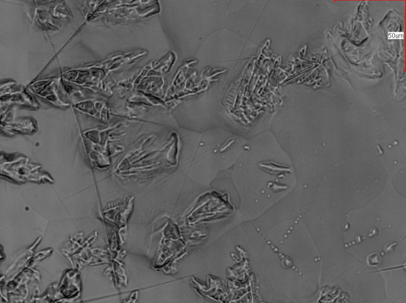
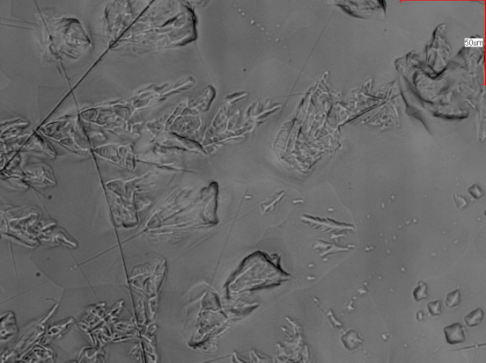
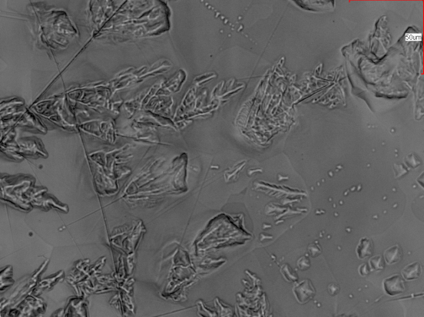
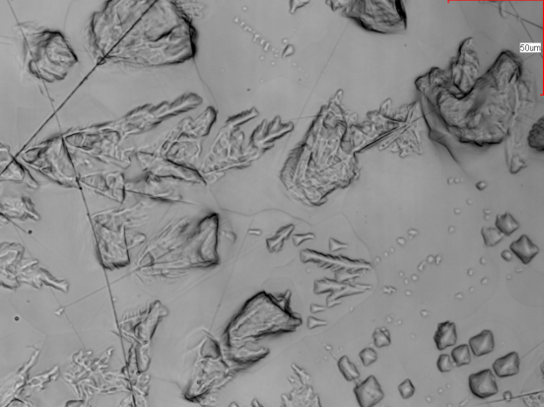
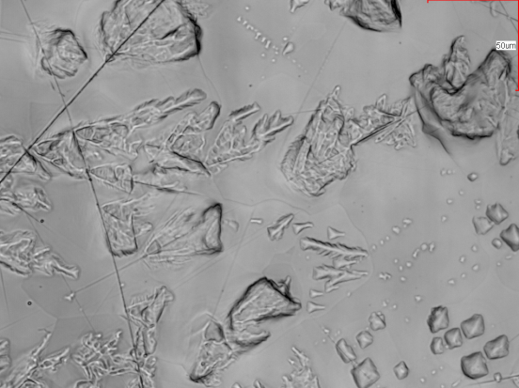
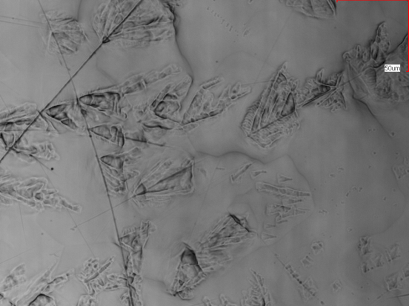
Second cooldown
Hydrides (both phases) now appear at higher T
300K
190K
180K
Second phase now growing larger
160K
140K
100K
Hydrides form much easier and at a higher temperature at both the “skeleton” left behind in the first cryocycle and at the locations of the second phase => cannot avoid Q-disease at 2nd cooldown
More “skeleton”
6K
300K

Slide 33
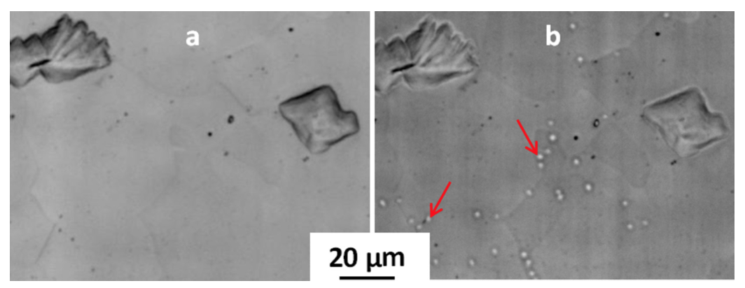
Small phase does NOT form in 120C baked niobium
Suggested possible involvement of H in the high field Q slope as well
F. Barkov et al, J. Appl. Phys. 114, 164904 (2013)

Slide 34
Progress in fundamental understanding
Microscopic details of Q-disease
Cause of the “high field Q slope”
Mechanism of 120C baking

Slide 35
Topic #2: origin of the “high field Q slope”
Hypothesis: can it be the Q-disease “in miniature” – same mechanism, but nanohydrides instead of micron-size ones?
Need free H near surface and enough time to precipitate during cooldown
Electropolished cavity
Too much H absorbed
#1: microscopic mechanism of “Q-disease”
#2: origin of the “high field Q slope”

Slide 36
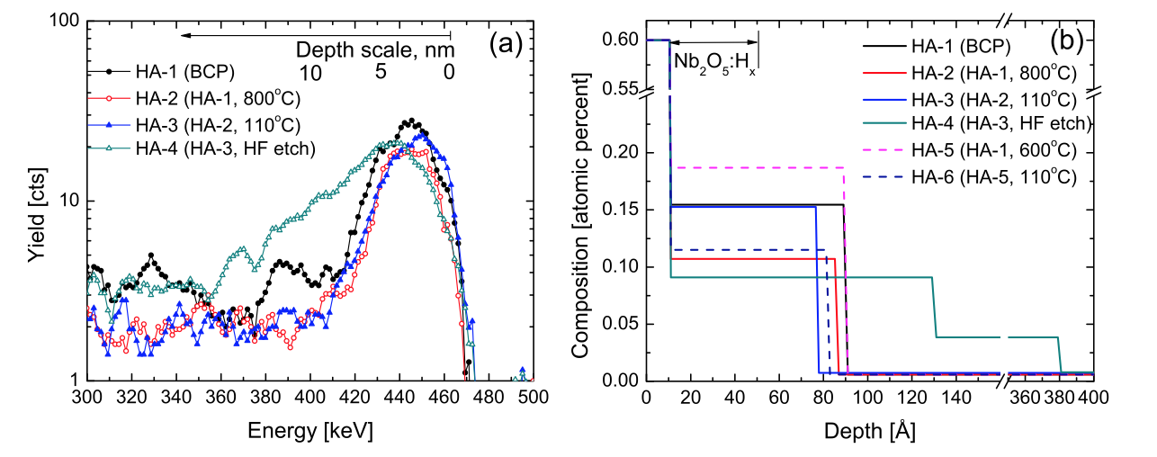
Near-surface H present even after 600-800C degasing
Almost impossible to remove all near-surface hydrogen
Q-disease is eliminated by the 600-800C H degassing (bulk H content drastically reduced), but the near-surface H-rich layer remains
A. Romanenko and L. V. Goncharova, 2011 Supercond. Sci. Tech. 24, 105017

Slide 37
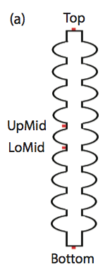
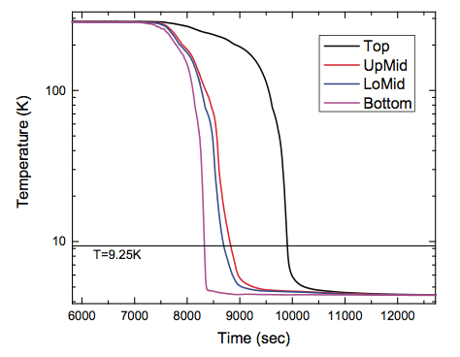
There is enough time for diffusion-controlled precipitation
Integrate the H diffusion over the time spent in the precipitation temperature range T < 160K => Diffusion length > 1 um
All free near-surface H has enough time to precipitate into normal conducting hydrides upon cooldown

Slide 38
Nanohydrides form upon cooldown
Not 120C baked sample
Oxide
Oxide
~50 nm
Interstitial hydrogen
Niobium hydrides
(non-superconducting)
“fast” cooldown
T= 300K
T= 2K

Slide 39
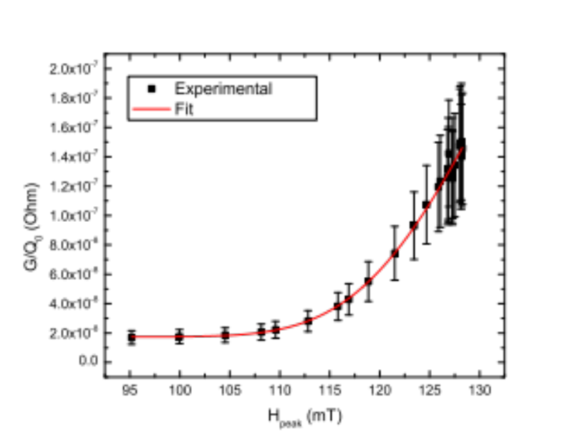
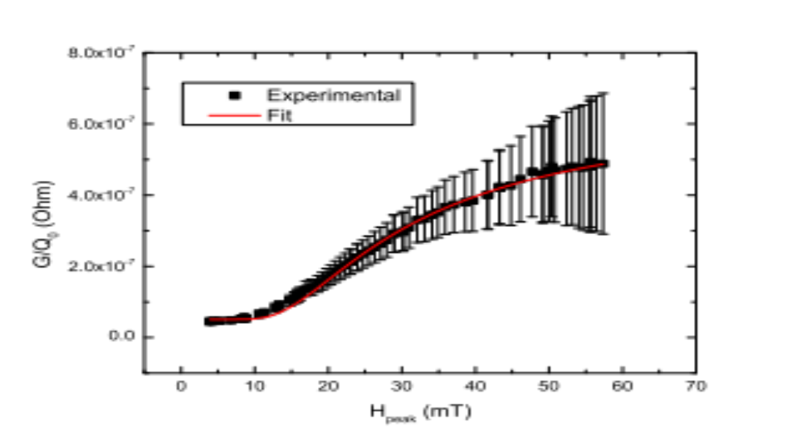
Proximity effect model of the “high field Q slope”
F_{H}
Cumulative distribution function of proximity-controlled breakdown fields of hydrides
R_{s}~ R₀ + R_{n} * F_{H}(H_{a})
Normal conducting hydrides of size d become superconducting by proximity effect up to the field H_{b} ~ 1/d
Shape is determined by the distribution of hydride critical fields H_{b}
H
Excellent fits
High field Q slope
Q disease
A. Romanenko, F. Barkov, L. D. Cooley, A. Grassellino, Supercond. Sci. Technol. 26 (2013) 035003

Slide 40
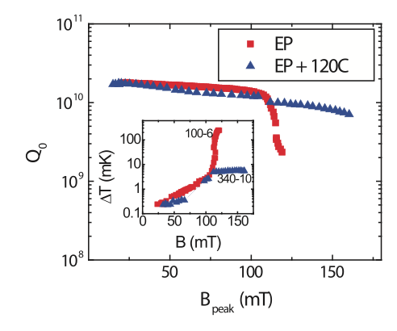


Temperature mapping
Array of 576 thermometers attached to the outside cavity walls allows mapping wall dissipation

Slide 41

Investigating cutouts
Extract samples from cavity walls locations identified by temperature mapping -> direct correlation of RF losses with material structure

Slide 42


TEM search for nanohydrides on cutouts
Identify samples based on T-map
Look at this area with subnanometer resolution in TEM at room AND T<100K temperatures
TEM
Y. Trenikhina et al, J. Appl. Phys. 117, 154507 (2015)

Slide 43






TEM sample preparation with focused ion beam IB – powerful method to fully analyze cross-section
Bulk of Nb
Lift out from the bulk
Sample on a Cu grid
SEM images during the FIB sample preparation
Pt protective layer
~3 μm
~10 μm
Cu grid

Slide 44


HRTEM imaging
Cold (baked)
Hot (not baked)
Pt layer
Pt layer
HRTEM: complicated defect structure in both cutouts

Slide 45




Room T phase in Hot and Cold spot
Hot (not baked) and Cold (baked) spot at room T
[113]
[011]
Nb a=3.33Å
@room T
[100]
[-111]
SAD, NED, SEND: only Nb at room T
H in solid solution (α-phase)

Slide 46






Cryogenic T comparison of cavity cutouts
SEND: diffraction mapping with low intensity beam
Hot (not baked) spot at 94K
120°C baked stop at 94K
ε
ε
β
β
Nb +ε,β
Nb
ε
ε+β
β
β
Nb
ε
ε
ε+β
ε+β
ε
ε
ε
ε
Nb+β(NbH)
ε
ε
ε
ε+β
ε
ε
ε
ε+β
Nb+ε(Nb4H3)
ε+β
β
ε
ε
_
_
_
_
NO Nb hydrides precipitation
Nb hydrides precipitation

Slide 47
Cryogenic T investigations of cavity cutouts
NED: diffraction with brighter beam, better S/N
Hot (not baked) at 94K
44%-68% probed
spots
~84-130 out
of 192 spots
120°C baked stop at 94K
26%-29%
probed spots
~49-55 out
of 192 spots
NED: Nb hydrides precipitation in all cutouts,
amount and/or size of NbHx is different

Slide 48

FIB sample and TEM image
TEM of FIB sample
SEM of FIB sample
Pt protective layer
Nb oxide
Pt protective layer
~3 μm
[001]
~10 μm
Cu grid
Nb bulk
200 nm

Slide 49

In addition: grain boundaries comparison
HRTEM image of GB: Hot
SEM image of GB
grain 1
Nb2O5
grain 2

Slide 50




Grain boundaries comparison
Cold
Hot
Nb2O5
HRTEM: No visible Nb2O5 oxide layer along GB

Slide 51
TEM evidence for nanohydrides
Measurements performed at Univ. of Illinois Urbana-Champaign
Direct nano-area electron diffraction (NED) phase characterization of the surface of the SRF cavity cutouts before and after in situ mild vacuum bake at room temperature and at 94K
Nb oxides
Room T: BCC Nb patterns, NO additional phases
NED probe
40 nm
Nb bulk
94K: stoichiometric Nb hydride phases!
TEM diffraction on cavity cutouts confirms the existence of nanohydrides
Supports the proximity effect model
[-111]
[-112]
Y. Trenikhina et al, J. Appl. Phys. 117, 154507 (2015)

Slide 52
Progress in fundamental understanding
Microscopic details of Q-disease
Cause of the “high field Q slope”
Mechanism of 120C baking

Slide 53
Topic #3: mechanism of the 120C baking
Electropolished cavity
Too much H absorbed
120C bake
#3: mechanism of the “120C baking”
#1: microscopic mechanism of “Q-disease”
#2: origin of the “high field Q slope”

Slide 54

Muon spin rotation at PSI (Switzerland)
B_{µ}
Contains physics
aG(t) ~ Muon Spin Polarization
Frequency – field amplitude
Damping – field non-uniformity

Slide 55


Muon spin rotation – measure B(z) directly
B(z)
Superconductor
in the Meissner State
B_{ext}
λ
z
0

Slide 56
120C bake leads to strong Meissner screening changes
A. Romanenko, A. Grassellino, F. Barkov, A. Suter, Z. Salman, T. Prokscha,
Appl. Phys. Lett. 104, 072601 (2014)
Heat treatment at 120C leads to the strong increase in the penetration depth
  Consistent with the depth-dependent mean free path decrease
Is also the first ever confirmation of non-locality in bulk niobium
  Textbook example
Baked at 120C
Unbaked

Slide 57
Positron annihilation Doppler broadening spectroscopy
S parameter corresponds to positron annihilation with valence electrons, W-> core electrons
S is sensitive to open-volume defects, W-to chemical surrounding at the annihilation site
Increase in S parameter indicates presence of vacancy defects

Slide 58
Positron annihilation studies on cavity cutouts
Collaboration with Bath University (UK) and Western University (Canada)
A. Romanenko, C. J. Edwardson, P. G. Coleman, P. J. Simpson, Appl. Phys. Lett. 102, 232601 (2013)
Fine grain
Large grain
BCP
EP
Positron annihilation spectroscopy: 120C baking results in “doping” of the first ~50 nm from the surface with vacancies
  So-called superabundant vacancy formation mechanism manifested in niobium [Y. Fukai and N. Okuma, Phys. Rev. Lett. 73, 1640 (1994)]

Slide 59
Effect of 120C baking
Oxide
Oxide
~50 nm
Free interstitial hydrogen
Hydrogen is trapped by vacancies
120C baking
T= 300K
T= 300K

Slide 60
Effect of 120C baking
Cooling down of 120C baked niobium
Oxide
Oxide
No/smaller hydrides are formed due to significant portion of hydrogen trapped
“fast” cooldown
T= 300K
T= 2K

Slide 61
TEM -> further evidence for 120C baking effect
Measurements performed at Univ. of Illinois Urbana-Champaign
Nb oxides
Room T: BCC Nb patterns, NO additional phases
NED probe
40 nm
Nb bulk
94K: stoichiometric Nb hydride phases
[-111]
[-112]
[001]
[011]
Hot spot: 44-68% of probed spots
Baked spot: 26-29% of probed spots
120C baking leads to the decrease in size/density of the nanohydrides

Slide 62
PART II: New Discoveries

Slide 63
Nitrogen doping

Slide 64

Nitrogen doping: a breakthrough in Q
Record after nitrogen doping – up to 4 times higher Q!
This was the highest Q possible up to 2012
Standard state-of-the art preparation
1.3 GHz
A. Grassellino et al, 2013 Supercond. Sci. Technol. 26 102001 (Rapid Communication) – highlights of 2013

Slide 65


Nitrogen doping
Injection of small nitrogen partial pressure at the end of 800C degassing-> drastic increase in Q
T=2K
A. Grassellino et al, 2013 Supercond. Sci. Technol. 26 102001 (Rapid Communication) – selected for highlights of 2013

Slide 66

N Doping – small deviation from standard ILC treatment
Example from FNAL 2/6 doping process:
Bulk EP
800 C anneal for 2 hours in vacuum
2 minutes @ 800C nitrogen diffusion
800 C for 6 minutes in vacuum
Vacuum cooling
5 microns EP
A. Grassellino et al, 2013 Supercond. Sci. Technol. 26 102001 (Rapid Communication)
Ship to DESY
Cavity after Equator Welding
HOM Tuning
X
EP 140 um
120C bake
Short HPR
Leak Check
External 20 um BCP
Final Assembly
XFEL
Long HPR
Ethanol Rinse
VT Assembly
800C HT Bake
Helium Tank Welding Procedure
RF Tuning
Long HPR
EP 40 um
Ethanol Rinse
HPR

Slide 67


Material level understanding

Slide 68

“Production” recipe for LCLS-II – 9-cells for prototype cryomodule(s)
A. Grassellino et al, IPAC’15

Slide 69




Statistics for two doping recipes on 1.3 GHz 9-cells
Recipe 2/6
16 MV/m
2.7e10
Data from FNAL/JLab
<Q>=3.6e10
<E_{max}>=22.2 MV/m
E_{max}median=22.8MV/m
Recipe 20/30
Data from Cornell/Jlab/FNAL
<Q>=3.24e10
<E_{max}>=16.3 MV/m
E_{max}median=16.5MV/m

Slide 70


“Reversed” field dependence of R_{BCS}
R_{s}(T) = R_{BCS}(T)+R_{res}
Origin of the anti-Q-slope
A. Grassellino et al, 2013 Supercond. Sci. Technol. 26 102001 (Rapid Communication)

Slide 71
What is BCS missing?
B.P. Xiao, C. Reece, M. J. Kelley from JLab and College of William and Mary
  Momentum of Cooper pairs leads to an inversed field dependence of R_{BCS}?
  [B.P. Xiao et al, Physica C 490 (2013) 26-31]
A. Gurevich from ODU
  Time-dependent density of states leads to the effect?
  [A. Gurevich, Phys. Rev. Lett. 113, 087001 (2014)]

Slide 72


Muon spin rotation – nitrogen doping
Use variable energy muons, which stop in the first ~100nm
~15 nm - no screening
mfp ~ 2 nm at the surface, increasing deeper
mfp~40 nm
mfp > 400 nm
BCP and EP unbaked -> strong screening, excellent fit provided by the clean limit Pippard/BCS model
EP+120C bake-> strongly suppressed m.f.p., gradient of the m.f.p. from the surface, dirty limit
N-doped -> intermediate m.f.p., no gradient
Ba = 25 mT

Slide 73

Non-equilibrium superconductivity – another possible mechanism?
Quasiparticle distribution deviates from thermal equilibrium and changes the “BCS” surface resistance
  Photon absorption (surface resistance source) is the cause of deviation
Effect in Al:
P. J. de Visser et al, Phys. Rev. Lett. 112, 047004 (2014)

Slide 74

Doping of 650 MHz -> Q=7e10 at 2K, 17 MV/m
Applying N doping to 650 MHz cavities leads to much higher Qs than with EP+120C
Should be further improved if 1.3 GHz results are directly scaled -> Q~1e11 at 2K
1-cell
Doping for other frequencies -> a lot to be explored

Slide 75
Meissner expulsion strongly affected by cooling

Slide 76


Proposed role of thermal currents in thermal cycling effect on Q
J.-M. Vogt, O. Kugeler, and J. Knobloch, Phys. Rev. ST Accel. Beams 16, 102002 (2013)
Thermal currents were proposed to play a major role in change of the residual resistance of a dressed BCP cavity due to thermal cycling
  Original recommendation – cool down slow and uniform through Tc to minimize the effect

Slide 77



FNAL discovery – Meissner expulsion
Single grain EP
N doped
By only varying the “speed” of cavity cooling through T_{c}=9.25K the residual surface resistance can be systematically and reversibly varied
Fine grain EP
A. Romanenko, A. Grassellino, O. Melnychuk, D. A. Sergatskov, J. Appl. Phys. 115, 184903 (2014)

Slide 78

Meissner effect
Normal
Superconducting

Slide 79


Magnetic probes – key diagnostics
Fluxgate magnetometers and thermometers on cavities during fast/slow cooldowns allowed us to discover the subtle underlying effect
mG
H=5mG
Field enhancement
due to Meissner effect – ambient flux expulsion
Fluxgate
magnetometers

Slide 80

Typical same magnetic probe reading for fast/slow cooling
Efficient flux expulsion
Poor flux expulsion

Slide 81

FNAL: Minimizing residual resistance (maximize Q) by avoiding the ambient magnetic flux to be trapped
Same cavity, just cooled differently through 9.2K
Flux expelled efficiently
Flux mostly trapped
2K, 1.3 GHz

Slide 82

Differences between fast/slow
#1: Difference in geometry of transition

Slide 83

Driving parameter of expulsion
A. Romanenko, A. Grassellino, A. C. Crawford, D. A. Sergatskov, and O. Melnychuk, Appl. Phys. Lett. 105, 234103 (2014)
Temperature difference at the phase front (dT/dx)

Slide 84

Observing fast and slow cooldown dynamics

Slide 85


Fast and slow cooldown dynamics captured
Fast from 300K
Slow from 12K
Top
Bottom
M. Martinello, M. Checchin - PhD work

Slide 86
Fast cooldown

Slide 87


Slide 88


Slide 89


Slide 90


Slide 91


Slide 92


Slide 93


Slide 94


Slide 95
Slow cooldown – encircling normal areas

Slide 96


Slide 97


Slide 98


Slide 99


Slide 100


Slide 101


Slide 102


Slide 103


Slide 104


Slide 105


Slide 106


Slide 107


Slide 108


Slide 109


Slide 110


Slide 111


Slide 112


Slide 113


Slide 114


Slide 115


Slide 116


Slide 117


Slide 118


Slide 119


Slide 120


Slide 121


Slide 122


Slide 123


Slide 124


Slide 125


Slide 126


Slide 127


Slide 128

Utilizing new physics for record high Qs
Combination of nitrogen doping and efficient flux expulsion =>
Record high Q >1e11 up to 28 MV/m in SRF cavities
1.5K, 1.3GHz 1-cell
Ambient magnetic fields are fully expelled
A. Romanenko, A. Grassellino, A. C. Crawford, D. A. Sergatskov, and O. Melnychuk, Appl. Phys. Lett. 105, 234103 (2014)

Slide 129
One more limit to push..!

Slide 130

FINAL: Non-accelerator applications: SRF for qubits
Single photons vs MV/m
  Ultralow field and temperature limit
    We did not explore it in SRF before
Where does the “low field Q slope” end?
What is the Q at single-photon field levels?

Slide 131
Final remarks
Exciting times – a lot to study/discover
I hope you will now be better prepared for the fundamental R&D talks and hot topics

Slide 132
Acknowledgments
All previous tutorial speakers
FNAL SRF science team

