Slide 1

First experimental signature of the Giant Pairing Vibration in ¹⁴C and ¹⁵C nuclei
Diana Carbone
DREB2016 9th International conference on Direct Reactions with Exotic Beams July 11 – 15, 2016, Halifax, Canada

Slide 2
Outline
Searching for the Giant Pairing Vibration with two-neutron transfer reactions between heavy nuclei
Summary of the GPV features and history
First experimental signature of the GPV
¹²C(¹⁸O,¹⁶O)¹⁴C and ¹³C(¹⁸O,¹⁶O)¹⁵C reactions @ 84 MeV
GPV signatures: energy, width, cross section, angular distributions
Preliminary results about new experiments with MAGNEX: (¹⁸O,¹⁶O) reactions @ 270 MeV
¹²⁰Sn(p,t)¹¹⁸Sn reaction @ 35 MeV
DREB2016 9th International conference on Direct Reactions with Exotic Beams July 11 – 15, 2016, Halifax, Canada

Slide 3
What is the Giant Pairing Vibration?
Predicted for the first time in 1977 by Broglia and Bes starting from the quantum symmetry between particles and holes
R.A. Broglia and D. Bes PLB 69 (1977) 129
Collective excitation of a pair across major shell
Analogous to Giant Resonances
L = 0 two-nucleon transfer reactions should populate it
(GDR, GQR)
Giant Resonances
Collective p-h excitations
Giant Pairing Vibrations (GPV)
Collective p-p or h-h excitations
DREB2016 9th International conference on Direct Reactions with Exotic Beams July 11 – 15, 2016, Halifax, Canada

Slide 4
GPV: an old story
Theoretical studies:
First theoretical predictions limited to heavy nuclei (Sn and Pb isotopes)
Use of weakly bound projectiles (as the (⁶He,⁴He) reactions)
Recent predictions on light nuclei (oxygen isotopes) by cQRPA calculations
R.A. Broglia and D. Bes PLB 69 (1977) 129-133
L.Fortunato et al. EPJ A14, 37-42(2002)
W.von Oertzen and A.Vitturi,Rep.Prog.Phys.64 (2001) 1247
L.Fortunato, Phys.of Atomic Nuclei,Vol.66 (2003) 1445
E.Khan et al. PRC 69 (2004) 014314
B.Avez et al. PRC 78 (2008) 044318
GPV predicted features
Excitation Energy ~ 20 MeV with respect to the unperturbed nucleus
Cross section comparable to that of the g.s. pairing vibration
L = 0 angular momentum transfer
FWHM no specific predictions, hypothesis of ~ 1-2 MeV
DREB2016 9th International conference on Direct Reactions with Exotic Beams July 11 – 15, 2016, Halifax, Canada

Slide 5
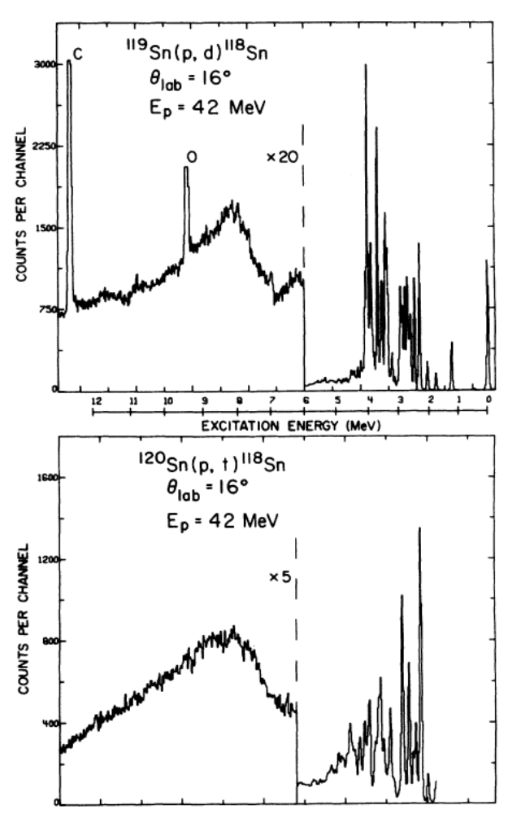
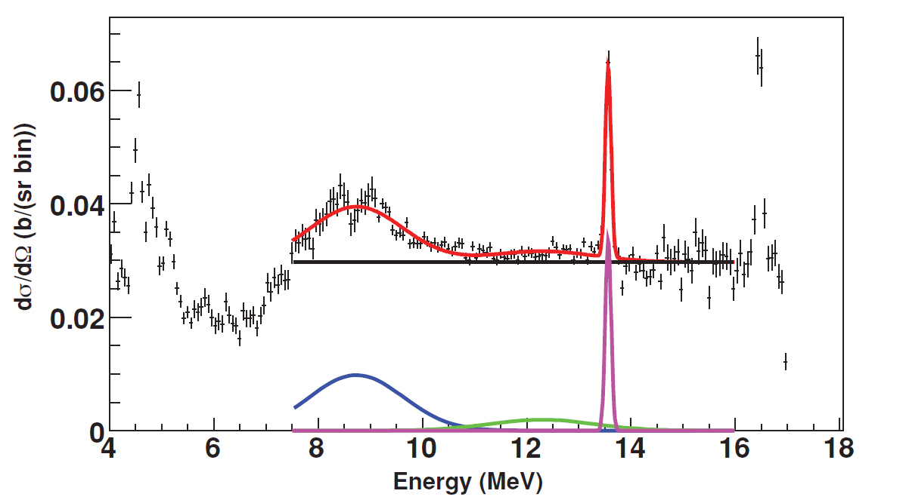
Unsuccessful experimental attempts
The ¹²⁰Sn(p,t)¹¹⁸Sn reaction
Small structure around 12 MeV
¹²⁰Sn(p,t)¹¹⁸Sn @ 50 MeV
B. Mouginot et al. PRC 83 (2011) 037302
Deep hole state → pickup of 2 neutrons which leaves 2 holes in deep-lying orbits
(ex. 1g_{9/2}, 2p_{3/2}, 2p_{1/2})
G.M. Crawley et al. PRL 39 (1977) 1451
G.M. Crawley et al. PRC 23 (1981) 689
DREB2016 9th International conference on Direct Reactions with Exotic Beams July 11 – 15, 2016, Halifax, Canada

Slide 6
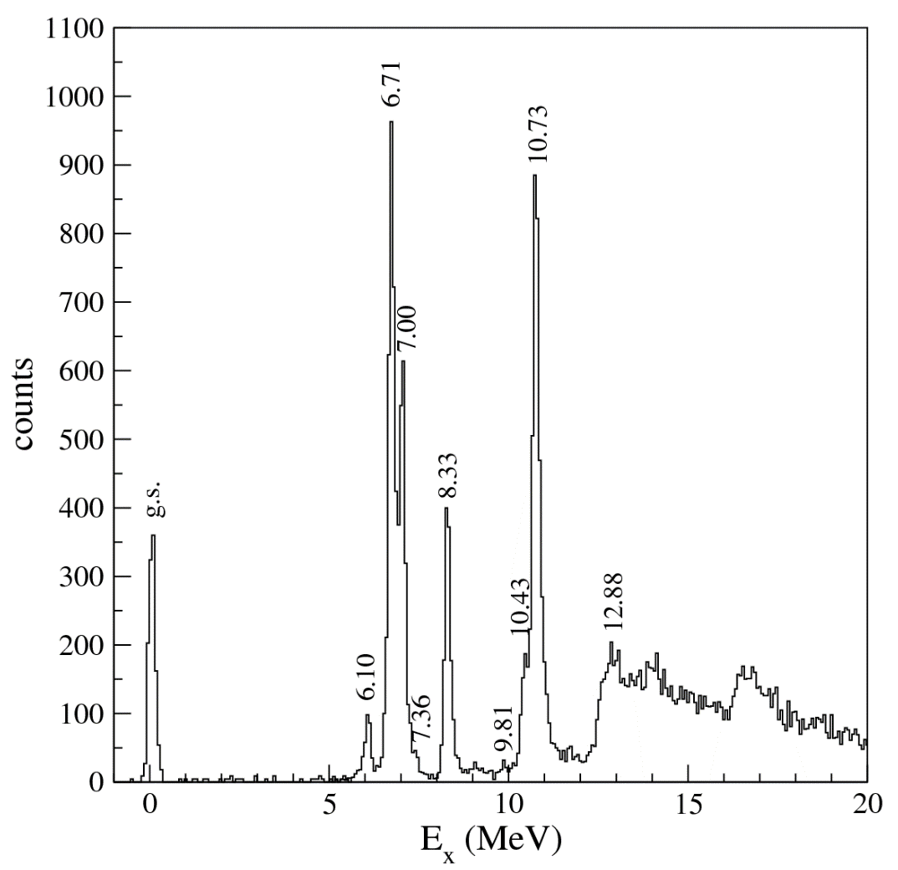
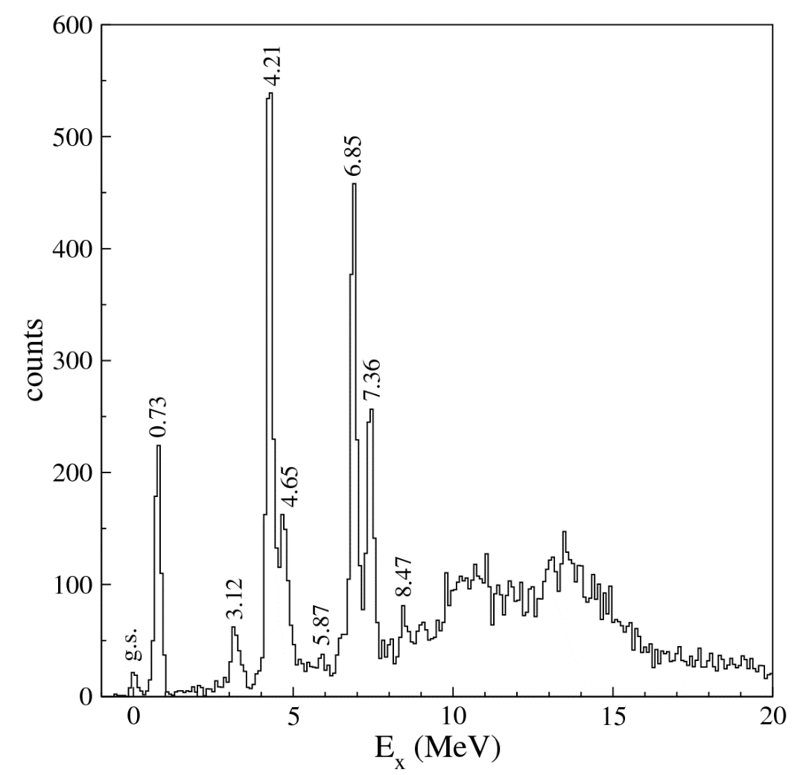
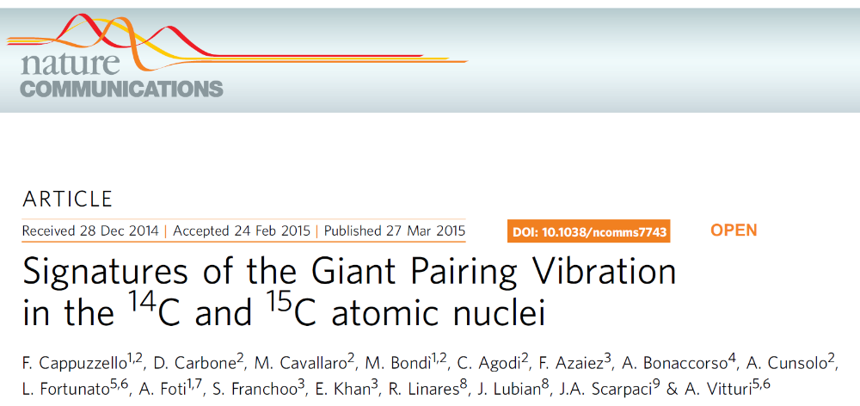
First experimental evidence
¹²C(¹⁸O,¹⁶O)¹⁴C and ¹³C(¹⁸O,¹⁶O)¹⁵C reactions @ 84 MeV
¹⁴C
¹⁵C
GPV
GPV
D. Carbone, EPJ Plus (2015) 130:143
DREB2016 9th International conference on Direct Reactions with Exotic Beams July 11 – 15, 2016, Halifax, Canada

Slide 7
Difficulties in observing the GPV
GPV population requires L = 0 transfer
Transfer reactions large angular momentum transferred
Brink’s matching conditions
In heavy nuclei the level density is very high already at low energy, thus making the identification of such modes very hard
Melting of the GPV peak in heavy ions due to the large widths of the unbound low orbital angular momentum states
$$ΔL={(λ}_{2}−λ_{1})+\frac{1}{2}k_{0}\left(R_{1}−R_{2}\right)+Q_{eff}R/{ℏv}≈0$$
D.M. Brink PLB 40 (1972) 37
M. Laskin et al. PRC 93 (2016) 034321
(¹⁸O,¹⁶O) reactions on light nuclei:
good candidates to populate the GPV
Low L transfer favoured by Brink’s matching conditions
Compromise between the level density and the collectivity
Preformed neutron pair in ¹⁸O
Very low polarizability of ¹⁶O core
DREB2016 9th International conference on Direct Reactions with Exotic Beams July 11 – 15, 2016, Halifax, Canada

Slide 8
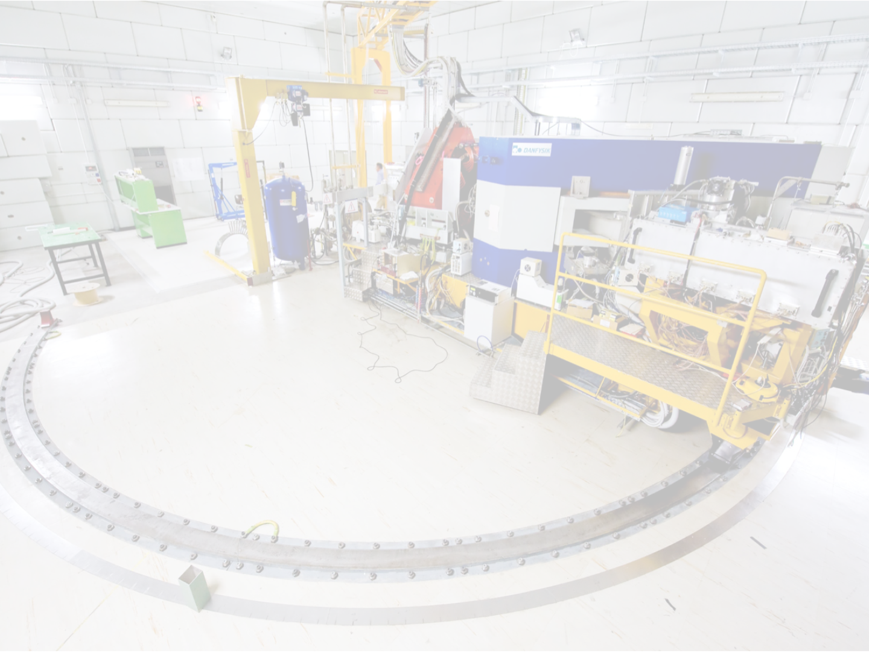
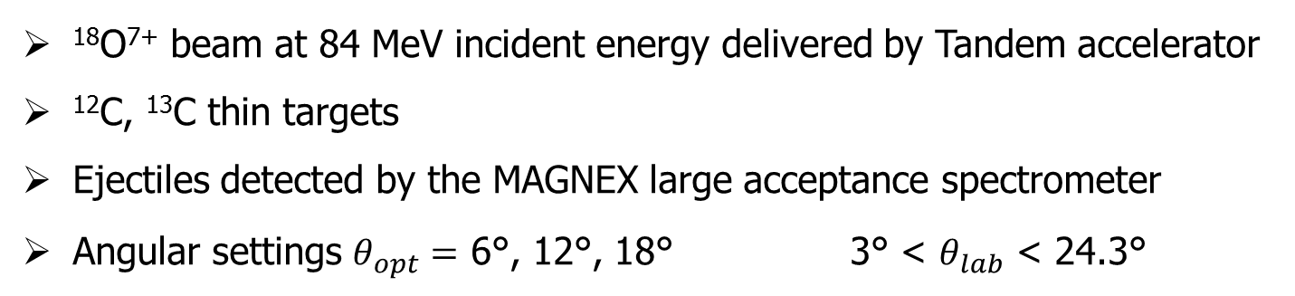
Experimental setup @ INFN-LNS
¹⁸O⁷⁺ beam at 84 MeV incident energy delivered by Tandem accelerator
¹²C, ¹³C thin targets
Ejectiles detected by the MAGNEX large acceptance spectrometer
Angular settings $θ_{opt}=$ 6°, 12°, 18° 3° < $θ_{lab}$ < 24.3°
MAGNEX spectrometer
Optical characteristics | Actual values
Maximum magnetic rigidity (Tm) | 1.8
Solid angle (msr) | 50
Momentum acceptance | -14%, +10%
Momentum dispersion | 3.68
First order momentum resolution | 5400
Good compensation of
the aberrations:
Trajectory reconstruction
Measured resolutions:
Energy ΔE/E ∼ 1/1000
Angle Δθ ∼ 0.3°
Mass Δm/m ∼ 1/160
F. Cappuzzello et al. Eur. Phys. J A (2016) 52:167
DREB2016 9th International conference on Direct Reactions with Exotic Beams July 11 – 15, 2016, Halifax, Canada

Slide 9
Energy spectra
¹²C(¹⁸O,¹⁶O)¹⁴C
¹³C(¹⁸O,¹⁶O)¹⁵C
S_{2n} = 13.12 MeV
S_{2n} = 9.35 MeV
GPV
GPV
9° < θ_{lab} < 10°
Energy resolution ~ 200 keV
DREB2016 9th International conference on Direct Reactions with Exotic Beams July 11 – 15, 2016, Halifax, Canada

Slide 10
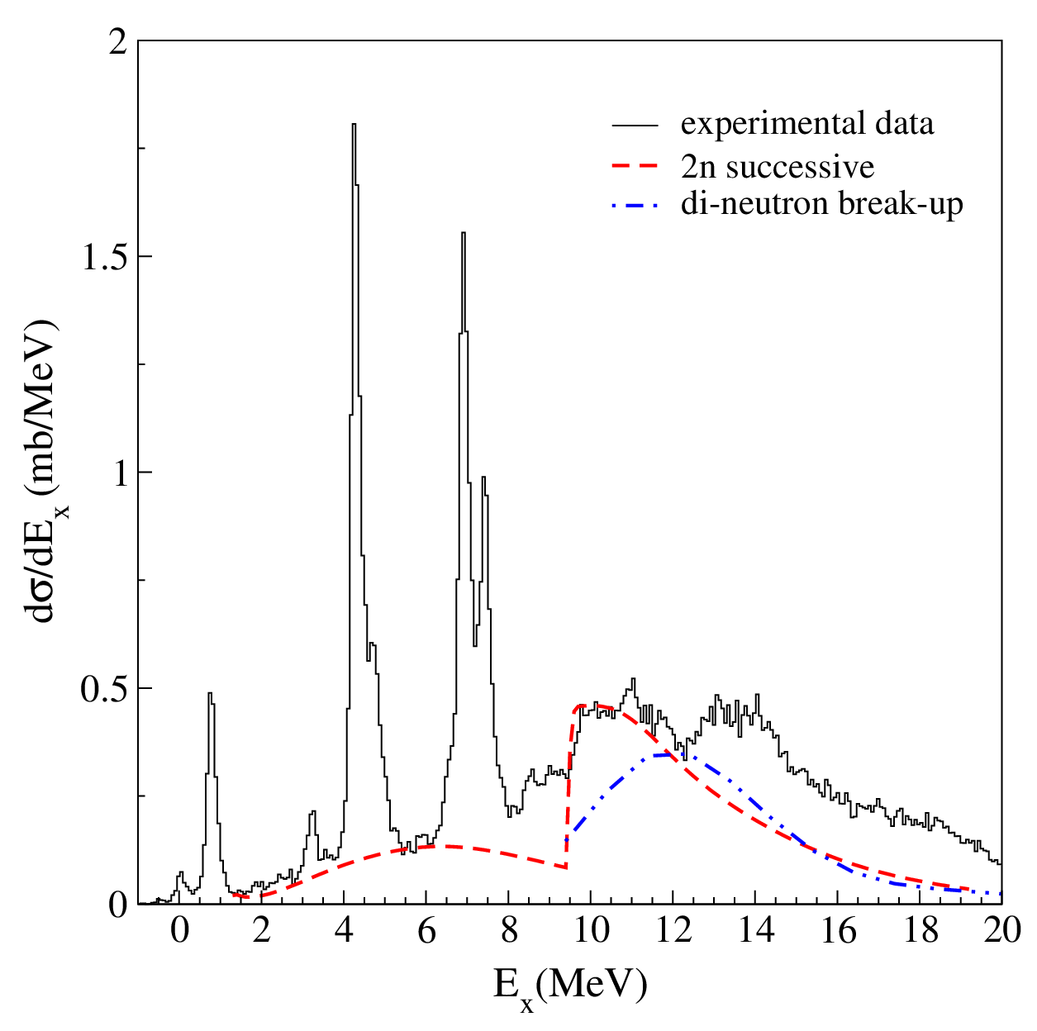
Projectile break-up contribution
¹³C(¹⁸O,¹⁶O)¹⁵C @ 7° < θ_{lab}<17°
Two independent semi-classical models
1) Towing of a di-neutron system
Extreme hypothesis of the removal of a di-neutron from projectile
TDSE approach
2) Removal of two independent neutrons from the projectile
Transfer to the continuum of the target+n+n
Two-step mechanism
No n-n correlations
Optical model S-matrix for the n-target interaction
J.A. Scarpaci et al., PLB 428 (1998) 241
GPV
F. Cappuzzello et al., PLB 711 (2012) 347
C. Rea, Master Thesis, Pisa 2010
Applied to the ⁹Be(¹⁸O,¹⁷O)¹⁰Be case
D. Carbone et al., PRC 90 (2014) 064621
The ¹⁵C bump at 13.7 ± 0.1 MeV is not reproduced
Similar results for ¹⁴C case
DREB2016 9th International conference on Direct Reactions with Exotic Beams July 11 – 15, 2016, Halifax, Canada

Slide 11
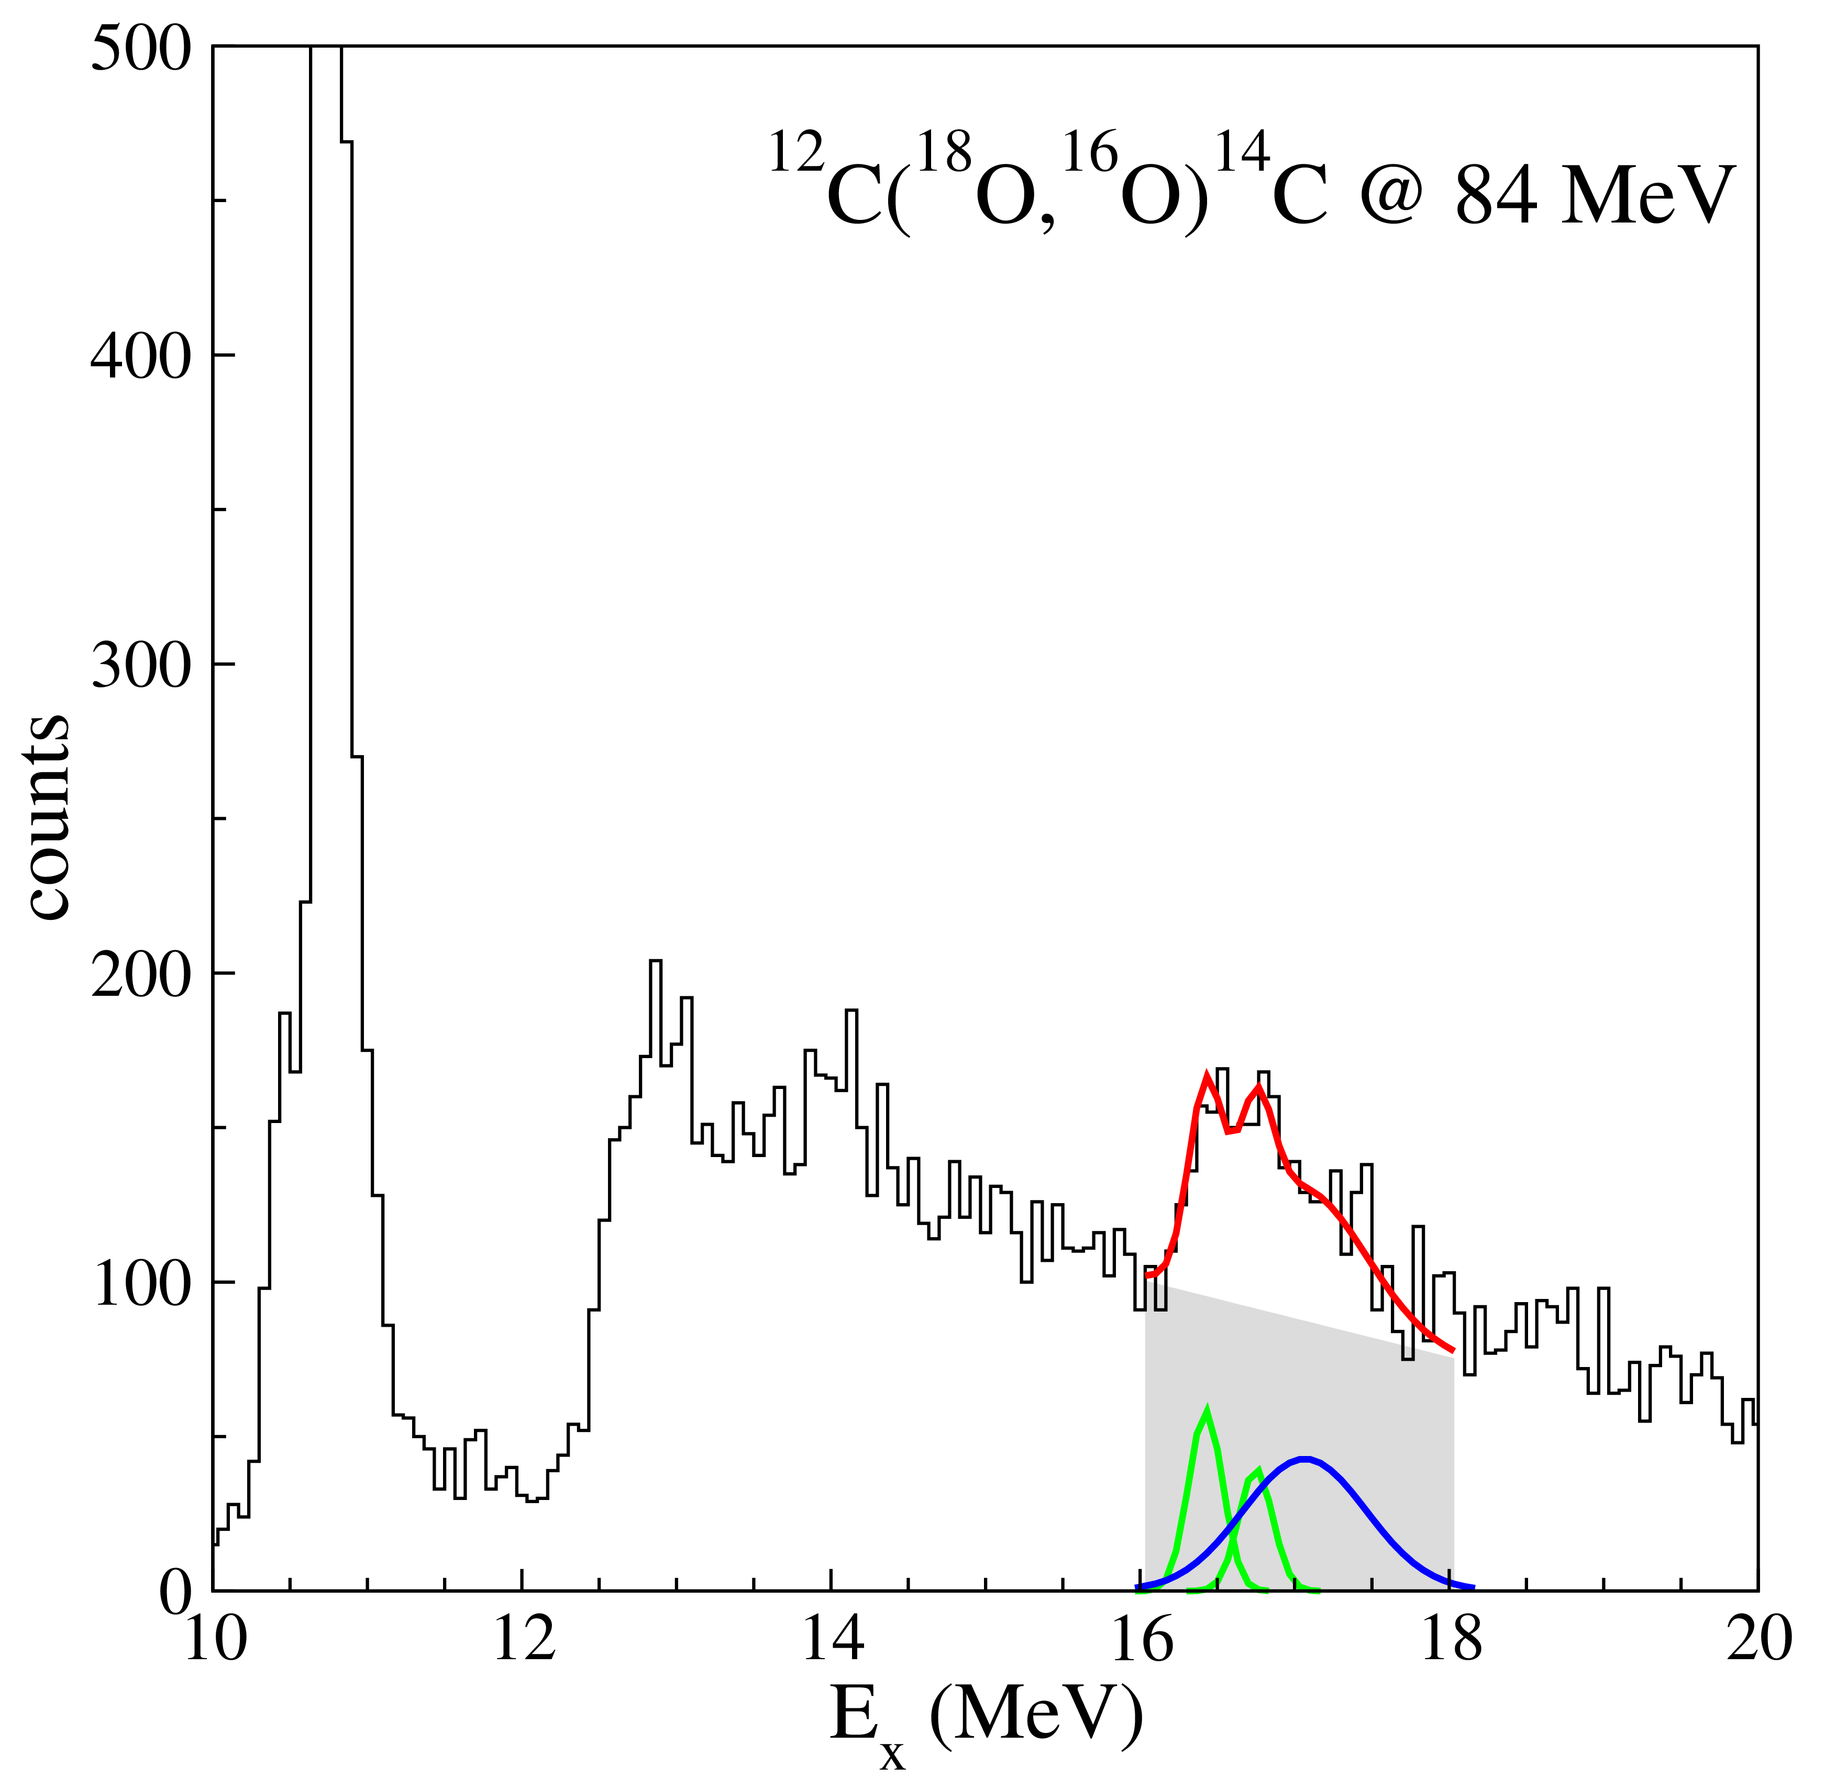
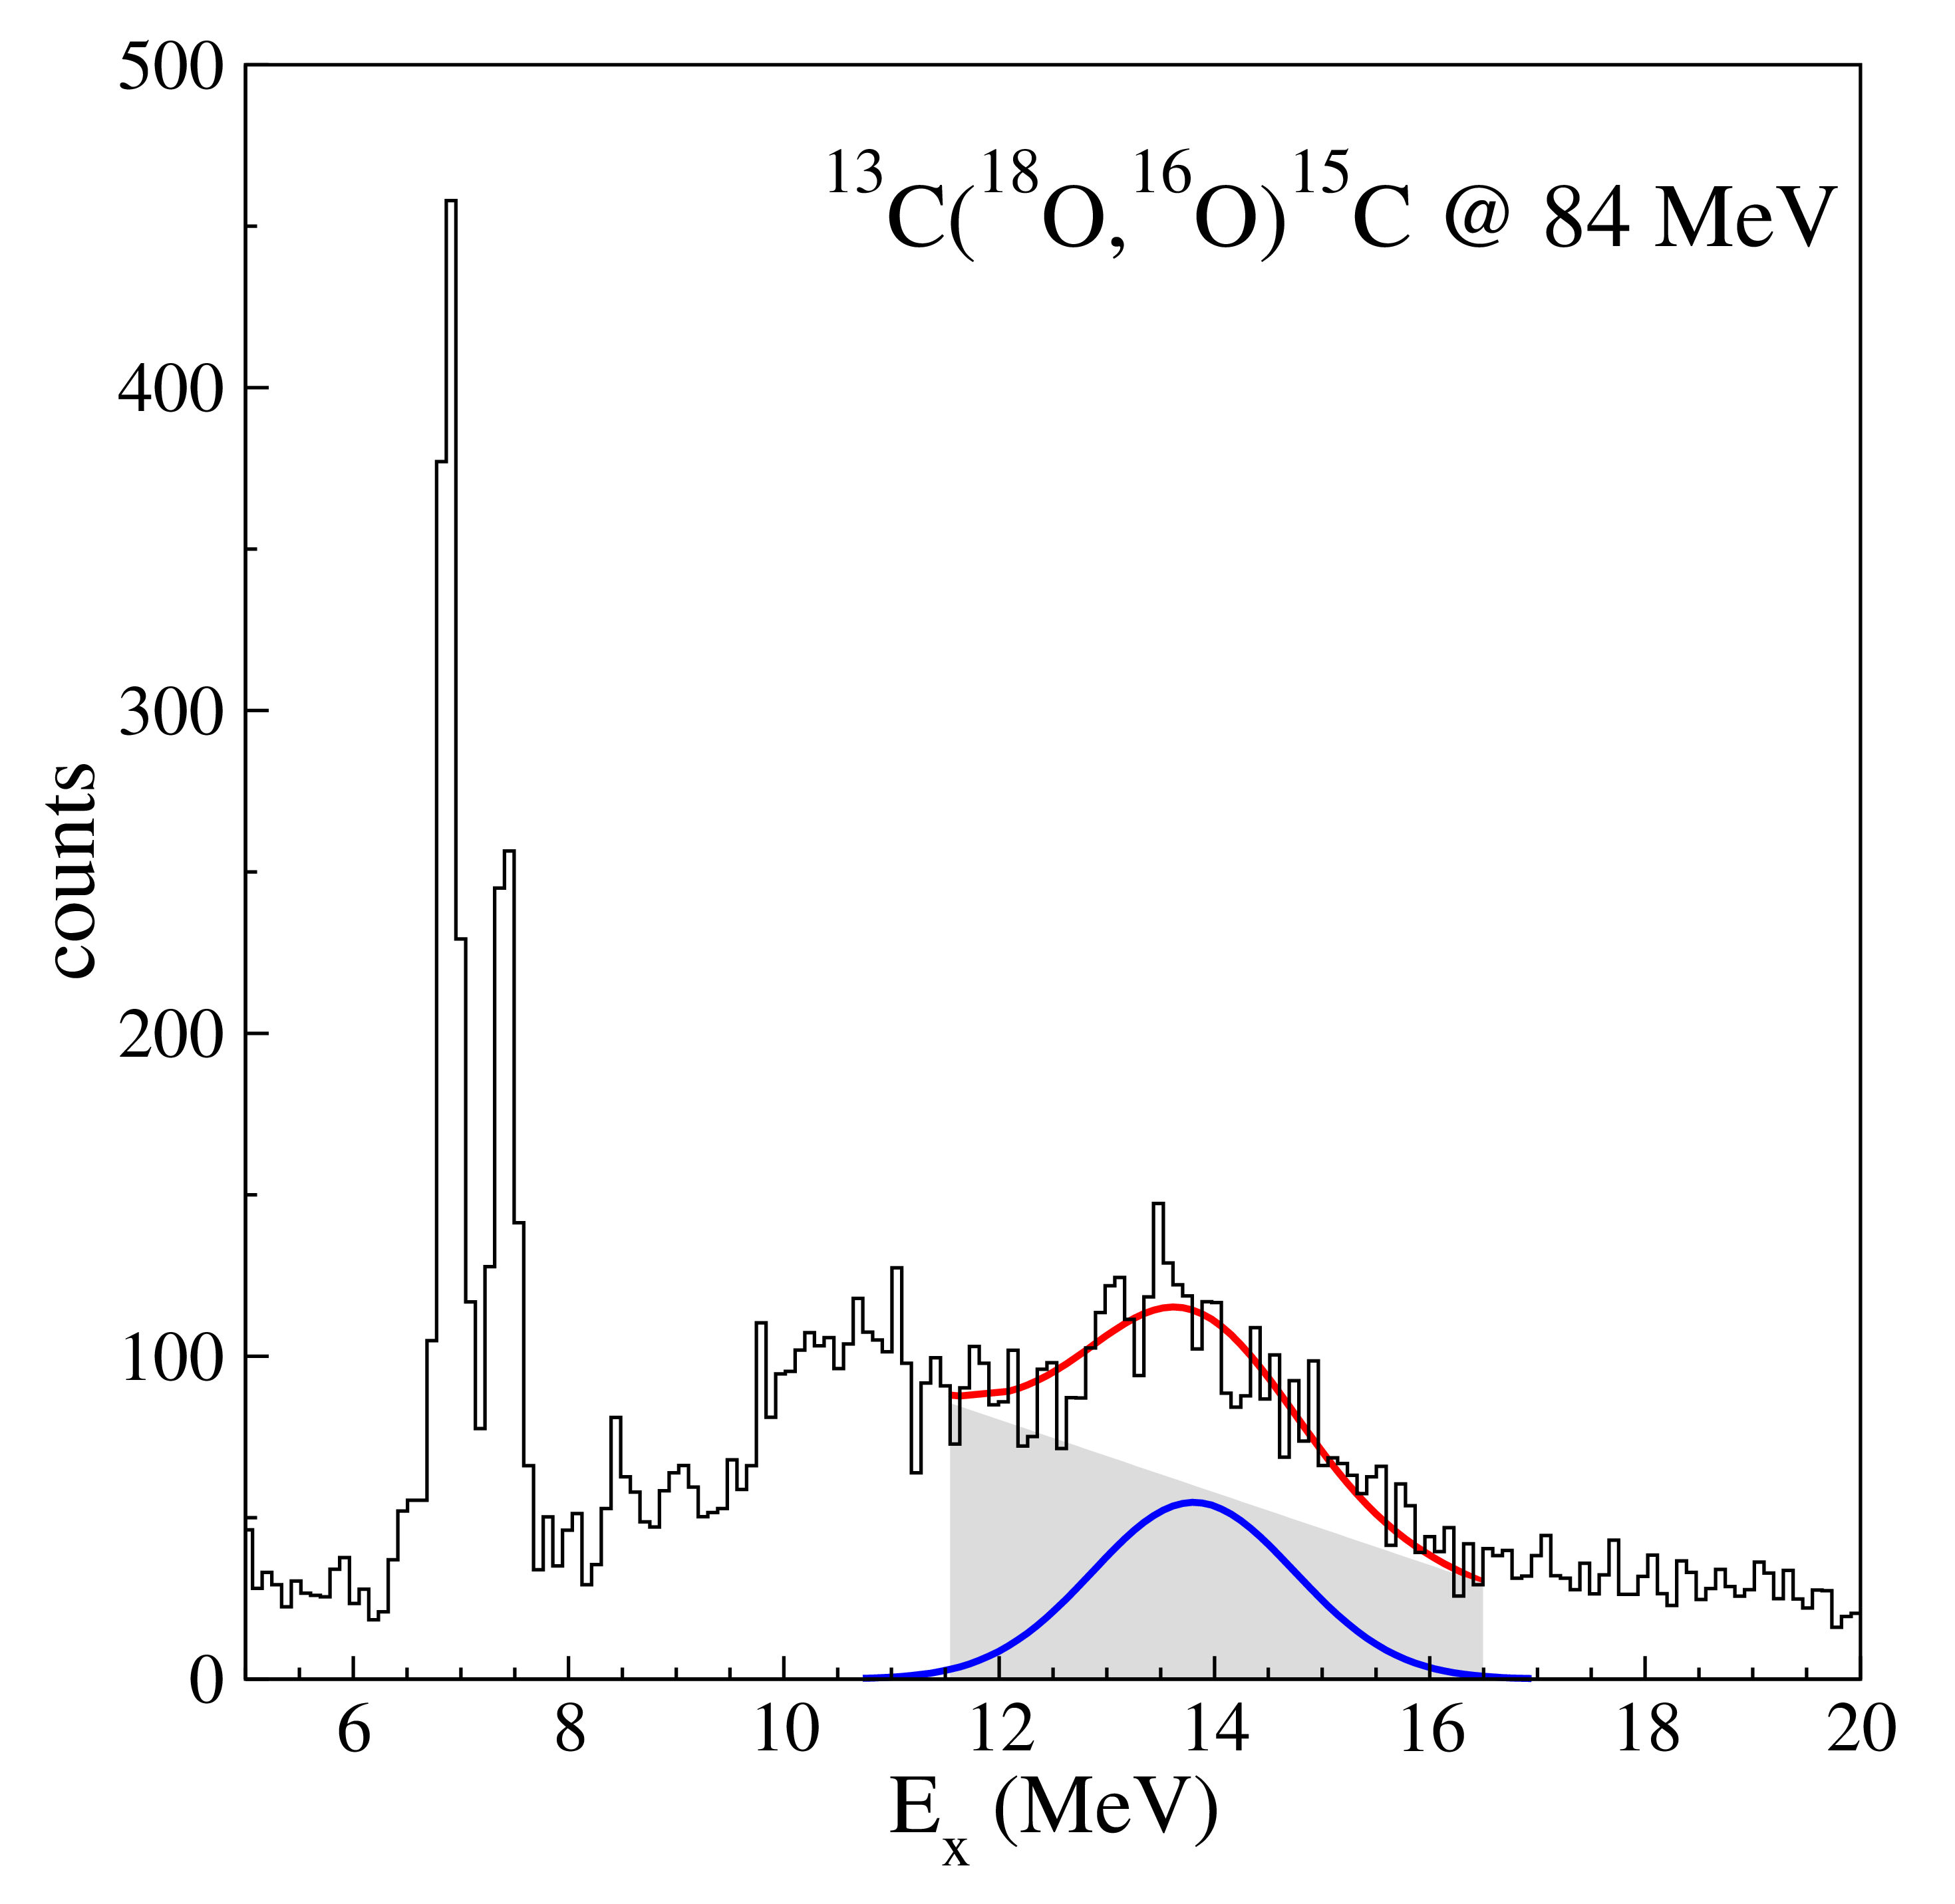
Energy and width of the bumps
16.43
16.72
Gaussian model superimposed on a linear background
¹⁴C E_{x} = 16.9 ± 0.1 MeV FWHM = 1.2 ± 0.3 MeV
¹⁵C E_{x} = 13.7 ± 0.1 MeV FWHM = 1.9 ± 0.3 MeV
DREB2016 9th International conference on Direct Reactions with Exotic Beams July 11 – 15, 2016, Halifax, Canada

Slide 12
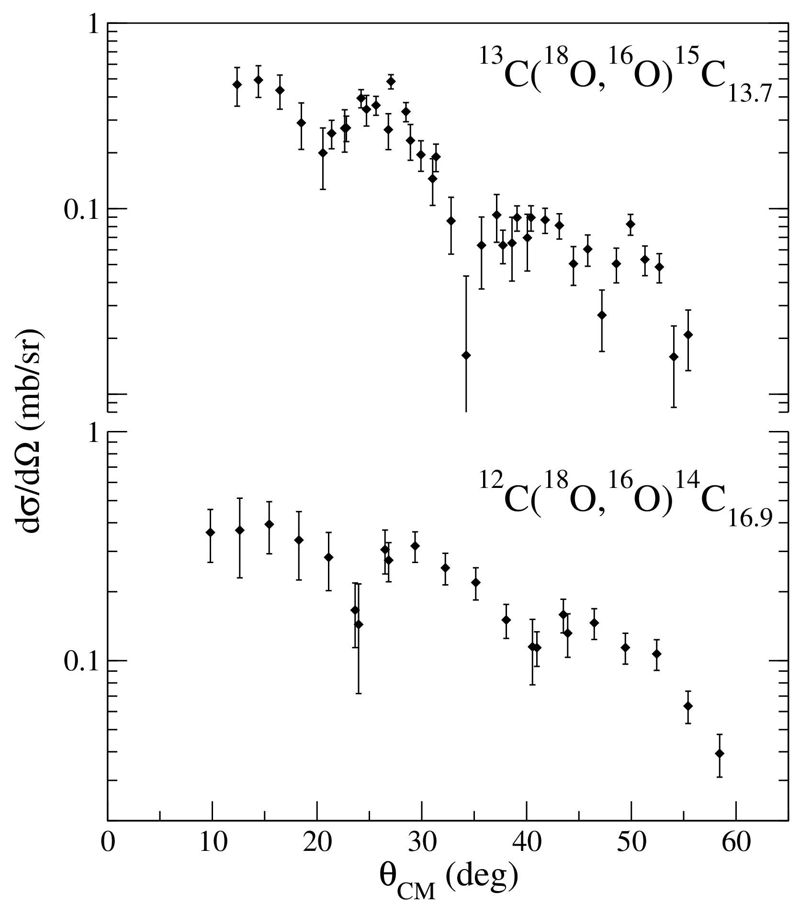
Bump angular distributions
Clear oscillating pattern in the bump angular distributions
Resonant states characterized by a well-defined angular momentum
DREB2016 9th International conference on Direct Reactions with Exotic Beams July 11 – 15, 2016, Halifax, Canada

Slide 13
GPV properties
Excitation Energy ~ 20 MeV with respect to the unperturbed nucleus
FWHM ~ 1-2 MeV
Cross section comparable to that of the g.s. pairing vibration
L = 0 angular momentum transfer
DREB2016 9th International conference on Direct Reactions with Exotic Beams July 11 – 15, 2016, Halifax, Canada

Slide 14
Excitation energy
The excitation energy of the two resonances compared to the target ground state is the same (~ 20 MeV)
19.92
16.9 MeV
20.4
13.7 MeV
¹⁴C_{GPV}
¹⁵C_{GPV}
Pairing energy scale
E^{t}_{x} = E_{x} + M_{r} - M_{t}
E^{t}_{x} (MeV)
E^{t}_{x} (MeV)
6.7
g.s.
¹⁵C
g.s.
Consistent with cQRPA predictions
3.02
¹⁴C
Δ¹⁵C - Δ¹³C = 6.7 MeV
Δ¹⁴C - Δ¹²C = 3.02 MeV
E.Khan et al. PRC 69 (2004) 014314
0
g.s.
0
g.s.
¹²C
¹³C
DREB2016 9th International conference on Direct Reactions with Exotic Beams July 11 – 15, 2016, Halifax, Canada

Slide 15
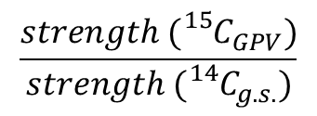
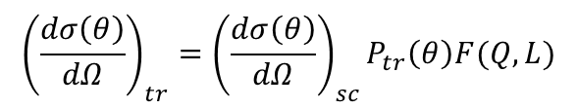
Width and cross section
Measured widths
¹⁴C E_{x} = 16.9 ± 0.1 MeV FWHM = 1.2 ± 0.3 MeV
¹⁵C E_{x} = 13.7 ± 0.1 MeV FWHM = 1.9 ± 0.3 MeV
Consistent with the discussions about the GPV
W. von Oertzen and A. Vitturi, Rep. Prog. Phys. 64 (2001) 1247
Cross section
The GPV cross section is predicted to be similar to the L = 0 transition to the g.s.
R.A. Broglia and D. Bes PLB 69 (1977) 129
σ(¹⁴C_{g.s.}) = 0.92 ± 0.10 mb
σ(¹⁴C_{GPV}) = 0.66 ± 0.07 mb
Consistent with theoretical predictions
¹⁴C case
$${\left(\frac{dσ\left(θ\right)}{dΩ}\right)}_{tr}={\left(\frac{dσ\left(θ\right)}{dΩ}\right)}_{sc}P_{tr}\left(θ\right)F(Q,L)$$
¹⁵C case
$$\frac{strength ({}_{}^{15}{C_{GPV})}}{strength ({}_{}^{14}{C_{g.s.})}}$$
W. von Oertzen and A. Vitturi, Rep. Prog. Phys. 64 (2001) 1247
= 3.5 ± 0.8
DREB2016 9th International conference on Direct Reactions with Exotic Beams July 11 – 15, 2016, Halifax, Canada

Slide 16
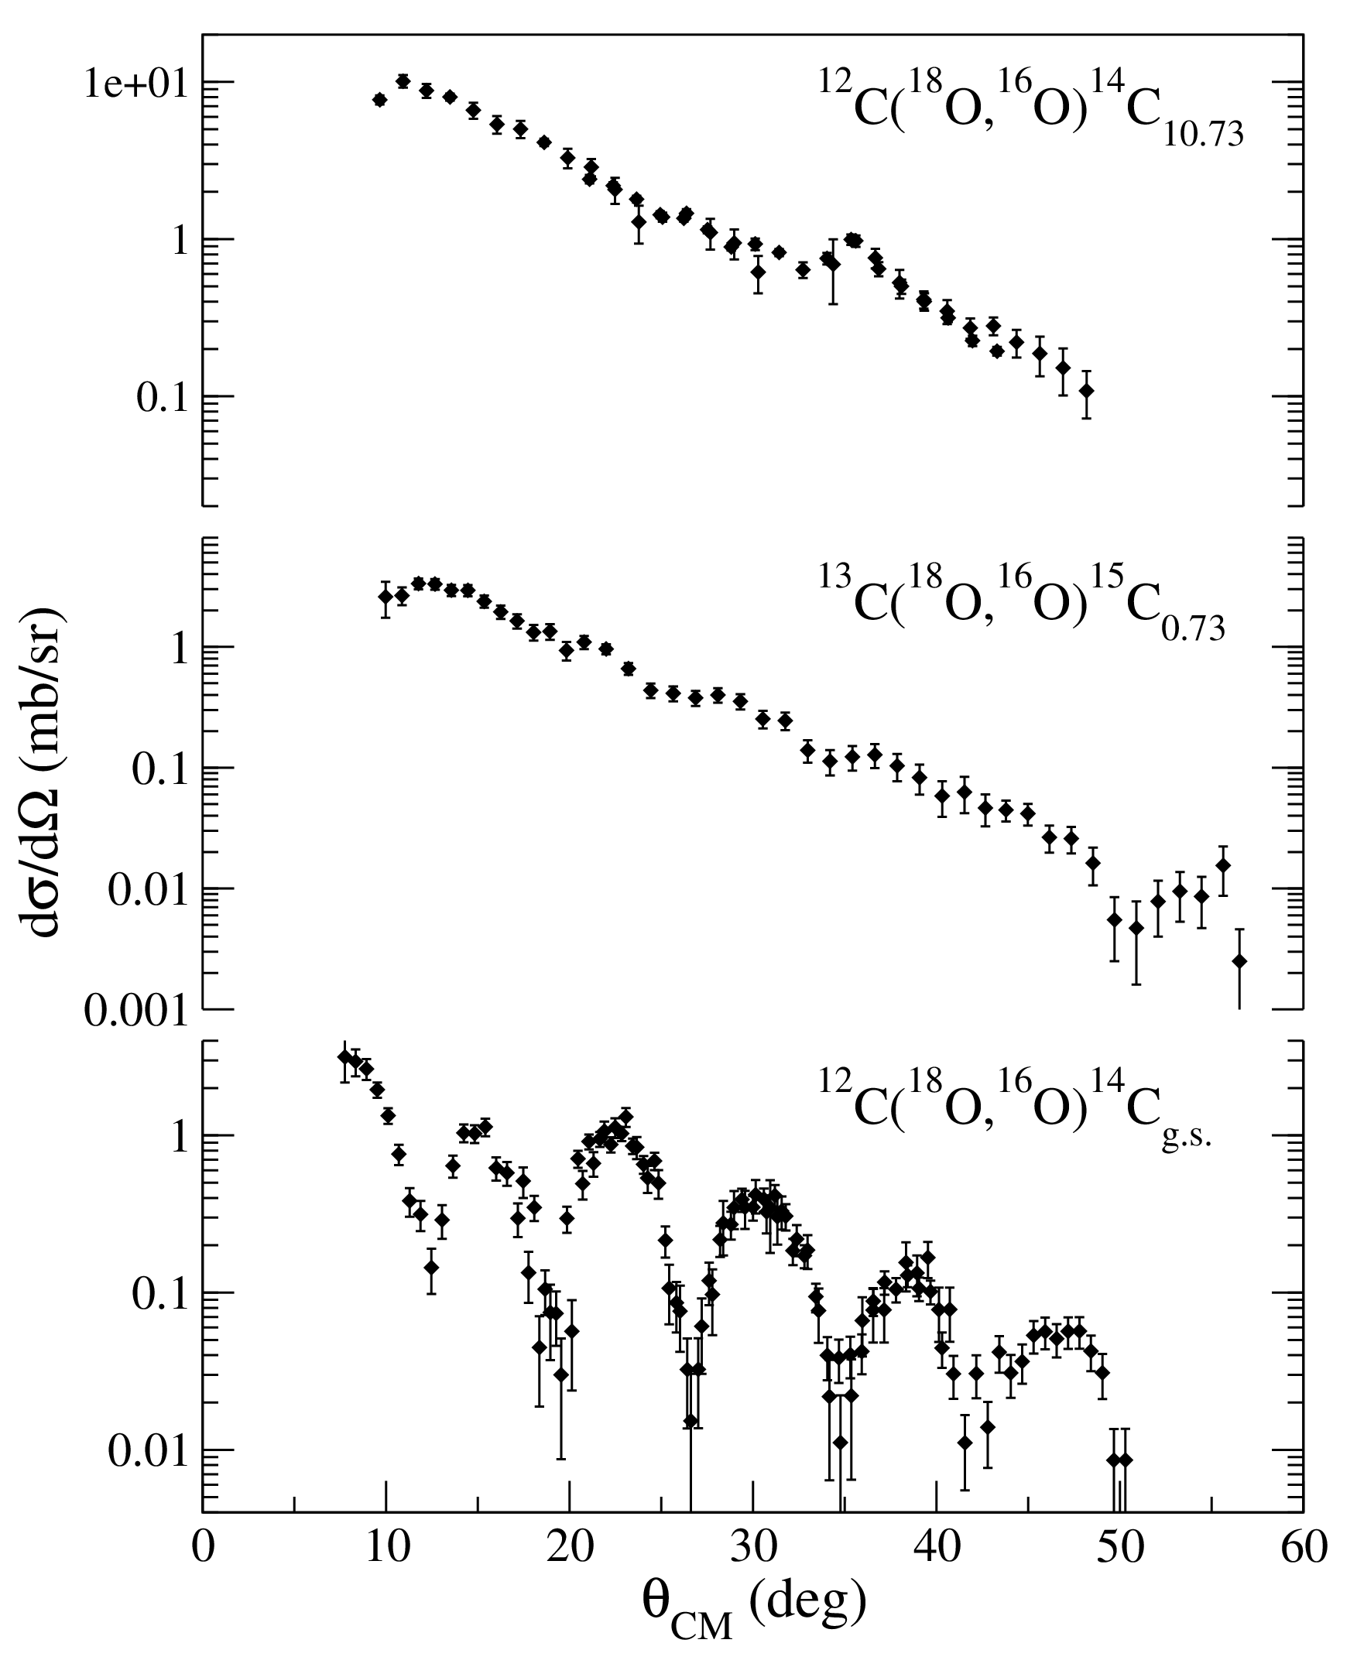
Multipolarity: angular distributions
L = 4
L = 3
L = 0
L = 0 indication
Equal population of the M-states in heavy-ion reactions near the Coulomb barrier
L ≠ 0 transitions: featureless shape
L = 0 transitions: oscillations clearly appear
DREB2016 9th International conference on Direct Reactions with Exotic Beams July 11 – 15, 2016, Halifax, Canada

Slide 17
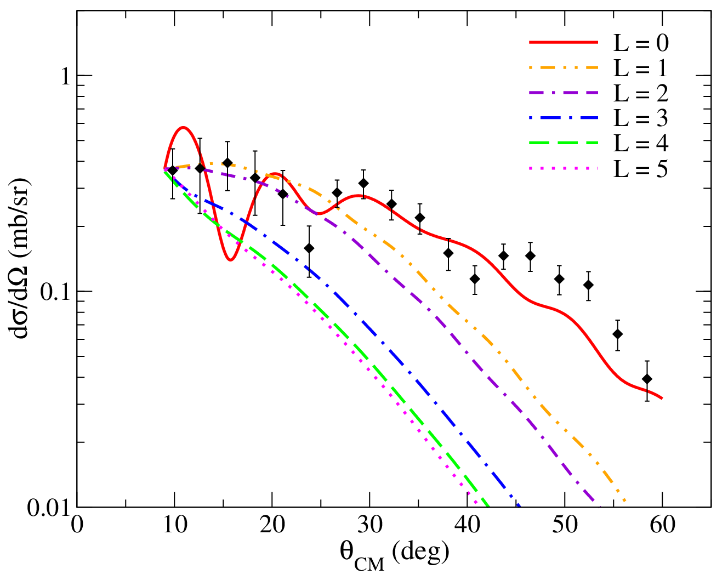
Multipolarity: calculations for ¹⁴C_{GPV}
Common ingredients: a. Sao-Paulo parameter free double folding potential
b. Extreme cluster model approximation for the two neutrons
1. Discretized continuum scheme calculations
Three body assumption finer details not accurate
Global features: L = 0 cross section absolute value is found consistent with the experimental without any scaling factor
A.M. Moro and F.M. Nunes, Nucl. Phys. A 767 (2006) 138
2. CRC calculations
Same approach used to describe transitions to bound and resonant states in ¹⁴C
Calculations for various L components
Artificial energy value of 12 MeV (below S_{2n})
No spectroscopic amplitudes available
Renormalization at θ_{CM} = 9°
Shape of the L = 0 calculation consistent with the experimental angular distribution
M. Cavallaro et al., PRC 88 (2013) 054601
Both approaches suggest L = 0 transfer for the ¹⁴C resonance at 16.9 MeV
DREB2016 9th International conference on Direct Reactions with Exotic Beams July 11 – 15, 2016, Halifax, Canada

Slide 18
First experimental evidence
¹⁴C E_{x} = 16.9 MeV FWHM = 1.2 MeV
¹⁵C E_{x} = 13.7 MeV FWHM = 1.9 MeV
Right energy
Right width
Right cross section
L = 0 transfer
GPV population
Particle-hole symmetry confirmation
D. Carbone, EPJ Plus (2015) 130:143
DREB2016 9th International conference on Direct Reactions with Exotic Beams July 11 – 15, 2016, Halifax, Canada

Slide 19
Future works
DREB2016 9th International conference on Direct Reactions with Exotic Beams July 11 – 15, 2016, Halifax, Canada

Slide 20
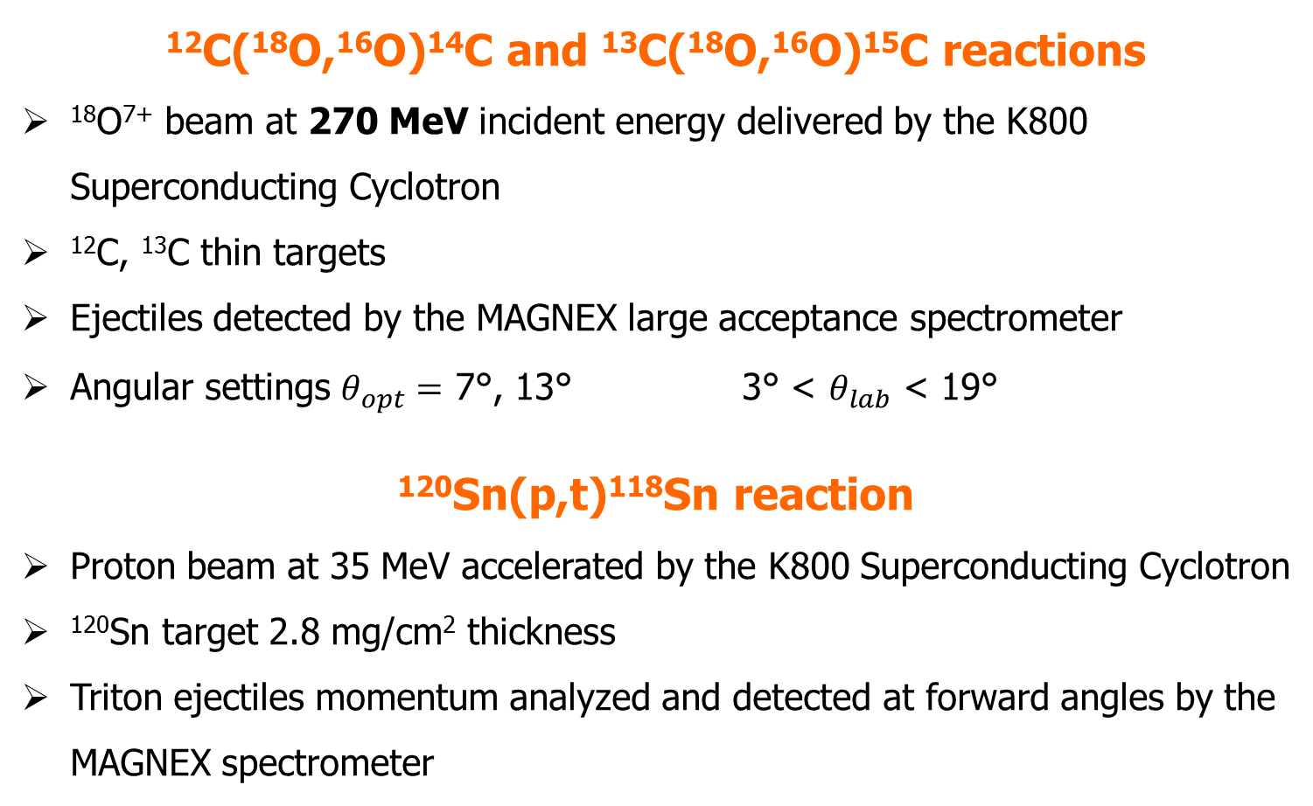
Experiments @ INFN-LNS
¹²C(¹⁸O,¹⁶O)¹⁴C and ¹³C(¹⁸O,¹⁶O)¹⁵C reactions
¹⁸O⁷⁺ beam at 270 MeV incident energy delivered by the K800 Superconducting Cyclotron
¹²C, ¹³C thin targets
Ejectiles detected by the MAGNEX large acceptance spectrometer
Angular settings $θ_{opt}=$ 7°, 13° 3° < $θ_{lab}$ < 19°
¹²⁰Sn(p,t)¹¹⁸Sn reaction
Proton beam at 35 MeV accelerated by the K800 Superconducting Cyclotron
¹²⁰Sn target 2.8 mg/cm² thickness
Triton ejectiles momentum analyzed and detected at forward angles by the MAGNEX spectrometer
F. Cappuzzello et al. Eur. Phys. J A (2016) 52:167
DREB2016 9th International conference on Direct Reactions with Exotic Beams July 11 – 15, 2016, Halifax, Canada

Slide 21
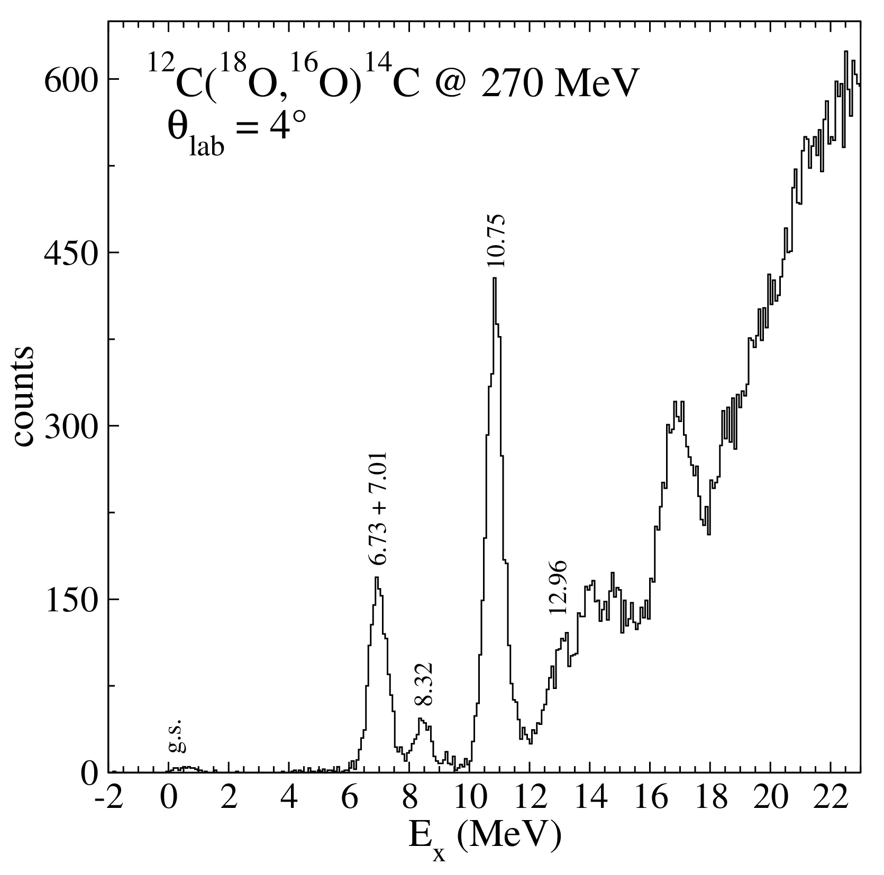
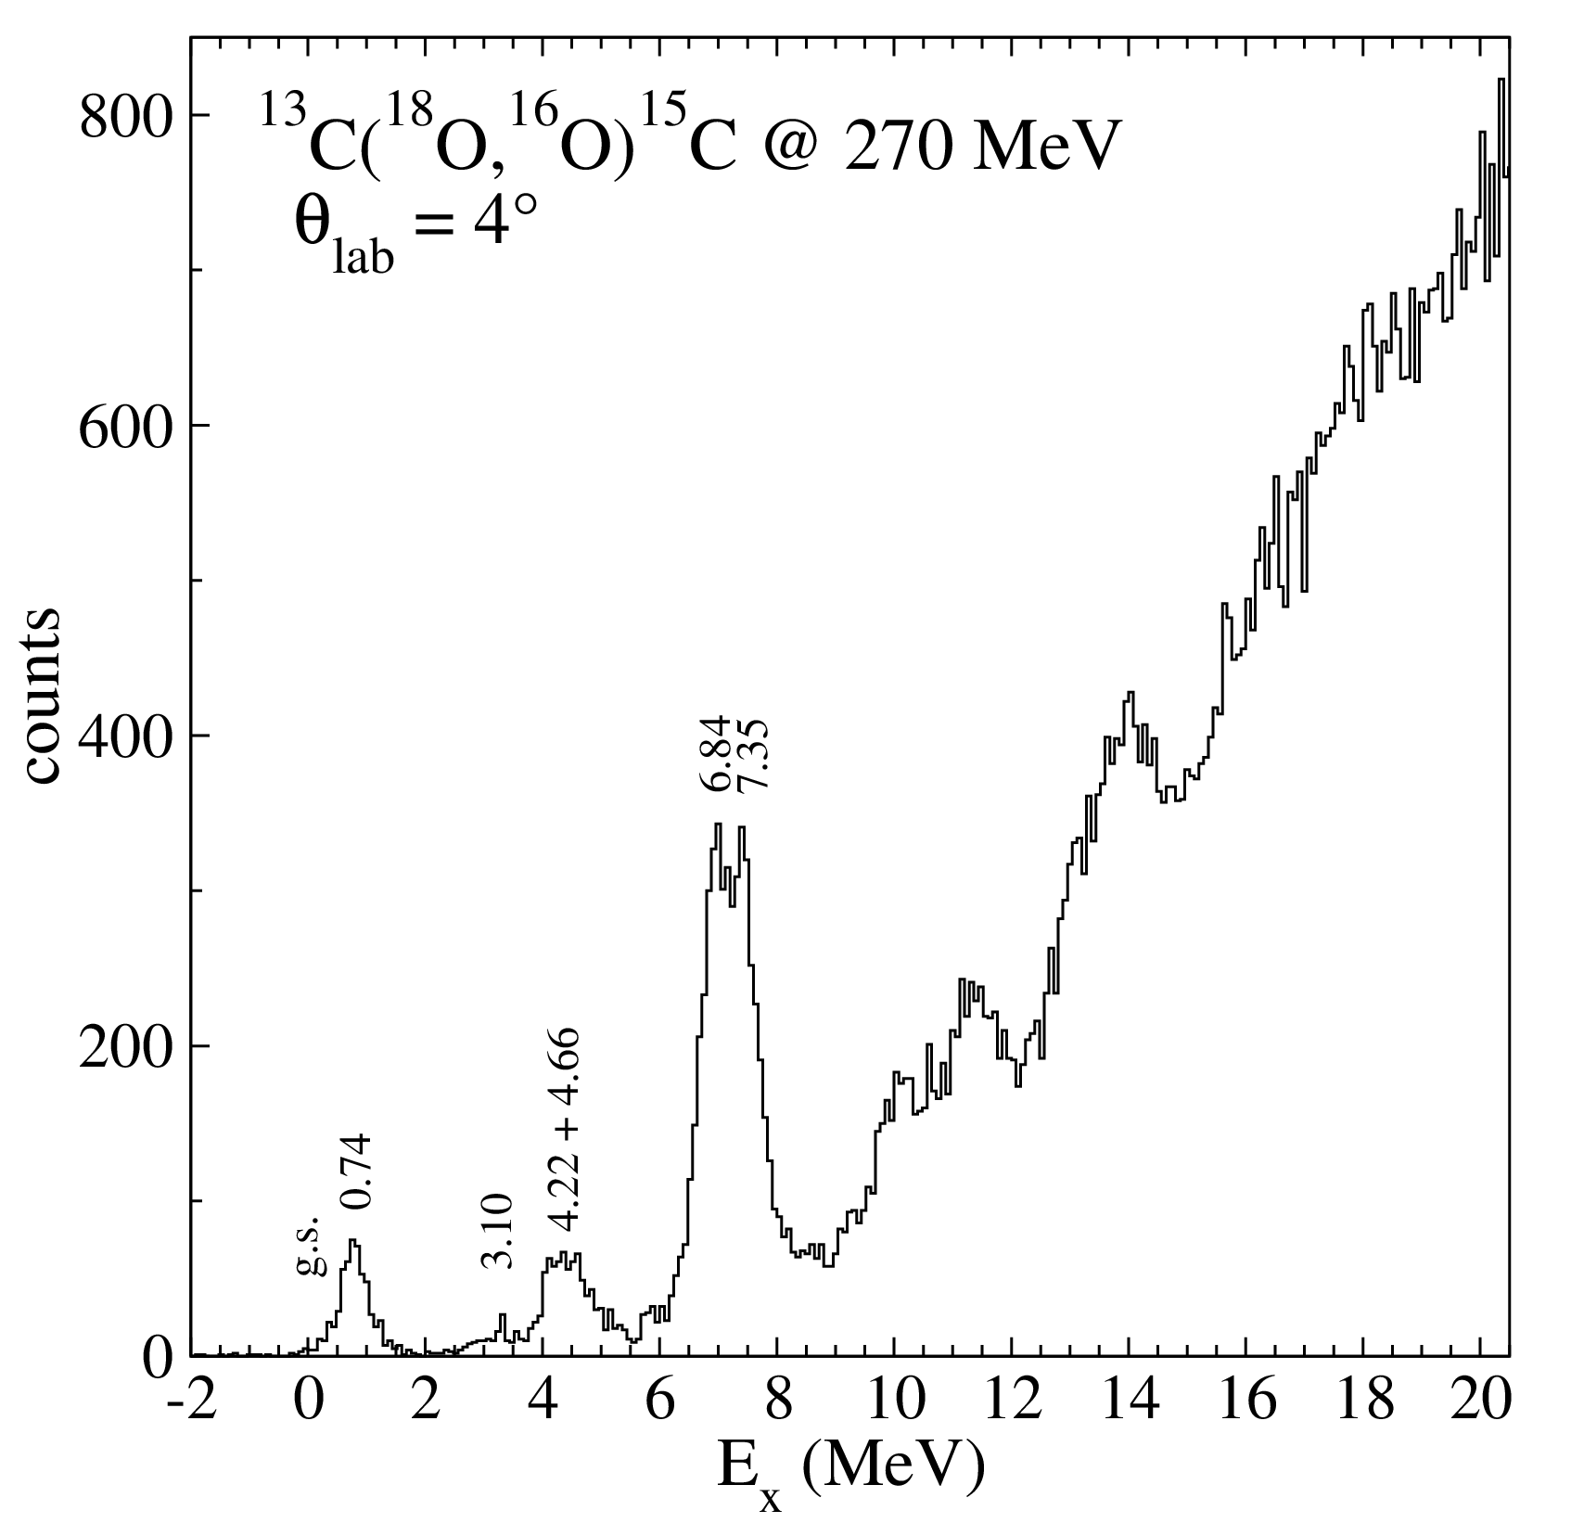
New experiment @ 270 MeV
GPV
GPV
Energy resolution ~ 600 keV
DREB2016 9th International conference on Direct Reactions with Exotic Beams July 11 – 15, 2016, Halifax, Canada

Slide 22
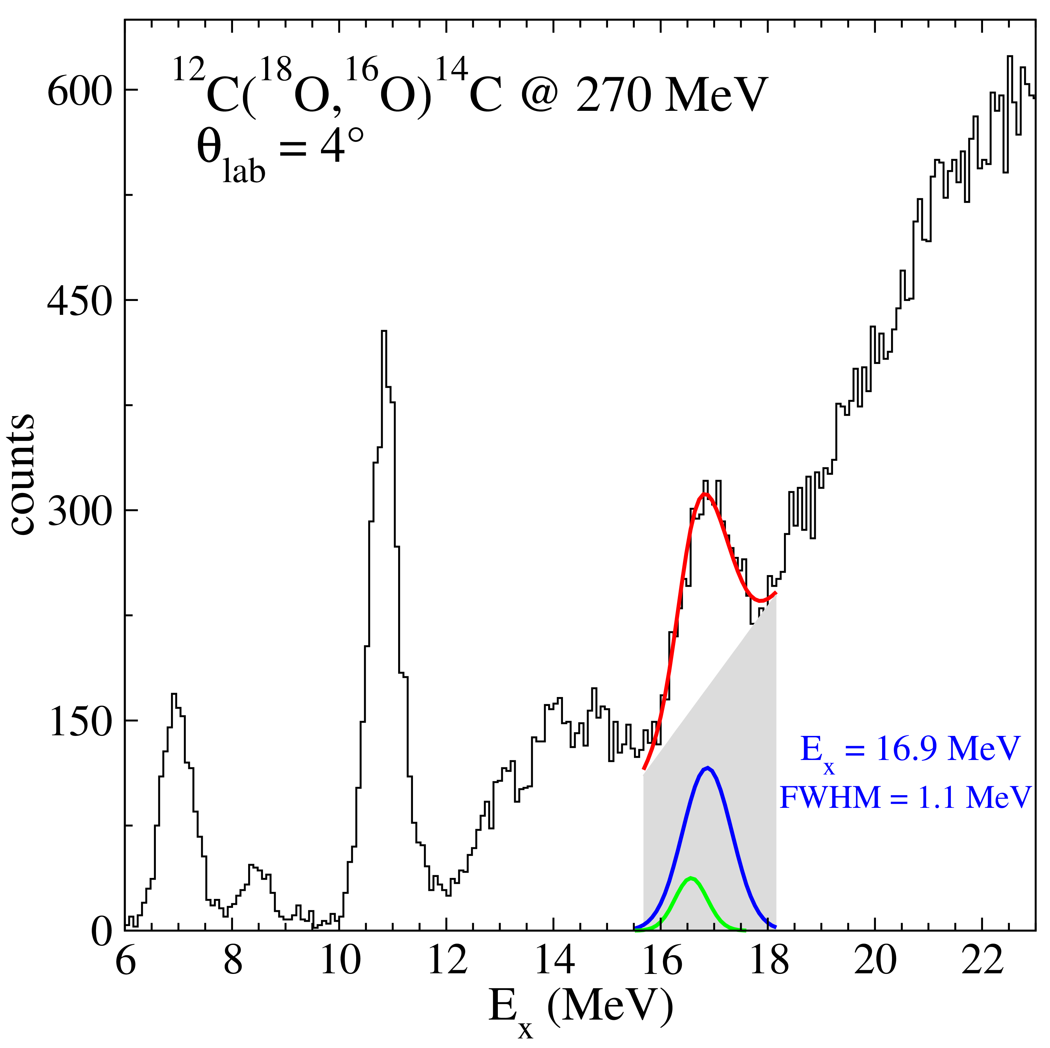
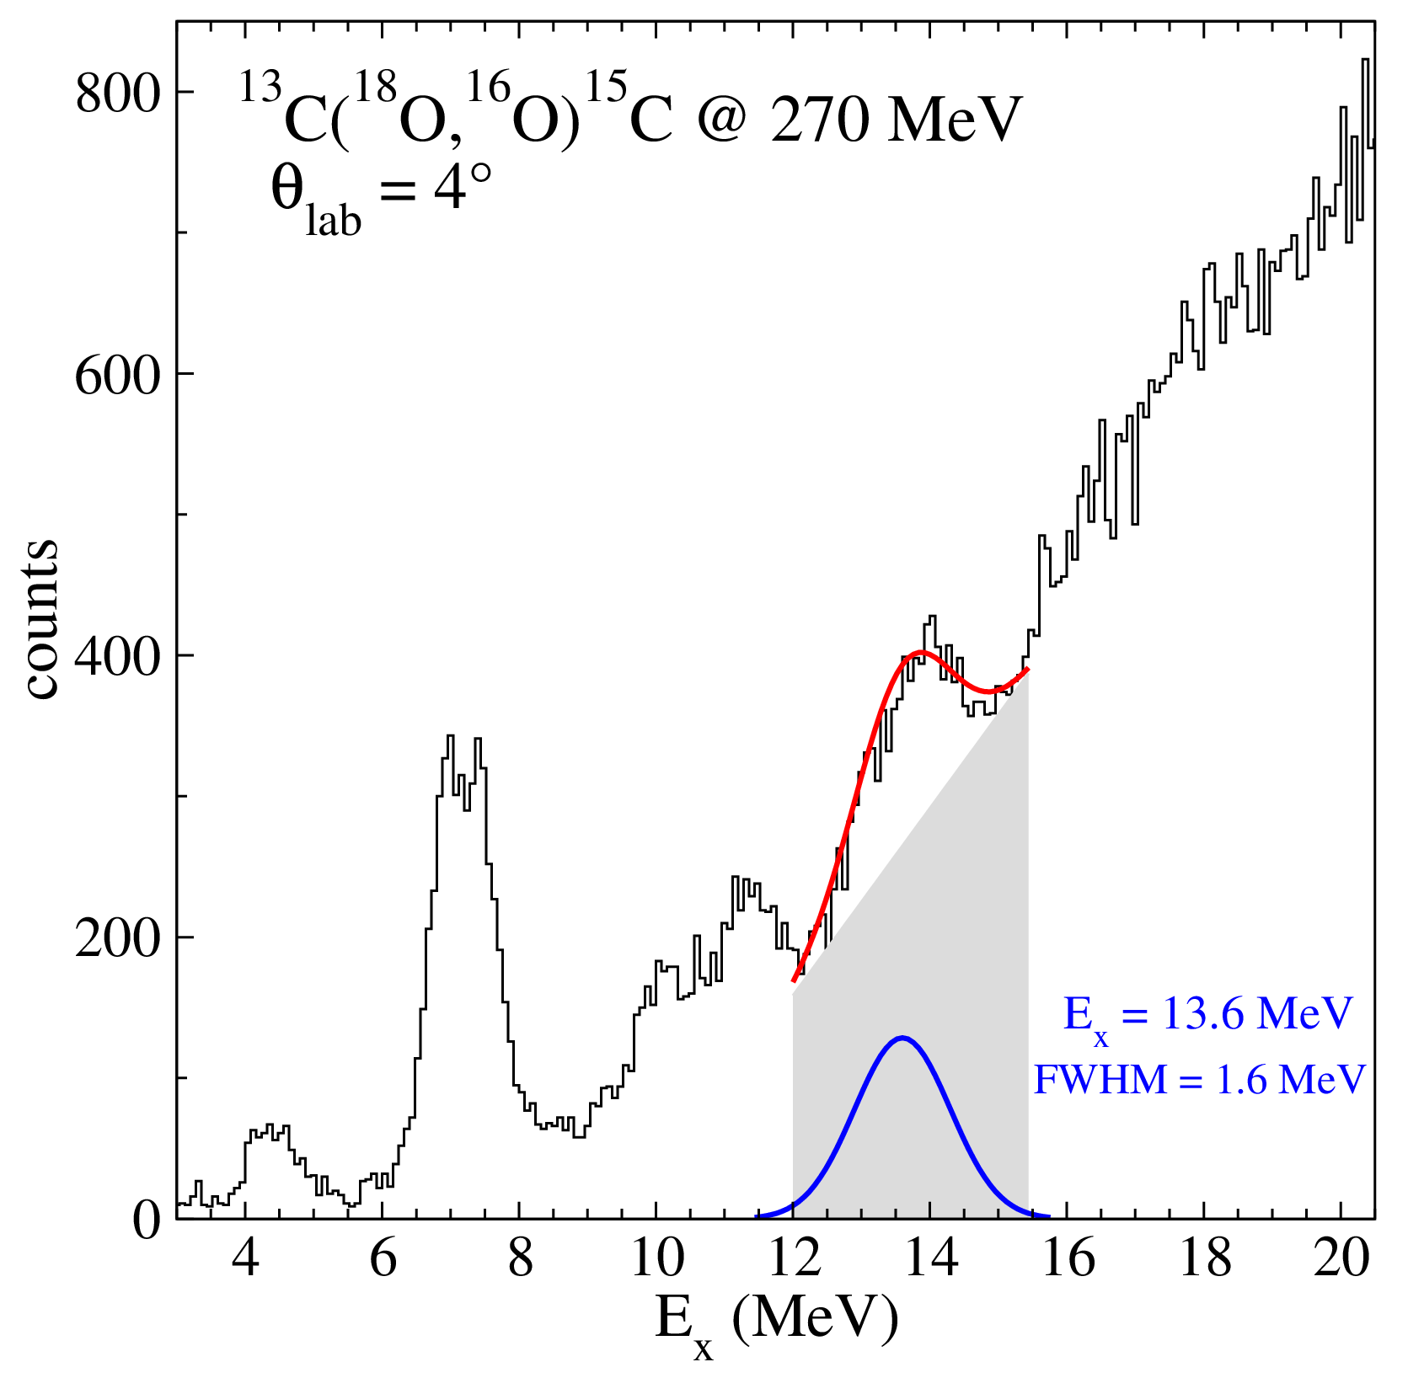
New experiment @ 270 MeV
16.43 + 16.72
@ 84 MeV incident energy
¹⁴C_{GPV} E_{x} = 16.9 ± 0.1 MeV
FWHM = 1.2 ± 0.3 MeV
¹⁵C_{GPV} E_{x} = 13.7 ± 0.1 MeV
FWHM = 1.9 ± 0.3 MeV
DREB2016 9th International conference on Direct Reactions with Exotic Beams July 11 – 15, 2016, Halifax, Canada
XXXIV Mazurian Lakes Conference on Physics September 6 – 13, 2015, Piaski, Poland

Slide 23
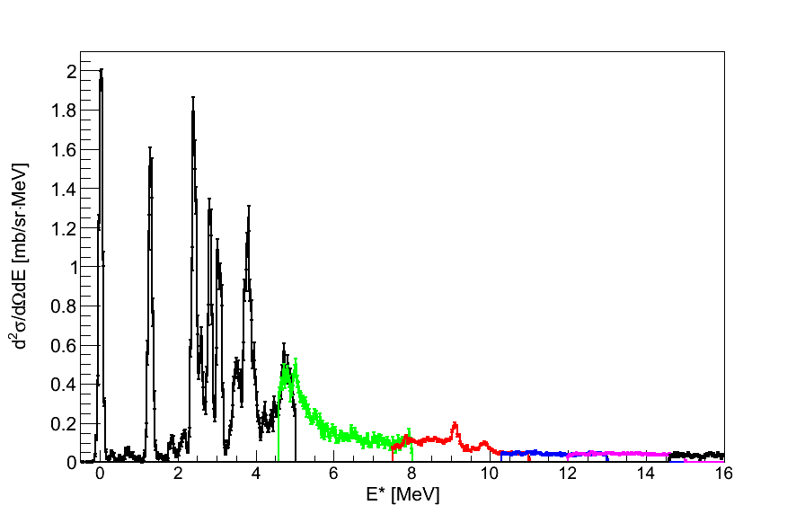
¹¹⁸Sn excitation energy
Different colors → Different spectrometer field settings
p + ¹²⁰Sn → t + ¹¹⁸Sn
g.s. (x 0.5)
8° ≤ θ_{lab} ≤ 12°
bin width 34 keV/bin
1.23 (x 0.2)
preliminary
d
DREB2016 9th International conference on Direct Reactions with Exotic Beams July 11 – 15, 2016, Halifax, Canada

Slide 24
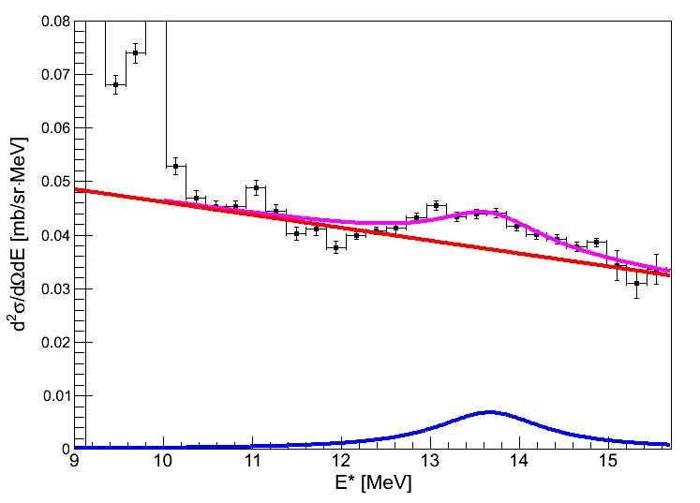
GPV energy region
The presence of a bump is clearly observed in the GPV energy region.
Fit with a Lorentz function + a linear background.
E₀ = 13.6 ± 0.1 MeV
FWHM = 1.5 ± 0.4 MeV
Right energy and width
preliminary
Cross Section of the GPV candidate in the angular region 8°≤θ_{lab}≤12°
σ =1.1 ± 0.1 μb
Such a small value could explain the historical difficulty to observe the GPV
DREB2016 9th International conference on Direct Reactions with Exotic Beams July 11 – 15, 2016, Halifax, Canada

Slide 25
Conclusions and Outlooks
¹²C(¹⁸O,¹⁶O)¹⁴C and ¹³C(¹⁸O,¹⁶O)¹⁵C at 84 MeV
Known bound and resonant states of the residual nuclei
Unknown bumps in the continuum
Particle-hole symmetry confirmation
Evidence of the GPV population
New experiments:
¹²C(¹⁸O,¹⁶O)¹⁴C and ¹³C(¹⁸O,¹⁶O)¹⁵C at 270 MeV
Population of the same resonances:
¹²⁰Sn(p,t)¹¹⁸Sn at 35 MeV
same energy
same width
indication of a resonance at 13.6 MeV
very low cross section
Outlooks:
Bumps angular distributions
Other targets
DREB2016 9th International conference on Direct Reactions with Exotic Beams July 11 – 15, 2016, Halifax, Canada

Slide 26
Working group
C.Agodi, M.Bondì, D.Carbone, M.Cavallaro, F.Cappuzzello, A.Cunsolo, A.Foti
Dipartimento di Fisica e Astronomia, Università degli Studi di Catania, Italy
Istituto Nazionale di Fisica Nucleare – Laboratori Nazionali del Sud, Italy
Istituto Nazionale di Fisica Nucleare – Sezione Catania, Italy
A.Bonaccorso
Istituto Nazionale di Fisica Nucleare – Sezione di Pisa
A.Vitturi, L.Fortunato
Università degli Studi di Padova
F. Azaiez, S.Franchoo, E. Khan, J.A.Scarpaci
CNRS - IN2P3 – Institut de Physique Nucléaire d’Orsay, France
R.Linares, J.Lubian
Universidade Federal Fluminense, Niteroi, Brazil
DREB2016 9th International conference on Direct Reactions with Exotic Beams July 11 – 15, 2016, Halifax, Canada

Slide 27
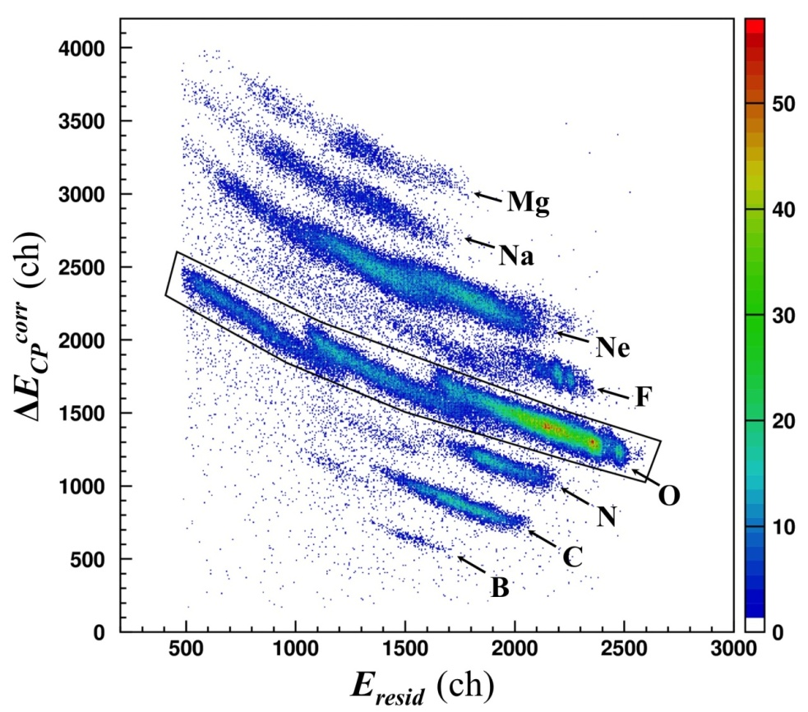
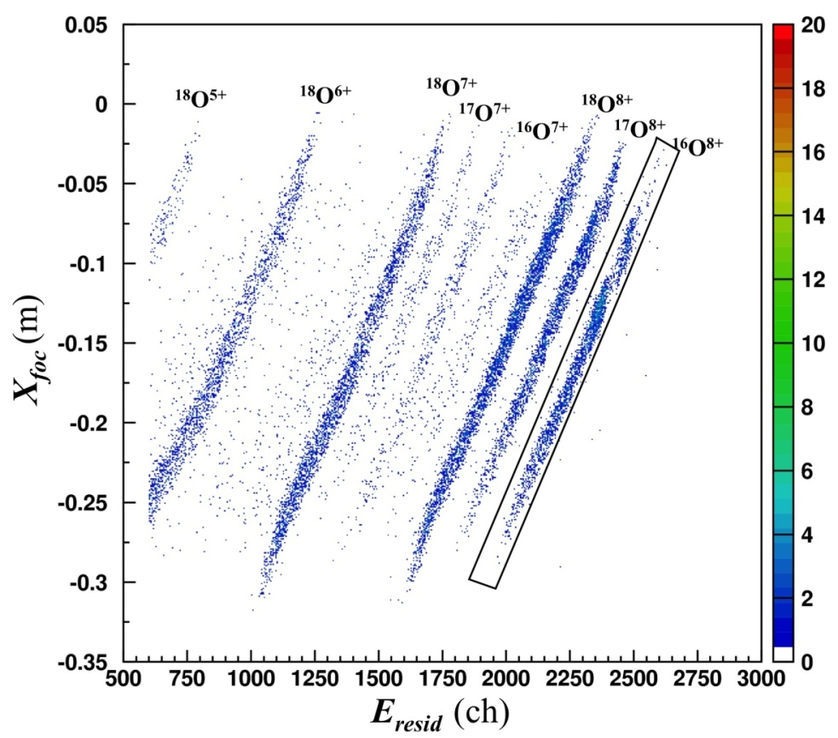
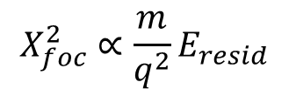
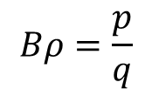
Particle identification
Z identification
A identification
$$Bρ=\frac{p}{q}$$
$$X_{foc}^{2}∝\frac{m}{q^{2}}E_{resid}$$
F. Cappuzzello et al., NIMA 621 (2010) 419
DREB2016 9th International conference on Direct Reactions with Exotic Beams July 11 – 15, 2016, Halifax, Canada

Slide 28
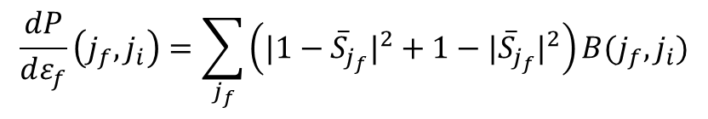
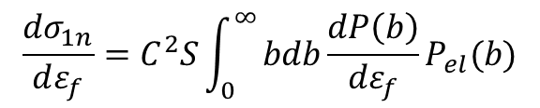
Break-up calculations
Sequential transfer to the continuum of uncorrelated neutrons
(two independent break-up processes)
E_{x} > S_{n} : ¹⁸O + ¹³C → ¹⁶O + ¹⁴C_{g.s.} + n
E_{x} > S_{2n} : ¹⁸O + ¹³C → ¹⁶O + ¹³C_{g.s.} + n + n
Calculation of the S-Matrix
Transfer probability
$$\frac{dP}{dε_{f}}\left(j_{f},j_{i}\right)=\sum_{j_{f}}{\left({|1−{\overline{S}}_{j_{f}}|}^{2}+1−|{\overline{S}}_{j_{f}}|^{2}\right)B(j_{f},j_{i})}$$
Elastic break-up
Neutron absorption
Total transfer cross section
$$\frac{dσ_{1n}}{dε_{f}}=C^{2}S\int_{0}^{∞}{bdb\frac{dP\left(b\right)}{{dε}_{f}}P_{el}(b)}$$
Semi-classical treatment of the relative motion
Initial state spectroscopic factor
Core-target elastic scattering
DREB2016 9th International conference on Direct Reactions with Exotic Beams July 11 – 15, 2016, Halifax, Canada

Slide 29
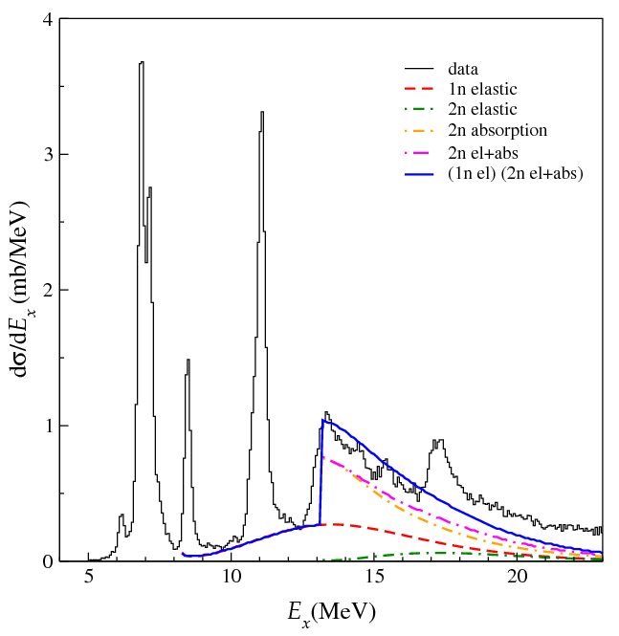
Projectile break-up calculations
Sequential transfer to the continuum of uncorrelated neutrons
Transfer to the continuum model by A. Bonaccorso et al.
¹²C(¹⁸O,¹⁶O)¹⁴C
A. Bonaccorso, et al., Phys. Rev. C 49 (1994) 329
Unknown
DREB2016 9th International conference on Direct Reactions with Exotic Beams July 11 – 15, 2016, Halifax, Canada

Slide 30
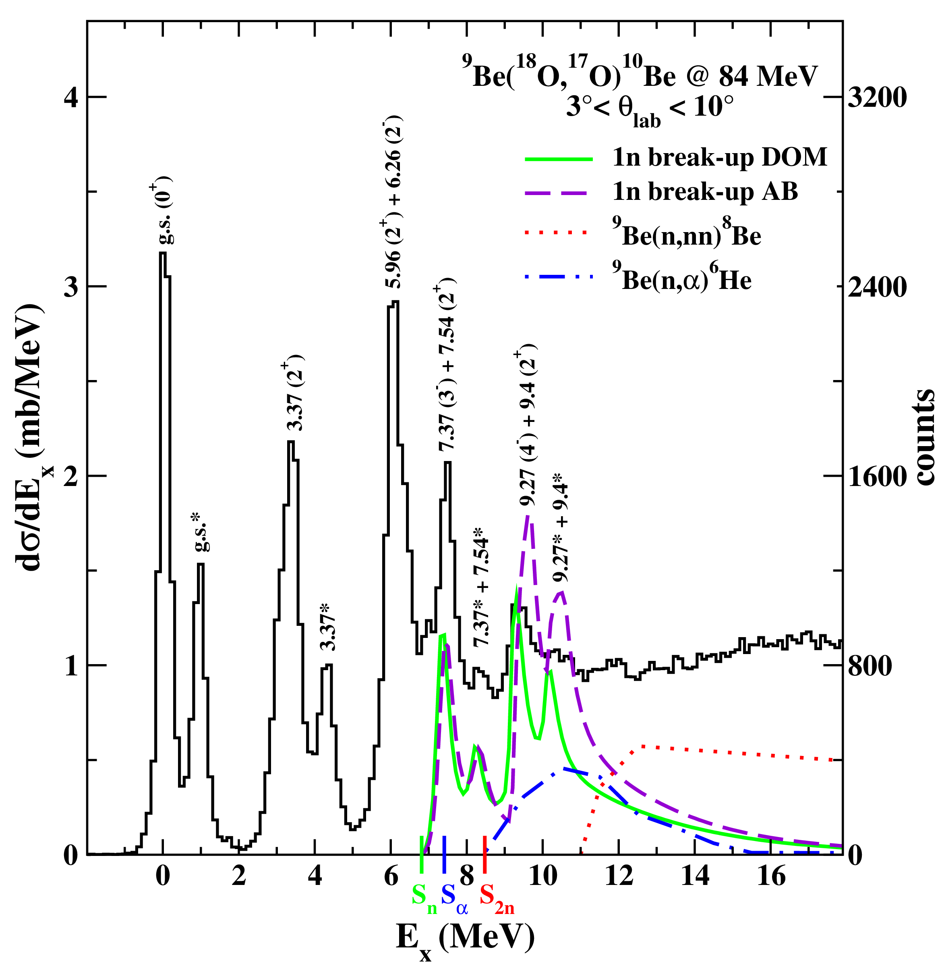
The ⁹Be(¹⁸O,¹⁷O)¹⁰Be reaction
3° < θ_{lab}<10°
Total 1-n breakup calculations using two new n-⁹Be potentials
experimental data for:
⁹Be(n,nn)⁸Be
⁹Be(n,α)⁶He
A. Bonaccorso and R. J. Charity, PRC 89, 024619 (2014)
Peaks marked with * refers to the ¹⁷O ejectile emitted in its first excited state at 0.87 MeV
D. Carbone et al., PRC 90 (2014) 064621
DREB2016 9th International conference on Direct Reactions with Exotic Beams July 11 – 15, 2016, Halifax, Canada

Slide 31
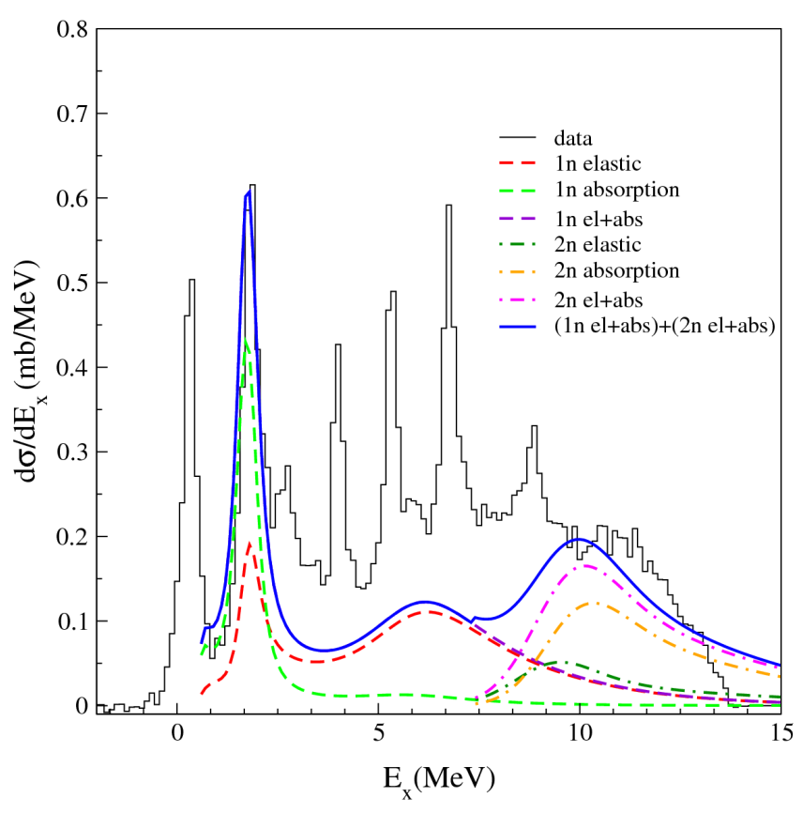
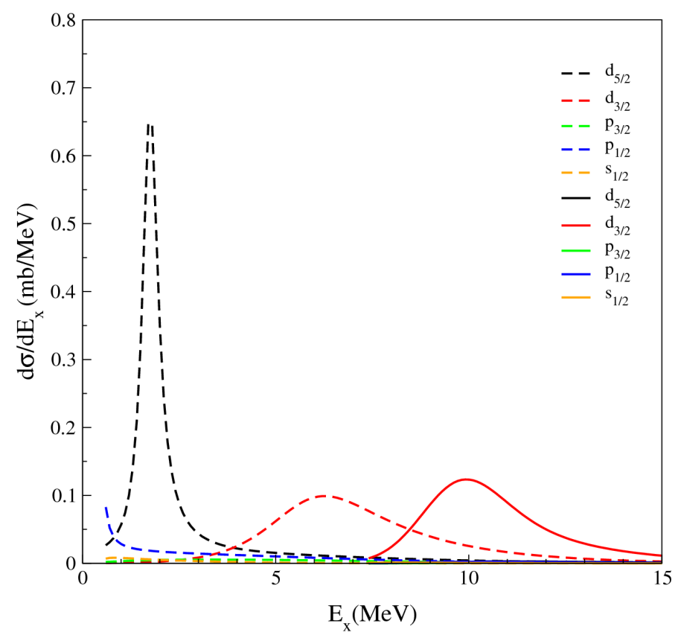

The ⁹Be(¹⁸O,¹⁶O)¹¹Be reaction
3° < θ_{lab}<10°
$$|{}_{}^{10}{{Be}_{g.s.}}\left(0^{+}\right)⨂{(1d_{5/2})}_{υ}>$$
Single-particle resonance at 1.78 MeV ( ) well reproduced
Dominance of the two-neutron absorption above S_{2n}
Main contribution from the d_{5/2} and d_{3/2} orbitals
n+¹⁰Be optical potential from G. Blanchon, et al., Nucl. Phys. A 784 (2007) 49
A. Bonaccorso and R. J. Charity, PRC 89, 024619 (2014)
DREB2016 9th International conference on Direct Reactions with Exotic Beams July 11 – 15, 2016, Halifax, Canada

Slide 32
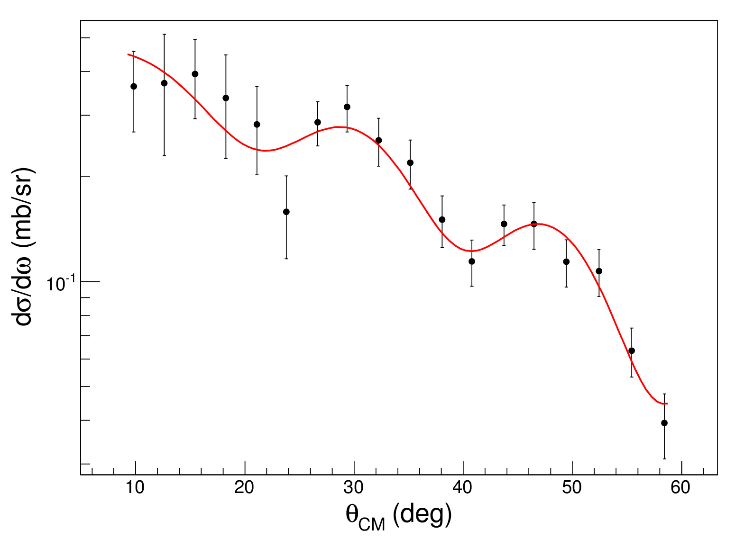
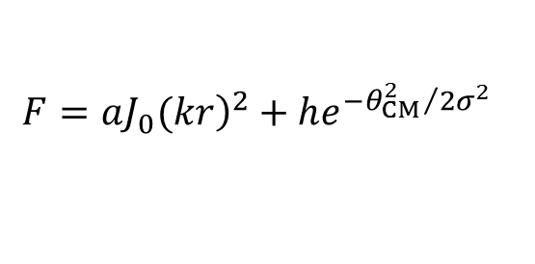
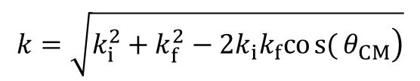
Statistical analysis
Comparison with a model function
Cylindrical Bessel (J₀)
+
Gaussian
where
a, h and σ free parameters
$$k=\sqrt{\left.k_{i}^{2}+k_{f}^{2}−2k_{i}k_{f}cos{(}θ_{CM}\right)}$$
$$F=a{\left.J_{0}(kr\right)}^{2}+he^{−{θ_{CM}^{2}}/2σ^{2}}$$
Fit procedure:
Bessel function necessary to describe the shape
Oscillations confidently established
a = 1.00 ± 0.24
h = 0.31 ± 0.04
σ = 29 ± 9
DREB2016 9th International conference on Direct Reactions with Exotic Beams July 11 – 15, 2016, Halifax, Canada

Slide 33
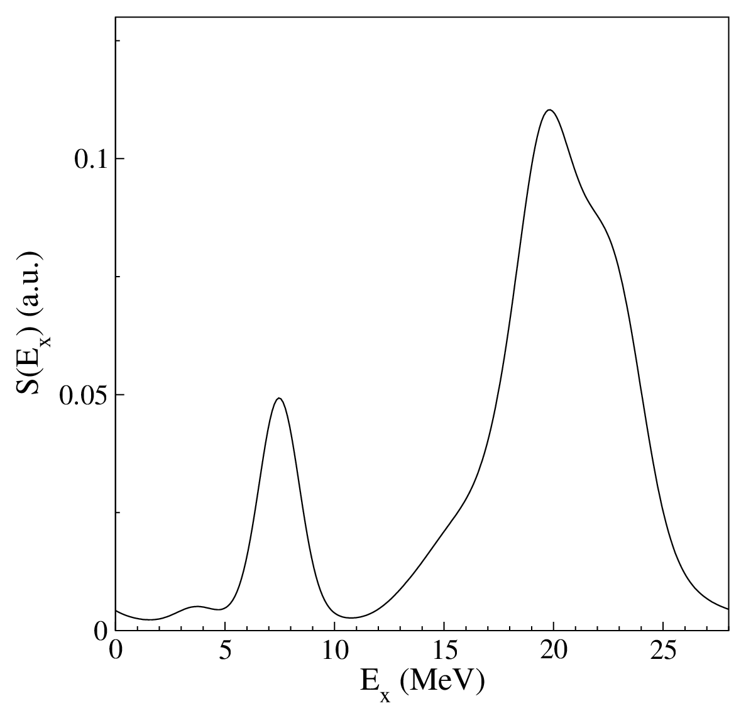
cQRPA calculations
Collective structure at ~ 20 MeV with respect to the ¹²C_{g.s.}
Experimental value consistent with GPV predictions
DREB2016 9th International conference on Direct Reactions with Exotic Beams July 11 – 15, 2016, Halifax, Canada

Slide 34
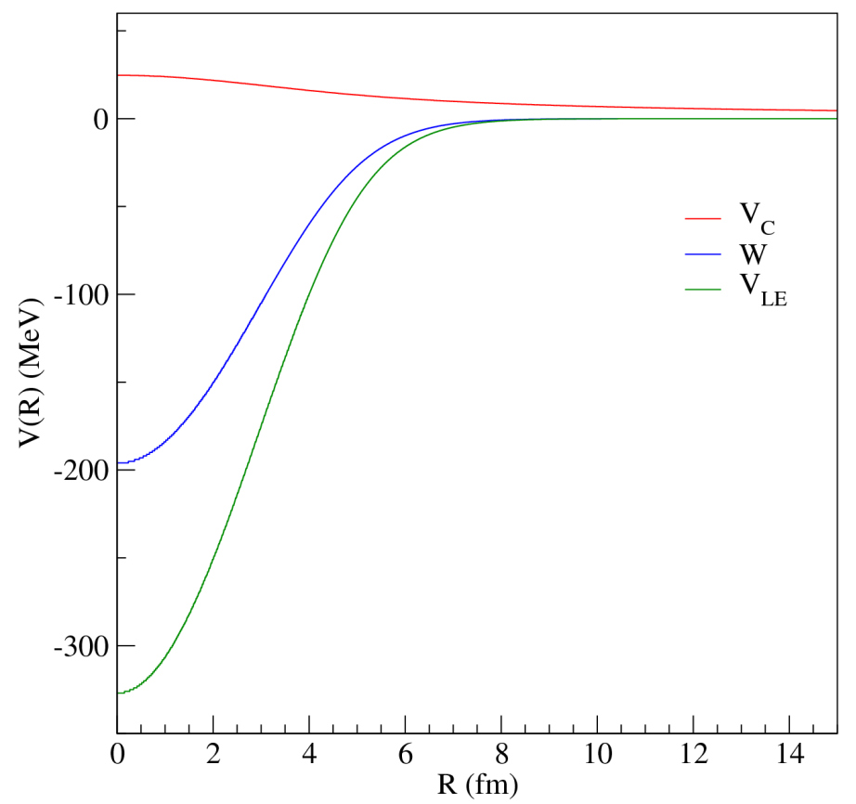




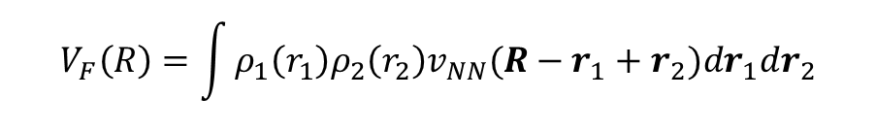

Sao-Paulo optical potential
$$V_{LE}\left(R,E\right)=V_{F}(R)e^{−\frac{4v^{2}\left(R\right)}{c^{2}}}$$
L.C.Chamon et. al. PRC 66 (2002) 014610
D. Pereira et al. PLB 670 (2009) 330
$$V_{F}\left(R\right)=\int{ρ_{1}\left(r_{1}\right)ρ_{2}\left(r_{2}\right)v_{NN}(R−r_{1}+r_{2}){dr}_{1}{dr}_{2}}$$
Double-folding potential
$$v_{NN}$$
nucleon-nucleon interaction: M3Y
$$ρ(r)$$
wide and systematic dataset
Pauli non-locality
$$e^{−\frac{4v^{2}\left(R\right)}{c^{2}}}$$
Imaginary part
$$W\left(R\right)=0.6{∙V}_{LE}(R)$$
DREB2016 9th International conference on Direct Reactions with Exotic Beams July 11 – 15, 2016, Halifax, Canada

Slide 35
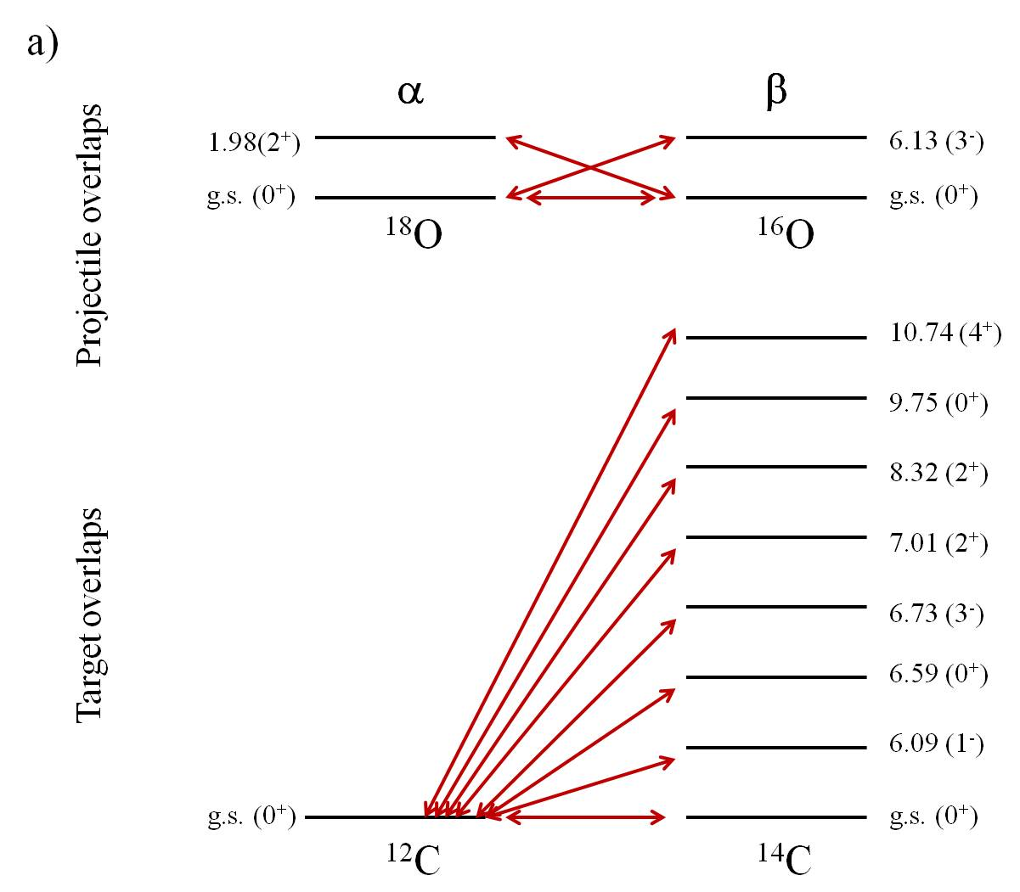
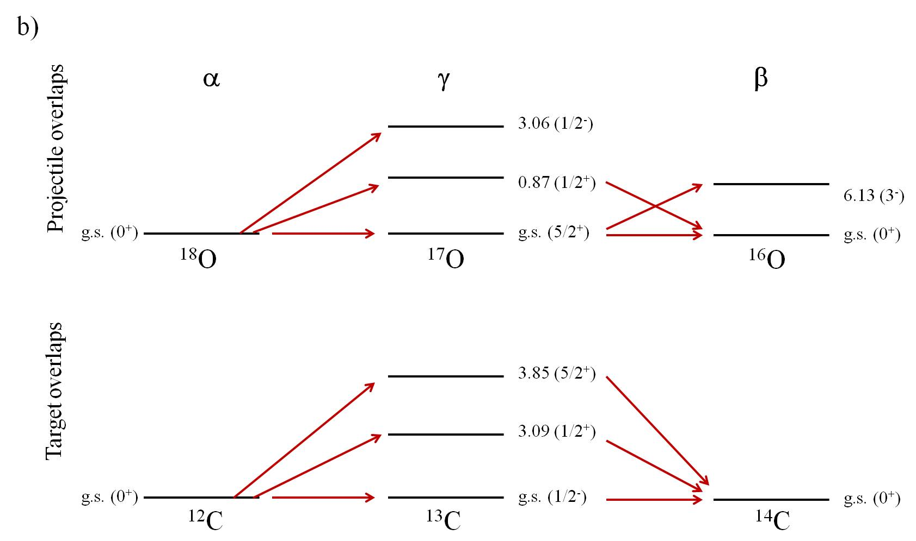
Coupling schemes
DREB2016 9th International conference on Direct Reactions with Exotic Beams July 11 – 15, 2016, Halifax, Canada

Slide 36
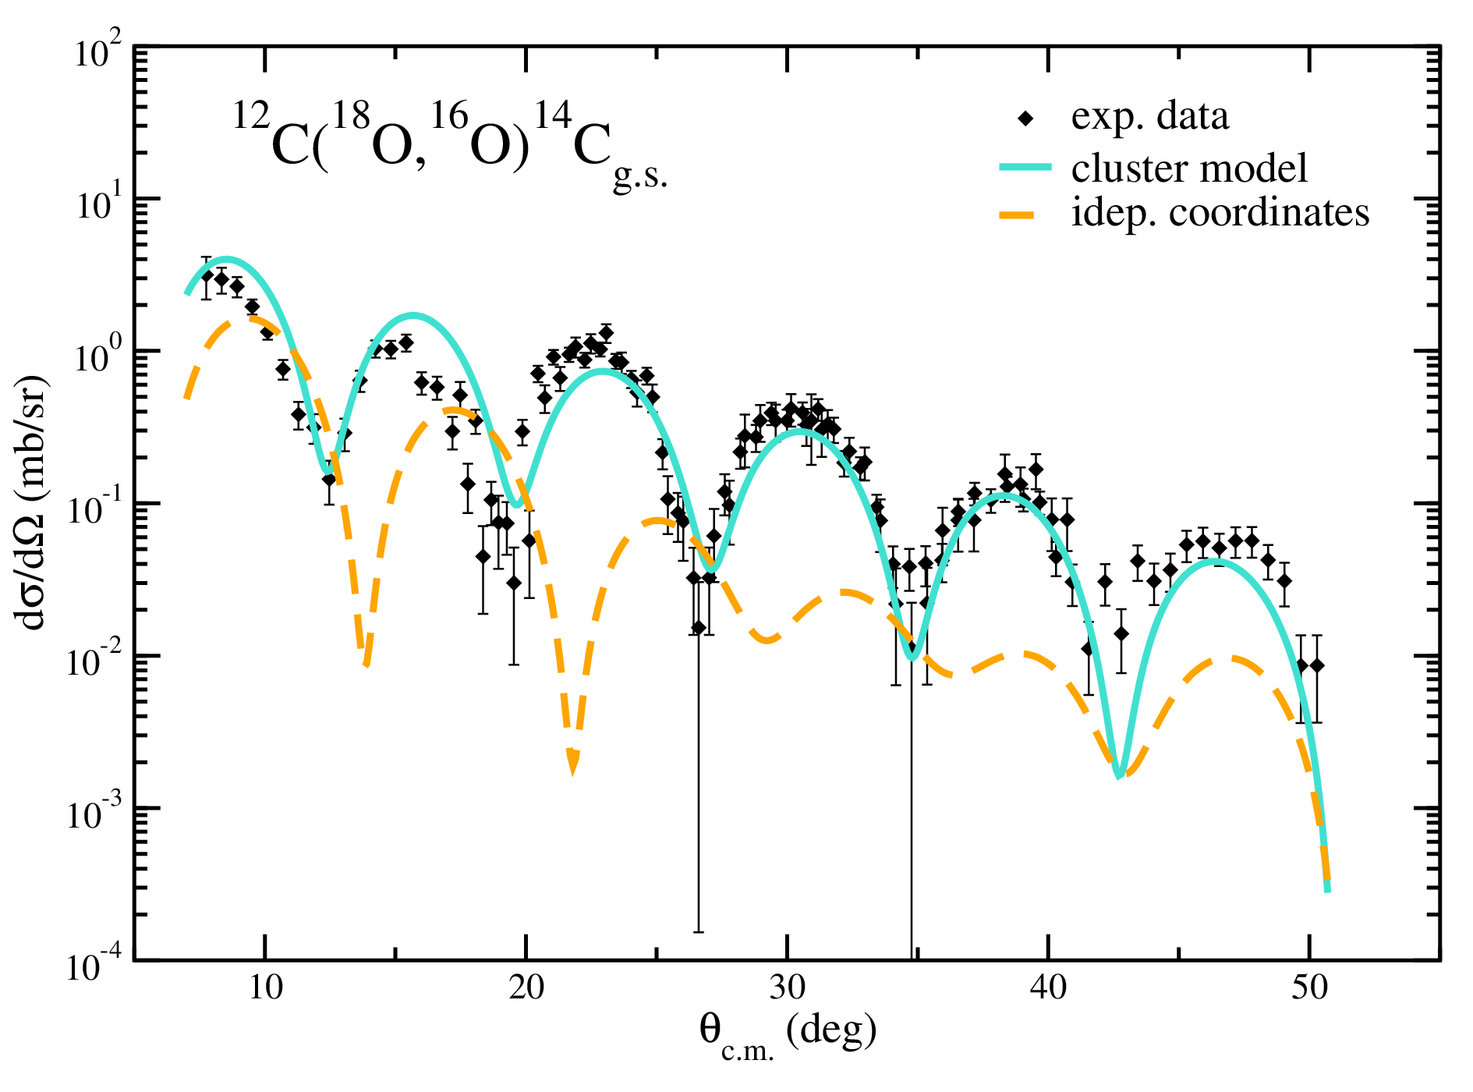
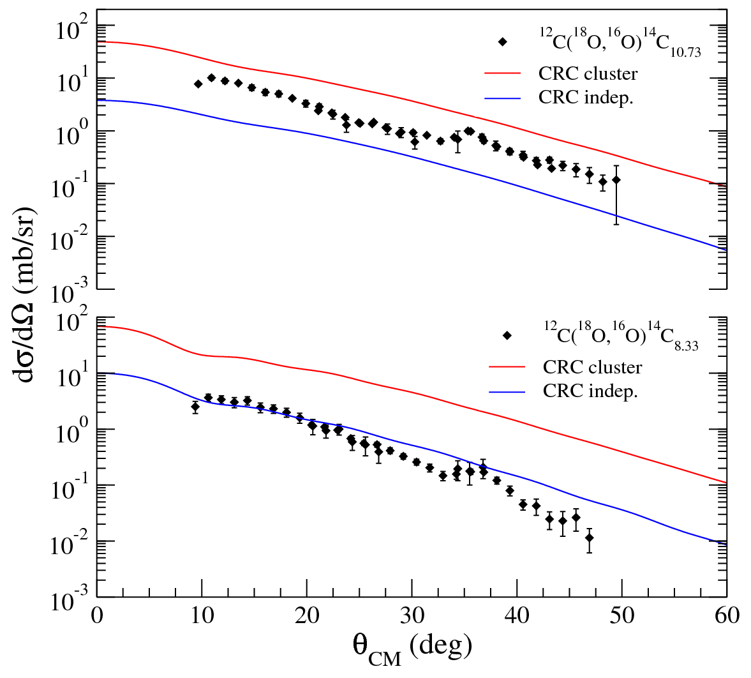
CRC calculations for ¹⁴C transitions
M. Cavallaro et al., PRC 88 (2013) 054601
CRC - Cluster model (L-S coupling)
CRC – Independent transfer (j-j coupling)
L = 0
L = 4
Coherent sum of direct (cluster model) and sequential calculations
Coherent sum of direct (independent coordinates) and sequential calculations
L = 2
DREB2016 9th International conference on Direct Reactions with Exotic Beams July 11 – 15, 2016, Halifax, Canada

Slide 37
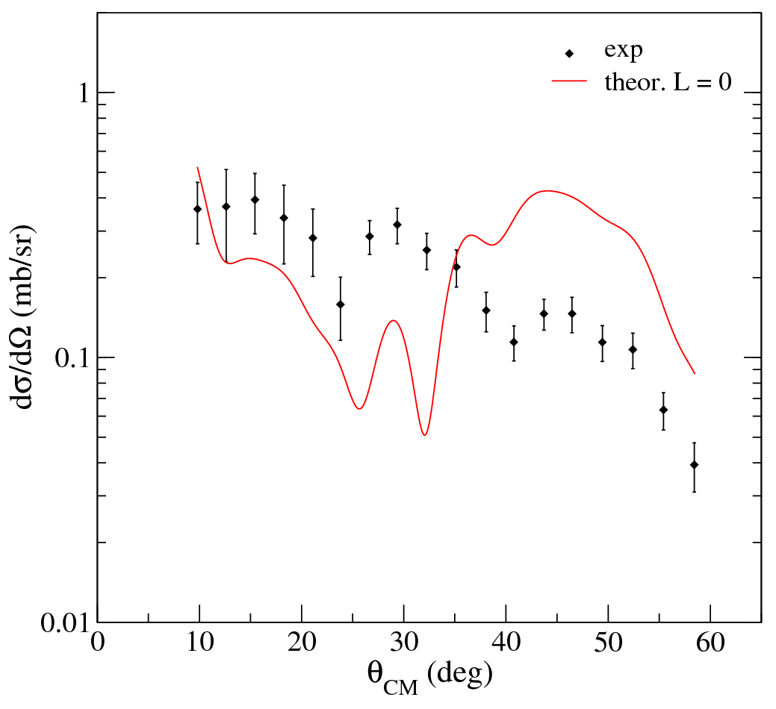
Discretized continuum scheme
Three 0⁺ bound states of the ¹⁴C were included (E_{x} = 6.589, 9.746, 16.9 MeV)
Maximum angular momentum of 100ħ
R_{max} = 600 fm for the ¹⁶O and ¹⁴C relative motion
r_{max} = 100 fm for the 2n-¹²C
Bin width set to 2 MeV
L = 0 state at 16.9 MeV in ¹⁴C
No scaling factors
DREB2016 9th International conference on Direct Reactions with Exotic Beams July 11 – 15, 2016, Halifax, Canada

Slide 38
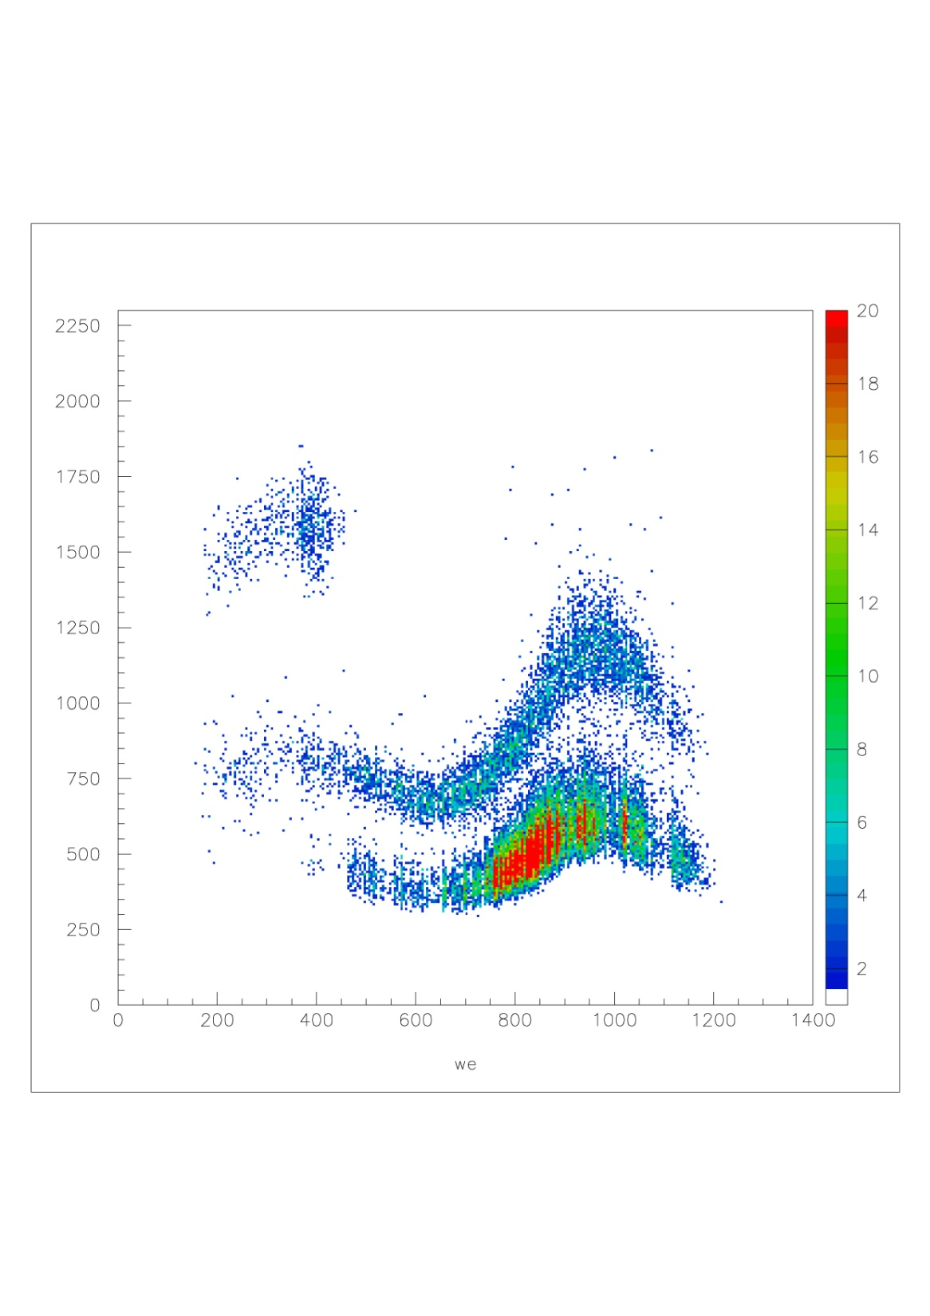
Particle identification
p + ¹²⁰Sn at 35 MeV
8° < θ_{lab} < 12°
α
ΔE
t
d
X_{f oc}(mm)
DREB2016 9th International conference on Direct Reactions with Exotic Beams July 11 – 15, 2016, Halifax, Canada

