Slide 1

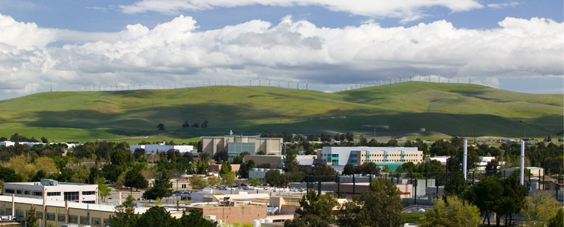




Ab Initio Structure and Reactions of Light Nuclei
Collaborators:
  A. Calci (TRIUMF)
  J. Dohet-Eraly (TRIUMF)
  J. Langhammer (Private sector)
  P. Navrátil (TRIUMF)
  F. Raimondi (U. of Surrey)
  C. Romero-Redondo (LLNL)
  R. Roth (TU Darmstadt)
  S. Quaglioni (LLNL)
Guillaume Hupin
DREB, Halifax, July 11st 2016.
IRIS collaboration:
A. Kumar, R. Kanungo, A. Sanetullaev et al.
Notes:
Good afternoon. I would like first to thanks the organizers for giving me the opportunity to present some results of ab initio structure and reaction. In this talk we will stay in the region of light nuclei.
In the first parts of these 20 minutes, I will try to convince you that we can use ab initio method and data from reaction with radioactive ion beam to refine our understanding of the nuclear interaction (bare).
While in the second part we will shift gears and use ab initio calculation to obtain observables that would be rather demanding to observe in the laboratory. We will be interested in the case of the polarized dt fusion.

Slide 2

Sandbox: exotic properties of the few-body systems
Stable
Nuclei exhibit:
Bound states
Resonant states
Scattering states
Halo densities
Cluster states
Skins
…
What is the nature
of the nuclear force?
Notes:
I just want to offer you a little reminder on all the exotic nuclear properties that populates the light sector, which gives a glimpse of what one may encounter in medium to heavy nuclei towards the drip lines.

Slide 3

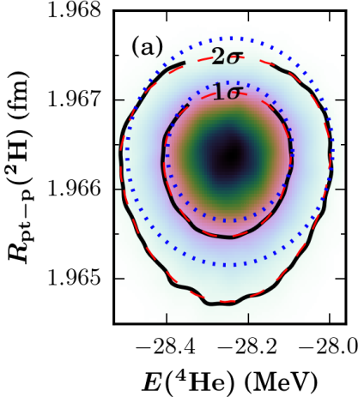







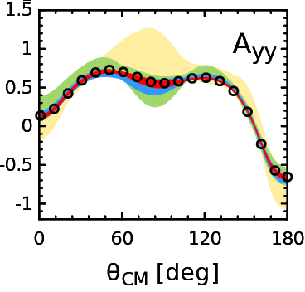
Chiral effective field theory: Towards precision nuclear physics
Importance
Chiral effective field theory is a low-energy expansion of the interaction between nucleons.
B. D. Carlsson et. al. PRX6 (2016)
n-p
NLO →N⁴LO
Constrained to provide an accurate description of the A=2 and A=3 systems.
E. Epelbaum, et al.
PRL115 (2015)
Predictions for nuclear structure and dynamic (A>3).

Slide 4


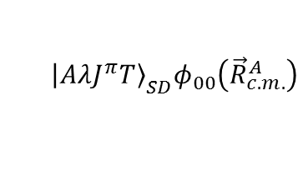

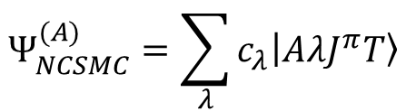
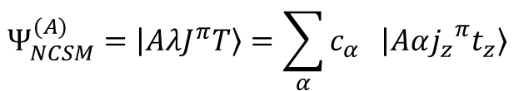

Equal treatment of bound and resonant states: couple NCSM and NCSM/RGM (NCSMC)
Methods develop in this presentation to solve the many body problem
$$Ψ_{NCSM}^{(A)}=\left|\left.AλJ^{π}T\right\rangle \right.=\sum_{α}{c_{α} \left|\left.Aα{j_{z}}^{π}t_{z}\right\rangle \right.}$$
Can address bound and low-lying resonances (short range correlations)
Mixing coefficients(unknown)
A-body harmonic oscillator states
$${\left|\left.AλJ^{π}T\right\rangle \right.}_{SD}φ_{00}\left({\vec{R}}_{c.m.}^{A}\right)$$
Second quantization
N_{max}
HO basis
$$ℏΩ$$
$$≈e^{−αr}$$
No-Core Shell Model
$$Ψ_{NCSMC}^{(A)}=\sum_{λ}{c_{λ}\left|\left.AλJ^{π}T\right\rangle \right.}$$
Notes:
So basically we merge the two approach
The one for the nuclear structure that will get a good shot at the low-lying resonance
The one that will deal with the scattering degree of freedom !
The NCSMC is born cf those paper.

Slide 5


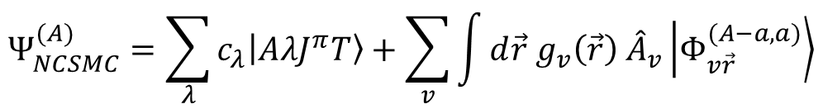

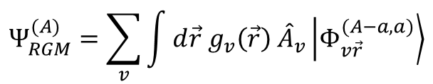



Equal treatment of bound and resonant states: couple NCSM and NCSM/RGM (NCSMC)
Methods develop in this presentation to solve the many body problem
Can address bound and low-lying resonances (short range correlations)
$$Ψ_{NCSM}^{(A)}=\left|\left.AλJ^{π}T\right\rangle \right.=\sum_{α}{c_{α} \left|\left.Aα{j_{z}}^{π}t_{z}\right\rangle \right.}$$
Can address bound and low-lying resonances (short range correlations)
Mixing coefficients(unknown)
A-body harmonic oscillator states
$${\left|\left.AλJ^{π}T\right\rangle \right.}_{SD}φ_{00}\left({\vec{R}}_{c.m.}^{A}\right)$$
Second quantization
$${\vec{r}}_{A−a,a}$$
$$Ψ_{RGM}^{(A)}=\sum_{v}{\int{d\vec{r} g_{v}\left(\vec{r}\right) {\hat{A}}_{v}\left|\left.Φ_{v\vec{r}}^{(A−a,a)}\right\rangle \right.}}$$
$$a$$
$$(A−a)$$
$$ψ_{α_{1}}^{(A−a)}ψ_{α_{2}}^{(a)} δ(\vec{r}−{\vec{r}}_{A−a,a})$$
Relative wave function (unknown)
Channel basis
Cluster expansion technique
Antisymmetrizer
NCSM/RGM
Cluster formalism for elastic/inelastic
$$Ψ_{NCSMC}^{(A)}=\sum_{λ}{c_{λ}\left|\left.AλJ^{π}T\right\rangle \right.+\sum_{v}{\int{d\vec{r} g_{v}\left(\vec{r}\right) {\hat{A}}_{v}\left|\left.Φ_{v\vec{r}}^{(A−a,a)}\right\rangle \right.}}}$$
Notes:
So basically we merge the two approach
The one for the nuclear structure that will get a good shot at the low-lying resonance
The one that will deal with the scattering degree of freedom !
The NCSMC is born cf those paper.

Slide 6
Equal treatment of bound and resonant states: couple NCSM and NCSM/RGM (NCSMC)
S. Baroni, P. Navrátil and S. Quaglioni PRL110 (2013); PRC93 (2013)
Methods develop in this presentation to solve the many body problem
$$Ψ_{NCSM}^{(A)}=\left|\left.AλJ^{π}T\right\rangle \right.=\sum_{α}{c_{α} \left|\left.Aα{j_{z}}^{π}t_{z}\right\rangle \right.}$$
Can address bound and low-lying resonances (short range correlations)
Mixing coefficients(unknown)
A-body harmonic oscillator states
$${\left|\left.AλJ^{π}T\right\rangle \right.}_{SD}φ_{00}\left({\vec{R}}_{c.m.}^{A}\right)$$
Second quantization
$${\vec{r}}_{A−a,a}$$
$$Ψ_{RGM}^{(A)}=\sum_{v}{\int{d\vec{r} g_{v}\left(\vec{r}\right) {\hat{A}}_{v}\left|\left.Φ_{v\vec{r}}^{(A−a,a)}\right\rangle \right.}}$$
$$a$$
Design to account for scattering states ( best for long range correlations)
$$(A−a)$$
$$ψ_{α_{1}}^{(A−a)}ψ_{α_{2}}^{(a)} δ(\vec{r}−{\vec{r}}_{A−a,a})$$
Relative wave function (unknown)
Channel basis
Cluster expansion technique
Antisymmetrizer
The many body quantum problem is best described by the superposition of both type of wave functions
$$Ψ_{NCSMC}^{(A)}=\sum_{λ}{c_{λ}\left|\left.AλJ^{π}T\right\rangle \right.+\sum_{v}{\int{d\vec{r} g_{v}\left(\vec{r}\right) {\hat{A}}_{v}\left|\left.Φ_{v\vec{r}}^{(A−a,a)}\right\rangle \right.}}}$$
NCSMC
Notes:
So basically we merge the two approach
The one for the nuclear structure that will get a good shot at the low-lying resonance
The one that will deal with the scattering degree of freedom !
The NCSMC is born cf those paper.

Slide 7


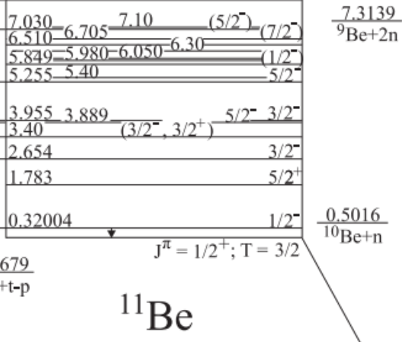
Neutron-rich halo nucleus ¹¹Be
Z=4
N=7
  In the shell model picture g.s. expected to be J^{π}=1/2⁻
    (Z=6, N=7) ¹³C and (Z=8, N=7) ¹⁵O have J^{π}=1/2⁻ g.s.
  In reality, ¹¹Be g.s. is J^{π}=1/2⁺ -- parity inversion
  Very weakly bound: E_{th}=-0.5 MeV Halo state -- dominated by ¹⁰Be-n in the S-wave
  The 1/2⁻ state also bound -- only by 180 keV
Can we describe ¹¹Be in ab initio calculations?
      Continuum must be included
      Does the 3N interaction play a role in the parity inversion?
1s_{1/2}
0p_{1/2}
0p_{3/2}
0s_{1/2}
  Single particle interpretation using nuclear shell model

Slide 8
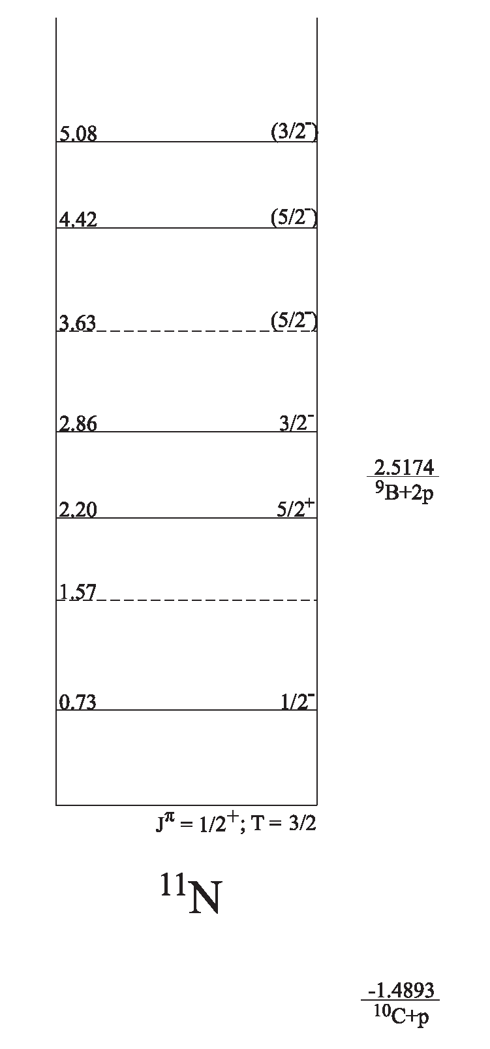
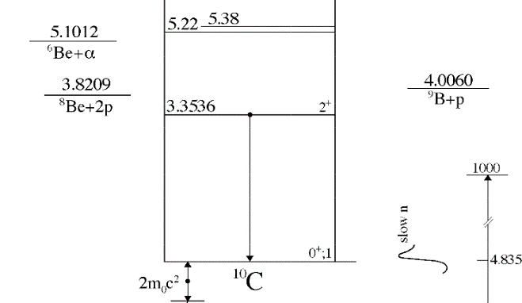
p-¹⁰C scattering: structure of ¹¹N resonances
  Limited information about the structure of proton rich ¹¹N – mirror nucleus of ¹¹Be halo nucleus
  Incomplete knowledge of ¹⁰C unbound excited states
  Importance of 3N force effects and continuum
  Can structure of exotic nuclei discriminate among different nuclear force models?

Slide 9
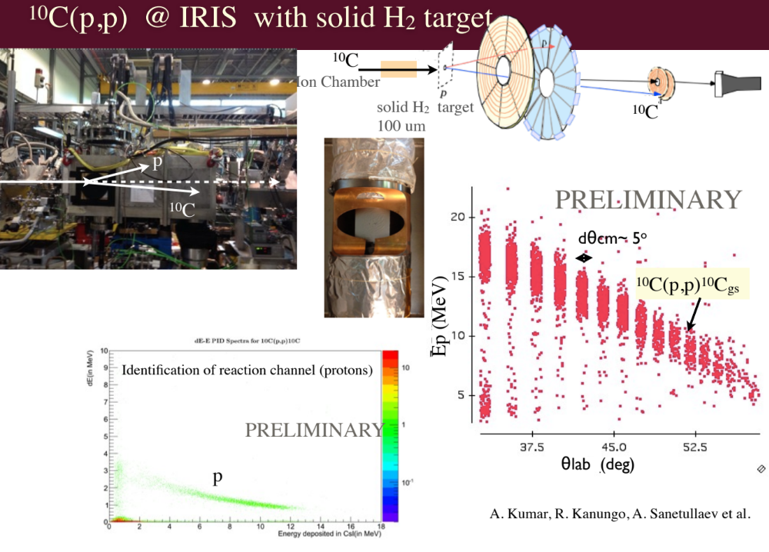
¹⁰C(p,p) @ IRIS with solid H₂ target
New experiment at ISAC TRIUMF with reaccelerated ¹⁰C
  The first ever ¹⁰C beam at TRIUMF
  Angular distributions measured at E_{CM} ~ 4.16 MeV and 4.4 MeV
IRIS collaboration:
A. Kumar, R. Kanungo, A. Sanetullaev et al.

Slide 10


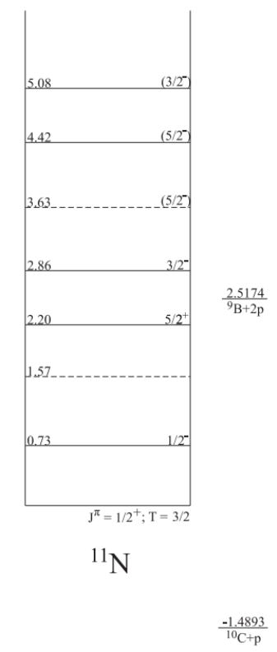
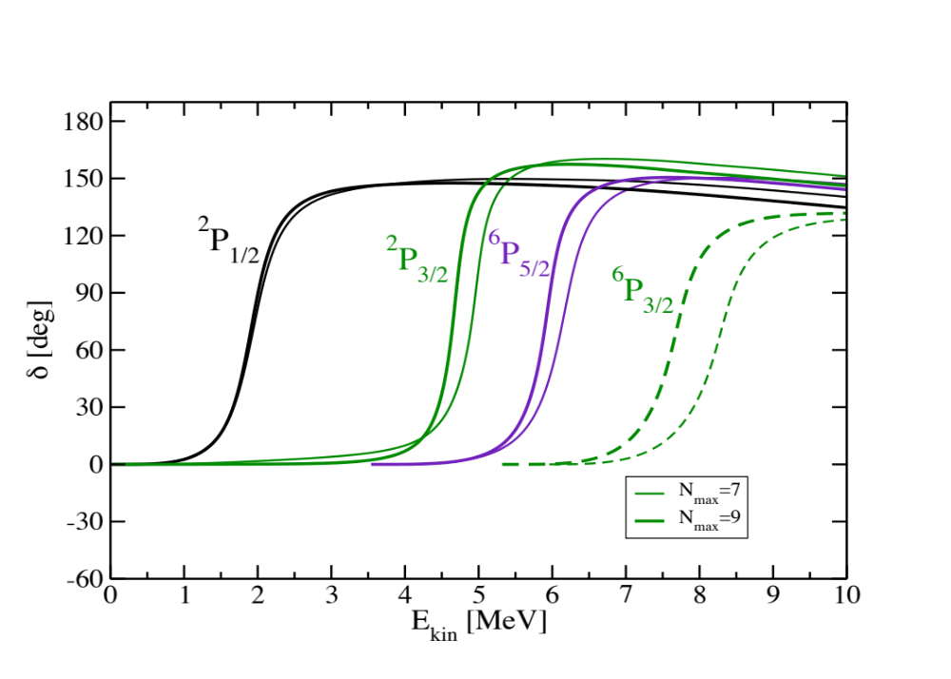
p-¹⁰C scattering: structure of ¹¹N resonances
A. Calci, P. Navratil, G. Hupin, S. Quaglioni, R. Roth et al. with IRIS collaboration, in preparation
NCSMC calculations with chiral NN+3N [N³LO NN+N²LO 3NF(400), NNLOsat]
    ¹⁰C: 0⁺, 2⁺, 2⁺ NCSM eigenstates
    ¹¹N: ≥4 (π=-1= and ≥3 (π=+1) NCSM eigenstates
p-¹⁰C phase shifts with NN+3N (Λ=400)
preliminary

Slide 11
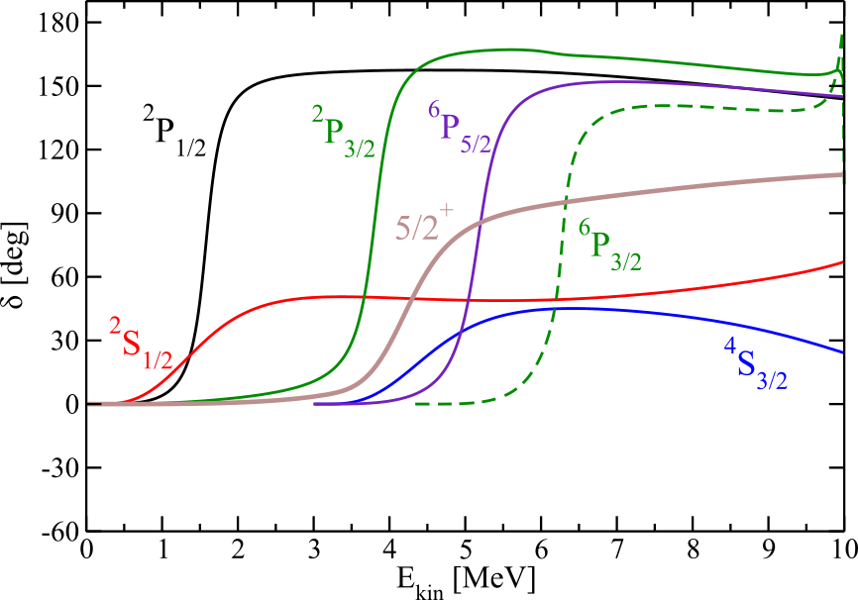
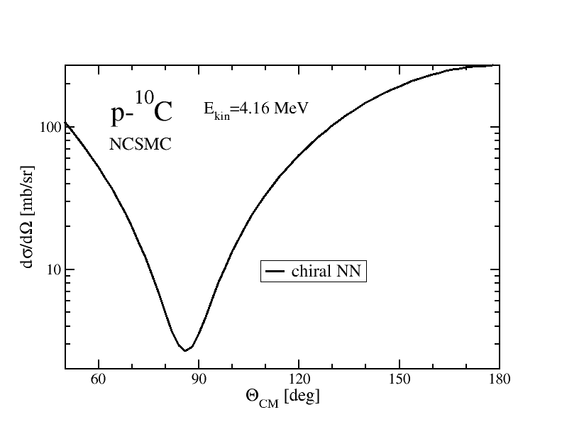
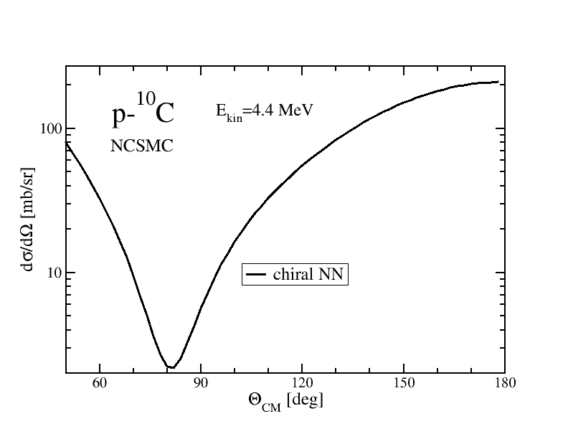
p-¹⁰C scattering: structure of ¹¹N resonances
A. Calci, P. Navratil, G. Hupin, S. Quaglioni, R. Roth et al. with IRIS collaboration, in preparation
4.16 MeV
4.4 MeV
  Chiral NN

Slide 12
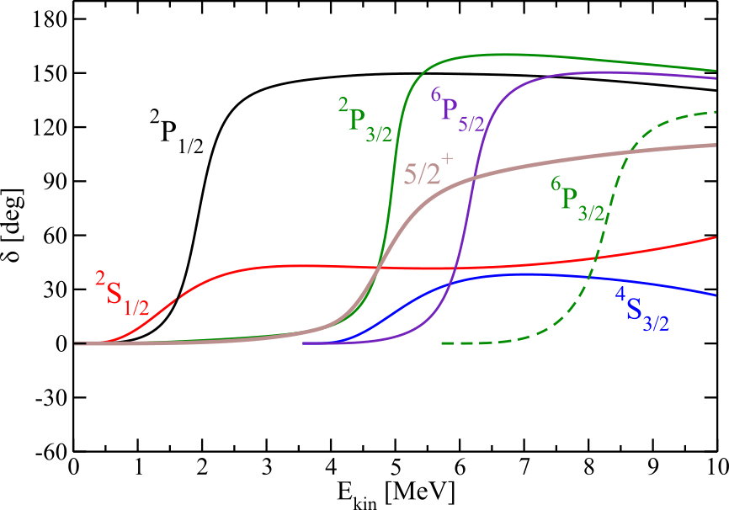
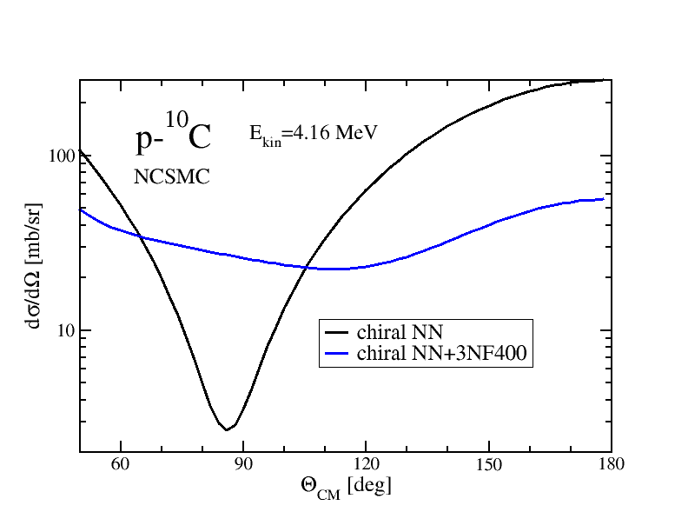
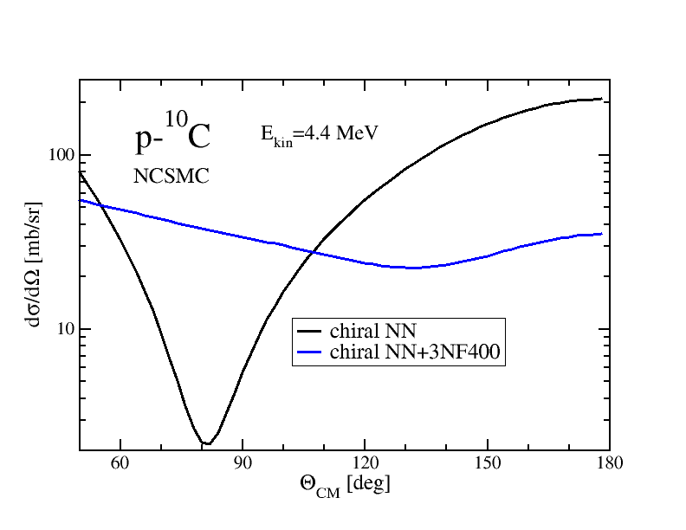
p-¹⁰C scattering: structure of ¹¹N resonances
A. Calci, P. Navratil, G. Hupin, S. Quaglioni, R. Roth et al. with IRIS collaboration, in preparation
Region of 3N force effects
  Chiral NN
  NN+3N(400)

Slide 13
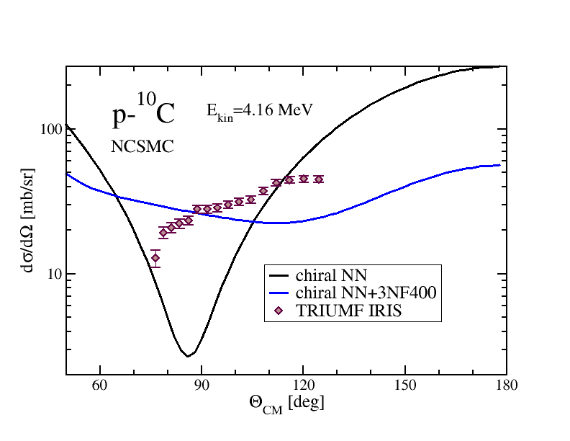
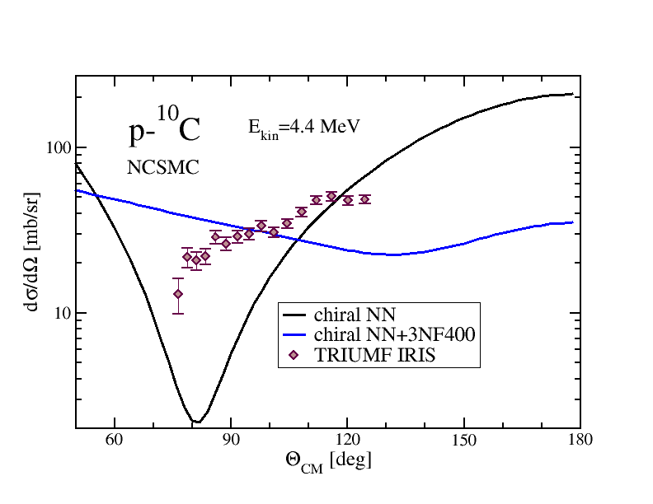
p-¹⁰C scattering: structure of ¹¹N resonances
A. Calci, P. Navratil, G. Hupin, S. Quaglioni, R. Roth et al. with IRIS collaboration, in preparation
Both interaction models fail to reproduce differential data!
preliminary
preliminary
IRIS collaboration: A. Kumar, R. Kanungo, A. Sanetullaev et al.

Slide 14
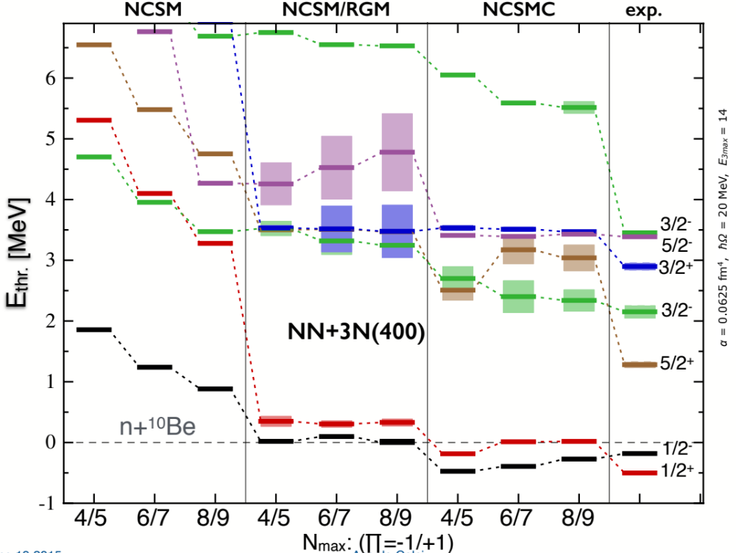
Structure of ¹¹Be from chiral NN+3N forces
A. Calci, P. Navratil, R. Roth, J. Dohet-Eraly, S. Quaglioni, G. Hupin, in preparation
NCSMC calculations including chiral 3N (N³LO NN+N²LO 3NF400)
    ¹⁰Be: 0⁺, 2⁺, 2⁺ NCSM eigenstates
    ¹¹Be: ≥6 (π=-1) and ≥3 (π=+1) NCSM eigenstates
Continuum effects
+
preliminary
N_{max}

Slide 15
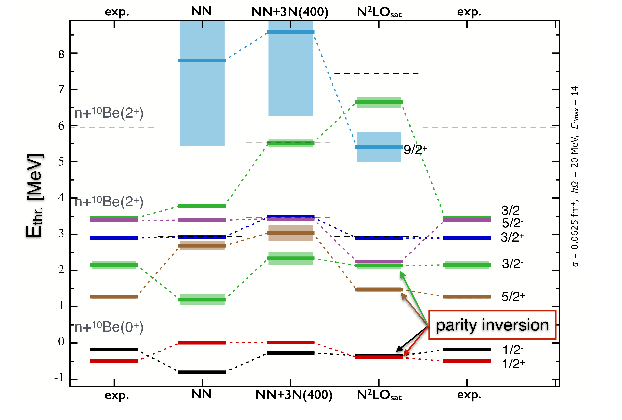
¹¹Be within NCSMC: Discrimination among chiral nuclear forces
A. Calci, P. Navratil, R. Roth, J. Dohet-Eraly, S. Quaglioni, G. Hupin, in preparation
preliminary
Parity inversion

Slide 16
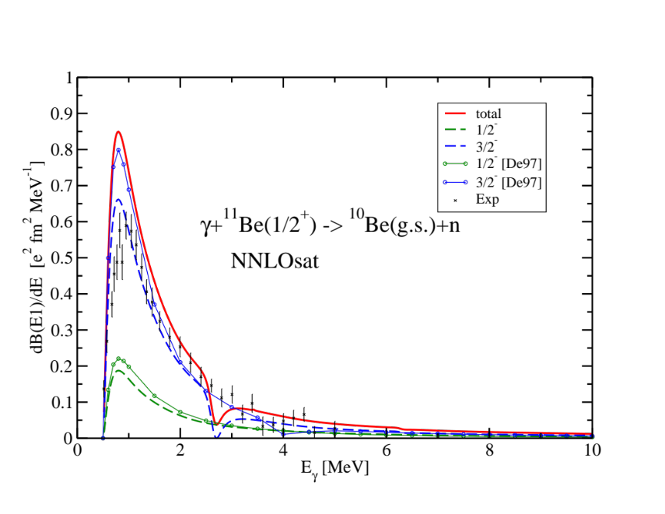
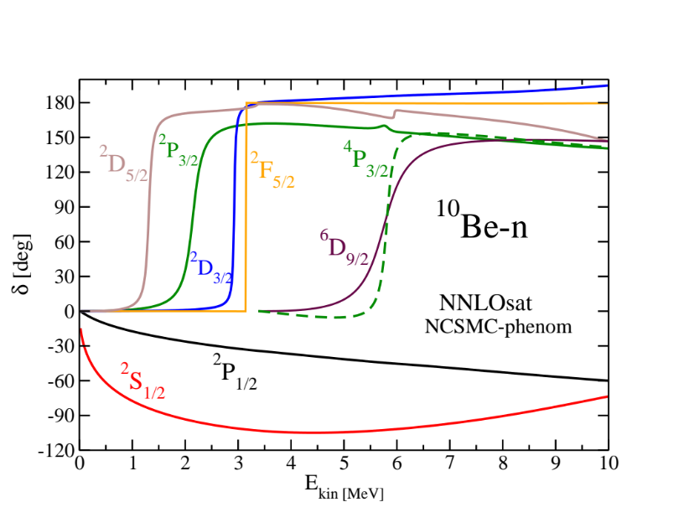
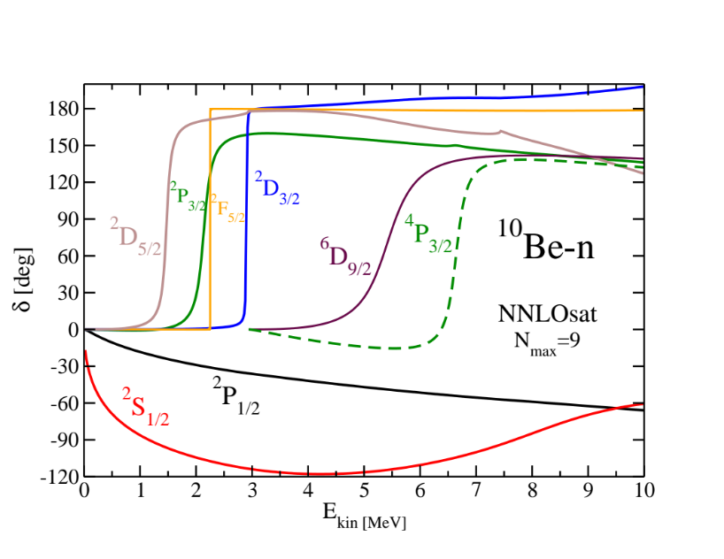
Photodissociation of¹¹Be
A. Calci, P. Navratil, R. Roth, J. Dohet-Eraly, S. Quaglioni, G. Hupin, in preparation
Bound to continuum
Bound to bound
 | NCSM | NCSMC-phenom | Expt.
B(E1; 1/2⁺➔1/2⁻) [e² fm²] | 5x10⁻⁶ | 0.118 | 0.102(2)
NCSMC-phenom
preliminary
NCSMC phenomelogy corrects (with a fit) for model error to reproduce centroid positions.

Slide 17
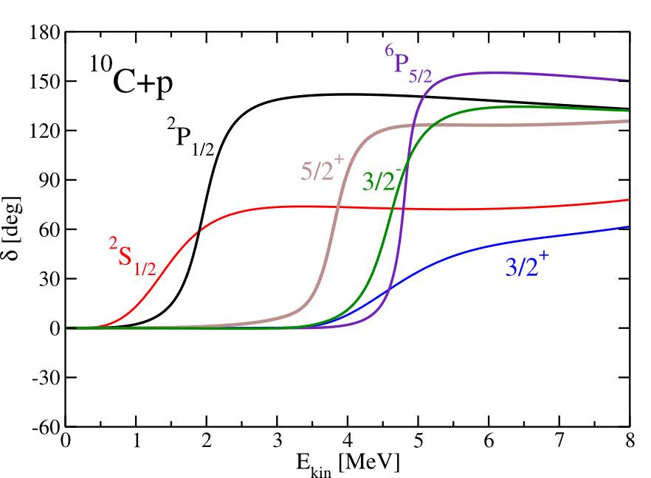
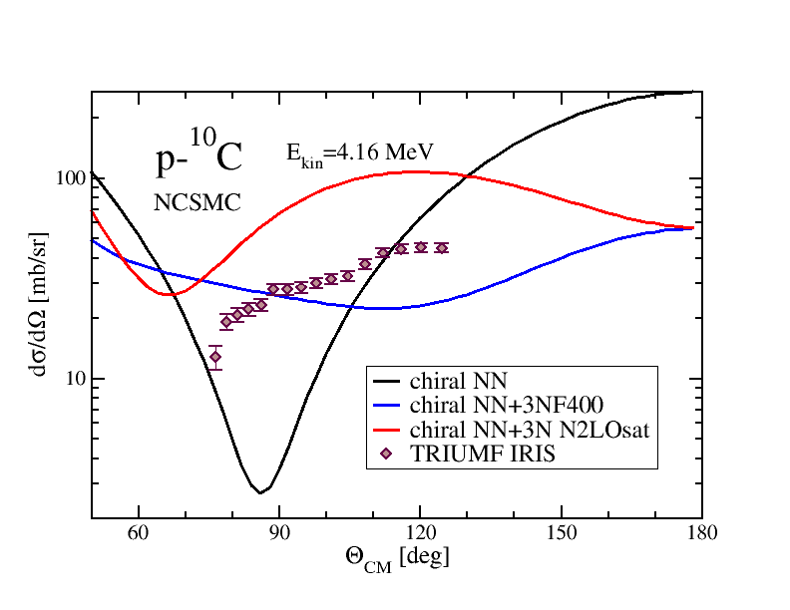
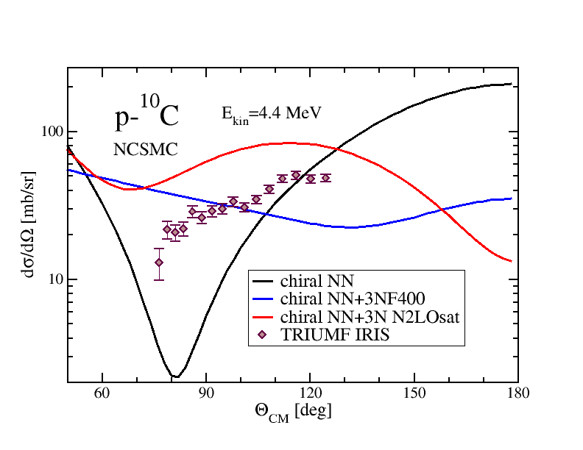
p-¹⁰C scattering: structure of ¹¹N resonances
A. Calci, P. Navratil, G. Hupin, S. Quaglioni, R. Roth et al. with IRIS collaboration, in preparation
IRIS collaboration:
A. Kumar, R. Kanungo, A. Sanetullaev et al.
  NNLOsat
Resonances correctly ordered
preliminary
preliminary

Slide 18
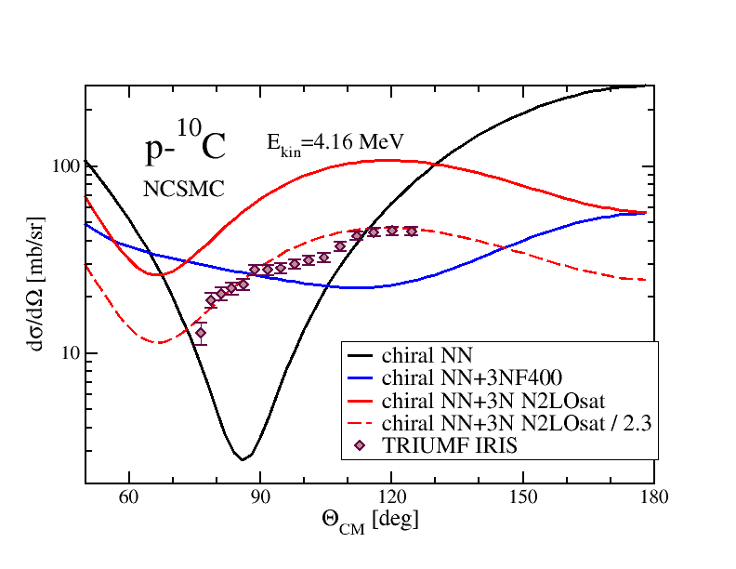
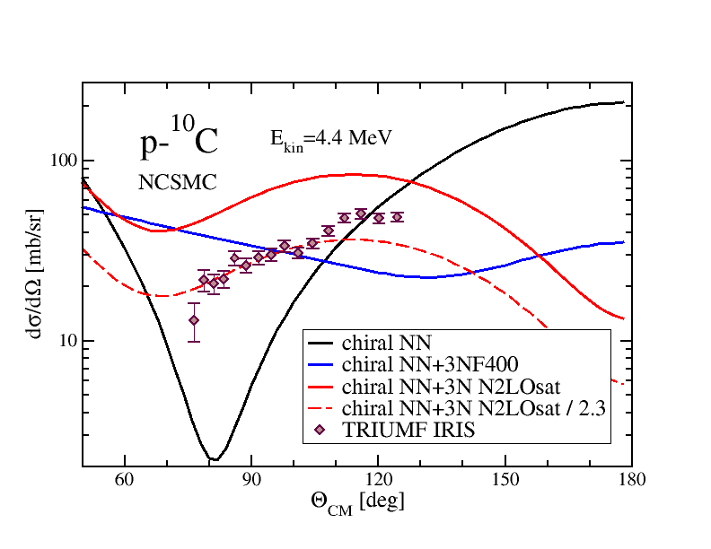
p-¹⁰C scattering: structure of ¹¹N resonances
A. Calci, P. Navratil, G. Hupin, S. Quaglioni, R. Roth et al. with IRIS collaboration, in preparation
IRIS collaboration:
A. Kumar, R. Kanungo, A. Sanetullaev et al.
Possibility to discriminate between chiral nuclear forces
preliminary
preliminary

Slide 19
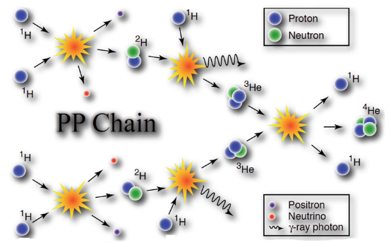



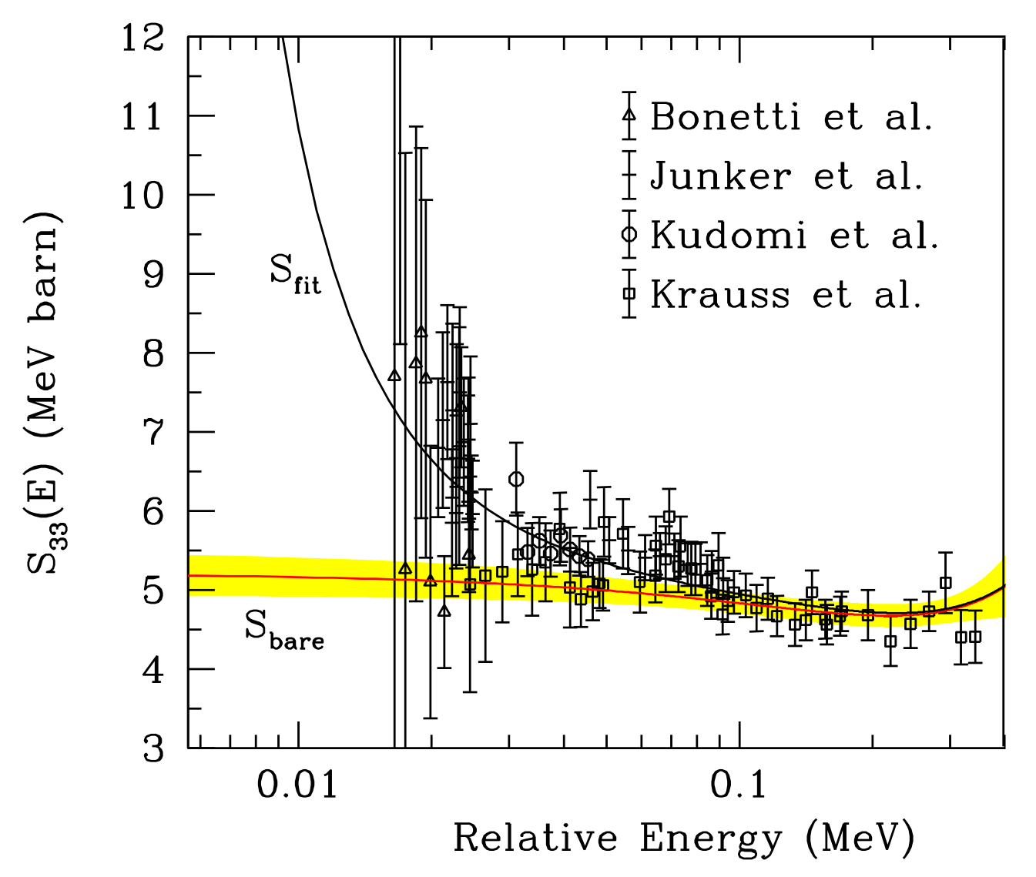
Fusion processes play an important role in determining the evolution of our universe, e.g. nucleosynthesis, stellar evolution …
What powers stars ?
How long does a star live ?
…
Nuclear astrophysics community relies on accurate fusion reaction observables among others.
Challenging for both experiment and theory:
  Low rates: due to Coulomb repulsion between target/projectile and low-energy reactions (quantum tunneling effects).
  Projectile and target are not fully ionized in a lab. This leads to laboratory electron screening.
  Fundamental theory is still missing.
S-factor for ³He(³He,2p)⁴He
E. G. Adelberger et al., RMP83 (2011)
Notes:
I would like to develop a little bit more on my first motivation which is a perfect case to advocate for ab initio calculations. The pp chain consists of a chain of low-energy nuclear reaction that happens in star like our sun. These are low-energy reaction because they are in a plasma medium meaning that the typical energy scale is thermal energy (related the temperature of the star). Nuclear astrophysicist who want to model the evolution of star, their death etc need some nuclear physics inputs. Those are sometime very challenging to obtain both exp and theoretically. There are a couple of reasons for that. First since it is low-energy reaction in a plasma you have “List”… for the theorist the fundamental theory that can predict the reaction cross-section without tuning is still not available above masses A>5.

Slide 20
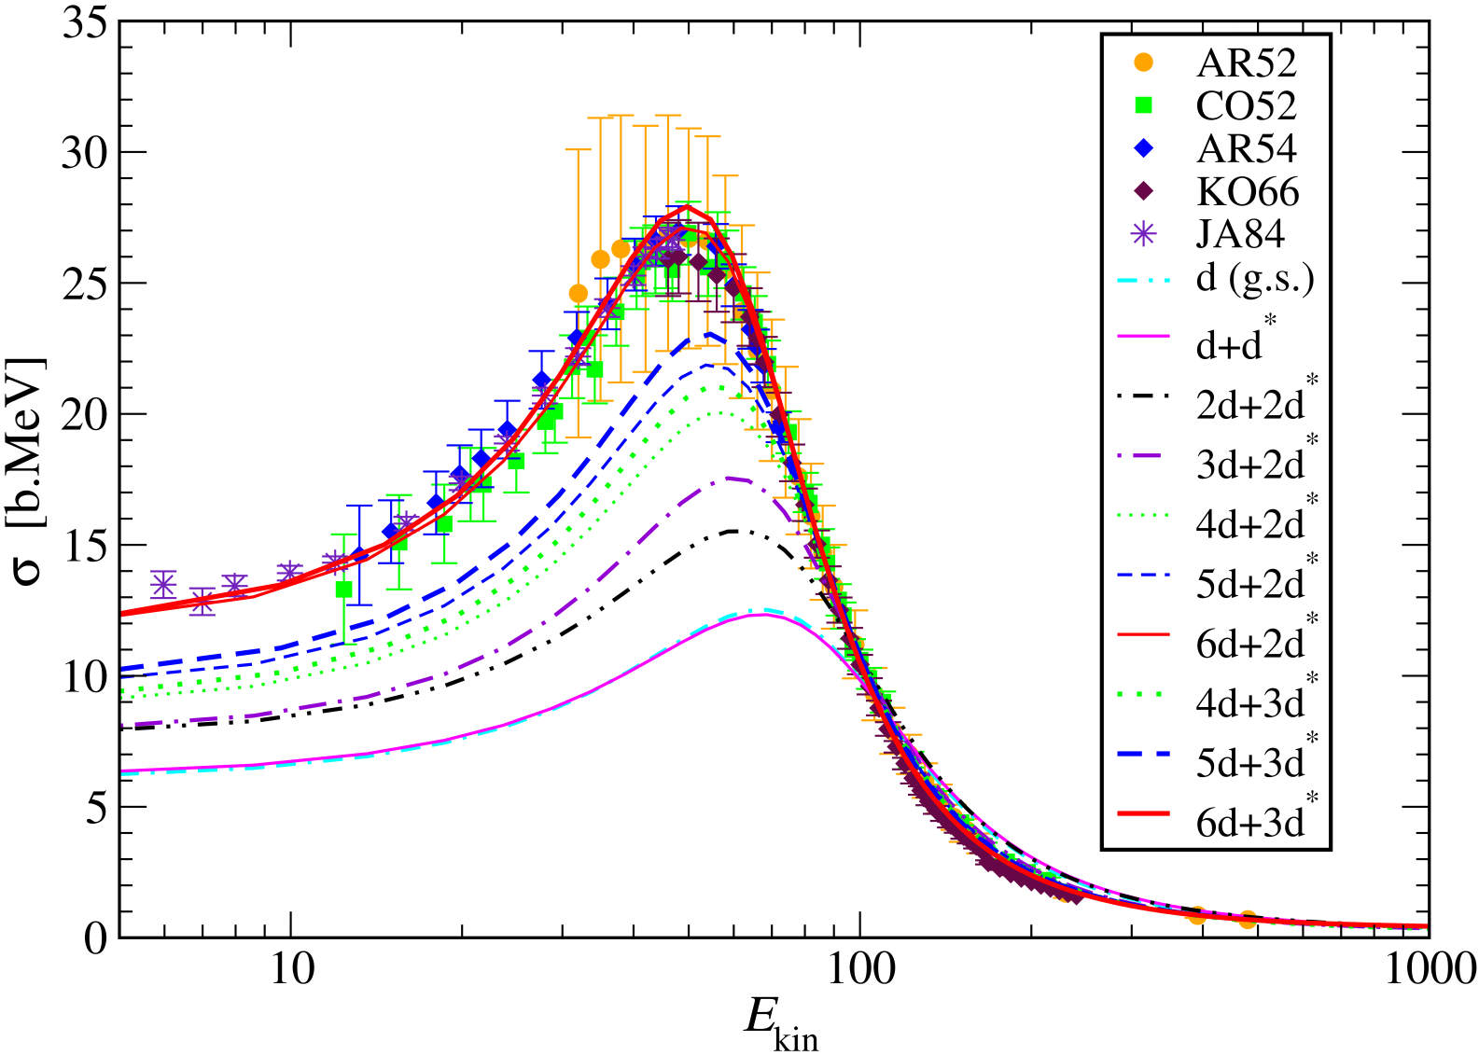
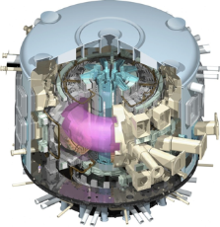
First steps towards Ab initio calculations of fusion
G. Hupin, S. Quaglioni, P. Navrátil work in progress
Ab initio d-t fusion cross-section
Preliminary..
Polarized cross-section will be a valued input to the design of energy based fusion technology.

Slide 21
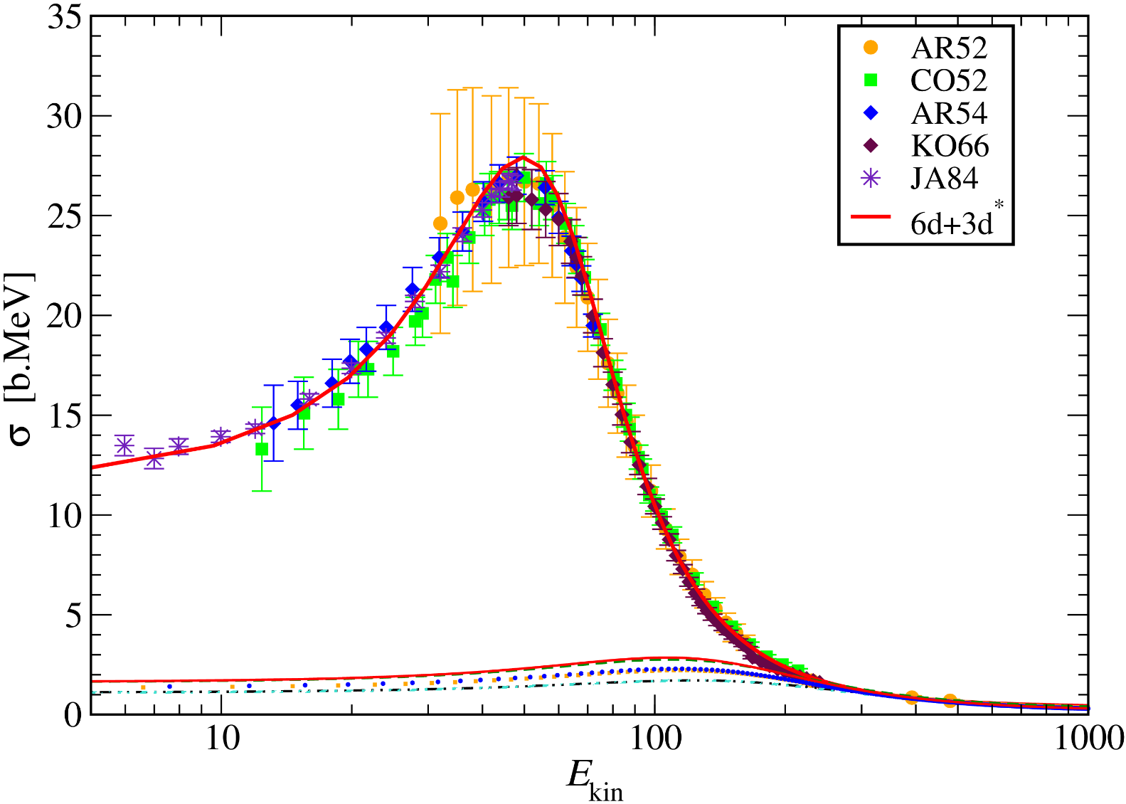
First steps towards Ab initio calculations of fusion
G. Hupin, S. Quaglioni, P. Navrátil work in progress
Ab initio d-t fusion cross-section
Cluster sector only
(NCSM/RGM)

Slide 22
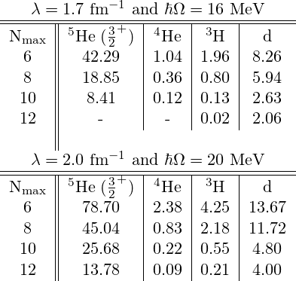
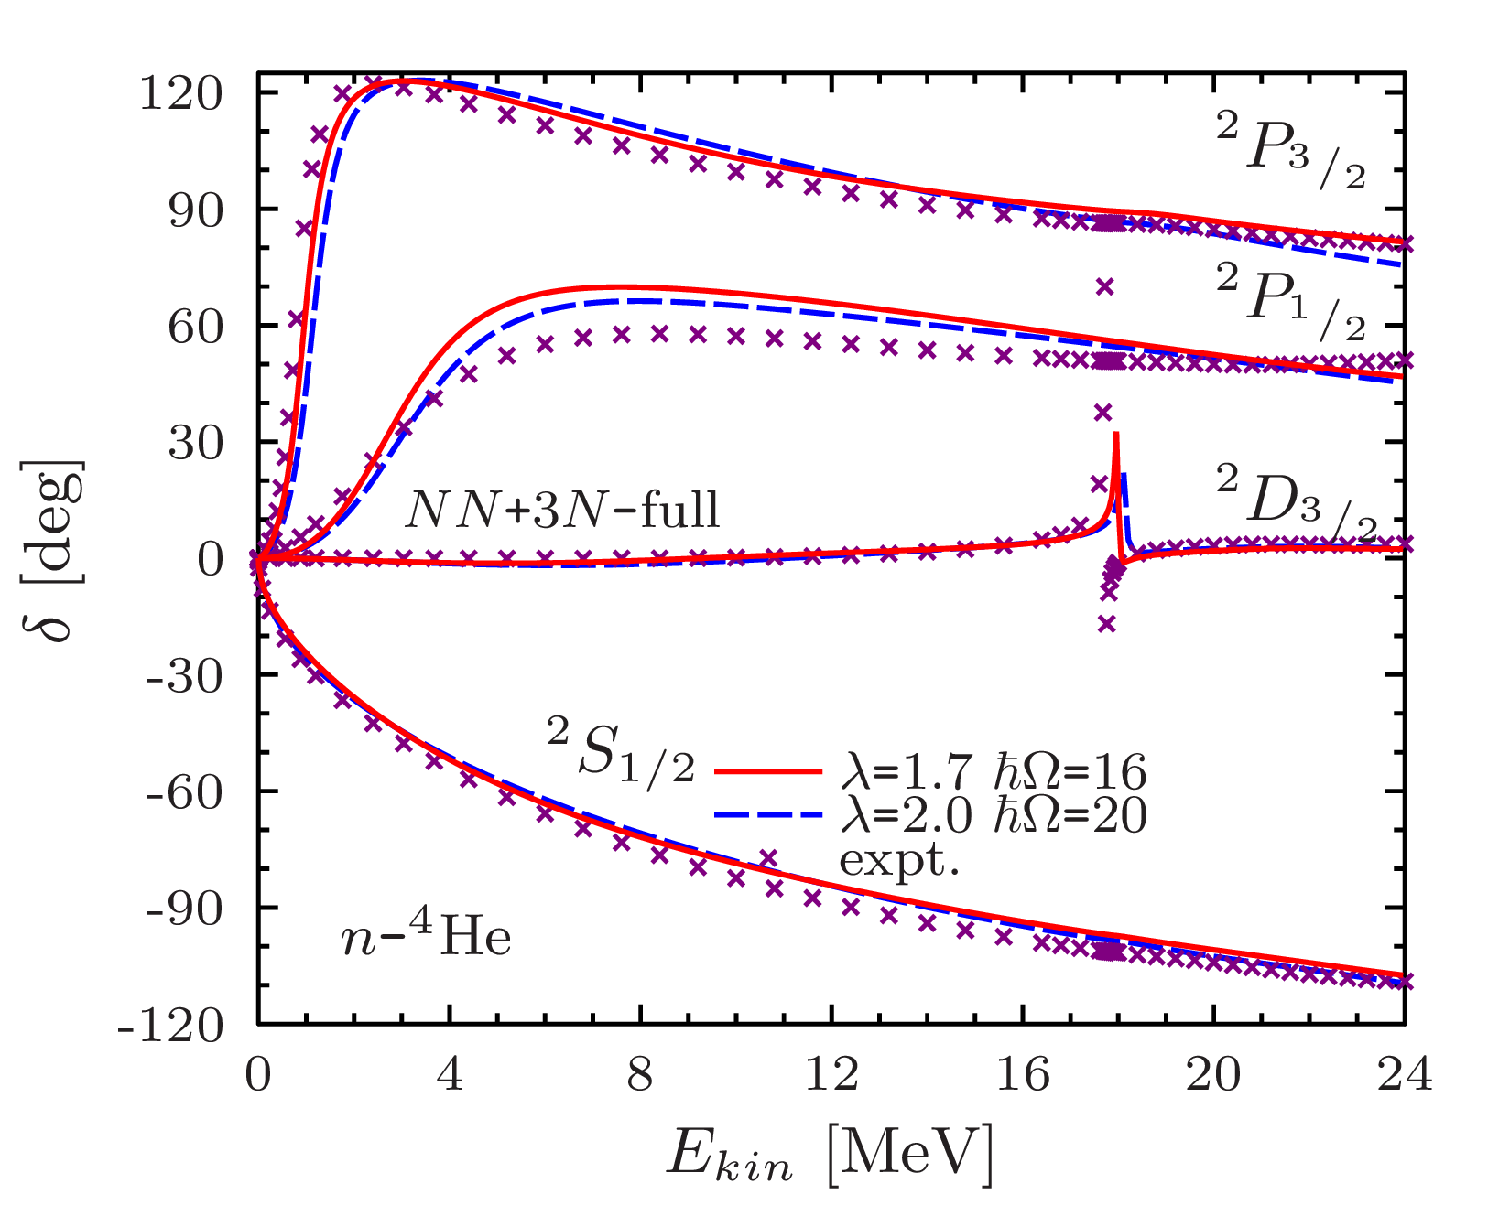
First steps towards Ab initio calculations of fusion
G. Hupin, S. Quaglioni, P. Navrátil work in progress
Towards d-t fusion with NCSMC: comparison between effective interactions
  Relative error (%) with respect to converged value
A smaller frequency allows us to capture the dilute nature of the ³/₂⁺ resonance.
  n+⁴He(g.s.) phase shifts with NN+3N potential, with eigenstates of ⁵He.

Slide 23
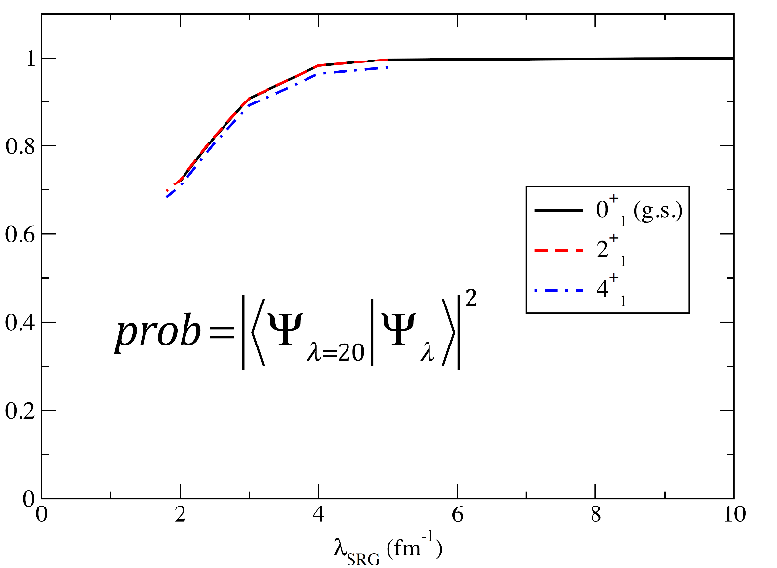

First steps towards Ab initio calculations of fusion
G. Hupin, S. Quaglioni, P. Navrátil work in progress
Towards d-t fusion with NCSMC: comparison between effective interactions
The eigenvalue changes a huge amount but the eigenvector only changes a little.
  n+⁴He(g.s.) phase shifts with NN+3N potential, with eigenstates of ⁵He.
C. Johnson, “Spectral distribution theory and the evolution of forces under the similarity renormalization group” at workshop “Progress in Ab Initio Techniques in Nuclear Physics” TRIUMF, Canada

Slide 24
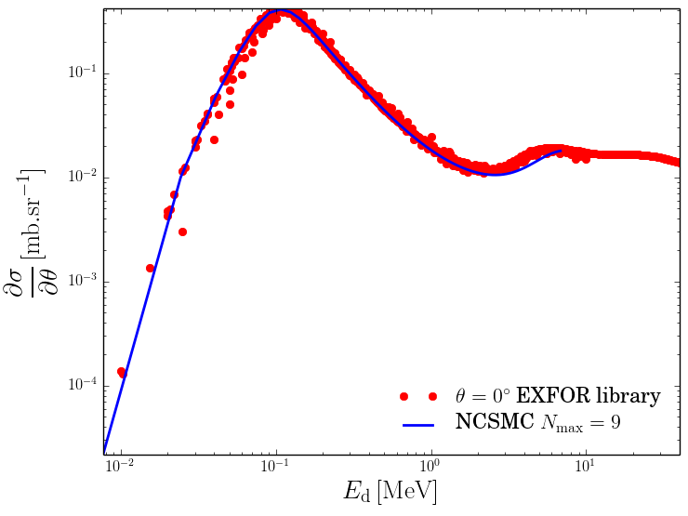
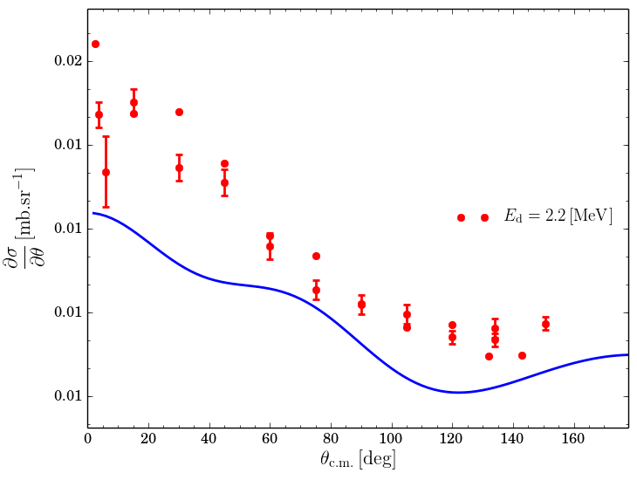
First steps towards Ab initio fusion:
G. Hupin, S. Quaglioni, P. Navrátil work in progress
Differential cross-section vs evaluation
Good reproduction of d-t fusion differential evaluated data
Differential cross-section at higher energies
E_{excitation}=18-19MeV (c.m.)
High energy tail is sensitive to higher centroid energy resonances. Current N_{max} is too low for that region.

Slide 25
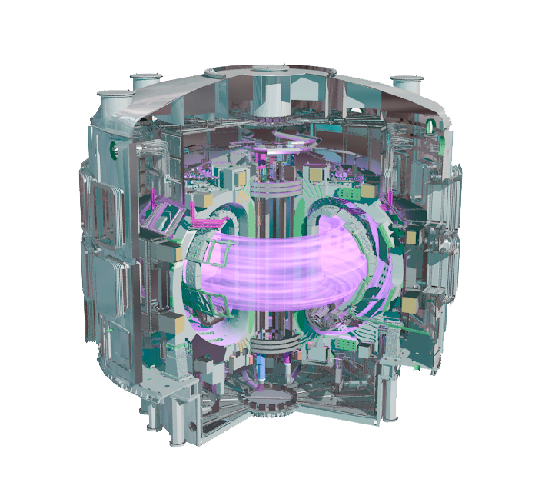
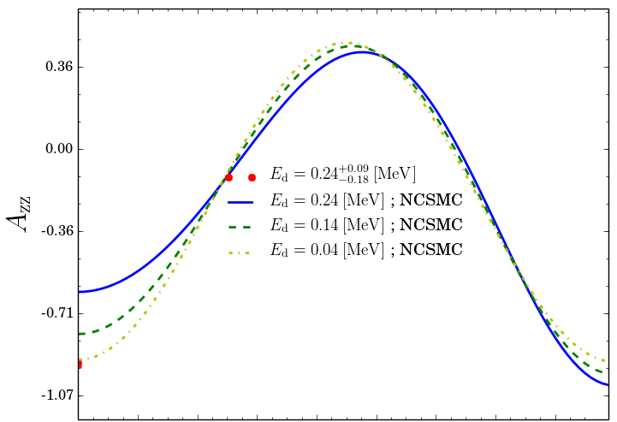
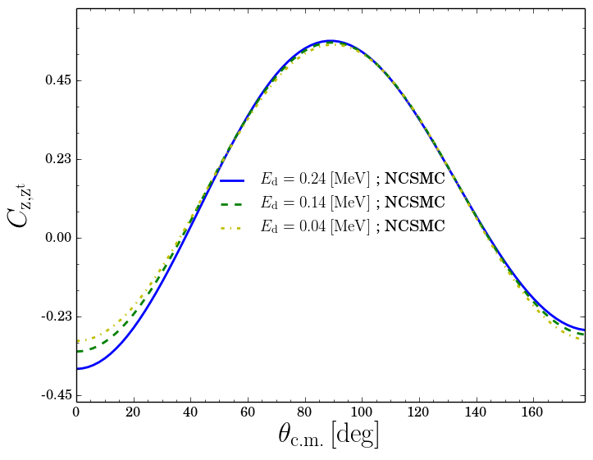


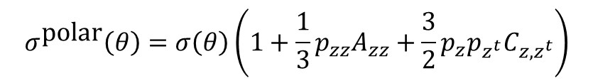
POLARIZED THERMONUCLEAR FUSION
G. Hupin, S. Quaglioni, P. Navrátil work in progress
Analysing power and polarization tensor
Expt
Magnetic field B ≈ 11.8T
Plasma T ≈ 150 million°C
$$σ^{\text{polar}}\left(θ\right)=σ\left(θ\right)\left(1+\frac{1}{3}p_{zz}A_{zz}+\frac{3}{2}p_{z}p_{z^{t}}C_{z,z^{t}}\right)$$
Assume a Boltzmann distribution of the spin:
$$p\left(m_{i}\right)={e^{(−m_{i}gμ_{0}B/(k_{b}T))}}/{Tr(p)}$$
$C_{z,z^{t}}$ challenging to observe in the lab

Slide 26
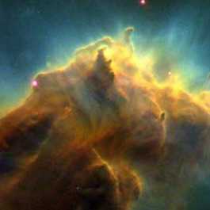
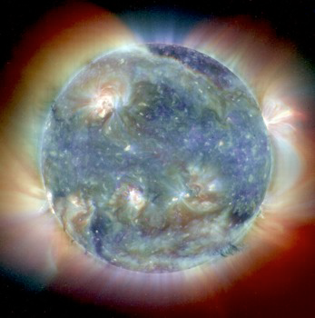
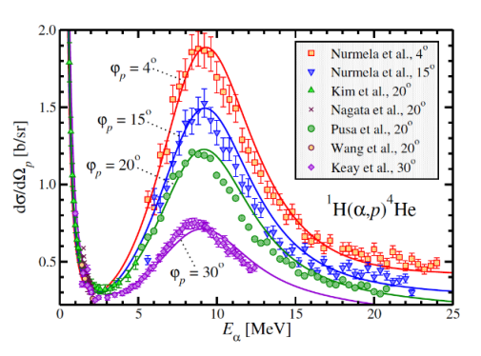
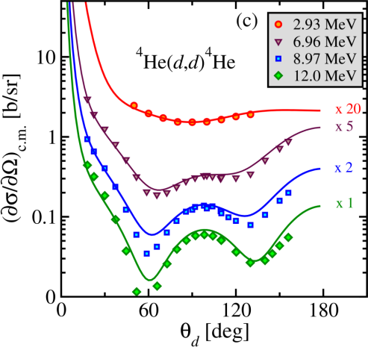



Conclusions and Outlook
⁵Li
⁶Li
Evolution of stars, birth, main sequence, death
⁶He
Notes:
In conclusion:
We are extending the ab initio no-core shell model to treat low-energy light-ion reactions.
The nucleon scattering on light nuclei with realistic NN potentials represent our recent achievements in this direction.
We have much more work ahead of us. Indeed, we need to implement and test the approach for heavier projectiles, startng with the deuteron projectile, up to the alpha-particle projectile, which is essential to calculate reactions of astrophysical interest.
Inaddition, it is clear that this approach is not always efficient. In particular when the target has a very small disintegration threshold. But we have already an idea of how make our method more efficient.
Merging the NCSM and RGM approaches represents our best opportunity to build a method able to describe both structure and continuum.
Indeed, the RGM equations can be solved also using bound-state boundary conditions. In this regard the RGM method can provide the long range part of the model space needed to describe system like the 6He.
In the next steps we are planning on introducing the NNN potential terms in the RGM formalism, as well as the treatment of two-cluster basis with two-, three- and four-nucleon projectiles.
Finally: our ultimate goal in the long run is to build a more complete microscopic theory of both structure and reactions, the ab initio NCSM with continuum, by constructing an over-complete model space containing the NCSM basis, the cluster basis, but also the coupling between them. With this kind of basis one has a better hope to tackle problems like the 9Be breakup in n+8Be.

