Slide 1



Second 0⁺ state of unbound ¹²O via the (p, t) reaction
Daisuke Suzuki
Riken Nishina Center
daisuke.suzuki@ribf.riken.jp
+81-(0)48-467-4958
Direct Reactions with Exotic Beams (DREB2016)
July 11 – 15, 2016 Halifax, Canada

Slide 2
¹²O (Z = 8, N = 4) mirrors ¹²Be with N = 8
N = 8
¹⁶O
¹⁴C
¹²Be

Slide 3
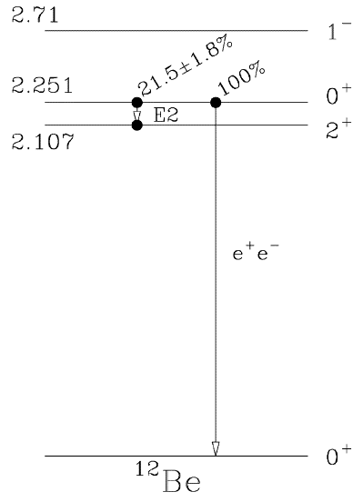
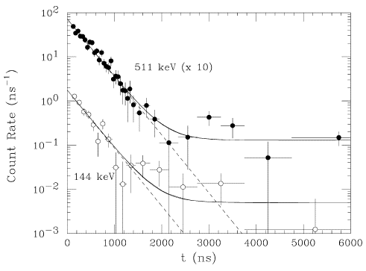
0₂⁺ isomer in ¹²Be
N = 8
¹⁶O
0₂⁺ decay@RIPS/RIKEN
τ = 331(12) ns
¹⁴C
e⁺e⁻ decay
¹²Be
E2 γ
S. Shimoura et al., Phys. Lett. B 560, 31 (’03)
S. Shimoura et al., Phys. Lett. B 654, 87 (’07)

Slide 4
0₂⁺ energies and shell quenching at N = 8
E_{x} [MeV]
0₁⁺
0₂⁺
¹⁶O
6.05
¹⁴C
6.59
¹²Be
2.25

Slide 5
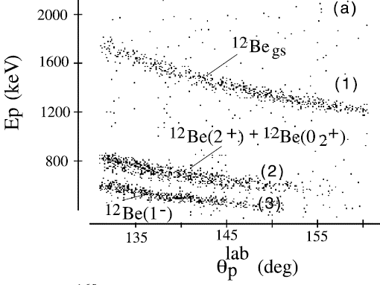
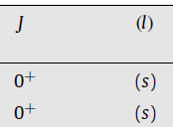
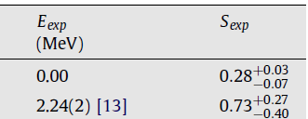
Intruder 2s_{1/2} component in 0₁⁺ and 0₂⁺
E_{x} [MeV]
0₁⁺
0₂⁺
¹⁶O
6.05
¹¹Be(d,p)¹²Be @ISAC II/Triumf
¹⁴C
6.59
¹²Be
2.25
R. Kanungo et al., Phys. Lett. B 682, 391, 108 (’10)

Slide 6
¹²O and its mirror symmetry
¹²O
¹⁴O
¹⁶O
¹⁴C
Dripline
¹²Be
Shell breaking at Z = 8 ?
Weakly-bound 2s_{1/2}
→ Reduces Coulomb energy ?
→ Enhances Thomas-Ehrman shift ?

Slide 7
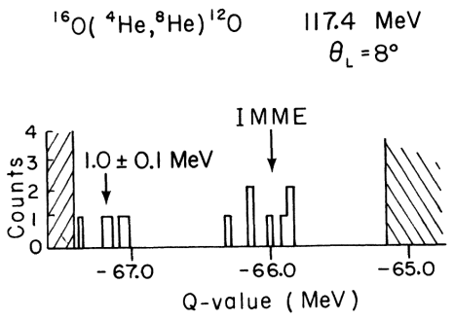
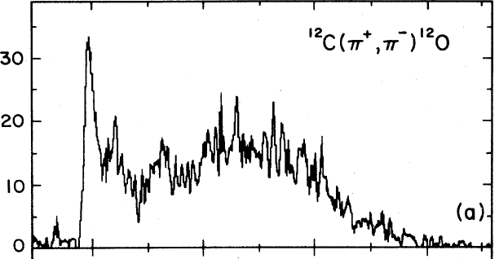
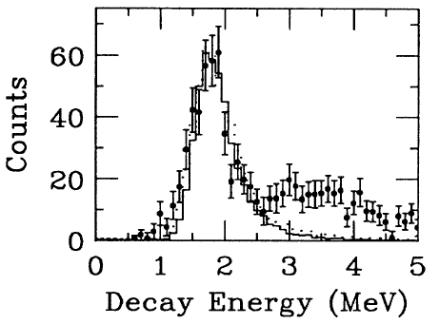
Experimental history
¹⁶O(α, ⁸He)¹²O
1.7 MeV
¹²C(π⁺, π⁻)¹²O
G.J. KeKelis et al., Phys. Rev. C 17, 1929 (’78)
S. Mordechai et al., Phys. Rev. C 32, 999 (’85)
¹³O 1n knockout @NSCL
R.A. Kryger et al., Phys. Rev. Lett. 74, 860 (’95)

Slide 8
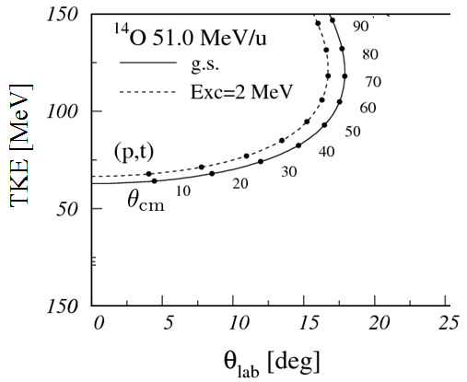
Missing mass method with (p, t) reaction
High energy tritons:
cryogenic hydrogen target
(1 mm ~7 mg/cm²)
Forward focus:
High efficiency by Si array
Very efficient measurement

Slide 9

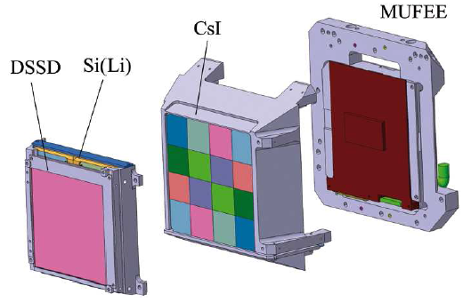
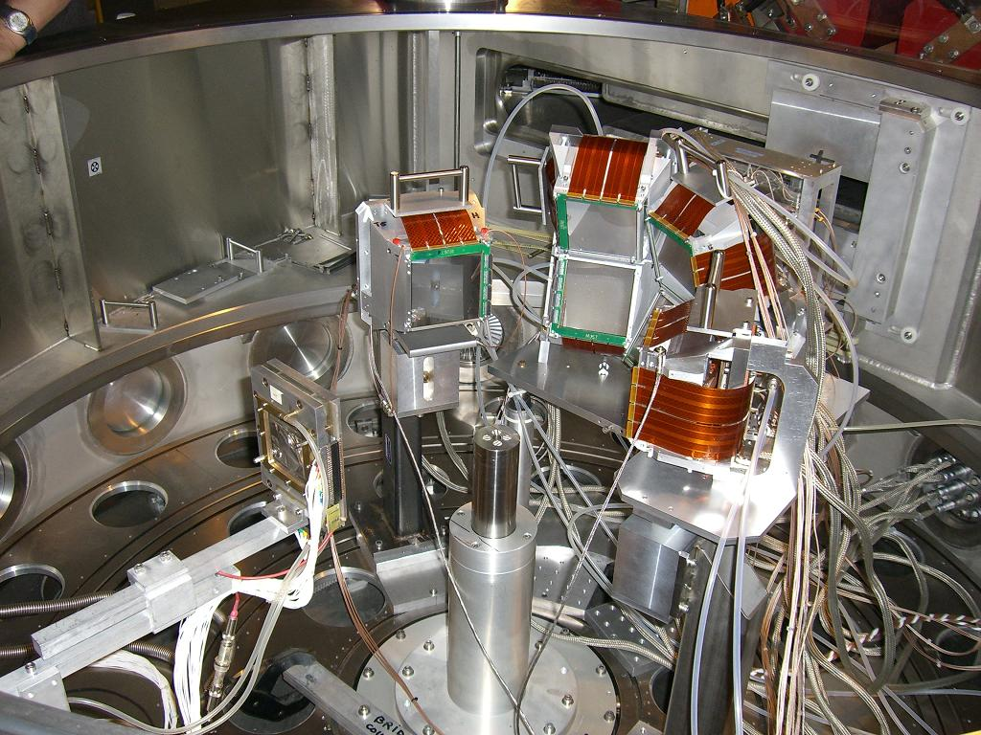
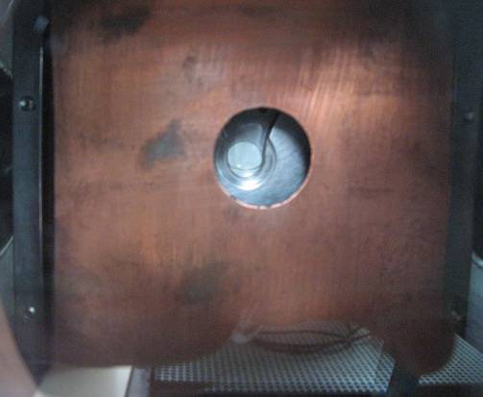
Setup
CsI
DSSD
10 x 10 cm²
0.3 mm
CATS
¹⁴O @51 MeV/u
1 mm^{t} solid hydrogen
~50 kpps
CATS: S. Ottini-Hustache et al., Nucl. Instr. Meth. A 431, 476 (’99).
Target: P. Dolégiéviez et al., Nucl. Instr. Meth. A 564, 32 (’06).
MUST2: E. Pollacco et al., Eur. Phys. J. A 25, 287 (’05).

Slide 10
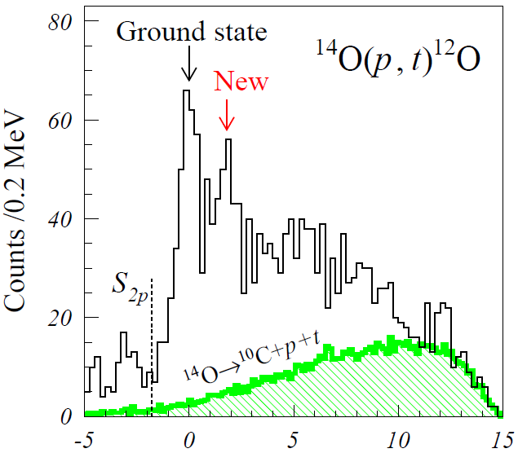
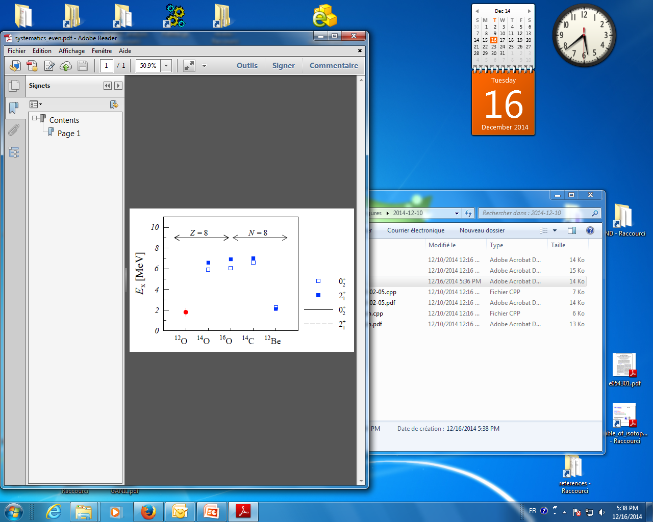
First study (1 day) at SPEG/GANIL
1.8(4) MeV
0⁺ or 2⁺
E_{x} [MeV]
No shell closure at Z = 8
D. Suzuki, H. Iwasaki, D. Beaumel et al., Phys. Rev. Lett. 103, 152503 (’09).
D. Suzuki, Euro. Phys. J. A 48, 130 (’12).

Slide 11
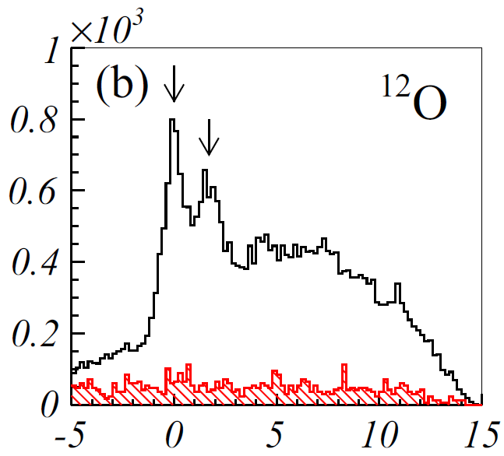
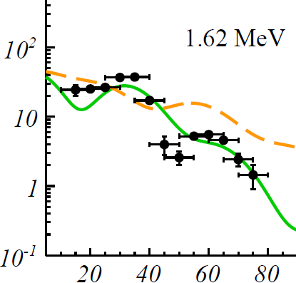
Second study (7 days) at LISE/GANIL
0₂⁺
1.62(13) MeV
dσ/dΩ [μb/sr]
L = 2
empty target
L = 0
θ_{c.m.} [deg]
E_{x} [MeV]
D. Suzuki, H. Iwasaki, D. Beaumel et al., Phys. Rev. C 93, 024316 (’16)

Slide 12
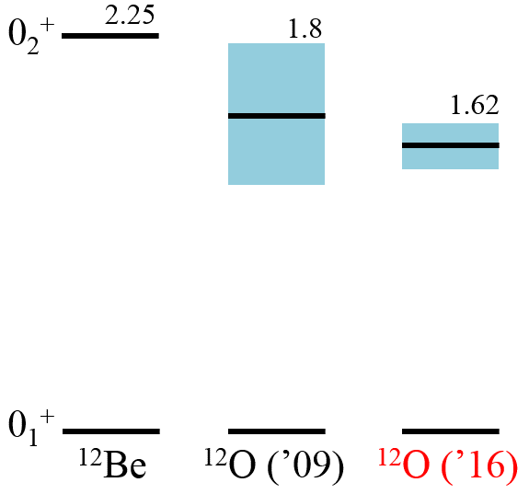
Mirror energy difference of the 0₂⁺ state
-0.63 MeV
How to quantify impact of weak binding to level shift?
Systematics of 0⁺ mirror pairs’ energy differences
Scaling for charge and mass ( = size)

Slide 13
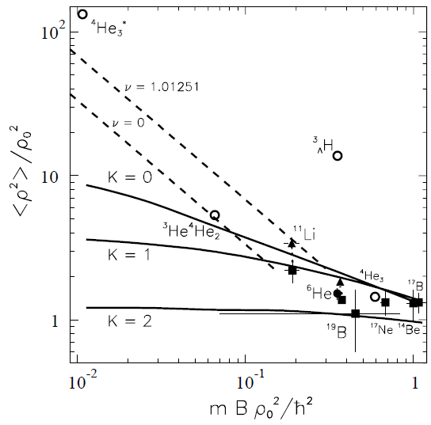
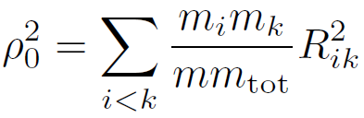
Riisager’s universal scaling for 2n halo radii
K. Riisager, D.V. Fedrov, A.S. Jensen, Europhys. Lett. 49, 547 (’00)
Scaling by 3-body hyperradii
Radius
m: unit mass
R_{ik}: length for i-th and k-th particles
2ρ₀
Binding energy
*B: binding energy

Slide 14


Scaling of mirror energy differences
Experimental observables
Scales
2ρ₀
Coulomb barrier
B_{exp}
Riisager’s universal scaling [1]
ΔE_{exp}
S_{2p}
S_{2n}
Coulomb energy with core in sphere [2]
¹²O
¹²Be
[1] K. Riisager, D.V. Fedrov, A.S. Jensen, Europhys. Lett. 49, 547 (’00)
[2] A. Muta, T. Otsuka, Prog. Theo. Phys. Suppl. 142, 355 (’01)

Slide 15
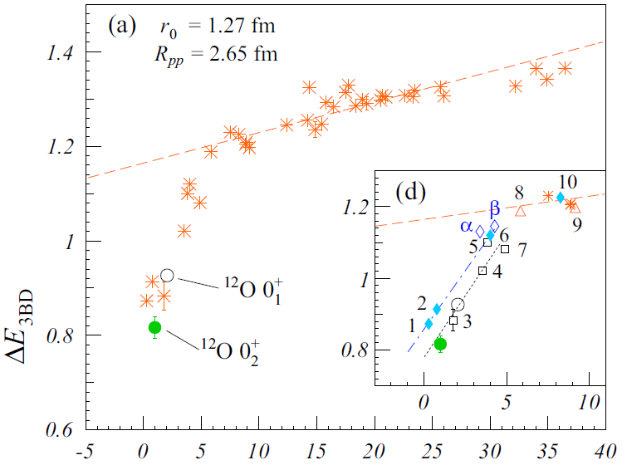
Universality of 0⁺ mirror energies
D. Suzuki et al., Phys. Rev. C 93, 024316 (’16)
all known 0⁺ mirror pairs
ΔE_{exp}/ ΔE_{C}(ρ₀)
2s_{1/2}
⁶He-⁶Be 0₁⁺
⁸He-⁸C 0₁⁺
¹⁶C-¹⁶Ne 0₂⁺
B_{exp}/B(ρ₀)

Slide 16
Summary
Unbound ¹²O was studied by the (p, t) reaction at GANIL.
Missing mass spectra were obtained from tritons detected by MUST2 telescopes.
The 0₂⁺ state of ¹²O was discovered at 1.62(13) MeV.
  Shell closure disappearing at Z = 8
  Level energy shift -0.63 MeV relative to ¹²Be
  Systematics of known 0⁺ states
  Scaling relation of mirror energy differences and binding energies.
  ¹²O 0₂⁺ state, under the influence of weak binding, represents the lowest energy difference.

Slide 17








Collaborators
H. Iwasaki, D. Beaumel, M. Assié, Y. Blumenfeld, N. De Séréville,
S. Franchoo, S. Giron, J. Guillot, F. Hammache, F. Maréchal, A. Matta,
L. Perrot, C. Petrache, A. Ramus, J-A. Scarpaci, I. Stefan
F. de Oliveira Santos, S. Grévy, D.Y. Pang, O. Sorlin,
P.C. Srivastava, C. Stodel
A. Drouart, A. Gillibert, V. Lapoux, L. Nalpas, J. Pancin,
E. Pollacco, P. Roussel-Chomaz
F. Naqvi, W. Rother
J. Gibelin
H. Baba, H. Otsu, H. Sakurai, S. Terashima
S. Mitimasa
H. Okamura
N. Keeley

Slide 18
Backup

Slide 19
Systematics of all known 0⁺ mirror pairs
D. Suzuki et al., Phys. Rev. C 93, 024316 (’16).
ΔE_{exp}/ ΔE(ρ₀)
2s_{1/2}
B_{exp}/B(ρ₀)

Slide 20
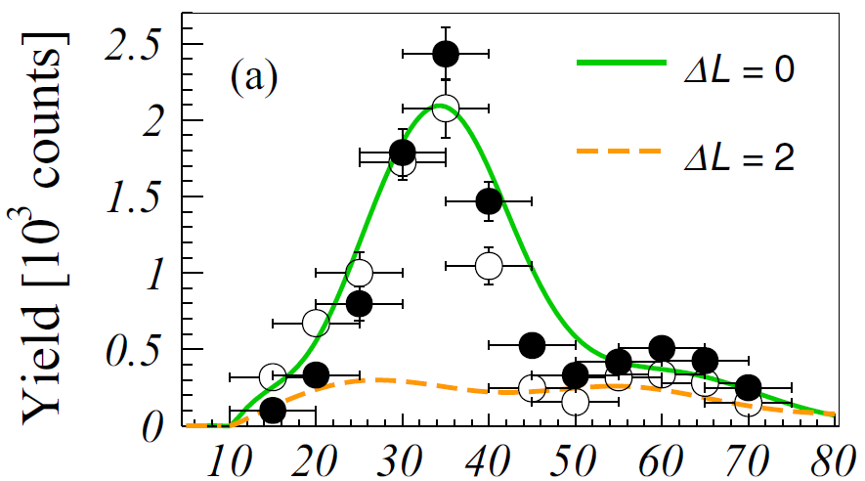
Level mixing
θ_{c.m.} [deg]

Slide 21
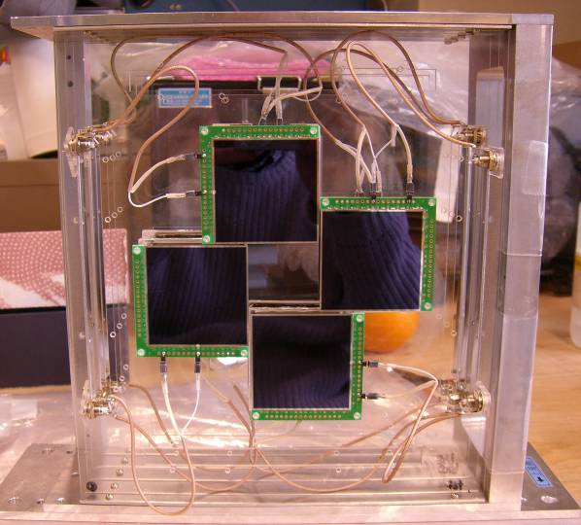
Setup
Silicon telescope
CATS
1 mm^{t} solid hydrogen
¹⁴O @51 MeV/u
CATS: S. Ottini-Hustache et al., Nucl. Instr. Meth. A 431, 476 (1999).
Target: P. Dolegieviez et al., Nucl. Instr. Meth. A 564, 32 (2006).
MUST2: E. Pollacco et al., Eur. Phys. J. A 25, 287 (2005).

Slide 22
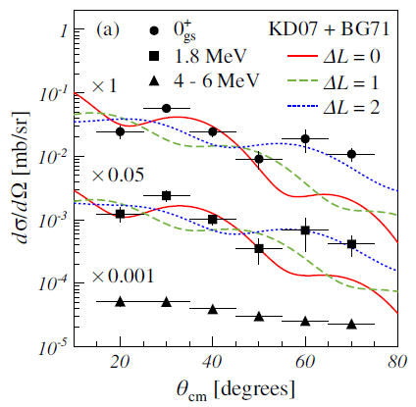
First study (1 day) at SPEG/GANIL
1.8(4) MeV
0⁺ or 2⁺
E_{x} [MeV]
D. Suzuki et al., Phys. Rev. Lett. 103, 152503 (’09).
D. Suzuki, Euro. Phys. J. A 48, 130 (’12).
Z = 8 shell closure vanishes

Slide 23
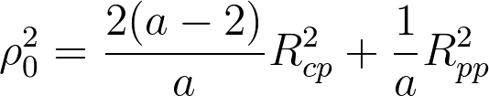


Radius & hyperradius
K. Riisager, D.V. Fedrov, A.S. Jensen,
Europhys. Lett. 49, 547 (’00)
Assumed. Not given in the literatures.
D.V. Fedrov, A.S. Jensen, K. Riisager,
Phys. Rev. C 49, 201 (’94)
a: mass number of the nucleus
 | ρ₀ [fm] | S_{2n} [MeV] | B_{3BD} *
⁶He | 2.57 | 0.975 | 0.321
¹¹Li | 3.47 | 0.369 | 0.223
¹⁴Be | 3.87 | 1.266 | 0.949
¹⁷B | 4.21 | 1.330 | 1.178
*) Present work: B_{3BD} = mS_{2n}ρ₀/h²
The calculated values in the table reasonably agree with the values in the literature.

Slide 24
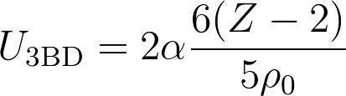
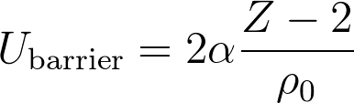


MED & binding energies
Mirror energy difference (experimental values)
E_{c}
S_{2n}: 2n separation energy (neutron-rich partner)
S_{2p}: 2p separation energy (proton-rich partner)
E_{x}^{n}: excitation energy (neutron-rich state)
E_{x}^{p}: excitation energy (proton-rich state)
S_{2p}
S_{2n}
Proton-rich
Neutron-rich
Mirror energy difference (reference)
z: atomic number of proton-rich partner
A. Muta, T. Otsuka,
Prog. Theo. Phys. Suppl. 142, 355 (’01)
Binding energy for 2p (unscaled)
Coulomb barrier energy for 2p
Assumed. Not given in the literatures.
Binding energy for 2p (scaled)
K. Riisager, D.V. Fedrov, A.S. Jensen,
Europhys. Lett. 49, 547 (’00)
m = 938.27 MeV/c² (unit mass)
For 2 body scaling, replace ρ₀ with R_{cp}

