Slide 1
Deformation and halo structure
through reaction cross sections
S. Watanabe¹
K. Minomo², M. Shimada³, S. Tagami³, M. Kimura⁴,
M. Takechi⁵, M. Fukuda⁶, D. Nishimura⁷, T. Suzuki⁸,
T. Matsumoto³, Y. R. Shimizu³, and M. Yahiro³
¹RIKEN, ²RCNP, ³Kyushu Univ., ⁴Hokkaido Univ., ⁵Nigata Univ.,
⁶Osaka Univ., ⁷Tokyo Univ. of Sci., ⁸Saitama Univ.
11/July/2016
Direct Reactions with Exotic Beams (DREB2016)
Halifax

Slide 2

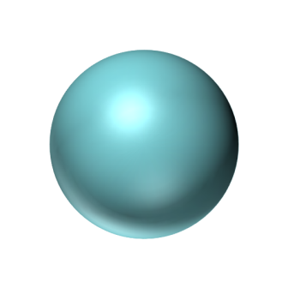
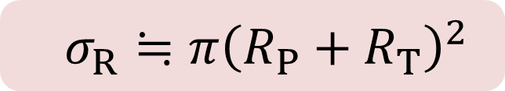


Reaction cross section (σ_{R})
⇒ A useful tool of extracting a nuclear radius
M. Yahiro, SW, M. Toyokawa, T. Matsumoto et al.,
PRC 93, 064609 (2016).
Halo
Deformation
Skin
I. Tanihata et al., PRL 55, 24 (1985).
SW, K. Minomo et al., PRC89, 044610 (2014).
0’30”
1’00”
W. Horiuchi et al., PRC93, 044611 (2016).
→ July 14 (Thursday)
$$R_{P}$$
Projectile
$$R_{T}$$
$σ_{R}≒π{\left(R_{P}+R_{T}\right)}^{2}$
Target
Notes:
As everybody knows, a total reaction cross section (σ_{R}) shown by this area is a useful tool of extracting nuclear radii. Since a nuclear radius a result of the shell evolution, one can expect that nuclear radius contains several structural information such as Halo deformation, and also skin structures. In this presentation, I would like to talk about our recent work on Halo. In this work, we proposed halo parameter quantifying the halo nature and investigate the general properties.

Slide 3
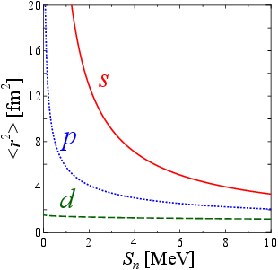


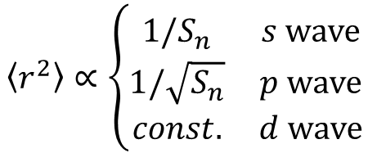
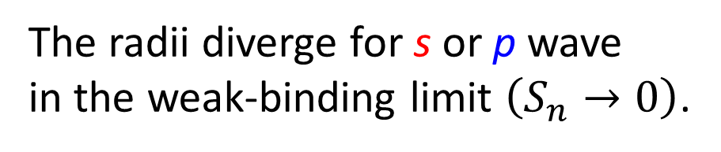
Divergence of mean square radii <r²>
The radii diverge for s or p wave
in the weak-binding limit $\left(S_{n}→0\right)$.
K. Riisager et al., NPA548, 393 (1992).
0’40”
1’50”
$$\left\langle r^{2}\right\rangle ∝\left\{\begin{matrix}1/S_{n} & s wave \\ 1/\sqrt{S_{n}} & p wave \\ const. & d wave\end{matrix}\right.$$
If it is s or p wave,
$$σ_{R}∝π{\left(R_{P}+R_{T}\right)}^{2}$$
$$→∞ ?(S_{n}→0)$$
Q. If there is an upper limit, what is it?
Notes:
When we discuss halo nuclei, divergence of mean square radii is one of the most important natures. This figure shows the mean square radii as a function of the separation energy. When the separation energy goes to 0, the radii diverge for s or p wave, but not for d or higher angular momenta. If this rule is directly applied to this relation, the reaction cross section also diverges. Of course, this is not true. But then, if there is an upper limit, what is it? I will answer this question in this talk.

Slide 4
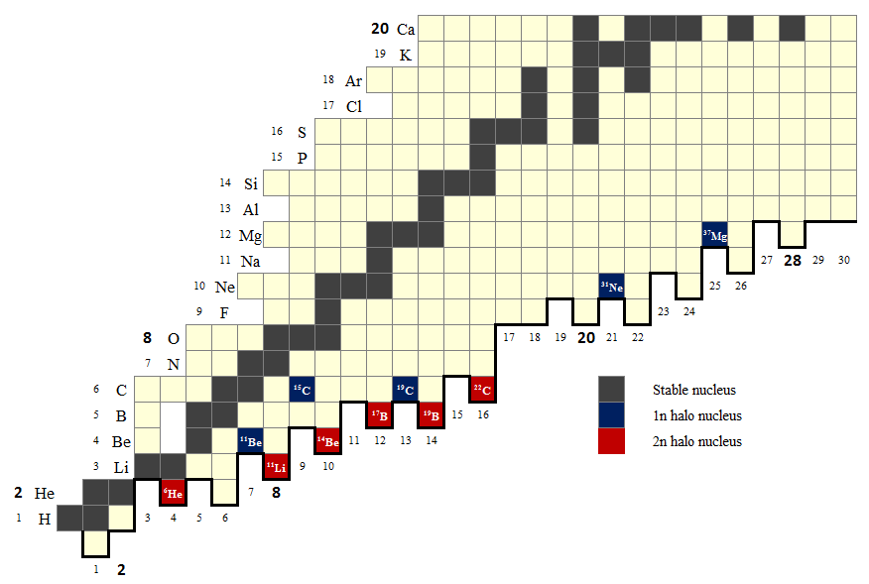

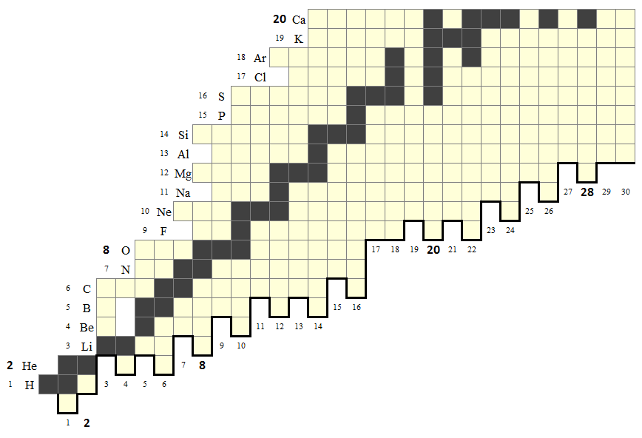


Resent measurements of σ_{R} and motivation
1’00”
2’50”
Heaviest halo（³⁷Mg）
M. Takechi et al., PRC 90, 061305(R) (2014).
cf. 1n-removal reaction
N. Kobayashi et al.,
PRL 112, 242501 (2014).
→ July 14 (Thursday)
Proton number Z
¹¹ Li
$$s_{n}≲1MeV$$
First halo（¹¹Li）
I. Tanihata et al., PRL 55, 24 (1985).
$$s_{2n}≲1MeV$$
Neutron number N
Notes:
After the observation of 11Li as the first halo nucleus, many kinds of neutron halos were observed. Now, the measurements reach the pf-shell region beyond the sd-shell region. Nowadays, 37Mg is considered as the heaviest halo nucleus that has been observed experimentally. If we include weakly-bound nuclei, it is like this.

Slide 5
Resent measurements of σ_{R} and motivation
New experimental data have been accumulated.
The σ_{R} (σ_{I}) depend on scattering conditions (E_{in} or T).
Heaviest halo（³⁷Mg）
M. Takechi et al., PRC 90, 061305(R) (2014).
cf. 1n-removal reaction
N. Kobayashi et al.,
PRL 112, 242501 (2014).
→ July 14 (Thursday)
Proton number Z
Motivation
We would like to introduce a measurable parameter quantifying the halo nature.
$$s_{n}≲1MeV$$
First halo（¹¹Li）
I. Tanihata et al., PRL 55, 24 (1985).
$$s_{2n}≲1MeV$$
Neutron number N
Notes:
As you see from this figure, new experimental data have been accumulated so far. On the other hand, the reaction cross sections depend on scattering conditions such as Ein or targets. Our motivation is this. We would like to introduce a measure able parameter quantifying the halo nature.

Slide 6
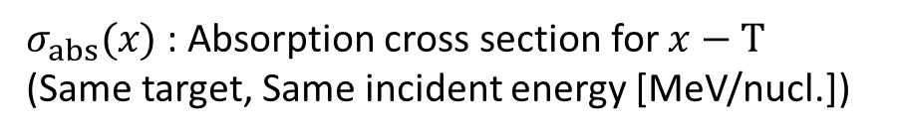
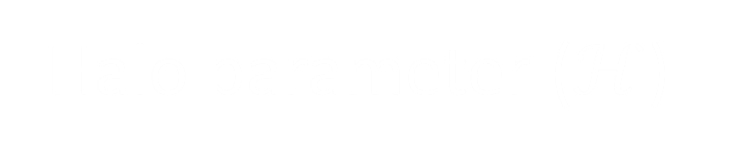



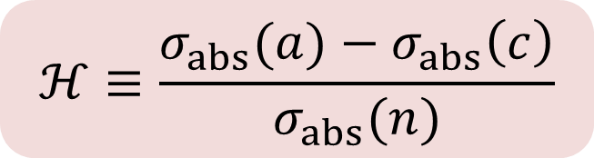
Halo parameter ($ℋ$)
ここまでが2’40”
で丁度。
We introduce the following parameter for 1n halo nuclei (a=c+n).
a
$$ℋ≡\frac{σ_{abs}(a)−σ_{abs}\left(c\right)}{σ_{abs}(n)}$$
T
n
1’00”
2’50”
$σ_{abs}(x)$ : Absorption cross section for $x−T$
(Same target, Same incident energy [MeV/nucl.])
c
Halo is not developed
Halo is well developed
1’00”
1’00”
a
a
n
n
c
c
$$ℋ$$
$$0$$
$$1$$
Notes:
Now, we introduce the halo parameter H for 1n halo nuclei a composed of c + neutron. Here, σabs(x) denotes the absorption cross section for the x-T system. Therefore, H is defined as an enhancement of sigma(a) from sigma(c) relative to sigma(n). Obviously, if halo is not developed H is small, and if halo is well developed H is large. I’ll show you later that H varies from 0 to 1. Please note the energy and target dependences are almost cancelled between the numerator and the denominator. This parameter is very simple, but interesting. So, please don’t stop listening to me.

Slide 7
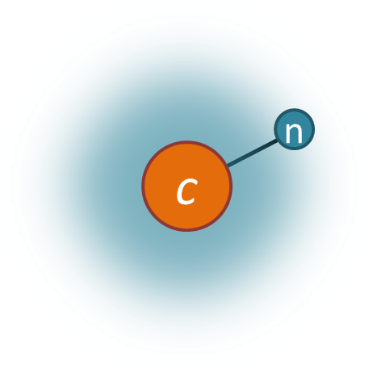
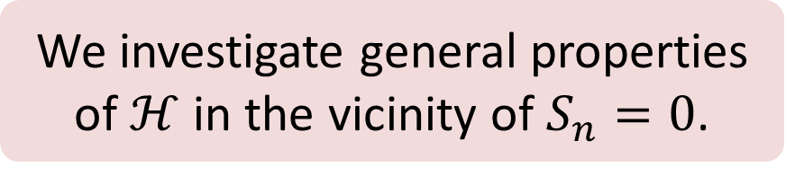
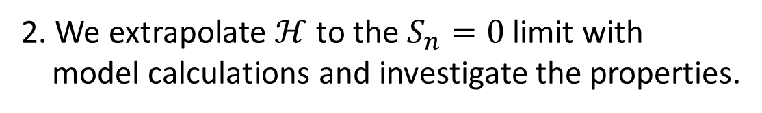
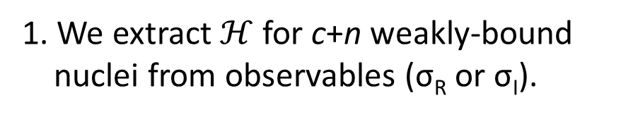
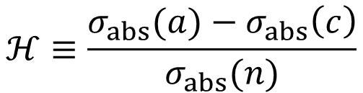
Purpose and Method of analysis
Purpose
We investigate general properties of $ℋ$ in the vicinity of $S_{n}=0$.
$$ℋ≡\frac{σ_{abs}(a)−σ_{abs}\left(c\right)}{σ_{abs}(n)}$$
1’20”
3’10”
Method of the analysis
1. We extract $ℋ$ for c+n weakly-bound
nuclei from observables (σ_{R} or σ_{I}).
1’00”
2’00”
1n halo
¹¹Be, ¹⁹C (s-wave)
³¹Ne, ³⁷Mg (p-wave)
1n halo
Non-halo nucleus
¹⁷C (d-wave), Sn=0.73 MeV
2. We extrapolate $ℋ$ to the $S_{n}=0$ limit with
model calculations and investigate the properties.
Notes:
In this presentation, we investigate general properties of $ℋ$ in the vicinity of $S_{n}=0$. For this purpose, we first extract H for c+n weakly-bound nuclei from measured reaction cross sections. We consider 11Be and 19C as s-wave halo nuclei, 31Ne and 37Mg as p-wave halo nuclei. We also consider 17C as a d-wave non-halo nucleus. Second, we extrapolate H to the Sn=0 limit with a model calculation and investigate the properties.

Slide 8
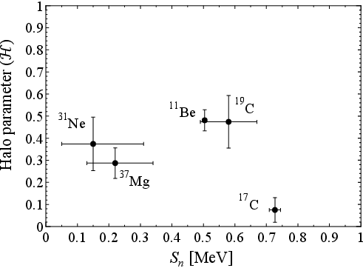


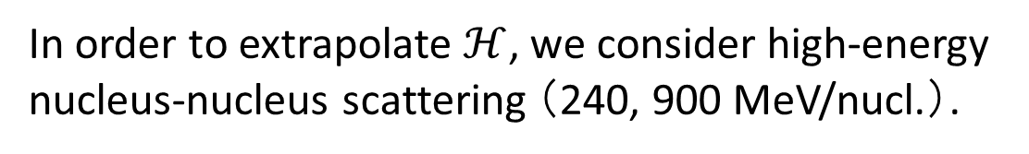
Empirical value of $ℋ$
In order to extrapolate $ℋ$, we consider high-energy nucleus-nucleus scattering （240, 900 MeV/nucl.）.
Experimental data on σ_{R} (σ_{I})
A. Ozawa, T. Suzuki, and I. Tanihata, Nucl. Phys. A 693, 32
(2001), and references therein.
M. Takechi et al., Phys. Lett. B 707, 357 (2012).
M. Takechi et al., Phys. Rev. C 90, 061305 (2014).
So what?
1’00”
4’10”
s
p
$σ_{abs}≈σ_{R}≈σ_{I}$
Glauber model is well established
d
0’50”
2’50”
We extrapolate the empirical value to the weak-binding limit with model calculations.
Experimental data on S_{n}
G. Audi et al., Nucl. Phys. A 729, 337 (2003).
T. Nakamura et al., Phys. Rev. Lett. 112, 142501 (2014).
N. Kobayashi et al., Phys. Rev. Lett. 112, 242501 (2014).
Notes:
In order to extrapolate $ℋ$, we consider high-energy nucleus-nucleus scattering. This is because, at high incident energy, this relation is well satisfied, and because the Glauber model is well established. What you see here is the extracted H. They seem to be separated by their angular momenta. But at this stage, you might think “so what?”. Therefore, we will extrapolate the empirical value to the weak-binding limit.

Slide 9
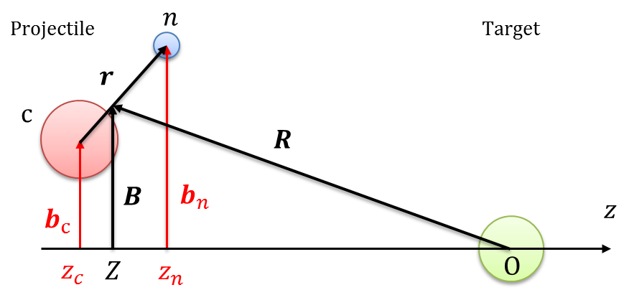
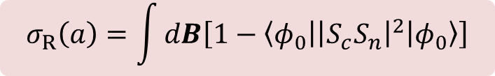

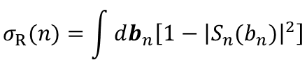
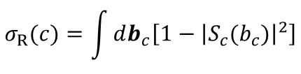

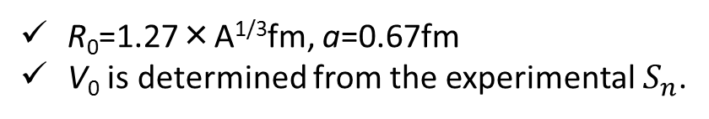
Model setting
Reaction model
Glauber model
a
The σ_{R} of a-T system is given by
T
$$σ_{R}\left(a\right)=\int{dB\left[1−\left\langle φ_{0} | {\left|S_{c}S_{n}\right|}^{2} | φ_{0}\right\rangle \right]}$$
1’20”
5’30”
Core:
$$S_{c}\left(b_{c}\right)=\exp\left[\frac{1}{iℏv}\int_{−∞}^{∞}{dz_{c}V_{c}(r_{c})}\right],$$
$$σ_{R}(c)=\int{db_{c}\left[1−{\left|S_{c}(b_{c})\right|}^{2}\right]}$$
Neutron:
$$S_{n}\left(b_{n}\right)=\exp\left[\frac{1}{iℏv}\int_{−∞}^{∞}{dz_{n}V_{n}(r_{n})}\right],$$
$$σ_{R}(n)=\int{db_{n}\left[1−{\left|S_{n}(b_{n})\right|}^{2}\right]}$$
1’30”
4’20”
Folding potential
Franey Love t-matrix × Factor
(readjusted to reproduce experimental σ_{R})
Structure model
Spherical Woods-Saxon model
R₀=1.27×A^{1/3}fm, a=0.67fm
V₀ is determined from the experimental $S_{n}$.
We can reproduce the experimental rms radii.
Notes:
As a reaction model, we take the Glauber model. In the Glauber model, the reaction cross section is given by this equation. Here, Sc and Sn denote the scattering matrices of core and neutron, respectively. As the potentials of these subsystems, we take the microscopic folding potential but readjusted to reproduce the experimental data.
As a structural model, we take the simple spherical Woods-Saxon model. Radius and diffuseness parameters are given like this, and the depth parameter is determined from the experimental Sn. With this parameter set, we can reproduce the experimental rms radius well.

Slide 10
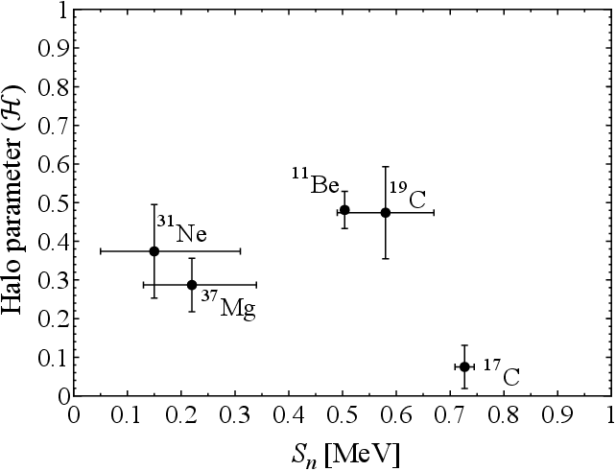
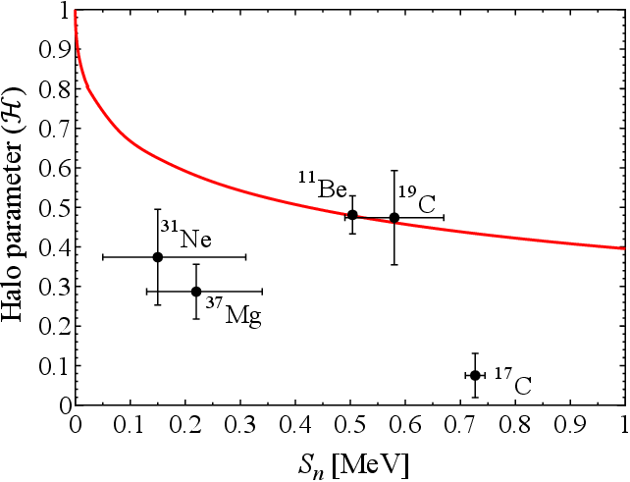
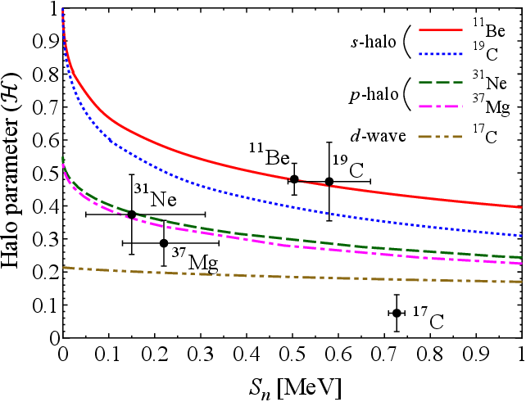
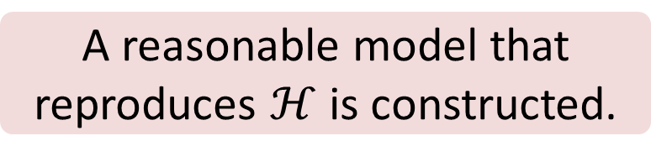
Result： Extrapolation of ℋ
0’40”
6’10”
0’40”
5’00”
A reasonable model that reproduces $ℋ$ is constructed.
Notes:
By using the Glauber model, we can get the red square for example for 11Be. Then, we extrapolate H to the weak-binding limit. For the other nuclei, we have these curves: Blue is 19C, Green is 31Ne, Pink is 37Mg, and yellow is 17C. A reasonable model that reproduces H is constructed. Since we are interested in the vicinity of Sn=0,

Slide 11
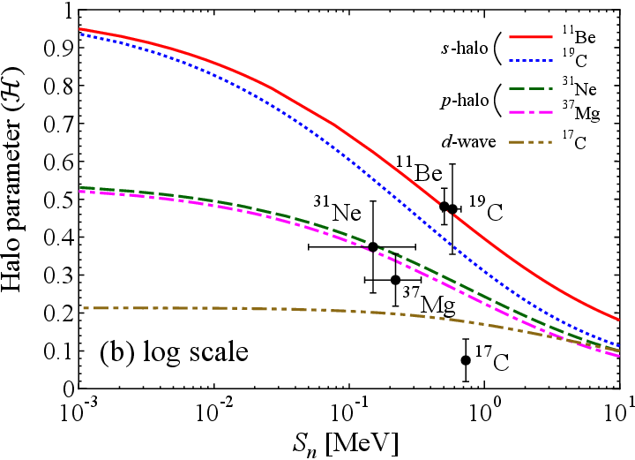
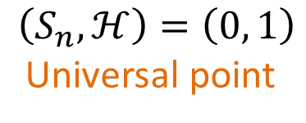
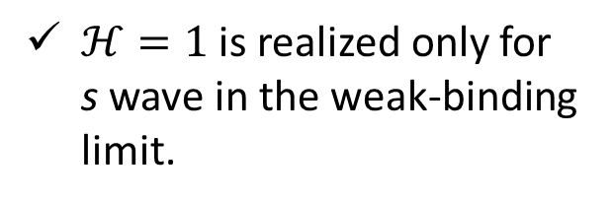
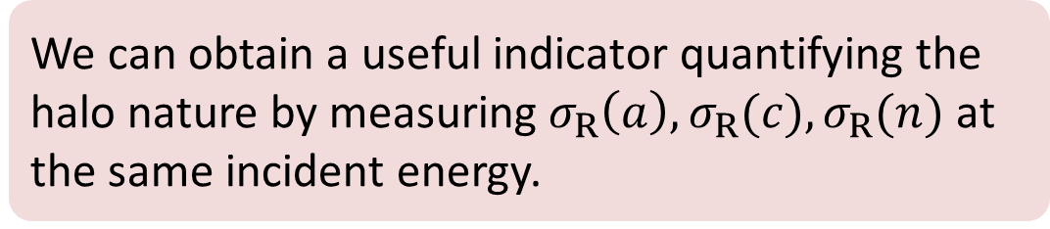
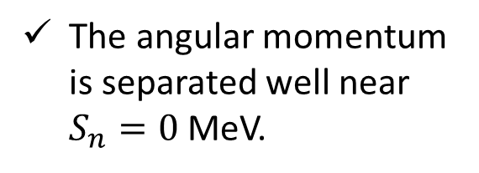
Result： Extrapolation of ℋ (log)
s
$$\left(S_{n}, ℋ\right)=\left(0, 1\right)$$
Universal point
≈
The angular momentum is separated well near $S_{n}=0$ MeV.
p
0’40”
6’50”
d
$ℋ=1$ is realized only for s wave in the weak-binding limit.
0’50”
5’50”
1 keV
10 MeV
We can obtain a useful indicator quantifying the halo nature by measuring $σ_{R}\left(a\right),σ_{R}(c),σ_{R}(n)$ at the same incident energy.
Notes:
the horizontal axis should be shown by the logarithmic scale. As you can see, the angular momentum is separated well near Sn=0. Furthermore, H=1 is realized only for s-wave in the weak-binding limit. In fact, this is a universal point for any s-wave halo nucleus regardless of the concrete form of the potential between neutron and a core. Thus, we can obtain a useful indicator quantifying the halo nature by measuring $σ_{R}\left(a\right),σ_{R}(c),σ_{R}(n)$ at the same incident energy.

Slide 12

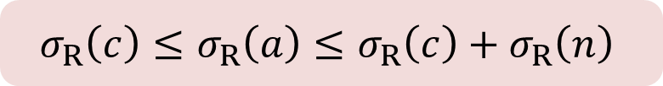


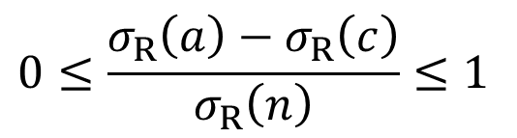



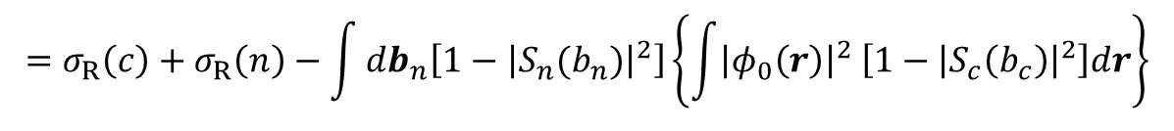

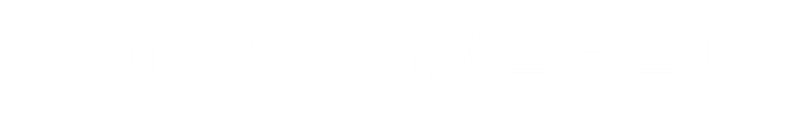
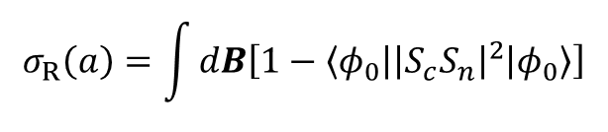

Discussion 1: Why $0≤ℋ≤1$ ?
Reaction cross section in the Glauber model
$$σ_{R}\left(a\right)=\int{dB\left[1−\left\langle φ_{0} | {\left|S_{c}S_{n}\right|}^{2} | φ_{0}\right\rangle \right]}$$
$$=σ_{R}\left(c\right)+σ_{R}\left(n\right)−\int{db_{n}\left[1−{\left|S_{n}(b_{n})\right|}^{2}\right]}\left\{\int{{\left|φ_{0}\left(r\right)\right|}^{2} \left[1−{\left|S_{c}\left(b_{c}\right)\right|}^{2}\right]dr}\right\}$$
1’10”
8’00”
cf. deuteron scattering:
R. J. Glauber, PR 100, 1 (1955).
Overlap between core and n
The lower and upper limits are obtained.
$$σ_{R}\left(a\right)$$
$$σ_{R}\left(c\right)≤σ_{R}\left(a\right)≤σ_{R}\left(c\right)+σ_{R}\left(n\right)$$
1’20”
7’10”
$${−σ}_{R}\left(c\right)$$
$$0≤σ_{R}\left(a\right)−σ_{R}\left(c\right)≤σ_{R}\left(n\right)$$
$$0≤\frac{σ_{R}\left(a\right)−σ_{R}\left(c\right)}{σ_{R}\left(n\right)}≤1$$
$${÷σ}_{R}\left(n\right)$$
$$σ_{R}\left(c\right)$$
$$σ_{R}\left(n\right)$$
$$≡ℋ$$
Notes:
Next, we will move on to the discussion. Why H varies from 0 to 1? This is the reaction cross section in the Glauber model again. This can be exactly rewritten like this. This equation tells us the reaction cross section of a halo nucleus is equal to the sum of the core and neutron reaction cross sections subtracted by the overlap between them. If we accept this equation, we can get the lower and upper limits for the cross section of a halo nucleus. By subtracting the core cross section from this equation and dividing this equation by the neutron cross section, we can obtain this inequality. As you may notice, this part is exactly what we defined as H. Therefore, H varies from 0 to 1 and becames a good indicator of Halo.

Slide 13
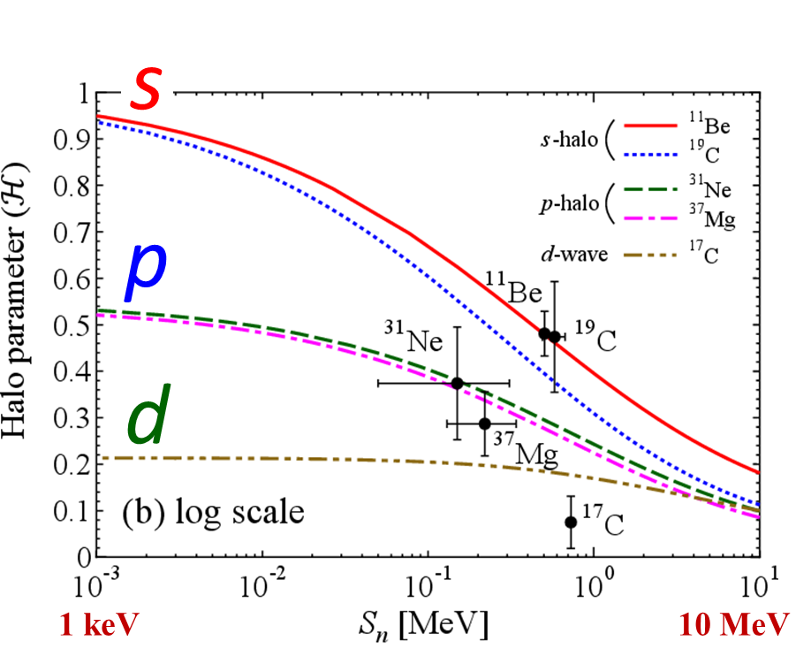

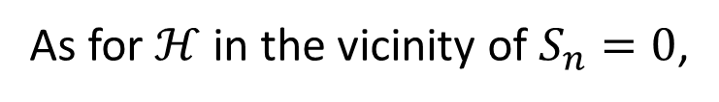

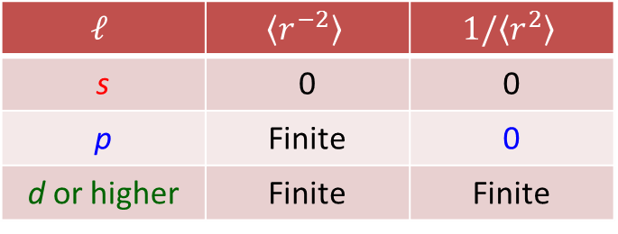

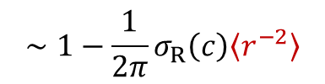
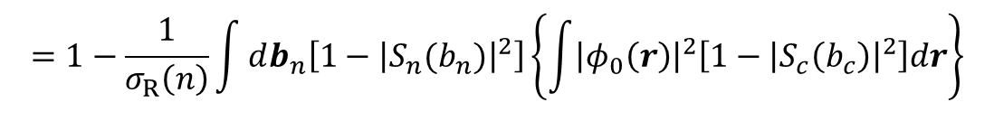

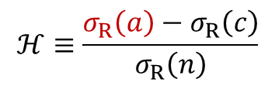

Discussion 2: Why can we separate $ℓ$ ?
$$ℋ≡\frac{σ_{R}\left(a\right)−σ_{R}\left(c\right)}{σ_{R}\left(n\right)}$$
$$=1−\frac{1}{σ_{R}\left(n\right)}\int{db_{n}\left[1−{\left|S_{n}(b_{n})\right|}^{2}\right]}\left\{\int{{\left|φ_{0}\left(r\right)\right|}^{2}\left[1−{\left|S_{c}\left(b_{c}\right)\right|}^{2}\right]dr}\right\}$$
$$∼1−\frac{1}{2π}σ_{R}\left(c\right)\left\langle r^{−2}\right\rangle$$
$$1−{\left|S_{n}(b_{n})\right|}^{2}=δ^{2}\left(b_{n}\right)σ_{R}\left(n\right)$$
Assumption
$$1−{\left|S_{c}(b_{c})\right|}^{2}=δ^{2}(b_{c})σ_{R}\left(c\right)$$
Value of $\left\langle r^{−2}\right\rangle$ in the $S_{n}=0$ limit
$$ℓ$$ | $$\left\langle r^{−2}\right\rangle$$ | $$1/\left\langle r^{2}\right\rangle$$
s | 0 | 0
p | Finite | 0
d or higher | Finite | Finite
1’20”
8’30”
As for $ℋ$ in the vicinity of $S_{n}=0$,
$\left\langle r^{−2}\right\rangle$ is more essential than $\left\langle r^{2}\right\rangle$.
Notes:
Next, we’ll proceed to the way of separating angular momentum. As we did in the previous slide, H can be exactly rewritten like this. In order to understand the essence of H, we assume that S matrices are given by a delta function like this. This assumption is satisfied when neutron has a enough distance from the core. Under this assumption, H becomes 1 minus constant value times the expectation value of r to the power of -2. We can mathematically show that the expectation value is 0 for s, and finite for p, d or higher ℓ in the Sn=0 limit. This behavior is different from that of r squared at the stage of a p wave. Therefore, we can separate s and p wave in the vicinity of Sn=0. In summary, as for H in the vicinity of Sn=0 limit, r to the power of -2 is more essential than r squared.

Slide 14
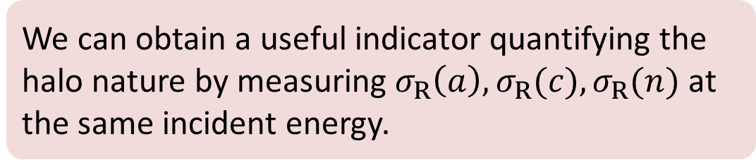
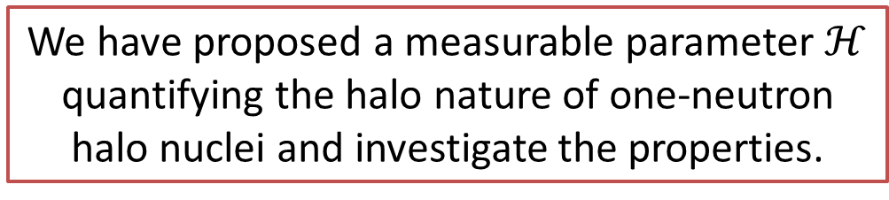
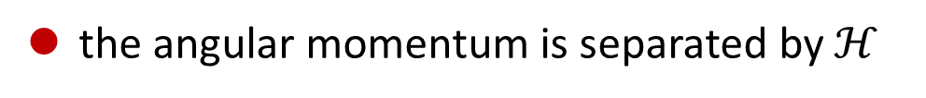
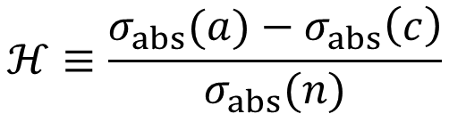

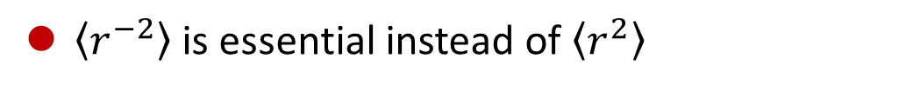
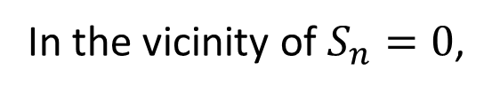
Summary
We have proposed a measurable parameter $ℋ$ quantifying the halo nature of one-neutron halo nuclei and investigate the properties.
M. Yahiro, SW, M. Toyokawa, T. Matsumoto et al., PRC93, 064609 (2016).
$$ℋ≡\frac{σ_{abs}(a)−σ_{abs}\left(c\right)}{σ_{abs}(n)}$$
$$(0≤ℋ≤1)$$
In the vicinity of $S_{n}=0$,
0’50”
9’20”
the angular momentum is separated by $ℋ$
$\left\langle r^{−2}\right\rangle$ is essential instead of $\left\langle r^{2}\right\rangle$
We can obtain a useful indicator quantifying the halo nature by measuring $σ_{R}\left(a\right),σ_{R}(c),σ_{R}(n)$ at the same incident energy.
Notes:
To sum it up, we have proposed a measurable parameter $ℋ$ quantifying the halo nature of one-neutron halo nuclei and investigate the properties. We showed H varies from 0 to 1 and becomes a common indicator of halo. By using H, the angular momentum is separated

