Slide 1



Study of the ³⁰P(d,n)³¹S Reaction to Probe
Astrophysical Resonance Strengths
Terri Poxon-Pearson
In collaboration with:
Anu Kankainen (JYU), Phil Woods (Edin.),
Alex Brown (NSCL), Filomena Nunes (NSCL)
DREB 2016

Slide 2
Outline
  Motivation from Astrophysics and Nuclear Structure
  Indirect reactions to probe ³⁰P(p,γ) ³¹S reaction rates
  Transfer reaction formalism
  Bound state approximation
  Recent Results

Slide 3
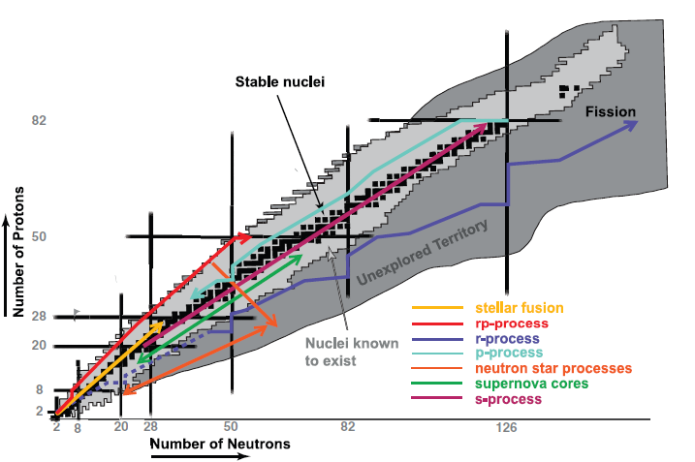
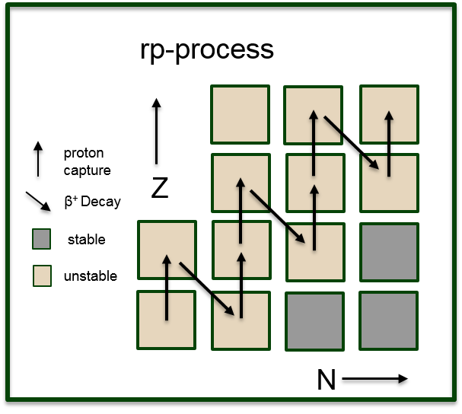
Astrophysical Motivations
  Rapid proton capture reactions occur in proton rich environments, such as novae outbursts
    ³⁰P(p,γ)³¹S
  Reactions with long β⁺ decay half lives serve as bottlenecks in these reaction networks
Image from Exploring the Heart of Matter, National Research Council

Slide 4
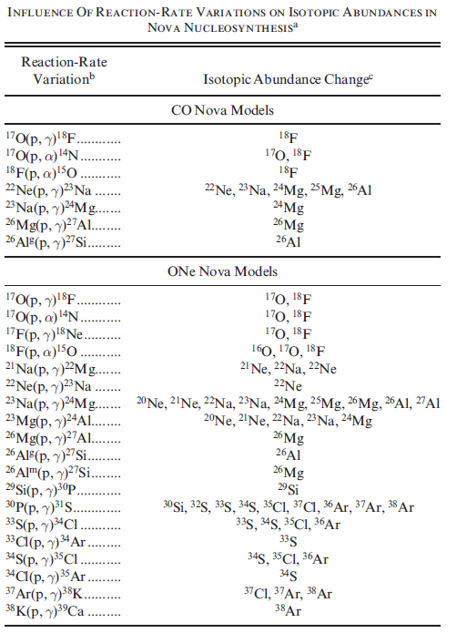
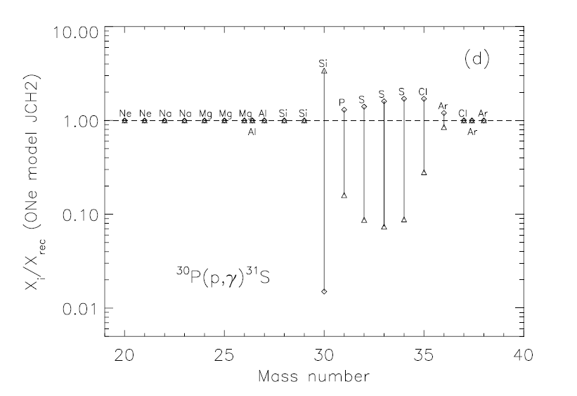
Astrophysical Motivations
Uncertainty in these reaction rates can lead to large discrepancies in isotopic abundances
Figure and Table from Iliadis et al. Astrophys.J.Suppl. 142 (2002) 105-138; AIP Conf.Proc. 637 (2003) 114-118

Slide 5
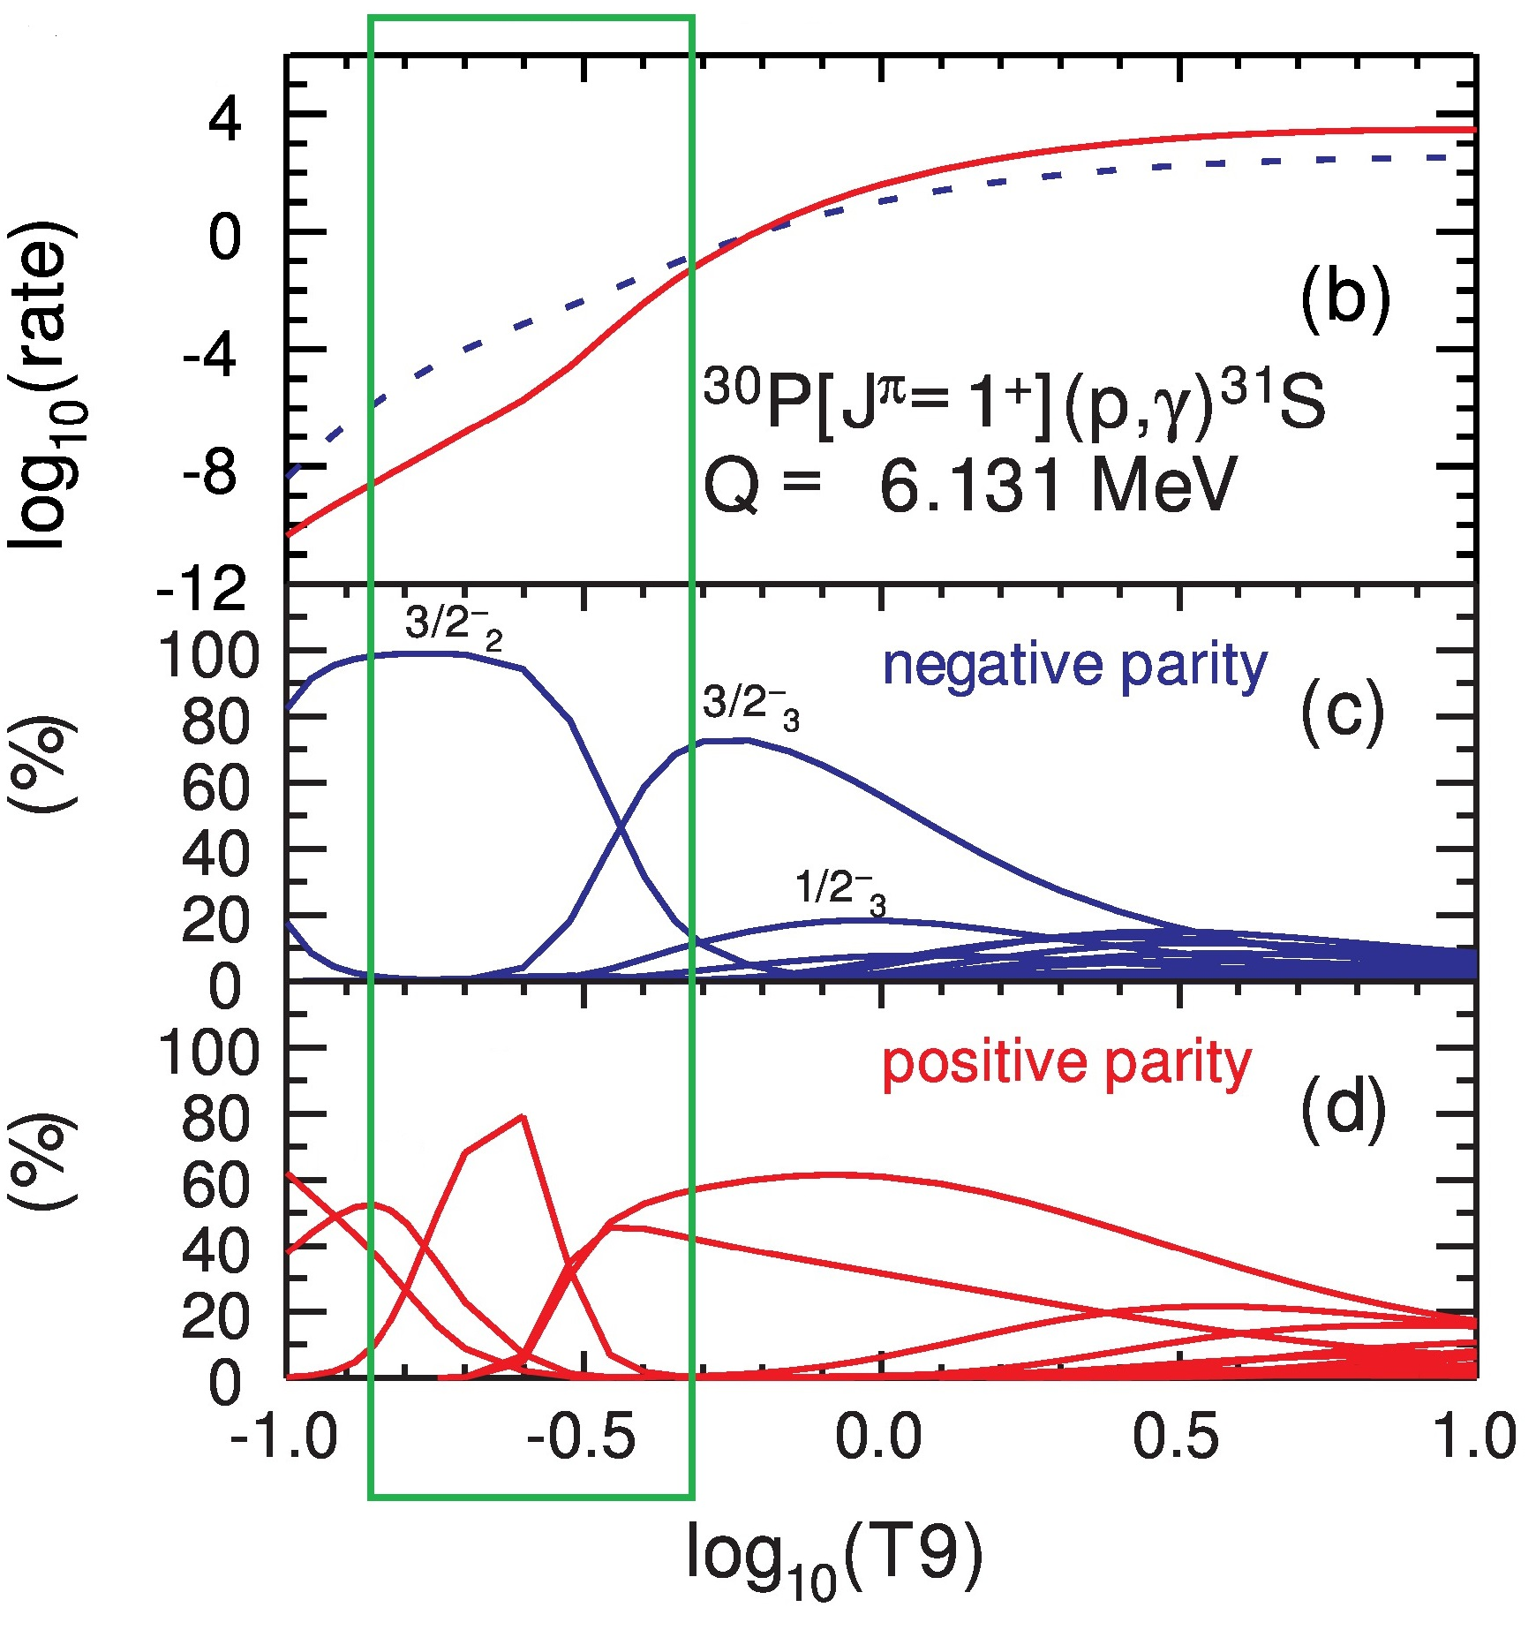
Structure Motivations for ³¹S
Spin Assignments for Resonances of ³¹S
Experimental |  |  |  | Theory
E_{res} (keV) | (2J)π |  |  | E_{res} (keV) | (2J)π
 | Wrede (2014) | Doherty et al (2012) | Parikh et al. (2011) | Brown (2014)
6160 |  | 7+ | 5 | 5825 | 5-
6327 |  | 3[-] | 1+ | 6327 | 3-
6377 | 9 | 9[-] | 9[-] | 6313 | 9-
6542 |  | 3[-] | 7,9 | 6757 | 3-
6583 | 7 | 3,5,7[-] | 7 | 6792 | 5-
6636 | 9 | 5,9 | 9[-] | 6682 | 9-
6833 |  |  | 11[-] | 6833 | 11-
Uncertainties in spin assignments for resonances in ³¹S
Recent shell model calculations show that negative parity states should dominate in Gamow window
Figure and Table from B. Alex Brown, W. A. Richter, and C. Wrede, Phys. Rev. C 89, 062801 June, 2014 Erratum: Phys. Rev. C 92, 069901(E) (2015)

Slide 6
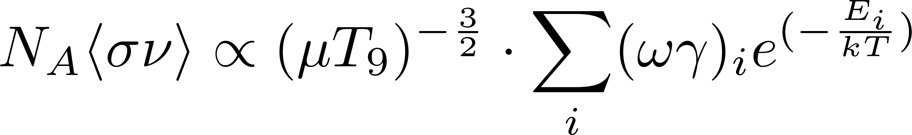
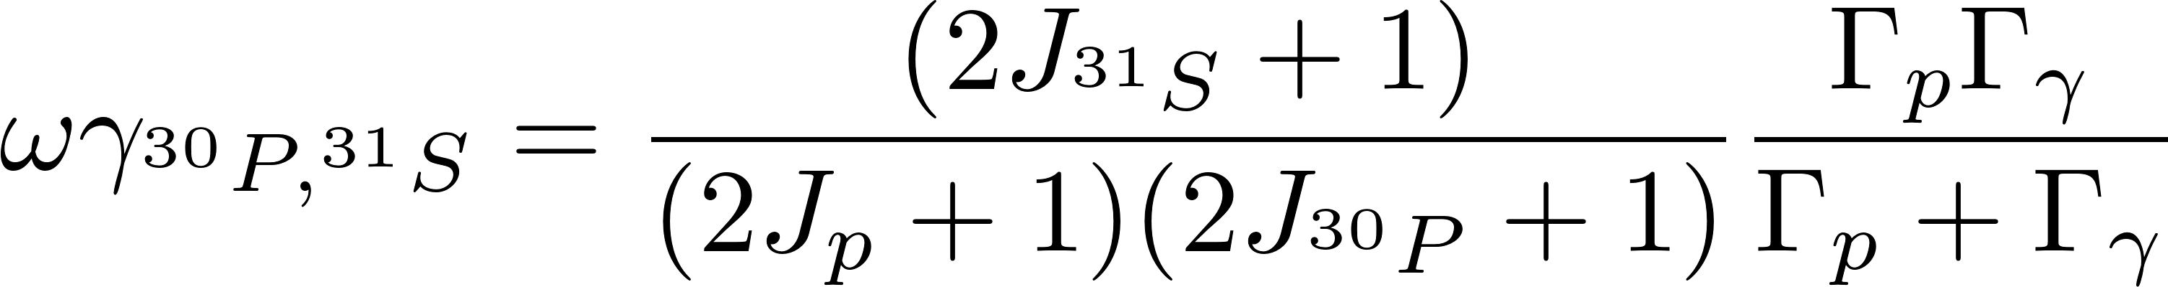
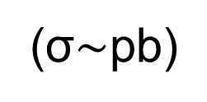
Indirect Reaction for ³⁰P(p,γ) ³¹S
Reaction rate for proton capture is too low to be measured directly
(σ$∼$pb)
γ

Slide 7
Indirect Reaction for ³⁰P(p,γ) ³¹S
Reaction rate for proton capture is too low to be measured directly
(σ$∼$pb)
γ
³⁰P(d,n) ³¹S

Slide 8
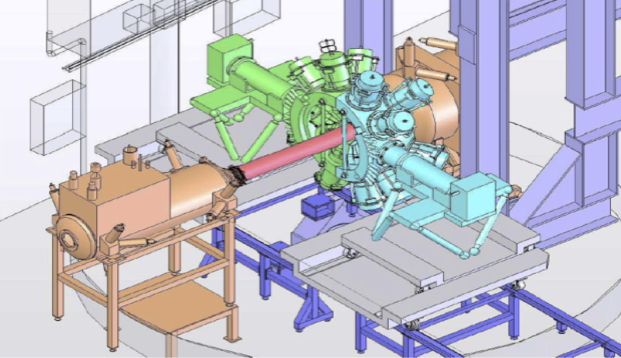
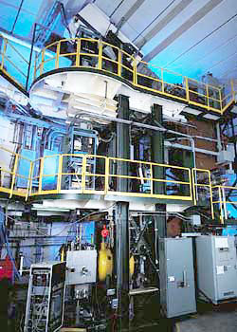
Experimental Method for ³⁰P(d,n) ³¹S
New experimental method preformed at the NSCL by experimental collaborators from Edinburgh (Anu Kankainen and Phil Woods)
γ

Slide 9
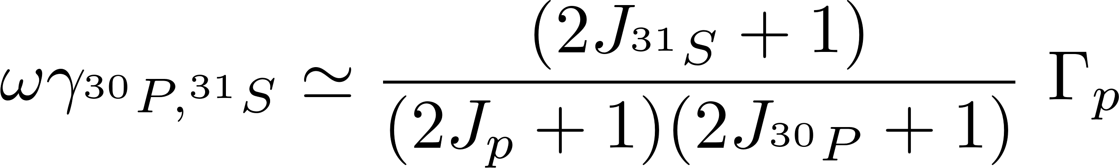
Experimental Method for ³⁰P(d,p) ³¹S
γ
Allows for very precise measurements of excitation energies
  Gamma decays allow us to probe the rate at which the relevant resonances have been populated (Γ_{p})
States of interest lie in the continuum and feeding into these states can be assumed to be low
Process does not have angular sensitivity and produces total transfer cross sections

Slide 10
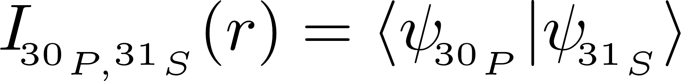
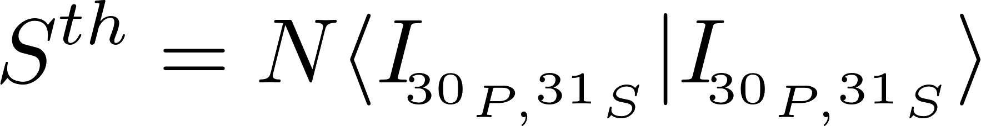
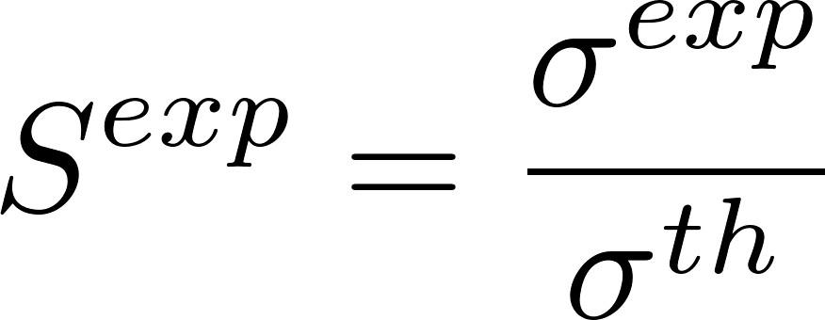
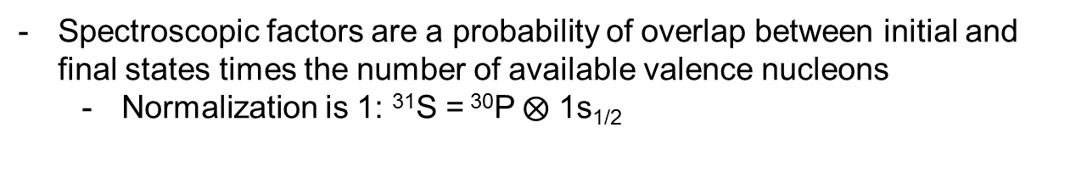
Comparing to Theory
Spectroscopic factors are a probability of overlap between initial and final states times the number of available valence nucleons
  Normalization is 1: ³¹S = ³⁰P$⨂$ 1s_{1/2}
Experimental spectroscopic factors can be found by normalizing experimental cross sections to reaction theory
Values can be compared to shell model (performed by Alex Brown) calculations to make J^{π} assignments.

Slide 11
Adiabatic Distorted Wave Approximation
The deuteron is weakly bound and not taking breakup into account is known to be inaccurate
3 body breakup can be taken into account by replacing the deuteron distorted wave in the incoming channel with an adiabatic distorted wave
Adiabatic potential relies on nucleon optical potentials
R.C. Johnson, P.C. Tandy, Nucl. Phys. A 235, 56 (1974)

Slide 12
Reaction Formalism
In ADWA formalislm, we only use proton- and neutron- target optical potentials which have been fit to scattering data.
    CH89 used for entrance and exit channels (Phys. Rev 201, 57 (1991))
  Reid used for NN interaction (Ann. Phys. 50, 411 (1968))
Uncertainty in the interactions can be estimated by changing the optical potential used and seeing the impact on total cross section.
  ~10% difference between CH89 and BG (Phys. Rev 292, 1190 (1969))

Slide 13
Bound State Approximation
Represent the resonance as a wave packet at the experimental resonance energy
Alternatively, we could represent a resonance as a quasi-bound state
Bound State Approximation artificially bind potential by 1 keV
Test of Bound State Approximation
State |  | Total Transfer Cross Section |  |  | Width
E_{res} (keV) | L value | Bound xs (mb) | Unbound xs (mb) | Percent Difference | Single Particle Width (eV)
226.0 | 1 | 1.52 | 1.43 | 6.13 | 3.67E-04
246.0 | 3 | 6.68 | 6.75 | -1.05 | 1.02E-06
262.0 | 2 | 1.14 | 1.16 | -1.39 | 2.64E-04
411.0 | 1 | 1.04 | 0.92 | 12.05 | 1.02E00
452.0 | 2 | 0.82 | 0.80 | 2.36 | 6.51E-02
702.0 | 1 | 1.55 | 1.23 | 22.51 | 2.02E+02

Slide 14
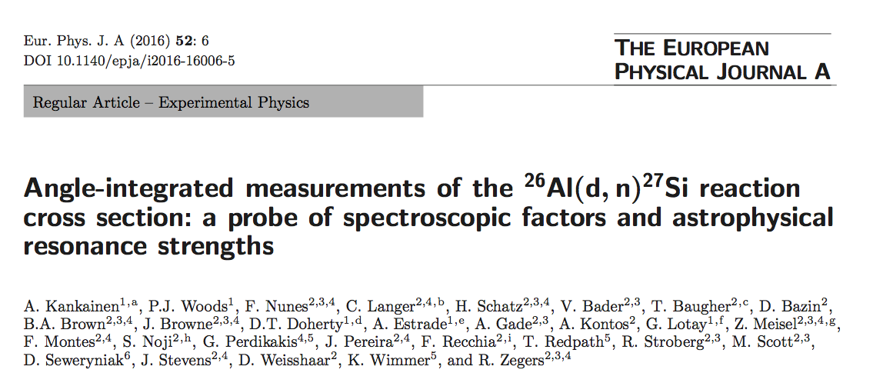
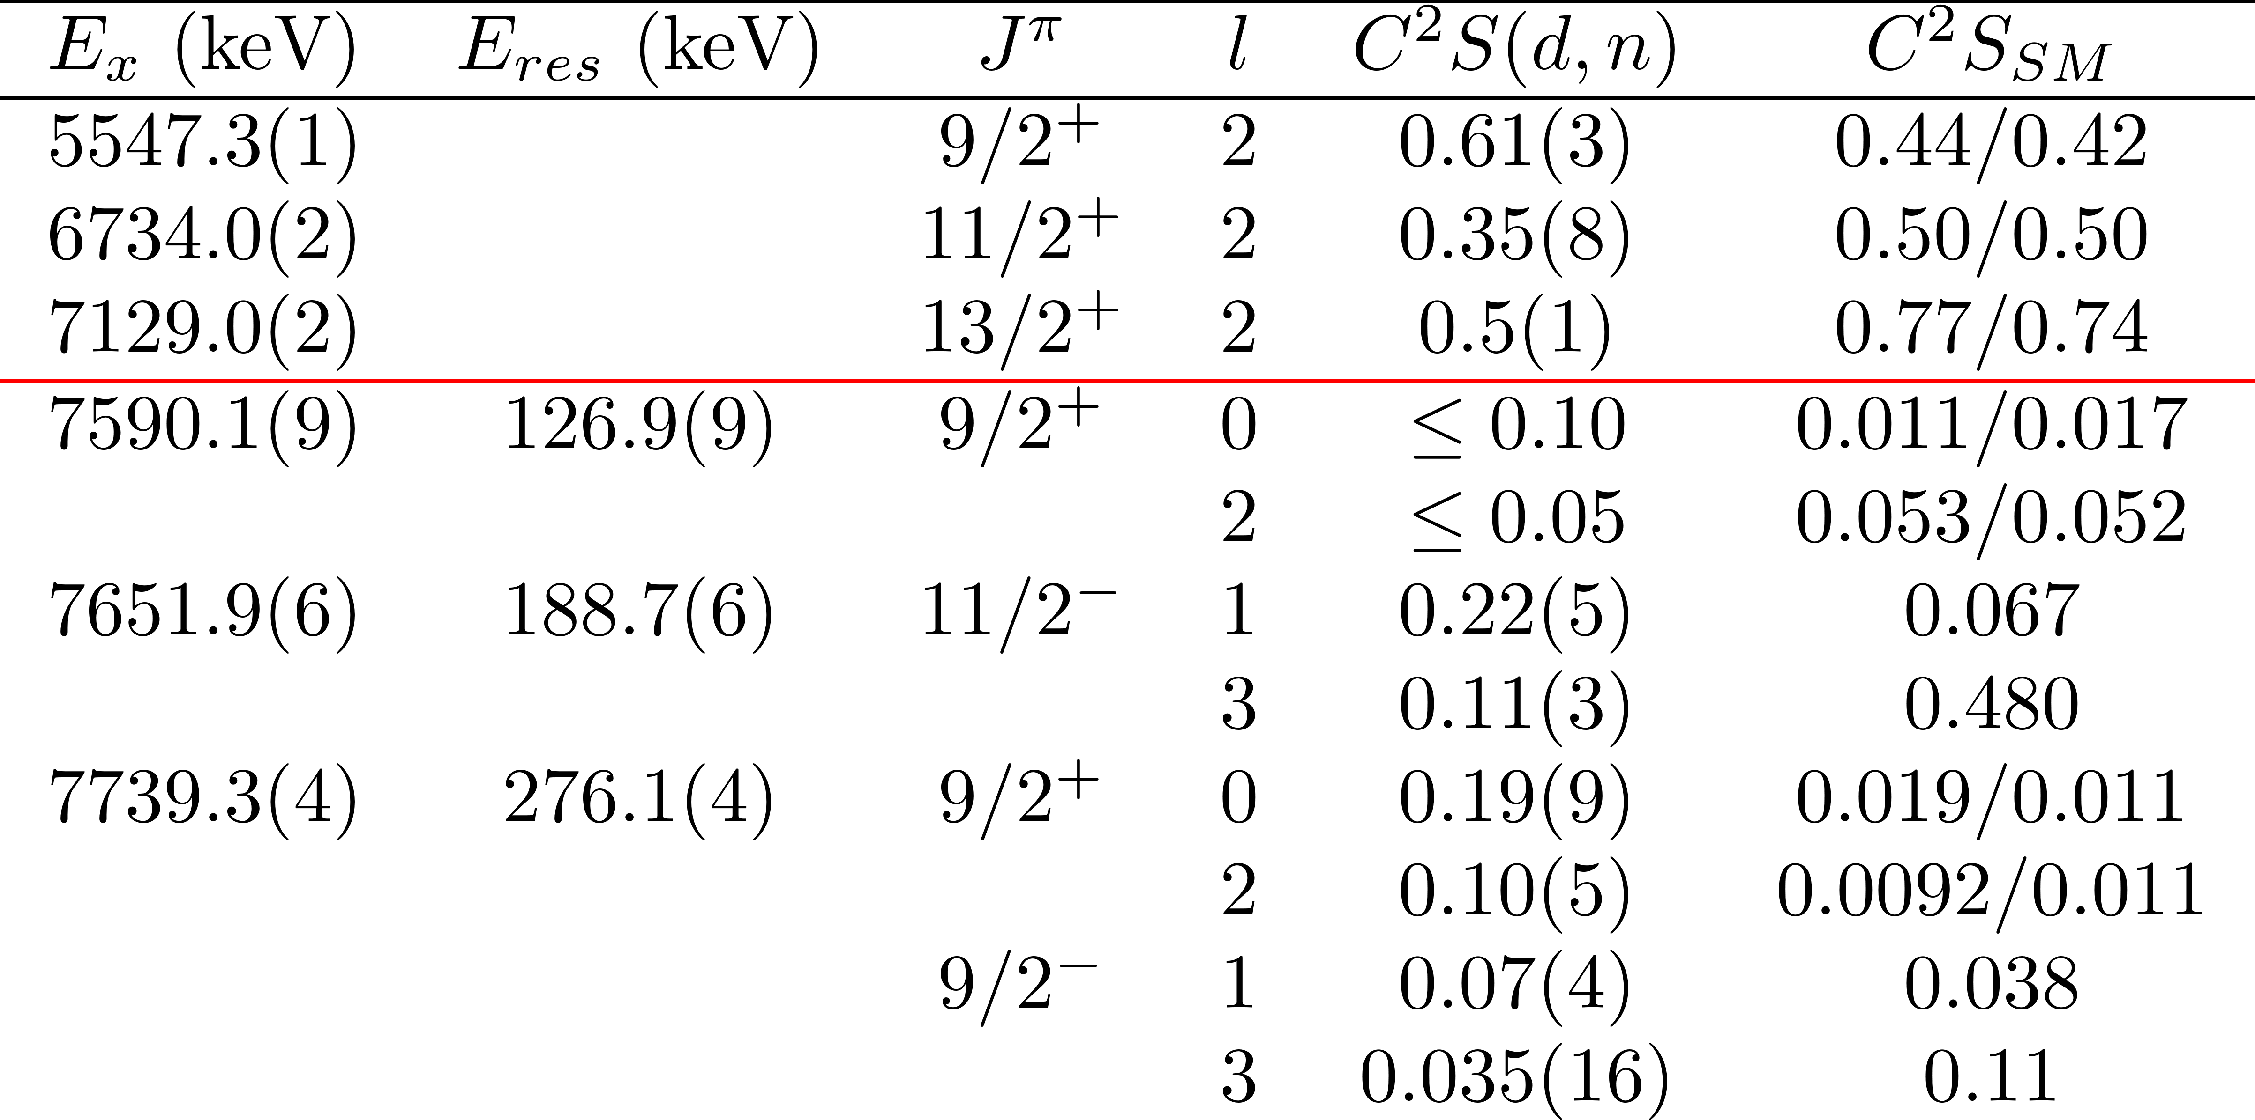
Past Results

Slide 15
Current and Future Work
³⁰P(p,γ)³¹S results are being finalized
A similar experiment looking at ⁵⁶Ni(d,n)⁵⁷Cu reaction ran recently at the NSCL
  ⁵⁶Ni(p,γ)⁵⁷Cu is a waiting point during X-ray bursters
Current method only allows for angle integrated cross sections
  Angular sensitivity would make comparison to theory much easier

Slide 16
Thank You
Group
  Advisor: Filomena Nunes
  Luke Titus, Amy Lovell, Alaina Ross, Jimmy Rotureau, and Gregory Potel
Collaborators
  Anu Kankainen, Phil Woods, Alex Brown
Questions?

Slide 17
Backup

Slide 18
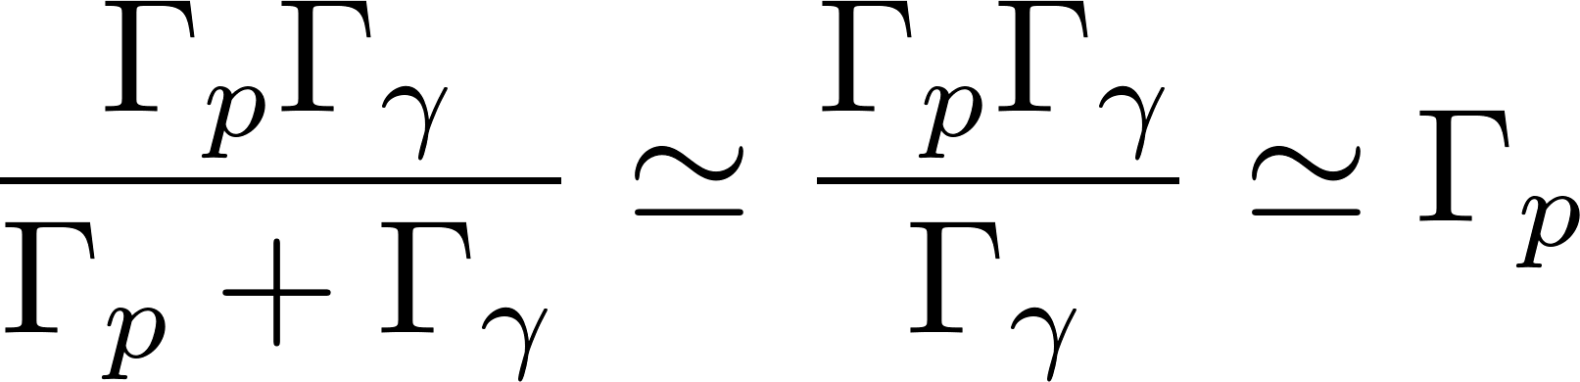
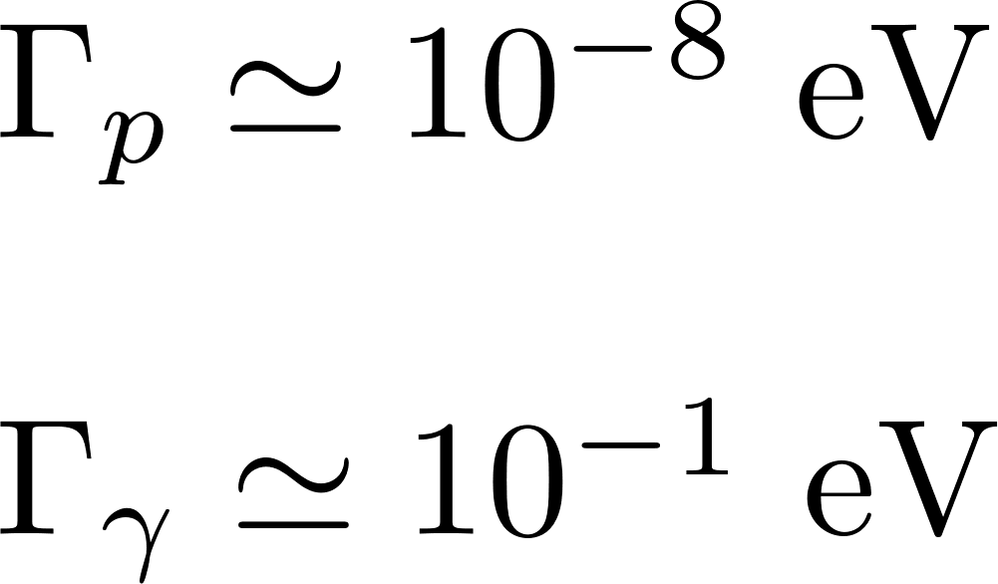
Indirect Reaction for ³⁰P(p,γ) ³¹S
Reaction rate for proton capture is too low to be measured directly
(σ$∼$pb)
γ

Slide 19
Decay Widths

Slide 20
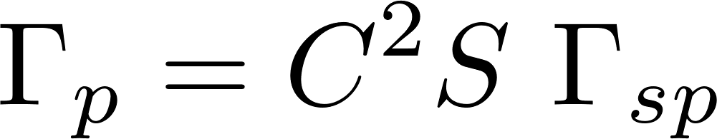
Decay Widths
Γ_{sp} can be calculated from elastic scattering of nucleon off mean field potential
Γ_{p} incorporates many body and structure information through the spectroscopic factors we determined

Slide 21
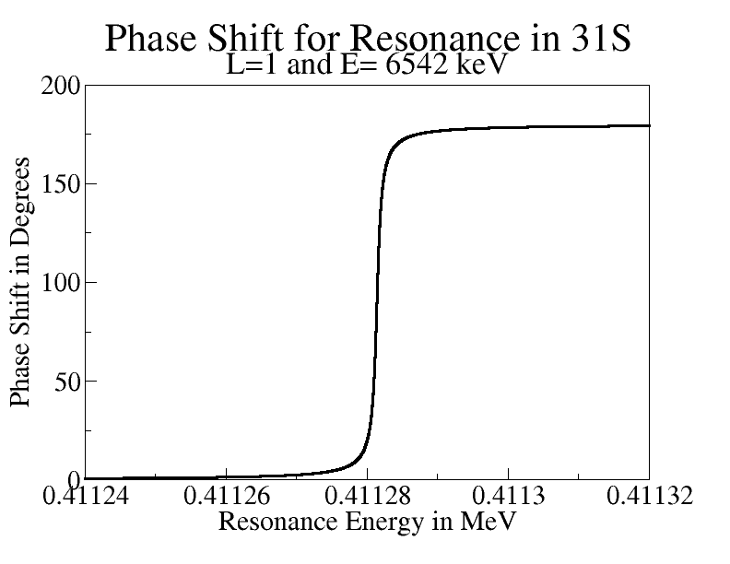
Decay Widths
Phase Shift for Resonance in ³¹S

Slide 22
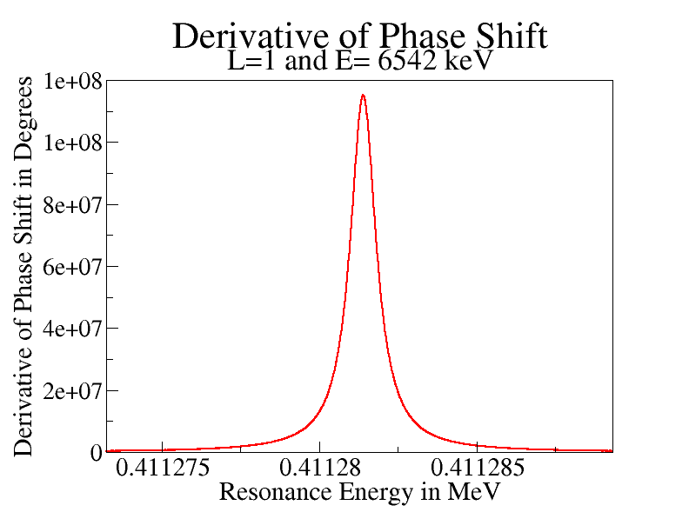
Decay Widths
Derivative of Phase Shift
Single Particle Widths
State
E_{res} | n, l , 2j | Width (eV)
196.0 | 2, 1, 3 | 3.67E-05
226.0 | 2, 1, 3 | 3.67E-04
246.0 | 1, 3, 7 | 2.50E-06
262.0 | 1, 2, 5 | 2.64E-04
411.0 | 2, 1, 3 | 1.02E+00
452.0 | 1, 2, 3 | 6.51E-02
702.0 | 2, 1, 3 | 2.02E+02

Slide 23
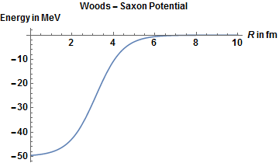
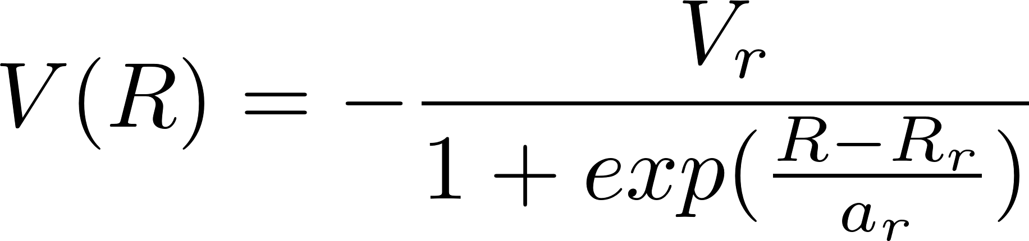
Reaction Formalism
For the entrance channel, the adiabatic potential is generated from the corresponding proton- and neutron-target interactions
Interactions use global optical potentials which have been fitted to scattering data
    CH89 used for entrance and exit channels (Phys. Rev 201, 57 (1991))
  Reid used for NN interaction (Ann. Phys. 50, 411 (1968))
Uncertainty can be estimated by changing the optical potential used and seeing the impact on total cross section.
  ~10% difference between CH89 and BG (Phys. Rev 292, 1190 (1969))

Slide 24
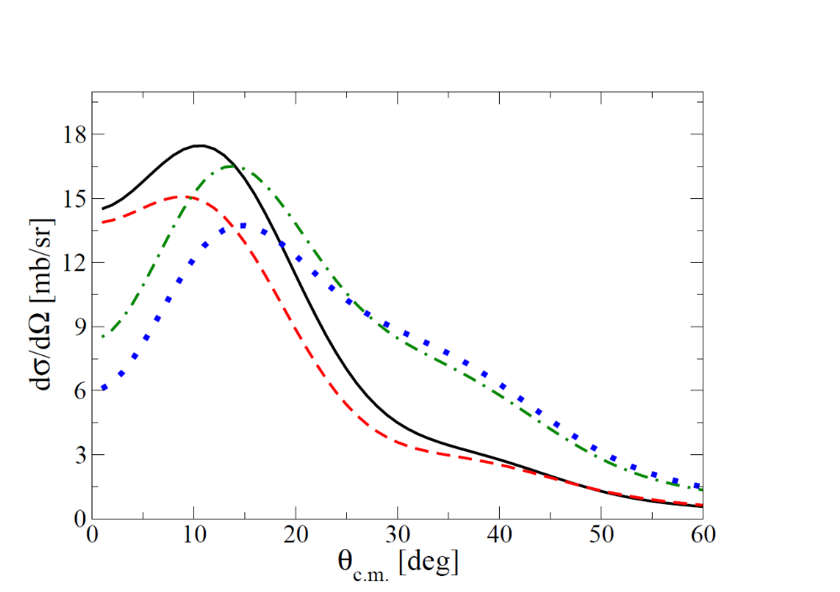
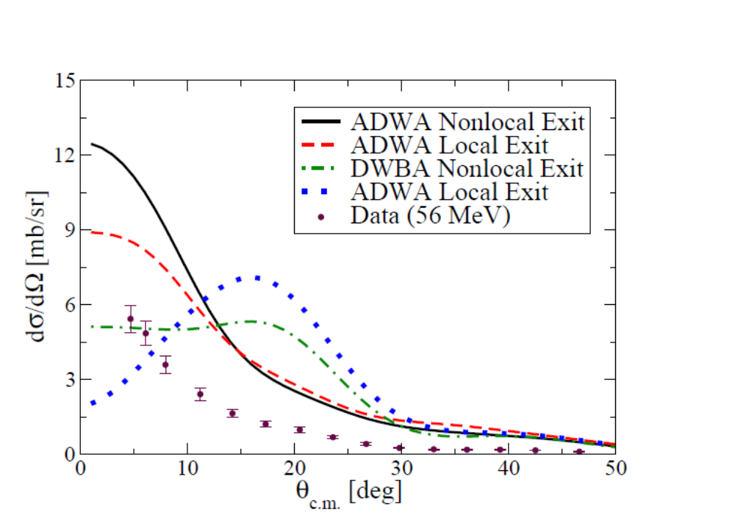
DWBA vs. ADWA
¹⁶O(d,p)¹⁷O at 50 MeV
⁴⁸Ca(d,p)⁴⁹Ca at 50 MeV
Breakup can change both shape and magnitude of distribution.
L.J. Titus, F.M. Nunes, and G. Potel, Phys. Rev. C., 93, 014604 (2016)
Y. Uozumi, et. al., Nucl. Phys. A, 576, 123 (1994) (Data)

Slide 25
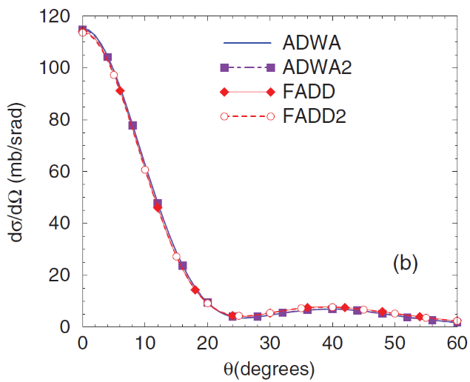
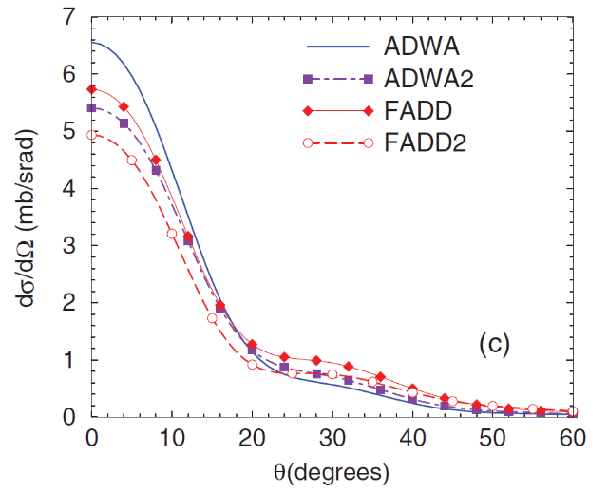
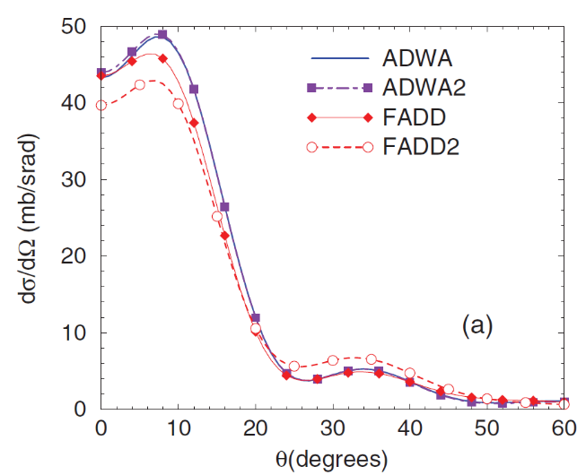
ADWA vs. Faddeev
¹¹Be(p,d)¹⁰Be at 10 MeV
¹²C(d,p)¹³C at 56 MeV
⁴⁸Ca(d,p)⁴⁹Ca at 19.3 MeV
F.M. Nunes and A. Deltuva, PRC 84, 034607 (2011)

