Slide 1
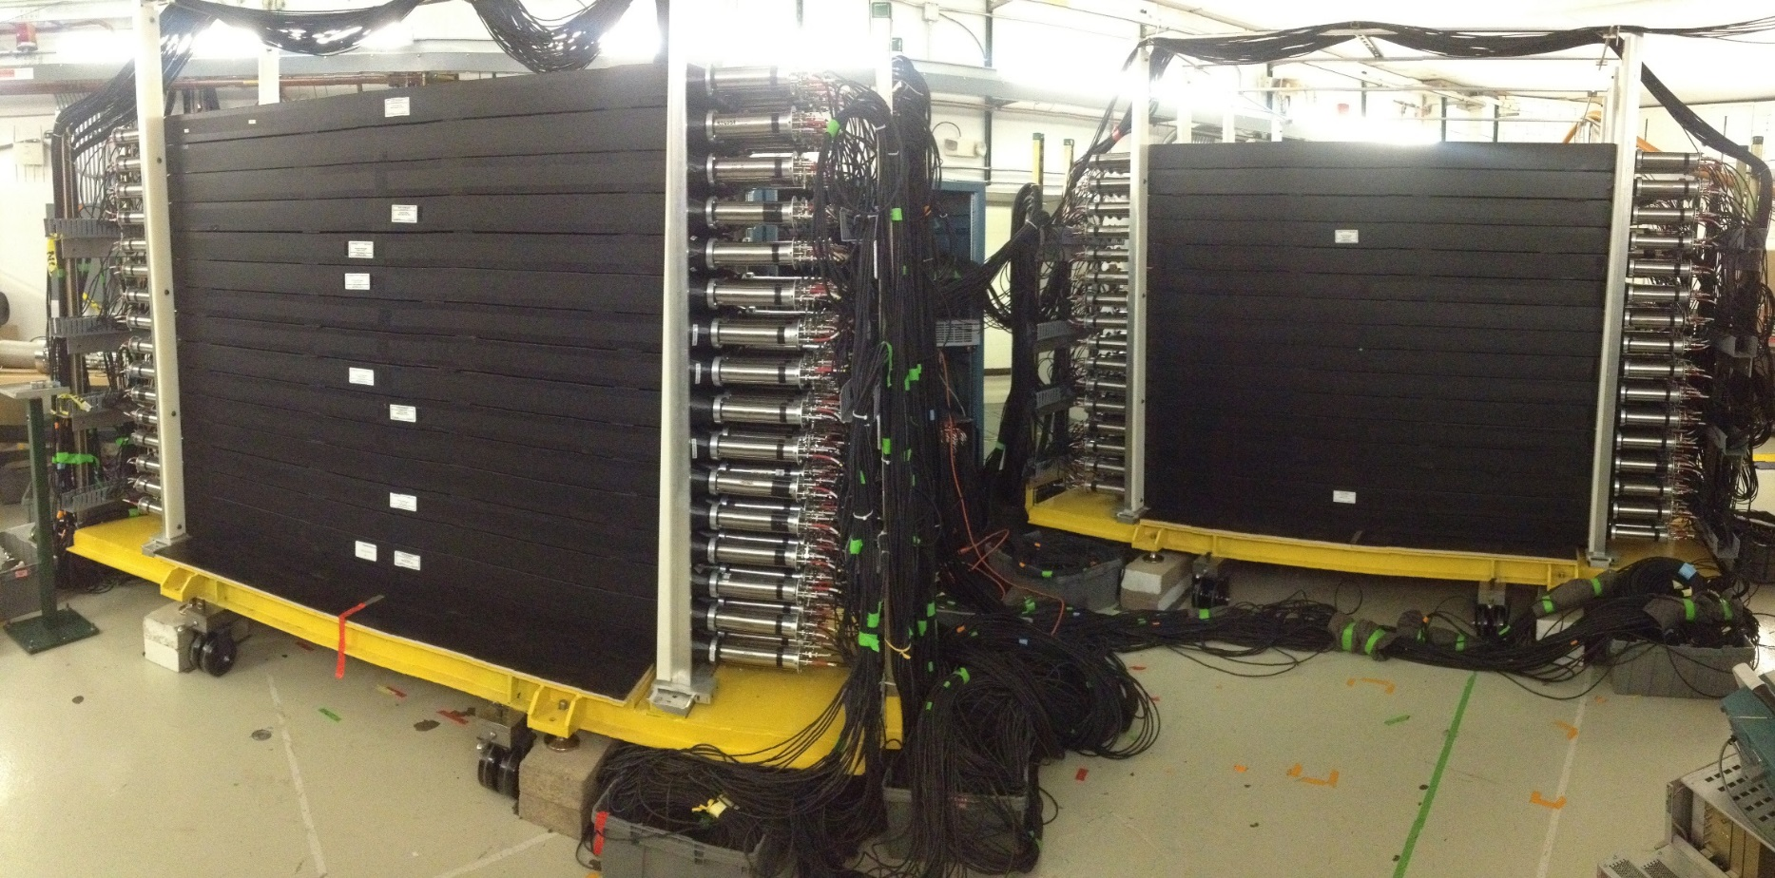

Identification of multiple neutrons (and knockout reactions) with MoNA
Anthony N. Kuchera
National Superconducting Cyclotron Laboratory
Michigan State University

Slide 2
Outline
Multiple neutron emission
  ²⁴O→²²O+2n
  ¹⁵Be → ¹²Be+3n
  ¹²He → ⁸He+4n
Recent Work on Knockout Reactions in p-shell nuclei
  Understanding proton-knockout reaction mechanism
  Using cross sections to guide structure theory
New Experiment at NSCL
  CCF facility and experimental set up
  Momentum distributions and gamma-ray spectra
  Preliminary results
  Future plans

Slide 3
Multiple neutron emission

Slide 4
Nuclear structure of light nuclei
Light nuclei are interesting for many reasons including many exotic features and are accessible for several theoretical approaches starting from first principles.
¹²O
¹³O
¹⁴O
¹⁵O
¹⁶O
¹⁷O
¹⁸O
¹⁹O
²⁰O
²¹O
²²O
²³O
²⁴O
²⁵O
²⁶O
Z
¹⁰N
¹¹N
¹²N
¹³N
¹⁴N
¹⁵N
¹⁶N
¹⁷N
¹⁸N
¹⁹N
²⁰N
²¹N
²²N
²³N
⁸C
⁹C
¹⁰C
¹¹C
¹²C
¹³C
¹⁴C
¹⁵C
¹⁶C
¹⁷C
¹⁸C
¹⁹C
²⁰C
²¹C
²²C
⁷B
⁸B
⁹B
¹⁰B
¹¹B
¹²B
¹³B
¹⁴B
¹⁵B
¹⁶B
¹⁷B
¹⁸B
¹⁹B
Stable
Bound
Unbound
⁶Be
⁷Be
⁸Be
⁹Be
¹⁰Be
¹¹Be
¹²Be
¹³Be
¹⁴Be
¹⁵Be
¹⁶Be
⁴Li
⁵Li
⁶Li
⁷Li
⁸Li
⁹Li
¹⁰Li
¹¹Li
¹²Li
¹³Li
²He
³He
⁴He
⁵He
⁶He
⁷He
⁸He
⁹He
¹⁰He
¹H
²H
³H
⁴H
⁵H
⁶H
⁷H
n
N

Slide 5
MoNA measurements for multiple neutrons
The red boxed nuclei have seen evidence for or searched for decays by multiple neutrons using MoNA(LISA).
¹²O
¹³O
¹⁴O
¹⁵O
¹⁶O
¹⁷O
¹⁸O
¹⁹O
²⁰O
²¹O
²²O
²³O
²⁴O
²⁵O
²⁶O
Z
¹⁰N
¹¹N
¹²N
¹³N
¹⁴N
¹⁵N
¹⁶N
¹⁷N
¹⁸N
¹⁹N
²⁰N
²¹N
²²N
²³N
⁸C
⁹C
¹⁰C
¹¹C
¹²C
¹³C
¹⁴C
¹⁵C
¹⁶C
¹⁷C
¹⁸C
¹⁹C
²⁰C
²¹C
²²C
⁷B
⁸B
⁹B
¹⁰B
¹¹B
¹²B
¹³B
¹⁴B
¹⁵B
¹⁶B
¹⁷B
¹⁸B
¹⁹B
Stable
Bound
Unbound
⁶Be
⁷Be
⁸Be
⁹Be
¹⁰Be
¹¹Be
¹²Be
¹³Be
¹⁴Be
¹⁵Be
¹⁶Be
⁴Li
⁵Li
⁶Li
⁷Li
⁸Li
⁹Li
¹⁰Li
¹¹Li
¹²Li
¹³Li
²He
³He
⁴He
⁵He
⁶He
⁷He
⁸He
⁹He
¹⁰He
¹²He
¹H
²H
³H
⁴H
⁵H
⁶H
⁷H
n
N

Slide 6
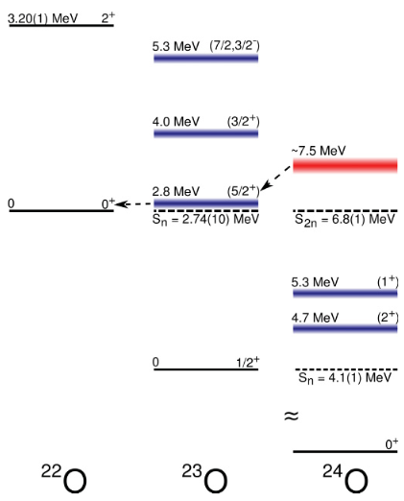
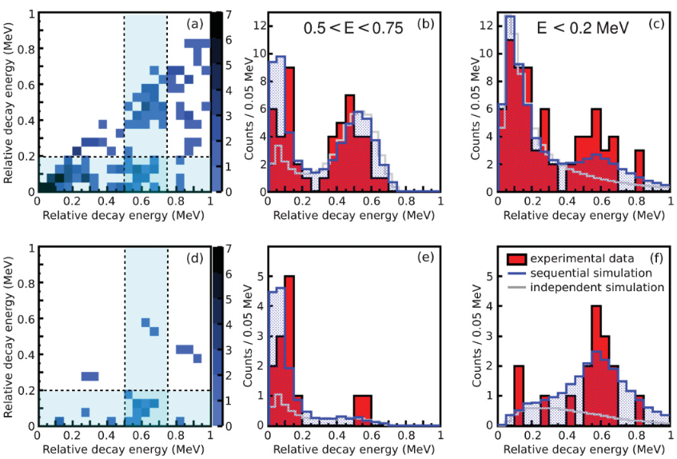
Two neutrons from ²⁴O
Using two discrete neutron energies in coincidence
C. R. Hoffman et al. Phys. Rev. C 83, 031303(R) (2011)

Slide 7
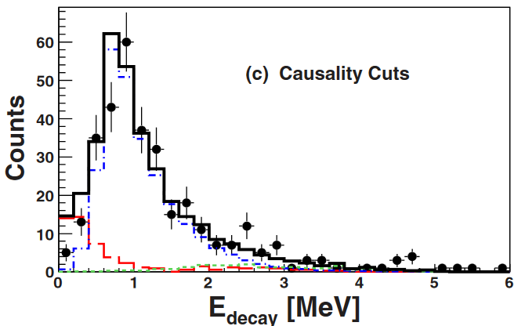
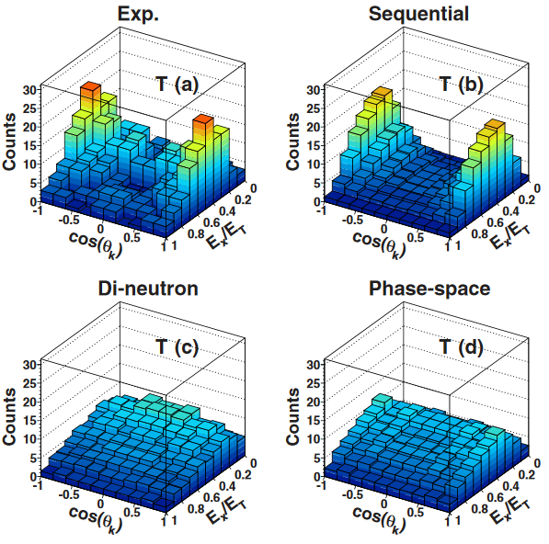
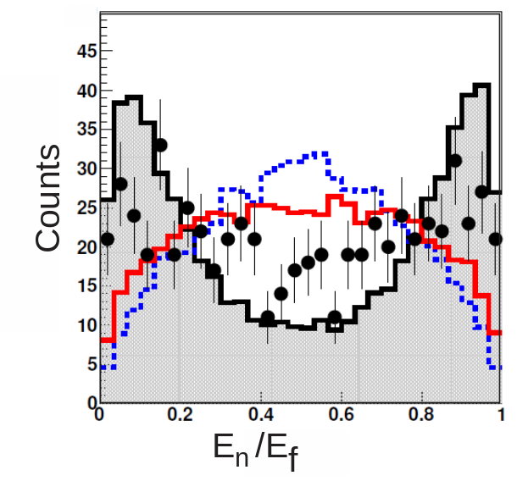
Two neutrons from ²⁴O
Using energy and angular correlations from ²⁴O→²²O+2n
Phase Space
Di-neutron
Sequential
M. D. Jones et al. Phys. Rev. C 92, 051306(R) (2015)

Slide 8
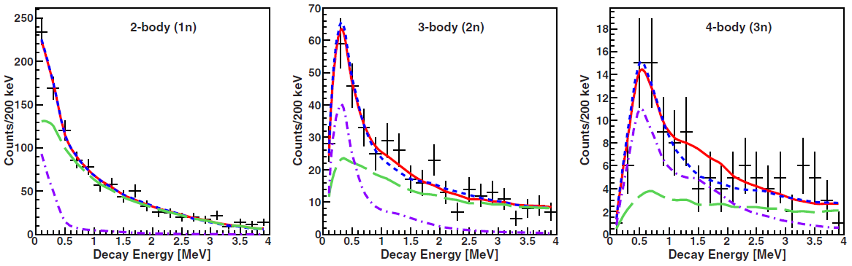
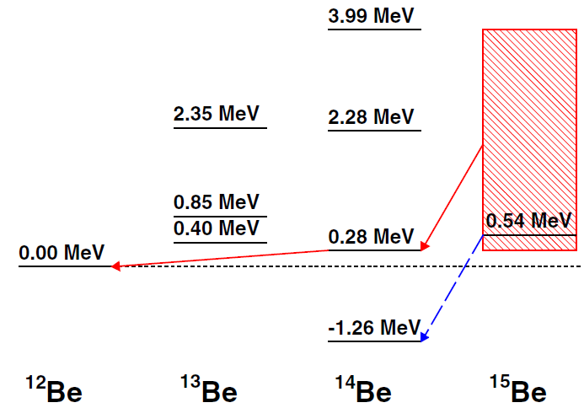
Search for three neutrons from ¹⁵Be
Simultaneous fitting of 2-, 3-, and 4-body spectra
Fit with ¹⁵Be
Fit without ¹⁵Be
¹⁵Be component
Background
A. N. Kuchera et al. Phys. Rev. C 91, 17304 (2015)

Slide 9
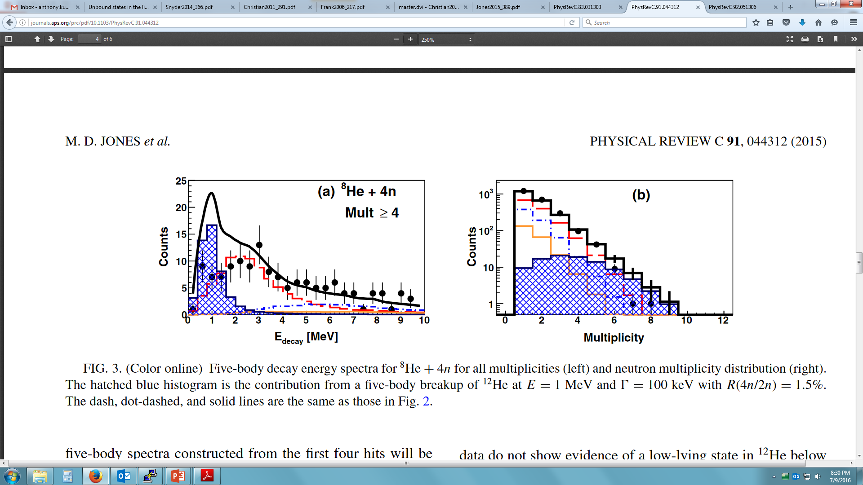
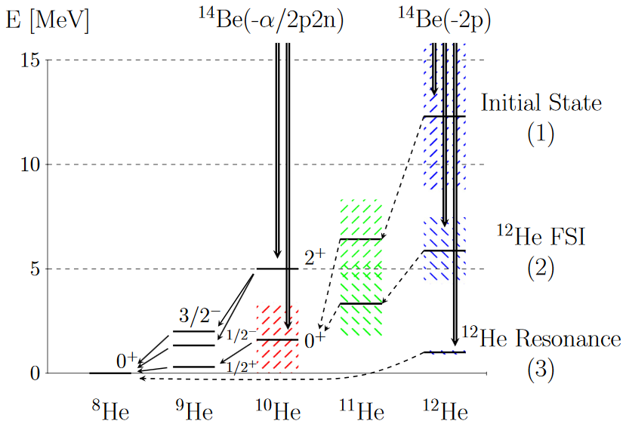
Search for four neutrons from ¹²He
Construct 5-body spectra and include weakly populated resonance
M.D. Jones et al. Phys. Rev. C 91, 044312 (2015)

Slide 10
Previous work on knockout reactions in the p-shell at NSCL

Slide 11

Nucleon-removal reactions
Nucleon-removal (knockout) reactions are used at fragmentation facilities, such as NSCL, where secondary beams are produced at E≈100 MeV/u.
Typically one or two nucleons are removed from projectile with a light nuclear target (ex. Be or C).
Knocked-out nucleon
Projectile (E≈100 MeV/u)
Detect fragment + gamma/neutron
Fragment
Target

Slide 12
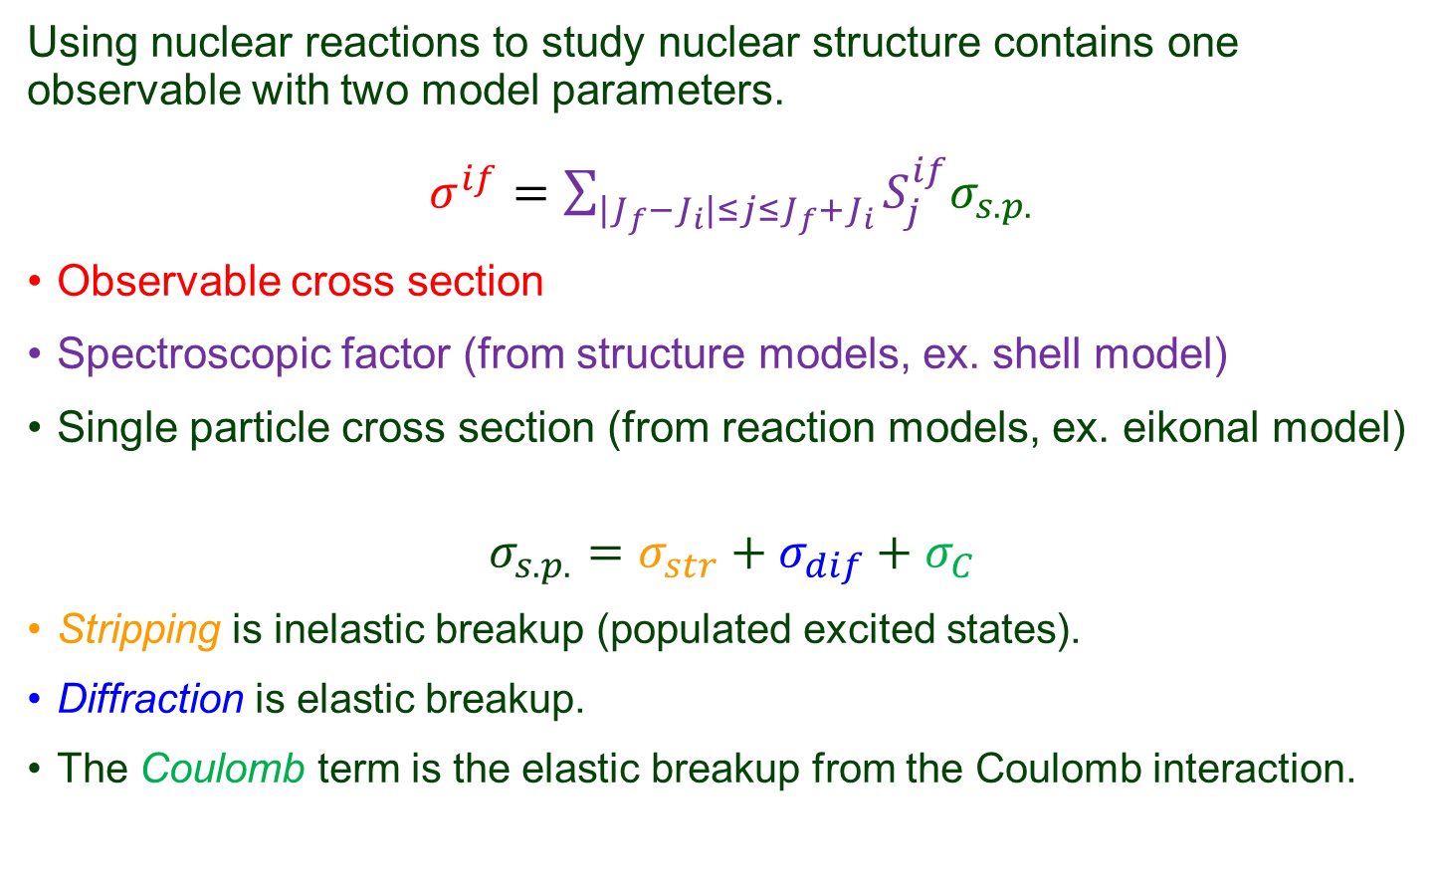
Structure and reaction models

Slide 13
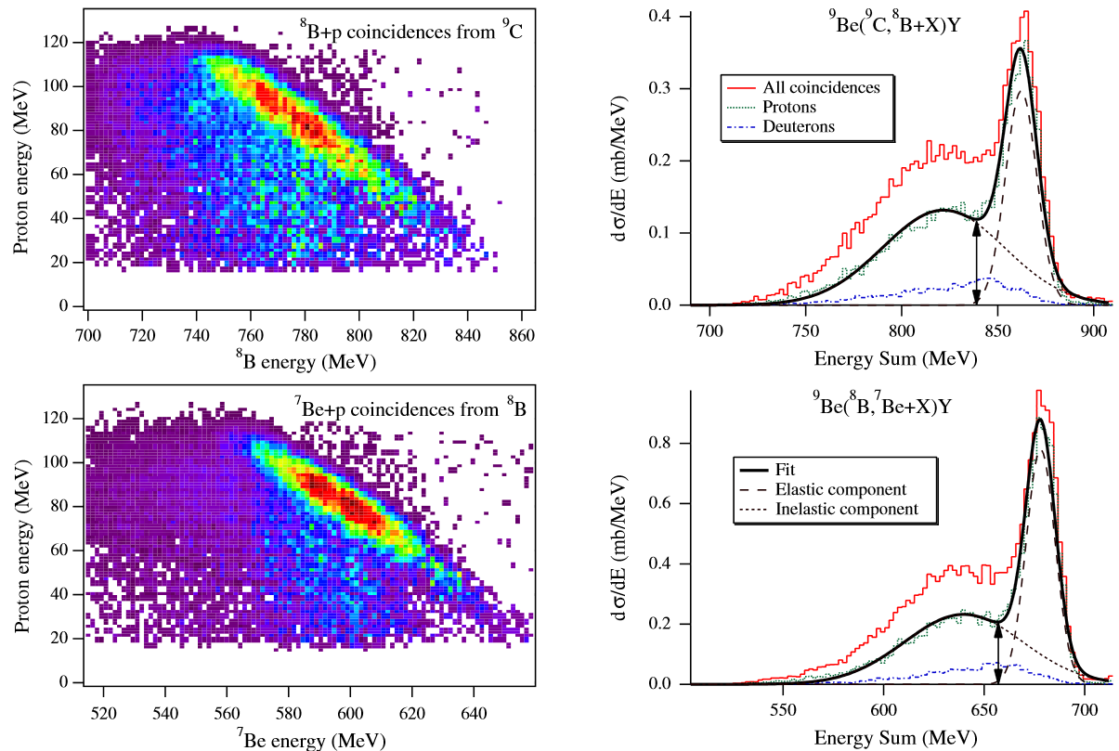
Proton knockout reaction mechanism
Typically the removed nucleon is not measured in knockout experiments and results rely on reaction model calculations.
Coincident measurements were made with the knocked-out proton and fragment were to quantify the cross section components.
Ratio of elastic cross section to total
Reaction | Eikonal | Experiment
(⁹C, ⁸B) | 26.8% | 25(2)%
(⁸B, ⁷Be) | 37.1% | 38(3)%
D. Bazin et al., PRL 102, 232501 (2009)

Slide 14
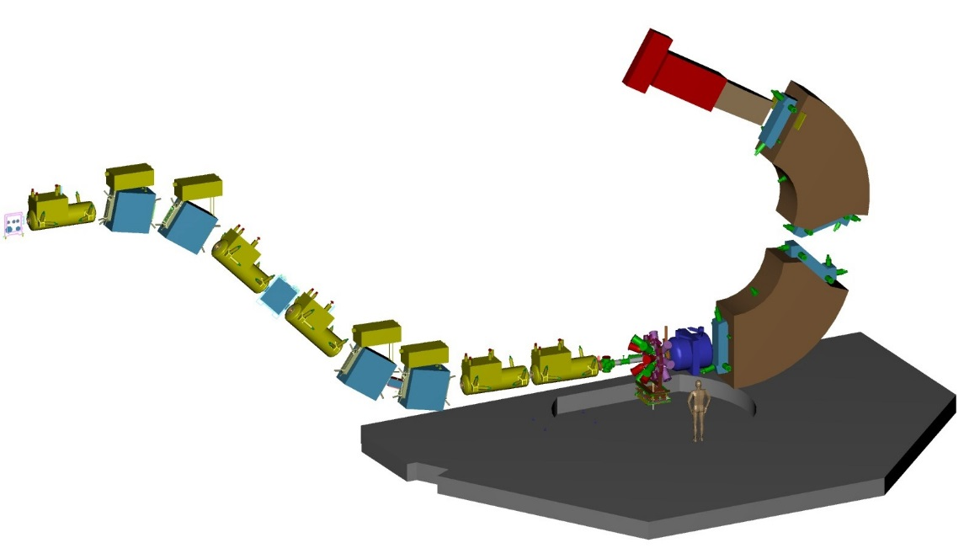
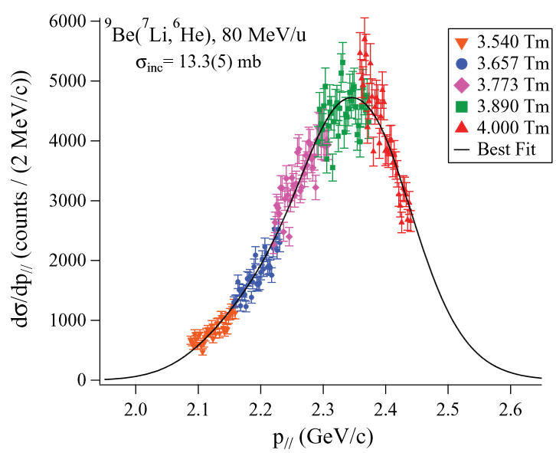
Single nucleon knockout cross sections
Precise cross sections needed to benchmark and guide theory.
Seven single-nucleon knockout reactions from p-shell nuclei were performed at the NSCL using S800 spectrograph (see below).
Inclusive cross sections were measured and compared to theory.
  G. F. Grinyer et al. PRL 106 162502(2011)
  G. F. Grinyer et al. PRC 86 24315 (2012)

Slide 15
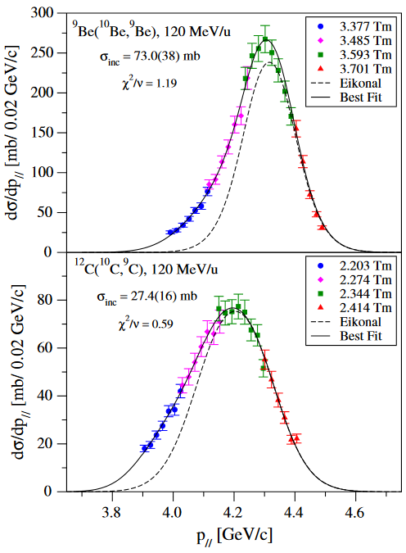
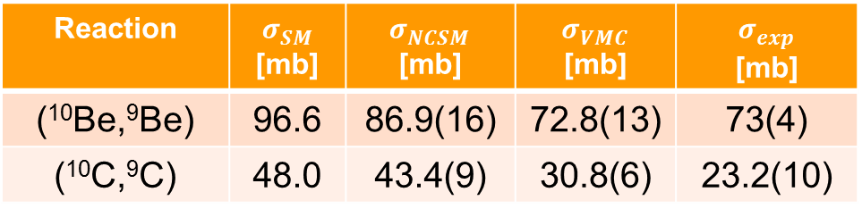
Examples without bound excited states
Two of the reactions include fragments that have no bound excited states: (¹⁰Be,⁹Be) and (¹⁰C, ⁹C).
These offer the most direct comparison to theory because the final state of the nucleus is immediately known.
Reaction
(¹⁰Be,⁹Be) | 96.6 | 86.9(16) | 72.8(13) | 73(4)
(¹⁰C,⁹C) | 48.0 | 43.4(9) | 30.8(6) | 23.2(10)
  G. F. Grinyer et al. PRL 106 162502(2011)

Slide 16
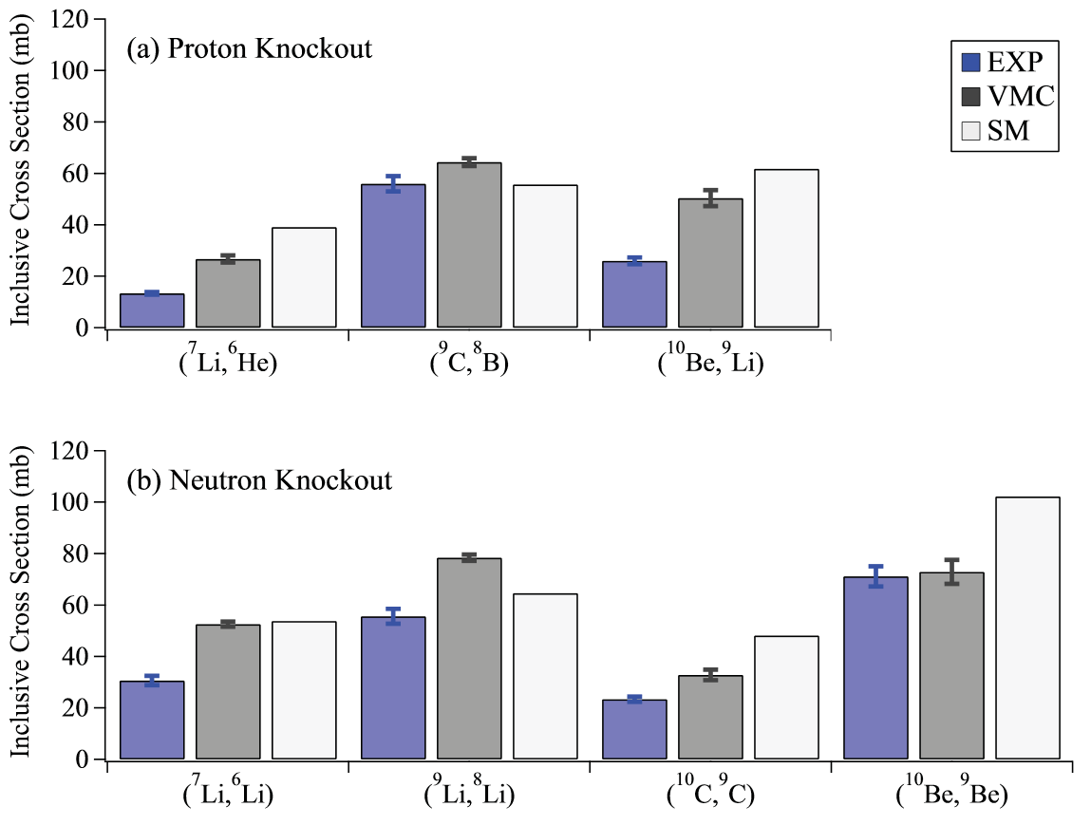
Inclusive cross section summary
More work is needed to better guide theory (exclusive cross sections).
  G. F. Grinyer et al. PRC 86 24315 (2012)

Slide 17
Recent experiment at NSCL

Slide 18
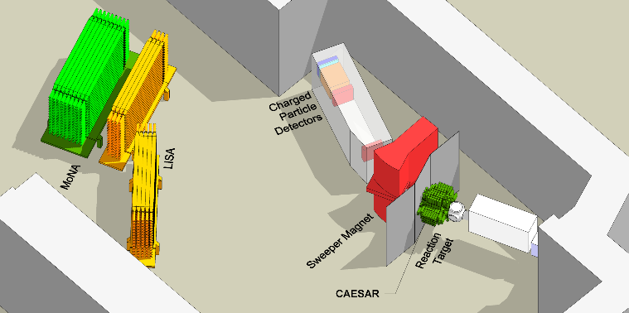
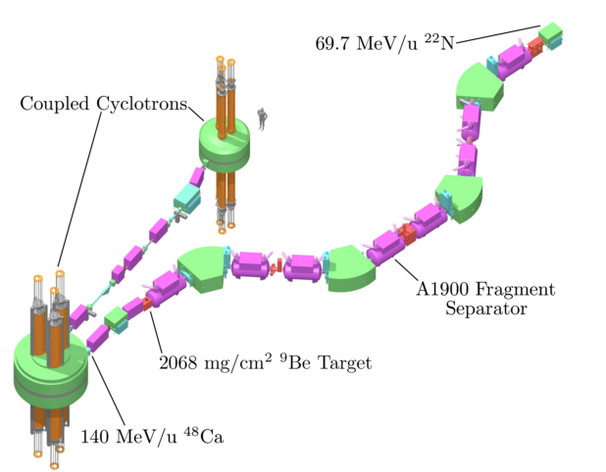
Coupled Cyclotron Facility - NSCL
Secondary Beam
Coupled Cyclotrons
Experimental Vault
150 MeV/u ¹⁶O
Secondary Beam | Energy [MeV/u]
⁷Li | 80
⁹Li | 80
¹⁰Be | 80
¹¹B | 100
¹¹C | 120
¹²C | 120
A1900 Fragment Separator
Be Production Target

Slide 19

Experimental setup

Slide 20
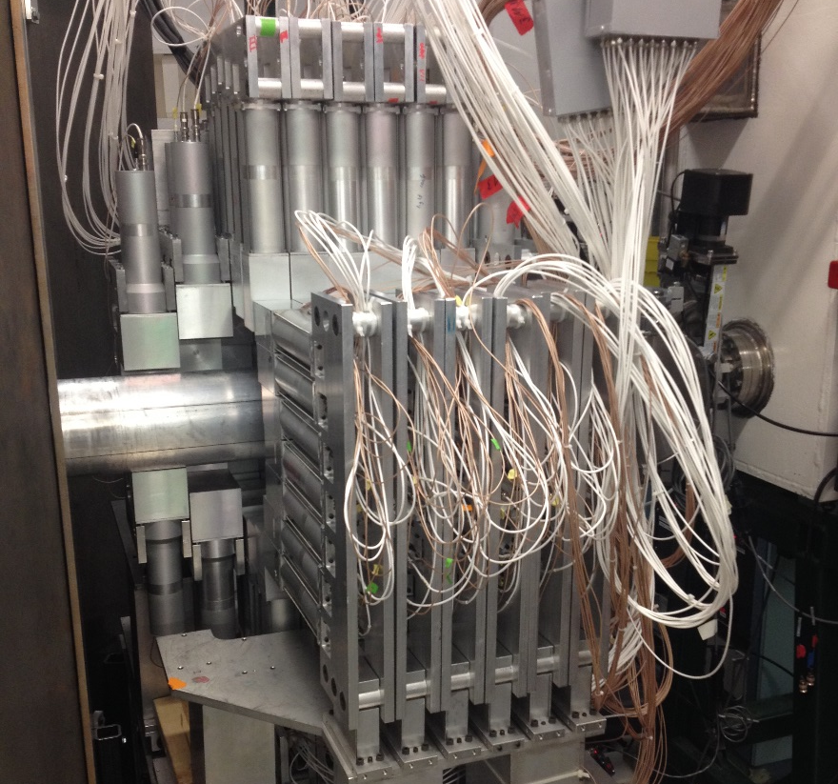
Reactions
Six secondary beams, eight reaction settings, four days!
Gamma-ray detector, CAESAR, surrounded the reaction target allows exclusive cross section measurements.
Reaction | Final States
(⁷Li,⁶He) | 0⁺(g.s.)
(⁷Li,⁶Li) | 1⁺(g.s.), 0⁺(3.5 MeV)
(⁹Li,⁸Li) | 2⁺(g.s.), 1⁺(1.0 MeV)
(¹⁰Be,⁹Li) | 3/2⁻(g.s.), 1/2⁻(2.6 MeV)
(¹¹B,¹⁰Be) | 0⁺(g.s.), 2⁺(3.4 MeV)
(¹¹C,¹⁰C) | 0⁺(g.s.), 2⁺(3.3 MeV)
(¹²C, ¹¹B) | 3/2⁻(g.s.), 1/2⁻(2.1 MeV)
(¹²C, ¹¹C) | 3/2⁻(g.s.), 1/2⁻(2.0 MeV)

Slide 21
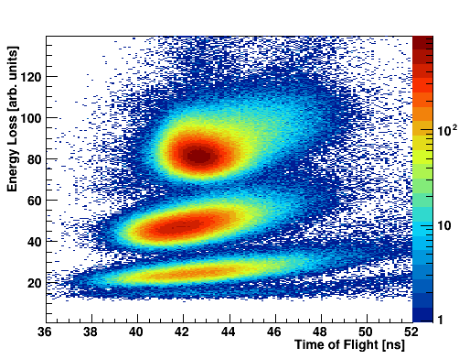
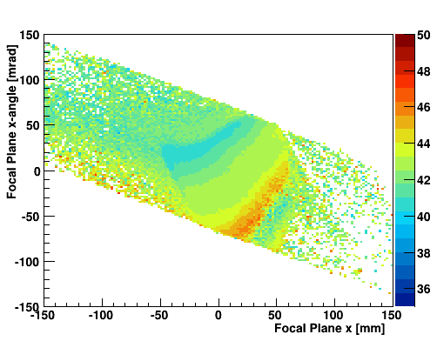
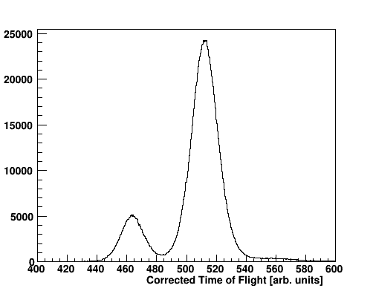
Example of particle ID: (¹¹B,¹⁰Be)
B
Time of Flight [ns]
Be
Li
¹⁰Be
⁹Be

Slide 22
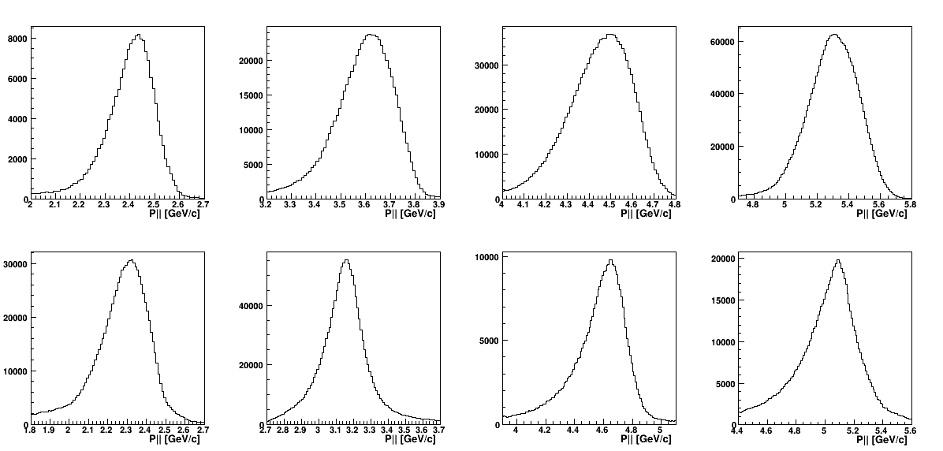
Parallel momentum distributions
(⁷Li,⁶He)
(¹⁰Be,⁹Li)
(¹¹B,¹⁰Be)
(¹²C, ¹¹B)
(⁷Li,⁶Li)
(⁹Li,⁸Li)
(¹¹C,¹⁰C)
(¹²C, ¹¹C)

Slide 23
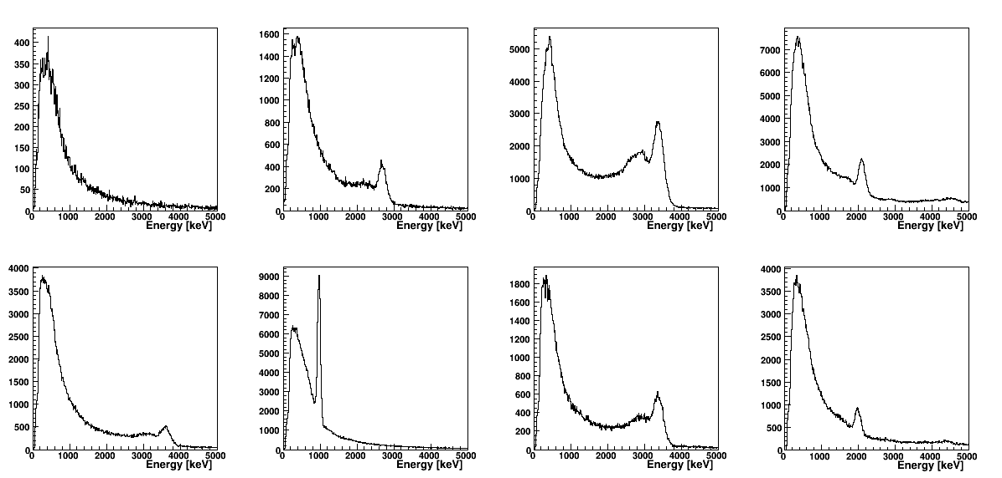
Gamma-ray spectra
(⁷Li,⁶He)
(¹⁰Be,⁹Li)
(¹¹B,¹⁰Be)
(¹²C, ¹¹B)
(⁷Li,⁶Li)
(⁹Li,⁸Li)
(¹¹C,¹⁰C)
(¹²C, ¹¹C)
Spectra are Doppler corrected and include neighboring crystal energy add-back.

Slide 24
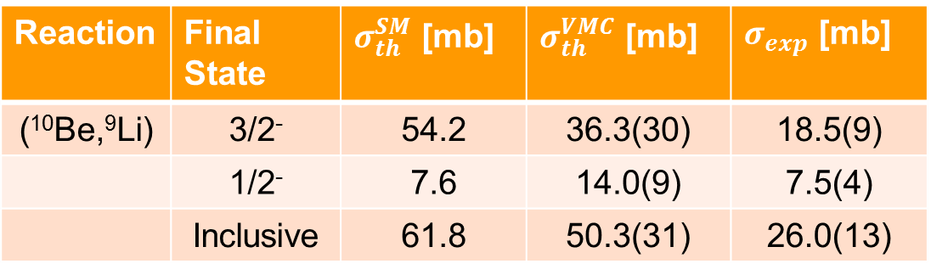
Preliminary results
Absolute cross sections are still being finalized.
Relative cross sections of excited to ground states have been obtained.
A similar discrepancy in cross section was observed in the (¹⁰C,⁹C) reaction and was attributed to the accuracy of the eikonal model when dealing with deeply bound nucleons.
  ⁹C+n: 21.3 MeV
  ⁹Li+p: 19.6 MeV
Reaction | Final State
(¹⁰Be,⁹Li) | 3/2⁻ | 54.2 | 36.3(30) | 18.5(9)
 | 1/2⁻ | 7.6 | 14.0(9) | 7.5(4)
 | Inclusive | 61.8 | 50.3(31) | 26.0(13)
All theoretical and experimental inclusive cross sections are taken from G. F. Grinyer et al. PRC 86 024315 (2012).

Slide 25
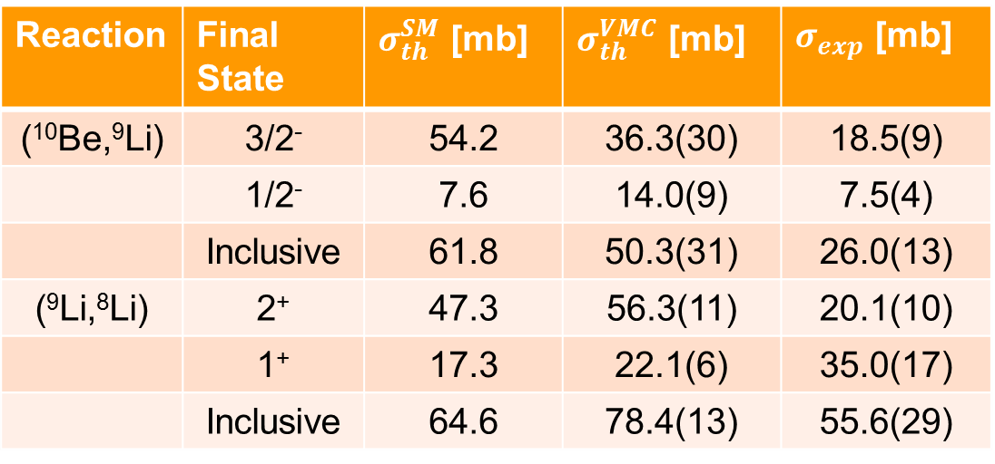
Preliminary results
Absolute cross sections are still being finalized.
Relative cross sections of excited to ground states have been obtained.
Unclear why the branching for the (⁹Li,⁸Li) states is so different from theory. Further analysis required to understand this result.
Reaction | Final State
(¹⁰Be,⁹Li) | 3/2⁻ | 54.2 | 36.3(30) | 18.5(9)
 | 1/2⁻ | 7.6 | 14.0(9) | 7.5(4)
 | Inclusive | 61.8 | 50.3(31) | 26.0(13)
(⁹Li,⁸Li) | 2⁺ | 47.3 | 56.3(11) | 20.1(10)
 | 1⁺ | 17.3 | 22.1(6) | 35.0(17)
 | Inclusive | 64.6 | 78.4(13) | 55.6(29)
All theoretical and experimental inclusive cross sections are taken from G. F. Grinyer et al. PRC 86 024315 (2012).

Slide 26

Future plans
Finalize absolute cross section measurements.
Compare exclusive cross sections to shell model and ab initio calculations such as VMC and NSCM.
Use neutron data from MoNA-LISA to check the validity of neutron-removal reaction models by extracting elastic and inelastic components of cross section.

Slide 27
Conclusions
The use of direct reactions, especially nucleon-removal reactions, have been successful in the investigations of nuclear structure.
Multiple-neutron decay experiments are pushing the frontier of nuclear structure.
A recent experiment at NSCL has been performed to provide more detail into the structure of p-shell nuclei for the guidance of ab initio approaches to nuclear theory.
New results to come with exclusive cross sections from particle-gamma coincidences.

Slide 28


Acknowledgements
D. Bazin, A. Gade, G. F. Grinyer, M. Thoennessen, M. Babo, T. Baumann, M. Bowry, J. Bradt, J. Brown, P. A. DeYoung, B. Elman, J. E. Finck, M. D. Jones, E. Lunderberg, T. Redpath, W. F. Rogers, K. Stiefel, D. Weisshaar, K. Whitmore

Slide 30
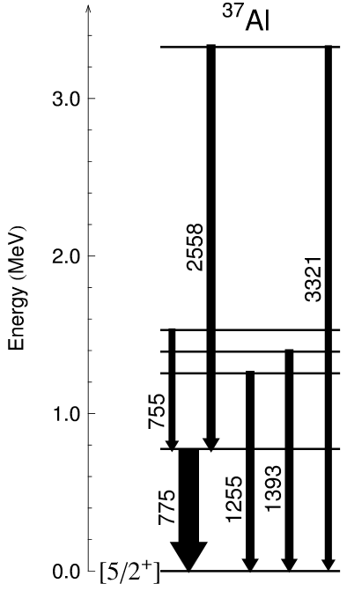
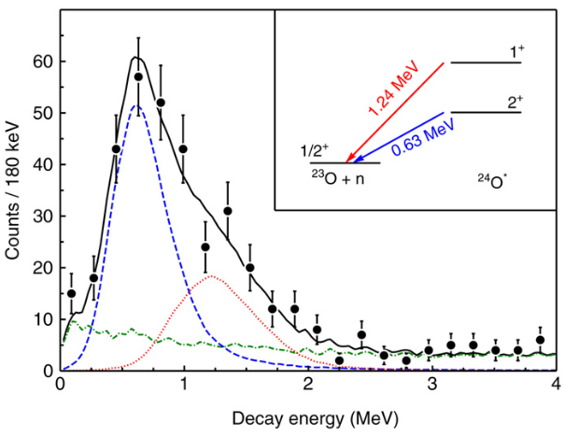
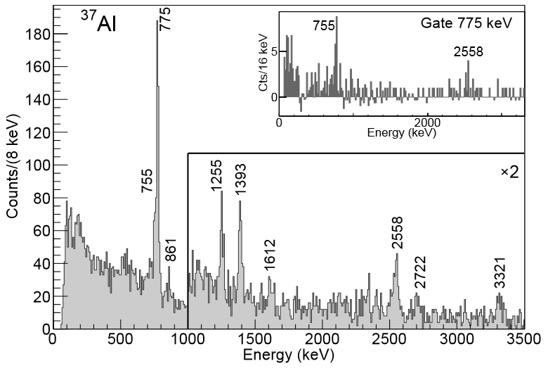
Spectroscopy of bound and unbound states
Gamma Spectroscopy: Bound states
Invariant Mass Spectroscopy: Neutron-unbound states
S. R. Stroberg et al. Phys. Rev. C 90 034301 (2014)
C. R. Hoffman et al. Phys. Lett. B 672 (2009)

Slide 31
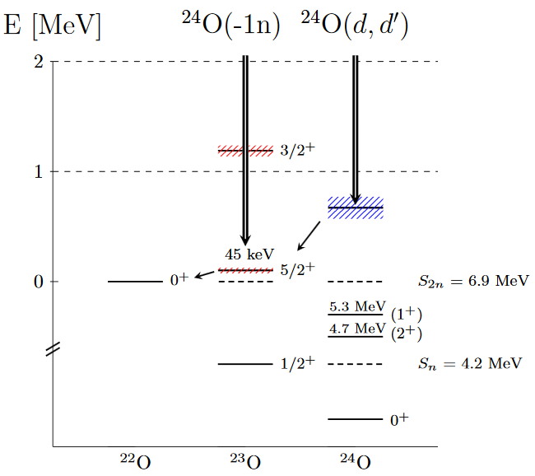
Two neutrons from ²⁴O
Using energy and angular correlations from ²⁴O→²²O+2n
Phase Space
Di-neutron
Sequential
M. D. Jones et al. Phys. Rev. C 92, 051306(R) (2015)

Slide 32
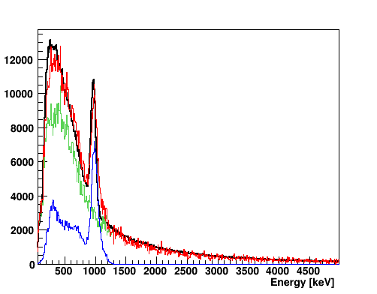
(¹⁰Be,⁹Li*) fitting
Relative strength to excited state determined from GEANT4 simulation of CAESAR combined with background of (⁷Li,⁶He).
Experiment
Simulation
Background
Sum

Slide 33
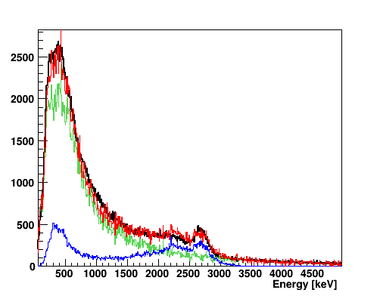
(⁹Li,⁸Li*)
Relative strength to excited state determined from GEANT4 simulation of CAESAR combined with background of (⁷Li,⁶He).
Experiment
Simulation
Background
Sum

Slide 34
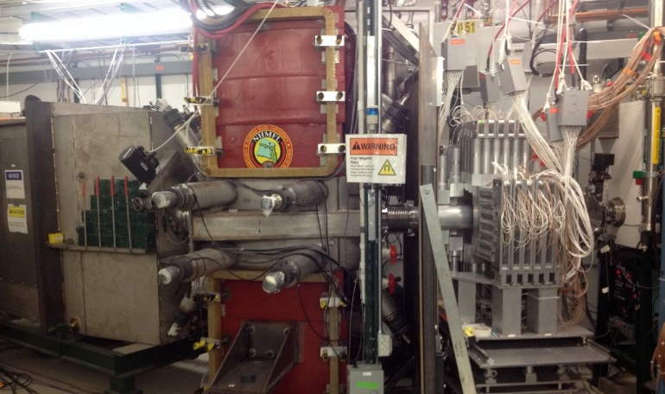

Experimental setup

