Slide 1







SuperSUN and PanEDM: a new superthermal UCN source for a new nEDM measurement
Skyler Degenkolb, Oliver Zimmer,
Peter Fierlinger,
Doug Beck,
Tim Chupp

Slide 2
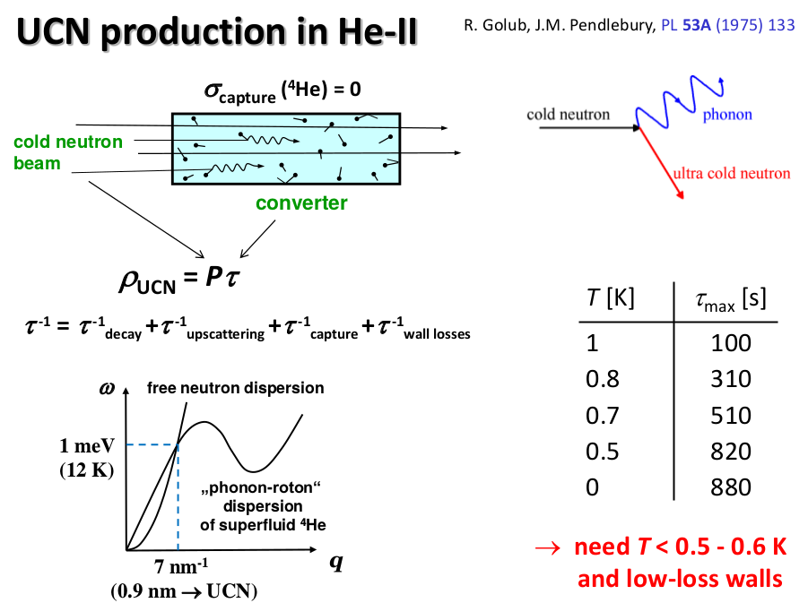
(from Oliver Zimmer)

Slide 3
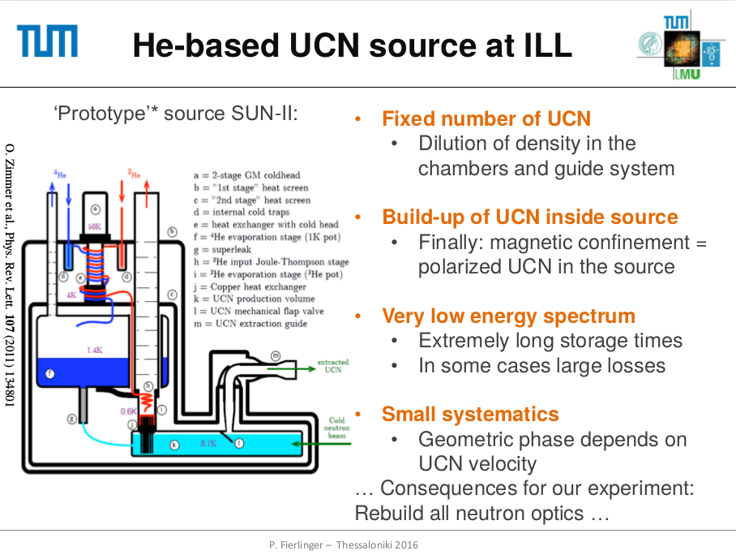

Slide 4
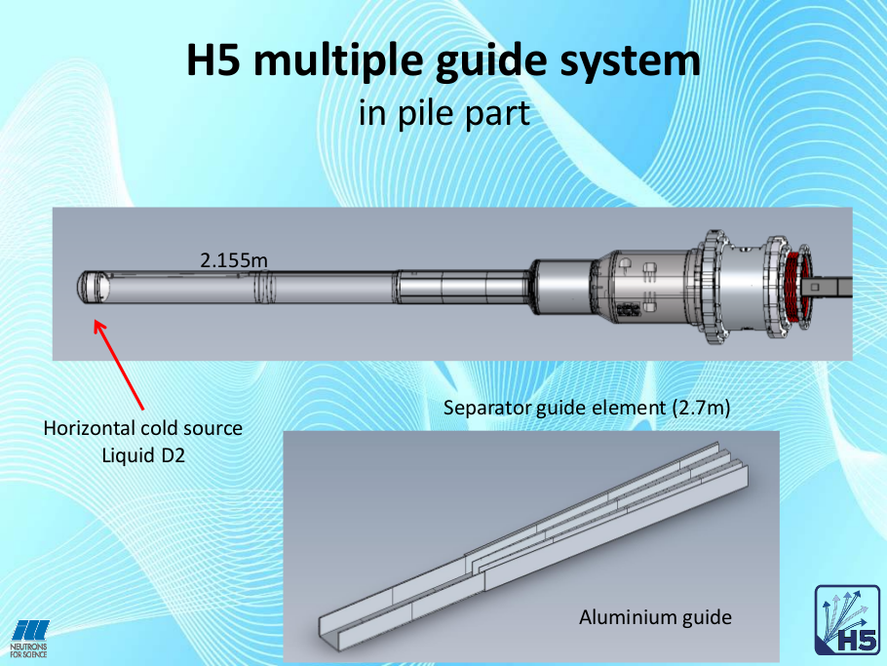

Slide 5
61218 (F)
Super-Adam
Gap A:
12 vacuum
0.8 Al
12 vacuum
Gap E:
85 vacuum
2 Al
25 air
1 Al
5 vacuum
D16
0
5803 (B)
20998
31605 (E)
focusing m=3
7286 (C)
4930 (A)
8020 (D)
1600
3155
H523 60×120
Gap B:
12 vacuum
straight
m=2
Gap F:
1 Al
250 air
1 Al
5 vacuum
Wasp sample
Gap C:
10 vacuum
H521 R=1500m m=2
Gap D:
75 vacuum
H523 R=800m m=1.2
straight m=2
H5/H52
H52 R=4000m
H522 R=4000m m=2
m=2.5
m=2
Gap G:
1 Al
250 air
2 graphite
250 air
1 Al
55403
74343 (G)
83664 (H)
70727
94405
91655
Gap H:
1 Al
250 air
H51 40×120
H52 68×132
H53 60×120
H52 120×240
H521 60×115
H522 120×120
H523 55×115
H521 60×150
60×150
30×120
H522 120×120 40×40
(from Ken Andersen)

Slide 7
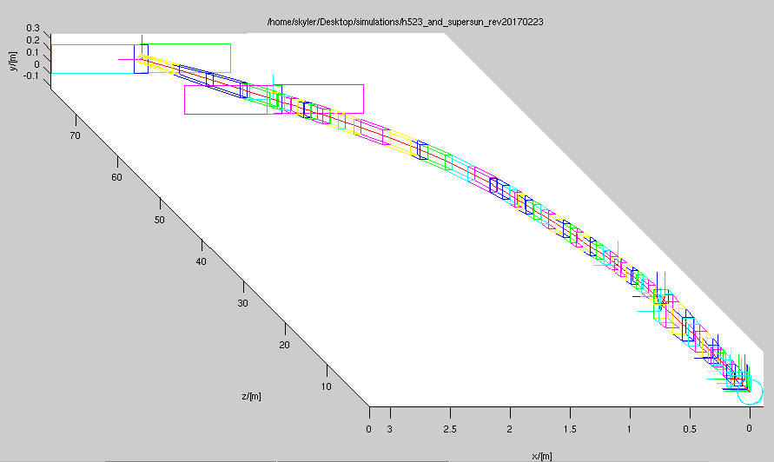
Existing Guide H523

Slide 8
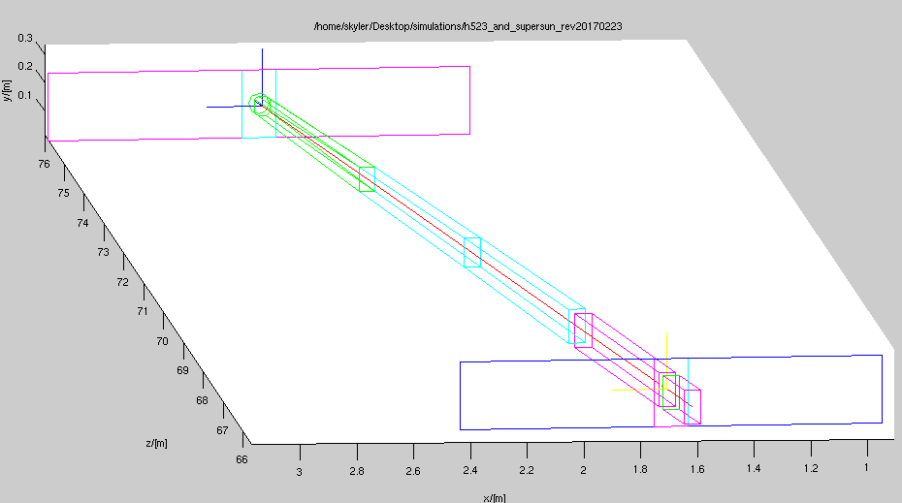
Existing Guide H523

Slide 9
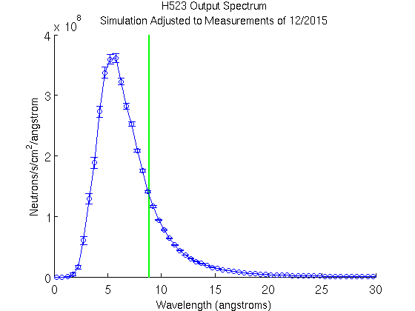
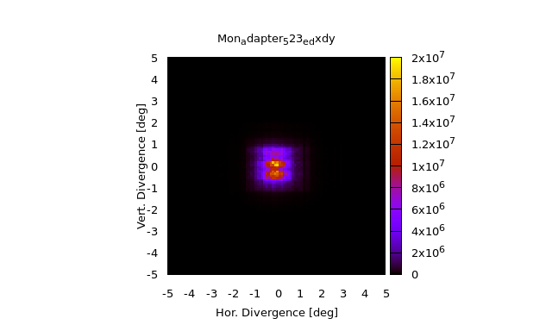
Existing Guide H523
1.0 x 10⁹ n/s in the useful wavelength range
  ~ 0.7% of total flux
Coating: m = 1.2 (expect m = 2.5 in converter)

Slide 10
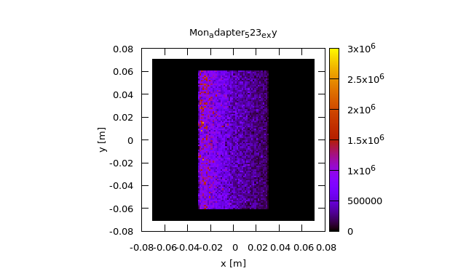
Existing Guide H523
1.0 x 10⁹ n/s in the useful wavelength range
  ~ 0.7% of total flux
Coating: m = 1.2 (expect m = 2.5 in converter)

Slide 11
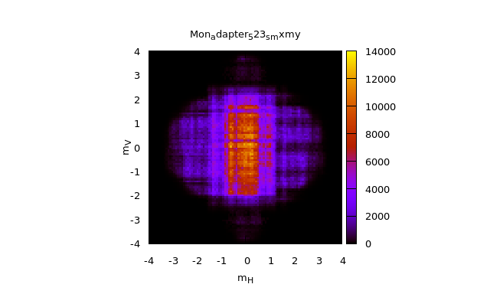
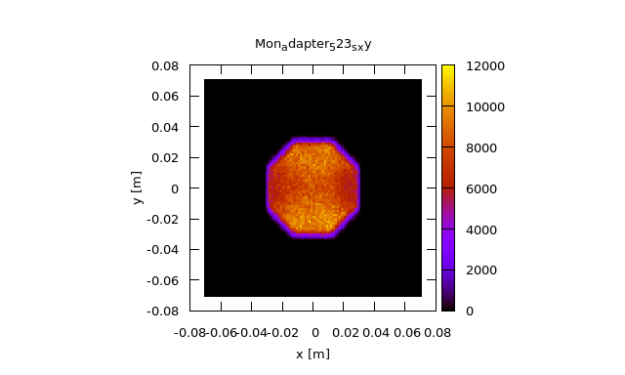
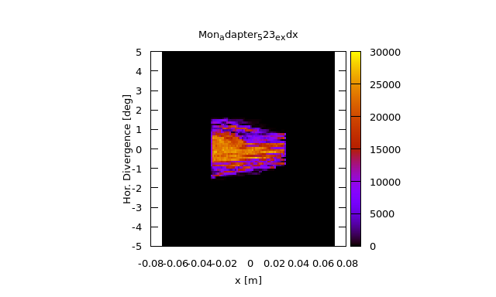
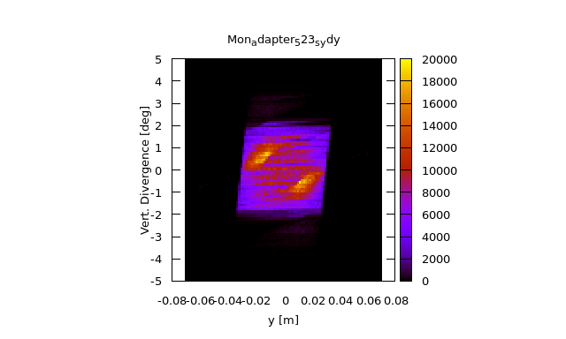
Simulated Phase Space

Slide 12
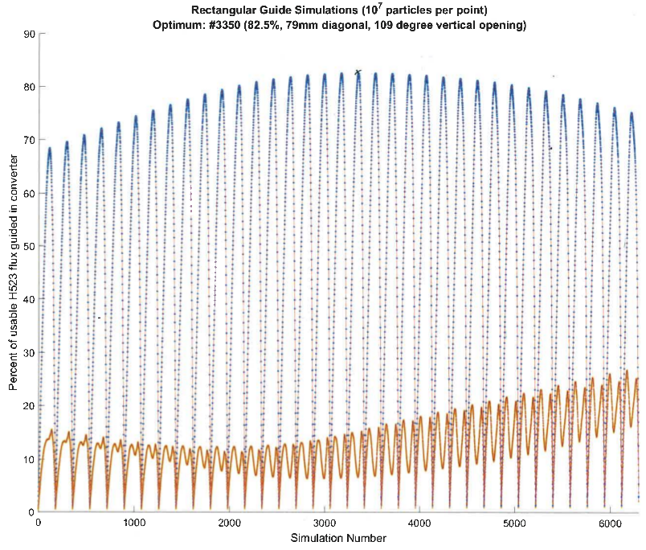

Slide 13
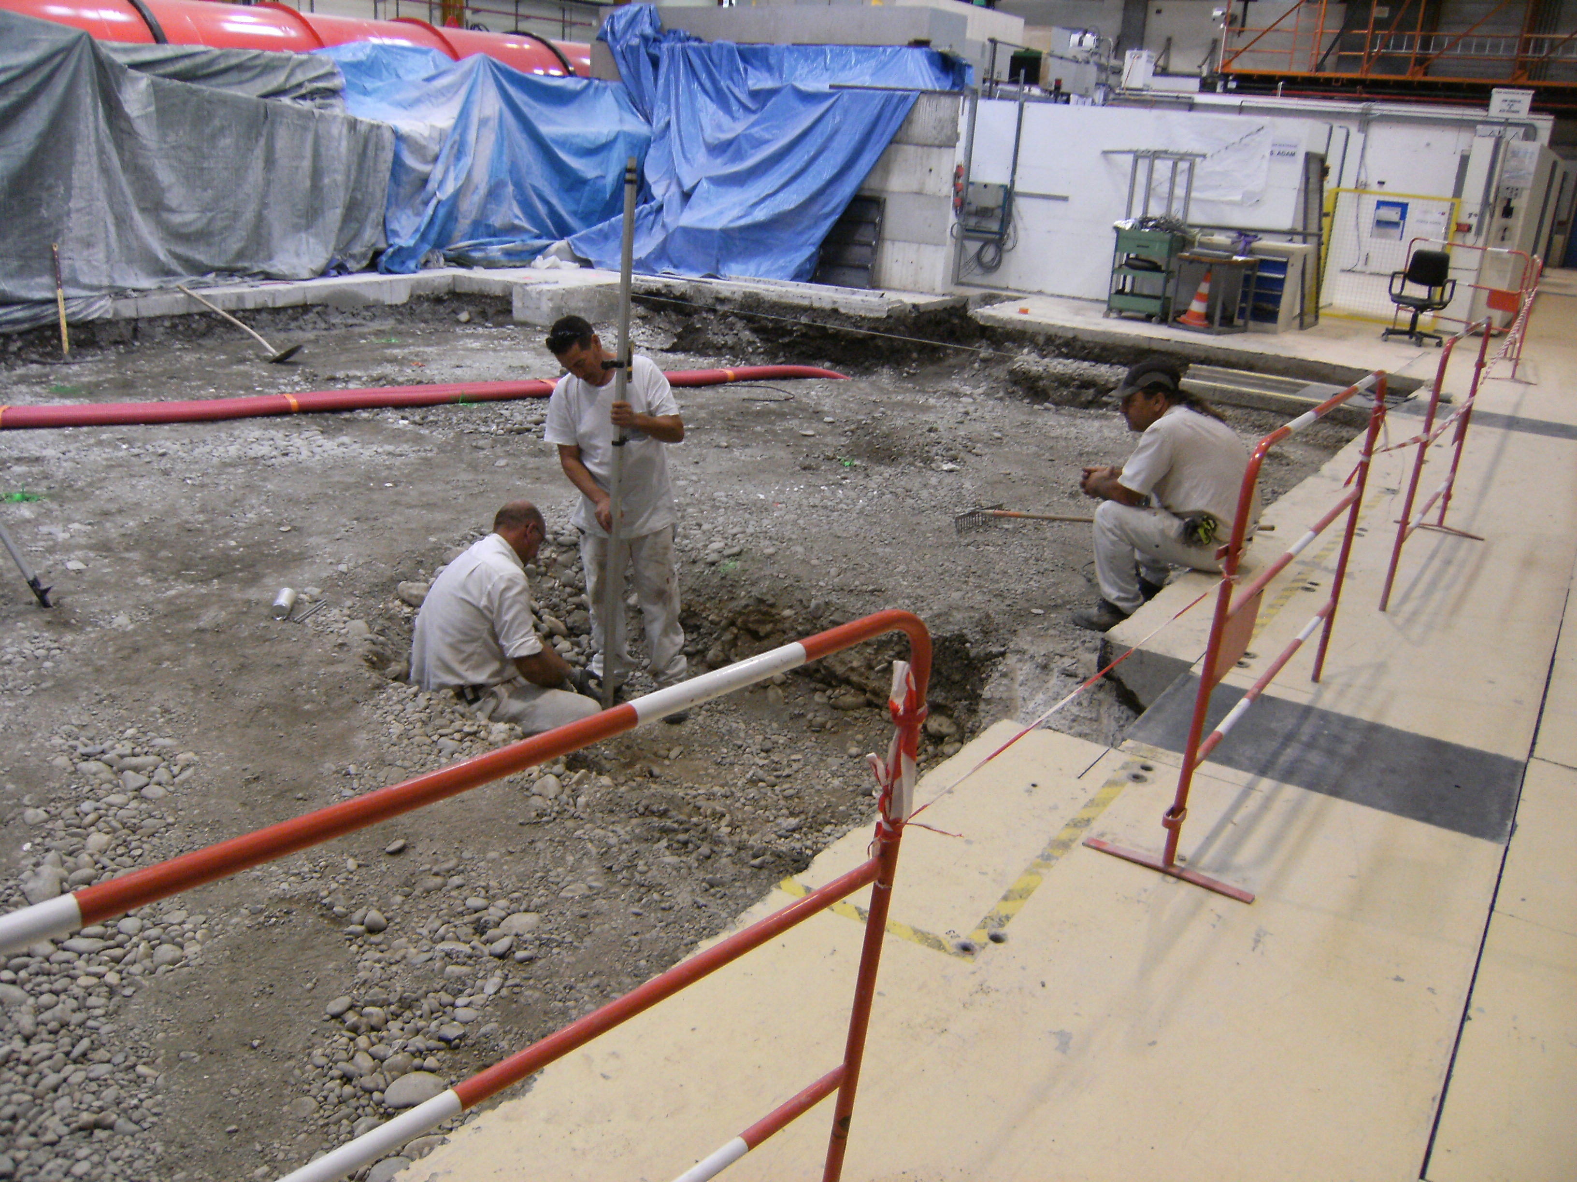

Slide 14
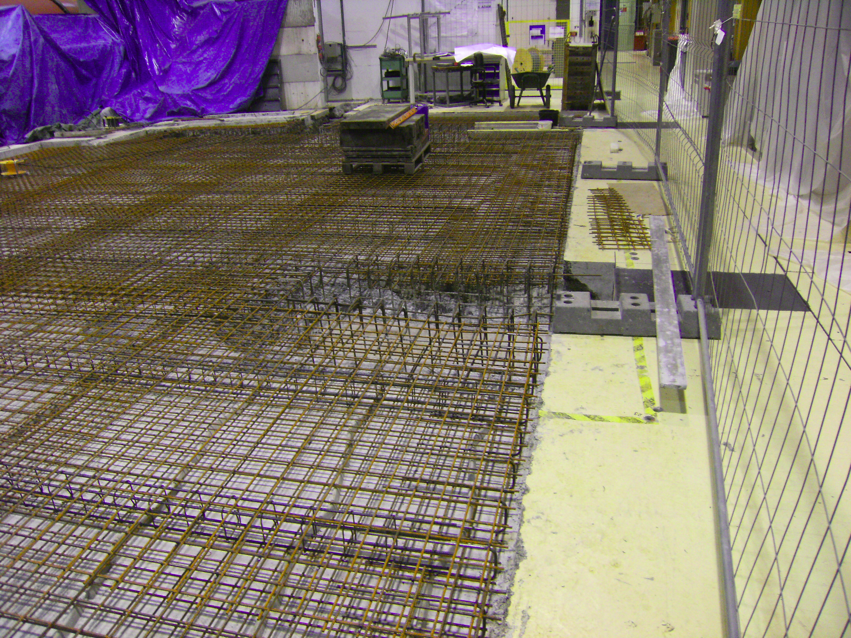

Slide 15
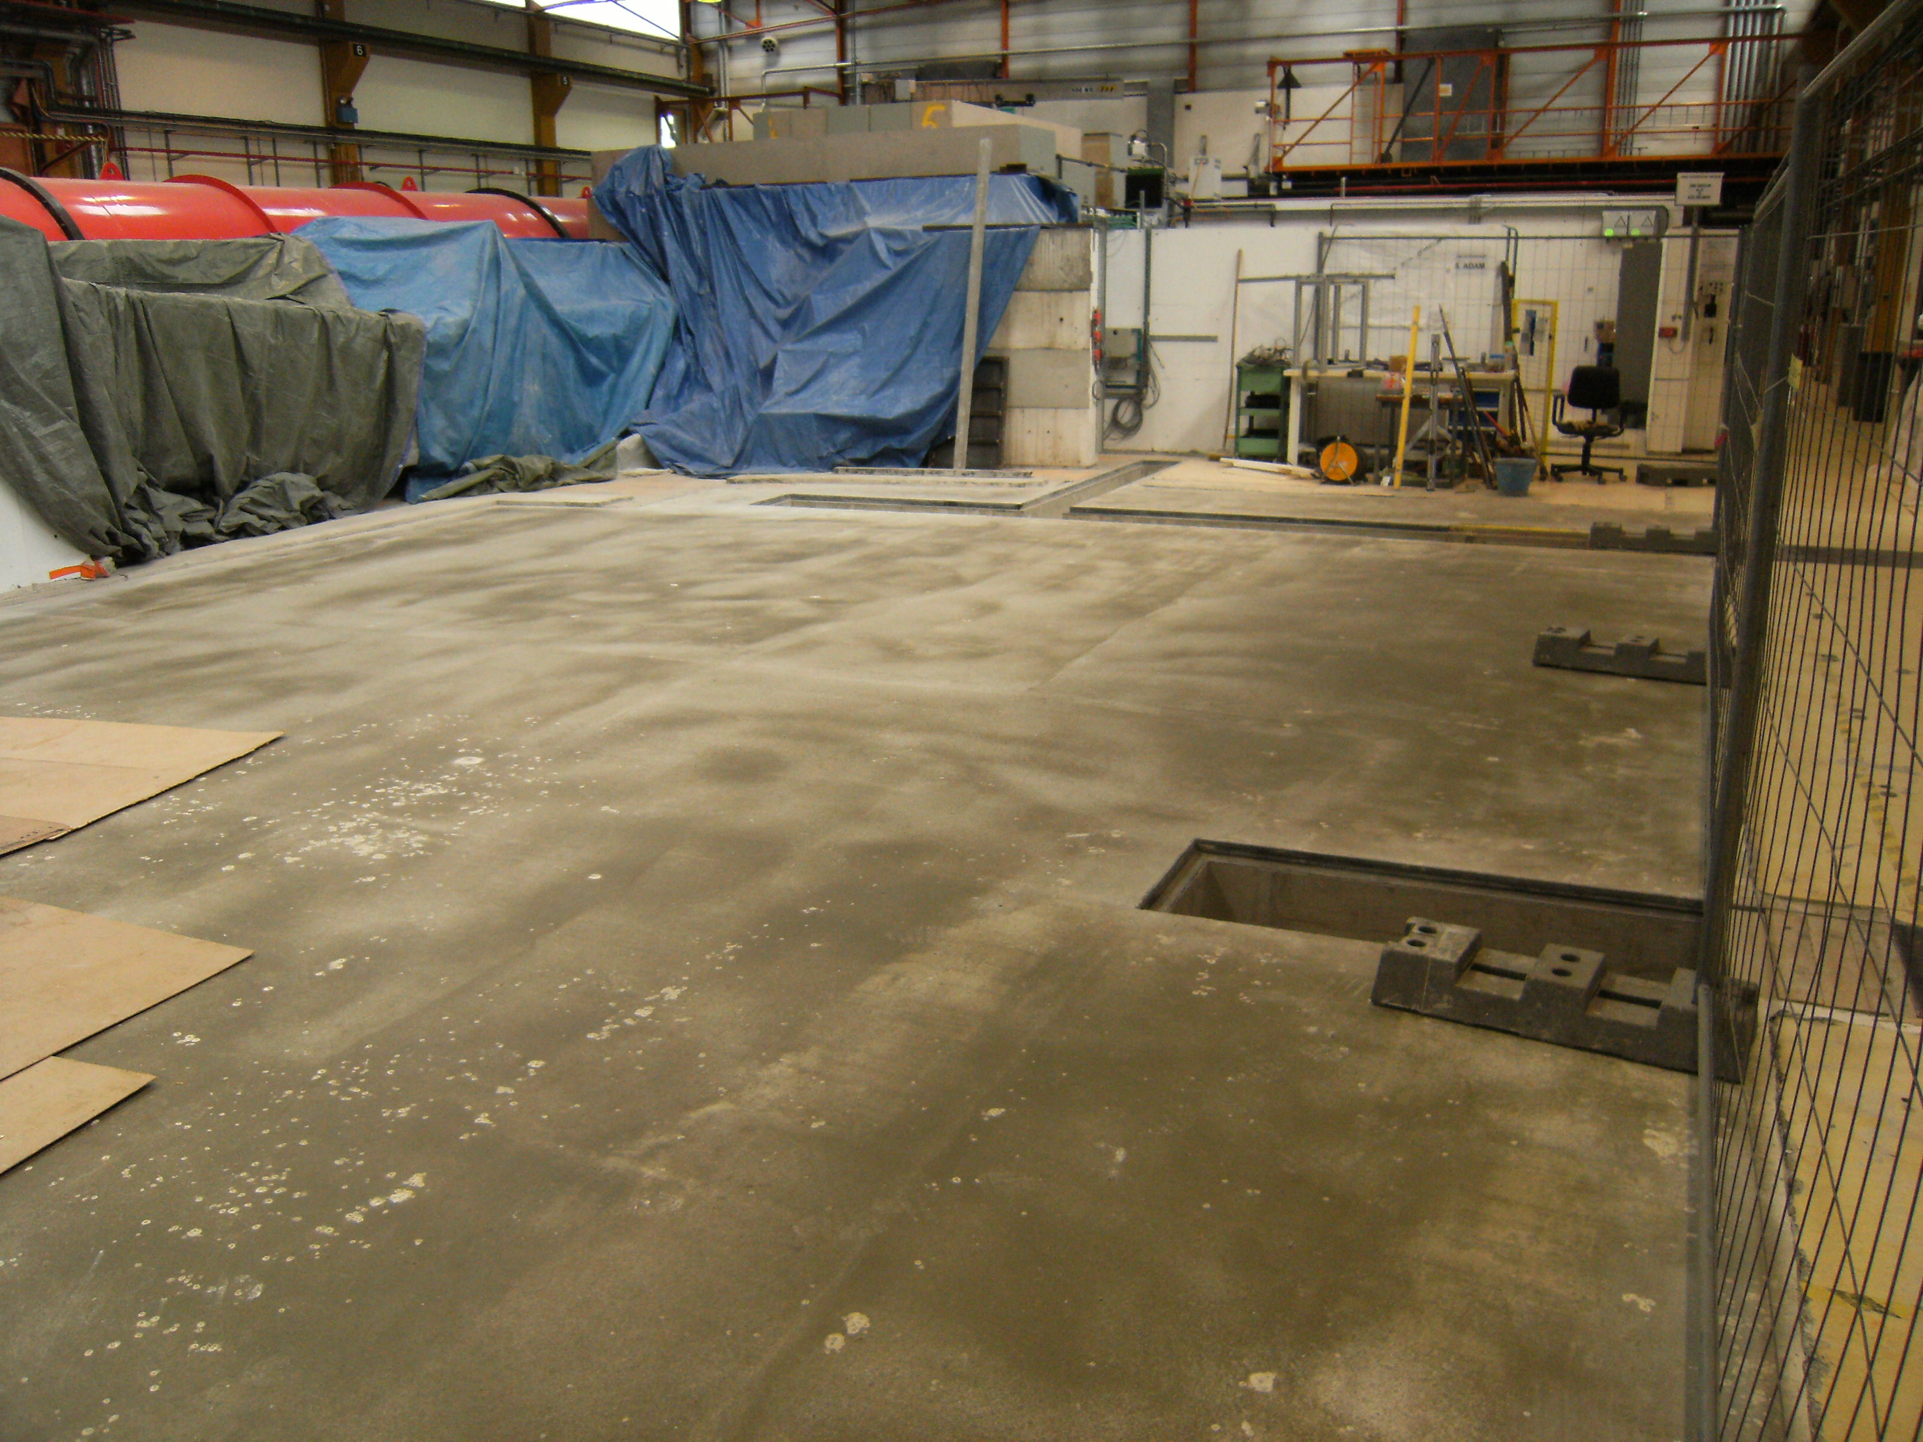

Slide 16
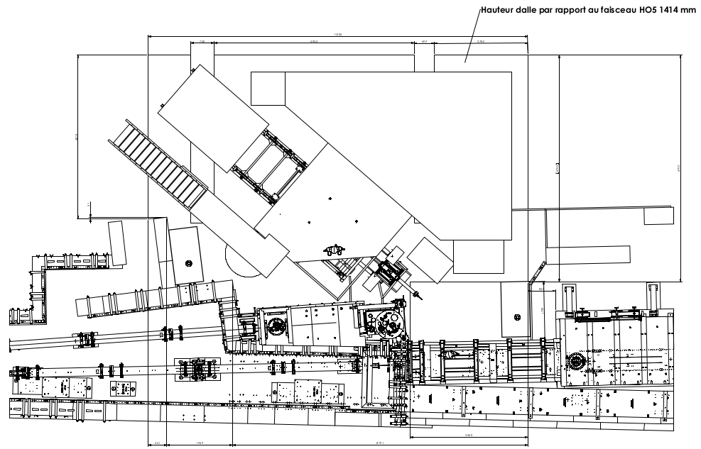

Slide 17
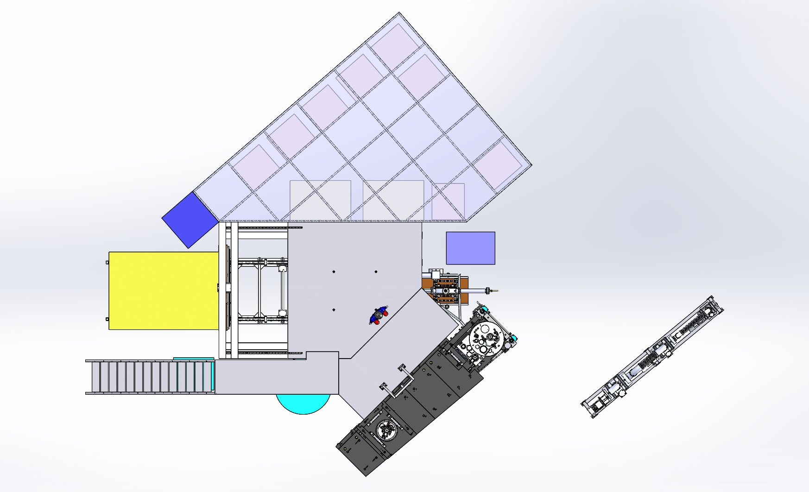

Slide 18
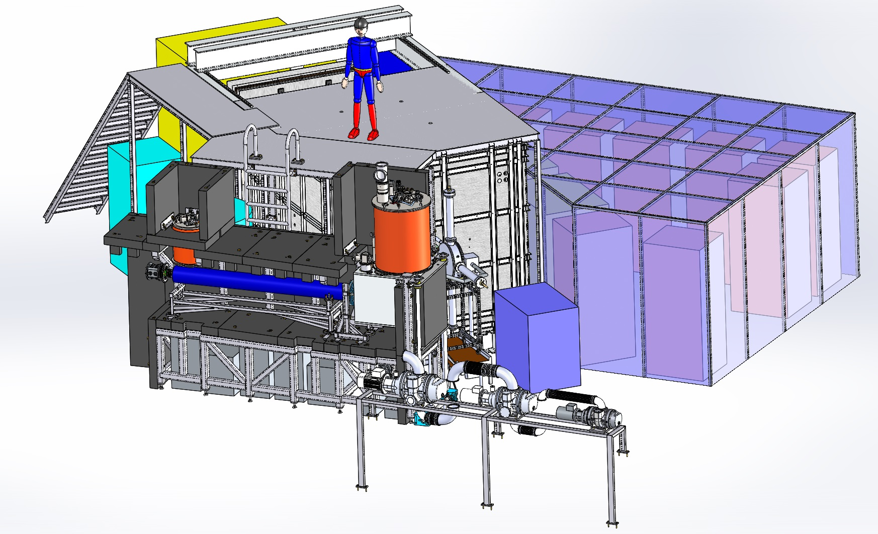

Slide 19
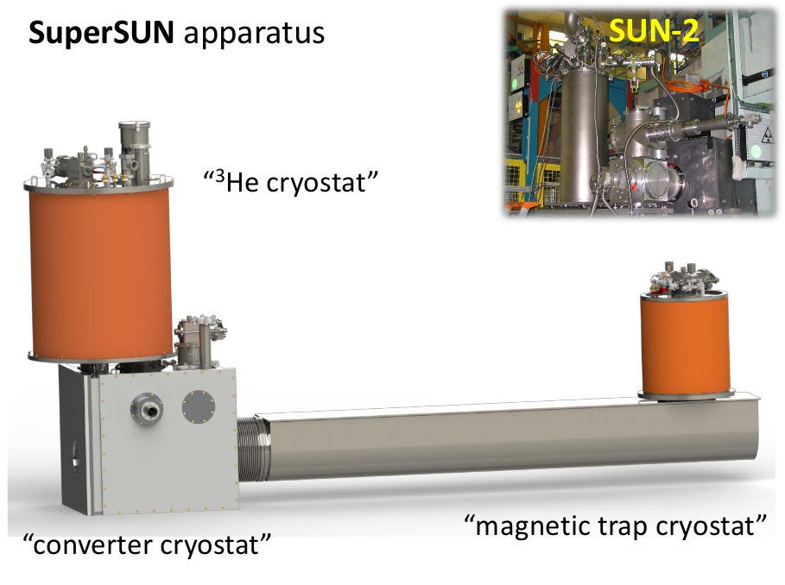
(from Oliver Zimmer)

Slide 20
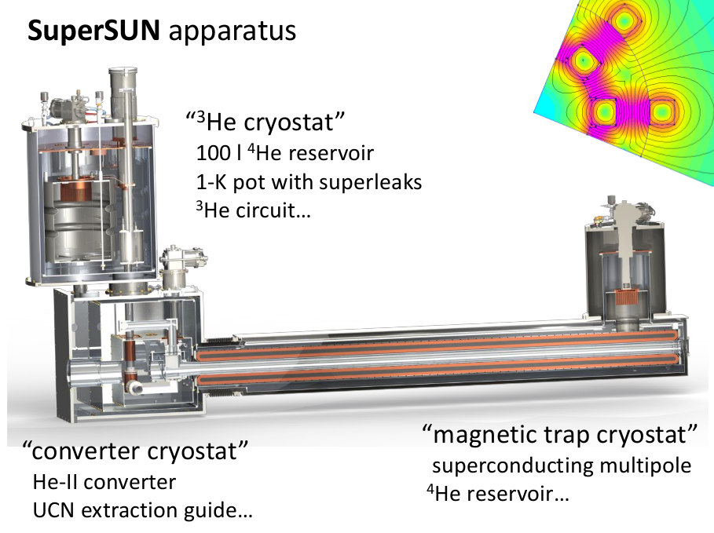
(from Oliver Zimmer)

Slide 21
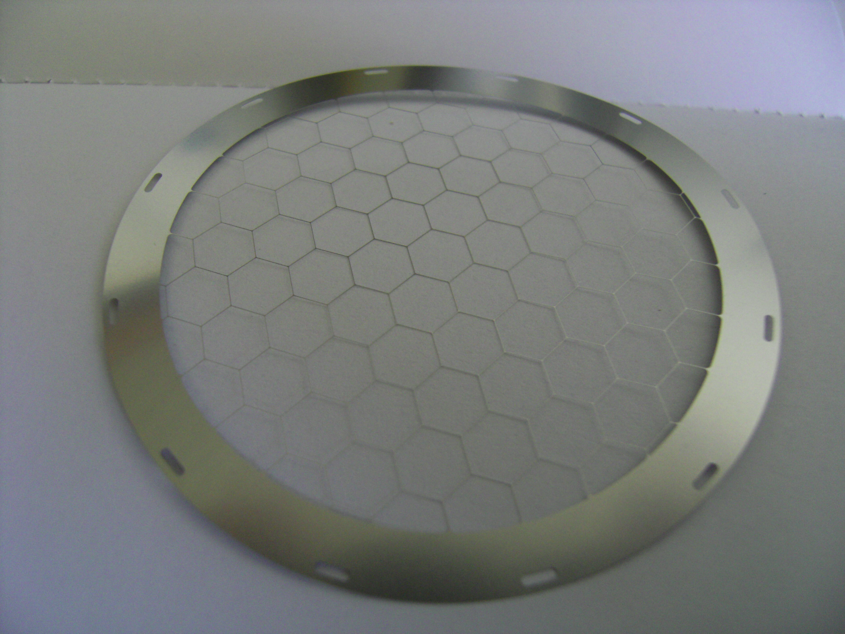

Slide 22
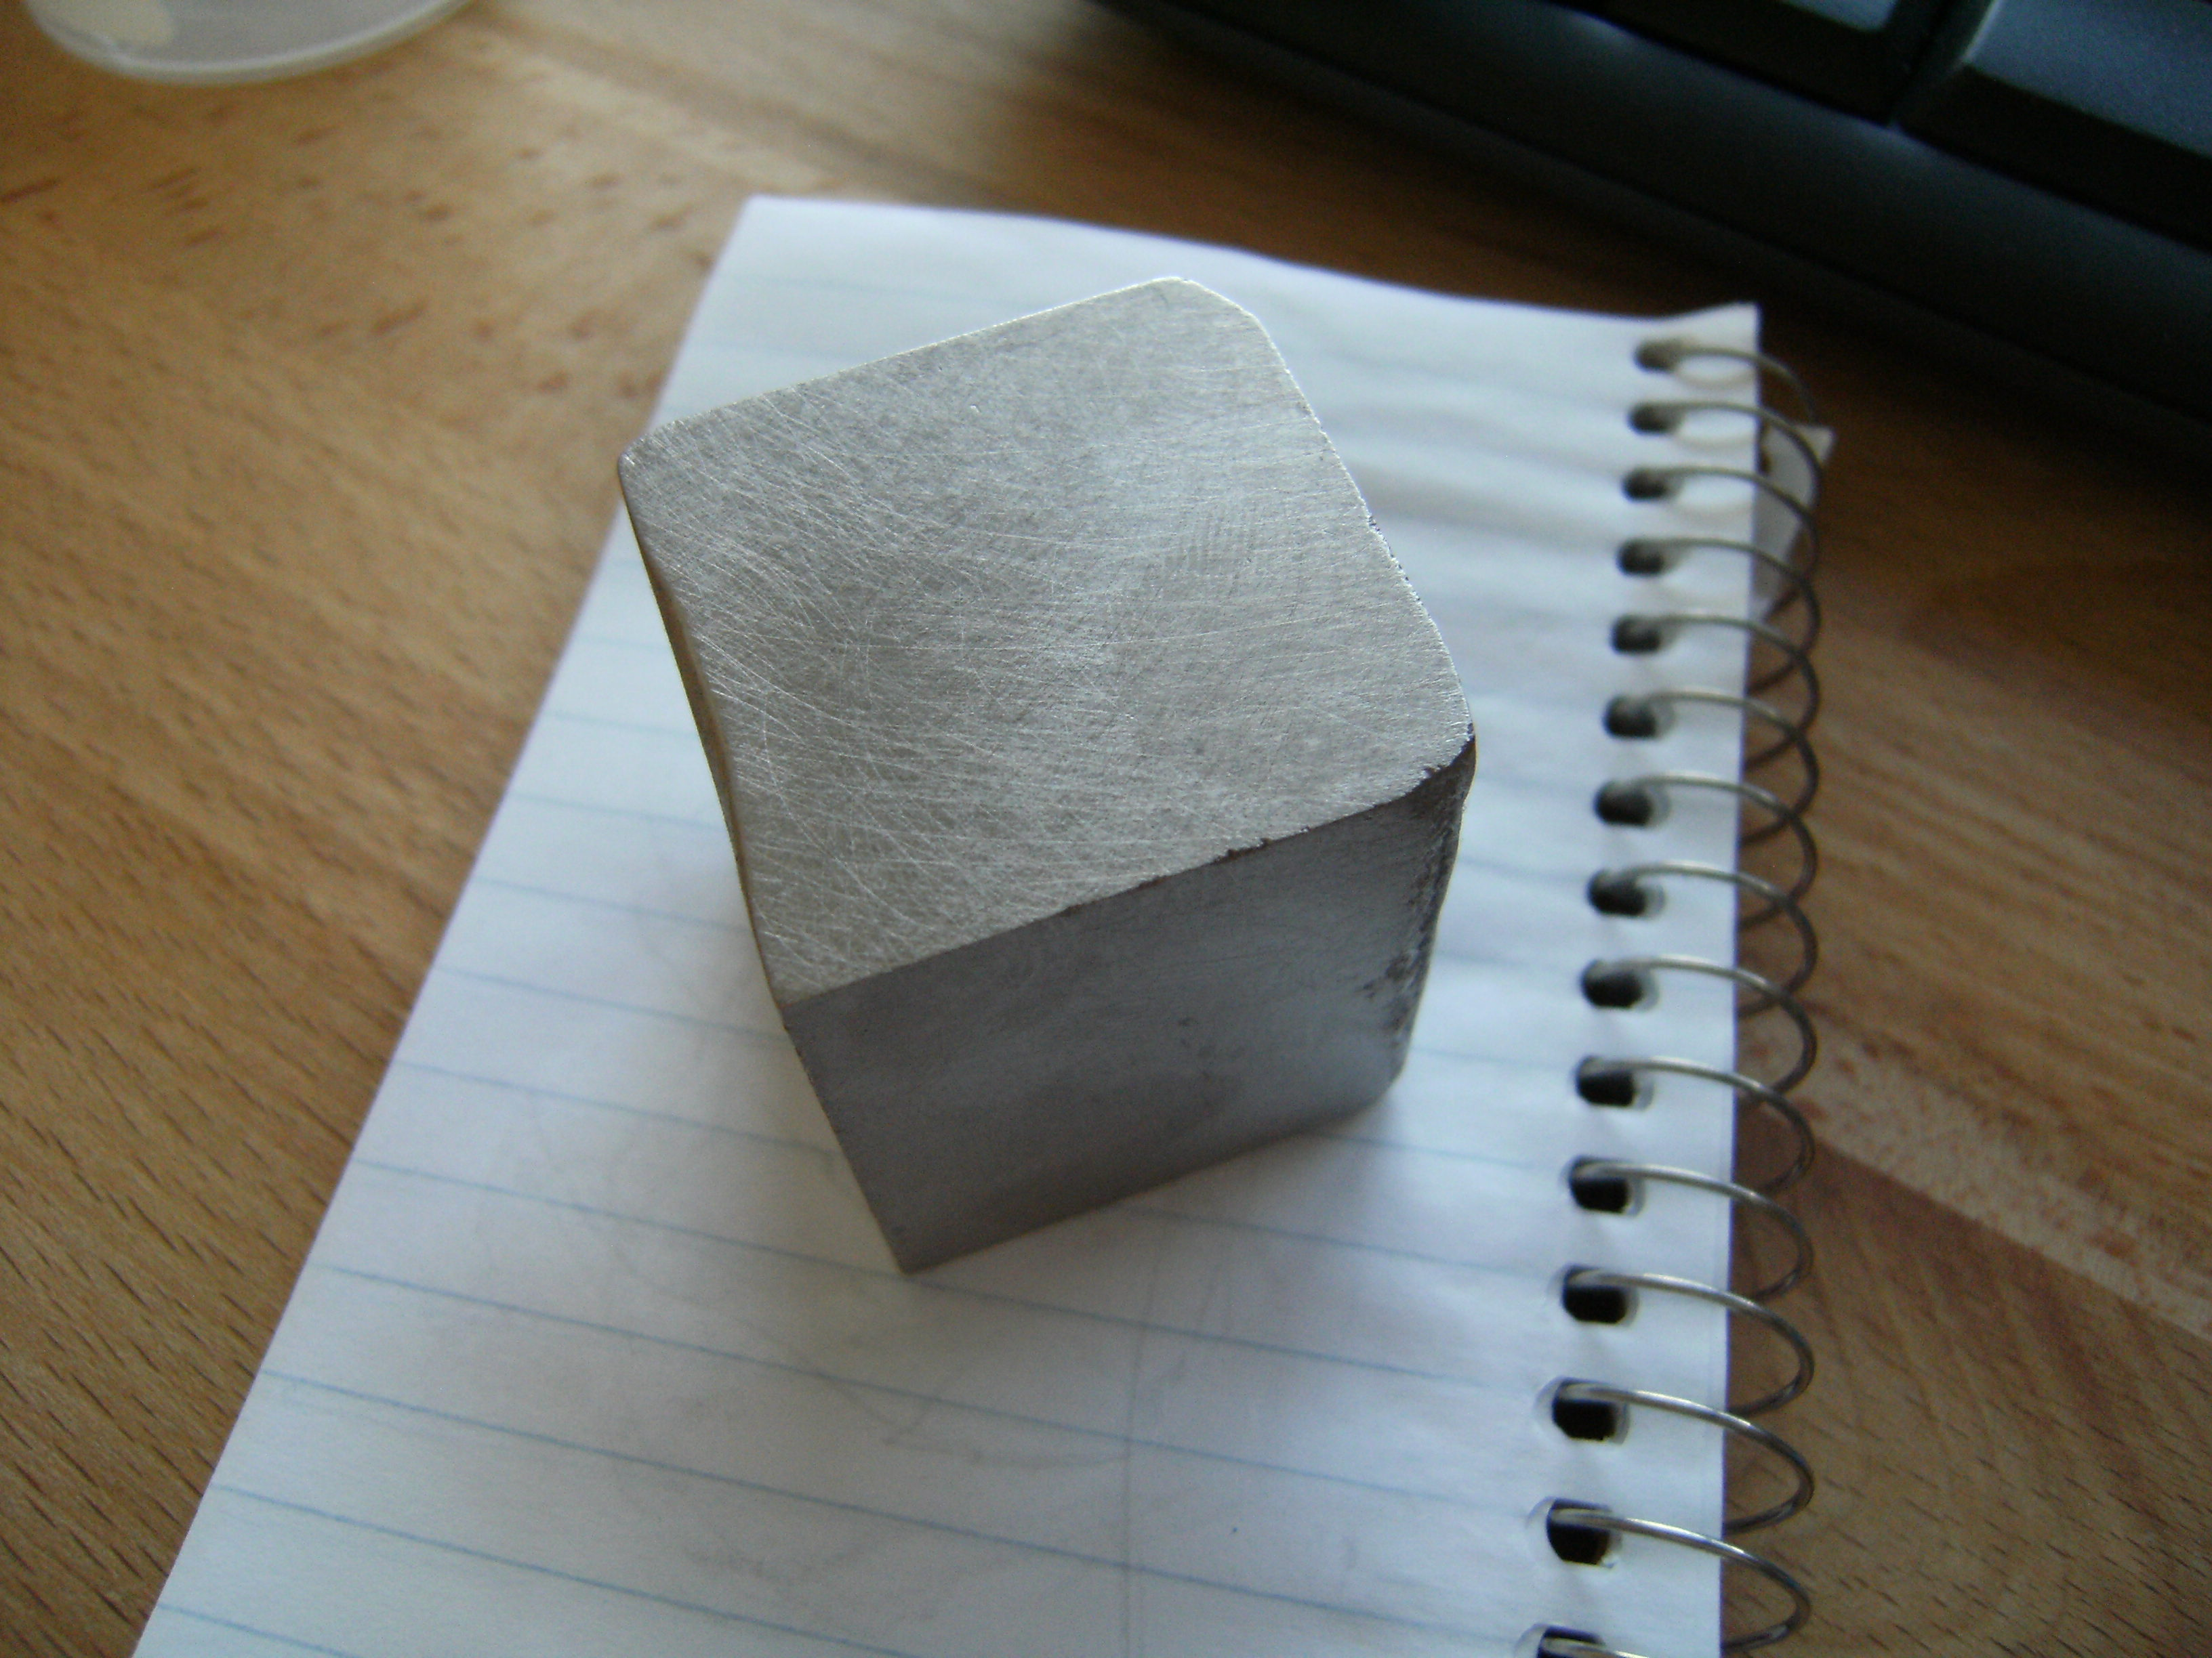

Slide 23
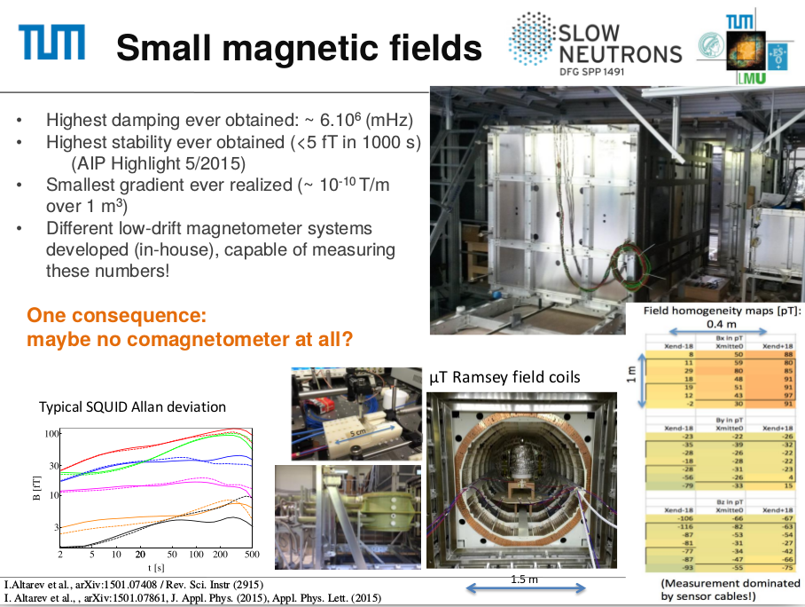
(from Peter Fierlinger)

Slide 24
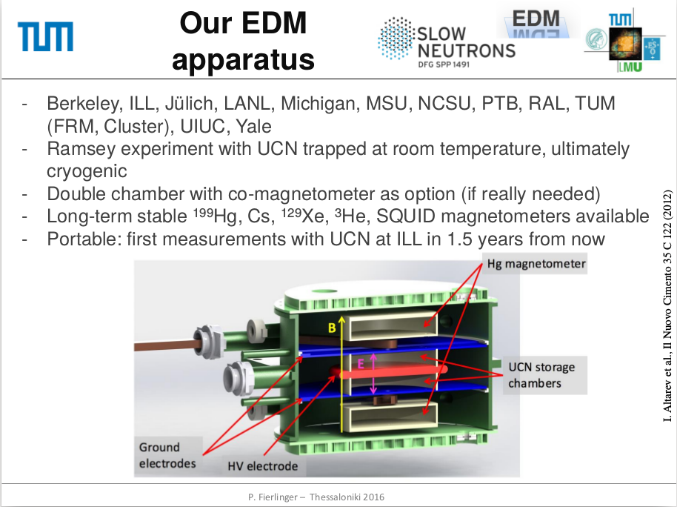

Slide 25
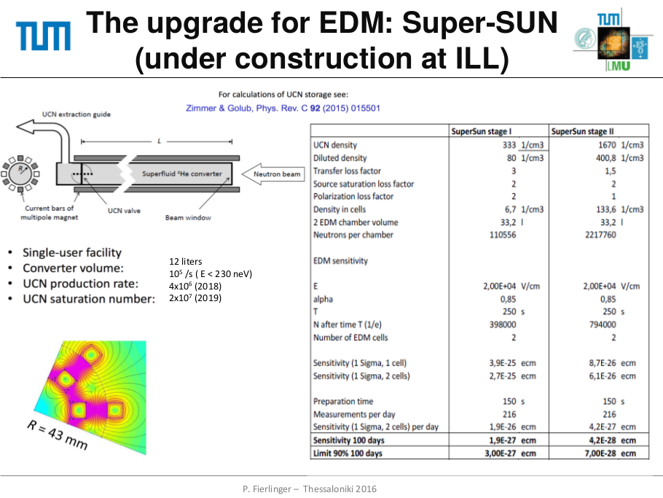

Slide 26
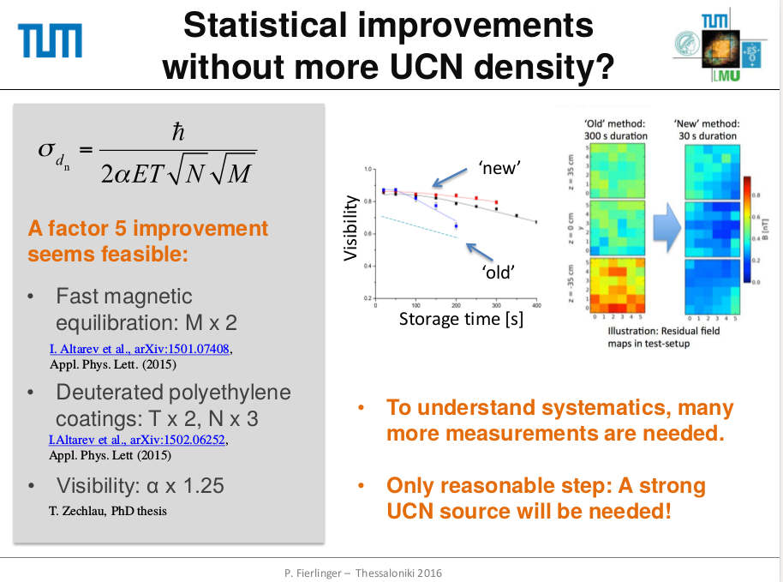

Slide 27
Thanks
Ken Andersen
Loris Babin
Karsten Baumann
Ben van den Brandt
Pierre Courtois
Martin Fertl
Beatrice Franke
Peter Geltenbort
Yves Gibert
Sergey Mironov
Sergey Ivanov
Dagmara Kepka
Jens Klenke
Michael Kreuz
Fabien Lafont
Thorsten Lauer
Eddy Lelievre-Berna
Kent Leung
Florian Martin
Florian Piegsa
Jose Perez-Rios
Christian Plonka
Dennis Rich
Felix Rosenau
Philipp Schmidt-Wellenburg
Martin Simson
Torsten Soldner
Xavier Tonon
Hans-Friedrich Wirth
GRANIT team
I. Altarev
V. Andreev
S. Chesnevskaya
M. Daimer
W. Feldmeier
E. Gutsmiedl
F. Kaspar
F. Kuchler
T. Lins
M. Marino
J. McAndrew
B. Niessen
S. Paul
G. Petzoldt
J. Rothe
C. Schneider
R. Schönberger
S. Seidel
R. Stoepler
T. Stolz
S. Stuiber
M. Sturm
B. Taubenheim
R. Thiele
J. Weber
D. Wurm
D. Budker
B. Patton
S. Sharma
M. Burghoff
A. Schnabel
J. Voigt
A. Frei
P. Link
A. Pichlmaier
T. Zechlau

