Slide 1
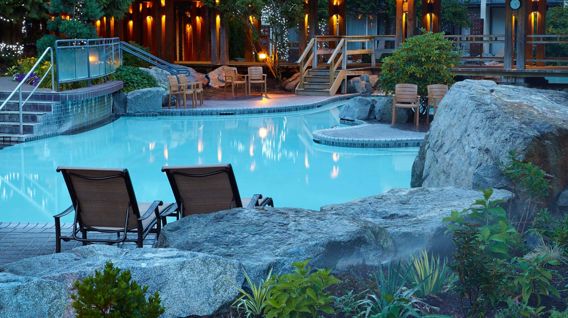
Workshop close-out
R. Picker

Slide 2
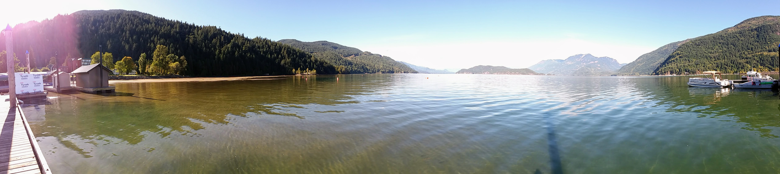
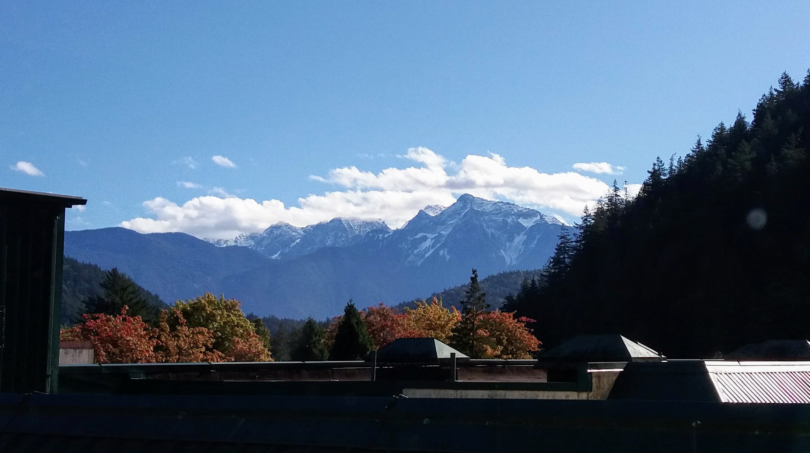
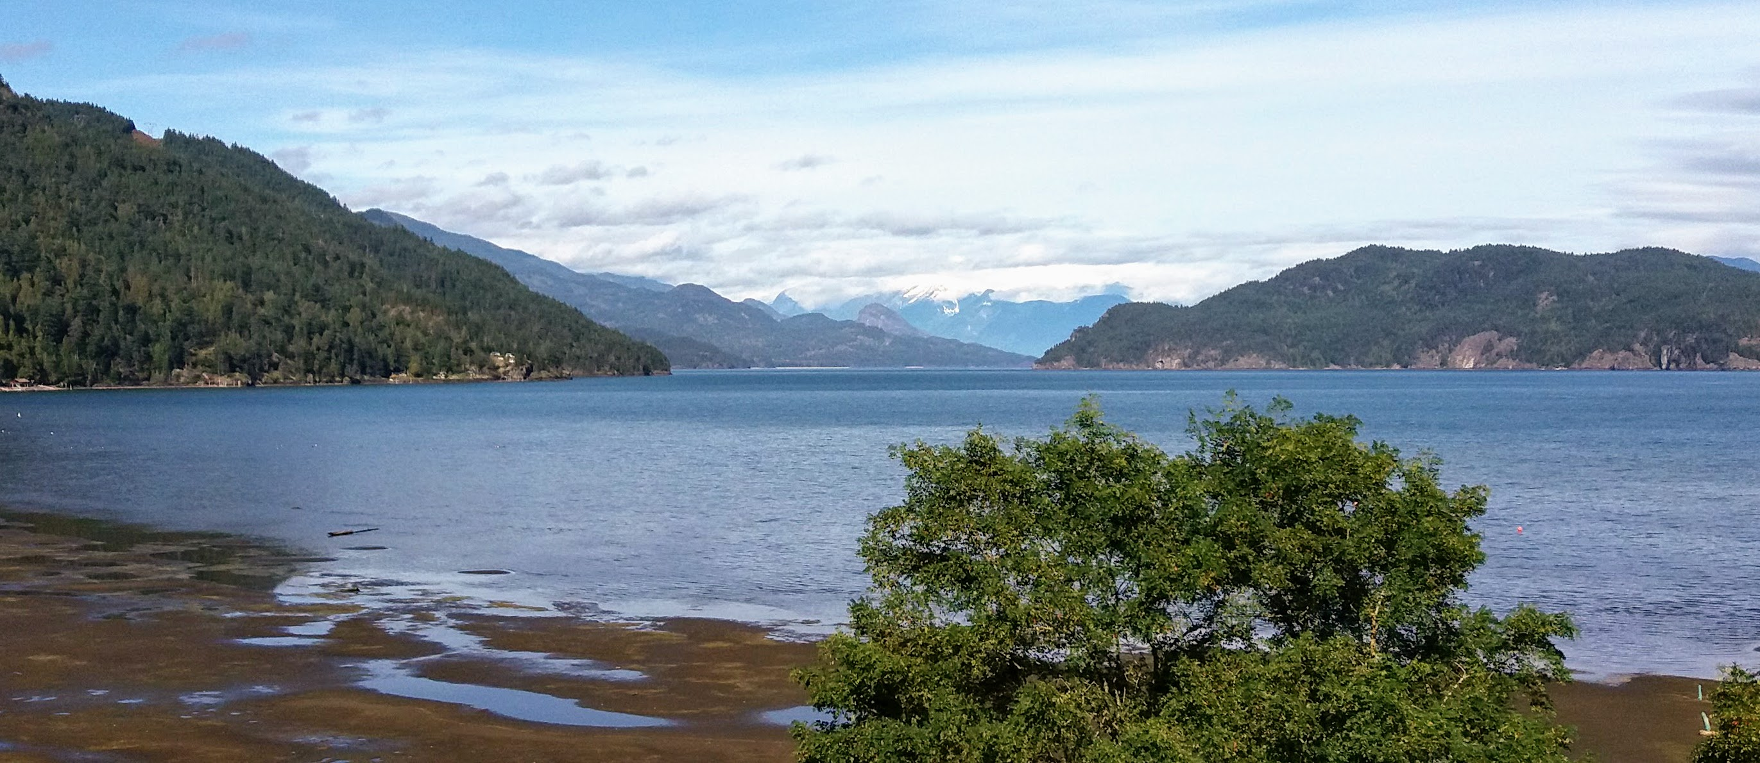
Sunday impressions

Slide 3
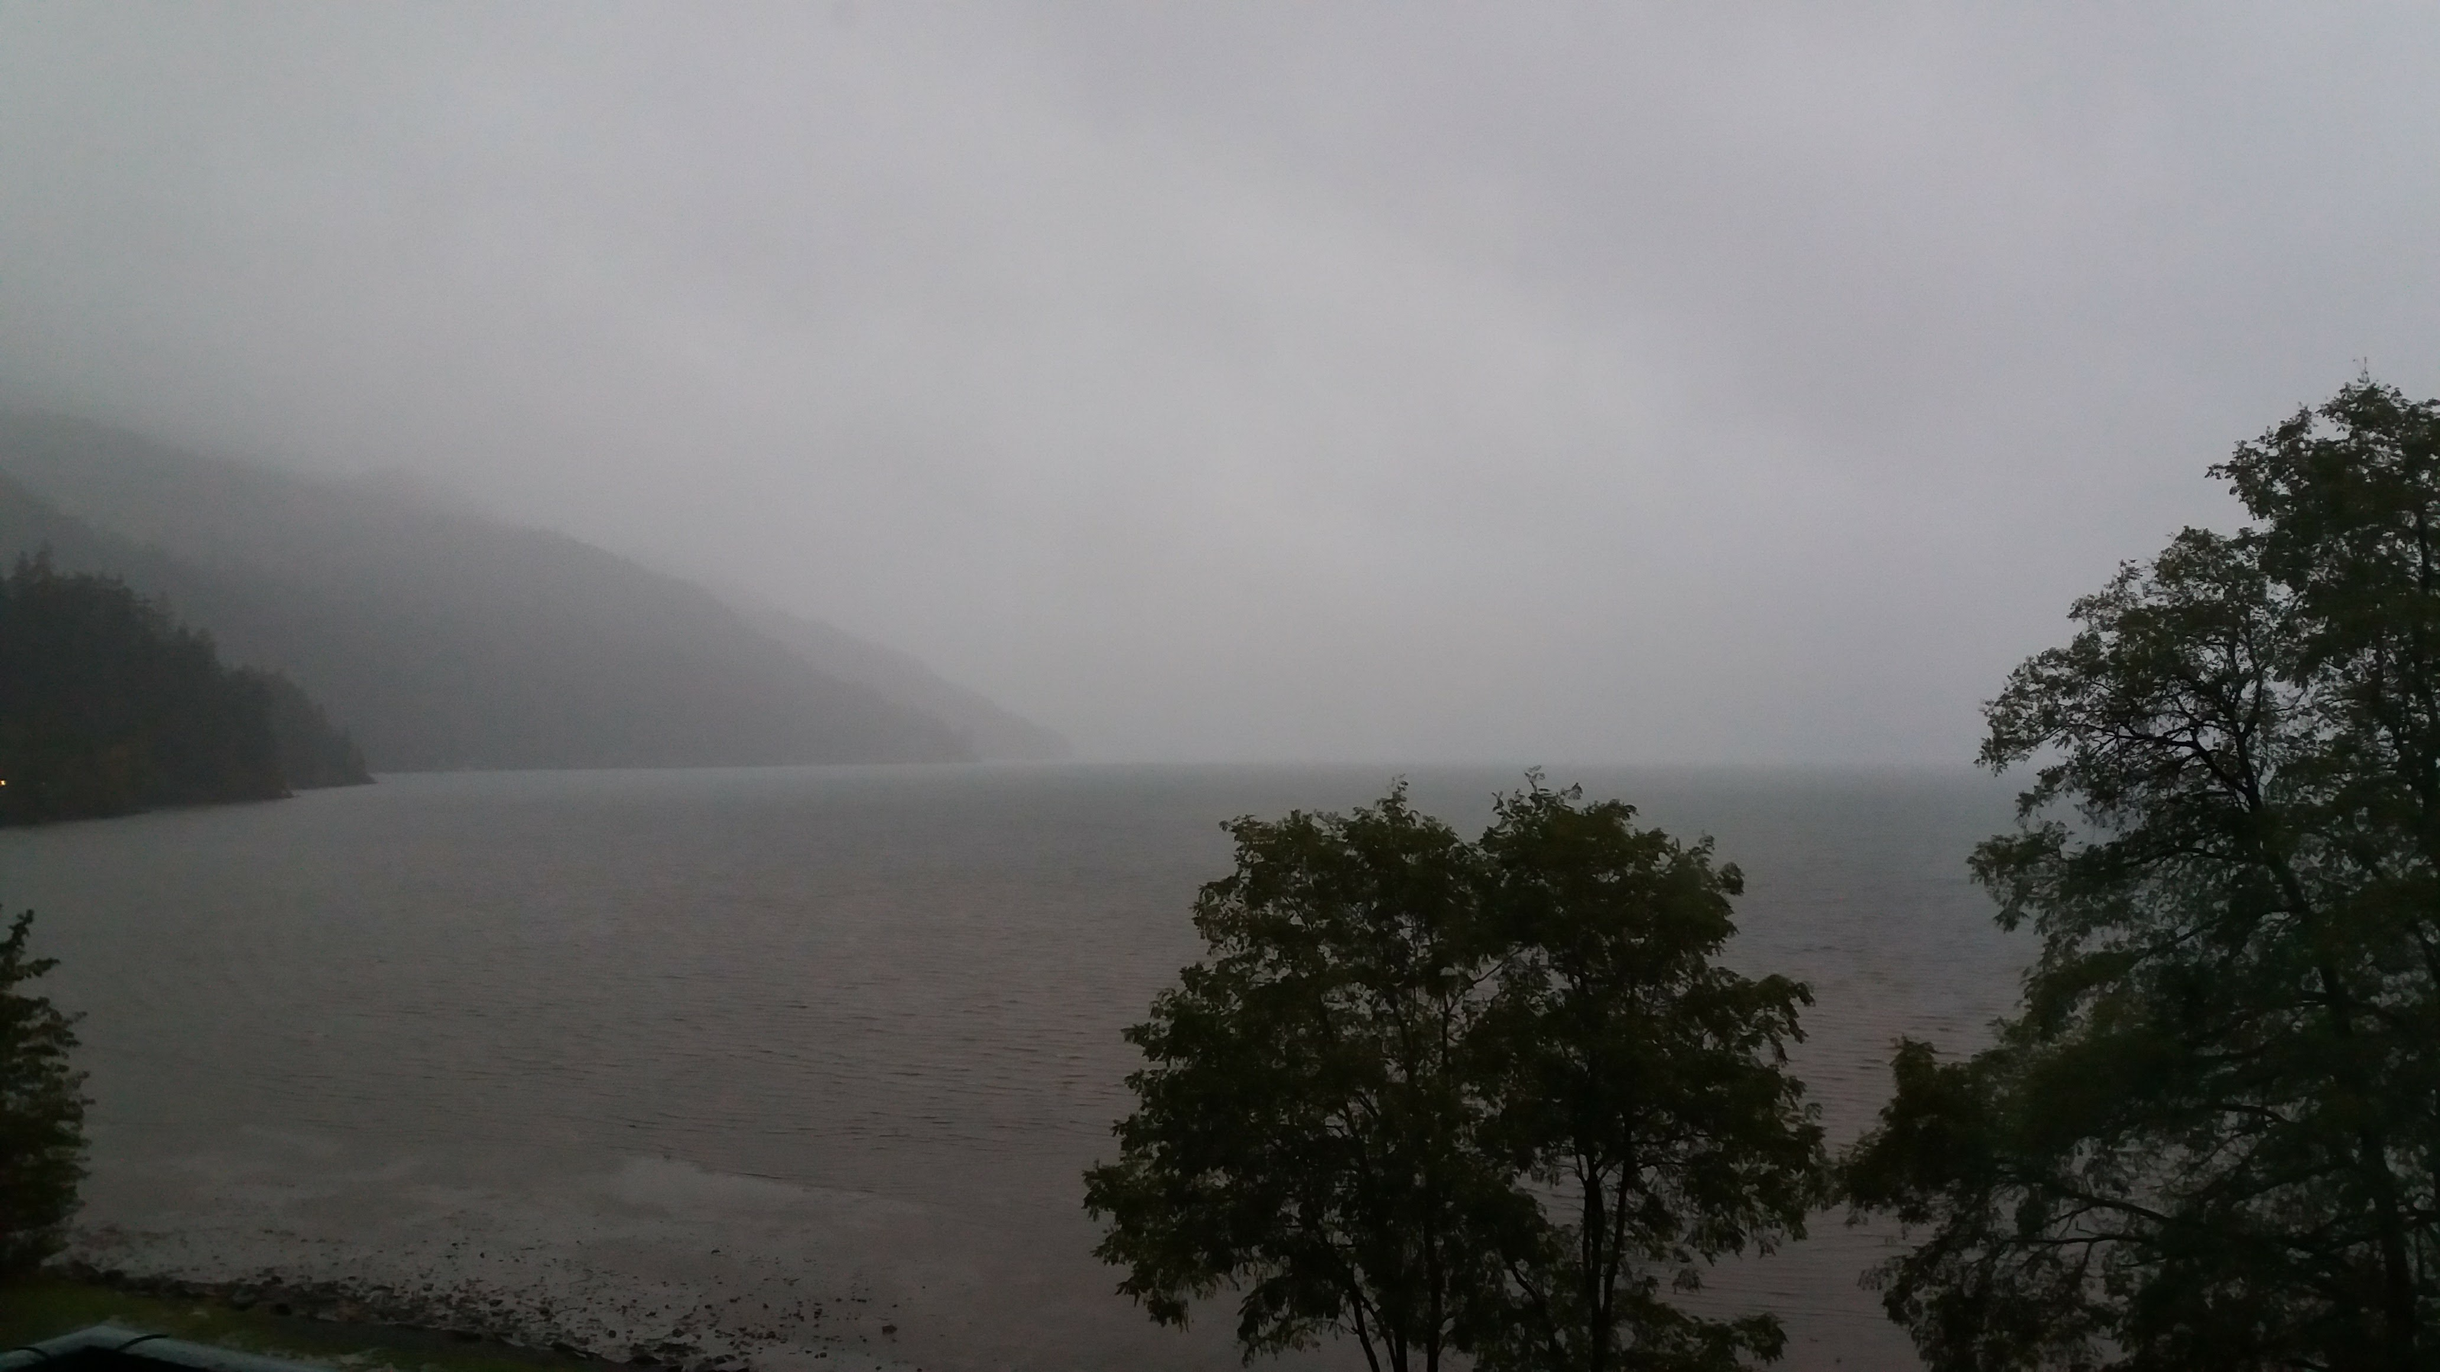
In between…

Slide 4
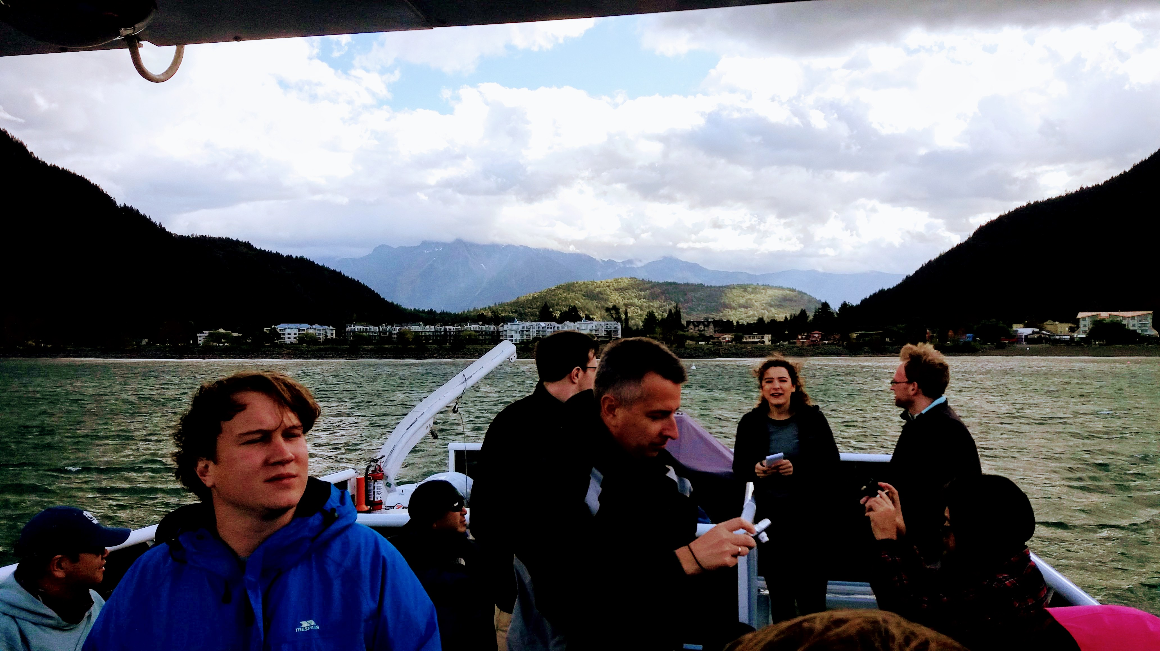
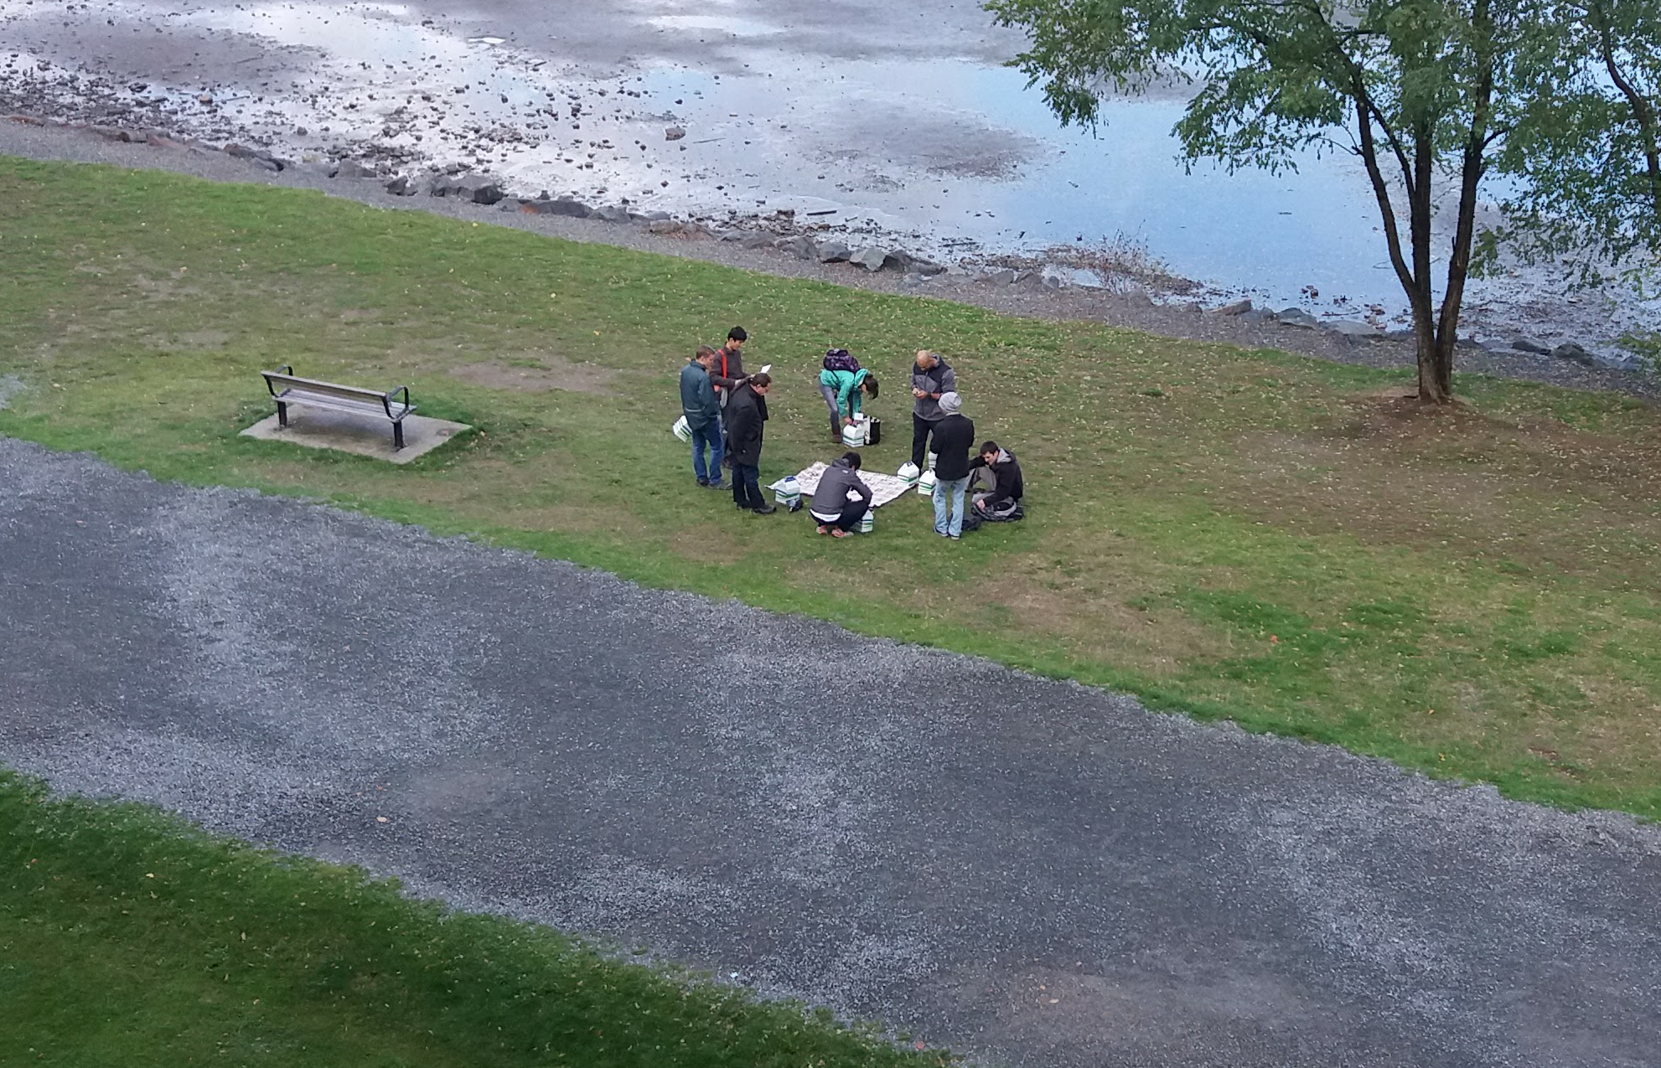
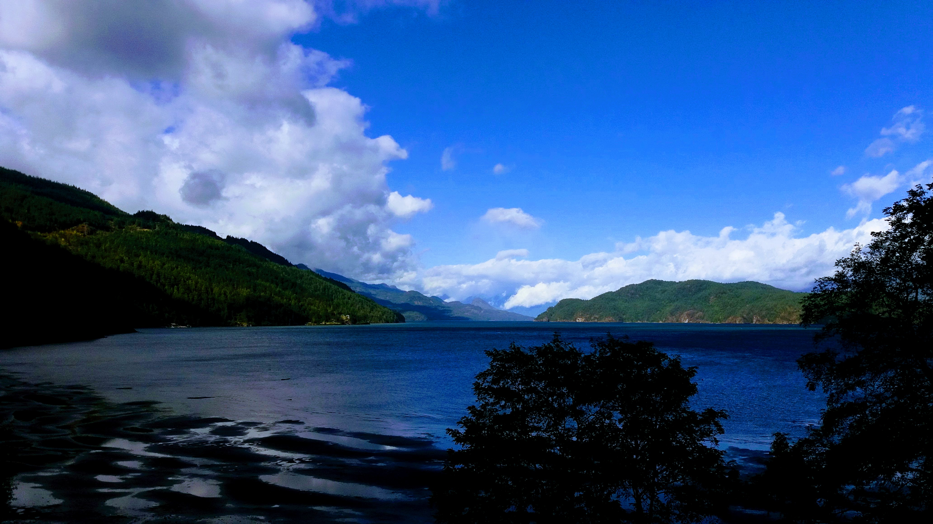
Tuesday afternoon

Slide 5
In between…

Slide 6
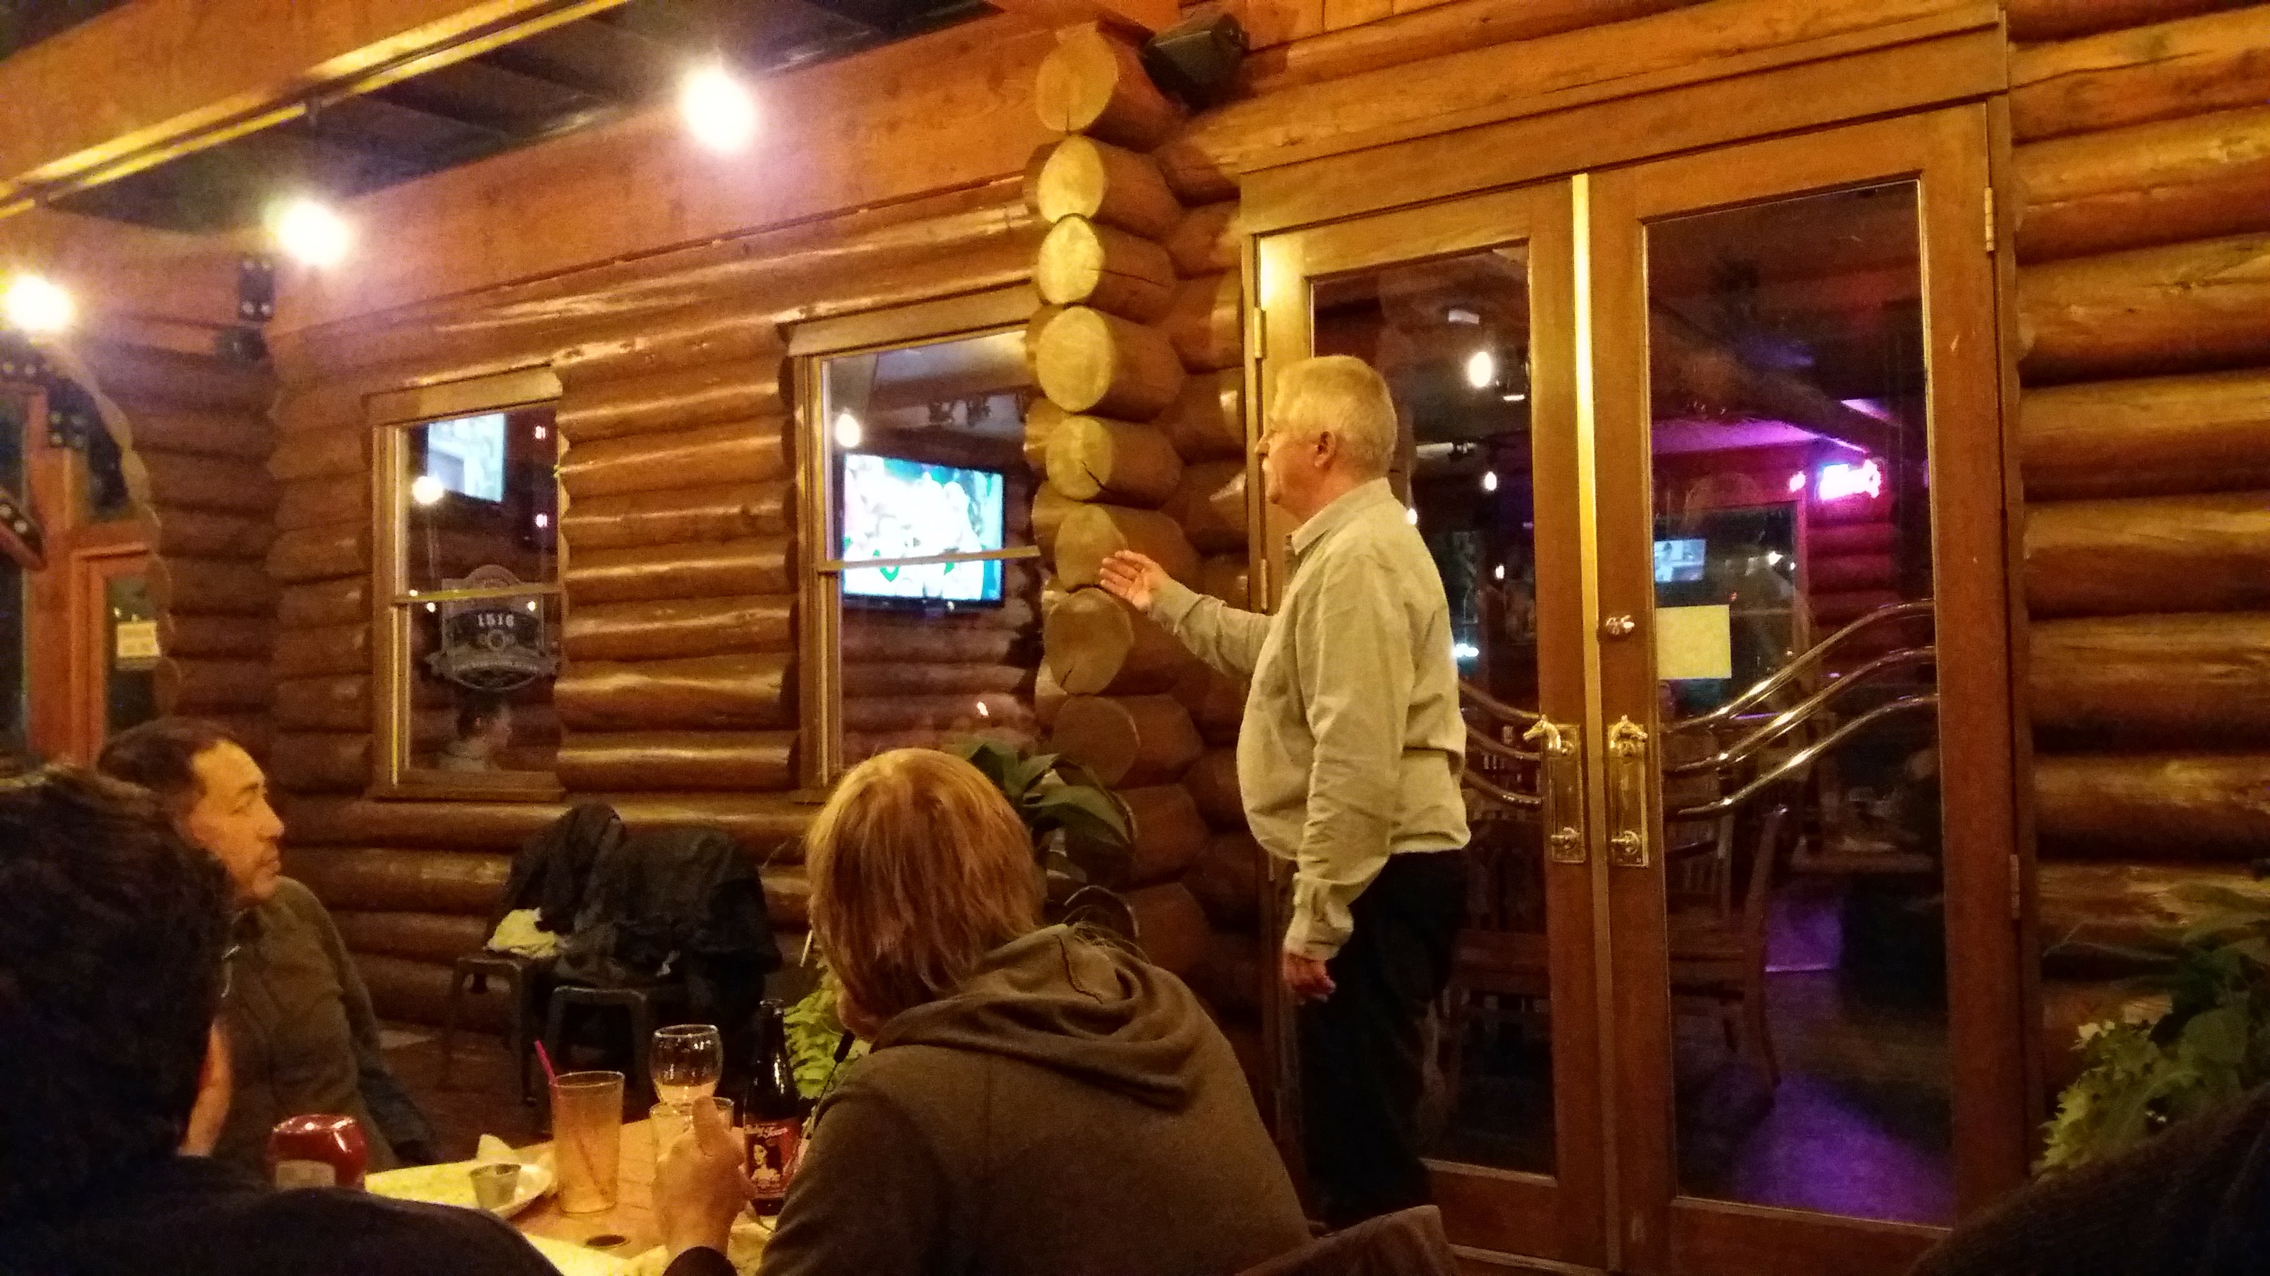
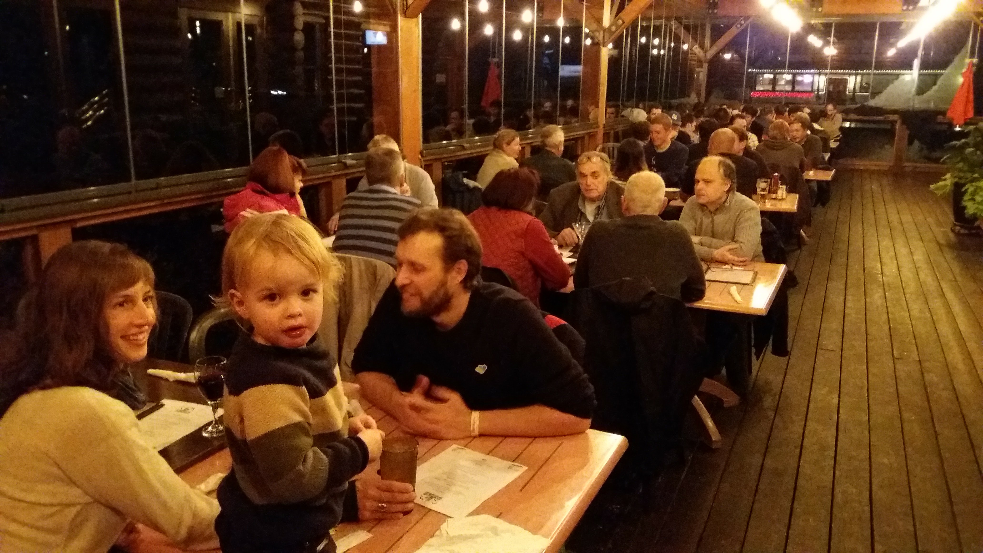
Dinner at the Old Settler

Slide 7
The scientific program
Everybody that submitted an abstract showed up and gave their talk!
50 contributions (6 were posters).
53 participants.

Slide 8
What was the workshop?
We wish everybody interesting, friendly, collaborative, productive,
steaming, soaking and delicious workshop days in Harrison Hot Springs, BC!
Interesting
Friendly
Collaborative
Productive
Steaming
Soaking
Delicious
Intense
Wet
It was a pleasure hosting you in BC and showing you what fall in the lower mainland around Vancouver means!

Slide 9






What’s next?
50th anniversary of ILL 2018
PSI2019
?

