Slide 1
Monte Carlo optimization of a next-generation ultracold-neutron source
Wolfgang Schreyer
for the TUCAN collaboration
2017-10-18, nEDM 2017, Harrison Hot Springs

Slide 2
Design parameters
Optimization
  FLUKA
  MCNP
  PENTrack
Preliminary optimization results

Slide 3
Design parameters
Spallation source
  Combination of neutron moderators
  Radiation shielding
Superfluid-helium converter
  Heating by γs, neutrons, β electrons
  Upscattering lifetime τ_{up} = 130K⁷s · T⁻⁷
Geometry of ultracold-neutron guides
He-II
(1K)
γ fast n
Target 480 MeV p

Slide 4
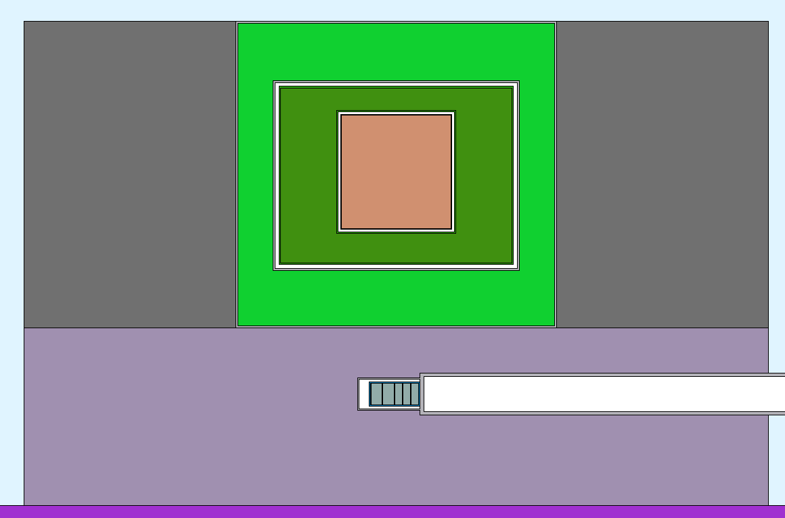
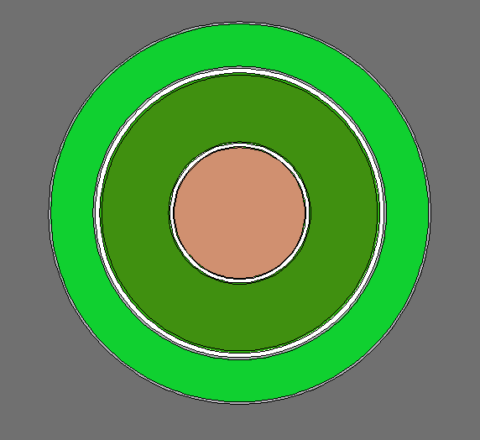
Optimization
Ø 80 cm
Starting geometry:
Best use of symmetry
Cylindrical aluminum vessels centered on target
He-II
(1 K)
Graphite
reflectors
80 cm
LD₂ (20 K)
D₂O (300 K)
Ø 80 cm
Beamline
Lead shielding
Light-water-cooled
Tungsten target

Slide 5
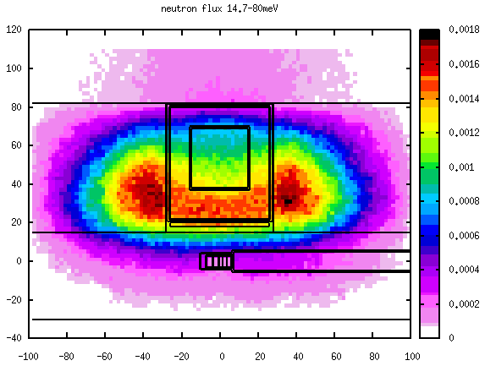
FLUKA
fluka.org (Free)
Monte Carlo simulation of particle
transport in matter
Including multi-group transport of
low-energy neutrons
Neutron-scattering models for many
isotopes at 296K, some at 87K and 4K
Geometry as combination of basic
shapes
Easy to use thanks to flair (geometry builder, plotter)
Can output particle flux in volume/over surface, production of radioactive nuclei, deposit of prompt and decay heat

Slide 6
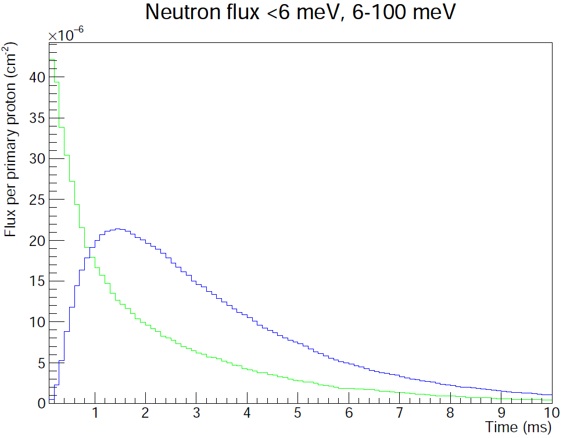
MCNP
mcnp.lanl.gov
Much more detailed nuclear-scattering data
Including many specialized neutron moderators
Combinatorial geometry,
can be exported from flair
Detailed output of particle flux in
volume/over surface, heat deposit,
binned in energy, time, and direction
Text-only configuration

Slide 7
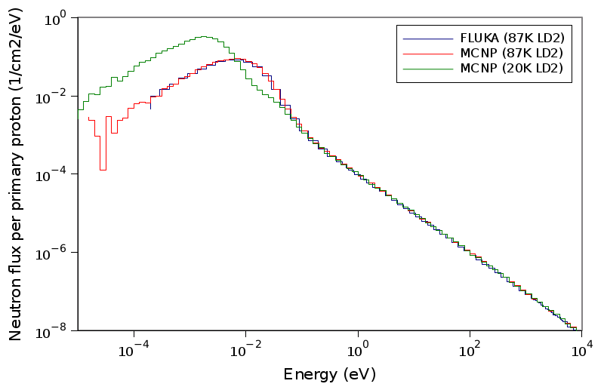
Comparison FLUKA and MCNP
FLUKA has no scattering data for liquid deuterium at 20K
Good agreement between MCNP/FLUKA for free-gas model at 87K
Cold-neutron flux 10 times higher with 20K deuterium in MCNP

Slide 8
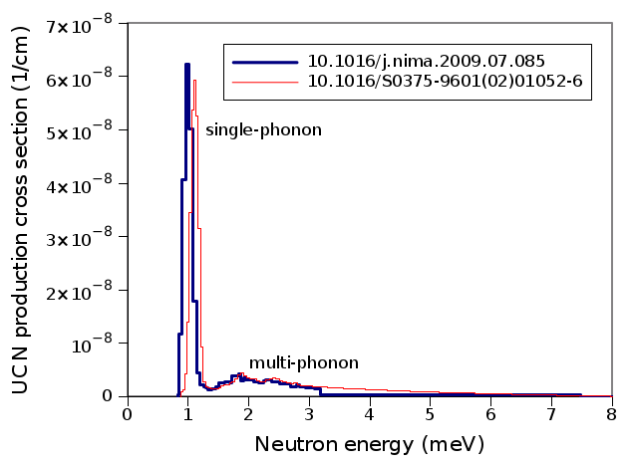
Optimization with MCNP
Goal: maximize number of UCN available to experiment
Constraints:
  Cooling power at 1K: ~10W
  Amount of cold moderators
  (liquid deuterium!)
Simple model: maximize UCN production per heat P/Q
Detailed model: maximize P·τ with
1/τ = 1/τ_{up}(Q) + 1/ τ_{wall} + 1/ τ_{β}

Slide 9
Optimization with MCNP
Individually optimize
  Thicknesses of moderators
  Size of He-II bottle
  Target position
Iterate several times
Manage config-urations with git
Ca. 15min runtime for each configuration on ComputeCanada cluster (100,000 p)
Graphite He
LD2
D2O
Lead

Slide 10
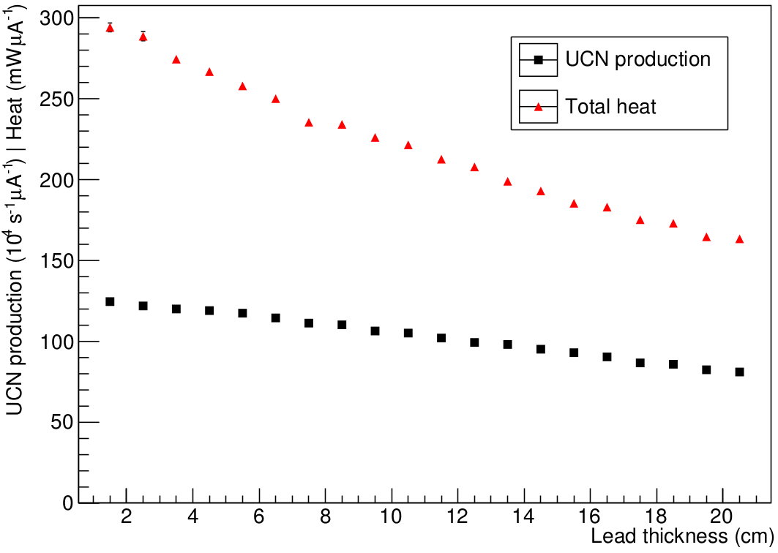
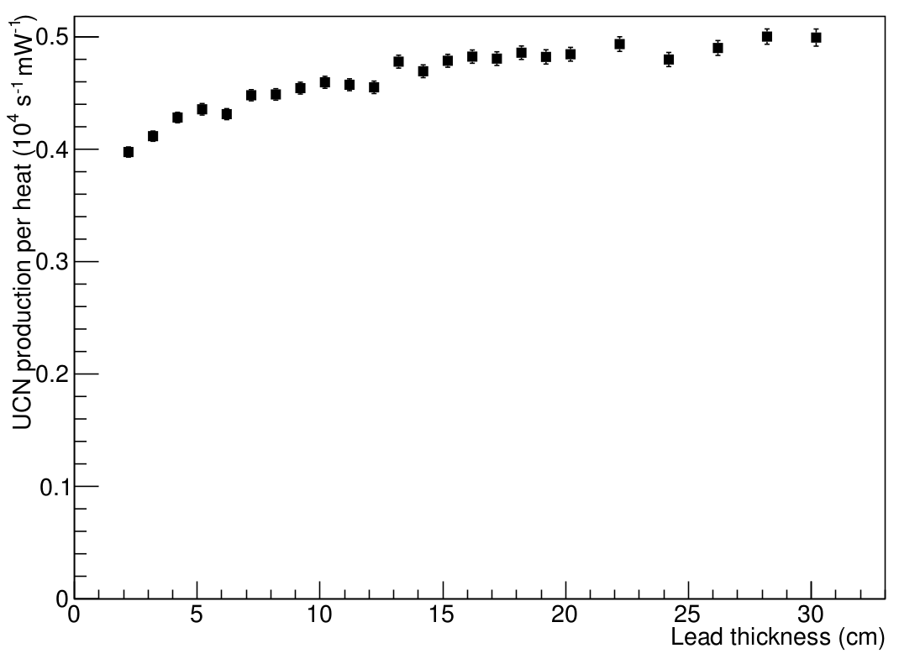
Optimization with MCNP
Lead layer above target
He-II
LD2
D2O
Lead

Slide 11
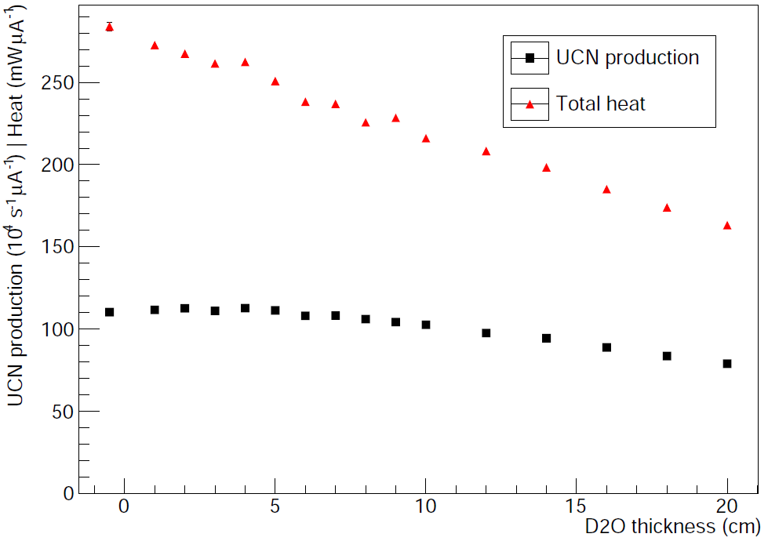
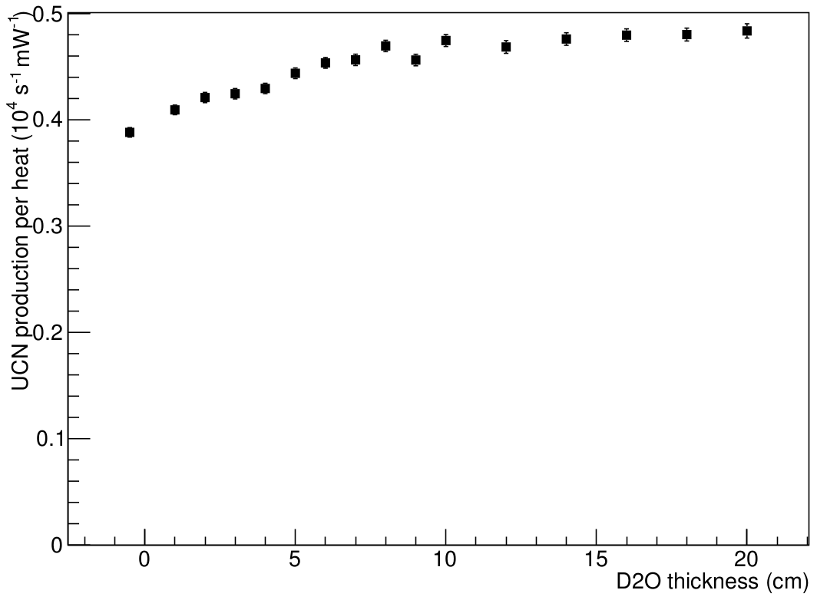
Optimization with MCNP
D₂O layer above target
He-II
LD2
D2O
Lead

Slide 12
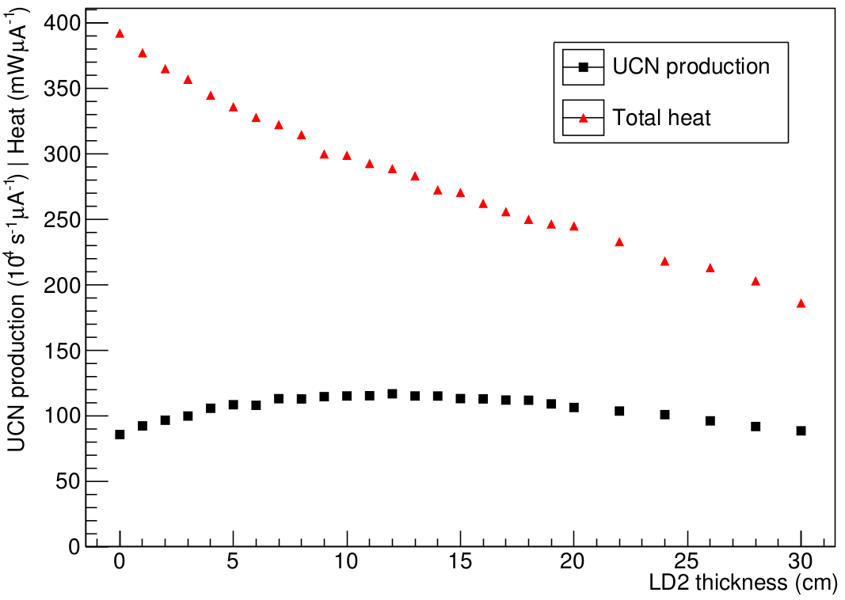
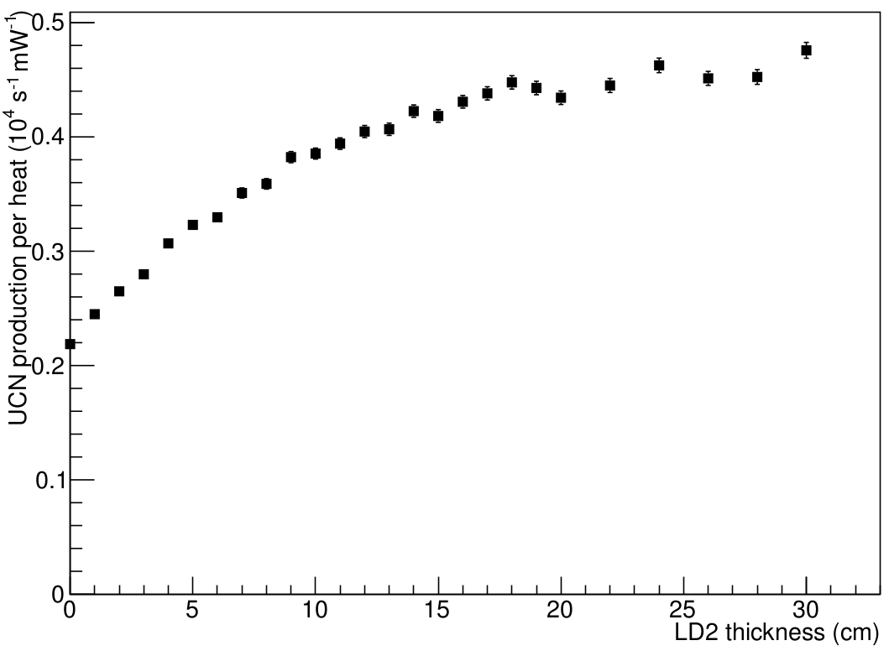
Optimization with MCNP
LD₂ layer above target
He-II
LD2
D2O
Lead

Slide 13
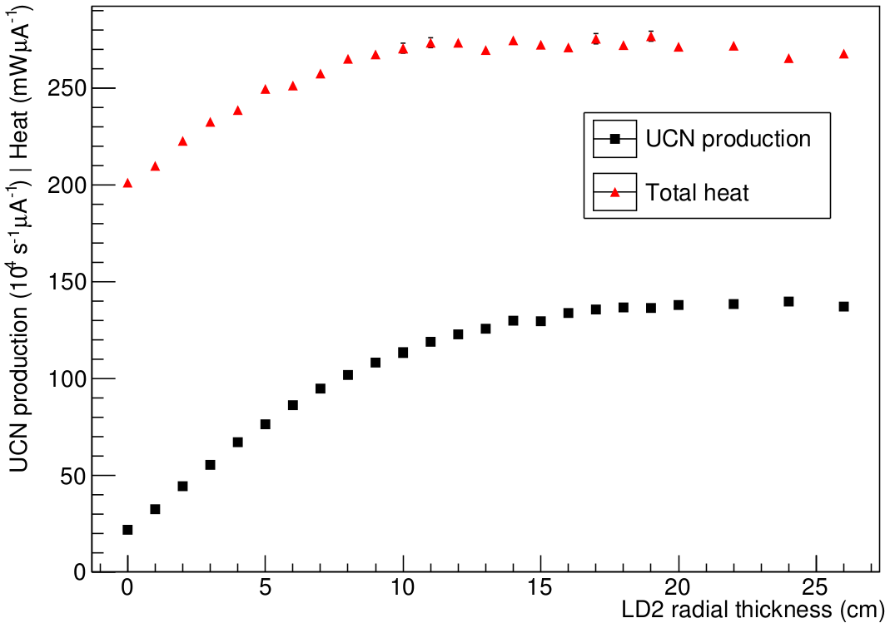
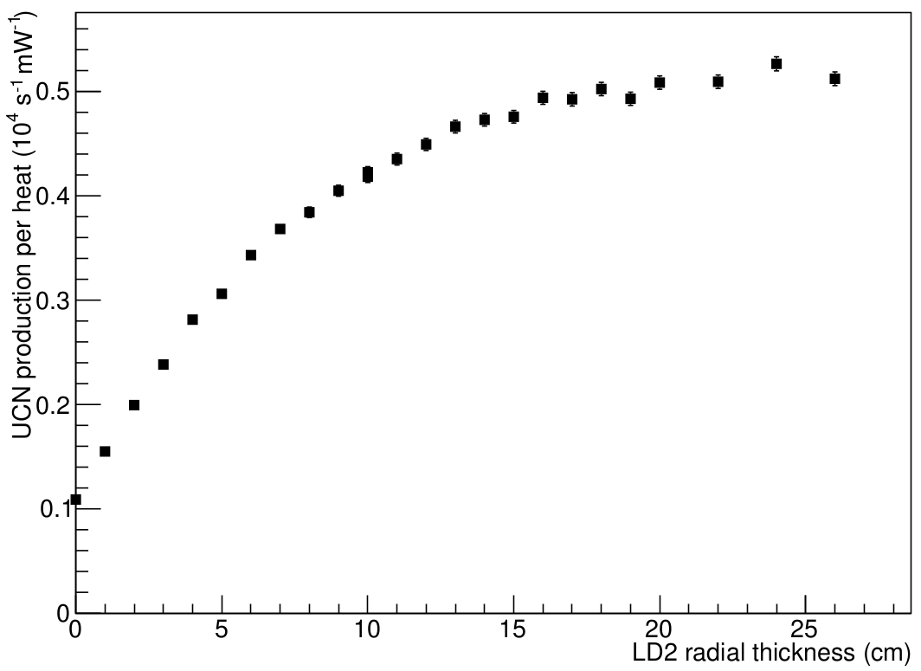
Optimization with MCNP
Radial LD₂ layer
He-II
LD2
D2O
Lead

Slide 14
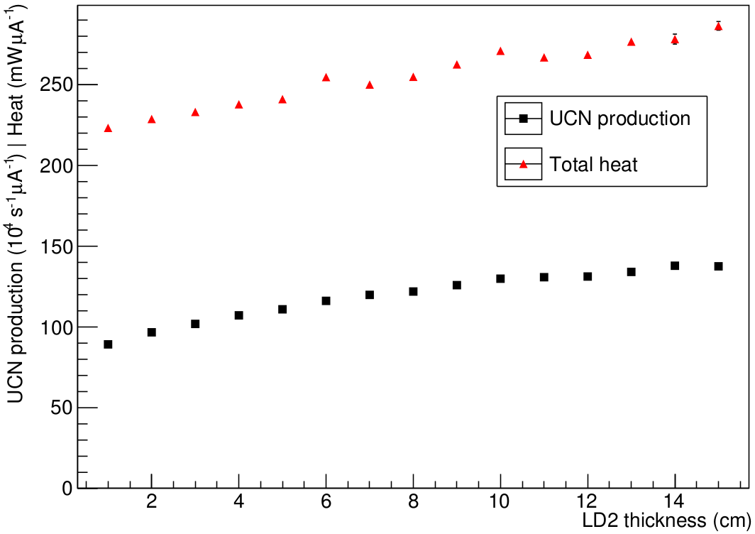
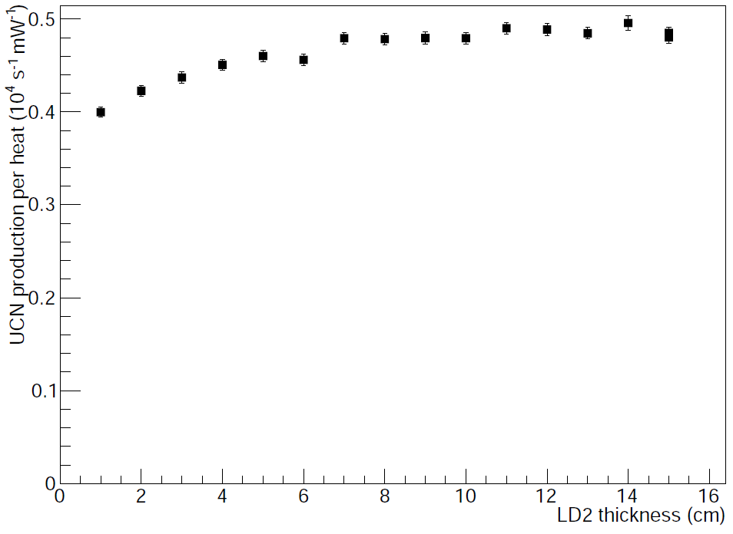
Optimization with MCNP
Trade-off between D₂O and LD₂ layer above target
He-II
LD2
D2O
Lead

Slide 15
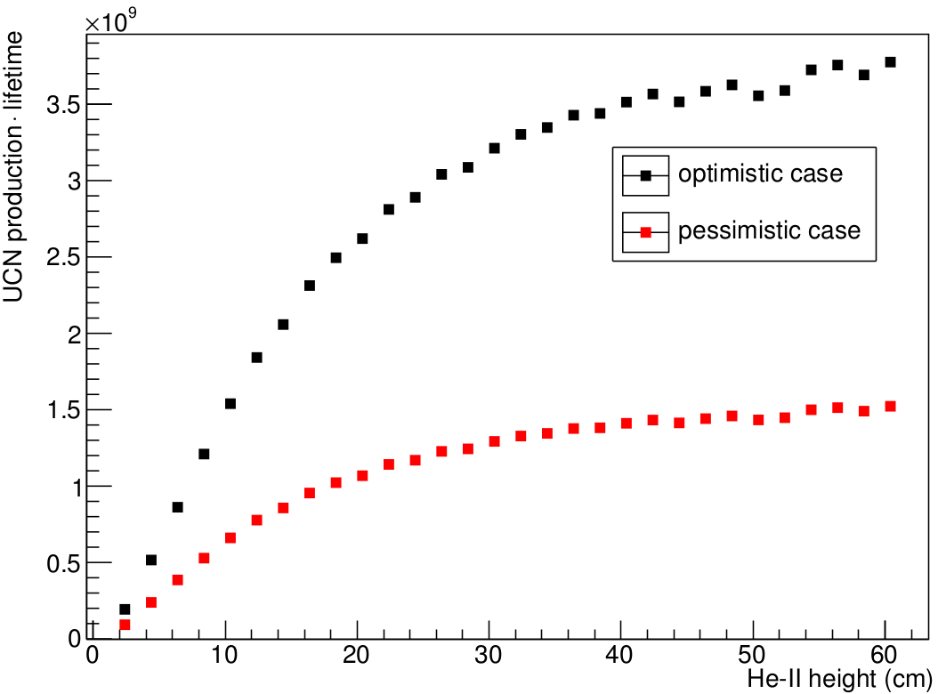
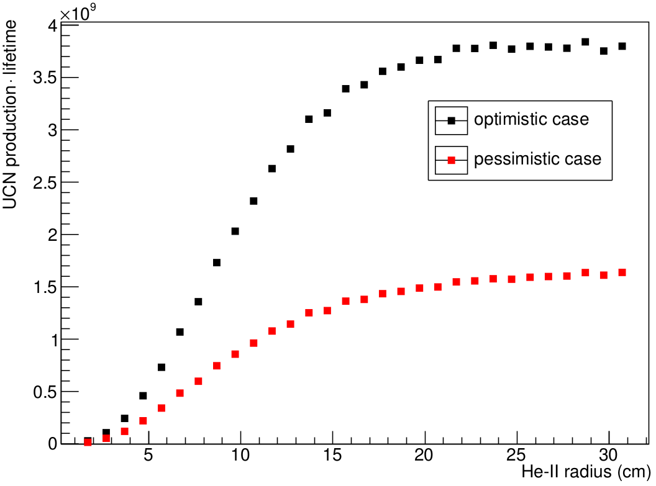
Optimization with MCNP
Height and radius of He-II bottle
using improved model: P·τ with 1/τ = 1/τ_{up}(Q) + 1/ τ_{wall} + 1/ τ_{β}

Slide 16
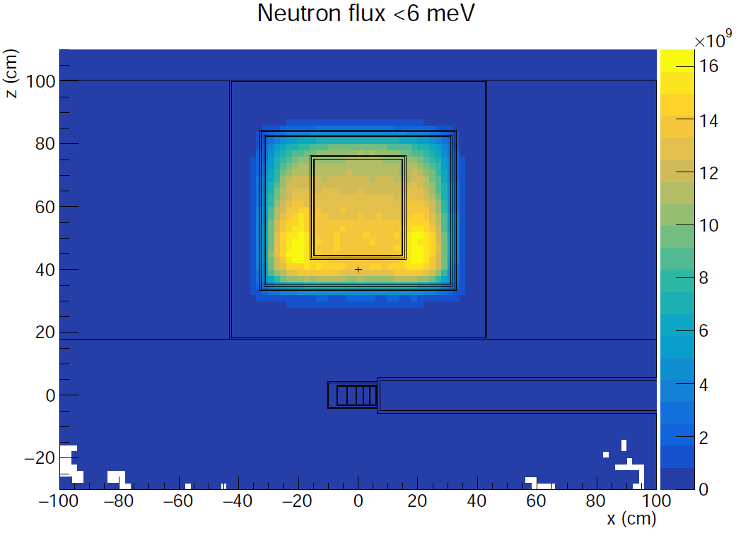
Preliminary results
16 cm
6 cm
15
7 cm 10
16 cm
13 cm
Radial LD₂ layer more important than lower
Best He-II-bottle height 30-40 cm, radius 15-20 cm
(for current cooling scheme)
Limited by amount of LD₂!
For He-II height 30 cm, radius 15 cm, 40 μA beam:
  20.6 l He-II, 115 l LD₂
  3.9·10⁷ UCN/s
  7.9 W max. heat in He-II
  65 W max. heat in LD₂
Best strategy to reduce LD₂:
reduce He-II size and go closer to target
He-II
LD2
D2O
Lead

Slide 17
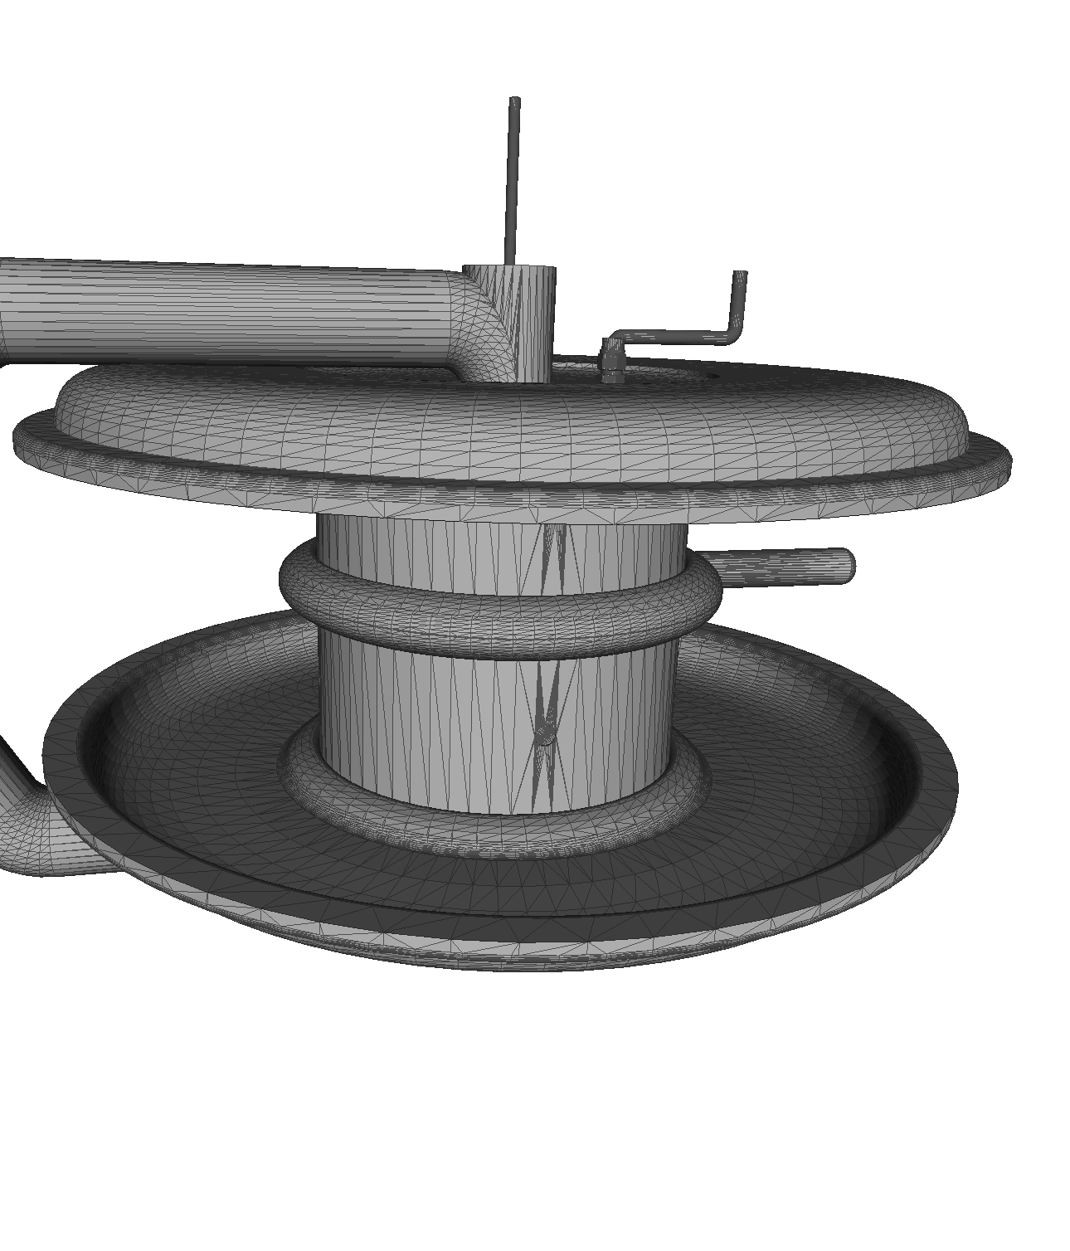
PENTrack
Self-developed Monte Carlo simulation for UCN (+protons, electrons, comagnetometer atoms)
Interactions:
  Fermi-potential formalism, microroughness model
  Magnetic moment in strong magnetic fields
  Precession of spins in weak magnetic fields
  Fully relativistic equations of motion, BMT equation
Geometry directly imported from CAD, time-dependent (valves, etc.)
Magnetic/electric field maps imported from FEM
Open source: github.com/wschreyer/PENTrack.git
Description: 10.1016/j.nima.2017.03.036

Slide 18
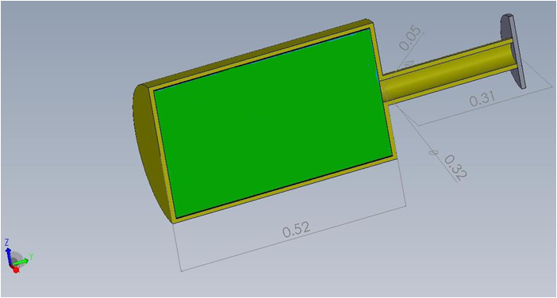
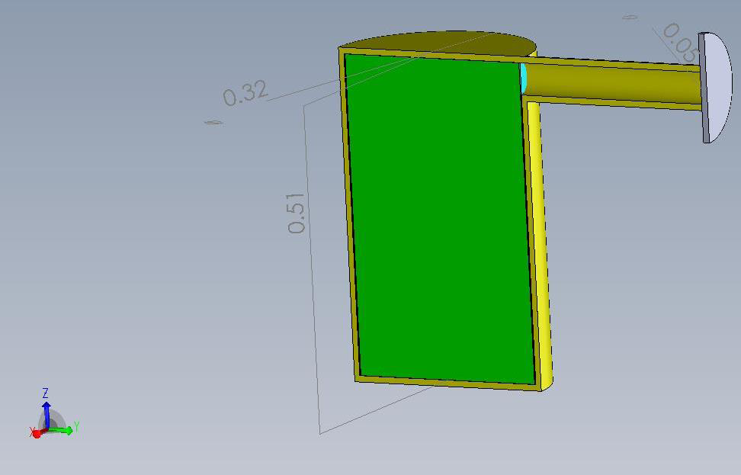
Optimization with PENTrack
Steve Sidhu & Patricia Gnyp:
Optimize geometry of UCN guides
Compare storage and extraction time for different bottle shapes

Slide 19
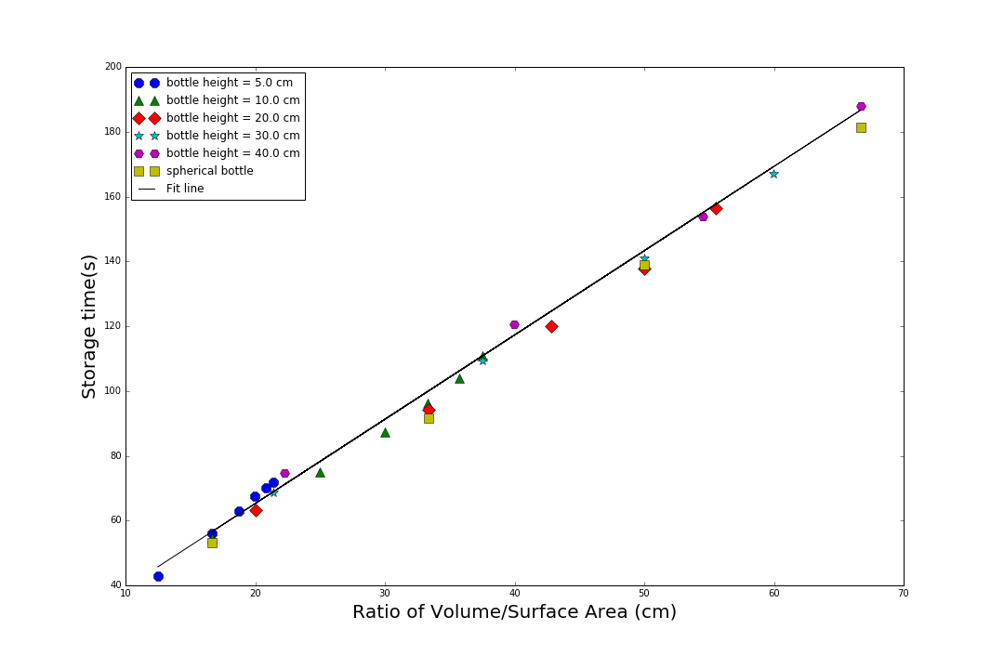
Optimization with PENTrack

Slide 20
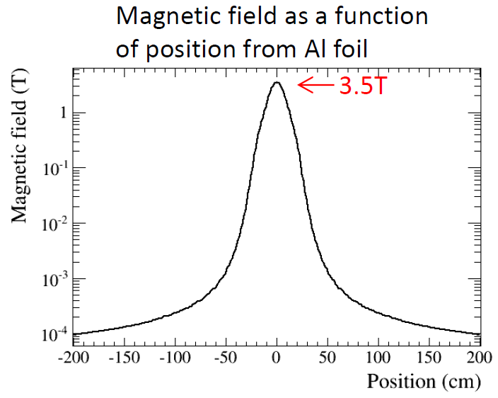
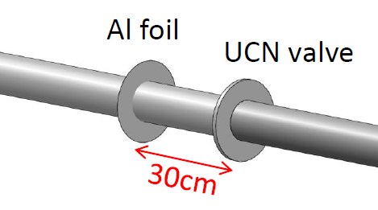
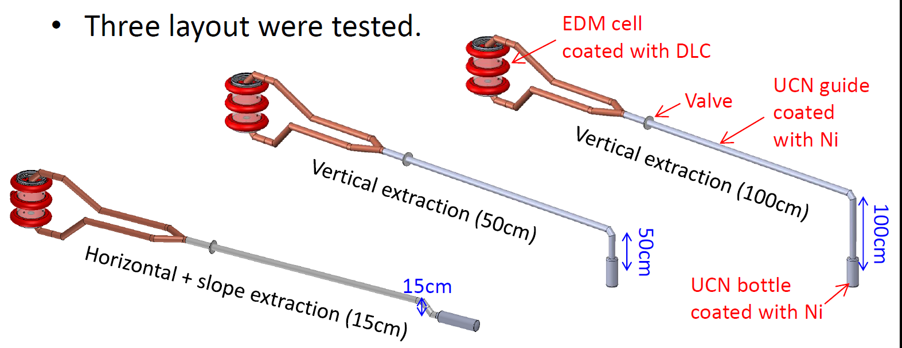
Optimization with PENTrack
Tatsuya Kikawa:
Optimize vertical extraction height
Steady-state mode vs. batch mode

Slide 21
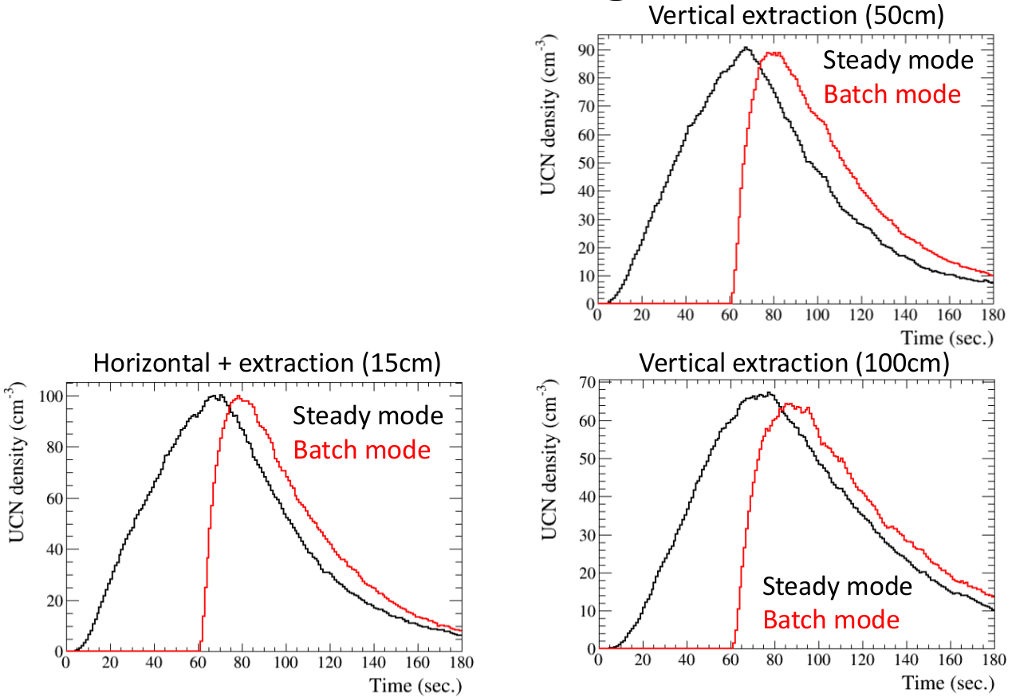
Optimization with PENTrack
Tatsuya Kikawa:
Optimize vertical extraction height
Steady-state mode vs. batch mode

Slide 22
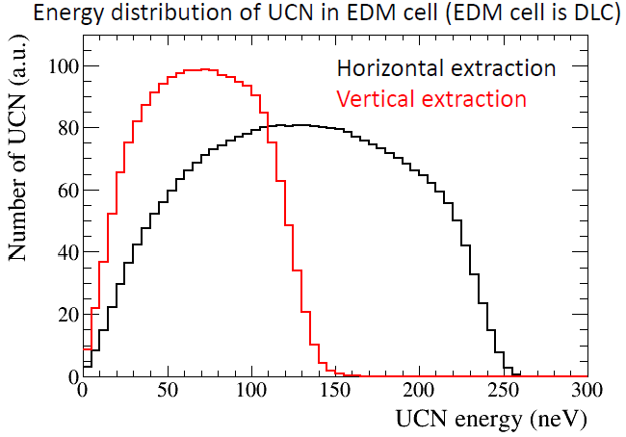
Preliminary results
Vertical extraction of 50-100 cm seems best for nEDM experiment
Work in progress, many unknown parameters
  He-II temperature
  Wall lifetime

Slide 23
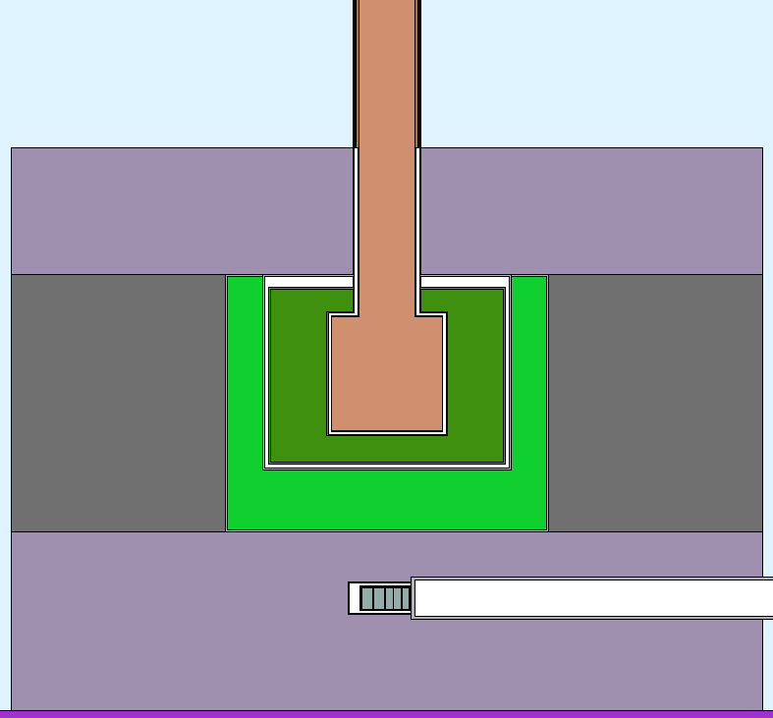
Next steps
More realistic source
  UCN guides
  Heat exchanger, ³He
  Cryostat
  Shapes of pressure vessel
Optimize shielding
  Heat deposition in heat exchanger
  Activation of cryostat
³He heat exchanger
UCN guide
Shielding

Slide 25
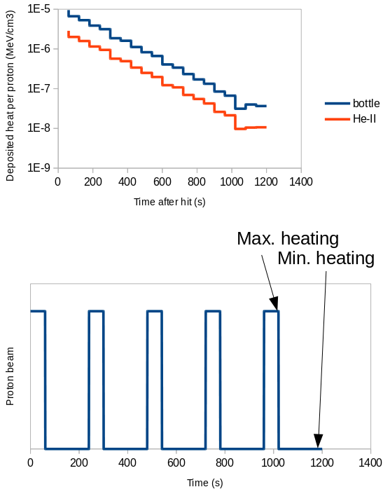
Delayed-heating model
Decay constant ~200 s
Assume 25% duty cycle
1 min beam, 3 min no beam
Use min./max. heat after 5 irradiations

Slide 26
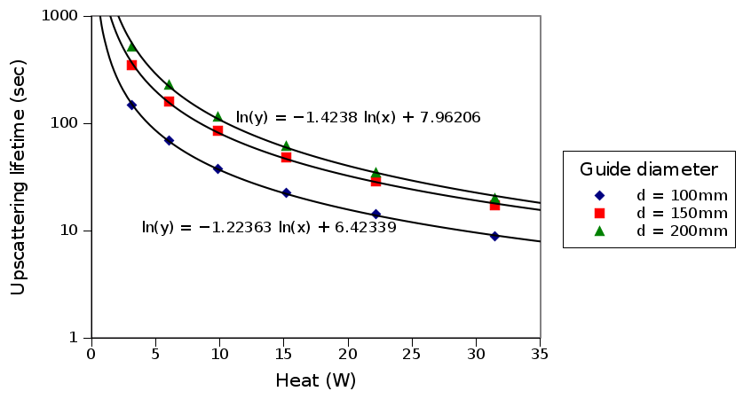
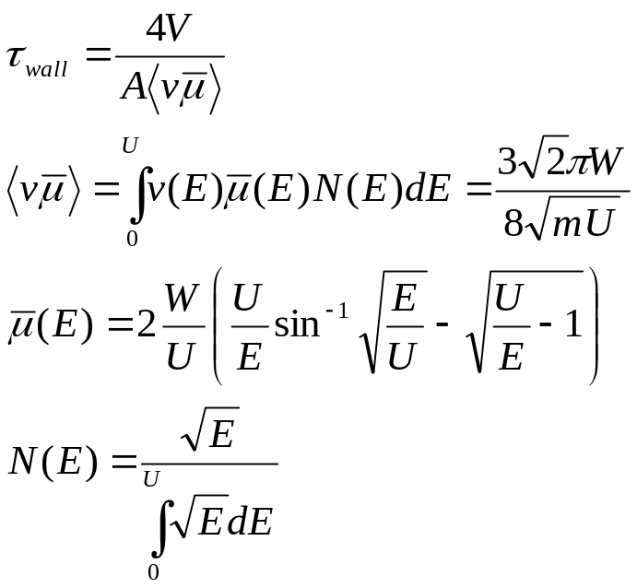
Detailed storage-time model
Detailed model: maximize P·τ with
1/τ = 1/τ_{up}(Q) + 1/ τ_{wall} + 1/ τ_{β}
τ_{up}(Q) ~ Q^{-1.2} to Q^{-1.4}

