Slide 1
The science program at TRIUMF
from a physical sciences perspective
Jens Dilling
Associate Director
Physical Science Division
October 16th 2017
nEDM workshop

Slide 2

A National Laboratory
TRIUMF has delivered nearly 50 years of science and innovation for Canada

Slide 3
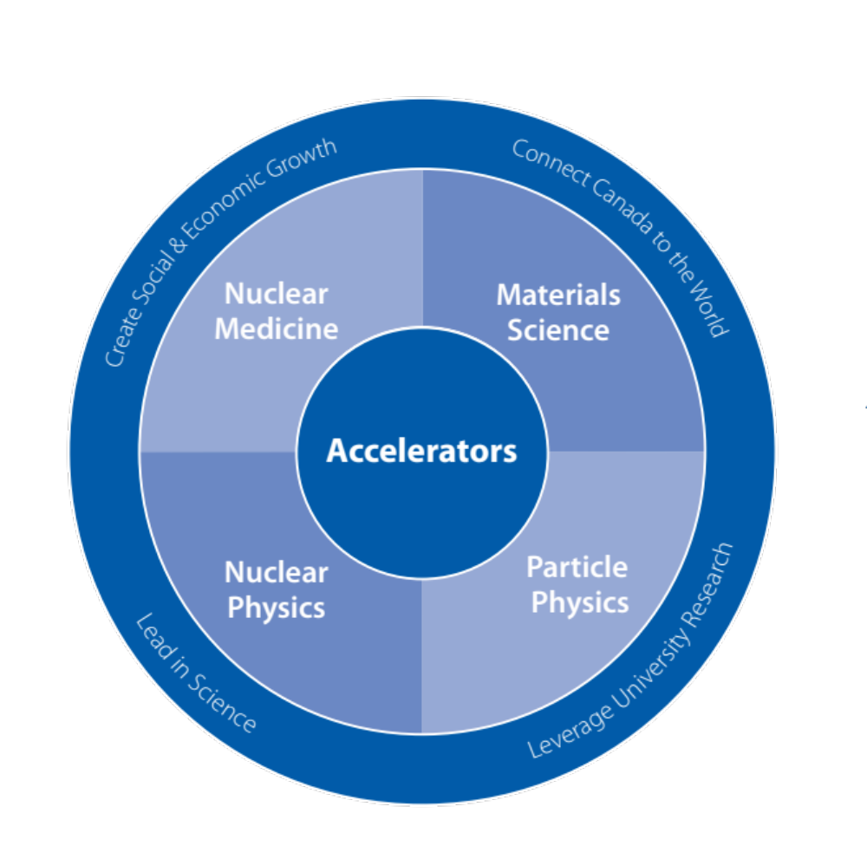
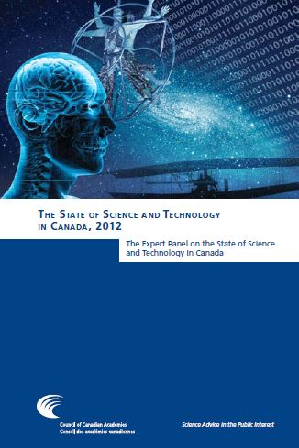
A National Resource
In 2012, the Council of Canadian Academies ranked physics and astronomy to be among the top six fields in which Canada excels globally. As Canada’s national laboratory for particle and nuclear physics, TRIUMF is key to this success.

Slide 4
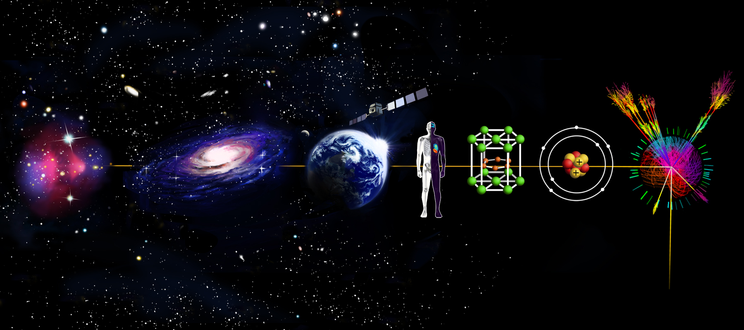
TRIUMF’s Research Program
Dark Matter
& Cosmology
Electronics
Radiation Testing
Molecular &
Materials Science
Particle
Physics
Nuclear
Astrophysics
Nuclear
Medicine
Nuclear
Physics

Slide 5
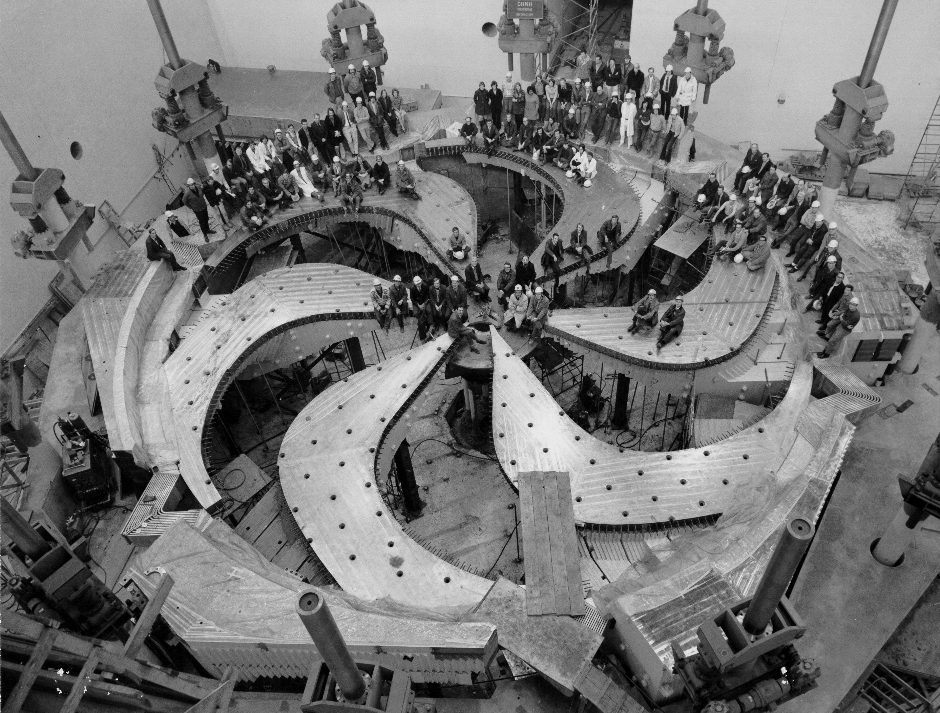
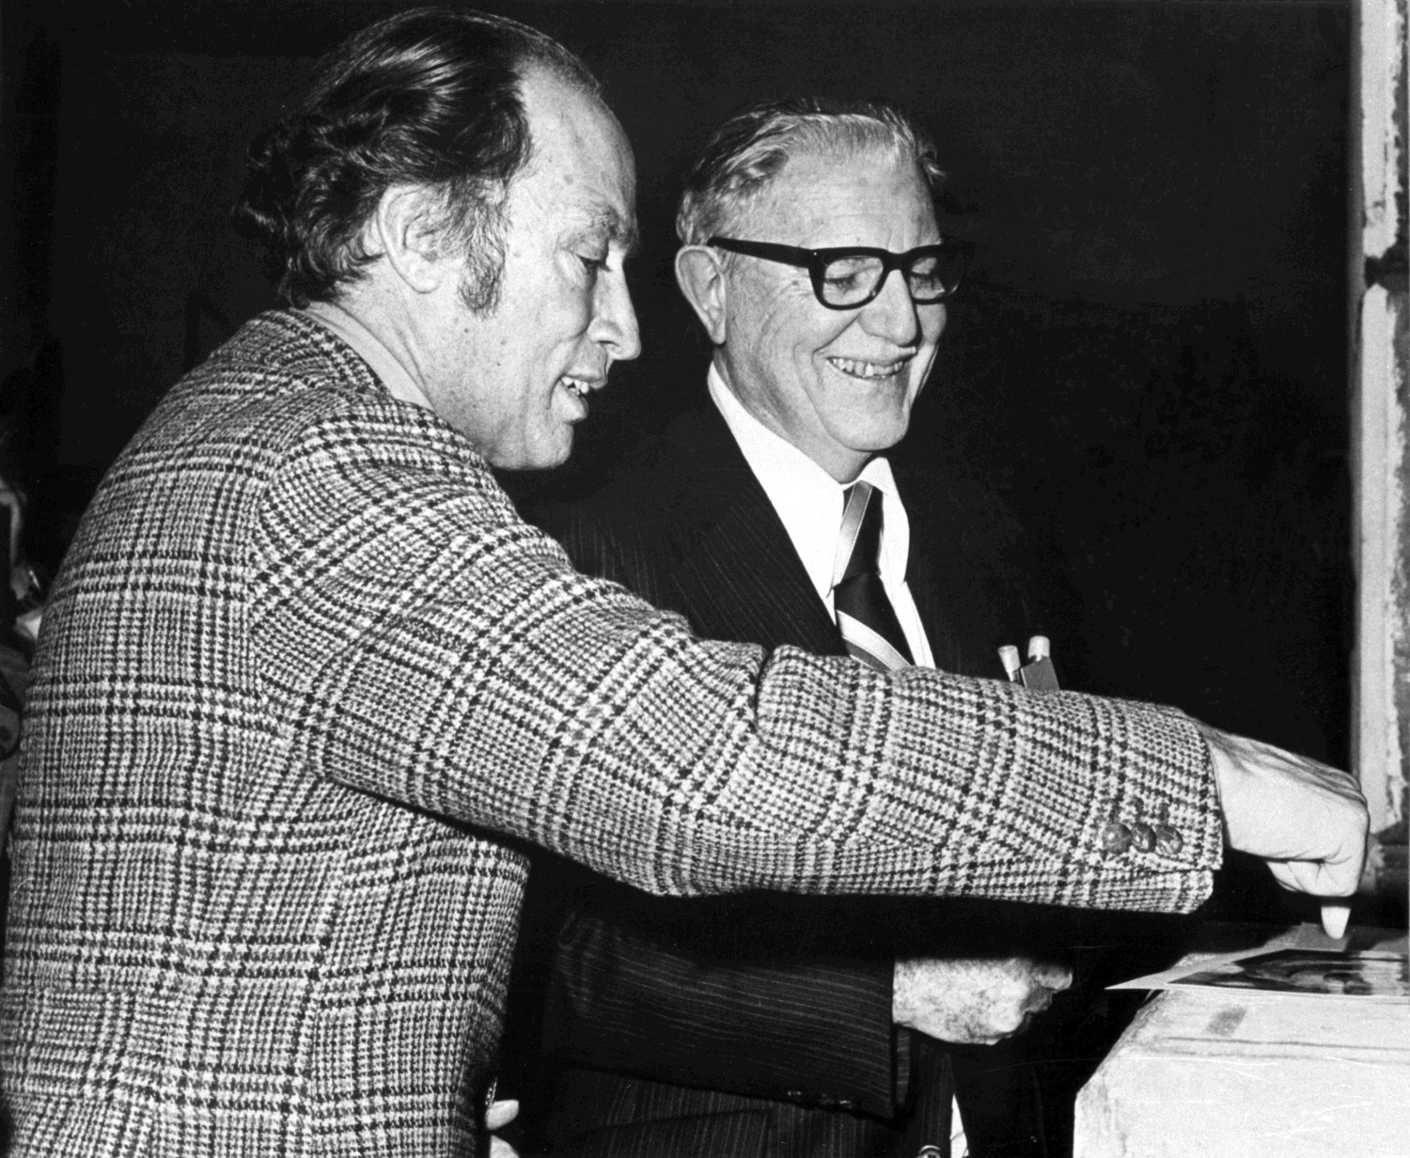
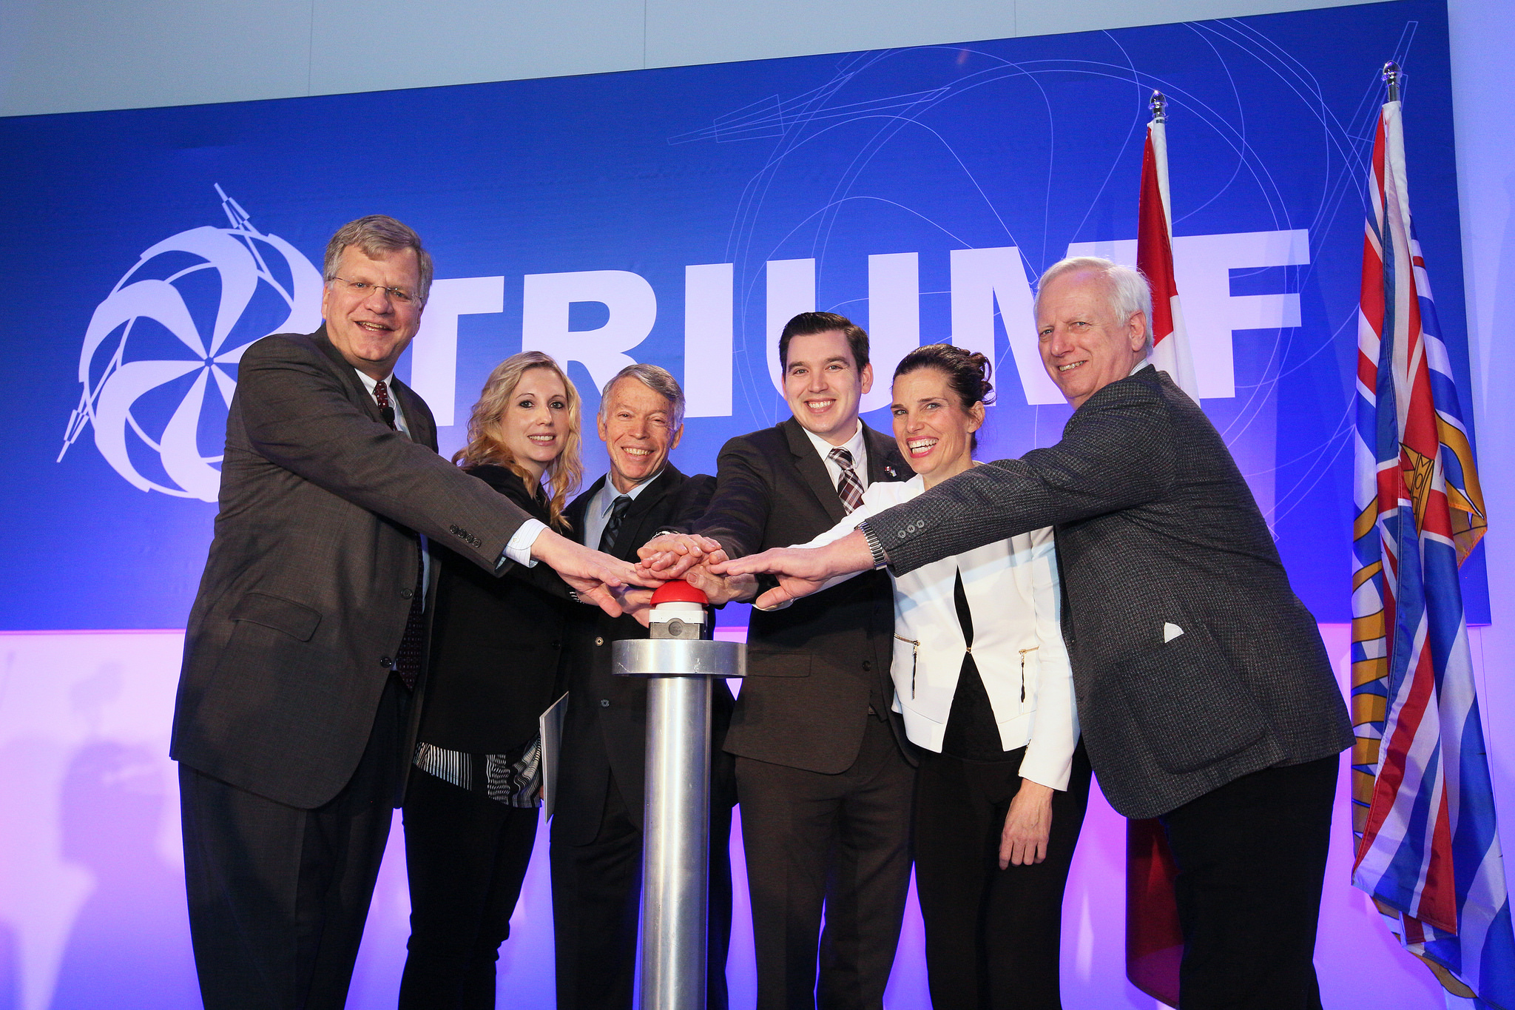
The Heart of TRIUMF
Feb 9, 1976
Feb 9, 2016
TRIUMF is home to the world’s largest cyclotron
  Celebrated the 40th anniversary of commissioning on Feb. 9, 2016
  Designated IEEE Historical Engineering Milestone in 2011

Slide 6
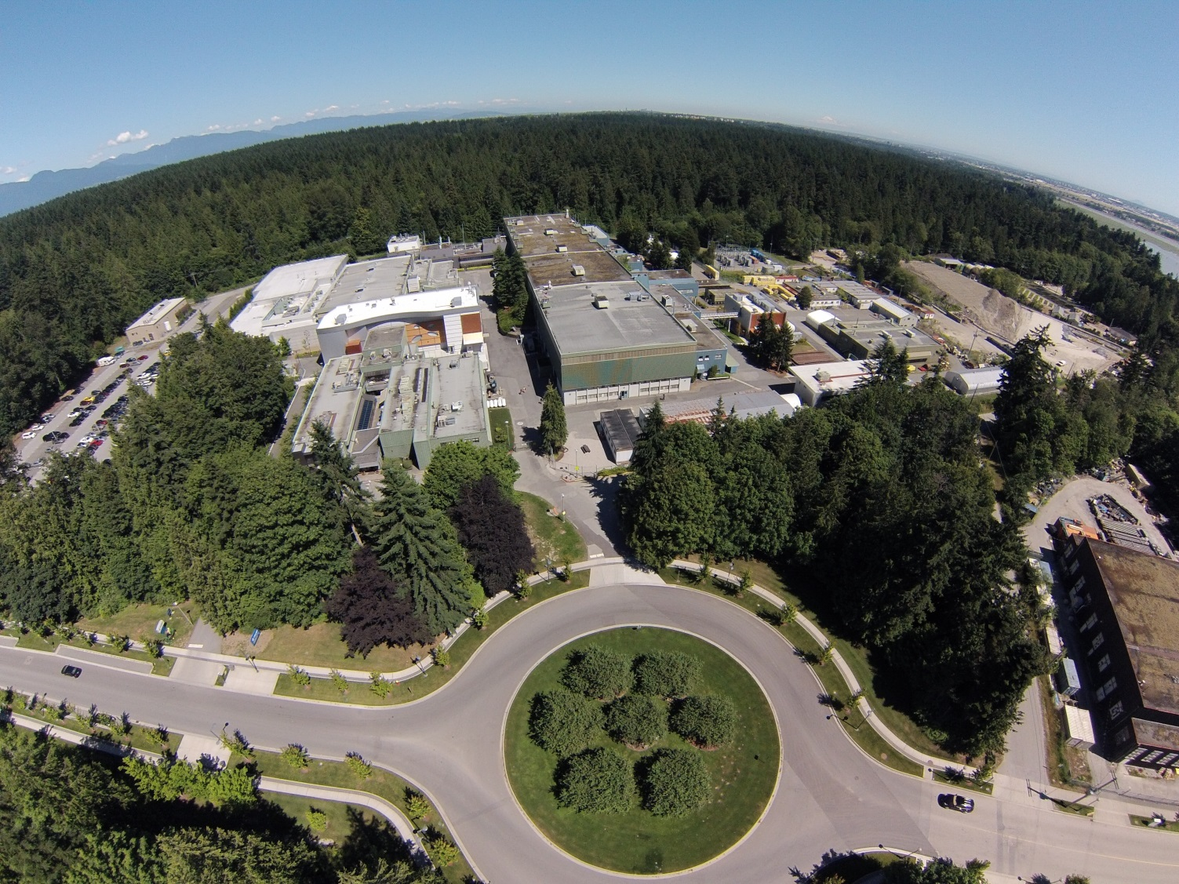
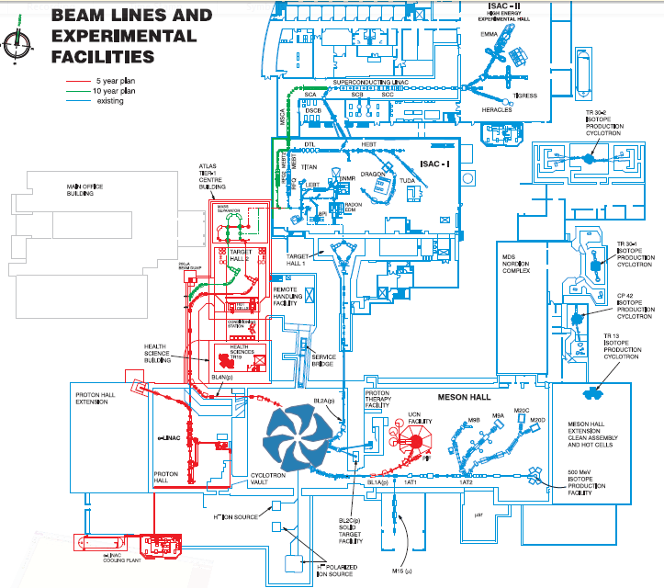
TRIUMF’s accelerator complex
Nordion
commercial medical isotope production
3 cyclotrons
Cyclotron
500 MeV
350 μA
Particle Physics
Pienu
Ultra Cold Neutrons
CMMS
Centre for Molecular and Material Science (μSR)

Slide 7
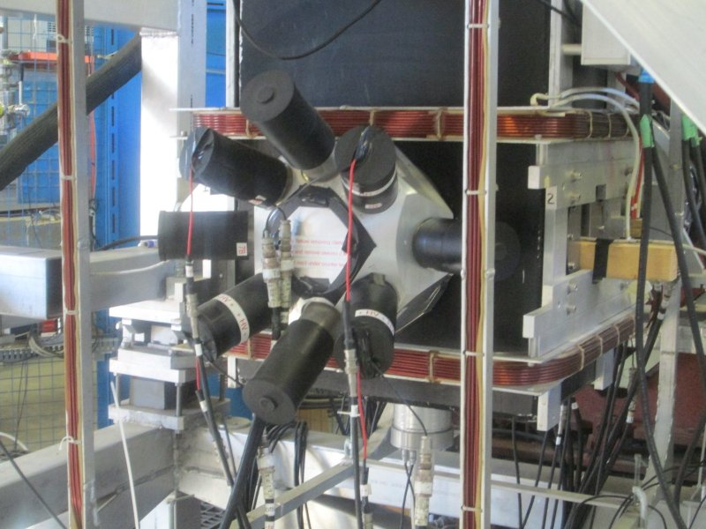
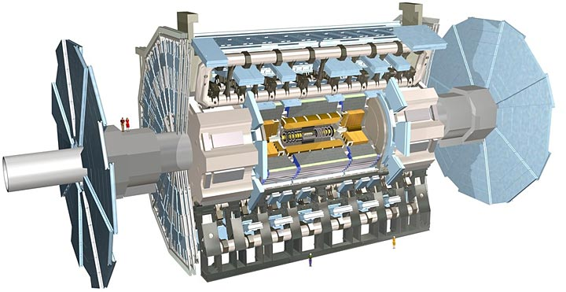
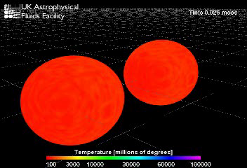
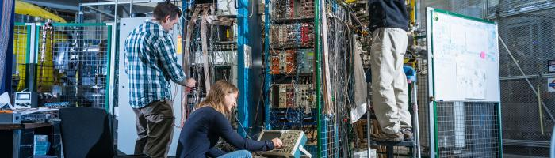
TRIUMF’s PS Div. Science Program
  Nuclear physics (local)
  Molecular and material science (local)
  Particle physics (local & off-site)
  Science technology (for the community)
  Theoretical physics (local)

Slide 8
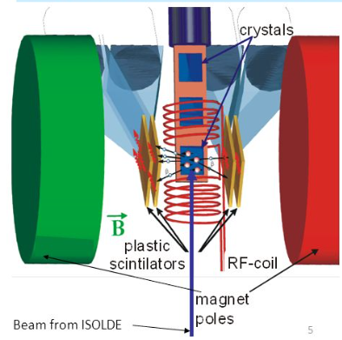
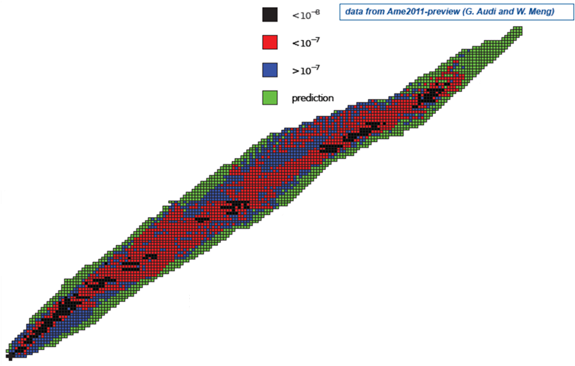
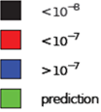
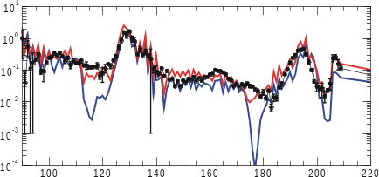
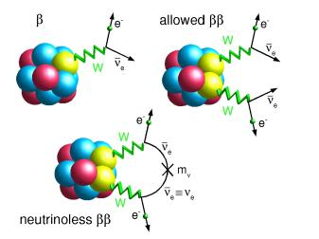
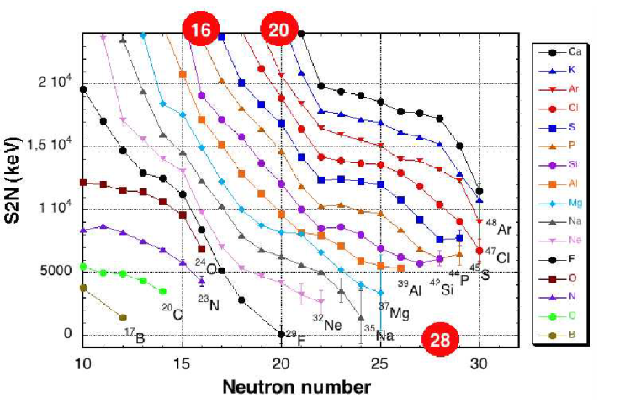
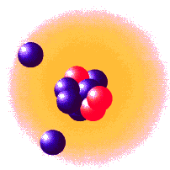
Rear isotope science and applications.
Tests of fundamental symmetries and SM
βNMR for material studies
Using polarized isotopes
Abundance vs. A
Element Synthesis
via r-process (supernova)
The nature of neutrinos
and double beta decay
Halos and skins
Evolution of Nuclear Shells & developing a nuclear theory
Notes:
Motivation:
different fields → different precision
nuclear structure, since masses = nuclear binding energies (by weighing nuclides)
nuclear structure: shells, magic numbers, shell quenching towards drip lines, halos
nuclear astrophysics, nucleosynthesis in stars and supernovas → r-process
nucleosynthesis & structure: precision not a big problem, but many nuclides need to be measured
fundamental tests: Quark mixing matrix, solar neutrino physics
8

Slide 9
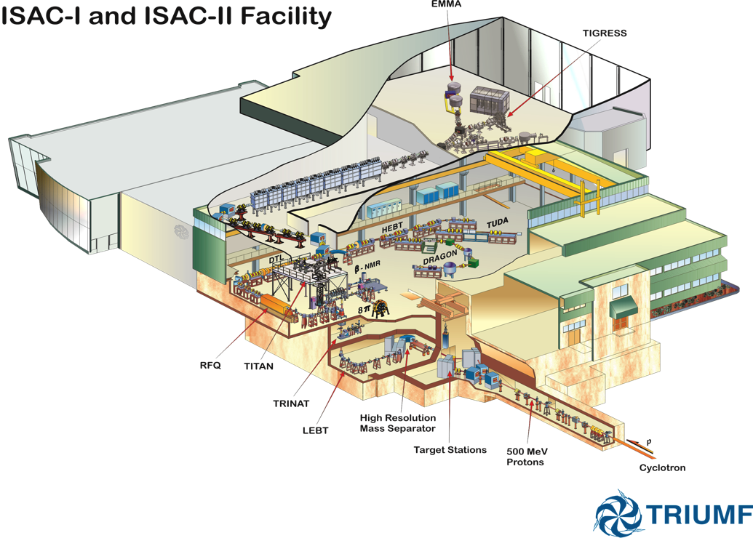
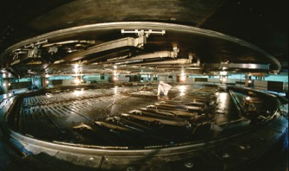
TRIUMF rare isotope program:
Programs in
Nuclear Structure
Nuclear Astrophysics
Electroweak Interaction Studies
Material Science
18 permanent experiments
ISAC II:
10 AMeV for A<150
16AMeV for A<30
ISAC I:
60 keV & 1.7 AMeV
ISOL facility with high primary beam intensity (100 μA, 500 MeV, p)
delivering RIBs since 1999.

Slide 10
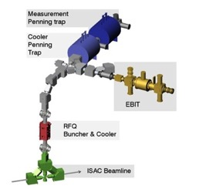
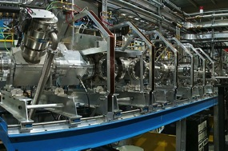
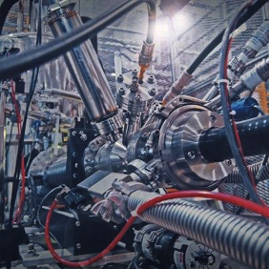
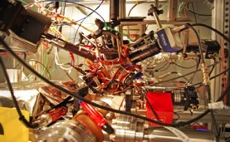
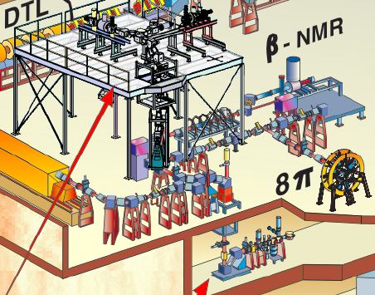
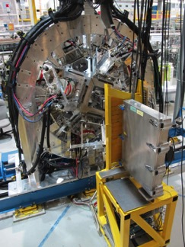
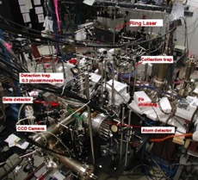
ISAC experimental areas (low energy)
TITAN
Penning Traps
(masses,
in-trap decay)
Low energy RIBs
< 60 keV
FRANCIUM MOT
(PNC, anapole moment)
Polarizer beamline
Laser spectroscopy, MTV CPT test, betaNMR
Beta-NMR
Material science
TRINAT
Neutral Atom Trap
(βν-neutrino correlations)
GRIFFIN
Gamma & Electron
spectrometer
(decay spectroscopy,
superallowed decays)

Slide 11
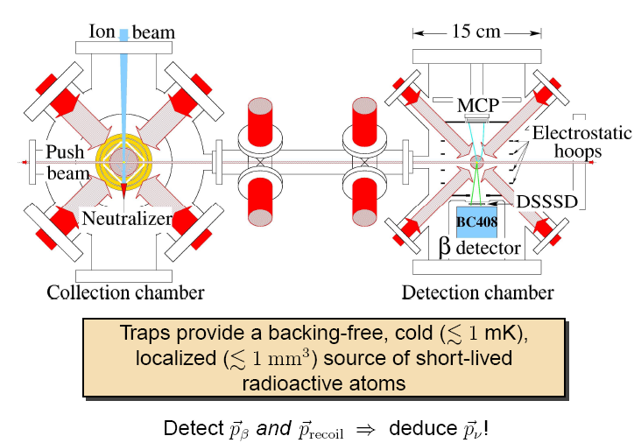


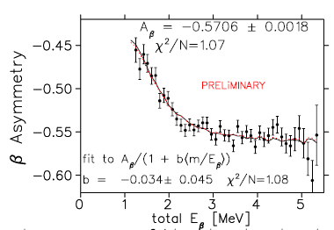
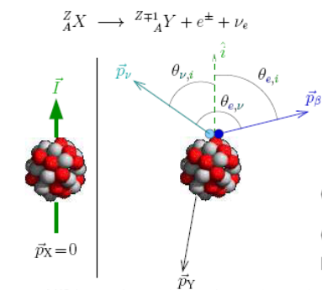
TRINAT: beta-neutrino correlation experiment
Atom trap: electro-weak study to probe
S/V/T interactions using β-ν correlations.
Testing the SM of electroweak
interactions
Complementary sensitivity to LHC for
4-fermion contact interaction.
Recently improved limits by factor of 10

Slide 12
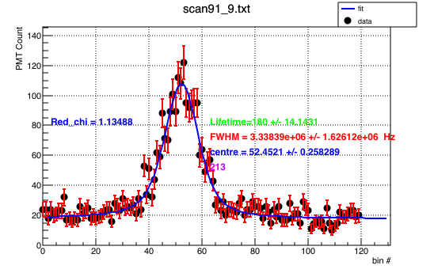
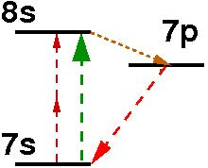
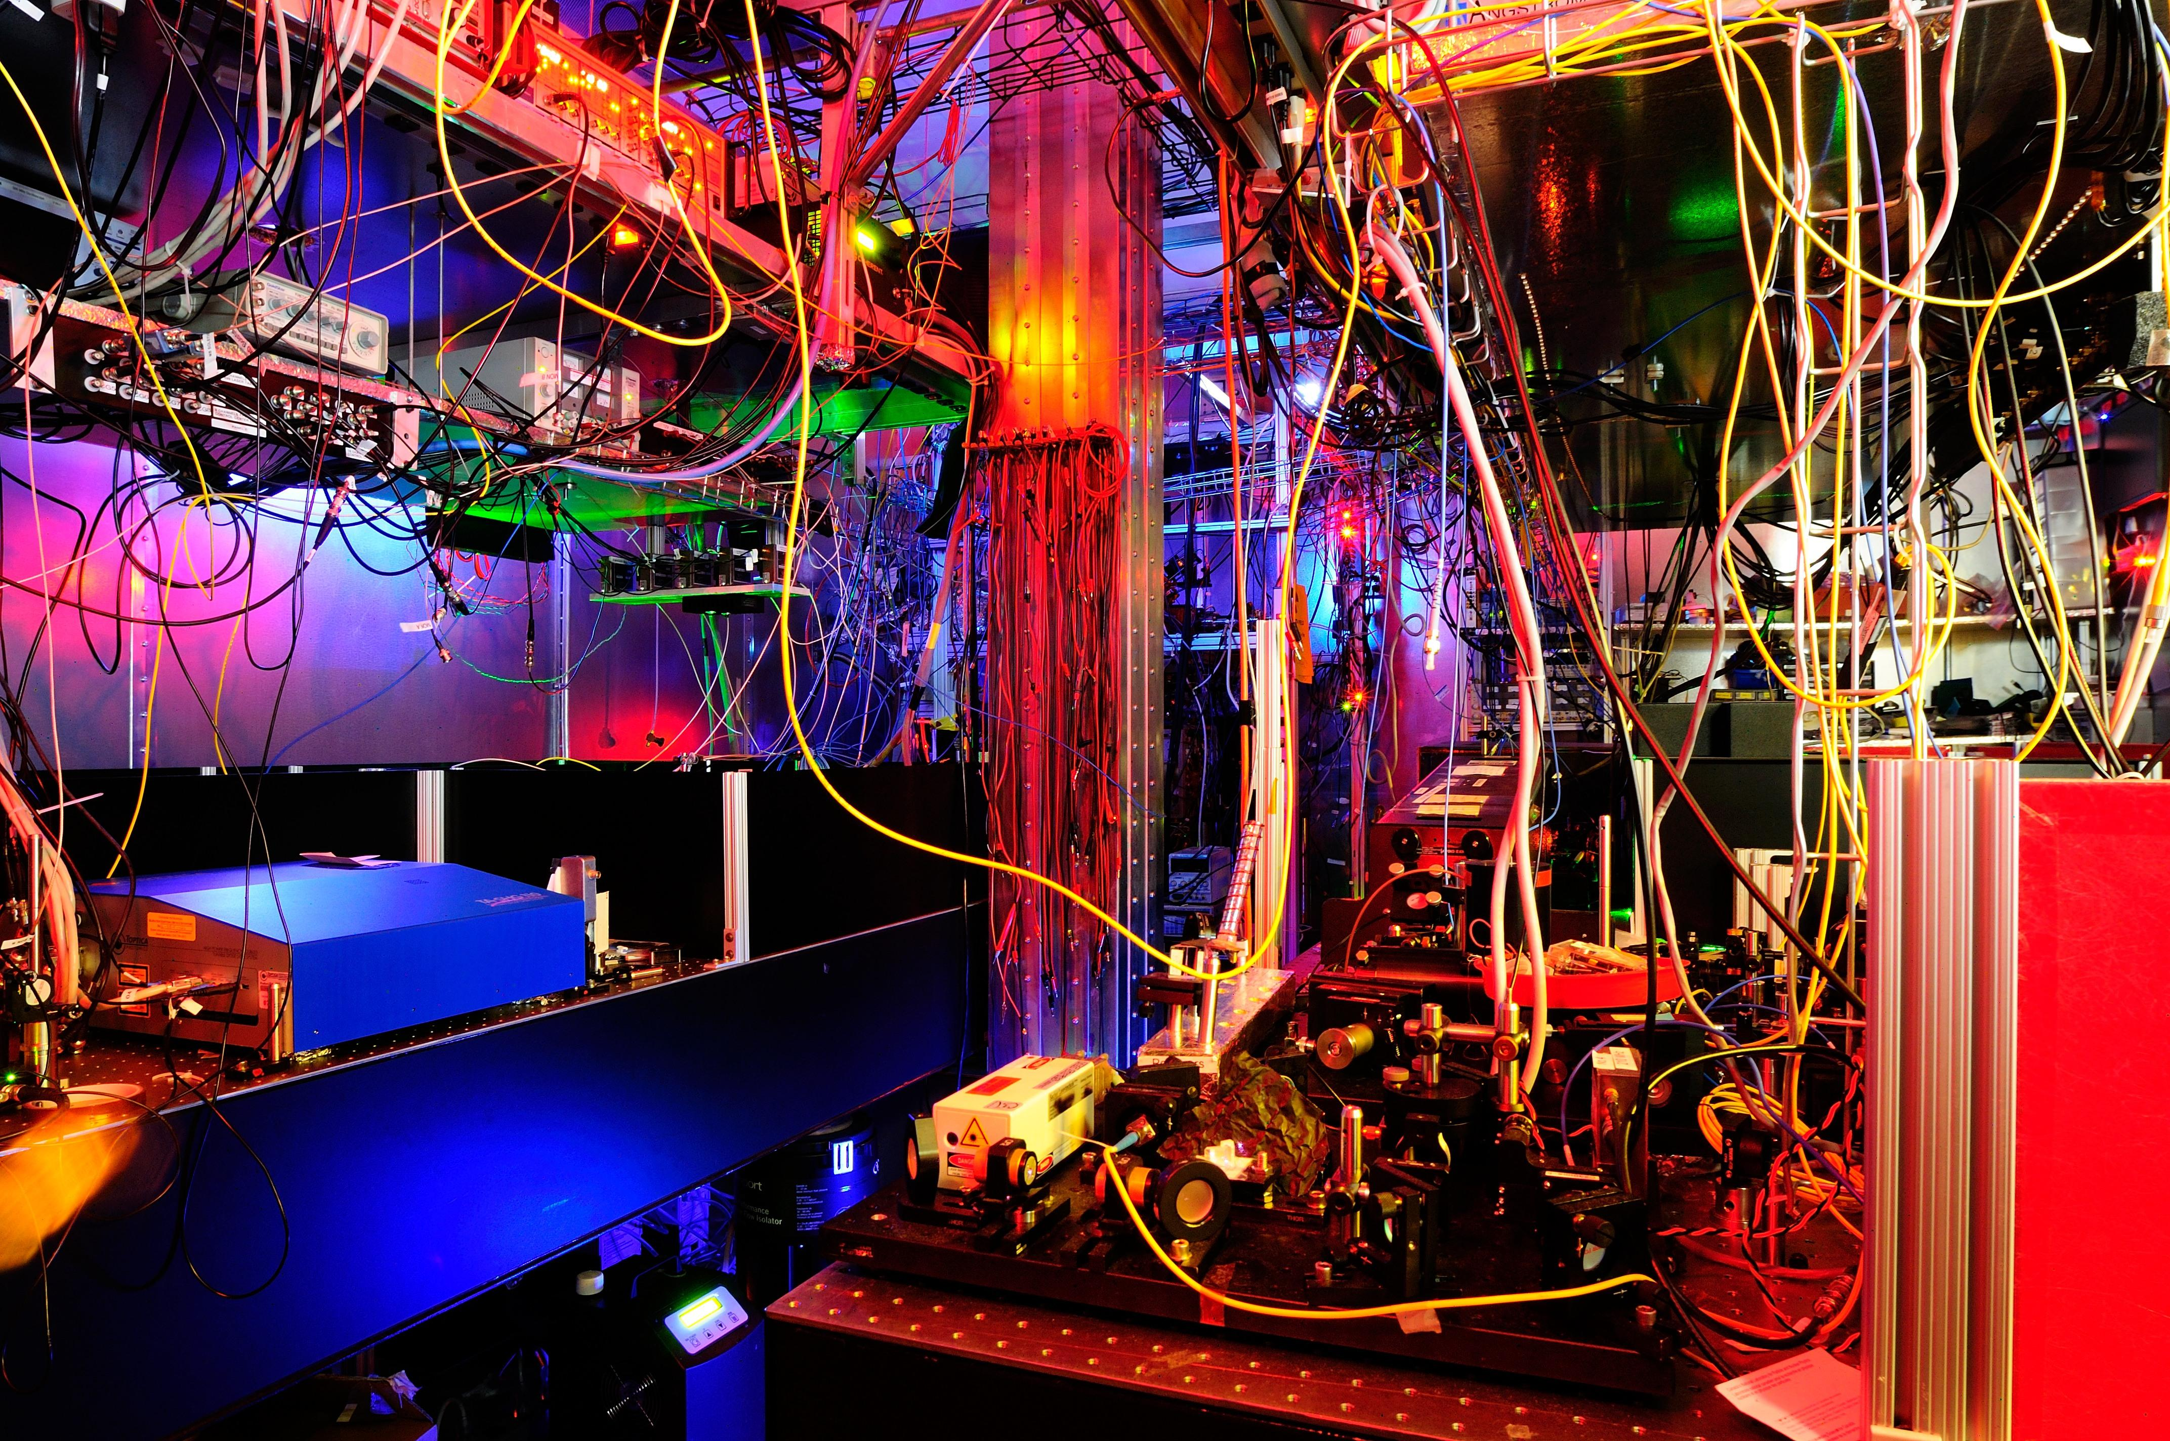




Fr parity violation atom trap experiment
Atom trap experiment for tests of
parity non-conservation and searches for an anapol moment in Fr isotopes.
²¹³Fr
Observed for the first time the 7s-8s transition (the parity-violating transition) using two-photon spectroscopy
Demonstrated DC Stark shift of the 7s-8s transition
Major milestone!
Preliminary
Fluorescence
0 18MHz
AOM freq.

Slide 13
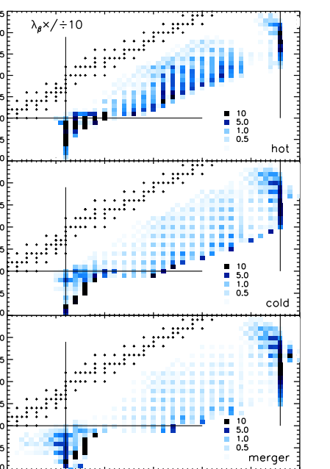


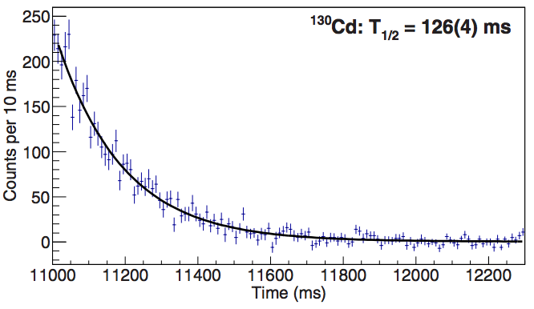
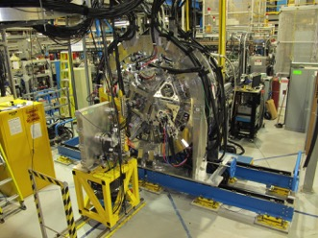








GRIFFIN: ^{128,129,130}Cd β-decay
Measurement of decay half lives and properties are important for astrophysical r-process calculations
Colorado School
of Mines
G. Lorusso et al. PRL 114 192501 (2015)
M. Mumpower et al., Prog.Part.Nucl.Phys. 86, 86 (2016)

Slide 14
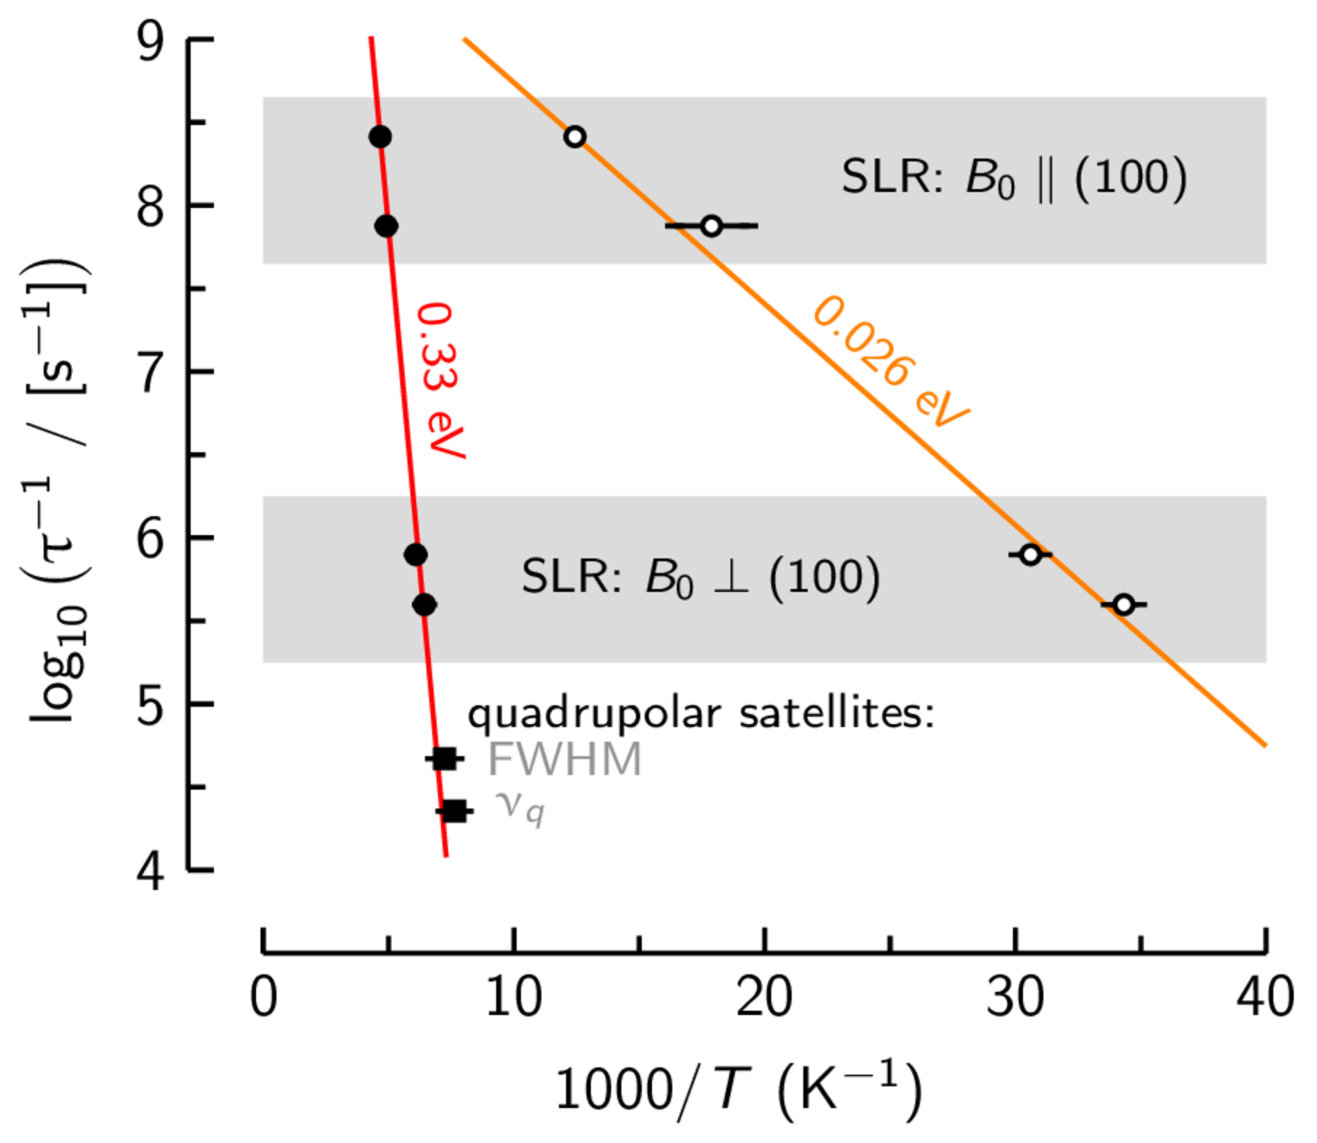
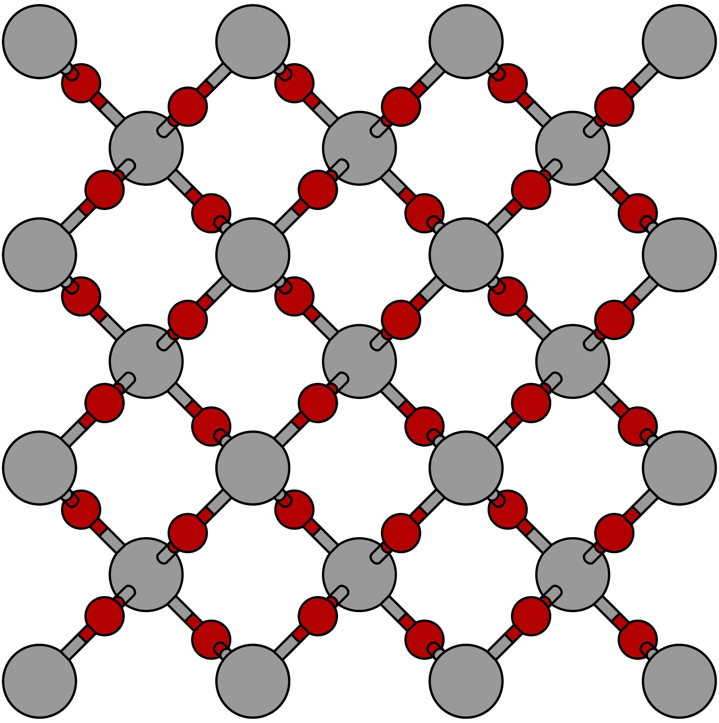







βNMR experiments: using polarized isotopes to probe materials
Li⁺ dynamics in rutile TiO₂:
solving a long-standing mystery
Long-range diffusion
Local motion
log₁₀( Li⁺ hop rate / [s⁻¹])
Rutile TiO₂: a candidate electrode for
solid-state lithium-ion batteries. Detailed studies
on ionic motion and diffusion behavior.
Publication: R. McFadden (UBC chem) PRL in prep
Notes:
- Rutile TiO2, a candidate electrode for solid-state lithium-ion batteries, is near ideal 1D lithium-ion conductor, owing to the open channels for diffusion along its c-axis (see structure).
- Li+ is the perfect size for the channels and is orders of magnitude more mobile than any other element.
- Giving the simplicity of the structure/ionic motion, its an attractive system to model, but here has been extreme disparity between theory and experiment.
- With beta-NMR, we find two sets of Li+ dynamics, one in agreement with macroscopic diffusion experiments, and a previously unobserved motion in agreement with theory.
- Interpretation: long-range motion dominated by defects that “trap” Li+, motion below 100 K is local
- Result reaffirms the predictive power of these models, highlights beta-NMR as a unique means to test them.

Slide 15
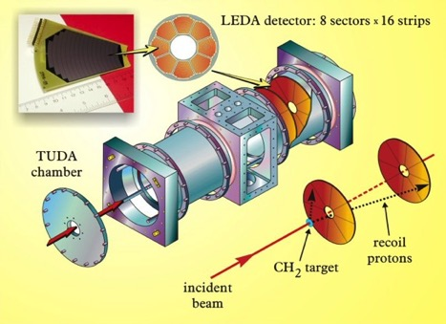
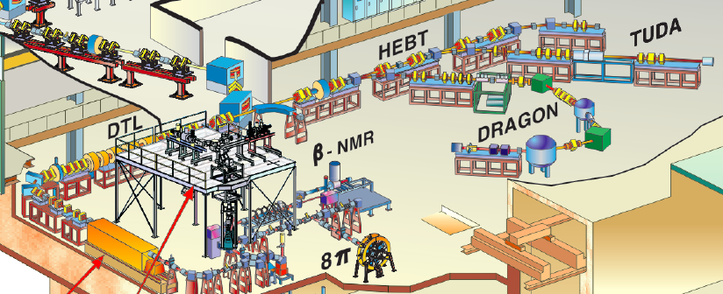
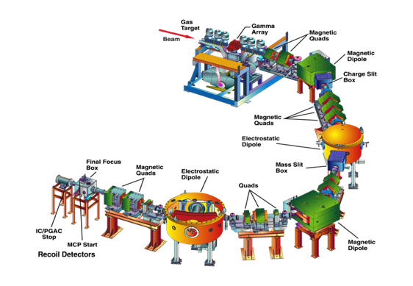
ISAC experimental areas
Medium energy RIBs
~ 0.15 -1.7 AMeV
TUDA
Astrophysical charged particle reactions
DRAGON
Astrophysical capture reactions

Slide 16
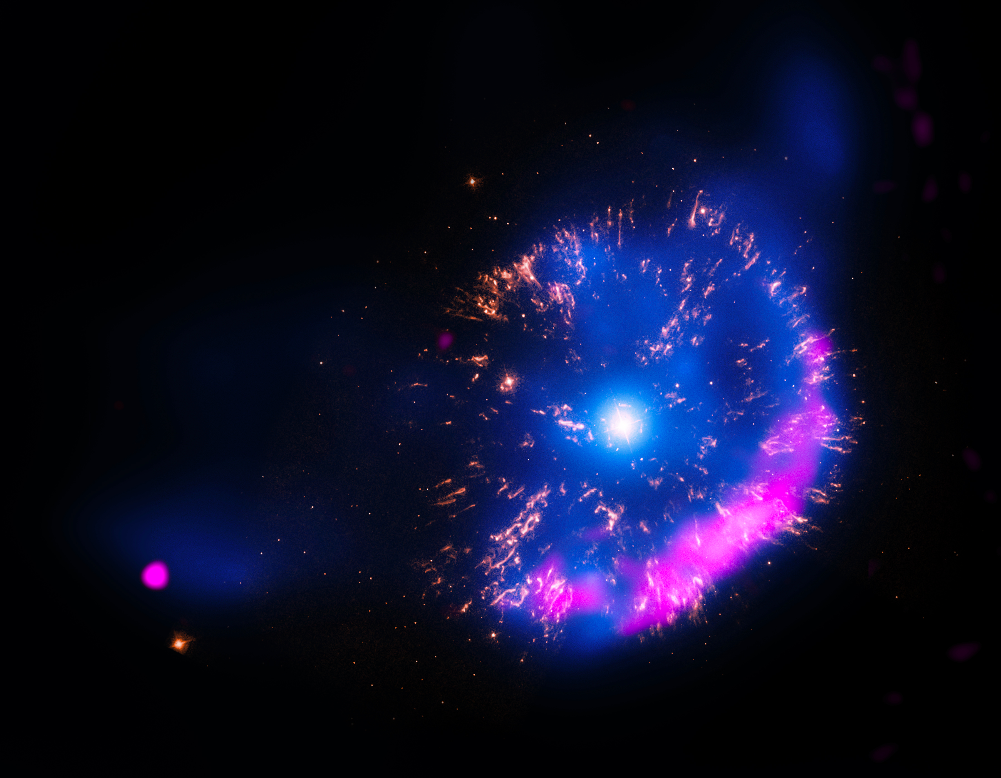
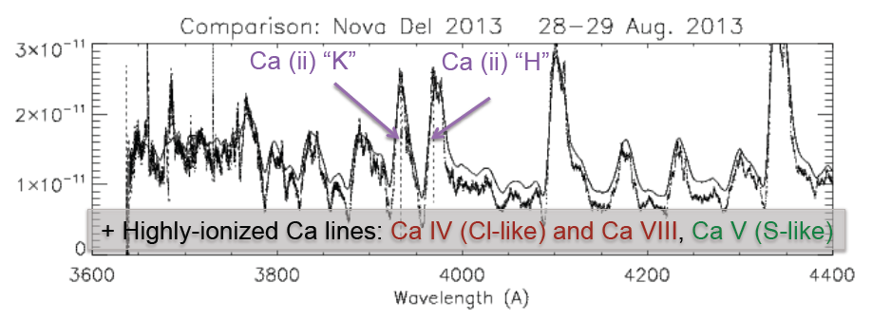
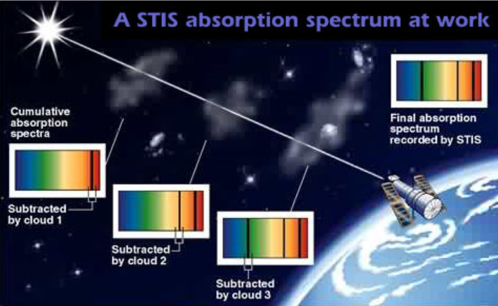
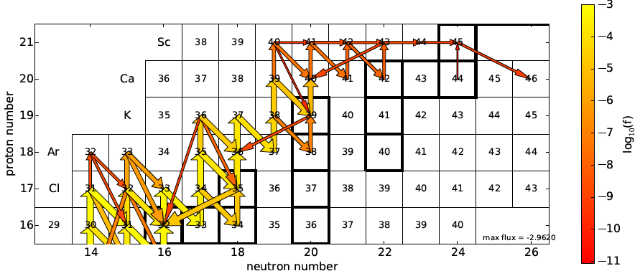
DRAGON: understanding the formation of elements in the universe
NuGrid network
calculations with
UVic, TRIUMF et al.
Calcium, potassium, argon have been observed (visible, UV, IR) in expanding nova shells
Ca is supposed to be the “end point” of nucleosynthesis in novae

Slide 17
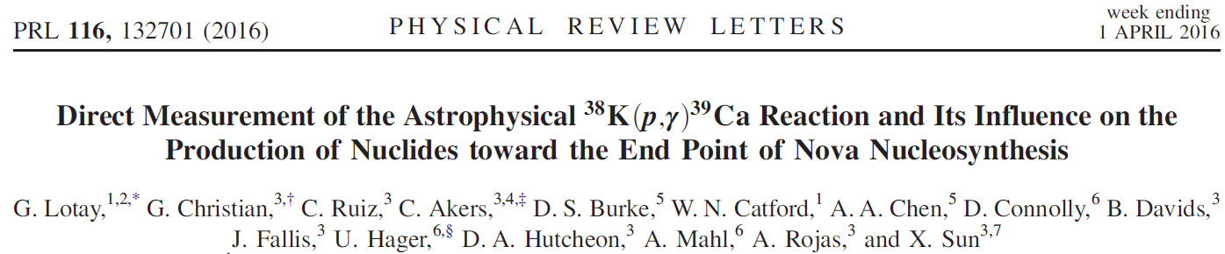
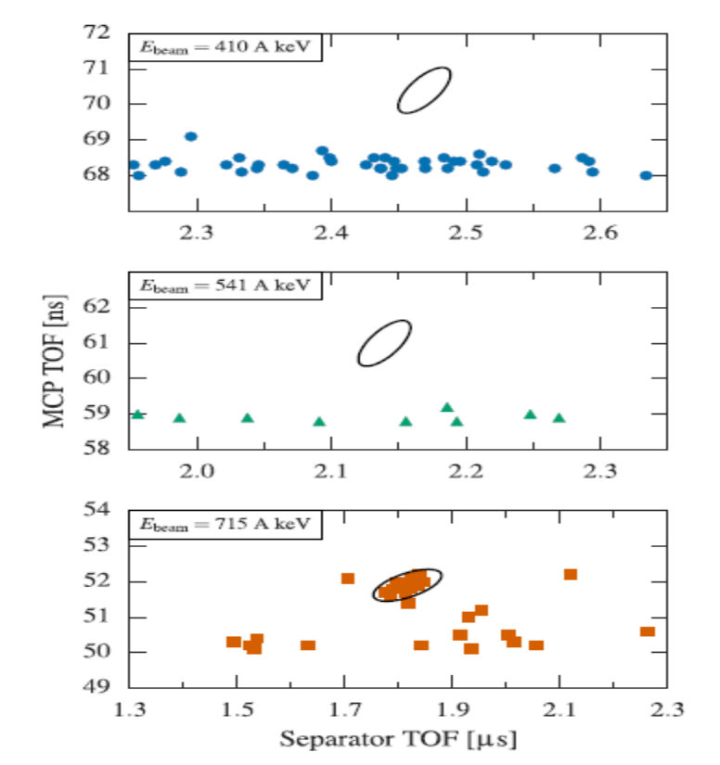
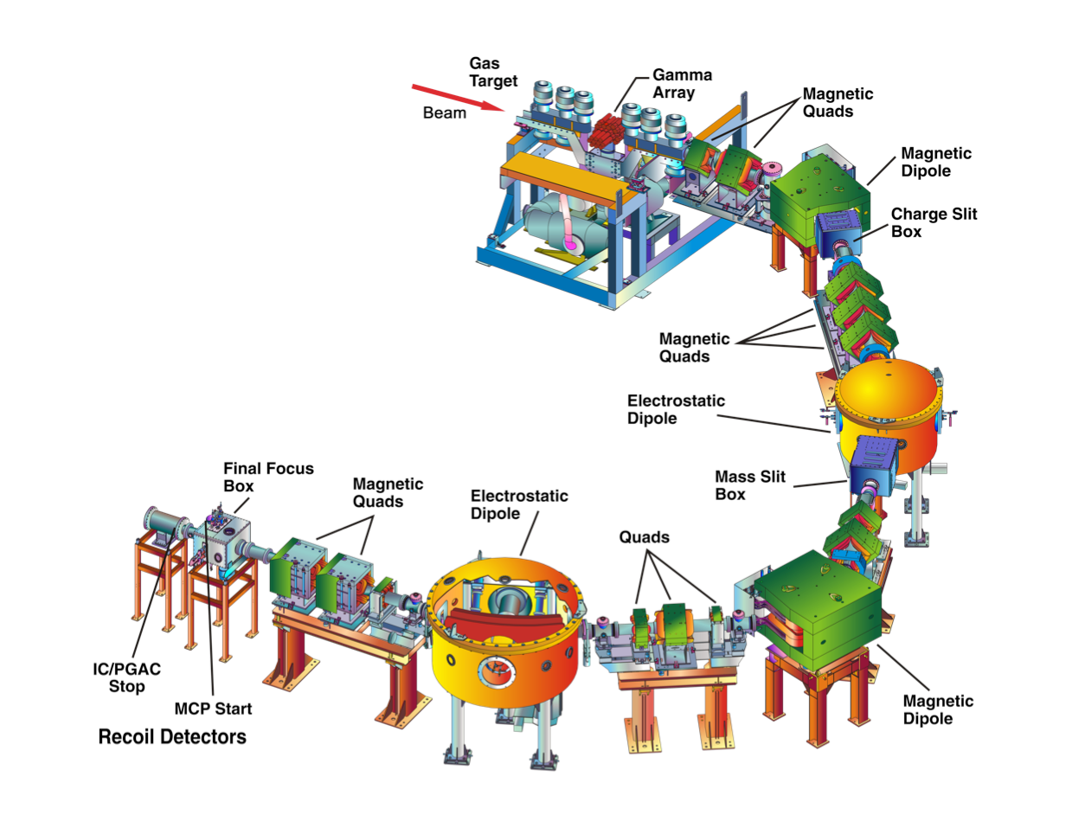



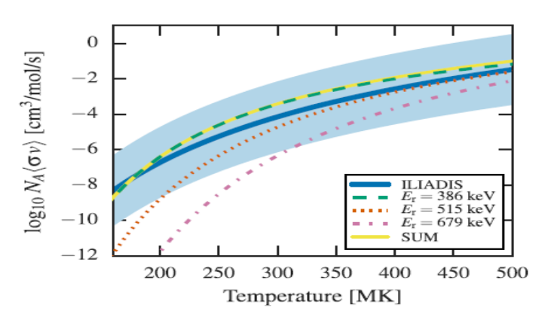

The ^{38g}K(p,γ)³⁹Ca reaction at DRAGON
Measurement at DRAGON recoil separator
using 2 x 10⁷ s^{-1 38g}K beam from ISAC
Uncertainty in Ar-K-Ca ejected abundances reduced by order of magnitude in model
Reproduce conditions as observed with satellite.
Local time of flight (ns)
Colorado School
of Mines
Time of flight through separator (μs)

Slide 18





ISAC experimental areas
High-energy RIBs
> 6 AMeV
TIGRESS + auxiliary detectors
EMMA
Mass analyzer for nuclear reactions
TUDA II
Scattering array
for direct reactions
IRIS
Solid hydrogen target for direct nuclear reactions

Slide 19





Direct measurement of ²¹Na(α,p)²⁴Mg at TUDA
Colorado School
of Mines
⁴⁴Ti/⁵⁶Ni distribution in Cas A, measured using NUSTAR
⁴⁴Ti production in core-collapse SNe
Affected by ²¹Na(α,p)²⁴Mg reaction in alpha-rich freeze-out
Measured with TUDA facility and ²¹Na beam
Energy (keV)

Slide 20



ARIEL: The future of isotopes at TRIUMF
The Advanced Rare IsotopE Laboratory will triple TRIUMF’s isotope beam capacity
  Uses state-of-the-art, made-in-Canada super-conducting electron linear accelerator technology; targets are designed to allow medical isotopes to be extracted alongside the experimental program
  Represents ~$100 million investment by federal and provincial governments; supported by 19 university partners from across Canada
  Project to occur in two phases:
    ARIEL-I completed in Fall 2014;
    ARIEL-II funded by Canada Foundation of Innovation, funding now secured.
  Will provide more and new isotopes

Slide 21


ARIEL Completion to Science
year
2019 | ISAC-CANREB-ISAC beams
2021 | ARIEL beam (Li-8)
2022 | ARIEL photo-fission beams to ISAC
2023 | ARIEL spallation beams to ISAC
ARIEL will provide excellent and new science opportunities.

Slide 22







ATLAS
LHC & ATLAS
    Searches for New Physics
    Higgs boson characterization
    Upgrades to high luminosity
    Computing support (Tier 1)
New Small Wheel
~10 m
Tier-1 computing center

Slide 23




T2K in Japan
Understanding neutrino oscillation and symmetries in the universe.
Recent progress this summer:
  Intensity upgrade from 400kW to 470kW
  Allows to double the neutrino mode statistics
HyperK/NuPRISM
  Future upgrades to investigate CP violation
  HyperK selected as a high priority large project by the Science Council of Japan
    Budget request lead by the president of University of Tokyo

Slide 24





ALPHA anti-matter experiment at CERN
Analysis by McKenna (PDF), Olin (Emeritus)
Cut based
Off-resonance
Trap ~14 anti-H per cycle
Inject laser for 600 sec:
  on-resonance, or
  off-resonance
If on-resonance, anti-H is destroyed
Observe annihilations with Si detector
On-resonance
MVA
Annihilation detection: key and unique feature
Anti-H losses vs axial position
Notes:
One of key analyses

Slide 25






Observation of 1s-2s transition in trapped anti-H
First laser spectroscopy on anti-H
1st demonstration:
  Precision already 2x10⁻¹⁰;
  Δf ~ 400 kHz
  Sensitive to antiproton internal structure at 20% level
Major Canadian contributions
  Cryostat with laser access
    RTI-funded; TRIUMF/Calgary
  Annihilation detection
    TRIUMF
  Magnetometry
    SFU/UBC
  Laser cooling development
    UBC/TRIUMF
  Operation & Run Coordination
M. Ahmadi et al., Nature 541 (2017)

Slide 26



Thank you!
Merci!
Follow us at TRIUMFLab

Slide 27



Isotopes for medical application: tumor treatment and imaging

Slide 28

Isotopes for medical application: tumor treatment and imaging
Alpha emitting isotopes: powerful way for direct tumor treatment

Slide 29






Isotopes for medical application: tumor treatment and imaging
Alpha emitting isotopes: powerful way for direct tumor treatment
Clustered DNA damage due to
‘heavy particle’ stopping power, short range.
²¹¹At particularly well suited for applications
Study surrogate functionality of ²⁰⁹At for imaging
²¹¹At is generated via
²¹¹Rn at ISAC and ARIEL via
protons and could be ‘exported’
across Canada.
First image with ISAC isotopes

