Slide 1


Data blinding for the nEDM experiment
(@ PSI)
Jochen Krempel
ETH Zürich
On behalf of the nedm@PSI collaboration

Slide 2
Outline
Why blinding
Why is blinding so difficult
How do we blind
Reblinding
Unblinding

Slide 3

Why blinding
Avoid psychological bias during data analysis
    Experimenter’s bias is defined as the unintended influence on a measurement towards prior results or theoretical expectations.
  Which cut to apply
    When to stop analysis/searching for bugs
    "We're more than one sigma from zero; we have to look at it some more, because we must be doing something wrong..."
Outside reputation
  some secrecy is necessary, simply trusting everybody is not enough.
  promise “to not look at result” very low threshold.
    can be overcome to quickly (accidentally, or for sneaking)
    The human brain is quick.
We do NOT protect against: Criminal energy, e.g. somebody installing spyware on DAQ computer
arXiv:physics/0312102v1
Blind Analysis in Particle Physics
Aaron Roodman
JR Klein A Roodman
BLIND ANALYSIS IN NUCLEAR AND PARTICLE PHYSICS
Annual Review of Nuclear and Particle Science 2005
Vol. 55: 141-163 DOI: 10.1146/annurev.nucl.55.090704.151521
Notes:
Mention 56 kinds of biases in medical research
We fix only one, and are scared to not introduce another one.

Slide 4
Blinding offset
The nEDM is
  a precision measurement
  with prior 0-value.
need an blinding offset
not blinding factor, neither fake events.
In other words:
nEDM measures value + uncertainty
  From that an upper limit is derived.
We blind the raw data by shifting the value
➔ Blinding offset

Slide 5
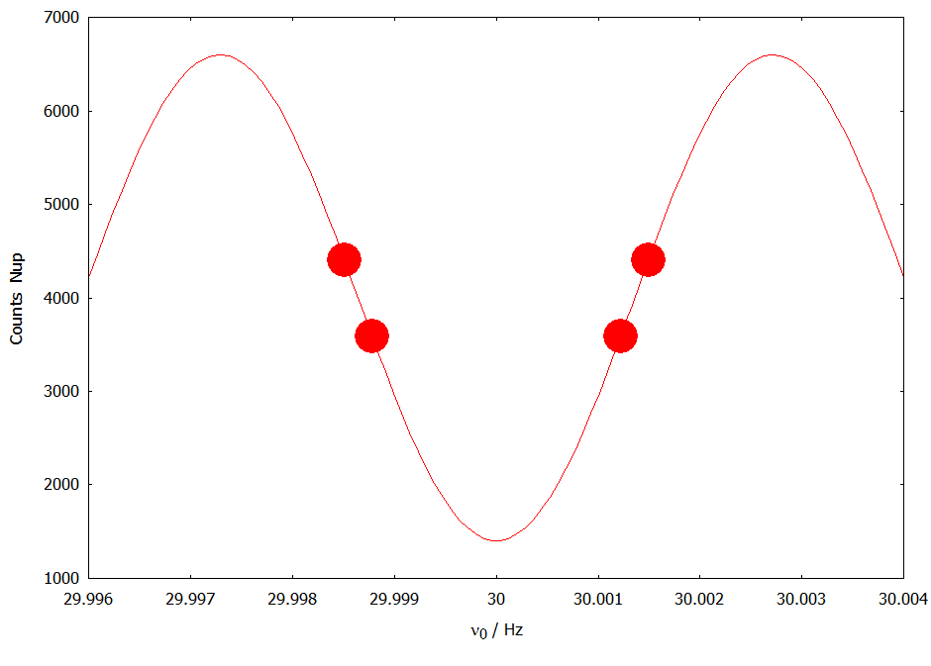
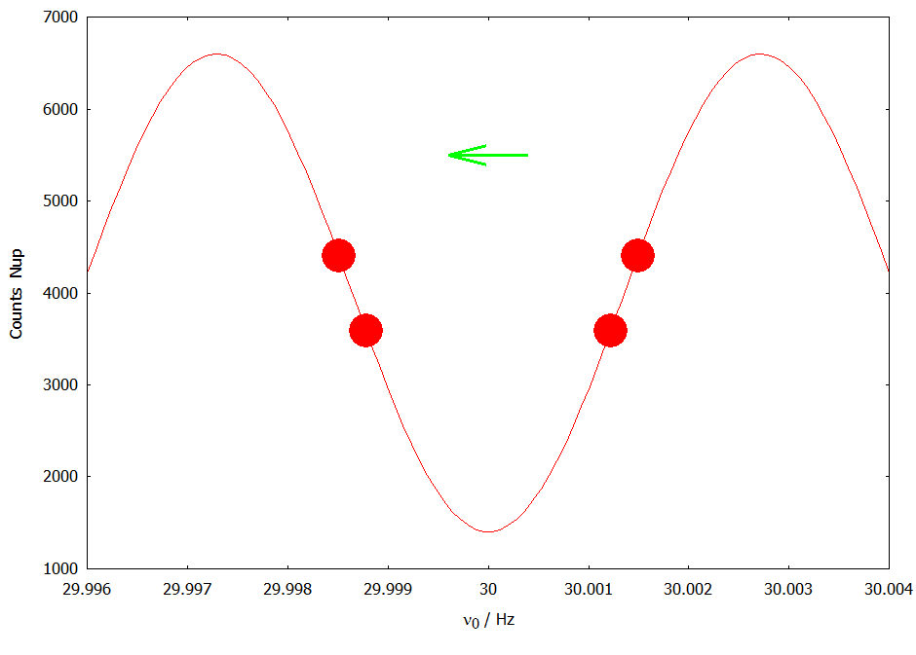
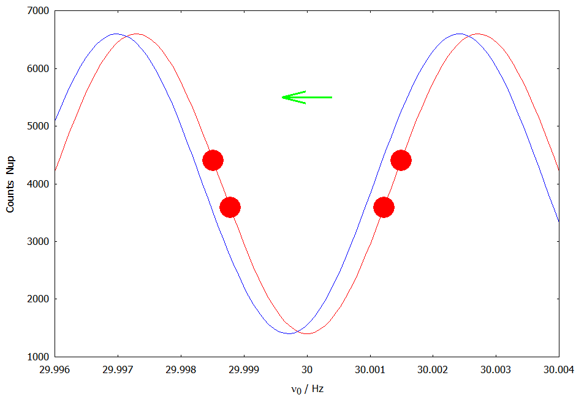
How do we blind?
ν_{i} /
Notes:
Shift neutron counts from one detector into the other
-> SpinDown becomes SpinUp (or vice versa)
Have to follow Ramsey curve
Have to know phase/frequency of spin flip
Have to know E-field
Have to know B0 direction, Detector config, spinFlipper 1 (per experiment)
problem with alpha and N average unknown before end of run

Slide 6
Various (not so good) options
Modify frequency of neutron spin flip
(synchronous to HV-polarity)
    blinding influences measurement (unknown systematic effects)
    impossible to remove or modify
Write down a false spin-flip frequency
    → Immediately visible in co-magnetometers
Modify reading of magnetometers (Hg, Cs)
  DAQ sampling clock
    → very delicate, and irreversible
  modify data
    Impossible to do consistently for Hg and Cs
    → immediately visible

Slide 7
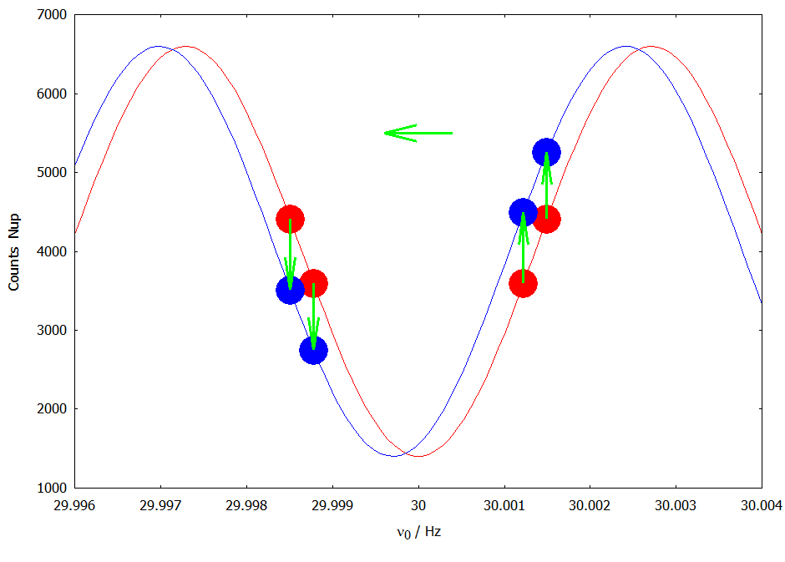
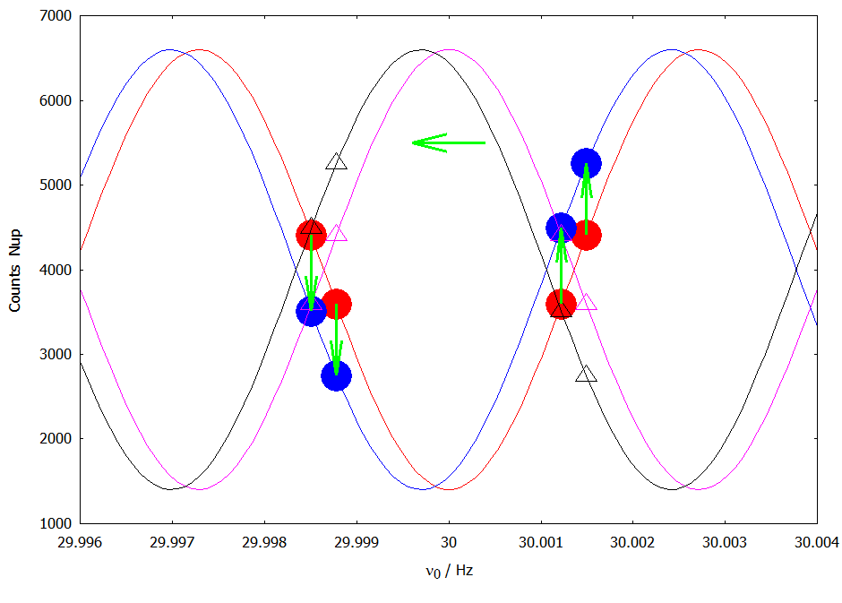
How we blind
ν_{i} /
Notes:
Shift neutron counts from one detector into the other
-> SpinDown becomes SpinUp (or vice versa)
Have to follow Ramsey curve
Have to know phase/frequency of spin flip
Have to know E-field
Have to know B0 direction, Detector config, spinFlipper 1 (per experiment)
problem with alpha and N average unknown before end of run

Slide 8

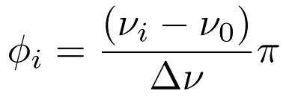
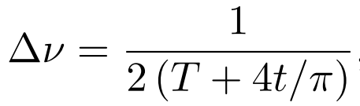

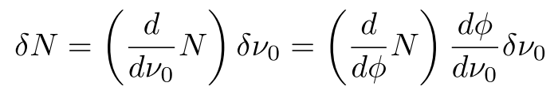
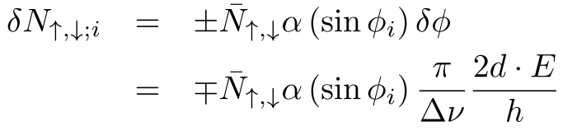



How many neutrons to shift
Δν
α
ν₀
$$\overline{N_{↑}}$$
ν_{i} /
Simplified model:
Actually the ordinate is Asymmetry,
the abscissa is corrected with Hg-reading
Notes:
Shift neutron counts from one detector into the other
-> SpinDown becomes SpinUp (or vice versa)
Have to follow Ramsey curve
Have to know phase/frequency of spin flip
Have to know E-field
Have to know B0 direction, Detector config, spinFlipper 1 (per experiment)
problem with alpha and N average unknown before end of run

Slide 9
How many neutrons to shift II
Design Values (from 2014):
$$\overline{N}=8000 α=0.65 \sin{φ}\text{=0.9}\text{9} \text{T}\text{=180}\text{s} \text{E}\text{=1}\text{0}\text{kV}\text{/}\text{cm}$$
$$δd={10}^{−25}e cm ⇒\left|δN_{↑,↓,i}\right|≈1.44$$
2016 max Values
$$\overline{N}=20000 α=0.75 \sin{φ}\text{=0.95 }\text{T}\text{=180}\text{s} \text{E}\text{=11}\text{kV}\text{/}\text{cm}$$
$$δd={10}^{−25}e cm ⇒\left|δN_{↑,↓,i}\right|≈4.95$$
Rounding to nearest integer
→ would limit granularity of blinding to multiples of 0.7 ∙ 10⁻²⁵ e cm
➔Add first a Gaussian Random Variable (width 2) and then round.
2 is large enough to linearly map between location and arithmetic mean
2 is small enough to not add too much noise << sqrt(N) = 90
Note well: we do NOT use a Poisson distribution
Notes:
mention Poisson

Slide 10
Blinding code
Do a Ramsey fit, using:
    Neutron counts (asymmetry)
    Frequency of spin flip
    Hg-frequency and uncertainty
    E-field
    Sign of:
      B0 direction
      Detector configuration (spin-flipper 2)
      Spin-flipper 1
  Obtain fit value of α (and ν₀) per run (≈1 day).
    This can be done only after the run has been completed!
For each cycle i calculate mean “number to be shifted”.
Initialise random generator; add Gaussian noise and round.
For each cycle i, select δN_{i} neutrons randomly.
  Change their detector flag.
    = convert them from up to down (or vice versa).

Slide 11
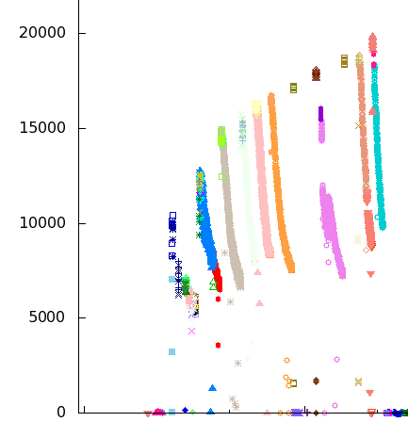
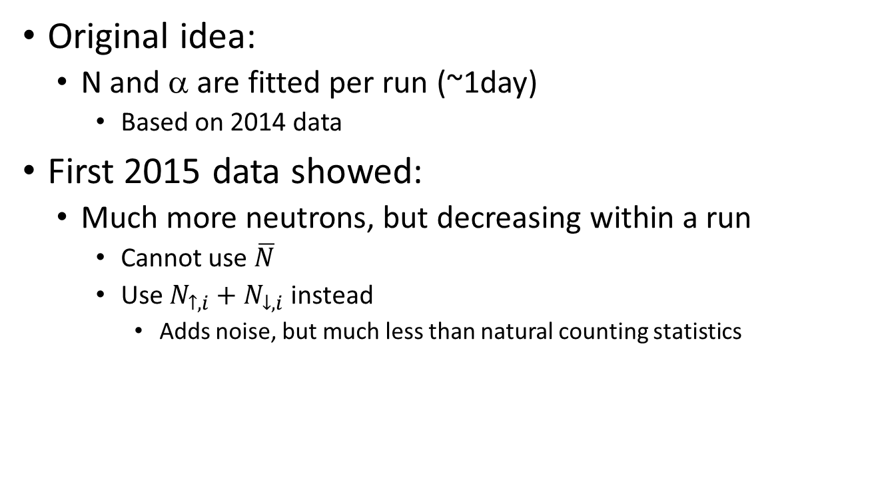
Something changed
Original idea:
  N and α are fitted per run (~1day)
    Based on 2014 data
First 2015 data showed:
  Much more neutrons, but decreasing within a run
    Cannot use $\overline{N}$
    Use $N_{↑,i}+N_{↓,i}$ instead
      Adds noise, but much less than natural counting statistics

Slide 12
Online blinding
Want Count numbers immediately for health check.
Blinding not yet available (missing α )
  → Online blinding
  with a separate offset – randomly chosen for each run
ν_{i} /
Online Ramsey-fit for gradient compensation done only at E=0, thus no blinding.

Slide 13
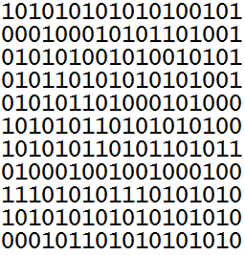
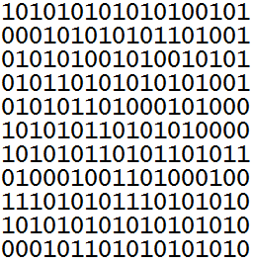
Re-blinding
if we ever find a bug in the blinding algorithm
→ we can re-blind
  previously blinded data stays public
    (but it is advised to not use them)
  additional data files (new blinding code) are published

Slide 14
Reblinding (how)
Reblinding uses the same (secret) offset
  (we can change if we want to, but we MUST keep the same sign)
Algorithm to chose UCNs for shifting (randomly):
the random number generator is initialized:
  freshly for each cycle.
  based on entropy only taken from this cycle.
→one cycle will have for various blindings always about the same n neutrons shifted.
works fine (does not reveal anything),
  but only if difference to previous blinding is not so large
  and for sure: no sign change!!!
quite some effort to develop this method
(especially to be sure to not have messed it up)

Slide 15
Secondary blinding / east-west
2 independent analysis groups (east, west)
Primary blinding on raw data (common)
Secondary blinding EAST on top of primary
same algorithm / different offset
Secondary blinding WEST on top of primary
same algorithm / another different offset
  raw data is kept secret
  primary data is kept secret
  eastern data published to eastern people (and not to western)
  western data published to western people (and not to eastern)
300 GB /year / blinding

Slide 16
Teething troubles
Cycles with 0 counts suddenly got negative counts (online blinding)
Decrease of neutron number during cycle
Non-edm use case required new exceptions

Slide 17
Positive side effect
There is now an EDM in the data.
→ Thus the sign and the magnitude becomes important.
➔ blinding helps to get your analysis correctly
(because bugs are visible)

Slide 18
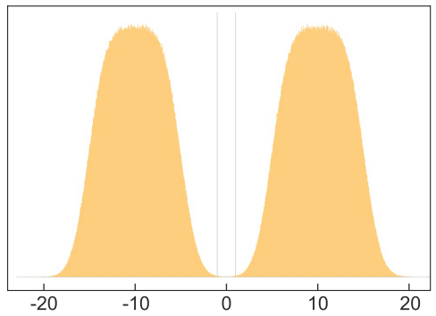
Who knows blinding offset
Graph by G. Bison
NO human
Blinding program needs to know it
Randomly generate offset, store it encrypted using a public key
private key is injected into blinding program during compile process
  Blinding offset is never written in clear text
  (nobody can accidentally read it)
  Blinding code can be modified at any time and recompiled
  one trustful person necessary to maintain the private key
Blinding offset / 10⁻²⁶ e cm

Slide 19
Timeline
January 17 2015: Formation of Blinding Task group
March: Concept
April - July:
  Implementation of dummy code
  Test on last years data
  implementation of real code
  tests with first UCNs, bug fixing
August: blinded data taking, but not secret, bug fixing
September 10 2015: change to new, secret blinding offset
Implement secondary blinding and re-blinding
February 2016: Release blinded data of 2015
Since then automatic blinding of most runs.

Slide 20
Performance (2015+2016)
1072 runs with data files from neutron detector
113 runs automatically blinded
14 runs needed manual blinding
20 runs needed manual revealing
Problems caused by:
  In 2015: mainly software problems (e.g. SpinFlipper state)
  In 2016: mainly heavy drifts of magnetic field.

Slide 21
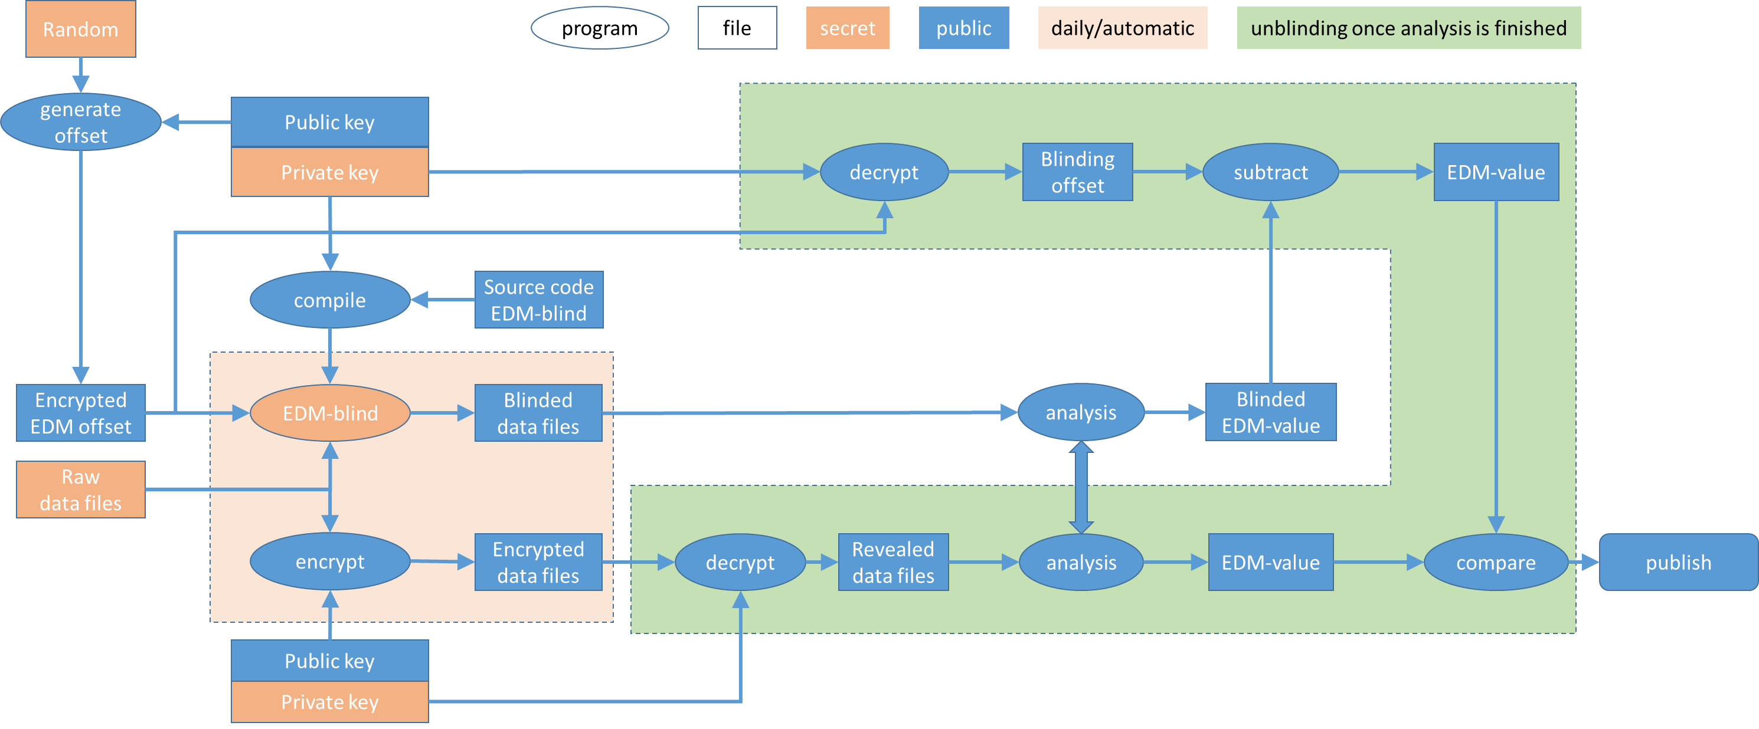
How to unblind

Slide 22
What to do before unblinding
Wait until
  analysis is close to statistical limit
  All systematics have been analysed
  The paper has been written
Define discrepancy limit

Slide 23
extending to n2EDM
double chamber, accurate Cesium sensors, Ramsey-sine
--> need new fit models
  Maybe add online gradient estimation
--> need some data for tuning threshold parameters
Extending to other experiments
Fine, as soon as they do have a simultaneous spin analyser.
³He as detector: needs a bit investigation how to shift counts.

Slide 24
Summary
successful blinding
  Blinding offset unknown to all humans
  Blinding secured by strong encryption + some enforcement rules
  unblinding still upcoming
can be used for 2nd phase
  blinding should be anticipated in early stage of DAQ-design
  final implementation only possible when knowing the performance of the apparatus

Slide 25
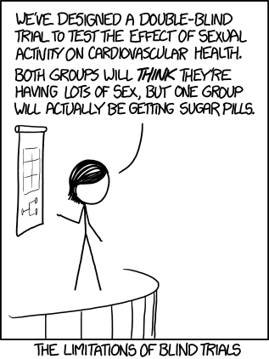
Thanks
http://xkcd.com/1462/
Phil Harris (U Sussex)
  Concept / maths / pushing people
Yoann Kermaidic (LPSC Grenoble)
  code Ramsey fitting / testing
Jacek Zemja (JU Krakow)
  code main DAQ
Nick Ayres (U Sussex)
  maths
Elise Wursten (KU Leuven)
  analysis / testing
Thomas Lefort, Jean Hommet, Yves Lemiere (LPC Caen)
  code neutron shifting
JK (ETH Zürich)
  concept / design / code review / code merging / testing

Slide 26
Backup Slides

Slide 27
Unblinding with 2 analysis groups
Not decided yet
Possible Option:
  As soon as both analysis group get below the same error
  (and close to irreducible statistical uncertainty)
  ➔ unblind secondary blinding
    Run analysis code on unblinded data,
    compare to blinding offset
  ➔ if happy (predefined Boolean expression), unblind primary blinding
Final result will be analysis code on raw data,
  But hopefully in agreement with analysis on
  blinded data minus blinding offset
Blinding on Toy-data

Slide 28

Secrecy of data files
Raw data (secret) + blinded data (public)
Backup scheme:
Encrypt secret data with RSA (asymmetric)
  Use public key for encryption
  Private key is kept in sealed envelope
Do not trust encryption
  -> keep additional copy (NOT encrypted) at hidden place
Slow control
Intern PSI
PSI -AFS
France
Main DAQ
PSI tape
Neutron
GRID Poland

Slide 29
BACKUP Secrecy for data files
Step 0) Get their public key
  openssl rsa -in id_rsa -pubout -outform pem > id_rsa.pub.pem
Step 1) Generate a 256 bit (32 byte) random key
  openssl rand -base64 32 > key.bin
Step 2) Encrypt the key (asymmetrically)
  openssl rsautl -encrypt -inkey id_rsa.pub.pem -pubin -in key.bin -out key.bin.enc
Step 3) Actually Encrypt our large file (symmetrically)
  openssl enc -aes-256-cbc -salt -in SECRET_FILE -out SECRET_FILE.enc -pass file:./key.bin
Step 4) Put key.bin.enc and SECRET_FILE.enc to Archive
Decryption (in 2 years)
  openssl rsautl -decrypt -inkey id_rsa.pem -in key.bin.enc -out key.bin
  openssl enc -d -aes-256-cbc -in SECRET_FILE.enc -out SECRET_FILE -pass file:./key.bin

Slide 30
BACKUP RSA algorithm
https://de.wikipedia.org/wiki/RSA-Kryptosystem
Calculate private key
  Chose 2 large prime numbers p = 11 and q = 13
  RSA-Modulus is N = p * q = 143
  Euler's totient function phi(N) = phi(143) = (p-1)(q-1) = 120
  Chose e coprime to 120. We chose e = 23.
  e = 23 and N = 143 are the public key.
Calculate public key (Inverse of e):
  e * d + k * phi(N) = 1 = ggT(e,phi(N)) (Greates Common Divisor)
  23 * d + k * 120 = 1 = ggT(23,120).
    Extended Euclidean algorithm → d=47 and k=-9
  23 * 47 + (-9 )* 120 = 1
  d=47 is the secret key, k can be disposed
encryption m=7 with public key (e,N) (m < N)
  c = m ^ e mod N
  7 ^ 23 mod 143 = 2
decrypt
  m = c ^ d mod N
  2 ^ 47 mod 143 = 7

Slide 31
Why blinding II
Extreme Example:
Imagine you unblind your data
and get: 6.0 e-26 e cm +- 1e-26 e cm
6 sigma from zero = clear discovery
2 sigma from previous measurements.
What do you do?
➔ Publish
If you re-analyse before publishing,
then you MUST mention the original result additionally.
Notes:
Mention 56 kinds of biases in medical research
We fix only one, and are scared to not introduce another one.

