Slide 1
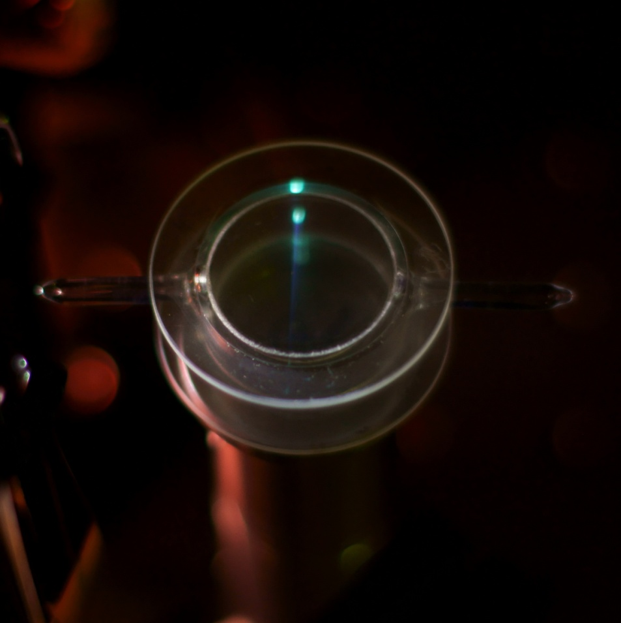
¹⁹⁹Hg EDM Measurement
Brent Graner
University of Washington
October 16, 2017

Slide 2
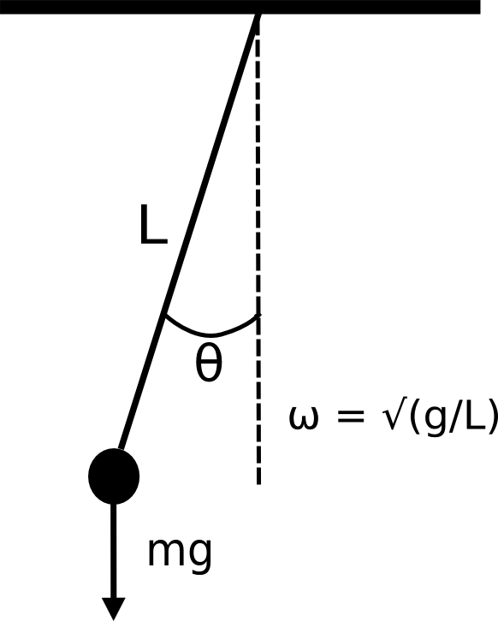
A time-reversal-sensitive atomic clock
Traditional clocks consist of an oscillator and escapement (i.e. counter)
More precise clocks are made by:
1) Using oscillators with more well-defined frequency (atoms vs. pendulum)
2) Isolating the oscillator from external disturbances
3) Using a reference oscillator checked for phase deviation from the primary oscillator (Ramsey Method)
Notes:
Before I start talking about EDM physics and the EDM experiment, I’d like to invite you all to think of a successful atomic EDM experiment as an atomic clock that is sensitive to the direction of time. As an atomic physics person, I think the analogy really highlights the way in which our experiment makes use of the methods of atomic clock makers, who have been enormously successful in developing ultra-precise time standards based on atomic transitions.
A typical clock is just some regular oscillator, like a pendulum coupled to some mechanism for counting up the number of periods that have elapsed. Because the clock only counts in the forward direction, a global time reversal can’t be observed unless it somehow changes the clock frequency. And in the case of a pendulum, the clock frequency doesn’t change because there is nothing in the physics of gravity that is sensitive to a time reversal. We want to know whether there is some part of the physics of the atomic nucleus that is.
To extend the clock analogy just a little bit further, we can think about some of the ways to make a better clock. First, you can base your clock on an oscillator with a well-defined central frequency, such as a quartz resonator or an atomic transition instead of a simple pendulum. Second, you can isolate the clock from disturbances; mount it on bearings, put it in a vacuum, or use ultracold atoms suspended in a laser beam. Third, you can avoid perturbing the clock by measuring it only briefly at spaced out intervals, checking it against some reference oscillator and making corrections to the phase as needed.

Slide 3

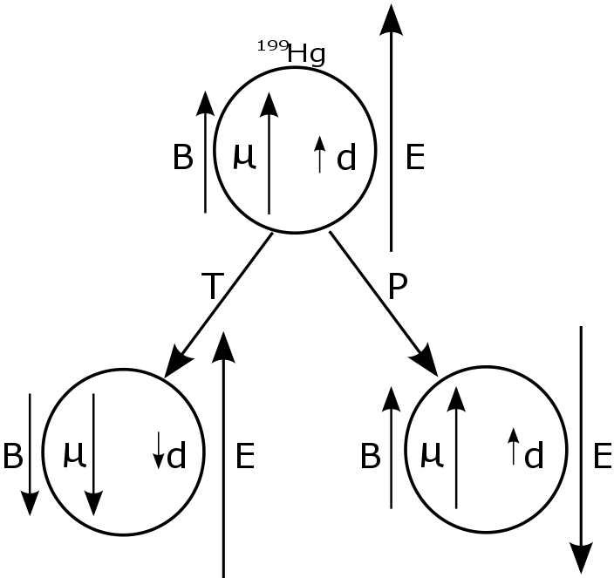
T and CP Symmetry Breaking
EDM represents charge separation
Units of e*cm
EDM must point along (nuclear) spin axis
Transforms like angular momentum (P-even, T-odd)
Breaks time-reversal (T) symmetry of the Hamiltonian
CPT conservation follows from Lorentz invariance
T violation is equivalent to CP violation
Notes:
The existence of an EDM in an atom or particle is interesting because it would violate discrete symmetries. An electric dipole moment is defined by a separation of charge along a particular axis. In the case of an atomic nucleus, that axis is the nuclear spin axis, because this is the only vector quantity that characterizes the system. There is one counterintuitive aspect of an atomic EDM, though, which is the fact that it behaves like an angular momentum vector under parity or time reversal. If the atom is in parallel electric and magnetic fields, the Hamiltonian is just these two dipole interactions. The EDM transforms the same way as the spin and the B field under time reversal or parity, and the electric field behaves in the opposite way. What this means is that changing the electric field direction relative to the magnetic field is physically equivalent to a parity transformation or a time reversal. If there is an EDM, either transformation will change the energy of the state, so the symmetry of the Hamiltonian is broken. Lastly, the time reversal is equivalent to a CP transformation due to the CPT theorem, which uses Lorentz invariance to show that CPT is a valid symmetry for all local quantum field theories.

Slide 4
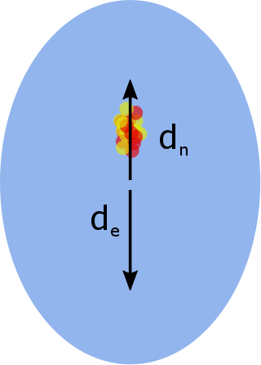
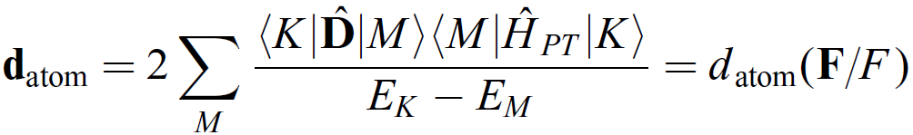
Atomic vs. Neutron EDMs
Schiff's Theorem: An EDM of a point-like nucleus would be perfectly screened by non-relativistic electrons interacting electrostatically
The EDM of an atomic system is due to the operator product of the EDMs of constituent particles and a P-odd, T-odd n-n or e-n interaction:
This P-even, T-odd “EDM” has a P,T-odd dipole interaction with electric field E
Notes:
Before I get into talking about our experiment, I want to go over a little bit of the nuclear and atomic physics that distinguishes EDM searches in diamagnetic atoms from neutron EDM experiments, so it’s clear exactly what we’re measuring. Given that mercury has no unpaired electrons in the outer subshell, we are primarily sensitive to an EDM generated by CP-violation in the nucleus. However, an EDM of the nucleus doesn’t imply an atomic EDM, since the electron cloud can be deformed to acquire an EDM which is equal and opposite to the nuclear EDM. Mathematically, this argument is known as Schiff’s theorem, which states that a point-like nuclear EDM is screened perfectly if the electrons are non-relativistic, and there are only electrostatic interactions involved.
So we need to take a more roundabout way to come up with an observable EDM in a neutral atom. We can end up with a nonzero atomic EDM if there is a net EDM to the constituent particles as well as a parity and time-reversal odd piece of the Hamiltonian. Taking the product of a polar vector EDM and a P-odd, T-odd operator gives us a pseudovector quantity that transforms like the angular momentum.

Slide 5
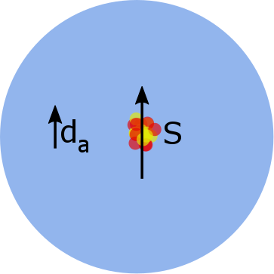

The Schiff Moment
Schiff's Theorem has 3 assumptions:
1) Point-like nucleus
2) Non-relativistic electrons
3) Electrostatic interactions
The Schiff moment S is the dominant P, T-odd nuclear moment (e fm³):
S goes to 0 in the limit of a point nucleus
Heavier nuclei give larger S values, larger atomic EDM/nuclear EDM ratios
Notes:
Looking at Schiff’s theorem again, you can see that there are three assumptions that it relies on: a nucleus with zero volume, electrons that move non-relativistically, and purely electric interactions. All of these assumptions are violated at some level, but for diamagnetic atoms, the first one is the most important. The leading-order nuclear moment that violates parity and time-reversal symmetry is known as the Schiff moment, and it takes the form of an integral over the nuclear volume. So the Schiff moment vanishes for a point nucleus as well as the EDM, and conversely, the Schiff moment and EDM increase with the nuclear volume, so it’s advantageous to look in heavy elements such as mercury, radium, and xenon.

Slide 6
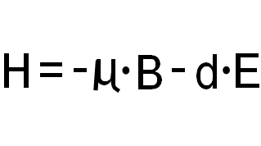
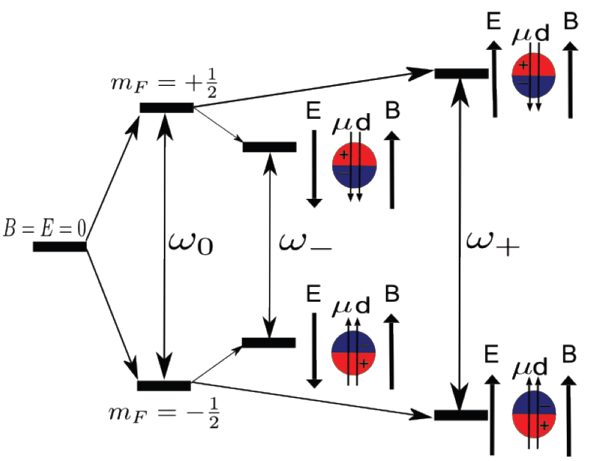
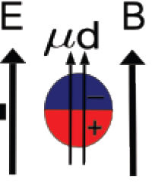
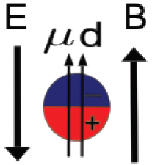
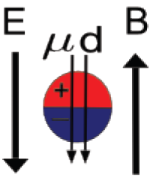
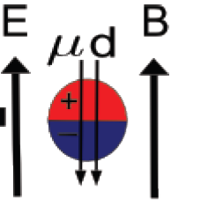
Measurement principle: Larmor frequency observation
Measurement is done on the ground state (¹S₀) hyperfine manifold with |F|=1/2
d_{atom} must always be parallel to μ
The 2 energy levels will shift farther apart or closer together when E is applied
For B = 15mG, E = 10kV/cm, we get Δω/ω < 10⁻¹⁰
This gives ΔE < 3.1*10⁻²⁵ eV!
Level diagram of ¹⁹⁹Hg ground state with parallel μ and d_{atom} in parallel, antiparallel E and B fields
Notes:
So now that we know what we’re looking for and why it’s interesting, we can see the basic measurement technique is actually really simple. The term in the Hamiltonian that violates P and T is the dot product of d and E, and any nonzero d will cause a shift in the energy levels that is linear in the electric field. The other term is just a magnetic dipole interaction, which is the basis of any Larmor precession experiment. So all we’re really doing here is splitting the ground state F=1/2 sublevels with a magnetic field and doing a slightly modified Larmor precession frequency measurement. When you do the experiment on a nice 2-level system like the Hg 199 nucleus, the physics is really simple-you split the 2 degenerate states with a magnetic field for some unperturbed frequency and then try to change that frequency with a parallel electric field.
The only hard part is the size of the effect-for the field strengths we use, the Larmor frequency is modified by less than 100 parts per trillion. So on top of an average frequency of about 17 Hz, we’re looking for a frequency shift on the order on nanohertz, and this gives us an associated energy shift of 10 to the -25 eV, which I claim makes it the most precise energy splitting measurement that’s ever been made.

Slide 7
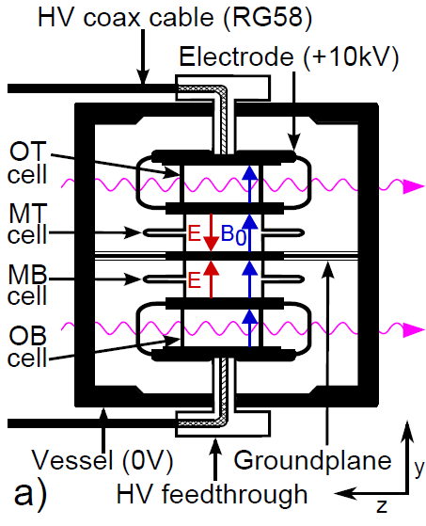
Measurement Technique
Atoms are contained in a stack of 4 vapor cells in a common B field
2 conducting plastic electrodes at the same potential hold the 2 outer cells
Opposite E field causes an EDM to shift the relative frequency of the 2 inner cells
¹⁹⁹Hg is pumped to align spins with laser beams
Precession is observed by detecting Faraday rotation of weak, linear polarized light
Notes:
So now we know what the experiment looks like in principle, here is what it looks like in practice. The experiment is built around a box with four Mercury 199 vapor cells arranged in a stack, with a fused-silica plate in the middle that defines the ground. The outer two cells are inside of electrodes made out of the same graphite-impregnated polyethylene that’s used to make the box, so they’re surrounded by an equipotential surface and don’t see any electric field—they’re just used as magnetometers. The electrodes are at the same potential relative to the groundplane in between them, so the electric field points towards or away from the groundplane in the center. The experiment is built to detect the change in the Larmor frequency of the two inner cells which couples to the applied electric field.

Slide 8
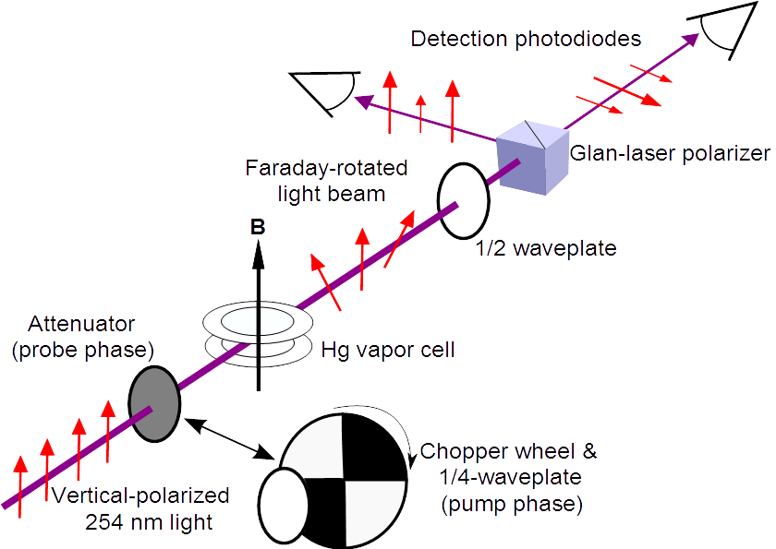
Faraday Rotation Detection
Atomic polarization changes the index of refraction for σ₊ and σ₋ light
Incoming linearly polarized probe light is rotated
Rotation angle oscillates at the Larmor frequency
A polarizing beam splitter separates the beam into
vertical, horizontal components
Intensity of 2 orthogonal polarization states oscillate
out of phase
Notes:
The mercury atoms are optically pumped with circularly-polarized UV, which polarizes the spins along the axis of propagation. This takes about 30 seconds for each run, so the pump beams are chopped at the average Larmor frequency so that atoms aren’t de-polarized as they precess around B. After that, a pneumatic arm automatically removes the chopper wheel and half-waveplate and replaces it with an attenuator. The laser wavelength is also moved 10 GHz to the blue, so we are probing with weak, off-resonant, linearly polarized light. Each beam coming out of the cells passes through a ½ waveplate at 45 degrees to the polarization axis, followed by a polarizing beam splitter to look at the sigma-plus and sigma-minus intensity. The difference of the 2 photodiode signals forms a decaying sine wave proportional to the optical rotation angle and the dot product of the atomic magnetization and the light propagation vector.

Slide 9
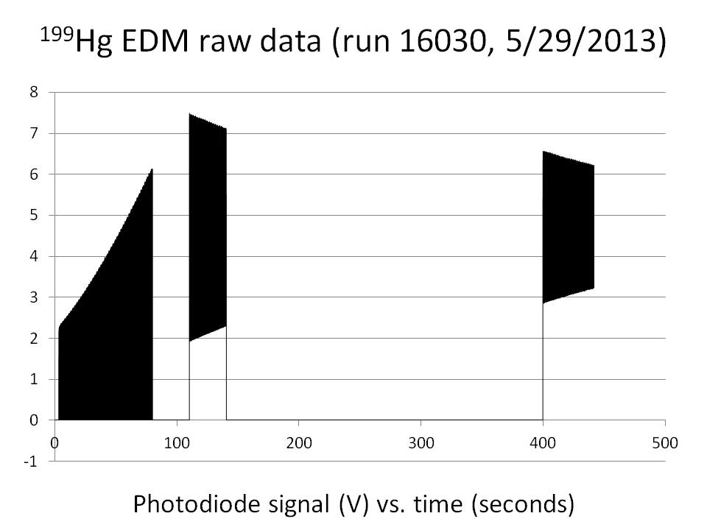
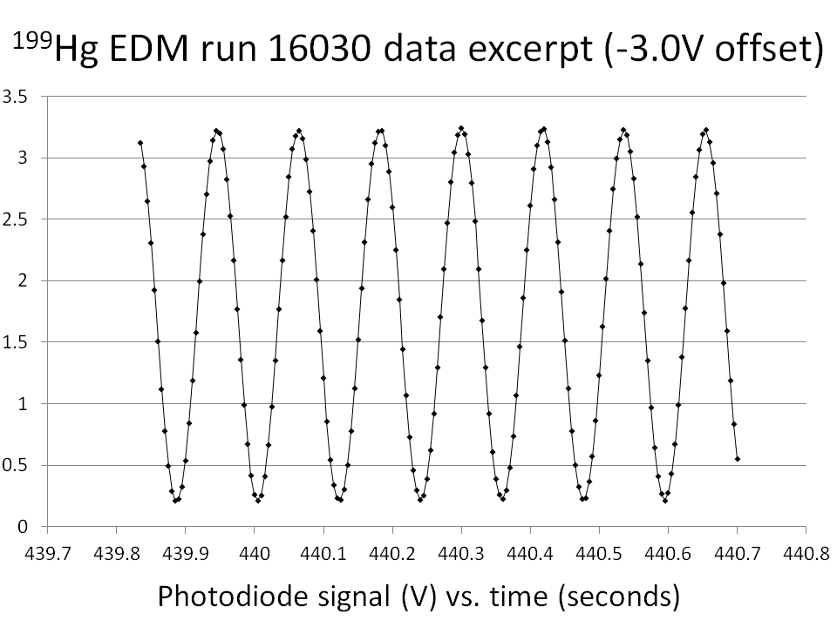
Phase Difference Analysis
Instead of fitting a single long sample for ω, we can apply the Ramsey method: fit 2 samples for Δφ with light off in between for time Δt
Freq. difference (ω_{MT} - ω_{MB}) = Δ φ_{MT-MB}(t_{f}) – Δφ_{MT-MB}(t_{i})
d_{Hg} signal = Δ_{HV}[(ω_{MT} - ω_{MB}) - 1/3(ω_{OT} - ω_{OB})]
Notes:
The chart on the top left shows you what the signal from one photodiode for a typical pump-probe cycle looks like: the pump period is followed by two probe periods with the light blocked in between. The individual Larmor oscillations are too fast to see on the left chart, but you can see the exponential decay envelope. The chart on the right shows the last second of the data train on the left, so you can see what the Larmor precession signal looks like.
To extract an EDM signal, we want to measure the part of the frequency difference between cells that correlates with the electric field difference. Because it’s a strictly relative measurement, there is no need to measure the average precession frequency of the individual cells-instead, we can extract the frequency difference from the accumulated phase difference divided by the dark time. The new data taking method is similar to using the Ramsey method, except that the cells are referenced to each other rather than an external oscillator.
Once we have the precession frequency difference for each of the six cell pairs, we take the difference between the difference in precession frequencies of the inner cells and the difference in frequencies of the outer cells (with no E field), and define our EDM signal as the correlation between the frequency combination and the high voltage.

Slide 10
Digital Phase Analysis
For each pair of cells, we measure Δω from Δφ_{initial} and Δφ_{final}
For cell a or b, our signal is proportional to S_{a,b}(t) = sin(tω ± tΔω + φ ± Δφ)
It can be shown that if ωΔt = π/2, then
S₁(t) * (½)[S₂(t + Δt) – S₂(t - Δt)] – S₂(t) * (½)[S₁(t + Δt) – S₁(t - Δt)]
= sin(2tΔω + 2Δφ) ≈ 2tΔω + 2Δφ
The data can then be fit to a straight line
We tune our precession frequency ω₀ to match the condition ωΔt = π/2 for our analog-to-digital conversion rate (2 kHz, 10 points averaged, Δt = 5 ms)
Δφ_{initial} is measured at the end of the first probe period, Δφ_{final} is measured at the beginning of the second probe period
Notes:
This slide shows the details of how we actually extract the phase difference between a pair of cells. We take the difference of the two photodiode readings over the sum to be the signal for each cell, which should work out to be a sine wave multiplied by a decaying exponential. Then we phase shift the cell signals by pi/2 by taking the sixth sample forwards or backwards in the data train, where the Larmor frequency has been tuned using the magnetic field such that there are 24 points in the data stream for each Larmor precession period. Once each cell signal can be shifted by pi/2, we can do some simple trigonometry to get a signal at the difference frequency of two cells, which should correspond to a straight line if the magnetic field gradients are small enough. The initial phase difference between the cells will be a constant offset, and we can fit each difference signal to a straight line by least-squares, then extract the final phase difference for the first probe period and the initial phase difference between the cells for the last probe period, and get the frequency difference in between from the difference of phase differences divided by the dark time.

Slide 11
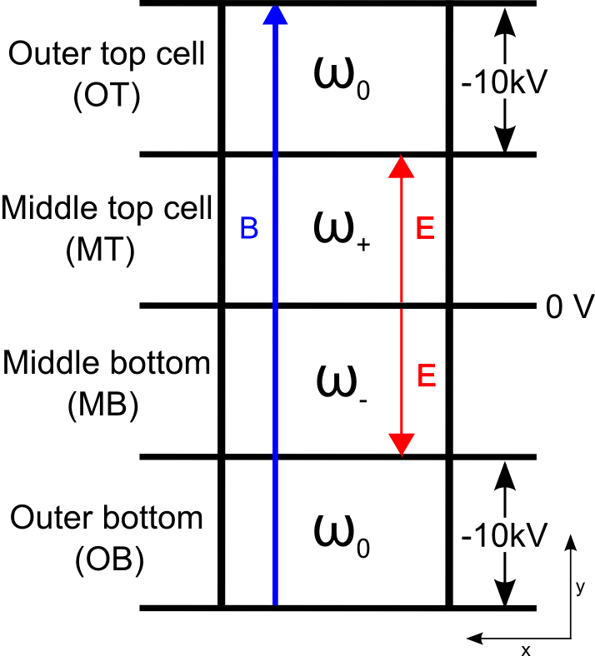
B Gradient Noise Reduction
With our 4-cell setup, outer 2 cells are used as magnetometers
EDM signal is equivalent to a 3rd-order B_{y} field gradient correlated with E:
d_{atom}= Δ_{HV}[(ω_{MT} - ω_{MB}) - 1/3(ω_{OT} - ω_{OB})]
In principle, this should cut down B field gradient noise
In practice, outer cells are more useful for looking at potential systematics
Blind offset is applied to EDM-sensitive channels
Notes:
One of the biggest advantages of mercury relative to other EDM experiments is that we don’t bother making any absolute measurements-every precession frequency measurement is referenced to something else. We actually have the only experiment that can record both perturbed frequencies at the same time, and the unperturbed frequency omega naught as well. In practice, this enables us to cut down substantially on noise generated by the magnetic field gradients with the 4-cell EDM signal. This combination takes out linear and quadratic gradients as well as changes in the average magnetic field.
Comparing multiple cell frequency differences at once also makes it easy to apply a blind offset to our data, by generating a small random number and adding it to the frequency differences that include the middle cells. The 4-cell setup enables us to look of pathological runs by checking the outer cell difference, and the blind offset enables us to cut runs without biasing the result.

Slide 12
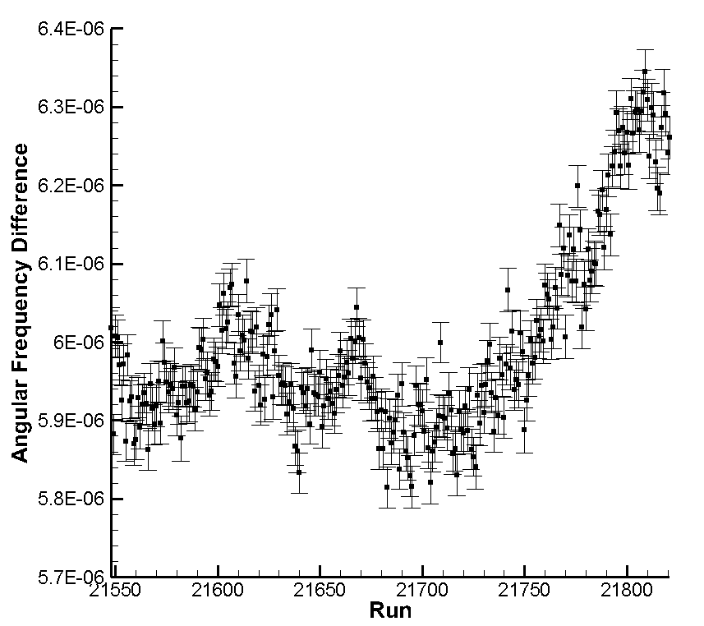
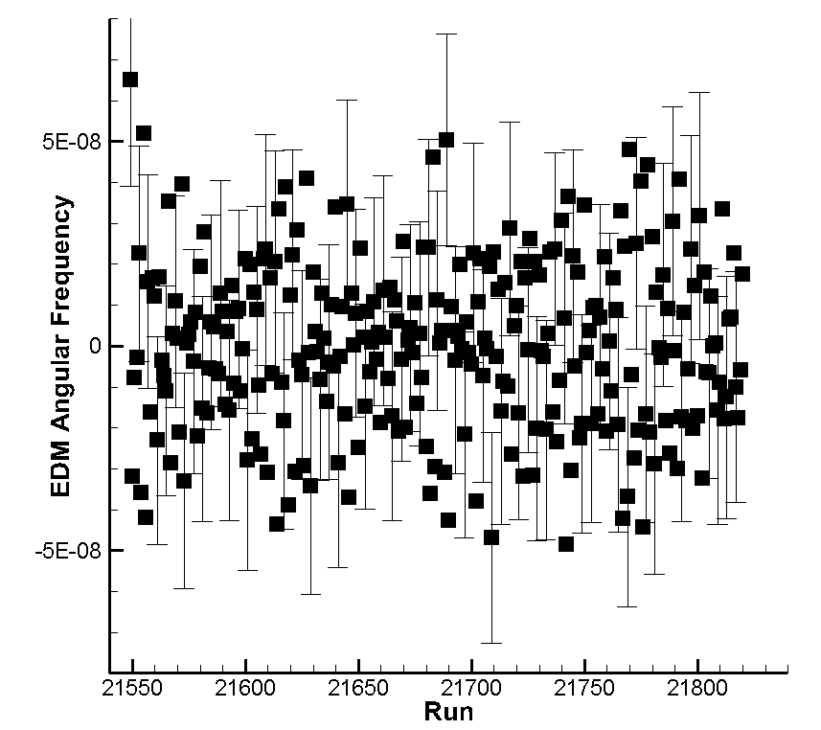
HV Correlation Analysis
Raw frequency difference measurements are dominated by low-frequency noise on B-field gradient
Take the HV-correlated signal: (-1)^{i} {(1/2)(Δω_{i-1} + Δω_{i+1}) – Δω_{i}}
Resulting signal is insensitive to slow drifts in the 3rd-order B_{y} gradient

Slide 13
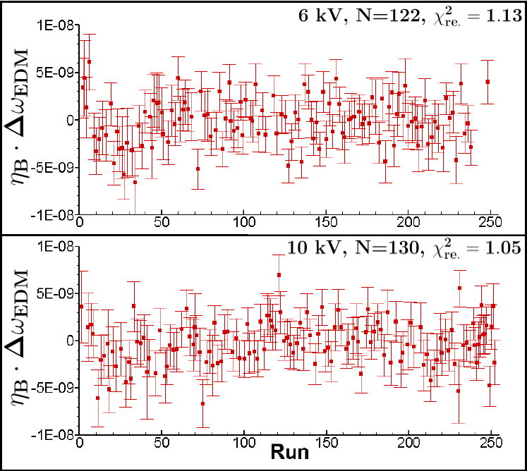
Statistical Performance
2009 EDM paper had statistical sensitivity of
6.43 *10⁻¹⁰ s⁻¹
New data set has an avg. daily error bar 2.0 *10⁻⁹ s⁻¹
252 runs remain after cuts
New EDM data set has a stat. error of 1.45 *10⁻¹⁰ s⁻¹
Notes:
It’s not shown in this plot, but the data set is divided into 14 sequences that have about 16 daily runs each, and between sequences we opened up the experiment and swapped cells around the various positions so we aren’t measuring an effect that’s unique to a particular cell in a particular place.
We took about 350 runs in total, and 252 made it into the final dataset. All the data were analyzed with a blind offset, so that we can make cuts without biasing the result. The blind offset scales with the voltage setting, and we randomized the offset value in software after each sequence so we didn’t start herding the data, making it more self-consistent artificially by throwing out runs on the fly. Then all the data was combined on a single offset value and the final cuts were made.
The cut data runs will actually turn out to be fairly important, which I’ll come back to after I go over a bit about the systematics.

Slide 14
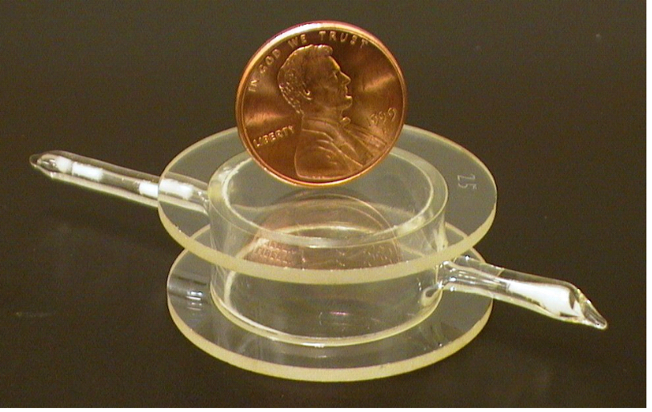
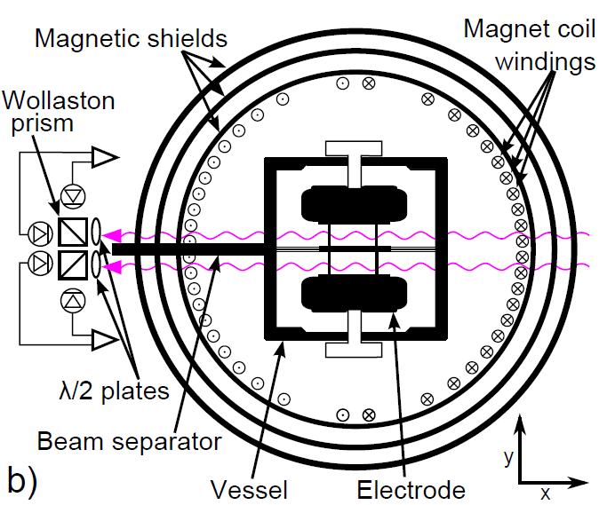
Performance Improvements
New generation of vapor cells have coherence lifetimes of 500-1000s (up from 100-200s)
New cells do not lose coherence time with UV exposure
New data analysis technique eliminates frequency shifts, relaxation due to probe light
New magnet coil allows for better trimming of B-field gradients, less eddy-current magnetic noise

Slide 15
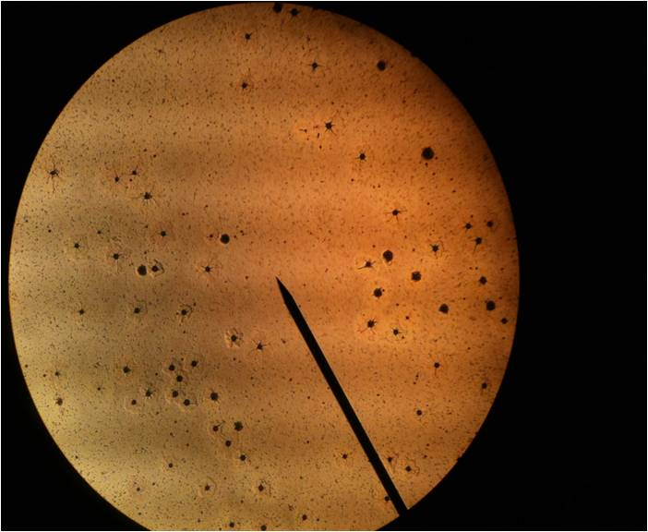
Vapor Cell Development
UV curing epoxy contains sulfur, can outgas and react with Hg
New cells are bonded with Lesker KL-5 vacuum leak sealant
Droplets of Hg can be found on waxed inner cell surfaces
Liquid Hg in droplets or films exchanges unpolarized atoms with polarized vapor
Resonant UV light promotes nucleation in saturated Hg vapor
Notes:
Before I go on to talk about the systematics I want to digress one more time and mention some of the things we’ve learned about the mercury vapor cells.

Slide 16
Systematic Performance
Source | Error (10⁻³¹ e cm)
Axial Cell Motion | 12.6
Leakage Currents | 5.02
Radial Cell Motion | 3.36
E² effects | 3.04
Parameter Correlations | 2.33
v x E B fields | 2.29
Charging Currents | 1.83
Geometric Phase | 0.06
Quadrature sum | 14.8

Slide 17
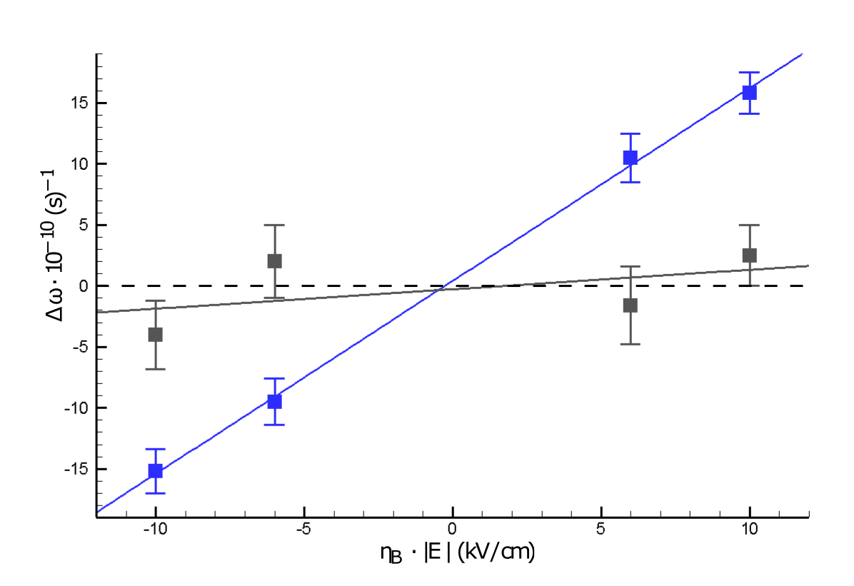


EDM Field Dependence
A substantial nonzero EDM signal would be linear, with no outer cell HV correlation
Notes:
The data set is divided into runs at 2 different voltages and 2 different magnetic field directions, which helps us look for systematic effects and subtract any frequency shifts that don’t behave like a real EDM. This plot represents an idealized EDM signal; if you plot the magnitude of the HV times the B field direction on the horizontal, and the frequency shifts on the vertical, and EDM would be a straight line through the origin with a well-resolved nonzero slope, together with an outer cell signal that is independent of the field.

Slide 18
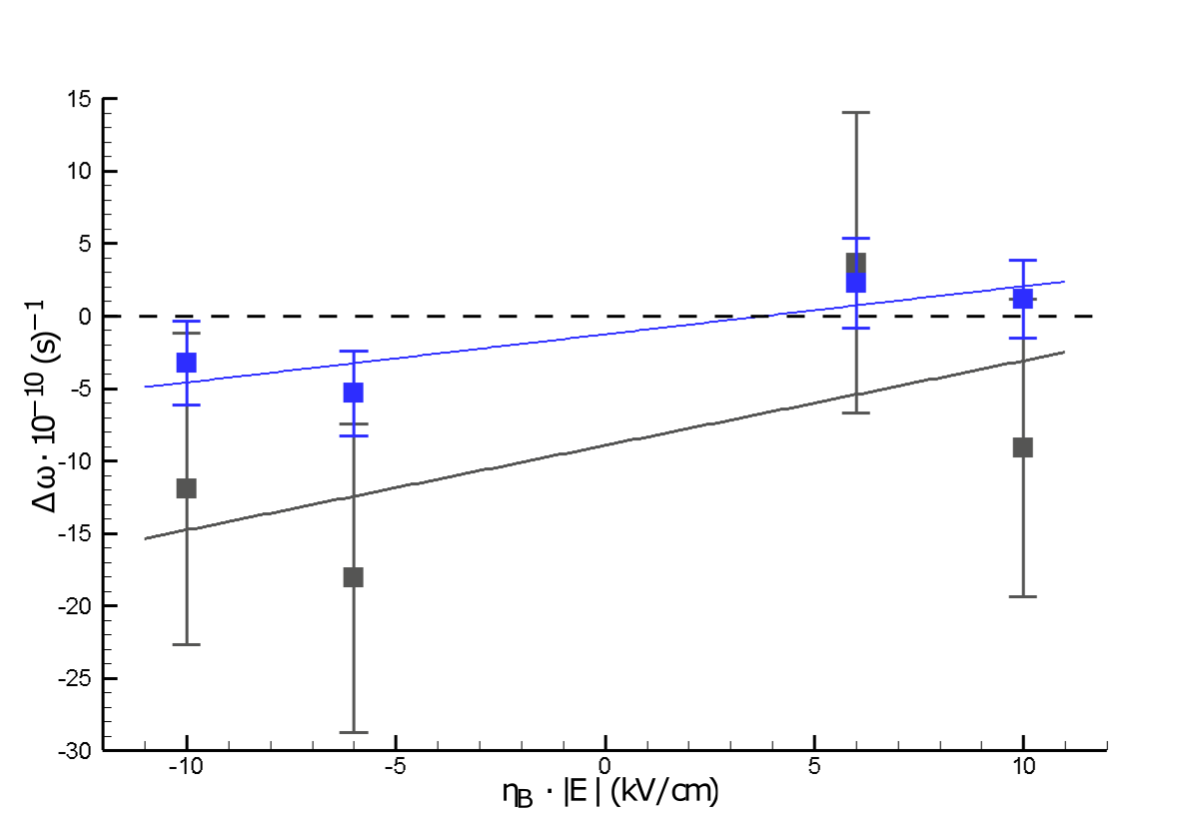
Systematics: Cell Motion
Latest EDM data has a HV-correlated outer cell difference
Errors and field dependence suggest this is driven by linear gradients
Notes:
This is what we actually see when we plot the measured frequency differences versus the E field strength and B field direction. The outer cell difference may have some voltage dependence, but there is much more distinct evidence of HV-correlated shifts that are nearly constant across the field values.
At first blush, this looks pretty bad, because remember these signals are not linearly independent. The outer cell difference is a direct input to the 4-cell EDM signal, so anything that changes the outer cell difference is a potential systematic.
The exception to this is linear field gradients, which the two-cell signals will show but which cancel on the 4-cell signal. If the cells are moving in a field gradient, we can explain this behavior and constrain the effect on the 4-cell signal.
I should also point out that the blind offset had not been removed when we started looking at this behavior, so there was no telling that the EDM result was going to be small.

Slide 19
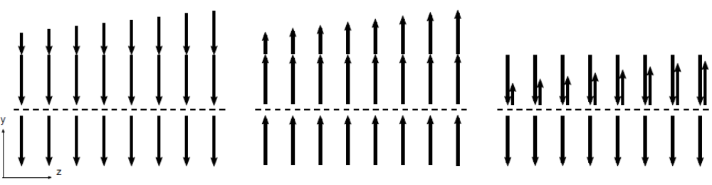

Systematics: Cell Motion
Reversing B gradient
Fixed B gradient
MT
MB
HV-correlated cell motion through B gradients generates frequency shifts
Gradients that reverse with B₀ will give a fixed freq. shift
Fixed gradients give a reversible freq. shift-mimics EDM behavior
Gradients perpendicular to the shield axis reverse to within 5%
Notes:
When you look at the possibility of cells moving in a field gradient, and compare their behavior across different field configurations, the reversibility of the gradient fields becomes important.
This is a sketch of a linear field gradient that changes in the horizontal direction. If the top half represents the middle top cell, the frequency difference is always positive and increases going to the right.
On the left side, the gradient reverses with the primary field. Because the cell frequency couples to the magnitude of the field, the reversing gradient causes a frequency shift that is positive everywhere and increases going to the right. So for any given displacement of the cells, a reversing gradient field generates a non-reversing frequency shift.
On the right side, the behavior is opposite. A static gradient field generates a frequency difference that gets smaller moving to the right.

Slide 20
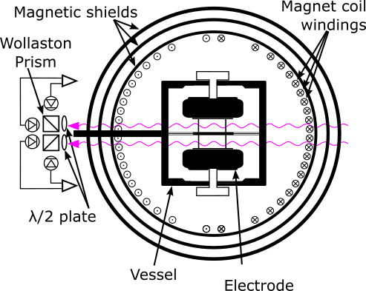
Systematics: Cell Motion
Gradients perpendicular to the shield axis reverse to within 5%
5% of the part of the EDM frequency shift signal that does not reverse with B₀ is the Radial Cell Motion systematic
Measured B gradients suggest this motion is approximately 2 nm
Source | Error (10⁻³¹ e cm)
Axial Cell Motion | 12.6
Radial Cell Motion | 3.36
Notes:
The measured gradient reversibility is important in explaining the non zero average frequency shift. When we mapped the field gradients inside the magnetic shields, we found that the gradients orthogonal to the shield axis reversed to within 5%. In practice, this means that 5% of the field-independent EDM 4 cell difference couples to a field-dependent systematic.
Given the value of the magnetic field gradients we had, we found that the HV-correlated displacement could be as small as 2 nanometers and still account for the measured frequency shift.

Slide 21
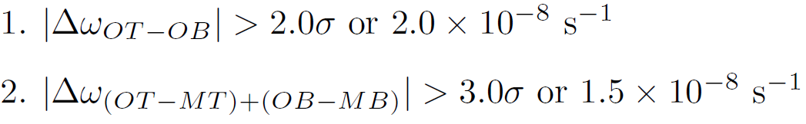
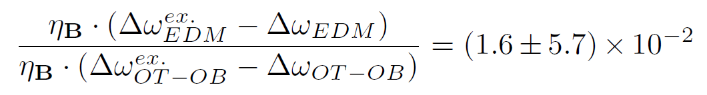
Axial Motion Constraints From Cut Data
We have 285 completed days (runs) in the data set
32 days were excluded from the set b/c of HV-correlated (ω_{OT} - ω_{OB})
Cut criteria:
We use the set of excluded data (32 cut runs + 63 systematic runs) to estimate the EDM dependence on outer cell Δω due to axial motion:
Excluded runs show that 7% of the outer cell freq. difference feeds through onto EDM channel
Notes:
So I mentioned that the field gradients orthogonal to the shield axis reversed to within 5%, but the gradients along the shield axis had a greater fixed component. To get the systematic from the gradient in this direction, we use the change in the EDM frequency difference when we take away runs that were deemed pathological in some way. Most of the runs that were removed got cut based on the outer cell difference, which changes the average value substantially, but the change on the EDM average value is only about 2% instead of the 33% that would be the naïve guess. This indicates that the field gradients are mostly linear, so the EDM and outer cell differences are much less coupled that you might expect. The 1-sigma limit on the EDM frequency difference change ended up being the dominant systematic error in our experiment.

Slide 22
Outer Cell Daily Avg. Freq. Difference
N=279
# Counts
(ω_{OT} – ω_{OB}) Daily Average

Slide 23
EDM Result Bias
# Counts
ω_{EDM} Daily Average

Slide 24
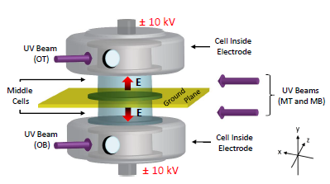
Systematics: Leakage Currents
Source | Error (10⁻³¹ e cm)
Leakage Currents | 5.0
Quadrature sum | 14.8
‘09 EDM data leakage current correlation = 0.42 pA
Flowing dry N₂ continuously helps reduce leakage
Field emission from sharp points on electrode surfaces can be reduced by polishing
Ground plane coating of SnO₂ instead of Au eliminates photoelectric currents
New measurement has 5 or 10x less leakage current than prev. measurement
Notes:
By far the most important contribution to the systematic error list is these leakage currents. In this diagram, the 2 electrodes surrounding the outer cells are at -10 kilovolts, and they sit on top of the inner cells which are connected to ground on the other side. So any currents that flow down the cell walls can create magnetic fields that change sign with the high voltage, mimicking an EDM. Specifically, we’re most worried about currents which flow in a helical pattern, because other currents add only quadratically to the main B field. Because the magnetic field couples to the precession frequency much, much more strongly than the electric field, even HV-correlated currents on the order of 10-15 amps are enough to cause huge problems if we don’t know what path they take. To try to get some kind of a grip on where these currents flow, we’ve broken the groundplane into inner and outer segments, so we measure the currents flowing to the cell endcaps separately from the currents flowing to the rest of the groundplane. What we find is that at least 80% of the total current is flowing to the outer groundplane, and we can argue that these currents flow from the electrode surface to ground along the electric field lines, so they can’t have a helical path.

Slide 25
Systematics: Parameter Correlations
Signals correlated with EDM and HV are treated as potential systematics
Each parameter contribution is the product of correlations + 1σ
Total systematic Δω = 1.41*10⁻¹¹ (cf. statistical error Δω = 1.45*10⁻¹⁰)
Parameter | HV correlation | error | EDM Sig. correlation | error | Systematic
Avg. Lifetime | -2.72E-05 | 5.57E-04 | -1.50E-09 | 7.97E-10 | 1.17E-12
Avg. Amplitude | 2.45E-06 | 1.50E-06 | -6.51E-07 | 6.02E-07 | 3.33E-12
Transmission | -3.40E-06 | 6.14E-06 | 2.83E-08 | 2.78E-08 | 2.96E-13
Laser Int. | -3.06E-07 | 7.91E-07 | 9.54E-08 | 9.93E-08 | 1.11E-13
Diode Current | 6.72E-09 | 4.62E-08 | 8.82E-06 | 7.42E-06 | 4.70E-13
Green Piezo | 5.18E-08 | 3.55E-06 | 6.36E-10 | 3.93E-09 | 2.30E-15
UV Piezo | 2.29E-07 | 3.12E-07 | -5.36E-10 | 2.62E-09 | 7.45E-16
Grad Coil 1 | 2.12E-10 | 1.64E-09 | -5.74E-05 | 3.34E-04 | 1.30E-13
Grad Coil 2 (endcaps) | 1.71E-09 | 2.81E-09 | -3.89E-05 | 1.12E-04 | 2.87E-13
Grad Coil 3 | 8.60E-11 | 1.37E-09 | 1.04E-04 | 2.65E-04 | 1.53E-13
Main Coil | -1.30E-09 | 3.40E-09 | 1.89E-05 | 1.37E-04 | 2.14E-13
dBy/dx Coil | 1.09E-10 | 2.85E-09 | 3.53E-05 | 2.69E-05 | 1.04E-13
Bx | -2.41E-05 | 2.46E-05 | -1.36E-07 | 1.83E-08 | 6.66E-12
By | 5.06E-08 | 1.60E-07 | -2.37E-08 | 6.62E-09 | 5.01E-15
Bz | -1.35E-05 | 5.96E-06 | -4.10E-07 | 4.49E-08 | 8.05E-12
Fluxgate (By) | 2.69E-09 | 2.36E-08 | 6.47E-07 | 4.69E-07 | 1.71E-14
Normalized Vertical quad PD | 1.17E-07 | 9.62E-08 | -6.89E-07 | 1.27E-06 | 2.43E-13
Normalized Horizontal quad PD | 6.70E-08 | 9.78E-08 | -6.89E-07 | 1.27E-06 | 1.55E-13
Slab Temperature | -3.57E-25 | 1.50E-15 | -1.38E-06 | 8.59E-07 | 2.08E-21
Table Temperature | 3.24E-25 | 1.50E-15 | -2.83E-07 | 5.52E-07 | 4.26E-22
Air Temperature | -1.95E-05 | 1.62E-05 | -4.72E-08 | 4.20E-08 | 2.04E-12
Chopper Frequency | 2.21E-06 | 4.19E-06 | 6.19E-07 | 3.56E-07 | 4.08E-12

Slide 26
Systematics: E² Effects
Source | Error (10⁻³¹ e cm)
Axial Cell Motion | 12.6
Leakage Currents | 5.02
Radial Cell Motion | 3.36
E² effects | 3.04
Parameter Correlations | 2.33
v x E B fields | 2.29
Charging Currents | 1.83
Geometric Phase | 0.06
Quadrature sum | 14.8
Any effect that couples Δω_{EDM} to |E| is a systematic if |E₊| is different from |E₋|
We measure |E₊| - |E₋| using the quad. Stark shift
Measure Δω_{EDM} (|E|) by taking ~10 scans each day at 0 kV between +/- 10 kV or +/- 6 kV

Slide 27
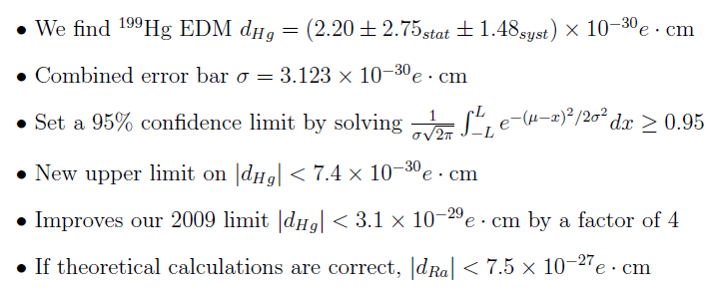
Null Result and New Limits

Slide 28
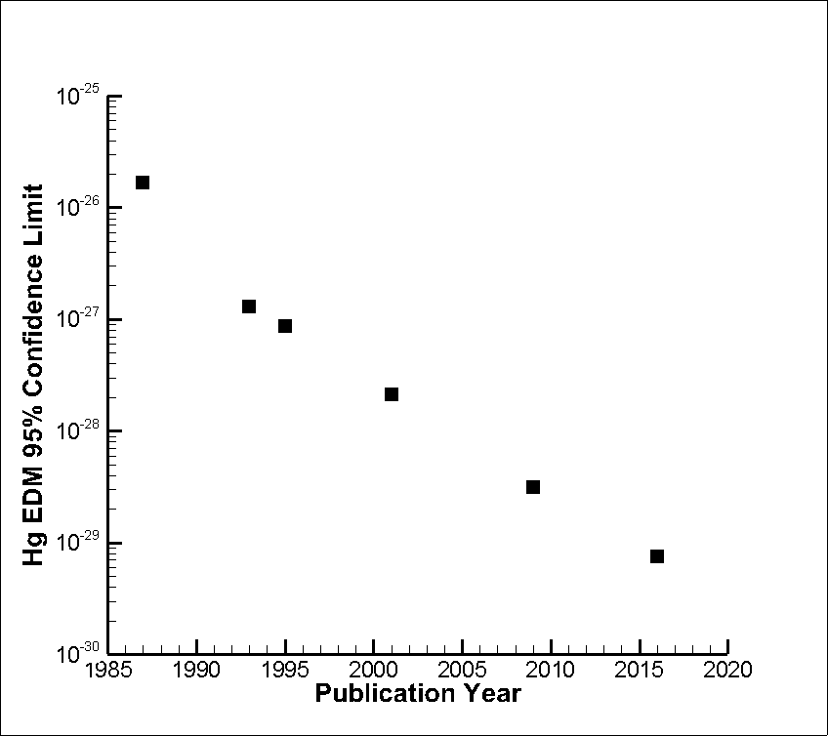
Hg EDM Limits vs. Time
'87: First published ¹⁹⁹Hg EDM result
'93-'95: Improved flash-lamp measurements
'01: First laser-based measurement
'09: First 4-cell measurement
Current work

Slide 29
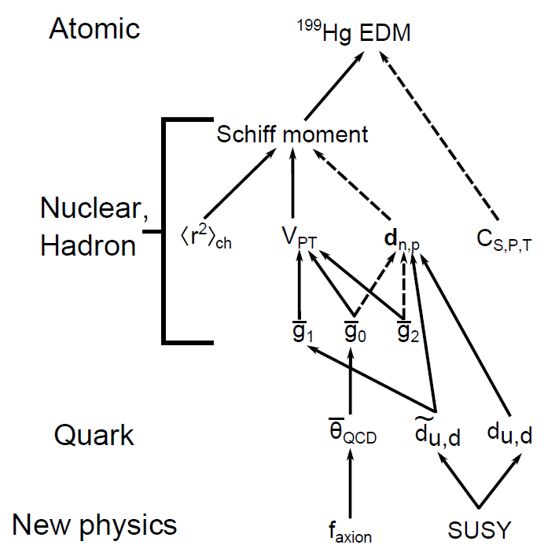
Hg EDM Limits on CP-odd Parameters
Hg EDM results can be used to put limits on CP-odd parameters
It is necessary to assume the EDM has only 1 contribution
d_{Hg} < 7.4*10⁻³⁰ e cm
→θ_{QCD} < 8.5 *10⁻¹¹
d_{n} < 1.6*10⁻²⁶ e cm

Slide 30
The Team
Blayne Heckel Norval Fortson
Eric Lindahl
Jennie Chen
Former Students and Postdocs:
Tom Loftus
Nathan Kurz
Adam Kleczewski
Clark Griffith
Matt Swallows

Slide 31
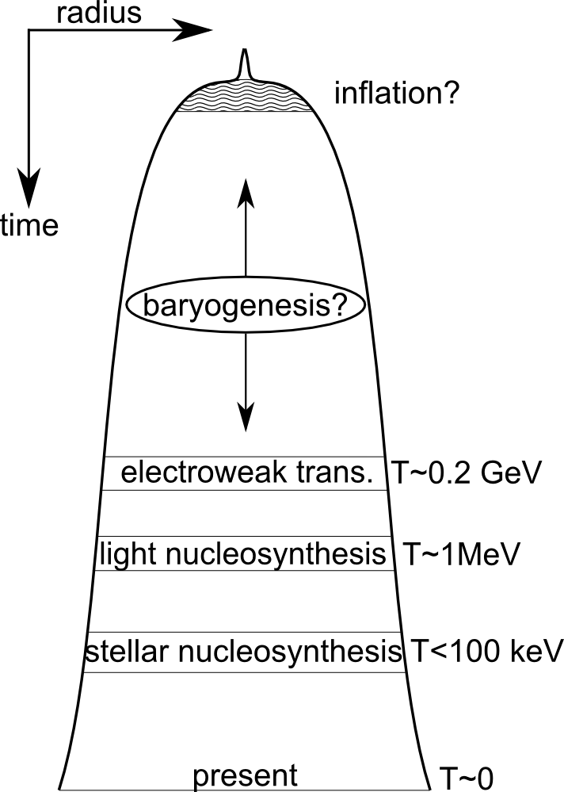
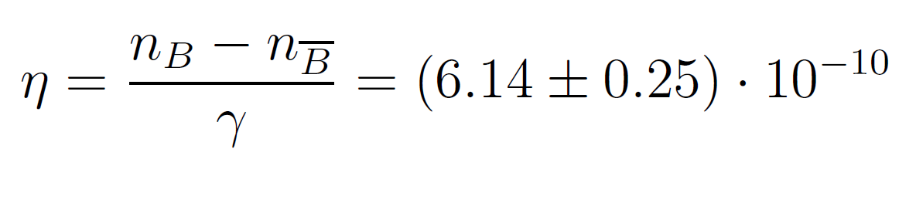
CP violation and baryogenesis
No theory explains the ‘excess’ of matter over antimatter:
Any baryogenesis model needs to satisfy the Sakharov conditions:
  1. Baryon number violation
  2. CP symmetry violation
  3. Departures from thermal equilibrium
Higgs is too massive for a workable theory based in standard model physics
Notes:
One of the most interesting reasons to study abstract symmetries in nuclear physics is the connection to the baryogenesis problem. There is no empirical evidence for antimatter anywhere in the present-day universe, but is it generally thought that the energy of the big bang should have been divided equally between baryonic and antibaryonic degrees of freedom. What this means is that the measured baryon excess has to be dynamically generated by some small asymmetry in the laws of physics that we just haven’t found yet.
While we don’t know what the mechanism for baryogenesis is, Andrei Sakharov wrote a famous paper back in the 60’s pointing out that any theory of baryogenesis needs to satisfy three conditions. The first and most obvious condition is some process that violates baryon number, the second is extra sources of CP violation, which is the most germaine to our experiment, and the third is departures from thermal equilibrium.
So canonically these are the three Sakharov conditions, but one of the things that people have realized since Sakharov’s paper is that the departures from thermal equilibrium should happen due to some kind of first-order phase transition, which was once thought to be the electroweak symmetry breaking. But the theory only works for Higgs masses up to about 75 GeV, so there is essentially another requirement, which is that we need some kind of physics outside the standard model to get a good theory of baryogenesis. So an EDM can satisfy 2 out of 4 criteria.

Slide 32
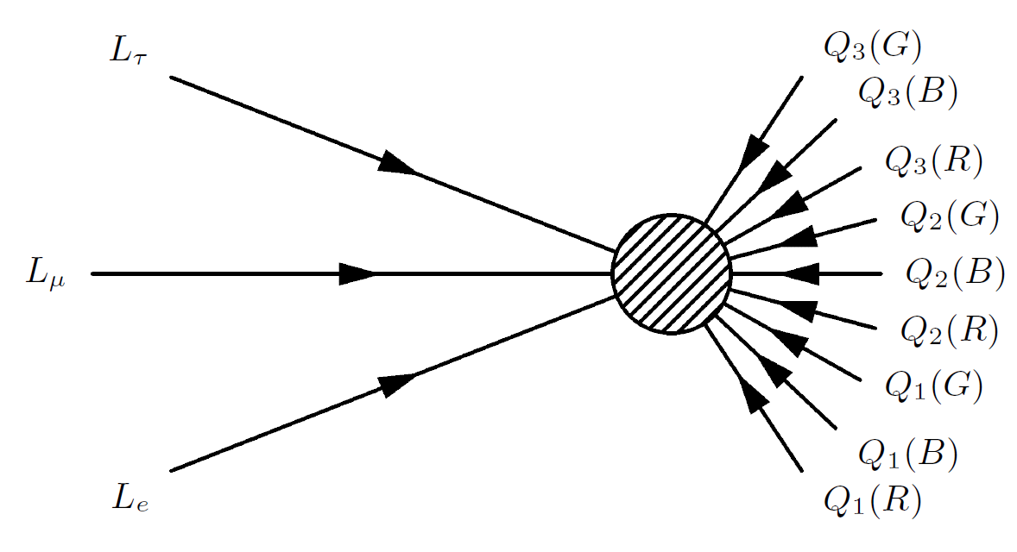
What does a B-violating process look like?
Best-known example is the sphaleron process:
  ΔB = +/-3
  Conserves B-L
  Suppressed below ~100 GeV
Could generate baryon excess from lepton excess (leptogenesis)

Slide 33
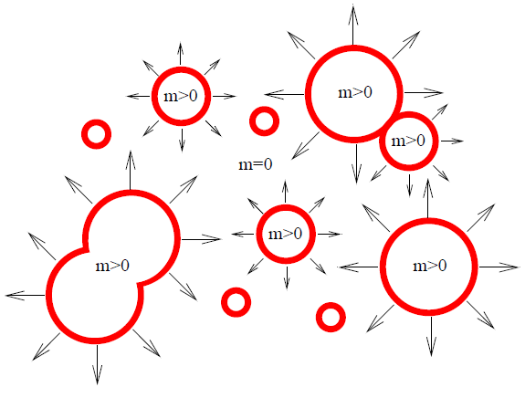
Out-of equilibrium decay:
Electroweak baryogenesis (EWBG)
Popular baryogenesis models focus on the EW symmetry breaking
Higgs field acquires multiple vacuum expectation values
Regions of broken EW symmetry can expand like bubbles
Interactions at the walls violate CP, are out of eq.

Slide 34
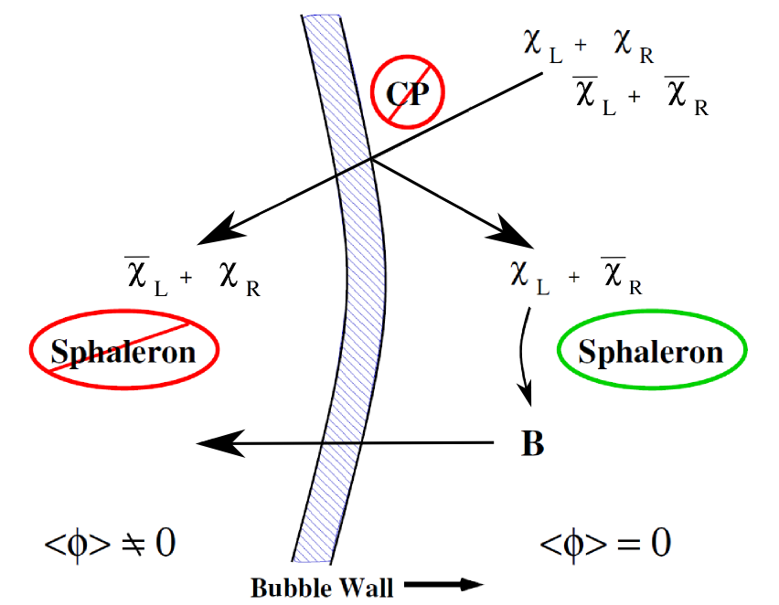
Where do the baryons actually come from?
CP-violating interactions at the wall reflect LH particles, RH antiparticles
Sphaleron process does not couple to RH (anti)particles, is frozen out by large M_{W,Z}
Net flux of baryons outside diffuses in before eq. is established

Slide 35
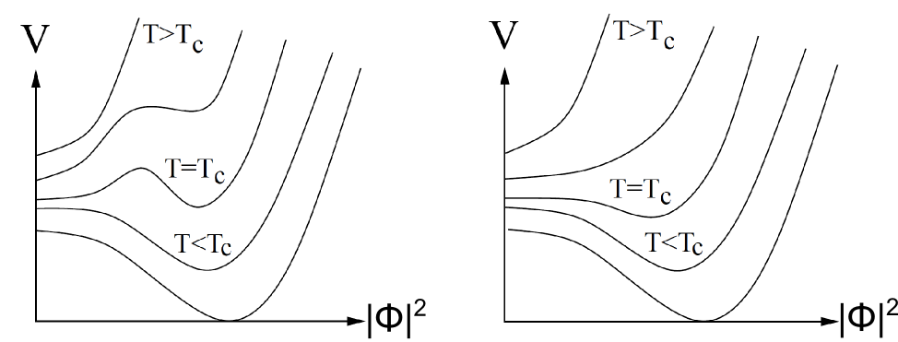
First-order phase transitions in EWBG
For bubble nucleation, the electroweak symmetry breaking must be a first-order phase transition
The effective Higgs potential at high temp. must have degenerate minima (T=T_{c}, left diagram)

Slide 36
Can this happen under the Standard Model?
No.
CP-violation in the CKM matrix is insufficient to create large enough particle number asymmetries outside the bubbles of non-zero Higgs VEV
Electroweak symmetry-breaking transition in the SM cannot involve bubble nucleation with M_{Higgs} > 75 GeV

Slide 37
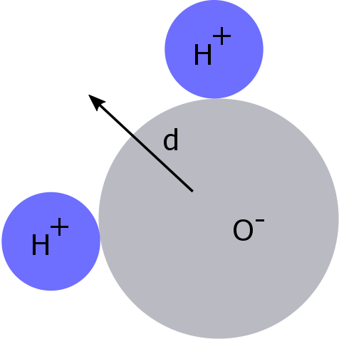
Atomic vs. Molecular EDMs
Parity violation requires a fixed EDM projection onto spin axis
Molecules have additional degrees of freedom-EDMs have no definitive spin projection

Slide 38
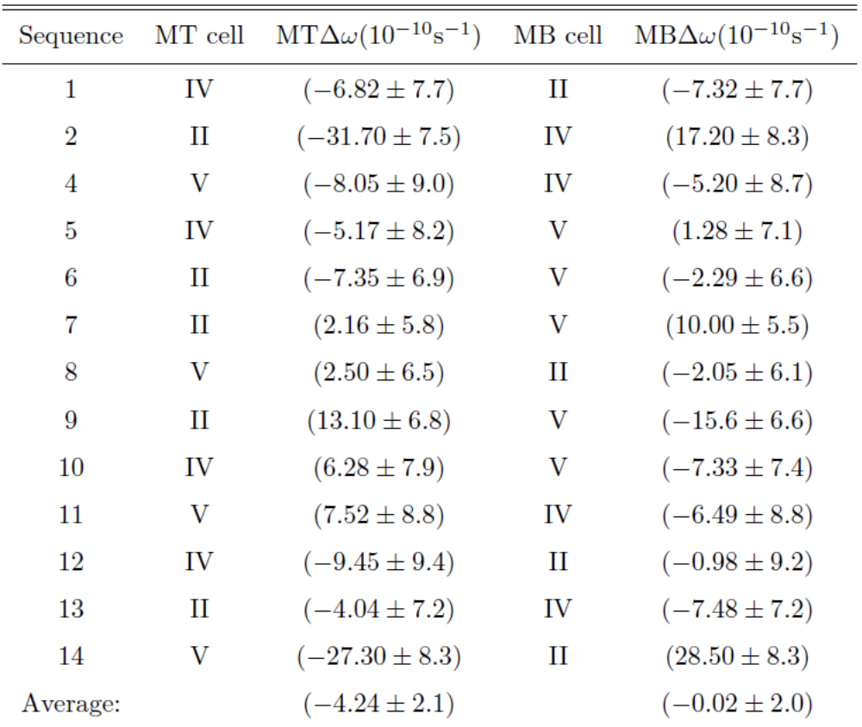
Cell Motion Causes
Magnetic shielding defects may cause gradients
HV-correlated quadratic gradients appear larger on top
Welded shield seam is nearest outer top cell
Effect of cell motion changes from sequence to sequence

