Slide 1
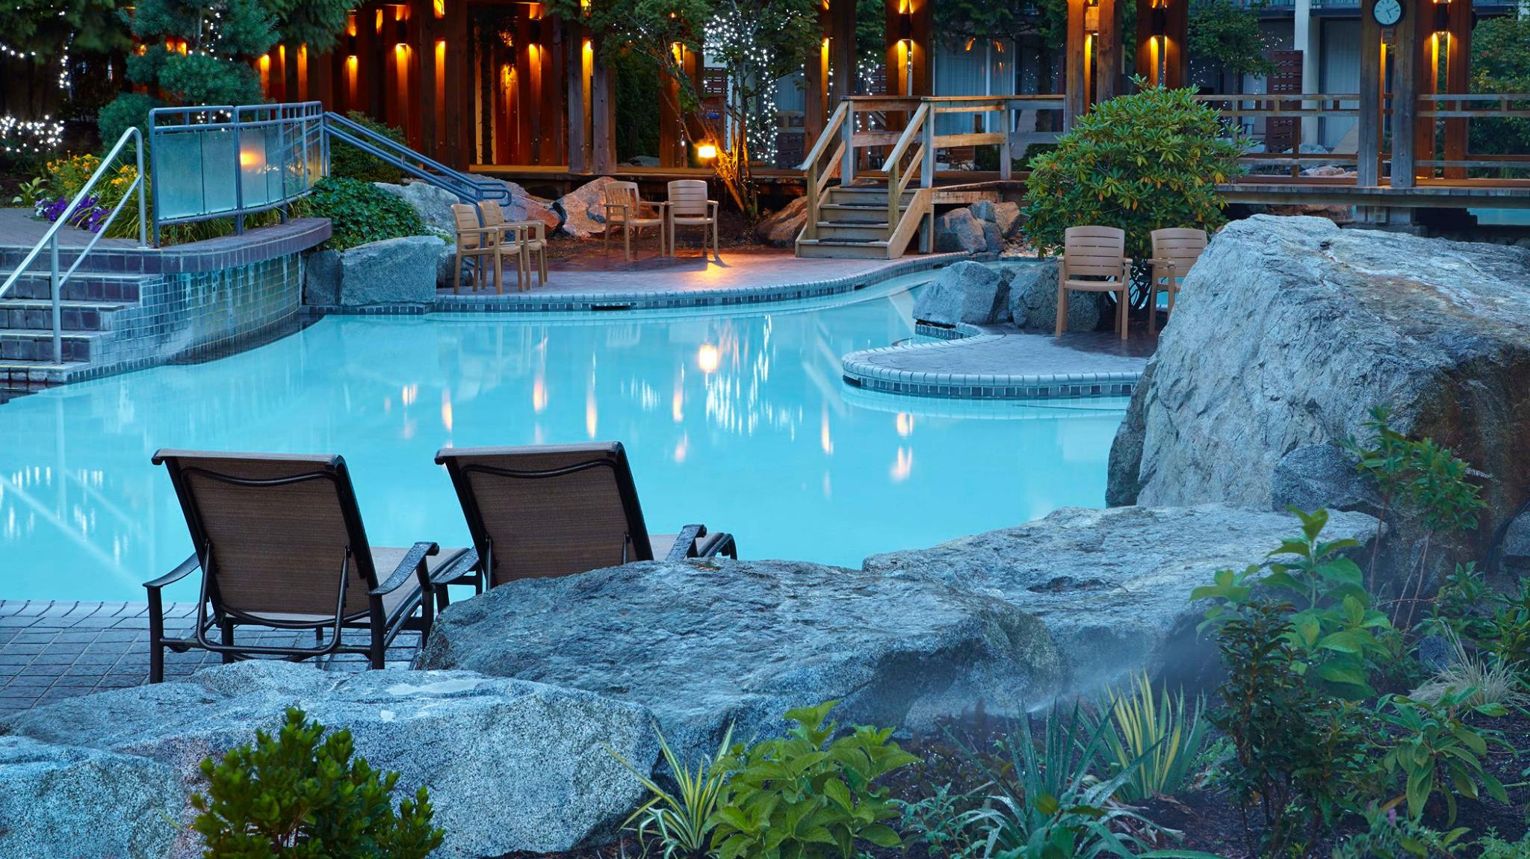
Welcome to Harrison Hot Springs and nEDM2017
Some logistics
R. Picker

Slide 2
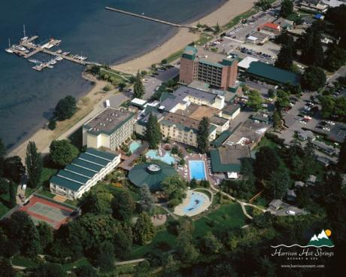
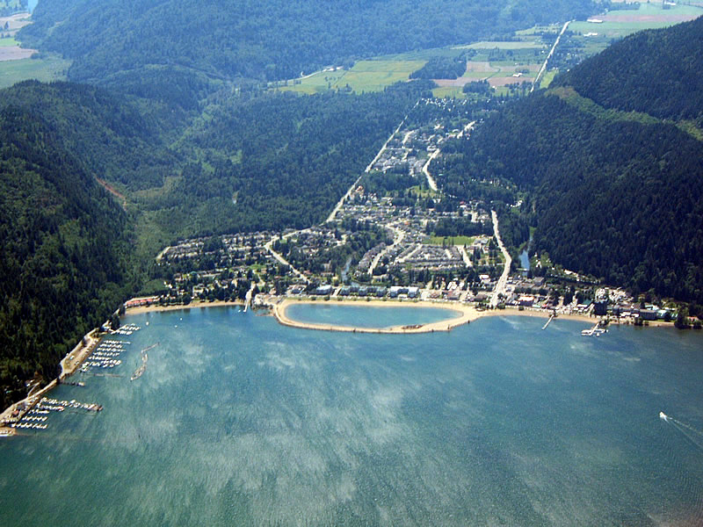
Harrison Hot Springs
x
x

Slide 3
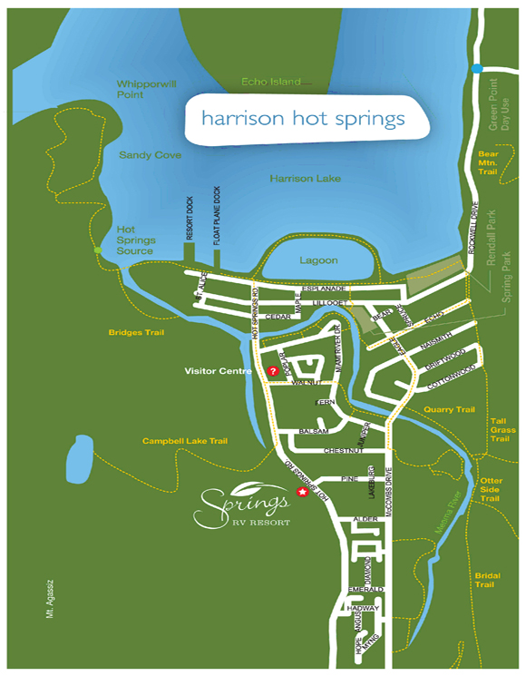
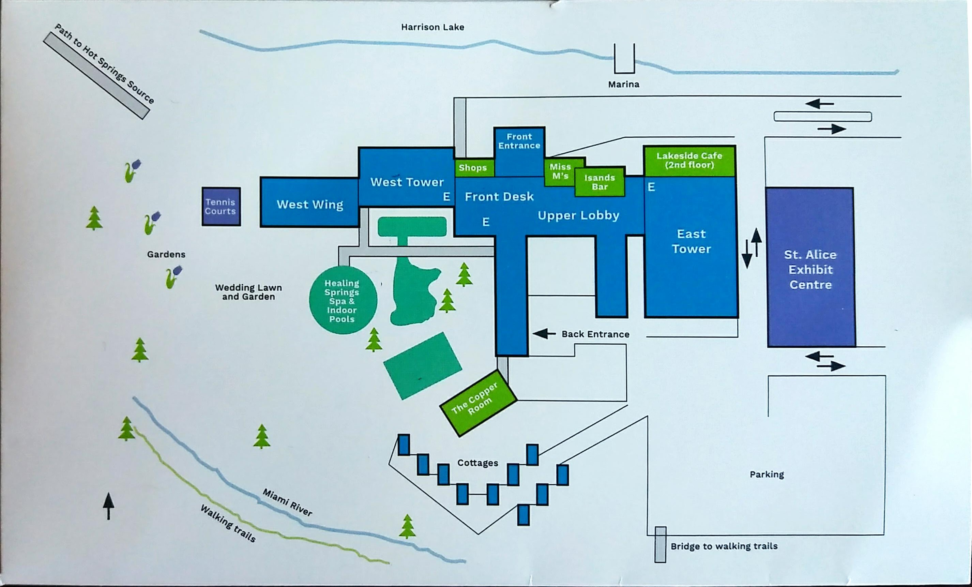
Maps
x
x

Slide 4
Pools are open
Outdoors: 8am-11pm
Indoors: 8am-1am

Slide 5
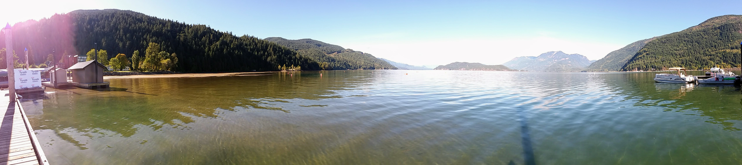
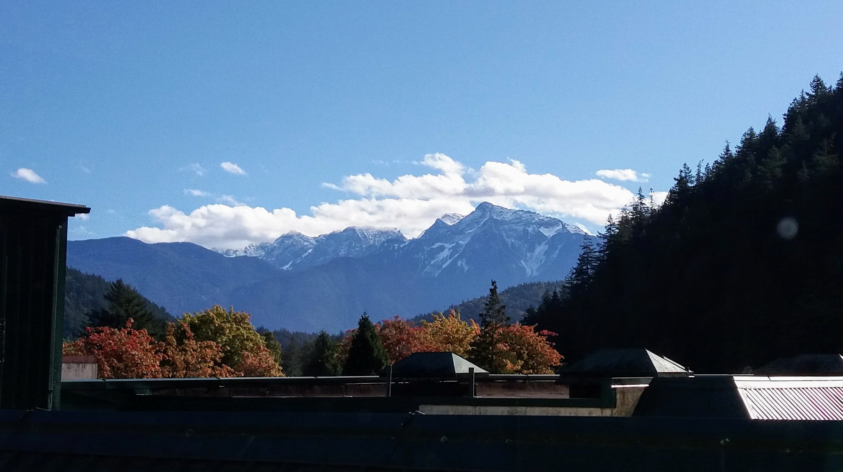
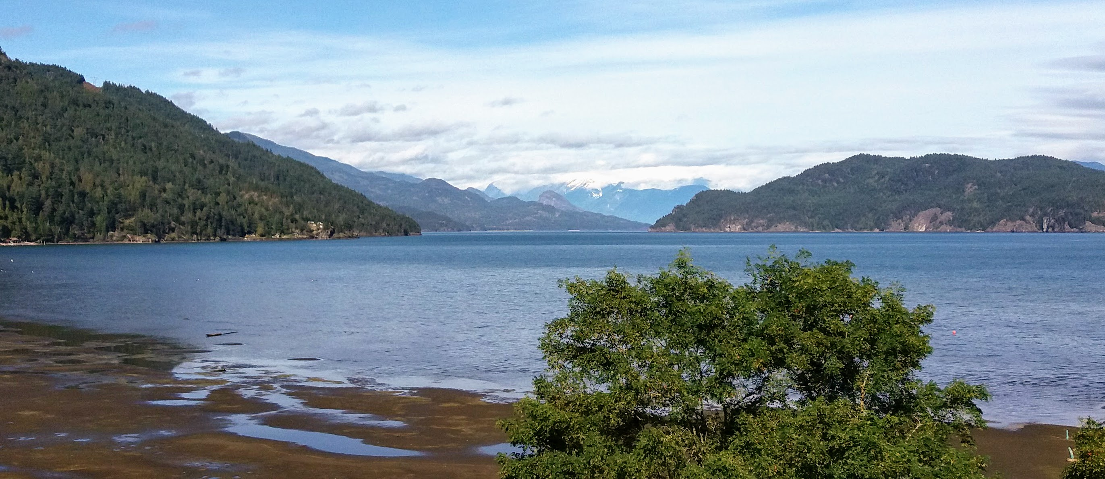
Weather yesterday…

Slide 6
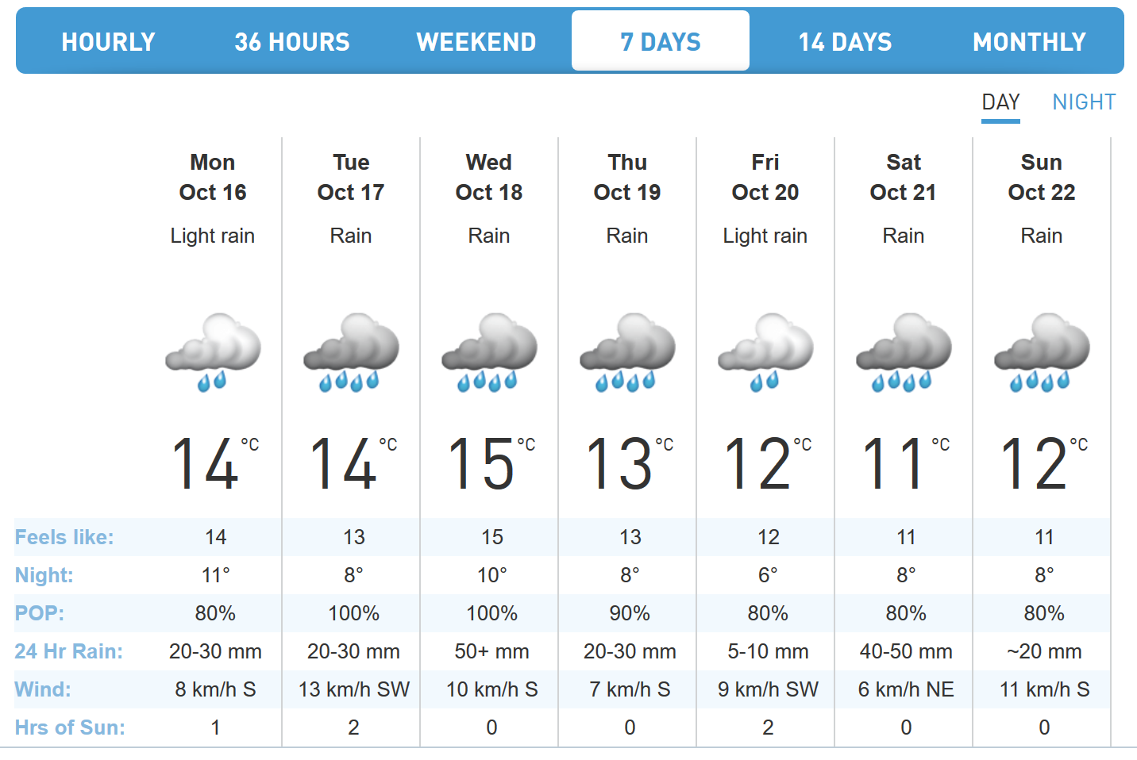
Weather in Harrison this week…
Expected rain: >107.5mm
https://www.theweathernetwork.com/ca/weather/british-columbia/harrison-hot-springs?wx_auto_reload=

Slide 7



The Weather in Ascona 2014
 | Sun Nov 2, 2014 | Mon Nov 3, 2014 | Tue Nov 4, 2014 | Wed Nov 5, 2014 | Thu Nov 6, 2014
Conditions
Temp high | 14º | 8º | 7º | 7º | 8º
Rain | 0mm | 5.4mm | 53.1mm | 87.2mm | 7.7mm
Total rain: 153.4mm
Rain seems to be a tradition…

Slide 8
Dinner tonight
Dinner tonight will be at the Copper Room.
It is a more formal place.
Dress code is Dress Casual: please try not to wear running shoes, shorts or T-shirts.
x

Slide 9
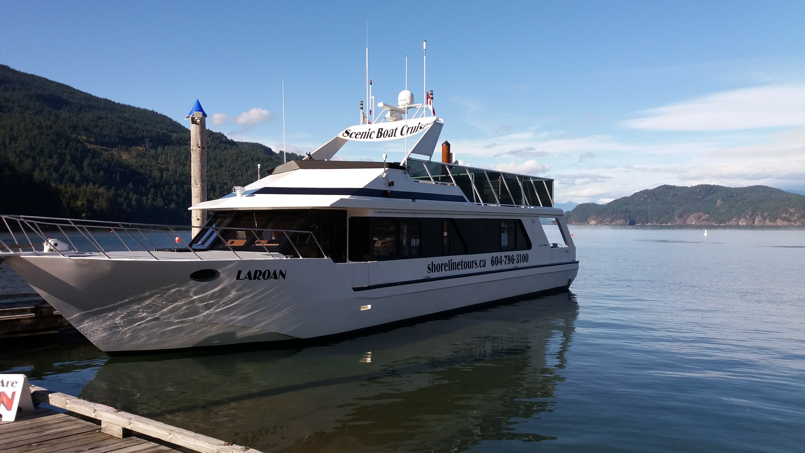
The boat tour on Tuesday
x
There are still a few spots open.
The trip will be along the river with chances to see wildlife.
There is indoor space, but bring weather proof clothes.
Duration: 2h
Appetizers and a drink are included
If you want to join, sign up and pay $10 with Jana, please!
Departure at 2pm here:

Slide 10
The TRIUMF tour
Friday at 11am
meet at the lobby
First general TRIUMF tour (ca 1h) ending at
Then UCN area
Sharing taxis to the airport ($35) would make sense.

Slide 11
The scientific program
Allotted presentation time always includes 5 min for discussion. Please allow for that.
We would like to use the Windows computer provided. It has Powerpoint and Adobe PDF installed and is connected to the sound system if you need it.
Your slides: either upload to Indico or bring to the front via USB stick ahead of each session.

Slide 12






Thank you for the financial support!
We wish everybody interesting, friendly, collaborative, productive,
steaming, soaking and delicious workshop days in Harrison Hot Springs, BC!

