Slide 1
Development a High Intensity Ultra-Cold Neutron Source using Superfluid Helium at TRIUMF
Shinsuke Kawasaki (KEK)
for the TRIUMF Japanese-Canadian UCN Collaboration

Slide 2
outline
Ultra-Cold Neutron (UCN)
UCN production by super thermal method
  storage time
³He cryostat
UCN source at TRIUMF
  Vertical source <- was discussed by R. Matsumiya yesterday
  new UCN source
    with high cooling power
    cooling scheme
      temperature distribution
    UCN production figure of merit as a function temperature
Summary

Slide 3
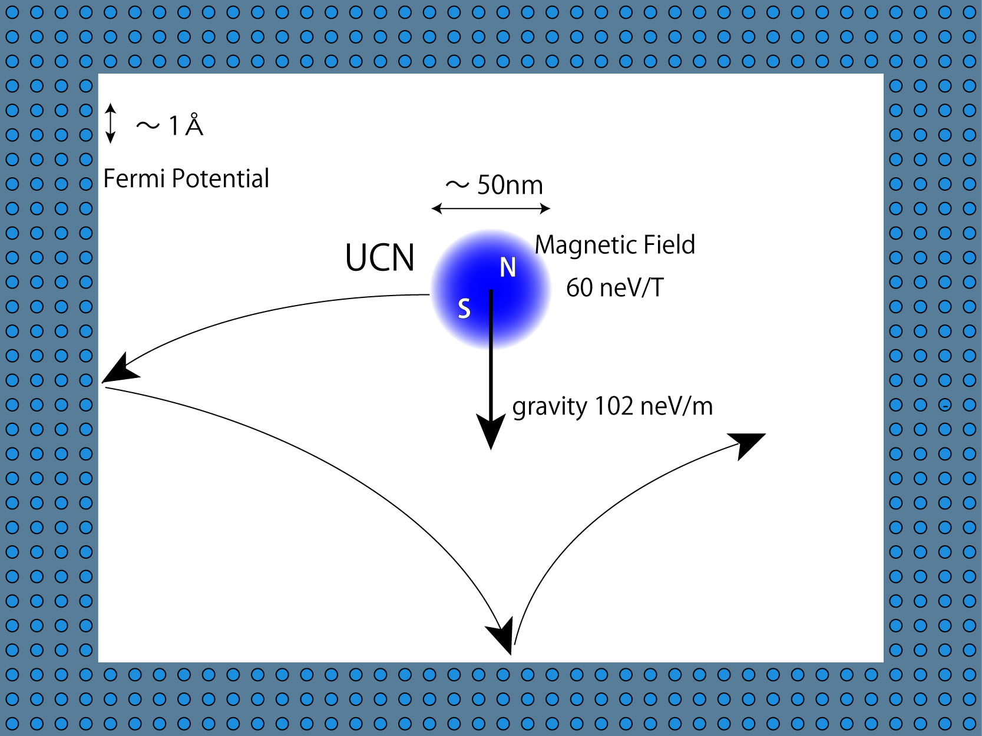
Ultra Cold Neutron (UCN)
Ultra Cold Neutron
Energy ～ 100 neV
Velocity ～ 5 m/s
Wave length ～ 50 nm
Interaction
Gravity 100 neV/m
Magnetic field 60 neV/T
Weak interaction
β-decay n → p + e
Strong interaction
Fermi potential 335 neV (⁵⁸Ni)
  atom distance : ~ Å
  UCN feels average nuclear potential
UCN can be confine material bottle
→Use various experiments

Slide 4
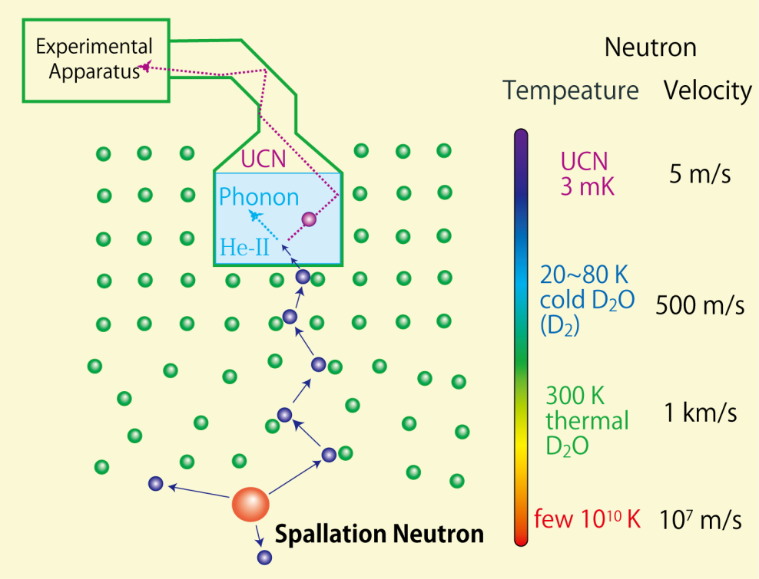
UCN production by super fluid Helium
UCN procution
spallation neutron
↓ D₂O, LD2 Moderator (300K, 20K)
cold neutron ～meV
↓ Phonon scattering in He-II
Ultra cold neutron ～100neV
Feature of our source
・spallation neutron
High neutron flux
  small distance between target and UCN production volume
・Super-fluid Helium converter
long storage lifetime
up-scattering by phonon
  τ_{s} = 600 s at T_{HeII} = 0.8 K
  τ_{s} = 36 s at T_{HeII} = 1.2 K
  1⁄ τ_{s} ∝ 𝑇⁷

Slide 5
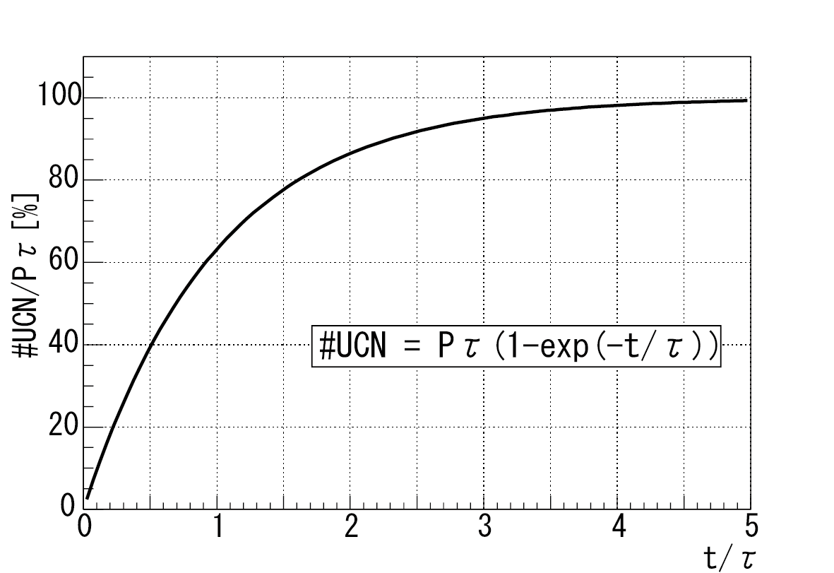
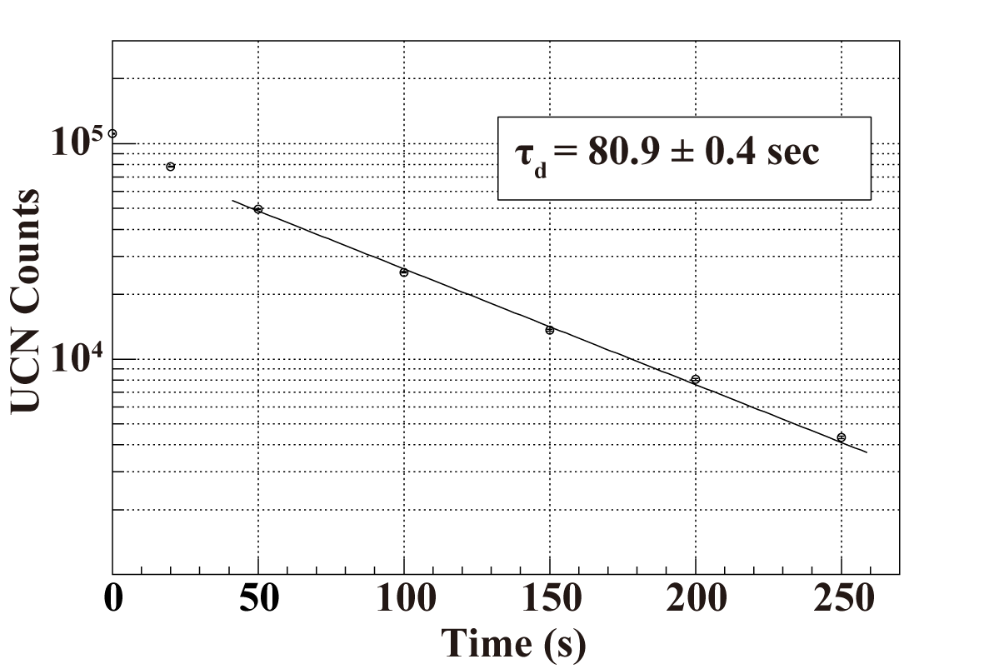
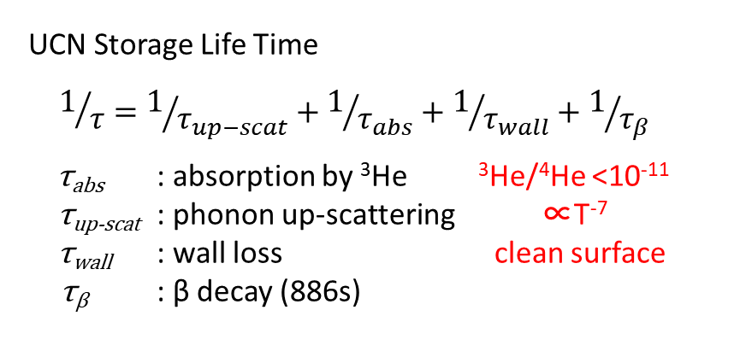
UCN Storage Life Time
UCN density
= Pτ (1 – exp(-t/τ))
P : UCN production rate ∝ cold neutron flux
τ : Storage time
t : proton irradiation time
large cold neutron flux
long τ
are important
UCN density during proton irradiation
UCN Storage Life Time
$$1/τ=1/{τ_{up−scat}}+1/{τ_{abs}}+1/{τ_{wall}}+1/{τ_{β}}$$
τ_{abs} : absorption by ³He ³He/⁴He <10⁻¹¹
τ_{up-scat} : phonon up-scattering ∝T⁻⁷
τ_{wall} : wall loss clean surface
τ_{β} : β decay (886s)
UCN Storage Time measurement
at RCNP

Slide 6
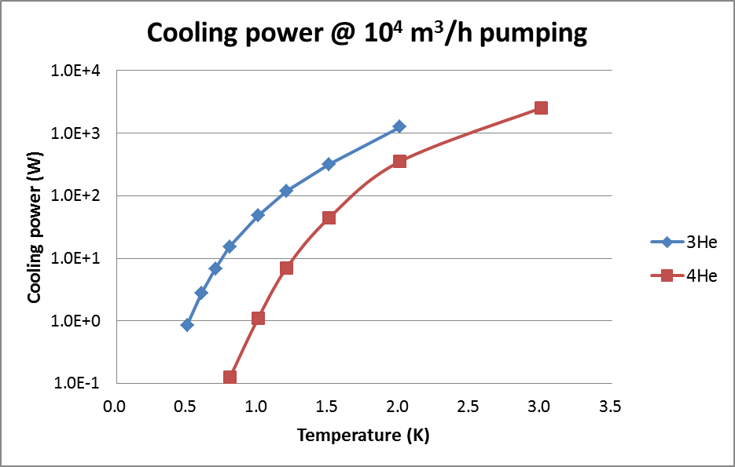
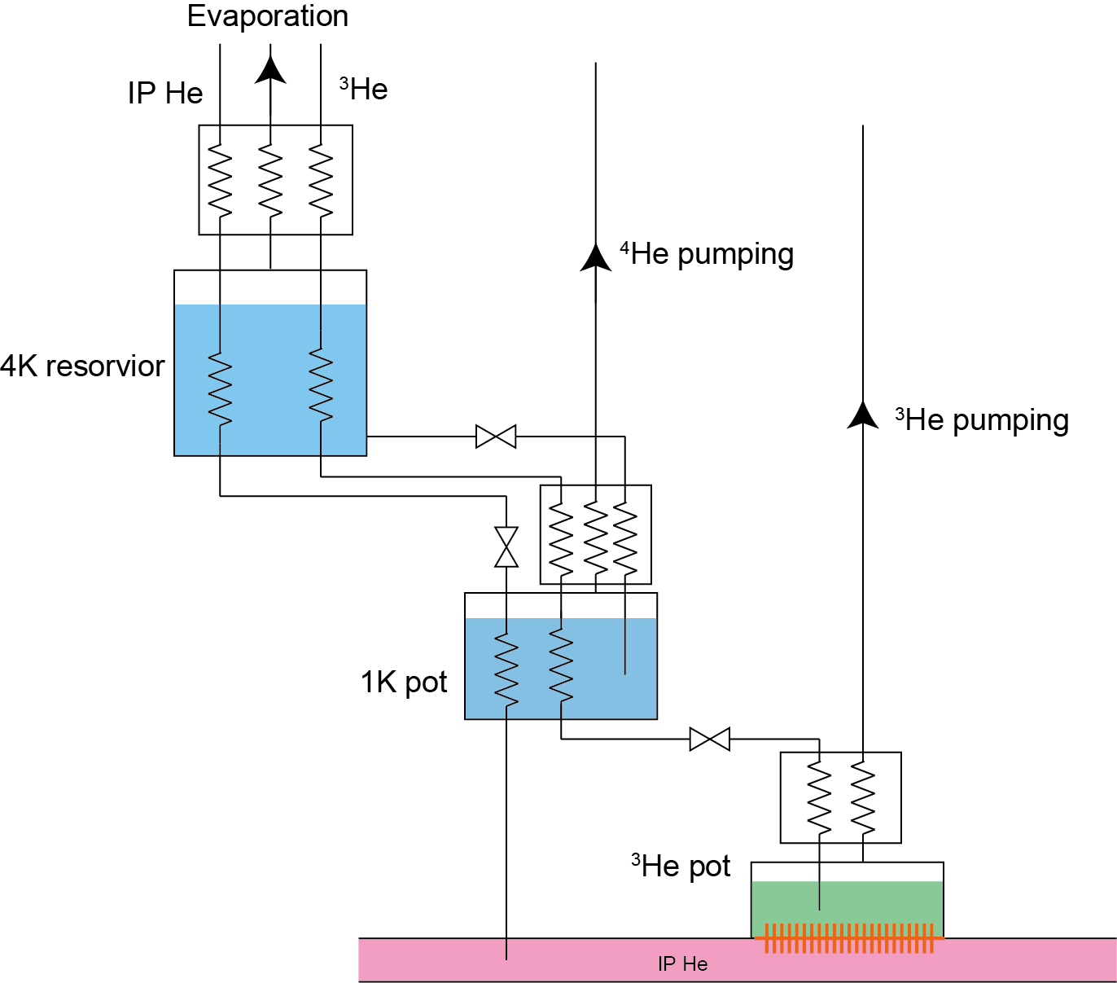
³He cryostat
to keep He-II temp. 1.0K
decompressed Helium 3
³He vs ⁴He
  vapor pressure @ 0.8K
    ³He: 9 Torr
    ⁴He: 0.1 Torr
  cooling power
  @ 1.0 K with 10, 000 m³/hour pumping
    ³He: 48 W
    ⁴He: 1.1 W
  Cooling power depend on temperature
    larger vapor pressure in higher temperature
³He cooling
  evaporated ⁴He gas
  liquid He bath 4.2K
  1K pot (⁴He pumping) 1.4K
  ³He pumping < 1.0K
Helium flow diagram

Slide 7
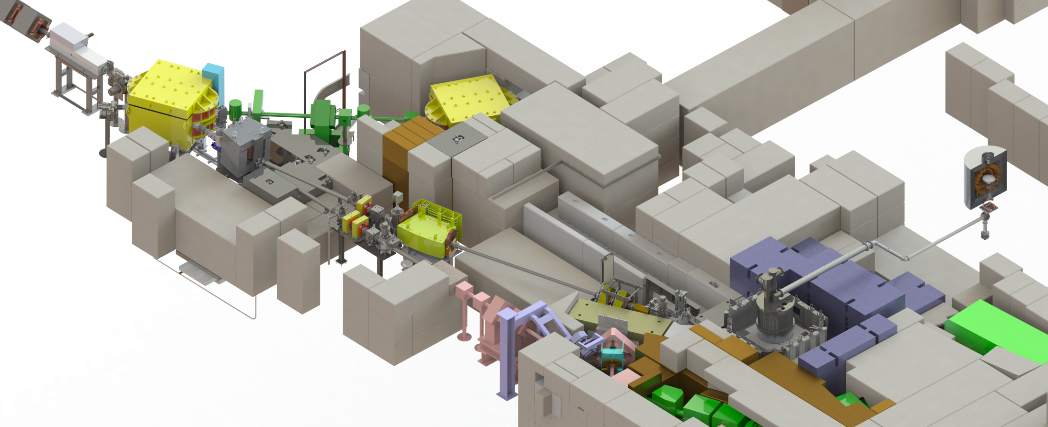
UCN Source @ TRIUMF
Kicker
2015
Bender
Septum Magnet
UCN Source
BL1U
Q Magnet
2014 shutdown
2017 shutdown
BL1A
W target
remote handling
2015 shutdown
2016 shutdown
Major Milestone
✓- 2016 proton beam line for UCN source(BL1U 500MeV, 40μA)
✓2016 commissioning proton beam line and cold neutron production
2017 UCN production by Vertical source (~ 1μA)
- 2020 High intensity UCN source (40μA)

Slide 8
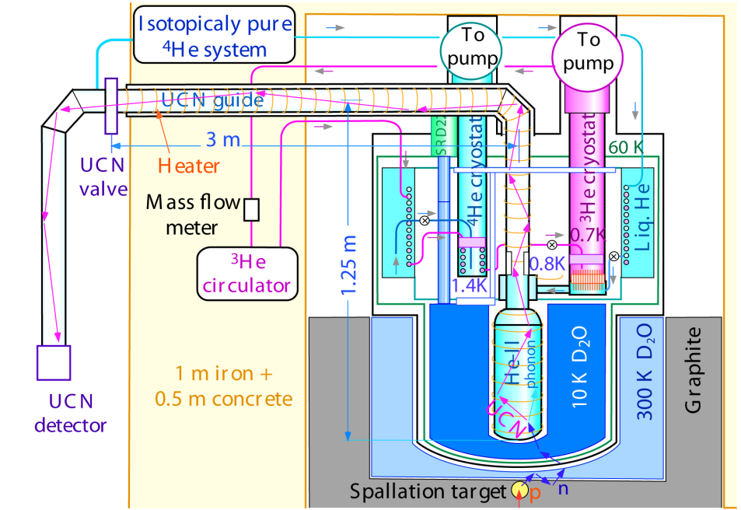
Vertical UCN source
Vertical UCN source
  developed at RCNP
    T_{He-II} : 0.8 K
    UCN life time: 81 sec
    UCN density: 9 UCN/cm³
      400 MeV × 1 μA = 0.4 kW
Y, Masuda et. al., Phys. Rev. Lett. 108, (2012), 134801
  move to TRIUMF
    modification for safety requirement
  2017 Jan. – Apr. install at Meson hall
  2017 Nov. UCN production

Slide 9
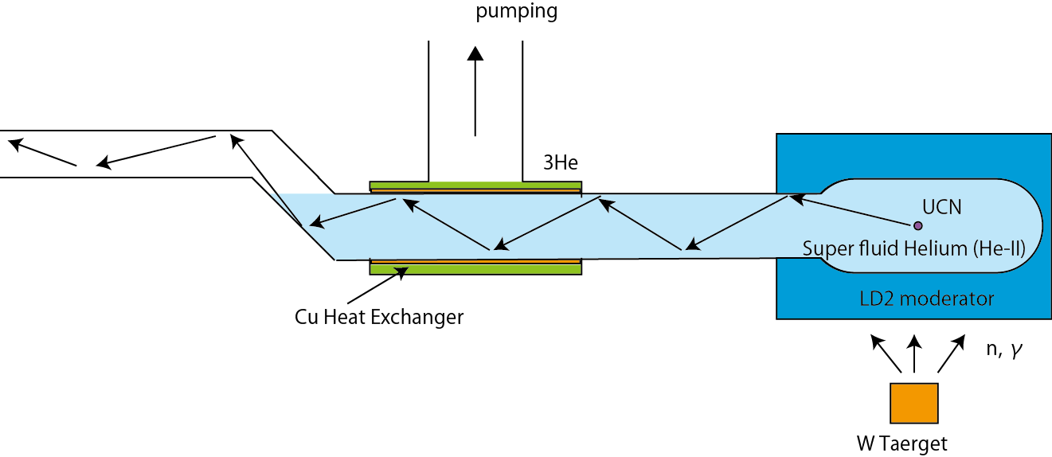
new UCN source
proton beam power
0.4 kW at RCNP -> 20 kW at TRIUMF
A new helium cryostat which has high cooling power is necessary
Heat load on He-II depends on geometry
distance between target and He-II
cold moderator
gamma shield and so on
higher cold neutron flux cause higher heat load
ratio of this is constant in some region
Optimization is necessary

Slide 10
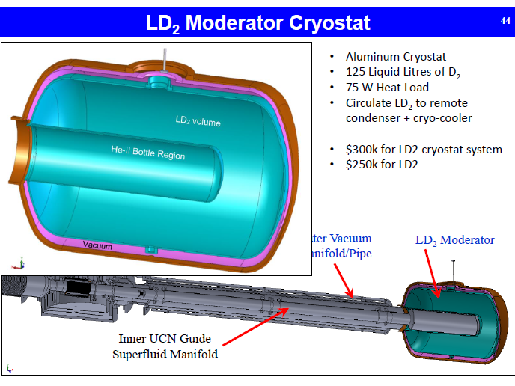
5 – 9 times large cold neutron flux is achivable compared with ice D₂O

Slide 11
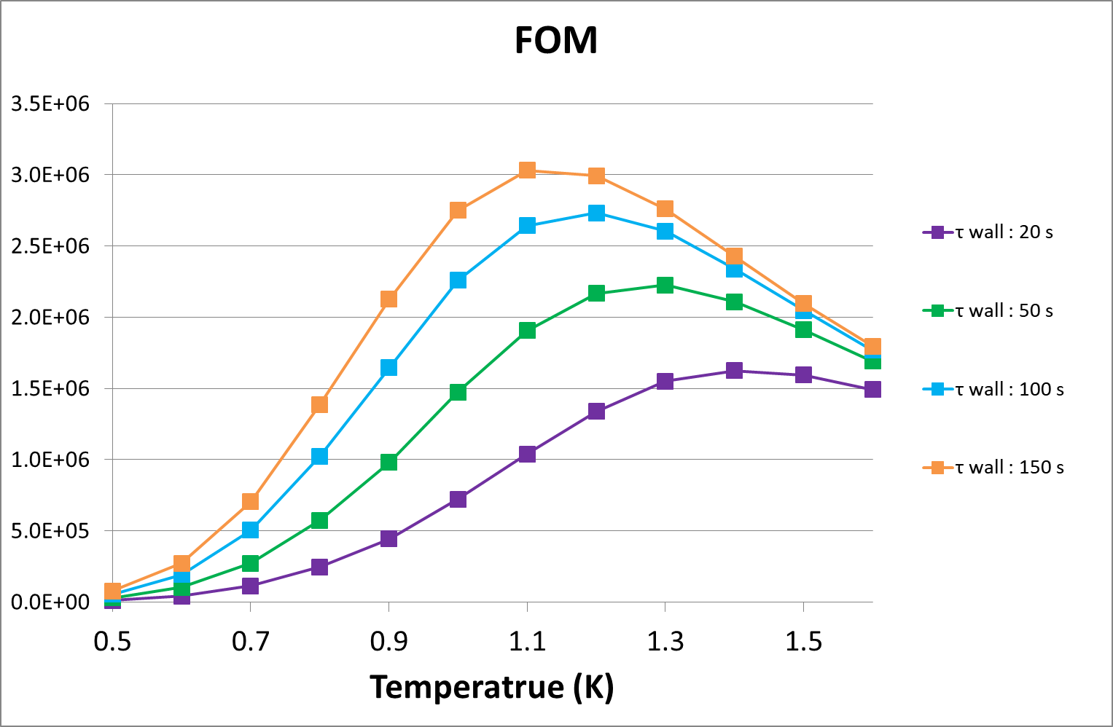
UCN Production Figure of Merit ideal case: ³He temperature is same as UCN production volume
UCN density ρ ∝ P x τ
  P : production rate
  ∝ cold neutron flux
  ∝ heat load
  = cooling power ( function of T)
  ∝ Vapor pressure * latent heat
  τ : UCN life time
    1/τ = 1/τ_{β} + r*1/τ_{upscat} + 1/τ_{wall}
      τ_{β} = 880s
      τ_{upscat} ∝ T⁻⁷
      1/τ_{wall} : ~100sec (depend on surface quality)
a.u.
Figure of Merit (FOM) as a function of T
FOM = Cooling power x τ

Slide 12
In Reality
There is temperature difference between UCN production volume and ³He
  UCN lifetime
    temperature at UCN production volume
  cooling power
    ³He temperature
The temperature difference is caused by following reason
  deposit heat at UCN production volume
  Heat transfer in He-II
  Kapitza conductance of heat exchanger

Slide 13
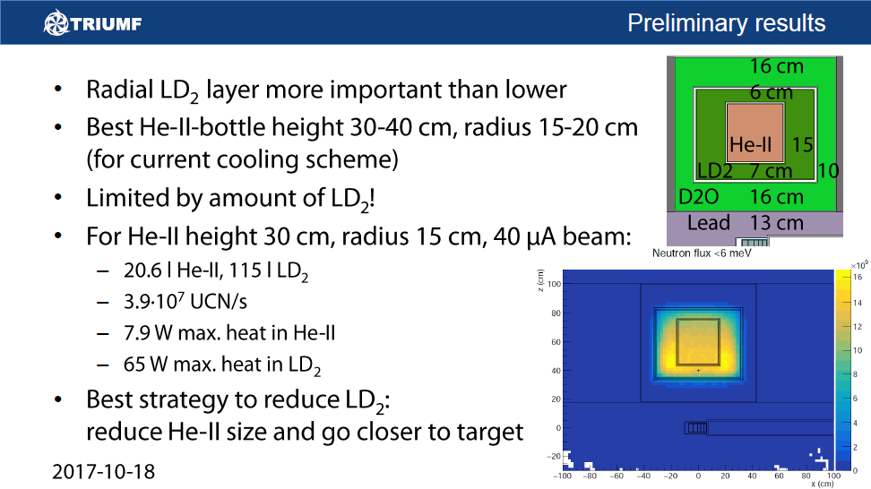
Heat load on UCN production volume
Will be discussed by S. Wolfgang
deal with such a huge heat load around 1 K

Slide 14
Heat transfer between heating point and cooling point
Heat transfer in He-II
  below 1 K, heat transfer is not good because of low fraction of normal fluid which convey heat (two fluid model)
Kapitza conductance of heat exchanger
  Conductance at the surface between liquid and solid is small at low temperature
³He pumping
Heat exchanger
heat deposit

Slide 15
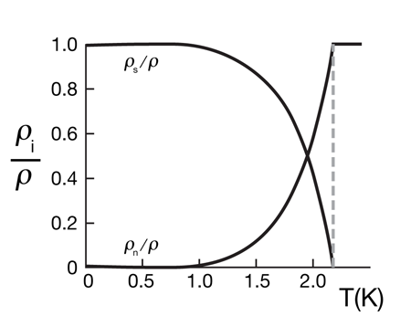
Superfluid Helium
Two Fluid Model
 | Normal fluid | Superfluid
Viscosity | Η_{n} | η_{s} = 0
Entropy | S_{n} | S_{s} = 0
Ratio of super/normal component depends on temperature dependence.
fraction of normal mode become small in low temperature.
10.1103/Physics.3.5
Heat transport
Since superfluid has no entropy, heat is transported only by normal fluid.
Heat transport in low temperature (< 1K) become small because of small fraction of normal fluid
v_{n}
v_{s}
Heat source

Slide 16
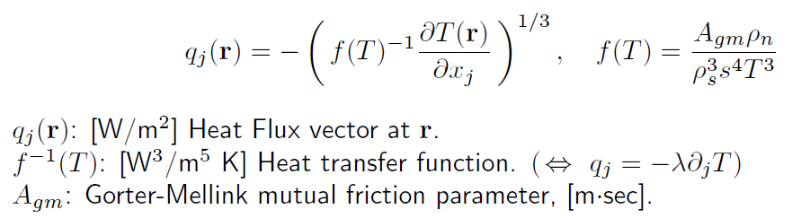
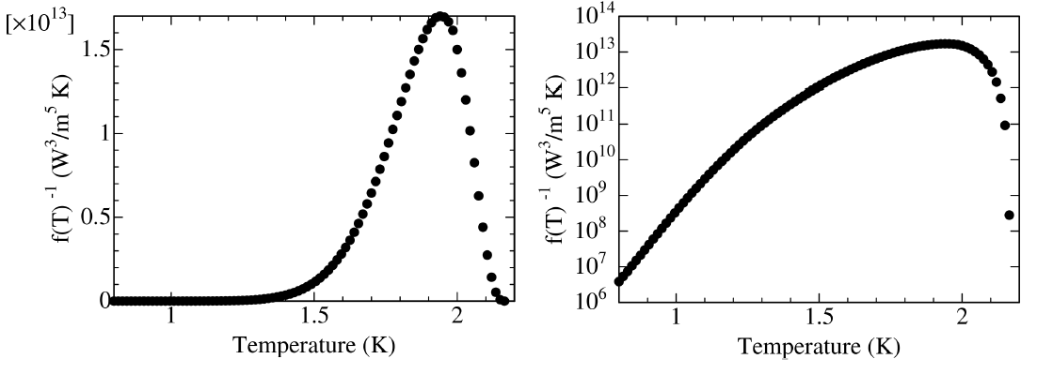
Gorter-Mellink Equation
f(T)⁻¹ : Heat transfer function of He-II based on Two fluid model

Slide 17
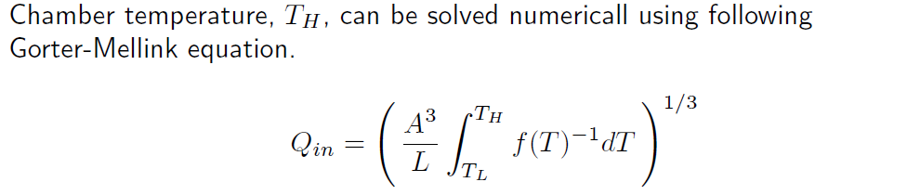
Temperature difference in He-II
A : cross section of He-II
L : distance of heat transfer
L = 1000mm

Slide 18
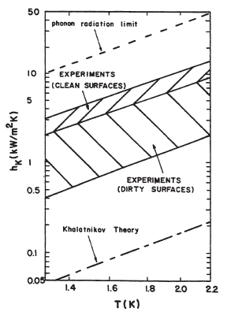
Kapitza Conductance
Kapitza conductance, h_{K}(T) is a function of temperature.
There are several theory on Kapitza conductance.
  Phonon limit
    h_{K}(T) ~ 4500 T³ [W/m²K]
      2 - 10 times larger than measured
  Khalatnikov theory
    h_{K}(T) ~ 20 T³ [W/m²K]
      10 - 100 times smaller than measured
Experimental data strongly depends on surface quality
  plan to measure Kapitza conductance of material before fabricating a heat exchanger
Phonon limit
experimental
data
  Khalatnikov theory
Kapitza conductance
between Copper and He-II
Helium cryogenics, Steven W. Van Sciver

Slide 19
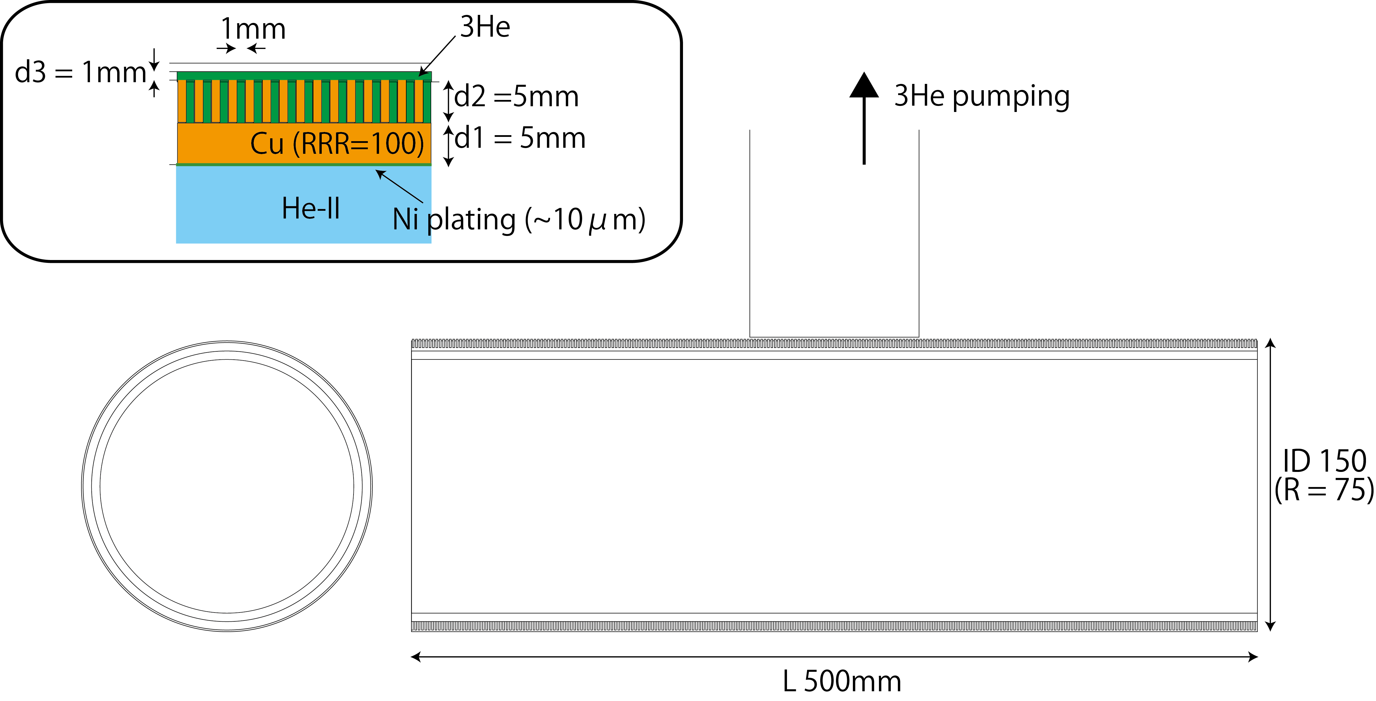
Heat exchanger
³He liq.
He-II
Cu Heat exchanger should be plated by Ni
Kapitza conductance between Cu-Ni is large enough since junction is solid-solid
Kapitza conductance between Ni and He-II
h_{K Ni} (T) = f*h_K_{K_Cu}(T) f = 0.61
Kapitza conductance between Cu and 3He
h_{K}(HeII) = ( 1.2 – 2.6 ) h_{K}(3He)
ex) average quality of Cu, 10 W heat load
junction between He-II and Ni
  h_{K Ni} (1.0K) = 244 [w/m2 K]
  ΔT _{He-II – Ni} = 0.16 K
  T _{Ni} = 0.84 K
junction between Cu and 3He
  h_{K Ni} (0.84K) = 232 [w/m2 K]
  ΔT _{He-II – Ni} = 0.09 K
  T _{3He} = 0.75 K

Slide 20
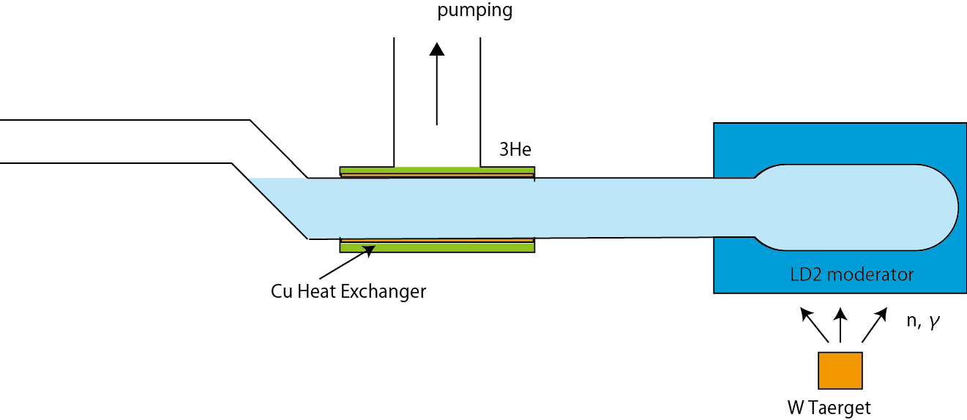
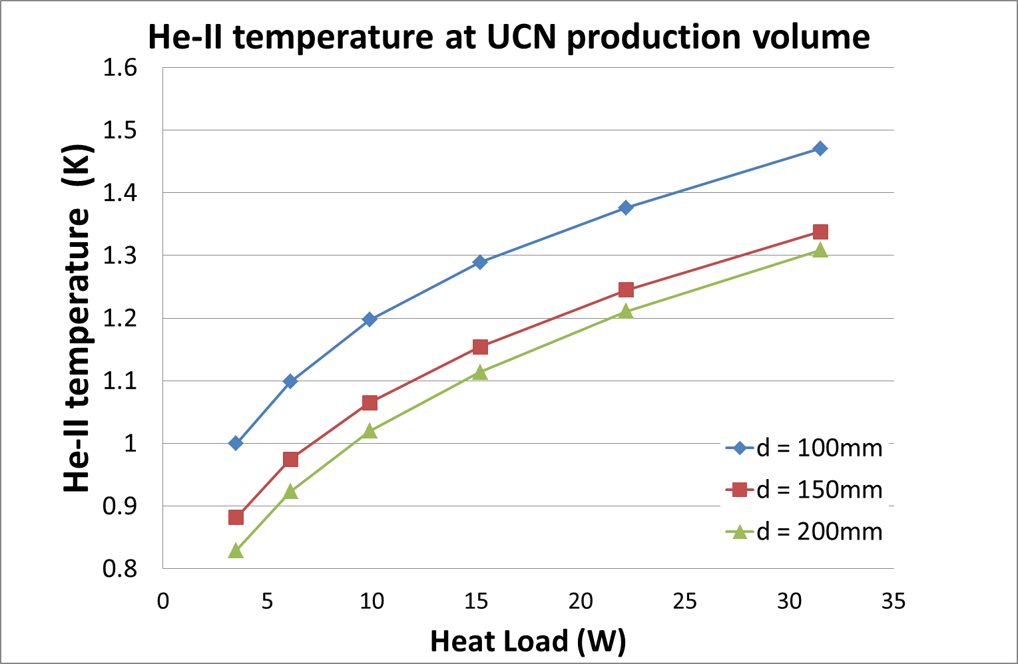
Equilibrium temperature
T_{3He}
T_{He-II L}
T_{He-II H}
Equilibrium temperature can be calculated as a function heat load.
example)
d = 150 mm, L = 1,000 mm
pumping speed 10,000 m³/hour
Heat load : 10 W case
Temperature distribution
  T_{He-II H} : 1.06 K (τ_{up-scat} = 87 sec)
  T_{He-II L} : 1.00 K
  T_{Cu H} : 0.84K
  T_{Cu L} : 0.83 K
  T_{3He} : 0.75 K
  ΔT = 0.31 K
Cu Heat Exchanger

Slide 21
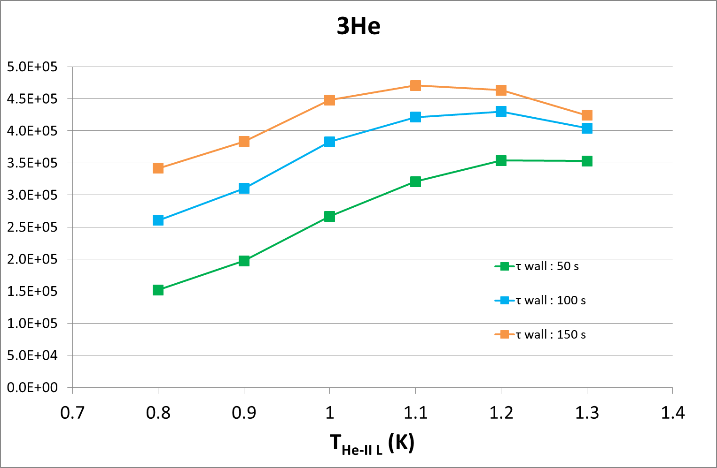
FOM in real case
temperature increase between UCN production volume and ³He is take into account
L = 1000mm, d = 150 mm
FOM = Cooling power x τ
FOM (a.u.)
T_{He H}
T_{He L}
T_{3He}
0.87
0.80
0.65
340
4.1
0.97
0.90
0.69
160
6.1
1.07
1.00
0.75
58
9.8
1.15
1.10
0.81
24
15
1.25
1.20
0.87
11
22
1.34
1.30
0.92
6
31
Temperature [K]
τ_{up-scatt} [s]
cooling power [W]

Slide 22
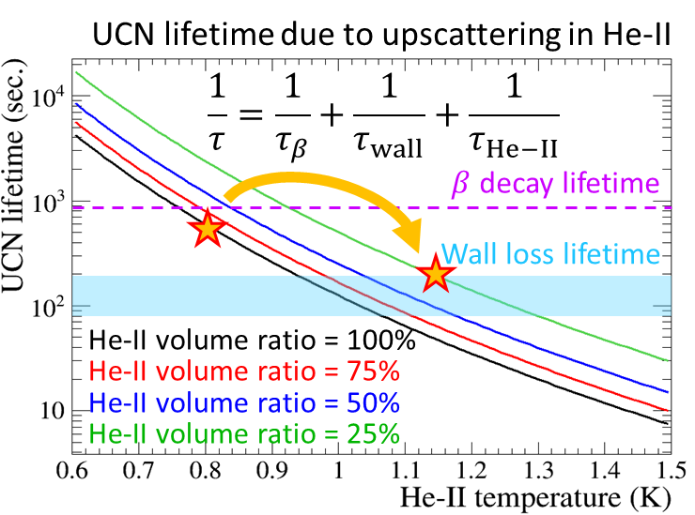
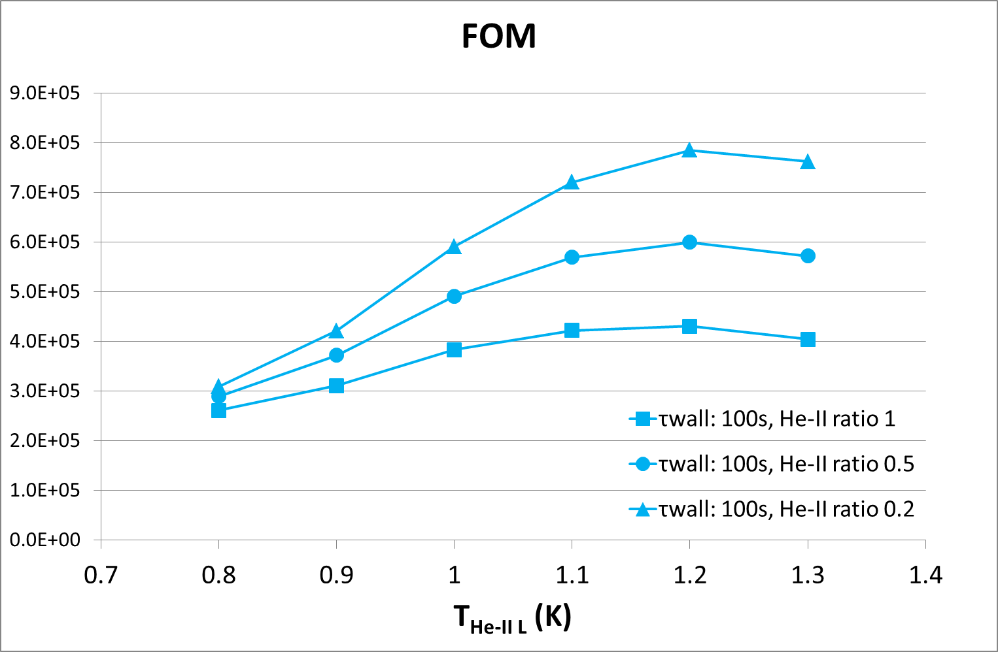
Effect of He-II Volume ratio
Volume ratio of He-II and Vacuum is also important parameter.
Total lifetime is increase when volume ratio is small
UCN scattering with vapor He become serious when He-II temperature above 1.4 K

Slide 23
He-II cryostat
A new He-II cryostat is been developing
  TRIUMF proton beam line BL1U
  500 MeV × 40 μA = 20 kW
  necessary cooling power is around 10 W at 1.0 K
  Heat conductance is important
    inside He-II
    Kapitza conductance between He-II/3He and heat exchanger
  FOM can be calculated as a function of temperature
  FOM = cooling power × UCN life time
  Optimum working temperature is around 1.0 – 1.2K

Slide 24
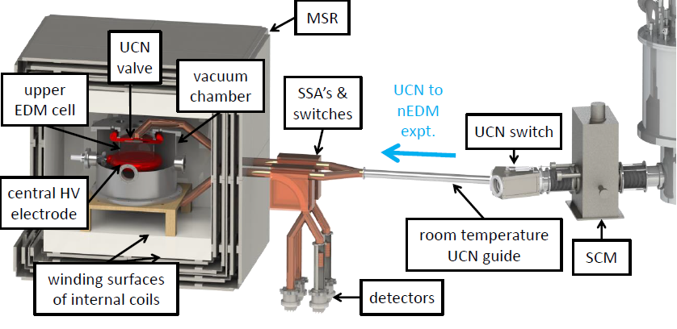
Second UCN port : Y switch
Bend is necessary for radiation protection
  not to see target area directly
Y switch can be diverted UCN to another area.
  R&D for UCN guide, detector and so on
  open for user facility in future

Slide 25
Summary
We will start UCN production with vertical UCN source comes from RCNP
  limit of proton beam power is ～0.5 kW due to small cooling power
High intensity UCN source is been developed
  proton beam power : 500 MeV * 40 μA = 20 kW
  new ³He cryostat with higher cooling power
    necessary cooling power : ~10 W at 1.0 K
  FOM can be calculated as a temperature
    optimum temperature is 1.0 – 1.2 K
  Final optimization is on going
    > 2.3×10⁷UCN/sec.
    > 600 UCN/cc at EDM cell -> statistical error of 10⁻²⁷ ecm / 100 MT day
  Plan to produce UCN from 2020

