Slide 1
Environmental Magnetic Fields for the Neutron Electric Dipole Moment Experiment at TRIUMF
By: Maedeh Lavvaf
Magnetically Shielded Room (MSR)
Mapping the magnetic field in TUCAN area

Slide 2
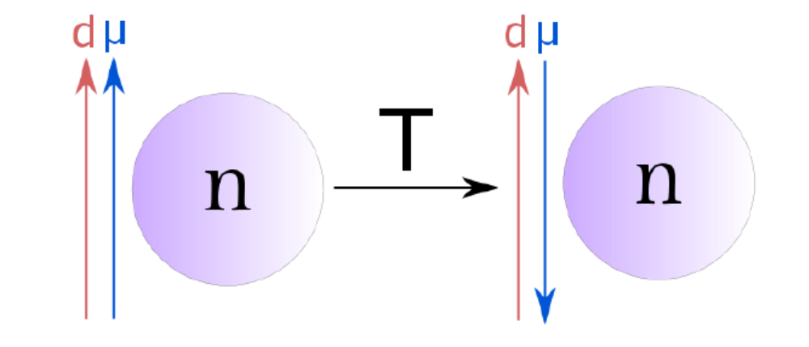
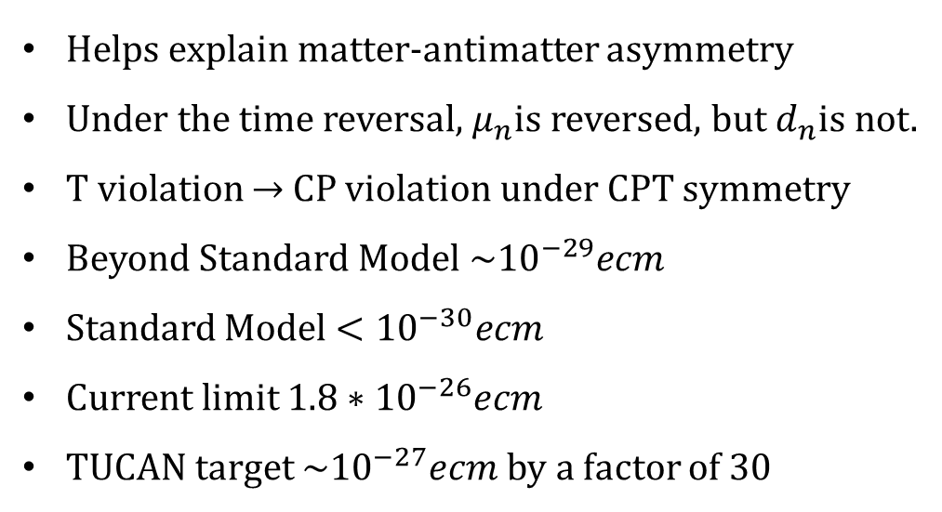
nEDM Experiment Motivation
Helps explain matter-antimatter asymmetry
Under the time reversal, $μ_{n}$is reversed, but $d_{n}$is not.
T violation $→$ CP violation under CPT symmetry
Beyond Standard Model $\sim {10}^{−29}ecm$
Standard Model $<{10}^{−30}ecm$
Current limit $1.8∗{10}^{−26}ecm$
TUCAN target $\sim {10}^{−27}ecm$ by a factor of 30
Notes:
SM doesn’t contain enough CP violation in order to explain particle creation. The non-zero nEDM is a source of CP violation that could explain baryon asymmetry. If the nEDM found, it could contribute to our understanding of extensions of the SM. The TRIUMF colaboration aims to improve the sensitivity by a factor of 30 with a goal of sensitivity of 10^-27e.cm

Slide 3
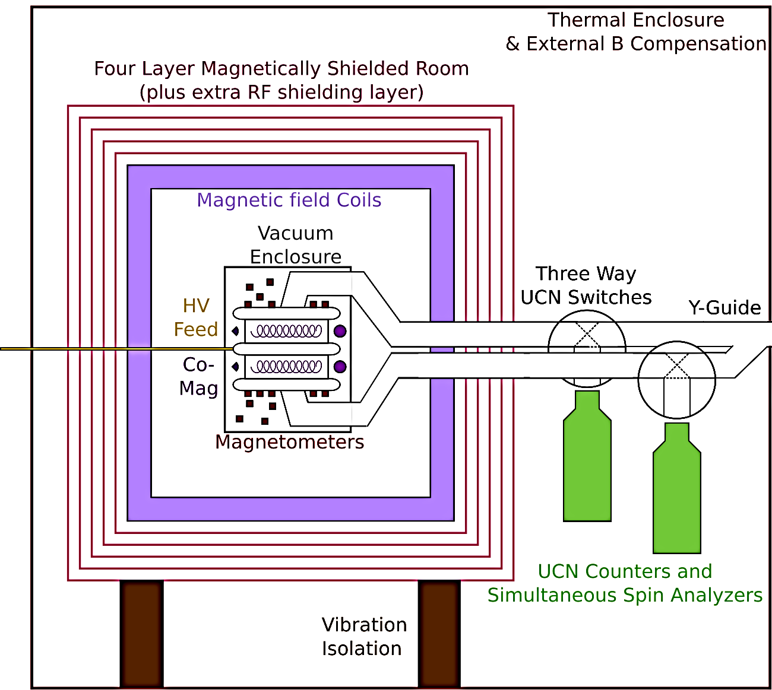
TUCAN nEDM Experiment
Goal: 10^-27 e.cm within 400 measurement days
Experiment | Timeline
Detailed design and build | Now -2022
Installation and Commissioning nEDM apparatus nEDM run | 2023

Slide 4
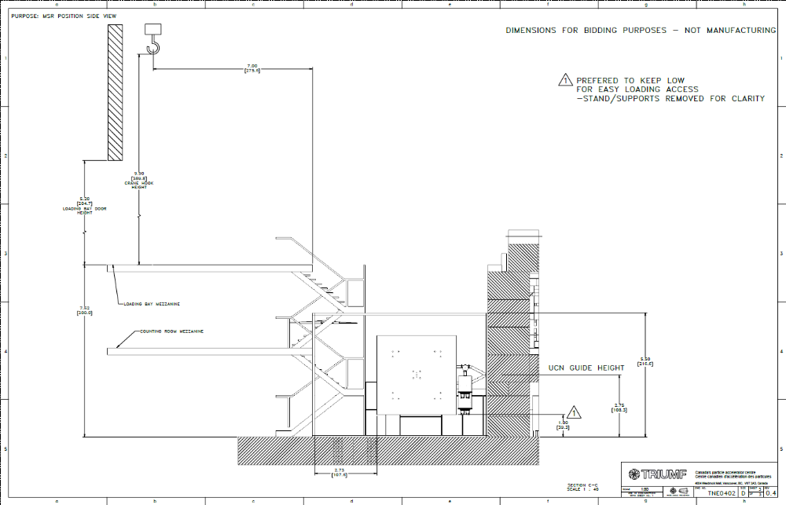
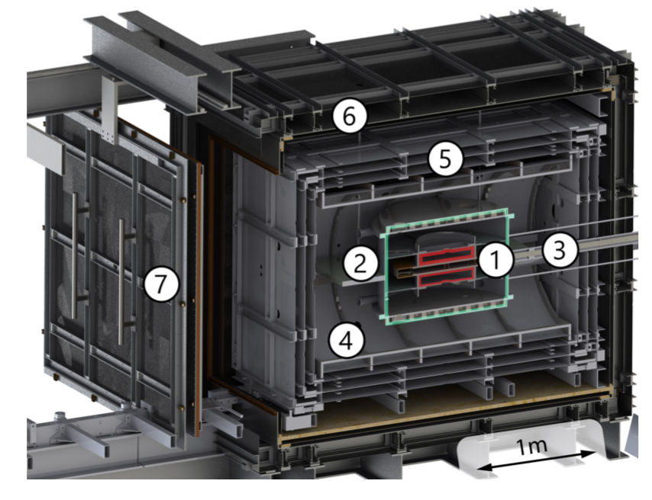
TUCAN Magnetically Shielded Room
A Magnetically Shielded Room (MSR) is a multi-layer room built with high permeability material, such as mumetal, and high conductivity sheet materials, such as copper.
Side View

Slide 5
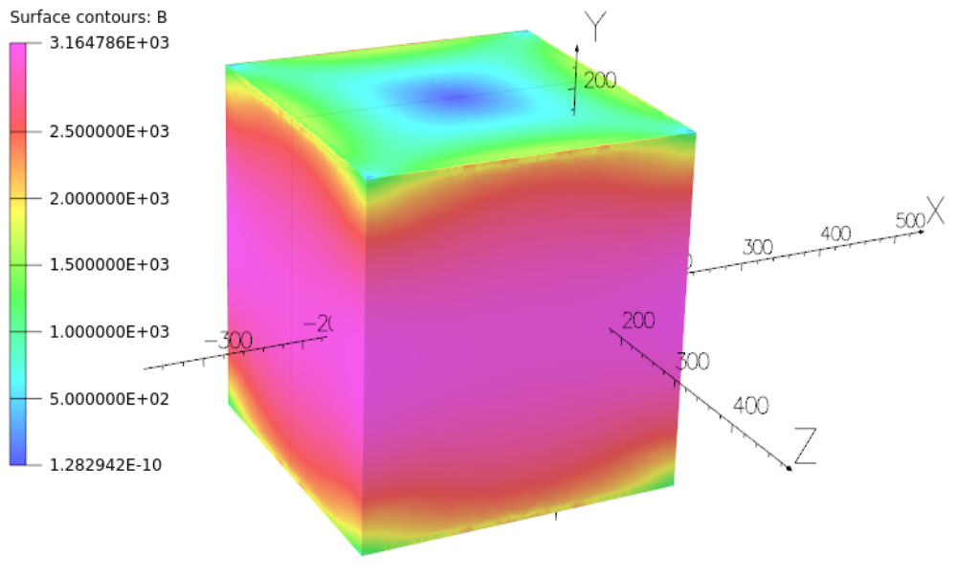
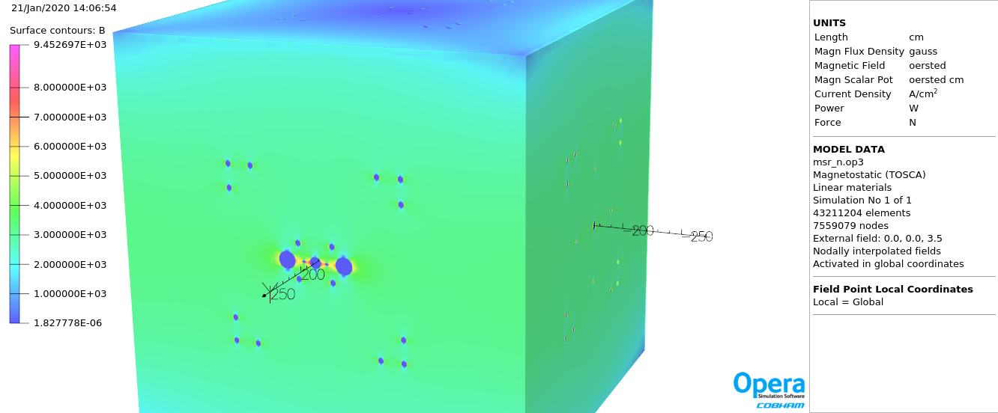
MSR Outer Layer Saturation
Unique Challenge: Saturation (0.7 T) of the MSR most outer layer from the TRIUMF Cyclotron fringe field
Surface B field (T)
Surface B field (T)
0.32
0.95
0.8
0.25
0.7
Saturation near big holes
0.20
0.6
0.5
0.15
0.4
0.10
0.3
0.2
0.05
0.1
1.3E-6
0.18E-3
Opera FEA (static mu=1M)
Using B=350 µT Vertical Field
Opera FEA (static mu=1M)
Using B=350 µT Vertical Field
MSR outerlayer > 0.1 T, especially near the holes
Need to use actual field at TRIUMF site

Slide 6
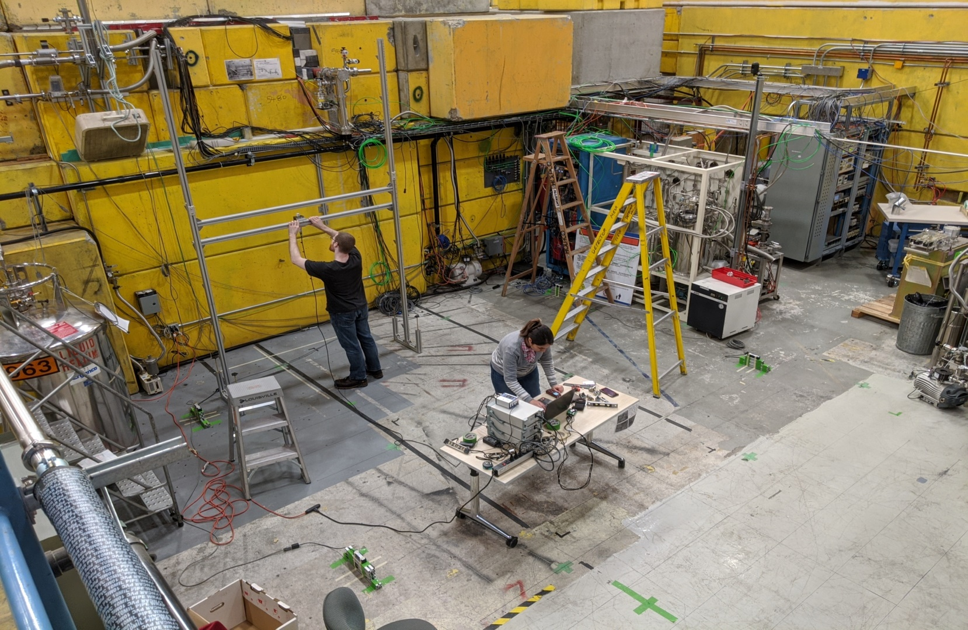
Field Mapping with TRIUMF cyclotron on/off
Map area:
Xtot =400cm
Ytot =500cm
Ztot =350cm
in 40 cm increments
MSR foot print
Mapping foot print

Slide 7
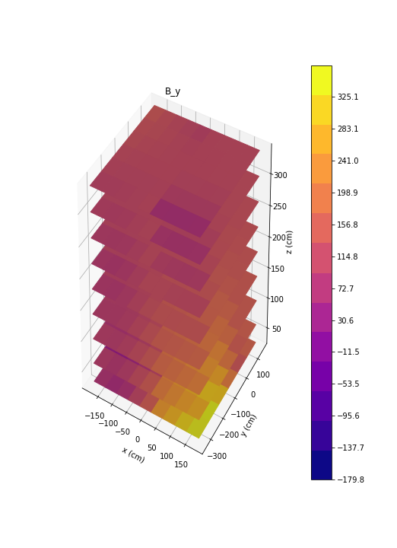
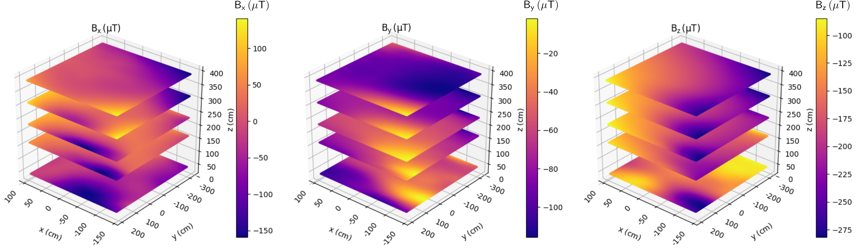
Field Mapping with TRIUMF cyclotron on/off
Cyclotron On
Cyclotron Off
505 µT
120 µT
  |B| ≃ 370 µT at strongest points
  MSR height above the floor: 1 m
  Z axis is height from floor

Slide 8

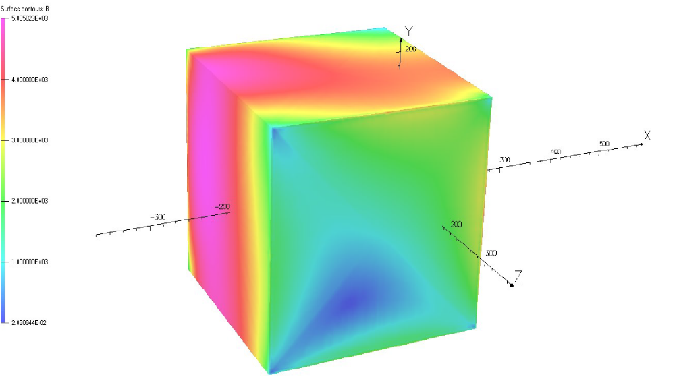
Opera scalar potential applied to boundary/ result
Surface B field (T)
Surface B field (T)
Cyclotron on
0.32
0.52
0.25
0.42
0.20
0.34
0.15
0.26
0.10
0.18
0.05
0.1
1.3E-6
2E-6
Opera FEA (static mu=1M)
Using B=350 µT Vertical Field
Opera FEA (static mu=1M)
Using B=350 µT Actual Field
Max field is 0.3 T
Max field is 0.5 T
Need An external B field compensation system

Slide 9
Summary
Going to measure the nEDM
Going to use an MSR at TRIUMF
Mapped the magnetic field
Need An external B field compensation system

Slide 10





Slide 11
Backup slides

Slide 12
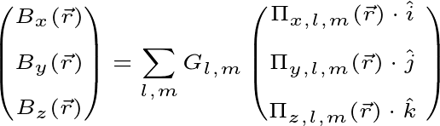


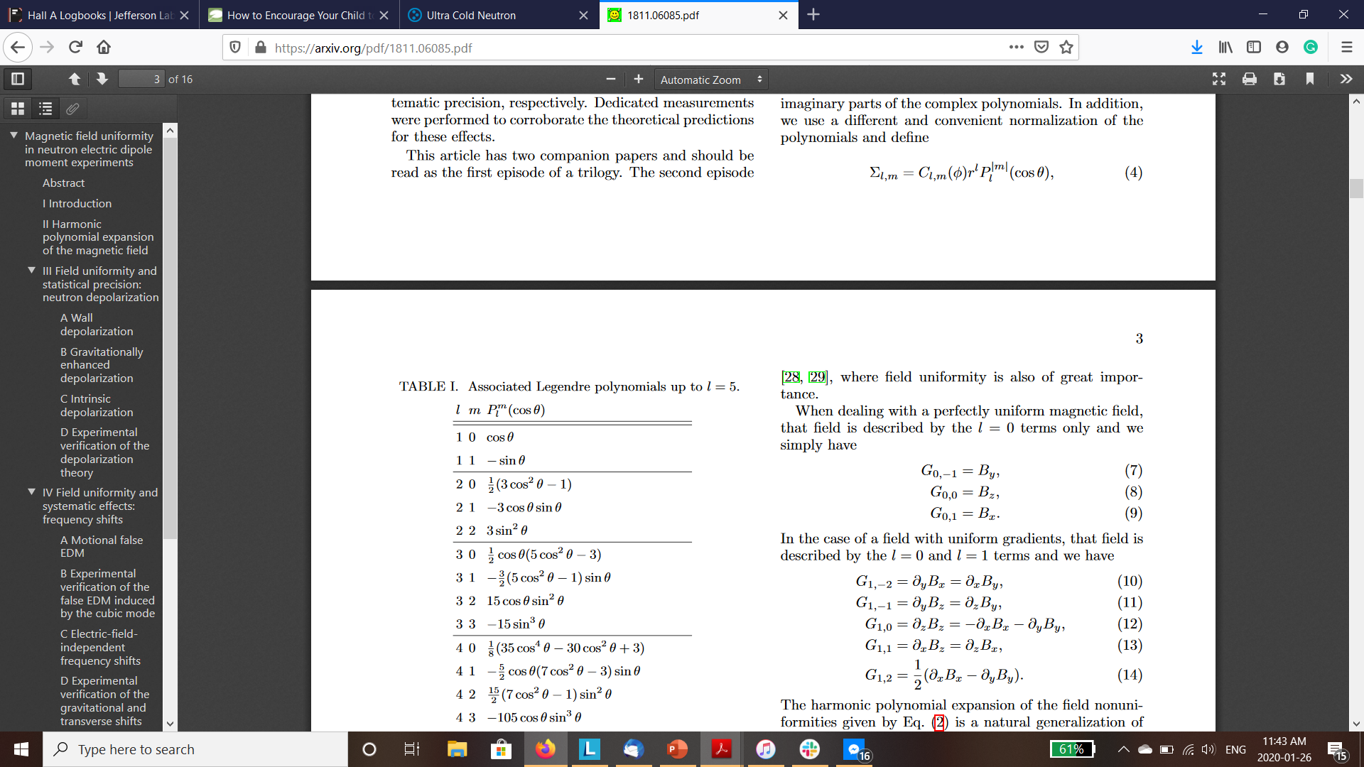


Decomposition into spherical harmonics
Use Decomposition as found in C. Abel et.al, Phys. Rev. A 99, 042112 (2019)
In free space,
Where Πi,l,m are the x, y, and z derivatives of the scalar basis functions. Gl,m are then the coefficients that describe the magnetic field in the volume by gradient.
$$G_{0,0}=B_{z}$$
$$G_{1,0}={∂_{z}B}_{z}$$
Fit our magnetic Field maps up to 3rd order in B

Slide 13
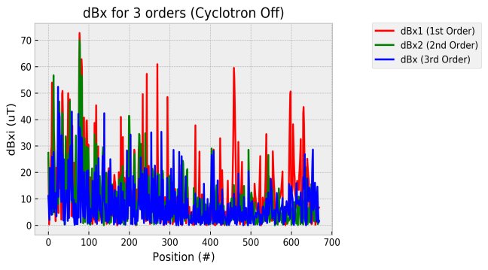
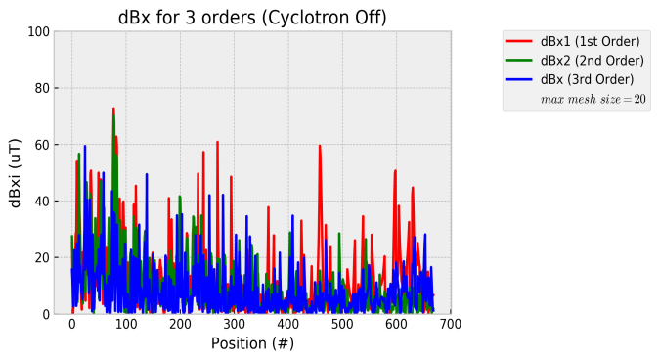
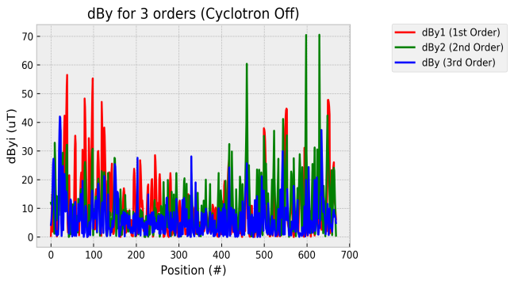
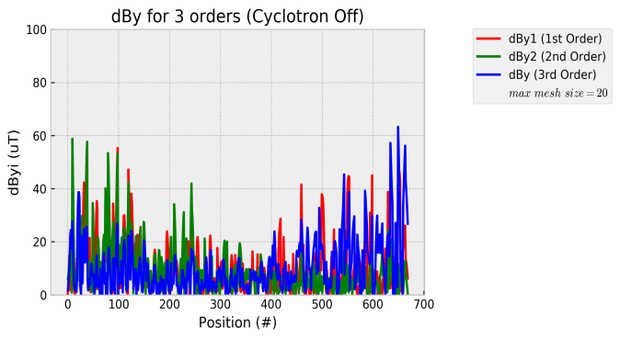
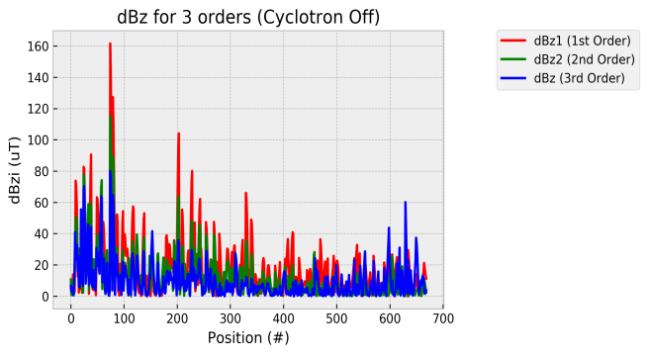
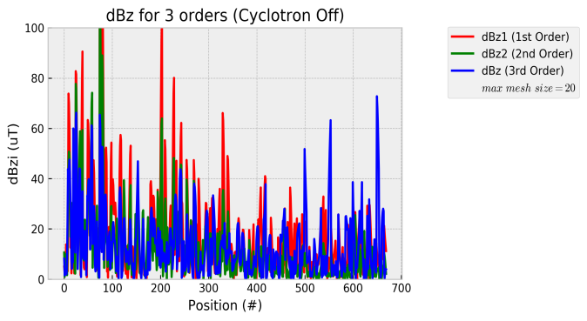
Comparison of B field from GLMs to measured field maps
Cyclotron off
Python
Opera

Slide 14
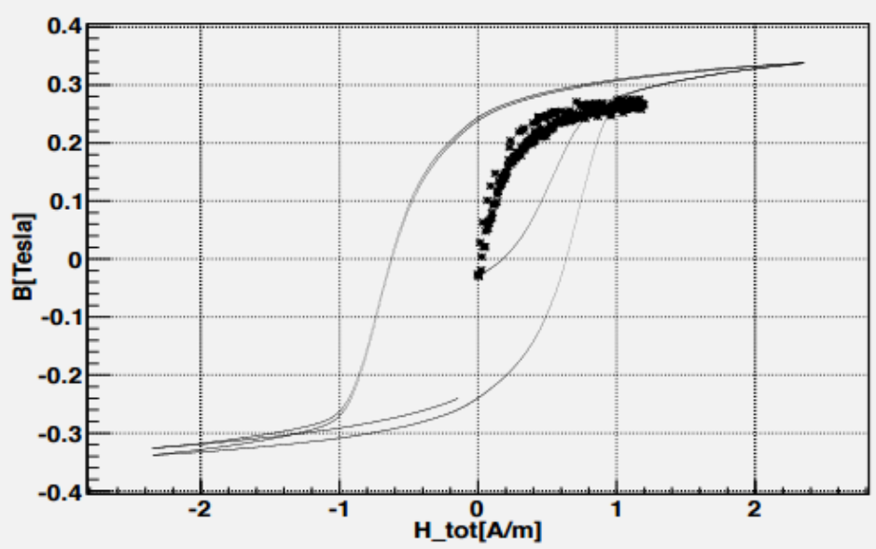
Magnetic Permeability

