Slide 1
Simulation and Data Comparison of Ultra Cold Neutron Experiments for TUCAN Collaboration
Background
A Detector Efficiency Comparison
  The Detector setup
  The results given EW bias in rotary valve
Simulations of the Spectrum and RCNP
  Spectrum Introduction
  The Simulation and discrepancies
Beryl Bell, Msc McGill University, TUCAN Collaboration

Slide 2
Background

Slide 3

Collaboration
TRIUMF UltraCold Advanced Neutron Collaboration
Goals
Next generation ultra cold neutron source
Order of magnitude improvement on sensitivity of neutron electric dipole measurement

Slide 4
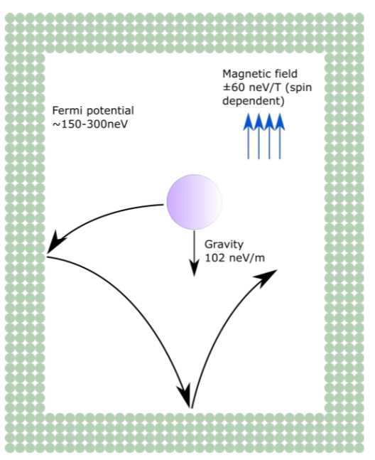
Ultra Cold Neutron Refresher
Ultra Cold Neutrons (UCNs) are neutrons with less than 300 neV of kinetic energy
In this energy range UCN can be treated as a thin gas. They interact with materials as a constant Fermi potential, rather than as individual atoms.
This enables the containment and transport of UCN in materials with sufficiently high Fermi Potentials
Notes:
say nano not n

Slide 5
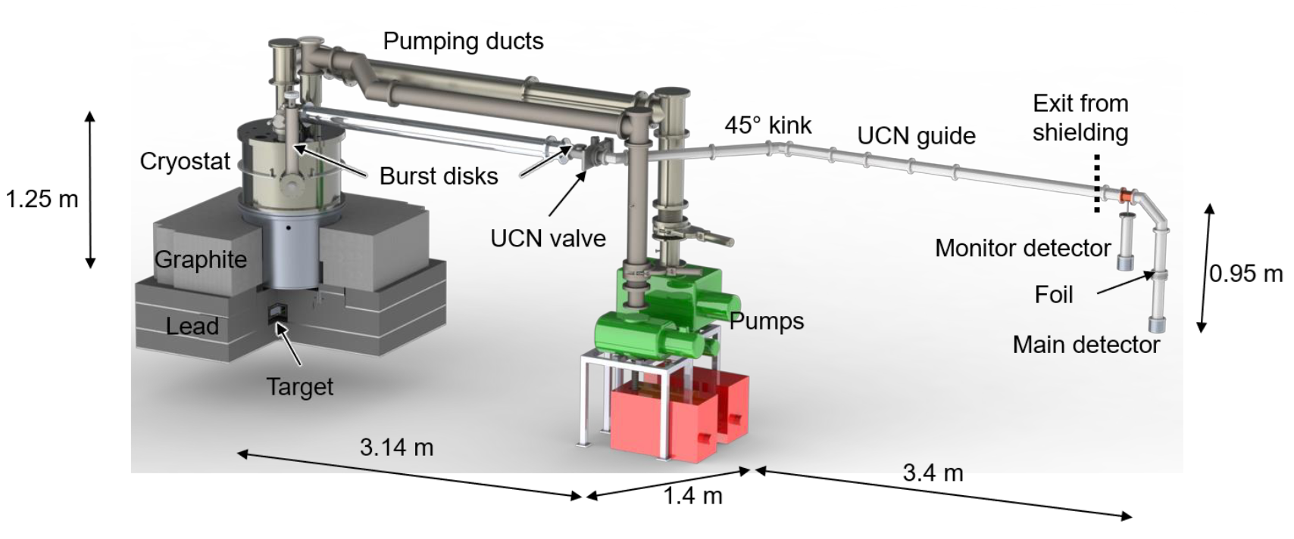
Monitor Detector
He3 Detector used to monitor UCN production
Li6 Detector used to count transmitted UCN

Slide 6
Detectors and Models

Slide 7
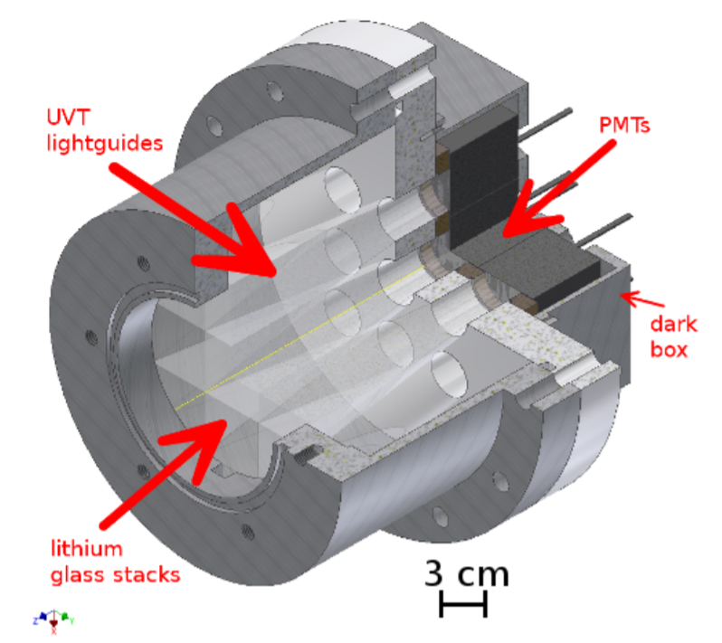

Li6 Glass Detector
Scintillating glass detector doped with Li6
Neutron capture cross section on the order of 10^5 bn
Background from thermal neutrons and gamma ray interactions
UCN
Triton
Li6 Depleted
Alpha
Li6 Enriched
Notes:
Pulse shape discrimination allows for an exclusion of most of these signals

Slide 8
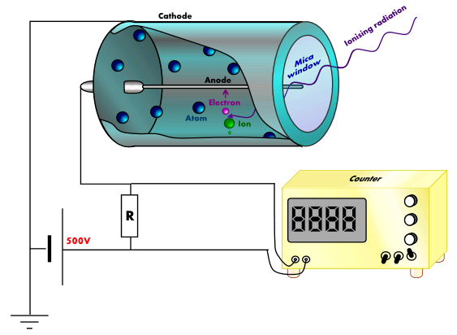
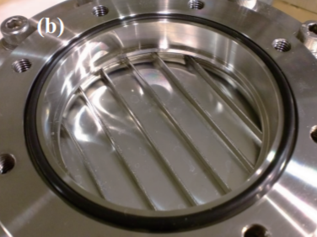

He3 Detector
UCN
Gas proportional counter injected with He3
Sensitive to slow moving neutrons
He-1
He3
He-3
Notes:
http://large.stanford.edu/courses/2012/ph241/lam1/images/f1big.png

Slide 9
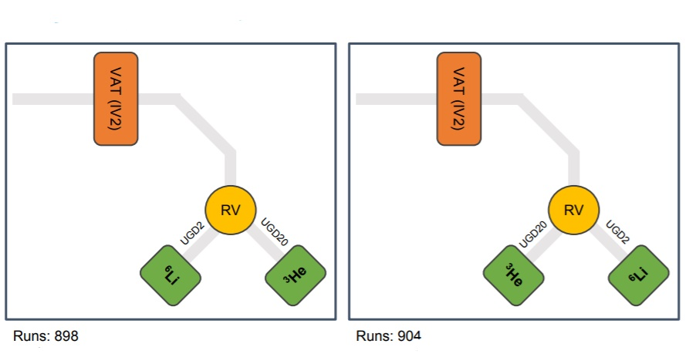
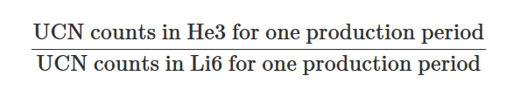

Symmetric positioning in experiment
Measurable:
East
West

Slide 10

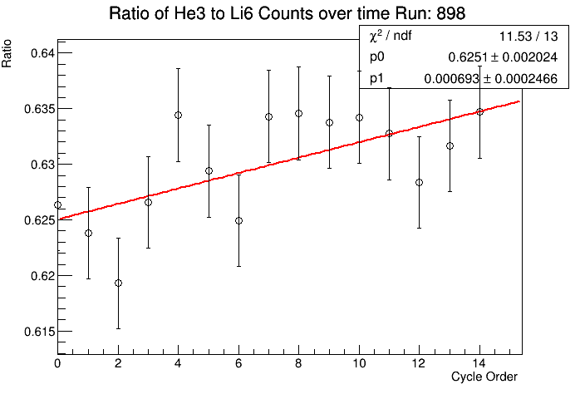
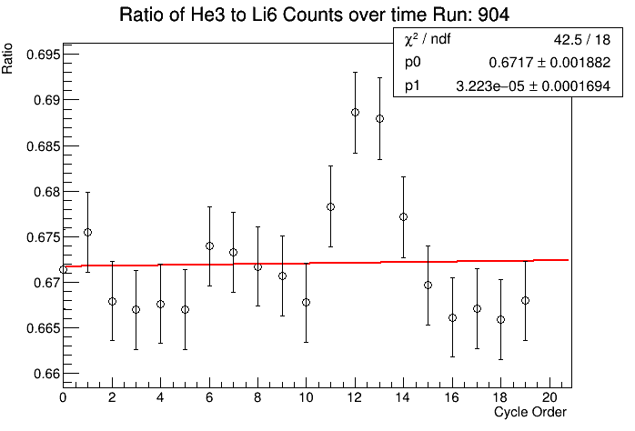
Results and Asymmetries
East
West

Slide 11
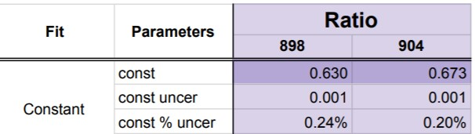
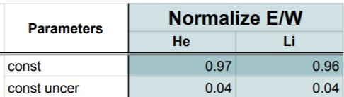
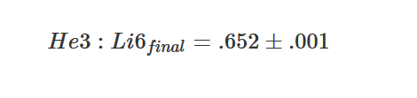
Results and Asymmetries
The ratio between the Li6 and He3 detectors is slightly different between the two runs
East
West
The comparison of the Li6 and the He3 on opposite sides shows an apparent asymmetry in the rotary valve which would account for the difference in ratios

Slide 12
RCNP(Research Center for Nuclear Physics)
Spectrum Analysis
Notes:
mention that source was at rcnp-> triumf
define RCNP

Slide 13
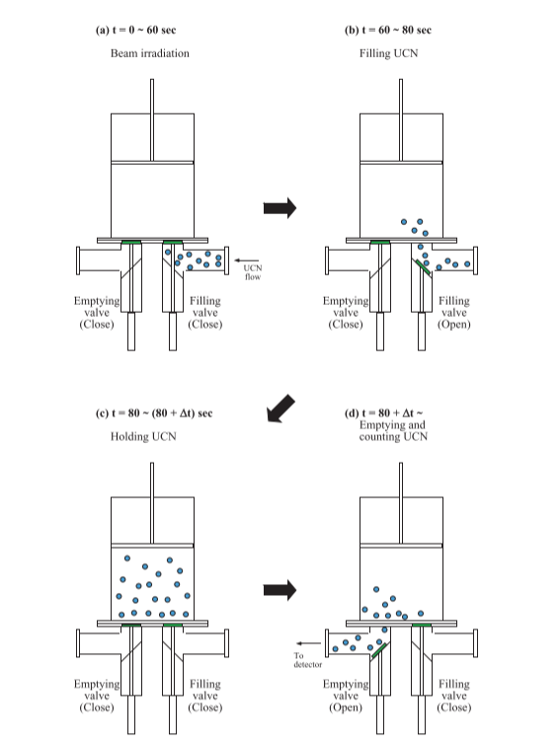
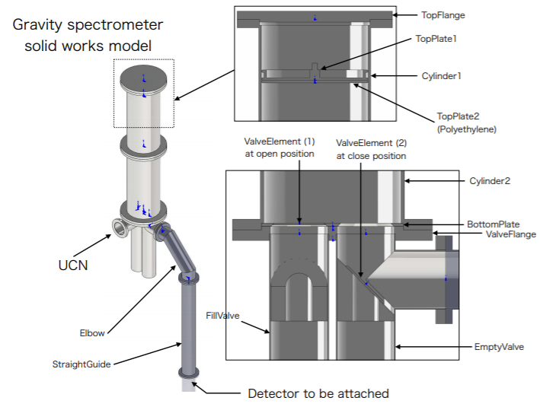

UCN Spectrum and Measurement
The produced UCN energy spectrum is expected to follow the form
This spectrum influences the how well the guides can be expected to contain the UCN in the production and transport process, and the materials have an energy dependant interaction with the neutrons .
Notes:
Spend time on filling and emptying

Slide 14
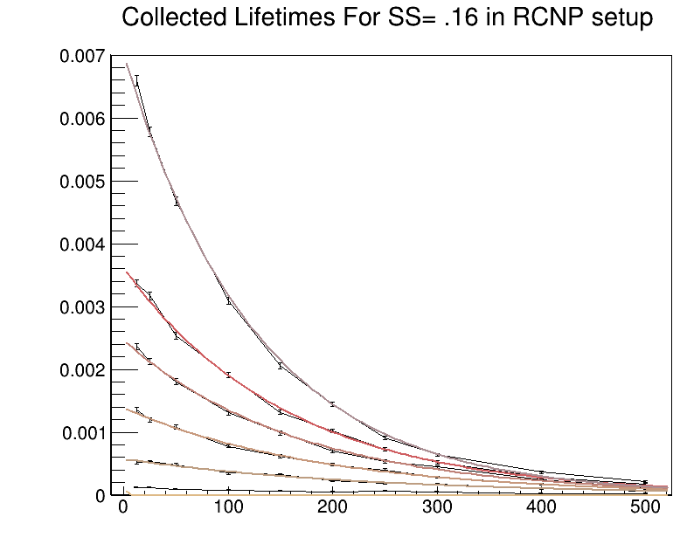

Simulations
Simulated RCNP Storage Lifetimes
The simulations done in PENTrack of the energy spectrum of the RCNP source differs from the experimental data in the trend of the longer lifetimes with lower lifetimes at higher plate levels
Potential causes
The absorber plate has been modeled as a better absorber than it is.
Wall loss probability is energy independent
Plate Height (cm) | Storage Lifetime Simulated (s)
10 | 289 ∓ 7
20 | 234 ∓ 8
30 | 190 ∓ 4
40 | 167 ∓ 3
50 | 156 ∓ 2
80 | 127 ∓ 1
percent UCN detected
delay time (s)

Slide 15
Conclusion
Symmetric comparisons of He3 and Li6 detectors gave relative efficiencies of the two .
Simulation of the RCNP UCN source are currently lacking in their ability to well represent the loss of the slow neutron population

Slide 16
fin

Slide 17
Extra Slides

Slide 18
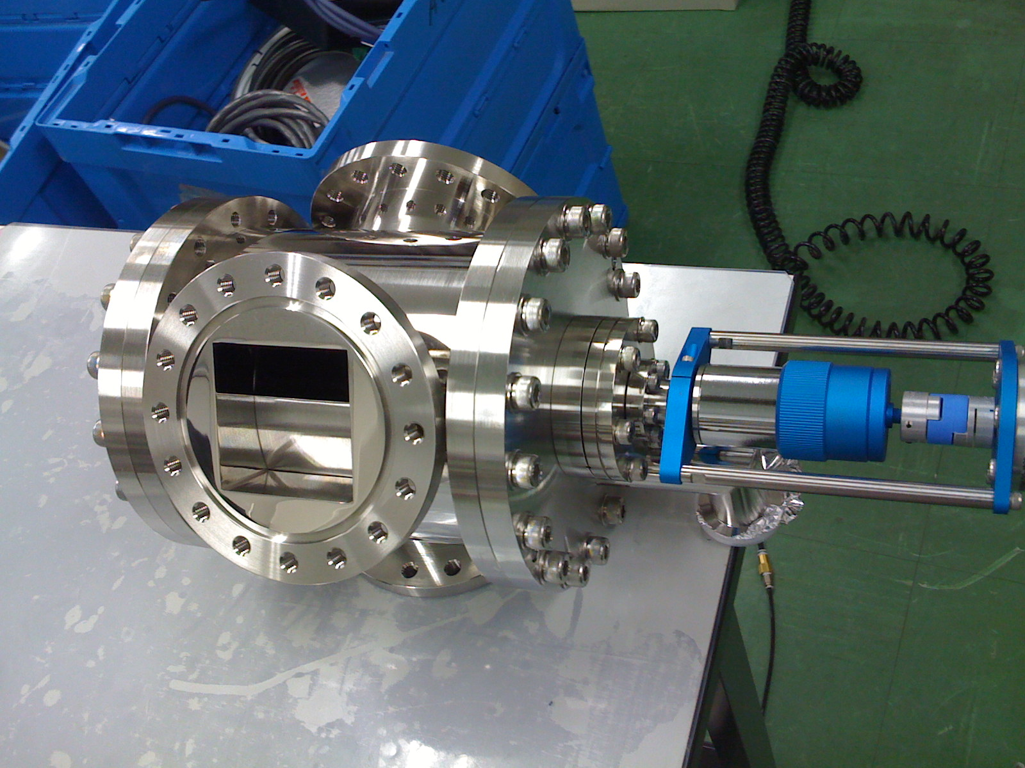
Rotary Valve
Valve with square guide which allows for the UCN to be sent in different directions.
In this experiment, alternating UCN producing shots are sent to the He3 and Li6 detector.
Potential asymmetries in the valve

Slide 19
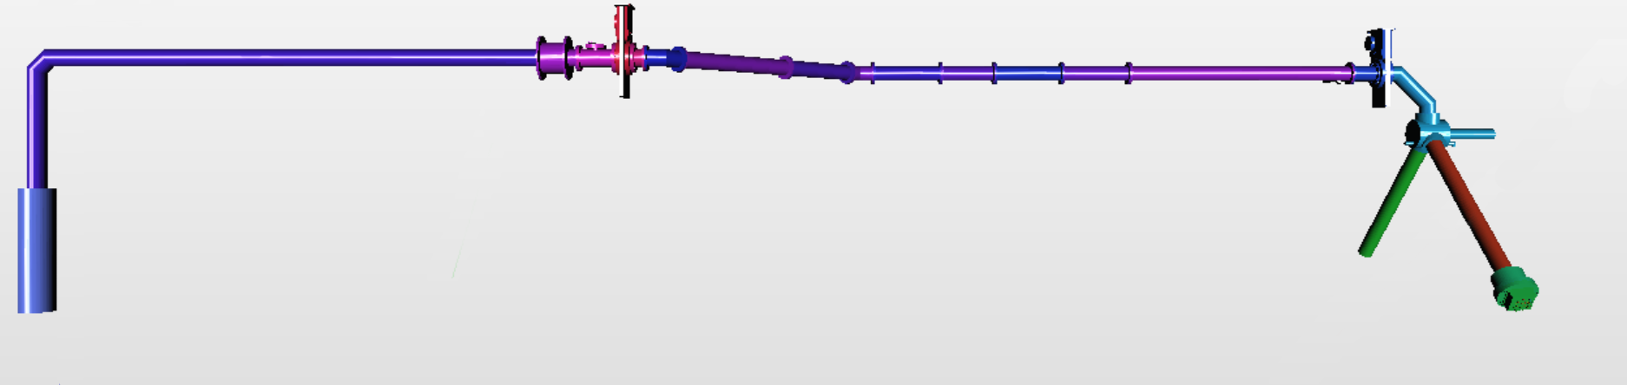
TUCAN18-020/021
Valve
Production Volume
Rotary Valve and Detectors

Slide 20
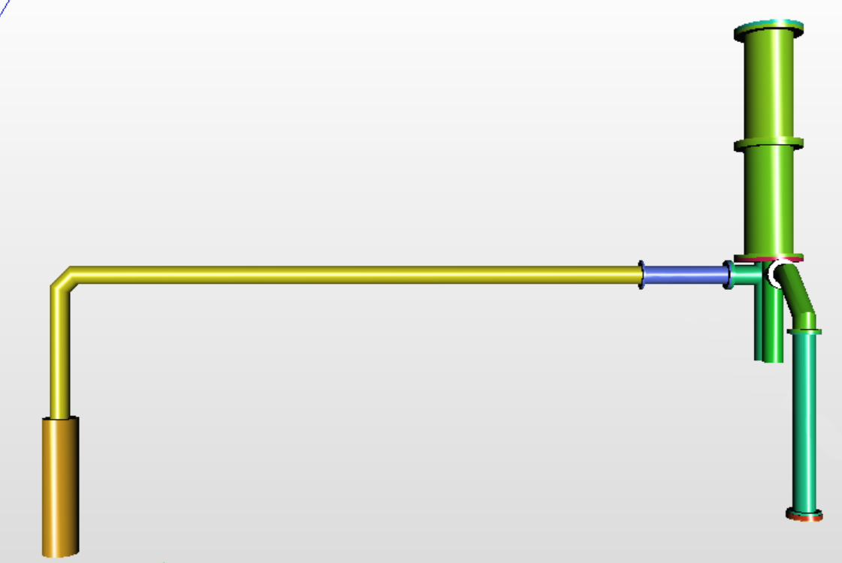
RCNP setup
Spectrum Bottle with Adjustable Plate
Production Volume
Helium Gas Detector

Slide 21
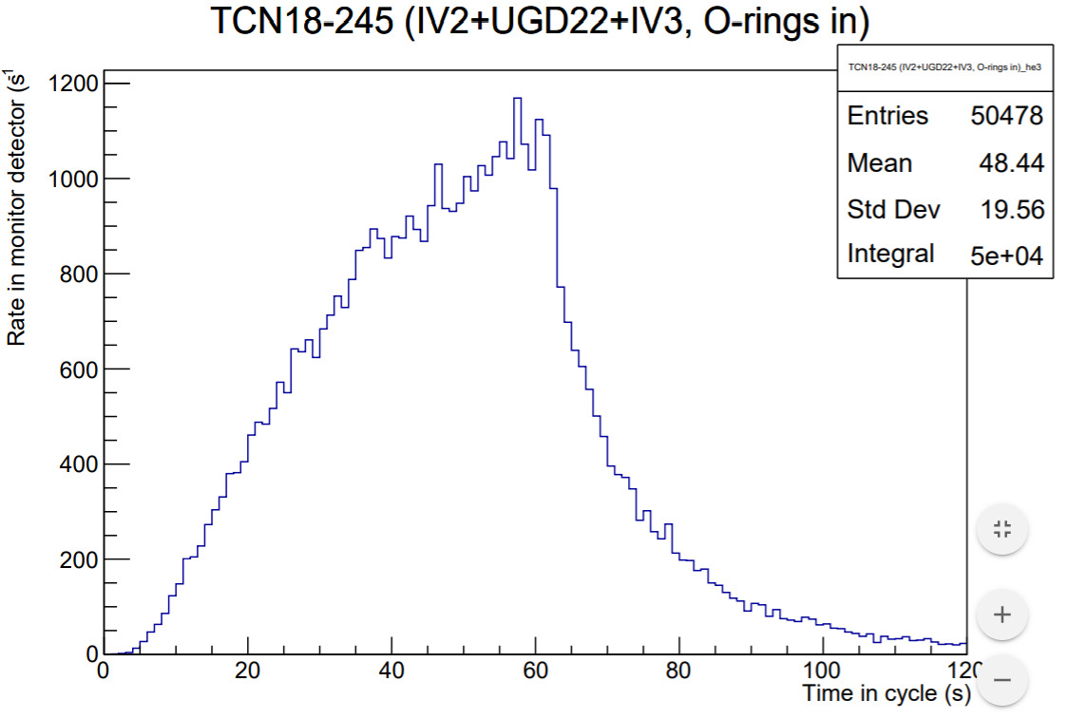


Monitor Counts
Integrate counts in He3 Detector during irradiation (first 60 seconds)
Instantaneous Number of UCN in volume after production

