Slide 1


Non-perturbative Extraction of the
Effective Mass in
Neutron Matter
Nawar Ismail
Mateusz Buraczynski
Alexandros Gezerlis
Feb 15, 2020
University of guelph
Department of physics

Slide 2
Overview
Motivation
Neutron Matter
Methods & Techniques
Effective Mass
Quantum Monte Carlo
Interpretations & Results
Density Dependence
Extraction
Extrapolation

Slide 3
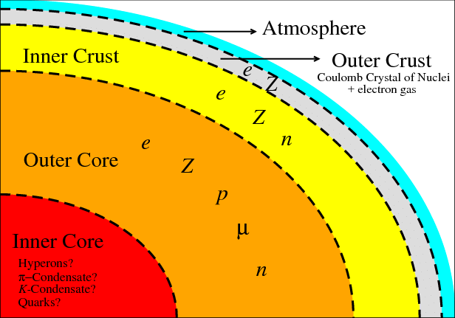
Motivation
Neutron Matter (NM)
  Inner crust of neutron stars
  Testing state-of-the-art nuclear forces
  EOS, pairing gap, static response of NM
Effective Mass
  Captures many-body physics
  Energy Density Functionals (EDF)
    Many-body properties expressed as single particle-density
    Requires precise determination of parameters
  Systematic, model-independent extraction
  Observables: Thermal index, maximum mass, static response, heat-capacity
X. Roca-Maza, J. Piekarewicz, T. Garcia-Galvez, and M. Centelles (2011)

Slide 4
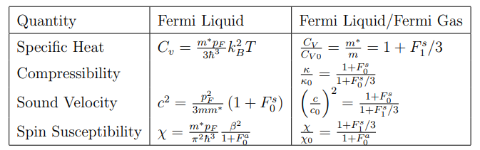
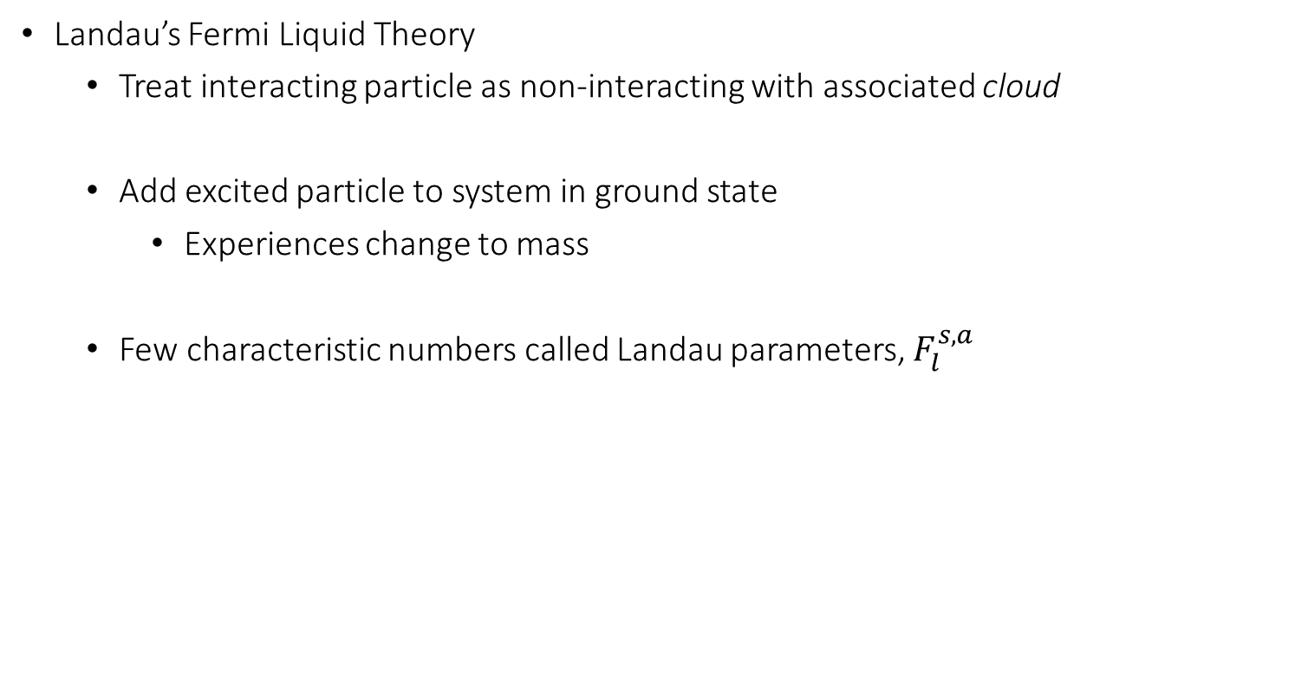
Effective Mass
Landau’s Fermi Liquid Theory
  Treat interacting particle as non-interacting with associated cloud
  Add excited particle to system in ground state
    Experiences change to mass
  Few characteristic numbers called Landau parameters, $F_{l}^{s,a }$

Slide 5
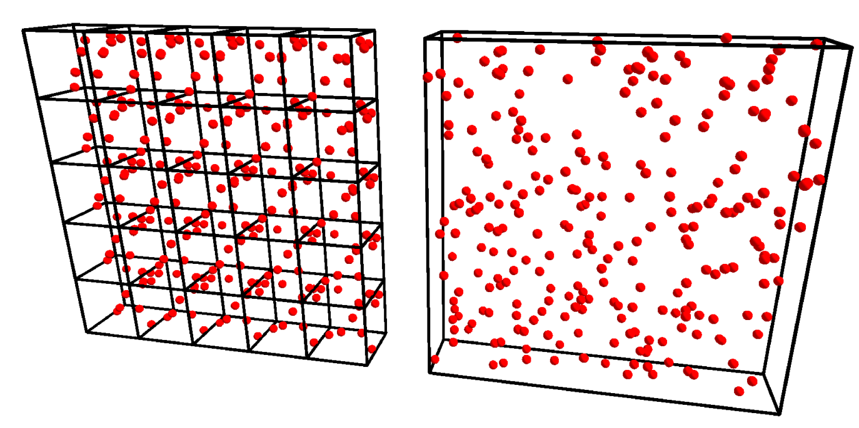
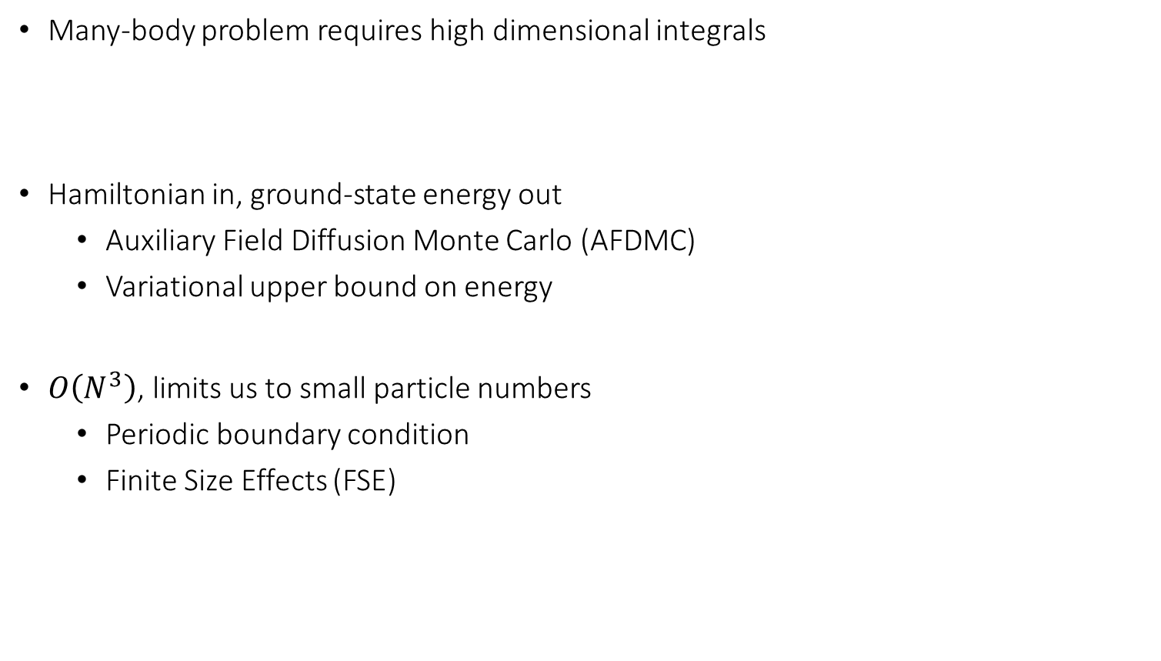
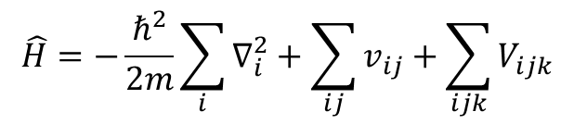
Quantum Monte Carlo (QMC)
Many-body problem requires high dimensional integrals
Hamiltonian in, ground-state energy out
  Auxiliary Field Diffusion Monte Carlo (AFDMC)
  Variational upper bound on energy
$O\left(N^{3}\right)$, limits us to small particle numbers
  Periodic boundary condition
  Finite Size Effects (FSE)
$$\hat{H}=−\frac{ℏ^{2}}{2m}\sum_{i}{∇_{i}^{2}}+\sum_{ij}{v_{ij}+\sum_{ijk}{V_{ijk}}}$$
Too Poor
Too Difficult
Hear more: Today 20:30-20:45
Palkanoglou, Georgios
The pairing gap

Slide 6
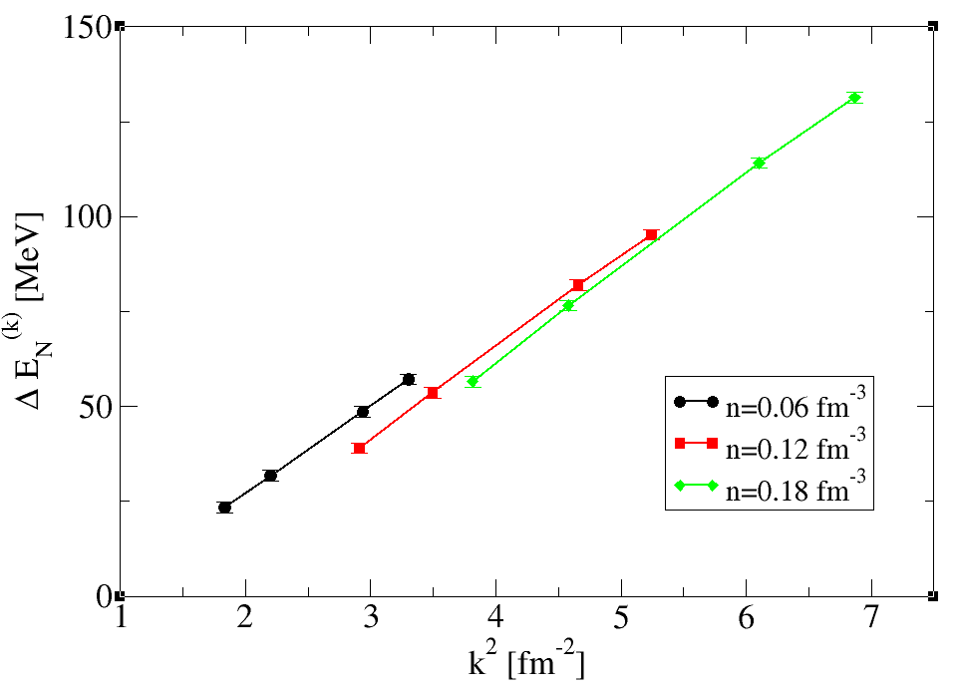


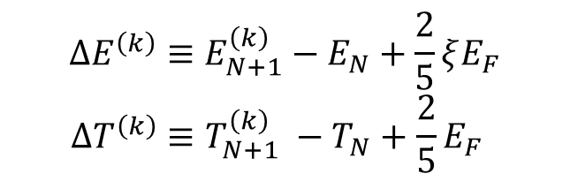
Extraction
Effective mass obtained from fit to quasi-particle dispersion relation
$ΔE^{\left(k\right)}=\frac{ℏ^{2}}{2m^{∗}}k^{2}$
$$ΔE^{\left(k\right)}≡E_{N+1}^{\left(k\right)}−E_{N}+\frac{2}{5}ξE_{F}$$
$$ΔT^{\left(k\right)}≡T_{N+1}^{\left(k\right)} −T_{N}+\frac{2}{5}E_{F}$$
Need energy and momentum calculations!

Slide 7
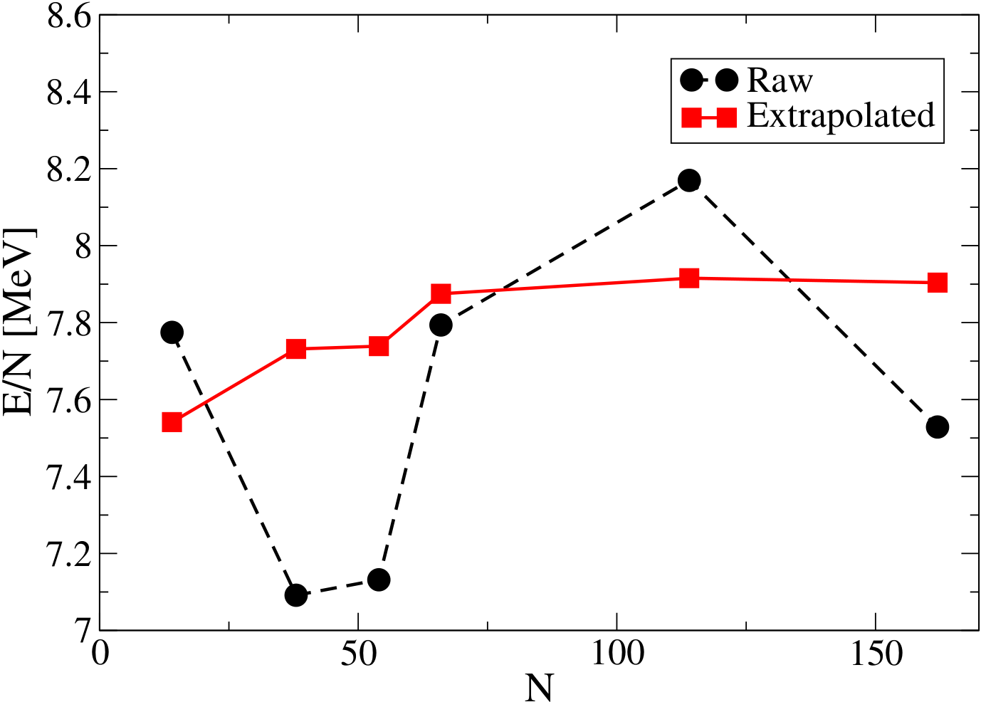
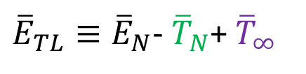

Extrapolation
Replace (analytic) kinetic energy with macroscopic value
${\overline{E}}_{TL}≡{\overline{E}}_{N}$- ${\overline{T}}_{N}$+ ${\overline{T}}_{∞}$
$←$ Energy Per Particle
Reduces FSEs to ~10%
Large N to ~1%

Slide 8
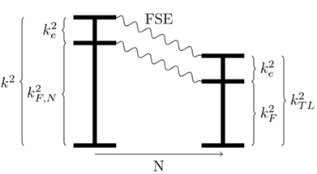
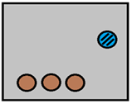

Extrapolation
$$k_{TL}^{2}≡k^{2}−k_{F,N}^{2}+k_{F}^{2}$$

Slide 9
Extrapolation
$$k_{TL}^{2}≡k^{2}−k_{F,N}^{2}+k_{F}^{2}$$

Slide 10
Extrapolation
$$k_{TL}^{2}≡k^{2}−k_{F,N}^{2}+k_{F}^{2}$$

Slide 11

Extrapolation
Replace (analytic) ground-state momentum with macroscopic value
$$k_{TL}^{2}≡k^{2}−k_{F,N}^{2}+k_{F}^{2}$$

Slide 12
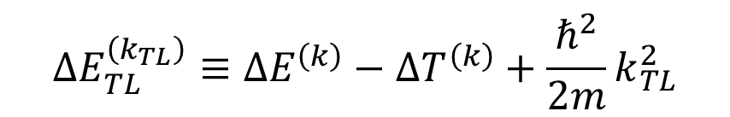
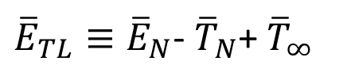
Extrapolation
${\overline{E}}_{TL}≡{\overline{E}}_{N}$- ${\overline{T}}_{N}$+ ${\overline{T}}_{∞}$
$$k_{TL}^{2}≡k^{2}−k_{F,N}^{2}+k_{F}^{2}$$
$$ΔE_{TL}^{\left(k_{TL}\right)}≡ΔE^{\left(k\right)}−ΔT^{\left(k\right)}+\frac{ℏ^{2}}{2m}k_{TL}^{2}$$

Slide 13
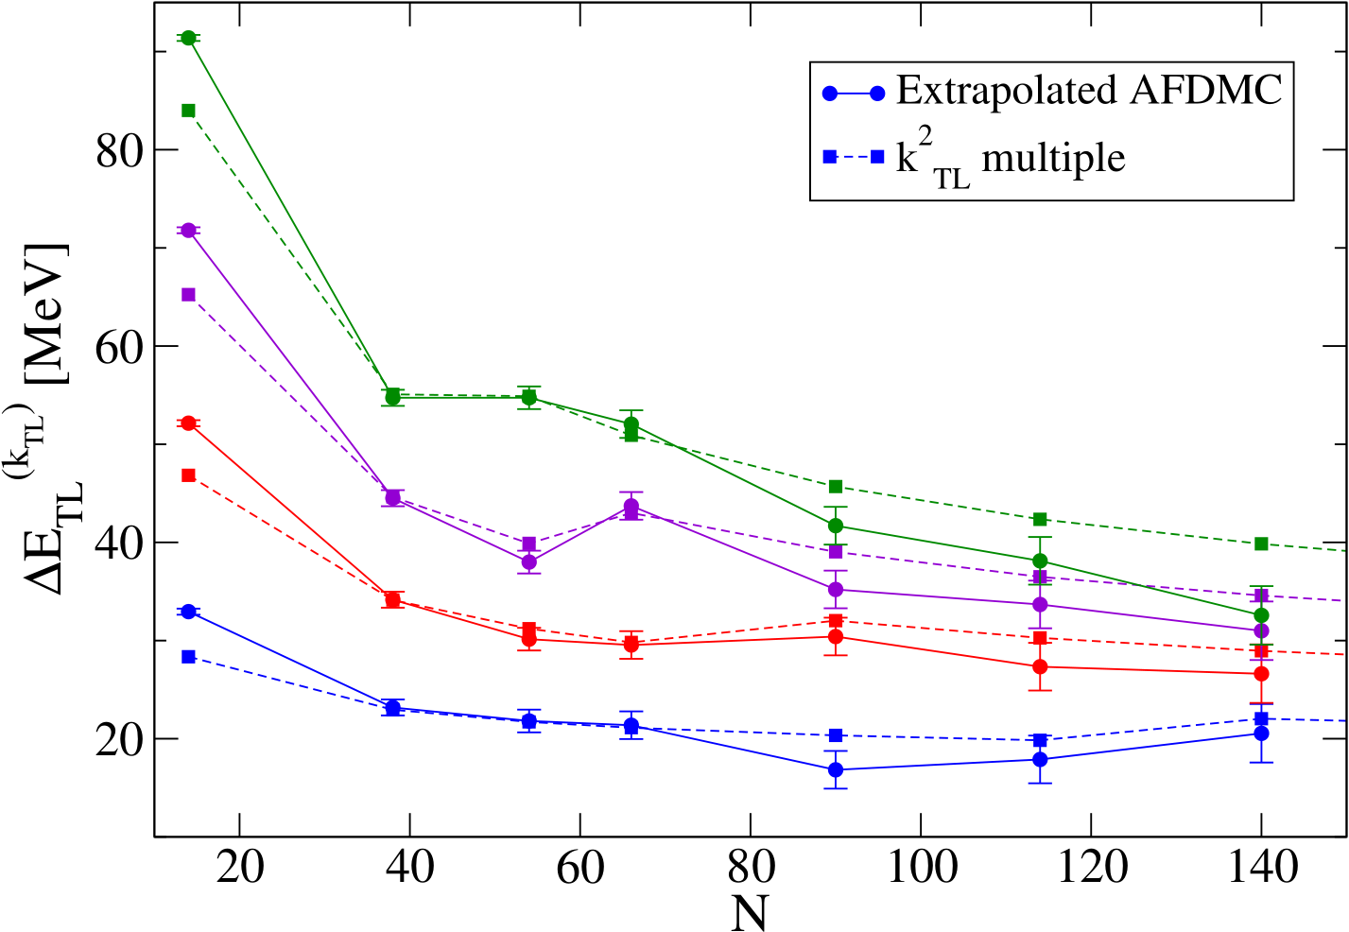
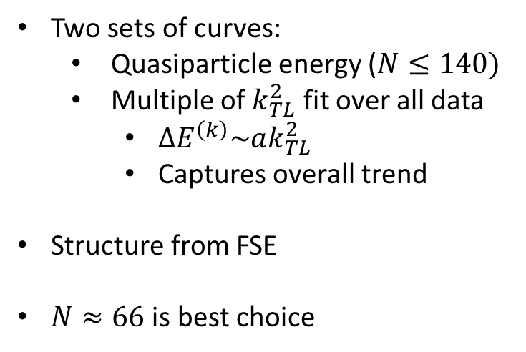
N-Dependences
Two sets of curves:
  Quasiparticle energy ($N≤140)$
  Multiple of $k_{TL}^{2}$ fit over all data
    $ΔE^{\left(k\right)}\sim ak_{TL}^{2}$
    Captures overall trend
Structure from FSE
$N≈66$ is best choice
Overestimate
Representative
Underestimate

Slide 14
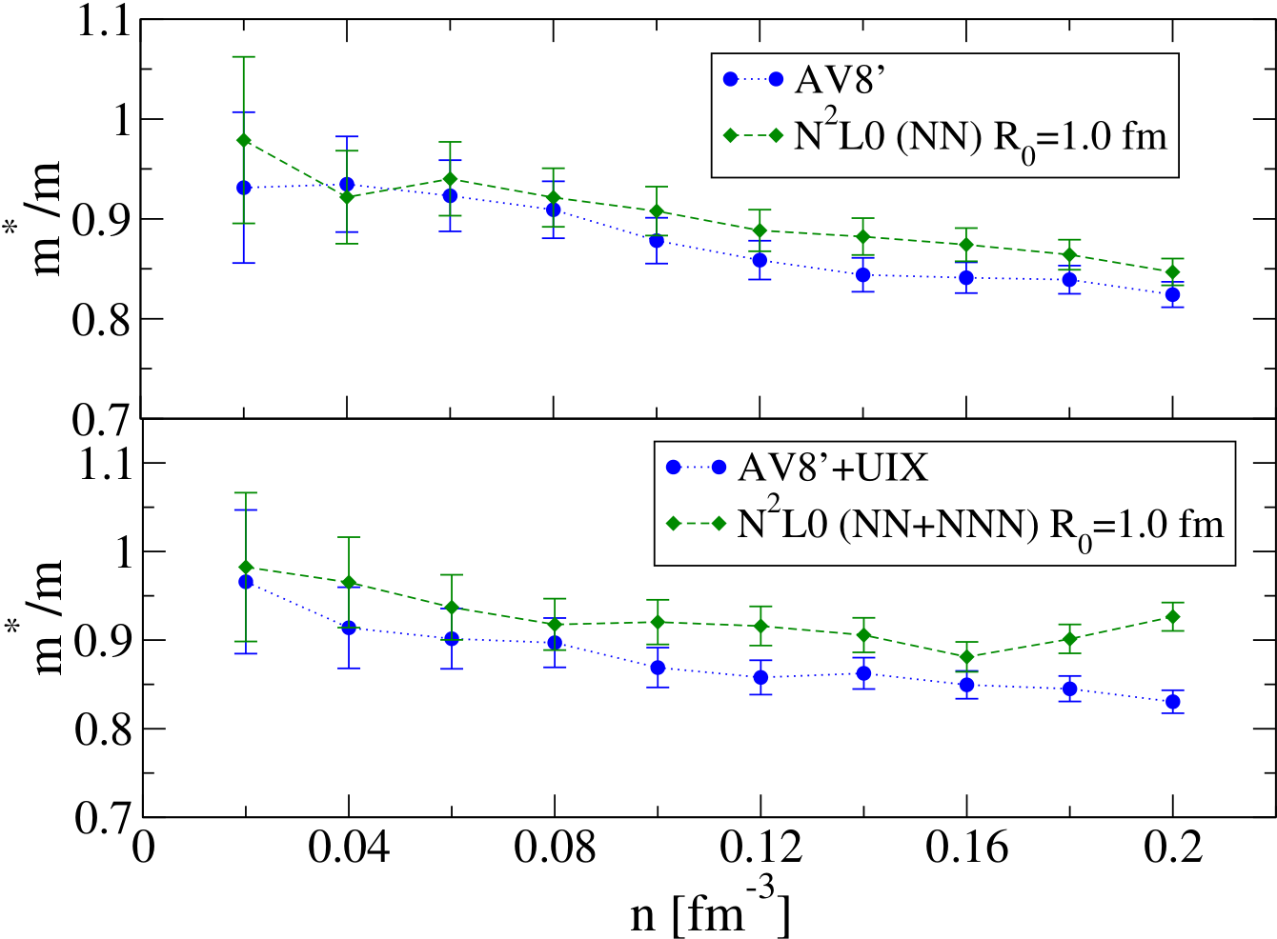
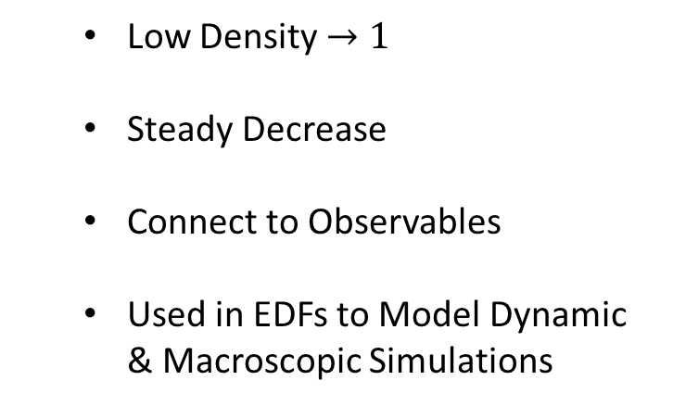
Density-Dependences
Ab initio
Phenomenological
  Low Density $→1$
  Steady Decrease
  Connect to Observables
  Used in EDFs to Model Dynamic & Macroscopic Simulations
QMC, Fitting
Density-Dependence
Potential
No Additional Parameters or Tuning!

Slide 15



Acknowledgements
Winter Nuclear & Particle Physics Conference (WNPPC)
Colleagues and Collaborators:
  Mateusz Buraczynski & Alexandros Gezerlis
  D. Lacroix, A. Boulet, S. Gandolfi, M. Grasso, I. Tews
Support:
  Natural Sciences and Engineering Research Council (NSERC) of Canada
  The Canada Foundation for Innovation (CFI)
  The Early Researcher Award (ERA) program of the Ontario Ministry of Research, Innovation and Science.
Computation Resources:
  SHARCNET
  NERSC

Slide 16
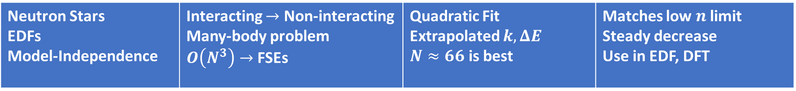
Summary
Extraction
Effective Mass
Motivation
Extrapolation
Density Dependence
QMC
N-Dependence
Neutron Stars EDFs Model-Independence | Interacting $→$ Non-interacting Many-body problem $O\left(N^{3}\right)→$ FSEs | Quadratic Fit Extrapolated $k, ΔE$ $N≈66$ is best | Matches low $n$ limit Steady decrease Use in EDF, DFT

Slide 17
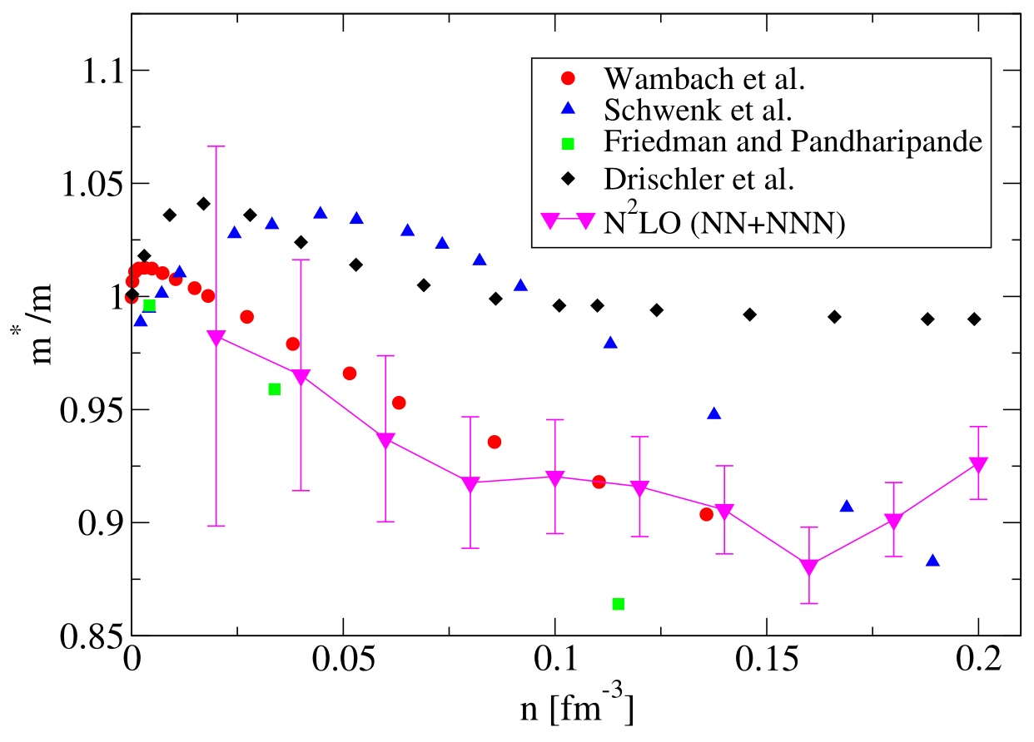
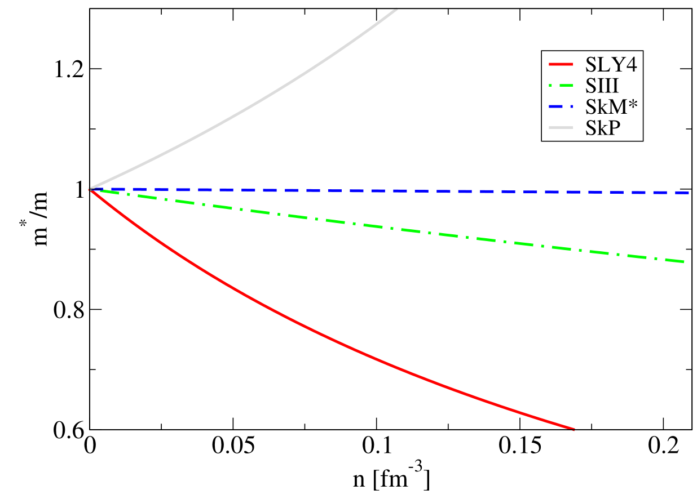
B. Friedman and V. R. Pandharipande, Nucl. Phys. A361, 502 (1981).
J. Wambach, T. L. Ainsworth, and D. Pines, Nucl. Phys. A 555, 128 (1993).
A. Schwenk, B. Friman, and G. E. Brown, Nucl. Phys. A 713, 191 (2003).
C. Drischler, V. Som`a, and A. Schwenk, Phys. Rev. C 89, 025806 (2014).

Slide 18
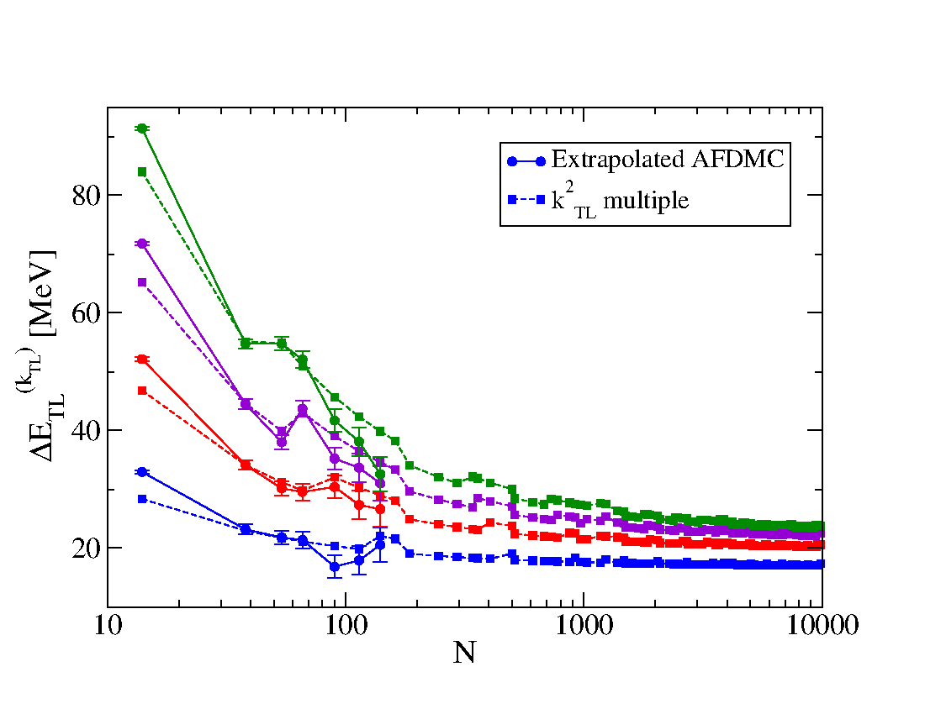

Slide 19
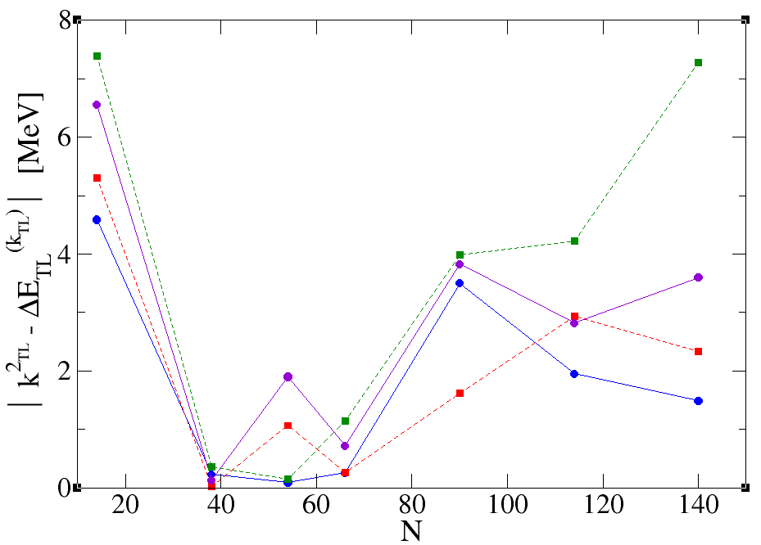

Slide 20
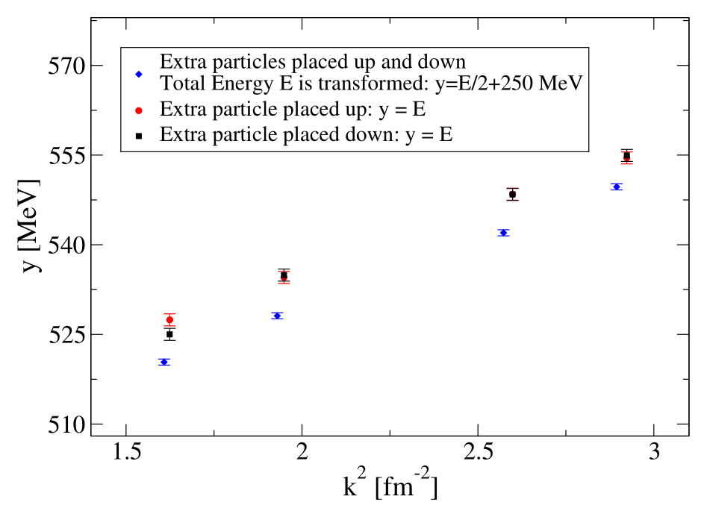

Slide 21
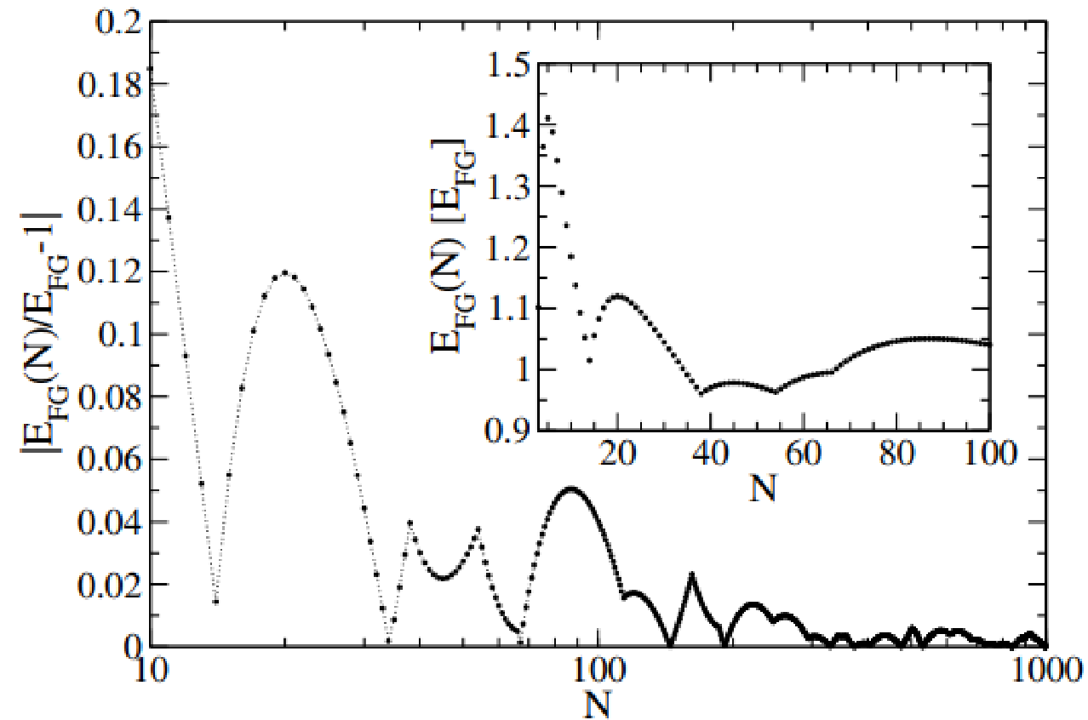

Slide 22
