Slide 1

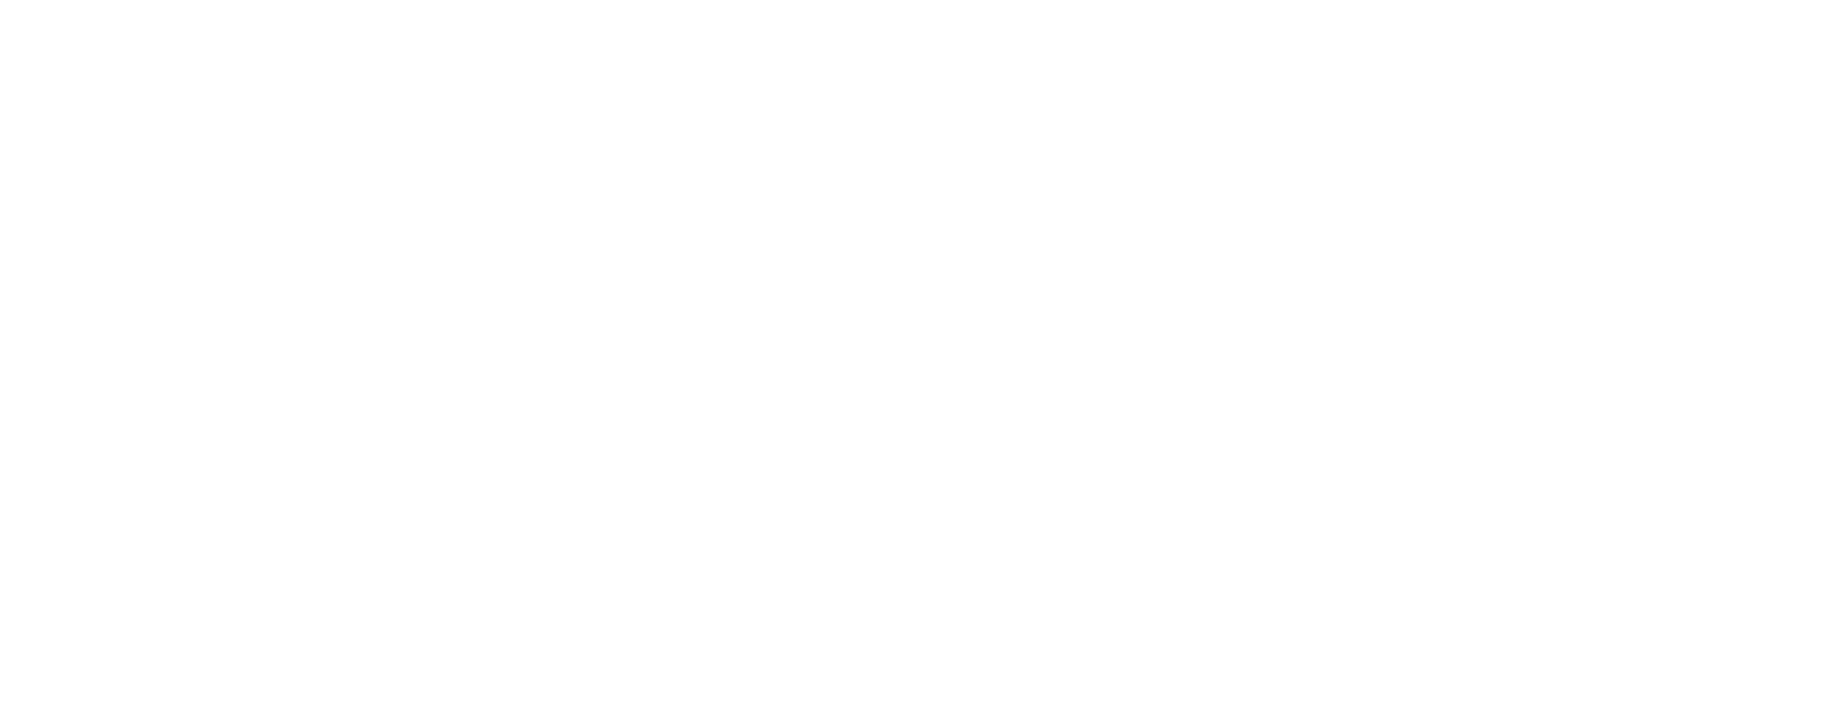

Charged 𝜋 - Meson Studies at Jefferson Lab
Ali Usman¹, G. M. Huber¹, D. Gaskell², T. Horn³, P. Markowitz⁴,
S. J. D. Kay¹, R. L. Trotta³, V. Kumar¹
On behalf of Hall C Collaboration

Slide 2
Scientific Motivation
How do the properties of mesons arise from their constituents?
What is the role of the form factor in the understanding of internal structure of meson?
Which theoretical model accurately predicts pion form factor at high Q² ?

Slide 3
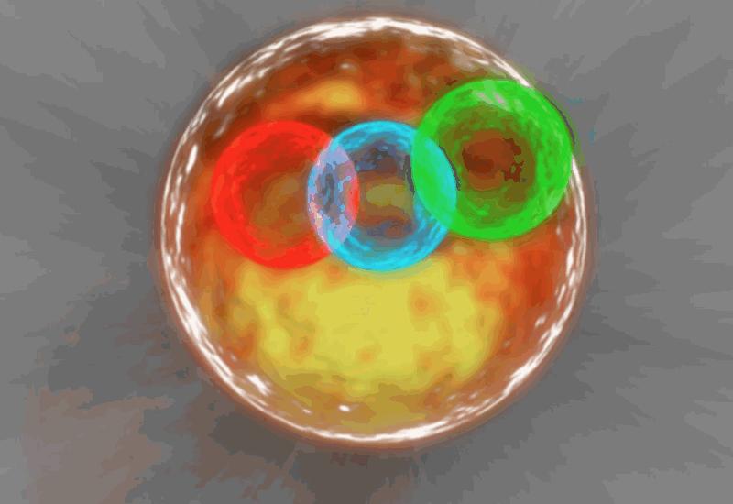
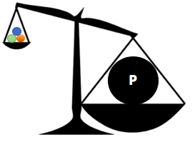
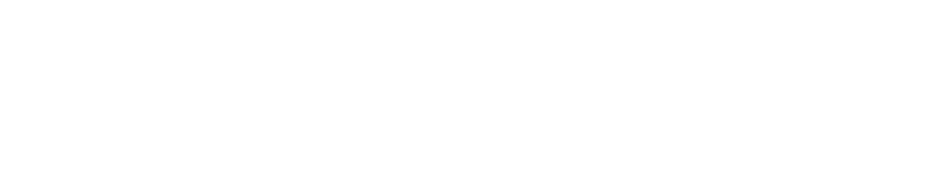

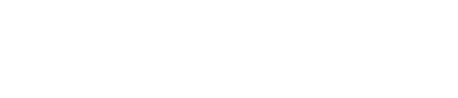
Introduction
Two well known hadronic states:
  Baryons ($qqq or \overline{q}\overline{q}\overline{q}$)
  Mesons ($q\overline{q}$)
Mass Comparison
$$m_{uud}\sim 9 MeV/c^{2}$$
$$m_{p}\sim 938 MeV/c^{2}$$
Reasons
Parton interactions are different from nucleon interactions.
Quark scale is smaller than the nucleon scale.

Slide 4

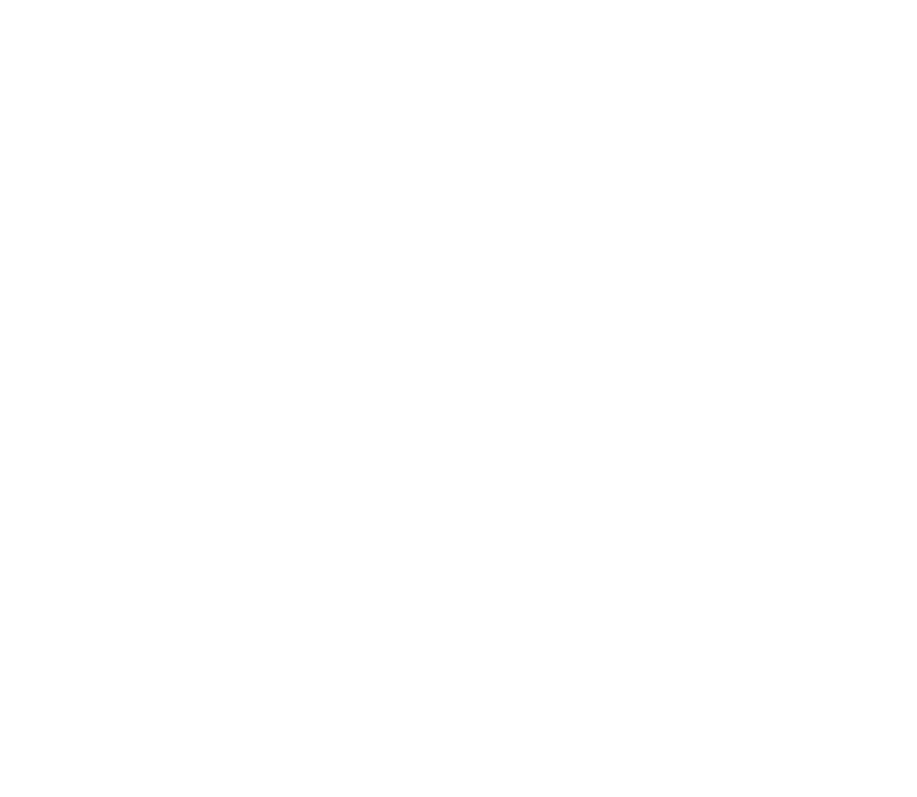
Pion – An ideal Candidate
Pion is lightest meson with only two valence quarks (up and down).
Pion is positronium atom of QCD.
Crucial in the understanding of dynamical mass generation.
The residual nuclear force is carried by pions inside a nucleus.
Charged Pion decay
  $π^{+}→μ^{+}+ν_{μ}$
  $π^{−}→μ^{−}+{\overline{ν_{μ}}}_{ }$
Charge | +1e/-1e
Spin | 0
Mass | 139.57 MeV/c²
Life Time | 2.6 x 10⁻⁶ s
Charge Radius | 0.659 ± 0.004 fm

Slide 5
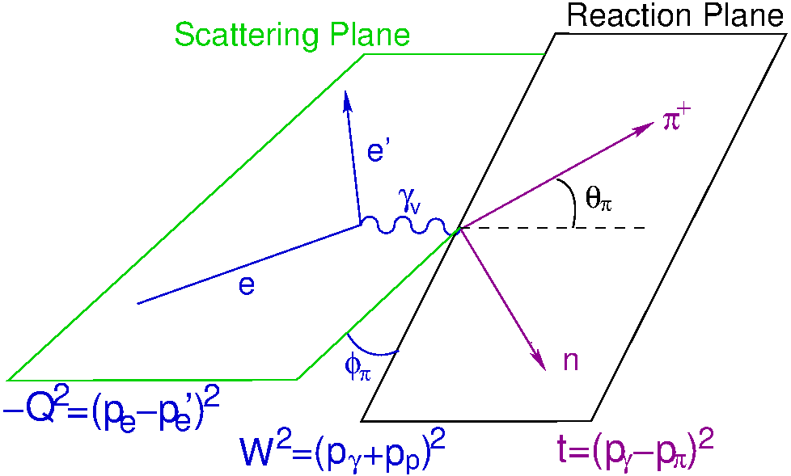
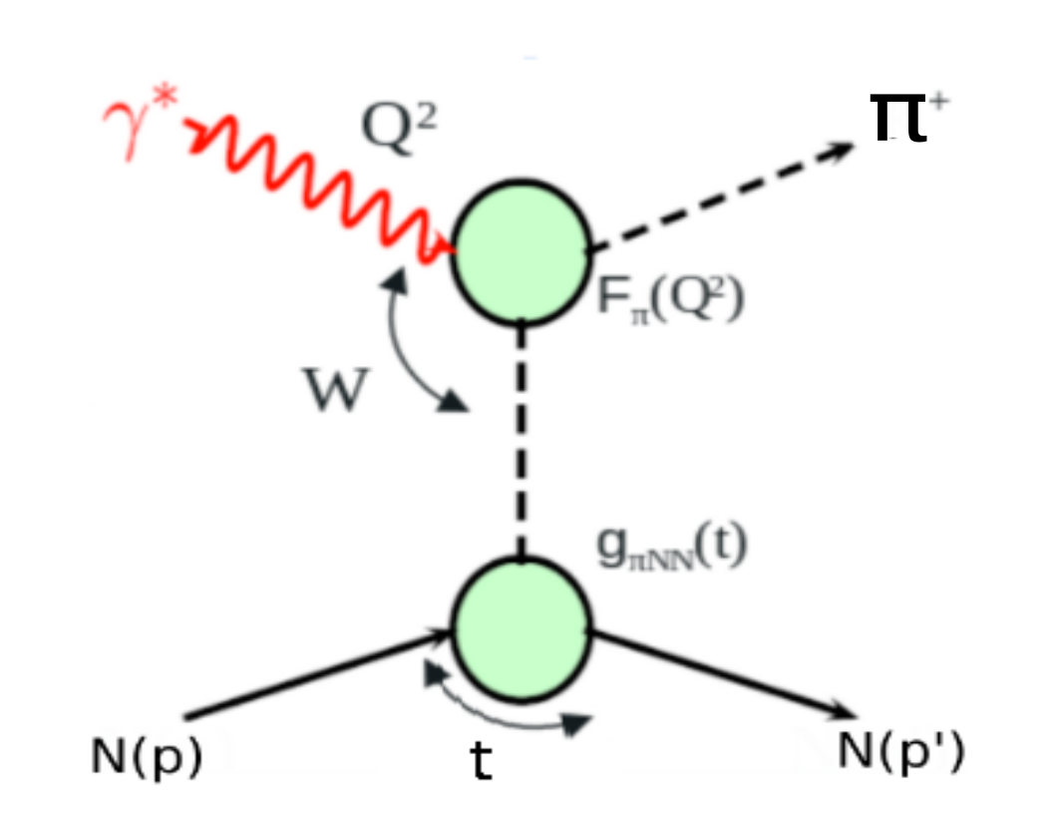
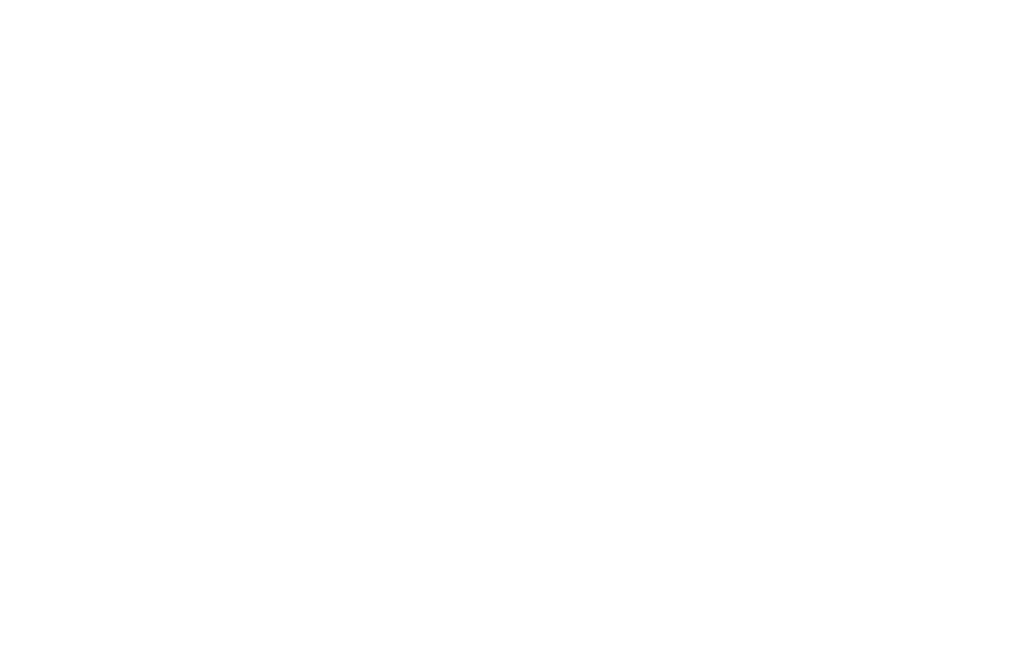
Exclusive Pion Electroproduction
Elastic scattering of electrons from pions gives
$e+π^{+}→e^{′}+π^{+ ′}$
No stable pion target for direct measurement.
Scatter electrons off a proton target to produce pions.
Reaction is
${{{p+e}^{−}→e}^{−′}+π}^{+}+n$
Need a precise measurement of the cross-section of this reaction.

Slide 6
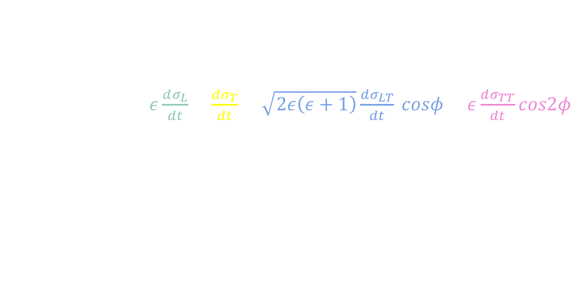
Cross-Section and L/T Separation
The physical cross-section can be decomposed into four structure functions.
$2π\frac{d^{2}σ}{dtdφ}=ε\frac{dσ_{L}}{dt}+\frac{dσ_{T}}{dt}+\sqrt{2ε\left(ε+1\right)}\frac{dσ_{LT}}{dt} cosφ+ε\frac{dσ_{TT}}{dt}cos2φ$
These structure functions depend on “$ε$” → polarization of virtual photon.
“Rosenbluth Separation technique” is used to separate the longitudinal and transverse cross-section terms.
The successful separation requires a range of kinematic settings.

Slide 7
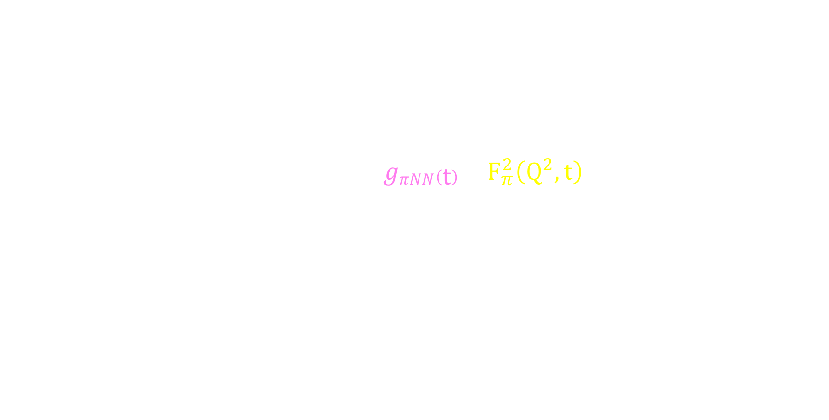
Pion Form Factor
Form factor describes the orientation of the momentum of the partons inside a hadron.
Pion form factor, $F_{π}$, can be extracted from the longitudinal cross-section.
In Born term model $F_{π}$ appear as
$\frac{dσL}{dt} ∝ \frac{−t}{\left(t−m_{π}^{2}\right)} gπNN\left(t\right)Q^{2}F_{π}^{2}\left(Q^{2},t\right)$
$F_{π}^{ }$ is cleanest case for studying transition from non-perturbative QCD to the perturbative QCD region.
Previous experimental measurements are limited and don’t give enough information.
Coupling constant
Form Factor

Slide 8
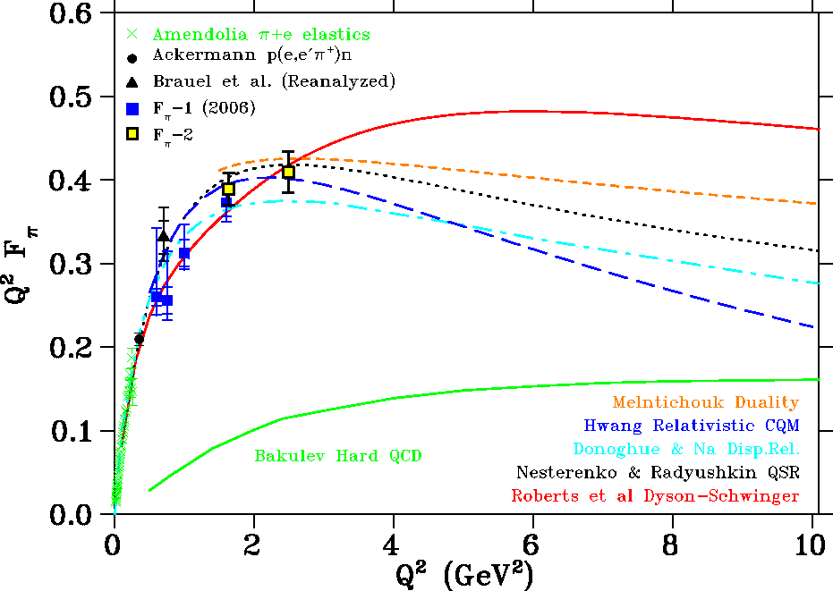
Limitations of Previous Studies
Only have experimental results at low Q².
Difficult to validate theoretical predictions at low Q².
At high Q², the theoretical predictions deviate from each other.
Need experimental data to validate any of the predictions at high Q².
Need a specific facility to study pions at high Q².

Slide 9
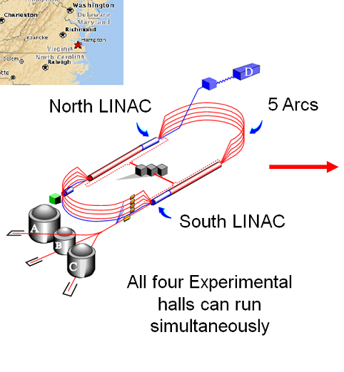
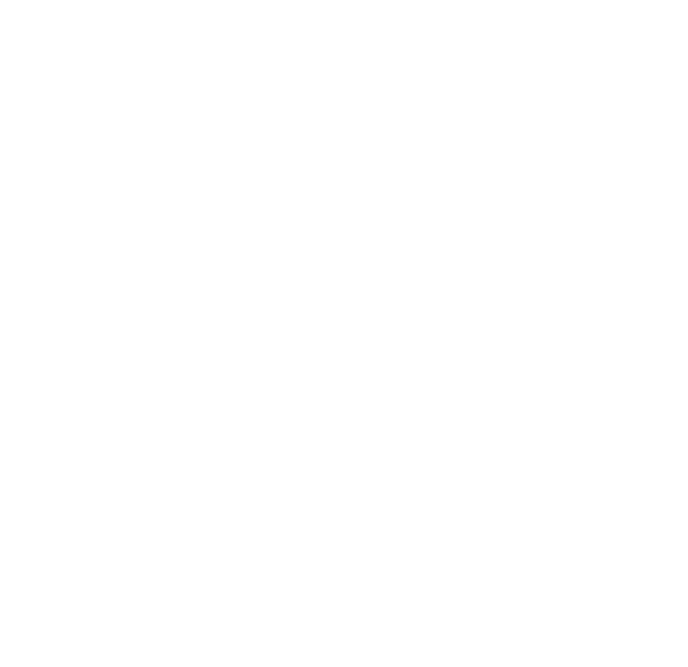
Jefferson Lab
Located in Newport News, VA
Continuous Electron Beam Accelerator Facility (CEBAF)
Consists of two superconducting LINACs
Capable of delivering a 12 GeV electron beam of up to 200 $μA$.
Four Experimental Halls which perform unique experiments.
  All four halls can run simultaneously

Slide 10
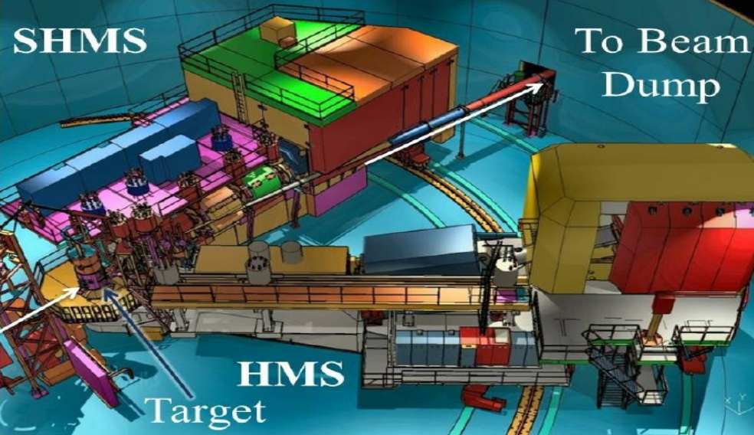
Experimental Hall C
Specifically designed to measure precise cross-sections and form factors for mesons.
Two advanced rotatable magnetic spectrometers.
  High Momentum Spectrometer (HMS)
  Super High Momentum Spectrometer (SHMS)
Particles of specific momentum are studied by using a dipole.
Capable of working at very high rates and different configurations.
Spec | Angle | Particle | Rate | Momentum range
HMS | 10.5 - 90 | Electron | < 1 MHz | 0.5-7 GeV
SHMS | 5.5 - 40 | Meson | < 1 MHz | 0.5-11 GeV

Slide 11
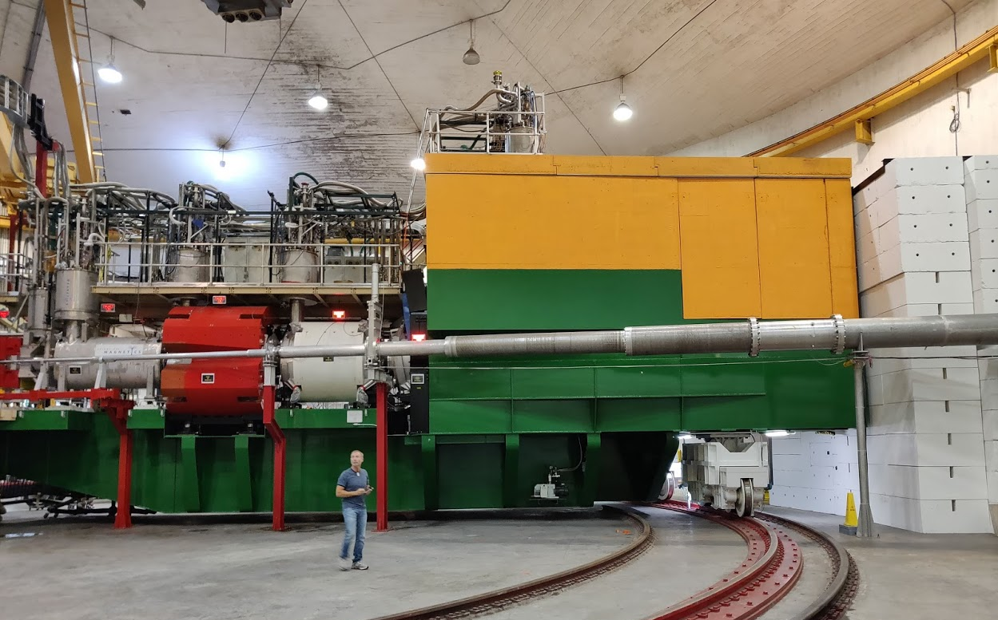
Super High Momentum Spectrometer (SHMS)
Detector Hut
Beamline
HB
Q1
Q2
Q3
Dipole

Slide 12
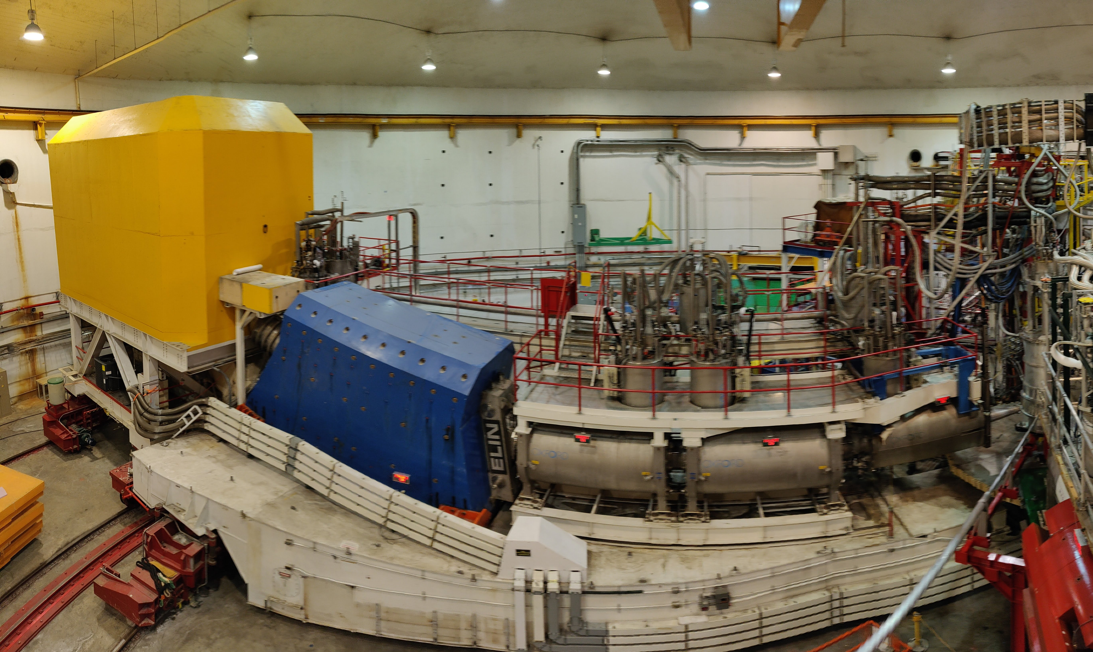
High Momentum Spectrometer (HMS)
Target Chamber
Detector Hut
Dipole
Q1
Q3
Q2

Slide 13
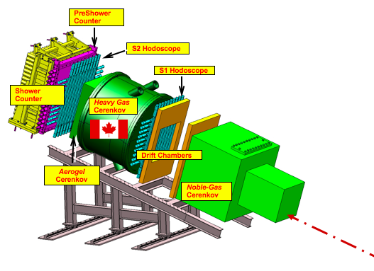
SHMS Detector System
DETECTOR | PURPOSE | NOTES
S1XY, S2XY Hodoscopes | Lowest-level Trigger. Time reference
Drift Chambers | Momentum Measurement. Tracking. | 5mm max. drift 300 micron resolution
Noble-Gas Cerenkov | Particle ID, Trigger. e±/π± at high momentum (replace by vacuum at low p) | Vary Ar/Ne mixture to set index at π± threshold.
Heavy-Gas Cerenkov | Particle ID, Trigger. π±/K± discrimination | C₄F₈O – Vary pressure to set index at K± threshold
Aerogel Cerenkov | Particle ID, K+/p discrimination | n= 1.011,1.015, 1.03,1.05
Preshower / Shower Counters | Particle ID, Trigger. Electron tag
Incident Particles through SHMS magnet optics

Slide 14
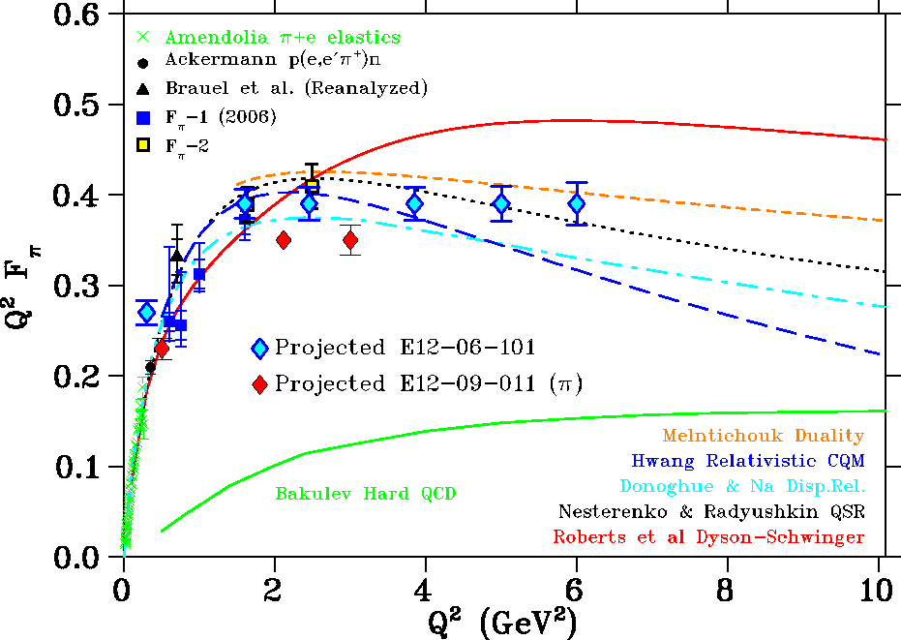
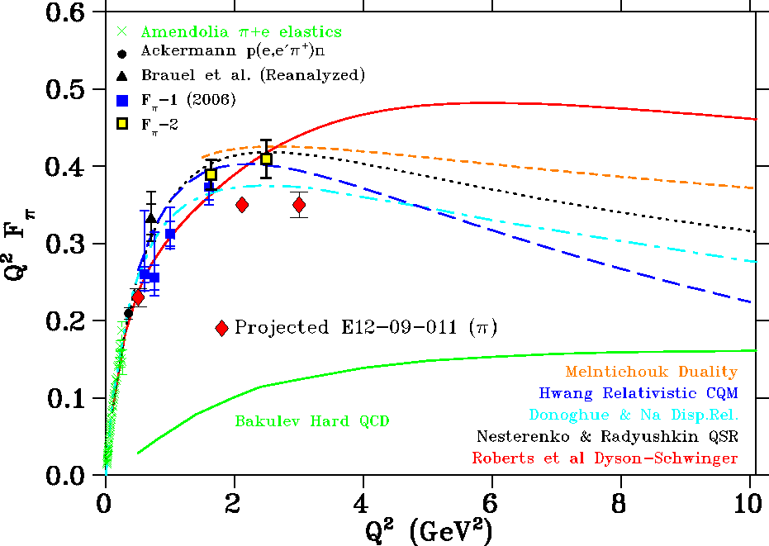
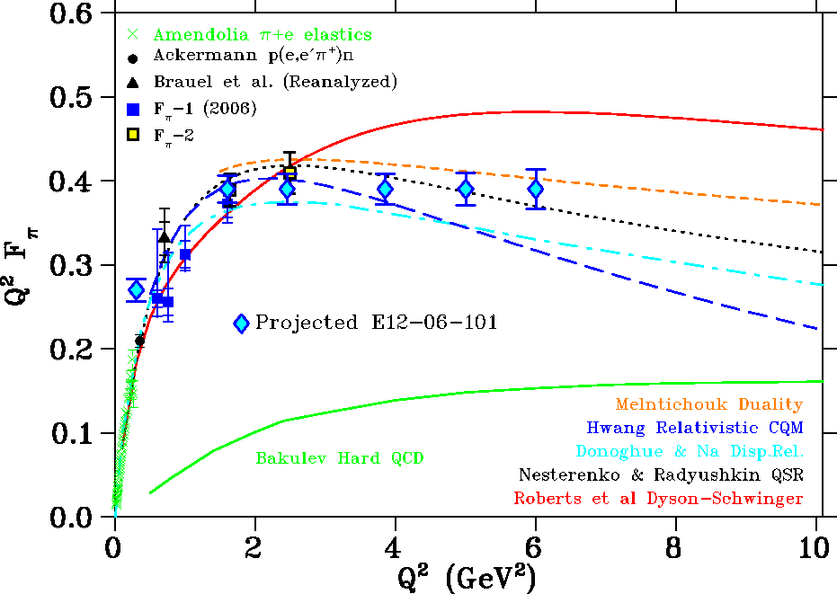
Projected Results
Two experiments were proposed for meson form factor studies for 12 GeV upgrade at Jefferson Lab.
E12-09-011
Mainly focused on Kaon studies but will also be used for pions due to high pion yield.
E12-06-101
(High Priority)
Actual pion form factor experiment which is planned to study high Q², up to 6 GeV².

Slide 15
Experiment Status
E12-09-011
E12-06-101
Data Collection | Done | Fall 2018 – Spring 2019
Calibrations | Done | Fall 2019
Efficiencies | In-Progress | Now
Cross-Section | Next | -
Form Factor | Next | -
E_{b} = 2.8 GeV | Done | Summer - 2019
E_{b} = 3.7 GeV | Done | Summer - 2019
E_{b} = 4.2 GeV | Done | Summer - 2019
E_{b} = 4.5 GeV | Done | Summer - 2019
E_{b} = 6.0 GeV | Scheduled | Summer - 2021
E_{b} = 8.0 GeV | Scheduled | Summer - 2021
E_{b} = 9.9 GeV | Scheduled | Summer - 2021
E_{b} = 6.7 GeV | Planned | 2023
E_{b} = 8.8 GeV | Planned | 2023
E_{b} = 9.2 GeV | Planned | 2023
E_{b} = 11.0 GeV | Planned | 2023

Slide 16
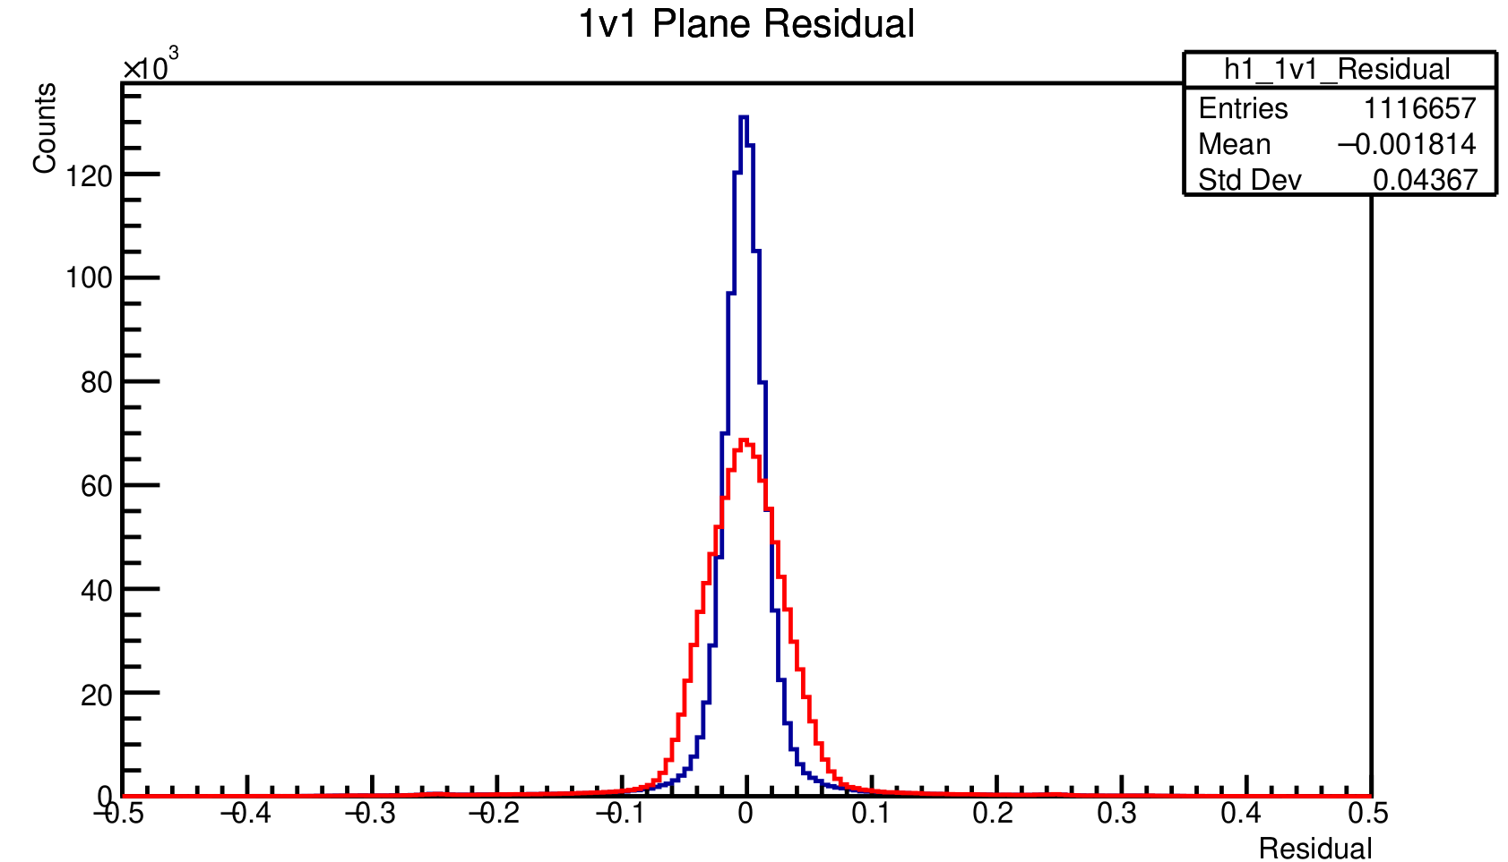
Calibrations - Drift Chambers
Residual is the difference between final track position and the hit location obtained from individual drift chamber planes.
HMS DC
Before calibration
After calibration

Slide 17
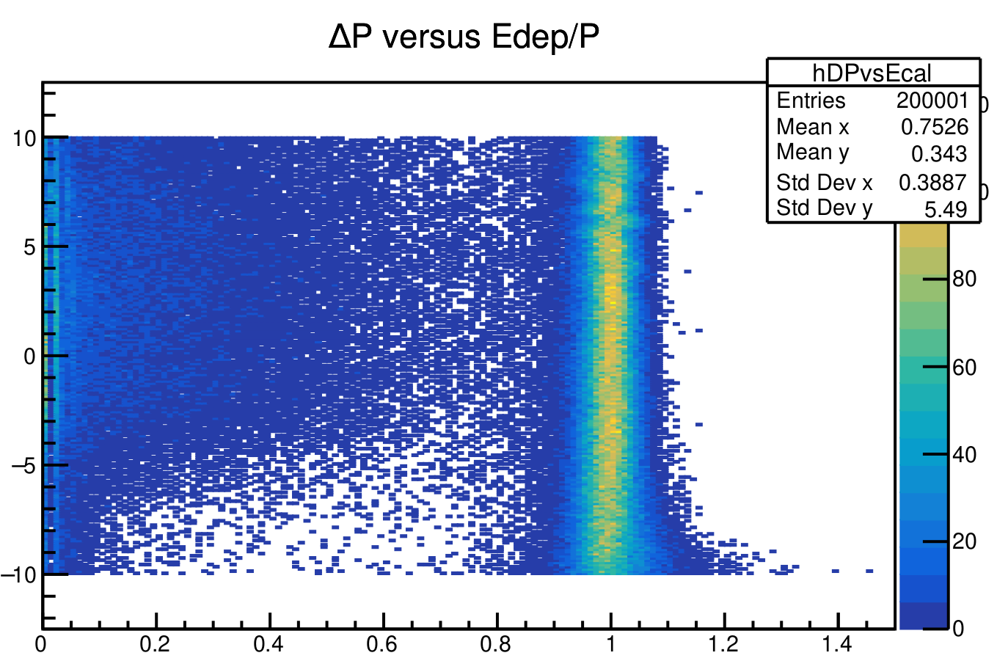



Calibrations - Calorimeter
Momentum distribution for electrons.
HMS
$$ΔP$$
Deviation of particle momentum from spectrometer central momentum
E/p - Normalized energy
Deposited energy/ particle momentum
Expect E/p = 1 for $e^{−}$
E/$P$

Slide 18
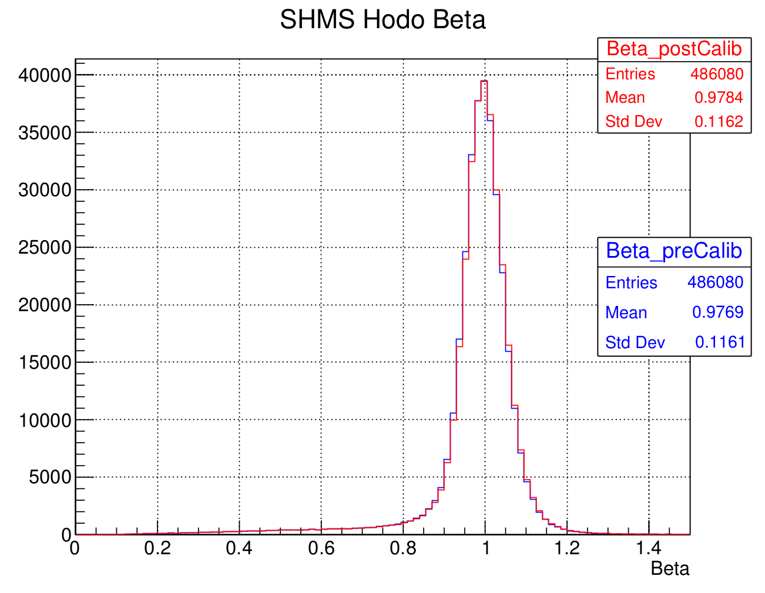
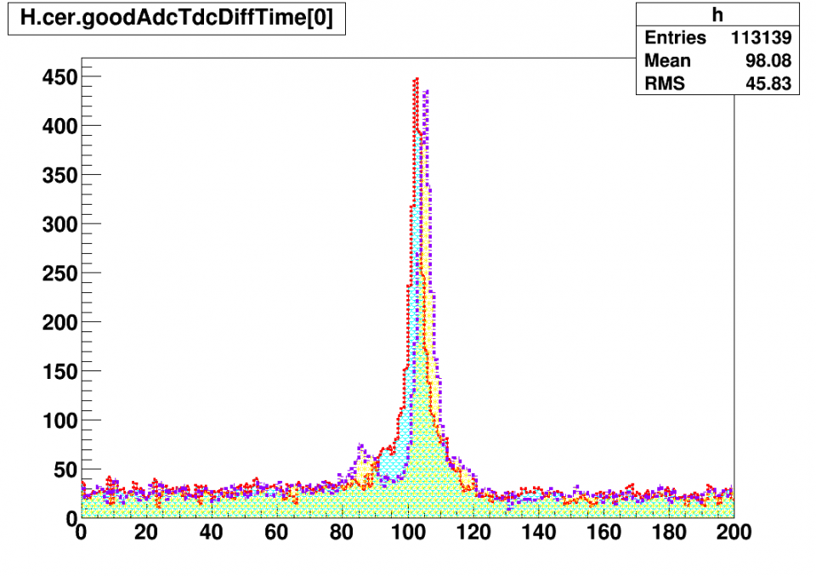
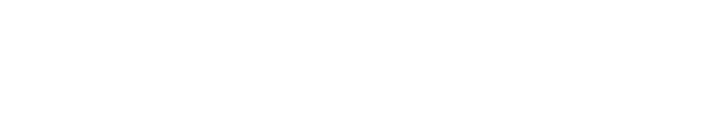
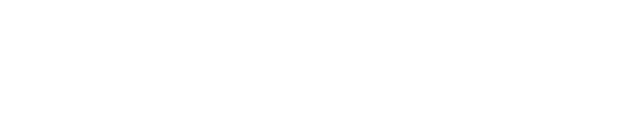
Hodoscope & Cerenkov
$β_{shms}=\frac{1}{c}\frac{Δl(h_{2}−h1)}{Δ{t(h_{2}−h1)}_{ }}$
$t=t_{HMS trig}−t_{HMS Cer}$
HMS
Time (ns)

Slide 19

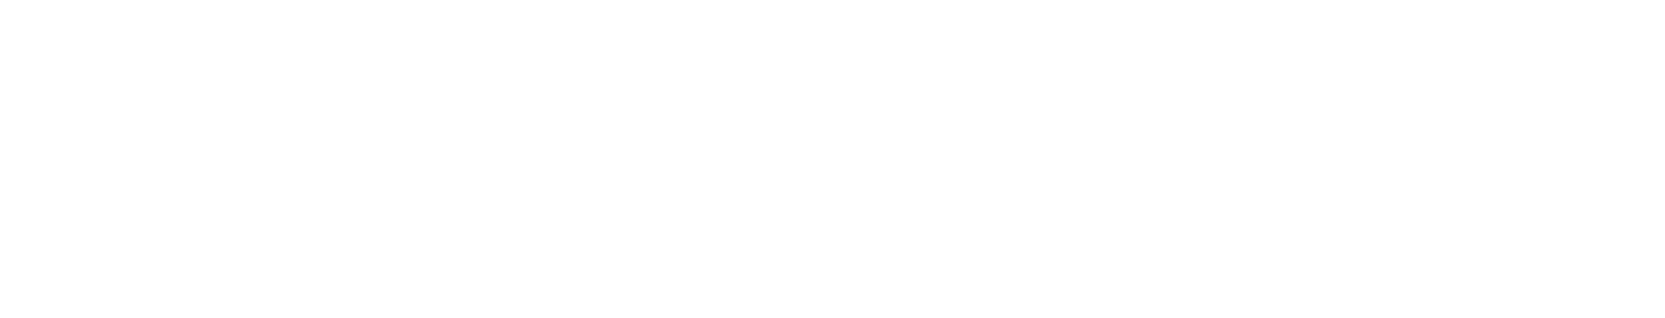
Summary and Outlook
$F_{π}^{ }$ is a key variable in our understanding of quark momentum distribution.
Hall C at Jefferson lab is the only facility in the world which can measure $F_{π}^{ }$ to a very high precision.
E12-09-011
Data Collection
Analysis
E12-06-101
Data Collection
Will continue in 2021-2023
Done
Partially Done
In Progress
Results coming soon (hopefully)
Stay Tuned!!!

Slide 20
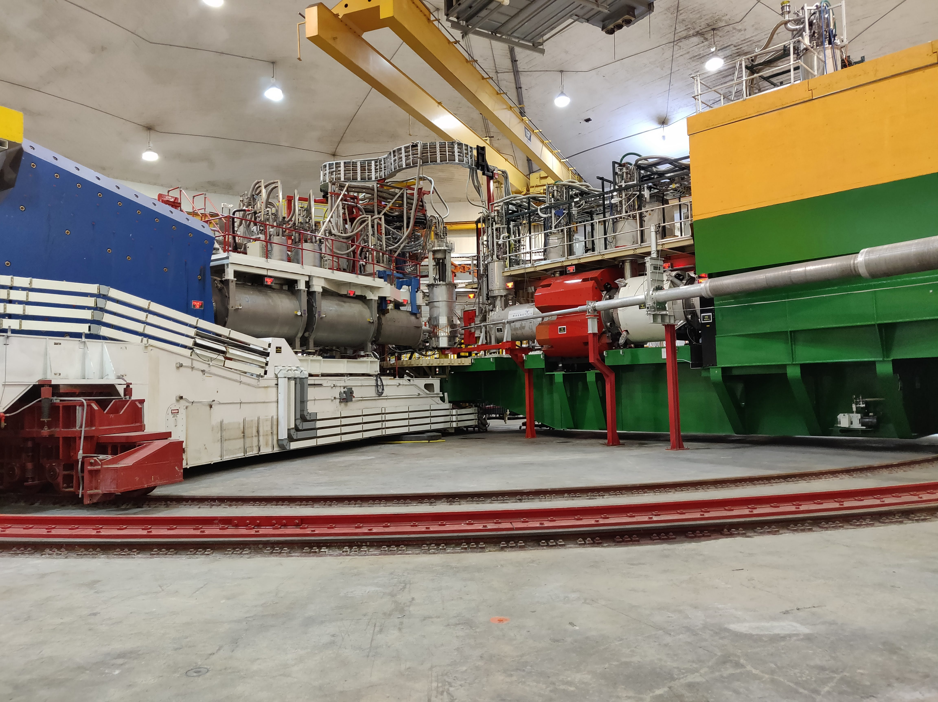
Collaborators
¹ University of Regina
² Thomas Jefferson National Accelerator Facility (JLab)
³ Catholic University of America
⁴ Florida International University
Thank You

Slide 21
Backup Slides

Slide 22
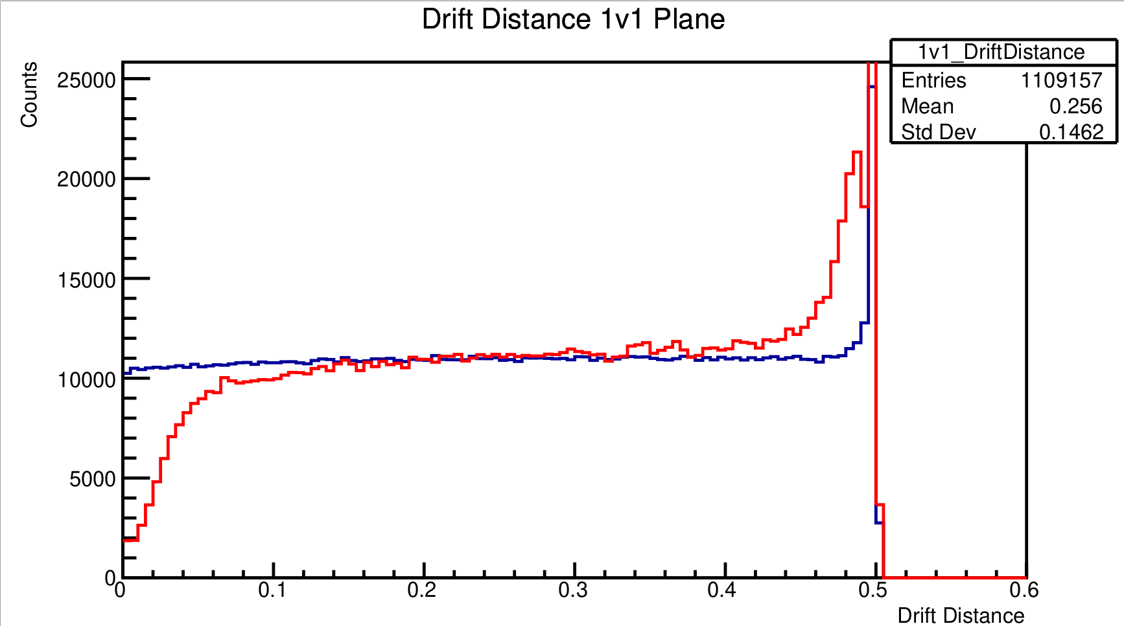
DC

Slide 23
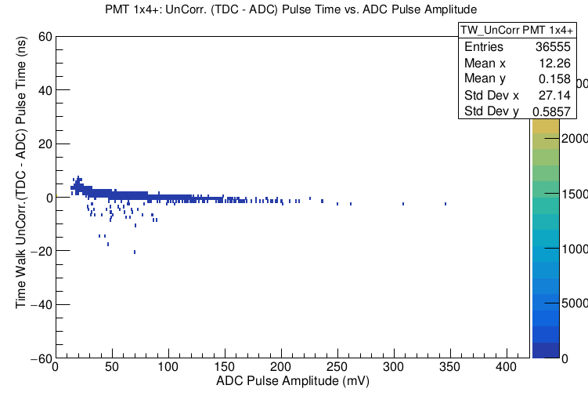
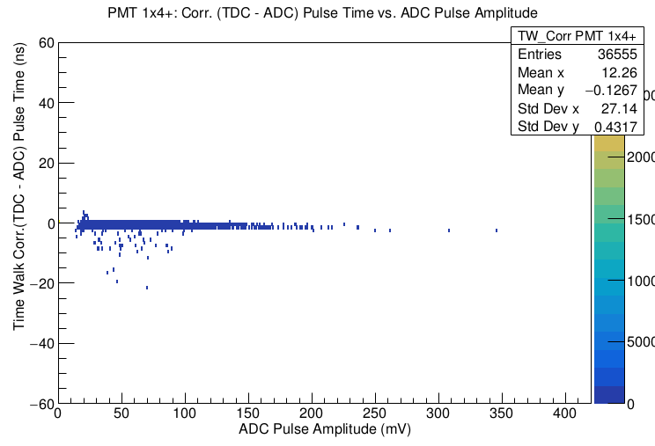
Hodoscope

Slide 24
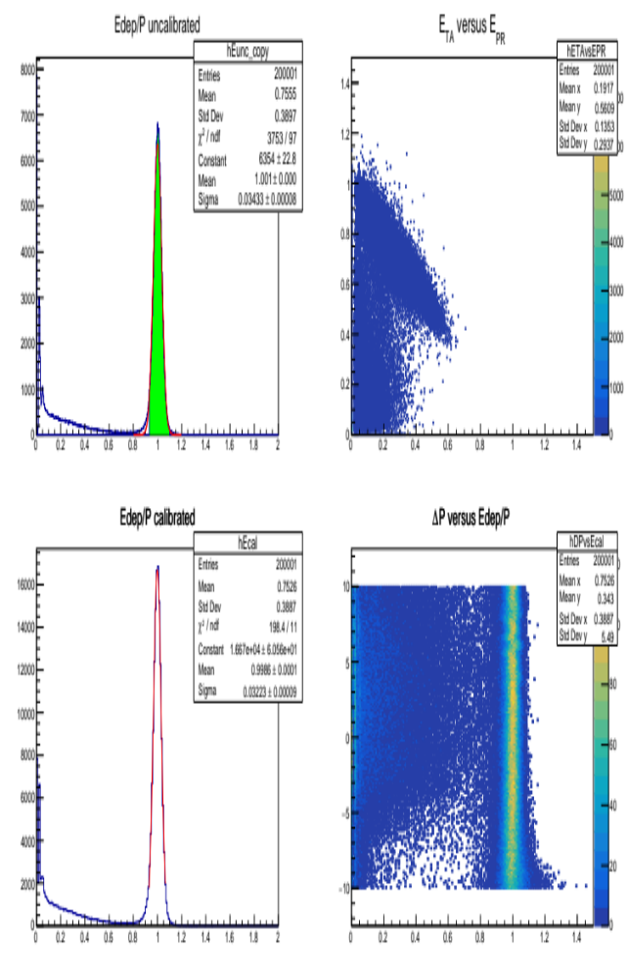
Calorimeter

Slide 25
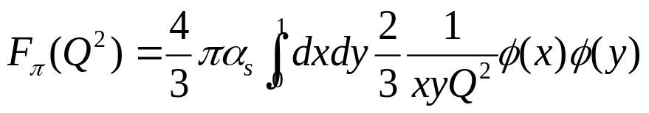
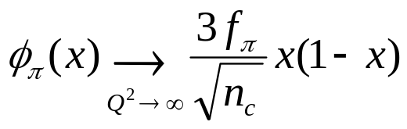
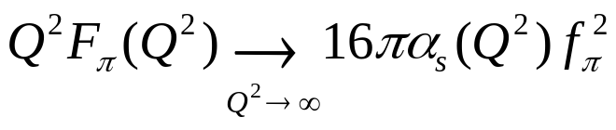
The Pion in perturbative QCD
At very large Q², pion form factor (F_{π}) can be calculated using pQCD
at asymptotically high Q², the pion distribution amplitude becomes
and F_{π} takes the very simple form
G.P. Lepage, S.J. Brodsky, Phys.Lett. 87B(1979)359.
This only relies on asymptotic freedom in QCD, i.e. (∂α_{S}/∂μ)<0 as μ→∞.
Q²F_{π} should behave like α_{s}(Q²) even for moderately large Q².
Can study the renormalization of α_{S} quark-gluon coupling, and QCD’s transition between asymptotic freedom and confinement.

