Slide 1
Magnetometry for Gravitational Measurements of Antihydrogen
Nathan Evetts
for the ALPHA Collaboration
WNPPC, 2020
Notes:
Good morning, I’m nathan, from the alpha collaboration. Which is a group based at CERN performing measurements on antimatter. THe next big experimental goal for us is a measurement of the gravitational interaction between matter and antimatter. They keys systematic of that experiment will boil down to magnetic field characterization. That is a problem we have started to work on but not yet fully solved. So in addition to telling you about our experiment, I’m also here to search

Slide 2
Outline
How to measure the gravitational force on an anti-atom
Systematic characterization
  Nuclear Magnetic Resonance (NMR) Magnetometry
Low temperature NMR challenge
Notes:
What is antimatter

Slide 3
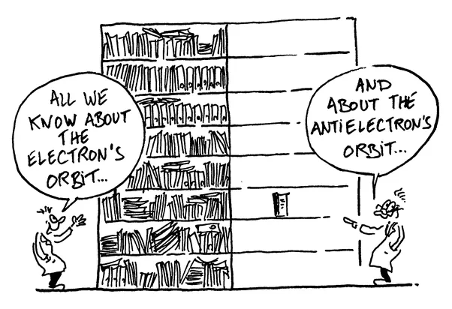
Asymmetry in the Universe
Why study antimatter?
Notes:
The universe is made almost entirely of matter. Which is wierd since we beleive that matter and antimatter should be symmetry. THat fact goes by the name of the BAP, and ..experimentally we have observed almost nothing about about. It is ALPHA’s goal to fill in the antimatter half of this library with experiments and observations that we hope will provide clues towards the resolution of the bayron assym prob. And help answer the question of why the universe is made of mostly matter.

Slide 4
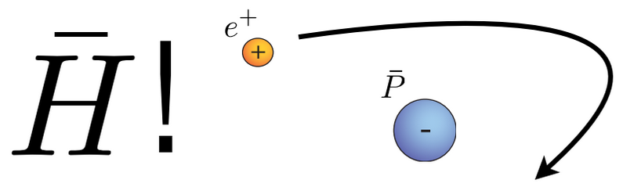
Antihydrogen recipe
~10⁴ antiprotons (from Antiproton Decelerator, CERN)
~10⁶ positrons (from beta decay , Na²² source)
Cool to ~20 K
Mix!
Notes:
….which we then use to make antihydrogen. We do this by smushing them together with positrons obtained from our own radioactive, sodium 22 source...

Slide 5
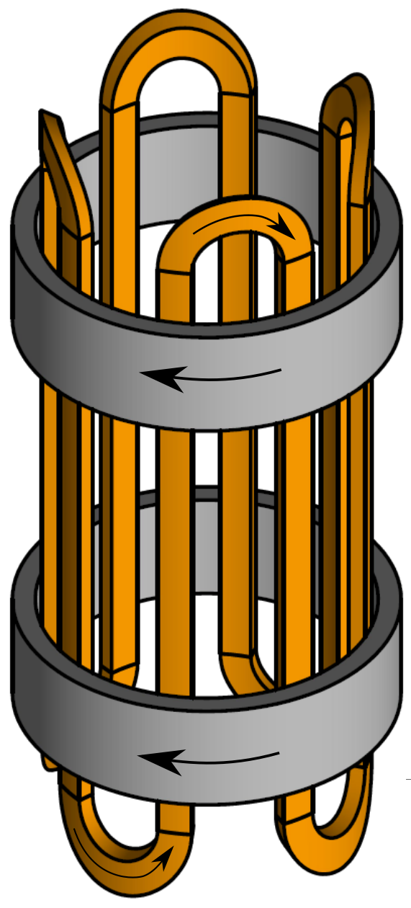
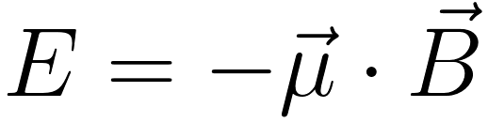
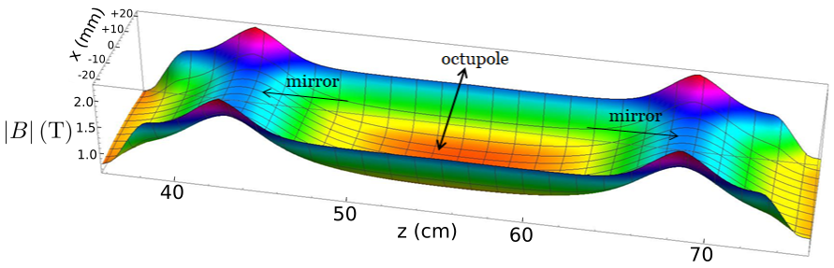
Antihydrogen Magnetic Trap
Octupole coil
Vertical Magnetic Trap
Trap depth ~ 0.5 K
~1000 anti-atoms trapped per day (ALPHA2 performance)
Mirror
coils

Slide 6
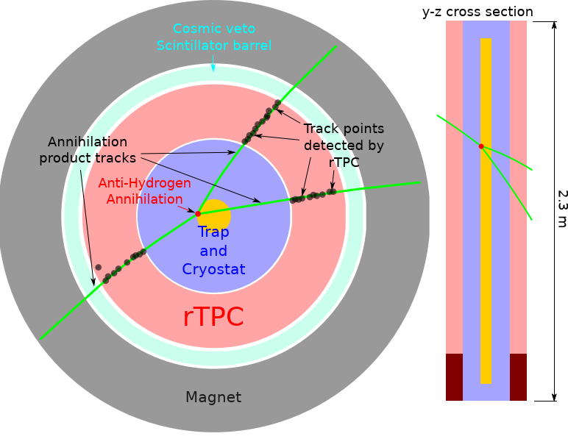
Annihilation detection
Single atom resolution
Vertex resolution ~ 6mm

Slide 7
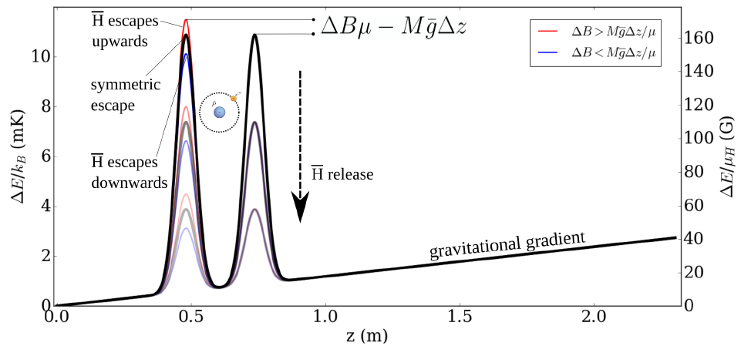
Antihydrogen Gravity Experiment
Release antiatoms from magnetic trap, infer gravity from annihilation patterns
On-axis potential energy
Notes:
** on axis** label to add
Talk about mirror coils mirror coils mirror coils

Slide 8

Antihydrogen Gravity Experiment
“Size” of gravitational signal (magnetic units)
Notes:
** on axis** label to add
Talk about mirror coils mirror coils mirror coils

Slide 9
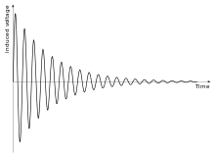
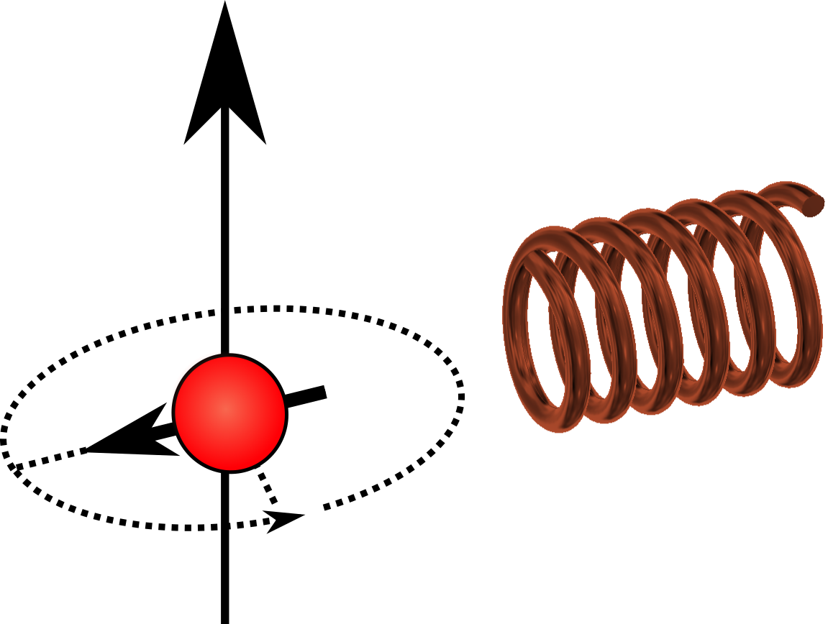

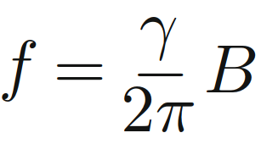
Magnetometry with Nuclear Magnetic Resonance (NMR)
Spin precession induces voltage in a coil
Precession frequency proportional to magnetic field
Coil Voltage
Time
Detection coil
Spin precession

Slide 10
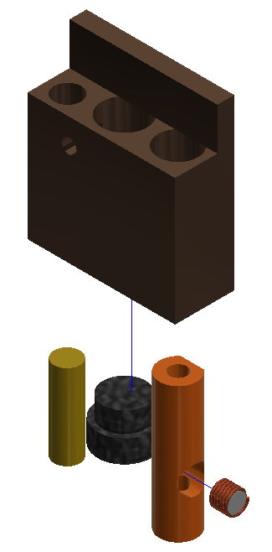
Cryogenic NMR probes Mirror coil diagnostic
Difficult environment: Cryogenic, poor physical access, non-uniform field, etc…
10mm
NMR sample:
Aluminum micro-particles
10µm
Hall sensor+ thermometer
Hand wound NMR coil
Notes:
Next is AL powder probe.
What is this package and why, constraints / backgroind /design desicions
Add coax, brighten figure, remove green coil
Mirror coils

Slide 11
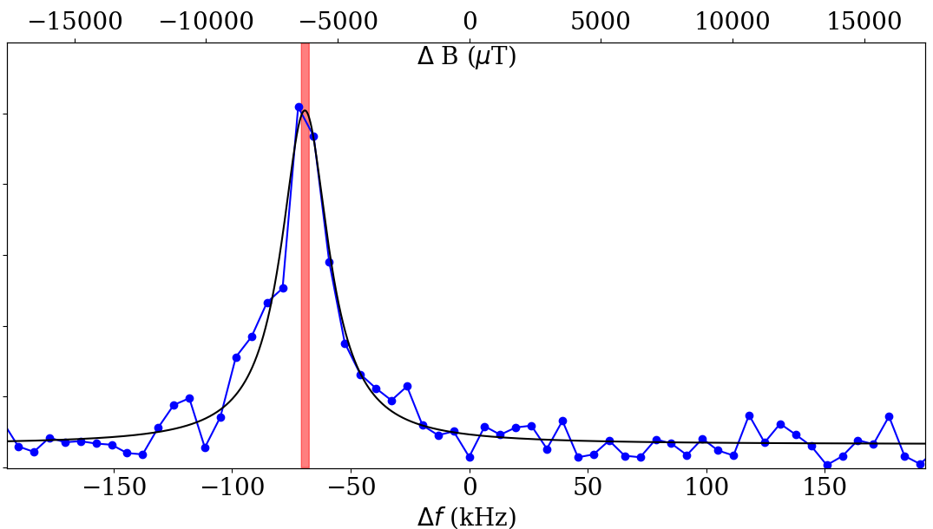

Aluminium NMR signal (at T~15K)
Power spectrum (arb.)
Notes:
MICRO meter symbol

Slide 12
Aluminium NMR signal (at T~15K)
Power spectrum (arb.)
Notes:
MICRO meter symbol

Slide 13
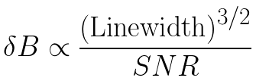

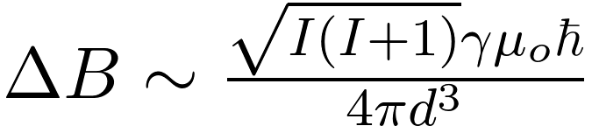
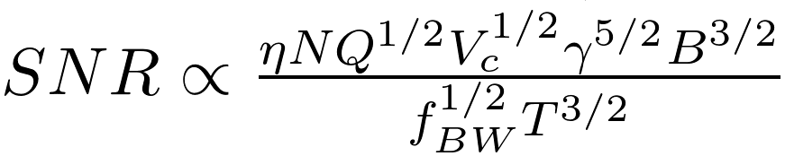
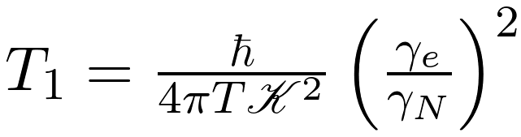
Magnetometer Performance Expectations
Sensor precision [1]:
(statistical lower limit)
Other important parameters
Sensor parameter | “Physics” | Estimate
NMR linewidth [2] | Dipolar broadening (“T2”)
Signal-to-noise ratio [2] | Spin magnetization Probe construction …complicated
Repetition time [3] | Spin lattice relaxation time
Linewidth
[1]
[2]
[3]
Notes:
Partial delta symbol

Slide 14
Magnetometer Performance Expectations
Materials I’d like to characterize
Current solution
Material | Linewidth
Lead | 160 µT
Indium Phosphide | 230 µT
Titanium - Phosphide | 200 µT
Rubber | 2000 µT
Linewidth
14
… and a dozen others...
Notes:
No E notation
Helium-3?? Maybe

Slide 15
NMR samples to Enable 1% gravity sensitivity?
Goal:
obtain precision relevant to a gravity experiment
Materials I’d like to characterize
Material | Linewidth
Lead | 160 µT
Indium Phosphide | 230 µT
Titanium - Phosphide | 200 µT
Rubber | 2000 µT
15
… and a dozen others...
Notes:
No E notation
Helium-3?? Maybe

Slide 16
Thank you

Slide 17
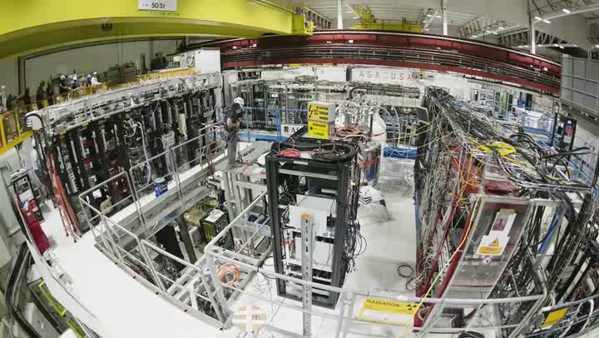
Building ALPHA-g

Slide 18
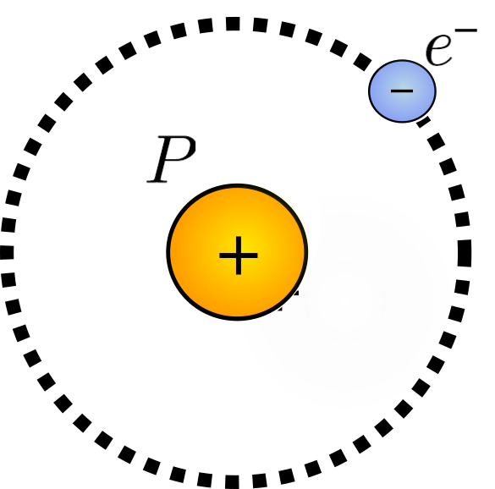
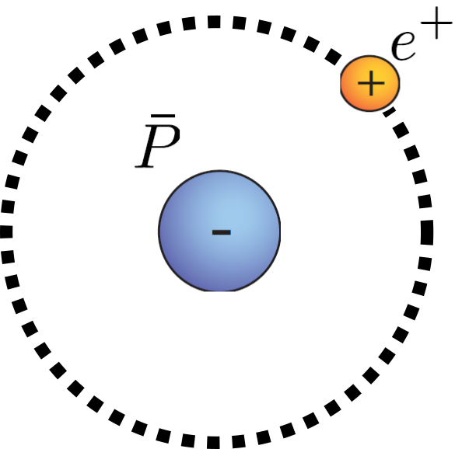

Matter - antimatter gravitational interaction
Hydrogen
Anti-Hydrogen
Anti-Hydrogen
CPT
????
Earth
Anti-Earth
Earth
Tests Equivalence principle
(Our experiment)
Notes:
Next lofty goal for that group is to driectly measure the gravitational interaction of matter and antimatter….No one has ever done that before...it sounds complicated, but in essensce, we are just “dropping” anti-matter atoms and carefully observing how the “fall”.

Slide 19
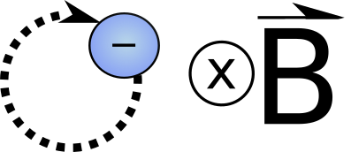

Magnetometry Overview
Electron cyclotron resonance
  Pro: Measures field in-situ
  Con: not fully understood
Nuclear magnetic resonance (NMR)
  Rubber samples
    Pro: Sufficient resolution
    Con: Best at room temperature
  Aluminium micro-powder samples
    Pro: Works at Low temperatures
    Con: Weaker field resolution
Spin precession

Slide 20

Magnetometry with Plasmas
Working principle: plasmas heat when irradiated at the cyclotron frequency
incoming microwave pulse

Slide 21
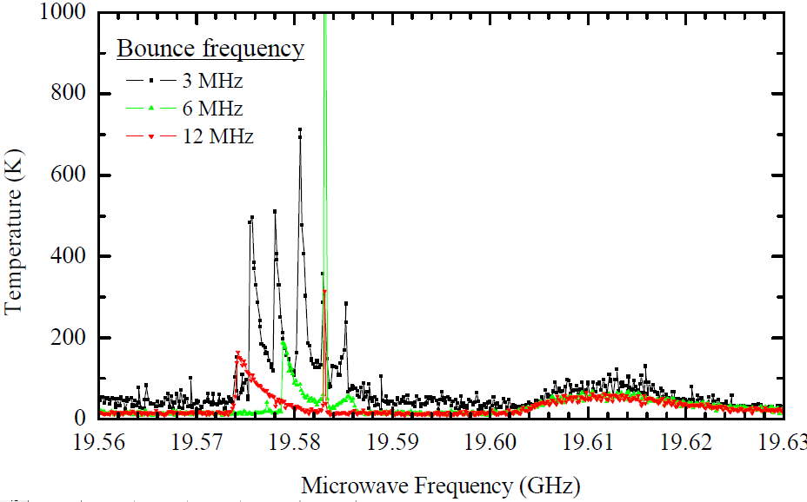
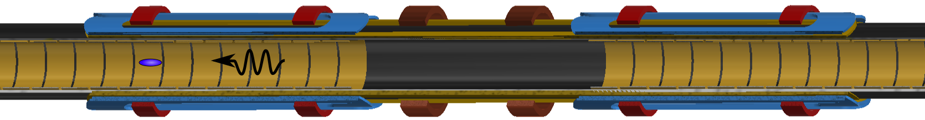
Magnetometry with Plasmas
Data by Eric Hunter
B ~ 1 T
F ~ 30GHz
Plasmas are “hot” when microwave frequency matches cyclotron frequency
Technique to measure plasma temperature:
Phys. Fluids B 4 3432–9 1992
New J. Phys. 16 (2014) 013037.
Penning trap electrodes
Electron plasma (~10⁴ particles)
Microwave pulse
Antihydrogen trap

Slide 22
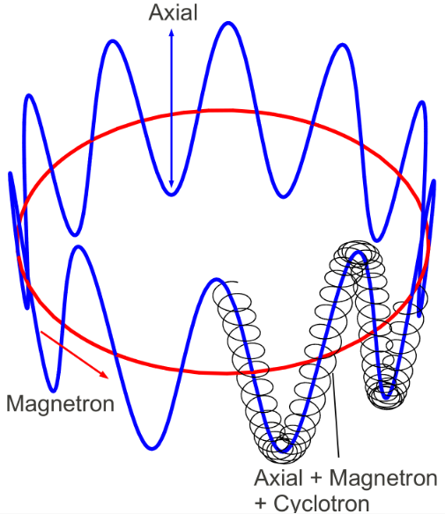
Magnetometry with Plasmas
Microwave pulse
Complicated particle motion creates “side-bands”
  Must identify “carrier” frequency
  Preliminary resolution < 1ppm
Data by Eric Hunter
“Carrier” frequency
cyclotron resonance

Slide 23

Problem with Cyclotron Resonance Method
Precision gravity experiment (no Penning trap)
Can’t be used for “precision” gravity region
  Penning trap electrodes impractical
Need to know fields here

Slide 24
Magnetometry Overview
Electron cyclotron resonance
  Pro: Measures field in-situ
  Con: not fully understood
Nuclear magnetic resonance (NMR)
  Rubber samples
    Pro: Sufficient resolution
    Con: Best at room temperature
  Aluminium micro-powder samples
    Pro: Works at Low temperatures
    Con: Weaker field resolution
Spin precession

Slide 25


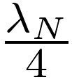
NMR System
Probe 1
Impedance match
10W Power Amplifier
Spincore
NMR spectrometer
Tecmag APOLLO
Duplexer
crossed diodes: noise gate,
Rx protection
Multiplexer
Low Noise Amplifier
Miteq AU 1114
Impedance match
Commercial subsystems / electronics
Custom NMR probes
Probe N

Slide 26
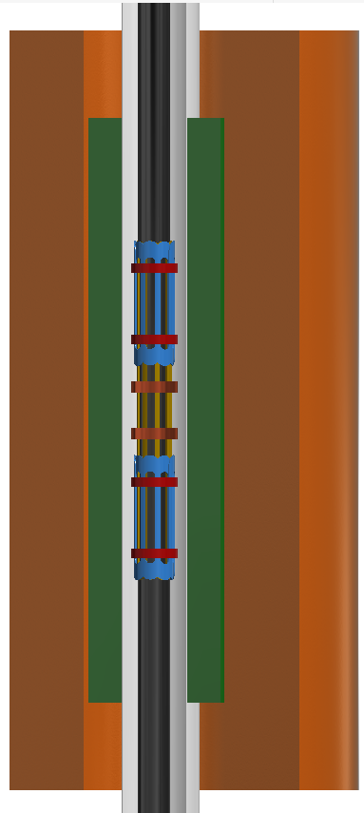
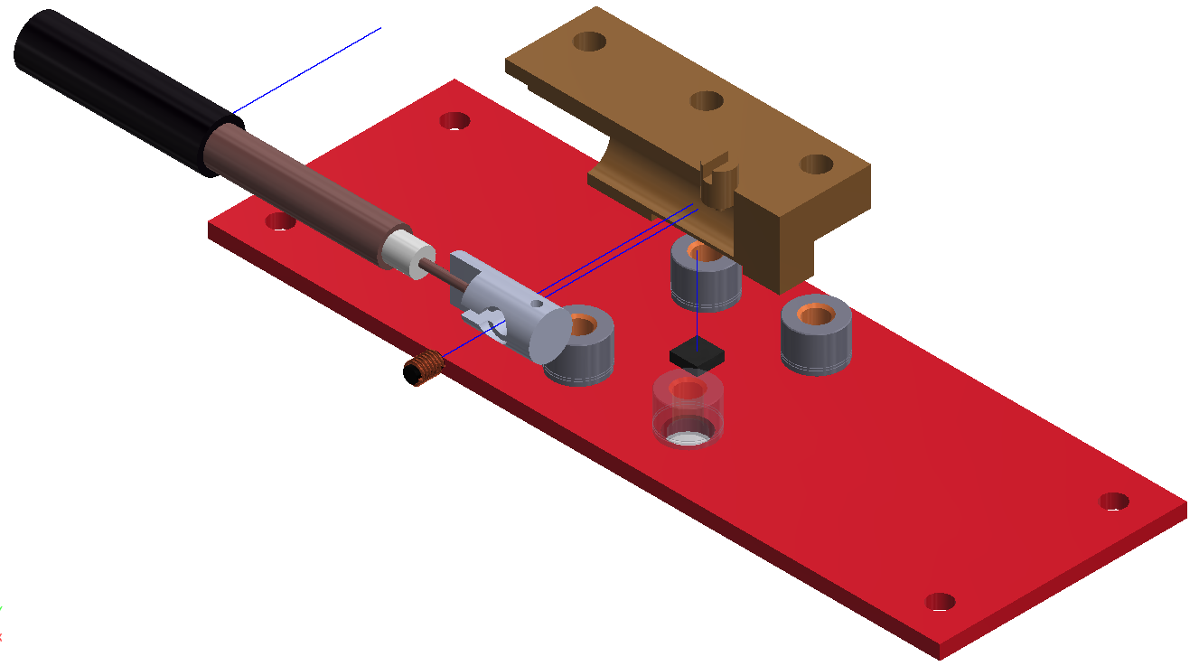
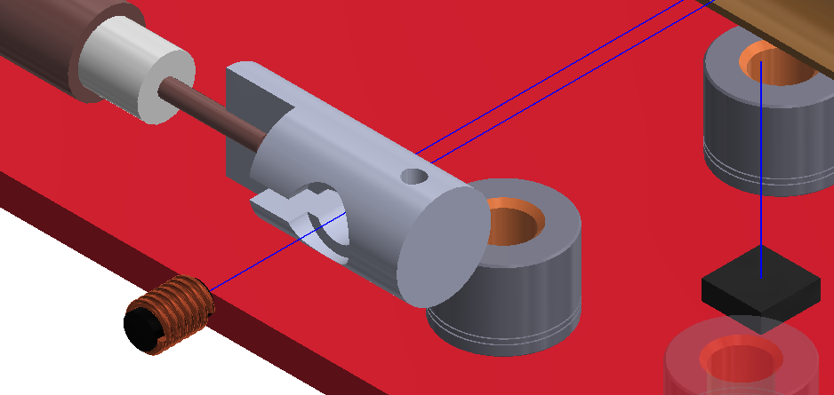
Room temperature NMR / Hall package
Environmental field monitor
~8m coax to impedance match
5mm
External solenoid ~1T
Annihilation detector
3-axis Hall sensor
Metrolab MV2
Natural Rubber NMR sample V ~ 4mm³
Possible improvement:
Notes:
The rubber NMR sensros is embedded in our annhilation detector. Which is sort of the easiest of the difficult environments for magnetometers at alpha….We have space and access constraints and therfore chose to use small samples, tuning capacitors a long distance from probe.
Its not as good as metrolab or state of the art in the literature...but it is good enough for us. Its main flaw for us is it the location...
Its for envir. Diag
Its at wrong location

Slide 27
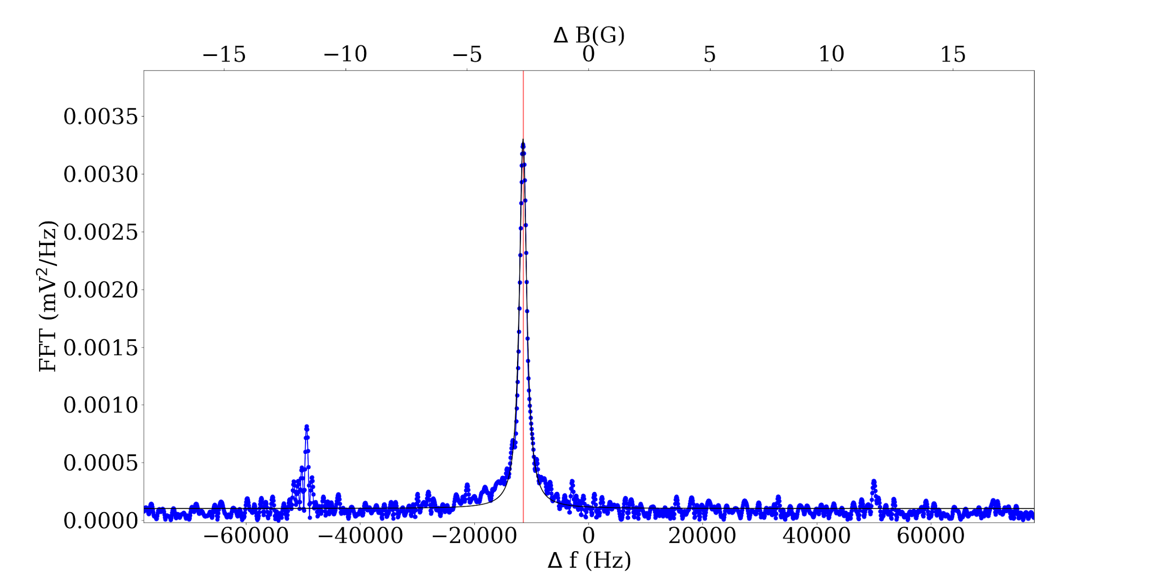

Rubber NMR Probe Performance
Power spectrum (arb.)
Notes:
Not state of the art, metrolab, epfl better, but its what you expect for this probe configuration...

