Slide 1


Single Photon Decay of The Positronium Ion
Md Samiur Rahman Mir
Supervisor: Dr. Andrzej Czarnecki
Winter Nuclear and Particle Physics Conference
Banff, 16 February 2020

Slide 2
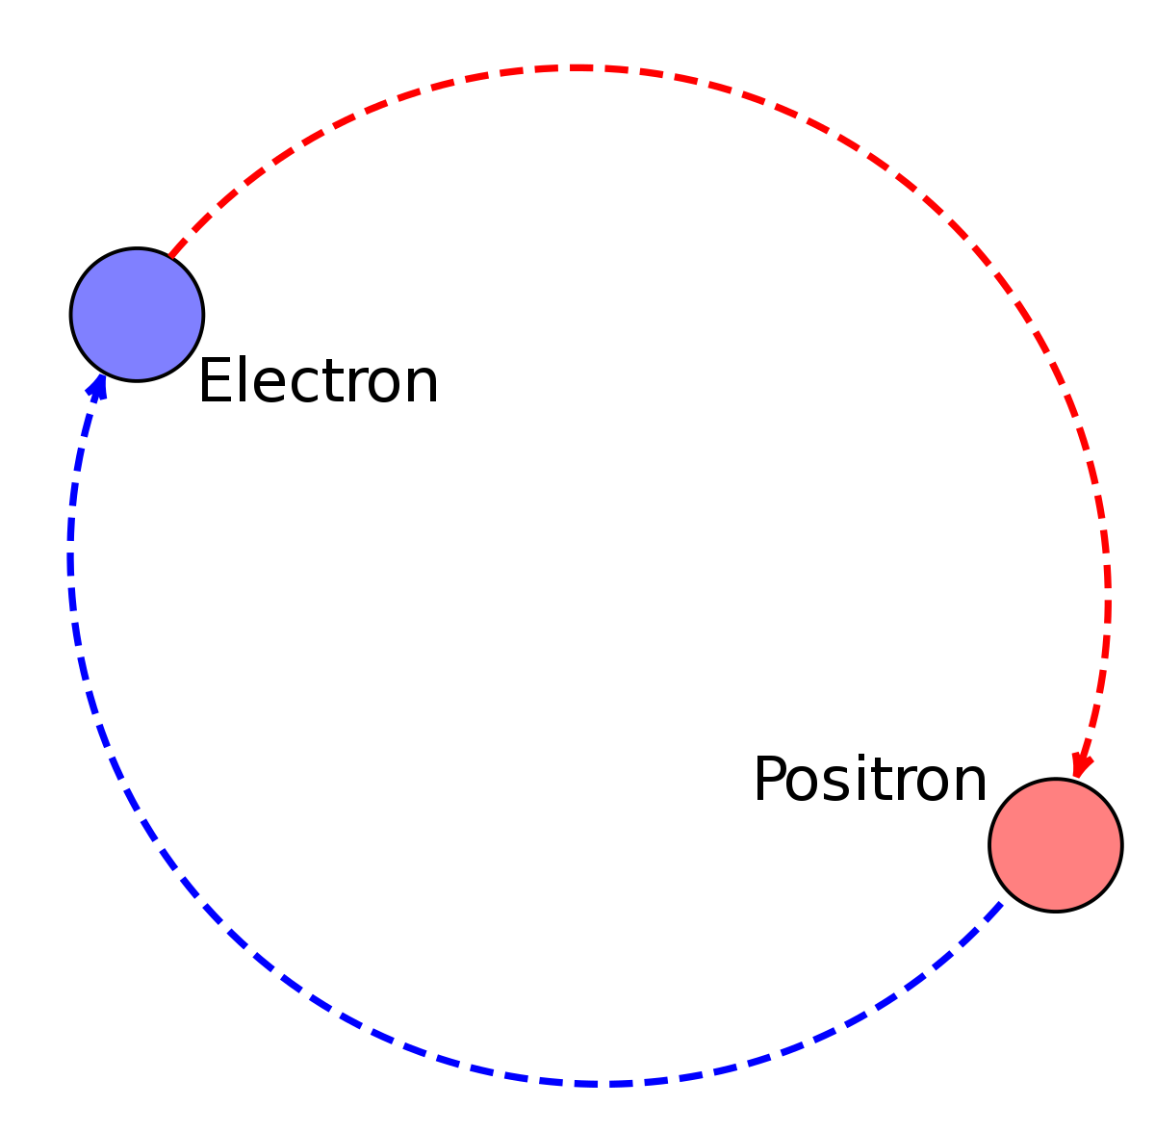
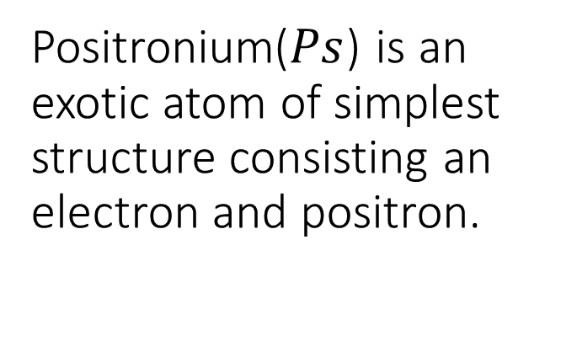
Positronium($Ps$) is an exotic atom of simplest structure consisting an electron and positron.

Slide 3
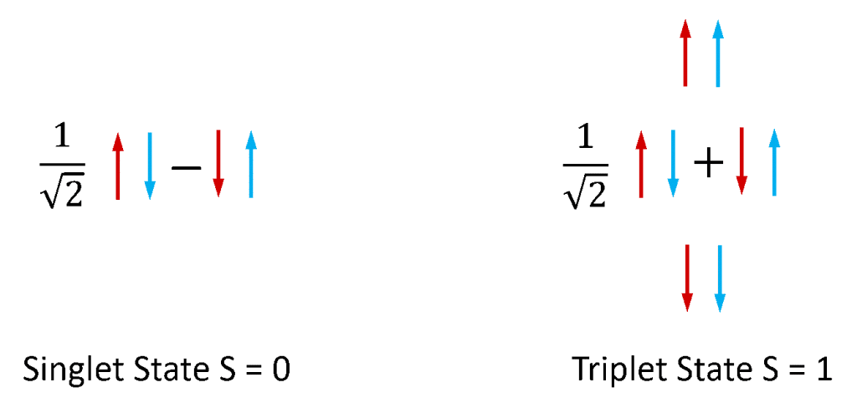
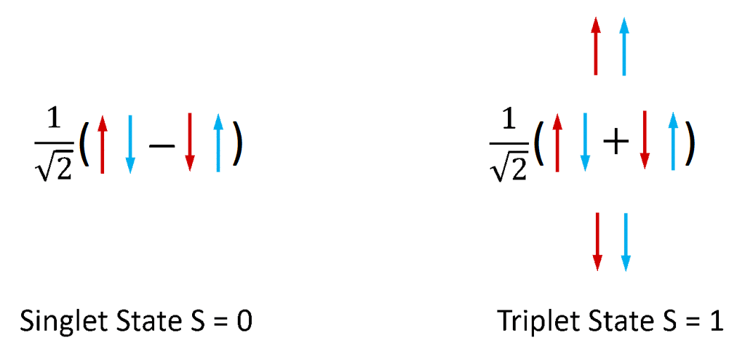
Positronium can have two possible spin states in its ground state.
Para-positronium
Ortho-positronium

Slide 4
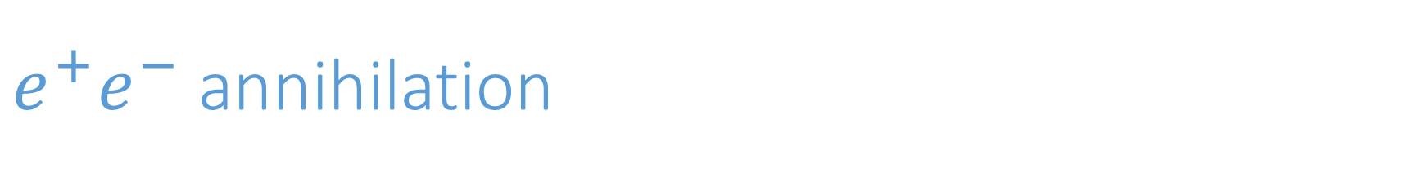
$e^{+}e^{−}$ annihilation
When a positron and an electron collide, they annihilate each other very quickly.
Lifetime of:
para-positronium 0.1244 ns
ortho-positronium 138.6 ns

Slide 5
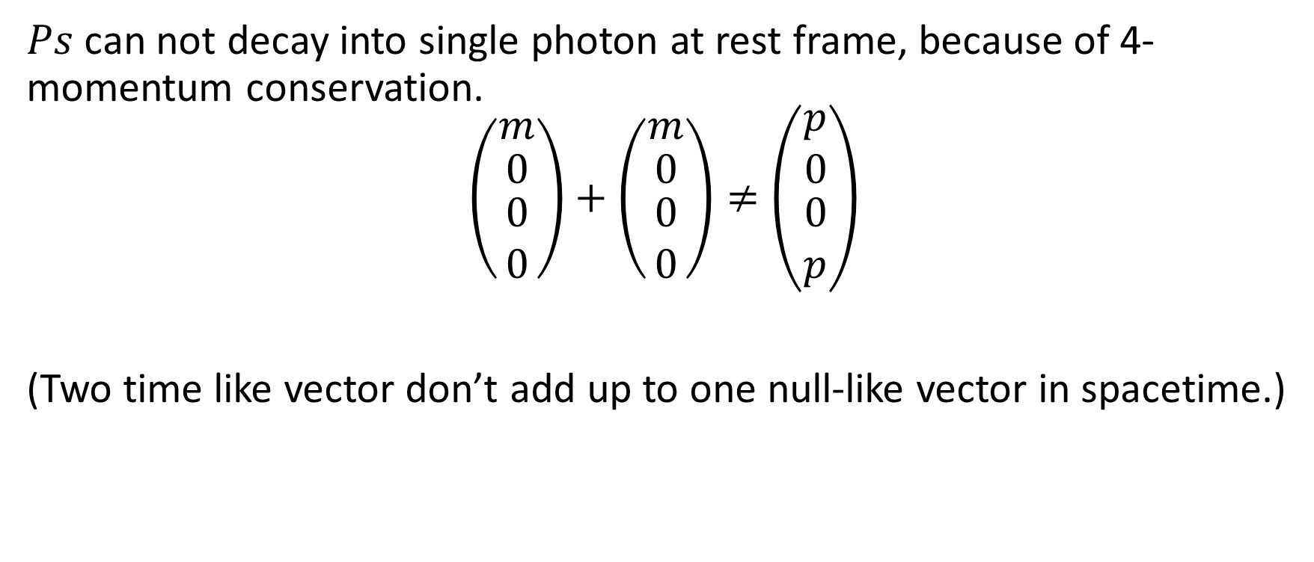
Single photon annihilation
$Ps$ can not decay into single photon at rest frame, because of 4-momentum conservation.
$$\left(\begin{matrix}m \\ \begin{matrix}0 \\ \begin{matrix}0 \\ 0\end{matrix}\end{matrix}\end{matrix}\right)+\left(\begin{matrix}m \\ \begin{matrix}0 \\ \begin{matrix}0 \\ 0\end{matrix}\end{matrix}\end{matrix}\right)≠\left(\begin{matrix}p \\ \begin{matrix}0 \\ \begin{matrix}0 \\ p\end{matrix}\end{matrix}\end{matrix}\right)$$
(Two time like vector don’t add up to one null-like vector in spacetime.)

Slide 6
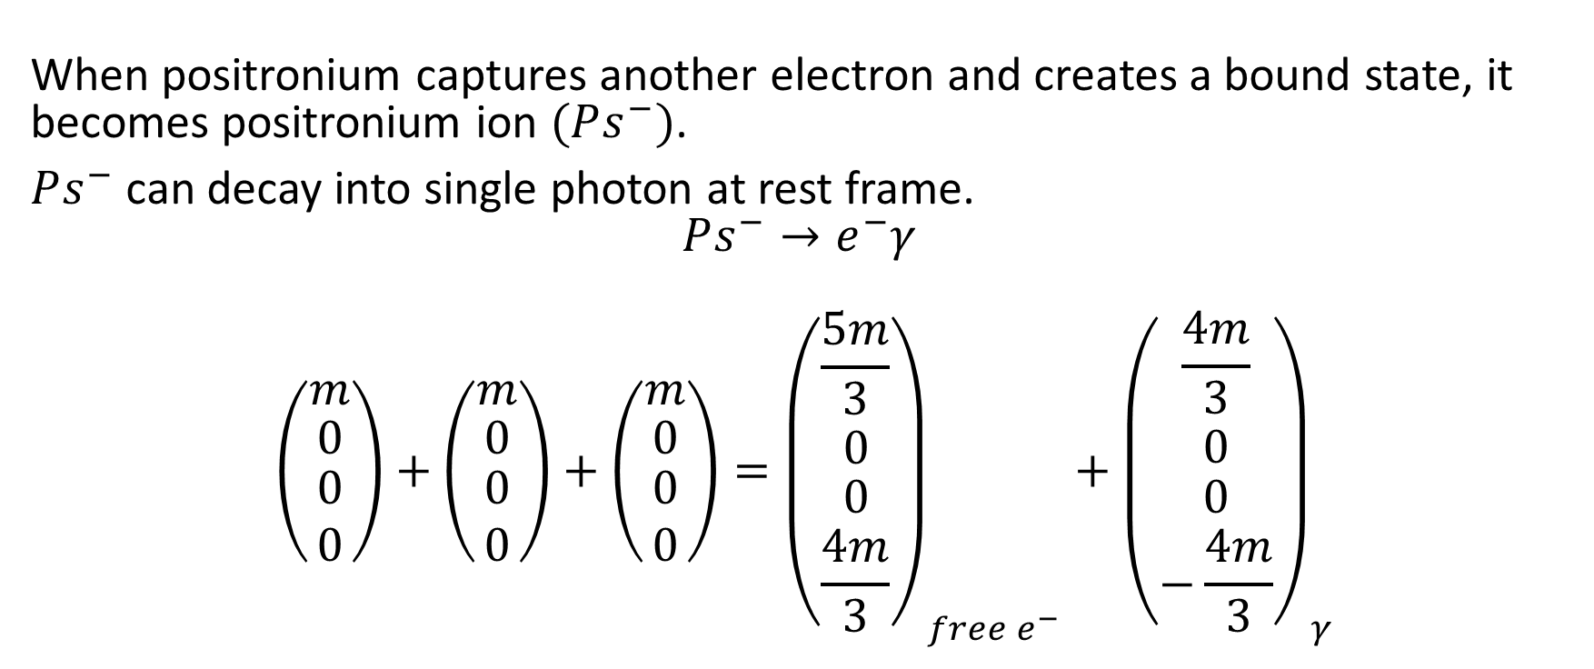
Single photon annihilation
When positronium captures another electron and creates a bound state, it becomes positronium ion $(Ps^{−})$.
$Ps^{−}$ can decay into single photon at rest frame.
$$Ps^{−}→e^{−}γ$$
$$\left(\begin{matrix}m \\ \begin{matrix}0 \\ \begin{matrix}0 \\ 0\end{matrix}\end{matrix}\end{matrix}\right)+\left(\begin{matrix}m \\ \begin{matrix}0 \\ \begin{matrix}0 \\ 0\end{matrix}\end{matrix}\end{matrix}\right)+\left(\begin{matrix}m \\ \begin{matrix}0 \\ \begin{matrix}0 \\ 0\end{matrix}\end{matrix}\end{matrix}\right)={\left(\begin{matrix}\frac{5m}{3} \\ \begin{matrix}0 \\ \begin{matrix}0 \\ \frac{4m}{3}\end{matrix}\end{matrix}\end{matrix}\right)}_{free e^{−}}+{\left(\begin{matrix}\frac{4m}{3} \\ \begin{matrix}0 \\ \begin{matrix}0 \\ −\frac{4m}{3}\end{matrix}\end{matrix}\end{matrix}\right)}_{γ}$$

Slide 7
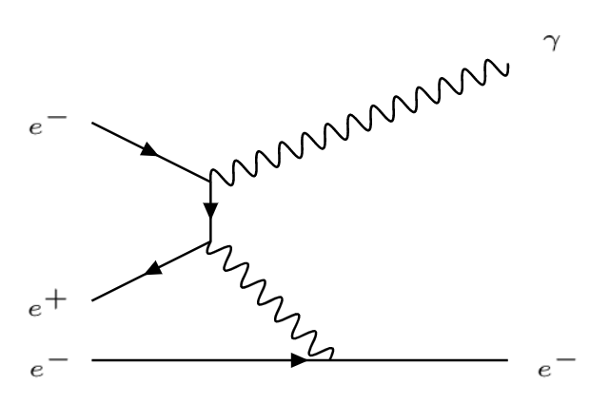
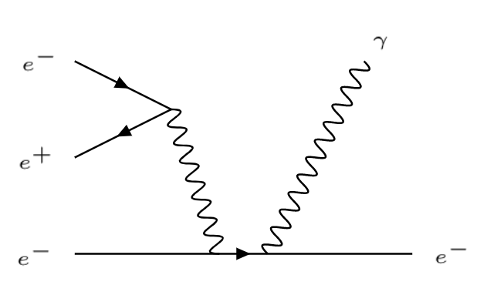
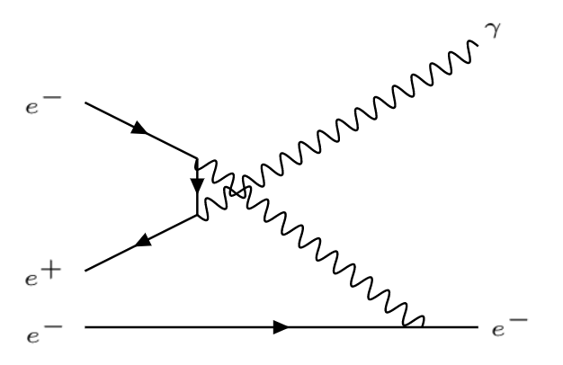
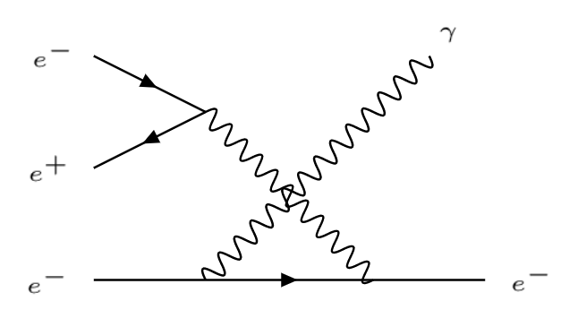
There are 8 possible ways this decay can occur.
4 are shown below, other 4 diagrams come from switching electrons.

Slide 8
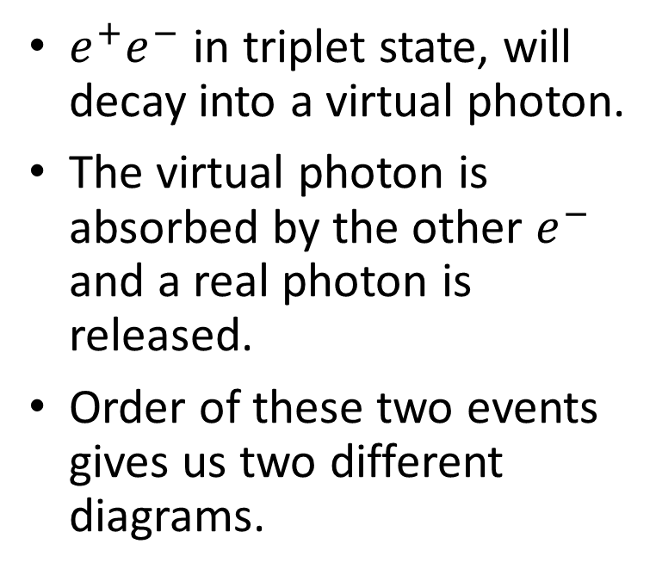
Triplet decay
$e^{+}e^{−}$ in triplet state, will decay into a virtual photon.
The virtual photon is absorbed by the other $e^{−}$ and a real photon is released.
Order of these two events gives us two different diagrams.

Slide 9
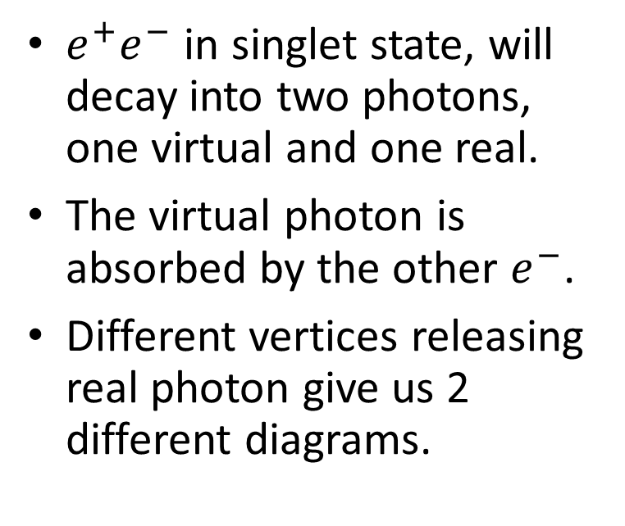
Singlet decay
$e^{+}e^{−}$ in singlet state, will decay into two photons, one virtual and one real.
The virtual photon is absorbed by the other $e^{−}$.
Different vertices releasing real photon give us 2 different diagrams.

Slide 10
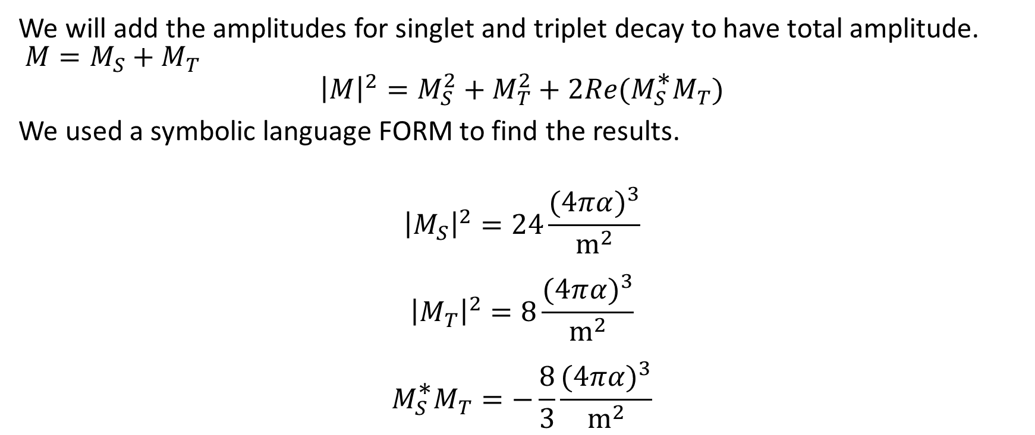

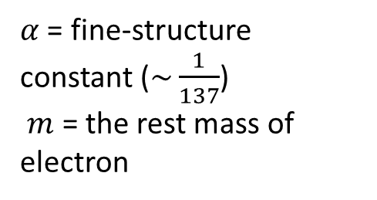
Total amplitude for $Ps^{−}→e^{−}γ$
We will add the amplitudes for singlet and triplet decay to have total amplitude. $M=M_{S}+M_{T}$
$${\left|M\right|}^{2}=M_{S}^{2}+M_{T}^{2}+2Re(M_{S}^{\text{∗}}M_{T})$$
We used a symbolic language FORM to find the results.
$${\left|M_{S}\right|}^{2}=24\frac{(4π{α)}^{3}}{m^{2}}$$
$${\left|M_{T}\right|}^{2}=8\frac{(4π{α)}^{3}}{m^{2}}$$
$$M_{S}^{\text{∗}}M_{T}=−\frac{8}{3}\frac{(4π{α)}^{3}}{m^{2}}$$
$α$ = fine-structure constant ($\sim \frac{1}{137}$)
$m$ = the rest mass of electron

Slide 11
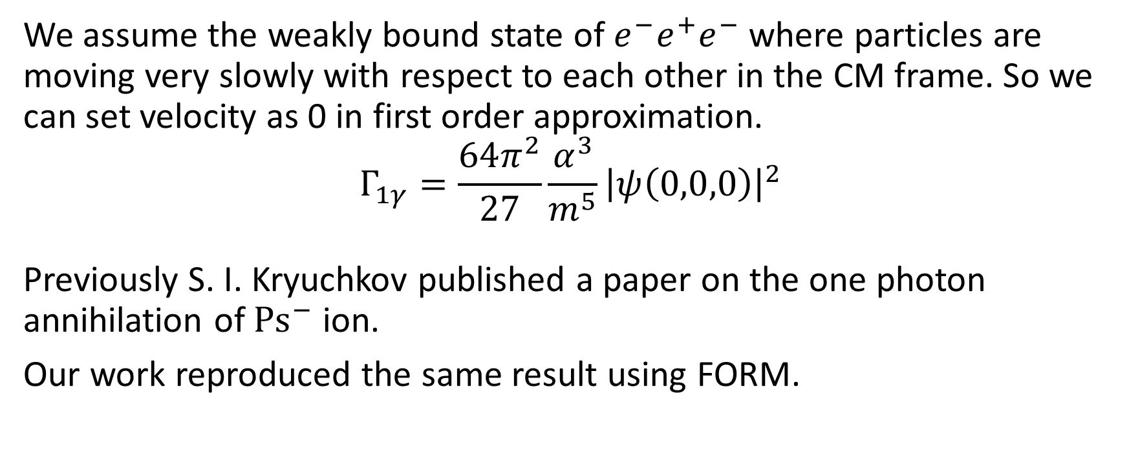
Decay rate
We assume the weakly bound state of $e^{−}e^{+}e^{−}$ where particles are moving very slowly with respect to each other in the CM frame. So we can set velocity as 0 in first order approximation.
$$Γ_{1γ}=\frac{64π^{2}}{27}\frac{α^{3}}{m^{5}}{\left|ψ\left(0,0,0\right)\right|}^{2}$$
Previously S. I. Kryuchkov published a paper on the one photon annihilation of ${Ps}^{−}$ ion.
Our work reproduced the same result using FORM.

Slide 12
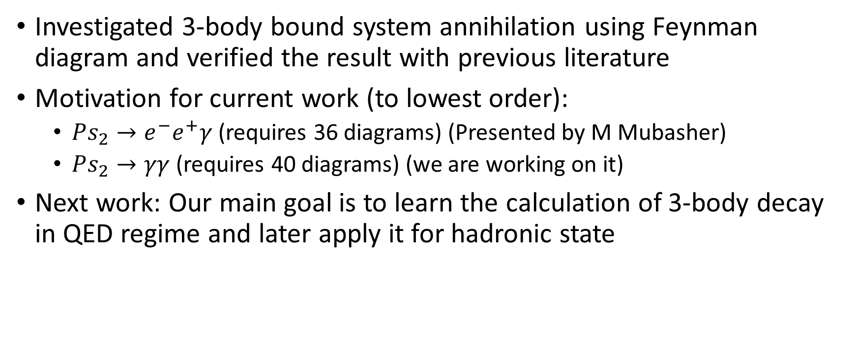
Conclusion
Investigated 3-body bound system annihilation using Feynman diagram and verified the result with previous literature
Motivation for current work (to lowest order):
  $Ps_{2}→e^{−}e^{+}γ$ (requires 36 diagrams) (Presented by M Mubasher)
  $Ps_{2}→γγ$ (requires 40 diagrams) (we are working on it)
Next work: Our main goal is to learn the calculation of 3-body decay in QED regime and later apply it for hadronic state

