Slide 1

Analysis of electron drift properties and fluctuations for NEWS-G
Jean-Marie Coquillat
WNPPC 2020

Slide 2
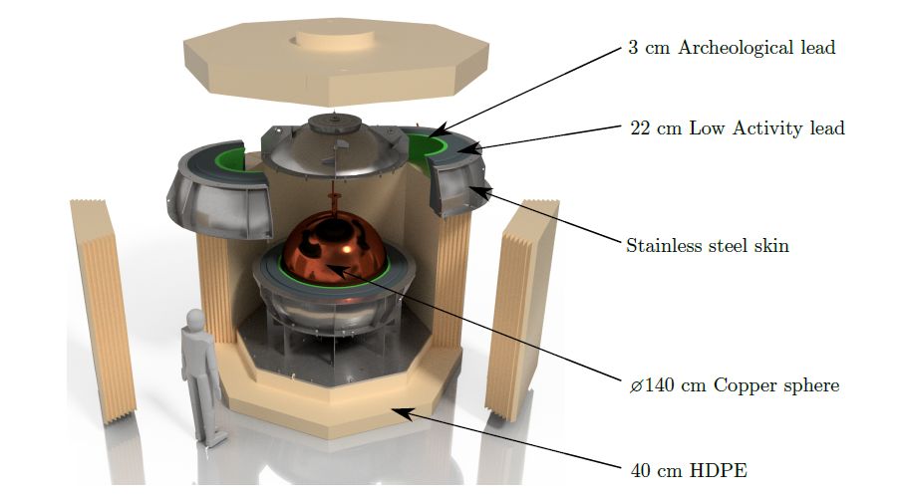
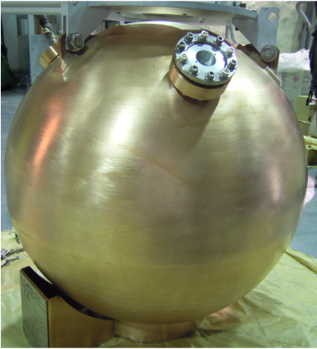
NEWS-G detector summary
Spherical proportional counter filled with gas
Trying to detect low mass WIMPs
Current data analysis from LSM
runs of Ne and CH₄
Installation ongoing
in SNOLAB

Slide 3
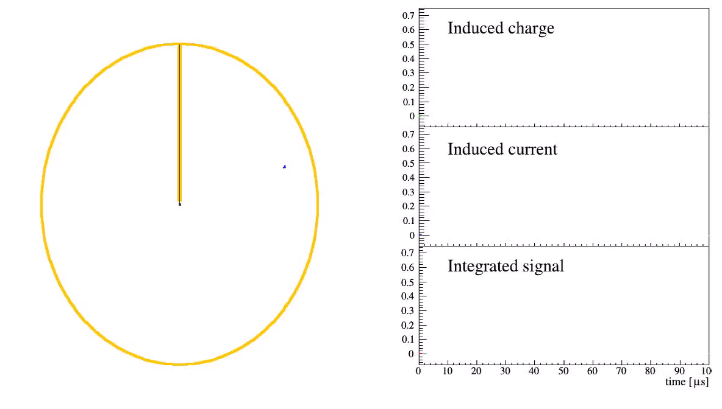
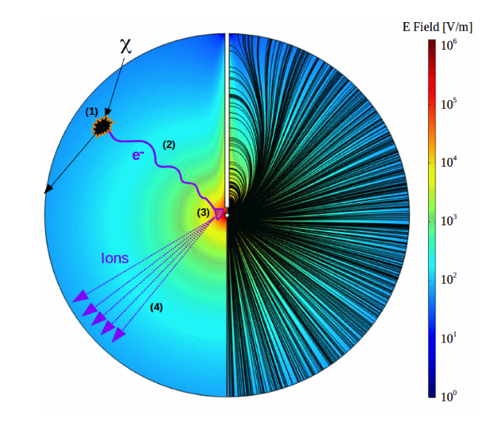
Event detection
Animation by Philippe Gros

Slide 4
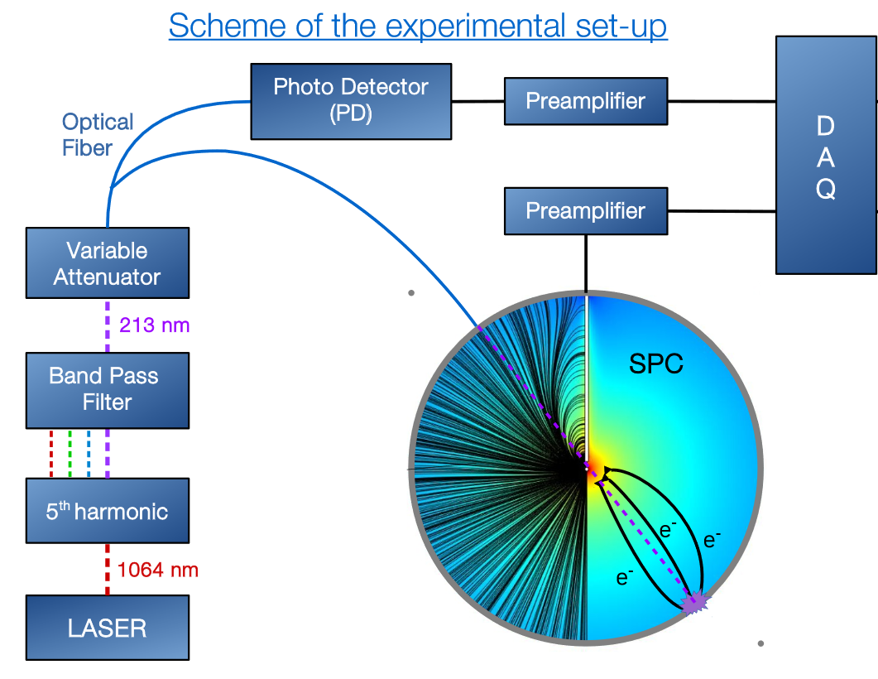
Drift time
Drift time: Mean time for e⁻ to travel from surface of the sphere to the central anode
Allows characterization of the detector, e.g. for simulations
Measured with a laser using a photodetector and the photoelectric effect

Slide 5
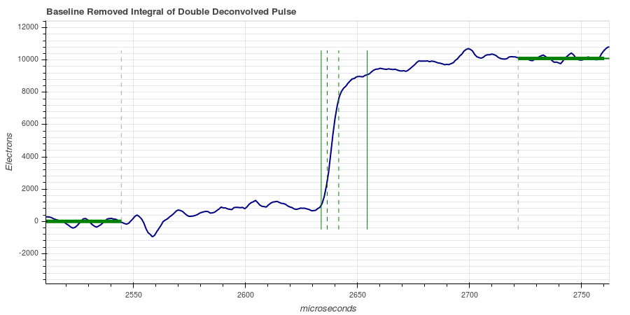
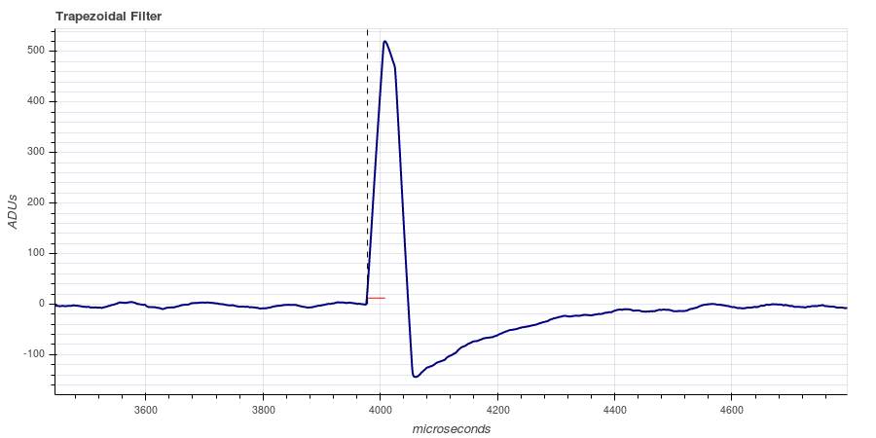
Calculation of Drift Time
Start of photodetector pulse [channel 2]
Rise 10%
Rise 25%
Rise 75%
Rise 90%
South [channel 1]
100%
Trapezoidal filter
Double deconvolved integral
0%
$$Drift time= \frac{\text{(}\text{Rise}\text{ 10\% + }\text{Rise}\text{ 25\% + }\text{Rise}\text{ 75\% + }\text{Rise}\text{ 90\%)}}{4}\text{−} \text{Start} \text{of} \text{photodetector} \text{pulse}\text{ + }\text{Δt}$$
$$Where Δt is the time shift between the two channels (Time[ch. 2]−Time[ch. 1])$$

Slide 6
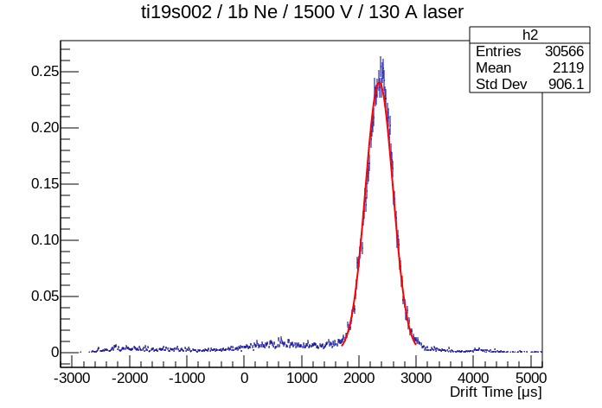
Calculation of Drift Time
Gaussian fit applied to the distribution to find the mean drift time and its uncertainty

Slide 7
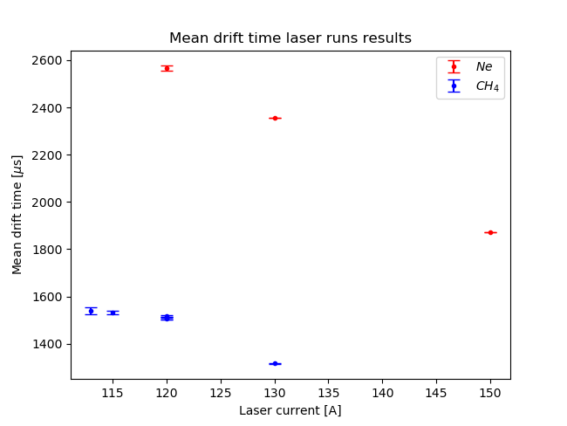
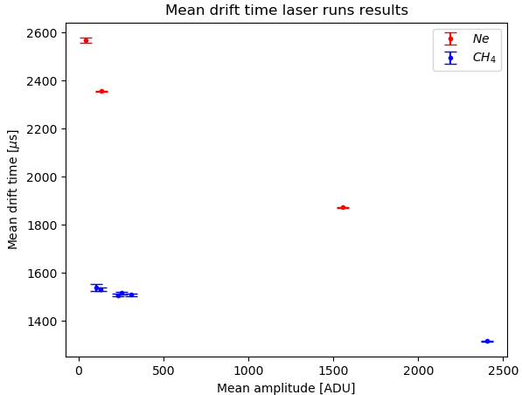
Drift time results – Gas and laser current
Neon: V = 1500 V, P = 1 bar
Methane: V=2030 V, P = 0.135 bar

Slide 8
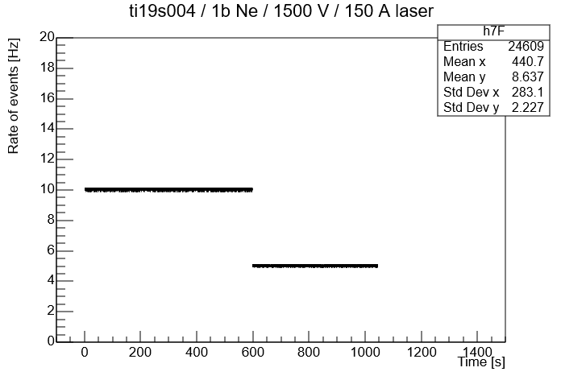
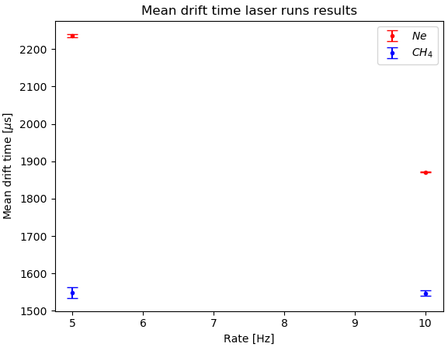
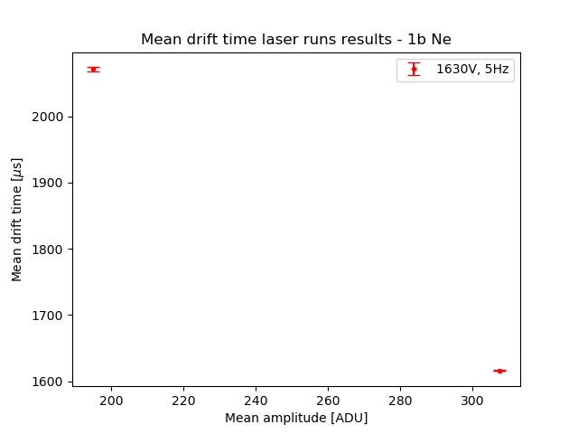
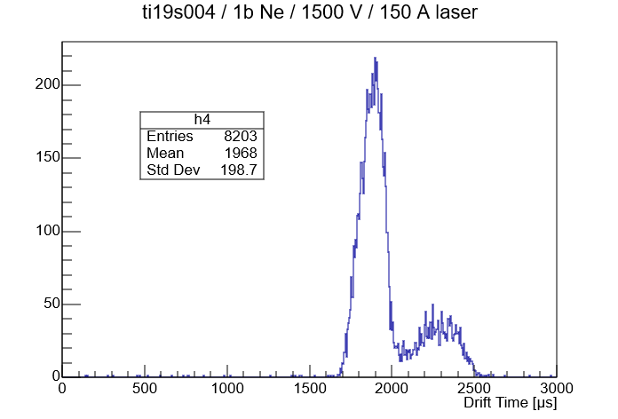
Drift time results – Rate and radioactive source
No source
Ar-37

Slide 9
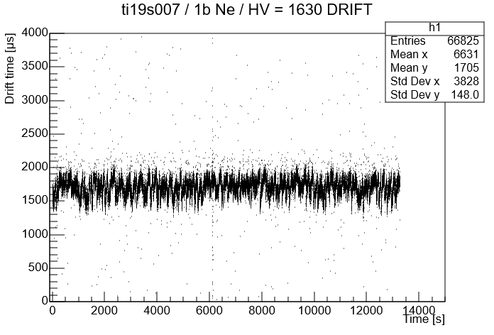
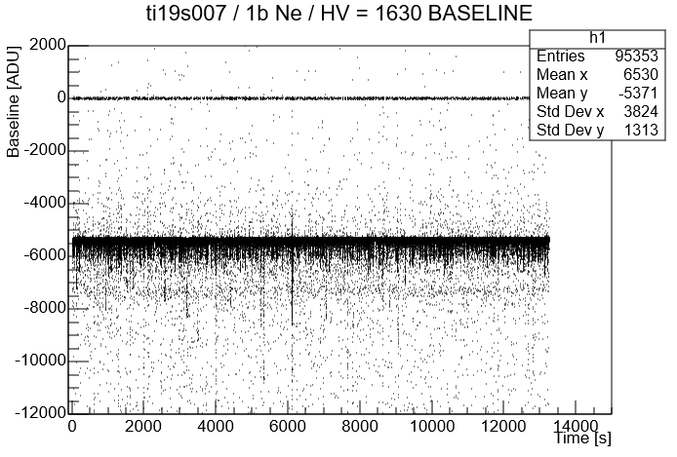
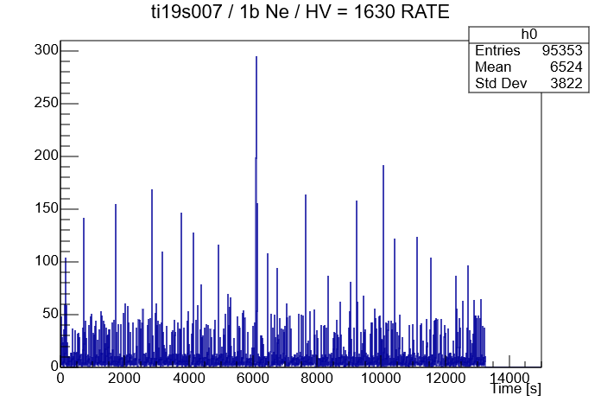
Fluctuations in the drift time

Slide 10
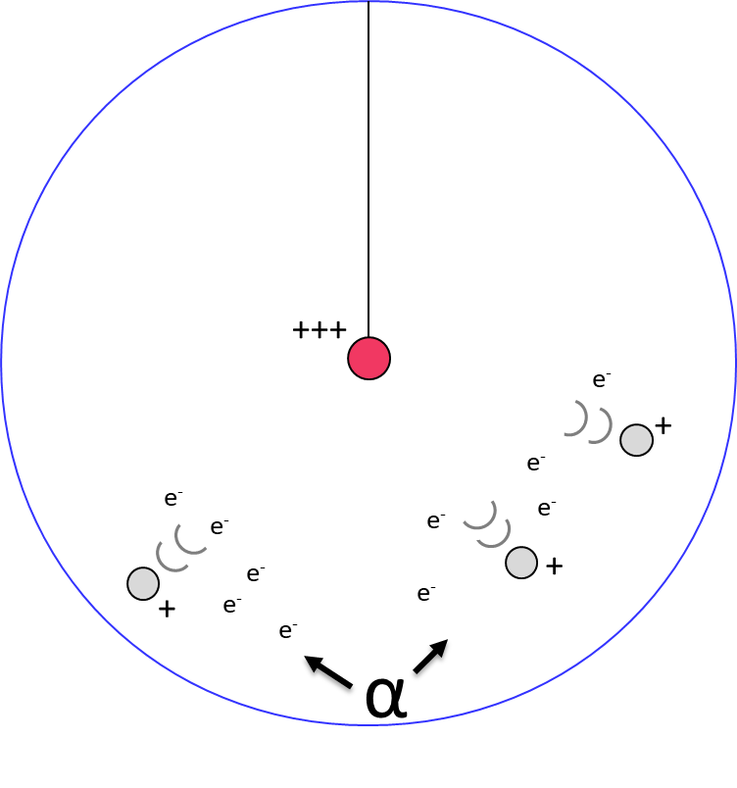
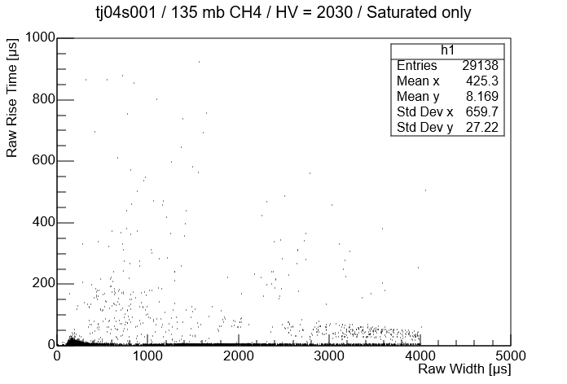
Alphas in the detector
“Space charge effect”: Drift of ions slowly perturbate the electric field

Slide 11
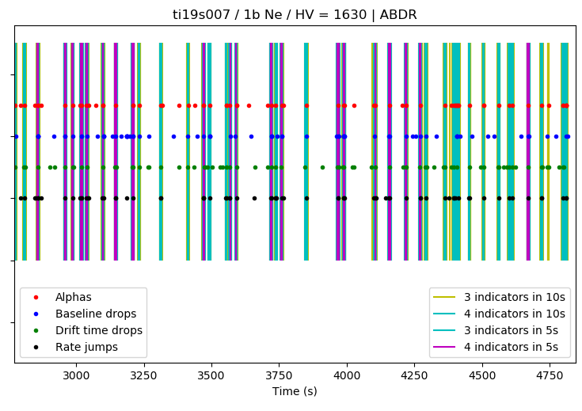
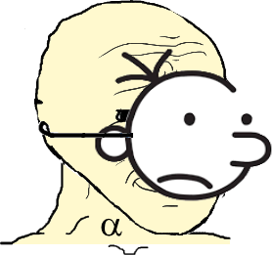
Fluctuations effects
Clear correlation between the different fluctuations
Problem:
A lot of seemingly “good events” created because of this phenomenon

Slide 12
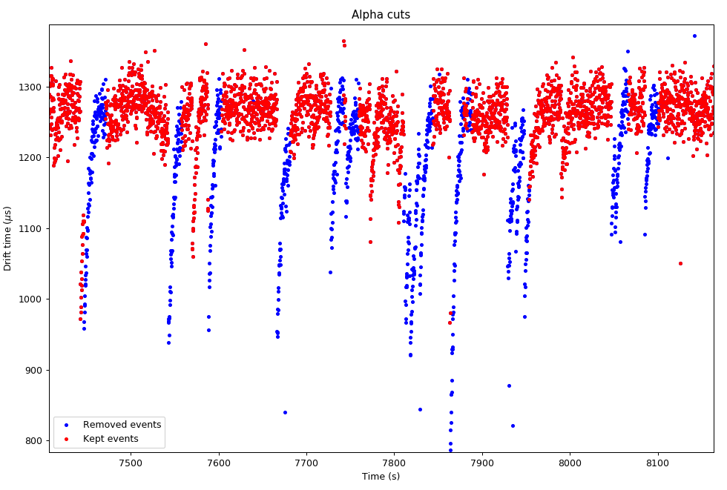
Solution: Cuts on alphas
Event selection on all four indicators
5-second dead time cut
Around 85% of total time kept

Slide 13
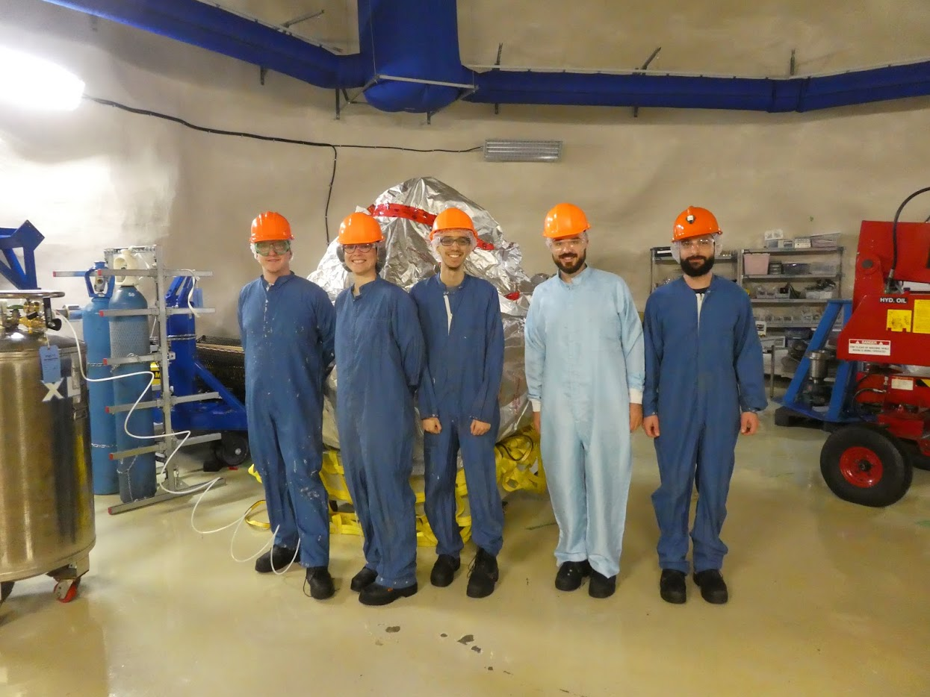
What’s next for SNOLAB
Removing the alpha source
  Etching on inner surface
  Waiting for Po disintegration
More event selection

Slide 14
References
Thank you!
Q. Arnaud et al., First results from the NEWS-G direct dark matter search experiment at the LSM, Astroparticle Physics97(2018) 54-52.
Q. Arnaud et al., Precision laser-based measurements of the single electron response of SPCs for the NEWS-G light dark matter search experiment, arXiv:1902.08960
A. Dastgheibi-Fard & G. Gerbier, Development of Spherical Proportional Counter for light WIMP search within NEWS-G collaboration, arXiv:1904.01944
And thanks to all members of NEWS-G

