Slide 1


Search for mono-Z signature dark matter with the ATLAS detector at the LHC
WNPPC, February 13-16, 2020
Samantha Taylor
Supervisor: Michel Lefebvre
University of Victoria

Slide 2
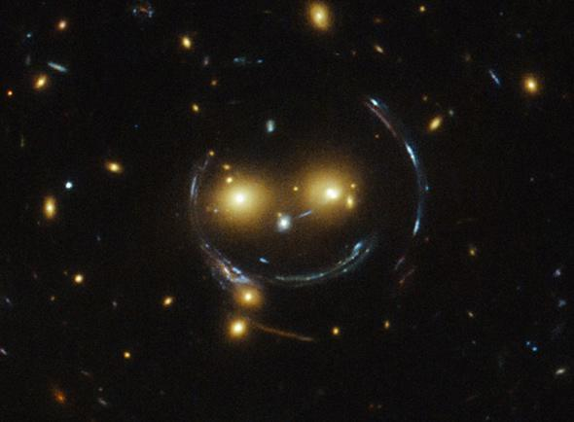
Dark matter
Motivation
Detection methods
Astronomical observations reveal the existence of dark matter
The nature of dark matter is not explained by our current knowledge of physics
Astronomical observations
  Ex: galaxy rotation curves, velocity dispersion, gravitational lensing
Direct detection
  ie: DM - nuclei scattering
Indirect detection
  ie: products of DM decay/annihilation
Production of dark matter
  ie: DM as product from particle collisions
Notes:
Why do we study the existence of dark matter? What's the motivation? There exist many astronomical phenomena that cannot be explained by our current understanding of physics. The existence of dark matter would explain many of these observations.
This in itself is a 'detection' method of dark matter, as astronomical observations reveal the existence of dark matter. Some of these observations include galaxy rotation curves, velocity dispersion, and gravitational lensing, which is shown in the picture. You can see the object in front curving the light from behind to create this halo effect. From observations, the galaxy shouldn’t have enough mass to create this effect, meaning something else is giving it extra mass.
Other methods include direct detection, with sensitive detectors such as SNOLAB that try to detect DM-nuclei scattering; indirect detection consists of products of DM decay or annihilation (ex: gamma rays) which may occur in the middle of galaxies or stars; production of dark matter is what we try to do at colliders such as the LHC.

Slide 3
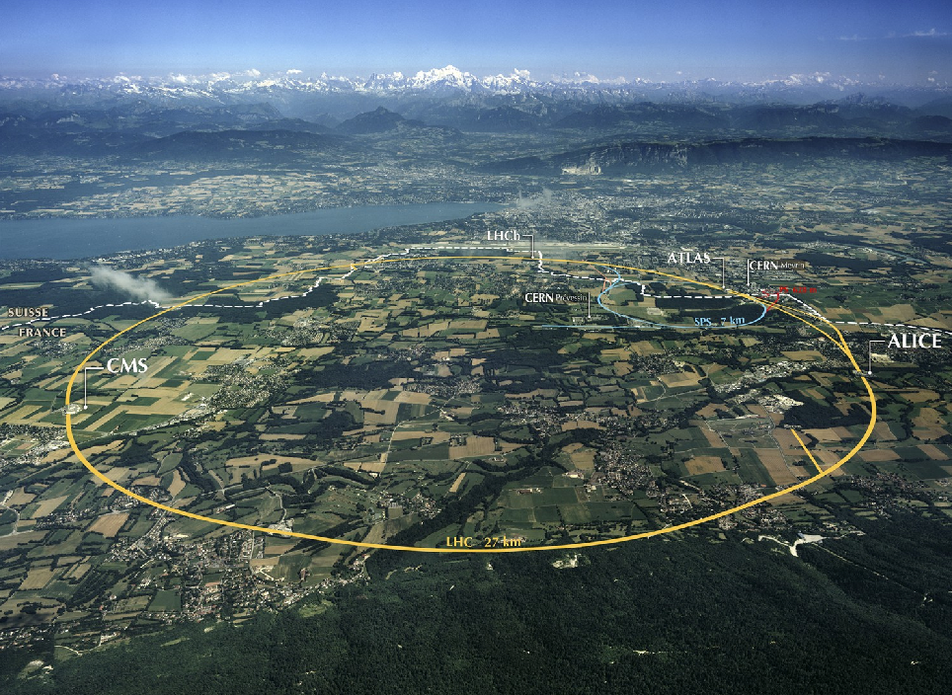
Dark matter production
LHC
pp beam collisions
Most recent results from Run II (2015-2018) at 13 TeV
Collection of 140 fb⁻¹ of data so far
Run III to operate 2021-2024 at 13-14 TeV
Cylindrical detector with nearly 4π coverage
Dark matter particle not yet detected
Use data collected to make exclusion plots for parameters of interest
Missing transverse momentum is usually the main discriminant
ATLAS
Notes:
The LHC, a 27km circumference collider, uses proton-proton beam collisions to study both Standard Model and Beyond Standard Model physics. The most recent results are from Run II, which ran from 2015-2018 at a center of mass energy of 13 TeV. So far, the LHC has collected 140 fb-1 (10^{-43} m^{-2}) of data so far, with the next run to start in 2021 at 13 TeV, with the goal of reaching 14 TeV. The ATLAS detector is cylindrical in shape, with nearly 4pi coverage. Although a dark matter particle has not yet been detected, we can use the collected data to make exclusion plots for parameters of interest. Missing transverse momentum is usually the quantity of interest during these studies, which I will discuss more in detail in a few slides.\\

Slide 4
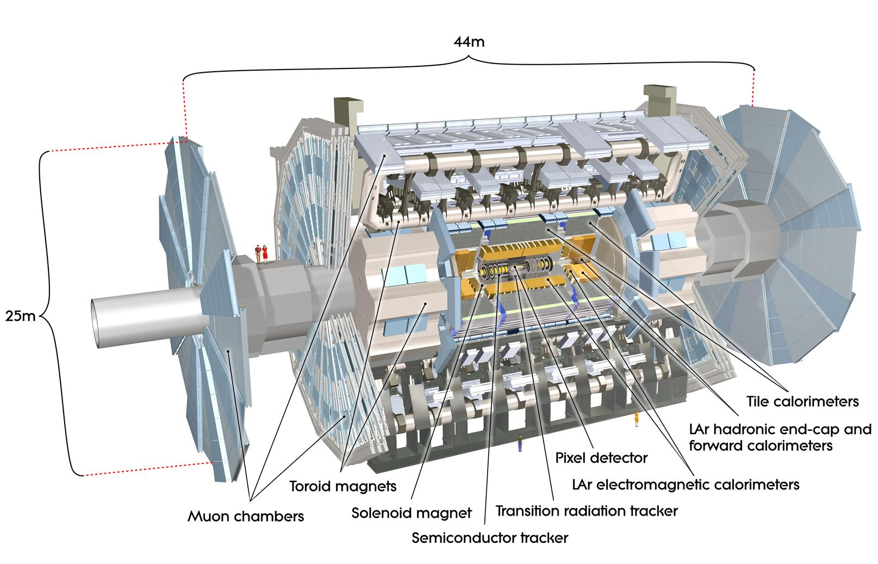
Quick overview of the
ATLAS detector
Notes:
This is a quick overview of the ATLAS detector with its three main components: the tracking inner detector, calorimeter, and muon detection system, which consists of a muon detector and magnet system. As you can see there is nearly 4$\pi$ coverage other than the beam pipe on each end. You can click on the link here for more information on the detector, and it will redirect you to the ATLAS site.

Slide 5

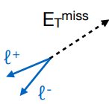
Missing transverse momentum
In principle, transverse momentum in particle collider final states should add to zero via conservation of momentum
Certain processes give weakly-interacting/undetected particles in final state, giving the illusion of the violation of momentum conservation (missing transverse momentum, MET, or )
  Ex: invisible Z decay to two neutrinos, poor signal reconstruction
Can search for the existence of DM by studying
  Important observable!
More info on : Eur.Phys.J. C78 (2018) no.11, 903
Notes:
In principle, transverse momentum in particle collider final states should add to zero by conservation of momentum. Certain processes that may occur in colliders can give weakly interacting or undetected particles in the final state, giving the illusion of the violation of momentum conservation. This is known as missing transverse momentum, MET, or $E_T^{miss}$. We use the $E_T^{miss}$ notation for the magnitude of missing transverse momentum. A process example would be invisible Z decay to two neutrinos, or it could simply happen by poor signal reconstruction. This is an important observable, as we cannot detect dark matter directly. More information can be found through this link here, which will redirect you to a published article on $E_T^{miss}$ reconstruction with the ATLAS detector.

Slide 6


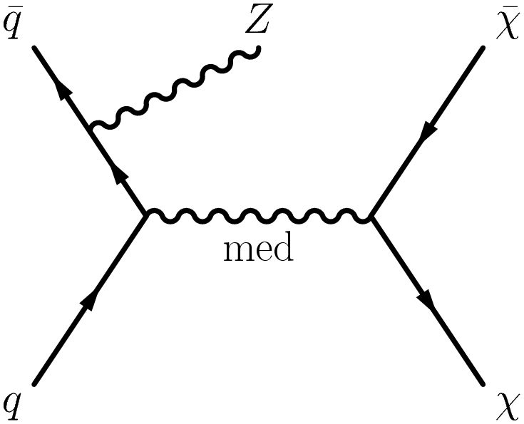
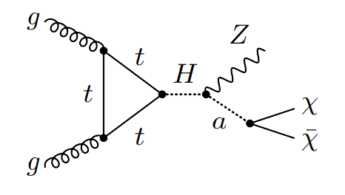
Models and signature
Mono-X signature: large and one energetic particle
  - Ex: Mono-jet, Mono-Higgs
Interested in Mono-Z signature in this analysis
Final state is and Z boson
Z decays to two same-flavour leptons (e⁺e⁻ or μ⁺μ⁻)
Simplified model
2HDMa
Vector or axial-vector mediators
Two Higgs doublet model plus pseudoscalar mediator
Notes:
One signature that gives a final state including $E_T^{miss}$ is the Mono-X signature. Some examples include Mono-jet and Mono-Higgs. In this analysis, we are interested in Mono-$Z$, where the Z decays to two same-flavour leptons, either ee or mumu. Two models that can give this signature is the simplified model, with vector or axial-vector mediator, and the 2 Higgs Doublet model with a pseudoscalar mediator. Here, dark matter is assumed to be a Dirac fermion, and the Higgs is assumed to be a heavy Higgs, not Standard Model.

Slide 7
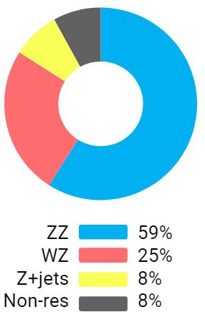
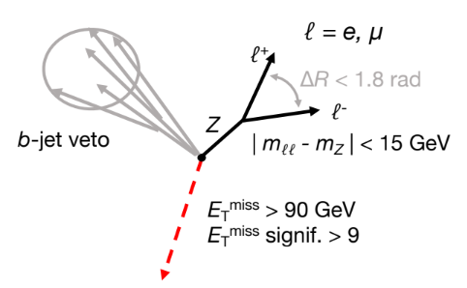
Event selection and main backgrounds
Notes:
Unfortunately, many backgrounds exist that may give off this signature. Therefore, in order to reduce these backgrounds, we must make selection cuts on the data. The main background is $ZZ$, where one $Z$ is signature, and the other goes to neutrinos that are invisible to the detector. This gives 59$\%$ of the total background and is irreducible.
The selection criteria we have to hone in on the signal we want and reduce background are that an event needs to have only one lepton pair with same flavour, opposite charge; veto events with a third lepton with $p_T >$ 7 GeV, which reduces the second largest background $WZ$; the total mass of the leptons must be in the $Z$ mass window: ie between 76 and 106 GeV, which reduces $WW$ background; $E_T^{miss}$ must be greater than 90 GeV, reduces $Z$+jets; angle between the two leptons must be $<$ 1.8, as the $Z$ is boosted, making the leptons more columnated, reduces $Z$+jets; b-jet veto, reduces $t\overline{t}$.\\

Slide 8
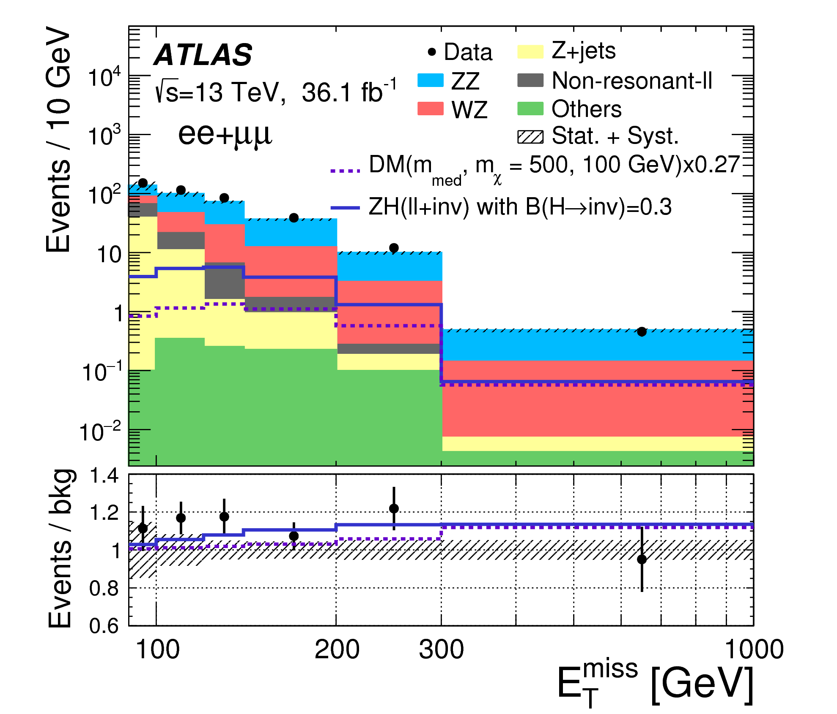
Published results in Phys. Lett. B 776 (2017) 318
Notes:
This is a published result of the background in the $ee+\mu\mu$ combined channel. It is a histogram of the $E_T^{miss}$, with the total number of events being on the vertical axis. Can see that the data, which is the black dots, is compatible with the background only hypothesis, as there is not a significant amount of excess or deficit. Because we have no excess, we try to exclude dark matter models.

Slide 9
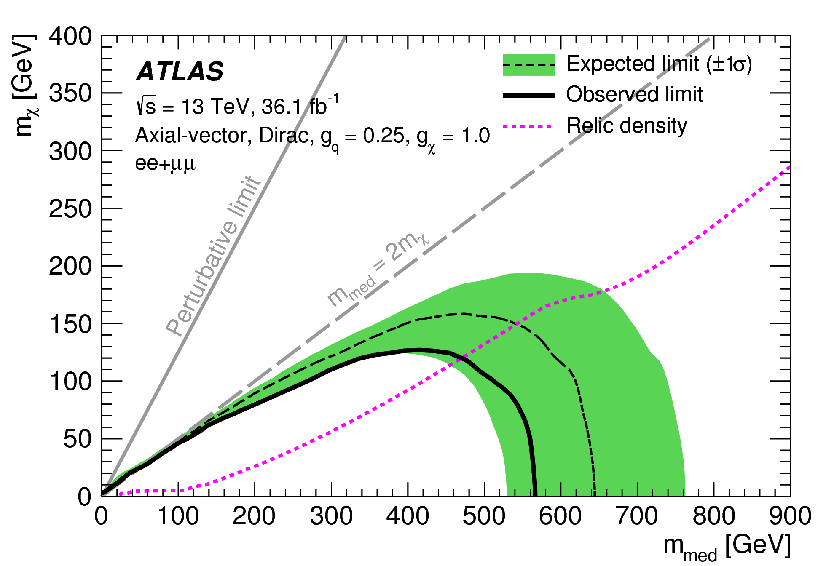



Simplified model (V/AV) and 36 fb⁻¹ result
6 free parameters:
  Coupling to quarks, leptons, DM
    g_{q} = 0.25, g_{l} = 0.00, g_{χ} = 1.00
  Dark matter mass
  Mediator mass
  Mediator width
Published results in Phys. Lett. B 776 (2017) 318
140fb⁻¹ result coming soon with Run II data
Notes:
The vector/axial-vector simplified model has 6 free parameters: $g_q$, $g_l$, $g_\chi$, which are coupling to quarks, leptons and DM respectively, where g_l is 0, meaning it is a leptophobic model, which is the less excluded model so far and the most interesting to look at. We also have $m_\chi$, the dark matter mass; $m_{med}$, the mediator mass, and $\Gamma_{med}$, the mediator width.
This is a contour plot for $m_\chi$ and $m_{med}$ for the axial vector model. The dashed line is the expected limit, with the $\pm1\sigma$ band in green, and the observed limit is the solid line. We can exclude anything underneath this line parameter-wise.\\
---------------------------------------------
Relic density line: assuming this is the only true model, and DM falls directly on the relic density line, it would be compatible with the relic density of the universe - would be the only source of DM\\
Leptophobic model: less excluded model so far, most interesting to look at\\
Above $m_{med}=2m_\chi$ line, highly suppressed, off-shell, less likely to see anything\\
Mediator width: consequence of the model, can be calculated - here assuming minimal width

Slide 10
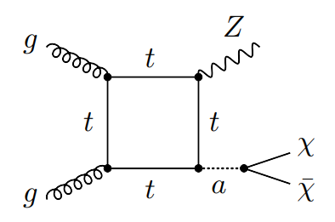


2HDMa
gg-induced leading order diagrams
5 free parameters:
  Mass of A, H, H+/-
  Mass of pseudoscalar a
  Mixing angle between A, a
  Ratio of VEVs of Higgs doublets
  Dark matter mass
Notes:
The Two-Higgs Doublet model has 5 free parameters: $m_A$, the heavy $A$ mass, is set to $m_H = m_{H\pm}$; $m_a$, the mass of the mediator, sin$\theta$, the mixing angle between heavy $A$ and mediator $a$, tan$\beta$, the ratio of the vacuum expectation values of the Higgs doublets, and $m_\chi$, the dark matter mass. Here we have the two main contributing Feynman diagrams, the resonant and box diagrams, which are both gg induced.\\
----------------------
Top diagram more important for low tan$\beta$ values, bottom more important for tan$\beta$$

Slide 11
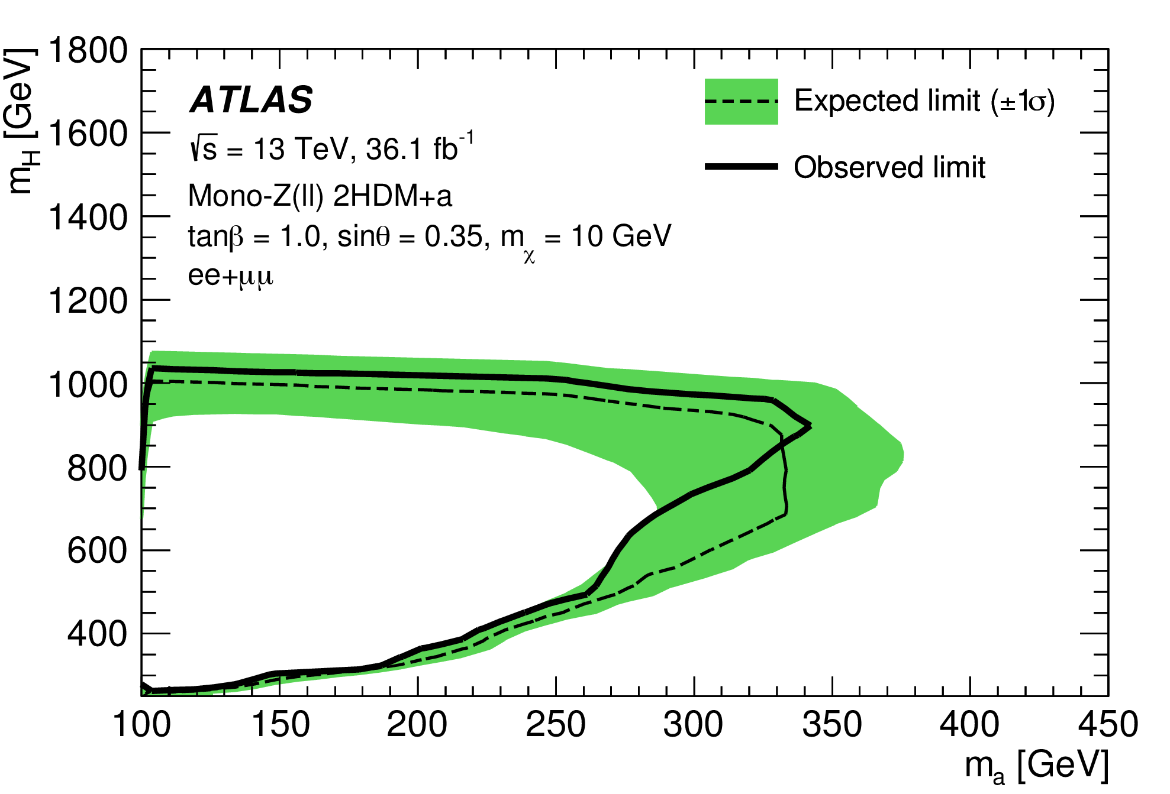
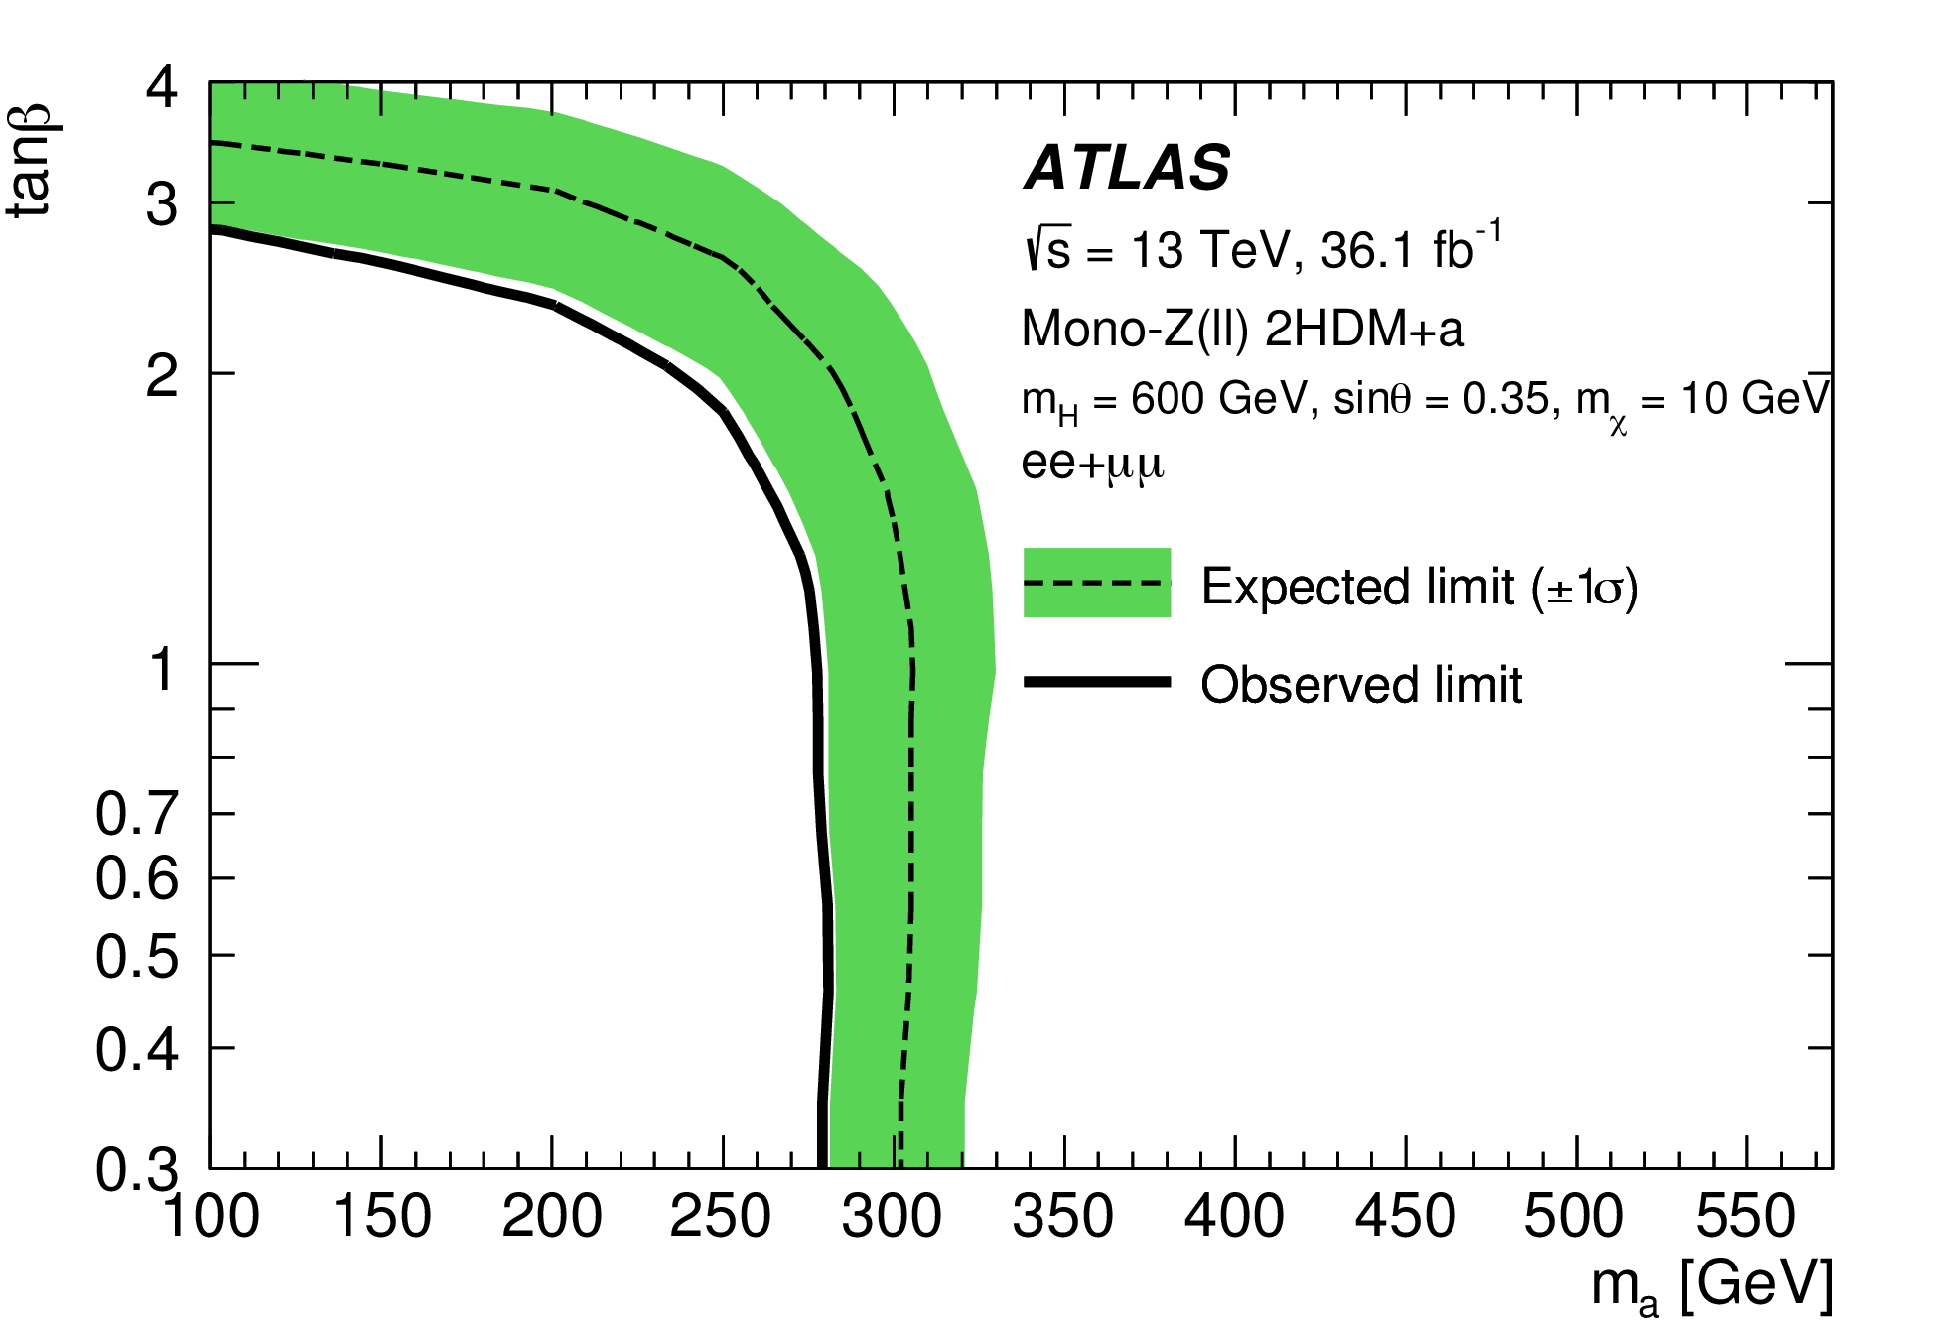
36 fb⁻¹ result (2HDMa)
Published results from JHEP 05 (2019) 142
Notes:
These results are from JHEP, for 36 fb$^{-1}$. The first is the contour plot for $m_H$ and $m_a$, and the second is for tan$\beta$ and $m_a$. These are both for $ee_\mu\mu$ combined channels, where again, we can exclude anything underneath the solid line.

Slide 12
Reweighting techniques
MadGraph reweighting
Histogram reweighting
Many model parameter points are needed for limit scans
  Full ATLAS simulation CPU intensive
Instead, only need to fully simulate a few model parameter points using MadGraph
Produce distributions using event reweighting to other target points
Based on matrix element ratios
2D histograms of two kinematic variables, p_{T}(χχ) and p_{T}(ll), characterizing the event
Take ratio of target parameter point histogram to fully simulated histogram for a given model parameter point
Use these ratios to obtain an event weight to emulate distributions to target point
Notes:
Clearly, we can study these models more in depth by simulating them. In order to make it less taxing to simulate each point on the grid, we have two reweighting techniques that we can use. MadGraph reweighting uses all kinematic variables in the matrix element ratios, which we can use to 'reweight' nominal points to other target points. MadGraph reweighting does not work for masses, as the ratio of matrix elements does not work well - phase space does not overlap well between point and target point. So instead we can use histogram reweighting, which takes 2D histograms of kinematic variables characterizing the event ($p_T(\chi\chi)$ and $p_T(ll)$ have been found to work well). It takes the ratio of the target parameter point histogram to the fully simulated histogram for a given model parameter point. We can then use these ratios to obtain an event weight to emulate distributions to a target point.\\

Slide 13
.
.
Full reconstruction
. . . . . . . . . . . . .
Emulation using RW techniques
. . . . . . . . . . . . .
. . . . . . . . . . . . .
. . . . . . . . . . . . .
. . . . . . . . . . . . .
. . . . . . . . . . . . .
The black and red dots are added on the published figure to illustrate the concept of emulation in model parameter space
. . . . . . . . . . . . .
Published results from JHEP 05 (2019) 142
Notes:
To better illustrate MadGraph reweighting, dots have been added to an existing contour plot to show how the points are generated - black dots are fully reconstructed points, which is CPU-intensive, and the red are emulated points using reweighting techniques. As you can see, instead of fully reconstructing every point in parameter space, we can reweight a nominal point to a target point, covering more parameter space in less time and using less storage.

Slide 14
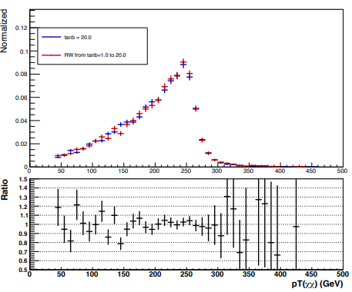
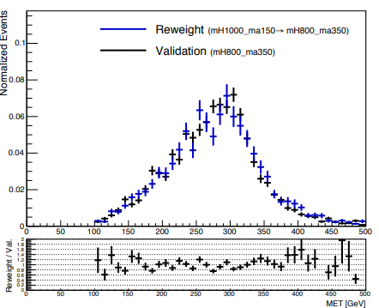
Closure tests of reweighting techniques
MadGraph reweighting
p_{T}(χχ) distribution
Reweight parameter: tanβ
Nominal value: 1.0
Target value: 20.0
Histogram reweighting
MET distribution
Reweight parameter: m_{H}, m_{a}
Nominal value: 1000, 150
Target value: 800, 350
tanβ = 20.0
m_{H} = 800, m_{a} = 350
RW from
tanβ = 1.0 to 20.0
RW from m_{H} = 1000, m_{a} = 150
to m_{H} = 800, m_{a} = 350
Notes:
To validate these techniques, we have closure tests for both of them. Here are examples of some of the tested distributions. The first is a closure test of MadGraph reweighting, where the red line is tan$\beta$ with a nominal value of 1.0, reweighted to a target value of 20.0. The blue is tan$\beta$ done with the full simulation to validate the technique. You can see that the ratio between the two curves, given on the bottom, is close to 1, within 10$\%$. The ratio of the error bars near the end are from low-statistic areas and not a concern. For histogram reweighting, here is an example of a MET distribution, with mass of $H$ and light $a$ reweighted from 1000, 150 to 800 and 350, respectively, in blue. The fully reconstructed events are in black.

Slide 15

2HDMa dark matter mass scan
Analysis method for parameter limits
m_{χ} = [1, 500] GeV mass scan
Dark matter signal simulation with MadGraph
'Fast' ATLAS detector simulation (Delphes)
Use SM background MET distribution from full analysis
Use data MET distribution from full analysis
  - 36 fb⁻¹ and/or 140 fb⁻¹ (currently blinded)
Extract parameter limits
  - frequentist profiled likelihood method
Notes:
To further study parameter limits in a low mass search, we can use MadGraph reweighting to simulate a dark matter signal, with Delphes to simulate ATLAS and Pythia for jets and hadronization. We can check the validity of the simulation by comparing the background and kinematic distributions (36 fb$^{-1}$) from the full analysis by my coworker Kayla. After validating, we can not only use this technique on simulated signals to better understand the model, but also on data (note: 140 fb$^{-1}$ soon to be unblinded). Then we can extract parameter limits using the frequentist profiled likelihood method for a dark matter mass scan between 1 and 500 GeV.

Slide 16
Conclusion
Lots of evidence for the existence of dark matter
LHC, ATLAS use pp collisions to try to produce and detect dark matter
Interested in Simplified V/AV and 2HDMa models
  Mono-Z signature
Know what main backgrounds are, and what selection criteria are needed to reduce them
If no discovery is made, can use data to create exclusion ranges for model parameters
Different reweighting techniques to efficiently simulate DM models
  Validated
Can then do 'fast analysis' to simulate data and create distributions to extend model parameter scans
  Must be validated
Can then extract parameter limits to create exclusion contour plots
Notes:
To conclude, there is lots of evidence for the existence of dark matter, and the LHC is trying to produce dark matter with proton-proton beam collisons, with ATLAS trying to detect it. The simplified and 2HDMa models give the mono-Z signature which is the focus of this particular analysis. We know what the backgrounds of this signature are and how to reduce them. If no discovery is made after analyzing the data, we can use it to create exclusion ranges for model parameters. To better understand these models, we can simulate them efficiently by using the validated reweighted techniques mentioned. After simulating the model and validating the analysis, we can extend model parameter scans and extract limits to create exclusion contour plots.

Slide 17
Questions?

Slide 18
Backup

Slide 19
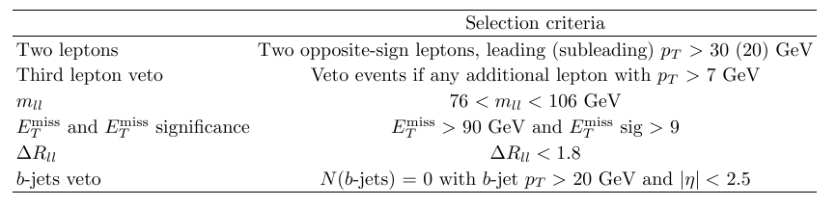
Selection criteria for event analysis

Slide 20
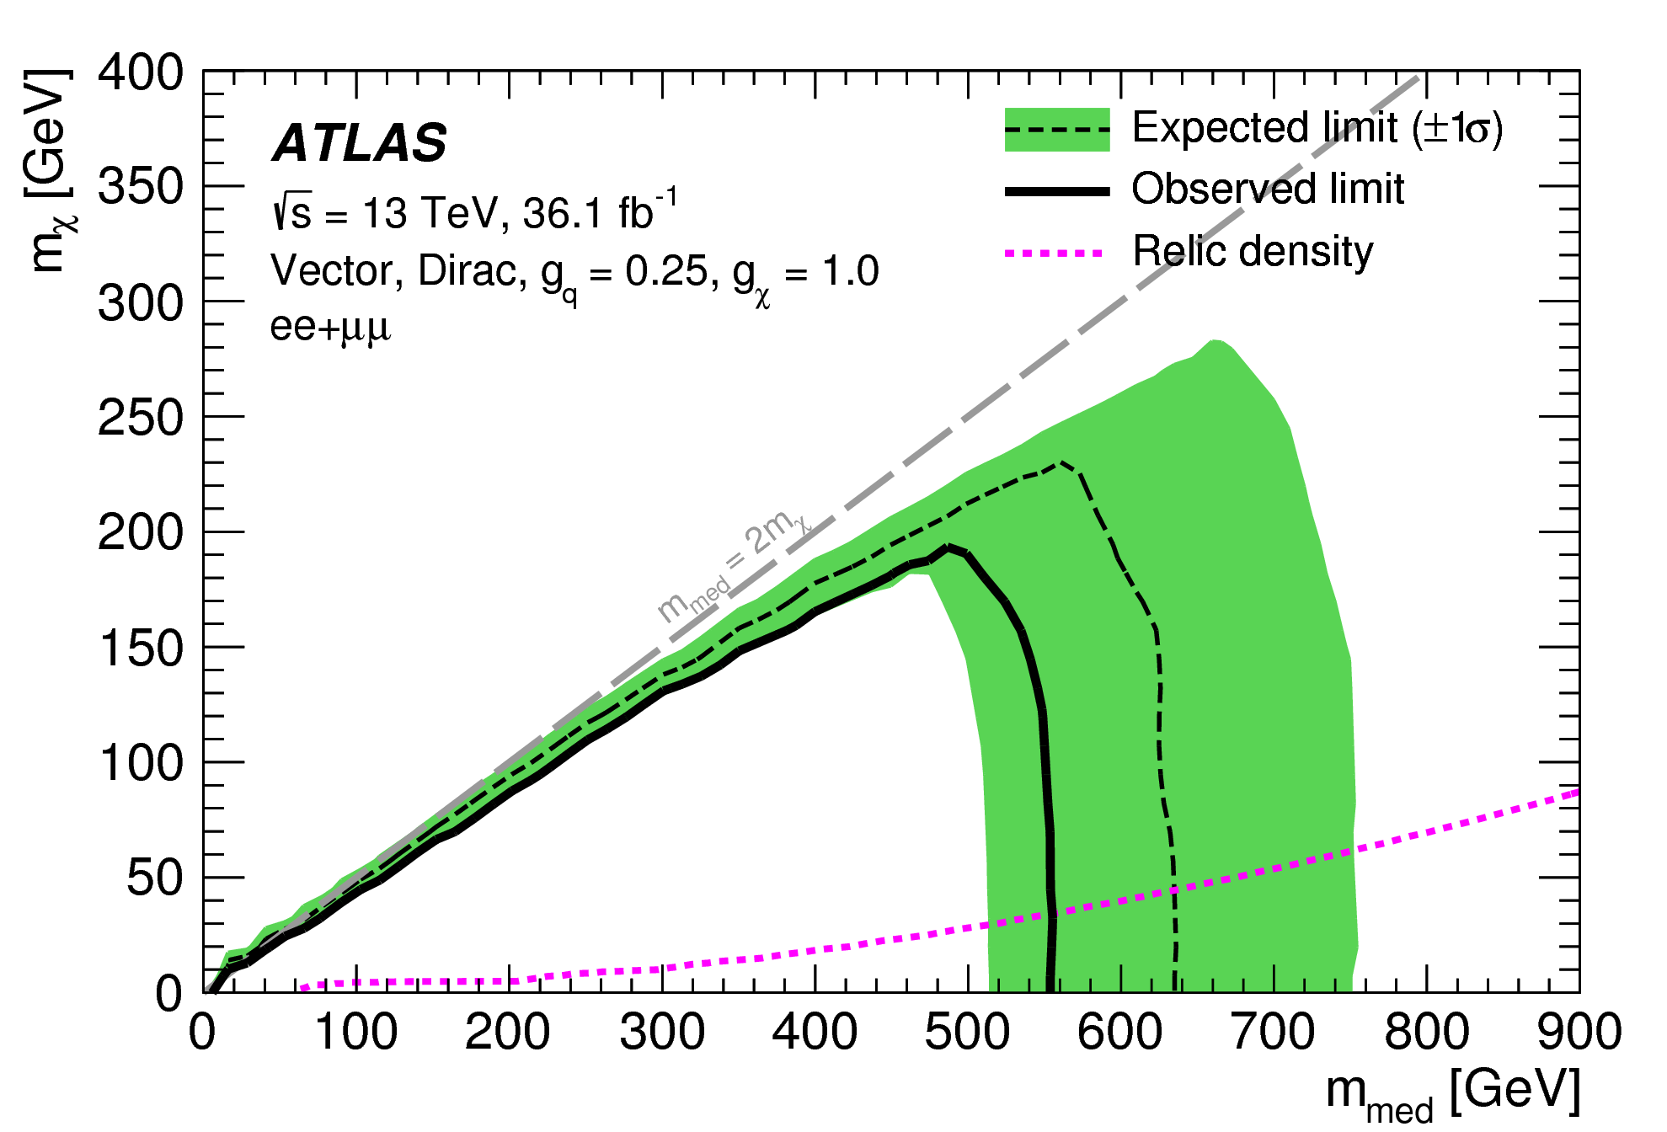
m_{χ}-m_{med} contour plot for vector mediator (ee+μμ)
Phys. Lett. B 776 (2017) 318
Auxiliary material:
https://atlas.web.cern.ch/Atlas/GROUPS/PHYSICS/PAPERS/HIGG-2016-28/
Notes:
ee+mumu channel,vector mediator, dirac dark matter

Slide 21
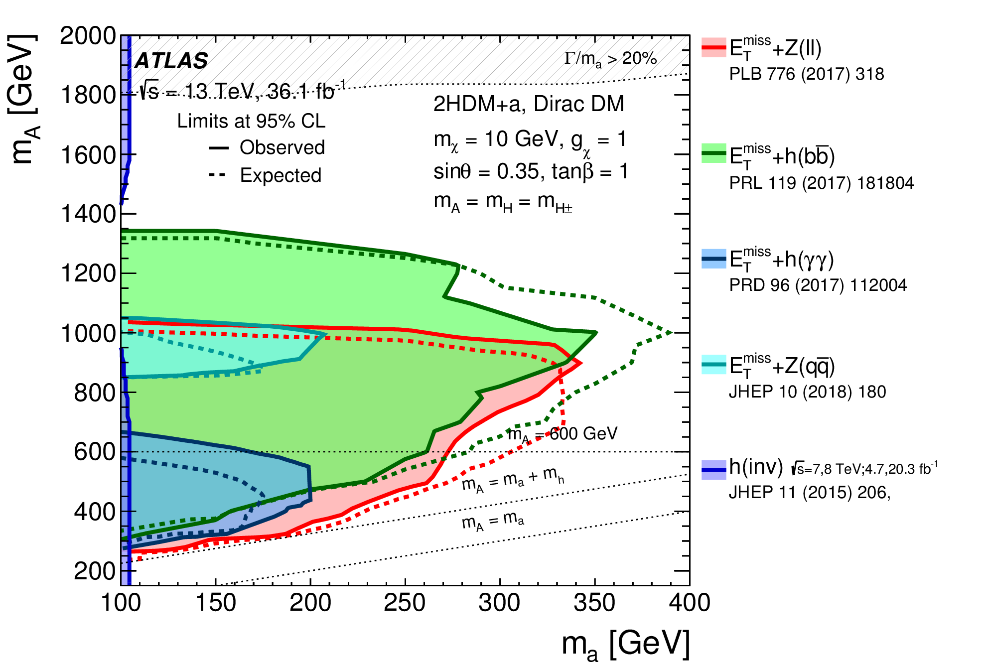
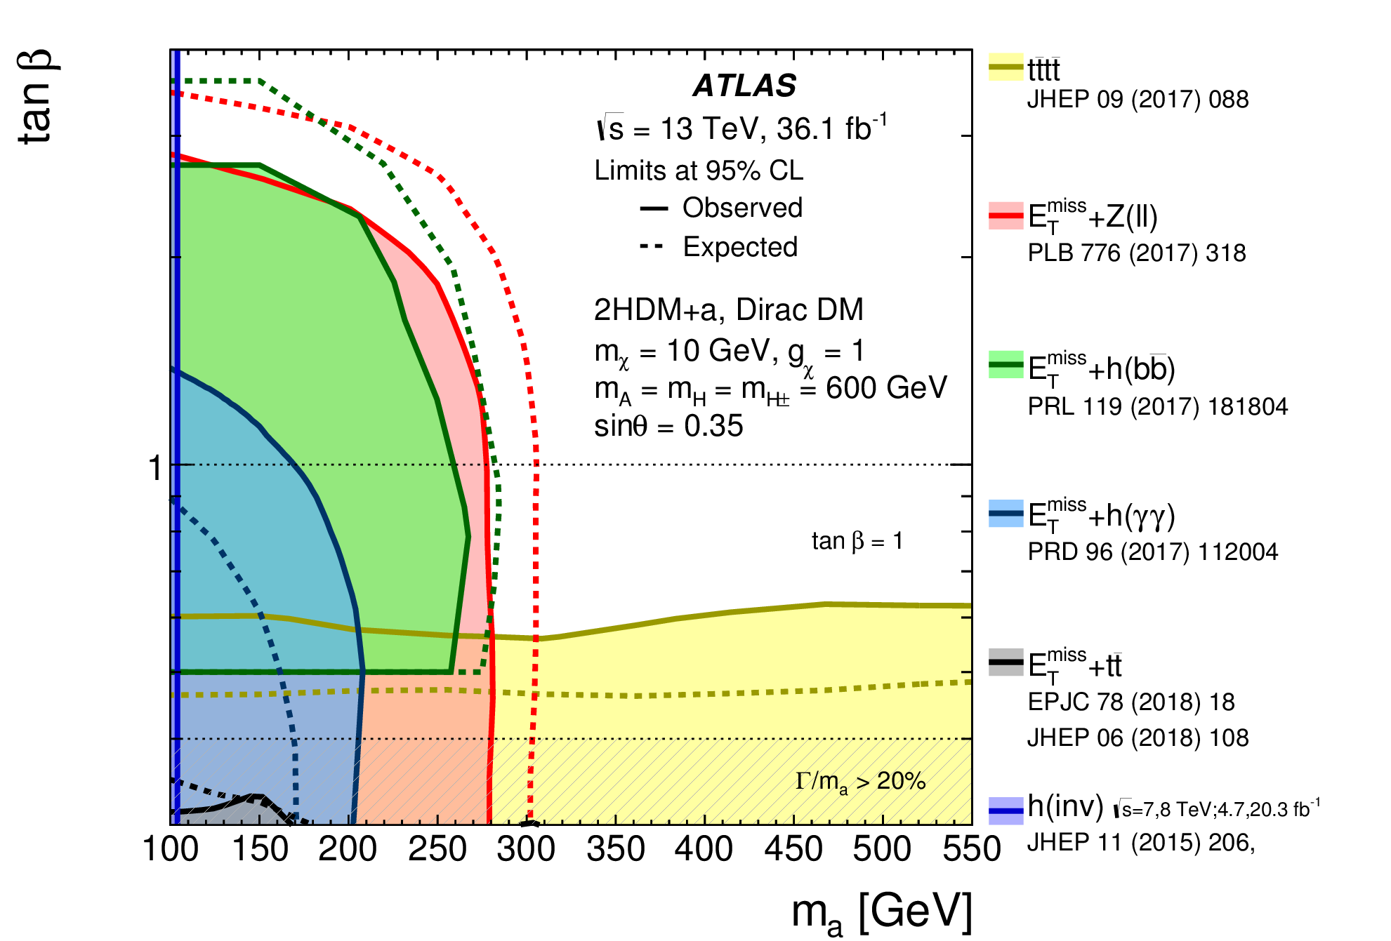
m_{A}-m_{a} and tanβ-m_{a} full contour plot for 2HDMa
JHEP 05 (2019) 142

Slide 22
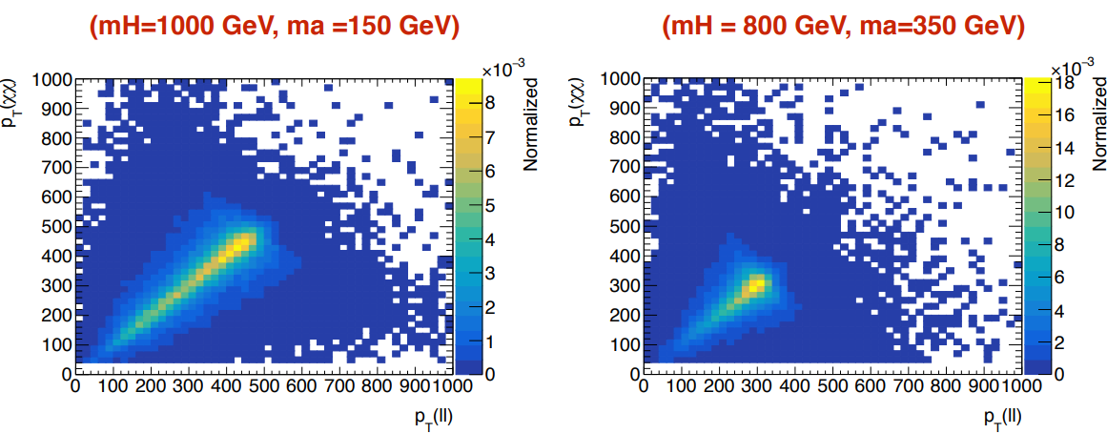
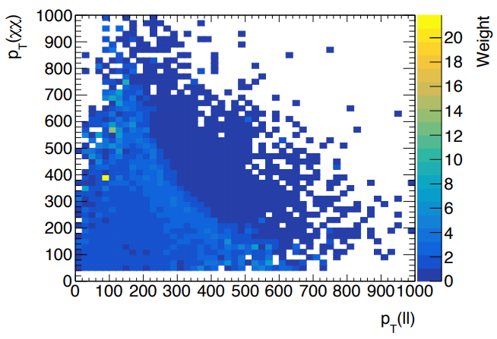
Histogram reweighting ratios

Slide 23
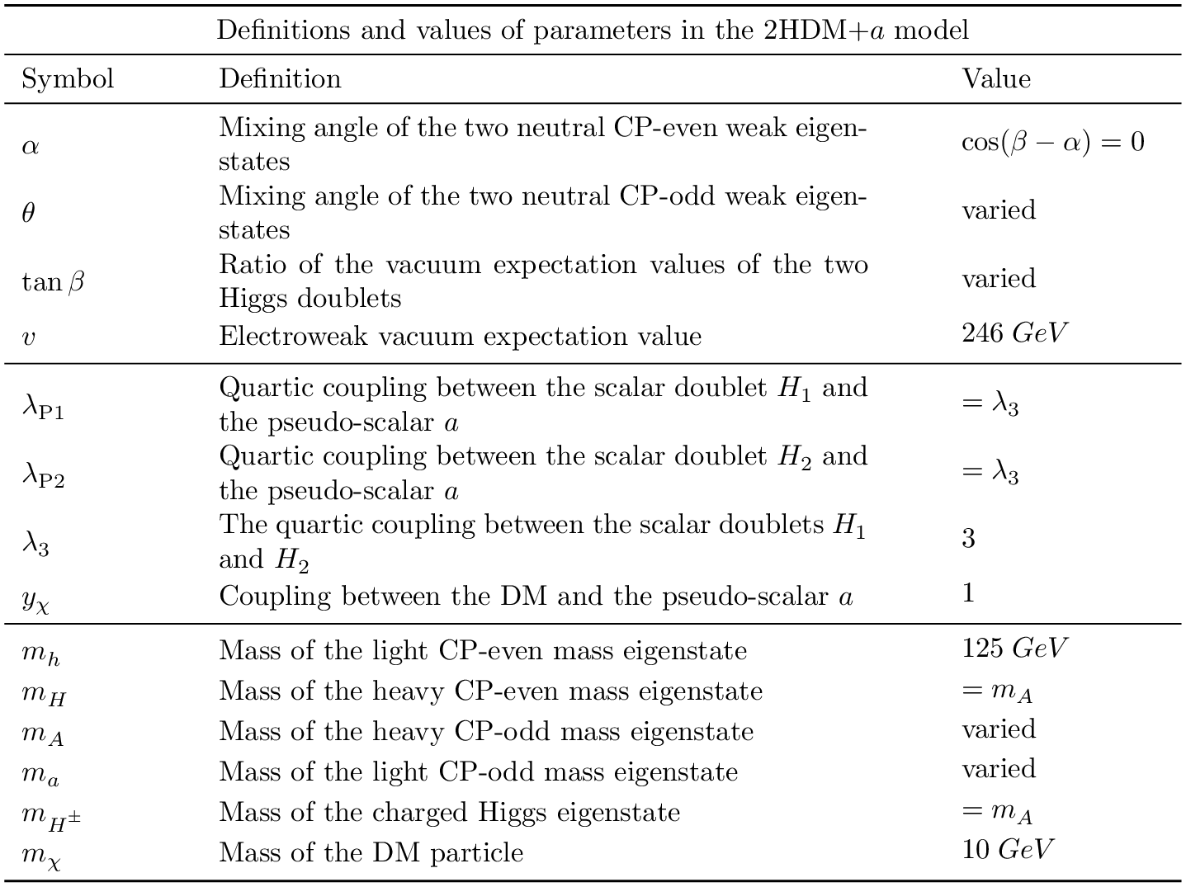
JHEP 05 (2019) 142

Slide 24
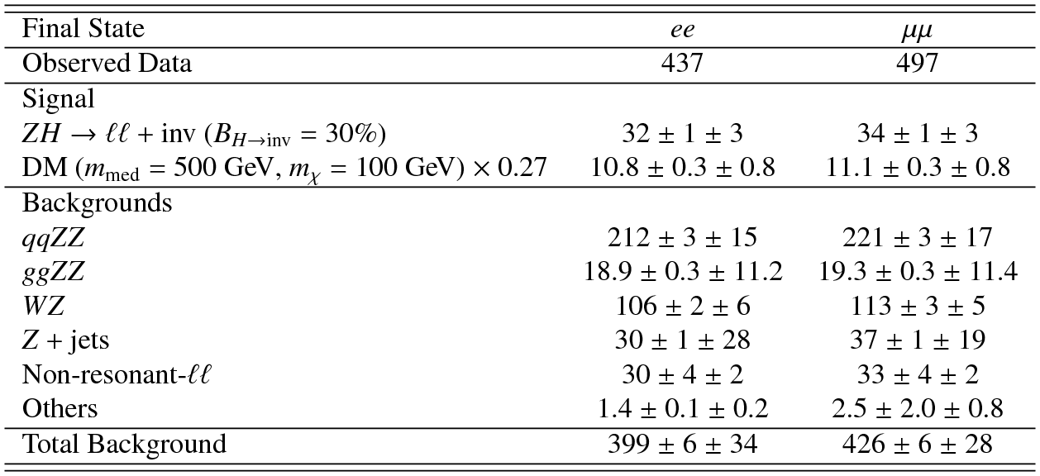
Observed data yield for signal and background
PLB 776 (2017) 318
Notes:
Observed data yield and expectations for signal and background. First error is statistical, second is systematic. 'Other' backgrounds: W + jets, VVV, ttV(V). The observed data is slightly more excessive than expected, and causes a worse limit since there is no discovery. About 2.2$\sigma$ significance for this data yield, need about 5$\sigma$+ for discovery, 3-5$\sigma$ for evidence.

