Slide 1
UCN Beamline Hand-Over
Yuri Bylinski
Accelerator Systems Department Head

Slide 2
Introduction
All primary beam lines at TRIUMF (except for BL1U) are owned and maintained by the Accelerator Division.
The UCN project build-up did not receive high enough priority for support from Acc Div due to high demand for specific resources from competing project ARIEL.
Hence, UCN group has designed and overseen the build of the non-standard elements of the beamline, such as the fast kicker, the septum, the in-pile section of the beamline in front of the target and the target, its water cooling and extraction system.
Wherever possible, TRIUMF traditional BL component solutions have been utilized.
Subject matter experts in the Accelerator Division provided expertise, designs or hardware for some of the standard elements and most of the diagnostics.
Beam line has been tested with the beam at low intensity (1 uA); all unique BL components have been proven operating properly.
The special time structure of the beam in BL1U required new specific read-out electronics for some of the diagnostic elements.
It was always assumed that the Accelerator Division would eventually take over ownership, operation and maintenance of the beam line and the target.

Slide 3
UCN Beamline Hand-Over (1)
May 1, 2019 there was an alignment meeting between UCN group and Accelerator Division on hand-over of maintenance and operational responsibility of the UCN Beamline.
Parties agreed on major points of the transition:
Accelerator Division will take over ownership of the beamline 1U (including kicker) and the target, but these components will be on different hand-over time scales
  beamline 1U (up to beamline end window) + kicker:
    handover to happen after installation of raster magnet and commissioning in 2020
    commissioning will be done under leadership of accelerator group with all necessary help from UCN group
  target and its extraction system:
    handover to happen after build of target storage flask and test of target extraction (shutdown 2021)

Slide 4
UCN Beamline Hand-Over (2)
Design and build of target storage flask should be responsibility of Remote Handling Group (Acc Div) with engineering and design manpower coming from PSD
The UCN source components outside of the target helium crypt will be owned by the TUCAN collaboration.
Exact demarcation lines between UCN ownership and other groups' ownership will be defined after additional consultations
  some BL1U infrastructure components (i.e. water package) will be owned by Eng Div
UCN group will produce a list of components with suggested owners, status and steps suggested towards full functional test
UCN group shall provide full set of design documentation for BL1U and target
Next meeting to agree on this list among all stakeholders shall be scheduled as soon as possible
  expected manpower for completion of the project and BL1U maintenance support should be generated and signed off by both parties

Slide 5
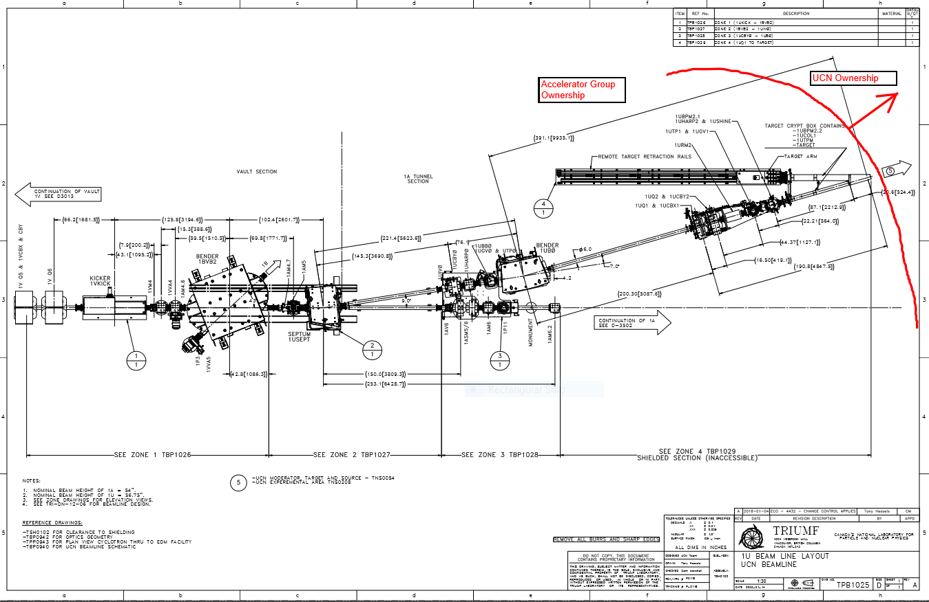
Proposed Ownership Demarcation (1)
Division

Slide 6
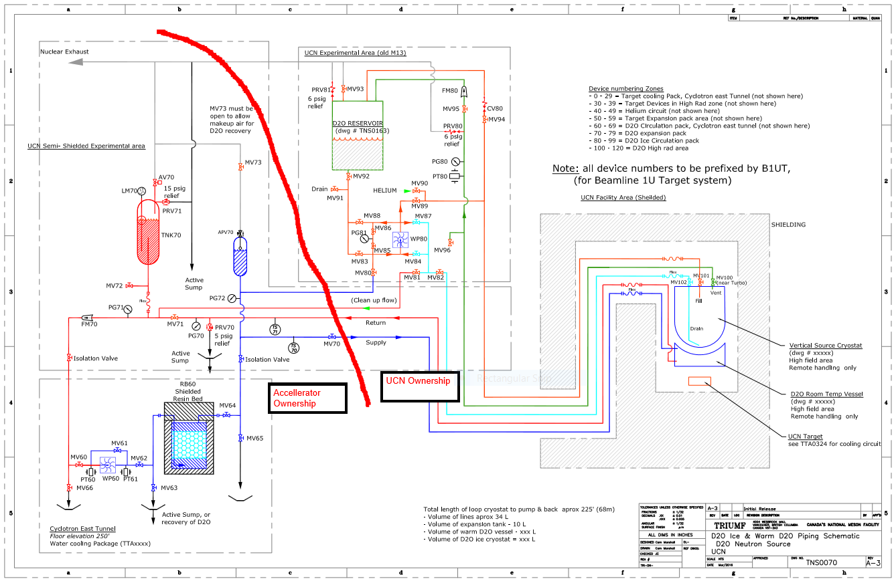
Proposed Ownership Demarcation (2)
Engineering Div

Slide 7
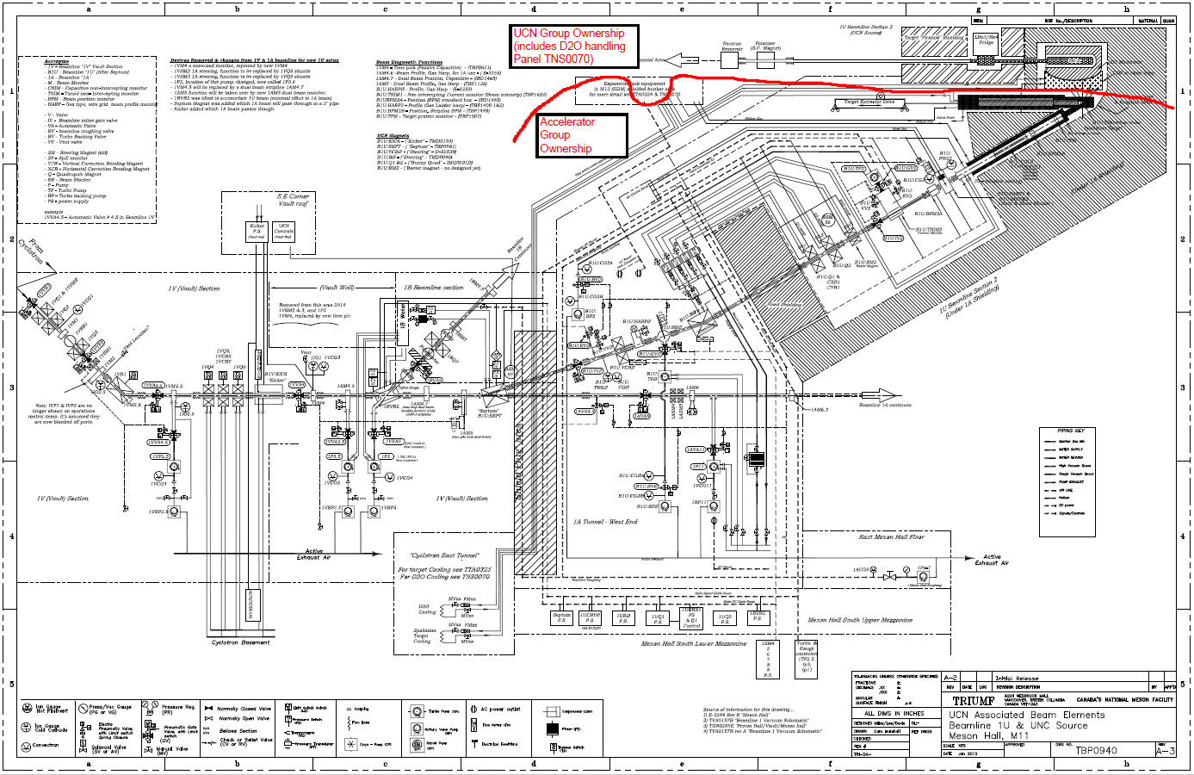
Proposed Ownership Demarcation (3) with Future Hardware

Slide 8
Present status
BL1U manual: OPS is working on it, already passed several iterations, ready for handover
OPS have been setting up beamline alone several times during past runs
Diagnostics:
  Notch monitor: great new tool – works well
  BPMs: controls group plans finishing in 2020 shutdown
  TPM: has been tested during beam development shifts
  TNIM: new electronics tested, accuracy marginal at low currents
  Profile Monitor: operational, though accuracy isn’t great
Beam dynamics simulations and beam quality characterization have greatly advanced through 2019 in support of beam spot control at the UCN target
Raster magnet: deemed not necessary; beam spot can be assured by other means
BL1U commissioning is feasible in 2020
RH group didn’t have resources/priorities in 2019 to work on target storage flask

