Slide 1
Budget
Jeff Martin
TUCAN Collaboration

Slide 2
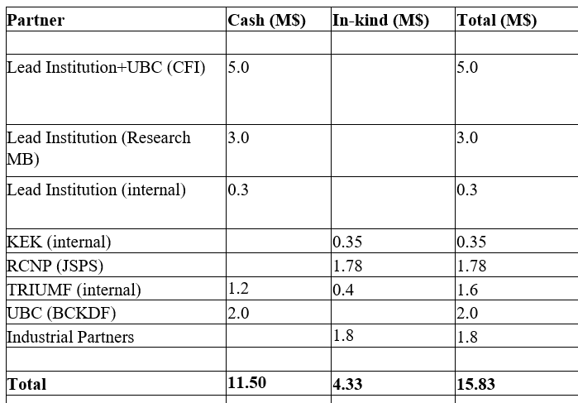
Budget sources
Infrastructure:
  TRIUMF matching funds.
  CFI IF + provincial matching, 2017
  JSPS support, 2018.
Personnel, travel:
  NSERC+CRC support $651k/yr.
    4 postdocs, 10 grad students, undergrads, all our travel
  CFI IOF support (ops+maint)
  CFI IF, technical personnel.
    2 engineers, PM, 2 physicists.
  JSPS
    2 postdocs, grad students from Nagoya
  PI salaries covered fully by university or lab.

Slide 3
Budget concerns
JSPS grant smaller than anticipated in original CFI request.
Many items on interface between Japanese and Canadian parts not included in original budget.
TRIUMF advises to “create contingency”, and “contingency board”.

Slide 4
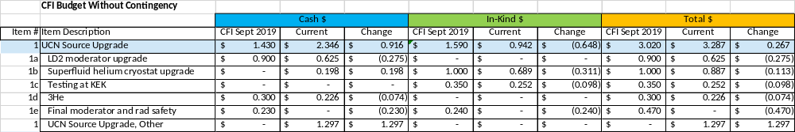
UCN Source Budget
“Other” category dominated by:
  Pumps ($750k)
  Fluids (*good news on ³He)
  Items on the Interface, e.g. gas panels, …

Slide 5
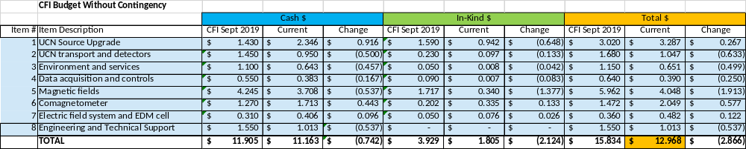
Rebaselined budget, Jan. 2020.
EDM Subsystems requested to present “minimal working” budget, to support UCN source cost overruns.
Retain funds for outlying facilities at UBC and The University of Winnipeg.

Slide 6
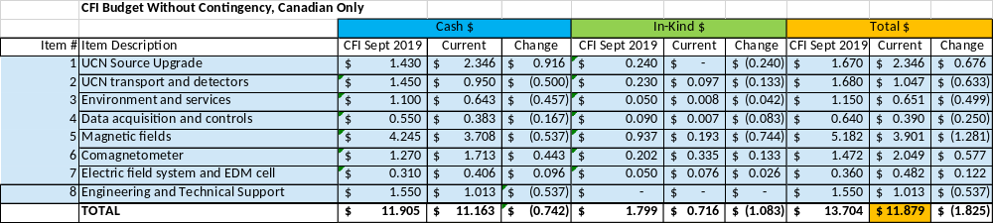
Canadian budget only
Focused on Canadian budget issues, for more accurate representation.

Slide 7
Examples of “restrained” budget
Examples of “restrained” budget
  MSR – work with less experienced company, in line after LANL EDM.
  Cs magnetometers – start with 5 magnetometers, understand scalability of cost with vendor.
  Guide-coating facility – acquire used parts for laboratory at The University of Winnipeg.
Need to apply this concept to UCN source as well, striking a balance between UCN source and EDM experiment.
  Scalability of pumping systems
  Not yet applied to the rebaselining, but it needs to be.
Some (but not all) priority given to UCN source and MSR.
  These will define the landscape of our experiment for many years to come.
Need to strike a balance (Source vs. MSR vs. other subsystems)

Slide 8
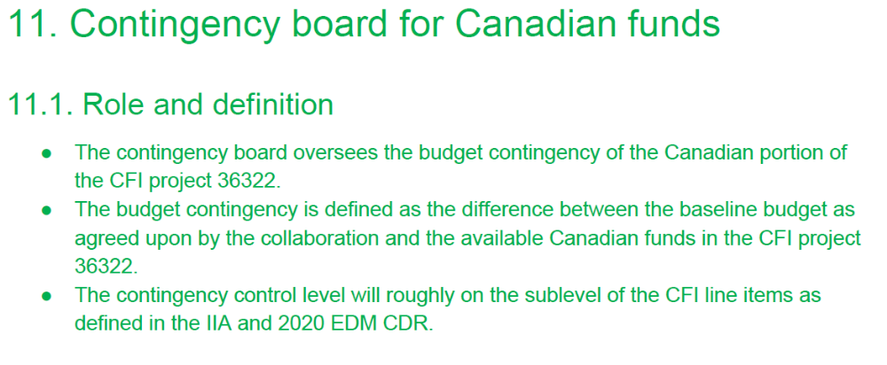
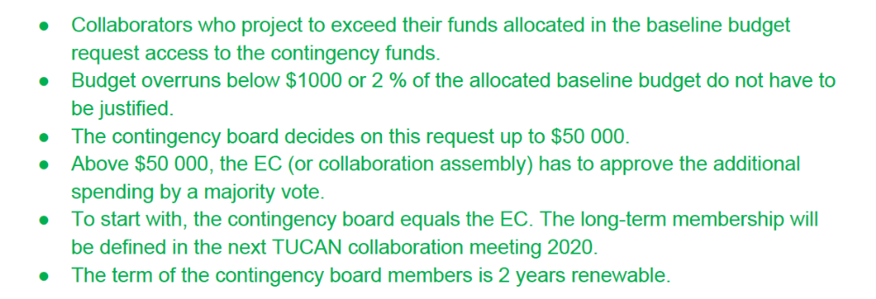
Contingency board
Proposed amendment to collaboration agreement.
Initially overseen by TUCAN Executive Committee (EC) (recent elections… Martin, Hatanaka, Picker, Momose, Kawasaki, Mishima)
Mostly concerns CFI, provincial, TRIUMF funds.
Comes into effect at some final stage of rebaselining.

Slide 9
Summary
Budget is a finite resource.
Need to reserve additional budget for UCN Source, at expense of other subsystems.
Staged, scalable, or restrained approach used for subsystems, where possible.
Contingency board to oversee release of additional funds.

