Slide 1
The TUCAN next generation UCN source overview and some details
R. Picker

Slide 2
Manpower:
C. Davis, B. Franke, C. Gibson, K. Hatanaka, T. Higuchi, S. Horn, S. Kawasaki, S. Imajo, T. Kikawa, A. Konaka, F. Kuchler, T. Lindner, Y. Makida, R. Mammei, C. Marshall, J.W. Martin, R. Matsumiya, K. Mishima, T. Okamura, R. Picker, D. Rompen, W. Schreyer, S. Sidhu, S. Vanbergen
Topics
UCN source key numbers
Source components and model
Schedule
Monte Carlo Optimization of UCN components
Gas handling systems, pumps and transfer line

Slide 3
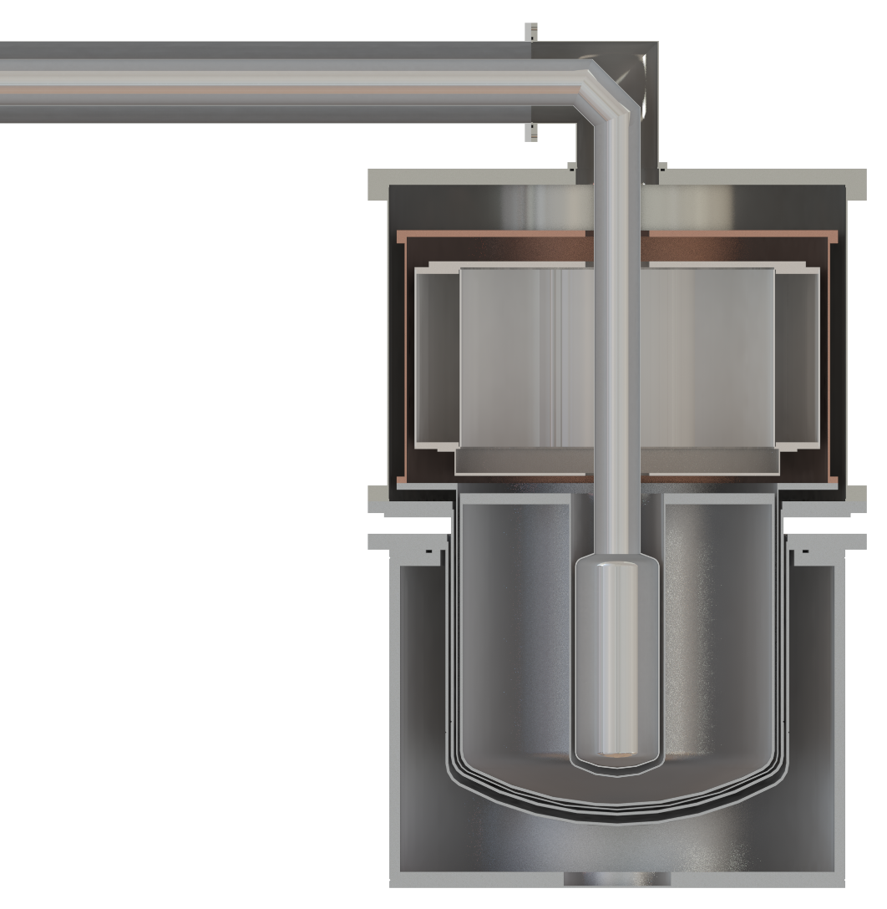
TUCAN UCN source recipe
using the prototype source as example
480 MeV protons on tungsten create spallation neutrons
lead, graphite, heavy water, (deuterium) moderate fast neutrons (MeV) to cold neutrons (meV)
⁴He at around 1 K converts 1 meV (9Å) neutrons to UCN
Extraction to experiments via material guides
UCN
1.2 m
⁴He <1 K
solid
D2O 10 K
graphite
300 K D₂O
graphite
lead
tungsten
protons

Slide 4
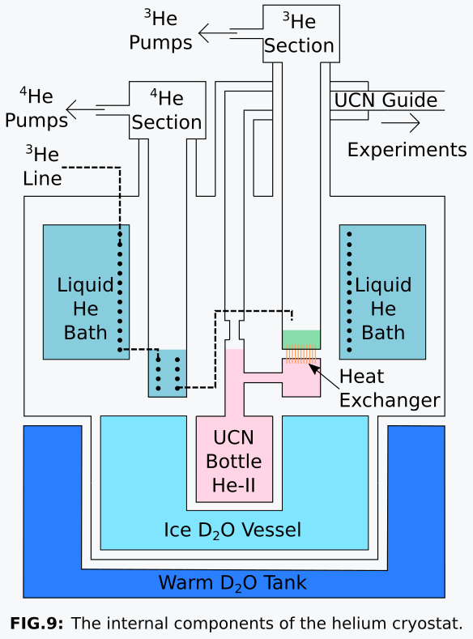
Vertical UCN source cryostat cooling scheme
from KEK/RCNP, Japan
3 cooling stages, heat exchanger to cool isopure ⁴He UCN converter
lHe bath cryostat (4.2 K)
⁴He pumping section (1.6 K)
³He pumping section (< 1.0 K)
Isopure ⁴He UCN converter cooled via heat exchanger
⇨ Running nominally at 1 µA beam (as at RCNP).
W. Schreyer, tomorrow
Ryohei Matsumiya, Shinsuke Kawasaki

Slide 5
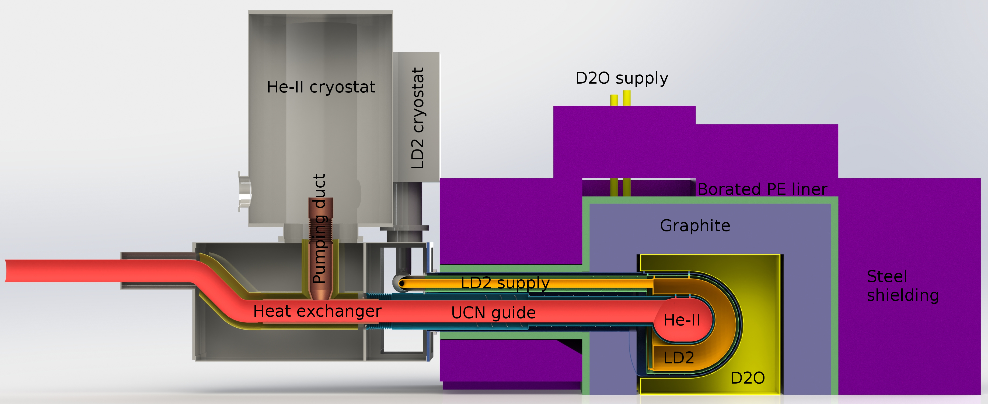
TUCAN Next generation UCN source strategy
Similar basic layout with major improvements:
Parameter | Prototype source | Next gen source
Beam current | 1 μA | 40 μA (480 MeV)
Production volume | 8 L | 27 L
Cold moderator | sD₂O | LD₂
Production rate | 2x10⁵ /s | 1.4-1.6x10⁷/s (500 s⁻¹cm⁻³)
UCN, vacuum valve
vacuum sep. foil
300 K
LHE
level
20 K
1.1 K
protons
lead
tungsten
5

Slide 6
TUCAN Next generation UCN source strategy
Similar basic layout with major improvements:
Parameter | Prototype source | Next gen source
Beam current | 1 μA | 40 μA (480 MeV)
Production volume | 8 L | 27 L
Cold moderator | sD₂O | LD₂
Production rate | 2x10⁵ /s | 1.4-1.6x10⁷/s (500 s⁻¹cm⁻³)
Cooling power | 0.3 W | 10 W
He-II temperature | 0.9 K | 1.1 – 1.15 K
Extraction | Vertical by 1.2 m | Near horizontal 0.3 m up
Vacuum separation | No foil | Warm vacuum sep foil + B field
Position of cryostat | On top of source | 2.5 m away
UCN, vacuum valve
vacuum sep. foil
300 K
LHE
level
20 K
1.1 K
protons
lead
tungsten
6

Slide 7
Next generation UCN source basics
≈ 2.5 m
B₄C liner
|B|
300 K
LHE
level
20 K
1.1 K
vacuum sep. foil
(HEX)
UCN, vacuum valve
protons
lead
tungsten

Slide 8
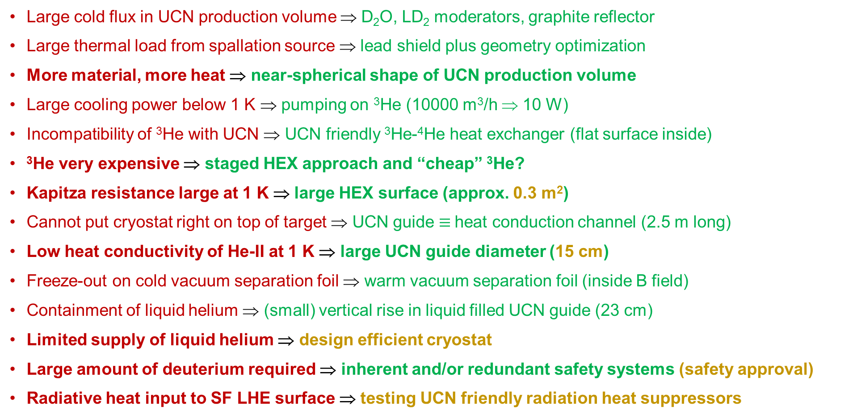
Main challenges and solutions
Covered in presentations by
C. Marshall
W. Schreyer
Large cold flux in UCN production volume ⇒ D₂O, LD₂ moderators, graphite reflector
Large thermal load from spallation source ⇒ lead shield plus geometry optimization
More material, more heat ⇒ near-spherical shape of UCN production volume
Large cooling power below 1 K ⇒ pumping on ³He (10000 m³/h ⇒ 10 W)
Incompatibility of ³He with UCN ⇒ UCN friendly ³He-⁴He heat exchanger (flat surface inside)
³He very expensive ⇒ staged HEX approach and “cheap” ³He?
Kapitza resistance large at 1 K ⇒ large HEX surface (approx. 0.3 m²)
Cannot put cryostat right on top of target ⇒ UCN guide $≡$heat conduction channel (2.5 m long)
Low heat conductivity of He-II at 1 K ⇒ large UCN guide diameter (15 cm)
Freeze-out on cold vacuum separation foil ⇒ warm vacuum separation foil (inside B field)
Containment of liquid helium ⇒ (small) vertical rise in liquid filled UCN guide (23 cm)
Limited supply of liquid helium ⇒ design efficient cryostat
Large amount of deuterium required ⇒ inherent and/or redundant safety systems (safety approval)
Radiative heat input to SF LHE surface ⇒ testing UCN friendly radiation heat suppressors
W. Schreyer
https://doi.org/10.1016/j.nima.2020.163525
C. Marshall
S. Kawasaki
S. Kawasaki
S. Kawasaki
S. Kawasaki
S. Kawasaki
S. Kawasaki
RP
This presentation
S. Kawasaki, C. Gibson
C. Marshall
RP, W. Schreyer

Slide 9
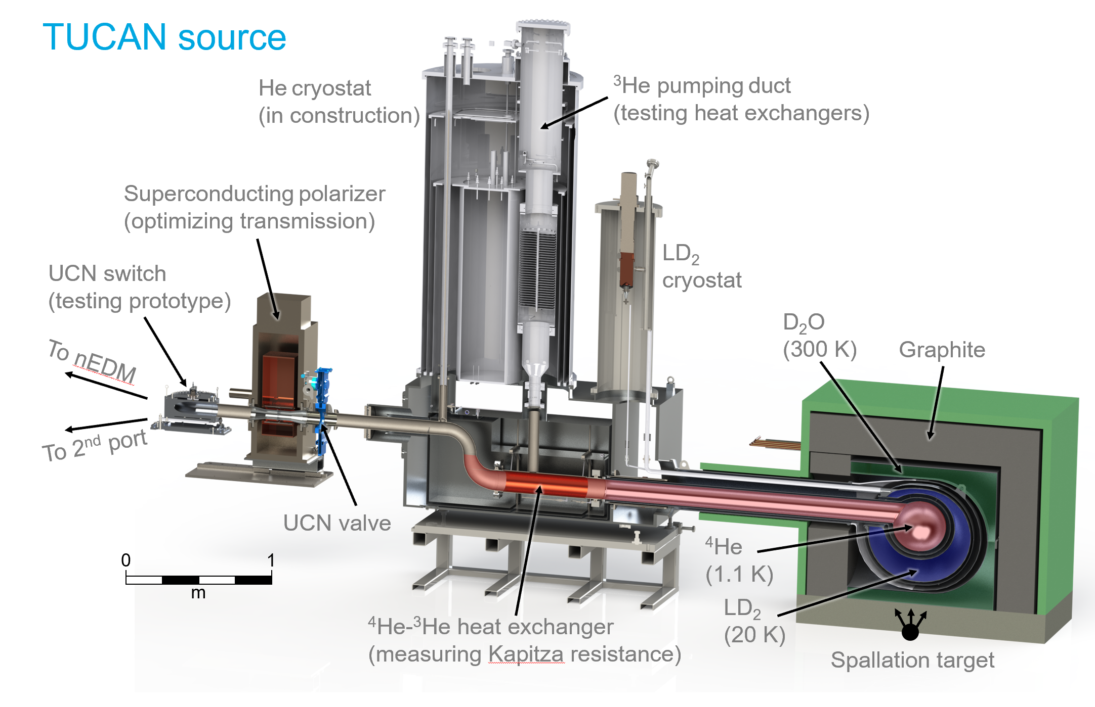


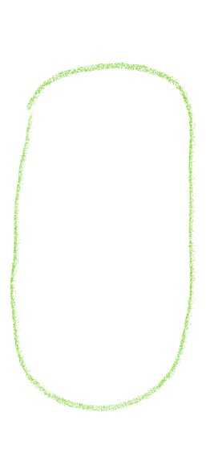

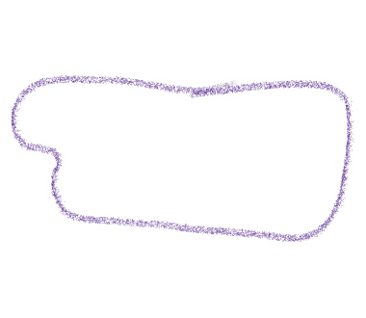
He cryostat
More detailed UCN source model
LD₂ cryostat
moderators,
tail section
vacuum separation foil
cryo connection box
UCN beam switcher
9

Slide 10
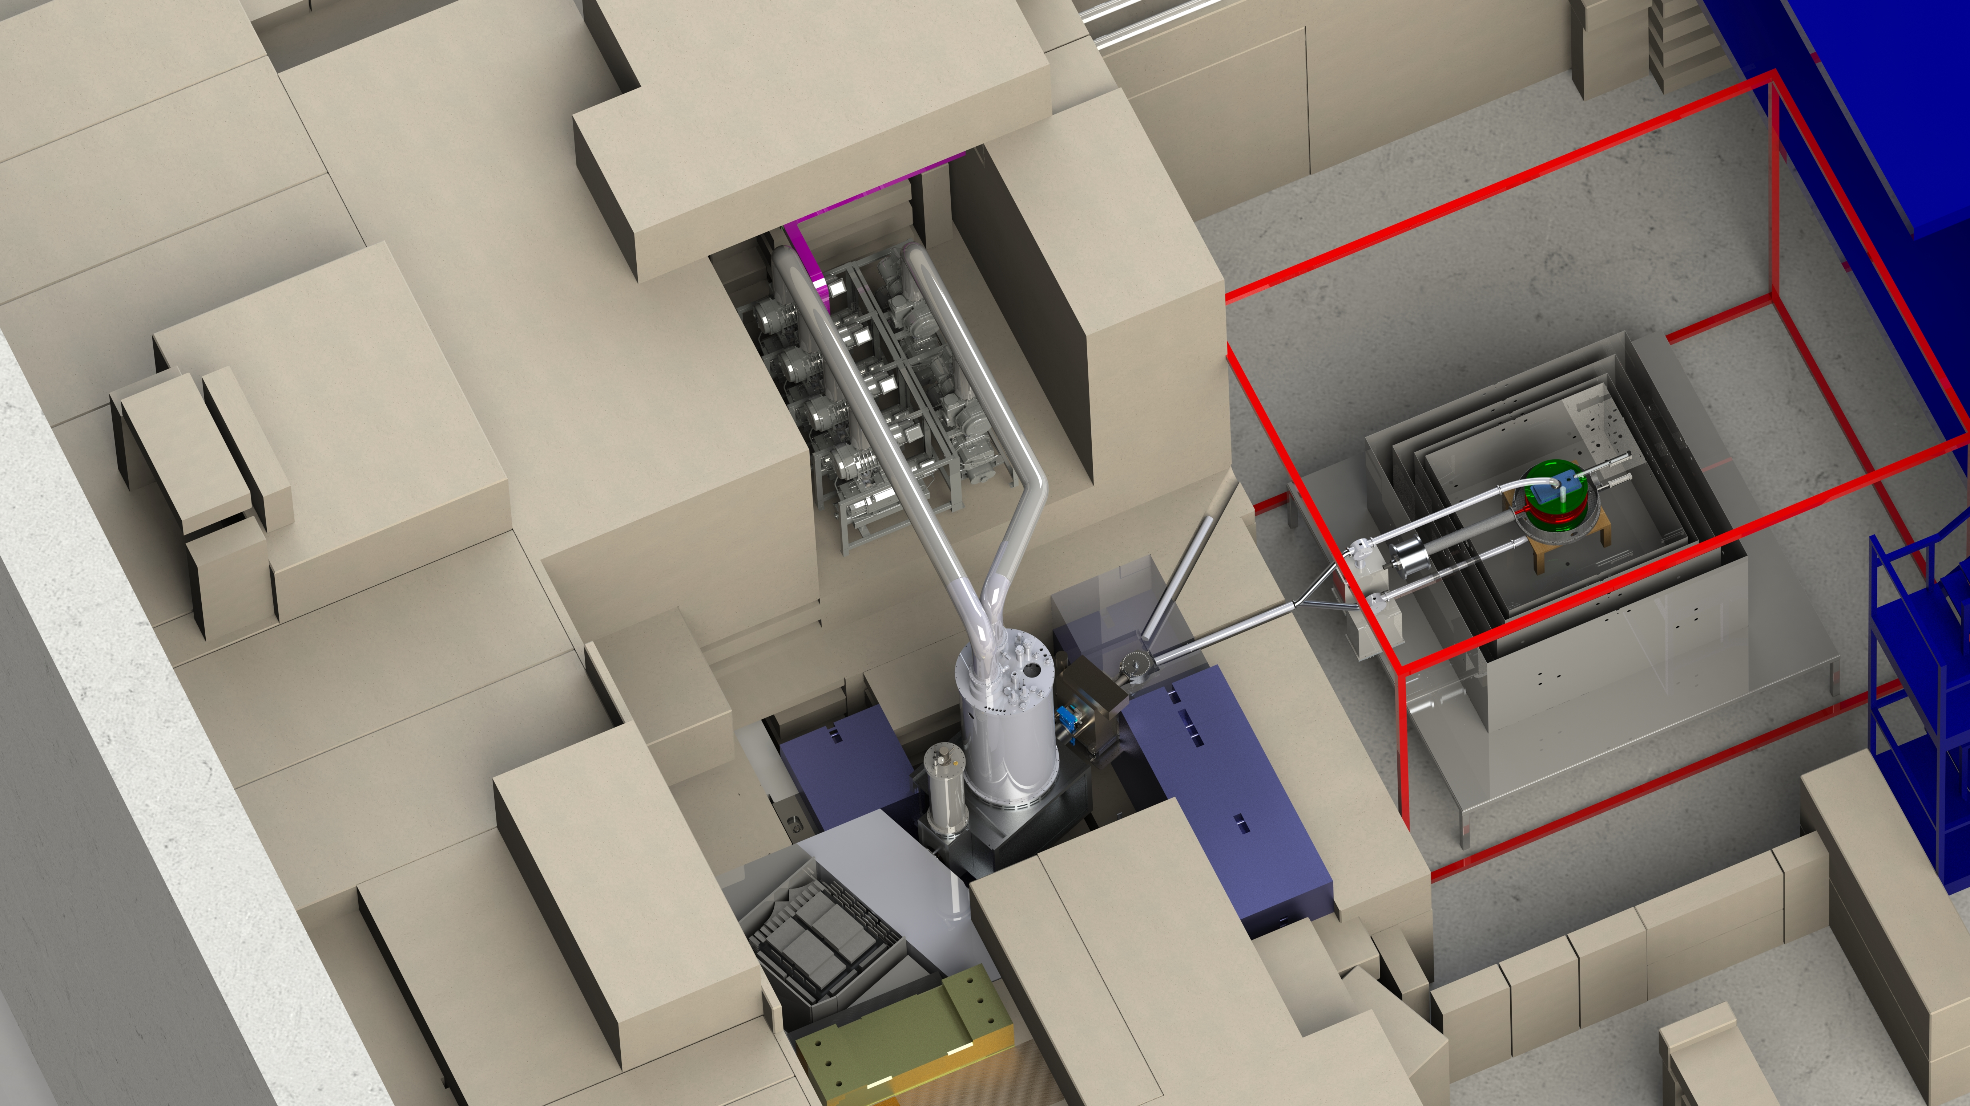

The source in the Meson hall
pump pit
proton beamline 1U
proton beamline 1A
cryostat pit
target pit
10

Slide 11
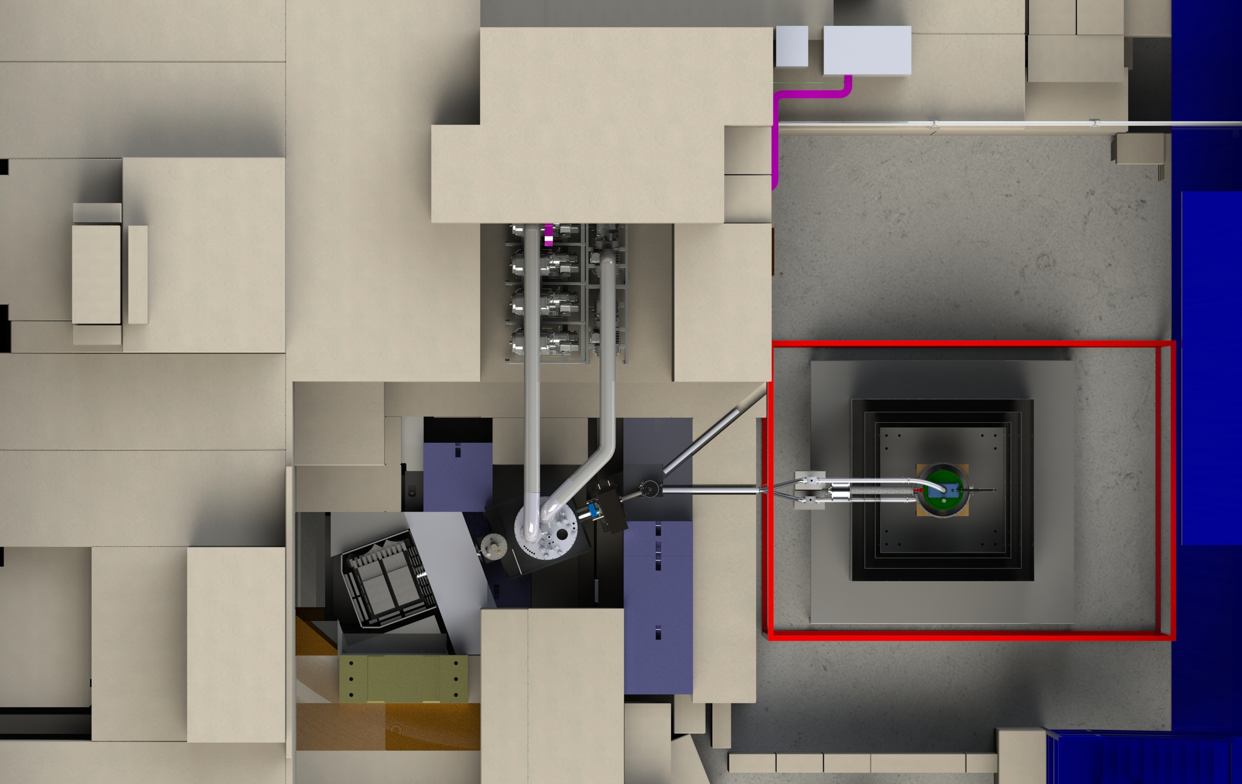
Installations here have to happen while BL1A is offline (mainly shutdown).
Installations here can take place while BL1A is running.
Installations here can take place while UCN is running.
Top view
pump pit
BL1A shielding envelope
UCN shielding envelope
proton beamline 1U
proton beamline 1A
cryostat pit
target pit
≈ 10 m
11

Slide 12
Some estimates for relevant numbers
Mostly coming from MC (MCNP, PENTrack)
TUCAN source
(engineering stage)
Production 1.4-1.6 x 10⁷ UCN/s
Source helium temp 1.03 K to 1.13 K
Cooling power 10 W (3He fridge)
Source storage lifetime 28 s
Figure of merit Pτ = 4.5 x 10⁸
Density in the source 3 x 10³ UCN/cc
Total number in the source 3 x 10⁸ UCN
Initial polarized density in 70 l EDM experiment 200 UCN/cc (> 10 m of guide)
Counted at the end of cycle 2 x 10⁶

Slide 13
Recent Milestones
copied from https://ucn.triumf.ca/meetings-and-workshops/review-meetings/2020-02-eac-review-meeting/documentation-for-eac-review/New_UCN_Source_Status_2020-2019-12-20.pdf
Summer 2018
JSPS (Japan Society for the Promotion of Science) funding for the helium cryostat has been grantedat 152 MJPY.
Final decision to go for ³He cryostat (not ⁴He direct pumping).
Initial System Engineering Design (System Block Diagram, Top level Requirements, nEDM Experiment Requirements, He Cryostat Requirements, LD₂ Subsystem Requirements, Initial Spec Sheetsgeneration)
Preliminary LD2 Safety Report Released
Initial release of UCN yield versus moderator and source design report
Released designs for UCN experiments in Fall 2018
Released schematics (P&IDs) for He-II Subsystem, LD2 Subsystem
Released initial design concept for biological shielding
Fall 2018
Tested first components for the new UCN source during 1-month of UCN beamtime at TRIUMF (UCN friendly vent port, UCN source valve, superconducting polarizer)
Performed UCN storage tests with a mock-up UCN production volume (NiP coating on aluminum) and determined that a bake out temperature of 100 C is sufficient.
Liquid deuterium system conceptual design received positive concept review from the safety authority Technical Safety BC.
Additional requirements documents released: He-II Subsystem, Simultaneous Spin Analyzer Subsystem
Some cryogenic calculations completed for He-Cryostat and LD2 Subsystem
Winter 2019
Additional requirements documents released: remaining source subsystems, nEDM Cell, UCN Guidance
Initial 3D concept of LD₂ Subsystem
Initial stress calculations and 3D Model for the multi-layered source vessel containing LD₂ and superfluid helium
Early orders for D2O
Spring 2019
Finished the bulk of UCN and cryogenics related calculations necessary to start detailed design.
Measurements at KEK confirm the Kapitza conductance at the 3He to 4He heat exchanger is in good agreement with our models.
Additional requirements documents released: Internal magnetometry
TRIUMF design review of biological shielding passed.
TRIUMF design review of He cryostat pumping system passed
Positive initial discussions with Technical Safety BC about LD2 system safety
Hemispherical production volume and moderator geometry chosen
Summer 2019
Target protect monitor (TPM) of BL1U commissioned
Detailed design of helium cryostat completed, start of production in Japan.
Confirm superleak tightness of a new designed helicoflex seal flange at KEK (it will be used for junction of the HEX1, which is the main heat exchanger, and the UCN guides.
Confirm superleak tightness of a junction of aluminum and stainless steel at KEK (it will be used for UCN guide upstream of the helium cryostat)
HEX7 test successfully completed at KEK (counterflow gas heat exchanger from room temperature to 10 K)
Fall 2019
UCN source storage valve upgrade tested successfully during UCN beamtime.
TRIUMF design review of He cryostat passed.
Important interfaces between He cryostat and remainder of He-II subsystem confirmed
UCN Y switch completed
Winter 2020
HEX5 test successfully completed at KEK (counterflow gas heat exchanger in the 1K pot pumping tube)

Slide 14
prepare
moderator
region
to allow BL1
operation
to allow BL1U operation
UCN source schedule
Calendar Year |  | 2020 |  |  |  |  |  |  |  |  | 2021 |  |  |  |  |  |  |  | 2022
 |  | 1 |  |  | 4 |  | 7 |  | 10 |  | 1 |  | 4 |  | 7 |  | 10 |  | 1 |  | 4
Vertical UCN source
Shielding
He cryostat
Moderators, tail section
Cryo conn, LD₂ cryost.
He pumping system
Services | LD₂, ³He, nat He, Isopure handling system
Slow control
UCN handling
BL1U
Mini Shutdown
Main Shutdown
Mini Shutdown
Main Shutdown
including moderators
UCN?
Uninstall?
uninstall
Construct, procure
lift
Inst
Inst
Inst
lift
Maintenance, repairs, upgrade
Inst
Construct (Torisha)
KEK tests
ship
Assemble
Install
Cryo testing
UCN
Detailing
Construct, procure
Assemble
Install
Detailing
Construct
Inst Cryo Conn Box
Install LD2
Tender
Procure
Test
Install
Concept
Detailing
Build, procure
Install
Plan
Procure
Assemble, connect, program
Detailing
Construct
Assemble
Beamspot calcs
beam
tests
Inst
Target cask detailing
Construct
Test
Gray shaded systems are inside the biological shielding.

Slide 15
UCN source test plan
General remarks
Planned test campaigns
LD₂
LD₂ handling system test with N₂
LD₂ cryostat cooldown
He cryostat
Cryo testing at KEK (no ³He)
1K pot pumping
³He pot pumping, probably with ⁴He first
HEX1 only test (if possible)
Connect tail section
Connect downstream UCN guide
He cryostat components are tested pre-assembly at KEK (2019/2020)
Extensive cryo testing of all components planned for 2021
He cryostat can be cooled down without cooling LD₂ system
Currently developing a more detailed installation and testing plan

Slide 16
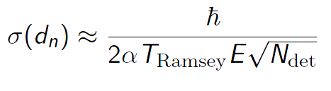
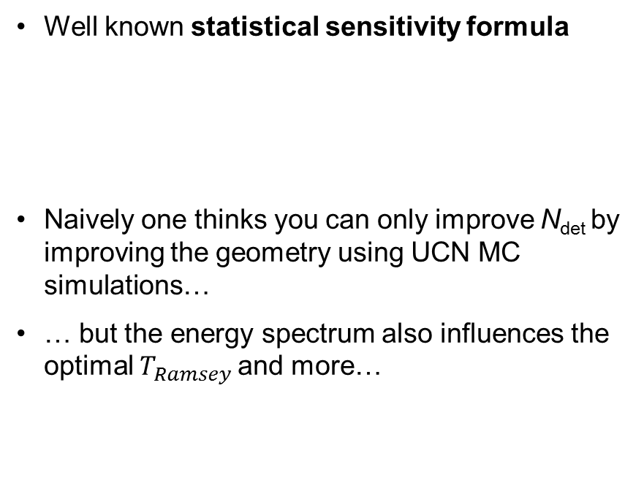
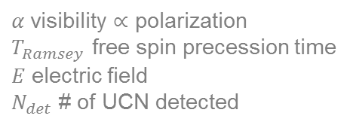
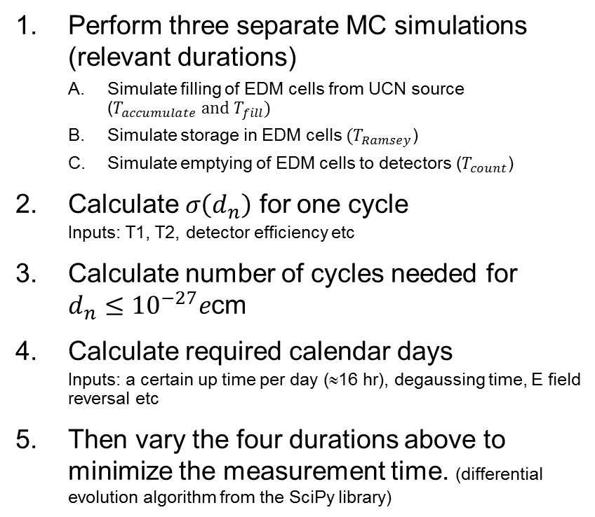
S. Sidhu, W. Schreyer, RP
Optimizing the UCN handling from source to EDM
Goal: minimize the measurement time to reach a sensitivity $d_{n}≤{10}^{−27}e$cm
Starting point
Steps:
Well known statistical sensitivity formula
Naively one thinks you can only improve N_{det} by improving the geometry using UCN MC simulations…
… but the energy spectrum also influences the optimal $T_{Ramsey}$ and more…
Perform three separate MC simulations (relevant durations)
  Simulate filling of EDM cells from UCN source (${T_{accumulate} \text{and} T}_{fill})$
  Simulate storage in EDM cells ${(T}_{Ramsey}$)
  Simulate emptying of EDM cells to detectors ($T_{count}$)
Calculate $σ\left(d_{n}\right)$ for one cycle
  Inputs: T1, T2, detector efficiency etc
Calculate number of cycles needed for $d_{n}≤{10}^{−27}e$cm
Calculate required calendar days
  Inputs: a certain up time per day (≈16 hr), degaussing time, E field reversal etc
Then vary the four durations above to minimize the measurement time. (differential evolution algorithm from the SciPy library)
next
slides
$α$ visibility $∝$ polarization
$T_{Ramsey}$ free spin precession time
$E$ electric field
$N_{det}$ # of UCN detected

Slide 17
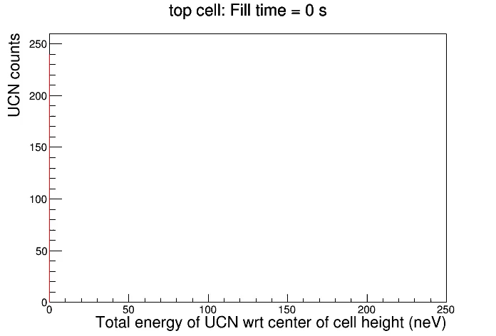
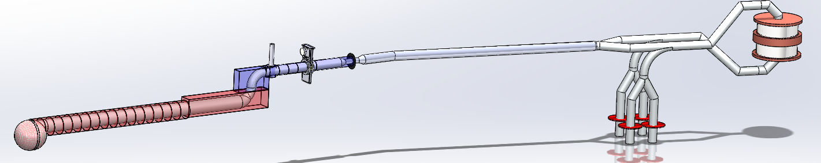
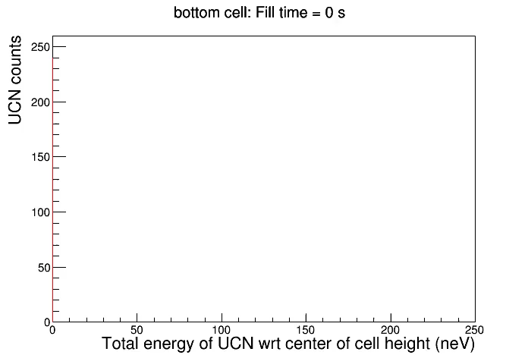
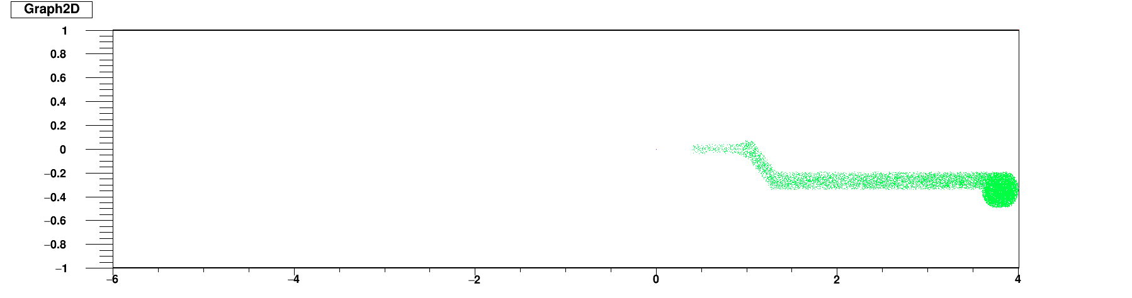
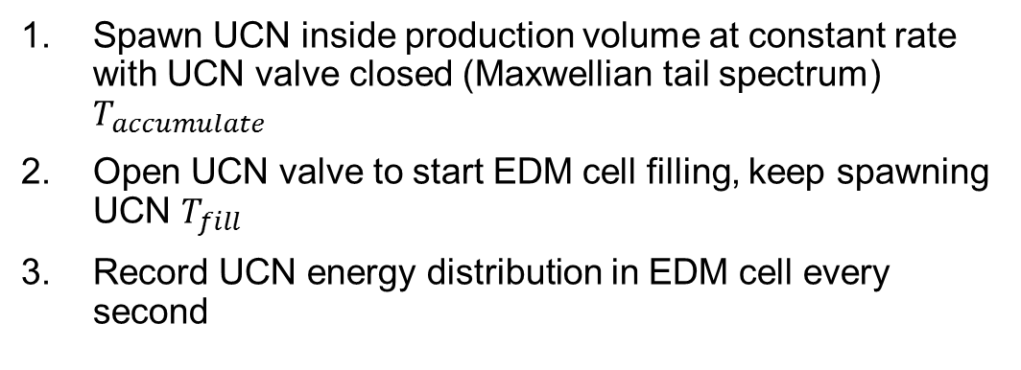
top
(A) Filling Simulation
# UCN in
EDM cell
mean energy
reference level for UCN energy
UCN valve
|B|
temperature distribution
helium gas
Al foil
liquid helium
HEX1
production volume
detectors
Spawn UCN inside production volume at constant rate with UCN valve closed (Maxwellian tail spectrum) $T_{accumulate}$
Open UCN valve to start EDM cell filling, keep spawning UCN $T_{fill}$
Record UCN energy distribution in EDM cell every second
bot
# UCN in EDM cell
Color: UCN production time
S. Sidhu
17

Slide 18
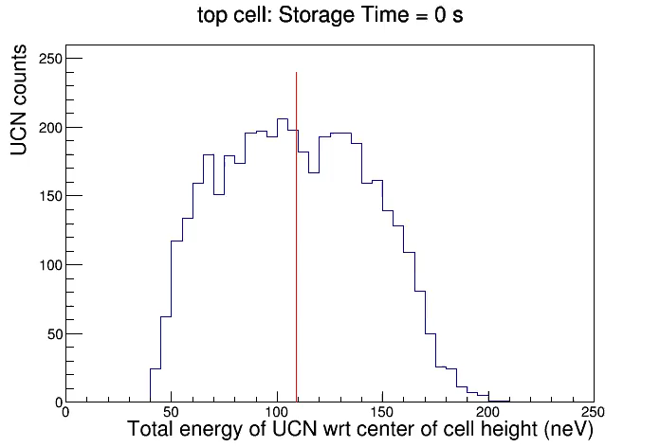
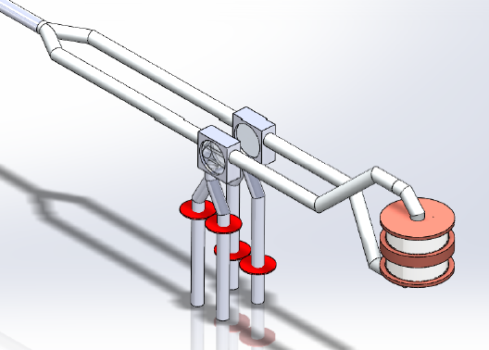
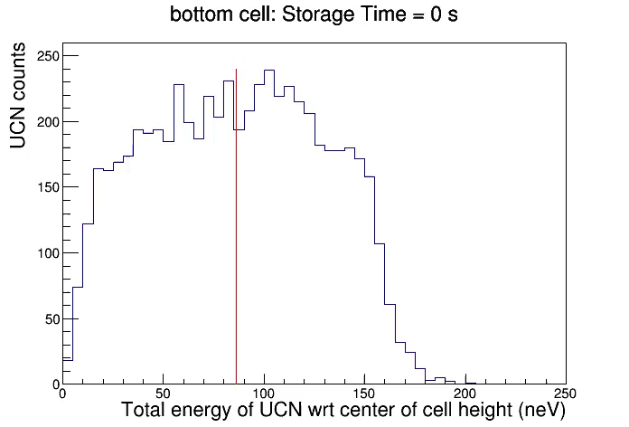
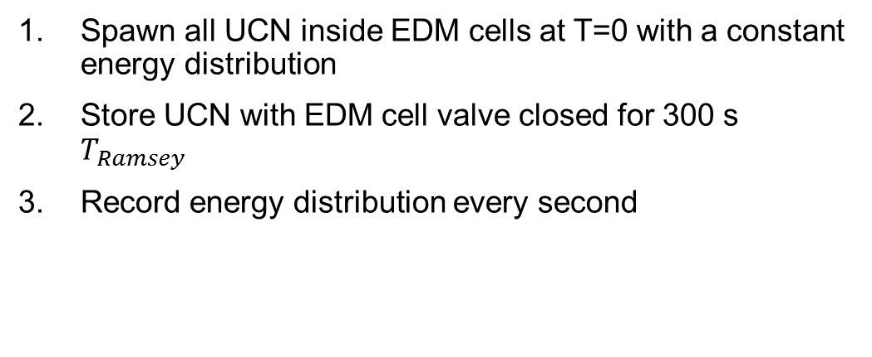
top
(B) Storage in cells
mean energy
# UCN in EDM cell
Not uniform:
energy distribution
weighed using (A)
and optimal timings
Spawn all UCN inside EDM cells at T=0 with a constant energy distribution
Store UCN with EDM cell valve closed for 300 s $T_{Ramsey}$
Record energy distribution every second
bot
# UCN in EDM cell
S. Sidhu
18

Slide 19
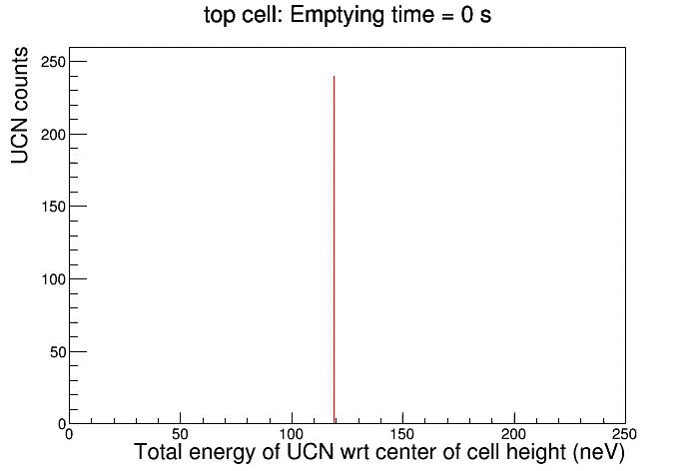
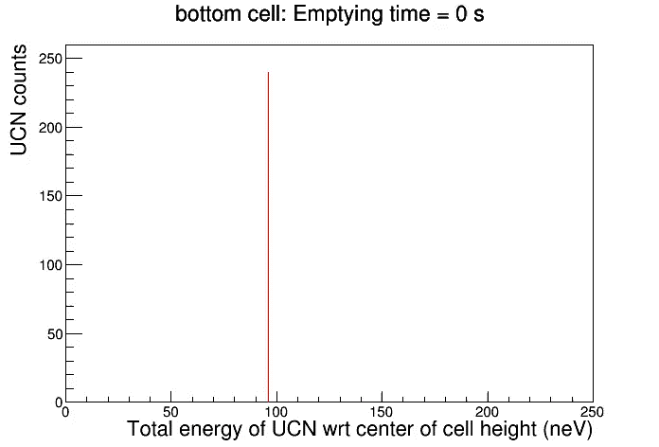
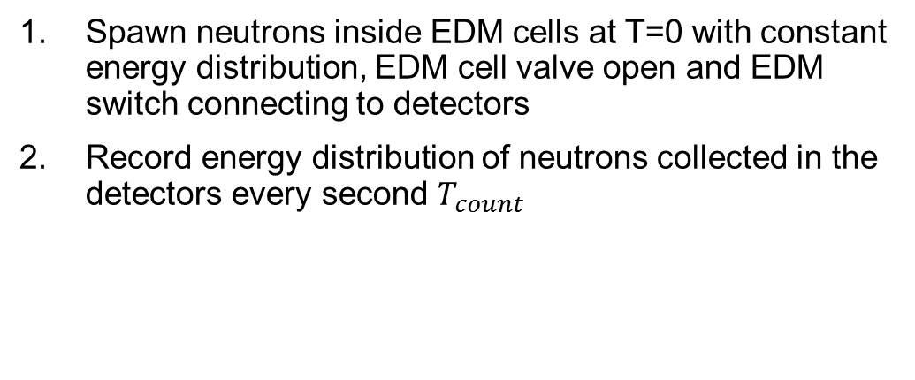
top
(C) Counting simulation
mean energy
# UCN detected
Starting:
energy distribution
weighed using (A) and (B)
and optimal timings
Spawn neutrons inside EDM cells at T=0 with constant energy distribution, EDM cell valve open and EDM switch connecting to detectors
Record energy distribution of neutrons collected in the detectors every second $T_{count}$
bot
# UCN detected
S. Sidhu
19

Slide 20
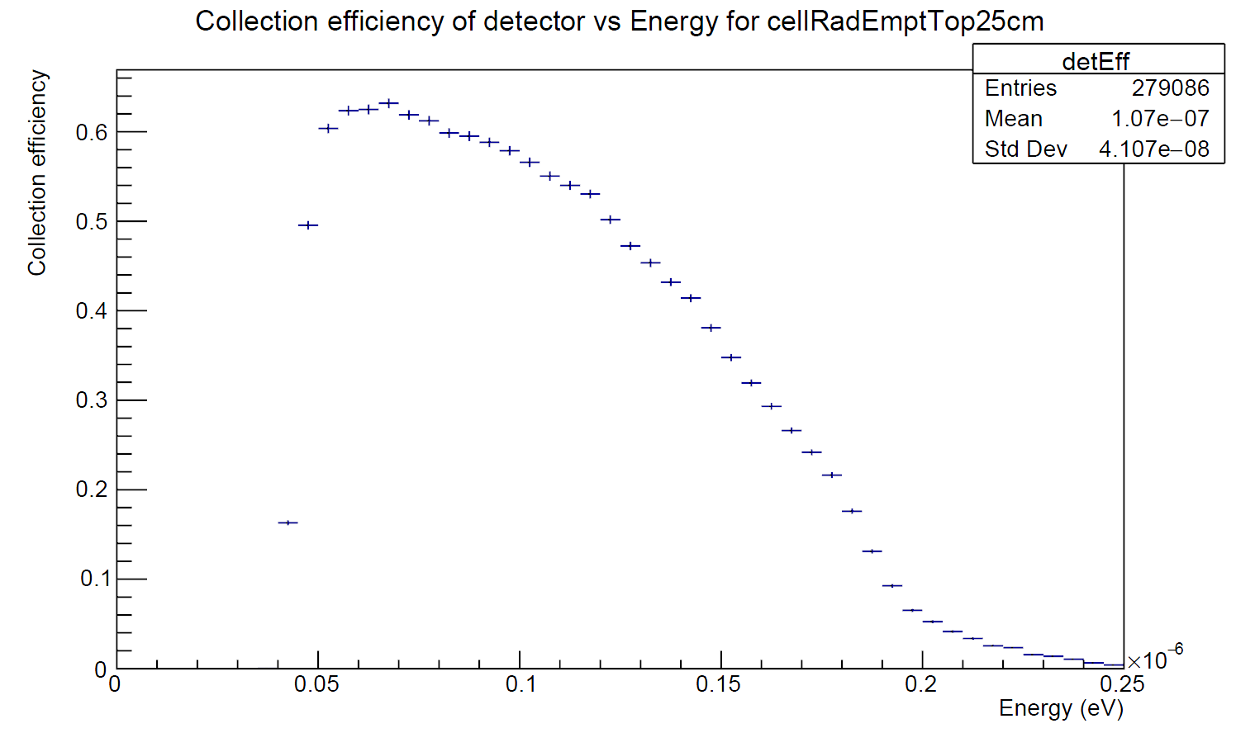
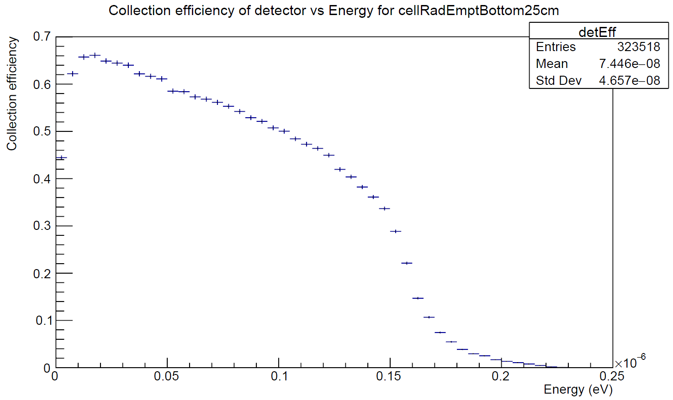
(C) Counting simulation
top
# UCN detected
Spawn neutrons inside EDM cells at T=0 with constant energy distribution, EDM cell valve open and EDM switch connecting to detectors
Record energy distribution of neutrons collected in the detectors every second $T_{count}$
bot
# UCN detected

Slide 21
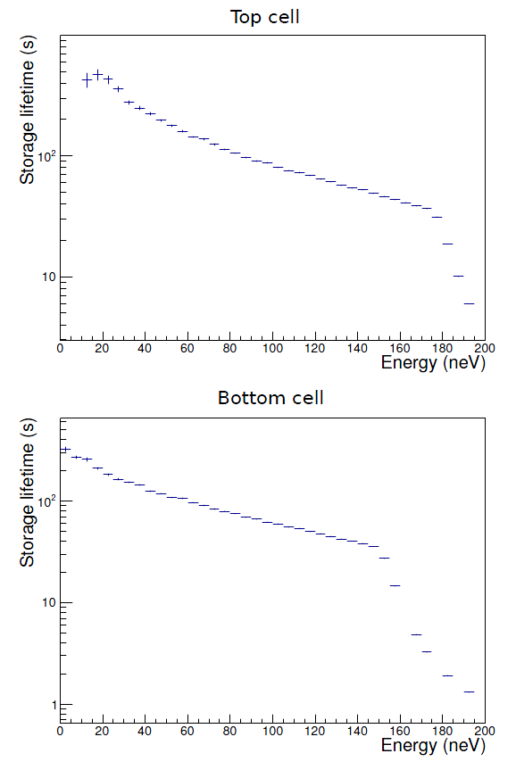
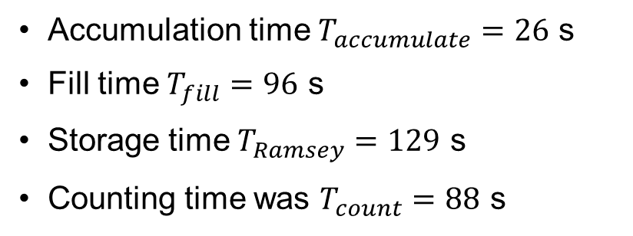
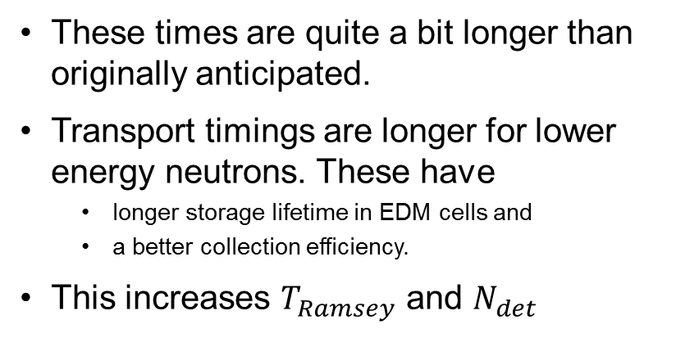
Remarks on the general optimization results
top
Optimal timings
Accumulation time $T_{accumulate}=26$ s
Fill time $T_{fill}=96$ s
Storage time $T_{Ramsey}=129$ s
Counting time was $T_{count}=88$ s
Conclusions
These times are quite a bit longer than originally anticipated.
Transport timings are longer for lower energy neutrons. These have
  longer storage lifetime in EDM cells and
  a better collection efficiency.
This increases $T_{Ramsey}$ and $N_{det}$
bot
21

Slide 22
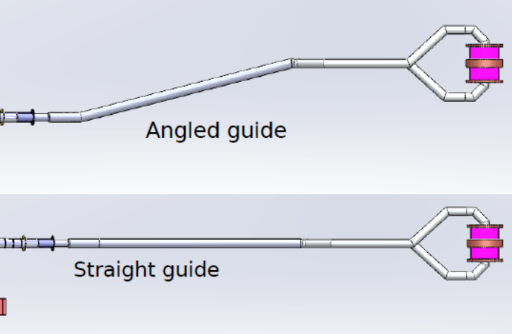
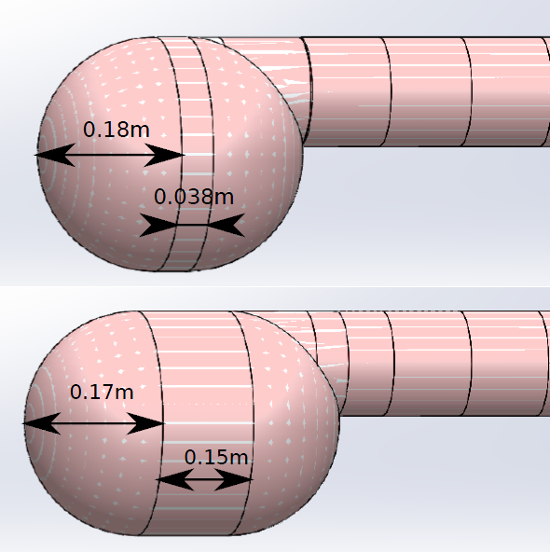
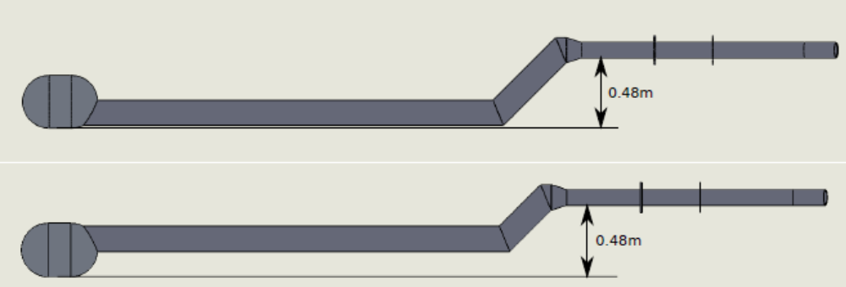
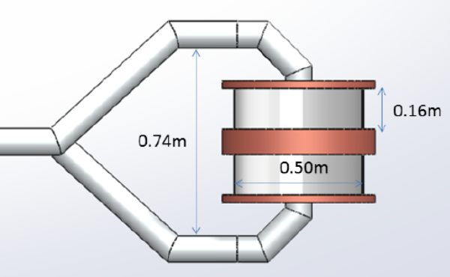
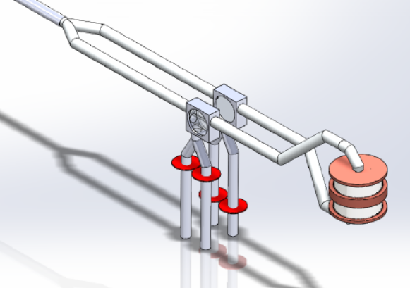
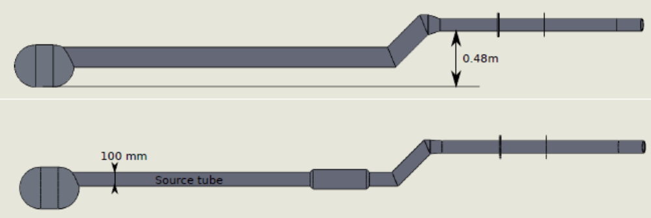
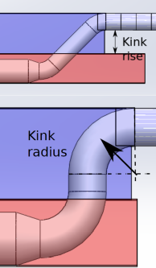
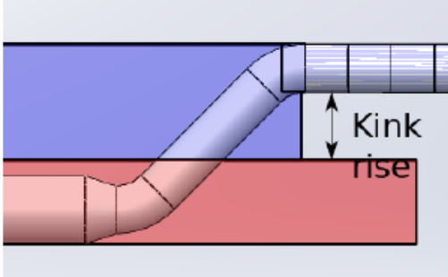
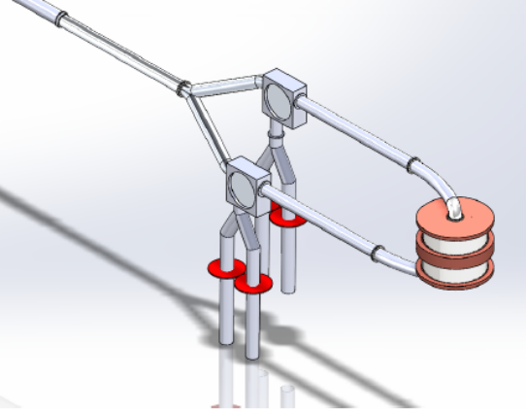
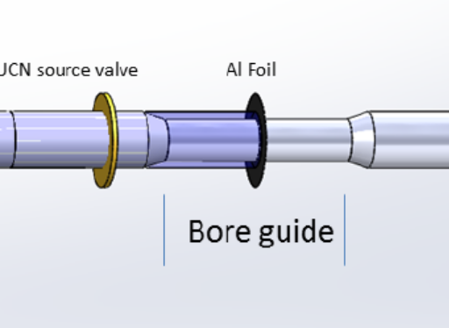
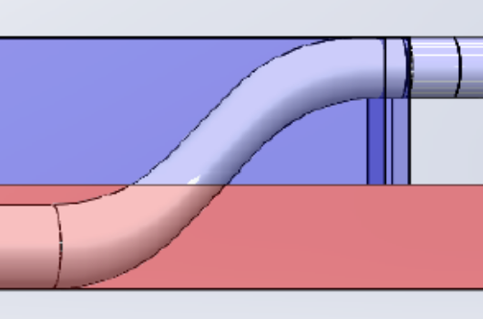
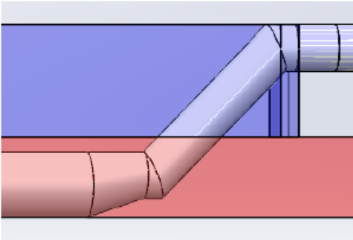
Parameters analyzed
vertical position of EDM cells
shape of bottle
extraction out of bottle
EDM cell size
guide diameter
EDM feeders
gravity bend shape, height
magnet bore shape
22
https://ucn.triumf.ca/meetings-and-workshops/review-meetings/2020-02-eac-review-meeting/documentation-for-eac-review/new-ucn-source/UCN_source_design_note.pdf

Slide 23
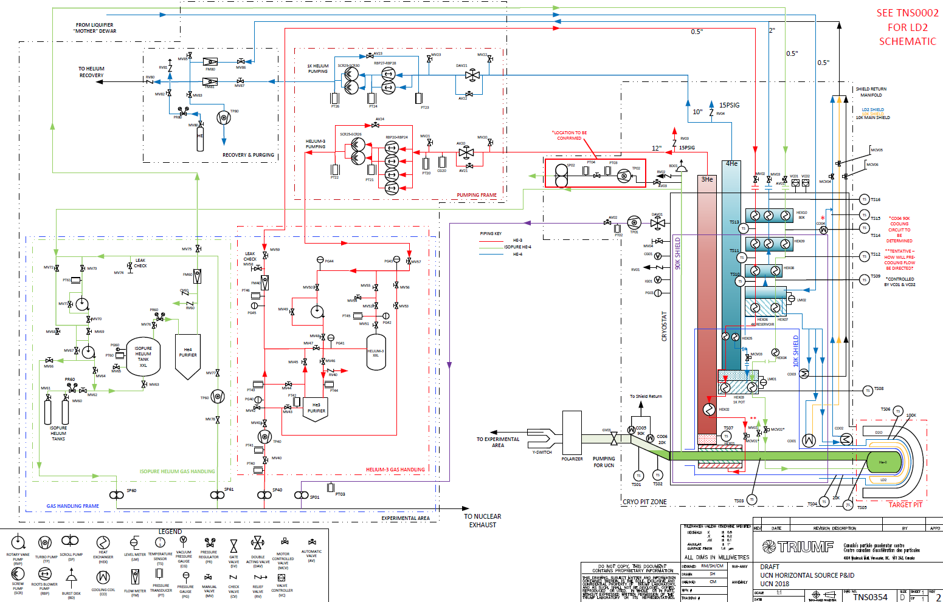
Components not covered in other presentations
He gas systems
Initial P&ID released
More detailed P&ID in progress
Component spec’ing ongoing at the moment

Slide 24
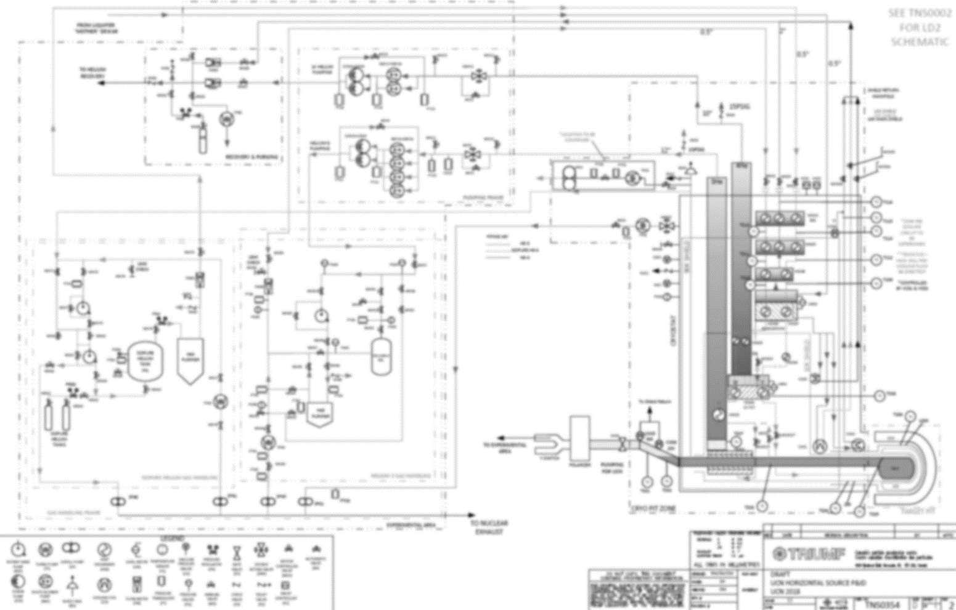
Components not covered in other presentations
He gas systems
Liquid helium transfer line
  43 m total length, ~4 m elevation drop
  Capacity ~100 L/hr
  Heat load as low as possible: <3 W, 4.2 L/hr LHe loss
  LN₂ or return gas cooled shield
  Requesting support from TRIUMF’s cryogenics group
  RFP planned by mid 2020
Initial P&ID released
More detailed P&ID in progress
Component spec’ing ongoing at the moment
Helium pumping system
Two systems required
  Natural helium (1K pot): 1.26 g/s at 5.4 Torr ($200k)
  Helium-3: 1.14 g/s at 2.38 Torr ($400k)
Ideally both systems use the same pump models.
Tender this spring
Starting with subset of pumps

Slide 25
Summary
We have solved nearly all major challenges posed by the TUCAN next generation source.
We are making good progress and have achieved major milestones.
We plan to install it in 2021 and perform first beam tests the same year.
This is highest priority of the TUCAN collaboration!
We have very challenging and demanding 2 years ahead of us to have many different components come together on time!
Main challenges, risks:
LD2 regulatory uncertainty
A lot of things have to click into place
Availability of TRIUMF support groups https://docs.google.com/spreadsheets/d/1UpaaIasmOP7XC00s2DEvn37fzRmK74w4TTxSC5PXwcs/edit?usp=sharing
Static heat input
Component failure

Slide 26
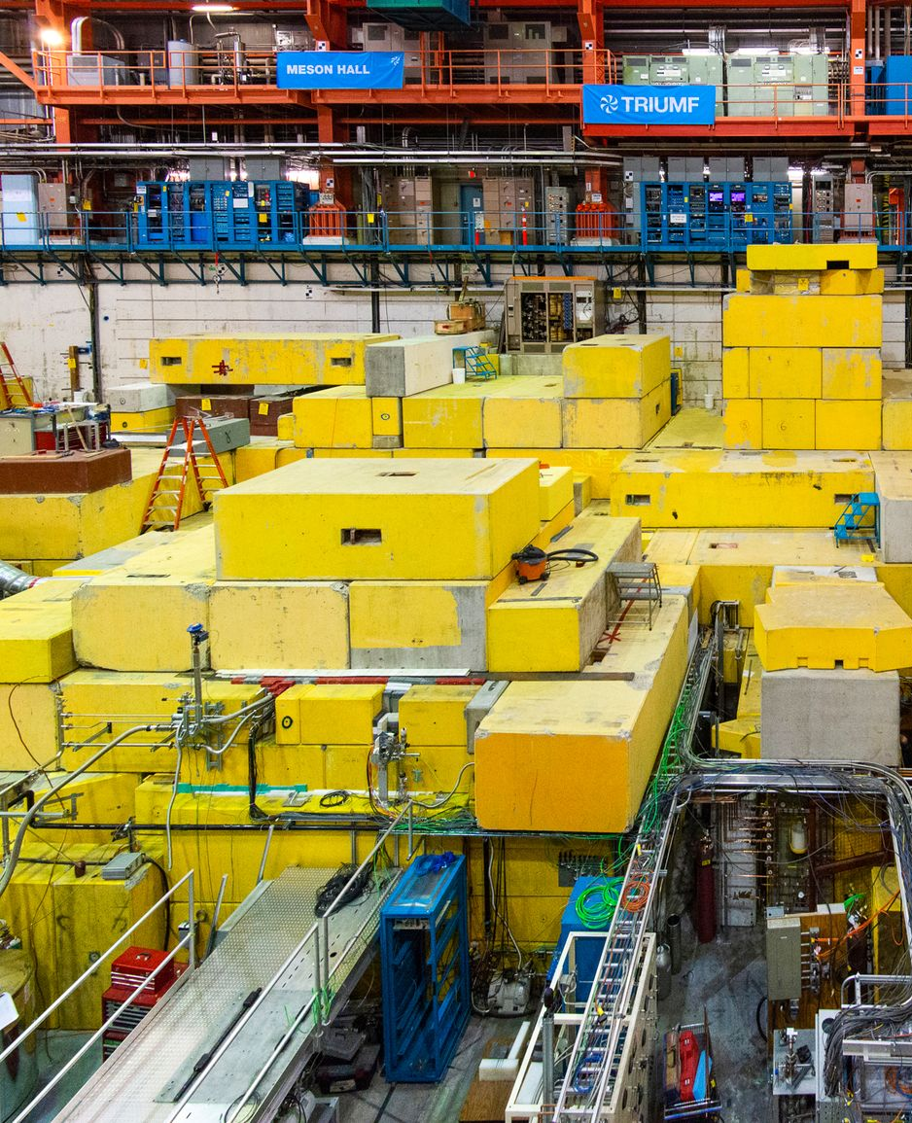




Thank you
Merci
www.triumf.ca
Follow us @TRIUMFLab

Slide 27
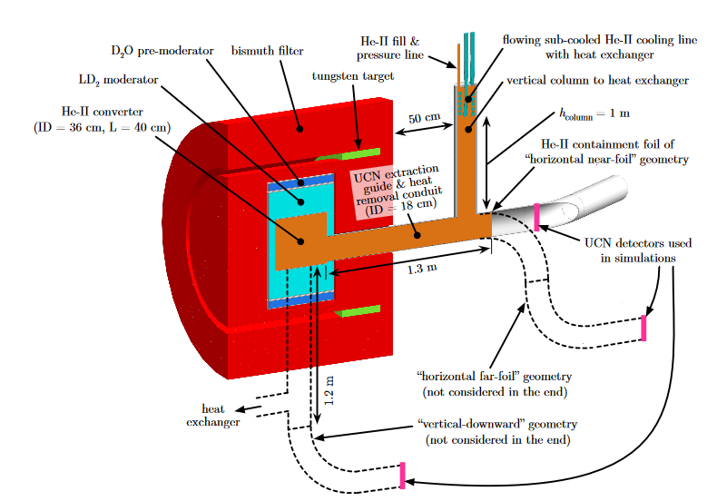
Some relevant numbers (compared to inverse geometry source)
TUCAN source
(engineering stage)
Inverse geometry source
(conceptual stage)
Production 1.4-1.6 x 10⁷ UCN/s
Source helium temp 1.03 K to 1.13 K
Cooling power 10 W (3He fridge)
Source storage lifetime 28 s
Figure of merit Pτ = 4.5 x 10⁸
Density in the source 3 x 10³ UCN/cc
Total number in the source 3 x 10⁸ UCN
Initial density in 70 l EDM expt 200 UCN/cc
Counted at the end of cycle 2 x 10⁶
Production 1.8 x 10⁹ UCN/s
Source helium temp 1.6 K
Cooling power 100 W (4He fridge)
Source storage lifetime 2 s
Figure of merit Pτ = 3.6 x 10⁹
Density in the source 5 x 10⁴ UCN/cc
Total number in the source 6.5 x 10⁹ UCN
Initial density in 100 l perfectly matched expt 10000 UCN/cc
https://arxiv.org/abs/1905.09459

Slide 28
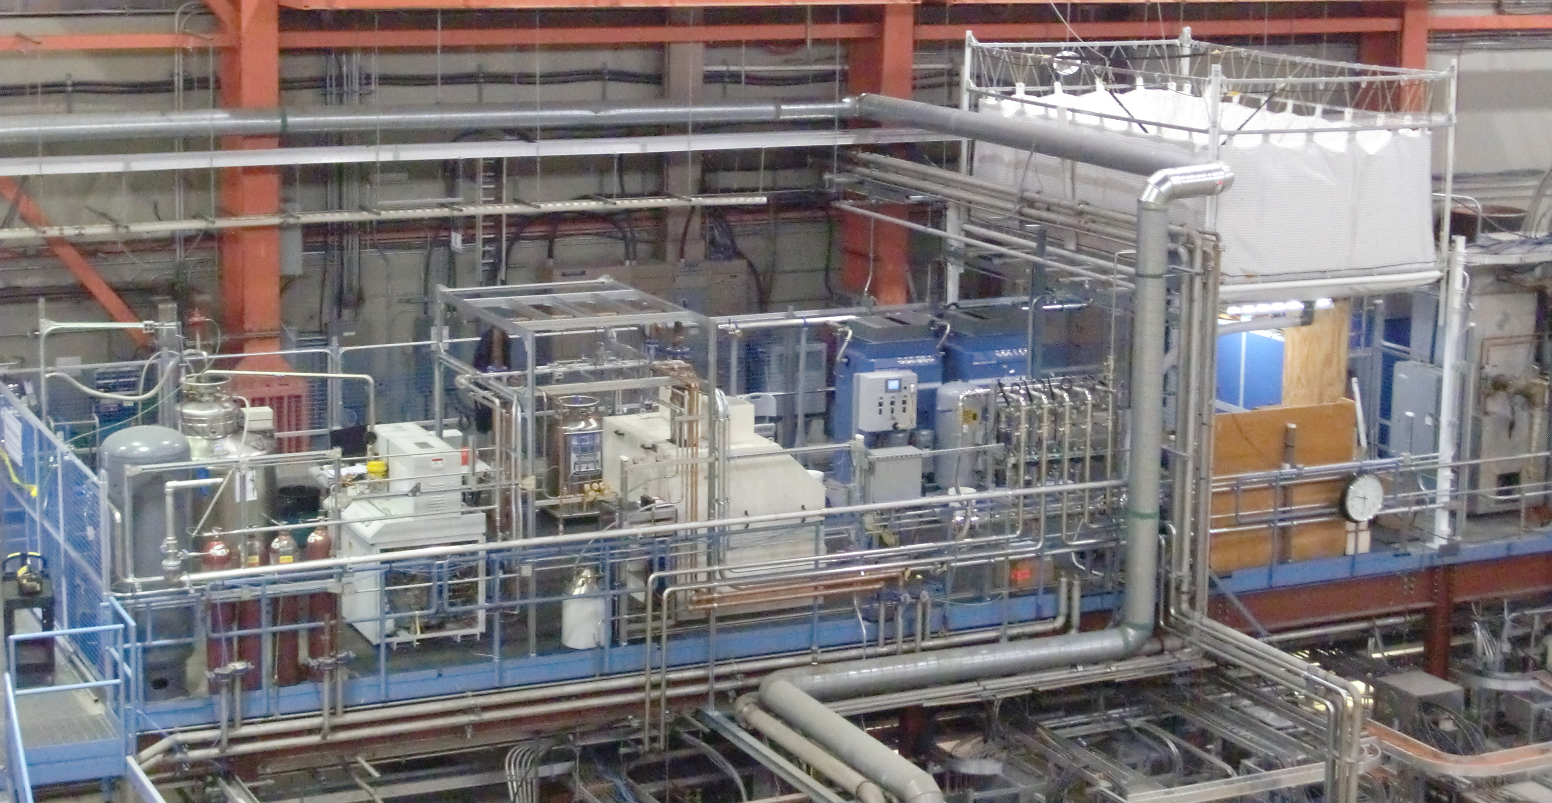
Meson hall He liquefier
Built 2012
liquefaction rate | 50 l/h
UCN needs 2017 | ca. 25 l/h
CMMS needs | Ca 15 l/h
He bag
1000l dewar
recovery compressors
Linde 1610
RSX compressor

Slide 29
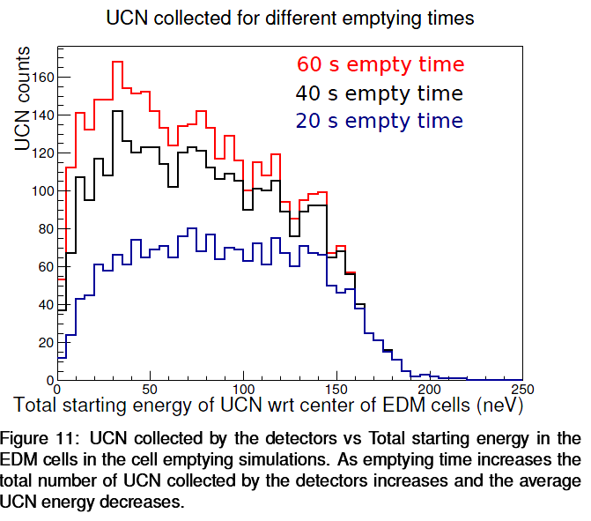
(C) Counting simulation
Spawn neutrons inside EDM cells at T=0 with constant energy distribution, EDM cell valve open and EDM switch connecting to detectors
Record energy distribution of neutrons collected in the detectors every second $T_{count}$
S. Sidhu

Slide 30
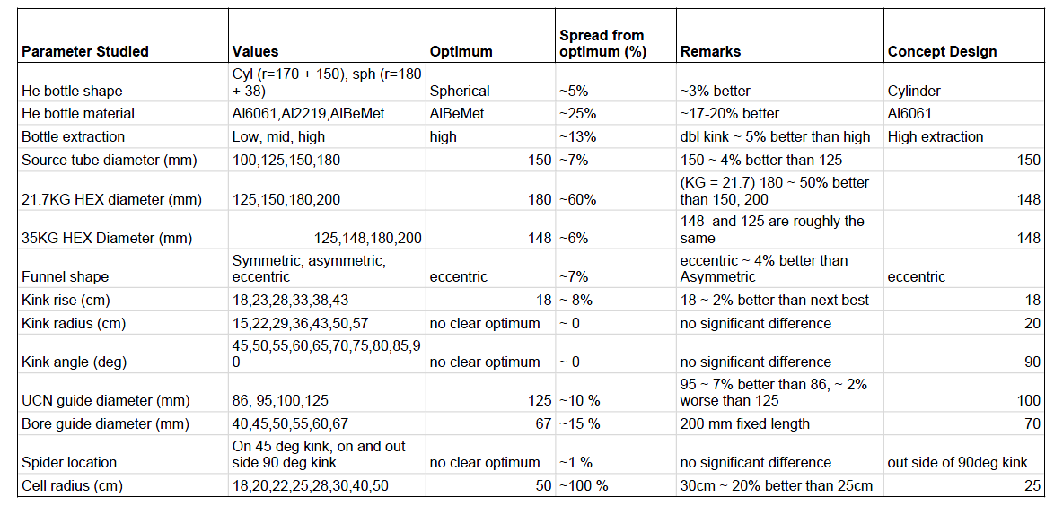
Simulation results summary
S. Sidhu

Slide 31
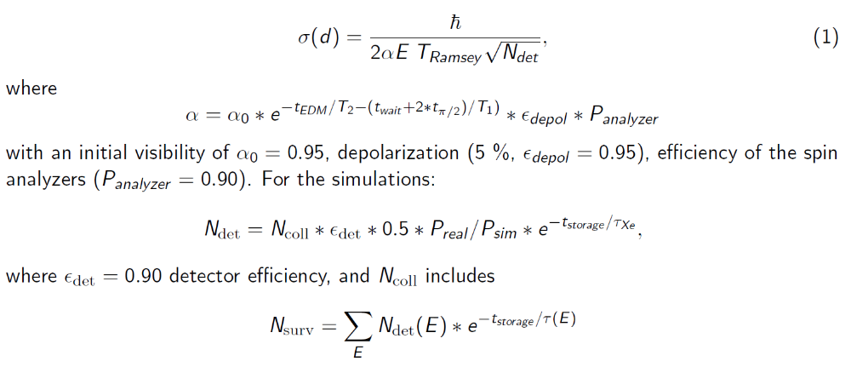
EDM sensitivity
S. Sidhu

Slide 32

Days to reach 10⁻²⁷ ecm
S. Sidhu

Slide 33

TUCAN UCN source pumping systems
Natural helium (1K pot): 1.26 g/s at 5.4 Torr
- well known pumping performance, low risk
- cost about 200 kCAD
Helium-3: 1.14 g/s at 2.38 Torr
- pumping performance only estimated
- minimize additional helium-3 for purges
- cost about 400 kCAD
- ideally both systems use the same pump models
Status
- discussion with three suppliers, 1-2 promising proposals
- TRIUMF conceptual design review in May 2019
- preparation of RFP ongoing
- approach to purchase minimal system first (possibly for Helium-3 only, use current pumps for Natural helium)
Example of proposed Helium-3 pumping system performance

Slide 34

TUCAN UCN source liquid helium supply line
Natural helium supply
  liquefier production currently 50-55 L/hr
  Full, reliable operation requires upgrade of production rate and mother dewar capacity
Natural helium transfer line
  43 m total length, ~4 m elevation drop
  UCN source avg consumption 10W, 35% duty: 31 L/hr
  LHe supply line capacity ~100 L/hr
  Heat load <3 W, 4.2 L/hr loss (as low as possible)
  LN2 or return gas cooled
Status
  Request support from TRIUMF’s cryogenics group
  RFP planned by mid 2020
Proposed route of LHe transfer line
from liquefier to UCN source cryostat

Slide 35

Inside shielding
Rendering issue,
disregard white tube
35

Slide 36
Overarching Schedule
UCN services schedule (will go to appendix…)
Calendar Year |  |  | 2020 |  |  |  |  |  |  |  |  | 2021 |  |  |  |  |  |  |  | 2022
 |  |  | 1 |  |  | 4 |  | 7 |  | 10 |  | 1 |  | 4 |  | 7 |  | 10 |  | 1 |  | 4
Shielding
Mod Pit Services |  | D2, D2O lines, controls, therm n det
Cryo Pit Services |  | D2, H20, air, power, controls, roughing, He pump lines
Cryo conn, LD₂ cryost.
He pumping system
Services | LD₂, ³He, nat He, Isopure handling system
Slow control
UCN handling
BL1U
Construct, procure
lift
Inst
Inst
Inst
lift
Inst
Install
Maintenance, repairs, upgrade
Install
Cryo testing
UCN
Detailing
Construct, procure
Assemble
Detailing
Construct
Assemble
Install
Tender
Procure
Test
Install
Detailing
Build, procure
Install
Plan
Procure
Assemble, connect, program
Detailing
Construct
Assemble
Beamspot calcs
beam
tests
Inst
Target cask detailing
Construct
Test
Gray shaded systems are inside the biological shielding.

Slide 37



accessible while BL1A is running
Shielding and pumps
BL1A shielding line
³He
⁴He
LD₂
cryostat
Has to be installed
during shutdown
valve
Y switch
polarizer
≈ 2.5 m
37

Slide 38


Technology choices for converter and cold moderator
Cam Marshall
Shinsuke Kawasaki
Ryohei Matsumiya
Takahiro Okamura
Cold moderator: LD2
Well known (scattering kernels)
Among the best moderating performances
Liquid (no burping)
Explosive
Safety concept will be laid out. Volume < 150 liquid liters.
Converter cryostat: ³He pumping
Best cooling performance < 1 K
Proven technology
Own expertise
Pressure drop in pumping duct manageable.
Reasonable pumps required.
Uncertainty in surface and superfluid helium conductivity
These uncertainties have been studied and are being experimentally tested.
Main disadvantages of 4He direct pumping:
huge pumping power
pressure drop very critical
_{0.77 K}
_{1.14 K}
_{1.16 K}
10 W
0.25 W static load, K_{g}=22, a=2.6, VanSciver

Slide 39

What is taken into account in the analytical model?
Analytical model useful to study many more parameter options than possible in simulation.
This is taken into account…
This is not… or not so well…
UCN production/heat input from MCNP simulations
Cryostat performance (pumps, pressure drop, HEX, heat conductivity)
Neutron storage lifetime in source (He liquid + vapor)
Phase space reduction due to wall Fermi potential and height differences
Dilution of neutron “gas”
Simple model of Ramsey cycle
Probable stable daily measurement period
Times for E field change, degaussing etc
Magnetic field of polarizer (it is in MC)
Transport is only modelled via loss per meter, bend, foil etc
Depolarization of UCN during transport (assuming 5% total)

Slide 40


Heat exchanger sensitivity
Kapitza resistance parameter K_{G}
³He Kapitza correction factor
okay above 25
okay below 3.5

Slide 41

Heat exchanger sensitivity continued
Fin length
0.5 mm seems enough

Slide 42


Heat exchanger sensitivity continued
HEX1 inner diameter
HEX 1 length
> 500 mm okay
> 0.14 okay

Slide 43


Helium-3 pumping system
Pumping speed
Pressure drop in helium-3 pumping line
> 5000 m³/h should work
smallish effect

Slide 44


Heat input and conduction
Static heat input
Model dependence
below 2.5 W is doable
both are acceptable,
but what if none fits?

Slide 45


Heat conduction continued
UCN guide and heat conduction channel diameter
Length of the same
> 0.14 m works well
pretty mild effect

Slide 46

General temperature dependence
Volume averaged isopure helium temperature
Model dependence
below 1.2 is fine,
above it hurts…
both are acceptable,
but what if none fits?

Slide 47
General temperature dependence
Volume averaged isopure helium temperature
Model dependence
below 1.2 is fine,
above it hurts…
both are acceptable,
but what if none fits?

Slide 48


nEDM parameter sensitivity
EDM cell radius
EDM cell height (E field kept at 13 kV/cm)
Above 200 kV reasonable?
Large lever arm…

