Slide 1
Production of ⁶⁷Cu at the TR-Flex Cyclotron
Santiago Brühlmann^{1,2}, Martin Walther¹, Martin Kreller¹, Hans-Jürgen Pietzsch¹, Torsten Knieß¹,
Klaus Kopka^{1,2}
¹ Helmholtz-Zentrum Dresden-Rossendorf, Institute of Radiopharmaceutical Cancer Research,
Bautzner Landstraße 400, 01328 Dresden, Germany
² Faculty of Chemistry and Food Chemistry, School of Science, Technical University Dresden,
01062 Dresden, Germany
August 22nd, 2022
Helmholtz-Zentrum Dresden-Rossendorf · Radiopharmaceutical Cancer Research · www.hzdr.de

Slide 2
Motivation and Introduction
Production of ⁶⁷Cu at the TR-Flex Cyclotron

Slide 3
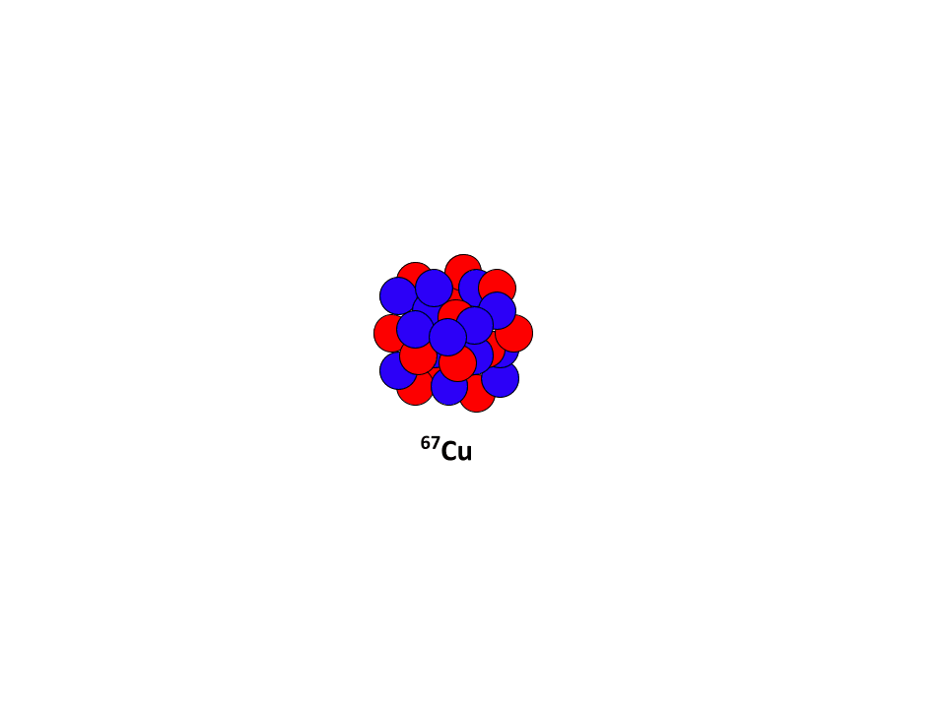
Introduction
Copper-67 as a Theranostic Radionuclide
Radiological properties¹:
    β⁻-emitter: mean energy 141 keV
    γ-emitter: 184.6 keV (48.7%), 93.31 keV (16.1%), i.a.
    Half-Life: 61.83 h
  Matched Pair of the β⁺-emitter ⁶⁴Cu
  Production routes:
    Cyclotron-based
    Nuclear reactor based
    Photo nuclear reaction
  (Pre)clinical studies in the GBq-range ⁶⁷Cu²
  Currently commercially ⁶⁷Cu available from IOTRON (research grade)³
IAEA Nuclear Data Services, https://www-nds.iaea.org/, last accessed on 04.07.2022.
The production, separation, and use of 67Cu for radioimmunotherapy: a review. N. A. Smith, D. L. Bowers, and D. A. Ehst. Applied Radiation and Isotopes 70.10 (2012): 2377-2383.
IOTRON Medial Inc. https://www.copper67.com/, last accessed on 04.07.2022.

Slide 4

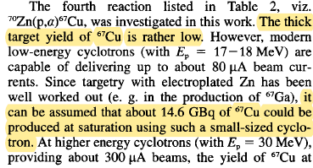
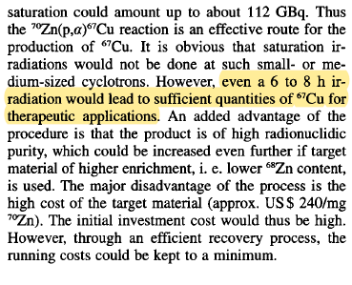
Motivation
Copper-67 production
Advantages of the ⁷⁰Zn(p,α)⁶⁷Cu Reaction:
Suitable for small Cyclotrons
No co-production of other Copper RN
Small quantities of byproducts
Some technical aspect should be taken into account…

Slide 5
Workflow
Closed Loop Strategy
Target Design
Two target alternatives: electrodeposited ⁷⁰Zn and [⁷⁰Zn]ZnO
Irradiation conditions based on tests and simulations
Radiochemical separation based on solid phase extraction
Expensive target material forces the implementation of a recycling strategy
Target Construction
Target Irradiation
Radio-chemical Separation
Target Recycling
Product QA

Slide 6
Results
Production of ⁶⁷Cu at the TR-Flex Cyclotron

Slide 7
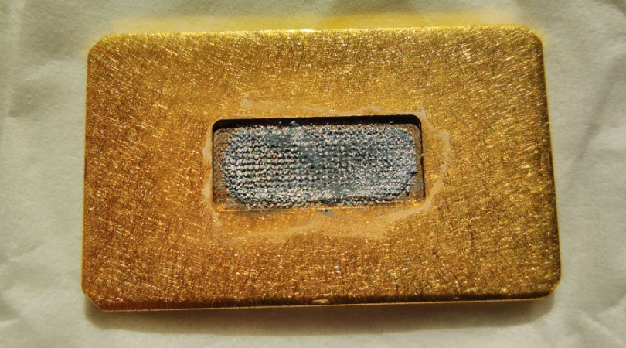
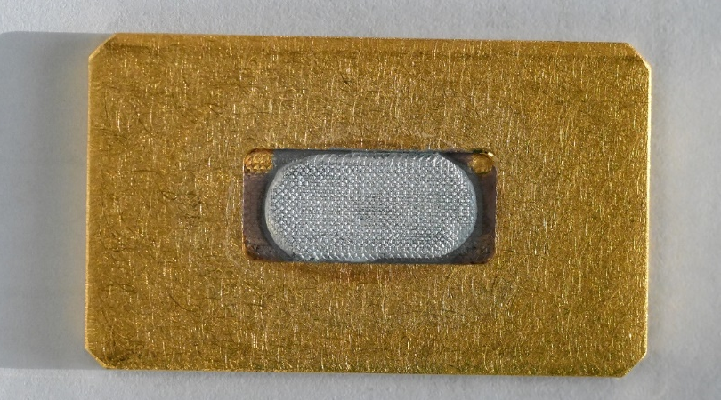
Results
Zinc Electrodepositing
    Electrodepositing on Gold subtract (disc)
    Electrodepositing bath:
      Zn²⁺ concentration around 15 g/dm³
      NH₄SO₄ as electrolyte
      Starting pH around 2
    Magnetic stirrer
    Electrochemical yield: 50-65%
    Surface density: around 1.13-1.46 g/cm²
Electrodeposited ⁷⁰Zn target from previous baths.
Electrodeposited ⁷⁰Zn target with the new technique.

Slide 8
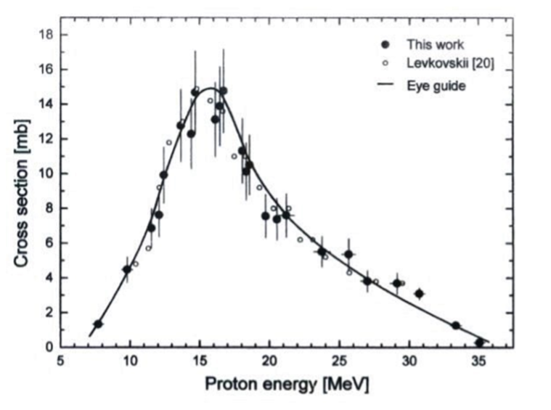
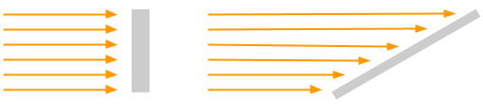
Results
Target Irradiation I
Irradiations carried out at the Cyclotron TR-FLEX with the 30°configuration.
    Irradiation parameters based on simulations:
    Activation simulations to estimate proton beam energy
    Irradiation simulations to estimate the maximal beam current
      Based on the COMSOL Software¹
      Parametric study of materials and currents
Possibility of production of ⁶⁷Cu at a small-sized Cyclotron via the (p,α)-reaction on enriched ⁷⁰Zn. S. Kastleiner, H.H. Coenen and S.M. Qaim, Radiochim. Acta 84 (1999), 107-110
Target irradiation configuration at the TR-FLEX Cyclotron: 90° and 30°.
COMSOL Multiphysics, https://www.comsol.com/, last accessed on 04.07.2022.

Slide 9
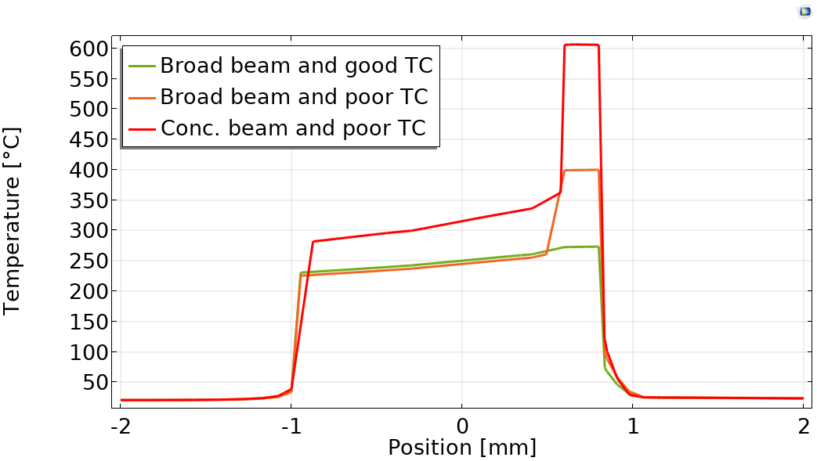
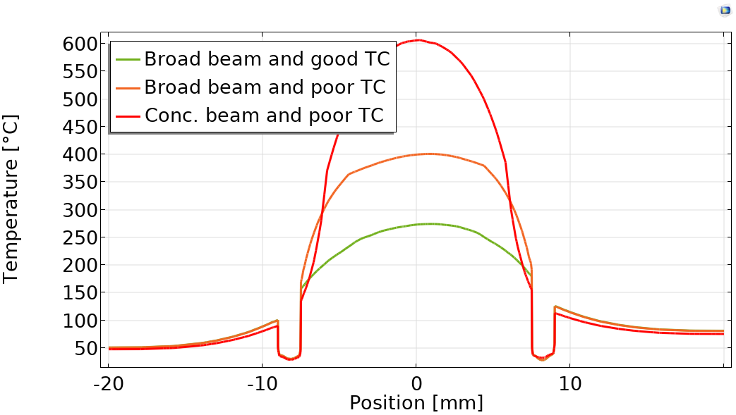
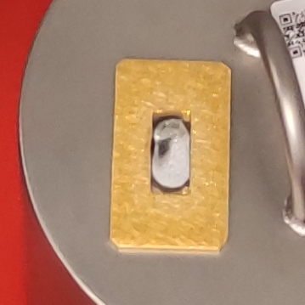
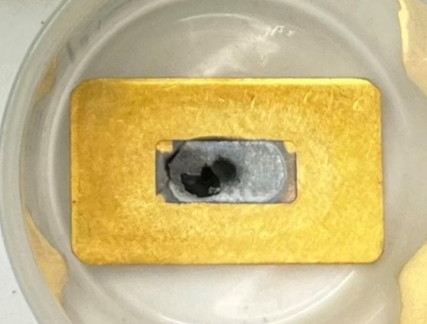
Results
Target Irradiation II: Metal Target
Thermal contact (TC) between disc and electrodeposited target
Proton beam profile: broad or concentrated
Axial (parallel to the beam) temperature profile of a electrodeposited ⁷⁰Zn Target. Proton beam current: 60 µA.
Lateral (normal to the beam) temperature profile of a electrodeposited ⁷⁰Zn Target. Proton beam current: 60 µA.
Electrodeposited ⁷⁰Zn target (E07) after irradiation
with 45 µA for 4 h. Beam profile not optimized.
Electrodeposited ⁷⁰Zn target (E10) after irradiation
with 60 µA for 4 h. Optimized beam profile.

Slide 10
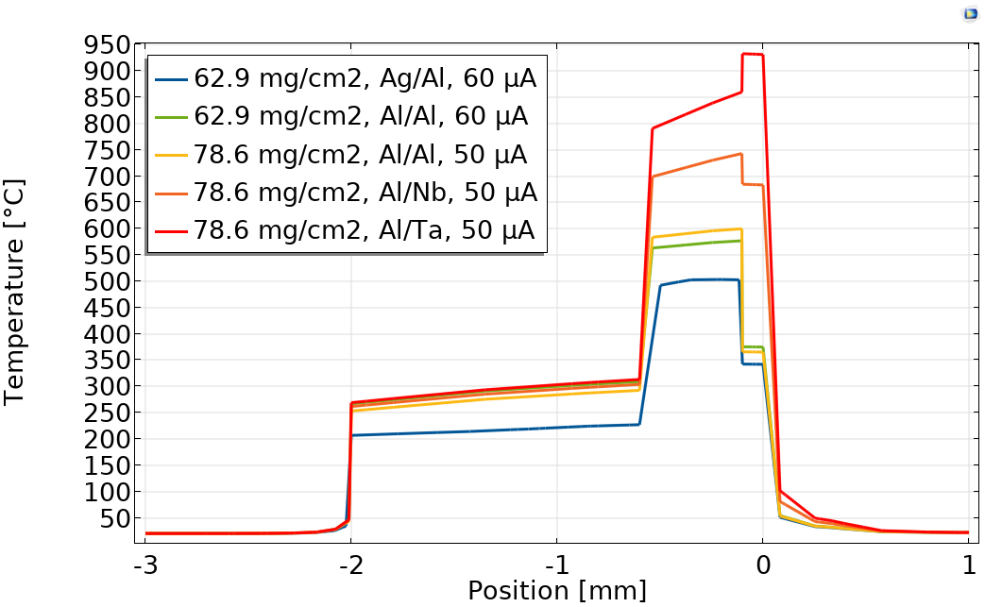
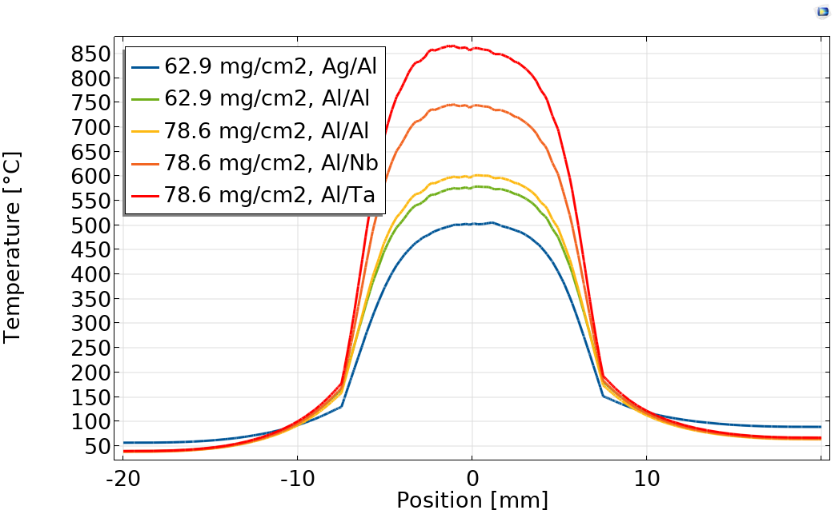
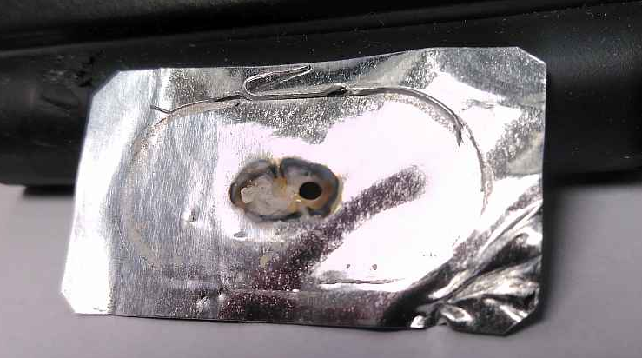
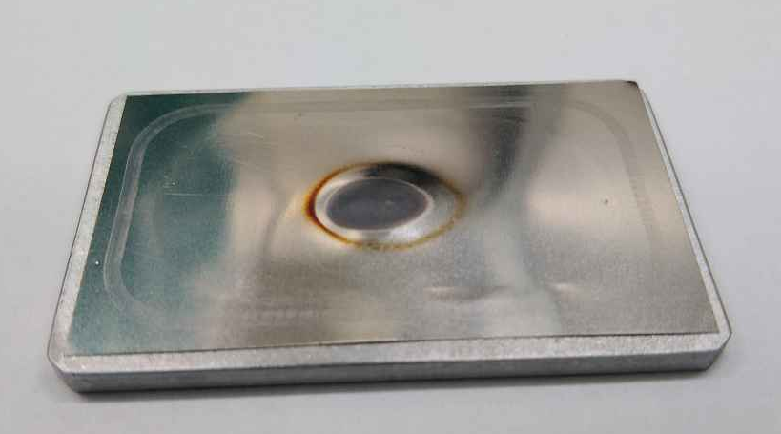
Results
Target Irradiation III: Oxide Target
Different backing disc and foil materials
Different [⁷⁰Zn]ZnO masses
Axial (parallel to the beam) temperature profile of [⁷⁰Zn]ZnO targets with different backing and foil materials and ZnO masses.
Lateral (normal to the beam) temperature profile of [⁷⁰Zn]ZnO targets with different backing and foil materials and ZnO masses.
Melted Aluminum foil (T03), irradiated with 70 µA.
Irradiated [⁷⁰Zn]ZnO target with Niobium foil. Current: 40 µA.

Slide 11
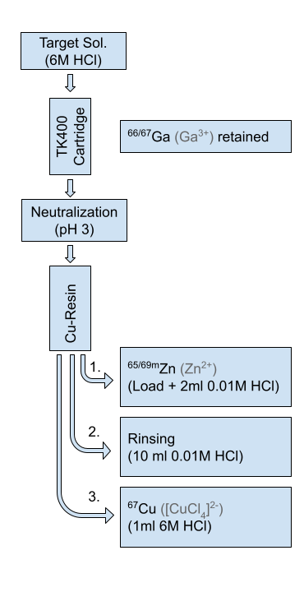
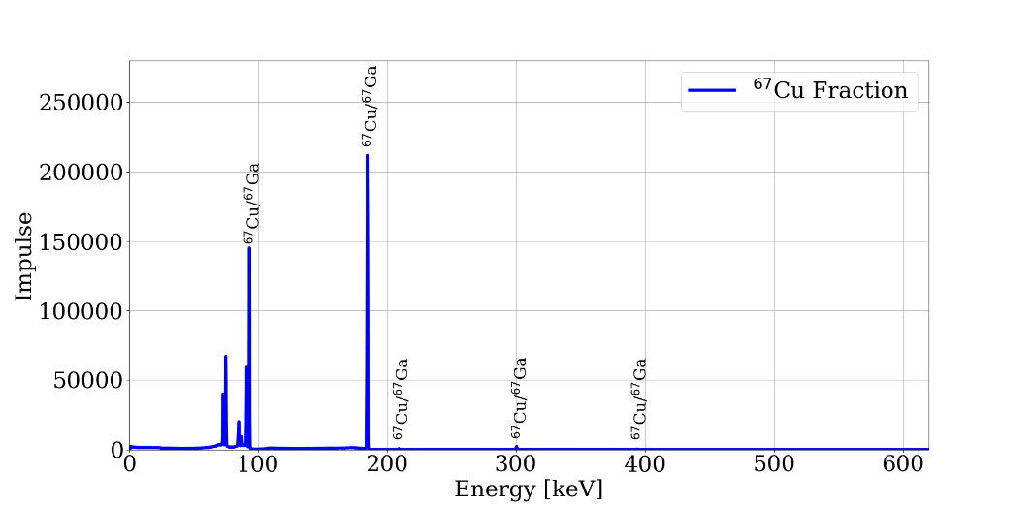

Results
Radiochemical Separation
    Separation carried out with Copper-selective resin
      Target dissolution – 6M HCl
      Gallium retention in TK-400 resin
      Neutralization – 12M NaOH / 1M NaOAc
      Column load and rinse – 0.01M HCl
      Copper elution – 6M HCl
        1 ml volume
        90-95% ⁶⁷Cu Activity
        ⁶⁷Ga impurities below quantification
Gamma-spectrometry of the [⁶⁷Cu]CuCl₂ fraction with a Canberra HPGe detector.

Slide 12
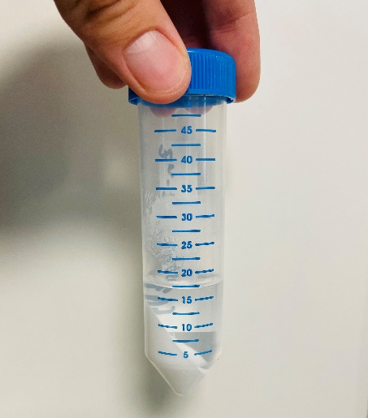
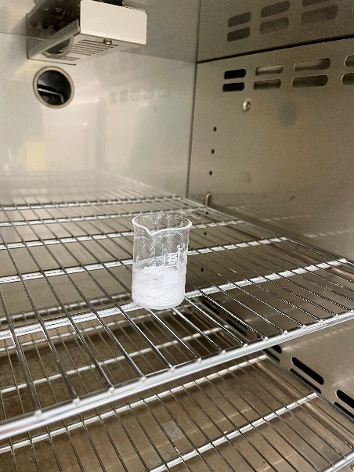
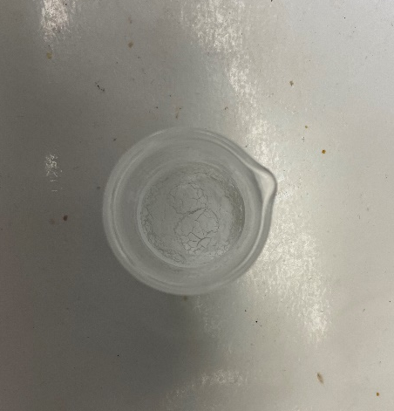
Results
Target recycling
    Further purification of Zn material
    Precipitation of Zn(OH)₂:
      Addition of 6M NaOH until pH 9
      Centrifugation, separation of the supernatant and further washing
      Drying of the precipitate
      Annealing
    Recovery efficiency 95%
    NaCl content estimated below 0.5% in weight
Precipitated and centrifugated [⁷⁰Zn]Zn(OH)₂.
Drying of the [⁷⁰Zn]Zn(OH)₂.
[⁷⁰Zn]ZnO recovered after annealing.

Slide 13
Results
Yields – First Irradiation Set
Target ID | Target Mass [mg] | Energy [MeV] | Current [µA] | Irr. Time [h] | A ⁶⁷Cu [MBq] | A ⁶⁷Ga [MBq] | Yield ⁶⁷Cu [MBq/µA h]
Metal ⁷⁰Zn Target
E00 | 109 | 17.5 | 50 | 4 | 30.3 | 65.4 | 0.151
E02 | 134 | 17.5 | 50 | 4 | 286 | 325 | 1.43
E04 | 129 | 17.5 | 60 | 3.33 | 170 | 135 | 0.841
E06ª | 134 | 17.5 | 50 | 4 | ~73.3 | - | -
E05 | 167 | 17.5 | 40 | 4 | 111 | 99.1 | 0.700
E07 | 141 | 17.5 | 45 | 4 | 158 | 140 | 0.872
[⁷⁰Zn]ZnO Target – 9 mm circle area
T01 | 10 | 17.5 | 30 | 120 | 5.24 | 2.06 | 0.087
T02 | 10 | 17.5 | 90 | 30 | 3.87 | 1.54 | 0.086
T03ª | 50 | 18 | 70 | 15 | 6.40 | 2.19 | 0.365
T04 | 40 | 17.2 | 30-60 | 195 | 41.1 | 10.37 | 0.305
a. Target partially melted.

Slide 14
Results
Yields and Effective Specific Activities (ESA) – Second Irradiation Set
Optimized beam profile
ESA quantified by titration with 1,4,8,11-tetraazacyclotetradecane-N,N’,N’’,N’’’-tetraacetic acid (TETA)
Target Number | Target Mass [mg] | Energy [MeV] | Current [µA] | Irr. Time [h] | Activity [MBq] | Yield [MBq/µA h] | Specific Activity [GBq/µmol]
Metal ⁷⁰Zn Target
E08 | 159 | 17 | 45-60 | 6 | 328 | 1.06 | 10
E09^{b,c} | 156 | 17 | 60 | 5 | 122 | 0.41 | 5.6
E10^{c} | 154 | 17 | 60 | 4 | 200 | 0.83 | 3.8
[⁷⁰Zn]ZnO Target
T05 | 100 | 17.2 | 40-60 | 5.75 | 220 | 0.70 | 21.8
b. Due to communication problems the beam profile was not as broad as in the other irradiations.
c. Target partially melted.

Slide 15
Outlook
Production of ⁶⁷Cu at the TR-Flex Cyclotron

Slide 16
Conclusions & Future Steps
    Couple hundred MBq of ⁶⁷Cu were produced from ⁷⁰Zn electrodeposited targets and ZnO targets, expecting to reach the GBq range with longer irradiation times. Two targets proposals should be considered:
      Electrodeposited ⁷⁰Zn target:1.0 MBq/µA h and 6.5 GBq/µmol
      [⁷⁰Zn]ZnO target: 0.70 MBq/µA h and 21.8 GBq/µmol
    [⁶⁷Cu]CuCl₂ product solution free of other radionuclides
    Recycling yield about 95%: reduction of the production costs

Slide 17
Thank you for your attention!

