Slide 1
⁶⁸Ga Production from liquid target: Determination of solubility of ZnCl₂ in HCl solutions
Mátyás Fodor^{I,II}
Zoltán Szűcs PhD^{II}
^{I}Doctoral School of Chemistry, University of Debrecen, Debrecen, Hungary
^{II}Radiochemical Laboratory, Institute for Nuclear Research, Debrecen, Hungary

Slide 2
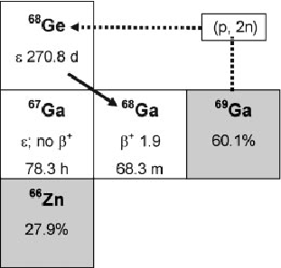
⁶⁸Ga’s role in nuclear medicine
⁶⁸Ga is a positron emitting radioisotope
It is produced:
by the ⁶⁸Zn(p,n) ⁶⁸Ga reaction in cyclotrons
from ⁶⁸Ge generators via electron capture decay
t_{1/2} for ⁶⁸Ga is 67.8 minutes
Gamma energies are 511keV, 1077keV and 1883keV⁽²⁾
It is well suited for PET diagnostics, and is routinely used
Normally solid Zn targets are employed for production⁽³⁾
⁽¹⁾

Slide 3
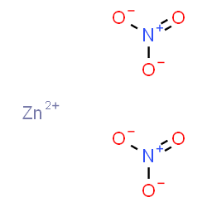
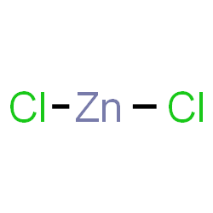
Production from liquid target
Literature mentions
production using Zn(NO₃)₂ solution⁽⁴⁾
Problems with this approach:
Zn(NO₃)₂ has worse solubility (in water) than ZnCl₂^{(5,6)}
For equal masses of solids, Zn(NO₃)₂ has less Zn²⁺ ions than ZnCl₂
More target nuclei for irradiation when using ZnCl₂
 | Molar mass (g/mol) | Zinc/100g (g)
ZnCl₂ | 136.3 | 48.0
Zn(NO₃)₂ | 189.4 | 34.5

Slide 4
Production from liquid target
Our goal is to develop a method with the following key parameters:
⁶⁸Ga production via cyclotron
using a liquid target
⁶⁸Zn enriched ZnCl₂ in HCl solution
He gas
An example of a liquid target system, based on⁽⁷⁾
[⁶⁸Zn]ZnCl₂ solution
Target
LOAD position
[⁶⁸Zn]ZnCl₂ solution to target, overflow waste can optionally be recovered...
/[⁶⁸Zn]ZnCl₂ recovery
IBA Synthera+
Syringe

Slide 5
Production from liquid target
Our goal is to develop a method with the following key parameters:
⁶⁸Ga production via cyclotron
using a liquid target
⁶⁸Zn enriched ZnCl₂ in HCl solution
He gas
An example of a liquid target system, based on⁽⁷⁾
[⁶⁸Zn]ZnCl₂ solution
Target
UNLOAD position
/[⁶⁸Zn]ZnCl₂ recovery
[⁶⁸Ga]GaCl₃ solution to IBA Synthera+ panel, for radiolabeling
(Future work...)
IBA Synthera+
Syringe

Slide 6
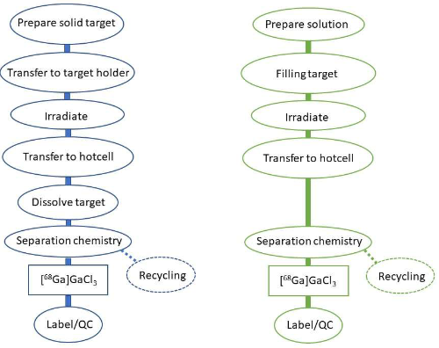
Determination of ZnCl₂ solubility in HCl solutions
Solid target
Liquid target
Benefactors:
Faster purification compared to solid targets
Fewer steps required (no need to dissolve a solid target)
Easily automated, compared to solid target systems (utilizing existing systems, eg. ¹⁸F)
(8)

Slide 7
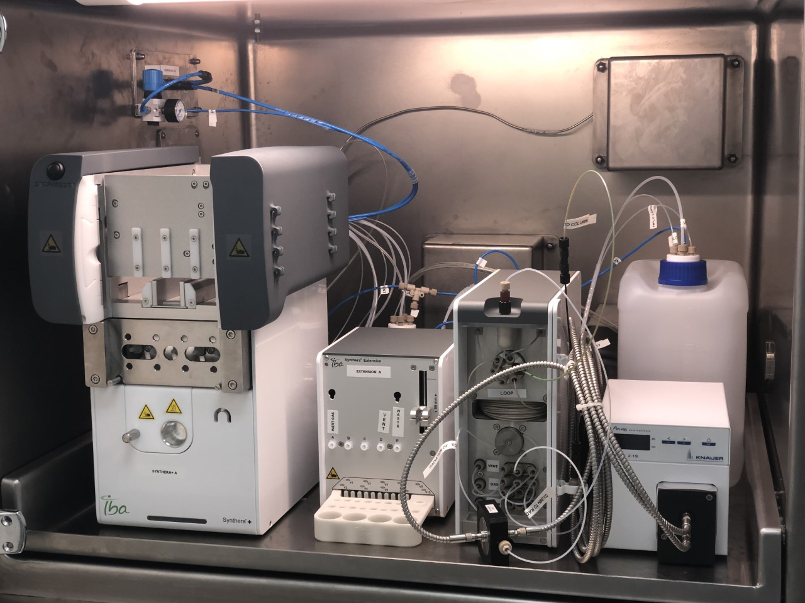
Determination of ZnCl₂ solubility in HCl solutions
Benefactors:
Faster purification compared to solid targets
Fewer steps required (no need to dissolve a solid target)
Easily automated, compared to solid target systems (utilizing existing systems, eg. ¹⁸F)
Problems:
Any liquid target will have fewer “useful” nuclei to irradiate, compared to solid targets
An optimum in concentration needs to be found, to generate highest activity
We need solubility data for different HCl concentrations
Recently purchased IBA Synthera+ system

Slide 8
Determination of ZnCl₂ solubility in HCl solutions – initial failures
Preparation of ZnCl₂ from metallic Zn was attempted
Zn metal in cc. HCl solution was dissolved
Evaporation to dryness failed
Even leaving the solution on the hotplate on 100°C (212°F) over the weekend yielded a thick syrup, not solid crystals

Slide 9
Determination of ZnCl₂ solubility in HCl solutions - challenges
Experiments were continued with anhydrous ZnCl₂ purchased from a manufacturer
The solids were protected from moisture in the air
This was done via storing the container in a vacuum desiccator above P₂O₅, and measuring the solids into screw-cap vials, in a glovebox under Ar atmosphere
glovebox under Argon atmosphere
vacuum desiccator

Slide 10
Determination of ZnCl₂ solubility in HCl solutions – more failures...
First, solubility was measured on ambient temperature, with continuous stirring
HCl solution was added dropwise
Temperature of the solution has risen greatly when the HCl solution was added to the solids
As solubility is temperature dependent, this led to inaccurate results
To counter this, a water bath and stirring was employed
1. ZnCl₂ solution in HCl acid
2. stirring bar
3. hotplate with magnetic stirring
4. screw-cap vial with the sample
4.
1.
2.
3.

Slide 11
Determination of ZnCl₂ solubility in HCl solutions – final adjustments
The measurements were carried out as shown on the diagram
Experimental temperatures were 20-80°C (68-176°F)
HCl concentrations were 1-12M
The temperature of the water bath fluctuated as much as ±10°C (± 18°F)
To counter this, a thermometer controlled hotplate was chosen
1. hotplate with magnetic stirring
2. water bath
3. stirring bars
4. screw-cap vial with the sample
5. thermometer
6. display of the hotplate’s
temperature
5.
4.
2.
3.
1.
6.

Slide 12
Determination of ZnCl₂ solubility in HCl solutions – measurement
With this new, improved setup, the experiments were carried out again
Temperature was more stable, in the range of ±2°C(±3°F) (measured with a calibrated thermometer)
The thermometer was placed as close to the vials as possible
Solution was allowed to warm up to the waterbath’s temperature
Overall, much better results
1. hotplate with magnetic stirring
2. water bath
3. stirring bars
4. screw-cap vial with the sample
5. thermometer connected to the
hotplate
6. display of temperature
5.
4.
2.
3.
1.
6.

Slide 13
Determination of ZnCl₂ solubility in HCl solutions – the results
Every measurement was repeated at least 3 times
First, solubility was determined at 23°C (73°F) for different acid concentrations
Solubility was highest in 3M HCl solution, with 274±18g solids dissolved in 100ml

Slide 14
Determination of ZnCl₂ solubility in HCl solutions – the results
Next, the water bath was heated to 50°C (122°F)
As expected, solubility increased
The highest solubility was 356±16g/100ml in 6M acid solution

Slide 15
Determination of ZnCl₂ solubility in HCl solutions – the results
Finally, 6M HCl solution was chosen and solubility was tested at different temperatures
As expected, solubility increased with temperature
Above 60°C (140°F), HCl evaporation became prevalent, as liquid drops appeared at the neck of the vial
This made measurements inaccurate

Slide 16
Determination of ZnCl₂ solubility in HCl solutions – conclusions
I’ve found that HCl solutions dissolve less ZnCl₂ than pure water
Despite this, 6M and more dilute HCl solution can still dissolve great amounts of ZnCl₂
6M solution might be ideal as it is anisotropic
Following experiments will include the design, and pressure test of the liquid target, and irradiation of [⁶⁸Zn]ZnCl₂ solution
By the optimal irradiation parameters, suggested Szelecsényi et al, the proton beam with energy range 4.5-14 MeV (metal Zn, thickness is 460μm) during 1 hour irradiation can produce 5.76 GBq activity. The dilution of Zn atoms up to 10 mol% still can guarantee the radioactivity of ⁶⁸Ga in range of GBq.⁽⁹⁾

Slide 17
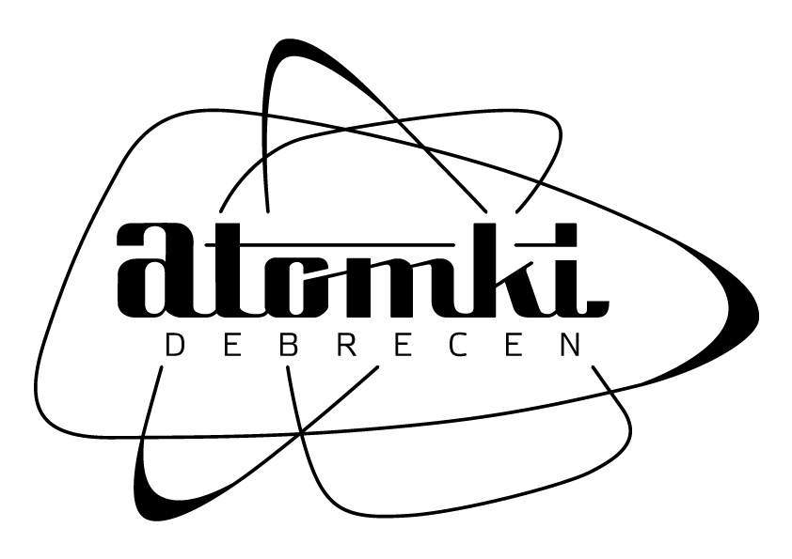
Acknowledgements
Special thanks for the Doctoral School of Chemistry, University of Debrecen.
This work was supported by the project TKP2021-NKTA-42 financed by the National Research, Development and Innovation Fund of the Ministry for Innovation and Technology, Hungary.

Slide 18
Thank you for listening
Referenses:
¹Maecke, H. R., & André, J. P. (n.d.). 68Ga-PET Radiopharmacy: A Generator-Based Alternative to 18F-Radiopharmacy. PET Chemistry, 215–242.
²Benešová M, Reischl G. Production of radionuclides: Cyclotrons and reactors. In: Signore A, editor. Nuclear Medicine and Molecular Imaging. Oxford: Elsevier; 2022. p. 52-65.
³Recommended cross sections with estimated uncertainties for the ⁶⁸Zn(p,n)⁶⁸Ga reaction [Internet]. https://www-nds.iaea.org/: IAEA; 2018 [updated 2018 Aug; cited 2022 Jul 21].
⁴International Atomic EA. Gallium-68 cyclotron production. International Atomic Energy Agency (IAEA): 2019. p. 17-21.
⁵Zinc chloride [Internet]. National Center for Biotechnology Information: PubChem; 2022 [updated 2022-07-15; cited 2022-07-22]. Available from: https://pubchem.ncbi.nlm.nih.gov/compound/ZINC-chloride#section=Solubility. ⁶Zinc nitrate [Internet]. National Center for Biotechnology Information: PubChem; 2022 [updated 2022-07-16; cited 2022-07-22]. Available from: https://pubchem.ncbi.nlm.nih.gov/compound/ZINC-nitrate#section=Solubility. ⁷International Atomic EA. Gallium-68 cyclotron production. International Atomic Energy Agency (IAEA): 2019. p. 21. ⁸International Atomic EA. Gallium-68 cyclotron production. International Atomic Energy Agency (IAEA): 2019. p. 4. ⁹Szelecsényi, F., Boothe, T.E., Takács, S., Tárkányi, F., Tavano, E.: Evaluated cross section and thick target yield data bases of Zn+p processes for practical applications. (1998) Applied Radiation and Isotopes, 49 (8), pp. 1005-1032.

