Slide 1
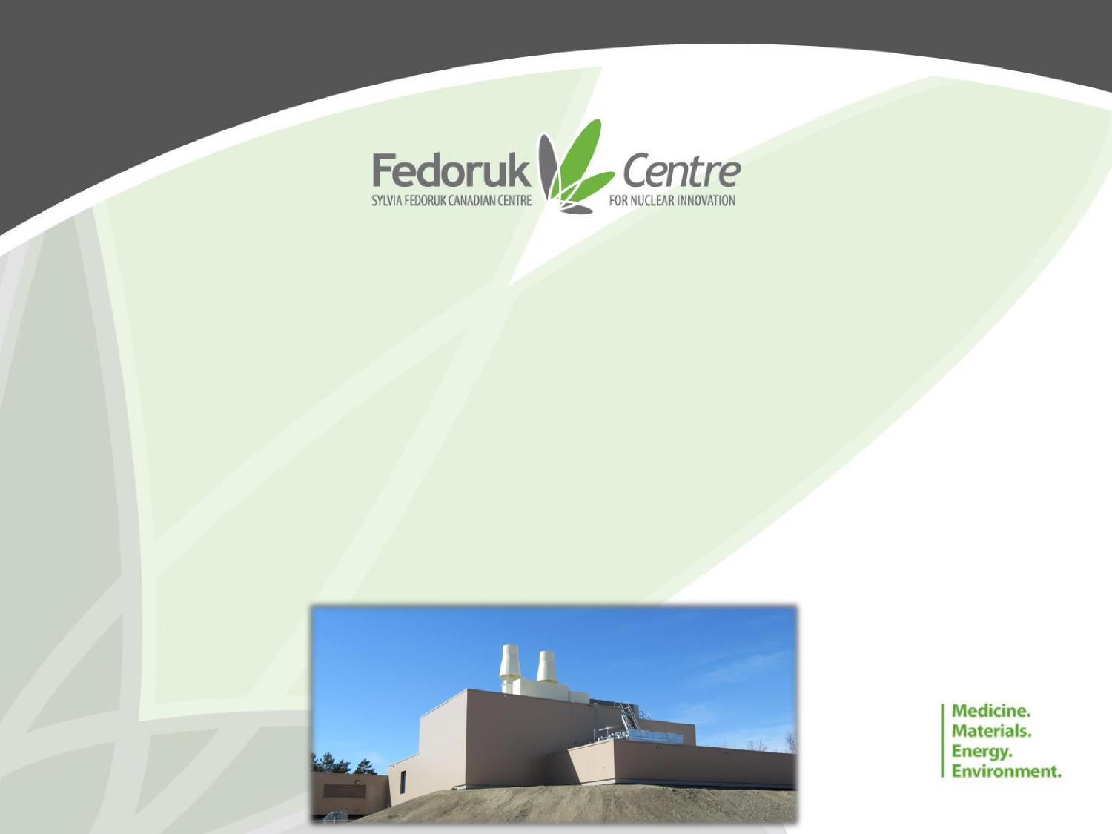
Installation and Testing of an ARTMS QIS™ at the Saskatchewan Centre for Cyclotron Sciences
D. Schick-Martin¹, D. Frattinger¹, J. MacKenzie¹, L. Regier¹, A. Thomas¹,
E. deLure², A. Steele², A. Welch², S. Khan², D. Alt², S. K. Zeisler², M. Dodd², J. Kumlin²
¹ Sylvia Fedoruk Canadian Centre for Nuclear Innovation, Inc., Saskatoon, SK, Canada
²ARTMS Inc., Burnaby, BC, Canada

Slide 2
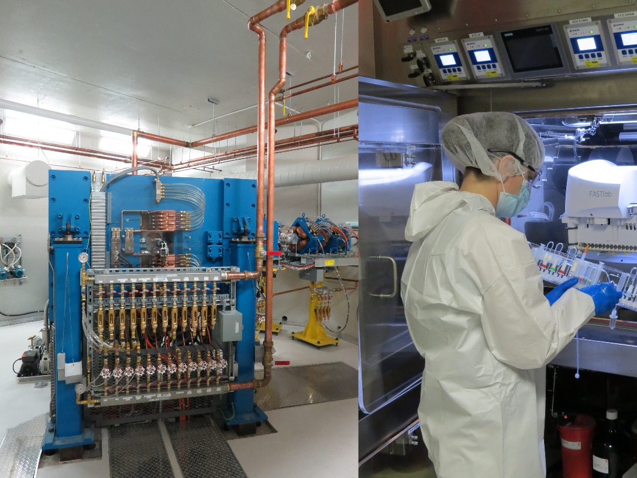
Overview of SCCS
A multi-user facility for research and innovation in the field of nuclear imaging
A GMP radiopharmaceutical production facility
2

Slide 3
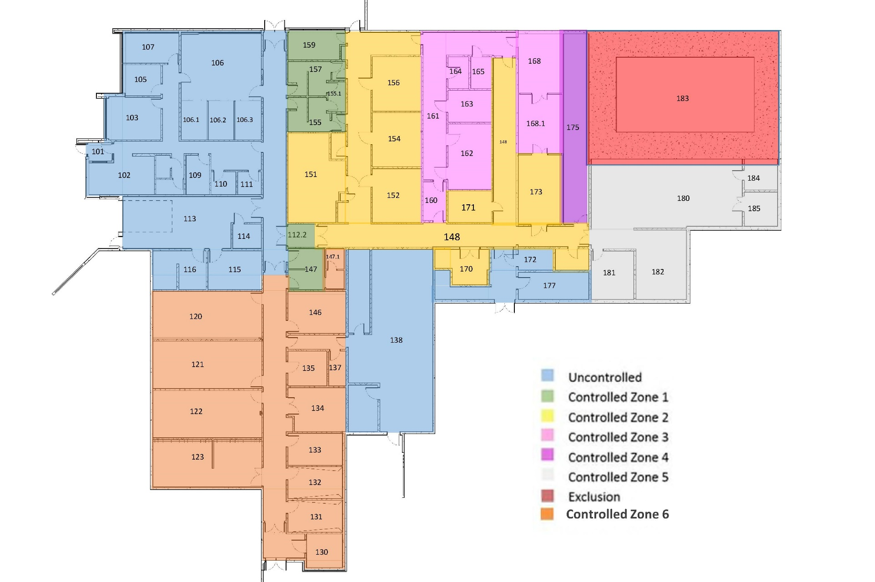
SCCS – Main Facility & Innovation Wing
QC labs, package room
GMP clean rooms, production labs
Changing Rooms
Cyclotron
Office Space
Main Facility
Technical rooms
Research hot cell Lab
Radiochemistry
Labs
Mechanical space (plus upstairs)
SPECT/PET-CT Scanners
Phytosuite
Small Animal Holding
3

Slide 4
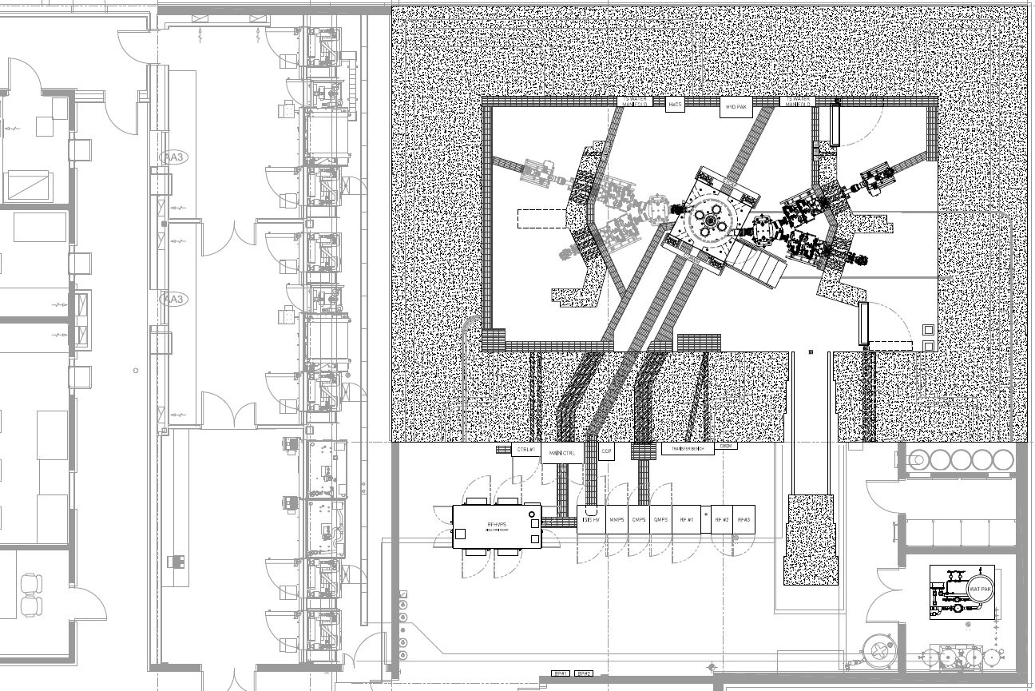
SCCS - Cyclotron
ACSI TR24 Cyclotron
Angled Solid Target
Potential for additional beamlines
2x 3-port target selectors
4

Slide 5
Previous and Planned Radiometal Work
Routine production of ⁸⁹Zr (Zr-oxalate) at ~2 GBq per batch
Performed experiments on ⁵⁵Co/⁶⁴Cu extraction from natural Ni (supporting Dr. Eric Price’s group)
Dr. Humphrey Fonge running [⁶⁸Ga]Ga-PSMA clinical trial using generator; interest in establishing cyclotron production to support similar work
Vijay Gaja, Jacqueline Cawthray, Clarence R. Geyer and Humphrey Fonge (2020).
Production and Semi‐Automated Processing of ⁸⁹Zr Using a Commercially Available TRASIS MiniAiO Module
Molecules 2020, 25, 2626
5

Slide 6
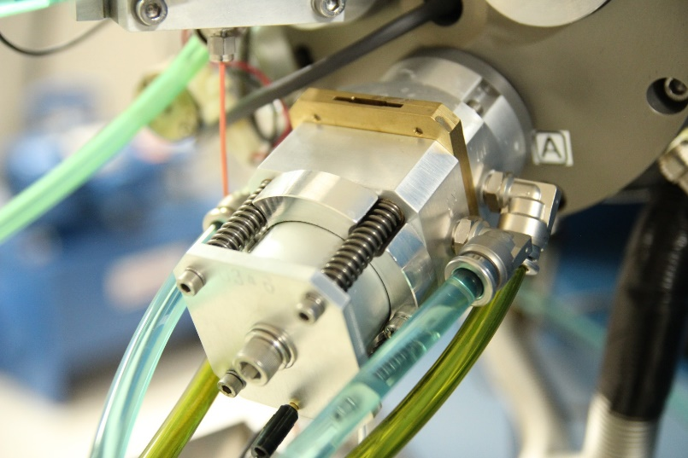
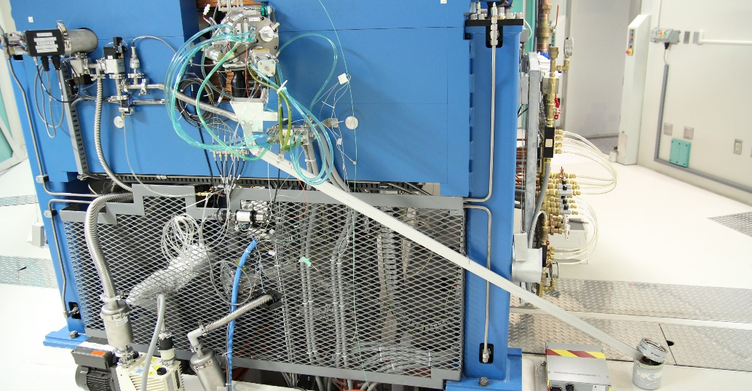
Existing Small Solid Target System
Currently use ACSI 90° coin holder for small solid targets
Adaptable and simple system for research or prototype targets
Has worked well for ⁸⁹Zr development and novel isotope production
Downside: Manual loading and handling
Gives technologists a dose at the cyclotron and to initiate production
Precludes high activity irradiations and back-to-back runs
6

Slide 7
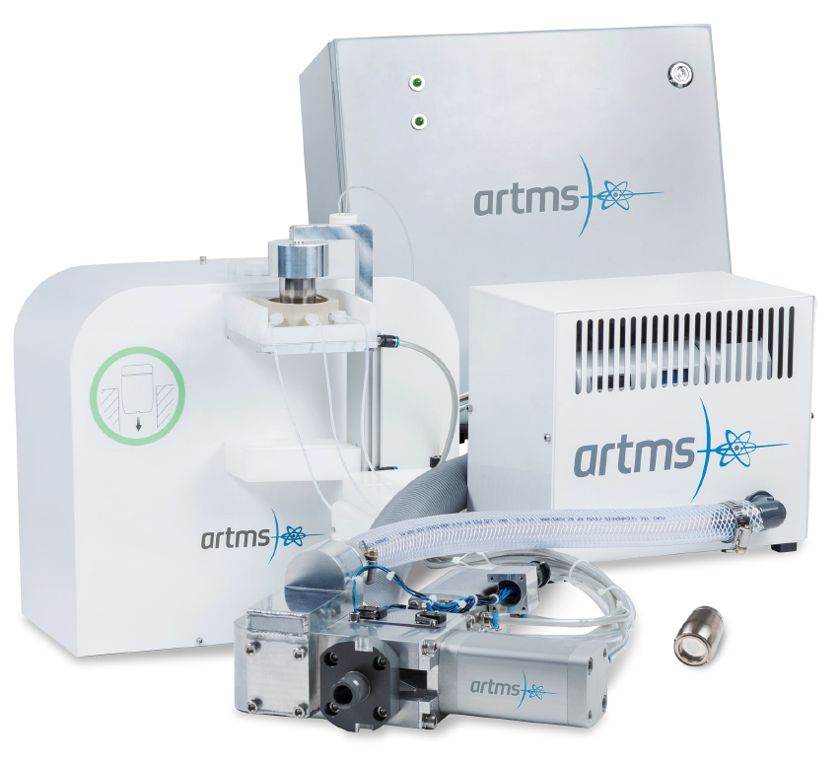
The ARTMS QUANTM Irradiation System (QIS)
Automatic 2-way solid target transfer and irradiation system
Equipped with (optional) removable energy degraders
Target dissolution system and transfer to synthesizer
Facilitates safe handling of high-activity targets
Facilitates the potential for back-to-back runs
7

Slide 8
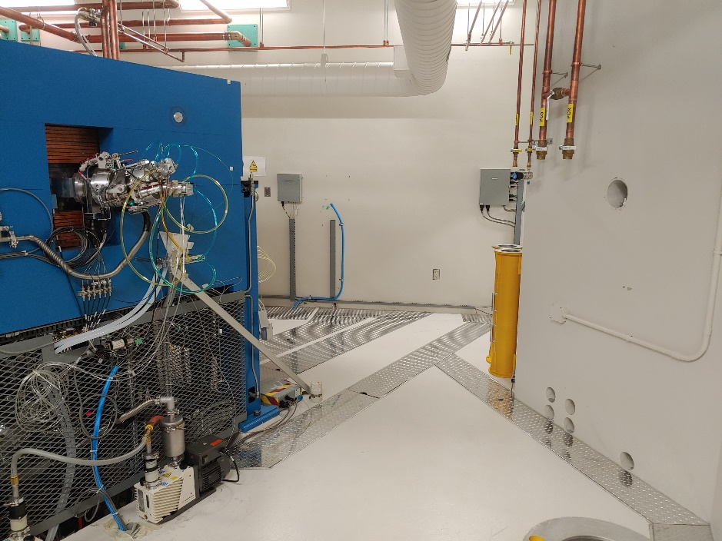
Challenge of Integrating the QIS on the TR-24 at SCCS
Normal procedure is to mount the QIS onto the cyclotron directly, but SCCS already has a 3-port target selector in place
Eventual plan is to utilize a dedicated beamline, but that is not immediately viable
So, to avoid losing 2 targets, how do we integrate the QIS with the target selector? And how will the cooling systems connect?
8

Slide 9
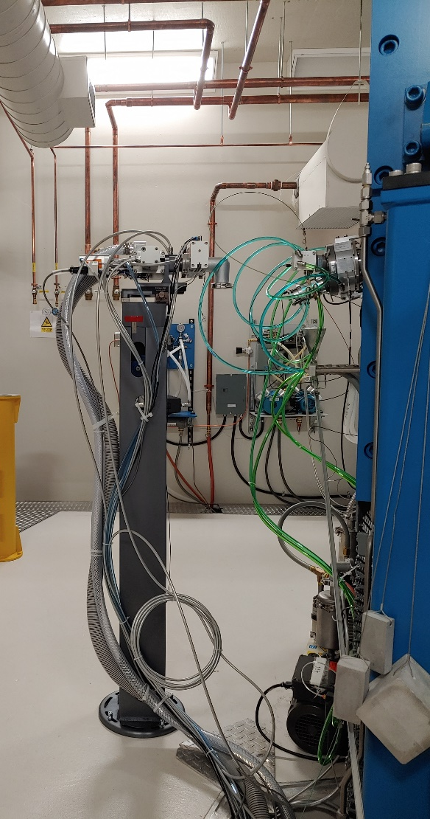
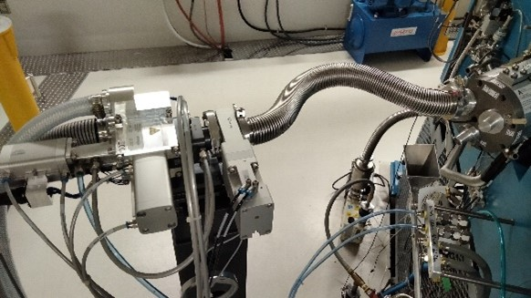
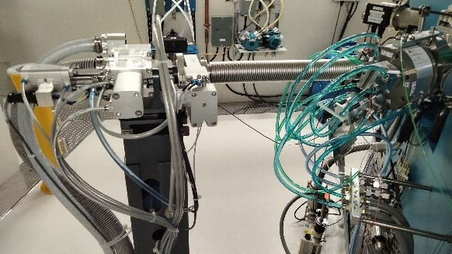
Adaptation Solution
Place the station on an adjustable post (settable height, stage position, and foot rotation)
Connect to the selector using short, flexible vacuum bellows
Free-sliding rails allow bellows to shift as selector moves to different target positions
9

Slide 10
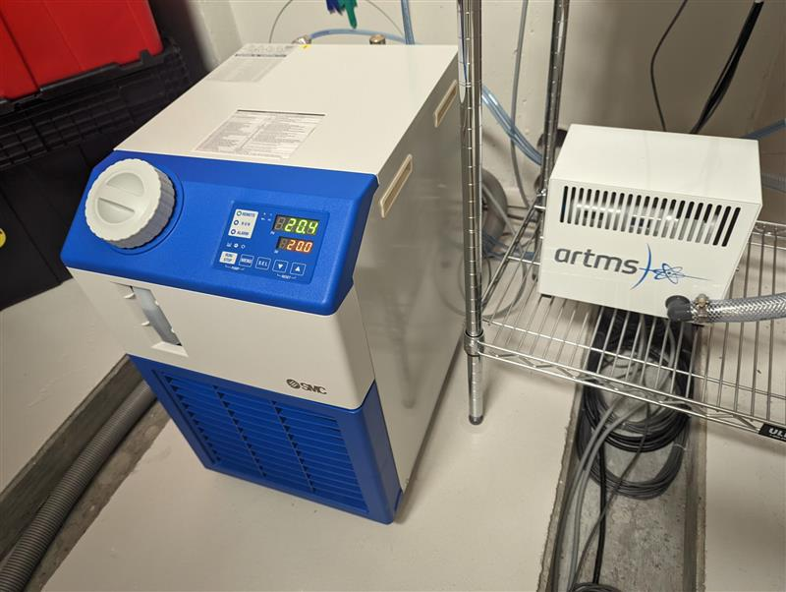
Cooling Integration: Independent Water
The QIS Target Station typically integrates with the cyclotron cooling system, but in this case an independent water cooling system was installed
A dedicated 1.3 kW chiller is installed inside the cyclotron vault, behind a protective wall, which runs the Target Station’s cooling water
The chiller is designed to operate using deionized water and can be refilled using cyclotron cooling water
The water system is integrated into the QIS control system so the chiller can be controlled remotely, and the Target Station is interlocked to its condition
10

Slide 11
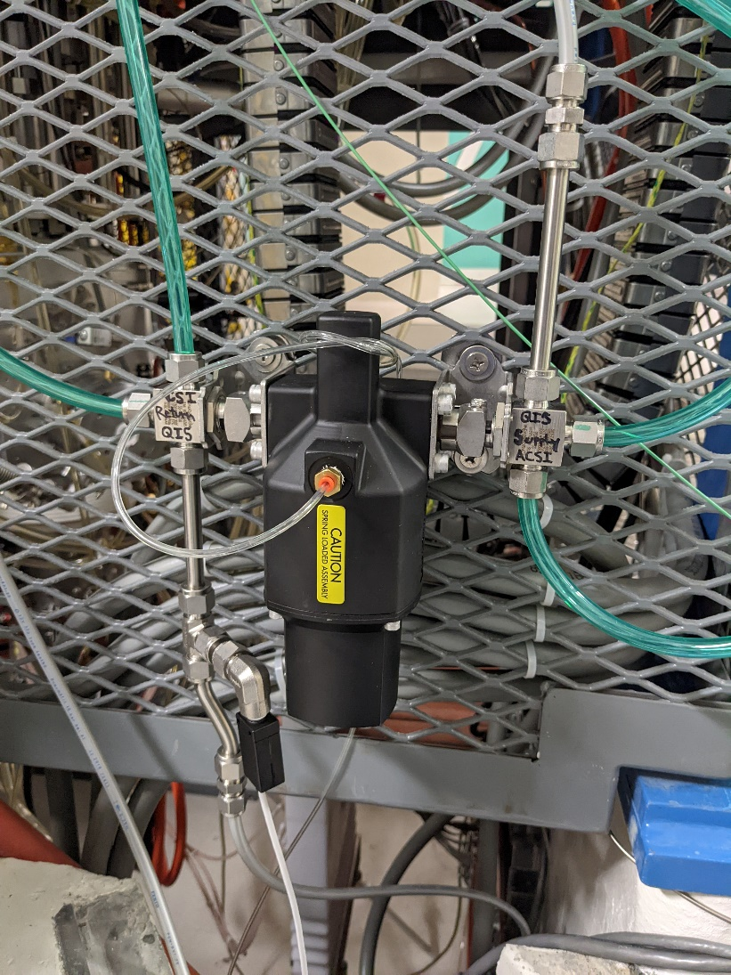
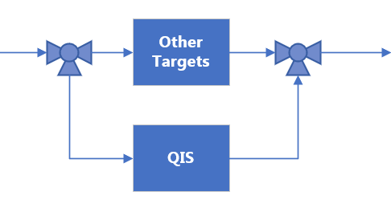
Cooling Integration: Helium Switch
A pair of valves can toggle helium cooling between the QIS Target Station and the ACSI targets
The control is mounted outside the vault, so switching between targets is done away from any activity
Each circuit runs as-designed with similar flow characteristics observed at the pump
11

Slide 12
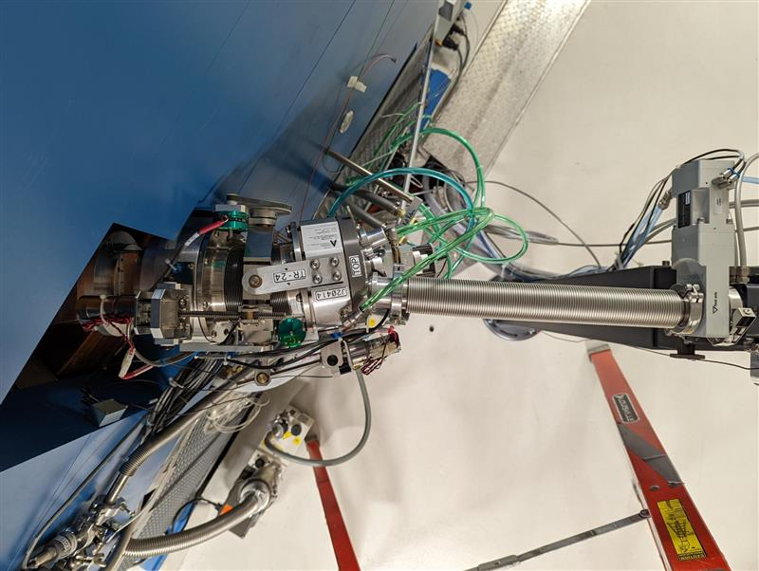
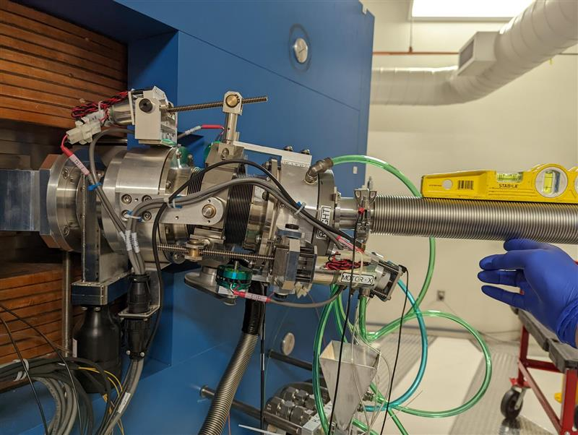
Alignment Challenges
Alignment of the station is non-trivial
Feedback from current on the station is limited; whole station is electrically connected with last collimators at the target selector
Test bombardments show promise but have lower than expected yields
12

Slide 13
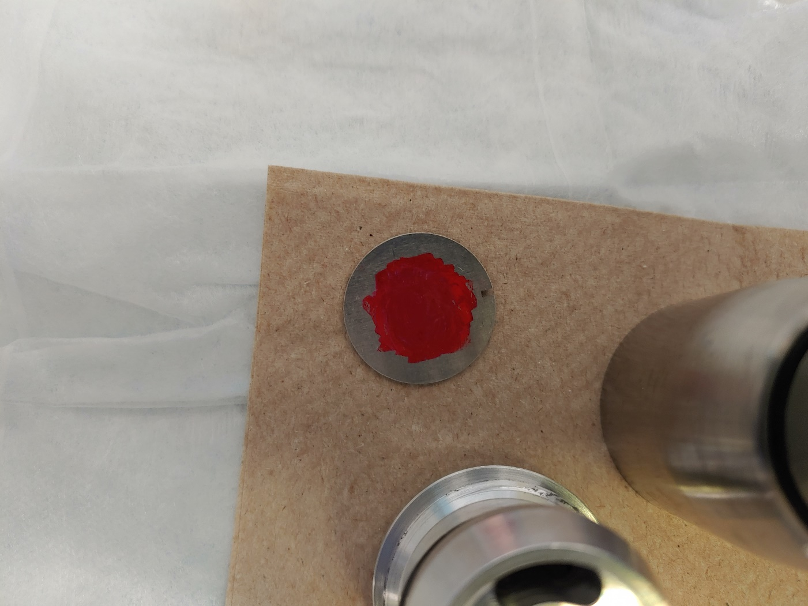
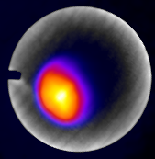
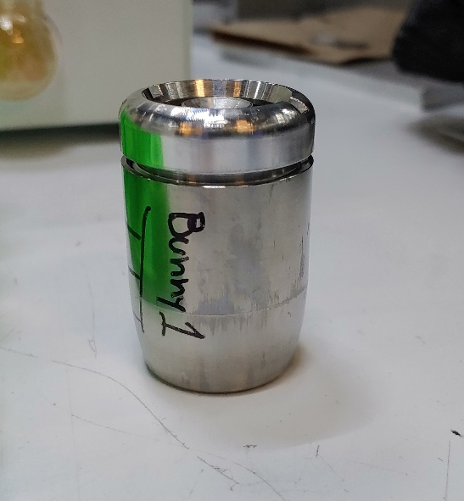
New Method Developed for Confirming Alignment
Loaded capsule with a notched, 0.8mm thick, aluminum alloy 7075 locator target (purchased from Goodfellow)
Nominal Al 7075 composition:
Al 90%
Zn 5.5%
Mg 2.5%
Cu 1.5%
Si 0.5%
Zinc activates to ^{66/68}Ga
Used a Sofie GNext PET/CT scanner to image the target and observe activation
Target cools quickly after
13

Slide 14
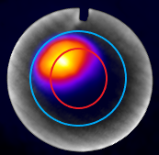
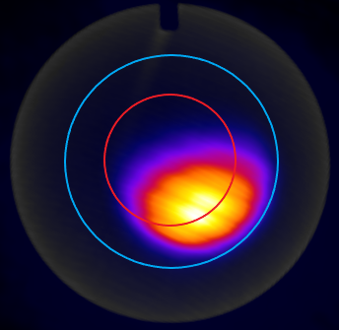
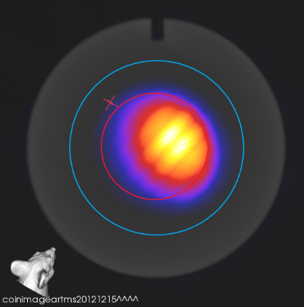
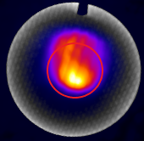
Observations Using Locator Coins
Above are 3 successive QIS target images, centered with 2 iterations
Inner red ring is 10mm diameter (representing target material), outer blue ring is 17mm aperture on the capsule
Below is an image taken using the ACSI target holder for comparison (smear is due to target selector adjustment early in run)
14

Slide 15
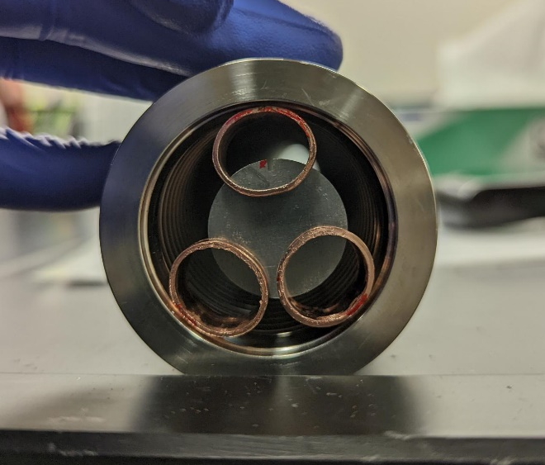
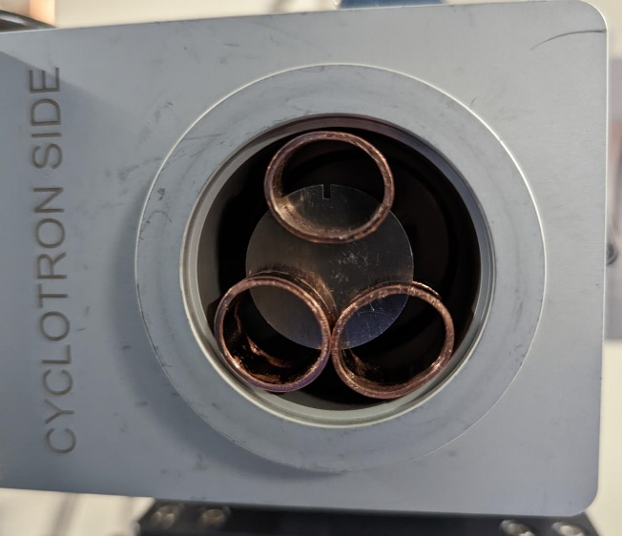
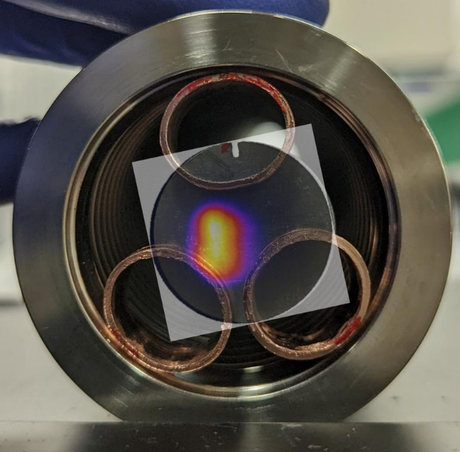
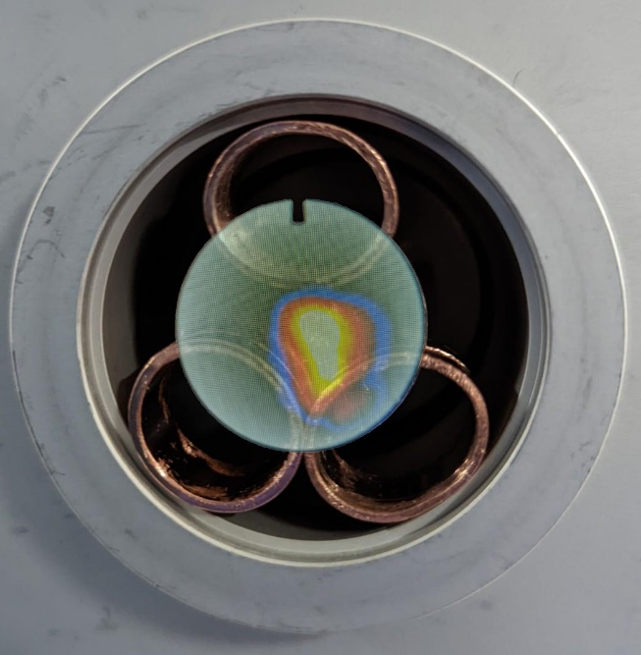
Looking Upstream Using Locator Coins
Tried placing locator targets in different positions along the beam path to the QIS
Left target is just downstream of the selector, inside the bellows
Right target is inside the Target Station gate valve, just past the bellows
Superimposed images show results from PET scan, a Ø10 mm red ring is superimposed for scale
Unfortunately, holders interfere with the beam and make assessment difficult
Entering bellows
Entering gate valve
15

Slide 16
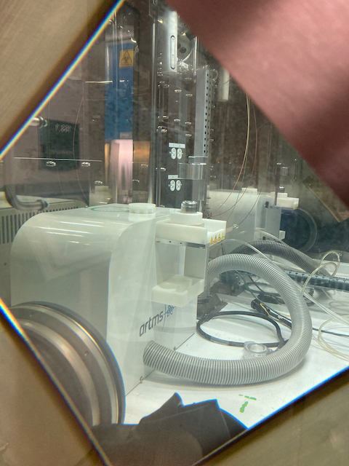
Next Steps for QIS Operation
Assess beam divergence more carefully; even if we align the beam perfectly, how much can we get on target?
If the beam is too big, find a way to move station closer to target selector without inducing interference (extend stage and rails?)
Assess energy profile on target; are we getting the expected 12.7 MeV on target? Could unexpected energy loss be responsible for lower yields?
If energy loss is a factor, review degrader construction; in the meantime, remove it and use “disposable” degraders
Adapt existing ⁸⁹Zr production method to the ARTMS dissolution system and convert routine production to QIS
Implement ⁶⁸Ga production directly on the QIS
16

Slide 17
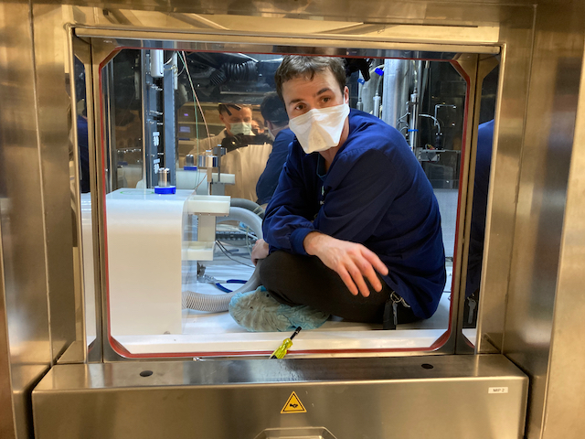
Acknowledgments
Fedoruk Centre team
John Root, Niki Schrie, Lidia Matei, Musharraf Khan, Leah Paluck, Kalum Jayawardhana, Rasika Ralalage, Maegan Ponack, Ashlynn Reimer, Hillary Mehlhorn, Anand Nambisan
ARTMS team
Oddy Trillo, Jansen Chua,
Mark Przekop, Doug Gentilcore,
Paul Schaffer
17

Slide 18
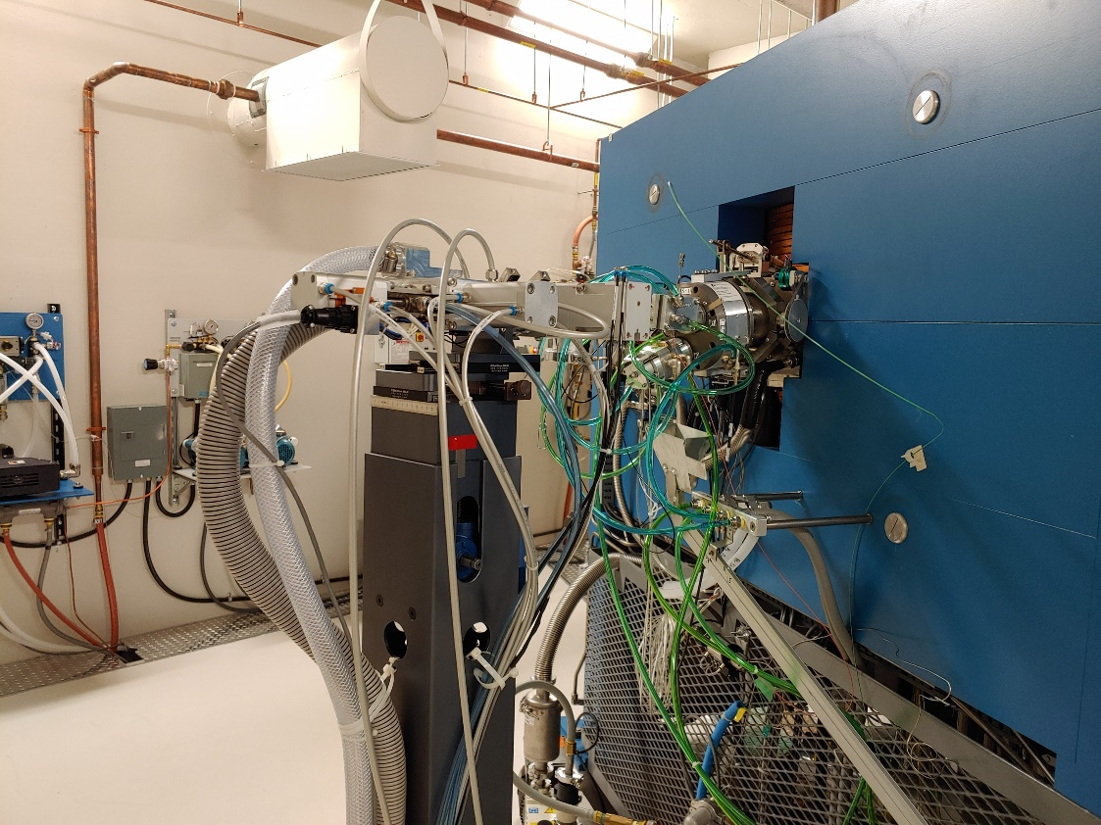
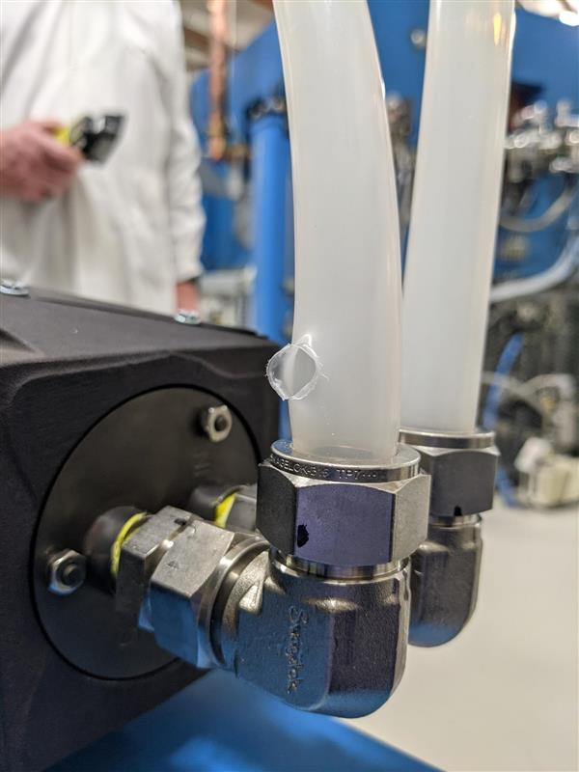
Install and Commissioning Challenges
Integrating cooling systems proved challenging
Decision to use separate chiller made early for water
Helium cooling still used existing circuit with all other targets
Splitting circuits into parallel paths could alter the designed cooling to all targets and compromise interlocks, but series circuit constrictions caused overpressure
18

Slide 19
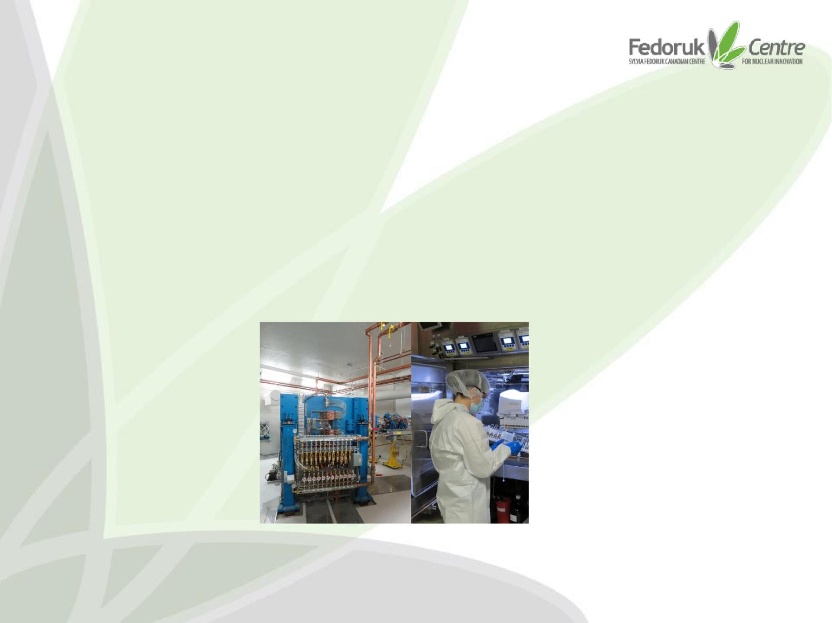
Saskatchewan Centre for Cyclotron Sciences
The SCCS is a multi-user facility for research and innovation in the field of nuclear imaging and therapeutics in addition to GMP radiopharmaceutical production facility
The facility is owned by the University of Saskatchewan and located on campus; it is operated by the Fedoruk Centre
SCCS Houses
Advanced Cyclotron Systems Inc. (ACSI) TR-24 Cyclotron
Grade C cleanrooms with grade A dispensing chambers for GMP radiopharmaceutical production
Research/innovation space for development of radioisotopes, radiochemicals and radiopharmaceuticals for use in animal and human health as well as plants/soils.
19

Slide 20
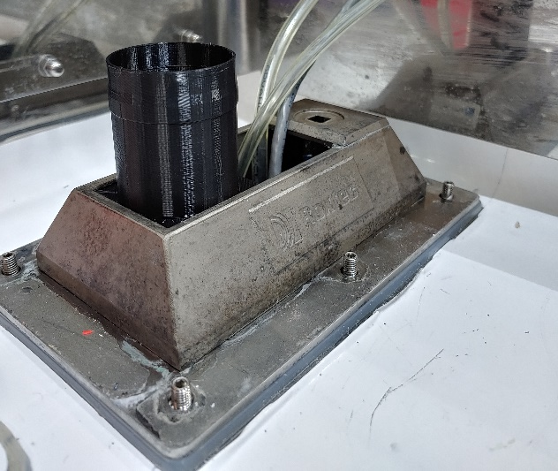
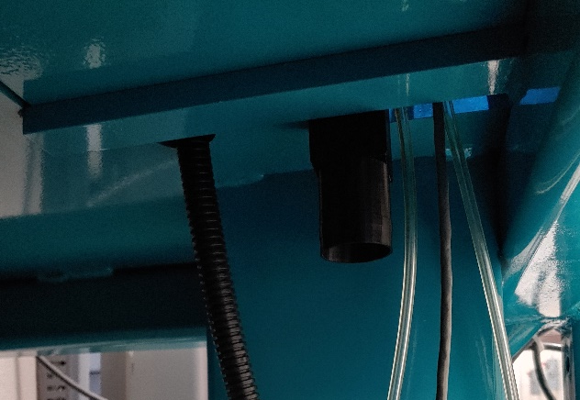
Routing and Feedthrough Solution
Instead of using existing capillary pathway, used a control cable trench inside the vault and a conduit intended for future beamline capillaries, avoiding any crowded routes
For hot cell access, instead of passing hose through Roxtec penetration, designed a feedthrough union; Send/Receive Station hose clamps to the top, Target Station hose clamps to the bottom
Pictured is a 3D-printed prototype for fitting; final version is machined aluminum
20

Slide 21
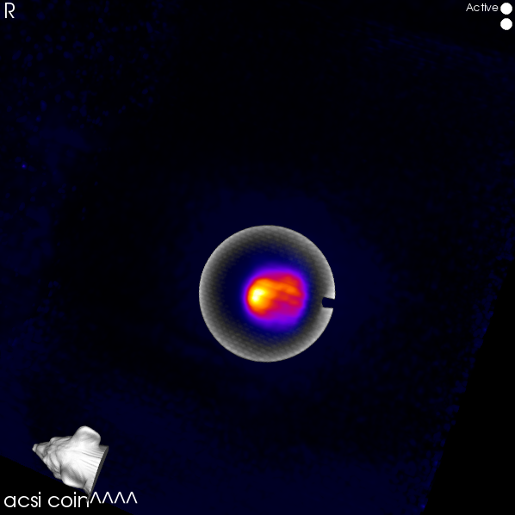
Extra Images
21

Slide 22
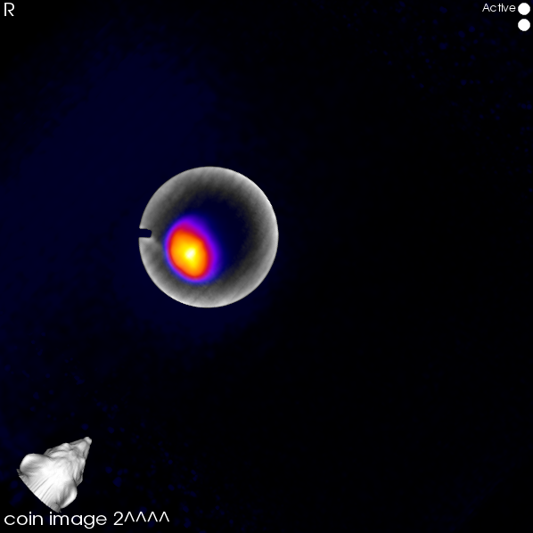
Extra Images
22

Slide 23
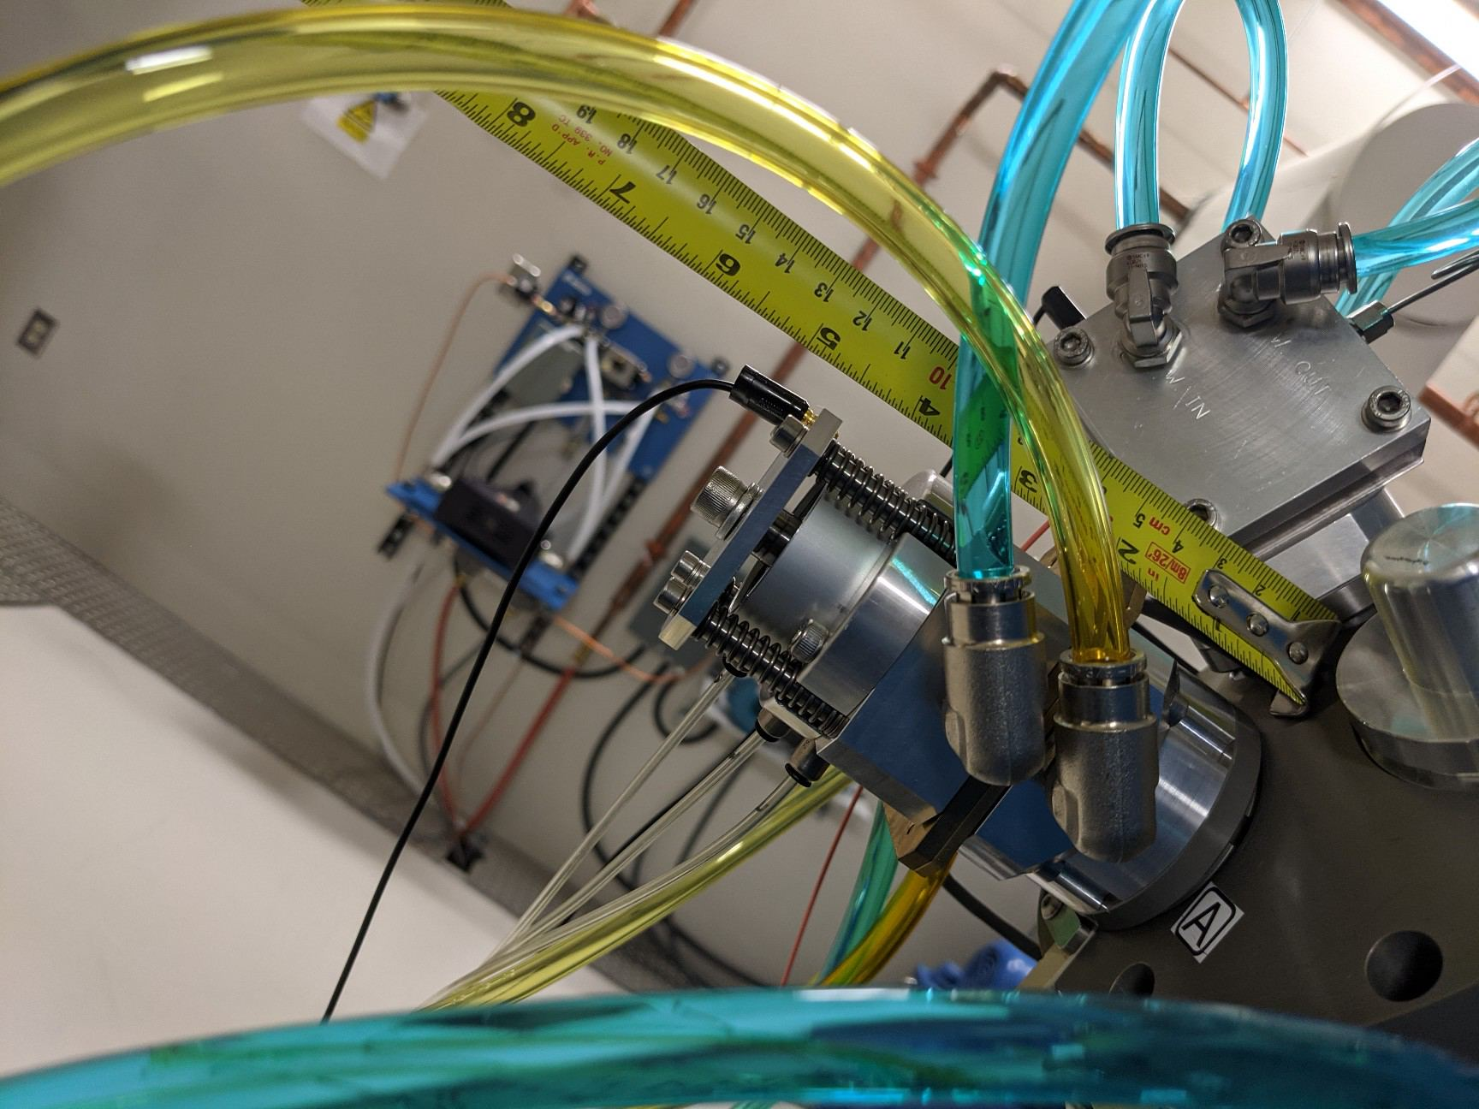
Extra Images
23

Slide 24
Extra Images
24

