Slide 1





Nuclear cross section measurements of the ^{48,49,50}Ti(p,x)⁴⁷Sc reactions:
Preliminary results of the REMIX project
Lucia De Dominicis^{1,2}, Liliana Mou¹, Sara Cisternino^{1,3}, Gabriele Sciacca^{1,3}, Matteo Campostrini¹, Valentino Rigato¹, Juan Esposito¹, Etienne Nigron⁴, Ferid Haddad⁴ and Gaia Pupillo¹*
¹ National Institute of Nuclear Physics, Legnaro National Laboratories (INFN-LNL), Legnaro (PD), Italy
² Department of Physics and Astronomy, University of Padova, PD, Italy
³ Department of Industrial Engineering, University of Padova, PD, Italy
⁴ GIP ARRONAX, Saint-Herblain, Nantes, France
*gaia.pupillo@lnl.infn.it
*Researcher at the INFN-LNL
Responsible of the “Radioisotope Service for Medicine and Applications”, Research Division
18th Workshop on Targetry and Target Chemistry (WTTC18)- Whistler, BC – 22-26 August 2022

Slide 2
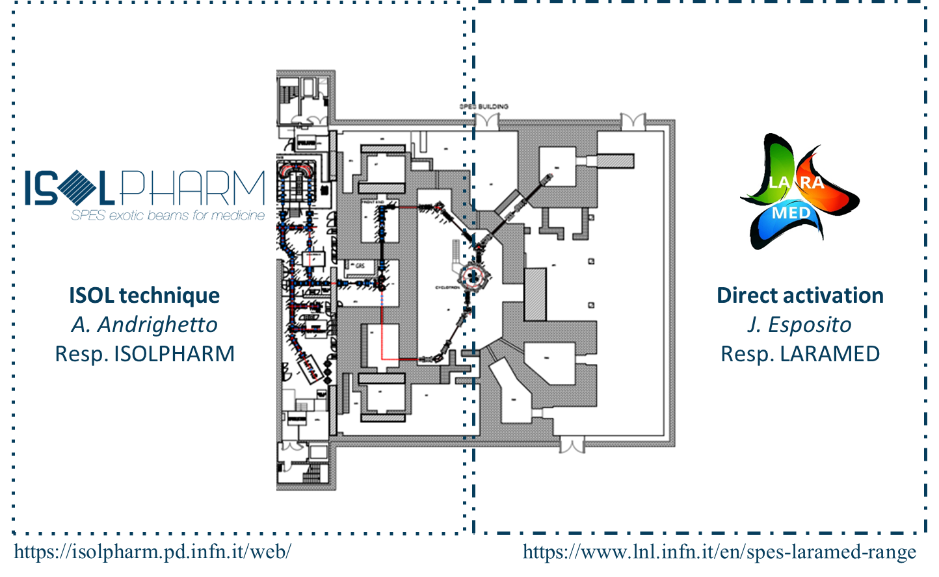


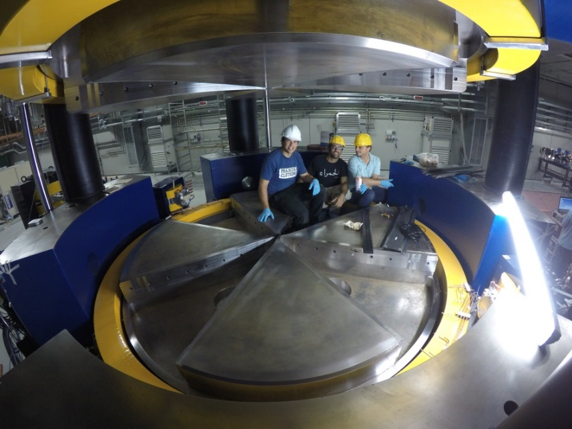

Medical Radionuclides @ INFN-LNL
“Radioisotope Service for Medicine and Applications”
SPES-γ
The production of radionuclides for applications
1/15

Slide 3
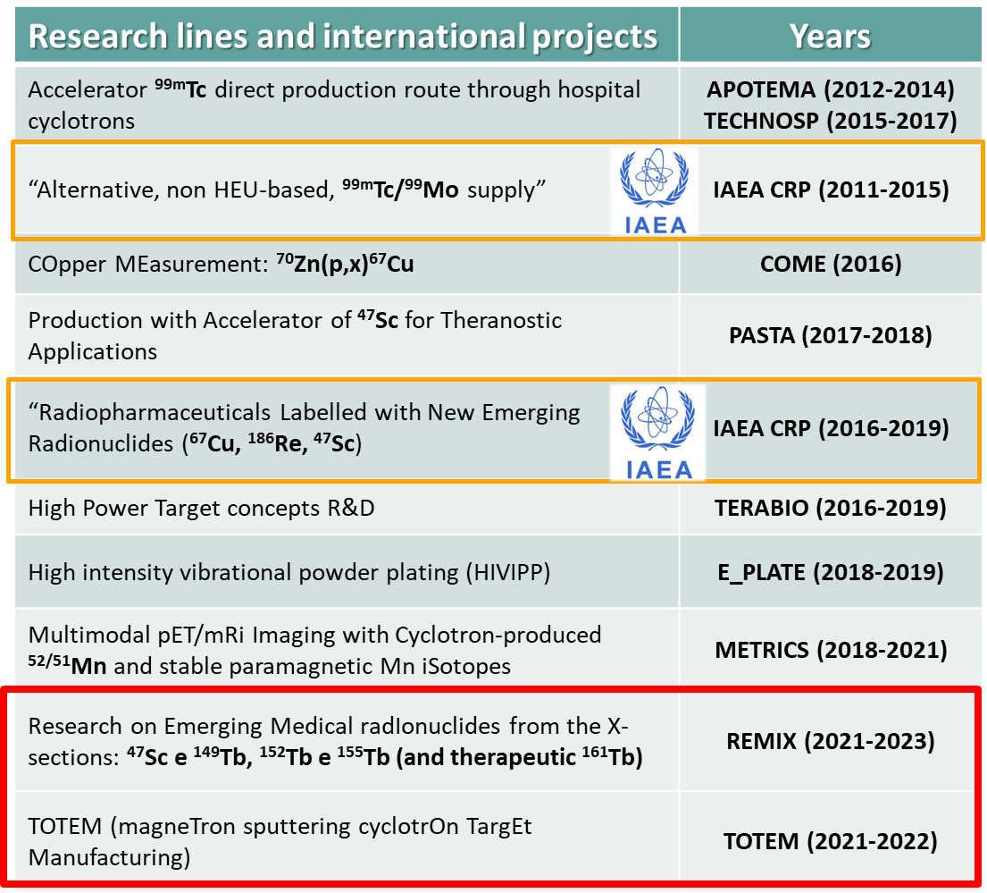


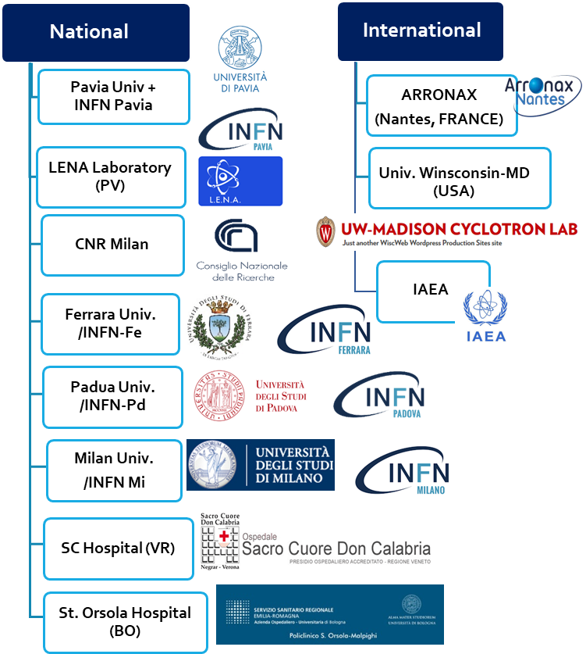





Medical Radionuclides of interest for LARAMED
^{99m}Tc
⁶⁷Cu
⁶⁴Cu
⁴³Sc
⁴⁷Sc
^{44m}Sc
⁶⁷Cu
⁶⁴Cu
⁵²Mn
¹⁵²Tb
¹⁴⁹Tb
focus Sc-47: vie di produzione
¹⁵⁵Tb
¹⁶¹Tb
J. Esposito et al, Molecules 24(1), 20 DOI:10.3390/molecules24010020 (2019)
2/15
Notes:
Immagine corpo da mostra “REAL BODIES, Image Exhibitions”

Slide 4






Research on Emerging Medical radIonuclides from the X-sections
REMIX is funded by INFN-CSN5 for the years 2021-2023
With the goals:
New XS measurements for cyclotron-based production of ⁴⁷Sc, ¹⁴⁹Tb, ¹⁵²Tb, ¹⁵⁵Tb and ¹⁶¹Tb
[N.B. the ⁴⁹Ti(p,x)⁴⁷Sc is unexplored!]
Nuclear codes are used to estimate yield & purity of the produced radionuclides, also considering the experimental data
Computational dosimetric studies with radiopharmaceuticals labelled with the
produced RN (and contaminant isotopes) are performed to find out the best production routes
¹⁵⁵Tb Thick Target Yield (TTY) measurement of the ¹⁵⁵Gd(p,n)¹⁵⁵Tb
reaction @ the SCDC hospital 19 MeV cyclotron (solid target station)
3/15

Slide 5




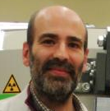





WP1. Production and target characterization
Sara Cisternino (INFN-LNL & UniPD)
WP7. Devices for INFN-LNL beam-line
Gabriele Sciacca (INFN-LNL & UniPD)
WP2. XS measurements with ⁴⁹Ti e ⁵⁰Ti
Liliana Mou (INFN-LNL)
WP6. ¹⁵⁵Tb TTY production @
The SCDC hospital
Petra Martini (UniFE & INFN-FE)
WP3. XS measurements with ^{nat}Dy,¹⁵⁹Tb, ^{nat}Eu
Simone Manenti (UniMI & INFN-MI)
WP5. Dosimetric calculations
Laura De Nardo (UniPD & INFN-PD)
Laura Melendez-Alafort (IOV)
WP4. Nuclear codes (TALYS, EMPIRE, FLUKA)
Luciano Canton (INFN-PD)
Andrea Fontana (INFN-PV)
4/15

Slide 6
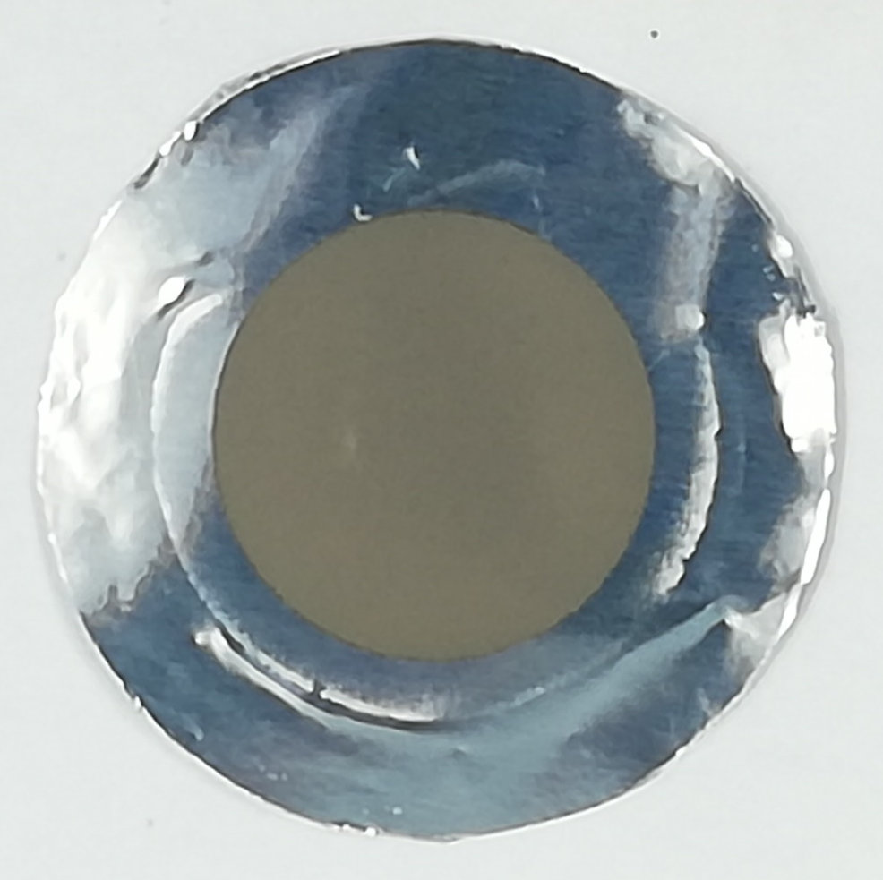
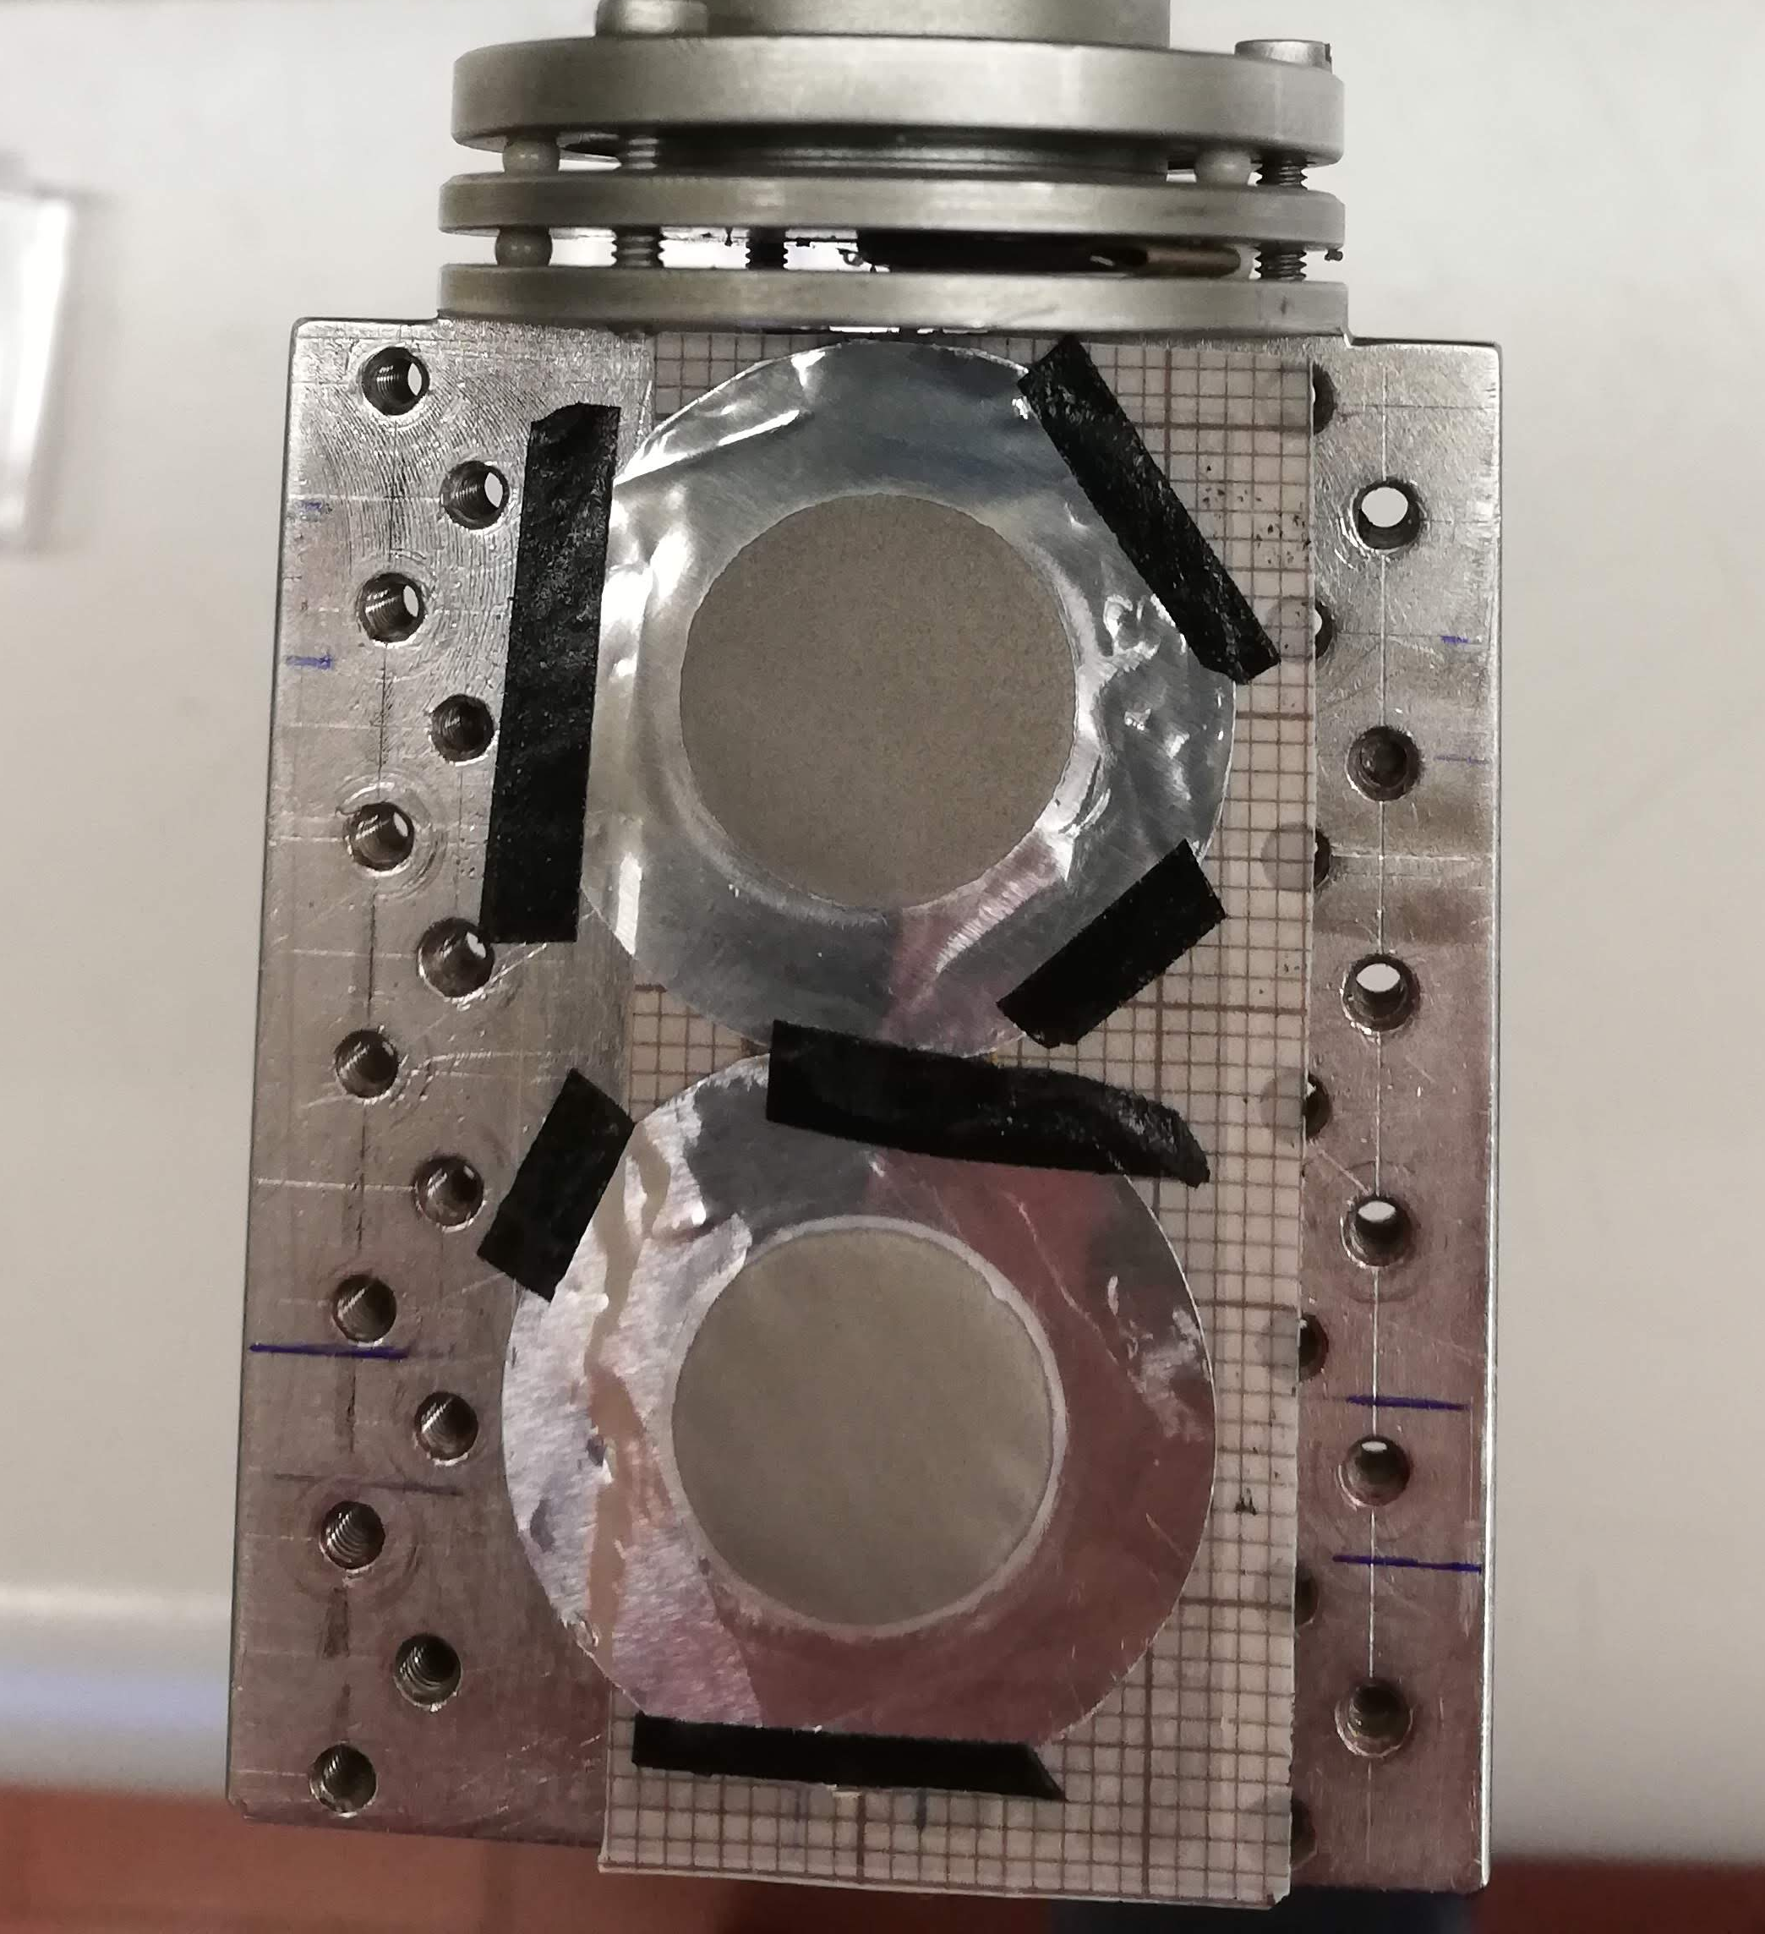
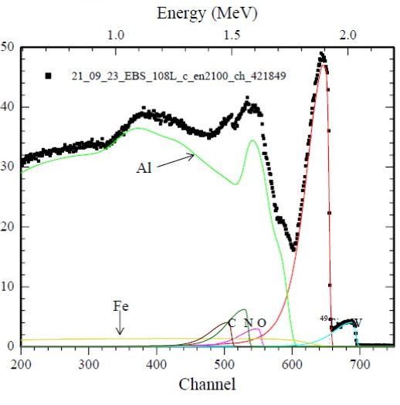
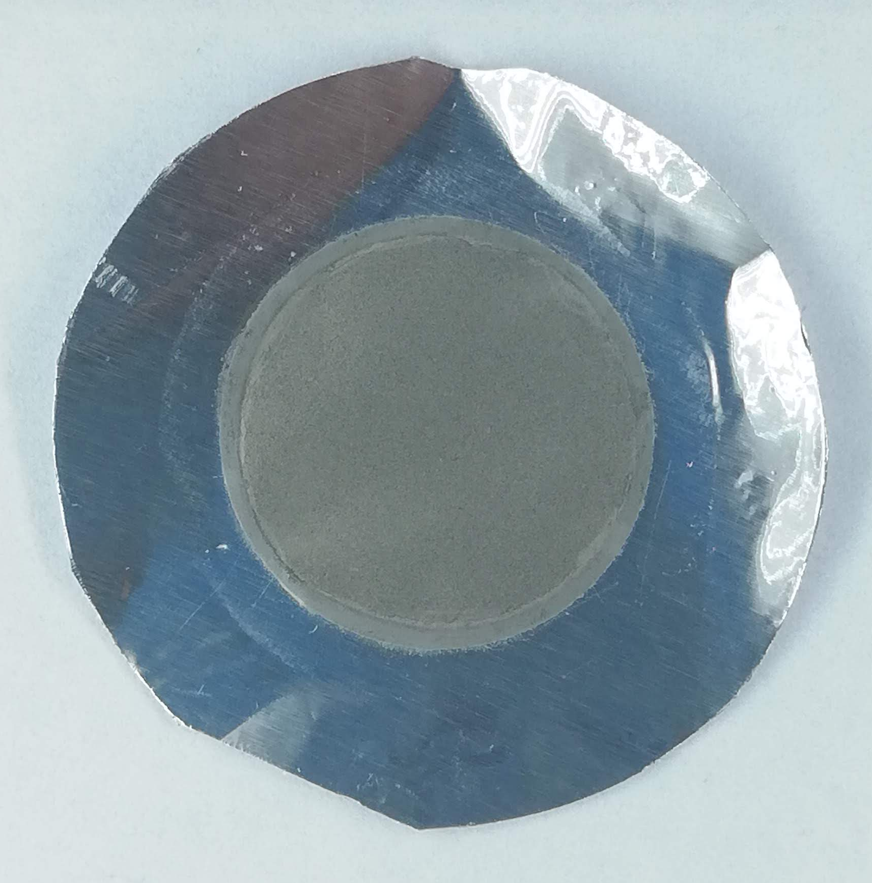

REMIX: WP1 Target manufacturing and characterization
HIVIPP depositions
Low contamination traces (about 10s ppm)
No. 20 ⁴⁹Ti targets
Uniform thickness
Mass thickness measured by weigh
486±110 µg/cm² (n=20)
No. 20 ⁵⁰Ti targets
Mass thickness measured by weigh
637±200 µg/cm² (n=20)
S. Cisternino et al., Upgrade of the HIVIPP deposition apparatus for nuclear physics thin targets manufacturing, Instruments (2022)
5/15

Slide 7

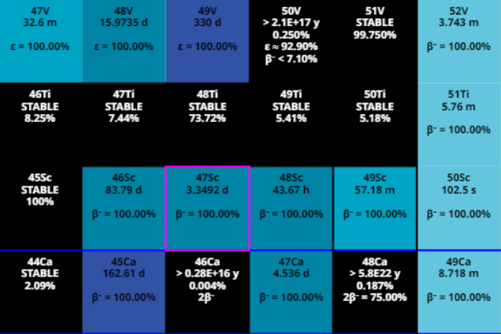

REMIX: WP2 Nuclear xs measurements for ⁴⁷Sc production
Interesting targets for proton-induced reactions
PASTA project, funded in 2017/2018 by INFN-CSN5
Only few literature data on enriched ^{xx}Ti..
.. I am going to show you the xs results obtained with proton-beams and enriched Ti targets irradiated at the ARRONAX facility!
G. Pupillo et al., Journal of Radioanalytical and Nuclear Chemistry 297, 3 (2019) doi: 10.1007/s10967-019-06844-8 F. Barbaro et al., Physical Review C (2021) arXiv:2107.13773, doi: 10.1103/PhysRevC.104.044619
6/15

Slide 8
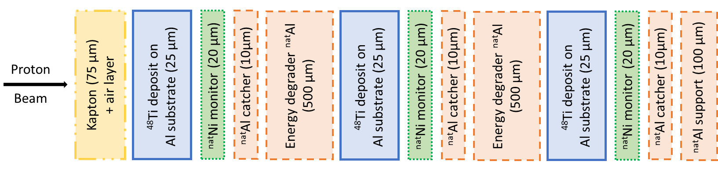
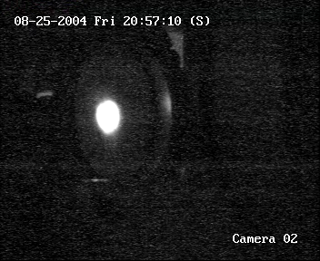
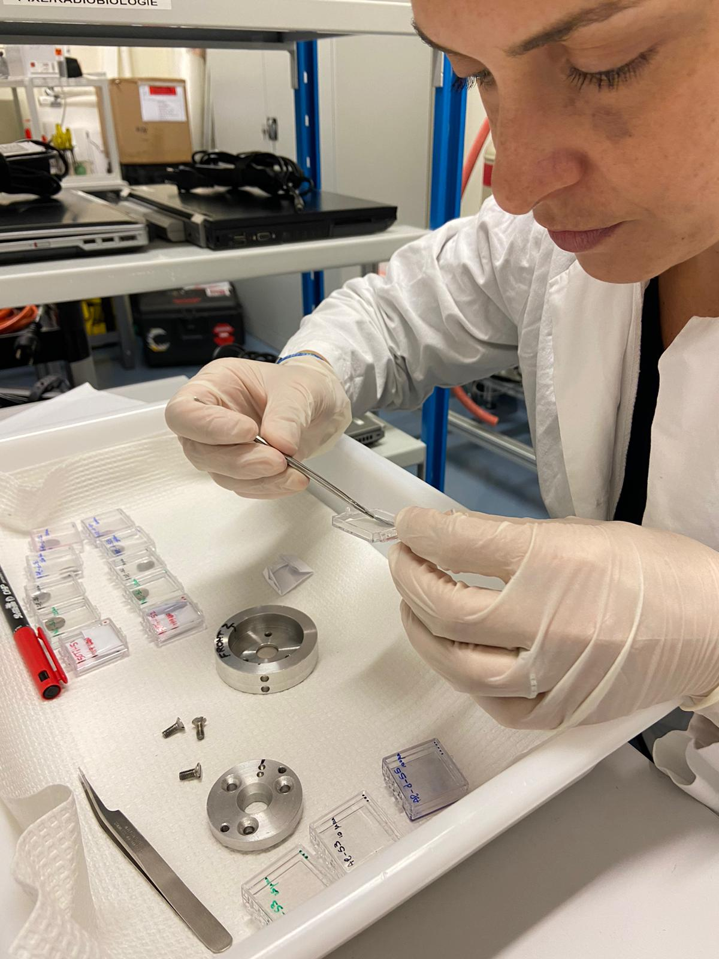
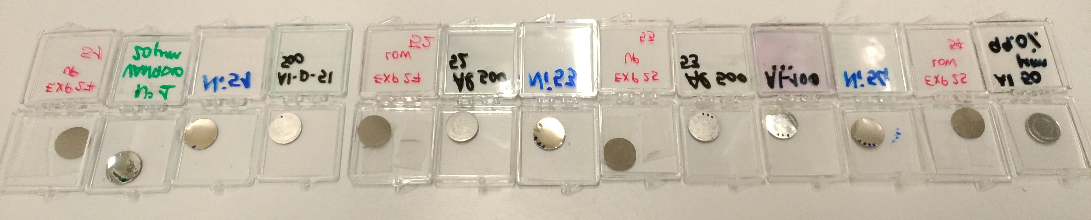
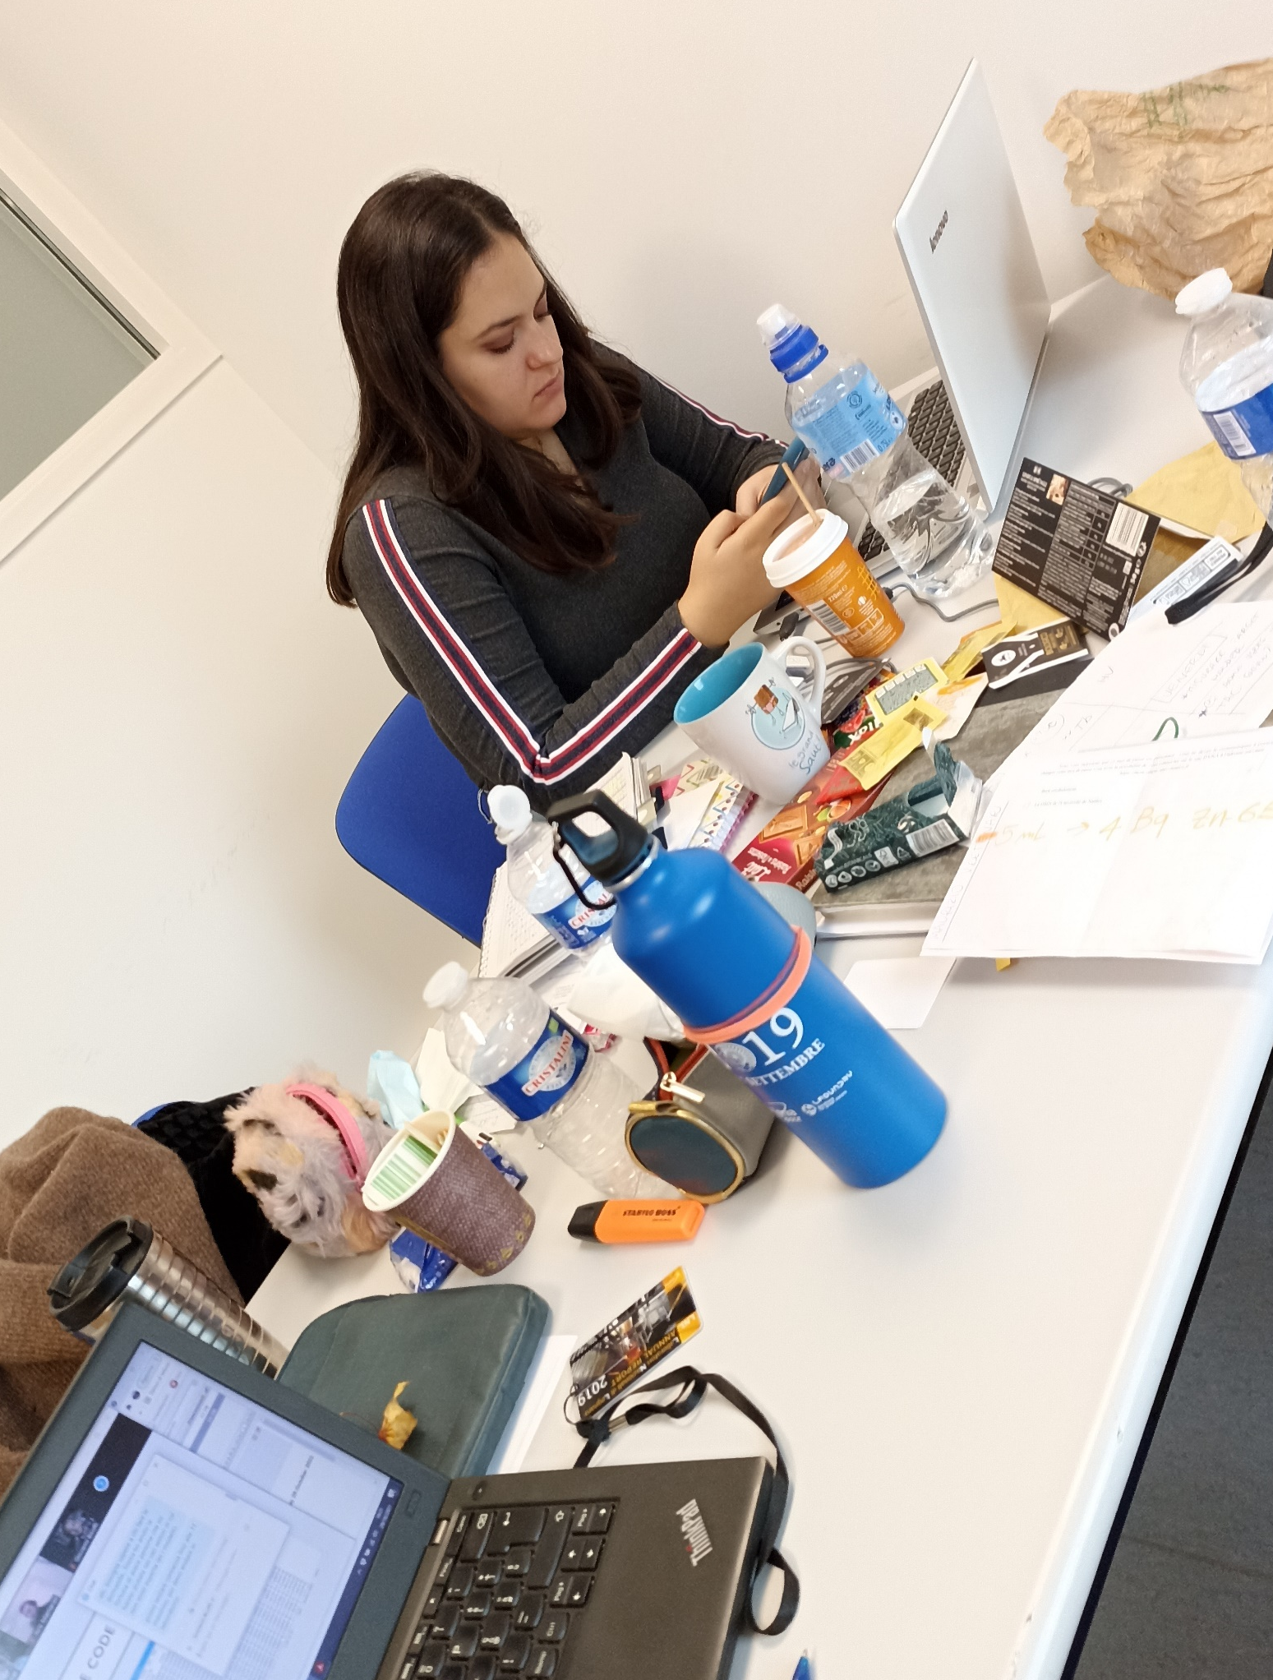
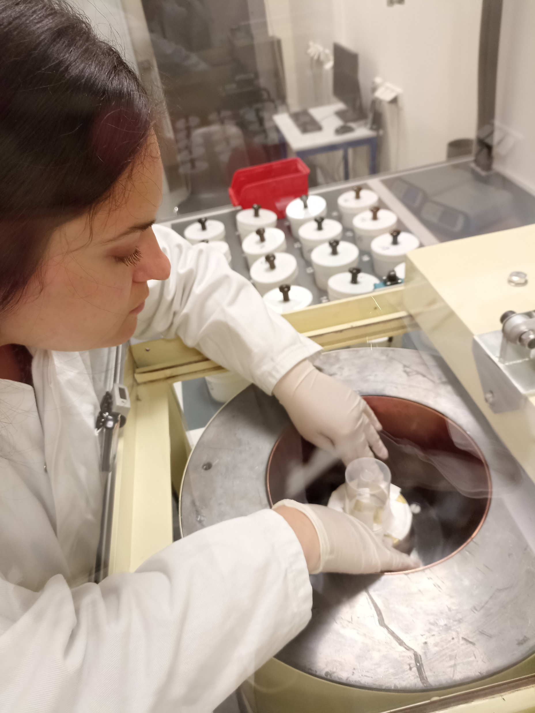
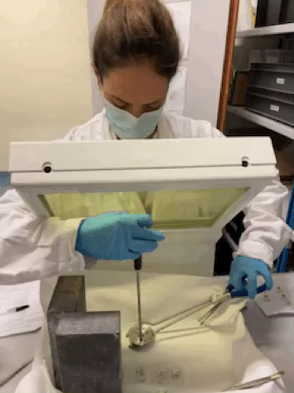
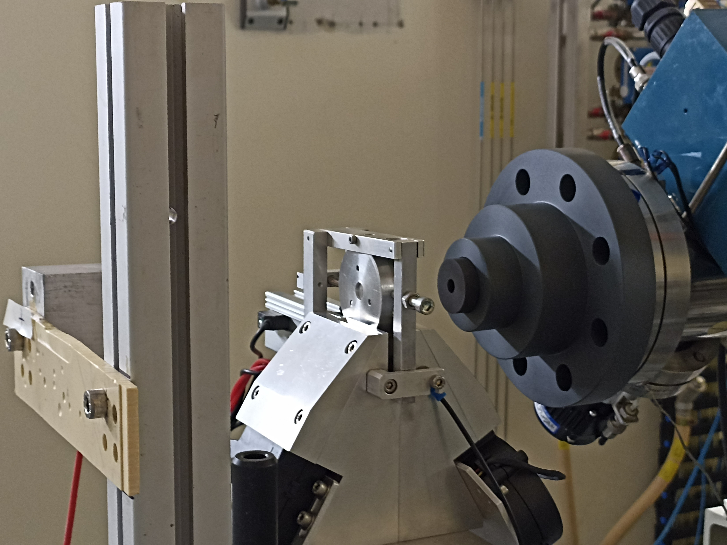
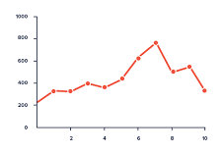
REMIX: WP2 ⁴⁷Sc nuclear cross section measurements
Scheme of a typical stacked-foils target
Stacked-foils target assembly
Beam setting with alumina
Irradiation runs on the AX3 beam-line
Data analysis
γ-spectrometry
Target disassembly
7/15

Slide 9
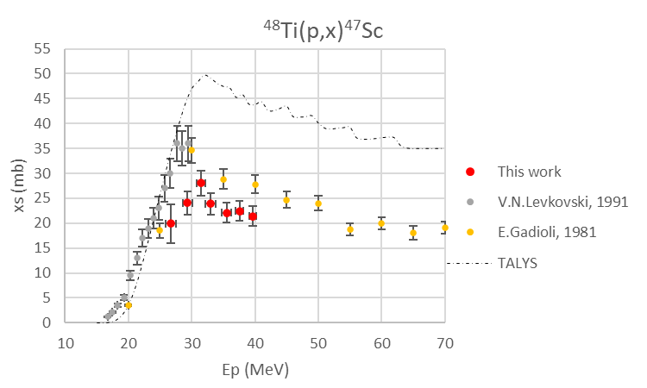
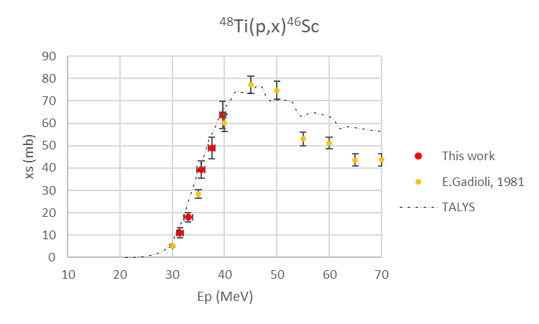




Proton-induced reactions on ⁴⁸Ti targets: ⁴⁷Sc and ⁴⁶Sc
⁴⁸Ti(p,2p)⁴⁷Sc
⁴⁷Sc half-life 3.3492 d
⁴⁶Sc half-life 83.79 d
Up to 20% discrepancy with literature data
Good agreement
L. Mou et al., Nuclear cross sections of proton-induced reactions on enriched ⁴⁸Ti targets for the production of the theranostic ⁴⁷Sc radionuclide (..)(2022) Submitted
8/15

Slide 10
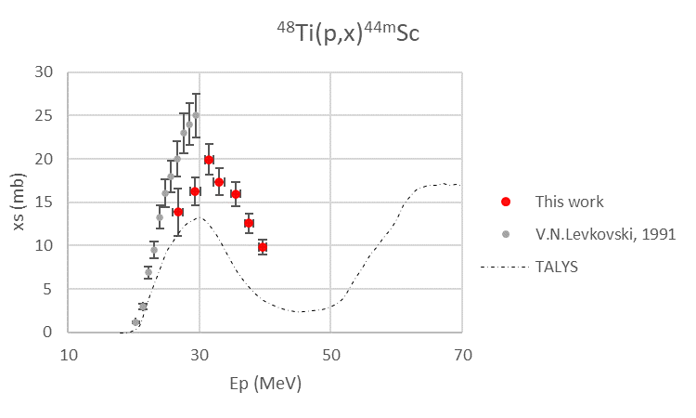
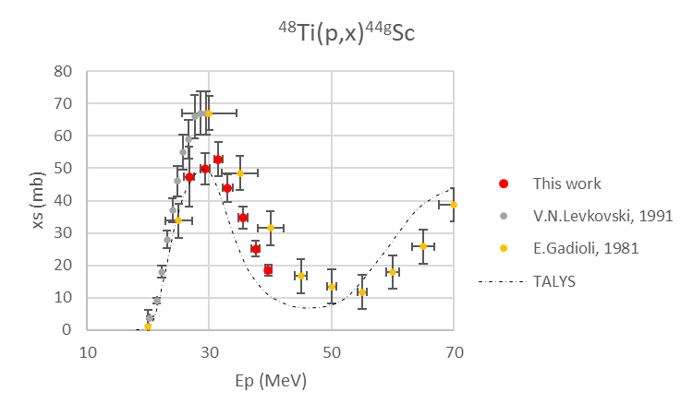
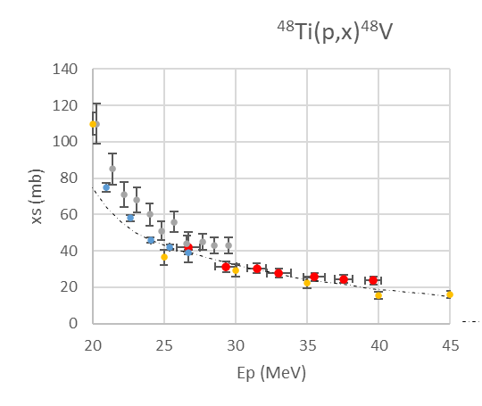
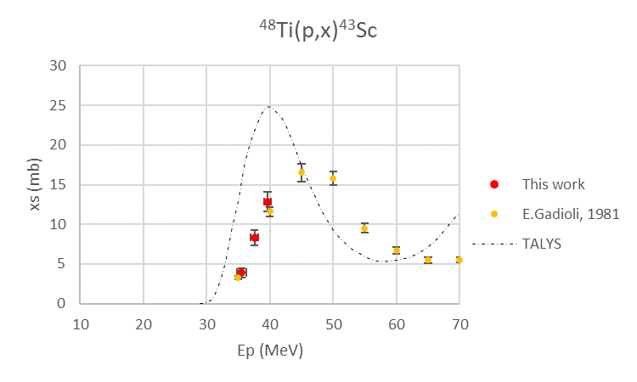
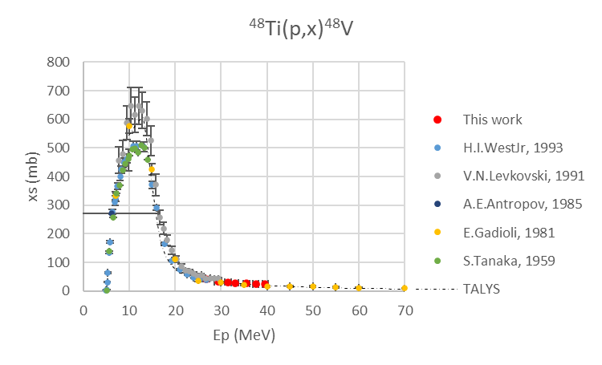

Proton-induced reactions on ⁴⁸Ti targets: ^{44m}Sc, ⁴⁴Sc, ⁴³Sc, ⁴⁸V
^{44m}Sc half-life 58.61 h
⁴⁴Sc half-life 3.97 h
⁴³Sc half-life 3.891 h
⁴⁸V half-life 15.974 d
⁴⁸Ti(p,n)⁴⁸V
⁴⁸Ti(p,n)⁴⁸V
L. Mou et al., Nuclear cross sections of proton-induced reactions on enriched ⁴⁸Ti targets for the production of the theranostic ⁴⁷Sc radionuclide (..)(2022) Submitted
9/15

Slide 11
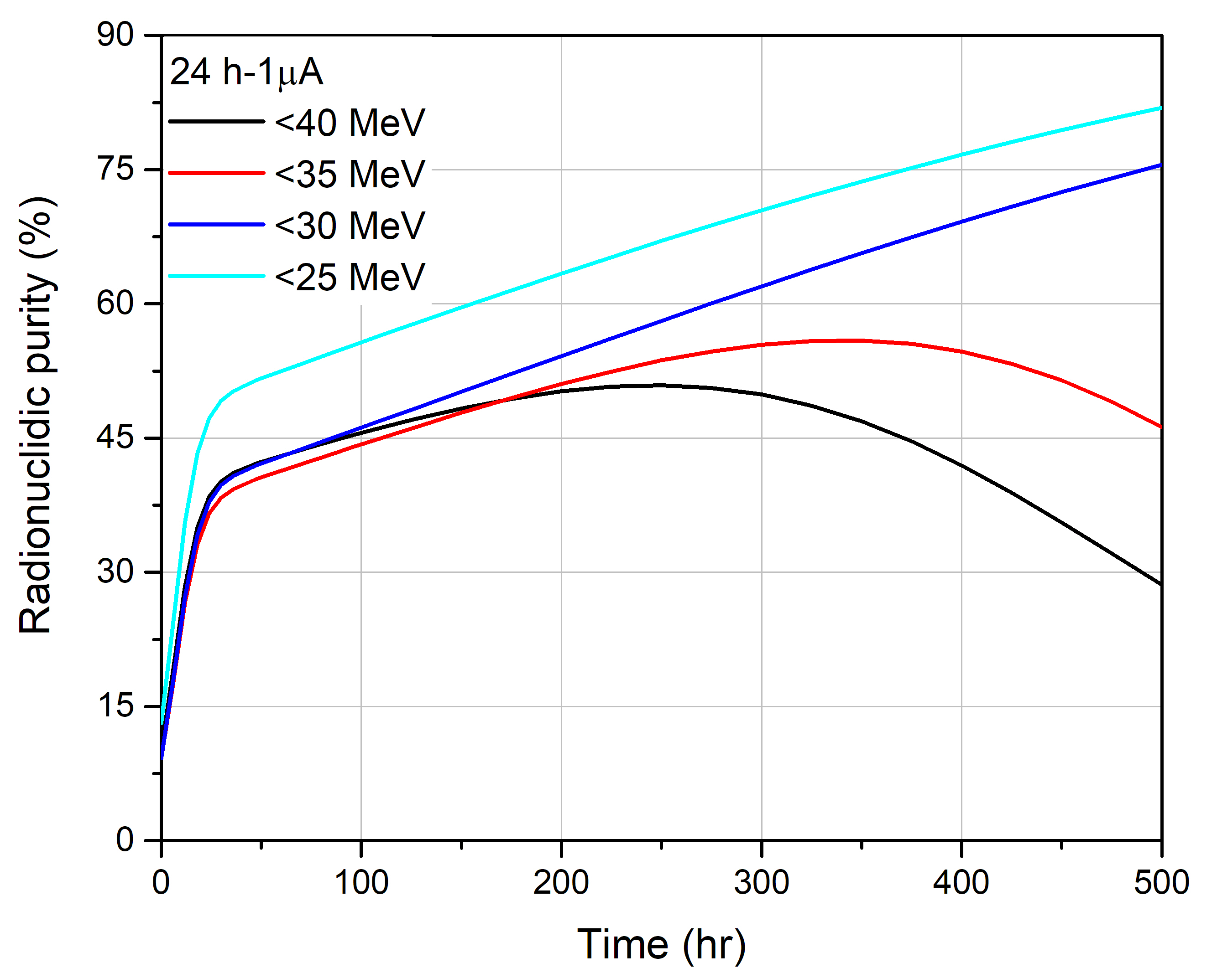
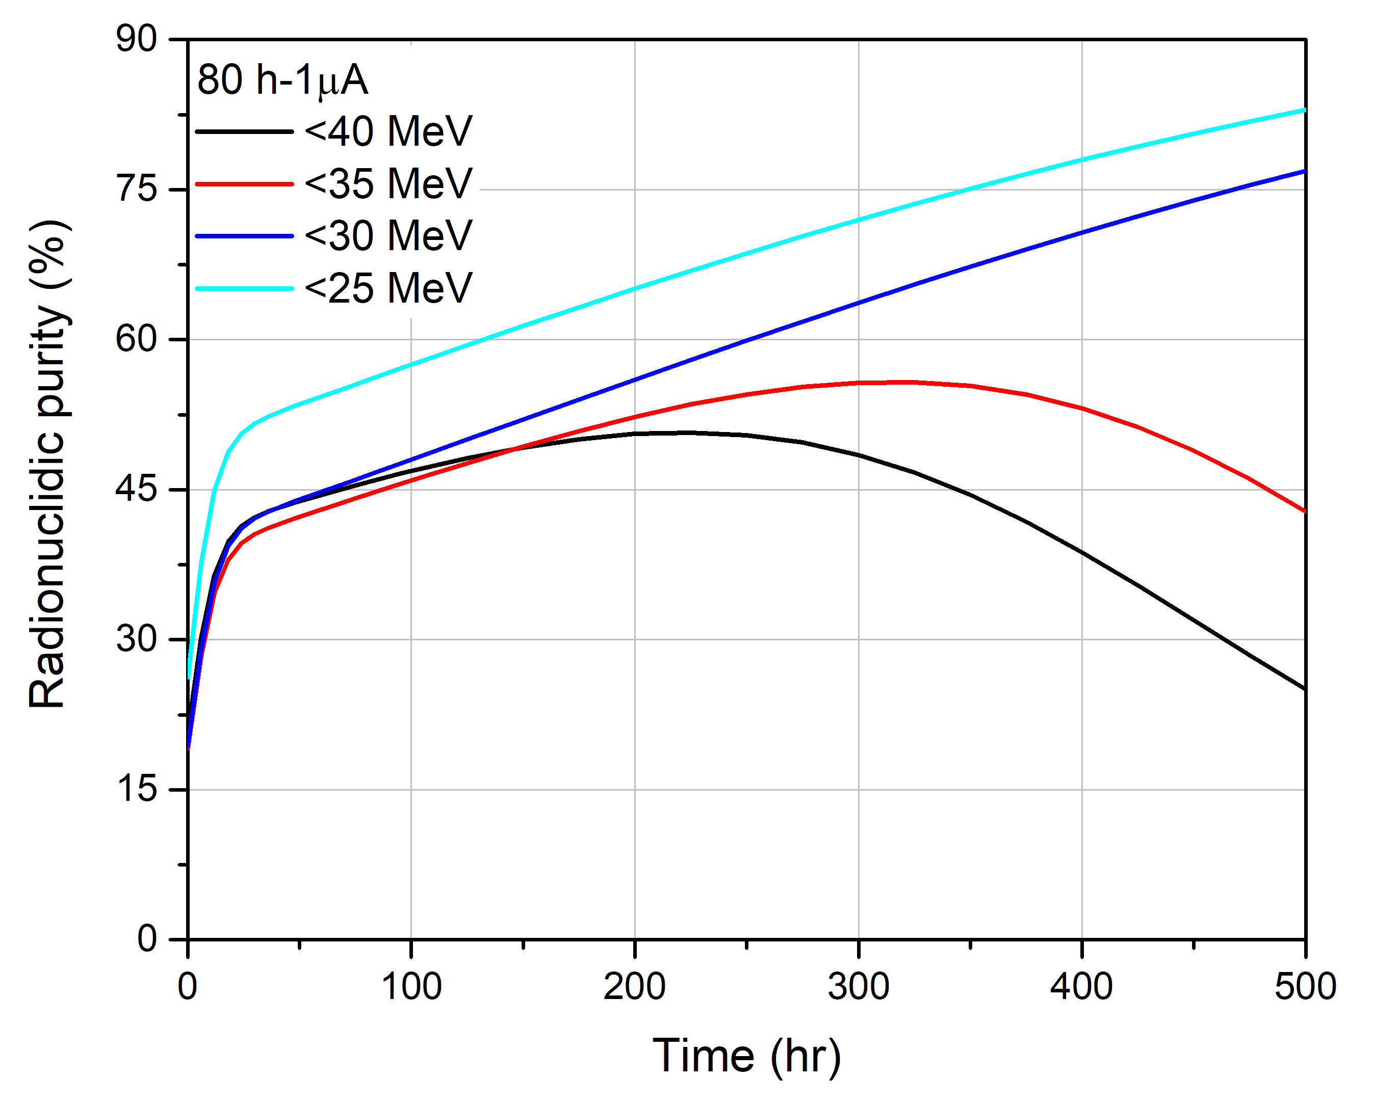

The ⁴⁷Sc Radionuclidic Purity (RNP) with ⁴⁸Ti targets
E_{P} < 30 MeV, co-production of ^{44m}Sc and ⁴⁴Sc ; E_{P} > 30 MeV co-production of ⁴³Sc, ^{44m}Sc, ^{44g}Sc and ⁴⁶Sc
T_{IRR}: 24 h
T_{IRR}: 80 h
Decay of the short half-time impurities ⁴³Sc and ^{44g}Sc
Decay of ^{44m}Sc
⁴⁶Sc activity
⁴⁸Ti targets are not suitable for a p-induced ⁴⁷Sc production!
L. Mou et al., Nuclear cross sections of proton-induced reactions on enriched ⁴⁸Ti targets for the production of the theranostic ⁴⁷Sc radionuclide (..)(2022) Submitted
10/15

Slide 12
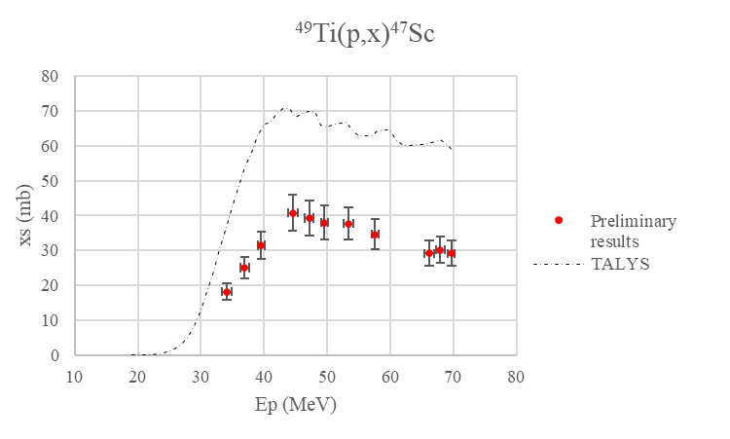


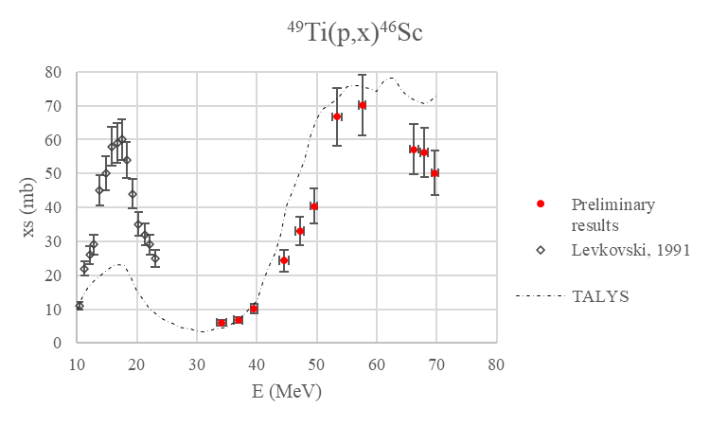

Proton-induced reactions on ⁴⁹Ti targets: Preliminary results
Preliminary data since we used the weighting values, but soon the ⁴⁹Ti EBS values will be available!
11/15

Slide 13
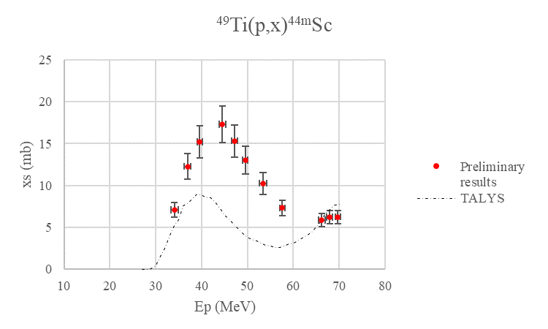
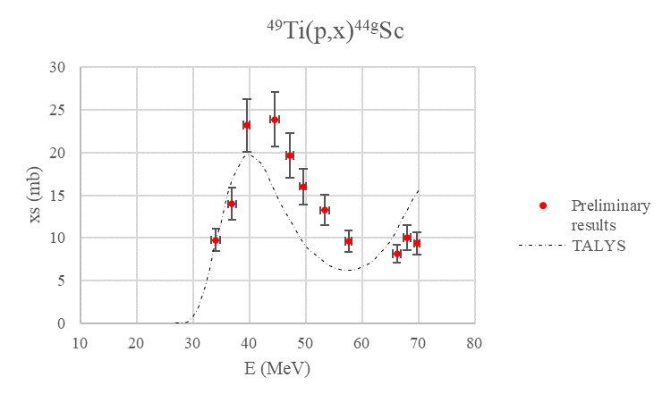
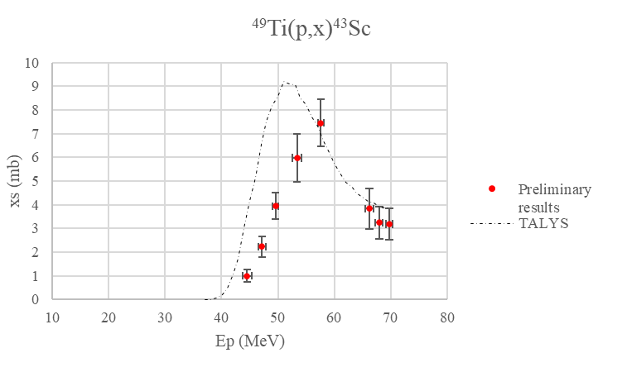
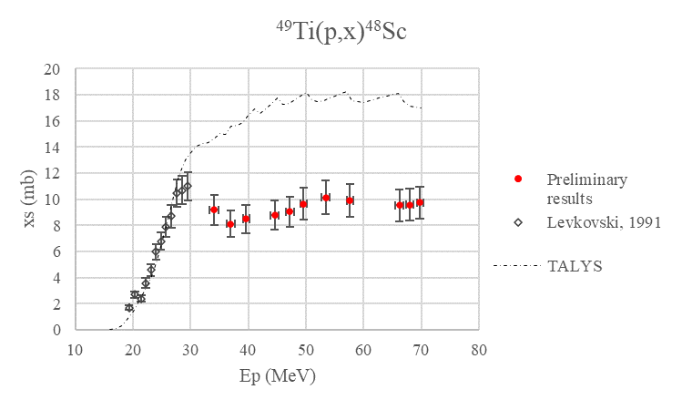

Proton-induced reactions on ⁴⁹Ti targets: Preliminary results
^{44m}Sc half-life 58.61 h
⁴⁴Sc half-life3.97 h
⁴³Sc half-life 3.891 h
⁴⁸Sc half-life 43.67 h
Since the most interesting energy range with ⁴⁹Ti targets is below 40 MeV, before RNP calculations we would measure the xs also at E_{P} < 35 MeV
12/15

Slide 14
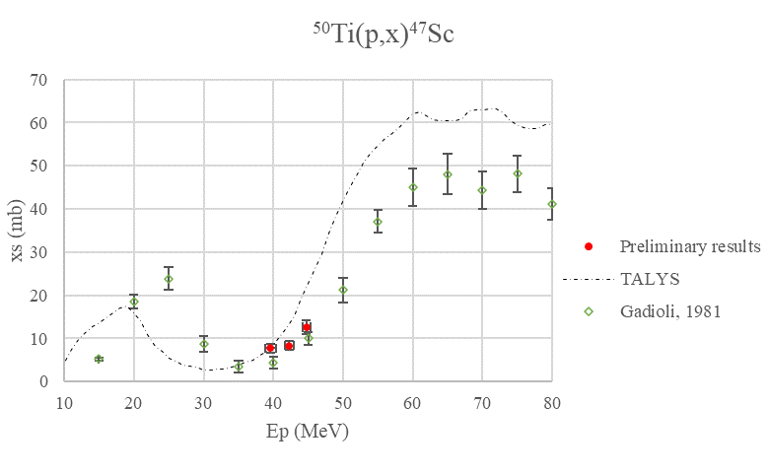

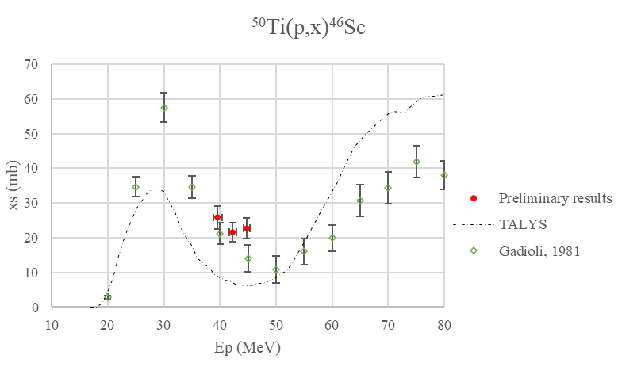
Proton-induced reactions on ⁵⁰Ti targets: Extra preliminary data
Extra preliminary data because the irradiation runs are ongoing!
Weighting values for the ⁵⁰Ti deposit thickness
13/15

Slide 15
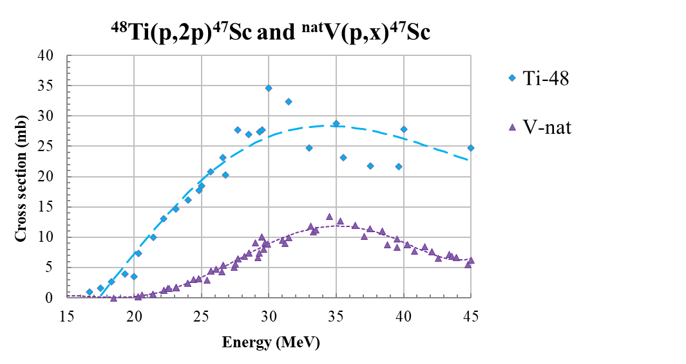
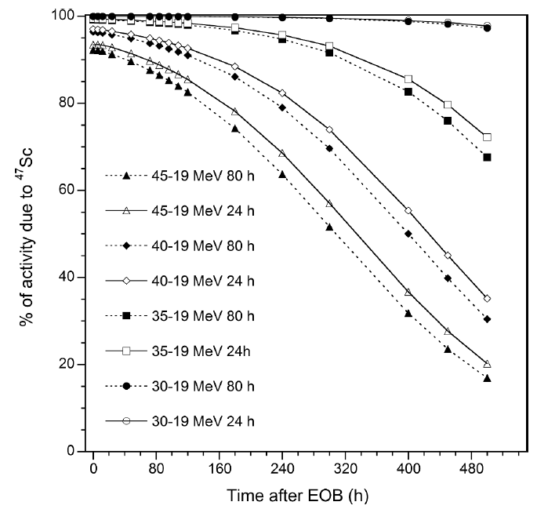
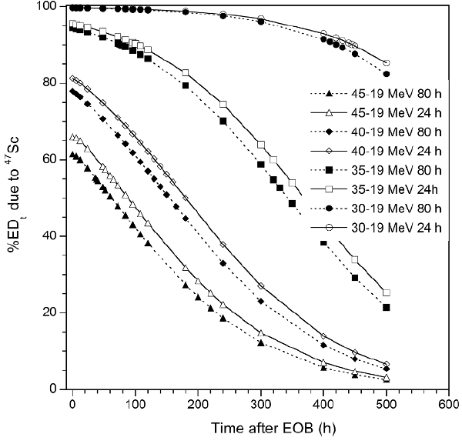

Comparison of ⁴⁷Sc production: ⁴⁸Ti vs ^{nat}V targets
The use of ⁴⁸Ti targets gives a larger ⁴⁷Sc yield in comparison to ^{nat}V, however the RNP is too low for medical applications!
Considering ^{nat}V targets, low ⁴⁶Sc co-production for E_{P} > 30 MeV
but at E_{P} > 35 MeV also ⁴⁸Sc is co-produced!
⁴⁷Sc produced with ^{nat}V (100 µA, 80 h) RNP > 99% :
E_{P}= 35-19 MeV ; t_{MAX} = 30 h ; ca. 28 GBq
E_{P}= 30-19 MeV ; t_{MAX} = 375 h ; ca. 11 GBq
⁴⁷Sc RNP (%)
⁴⁷Sc total effective dose (%)
As expected, higher the ⁴⁷Sc purity lower the yield!
L. De Nardo et al., Physics in Medicine and Biology DOI:10.1088/1361-6560/abc811 (2021)
14/15

Slide 16





Future works and conclusions
Thin homogeneous enriched metallic ^{xx}Ti-targets manufactured and characterized (WP1)
Irradiation runs ongoing at ARRONAX to measure the xs for ⁴⁷Sc (and contaminant) production (WP2)
Cross sections always show a regular trend and a general agreement with few literature data
Modeling with nuclear codes to find out the best parameters to describe the xs of interest (WP4)
Dosimetric calculations to find out the best irradiation conditions for ⁴⁷Sc production (WP5)
New irradiation runs @ ARRONAX to describe the nuclear xs using enriched ⁴⁹Ti and ⁵⁰Ti targets (WP2)
During 2023 it is expected to perform the first tests @ INFN-LNL for xs measurements (WP7)
lucia.de.dominicis@lnl.infn.it
liliana.mou@lnl.infn.it
15/15

Slide 17
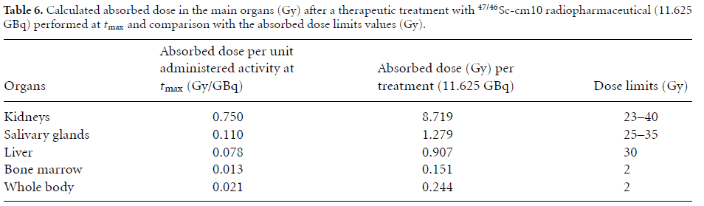

Dosimetric calculations of ⁴⁷Sc-cm10 using ^{nat}V targets
Calculation of the ⁴⁷Sc and ^{xx}Sc-contaminants production for different scenarios with ^{nat}V targets
Biodistribution considered for ^{xx}Sc-cm10 (literature data: Müller et al., 2014) rescaled to the human case
OLINDA code to estimate the total effective dose and the absorbed dose to each organ due to ⁴⁷Sc and ^{xx}Sc-contaminants
Irradiation parameters suitable for medical use of ⁴⁷Sc-cm10!
E_{P} < 35 MeV → only ⁴⁶Sc low amount & low ⁴⁷Sc yield
E_{P} > 35 MeV → ⁴⁶Sc, ⁴⁸Sc contaminants & high ⁴⁷Sc yield
⁴⁷Sc produced for 80 h irradiation with 100 µA of 35-19 MeV protons on ^{nat}V targets should be enough for 2-6 treatments with ⁴⁷Sc-cm10!
L. De Nardo et al., Physics in Medicine and Biology DOI:10.1088/1361-6560/abc811 (2021)
Extra

