Slide 1


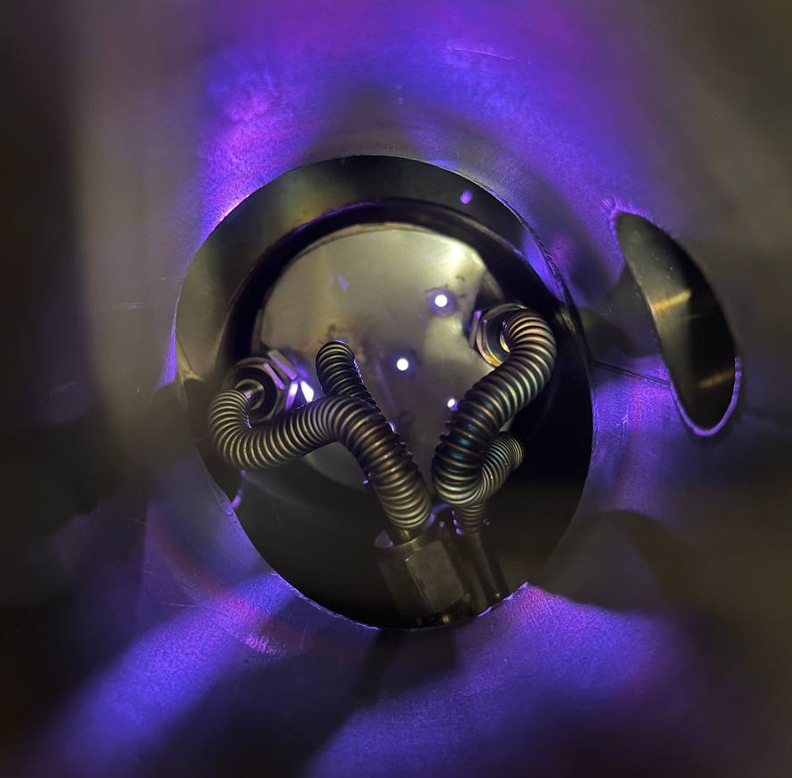

Possible Material-Saving Approach of Sputtering Techniques for Radiopharmaceutical Target Production
Ph.D student
Alisa Kotliarenko
Co-authors: Dr. Oscar Azzolini, Sara Cisternino, Mourad El Idrissi, Dr. Giorgio Keppel , Dr. Juan Esposito
18th Workshop on Targetry and Target Chemistry Whistler, BC August 22-26, 2022

Slide 2


Work Goal
To evaluate the main magnetron sputtering technique issues and to found a possible solution to use this technique for solid target production
This research was funded by CSN5 of the INFN, Italy for 2018–2022, in the framework of METRICS project. PI: J. Esposito
and by INTEFF program at INFN funded by MISE, Italy – in the framework of TOTEM project PI: S.Cisternino.
18th Workshop on Targetry and Target Chemistry Whistler
Alisa Kotliarenko – alisa.kotliarenko@lnl.infn.it
2/21

Slide 3
Outline
1
Introduction to Sputtering techniques
2
Results on magnetron sputtering optimization
3
Results on nat-ZnO targets realization
18th Workshop on Targetry and Target Chemistry Whistler
Alisa Kotliarenko – alisa.kotliarenko@lnl.infn.it
3/21

Slide 4
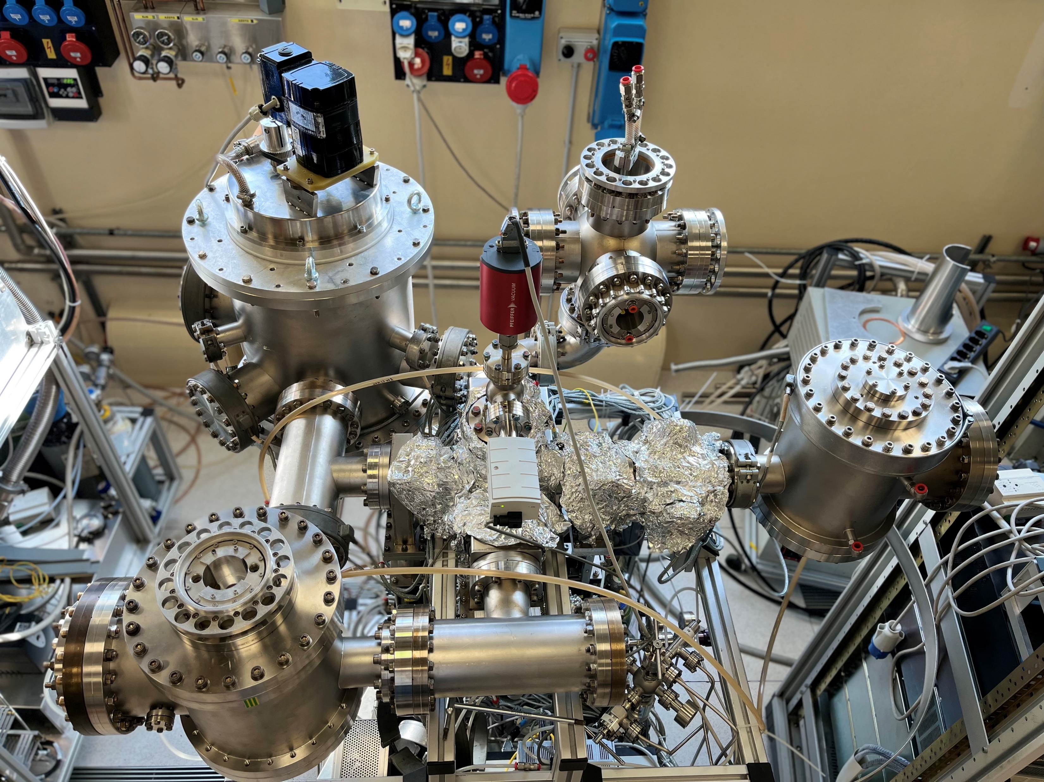
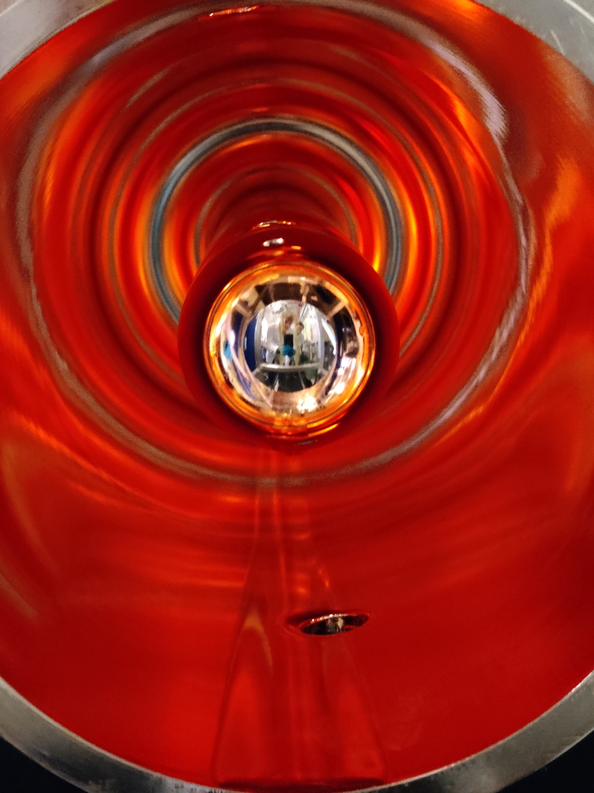
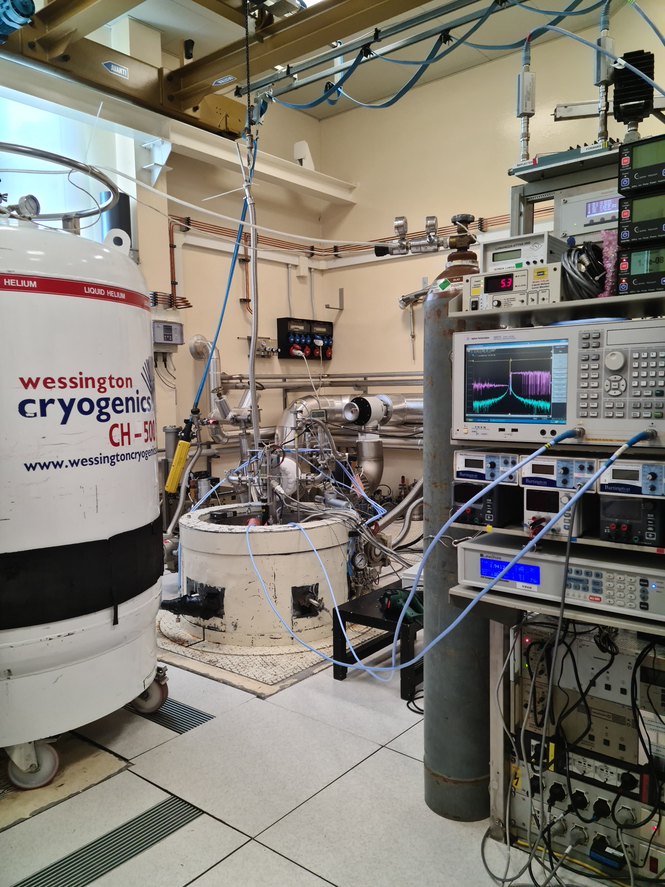
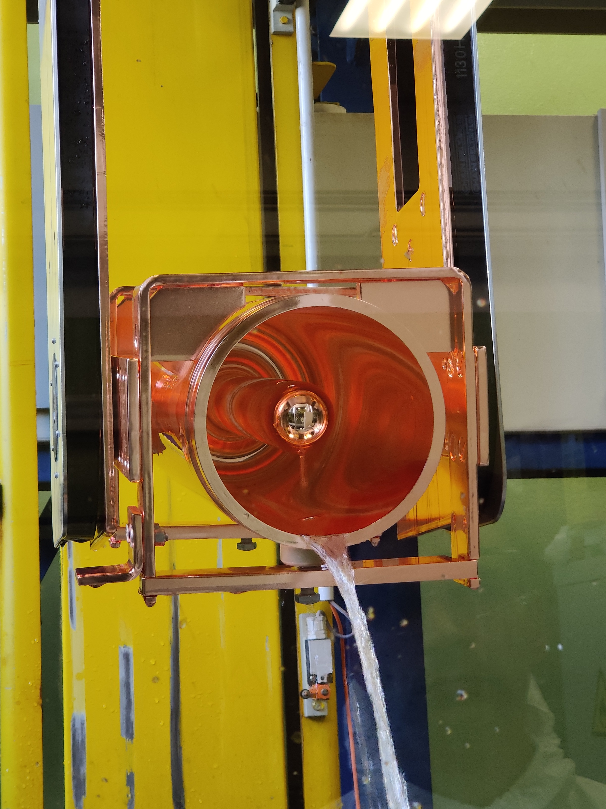
Surface Technologies and Superconductivity Service
1
Chemistry laboratory
Cryo laboratory
Sputtering laboratory
Advanced surface treatments for Cu and Nb accelerating cavities
Various PVD machines for industrial and scientific interests
Deposition of metals and ceramic compounds on different substrates
Superconductive Nb depositions
Cryogenic characterization
18th Workshop on Targetry and Target Chemistry Whistler
Alisa Kotliarenko – alisa.kotliarenko@lnl.infn.it
4/21

Slide 5
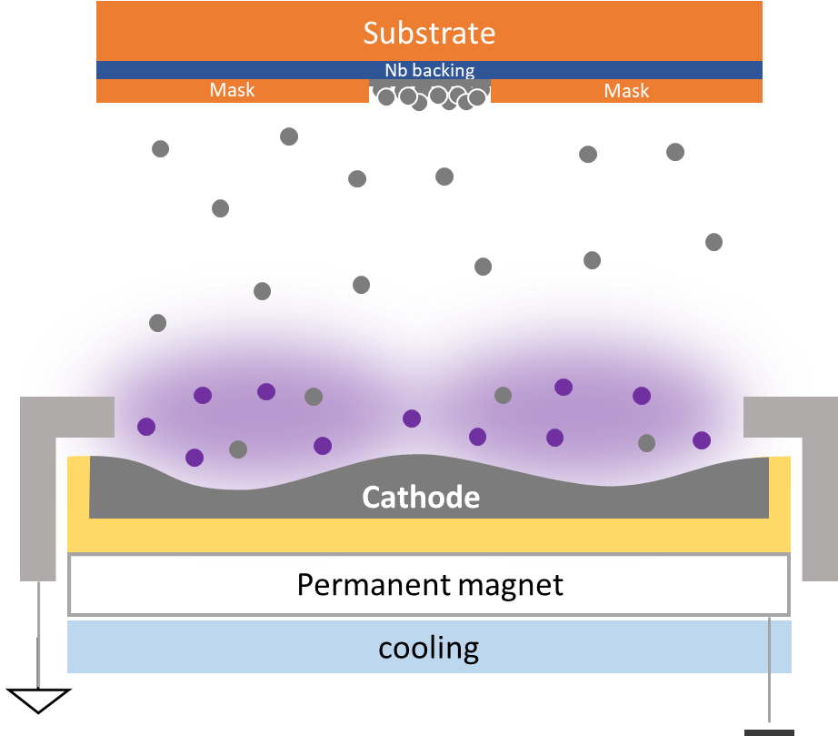
Magnetron sputtering
1
Planar magnetron sputtering
18th Workshop on Targetry and Target Chemistry Whistler
Alisa Kotliarenko – alisa.kotliarenko@lnl.infn.it
5/21

Slide 6
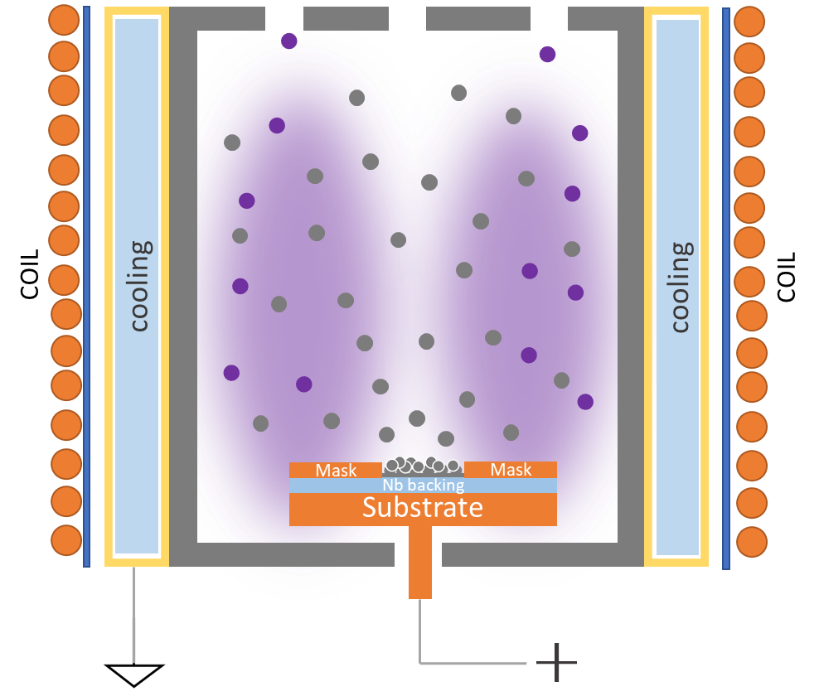
Magnetron sputtering
1
Planar magnetron sputtering
Idea of inverted magnetron sputtering
18th Workshop on Targetry and Target Chemistry Whistler
Alisa Kotliarenko – alisa.kotliarenko@lnl.infn.it
5/21

Slide 7
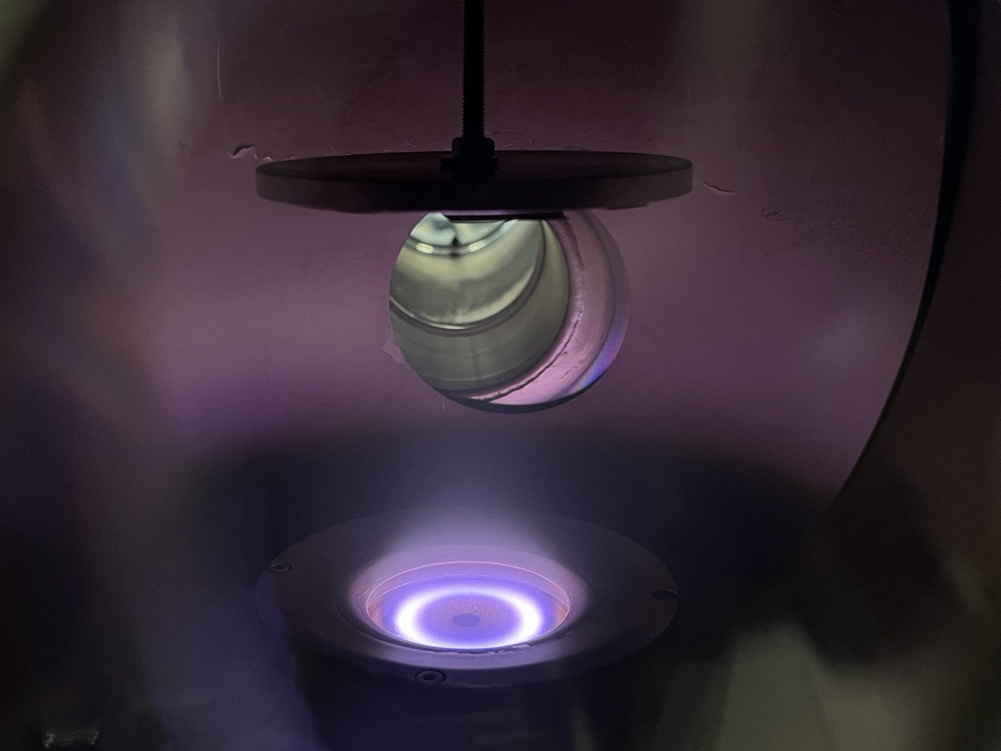
Magnetron sputtering - characteristics
1
Precise thickness control
High adherence
Densification of the deposition
Material sputtered everywhere in the vacuum chamber
Material losses – 80%
18th Workshop on Targetry and Target Chemistry Whistler
Alisa Kotliarenko – alisa.kotliarenko@lnl.infn.it
6/21

Slide 8
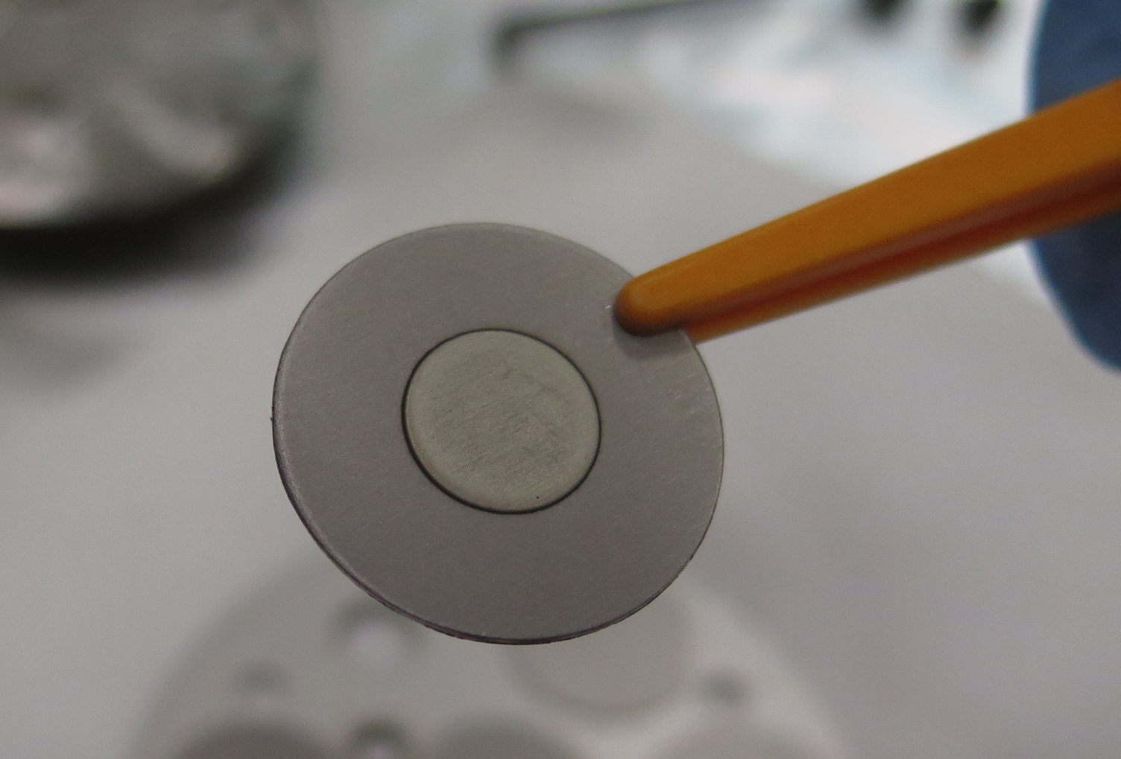
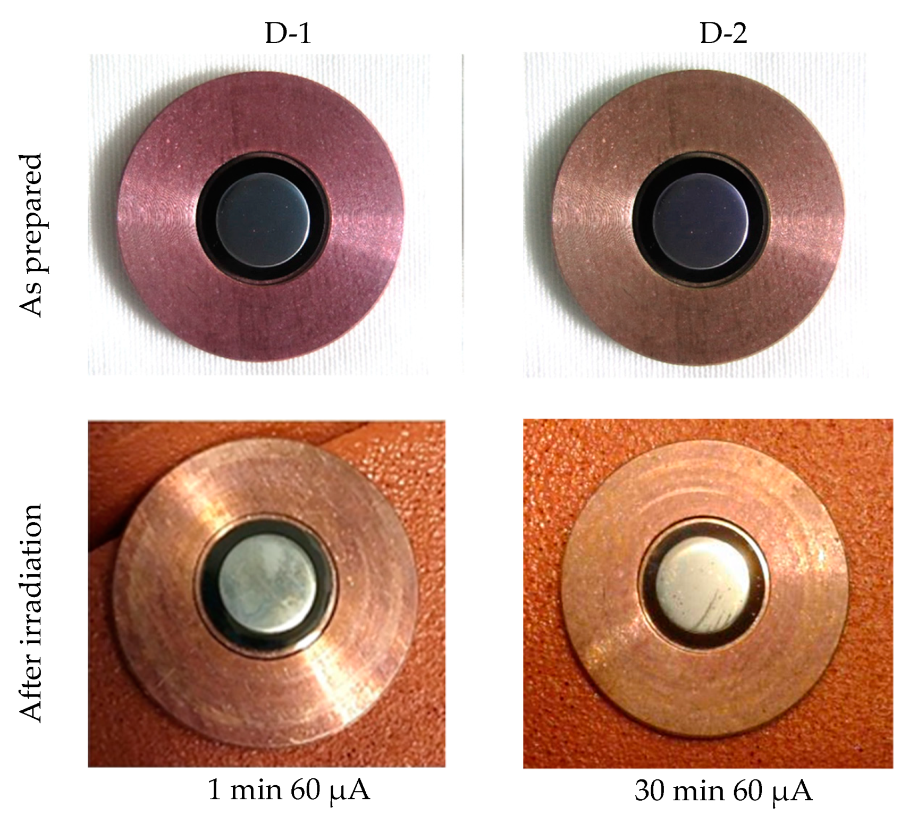
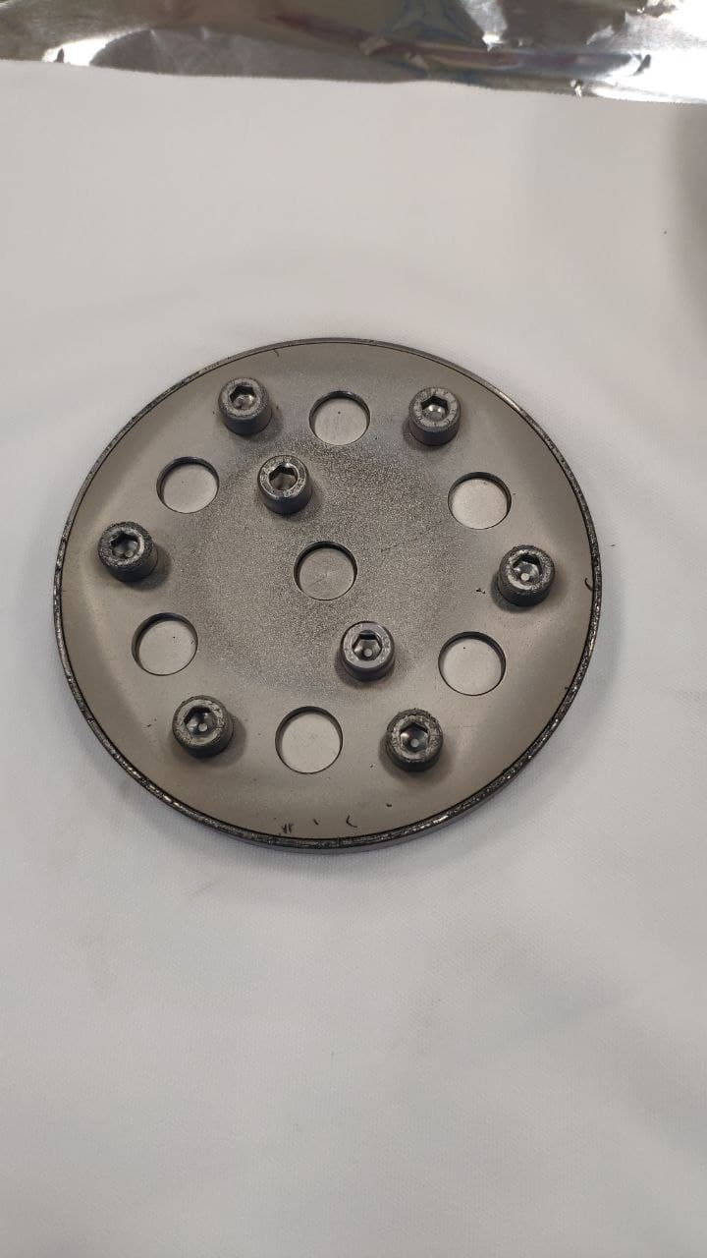
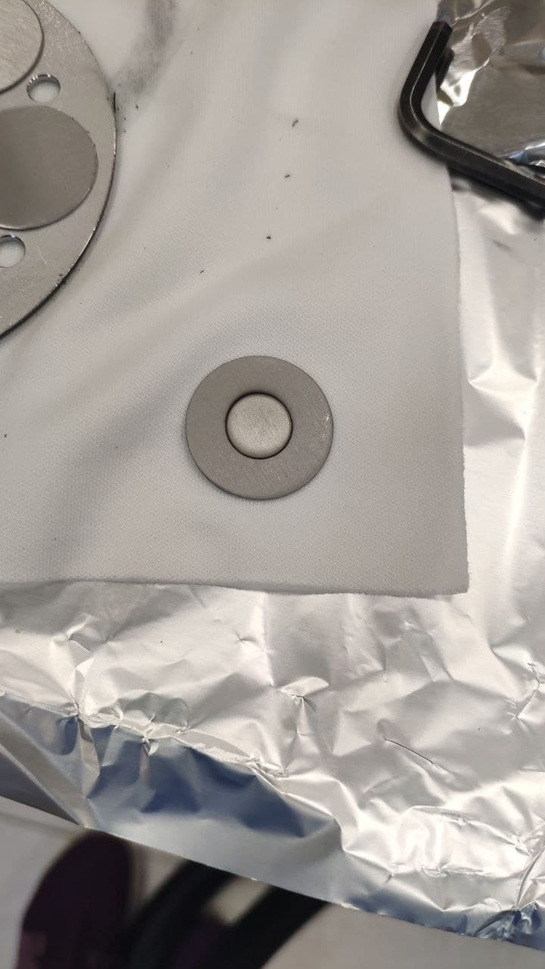
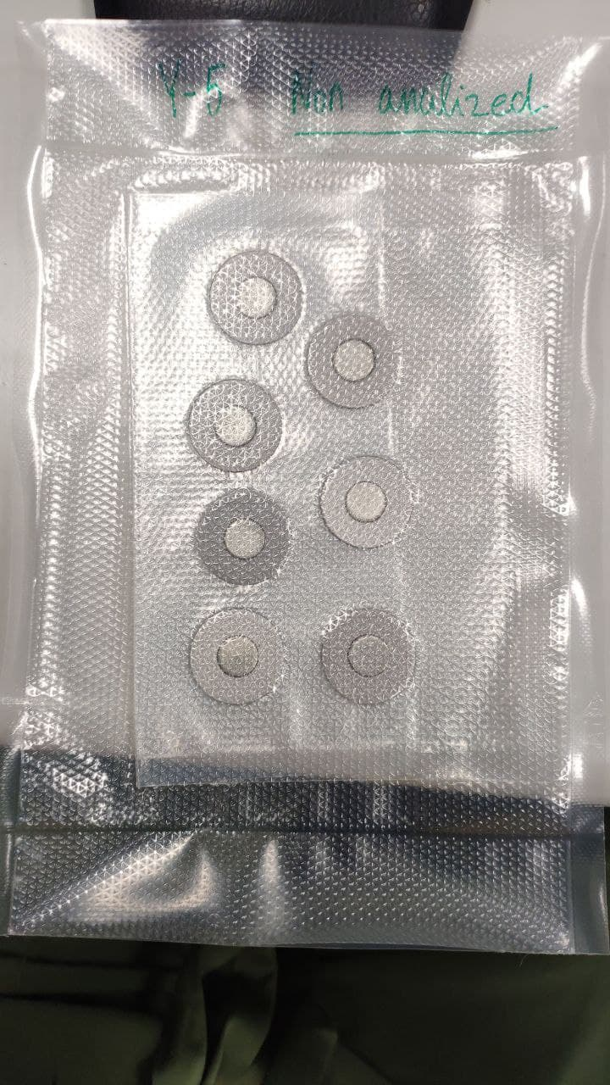
Magnetron sputtering for target production
1
nat-Mo targets preparation
nat-Y target preparation
[Patent n. WO 2019/053570]
7 targets simultaneous depositions
Thickness range – 150-200 µm
[Skliarova et al., Molecules 2021]
18th Workshop on Targetry and Target Chemistry Whistler
Alisa Kotliarenko – alisa.kotliarenko@lnl.infn.it
7/21

Slide 9
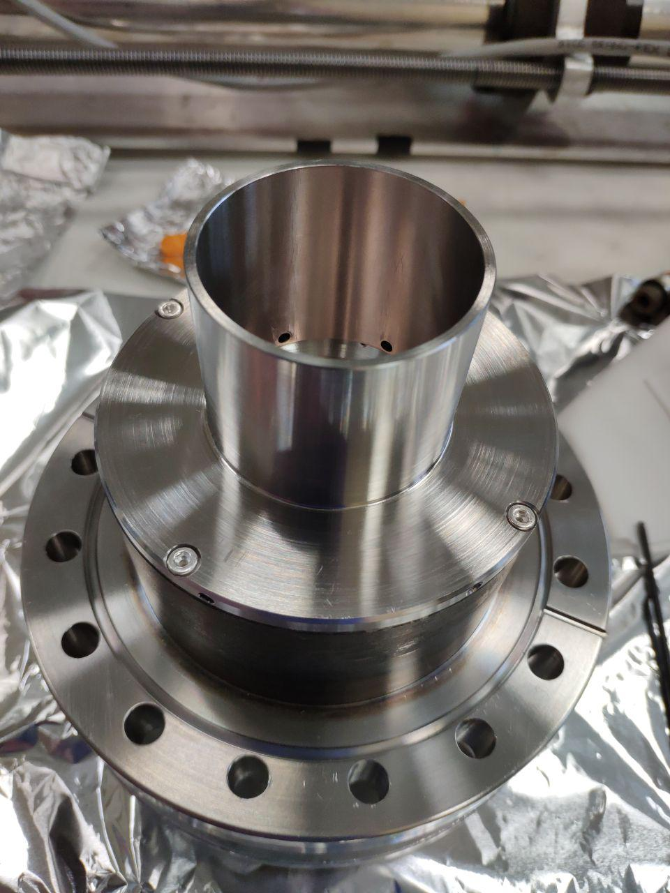
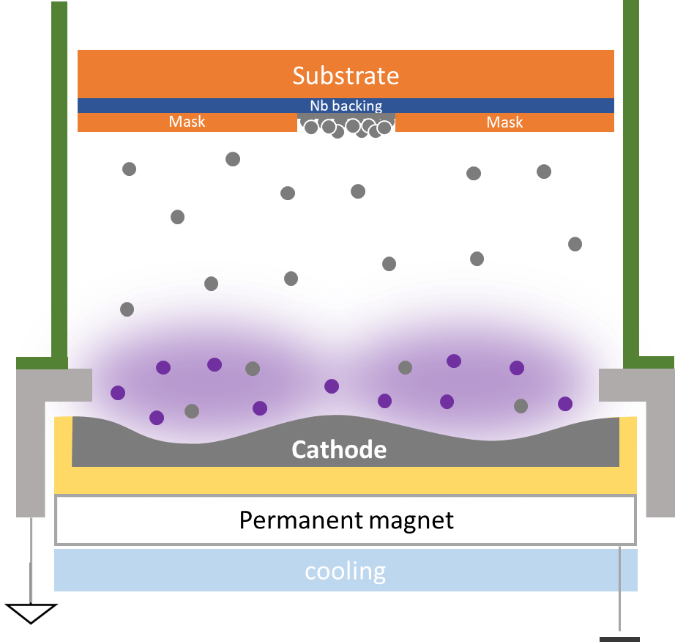
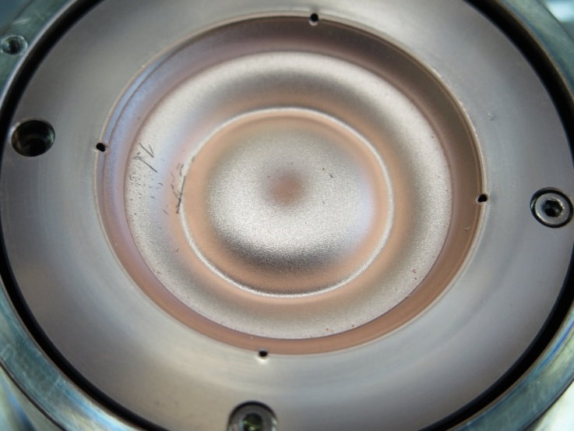
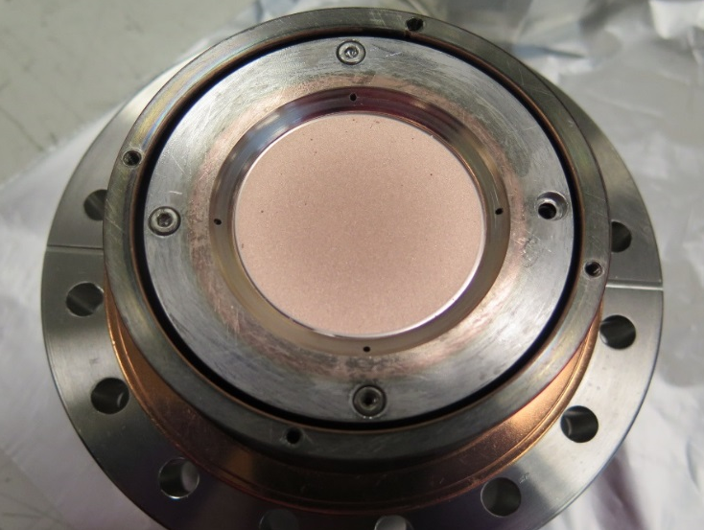
Possible material-saving approach
2
2 inch planar magnetron evaluation
Recovering shield
Magnetron and diode sputtering techniques
18th Workshop on Targetry and Target Chemistry Whistler
Alisa Kotliarenko – alisa.kotliarenko@lnl.infn.it
8/21
Notes:
Idea of the reaserch ( article)
The combination of MS and DS

Slide 10
Possible material-saving approach
2
Material results | Magnetron,% | Diode, %
On the substrate | 38,9±0,003 | 21,6±0,035
On the shield | 56,3±0,005 | 71,6±0,113
Losses | 4,8±0,008 | 6,8±0,148
[Kotliarenko et al., Applied Science 2021]
Growing beheviour of MS and Diode depositions
18th Workshop on Targetry and Target Chemistry Whistler
Alisa Kotliarenko – alisa.kotliarenko@lnl.infn.it
9/21
Notes:
Idea of the reaserch ( article)
The combination of MS and DS

Slide 11
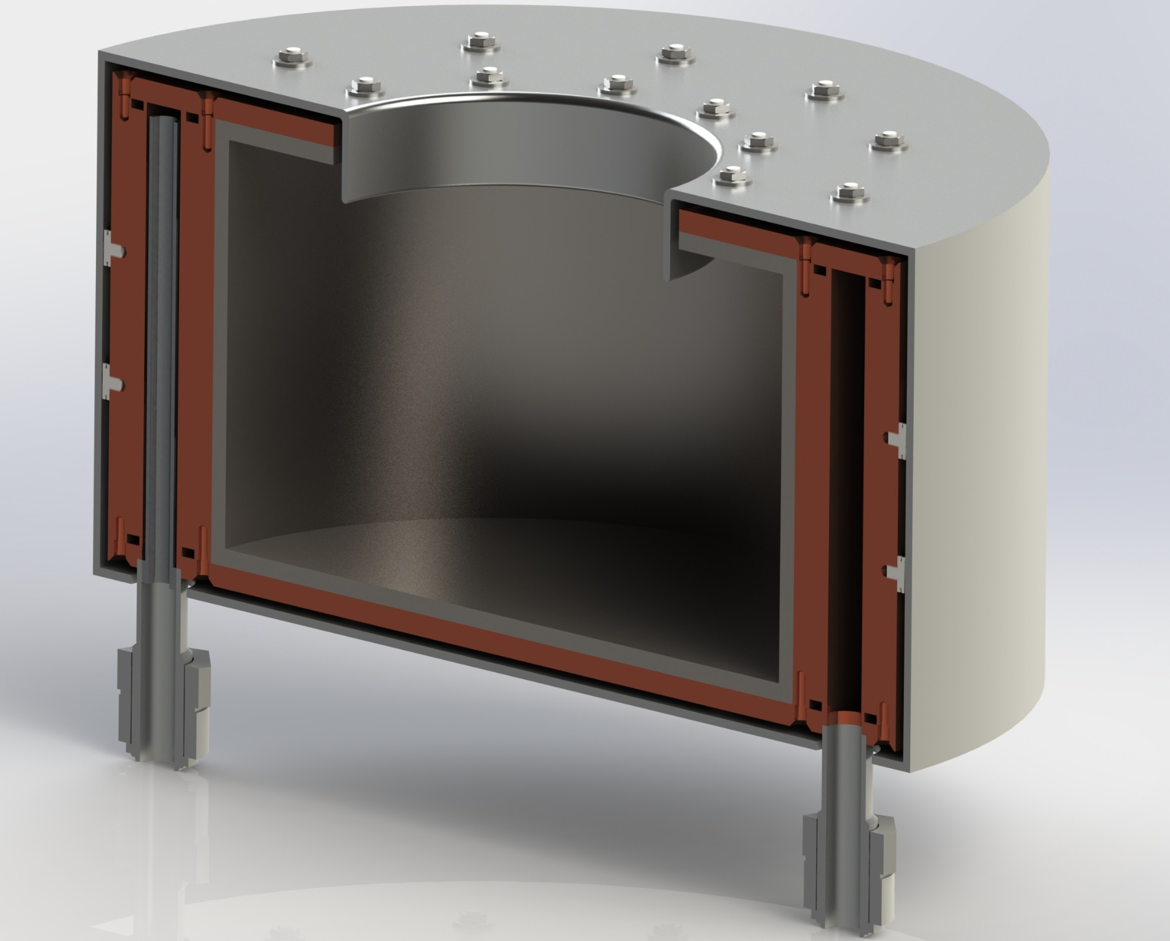
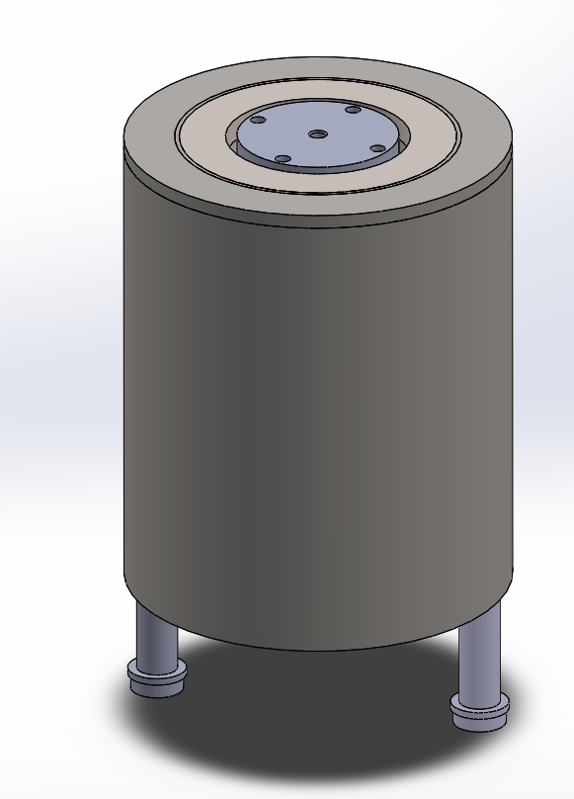
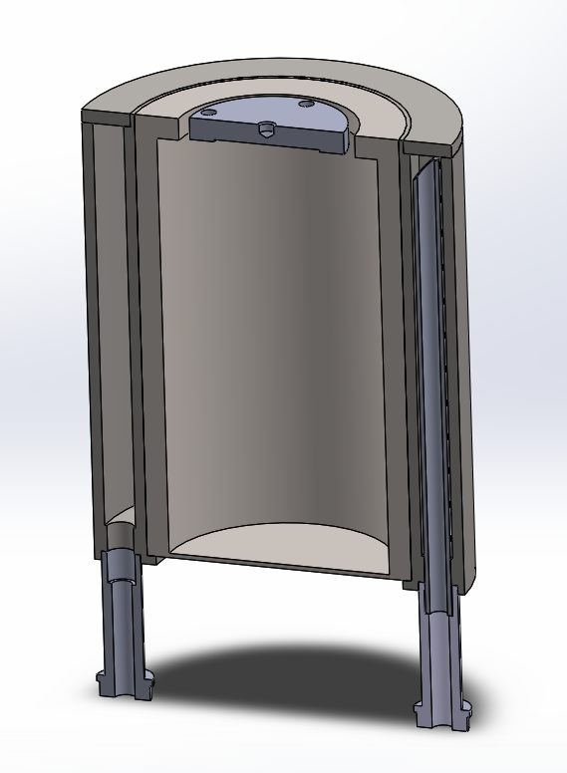
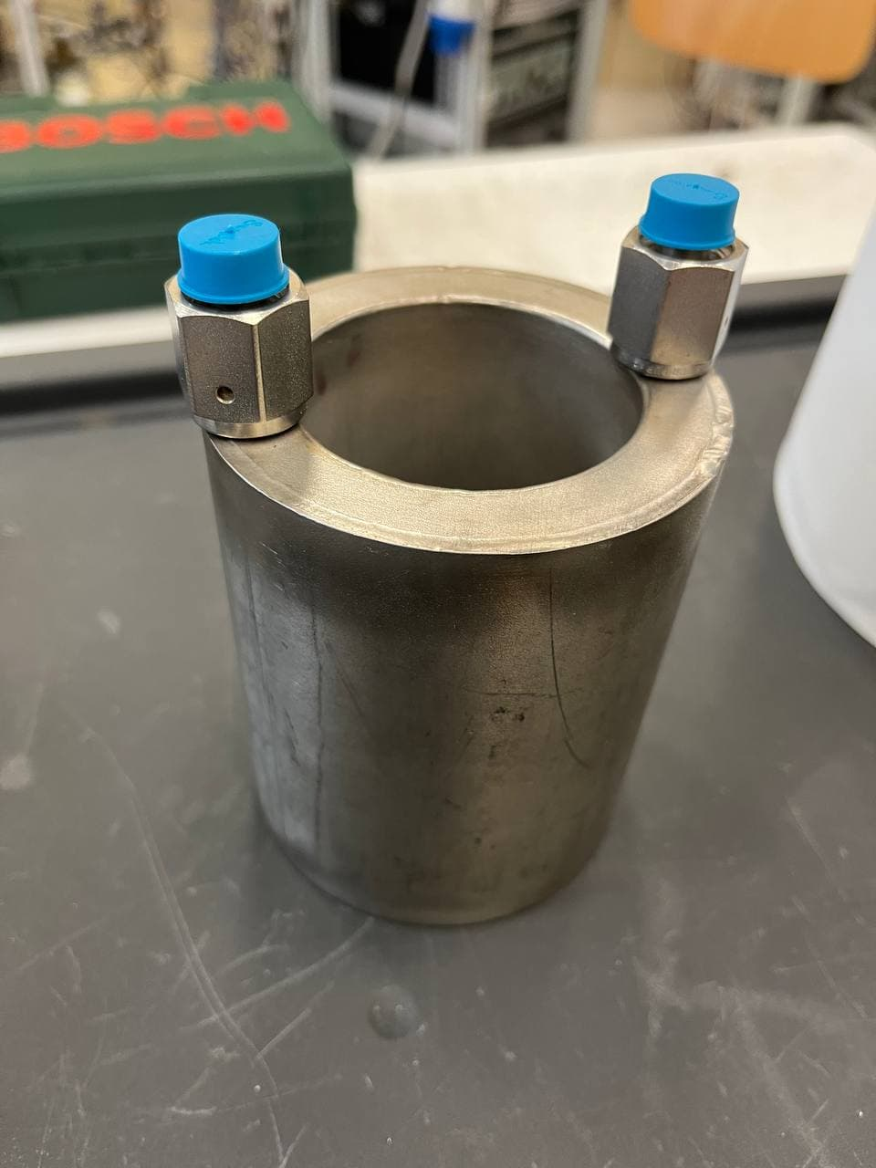
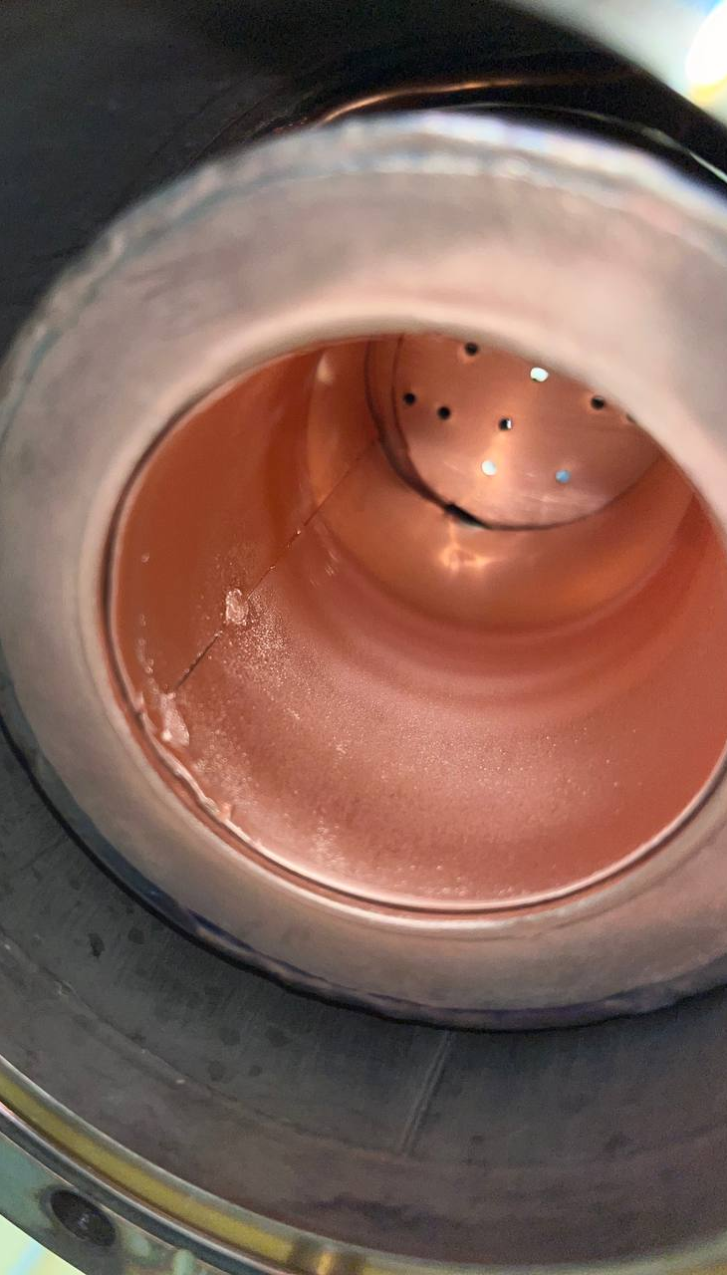
Inverted magnetron idea
2
Initial design
Prototype design
Produced prototype
Cathode
Cathode
Ground shield
Dimensions:
External h 80 mm Ø 160 mm
Cathode h 60 mm Ø 100 mm
Simpler system
Does not require shielding
Easy maintenance
Dimensions:
External h 106 mm Ø 89 mm
Cathode h 106 mm Ø 59 mm
18th Workshop on Targetry and Target Chemistry Whistler
Alisa Kotliarenko – alisa.kotliarenko@lnl.infn.it
10/21

Slide 12

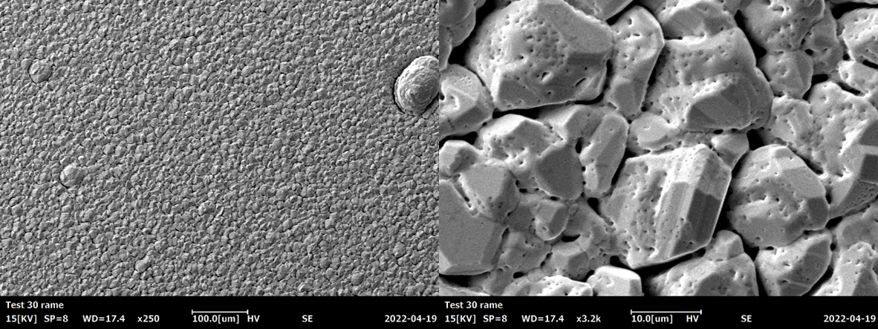
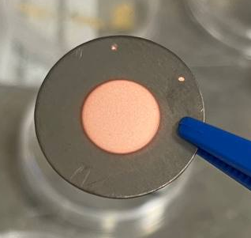
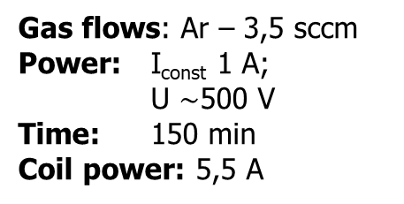
Inverted magnetron - proof of concept
2
TEST 30
Deposition parameters
Gas flows: Ar – 3,5 sccm
Power: I_{const} 1 A;
U $\sim$500 V
Time: 150 min
Coil power: 5,5 A
Cu deposition: Ø10 mm x 40 µm
Nb: Ø24 x 0,5 mm
Morphology of Cu deposition
18th Workshop on Targetry and Target Chemistry Whistler
Alisa Kotliarenko – alisa.kotliarenko@lnl.infn.it
11/21

Slide 13
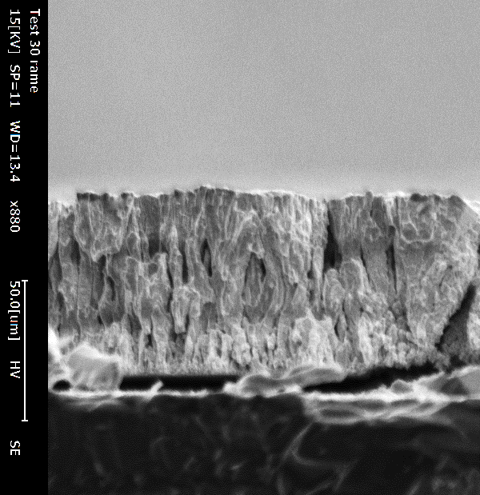
Inverted magnetron – standart magnetron
2
Inverted MS
Standard MS
Growing beheviour of Cu deposition
18th Workshop on Targetry and Target Chemistry Whistler
Alisa Kotliarenko – alisa.kotliarenko@lnl.infn.it
12/21

Slide 14
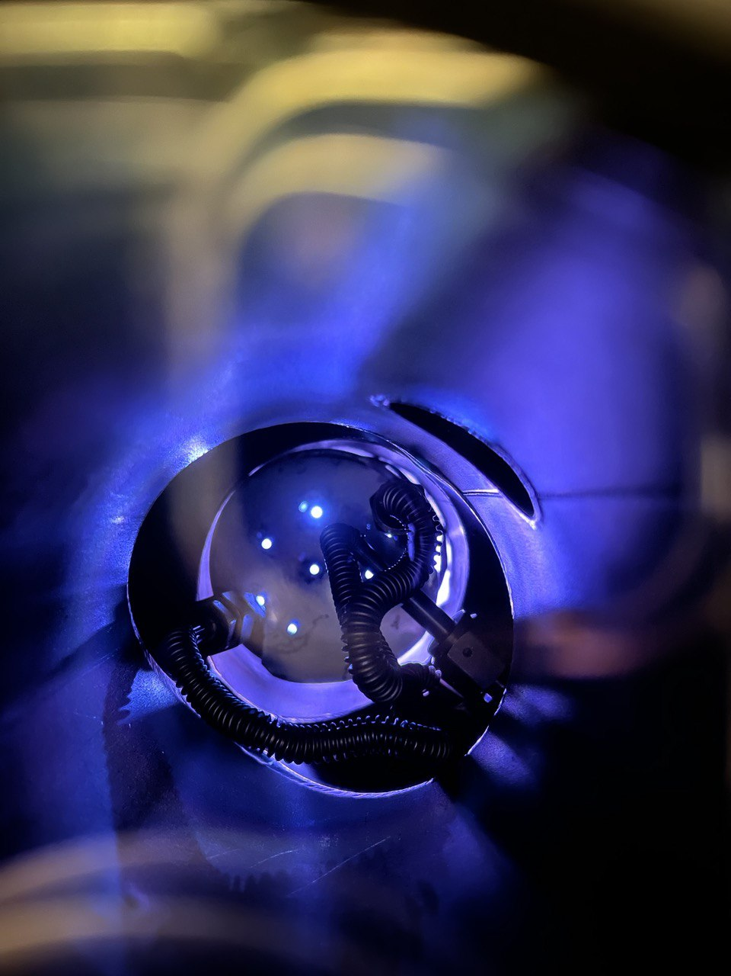
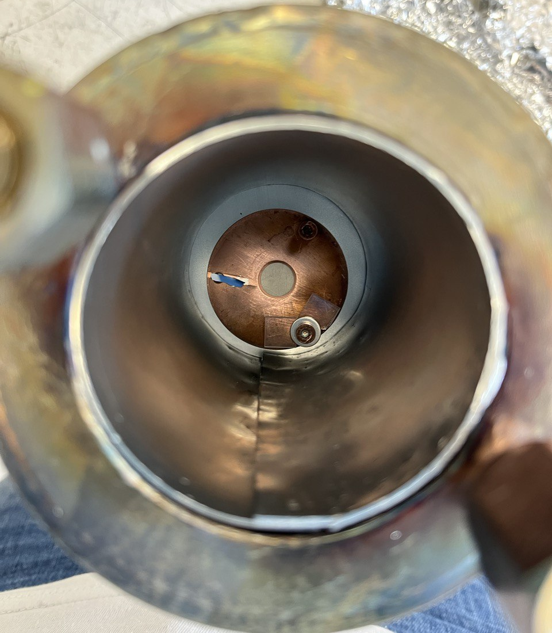
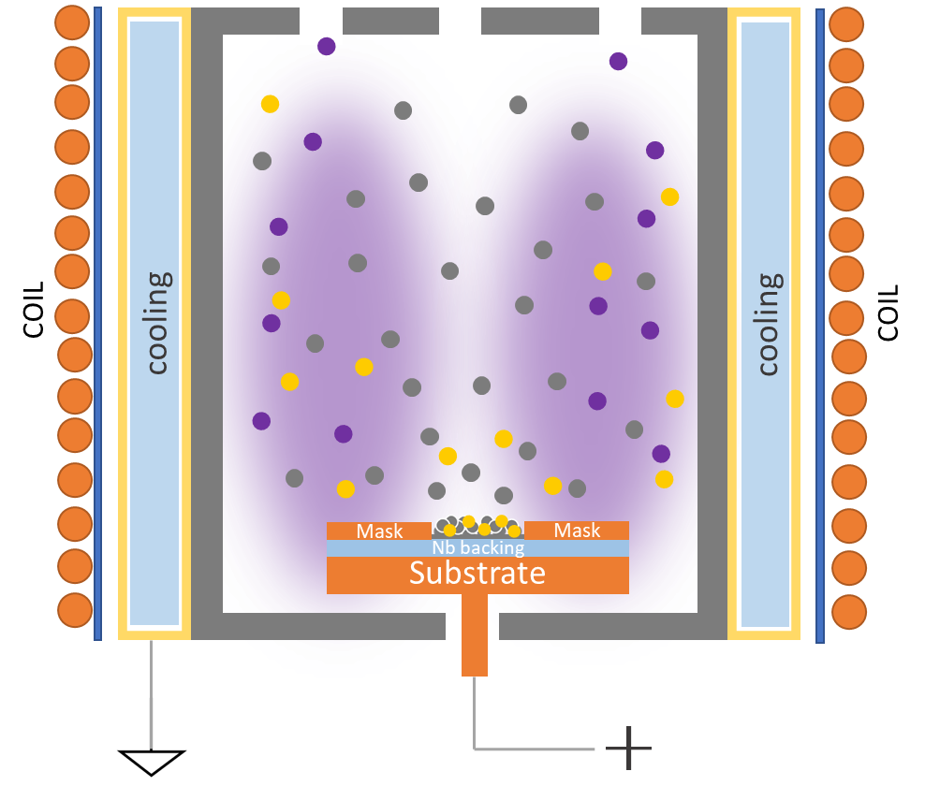
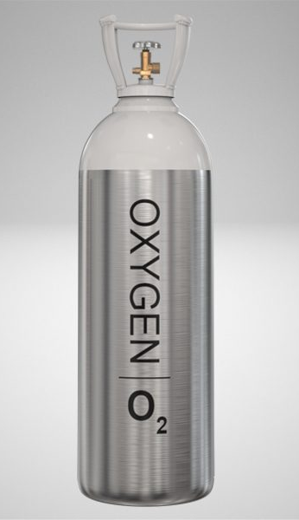
nat-ZnO deposition test
3
Reactive sputtering process
Zn cathode
Reactive gas – O₂
Reactive process of ZnO
18th Workshop on Targetry and Target Chemistry Whistler
Alisa Kotliarenko – alisa.kotliarenko@lnl.infn.it
13/21

Slide 15
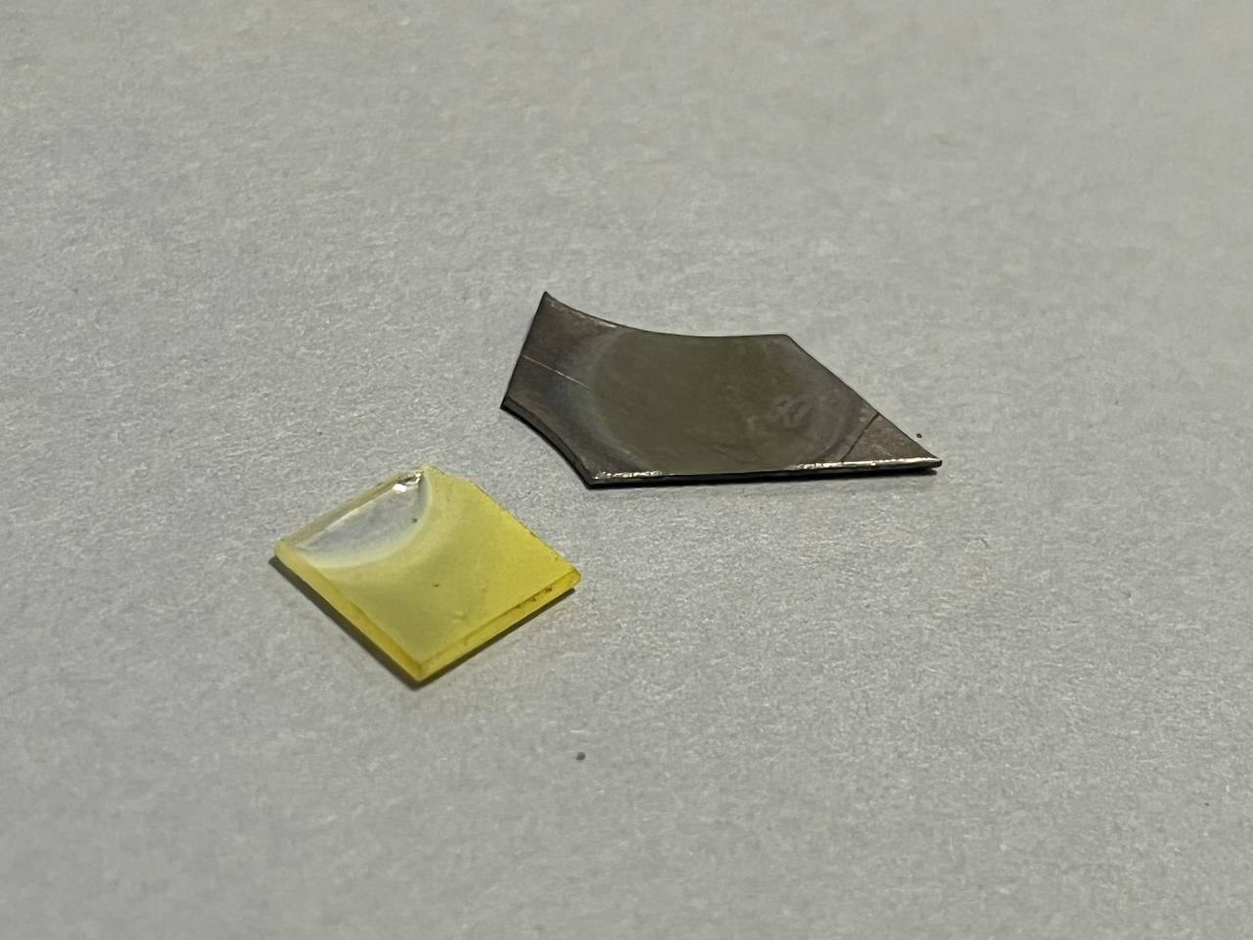
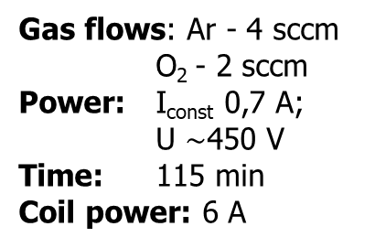
nat-ZnO deposition test - results
3
Morphology of ZnO deposition
TEST ZnO - 8
Gas flows: Ar - 4 sccm
O₂ - 2 sccm
Power: I_{const} 0,7 A;
U $\sim$450 V
Time: 115 min
Coil power: 6 A
18th Workshop on Targetry and Target Chemistry Whistler
Alisa Kotliarenko – alisa.kotliarenko@lnl.infn.it
14/21

Slide 16
nat-ZnO deposition test - results
3
TEST ZnO - 8
Polycristalline growing beheviour of ZnO deposition
Gas flows: Ar - 4 sccm
O₂ - 2 sccm
Power: I_{const} 0,7 A;
U $\sim$450 V
Time: 115 min
Coil power: 6 A
Deposition rate: 130 nm/min
18th Workshop on Targetry and Target Chemistry Whistler
Alisa Kotliarenko – alisa.kotliarenko@lnl.infn.it
15/21

Slide 17
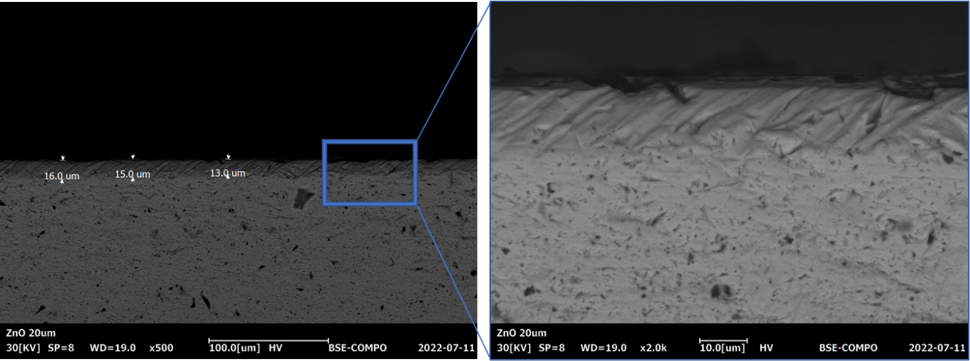
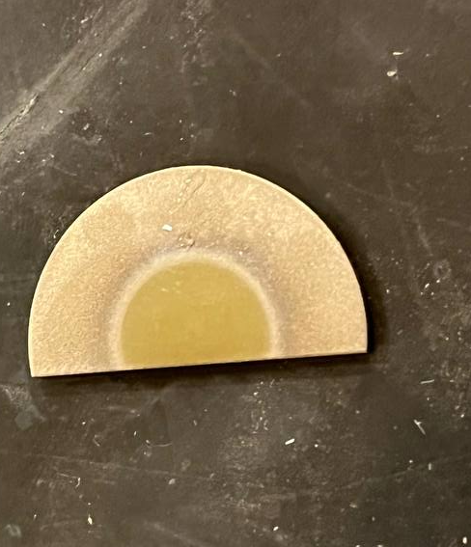
nat-ZnO deposition test - results
3
Interface analysis
Sample preparation
Cutting with electro erosion and step-lapping with different abrasive papers
High adhesion of ZnO to Nb
18th Workshop on Targetry and Target Chemistry Whistler
Alisa Kotliarenko – alisa.kotliarenko@lnl.infn.it
16/21

Slide 18
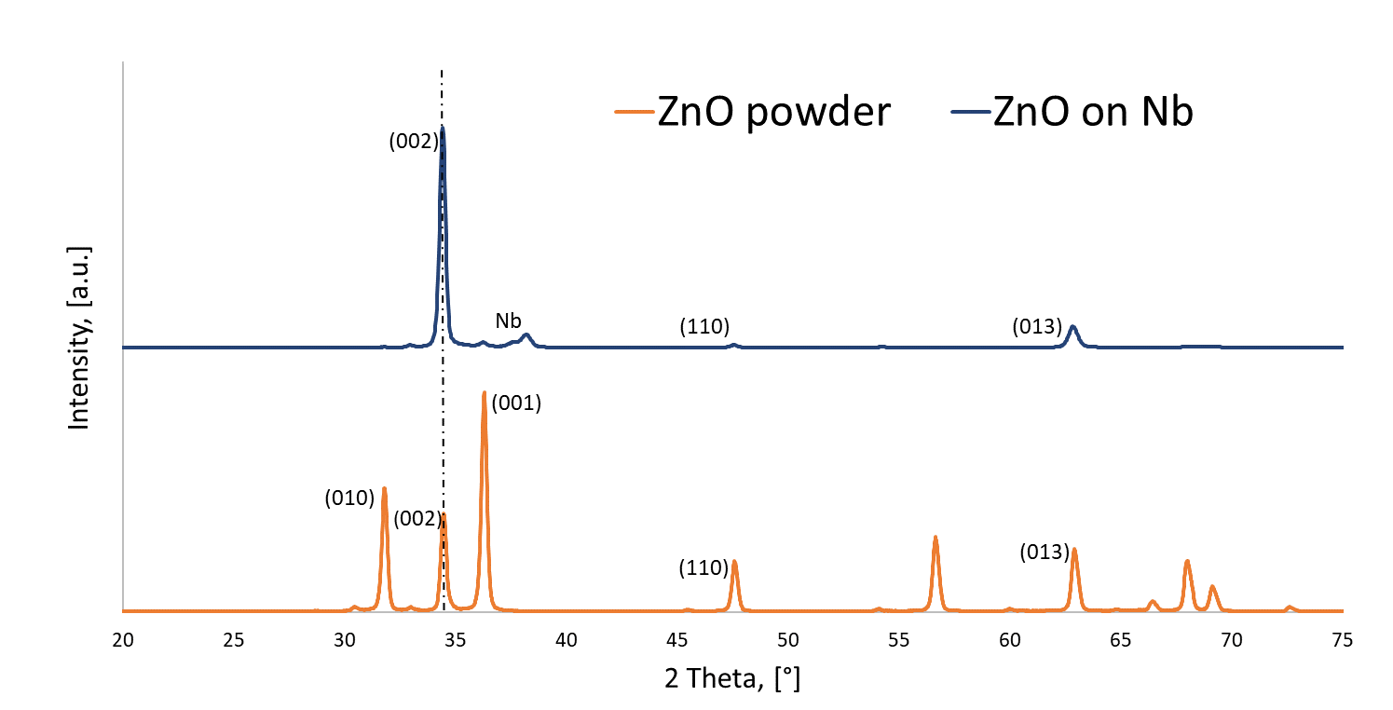
nat-ZnO deposition test - results
3
Crystalline structure
Similar to nat-ZnO powder
Preferential (002) crystal growing
XRD diffractogram
18th Workshop on Targetry and Target Chemistry Whistler
Alisa Kotliarenko – alisa.kotliarenko@lnl.infn.it
17/21

Slide 19
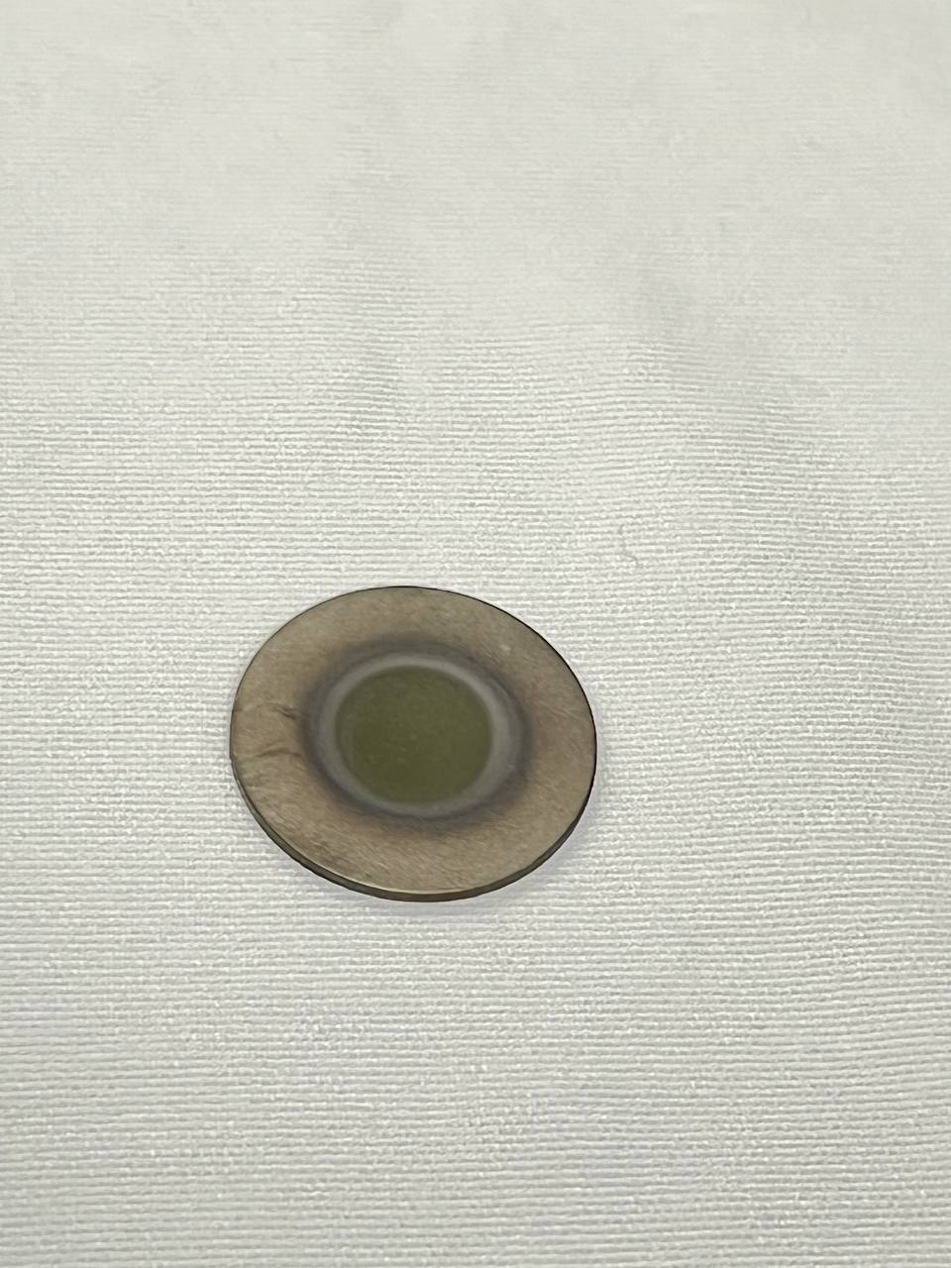
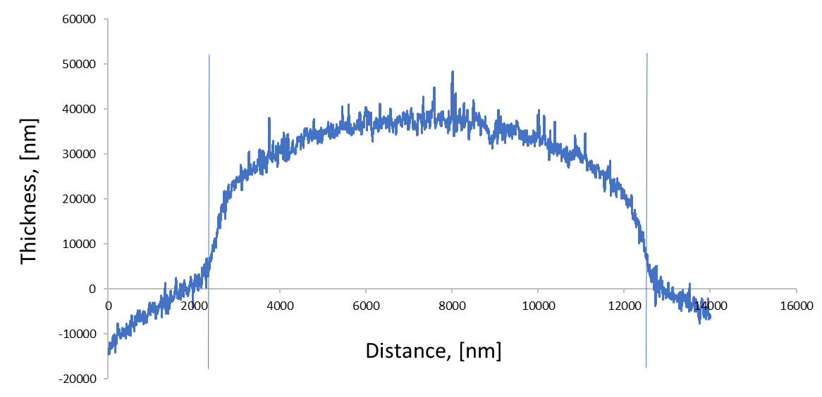
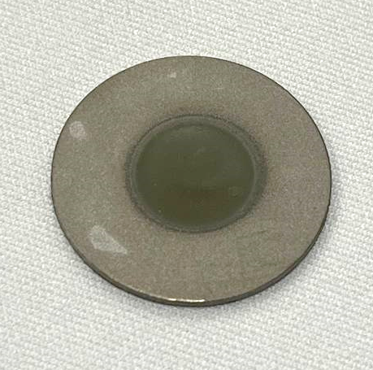
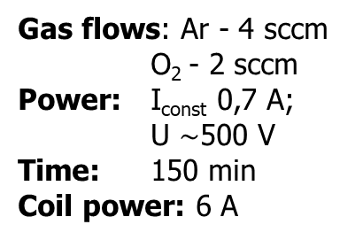
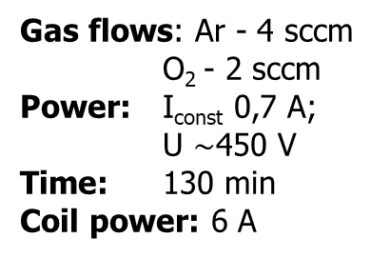
nat-ZnO deposition test - results
3
Sputtering parameters
Gas flows: Ar - 4 sccm
O₂ - 2 sccm
Power: I_{const} 0,7 A;
U $\sim$450 V
Time: 130 min
Coil power: 6 A
Thickness uniformity measurements by profilometer
Deposited area - Ø10 mm
20 µm
Gas flows: Ar - 4 sccm
O₂ - 2 sccm
Power: I_{const} 0,7 A;
U $\sim$500 V
Time: 150 min
Coil power: 6 A
30 µm
18th Workshop on Targetry and Target Chemistry Whistler
Alisa Kotliarenko – alisa.kotliarenko@lnl.infn.it
18/21

Slide 20
nat-ZnO deposition test - results
3
Targets parameter
ZnO deposition:
Ø10 mm x 20 µm;
ρ_{ZnO}~ 73 % bulk
Nb: Ø23.7 x 1,2 mm
Areal ρ ~ 8,4 mg/cm²
Morphology of ZnO targets
ZnO deposition:
Ø10 mm x 30 µm;
ρ_{ZnO}~ 71 % bulk
Nb: Ø23.7 x 1,2 mm
Areal ρ ~ 12,1 mg/cm²
18th Workshop on Targetry and Target Chemistry Whistler
Alisa Kotliarenko – alisa.kotliarenko@lnl.infn.it
19/21

Slide 21

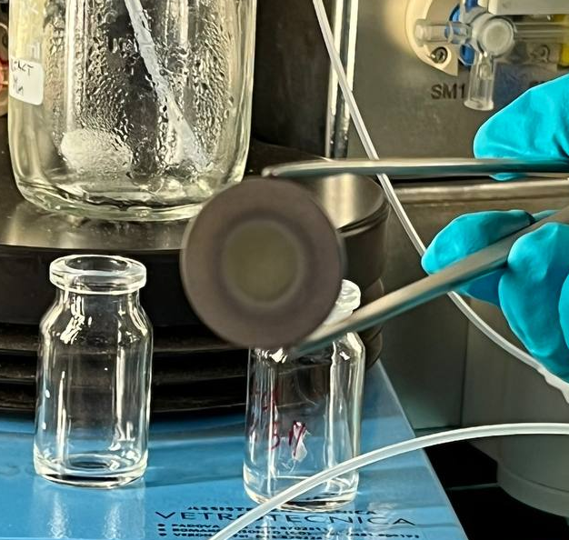

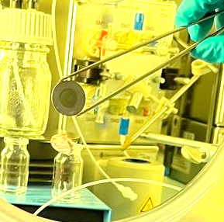
nat-ZnO deposition test – irradiation
3
Targets parameter
Irradiation parameter
Thermo-mechanical irradiations tests
ZnO deposition:
Ø10 mm x 20 µm;
ρ_{ZnO}~ 73 % bulk
Nb: Ø23.7 x 1,2 mm
Areal ρ ~ 8,4 mg/cm²
Energy 19 MeV,
p+ current 10 µA
5 min
ZnO deposition:
Ø10 mm x 30 µm;
ρ_{ZnO}~ 71 % bulk
Nb: Ø23.7 x 1,2 mm
Areal ρ ~ 12,1 mg/cm²
Energy 19 MeV,
p+ current 20 µA
5 min
18th Workshop on Targetry and Target Chemistry Whistler
Alisa Kotliarenko – alisa.kotliarenko@lnl.infn.it
20/21

Slide 22
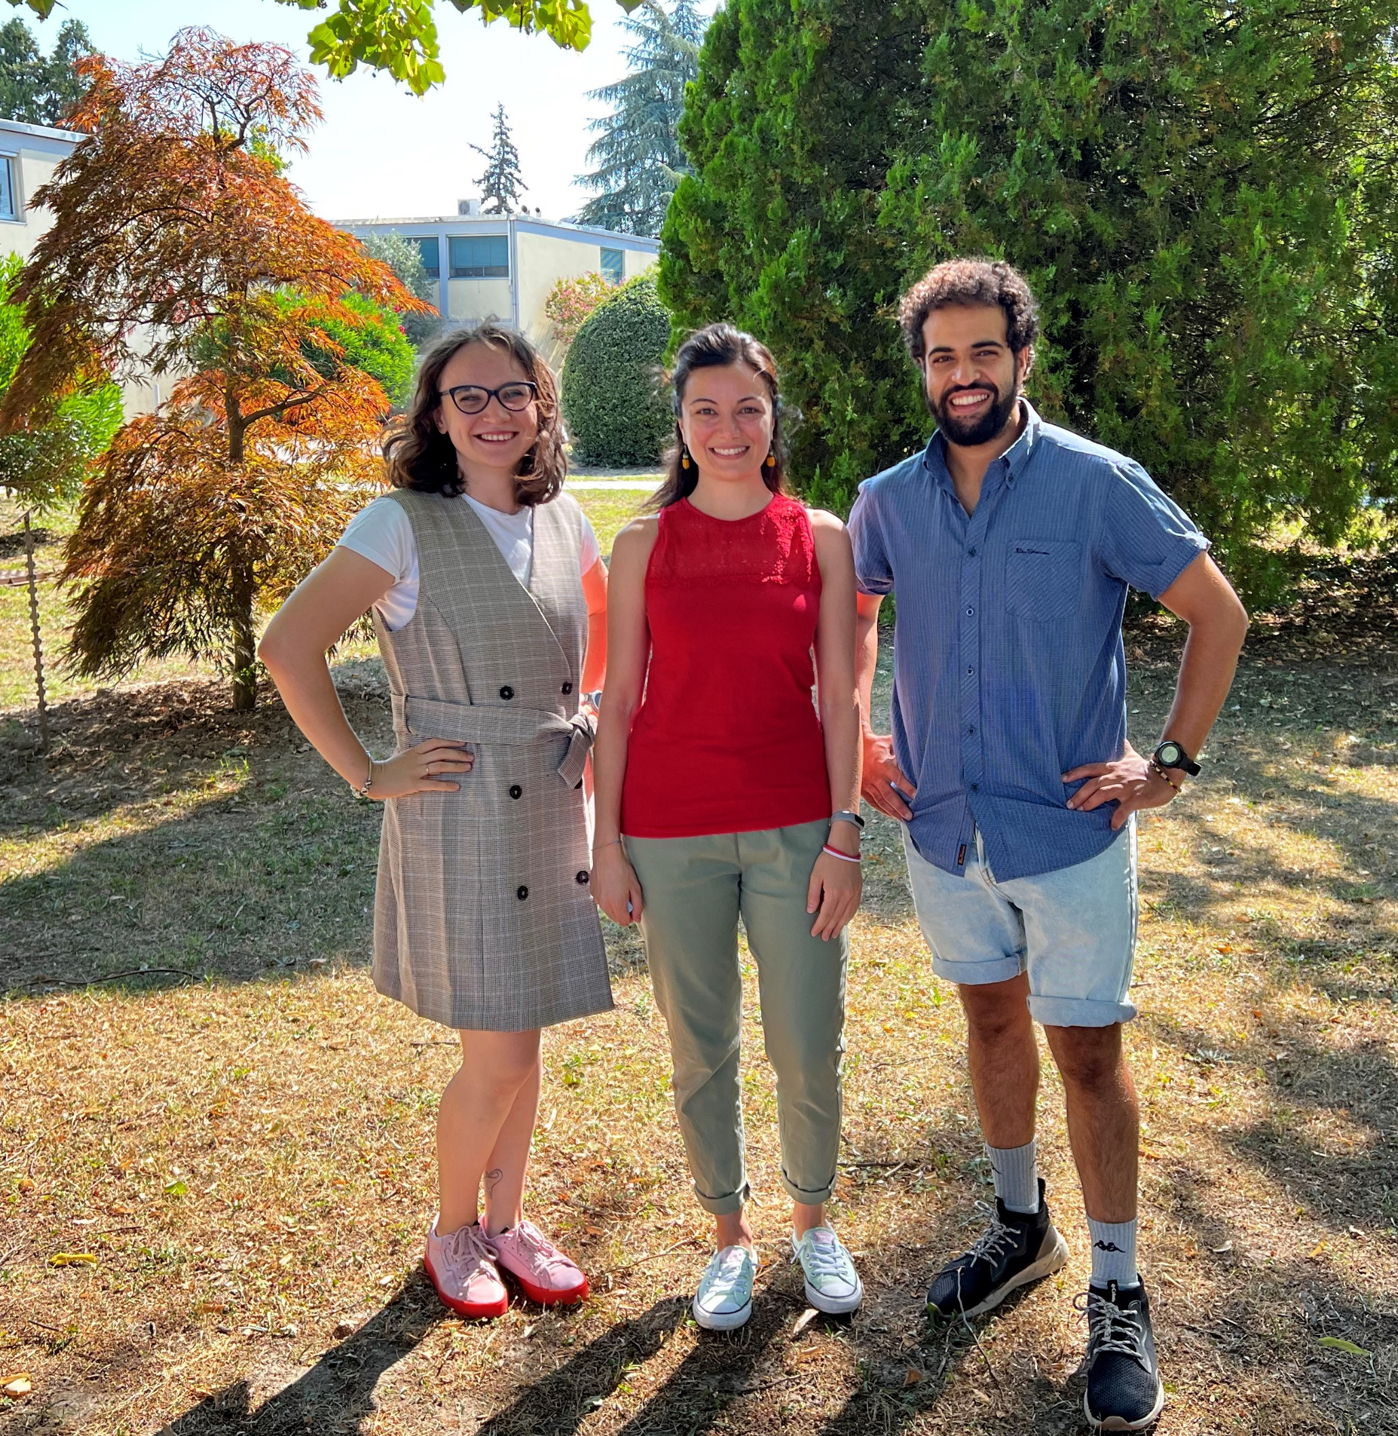
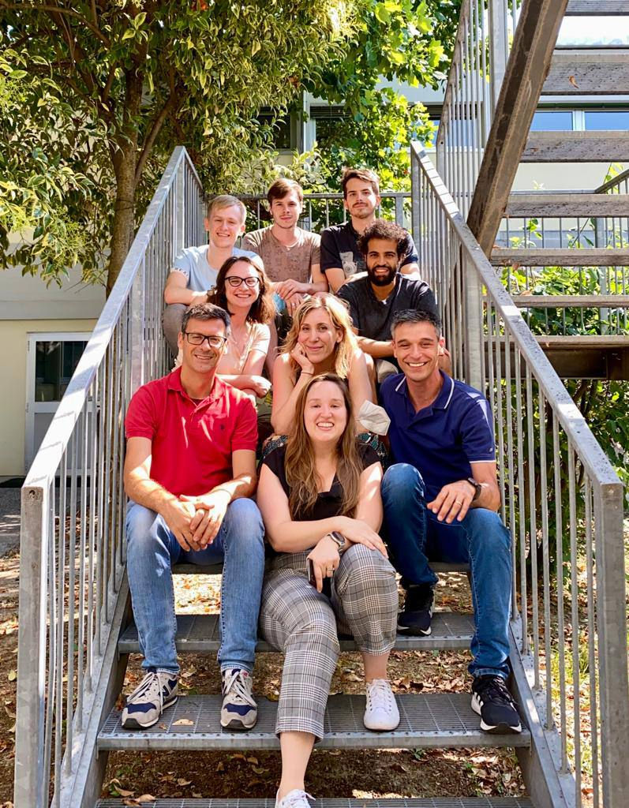
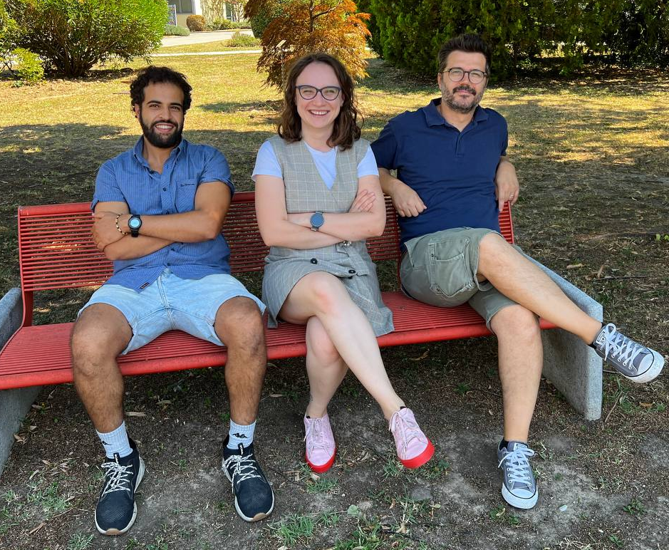

Conclusions
Sara Cisternino
1
Evaluation of sputtering techniques from the material point of view
Realization of recovering shield for standard magnetron deposition
Mourad El Idrissi
An alternative sputtering configuration proposed and realized
First nat-ZnO targets realization by inverted magnetron technique
Oscar Azzolini
Surface Technologies and Superconductivity Service group
Is the magnetron sputtering technique suitable for ZnO target production?
Thank you for your attention!
18th Workshop on Targetry and Target Chemistry Whistler
Alisa Kotliarenko – alisa.kotliarenko@lnl.infn.it

Slide 23

Conclusions
Sara Cisternino
1
Evaluation of sputtering techniques from the material point of view
Realization of recovering shield for standard magnetron deposition
Mourad El Idrissi
An alternative sputtering configuration proposed and realized
First nat-ZnO targets realization by inverted magnetron technique
Oscar Azzolini
Surface Technologies and Superconductivity Service group
Is the magnetron sputtering technique suitable for ZnO target production?
Thank you for your attention!
18th Workshop on Targetry and Target Chemistry Whistler
Alisa Kotliarenko – alisa.kotliarenko@lnl.infn.it

Slide 24
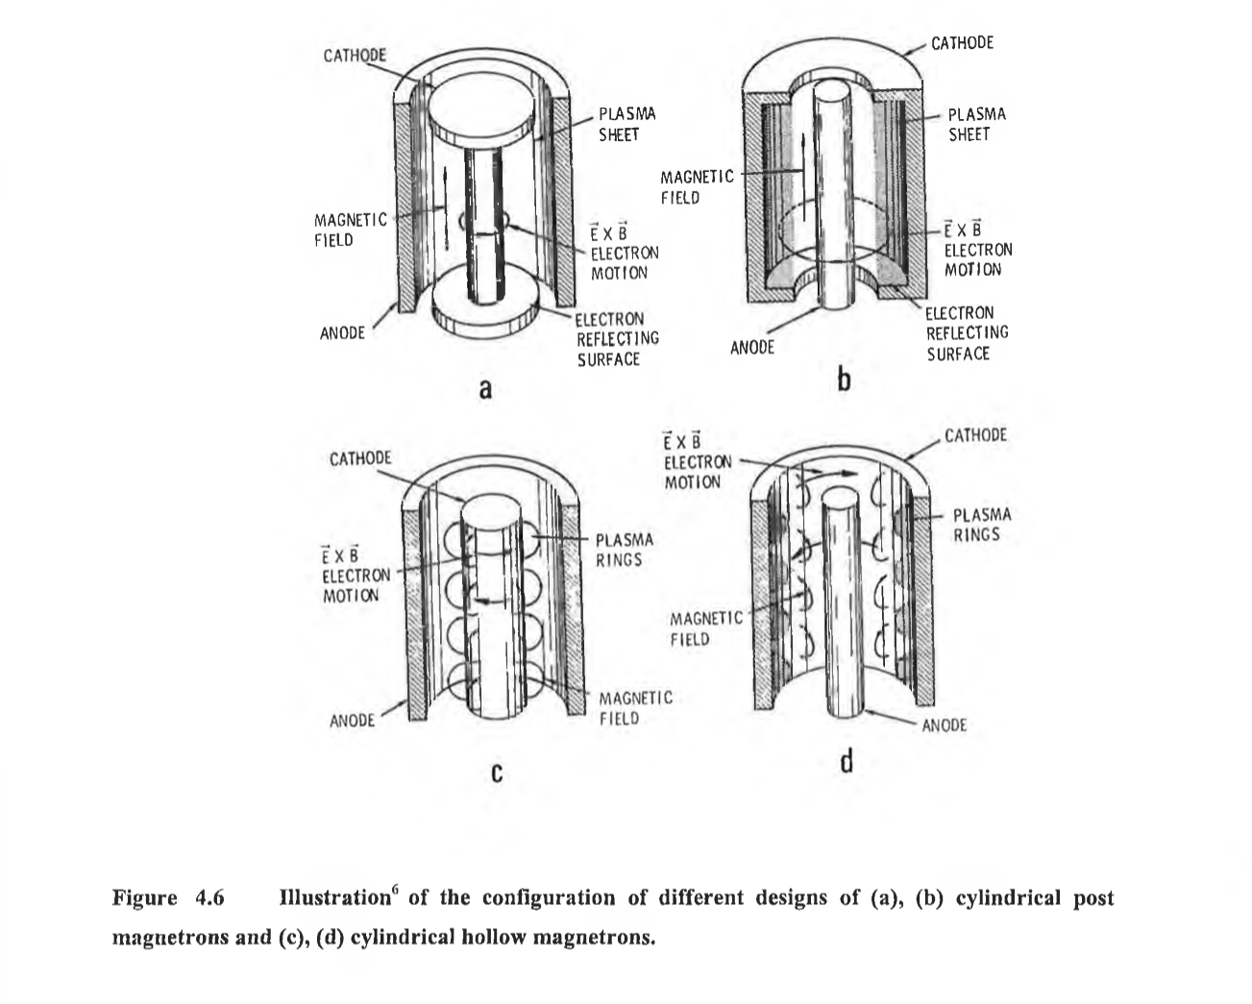

Known hallow magnetron configuration
[O'Leary, Colm (1999) Design, construction and characterisation of a variable balance magnetron sputtering system. Master of Engineering thesis, Dublin City University.]
18th Workshop on Targetry and Target Chemistry Whistler
Alisa Kotliarenko – alisa.kotliarenko@lnl.infn.it

Slide 25
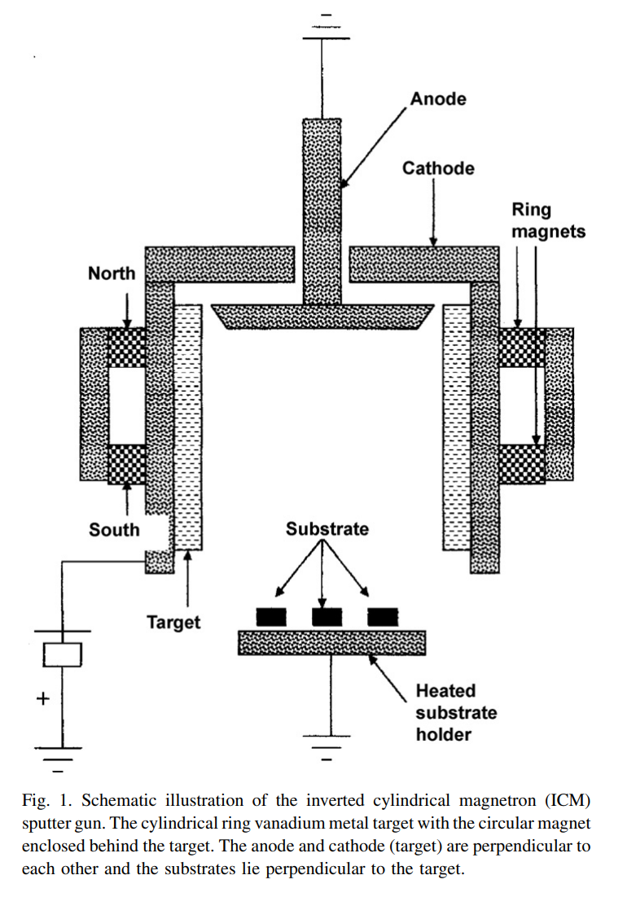
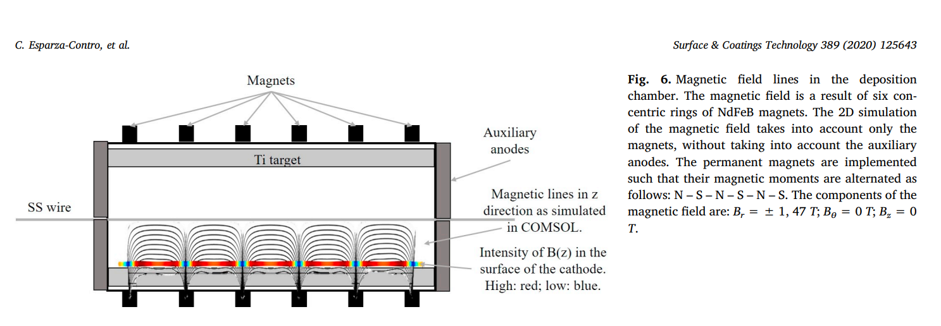
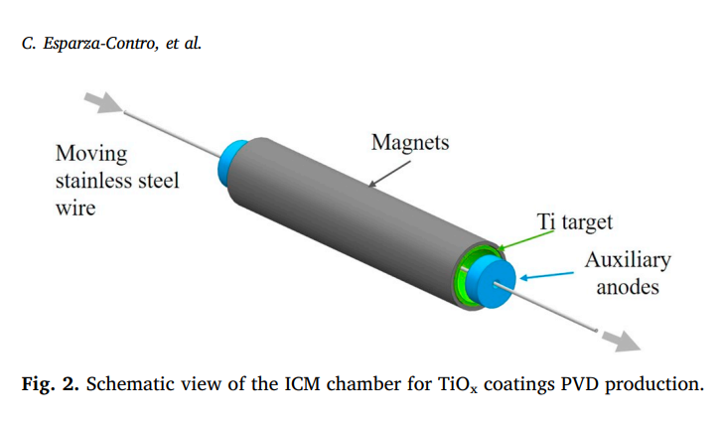
Known hallow magnetron configuration
[J.B.K. Kana et al. / Applied Surface Science 254 (2008) 3959–3963]
18th Workshop on Targetry and Target Chemistry Whistler
Alisa Kotliarenko – alisa.kotliarenko@lnl.infn.it

Slide 26
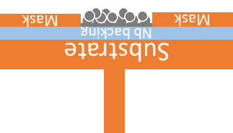


Work in consideration
cooling
cooling
Reduced dimensions
Two targets deposition
COIL
COIL
Mask
Mask
Nb backing
Substrate
18th Workshop on Targetry and Target Chemistry Whistler
Alisa Kotliarenko – alisa.kotliarenko@lnl.infn.it

Slide 27


Work in consideration
cooling
cooling
Sample holder
+ Mask
COIL
COIL
Mask
Mask
Nb backing
Substrate
18th Workshop on Targetry and Target Chemistry Whistler
Alisa Kotliarenko – alisa.kotliarenko@lnl.infn.it

Slide 28
Manufacturing techniques comparison
Target preparation method | MS | HIVIPP | SPS
Target thickness | 0.1µm-1mm | 0.1-10µm | >150µm
Density, % of bulk | >95% | <80% | ~95%
Efficiency (reverse to material losses), % | <20% | 95% | >95%
Backing | Any | El. conductive | Metal
Target preparation time | 1-2 days | 1-2 days | minutes
Thermomechanical performance | >1kW/cm² Excellent | Tested only at low current | >1kW/cm² Excellent
Main defect | High losses | Thickness limitation | NO low thickness
18th Workshop on Targetry and Target Chemistry Whistler
Alisa Kotliarenko – alisa.kotliarenko@lnl.infn.it

Slide 29

XRD comparison
18th Workshop on Targetry and Target Chemistry Whistler
Alisa Kotliarenko – alisa.kotliarenko@lnl.infn.it

Slide 30
Substrate
cooling
cooling
Nb backing
Mask
Mask
COIL
COIL
Cathode
Mask
Mask
Nb backing
Substrate
Permanent magnet
cooling

