Slide 1
Ionic Liquids as Novel Extractants for Separation of Lanthanides and Actinides
Ivis F. Chaple¹, Guy Dutech¹, Veronika Mocko¹, Michael E. Fassbender^{1*}
¹ Los Alamos National Laboratory, P.O. Box 1663, Los Alamos, NM 87545, USA
* Corresponding Author Email Address mifa@lanl.gov

Slide 2
Overview
  Background
  Synthesis
  Data analysis
  Applications
  Conclusions
  Future directions

Slide 3
Background

Slide 4
Background
Lanthanides (4f elements) find use in various everyday technologies, while actinides (5f elements) play an important role in nuclear energy applications.
Lanthanides are considered critical materials, and the development of lanthanide chemical separation methods is paramount for recovery, recycling and purification purposes.
Radiolanthanides also find use as clinical diagnostic (¹⁵²Tb, ¹⁴⁰Nd) and therapeutic (¹⁷⁷Lu, ¹⁶¹Tb) agents.
Lanthanide separation from each other is difficult due to the nearly identical chemical properties.
In order to meet the goal of efficient lanthanide separation, IL extractants will be evaluated for liquid-liquid extraction efficiency.
Notes:
Shows dissociation of 45Ti

Slide 5
Ionic Liquids
At the most basic level, RT ionic liquids are salts that are liquid at room temperature
They are usually composed of large cations, and anions of varying sizes
Less optimal sizes of anions and cations in these salts, are the reason ionic liquids, are liquid at room temperature
Ionic liquids have been observed throughout history
  In 1914, [EtNH₃][NO₃] was synthesized with a melting point of 12°C (53.6°F) [1,2]
They can be used to extract metal ions, in place of other more conventional molecular solvents
Environmentally friendly.
Low toxicity
Welton, T. (1999). "Room-Temperature Ionic Liquids. Solvents for Synthesis and Catalysis." Chemical Reviews 99(8): 2071-2084.
Wasserscheid, Peter, and T. Welton. Ionic Liquids in Synthesis. Wiley-VCH, 2008

Slide 6
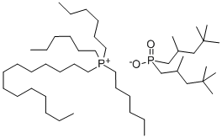
Cyphosil 104
A phosphonium ionic liquid

Slide 7
Previous work at LANL
Measured equilibrium distribution coefficients for Ln(III), Sc(III), Y(III), Th(IV), U(VI), and ²²⁵Ac(III) on the SIR from solutions of HNO₃ and HCl.
Developed chromatographic column systems for the separation of ²²⁵Ac from Ln and Ln from each other.
Inert solid phase IL solvent Extractant
Amberlite XAD7HP
[Bmim][NTf₂]
DODGAA

Slide 8
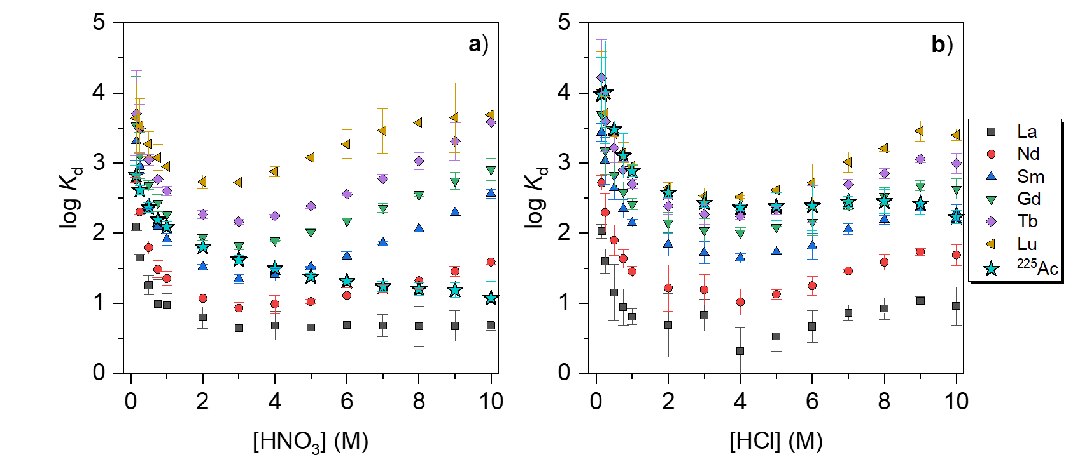
Equilibrium Distribution Coefficients:
“Asymmetric” Ln Sorption Behavior
High selectivity for heavier Ln
High separation factors for lighter Ln
M.T. Friend et al, Extraction chromatography of ²²⁵Ac and lanthanides on N,N‑dioctyldiglycolamic acid /1‑butyl‑3‑methylimidazolium bis(trifluoromethylsulfonyl)imide solvent impregnated resin, J Chrom A, 1624, 461219.

Slide 9

Previous work at LANL
Column chromatography: two possible separation systems
(there are more: U/Th, Th/REE)
²²⁵Ac// ^{223/224/225}Ra/¹⁴⁰Ln/^{141/144}Ce
Ac/Ln separation parameters:
1 mL resin bed, 0.1 mL∙min⁻¹, 5 mg∙L⁻¹ La‑Lu (excluding Pm) each; spiked with 5 kBq of ²²⁵Ra(II) and 10 kBq of ²²⁵Ac(III).
¹⁴⁰Nd//¹⁴¹Pr
Ln/Ln separation parameters:
2 mL resin bed, 0.03 mL∙min⁻¹, 5 mg∙L⁻¹ each Ln(III).

Slide 10
Synthesis

Slide 11
Resin Synthesis
Cyphosil 104 Impregnated Amberlite
Peak at 983 cm⁻¹ shifted to 947 cm⁻¹ when functionalized due to stretching vibration of the bond Cr-O
Peaks at 2930cm⁻¹, 2859 cm⁻¹, and 2957 cm⁻¹ are stretching vibrations of CH₃ and CH₂ in Cyphos IL 104
Peak at 1735 cm⁻¹ is the vibration of C=O in resin
*
*
*
Notes:
Trihexyltetradecylphosphonium bis(2,4,4-trimethylpentyl)phosphinate is a phosphonium-based ionic liquid. It can be prepared by reacting trihexyl(tetradecyl)-phosphonium chloride with bis(2,4,4-trimethylpentyl)phosphinic acid in the presence of a base.
It can be used as an extractant for the removal of dibenzothiophene from liquid fuels via extractive desulfurization (EDS).

Slide 12
Data Analysis

Slide 13
Preliminary Results
2 hour incubation (HNO₃)
24 hour incubation (NH₄NO₃)

Slide 14
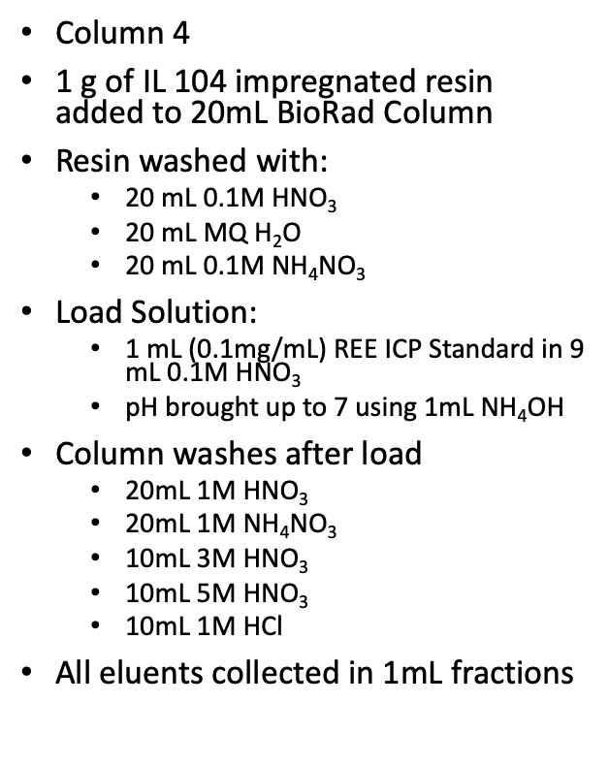
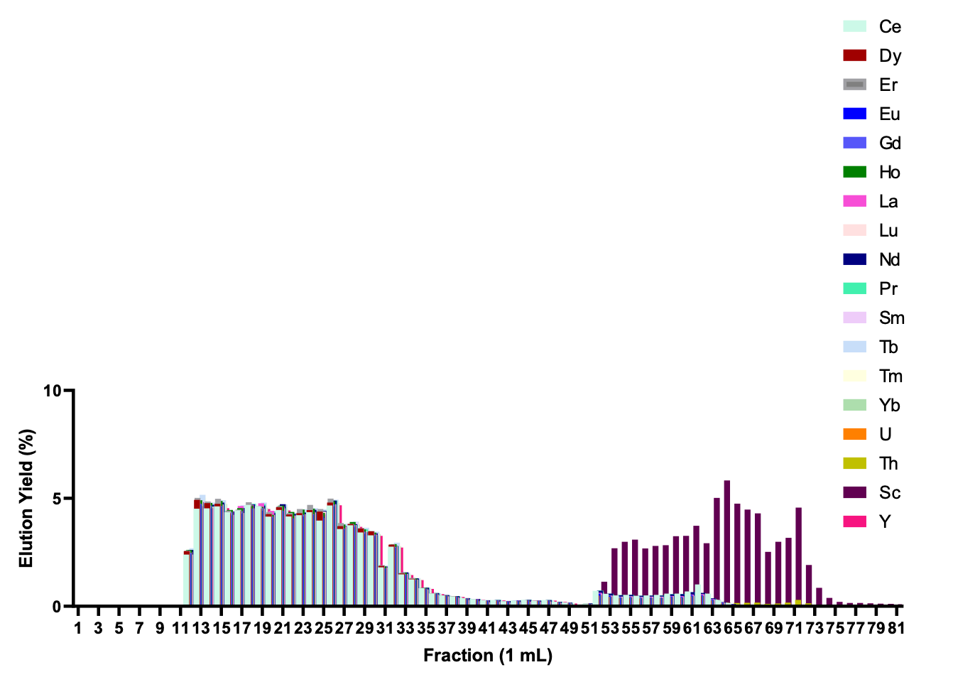
Column Separation
Notes:
•Yields
•95%-100% recovery of most lanthanides
•3% recovery of Th
•76% recovery of Sc
•1% recovery of U

Slide 15
Section Two
Conclusion
Ionic Liquid impregnated resin can be synthesized
Separation of certain metals can be achieved
A “greener” alternative to other extractants

Slide 16
Section Three

Slide 17
Conclusions
Radioisotopes find a multitude of uses
Current research allows for production, purification, and specific applications in various fields
Nuclear medicine is a powerful tool with the potential to impact patient care
Ionic liquids may be helpful in the nuclear fuel waste problem

Slide 18
Future Directions
Separation of medically relevant radioisotopes
  Lanthanides; ¹⁶¹Tb, ¹⁷⁷Lu.
  Actinides; ^{225/227}Ac, ²²⁷Th.
  Transition metals; ^{44/47}Sc
Radiochemistry
  Research and development of radiopharmaceuticals

Slide 19
Acknowledgements
This research was supported by the U.S. Department of Energy Isotope Program, managed by the Office of Science for Isotope R&D and Production

Slide 20
Thank you!

