Slide 1
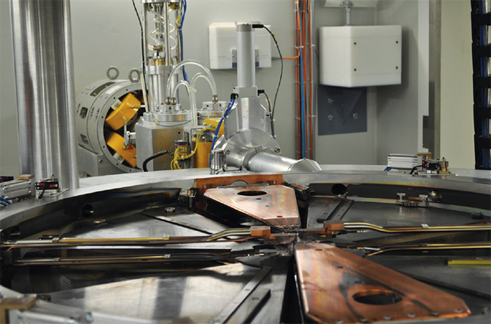


Towards optimized production of ¹⁵⁵Tb with solid targets
at the Bern medical cyclotron
G. Dellepiane¹, P. Casolaro¹, C. Favaretto², P.V. Grundler², I. Mateu¹, P. Scampoli^{1,3}, Z. Talip², N.P. van der Meulen², S. Braccini¹
¹ Albert Einstein Center for Fundamental Physics, Laboratory for High Energy Physics, University of Bern, Switzerland
² Center for Radiopharmaceutical Sciences, Paul Scherrer Institute, Villigen, Switzerland
³ Department of Physics «Ettore Pancini», University of Napoli Federico II, Complesso Universitario di Monte S. Angelo, Italy

Slide 2

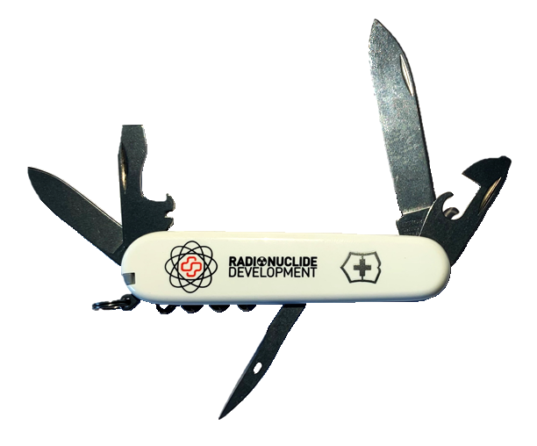




Theranostics in nuclear medicine
PET / SPECT imaging
(β⁺ / γ)
Terbium: the Swiss Army Knife
Tb 152
17.5 h
Tb 161
6.90 d
ε
β⁺
γ
β⁻
γ
e⁻
Tb 155
5.32 d
Positron
511 keV gamma ray
ε
γ
β⁺ emitter
Tb 149
4.1 h
Auger-therapy
511 keV gamma ray
Electron
ε
α
β⁺
γ
PET
α-therapy
SPECT
gamma ray
γ emitter
Müller et al. 2012 J Nucl Med 53 1951
Targeted radionuclide therapy
(α, β⁻, Auger)
Research program ongoing at
the Bern cyclotron laboratory:
Theranostic and non-standard radioisotope production with solid targets;
Accelerator and detector physics developments;
Proton beam energy measurement;
Nuclear cross-section measurements.
DNA
Charged particle
track
clustered DNA damage
α, β⁻,
Auger emitter
G. Dellepiane – WTTC18

Slide 3
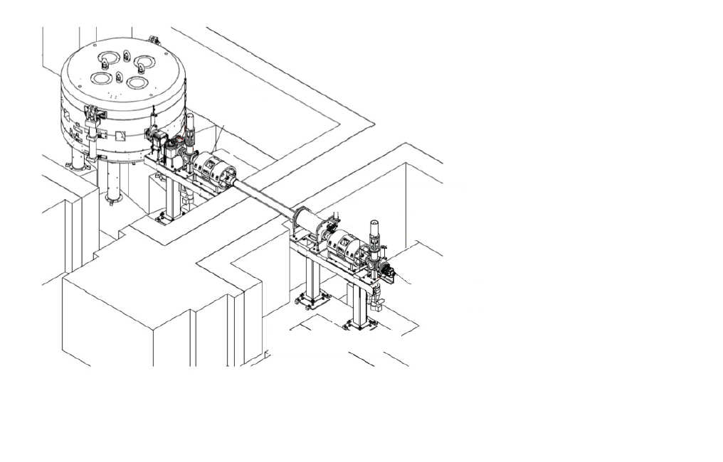
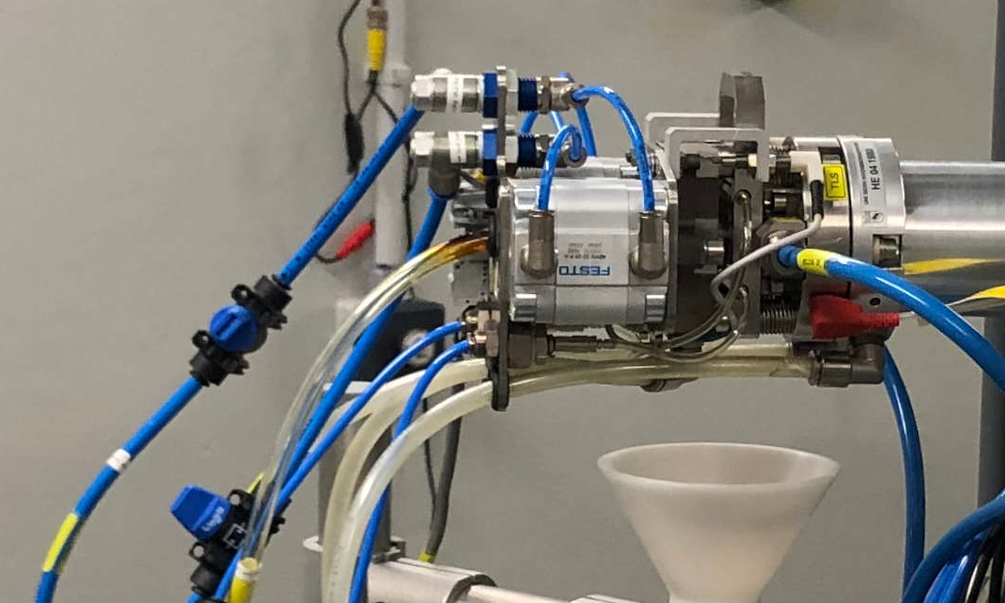
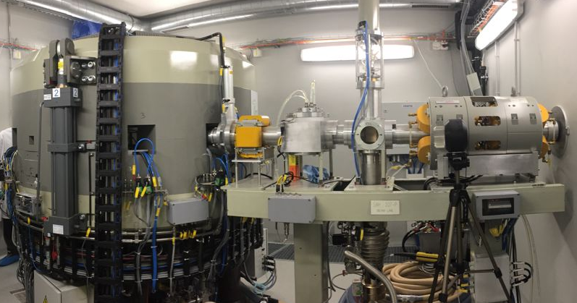

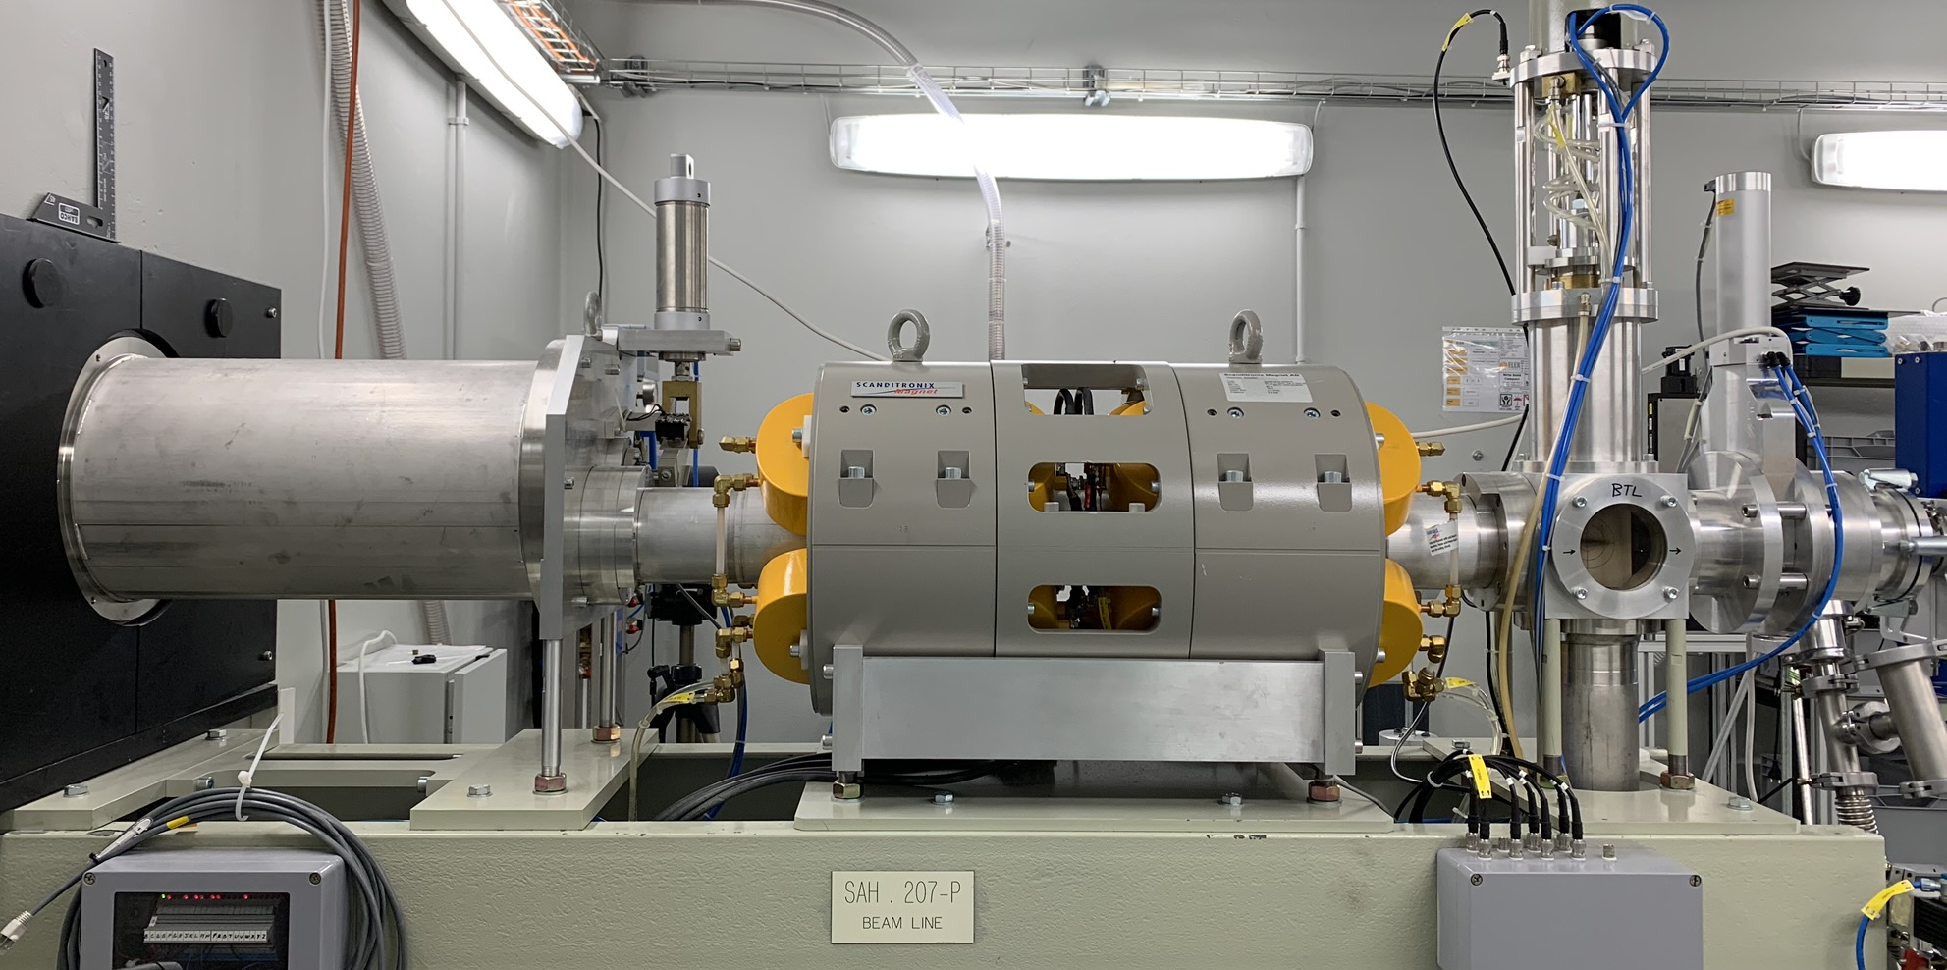
The Bern medical cyclotron laboratory
Solid Target Station (STS)
18 MeV Bern medical cyclotron
Beam Transfer Line (BTL)
IBA 18/18 HC cyclotron
Two H⁻ ion sources
High current (max 150 µA)
8 out ports:
  6 ¹⁸F liquid targets [industrial production]
  Solid Target Station (STS) [research]
  Beam Transfer Line (BTL) [research]
G. Dellepiane – WTTC18

Slide 4
Terbium radioisotopes
 | ¹⁵²Gd | ¹⁵⁴Gd | ¹⁵⁵Gd | ¹⁵⁶Gd | ¹⁵⁷Gd | ¹⁵⁸Gd | ¹⁵⁹Gd
Nat [%] | 0.20 | 2.18 | 14.80 | 20.47 | 15.65 | 24.84 | 21.86
Enr-155 [%] | <0.02 | 0.5 | 91.90(30) | 5.87 | 0.81 | 0.65 | 0.27
Enr-156 [%] | <0.01 | 0.05 | 0.87 | 93.30(10) | 4.38 | 1.08 | 0.32
¹⁵³Tb
(t_{1/2} = 2.34 d)
¹⁵⁴Tb
¹⁵⁵Tb
(t_{1/2} = 5.32 d)
¹⁵⁶Tb
^{154g}Tb
(t_{1/2} = 21.5 h)
^{154m1}Tb
(t_{1/2} = 9.4 h)
^{154m2}Tb
(t_{1/2} = 22.7 h)
^{156g}Tb
(t_{1/2} = 5.35 d)
^{156m1}Tb
(t_{1/2} = 24.4 h)
^{156m2}Tb
(t_{1/2} = 5.3 h)
ec, β⁺
100%
ec, β⁺
78.2%
IT
21.8%
ec, β⁺
98.2%
IT
1.8%
ec, β⁺
100%
IT
100%
IT
100%
¹⁵⁴Gd
¹⁵⁴Gd
^{154g}Tb
¹⁵⁴Gd
^{154g}Tb
¹⁵⁶Gd
^{156g}Tb
^{156g}Tb
ec, β⁺
100%
ec, β⁺
100%
ec, β⁺
100%
ec, β⁺
100%
¹⁵⁴Gd
¹⁵⁴Gd
¹⁵⁶Gd
¹⁵⁶Gd
G. Dellepiane et al, Appl. Radiat. Isot. 2022, 184, 110175
G. Dellepiane – WTTC18

Slide 5
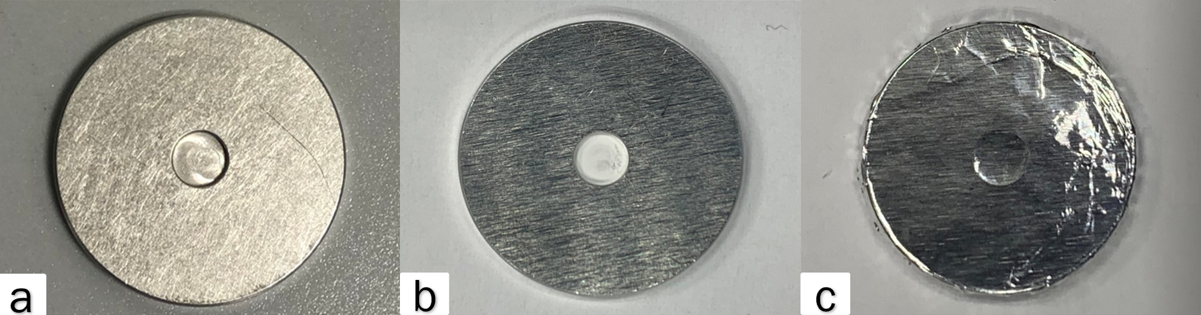
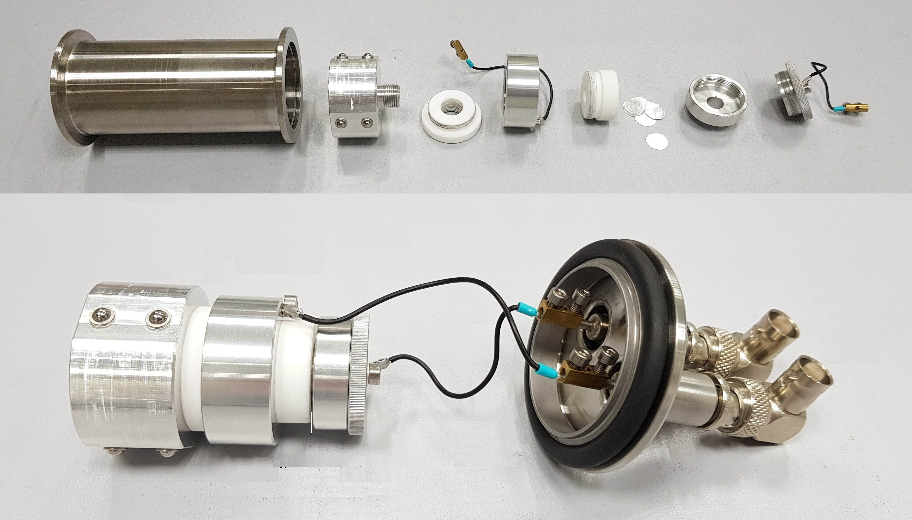
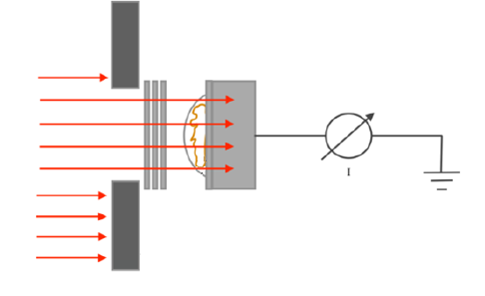
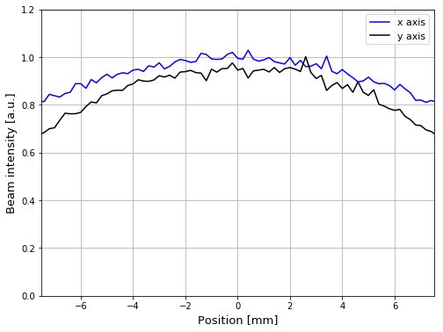
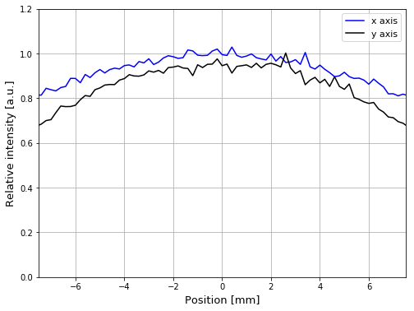
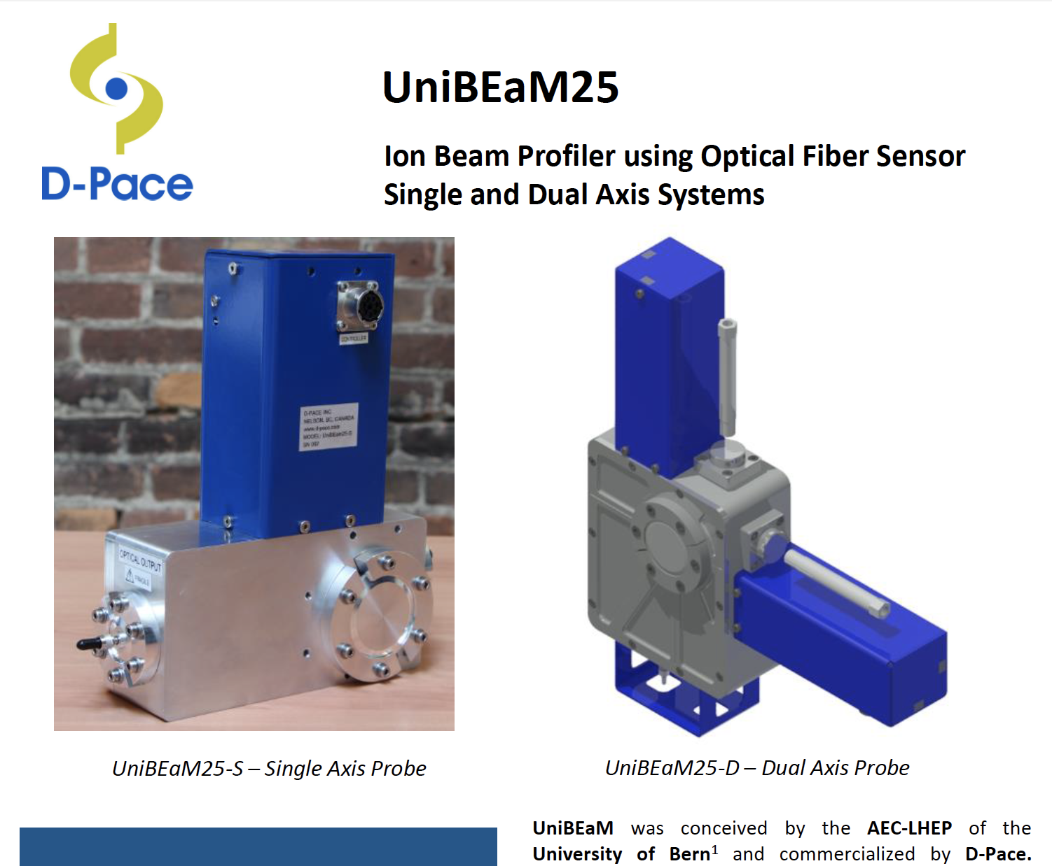

Cross-section measurements
p
Aluminum attenuators
Grounded
collimator
Electron suppressor ring
Target position
Beam current signal
Target for cross section measurement: (a) empty aluminum disc (24 mm diameter, 2 mm thick); (b) aluminum disc filled with Gd₂O_{3;} (c) aluminum disc covered with a thin aluminum foil
p
Flat beam procedure
Attenuators position
Bias voltage
Target material
$\frac{dm}{dS}≠$ const$; \frac{dI}{dS}=$ const
COLLIMATOR
Flat proton beam
Attenuators
UniBEaM detector
Developed by LHEP
commercialized by
D-Pace
Collimator
TARGET
T.S. Carzaniga et al, Appl. Radiat. Isot. 2017, 129, 96
G. Dellepiane – WTTC18

Slide 6
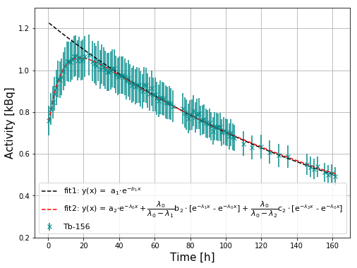
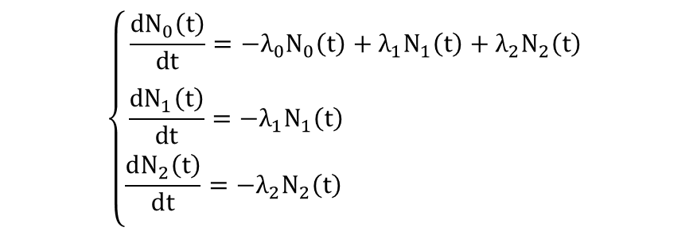
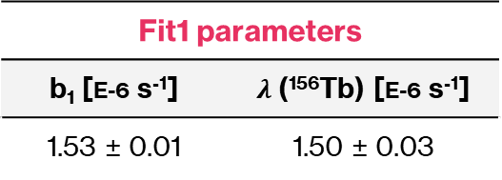
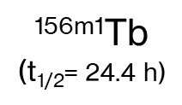
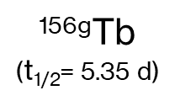
Cross-section measurements: ¹⁵⁶Tb
Method 1: t >> T_{1/2} (^{156m1}Tb, ^{156m2}Tb)
cumulative-type ¹⁵⁶Tb cross section
Gd(p,X)
Method 2: several measurements during the decay time
^{156g}Tb
($\text{t}\text{1/2}$= 5.35 d)
^{156m1}Tb
($\text{t}\text{1/2}$= 24.4 h)
^{156m2}Tb
(t_{1/2} = 5.3 h)
Enriched ¹⁵⁵Gd₂O₃
EC, β⁺ (100%)
IT (100%)
IT (100%)
¹⁵⁶Gd
^{156g}Tb
^{156g}Tb
EC, β⁺ (100%)
EC, β⁺ (100%)
¹⁵⁶Gd
¹⁵⁶Gd
Bateman equations
$$\left\{\begin{aligned}\frac{dN_{0}\left(t\right)}{dt}=−λ_{0}N_{0}\left(t\right)+λ_{1}N_{1}\left(t\right)+λ_{2}N_{2}\left(t\right) \\ \begin{aligned}& \\ \frac{dN_{1}\left(t\right)}{dt}=−λ_{1}N_{1}\left(t\right) \end{aligned} \\ &\frac{dN_{2}\left(t\right)}{dt}=−λ_{2}N_{2}\left(t\right) \\ &\end{aligned}\right.$$
^{156g}Tb:
^{156m1}Tb:
^{156m2}Tb:
Fit1 parameters
b₁ [E-6 s⁻¹] | $λ$(¹⁵⁶Tb) [E-6 s⁻¹]
1.53 ± 0.01 | 1.50 ± 0.03
Fit2 parameters | Fit1 parameters
a₂ [kBq] | b₂ [kBq] | c₂ [kBq]
0.726 ± 0.007 | No Signal | 11.6 ± 0.2
G. Dellepiane – WTTC18

Slide 7
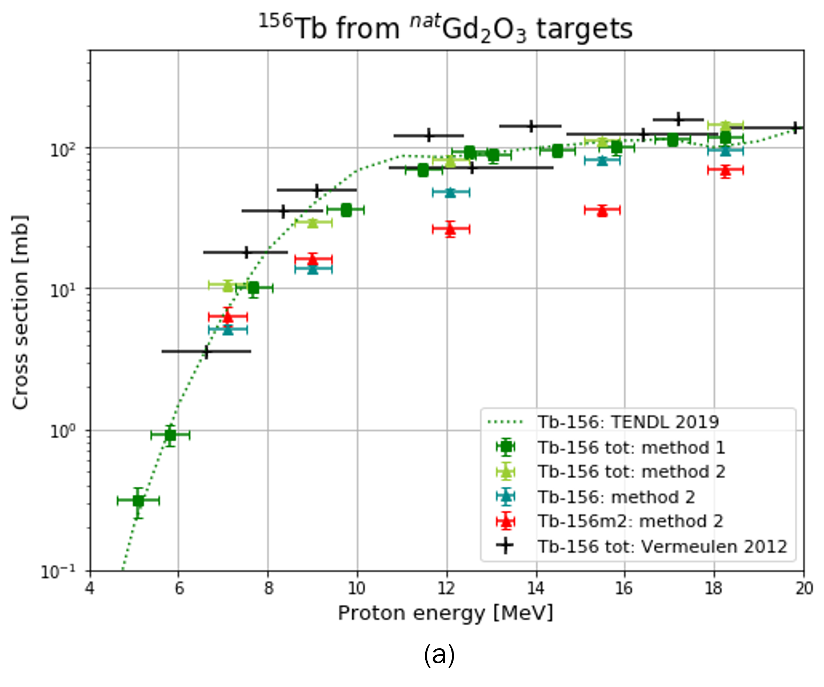
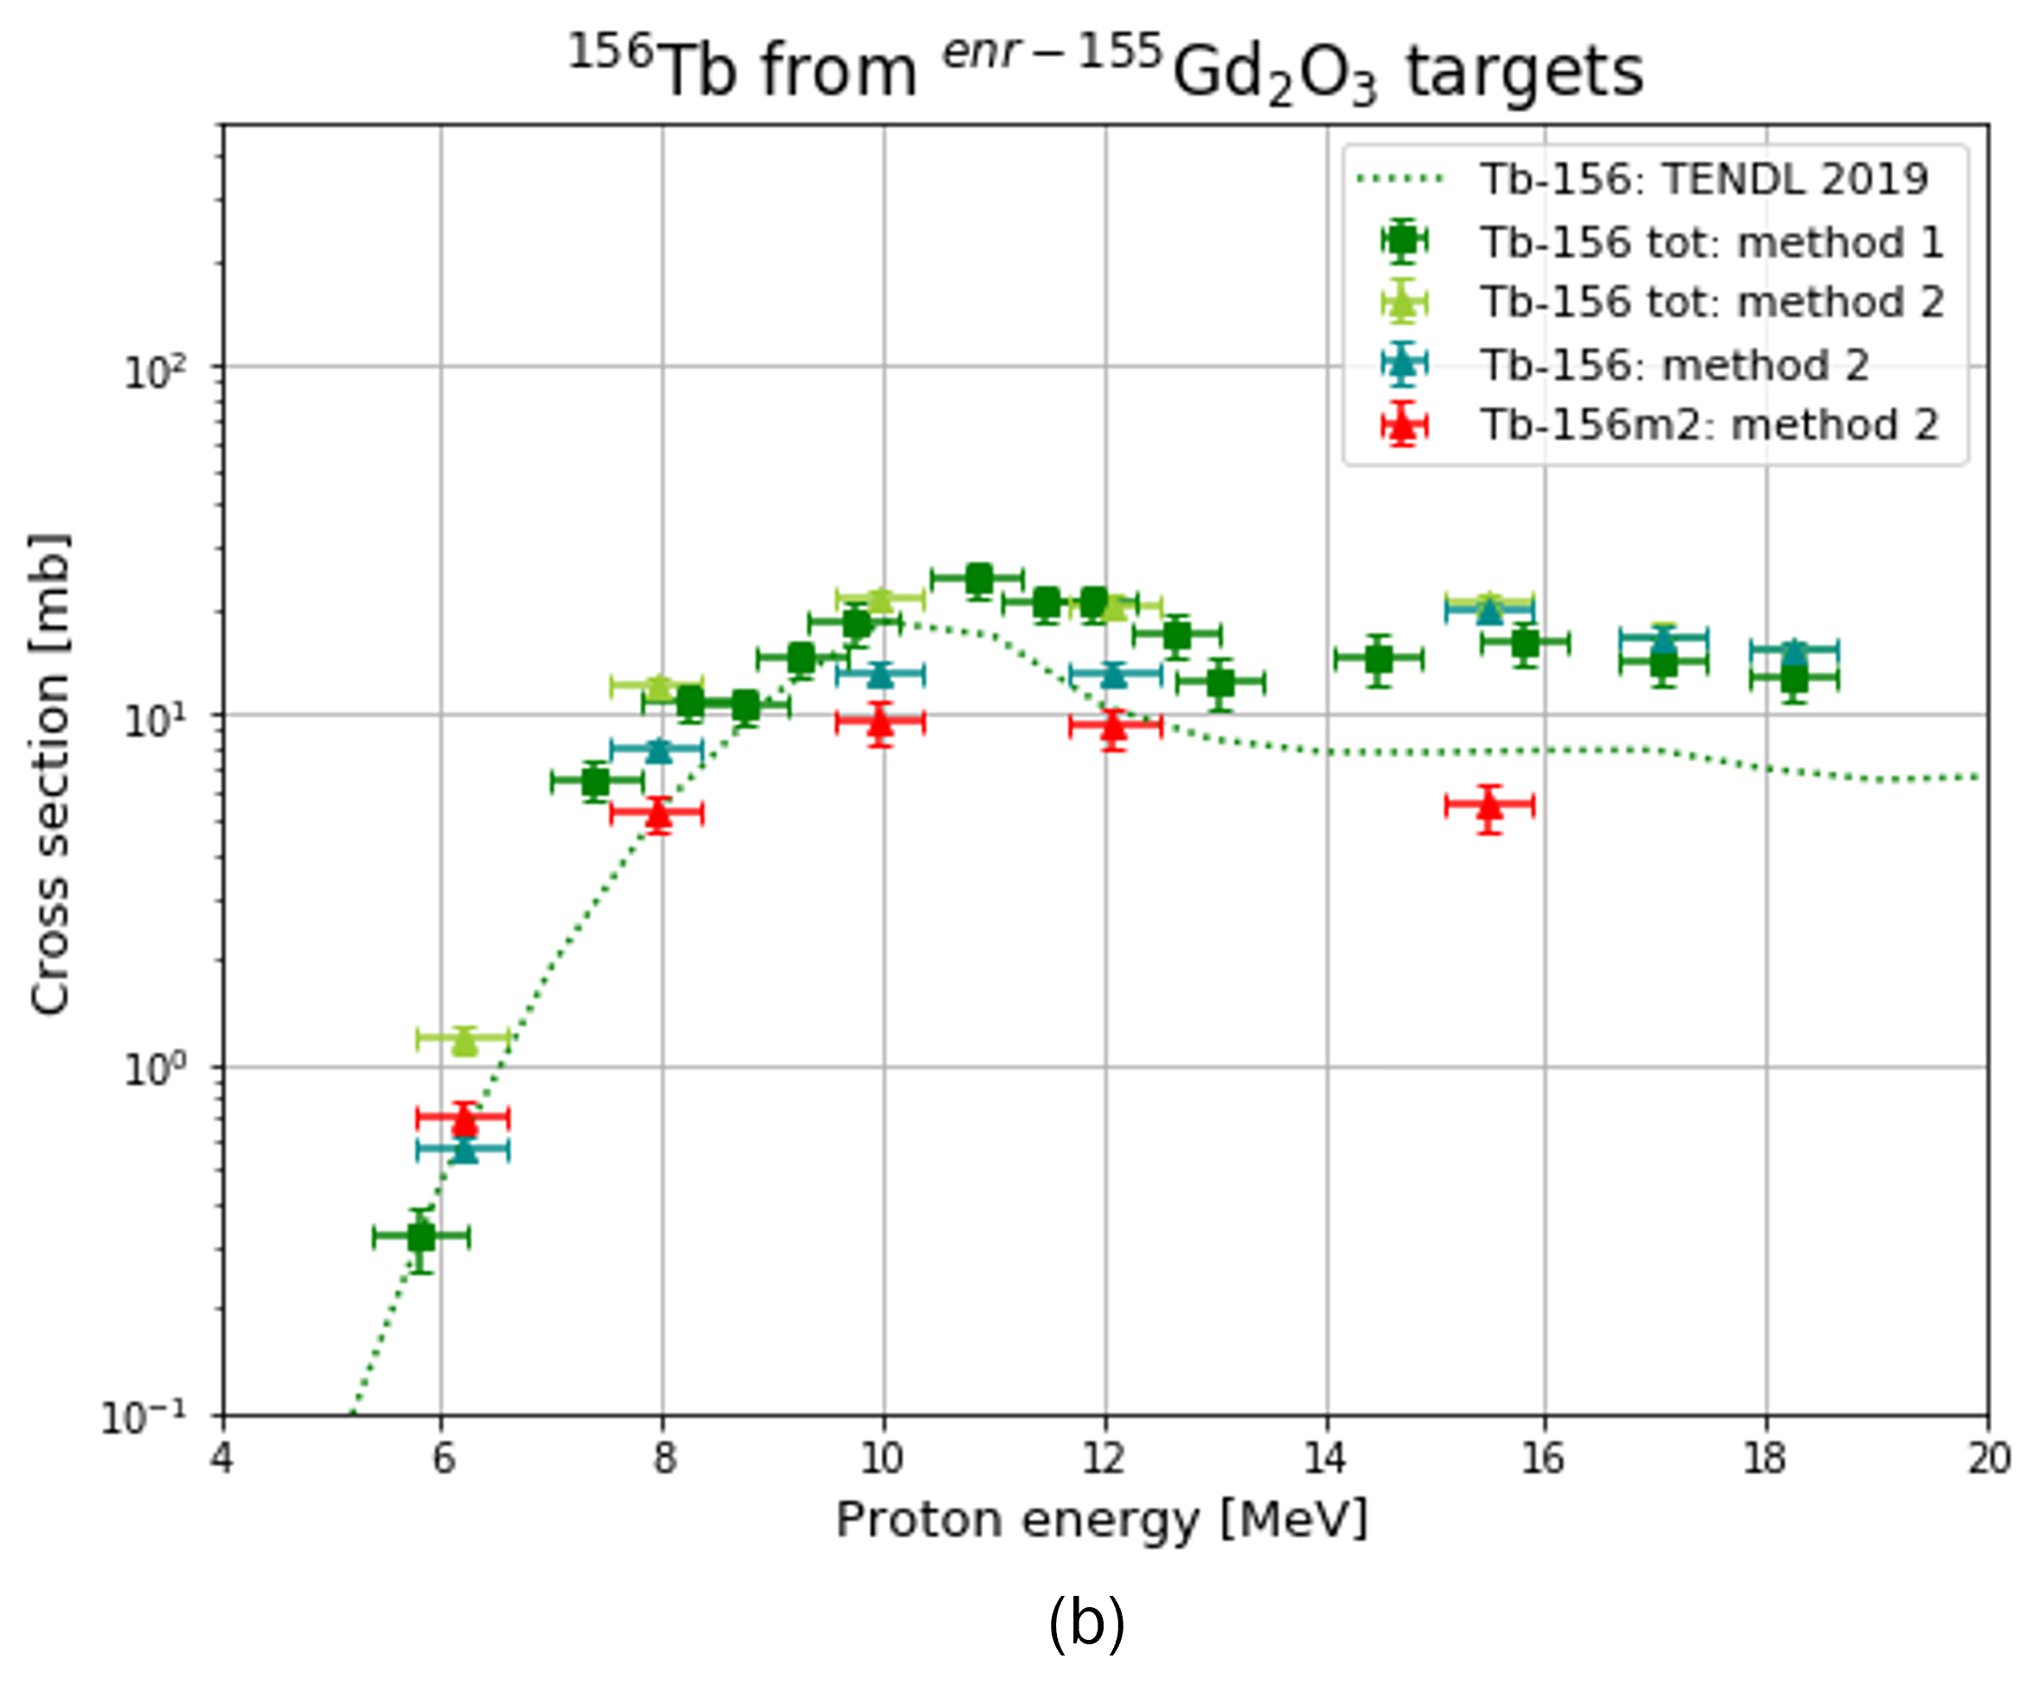
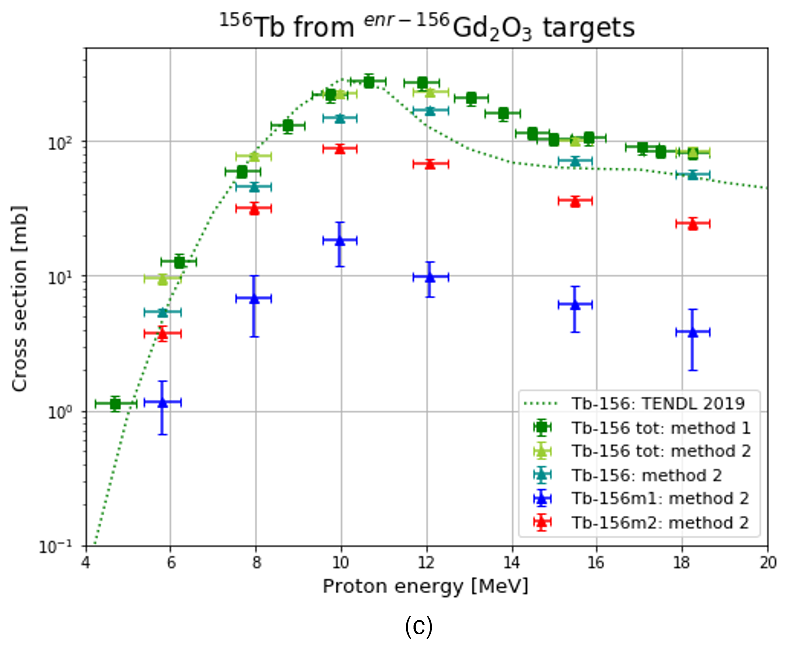
Cross-section measurements: ¹⁵⁶Tb
G. Dellepiane – WTTC18

Slide 8
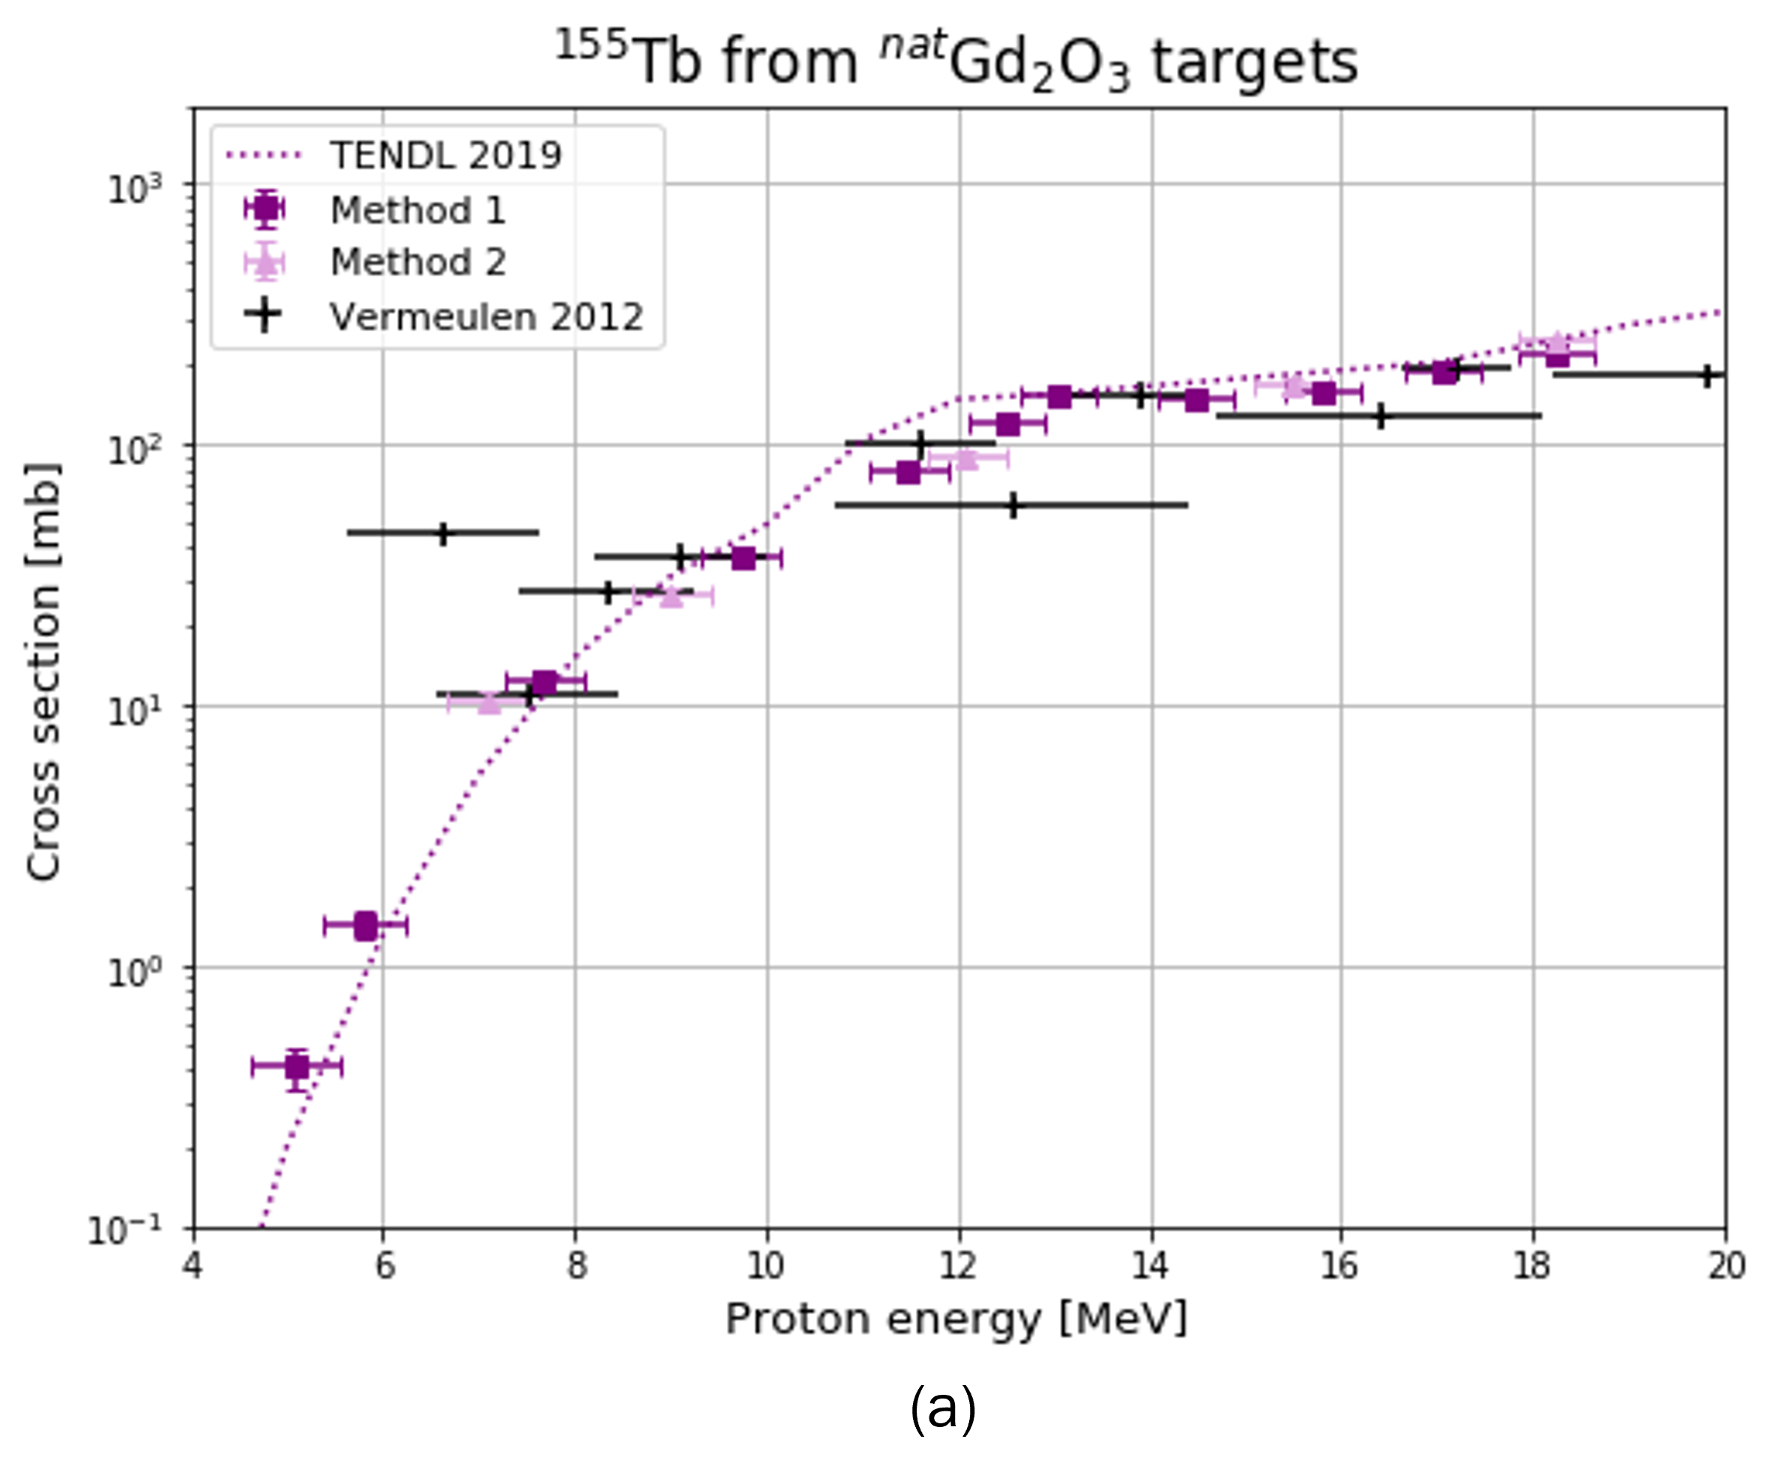
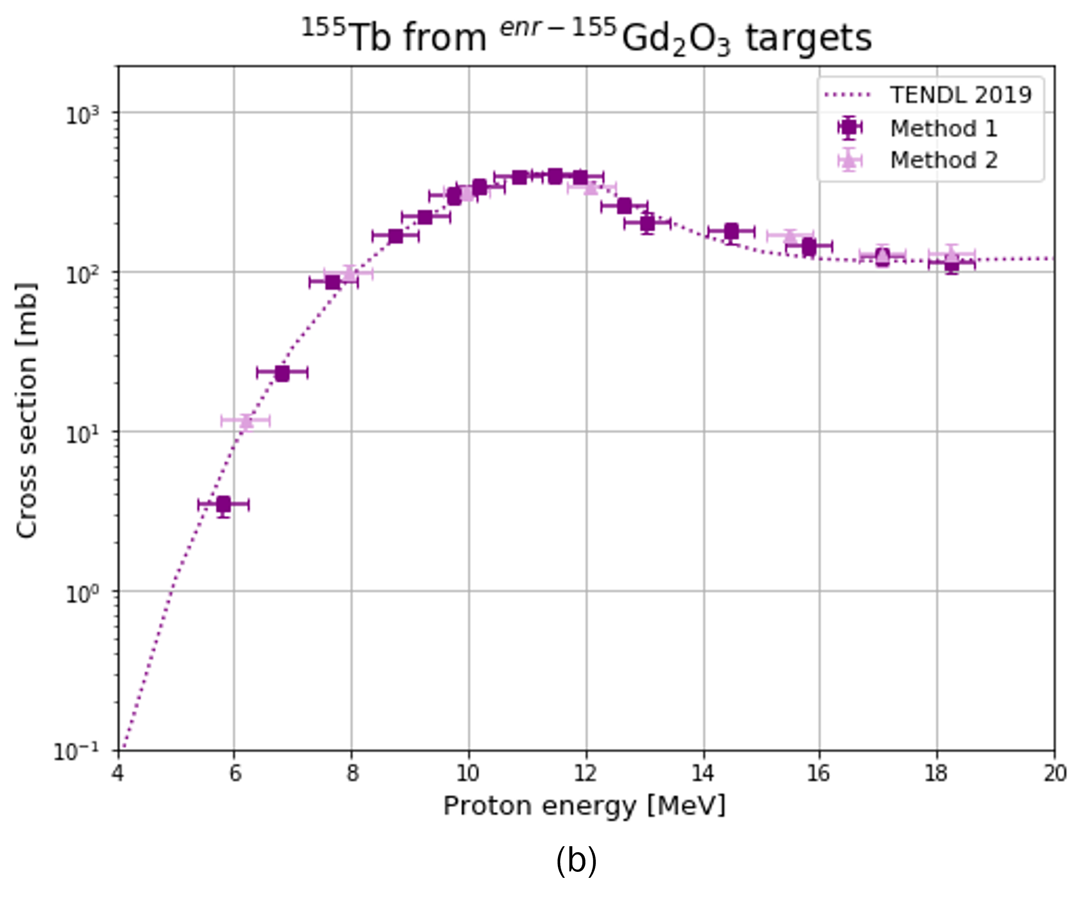
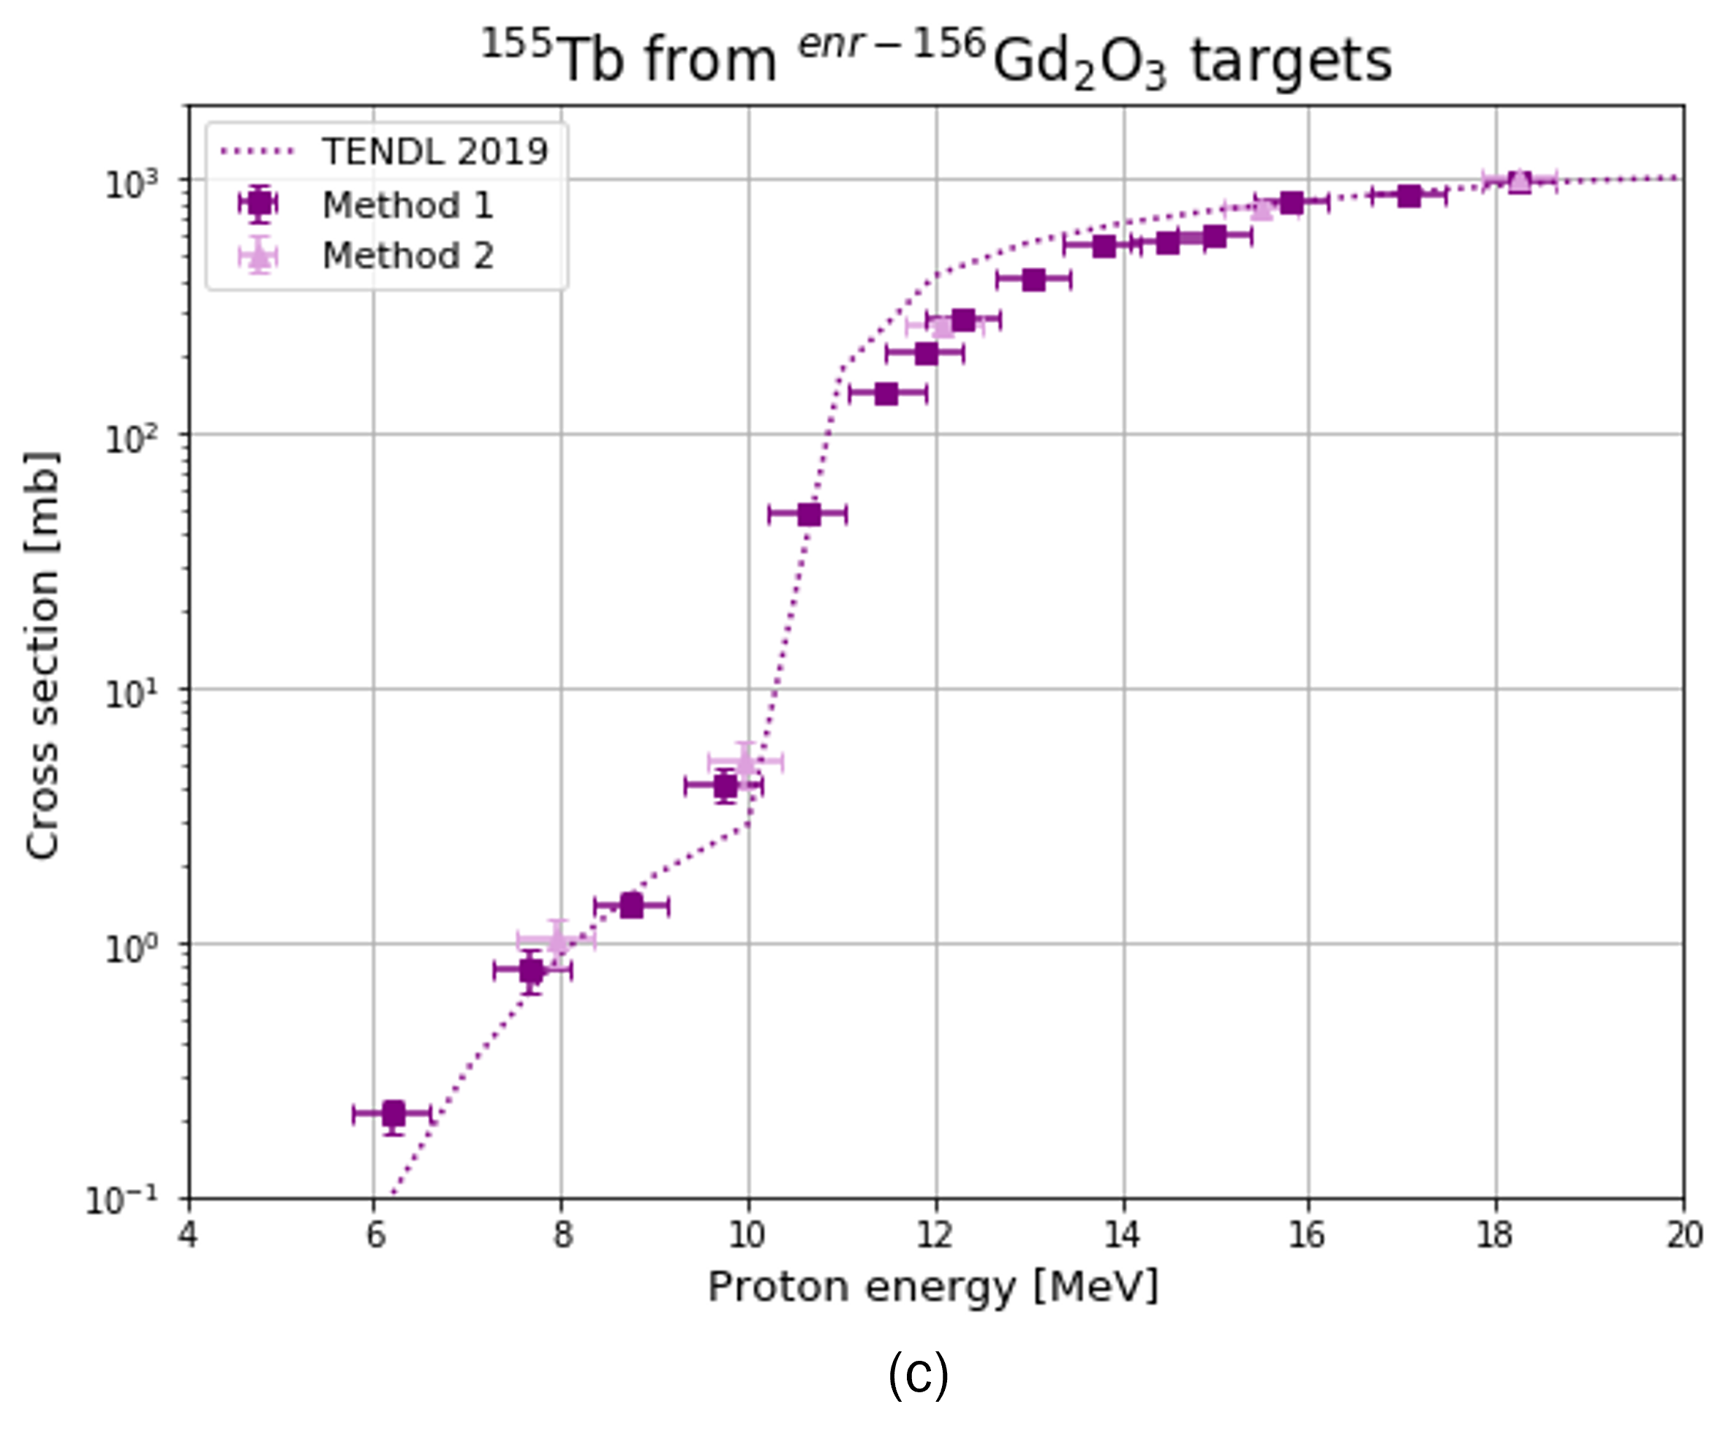

Cross-section measurements: ¹⁵⁵Tb
Gd(p,X)
¹⁵⁵Tb
($\text{t}\text{1/2}$= 5.32 d)
EC (100%)
¹⁵⁵Gd
G. Dellepiane – WTTC18

Slide 9
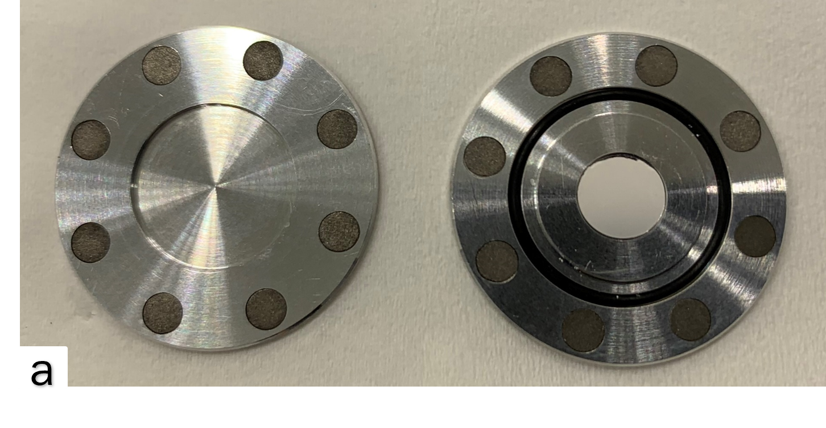
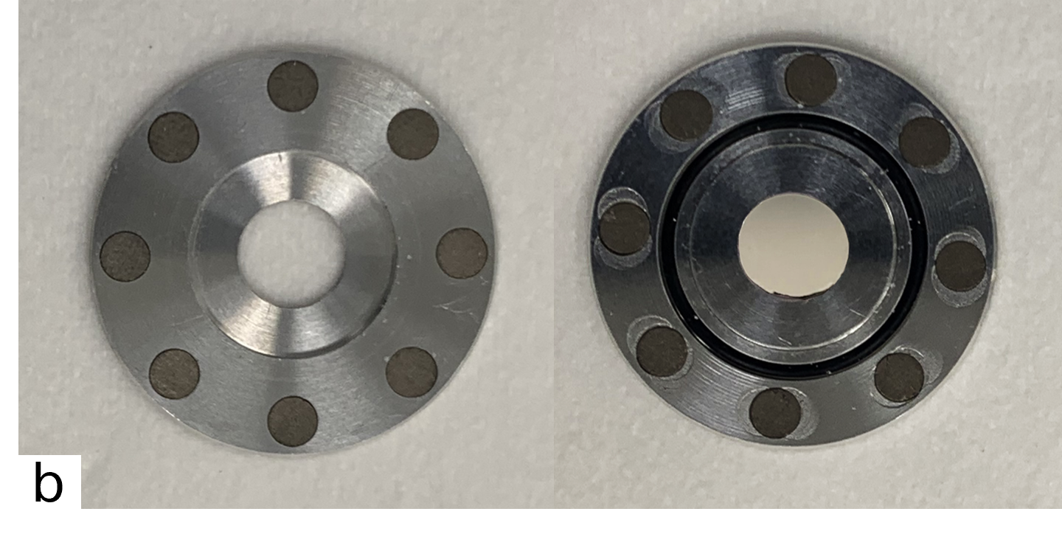
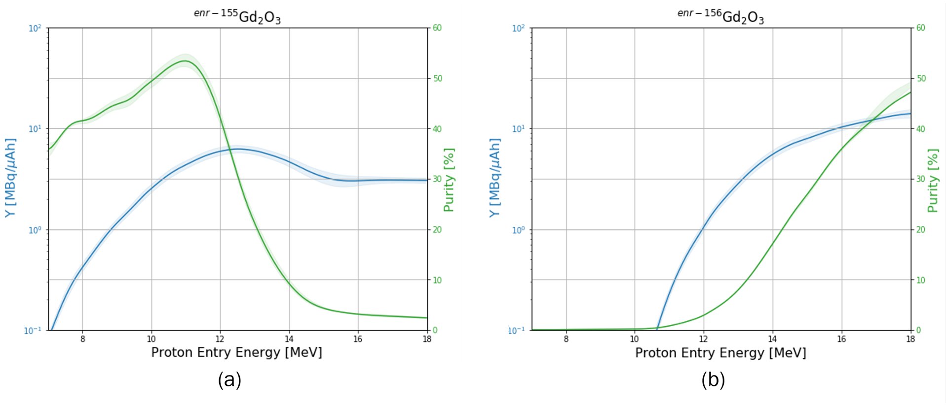
¹⁵⁵Tb production
Targets for ¹⁵⁵Tb production tests: (a) coin with a 0.24 mm covering lid, containing a ~40 mg ¹⁵⁵Gd₂O₃ pellet; (b) coin with a 7 mm hole in the lid, containing a ~40 mg ¹⁵⁶Gd₂O₃ pellet
Enriched ¹⁵⁵Gd₂O₃
Enriched ¹⁵⁶Gd₂O₃
G. Dellepiane – WTTC18

Slide 10
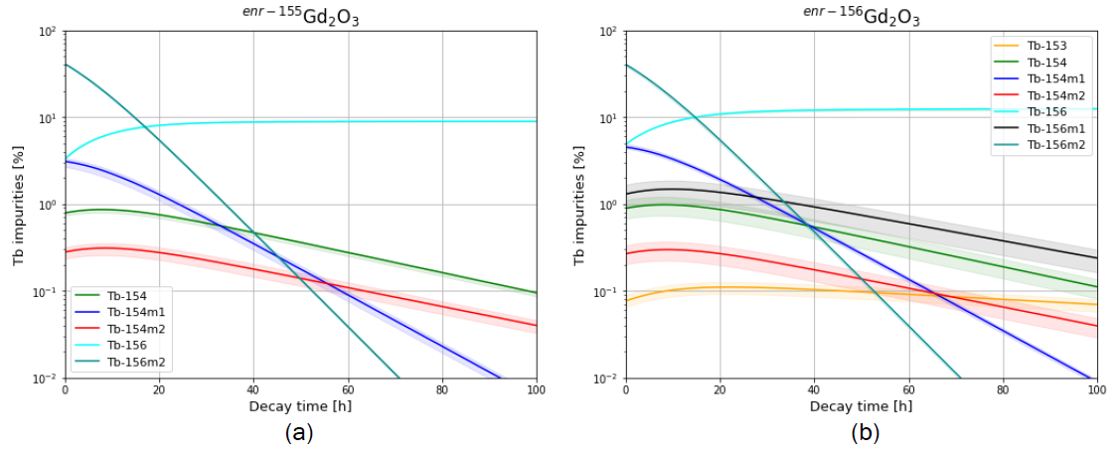
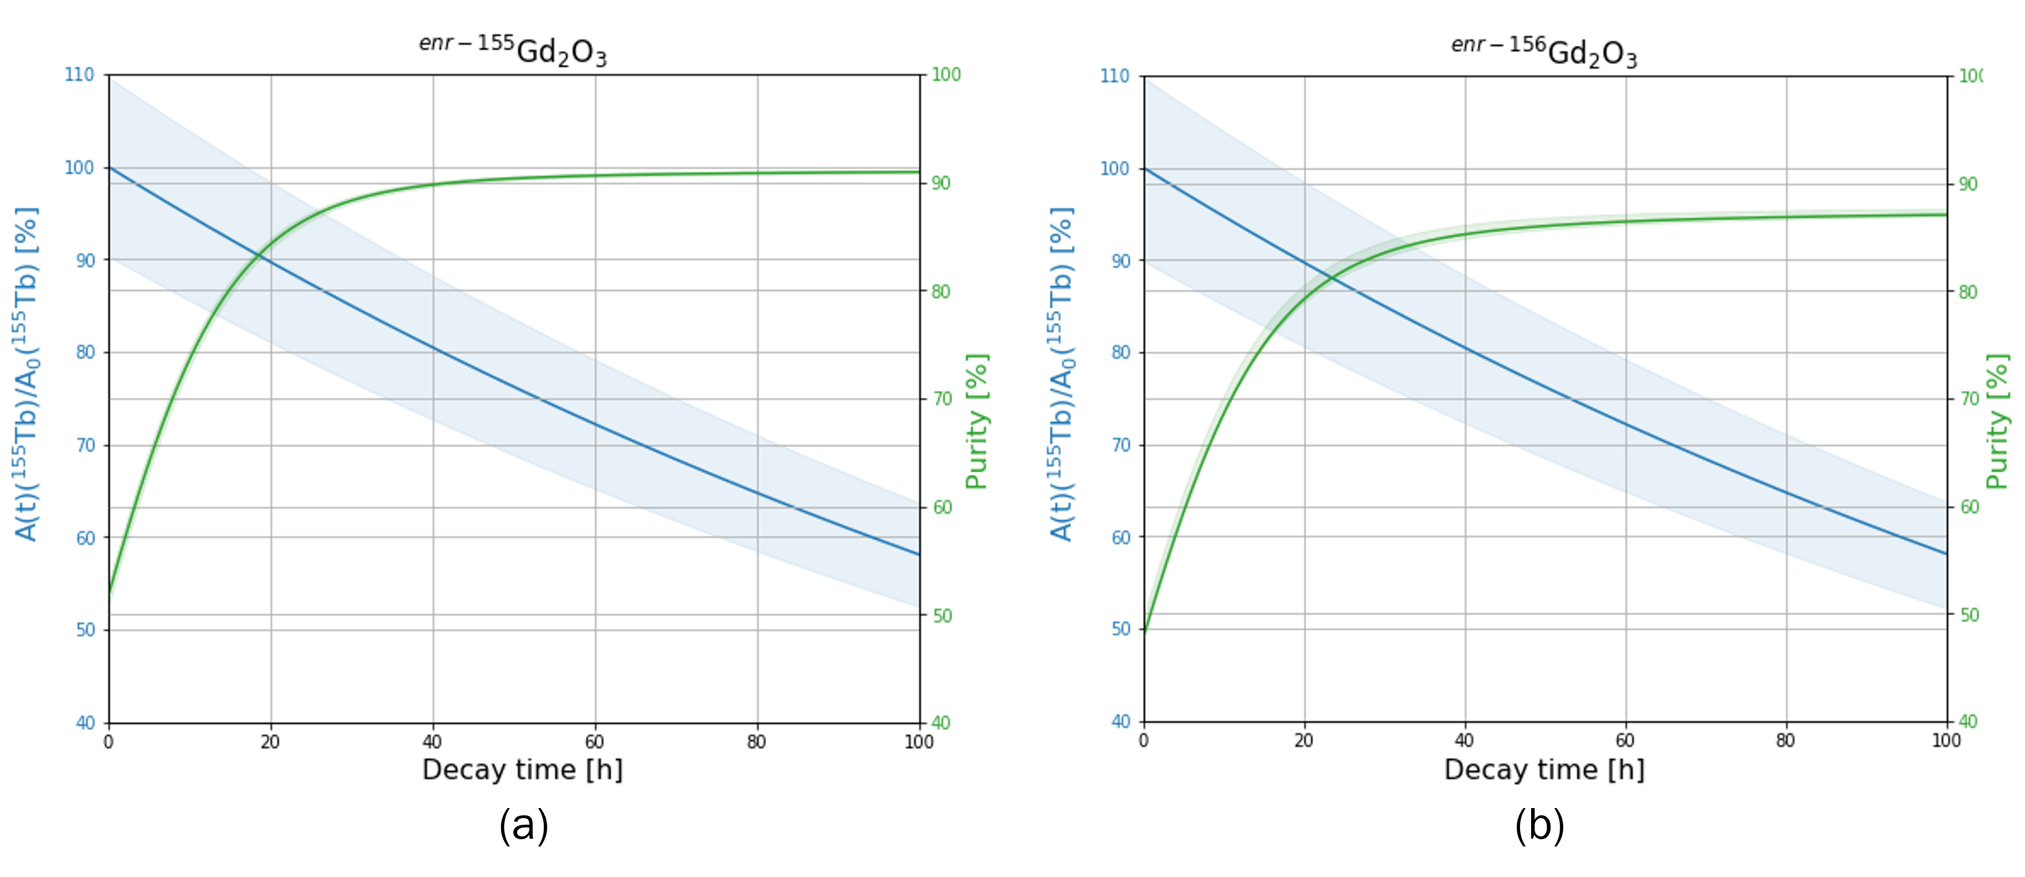
¹⁵⁵Tb production
Enriched ¹⁵⁵Gd₂O₃
Enriched ¹⁵⁶Gd₂O₃
G. Dellepiane – WTTC18

Slide 11
Results
 | ¹⁵⁵Gd₂O₃ | ¹⁵⁶Gd₂O₃
E_{in} [MeV] | 10.5 ± 0.4 | 18.2 ± 0.4
m [mg] | 37.0 ± 0.5 | 37.5 ± 0.5
Q [10⁻³ µAh] | 5.3 ± 0.3 | 2.6 ± 0.1
Production yield [MBq/µAh]
¹⁵⁵Tb | 3.4 ± 0.2 (3.1) | 11.0 ± 0.6 (12.4)
¹⁵⁶Tb - tot | 0.23 ± 0.01 (0.22) | 1.3 ± 0.1 (1.3)
^{156g}Tb | 0.14 ± 0.01 (0.16) | 0.93 ± 0.05 (0.91)
^{156m1}Tb | No Signal (0) | 0.32 ± 0.12 (0.34)
^{156m2}Tb | 2.2 ± 0.1 (2.6) | 9.7 ± 0.6 (10.5)
Purity ¹⁵⁵Tb
EoB | 53.3 ± 0.5 (53) | 46.4 ± 0.9 (49)
96 h | 93.4 ± 0.1 (93) | 87.9 ± 0.3 (89)
C. Favaretto et al, ENJMMI Radiopharm. Chem. 2021, 6, 37
G. Dellepiane et al, Appl. Radiat. Isot. 2022, 184, 110175
G. Dellepiane – WTTC18

Slide 12
Conclusions and outlook
The production of ¹⁵⁵Tb was investigated via the ¹⁵⁵Gd(p,n)¹⁵⁵Tb and ¹⁵⁶Gd(p,2n)¹⁵⁵Tb nuclear reactions;
Cross sections were measured by irradiating natural Gd, enriched ¹⁵⁵Gd and enriched ¹⁵⁶Gd targets. No cross-section data were reported for ^{156m1}Tb and ^{156m2}Tb;
The production yield and purity were studied to determine the optimum irradiation conditions;
The ¹⁵⁶Gd(p,2n)¹⁵⁵Tb route requires a higher beam energy;
Tests were carried out by irradiating enriched ¹⁵⁵Gd₂O₃ and ¹⁵⁶Gd₂O₃ solid targets;
G. Dellepiane – WTTC18

Slide 13
Conclusions and outlook
The ¹⁵⁶Gd(p,2n)¹⁵⁵Tb reaction provides a higher yield than the ¹⁵⁵Gd(p,n)¹⁵⁵Tb but lower EoB radionuclidic purity;
The radionuclidic purity increases over time. ¹⁵⁶Tb is the only impurity in the samples;
Off-line mass separation technique to isolate ¹⁵⁵Tb;
Further studies to establish the impact of ¹⁵⁶Tb from a dosimetry perspective;
The obtained results contribute to pave the way towards the use of medical cyclotrons to produce ¹⁵⁵Tb for theranostics.
G. Dellepiane – WTTC18

Slide 14
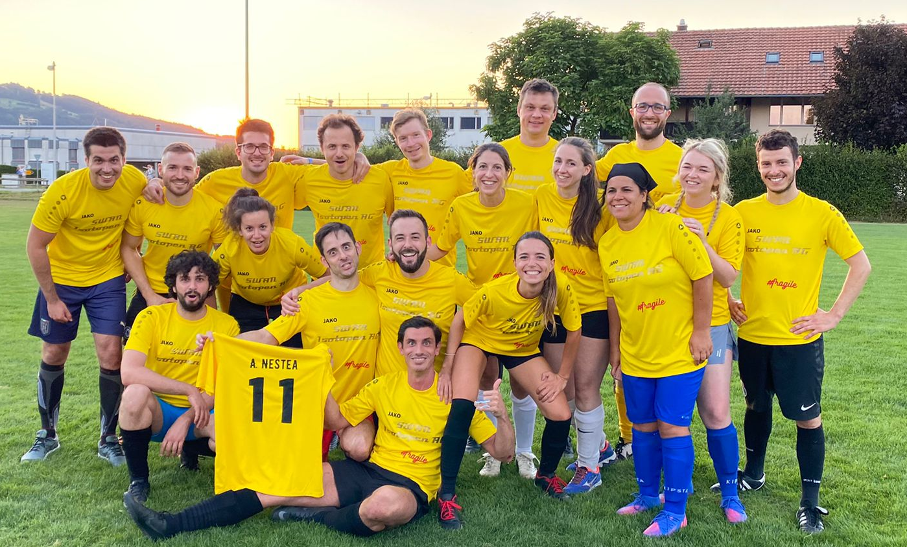
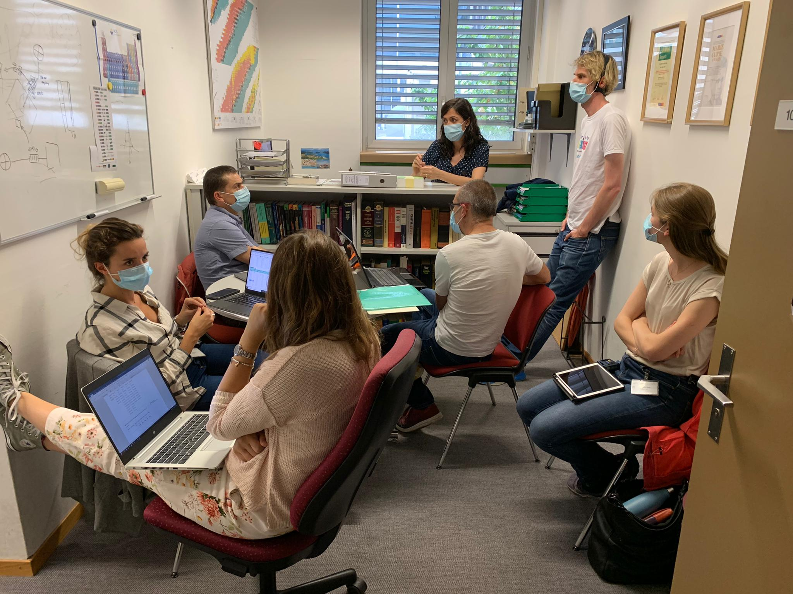
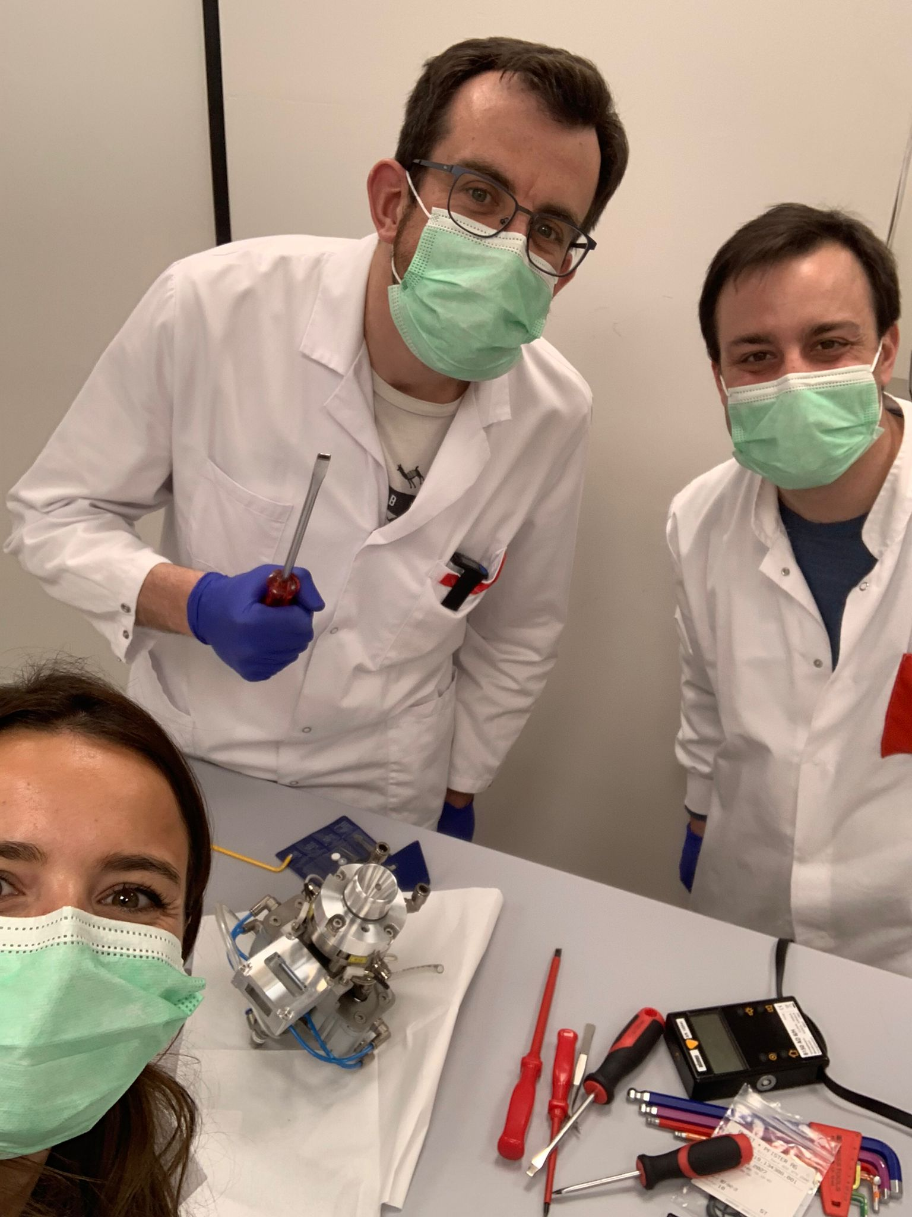
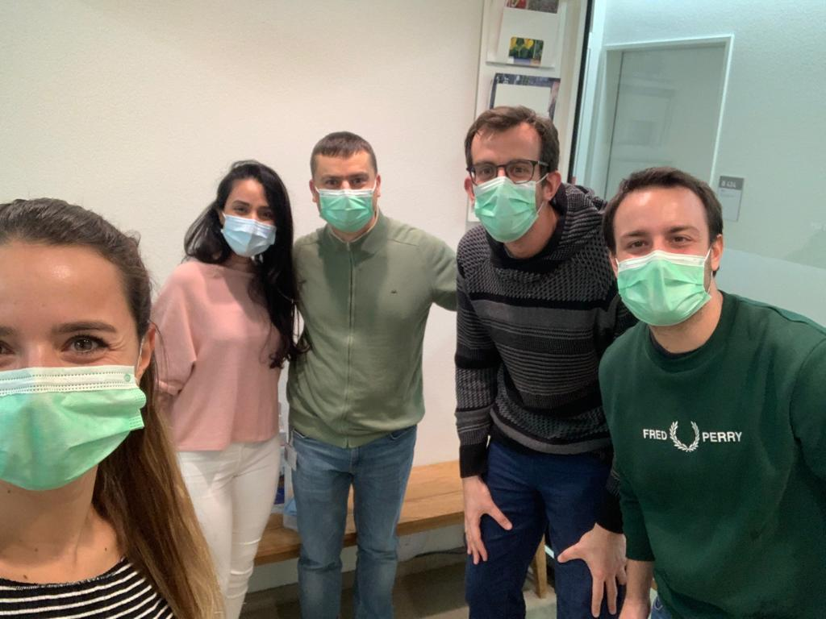
Acknowledgments
Group on medical application of particle physics at LHEP
Group on radionuclide development at PSI
SWAN Isotopen AG maintenance team
LHEP engineering and techincal staff
G. Dellepiane – WTTC18

Slide 15

Thank you all for your attention!

Slide 16
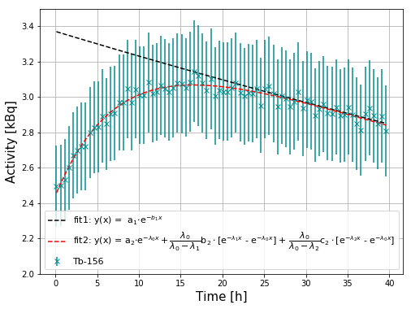
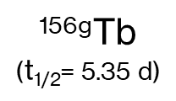
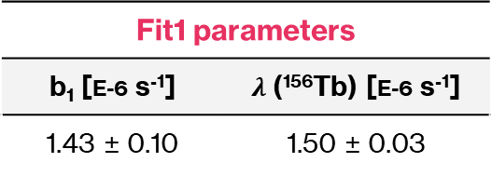
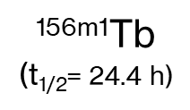
Cross-section measurements: ¹⁵⁶Tb (1)
Enriched ¹⁵⁶Gd₂O₃
Gd(p,X)
^{156g}Tb
($\text{t}\text{1/2}$= 5.35 d)
^{156m1}Tb
($\text{t}\text{1/2}$= 24.4 h)
^{156m2}Tb
(t_{1/2} = 5.3 h)
EC, β⁺ (100%)
IT (100%)
IT (100%)
¹⁵⁶Gd
^{156g}Tb
^{156g}Tb
EC, β⁺ (100%)
EC, β⁺ (100%)
¹⁵⁶Gd
¹⁵⁶Gd
Fit1 parameters
b₁ [E-6 s⁻¹] | $λ$(¹⁵⁶Tb) [E-6 s⁻¹]
1.43 ± 0.10 | 1.50 ± 0.03
Fit2 parameters | Fit1 parameters
a₂ [kBq] | b₂ [kBq] | c₂ [kBq]
2.45 ± 0.02 | 0.71 ± 0.24 | 22.75 ± 0.87
G. Dellepiane – WTTC18

Slide 17
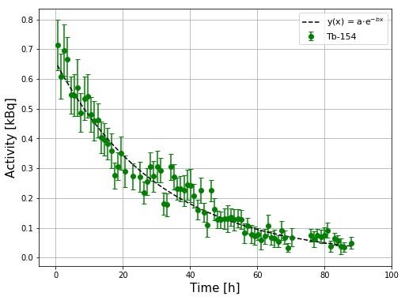
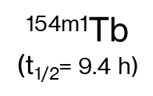
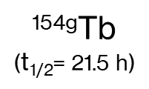
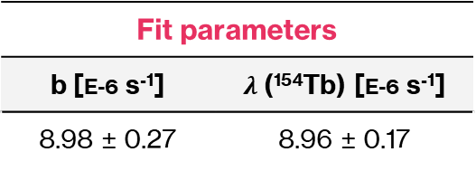
Cross-section measurements: ¹⁵⁴Tb
Gd(p,X)
^{154g}Tb
($\text{t}\text{1/2}$= 21.5 h)
^{154m1}Tb
($\text{t}\text{1/2}$= 9.4 h)
^{154m2}Tb
(t_{1/2} = 22.7 h)
EC, β⁺ (100%)
ec, β⁺
78.2%
IT
21.8%
ec, β⁺
98.2%
IT
1.8%
¹⁵⁴Gd
¹⁵⁴Gd
^{154g}Tb
¹⁵⁴Gd
^{154g}Tb
EC, β⁺ (100%)
EC, β⁺ (100%)
¹⁵⁴Gd
¹⁵⁴Gd
Fit parameters
b [E-6 s⁻¹] | $λ$(¹⁵⁴Tb) [E-6 s⁻¹]
8.98 ± 0.27 | 8.96 ± 0.17
G. Dellepiane – WTTC18

Slide 18
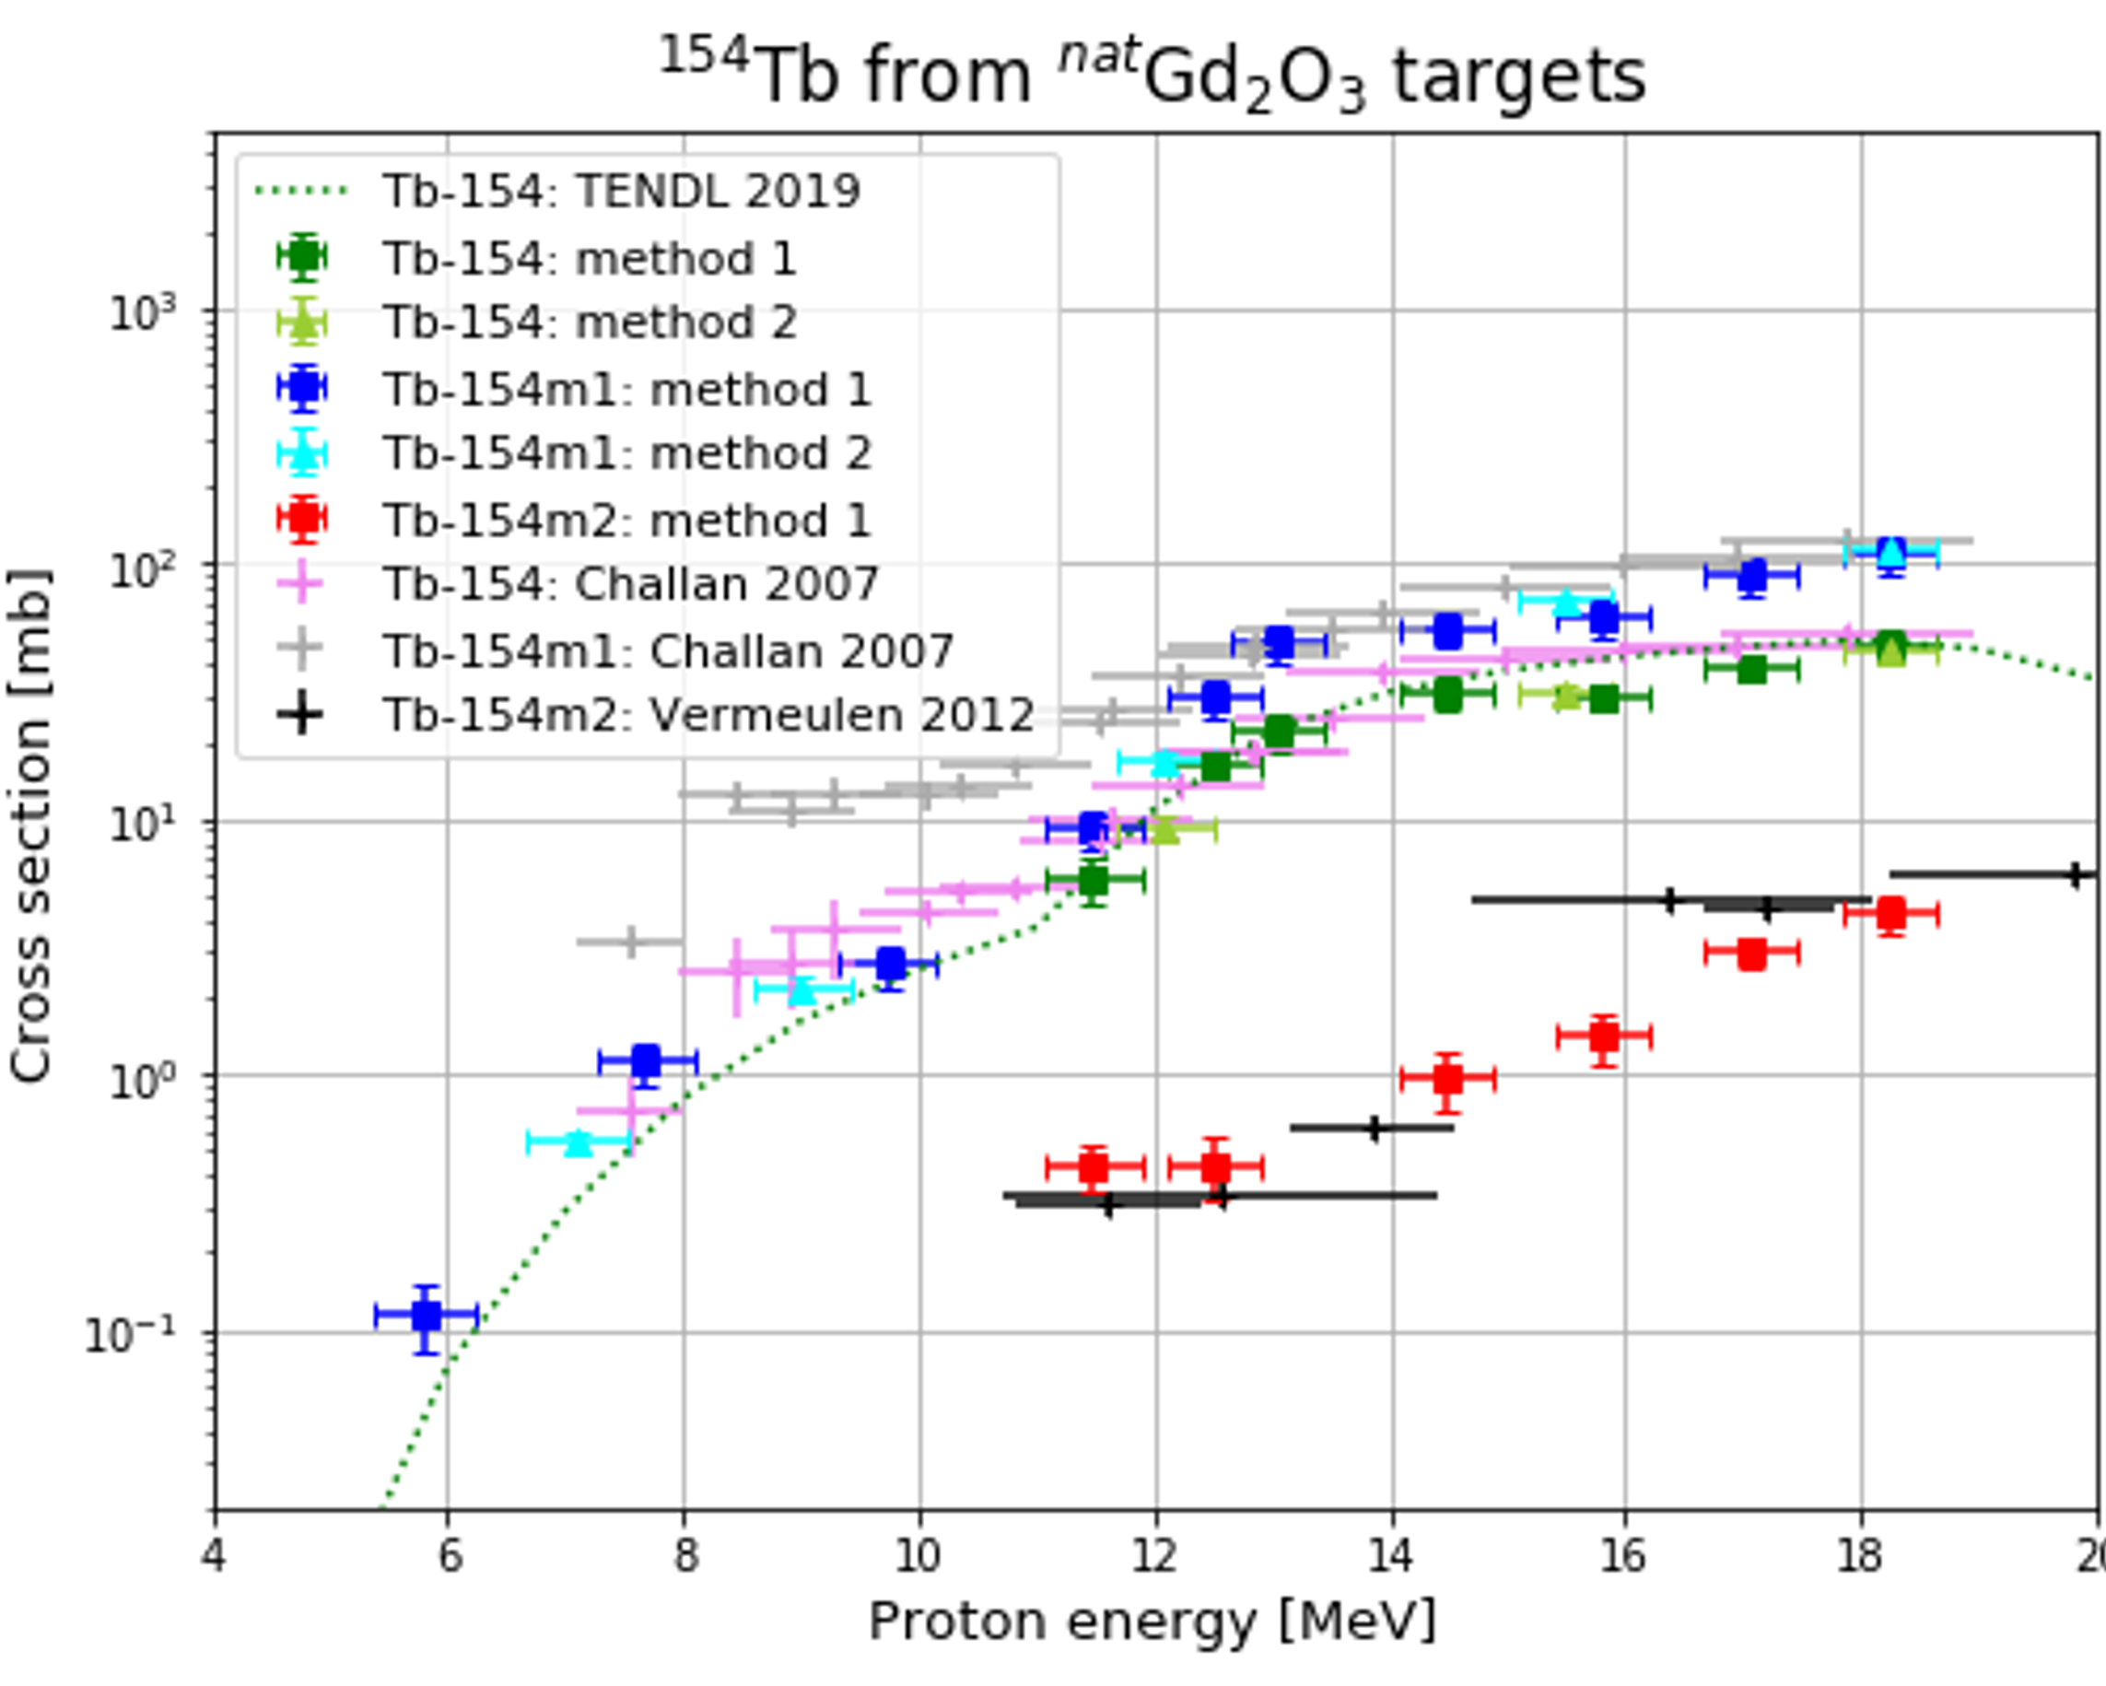
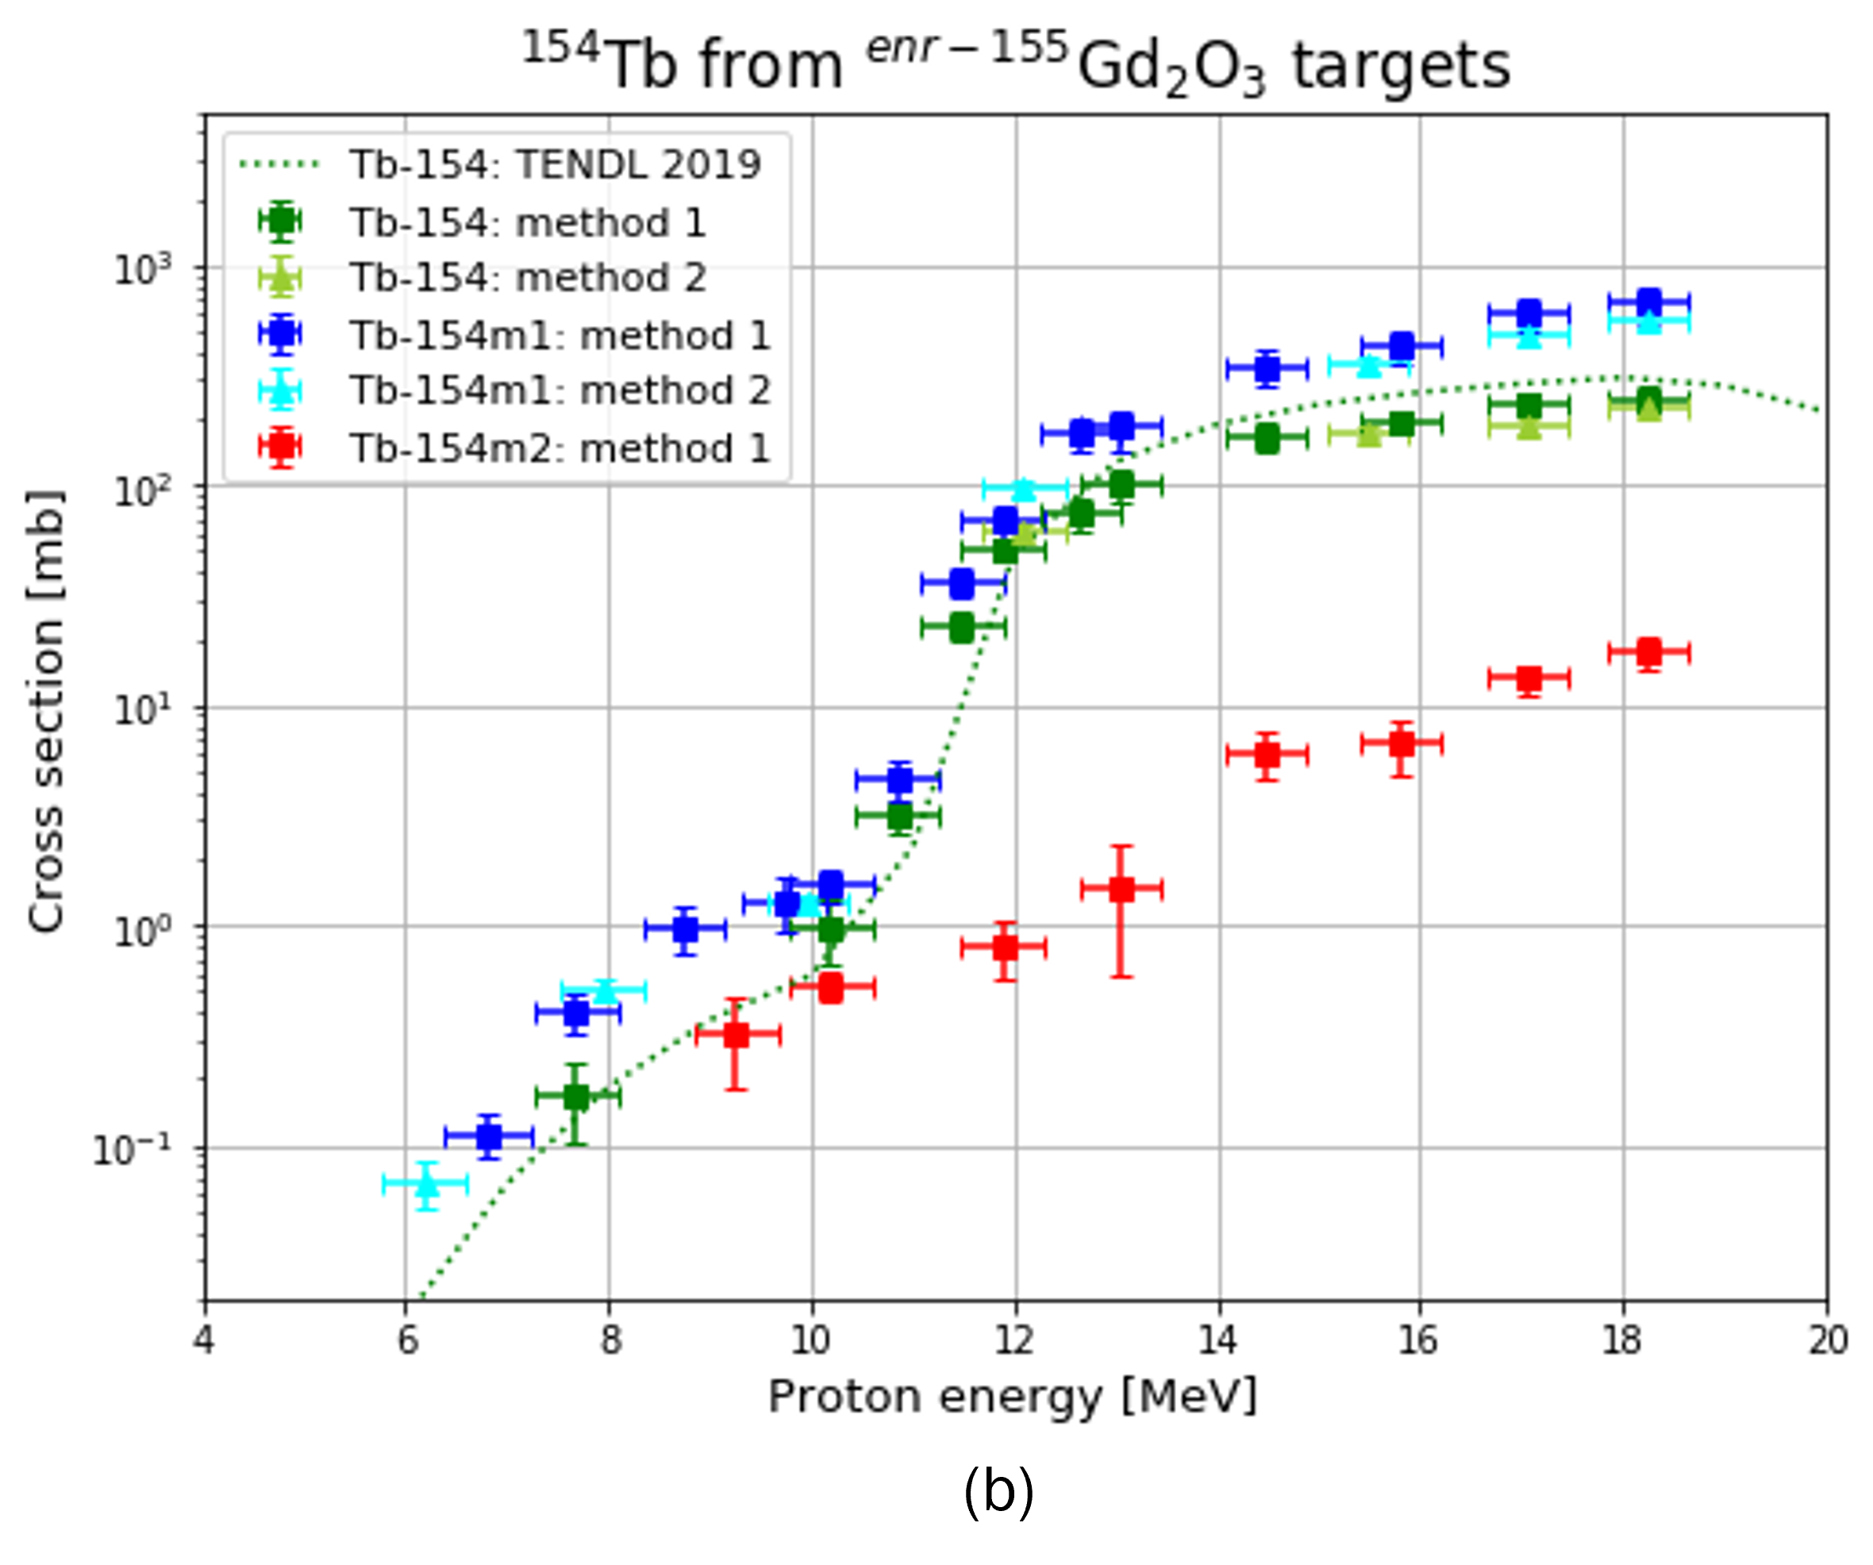
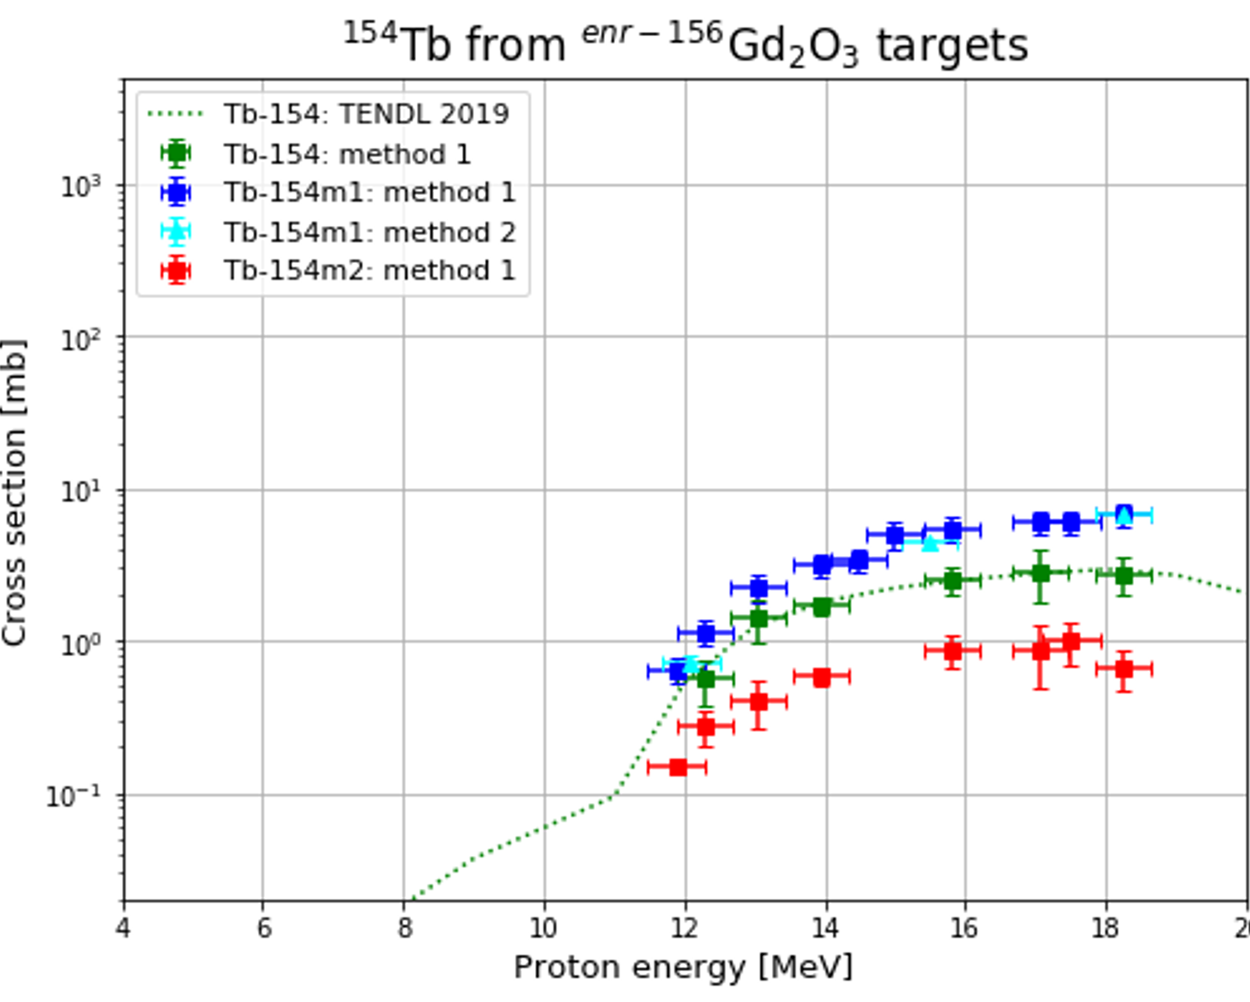
Cross-section measurements: ¹⁵⁴Tb
G. Dellepiane – WTTC18

