Slide 1
Comparison of Dowex AG1-X8 and Poros XQ anion exchange resins for ⁷²Se/⁷²As generator development
Chathurya S. Munindradasa, Anster Charles, Mary F. Embree, John D. Lydon, Dmitri Medvedev, Cathy S. Cutler,
D. Scott Wilbur, Yawen Li, Silvia S. Jurisson, Heather M. Hennkens
1
Notes:
Insert authors

Slide 2
Outline
Arsenic radioisotopes
⁷²Se/⁷²As generator
2 anion exchange resins
Synthesis and radiolabeling of trithiol ligand with generator-produced ⁷²As
2

Slide 3
Theranostic As radioisotopes
⁷²As and ⁷⁷As are a matched isotope pair
Radio- nuclide | Half-life | Relevant emission (abundance) | Energy
⁷⁷As | 38.8 h | β⁻ (100%) | 226 keV*
⁷²As | 26.0 h | β⁺ (64%) | 1117 keV*
⁷²Se | 8.4 d | EC (100%) | 46 keV
⁷²As is produced via ⁷²Se decay
⁷²Se and ⁷²As reach a transient equilibrium
Maximum ⁷²As production is at 3.5 d
* E_{ave} shown
3
Notes:
achieved

Slide 4
Production of ⁷²Se
University of Washington, Drs. Yawen Li & Scott Wilbur:
⁷⁰Ge(⍺,2n)⁷²Se
95.85% enriched ⁷⁰Ge
Brookhaven National Laboratory (BNL), Drs. Cathy Cutler & Dmitri Medvedev:
⁷⁵As(p,4n)⁷²Se
⁷⁵As is monoisotopic
4
Notes:
I am not going to talk abt the production,but about the separation of Se and As

Slide 5
Arsenate and selenate
As(V) as arsenate (AsO₄³⁻) and Se(VI) as selenate (SeO₄²⁻)
Selenic acid (H₂SeO₄) is a strong acid with pKa₁= -3.8 and pKa₂= 1.7
Arsenic acid (H₃AsO₄) is a weak acid with pKa₁= 2.2
At pH 1.5, arsenic as H₃AsO₄ and selenium as HSeO₄⁻
5
Notes:
Predominately

Slide 6
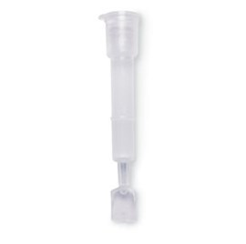
⁷²Se/⁷²As generator previous studies
Used Dowex AG 1-X8 anion exchange resin (Cl form)
Preconditioned to pH 7
Loaded the target sample containing oxidized ⁷²As(V) and ⁷²Se(VI)
Eluted the column at pH 1.5 (0.027 M HCl)
13% ⁷²Se breakthrough was observed during loading
https://www.bio-rad.com/en-jp/sku/7326008-bio-spin-chromatography-columns?ID=7326008
6
Feng, Y.; Phipps, M. D.; Phelps, T. E.; Okoye, N. C.; Baumeister, J. E.; Wycoff, D. E.; Dorman, E. F.; Wooten, A. L.; Vlasenko, V.; Berendzen, A. F.; Wilbur, D. S.; Hoffman, T. J.; Cutler, C. S.; Ketring, A. R.; Jurisson, S. S. Evaluation of ⁷²Se/⁷²As Generator and Production of ⁷²Se for Supplying ⁷²As as a Potential PET Imaging Radionuclide. Appl. Radiat. Isot. 2019, 143, 113–122.

Slide 7
New resin: Poros XQ
Find a suitable resin with higher capacity
Determine the distribution coefficient (K_{d}) for new resin, Poros XQ
Compare K_{d} values of Poros XQ (Poros) and Dowex AG 1-X8 (Dowex) resin
Build a ⁷²Se/⁷²As generator using the Poros resin
7
Notes:
^{talk 72}Se/⁷²As generator was prepared using Dowex AG 1-X8 resin
Had a Se breakthro

Slide 8
K_{d} values
Dowex AG 1-X8
Poros XQ
8
Notes:
Font size image align

Slide 9
Tracer test
Prepared columns of Poros resin (1 g each)
Loaded solutions with oxidized ⁷⁵Se(VI) or ⁷⁷As(V)
Eluted with 0.027 M HCl (pH 1.5) solution and ⁷⁵Se stripped off with 1 M HCl (pH 0)
Elution profile of ⁷⁷As (arsenate)
Elution profile of ⁷⁵Se (selenate)
pH 0
9
Notes:
Se loading space

Slide 10
⁷²Se sample from BNL
Sample of ⁷²Se obtained from BNL in HNO₃
⁷²Se/⁷²As generator built from Poros resin
⁷²Se and ⁷²As (2 mCi) oxidized by refluxing with 30% H₂O₂ for 1 h
Dried under N₂ and reconstituted with 0.0025 M NH₄OH
10
Notes:
21.9 mCi in 2.29 mL, 0.05 M HNO₃ solution

Slide 11
Generator column preparation
Preconditioned 1 g of Poros XQ resin with
1 M HCl
DI water
1 M NaOH
0.3 M NH₄OH
0.0025 M NH₄OH (until pH 7-8)
https://www.bio-rad.com/en-jp/sku/7326008-bio-spin-chromatography-columns?ID=7326008
11

Slide 12
Generator column
Loaded solution of ⁷²Se and ⁷²As in 0.025 M NH₄OH onto the column
Eluted with 0.027 M HCl, collected fractions, and analyzed by HPGe
No ⁷²Se breakthrough during loading or 1st elution observed!
92.3% ⁷²As recovery on 1st elution
Second elution at 3.5 d, 4.8% ⁷²Se breakthrough
86.1% ⁷²As recovery on 2nd elution
12
Notes:
Compare dowex precondition same, forshadow, se breakthru

Slide 13
Trithiol ligand synthesis
13
Ma, L.; Grant, C.; Gallazzi, F.; Watkinson, L. D.; Carmack, T. L.; Embree, M. F.; Smith, C. J.; Medvedev, D.; Cutler, C. S.; Li, Y.; Wilbur, D. S.; Hennkens, H. M.; Jurisson, S. S. Development and Biodistribution Studies of ⁷⁷As-Labeled Trithiol RM2 Bioconjugates for Prostate Cancer: Comparison of [⁷⁷As]As-Trithiol-Ser-Ser-RM2 vs. [⁷⁷As]As-Trithiol-Glu-Ser-RM2. Nucl. Med. Biol. 2022, 108–109, 61–69

Slide 14
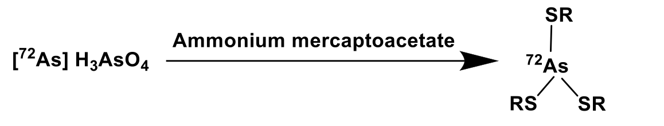
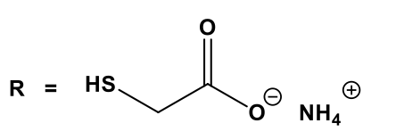
Arsenic reduction
⁷²As was eluted from generator with 0.027 M HCl
The solvent was removed under N₂ and reconstituted with DI water
⁷²As was reduced to As(III) using ammonium mercaptoacetate
14
Notes:
by mixing with Ammonium mercaptoacetate, DI water and acetonitrile and heating at 55 °C for 45 min
tranchelator

Slide 15
Trithiol-ligand radiolabeling with ⁷²As
⁷²As (0.5 mCi) added to the thiol ligand (5 nmol) solution, heated at 55 °C for 45 min
Retention time non-radioactive standard 19.4 min, radioactive 20.4 min
Radiolabeling yield 76%
15
TCEP= tris(2-carboxyethyl)phosphine
Notes:
0.005 mmol ligand, 0.5 mCi As, V=530 microL
Transchlator diplcae
No carrier added as-77

Slide 16
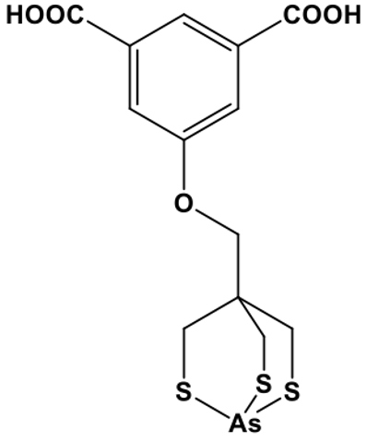
Purified product
C18 column (Beta Basic)
Gradient: 30-60% acetonitrile in H₂O (both with 0.1% TFA) over 30 min
Retention time 20.4 min
72
Time (min)
16
Notes:
Clean product

Slide 17
Distribution coefficient (log D_{7.4})
HPLC-purified tracer compound (20 µCi, 0.1 mL PBS) was added to the centrifuge tube containing PBS (phosphate buffered saline, 1.9 mL) and n-octanol (2.0 mL)
Mixed at 25 °C and then centrifuged
The aqueous (1 mL) and organic layers (1 mL) were separated, and each layer counted by HPGe
The log D_{7.4} value was -1.8 ± 0.7 (for ⁷⁷As analogue, -1.5 ± 0.1)
17

Slide 18
Stability in PBS
10 h
HPLC-purified radiotracer (0.2 µCi/µL) in PBS with radioprotectant cocktail* at room temperature
The radiotracer stability monitored over time by HPLC
Stable under these conditions over 10 h
8 h
6 h
4 h
*10 mg ascorbic acid, 30 µg resveratrol, 50 µg selenomethionine
18
Notes:
10 mg of ascorbic acid, 30 µg of resveratrol, and 50 µg of selenomethionine

Slide 19
Summary
Poros resin demonstrated higher capacity than Dowex resin
Poros resin was successfully used for ⁷²Se/⁷²As generator
No breakthrough of ⁷²Se on loading or 1st elution
Trithiol ligand was radiolabeled with generator eluted ⁷²As, with same conditions to ⁷⁷As radiolabeling
19

Slide 20
Future plans
Capacity studies with excess As and Se for Poros and Dowex resins
Prepare additional column containing 5-10 mCi of ⁷²Se with Poros resin
Test the resin stability to radiolysis
Test stability of Se(VI) in different solutions
20
Notes:
Some future plans

Slide 21




Acknowledgments
University of Missouri:
  Research Reactor (MURR)
  Chemistry Department
  Dr. Hennkens group members
  Dr. Jurisson group members
University of Washington
Brookhaven National Laboratory
This research is supported by the U.S. Department of Energy Isotope Program, managed by the Office of Science for Isotope R&D and Production
DOE Funding:
DE-SC0010283
DE-SC0020159
Bursaries
WTTC18 Travel Bursary
Troutner Radiochemistry Graduate Travel Award
GPC Conference Presentation Travel Award 2022
21
Notes:
Wttc18 organizers and sponsors for the travel bursary

Slide 22


Thank you!
Questions?
Email Chathurya Munindradasa at
wsmf2n@mail.missouri.edu
22
Notes:
Photo email name

Slide 24
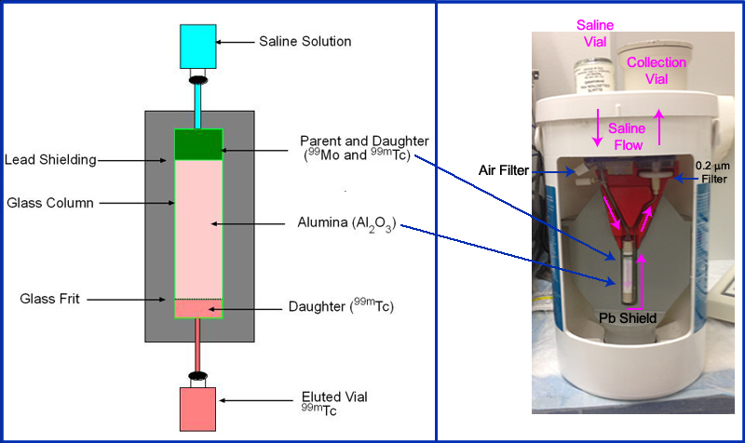
Example of a generator
Transient equilibrium- ⁹⁹Mo/^{99m}Tc generator
Parent ⁹⁹Mo t_{1/2} = 66 h
Daughter ^{99m}Tc t_{1/2} = 6.0 h
http://www.people.vcu.edu/~mhcrosthwait/clrs461/Radionuclide%20Production2.html
4

Slide 26
