Slide 1



Isotope Production Activities at LBNL: The Tri-Lab Effort in Nuclear Data, and Novel Production Pathways for ²²⁵Ac
Andrew S. Voyles | 24 Aug 2022 | WTTC18
Notes:
Emerging trends for next-generation (targeted & personalized) nuclear medicine:
Targeted alpha therapy (5-10 MeV)
40-80 μm range → single cell
Targeted Auger therapy (20 eV – 1 keV)
1 nm – 2 μm → cellular nucleus
Theranostic medicine
Simultaneous imaging and therapy

Slide 2
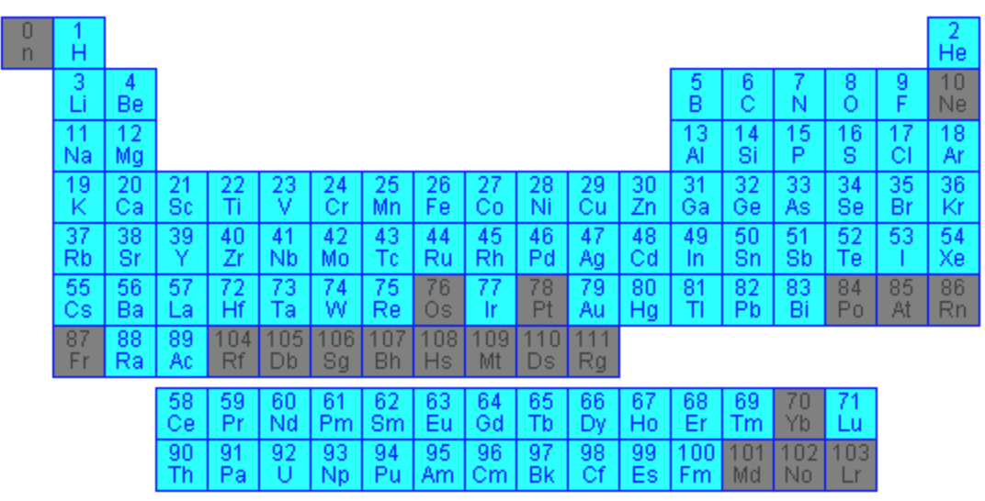
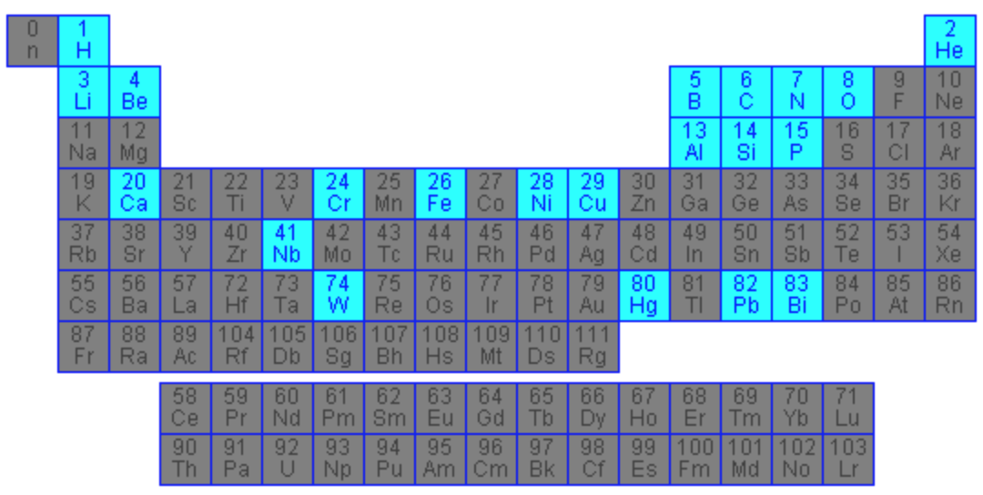

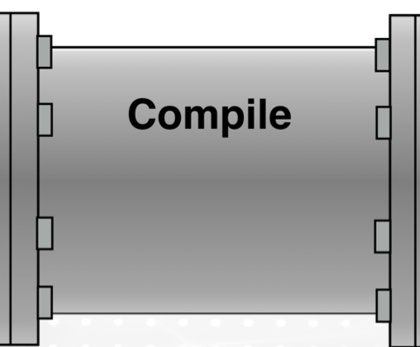
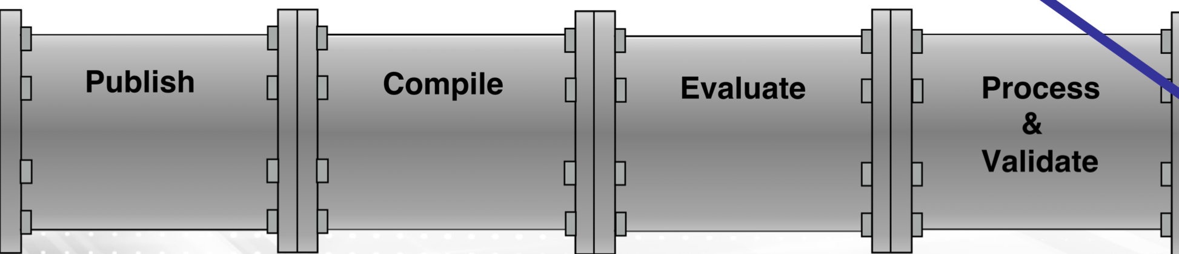



The Nuclear Data Pipeline
ENDF/BV-11.1: Neutron Reactions
ENDF/BV-11.1: Proton Reactions
Compilation (EXFOR)
24 000 datasets (46% for (n,x))
(p,x) reactions - 20%
4600 datasets
(d,x) reactions 2000 datasets – 9%
(p,x) with E_{p} > 100 MeV
10 datasets
Measure
User
D.A. Brown, Nuclear Data Sheets, 148:1–142, 2018.
A.J. Koning, Nuclear Physics A, 744:15–76, 2004.
Notes:
And for the most part, we really don’t have a lot of answers to these experimental or modelling questions. Consider a version here of the nuclear data pipeline, and let’s see how the current proton reactions state fall into it. In the publishing and compilation steps, which is basically the body of existing experimental work, we see that there are 32 000 cross section datasets for all incident particle types. Of those, about a 20% subset are proton induced reactions, about out 6000 datasets. But of all those datasets, only 18 datasets guide our evaluation and modelling above 100 MeV, which the important range of our regional LINACS that I’ve discussed for isotope production.
And in terms of evaluation and recommended datasets across all energies, even from all those 6000 data sets, there are very few. And especially very few evaluated heavier target cases, which are the ones actually relevant to medical isotope production. So our basis of (p,x) in terms of experiment, evaluation, and modelling work is generally sparse. We certainly don’t know all that we should. And you can see our evaluation portion of the pipeline really lacks for protons versus neutron data, and the comparison is here.
In terms of neutrons reactions, we’ve done well to address some of these questions, still not necessarily at high energies though, but still for proton reactions we are really laid bare and clearly need improvement if we want to better our charged-particle isotope production capabilities.

Slide 3
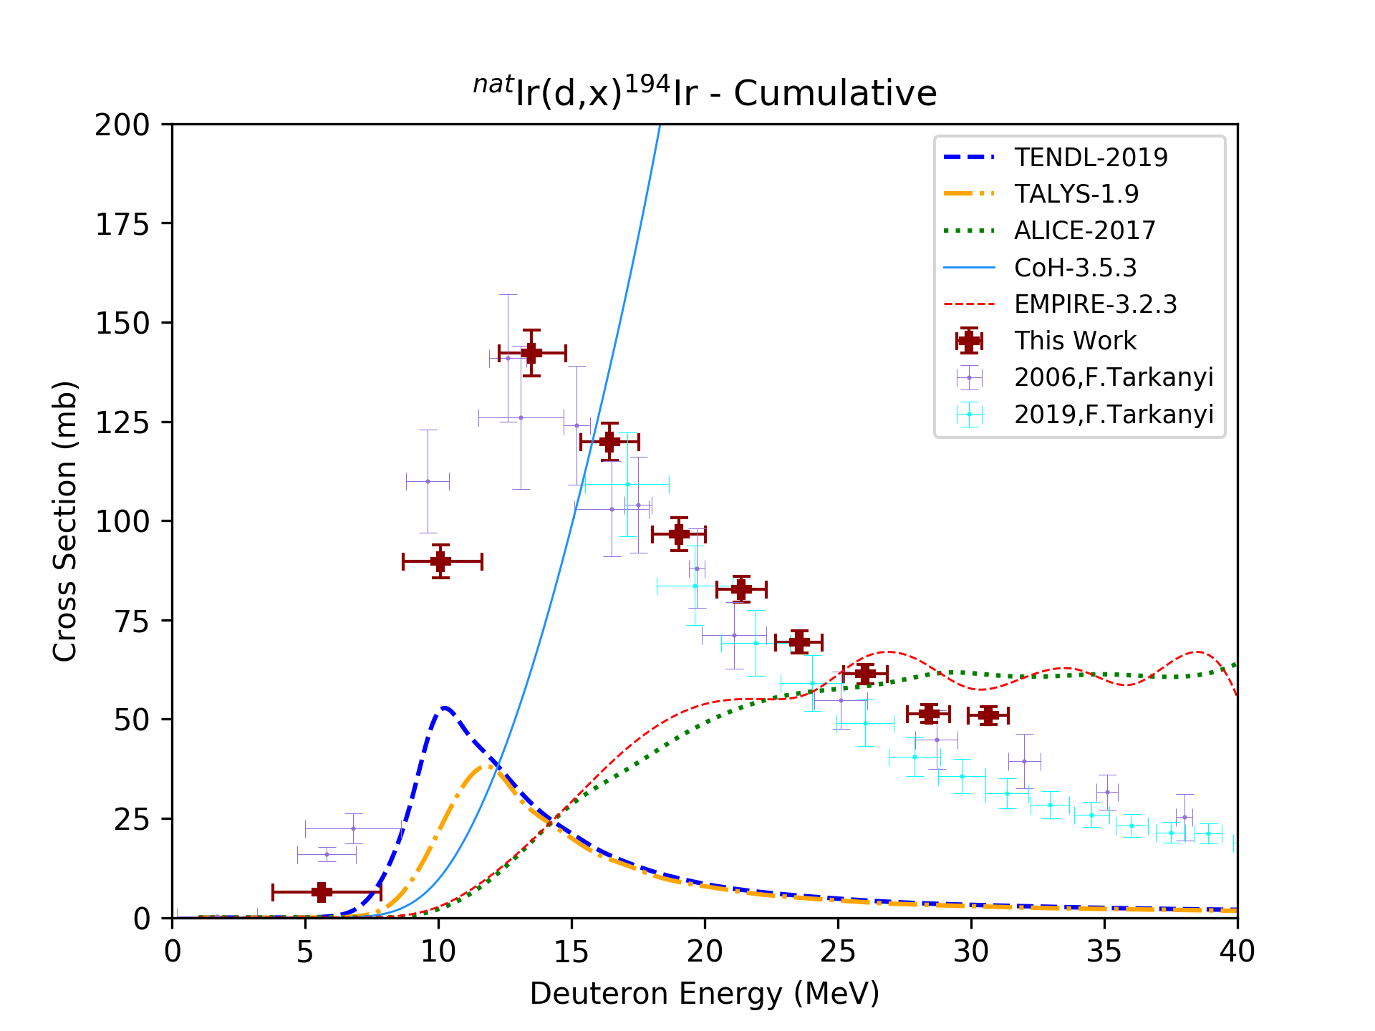
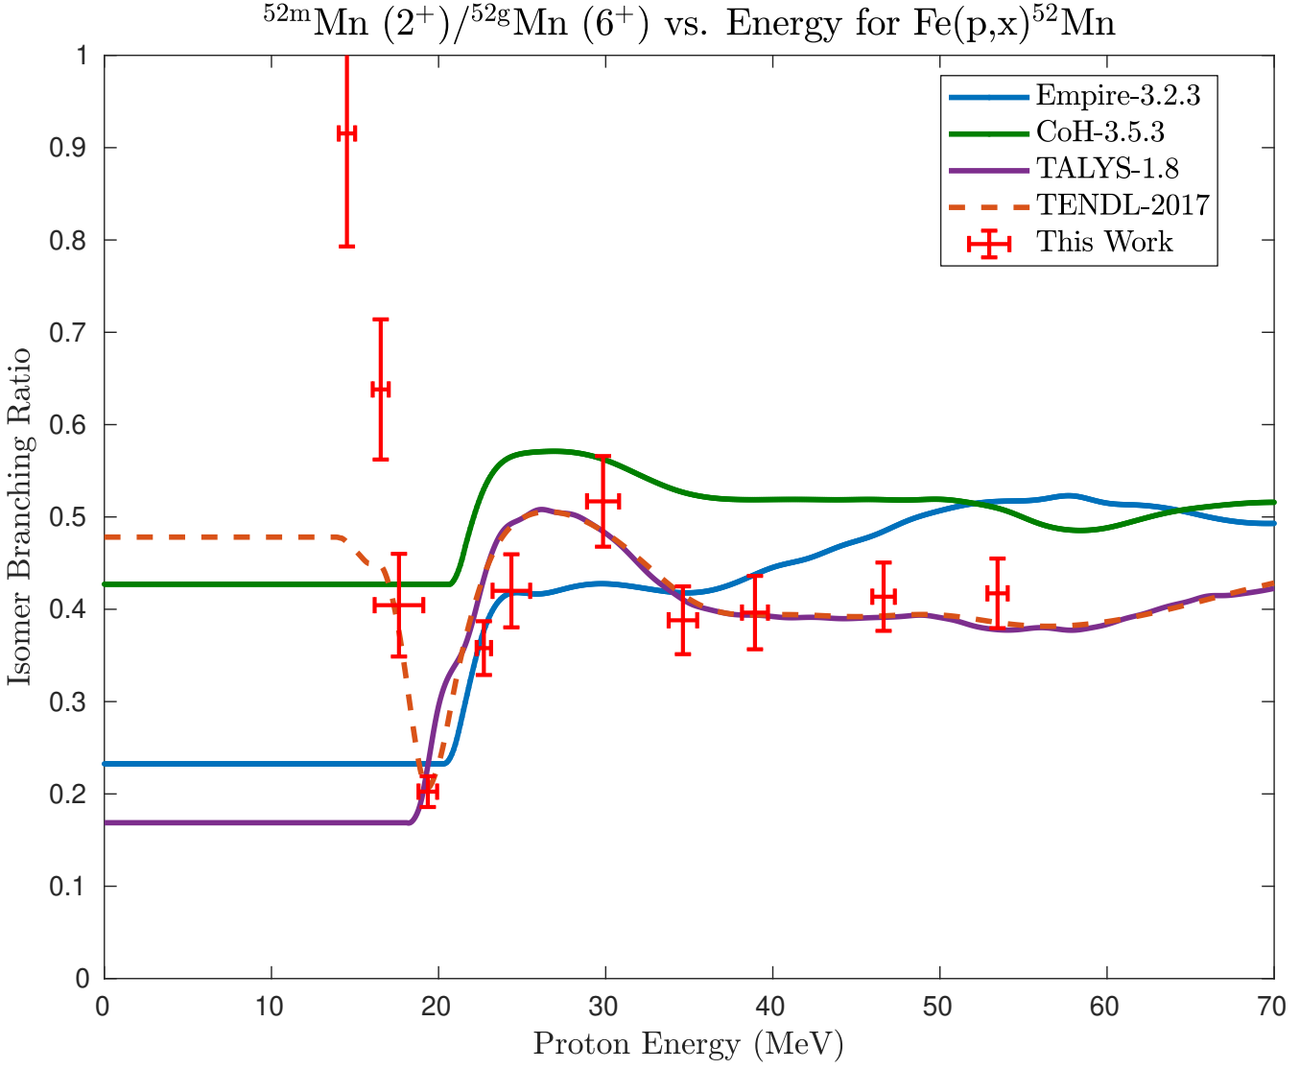
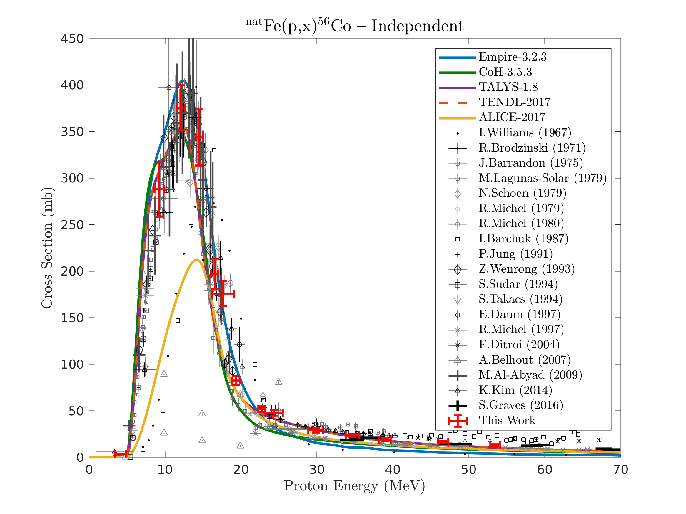
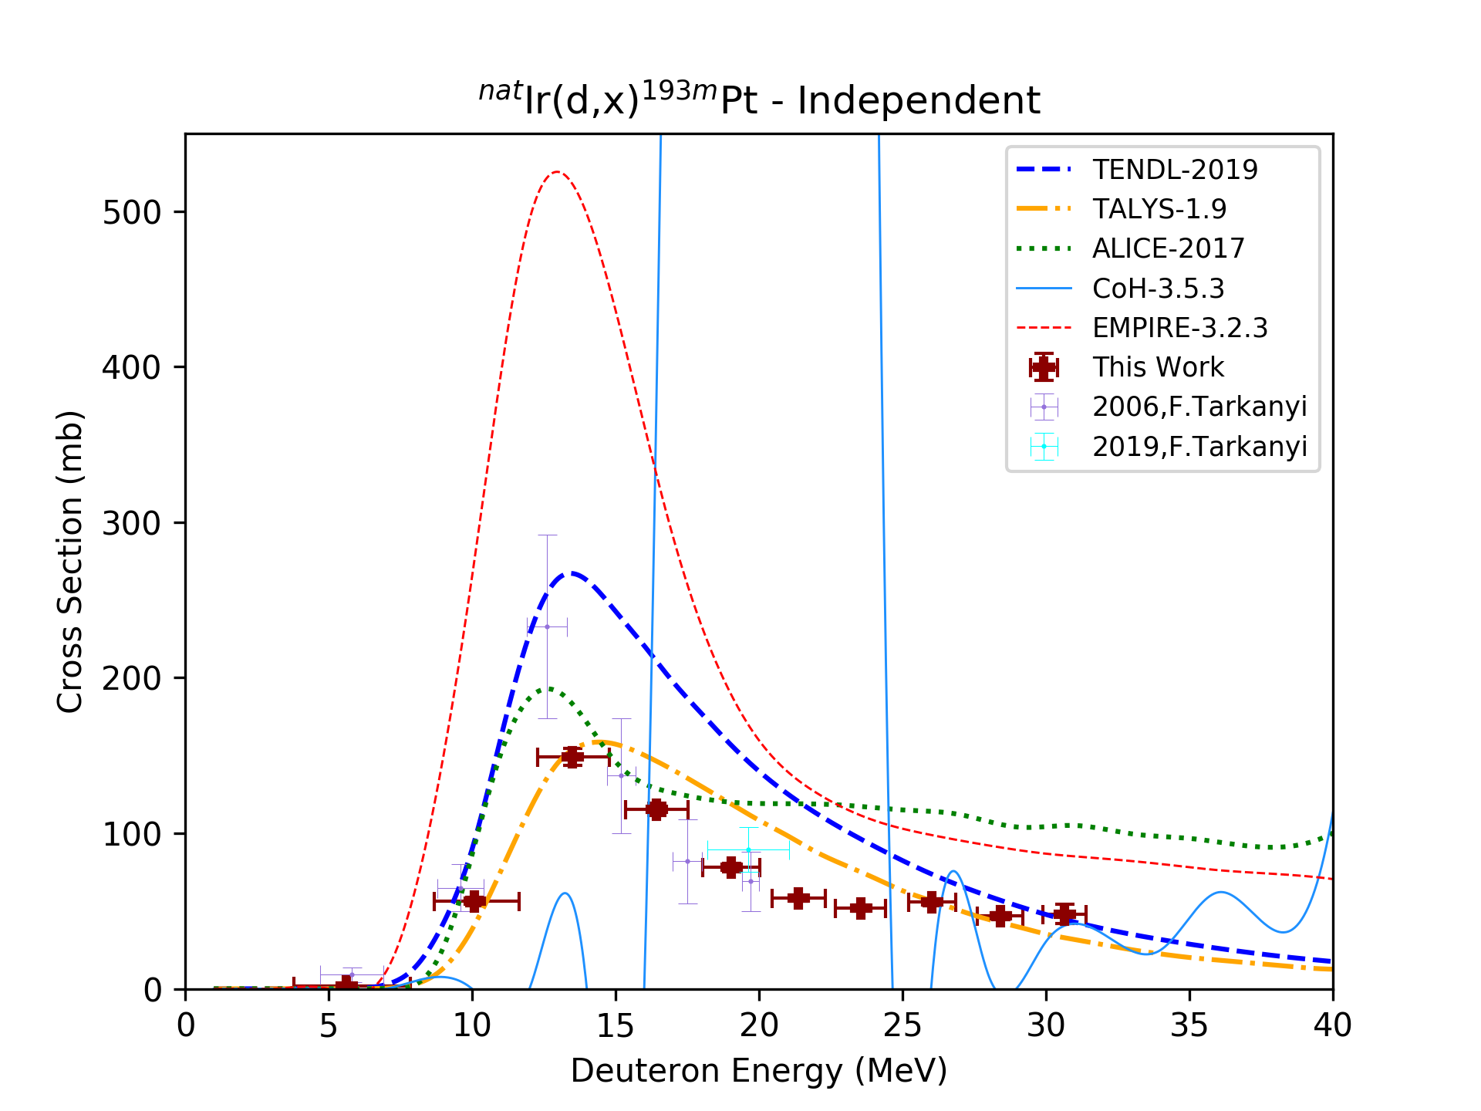
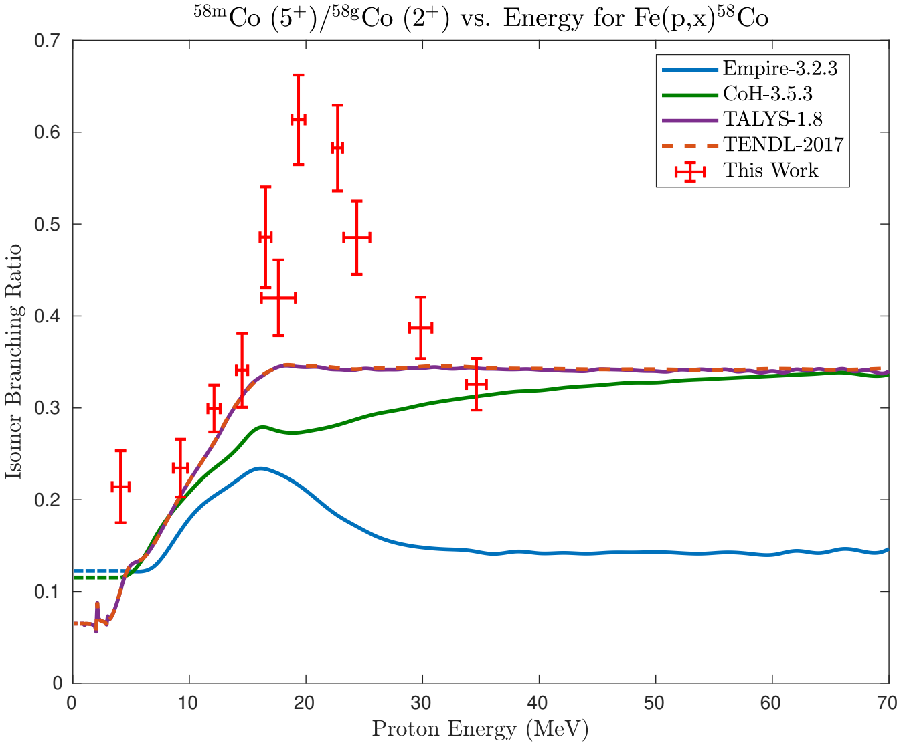
What If No Experimental Data Exist?
The good…
The ugly…
The bad…
Current nuclear data needs for applications
Phys. Rev. Res. 4, 021001 (2022)
A.S. Voyles, EPJ A, 57 (2021) 94
H.L.O. Ekeberg, M.S. Thesis 2020
Notes:
What about when there’s no data? Modeling codes must be used to predict XS, to design thick targets, or guide the design of a thin-target measurement. However, modeling efforts using default parameters often fail to exhibit modest predictive power (within ~20%).
Several trends:
Modeling is better where data have been measured previously, for strongly fed channels, and for reactions whose ejectiles don’t need to cross shell closures.
Common issues are: failure to model high-spin transfer reactions, or miss the shape (wrong compound peak, wrong amplitude)
3

Slide 4
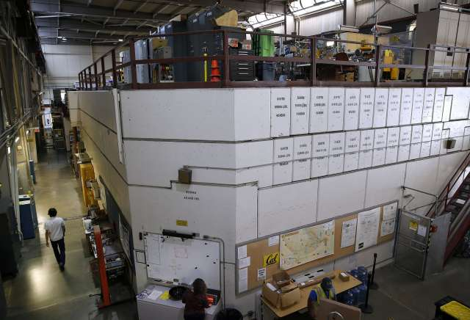
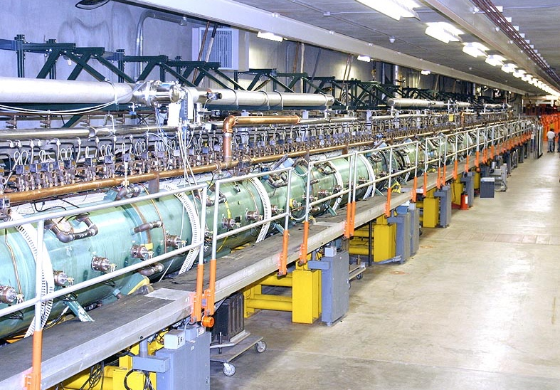
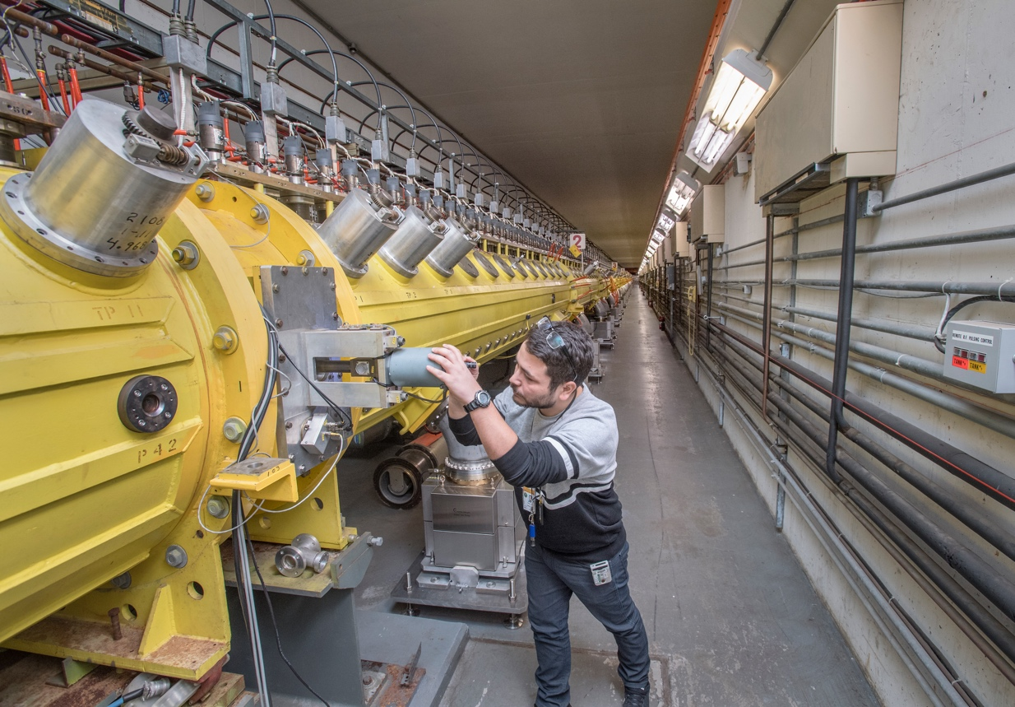
Isotope Production Research
A Tri-lab collaboration has been formed between LBNL, LANL, and BNL to measure (p,x) reactions relevant to isotope production from threshold to 200 MeV for primary isotopes of interest and their impurities.
LBNL 88-Inch Cyclotron
E_{p,max} = 60 MeV
LANL IPF
E_{p,max} = 100 MeV
BNL BLIP
E_{p,max} = 200 MeV
The unique strength of this group is its access to the different irradiation facilities and expertise

Slide 5

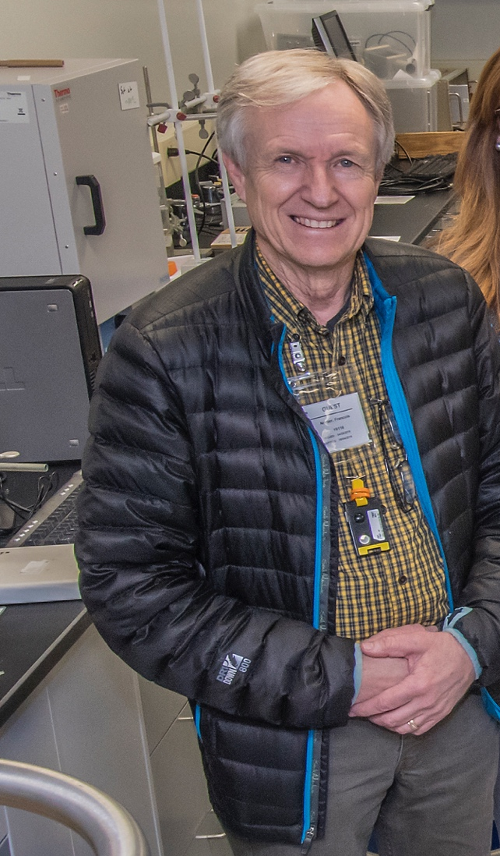

The Tri-Lab Effort in Nuclear Data
Catherine Apgar
(UCB)
Michael Skulski
(BNL)
Not Pictured:
Eva Birnbaum (LANL)
Cathy Cutler (BNL)
Amanda Lewis (UCB)
Arjan Koning (IAEA)
Ellen O’Brien
(LANL)
Dmitri Medvedev
(BNL)
Andrew Voyles
(UCB)
Jon Morrell
(LANL)
Etienne Vermeulen
(LANL)
Lee Bernstein
(UCB/LBNL)
Jon Batchelder
(UCB)
Special Guest: Laura McCann
(TAMU)
Meiring Nortier
(LANL)
Morgan Fox
(UCB)

Slide 6
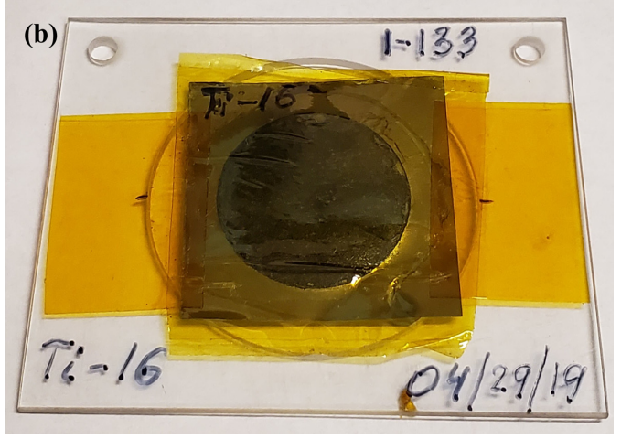
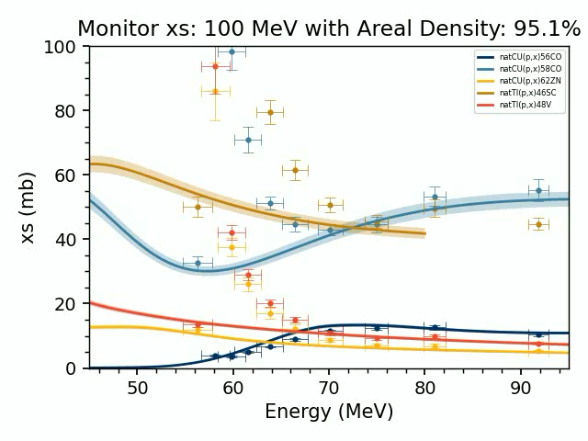
Stacked-Target Experimental Method
Degraders
Al, Cu
Monitor Foils
Al, Ti, Cu, Fe, …
H⁺ Beam
Foils of Interest
⁷⁵As, ⁹³Nb,…
Check out Curie! (and help improve it!)
https://jtmorrell.github.io/curie/build/html/index.html
A.S. Voyles et al., NIM B 429 (2018) & EPJ A 57:94 (2021)
J.T. Morrell et al., EPJ A 56:13 (2020)
M. B. Fox et al., PRC, 103(3):034601 (2021) & PRC 104, 064615 (2021)

Slide 7
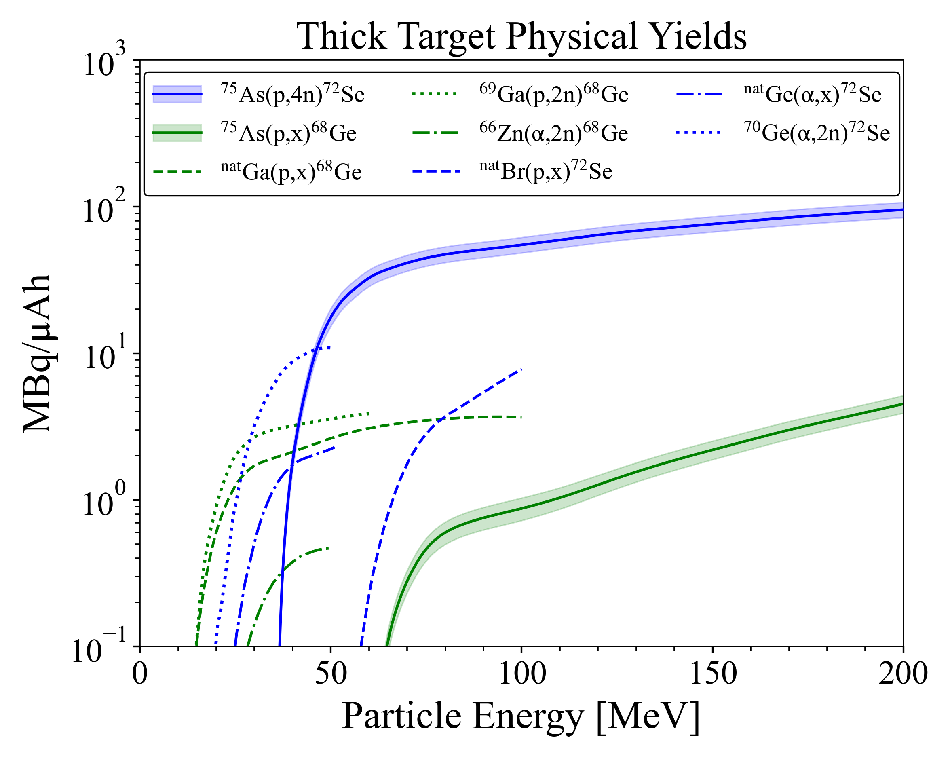
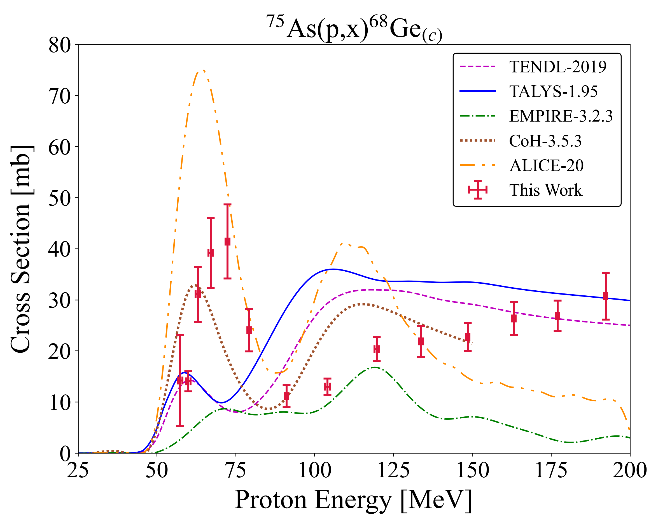
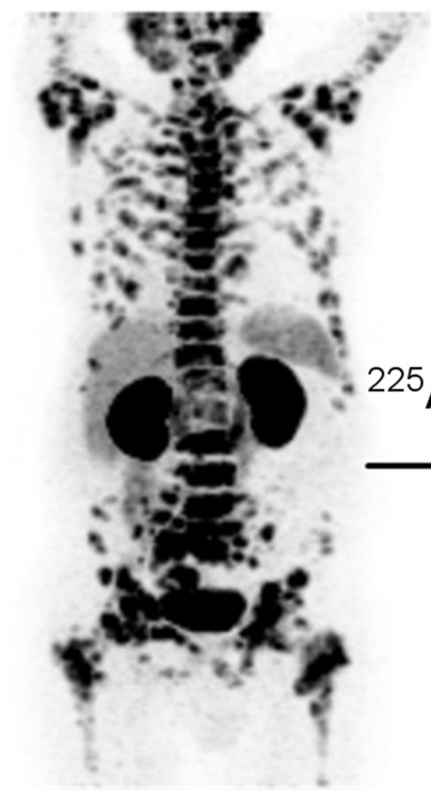
⁷²Se and ⁶⁸Ge Production
t_{1/2} = 270.93 ± 0.13 d
ε
t_{1/2} = 67.71 ± 0.09 m
→ ⁶⁸Ga
LBNL
LANL
BNL
t_{1/2} = 8.40 ± 0.08 d
t_{1/2} = 26.0 ± 0.1 h
⁷²Se → ⁷²As
ε
⁶⁸Ga
Arsenic route offers highest yield and purity for ⁷²Se
PRC 104, 064615 (2021)
J.Nuc.Med 57.12 (2016)
Notes:
The data from TREND suggests that across all rele-
vant incident particle energies beyond reaction threshold,
the 75As(p,4n)72Se is the optimal production pathway
to the 72 Se/72 As generator system. The arsenic target
route offers an increase in yield of greater than an order
of magnitude versus the current methods, while still af-
fording radioisotopically pure production as best as pos-
sible. Specifically, no charged-particle production route
to the 72Se/72As generator system is uncontaminated
from 75−73Se co-production.
that 72As will be efficiently separated from the parent 72 75−73Se when needed, and that the co-produced Se will also follow the chemical separation [9, 11]. Additionally, the 75As(p,4n) pathway avoids any potential long-lived 74,73,71As contamination.

Slide 8
Nuclear Data Contributions – Medical and Models
Our data adds direct value for isotope production
But we are also a nuclear data group
  And this is a large contribution of scarce data
  A valuable opportunity to study high-energy reaction modeling and evaluation
LBNL
LANL
BNL
How do we improve modeling for high-energy proton-induced reactions?
PRC 104, 064615 (2021)

Slide 9
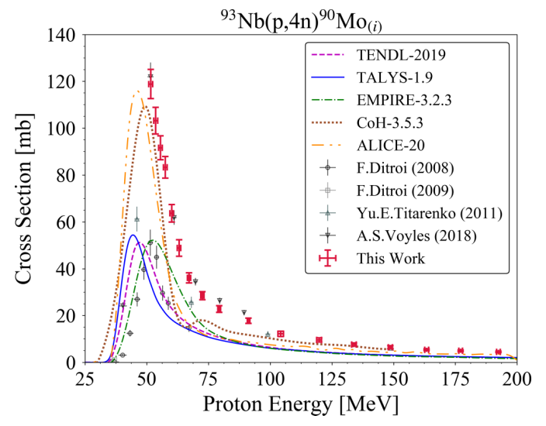
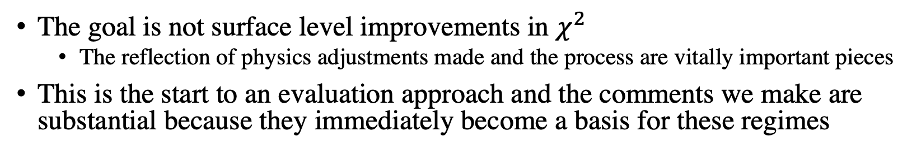
Impact Beyond “Better Fitting Lines”
The goal is not surface level improvements in $χ^{2}$
  The reflection of physics adjustments made and the process are vitally important pieces
This is the start to an evaluation approach and the comments we make are substantial because they immediately become a basis for these regimes
Compound (10⁻¹⁶⁻¹⁸ s)
n
n
⁹³Nb
⁹⁴Mo
⁹⁰Mo
p
n
Increasing Energy/Nucleon
Exciton
interactions
n
⁹³Nb
⁹³Nb
n
⁹⁰Mo
n
p
Pre-equilibrium (10⁻¹⁹⁻²² s)
n
n
M. B. Fox et al., PRC, 103(3):034601, 2021

Slide 10
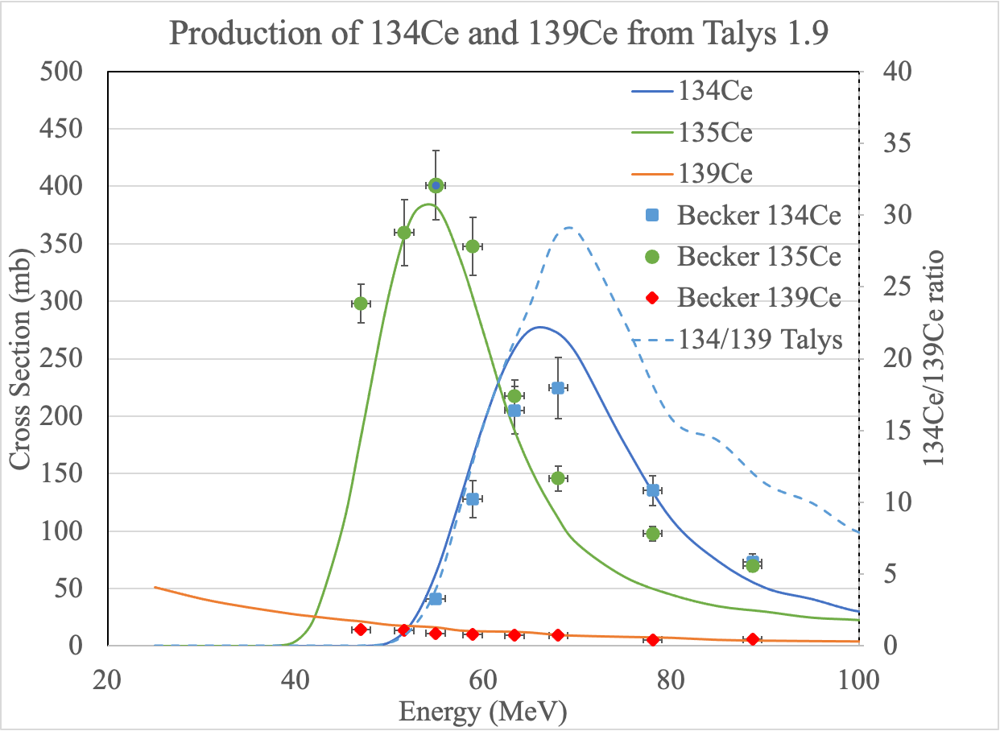
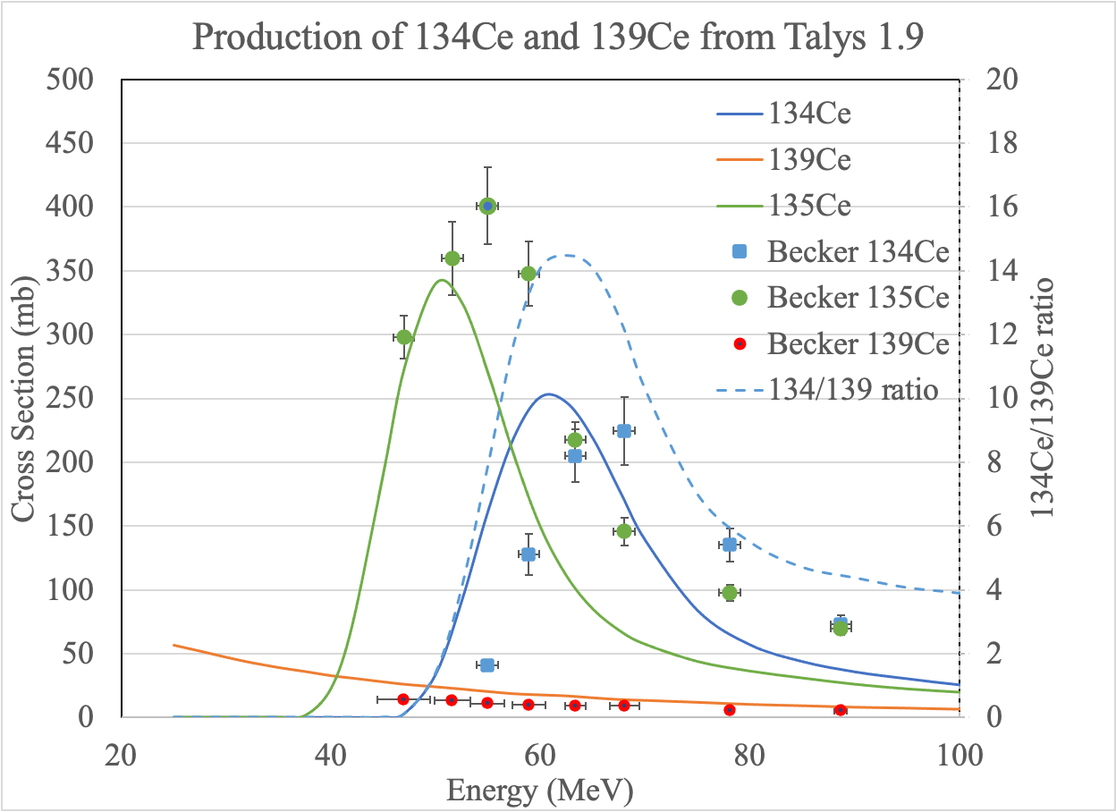
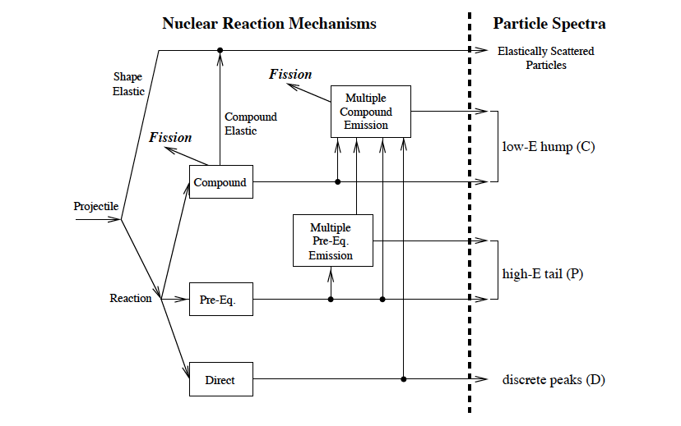
This effort* seeks an improvement in the ability of reaction modeling to optimize radioisotope production
But there are literally thousands of other parameters that can be adjusted!
More data is needed to obtain the correct set of reaction parameters
*M. B. Fox et al., PRC, 103(3):034601, 2021 & PRC 104, 064615 (2021)

Slide 11
What Happens if We Don’t Do the Right Thing?
Consider 10 different models, with arbitrary choices of which simplistic or complex parameters are adjusted, to reproduce similar improvements over the default prediction...
Using the TALYS framework, what parameters might be chosen for adjustments?
  Level density: ldmodel, ctable, ptable (Compound)
  Optical Model: avadjust, rvadjust, w1adjust, v1adjust (Mostly Compound)
  E1 gamma-ray strength model: strength (Both)
  Pre-equilibrium: preeqmode, M2constant, M2shift, M2limit (Pre-Equilibrium)
M. Fox, PRC 103(3):034601, 2021
Notes:
And finally, with this all seemingly set and a true physical result taken out from it, we can see what happens if we don’t do this right thing. What if we don’t follow the procedure when making adjustments and what if we only look at one residual product channel instead of them multiple simultaneously, basically throwing that first puzzle piece step out the window.
Well, here’s the strongly fed 90Nb channel. If we were to just look at this, we can see that it’s possible to make a whole bunch of different sets of adjustments that reproduce/do better than the default. But which one is most correct, which one represents reality best. Well, if we are just looking at this one channel, we would say models 1,2,10. Am I actually improving predictive power from this, have I generated some sort of information to help me improve modelling and get out a correct solution. Questions you should ask if you’re making these type of adjustments. But as soon as you look at a neighbouring channel, you’ll find this approach is certainly not correct. Here models 1,2,10 perform extremely poorly.
Nevertheless, this type of single channel, arbitrary parameter adjustments is a norm in literature and it clearly leads to compensating errors. All of which can certainty be improved by the fitting approach I presented.

Slide 12
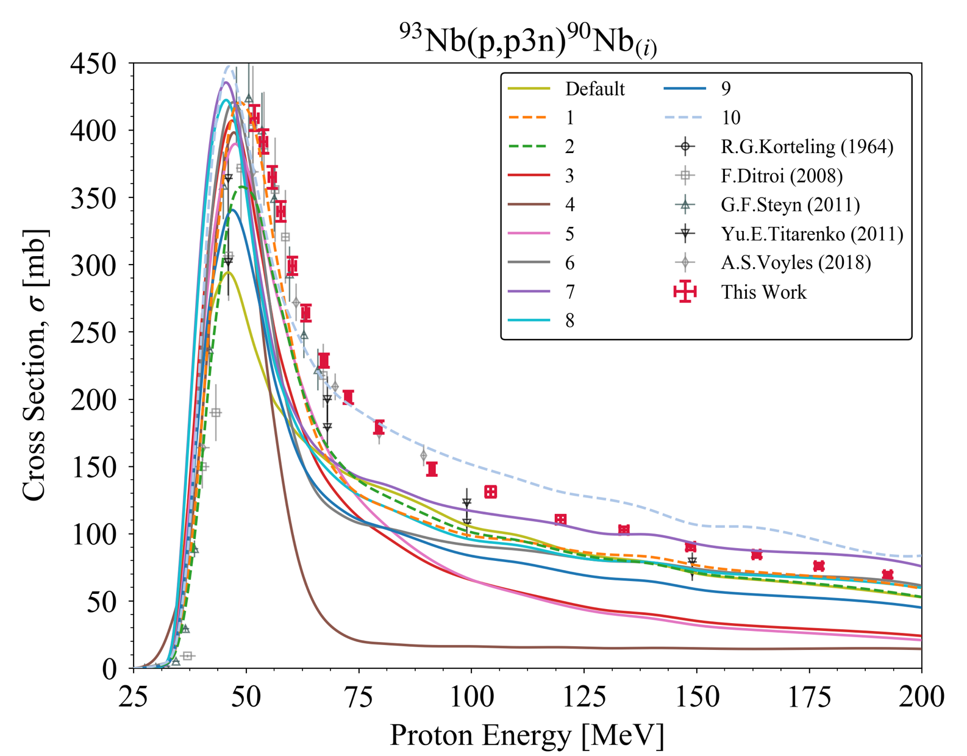
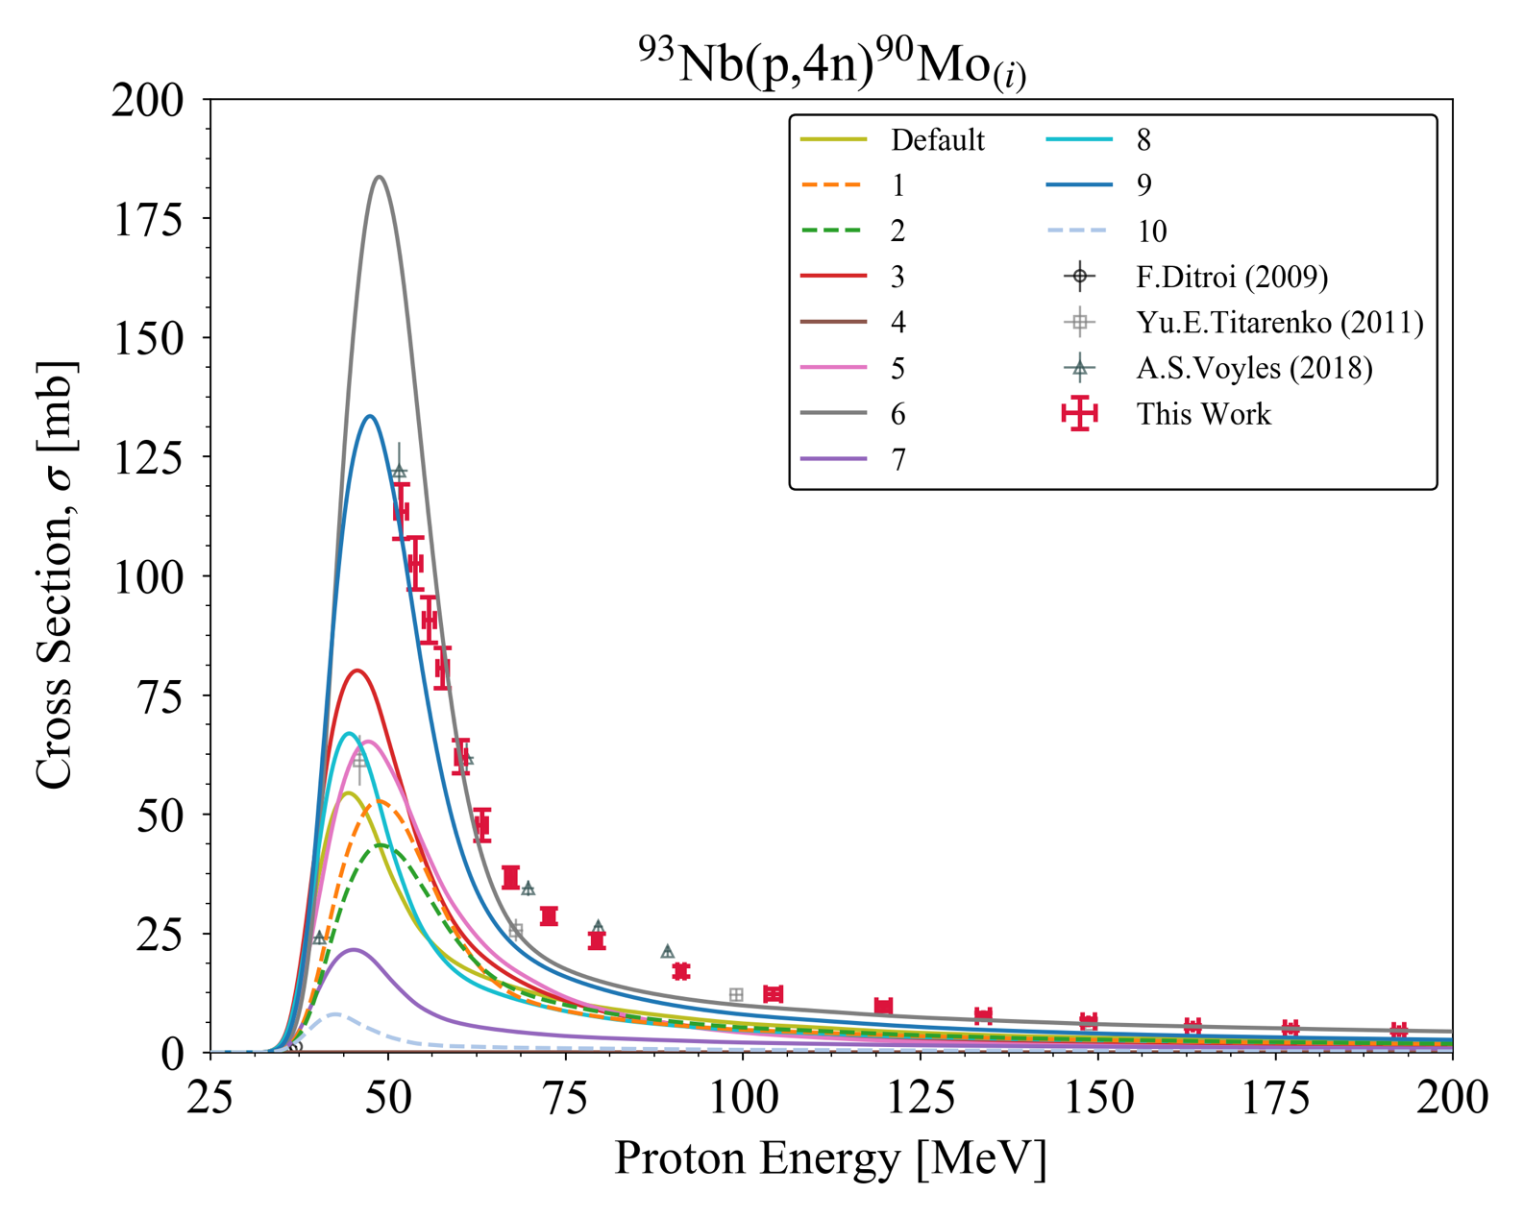
What Happens if We Don’t Do the Right Thing?
Consider 10 different models, with arbitrary choices of which simplistic or complex parameters are adjusted, to reproduce similar improvements over the default prediction…
Using the TALYS framework, what parameters might be chosen for adjustments?
  Level density: ldmodel, ctable, ptable
  E1 gamma-ray strength model: strength
  Pre-equilibrium: preeqmode, M2constant, M2shift, M2limit
  Optical Model: avadjust, rvadjust, w1adjust, v1adjust
Models 1, 2, 10 perform best over default
Models 1, 2, 10 perform extremely poorly
Single-channel optimizations lead to non-unique, non-physical solutions!
M. Fox, PRC 103(3):034601, 2021
Notes:
And finally, with this all seemingly set and a true physical result taken out from it, we can see what happens if we don’t do this right thing. What if we don’t follow the procedure when making adjustments and what if we only look at one residual product channel instead of them multiple simultaneously, basically throwing that first puzzle piece step out the window.
Well, here’s the strongly fed 90Nb channel. If we were to just look at this, we can see that it’s possible to make a whole bunch of different sets of adjustments that reproduce/do better than the default. But which one is most correct, which one represents reality best. Well, if we are just looking at this one channel, we would say models 1,2,10. Am I actually improving predictive power from this, have I generated some sort of information to help me improve modelling and get out a correct solution. Questions you should ask if you’re making these type of adjustments. But as soon as you look at a neighbouring channel, you’ll find this approach is certainly not correct. Here models 1,2,10 perform extremely poorly.
Nevertheless, this type of single channel, arbitrary parameter adjustments is a norm in literature and it clearly leads to compensating errors. All of which can certainty be improved by the fitting approach I presented.

Slide 13
These results were used to develop a new data evaluation methodology for high-energy (p,x) reactions
Based in TALYS code
We established a collaboration with the TALYS lead developer, Dr. Arjan Koning (Head of the IAEA Nuclear Data Section)
Emphasis placed on
pre-equilibrium parameter
adjustments to match the
strongest-fed channels
The modeling is validated
via comparison to nonelastic,
cumulative channels
(same product formed by
several exit channels)
Morgan Fox

Slide 14
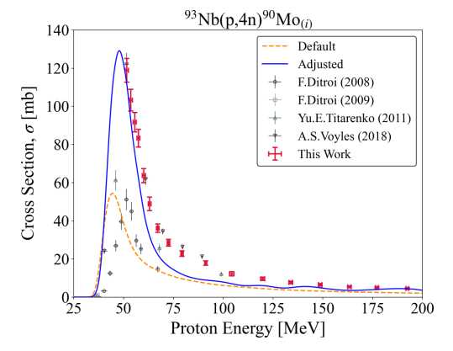
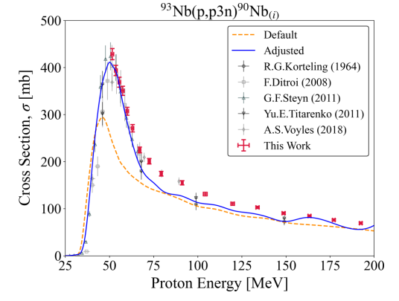
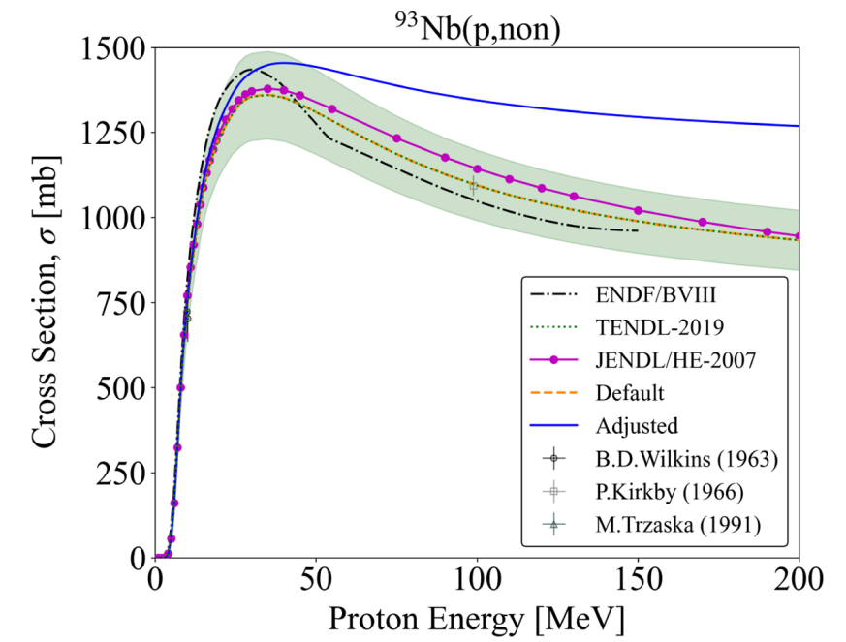
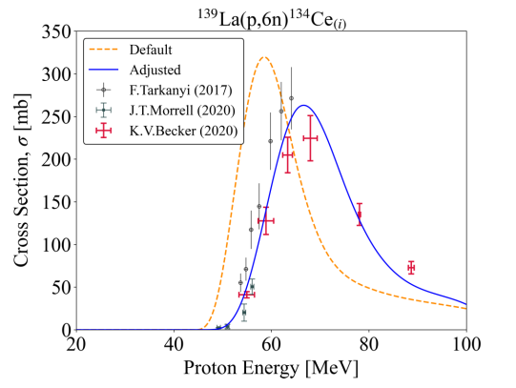

Evaluation Procedure applied to ⁹³Nb(p,x), ¹³⁹La(p,x)
Exciton model adjustments in this mass region have led to significant improvements in pre-equilibrium, with global $χ^{2}$ improvements up to 40x
However, the base level density (ldmodel 4, Goriely HFB + Skyrme) needed to be changed (ldmodel 5, Hilaire HFB + Skyrme) for most Nb, Mo products
All is not well in the state of Denmark w.r.t. level density!
*M. B. Fox et al., PRC, 103(3):034601, 2021 & PRC 104, 064615 (2021)

Slide 15
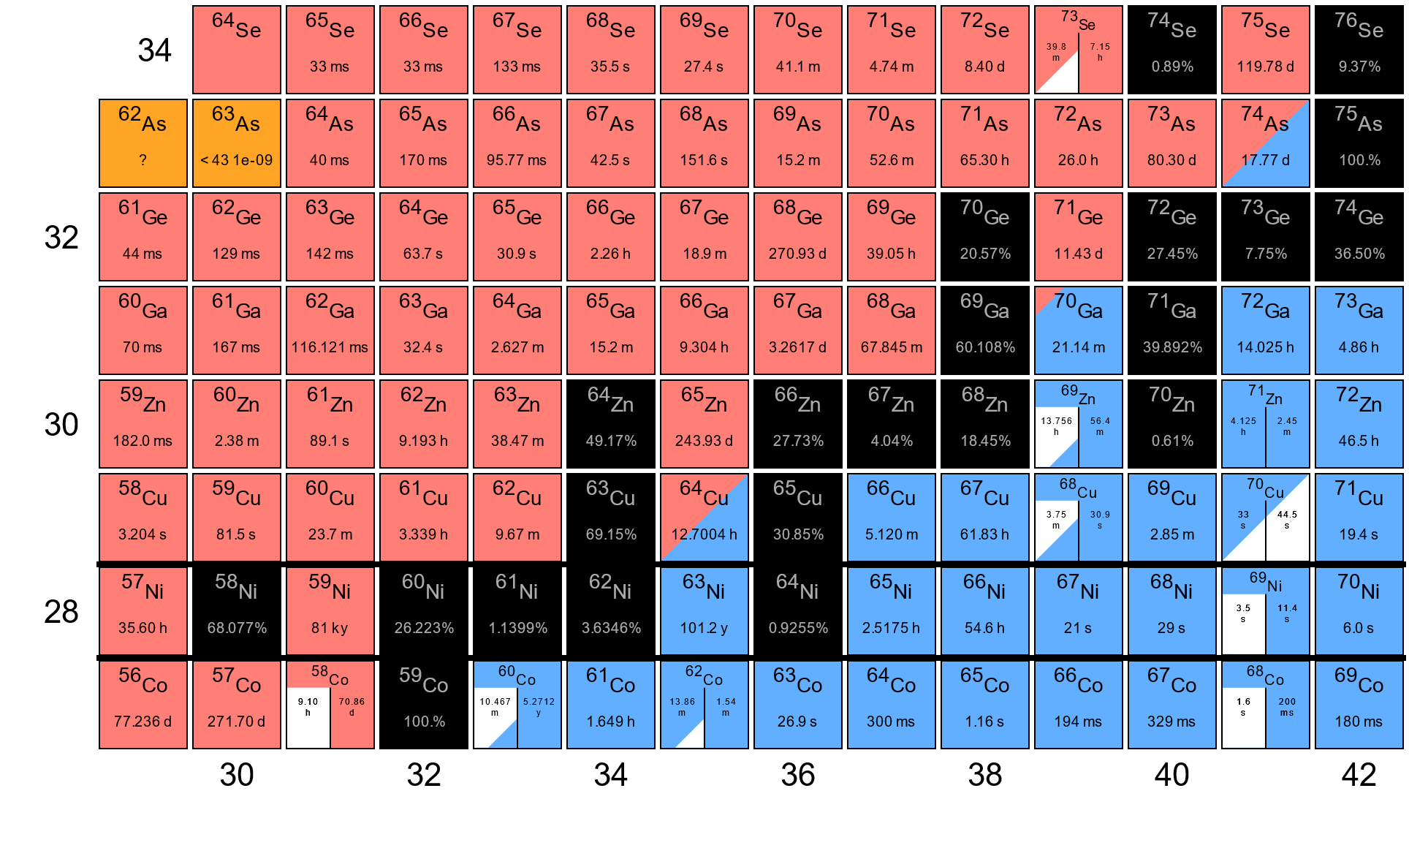
Level Density Adjustments in ⁷⁵As(p,x)
Like with Nb/La, we see a clear need to transition to a new level density model as we get far from target
  Effect is more prominent in As, as we produce isotopes further from stability
  More pronounced for (p,xn) channels
  This does NOT imply that one ldmodel is better than others – none work globally for high E_{x}!
→ ldmodel 4, Goriely HFB + Skyrme
→ ldmodel 5, Hilaire HFB + Skyrme
All others → ldmodel 6, Temperature-Dependent HFB + Gogny
This is a problem!
*M. B. Fox et al., PRC, 103(3):034601, 2021 & PRC 104, 064615 (2021)
Notes:
Unfortunately, TALYS’s implementation of the ECIS-06 code
for optical model and CC calculations is unsuited for a pure
vibrational coupling scheme for odd-Z nuclei, and the weakcoupling model has to be used in such cases. Moreover, the
only odd-Z nucleus with any sort of vibrational deformation file in TALYS is 241Am, where vibrational collectivity
is built on top of rotational character. Therefore, taking the
241Am deformation formatting as a guide, a weak vibrational
band consisting of the 75As 9/2+ (303.9243 keV), 5/2+
(400.6583 keV), and 1/2+ (860.0 keV) levels was added to a
second created coupling scheme including the prior discussed
rotational band. In this suggested vibrational band, the 1/2+
level is dominated by transition to 5/2+, which then has an E2
transition to the 9/2+ of 76.4 (25) Weisskopf units [104]. The
9/2+ deexcitation is dominated by E3 decay to the ground
state. This mixed rotational+vibrational coupling scheme was
also added to TALYS.

Slide 16
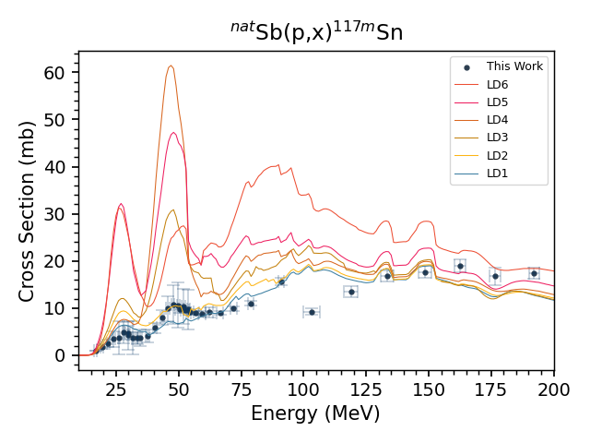


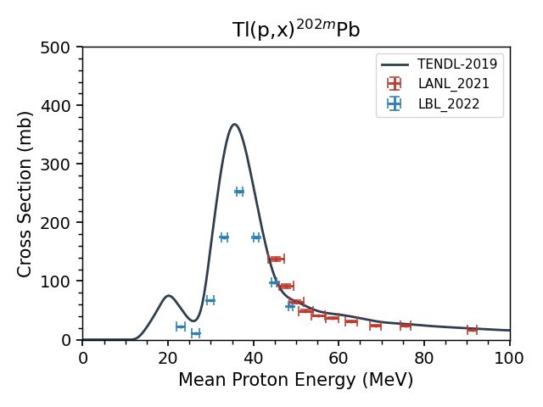
Limitations to Residual Product-Based Fitting
This approach can’t be used to fit to any products which are stable, lack observable decay gammas, or are too short-lived (< 10ish minutes)
  We need something beyond the stacked-foil technique!
Catherine Apgar
Isotope Production
Preliminary
Isotope | Target | Beam | Measurement focus | Energy range | Site | Year
⁷²Se, ⁶⁸Ge | ⁷⁵As | p | Primary: ⁷²Se, ⁶⁸Ge Impurities: ^{70,71,73,75}Se, ^{66,67,69,71}Ge | Up to 200 MeV | All | 1
²⁰²Pb | ²⁰⁵Tl | p,d | Primary: ^{202m,202g}Pb Impurities: ¹⁹⁸⁻²⁰⁵Pb | Up to 200 MeV | All | 2
²⁰²Pb | ²⁰³Tl | p,d | Primary: ^{202m,202g}Pb Impurities: ¹⁹⁸⁻²⁰³Pb | Up to 200 MeV | All | 3
¹¹⁹Te, ^{117m}Sn | ^{nat}Sb | p,d | Primary: ^{119m,119g}Te, ^{117m}Sn Impurities: ^{116-118,121m/g,123m}Te, ^{113,119m,121m/g}Sn | Up to 200 MeV | All | 4
¹³⁴Ce | ^{nat}La | p,d | Primary: ¹³⁴Ce Impurities: ^{132,133,133,137,139}Ce | Extend to 200 MeV | LANL, BNL | 4
Stay tuned!
Preliminary
Flux Monitoring
Nuclear reaction | Energy range | Site | Year
^{nat}Ti(p,x)⁴⁸V | Extend to 200 MeV | All | 2
^{nat}Nb(p,4n)⁹⁰Mo | Up to 200 MeV | BNL | Out years
*M. B. Fox et al., PRC, 103(3):034601, 2021 & PRC 104, 064615 (2021)
Michael Skulski

Slide 17

And Now, For Something Completely Different…
Notes:
Production of clean 225Ra beta precursor allows for milking of radiopure 225Ac

Slide 18
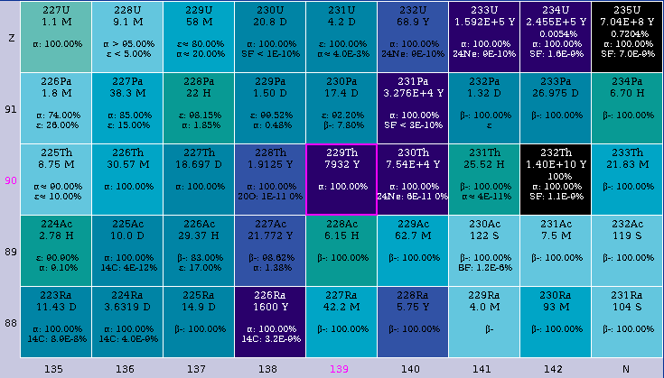
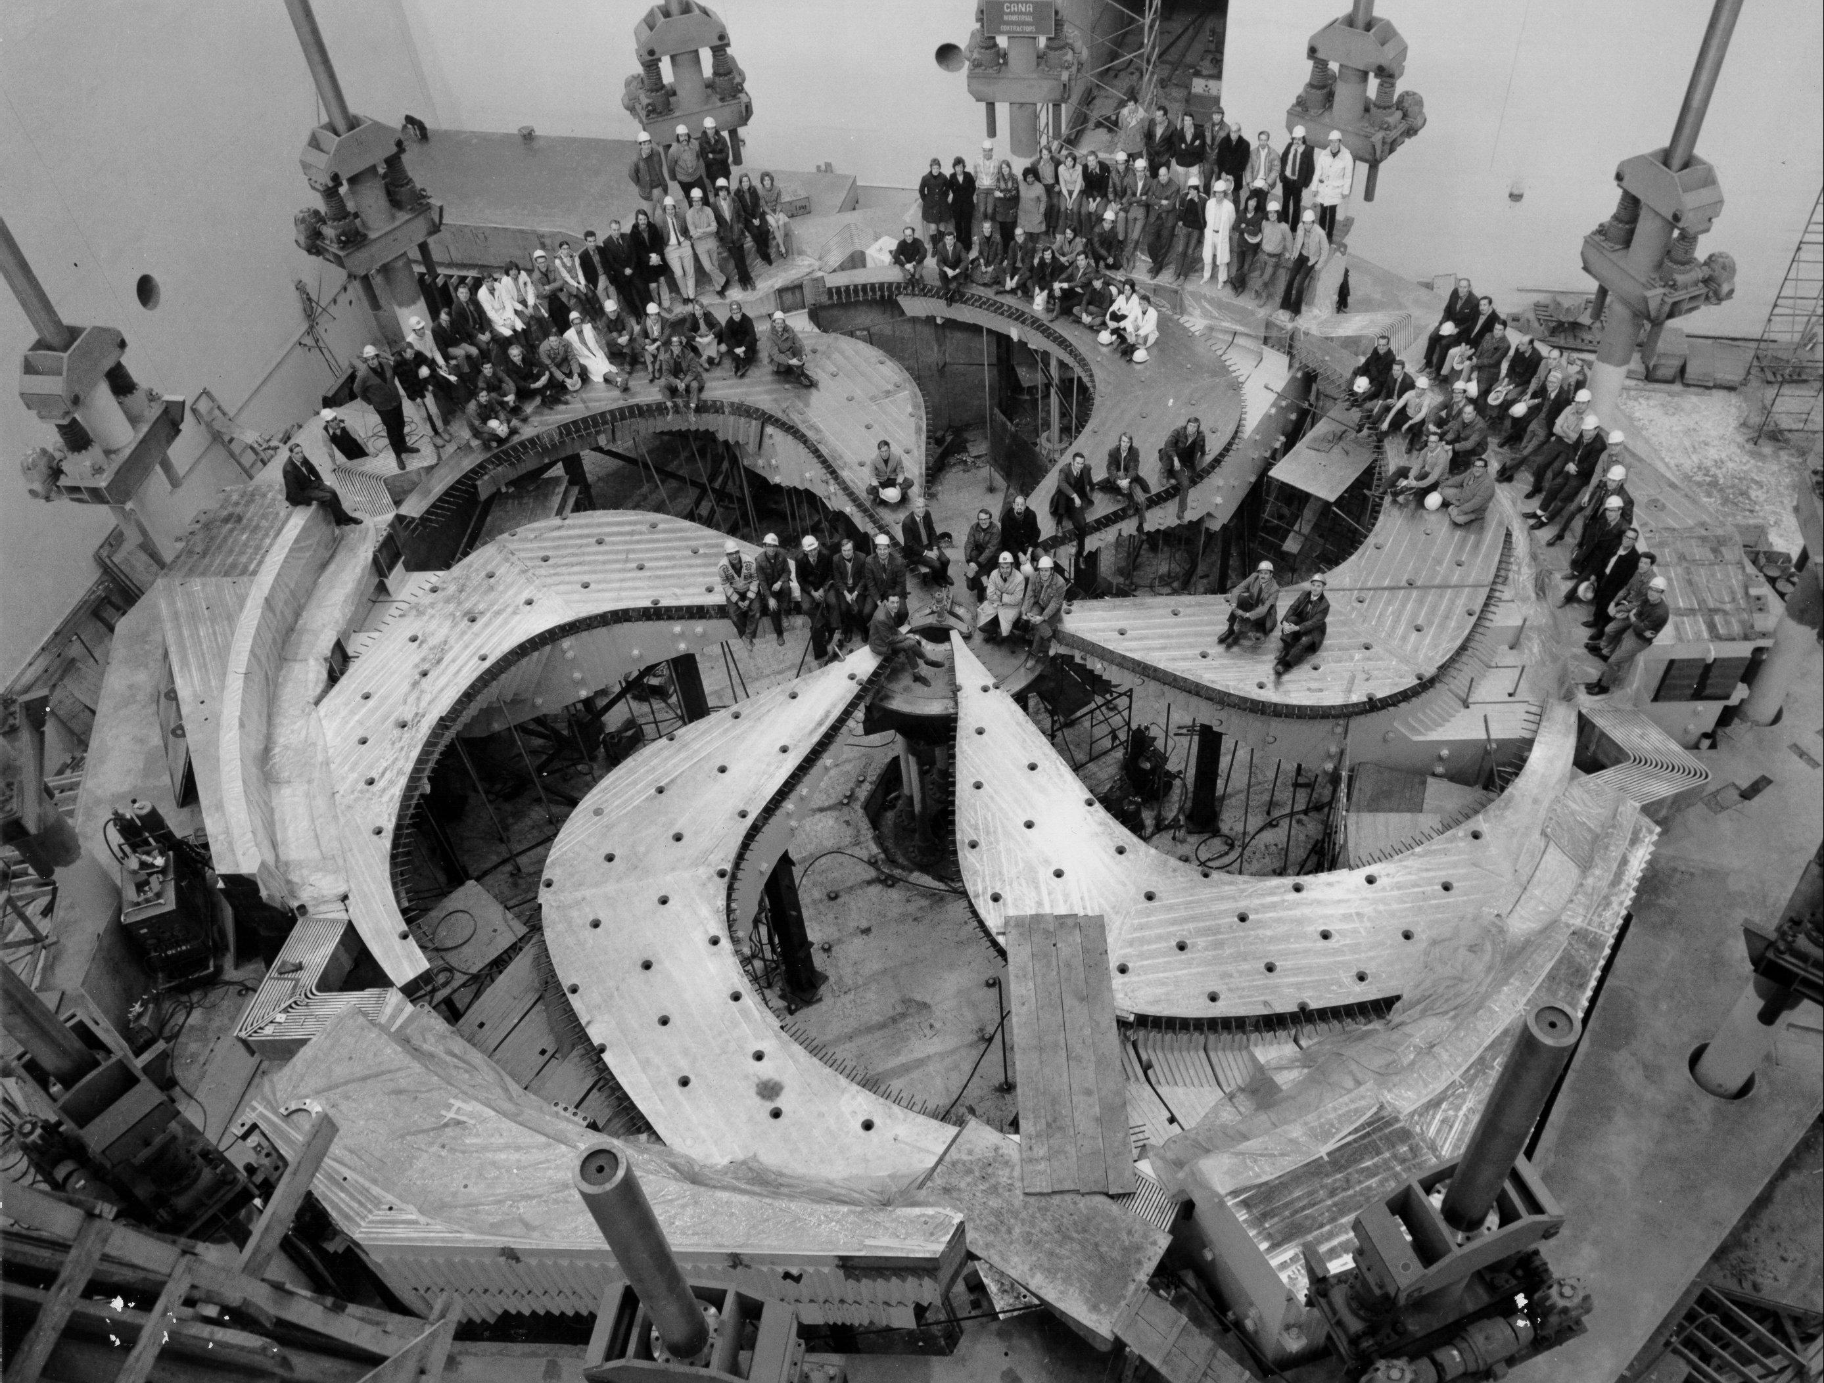
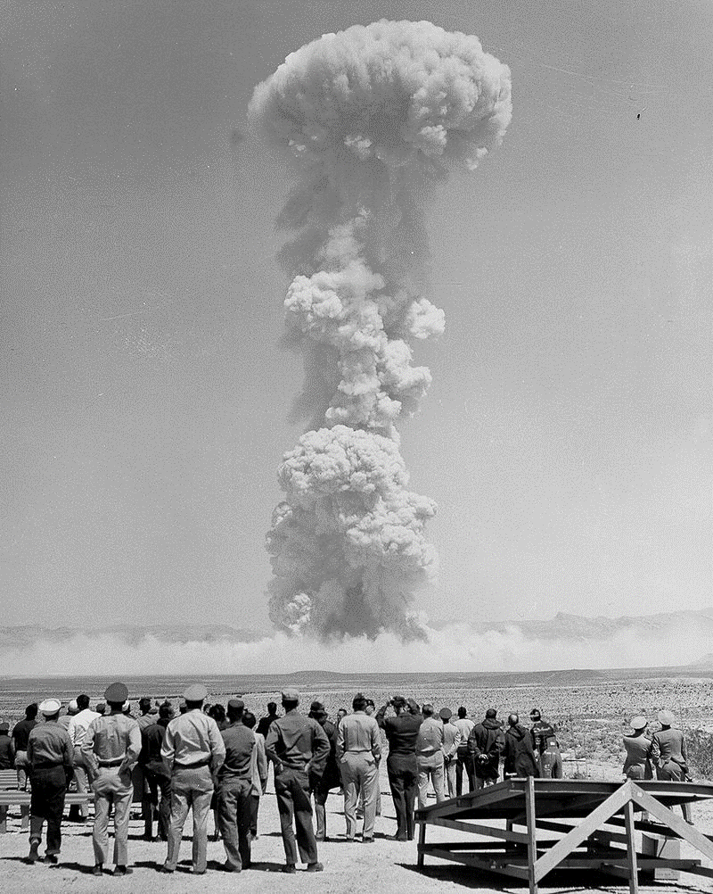

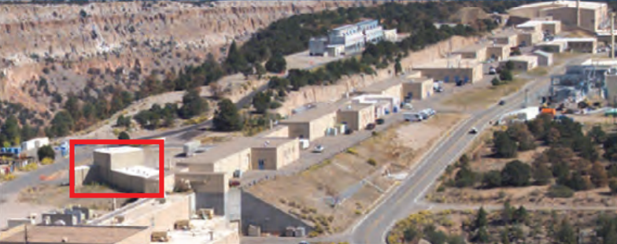
How to (not) Make ²²⁵Ac
α
²³²Th(p,x)
TRIUMF
²²⁶Ra(p,2n)
α
β-
BLIP @ BNL
What about neutrons?
²²⁶Ra(γ,n)
IPF @ LANSCE
²²⁷Ac Long-Term Dose: R.J. Abergel, et al., J. Med. Imag. Rad. Sci. 50.4 (2019): S93.
Notes:
Production of clean 225Ra beta precursor allows for milking of radiopure 225Ac

Slide 19
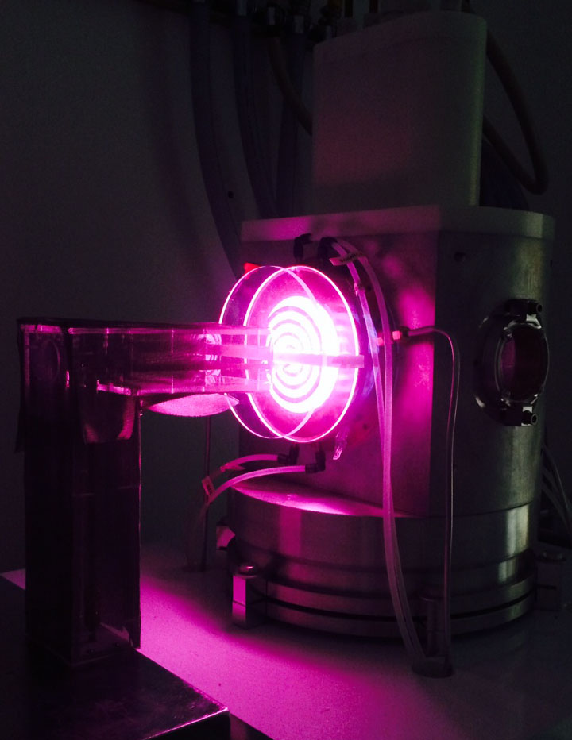
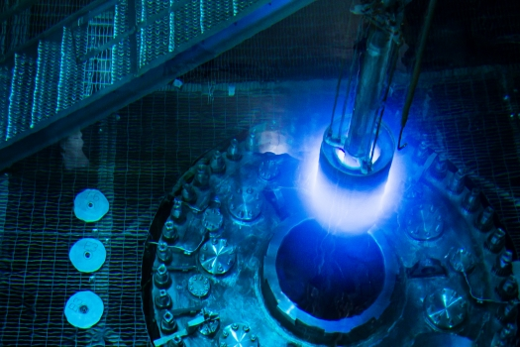
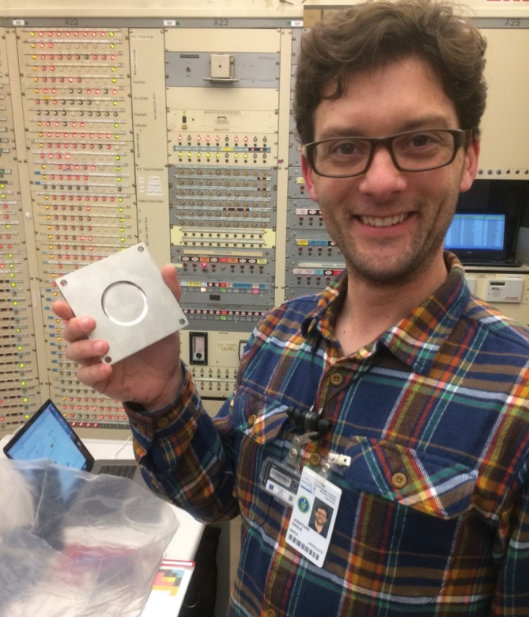
What About Neutrons?
D-breakup (Au → Be)
10¹⁰⁻¹² neutrons/cm²/s/µA
5 < E_{n} (MeV) < 30
IPF – 230 µA•h
LANSCE - IPF
10⁷ neutrons/cm²/s/µA
5 < E_{n} (MeV) < 100
(Low flux)
DD / DT Generator
10⁷⁻⁹ neutrons/cm²/s
2.7 / 14.1 MeV
(Low current)
HFIR
10¹⁴⁻¹⁵ neutrons/cm²/s
Fast fission spectrum
(Low energy)
Li(p,n) QMN
10⁴⁻⁶ neutrons/cm²/s
0 < E_{n} (MeV) < 60
(Low flux)
Jon Engle
M.A. Mosby, NIMB 381 29-31 (2016).
K.P. Harrig, NIMA 877 359–366 (2018).

Slide 20

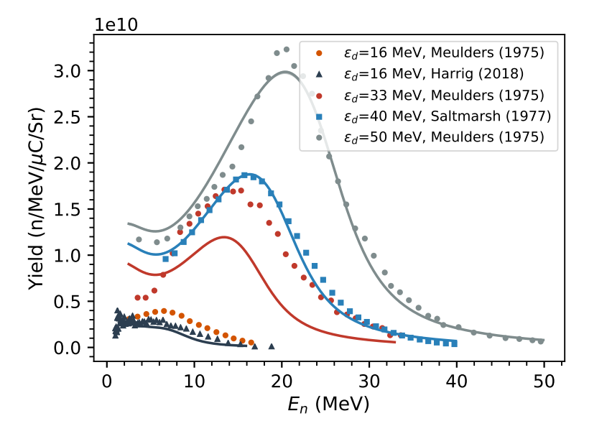
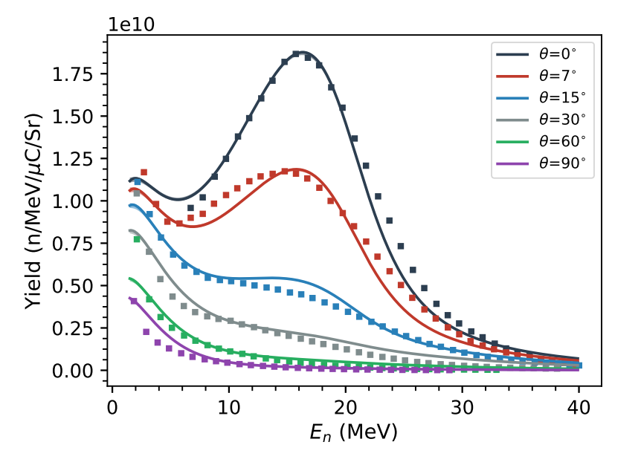
Deuteron Breakup
Deuteron has no bound excited states
  Excitation / stripping causes the deuteron to breakup into constituent proton + neutron
  ~5-10% of deuterons are converted into neutrons
  Conservation produces a highly (θ≈10°) forward-focused “blowtorch” of neutrons
  Be breakup target gives highest n-yield, and doesn’t activate
  Tunable E_{n}, negligible target heating
n
n
Jon Morrell
θ
n
Beryllium
d
d
d
d
n
J.T. Morrell PhD Thesis (2021)
& PRC (Submitted, 2022)
J.P. Meulders, P. Leleux, P. C. Macq & C. Pirart
Phys. Med. Biol. 20, #. 2, 235-243, (1975)

Slide 21
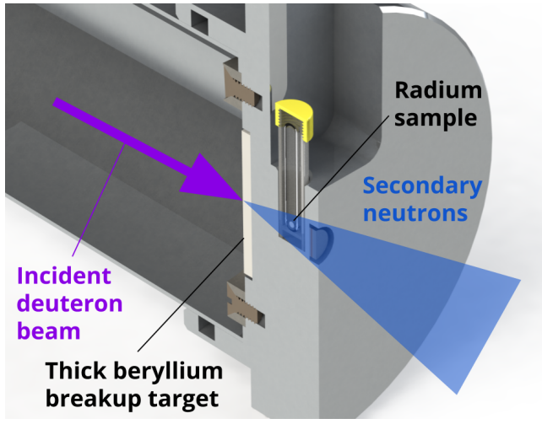
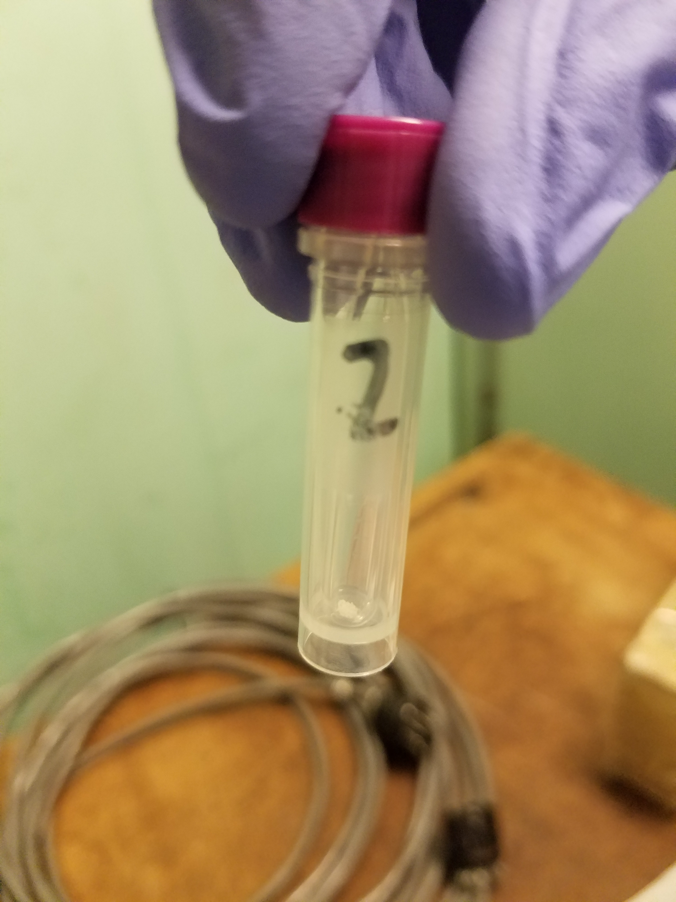
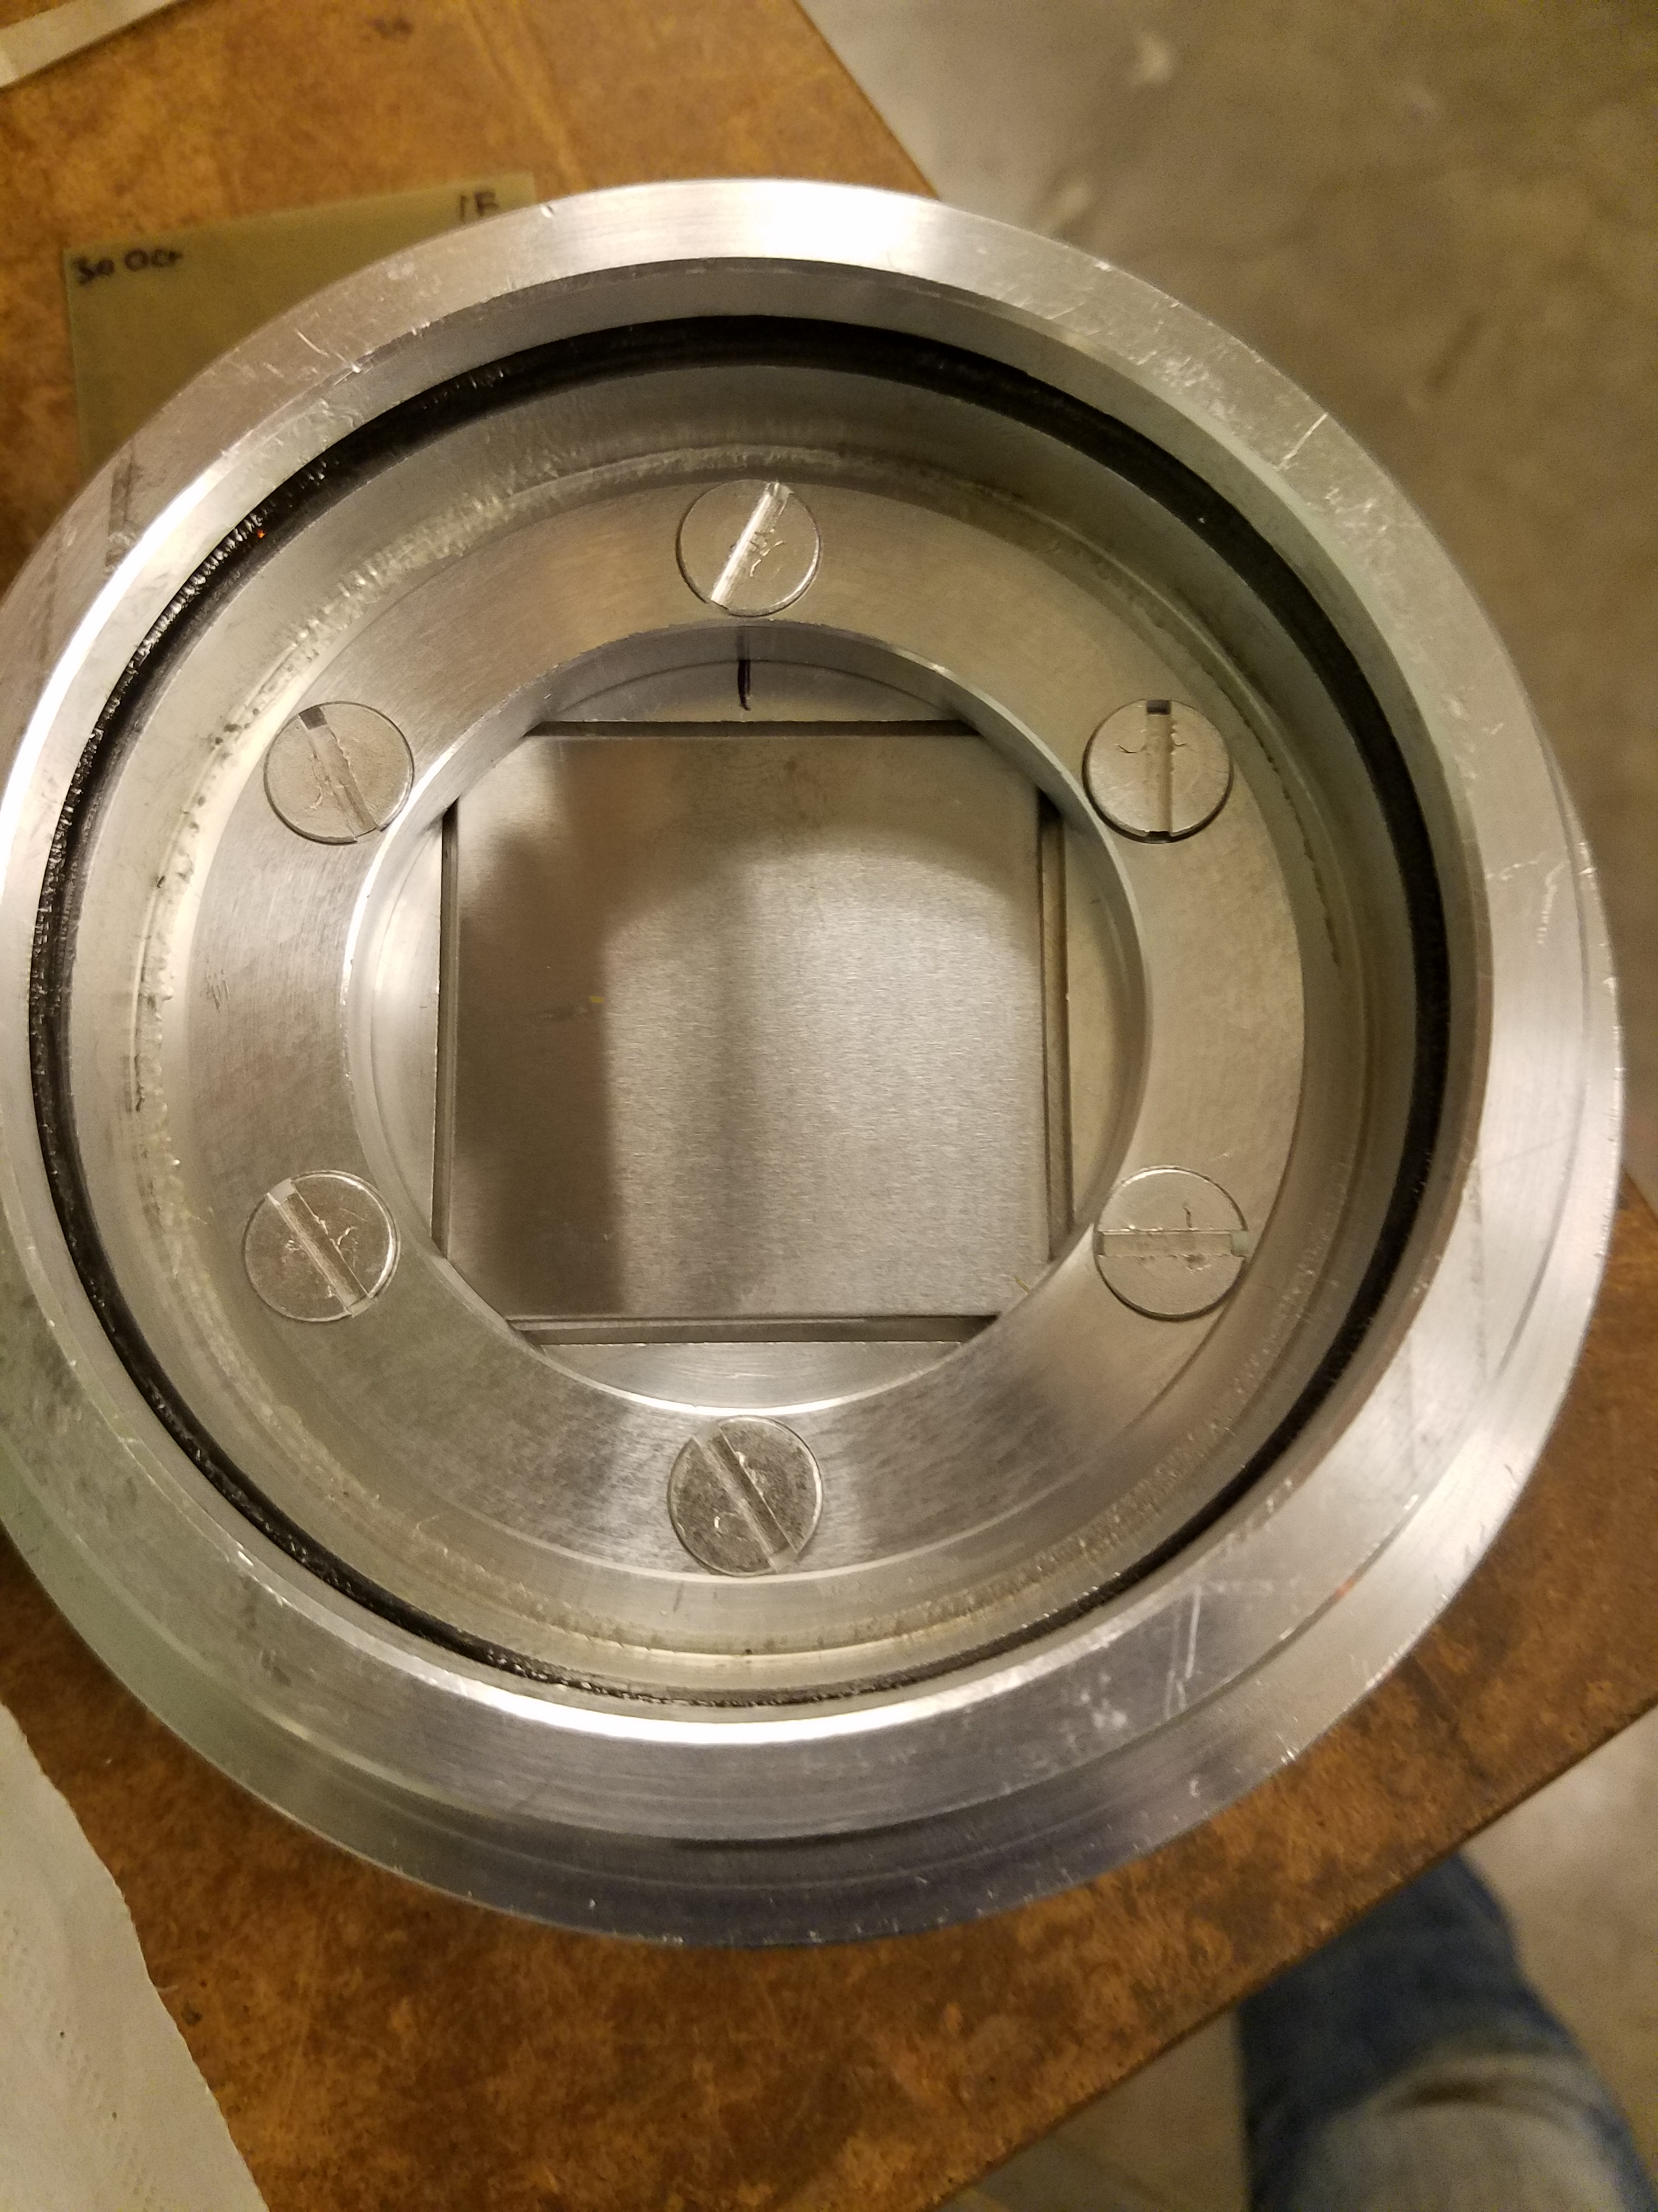
The High Energy Incident Flux for Emerging Radionuclides Target:
HEIFER
33 MeV d+ beam,
1cm OD
1 mg = 1 mCi ²²⁶Ra
target at atmosphere
In vacuum: 6mm Be
breakup target
J.T. Morrell PhD Thesis (2021)
& PRC (Submitted, 2022)
Patent US20220199276A1
WO2020210147A1
EP3953949A1

Slide 22
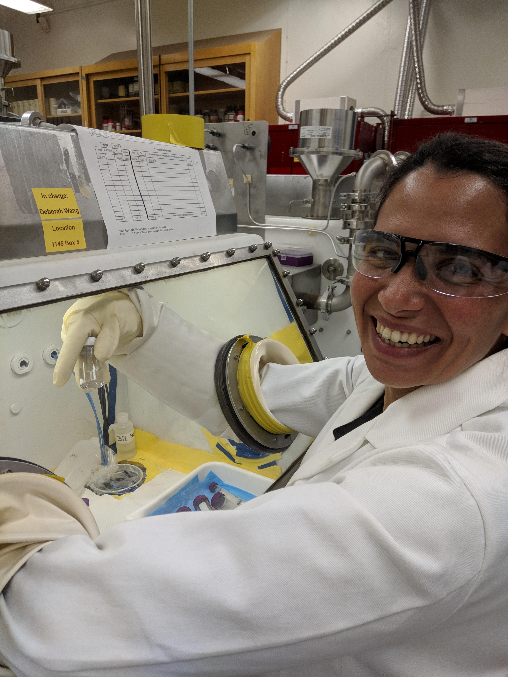
Alpha and gamma-ray spectra taken at LBNL
Radiochemical Ac/Ra separation at 14 days post-EOB
  Dissolve down 1 mg Ra target in 3M HNO₃
  Precondition 2 mL Eichrom DGA resin column with 5 bed volumes 3M HNO₃
  Load column with Ra/Ac solution at 0.8 mL/min
  Wash column with 2 bed volumes 3M HNO₃
  Strip Ac from column with 5 bed volumes 0.1 M HCl at 0.8 mL/min
  Rinse column with 5 bed volumes DI water
Activities and separation efficiency quantified via LSC, HPGe, α-spec
 | Eichrom DGA | Eichrom DGA (Aliquot 1) | Bio-Rad AG50 (Aliquot 2)
²²⁵Ac Recovery | 60% (0.84 µCi) | 37% (0.143 µCi) | 44% (0.168 µCi)
²²⁶Ra Breakthrough | 4.3 ∙ 10⁻³ % (35.1 nCi) | 2.6 ∙ 10⁻³ % (12.8 nCi) | 3.5 % (17.7 µCi)
Ac/Ra Separation Factor | 13900 | 14500 | 12.7
Separation protocol still under refinement
Rebecca Abergel
Patent US20220199276A1
WO2020210147A1
EP3953949A1
J.T. Morrell PhD Thesis (2021)

Slide 23
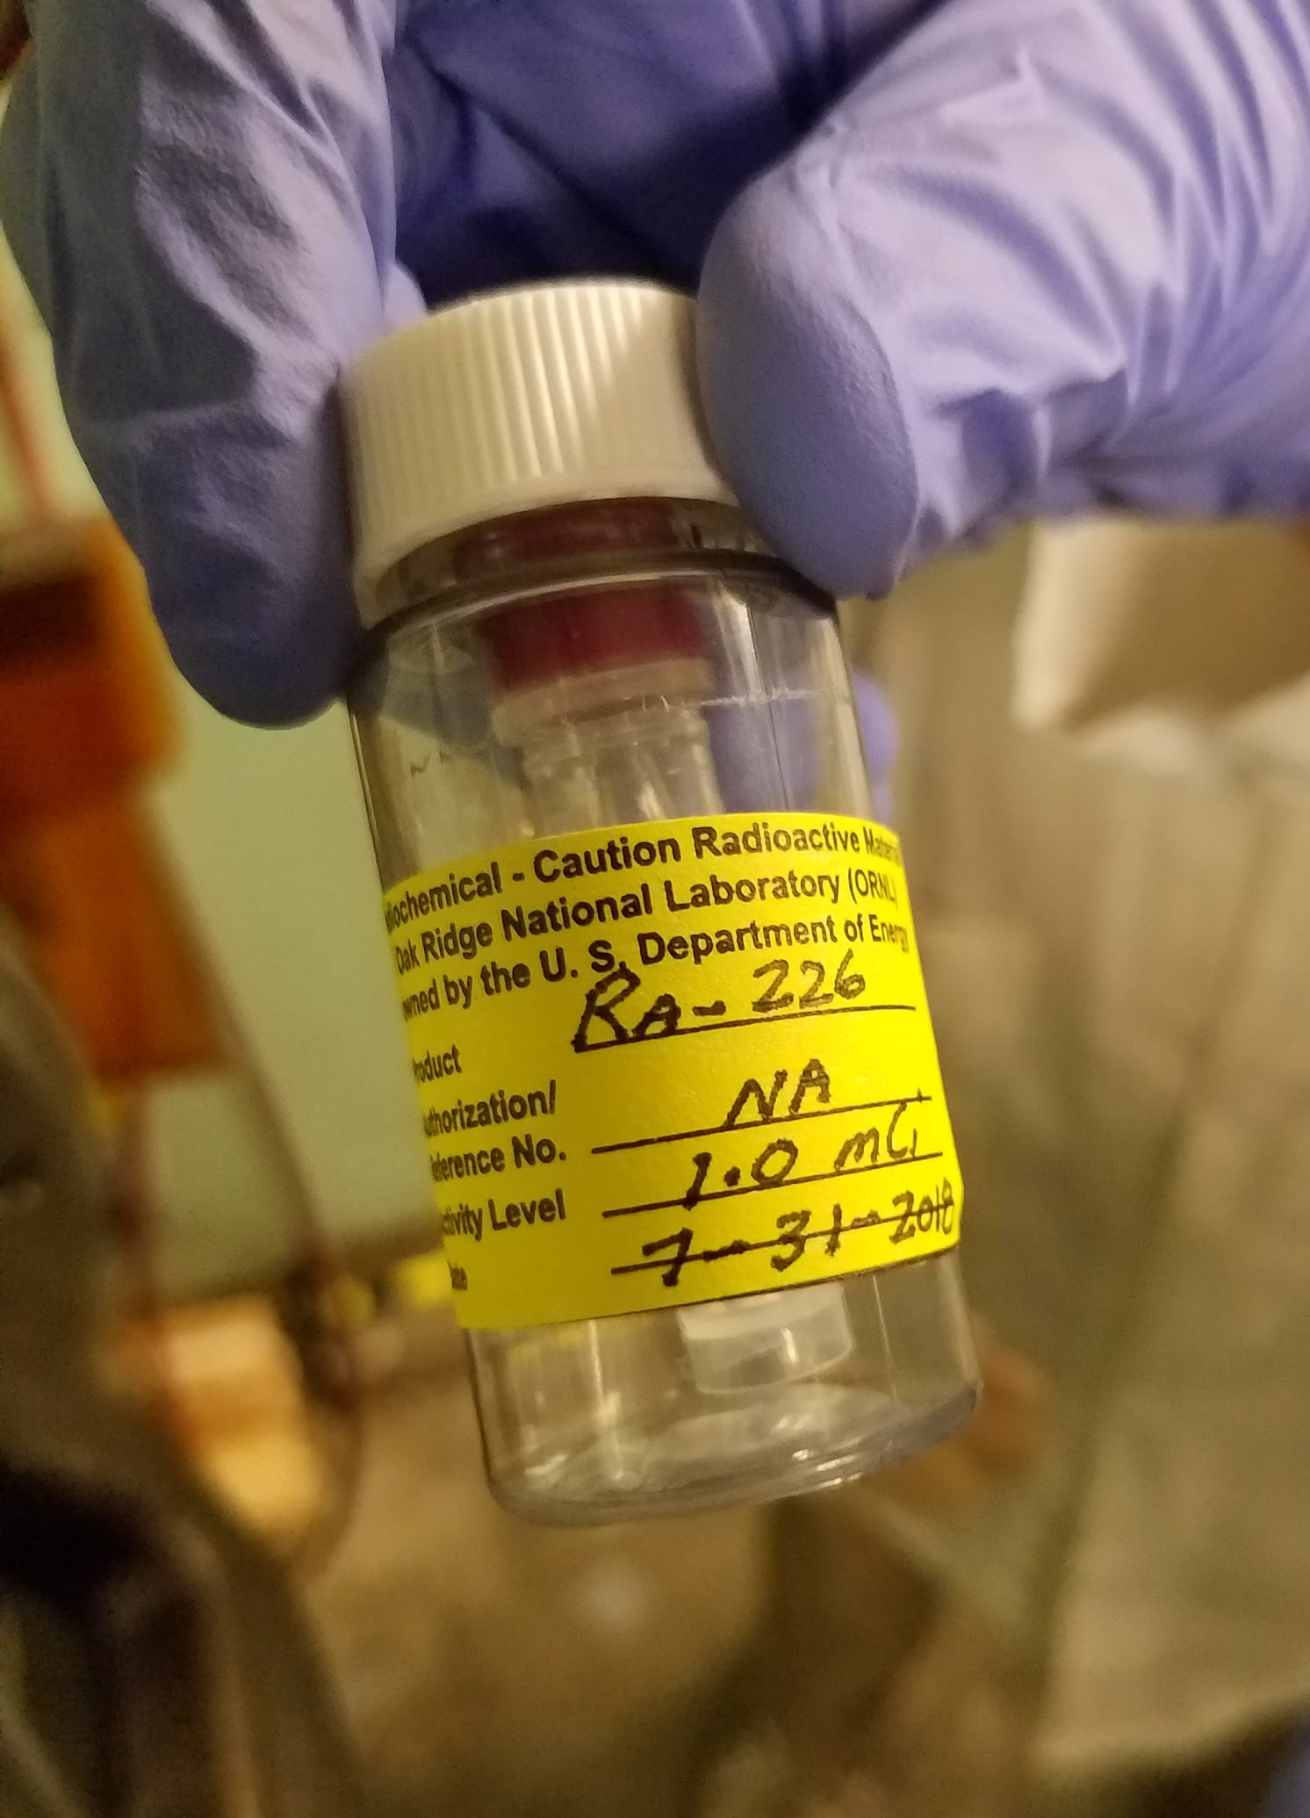
Production of ²²⁵Ac at the LBNL 88” Cyclotron
Chemical Separation
Pre-clean (remove ²²⁸Th)
Irradiation
²²⁷Ac separation (7 hour)
²²⁵Ac in-growth (10-15 day)
²²⁵Ac separation (multiple?)
²²⁶Ra recovery
Initial Results
Production rate: 2.1 mCi/mAh/g_{226Ra}
Subsequent milking would produce more
2-month count period on HPGe shows:
No fission fragments identified in recovered ²²⁵Ac
No detectable activity of ²²⁷Ac (²²⁷Ac MDA: approx. 218 Bq (5.9 nCi) or <0.4% radio-impurity)
Next Steps:
Pre-clean ²²⁶Ra sample to remove ²²⁸Th
Use different deuteron energies to optimize yield
Optimize chemical separation procedure
Patent US20220199276A1
WO2020210147A1
EP3953949A1
J.T. Morrell PhD Thesis (2021)

Slide 24
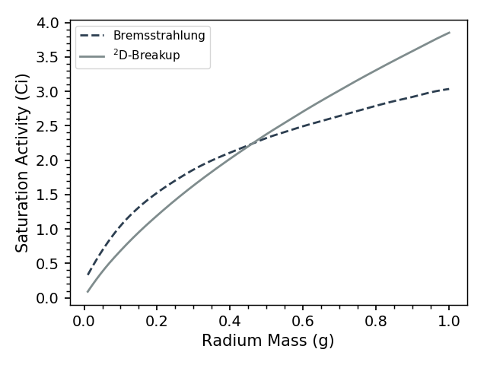
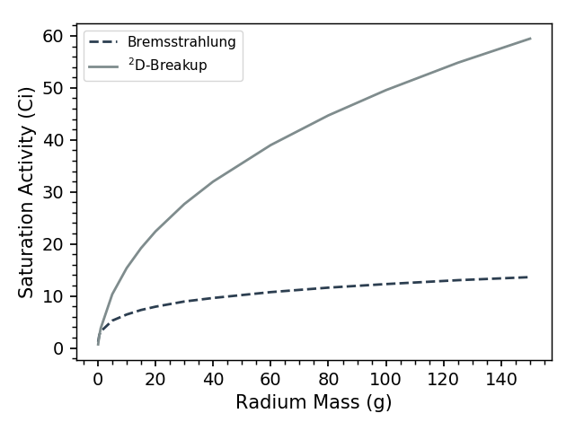
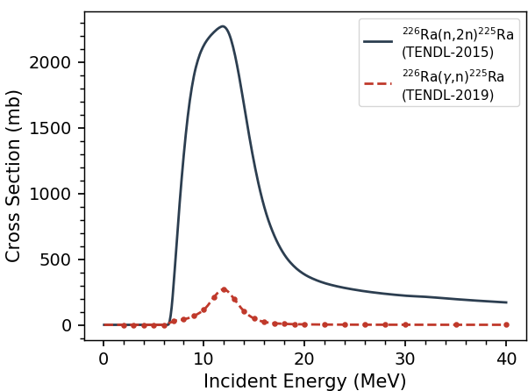

D-breakup neutron production is most effective on thick targets
²²⁶Ra(γ,n) (40 MeV e⁻ Brehm)
²²⁶Ra(n,2n) (40 MeV D-breakup)
²³²Th(p,x) TTY (<200 MeV)
²²⁶Ra Cross Sections
We benchmarked these numbers at 33 and 40 MeV using a 1 mg ²²⁶Ra sample
Assumptions: 40 MeV D and e beams; 25 kW beam power; cylindrical target
Note: No fission products observed at either deuteron energy
J.T. Morrell PhD Thesis (2021)
& PRC (Submitted, 2022)
Patent US20220199276A1
WO2020210147A1
EP3953949A1
24

Slide 25




Simultaneous production using Deuteron Breakup neutrons
⁶⁷Cu
⁴⁷Sc
Assumptions: 40 MeV D and e beams; 25 kW beam power; cylindrical target
Difference in production attributable to cross section differences
J.T. Morrell PhD Thesis (2021)
& PRC (Submitted, 2022)
Patent US20220199276A1
WO2020210147A1
EP3953949A1
25

Slide 26

Takeaways + Questions for YOU!
Nuclear Data
  When measuring cross sections / yields for isotope production, please report all products you observe!
  Question: Where do you see issues in modeling cross sections / yields?
²²⁵Ac Production
  Currently designing a 20kW production target!
  Question: how to benchmark thermal modeling?
Cross-Cutting
  The Nuclear Data community is currently organizing 5-10 year priority plans, and Isotope Production is one of the top priorities for applications
What data needs do you have for quantifying issues / uncertainties / covariances in Isotope Production?
Email: ASVoyles@lbl.gov
26

Slide 27







Thank you for your attention!
Andrew S. Voyles¹, Rebecca J. Abergel^{1,2}, Catherine E. Apgar¹, Jon C. Batchelder¹, Lee A. Bernstein^{1,2},
Eva R. Birnbaum³, Cathy S. Cutler⁴, Morgan B. Fox¹, Arjan Koning⁵, Amanda M. Lewis¹, Dmitri Medvedev⁴, Jon T. Morrell³, F. Meiring Nortier³, Ellen O’Brien³, Michael A. Skulski⁴, and Etienne Vermeulen³
¹ University of California-Berkeley Dept. of Nuclear Engineering
² Lawrence Berkeley National Laboratory
³ Los Alamos National Laboratory
⁴ Brookhaven National Laboratory
⁵ International Atomic Energy Agency
This research was supported by the U.S. Department of Energy Isotope Program, managed by the Office of Science for Isotope R&D and Production, carried out under Lawrence Berkeley National Laboratory (Contract No. DE-AC02-05CH11231), Los Alamos National Laboratory (Contract No. 89233218CNA000001), and Brookhaven National Laboratory (Contract No. DEAC02-98CH10886).
https://nucleardata.berkeley.edu/
27

