Slide 1


Alpha Irradiation of Germanium Metal Targets for Production of High Specific Activity ⁷²Se/⁷²As: Challenges Associated with Thick Target Preparation
18th Workshop on Targetry and Target Chemistry
Sean Tanzey¹, Eric Dorman¹, Ezgi Yalcintas Bethune¹, Robert Smith¹, A. Lake Wooten¹, Greg Felsted², Peter Pauzauskie², Marissa Kranz¹, David Argento¹, Robert Emery¹, Heather M. Hennkens^{3,4}, Silvia S. Jurisson³, Dmitri G. Medvedev⁵, Cathy S. Cutler⁵, D. Scott Wilbur¹, Yawen Li¹
Department of Radiation Oncology, University of Washington, Seattle, WA, USA
Department of Materials Science & Engineering, University of Washington, Seattle, WA, USA
Chemistry, University of Missouri, Columbia, MO, USA
Research Reactor, University of Missouri, Columbia, MO, USA
Collider Accelerator Department, Brookhaven National Laboratory, Upton, NY, USA

Slide 2
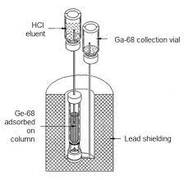
Selenium-72/Arsenic-72
Arsenic-72: PET isotope with a 26 hr half-life and E_{ß+max} = 2.5 MeV
  Produced directly from natural germanium (^{nat}Ge) with proton irradiation.
    Multiple As radioisotopes produced that cannot be separated
  Decay product of Selenium-72 parent (t_{1/2} = 8.4 d)
    Produced from the ⁷⁰Ge(α,2n)⁷²Se
Has a theranostic isotope pair As-77
Potential for making As-72 generator after
isolation of Se-72
Y. Feng, et al., Applied Radiation and Isotopes, 2019, 143, 113–122
Example generator system
Ga-68
2

Slide 3
Cross-Section Data
Se-72 produced from 18-50 MeV alpha
Coproduction of Se-73 and Se-75 at 20-30 MeV
Se-73 half-life is 7.15 h (28x less than Se-72 half-life)
Se-75 half-life is 119.8 d and decays to stable As-75
Dmitriev, P.P., et al. At Energy, 1973, 34, 499–500
3

Slide 4
Previous Work
4

Slide 5
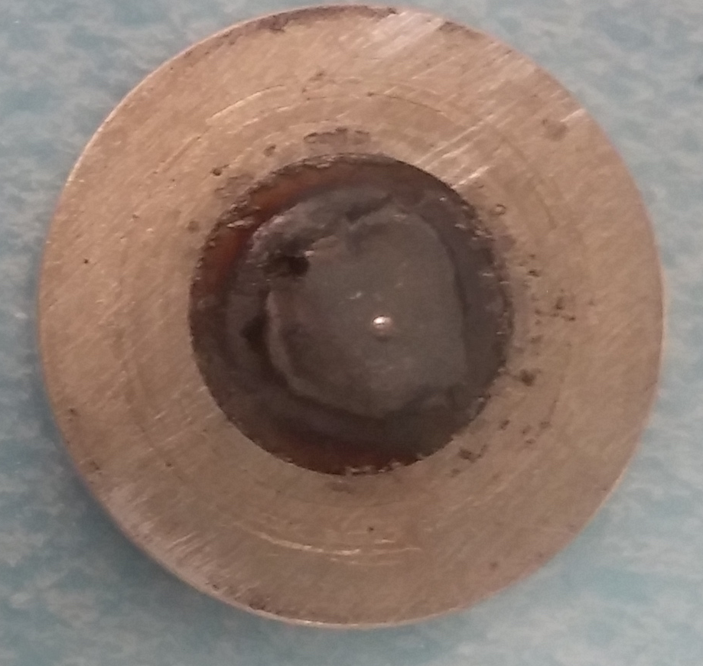
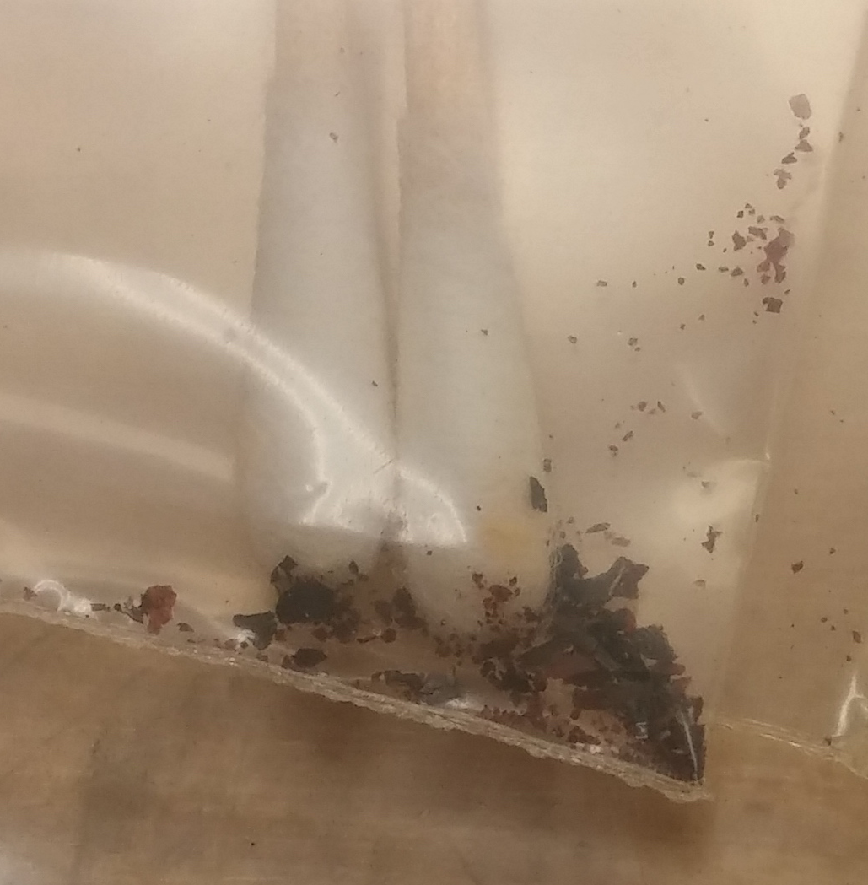
Graphite-Encased Germanium Target
47.3 MeV α-beam at 120 µAh
Max beam current: 20 µA
Enriched Ge-70 metal powder
Graphite attenuation: 47.3 to 34.8 MeV
Degradation of graphite layer during irradiation
13 mm
Graphite powder
1.5 mm
Ge metal powder
3 mm
Graphite powder
25.4 mm
With Ethan Balkin
Y. Feng, et al., Applied Radiation and Isotopes, 2019, 143, 113–122
5

Slide 6
Aluminum-Covered Germanium Target
47.3 MeV α-beam at 22 µAh
Max beam current: 20 µA
Aluminum attenuation: 47.3 to 44 MeV
Hole burned through Al layer
Na-24 and Na-22 produced in Al cover making it difficult to work with
13 mm
Aluminum
Al
mp = 660 °C
ρ = 2.7 g*cm⁻³
Thermal Conductivity = 239 W*m⁻¹ * K ⁻¹
1.5 mm
Ge metal powder
3 mm
Graphite powder
25.4 mm
6

Slide 7
Current Work
7

Slide 8
Silicon wafer irradiation test
Si
mp = 1,410 °C
ρ = 2.3 g*cm⁻³
Thermal Conductivity = 130 W*m⁻¹ * K ⁻¹
12 mm
Si disc
Si disc
3 mm
1 mm
Si disc
47.3 MeV α-beam at 5 µA for 15 minutes
47.3 MeV α-beam at 10 µA for 15 minutes
Na-22 found in all Si discs
  Majority in 1st disc and the least amount in 5th (last) disc
Si disc
Si disc
25.4 mm
HPGe analysis 2 h after EOB
Isotopes Observed | t_{1/2} (h) | Total | Target Holder | Disk 1 | Disk 2 | Disk 3 | Disk 4 | Disk 5
Al-28 | 0.037 | N.A. | 21% | 79% | 0% | 0% | 0% | 0%
Mg-28 | 20.9 | 39.6 nCi | 32% | 68% | < 1% | < 1% | < 1% | 0
Be-7 | 1274.9 | 37.1 nCi | 0% | 80% | 20% | < 1% | 0 | 0
Na-24 | 15 | 4086 nCi | 60% | 39% | 1% | 0 | 0 | 0
Na-22 | 22791.8 | 2.6 nCi | 67% | 33% | 1% | < 1% | < 1% | < 1%
8

Slide 9
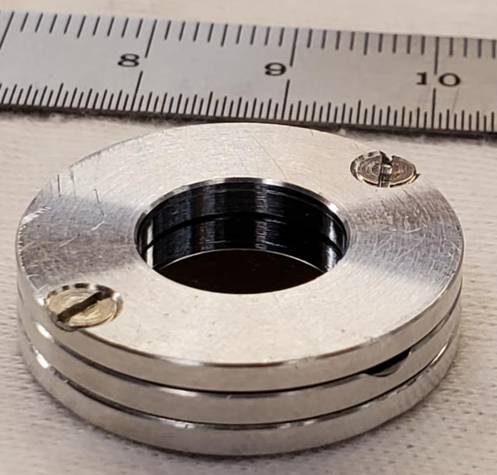
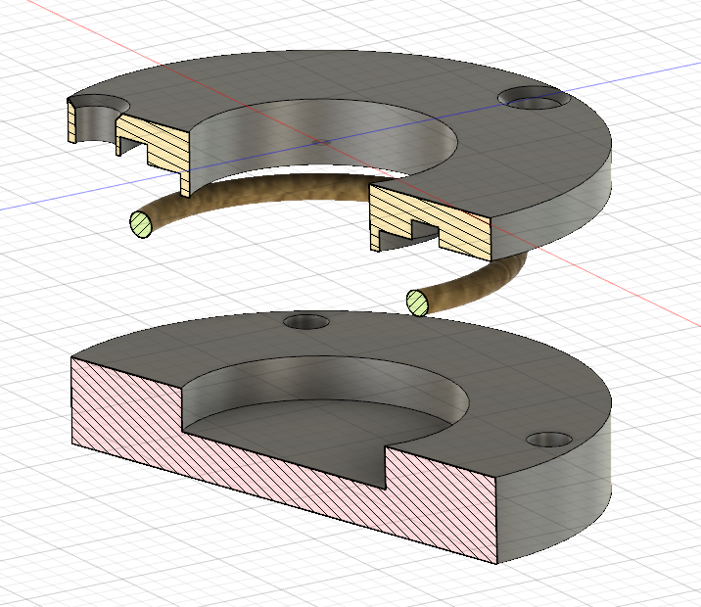
Target Design
3-piece target design
  Aluminum 6061
  Metal-metal contact interfaces
  Warped at pressure needed to press Ge
  Could not hold vacuum
2-piece target design
  Aluminum 6061
  O-ring placed between two pieces
  Withstands pressure needed to press Ge
  Holds vacuum
With Bob Smith
9

Slide 10
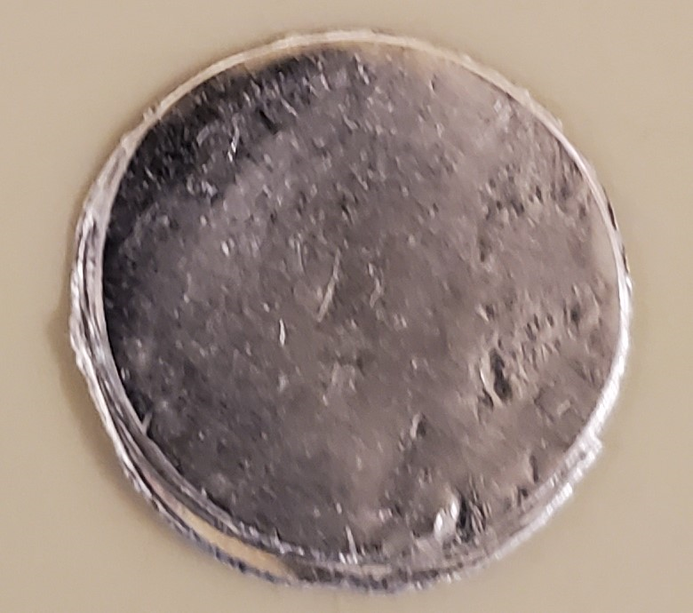
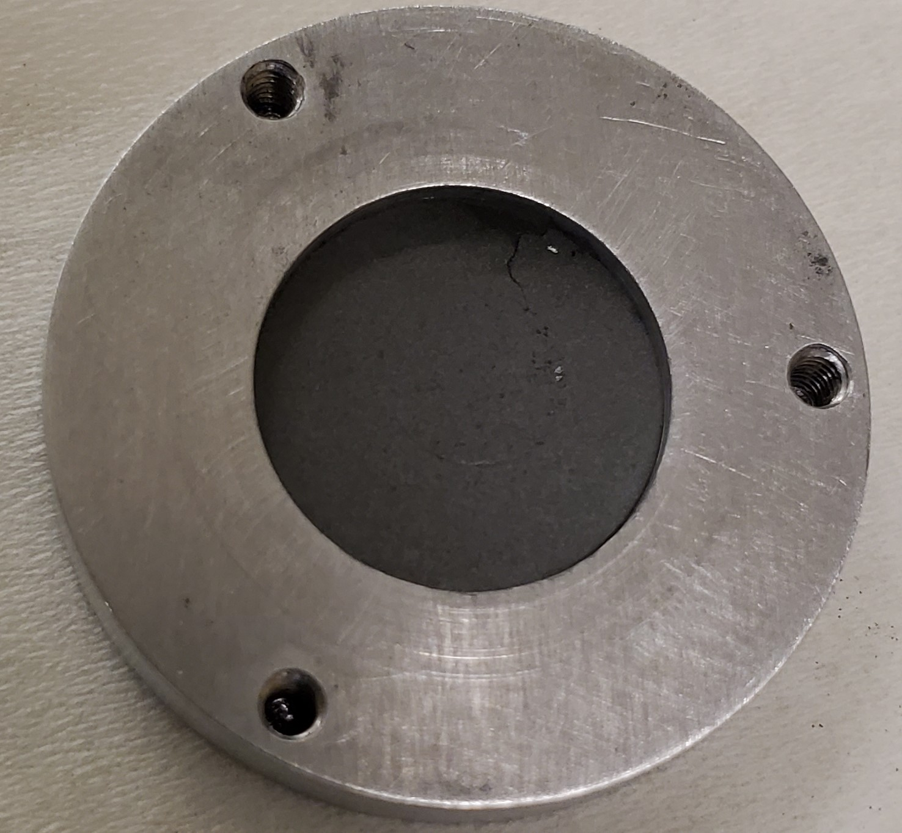
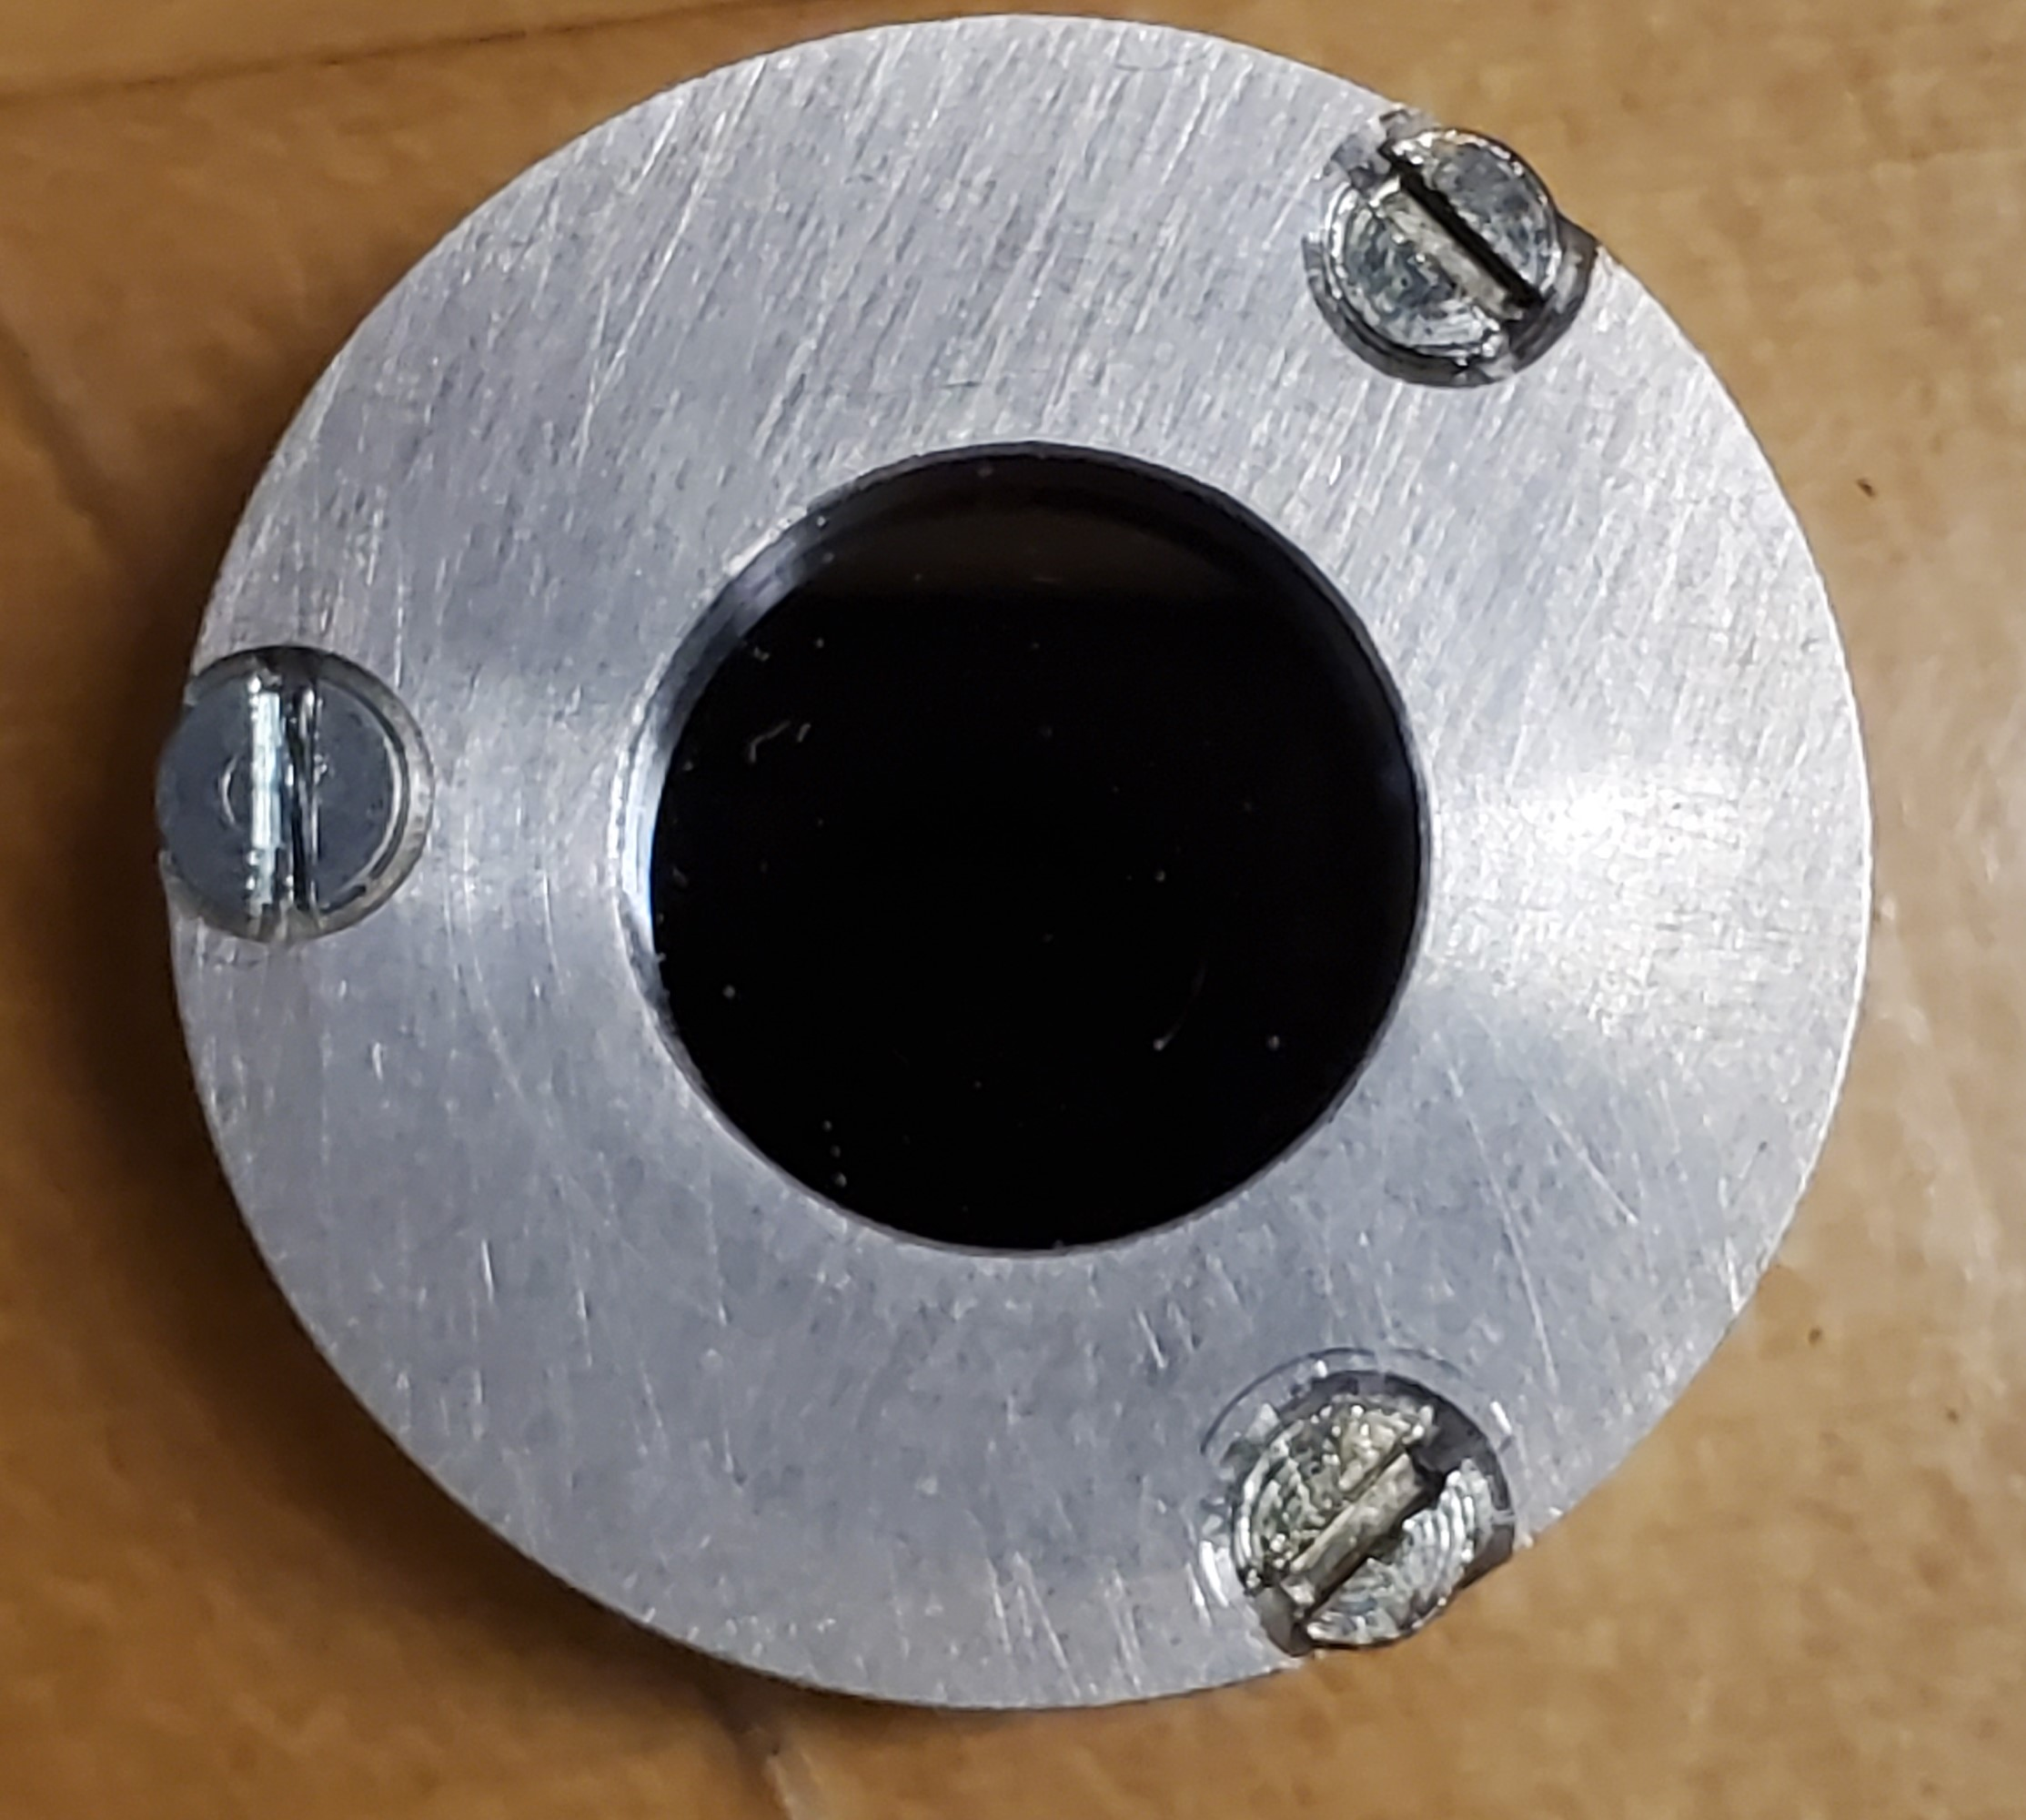
Target Preparation
Thermal Conductivity (W*m⁻¹ * K ⁻¹)
Press 2 Al discs at 10 MPa for 1 min
  0.2 mm thick/Al disc (0.38-0.4 mm total thickness)
Press 170 mg Ge powder at 10 MPa for 10 min
  Captures 20-41 MeV alphas
  Press ~90 mg of Ge powder 2x
  Ge pellet density does not reach actual density
    3.2 g/cm³ vs 5.5 g/cm³
Place Si disc on top and screw down lid with O-ring
Al
239
Ge
59.9
Si
130
10

Slide 11
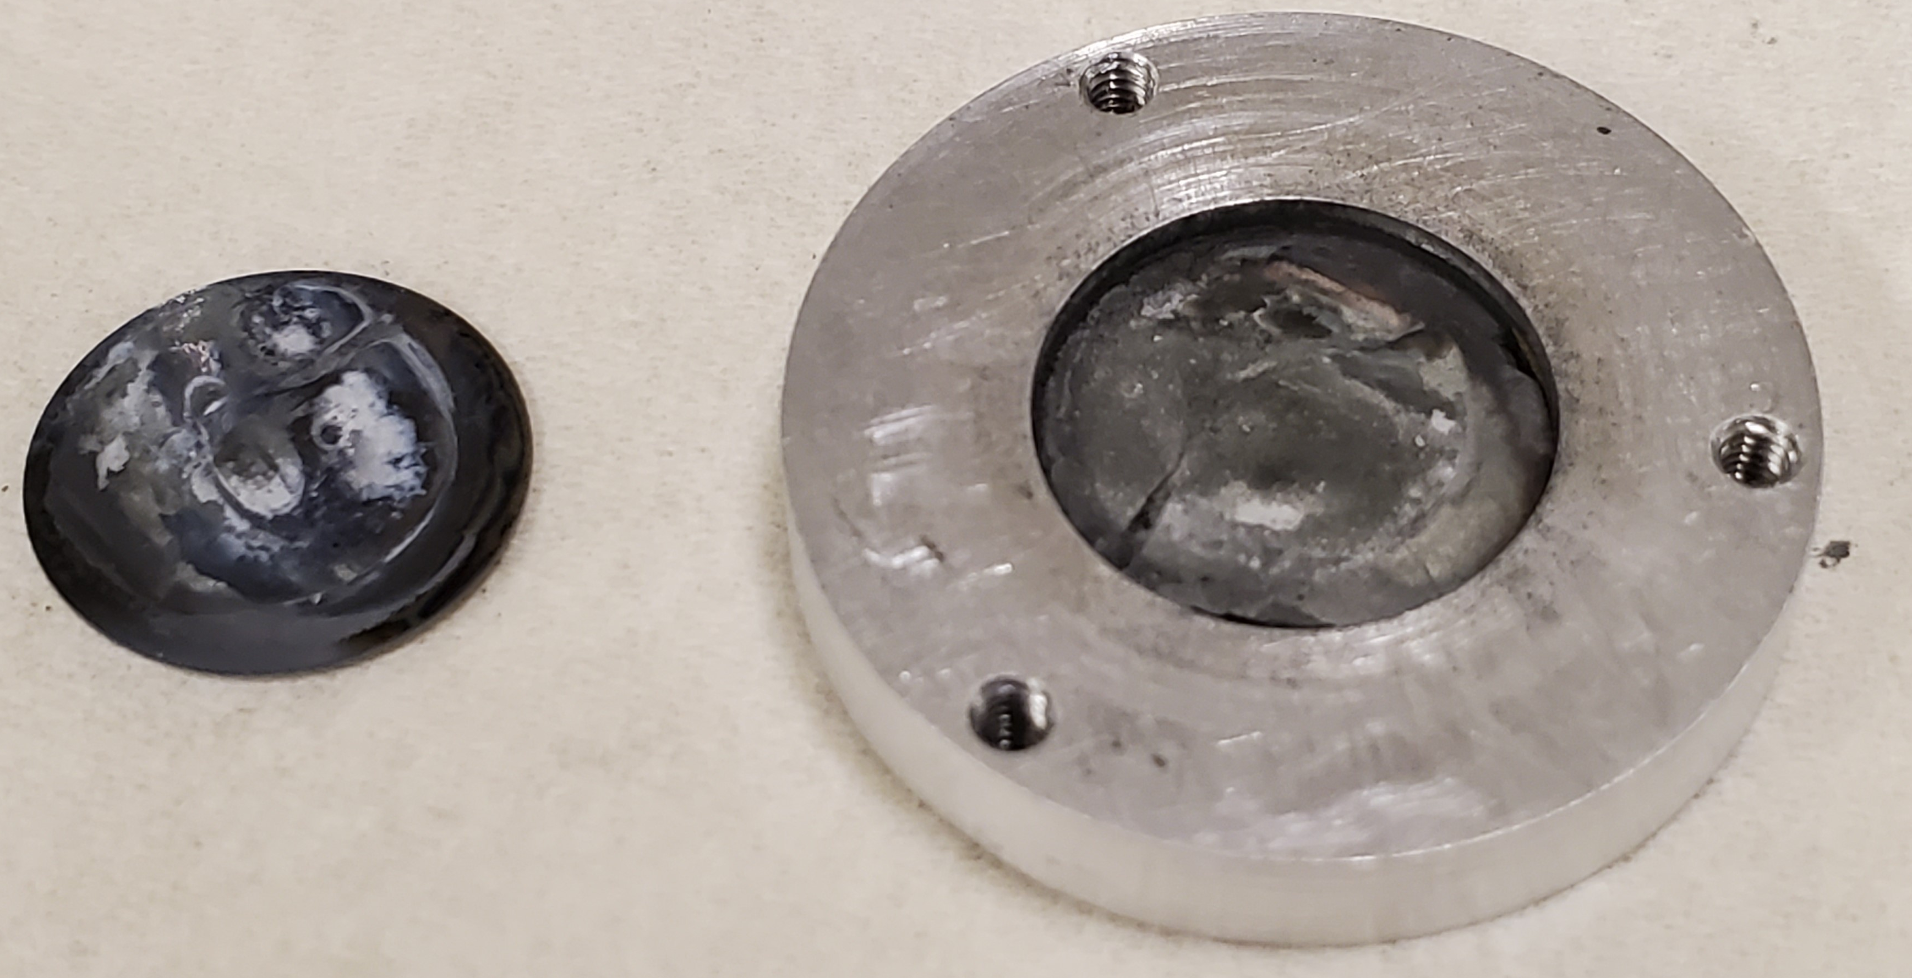
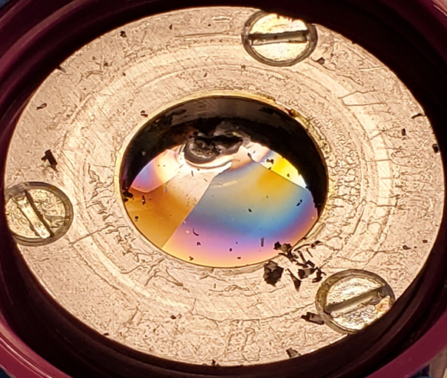
Silicon Window Germanium Target
47.3 MeV α-beam at 5 µAh
Max beam current: 7 µA
Si wafer removed with gravity
  Some Ge bonded to Si disc post-irradiation
80% of germanium pellet recovered using spatula
47.3 MeV α-beam at 6 µAh
Max beam current: 15 µA
Had difficulty removing material where “burn” spot was and had trouble fully dissolving material
Target material thought to have melted possibly due to overfocusing of beam
11

Slide 12
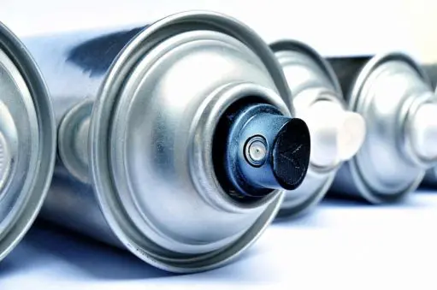
Releasing Agent
Want something that will form a thin film, be resistant to high temperatures, water/carbon/silicon based
Boron Nitride (BN)
  High temperature release coating from Miller-Stephenson
  Thermal Conductivity:
    751 W/(m*K) (Cai et al., Sci. Adv. 2019; 5:eaav0129)
    550 W/(m*K) (Yuan et al., Comm. Phys, 2019, 2:43)
  100% non-flammable aerosol formulation
12

Slide 13
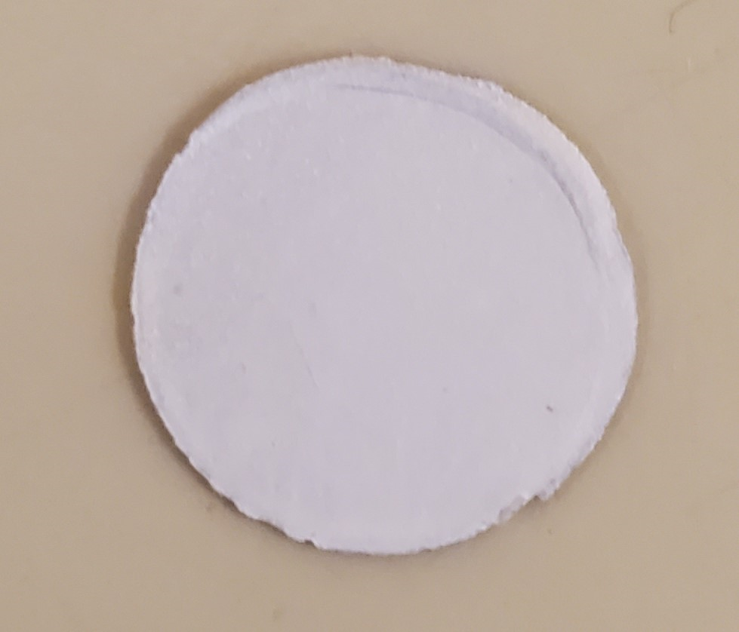
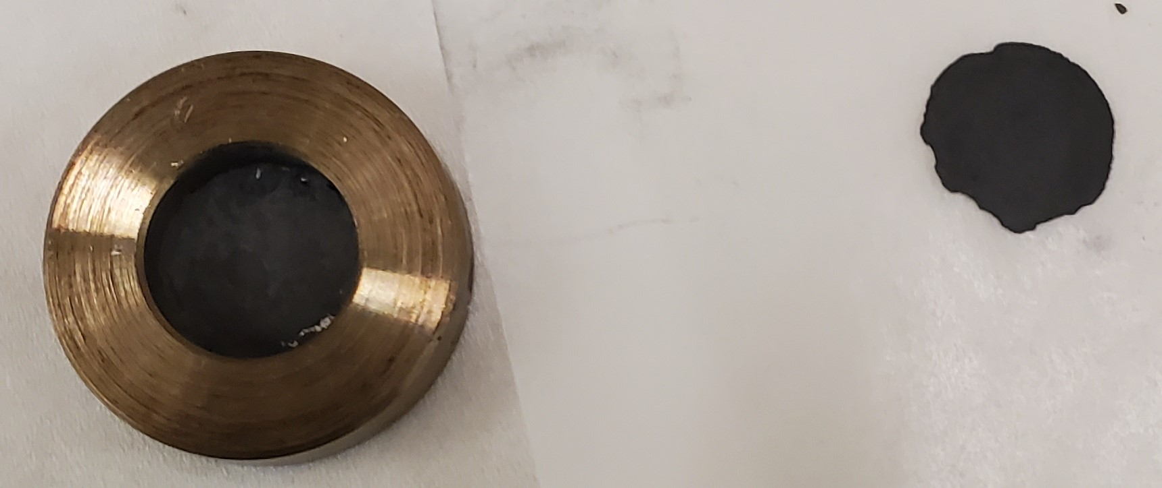
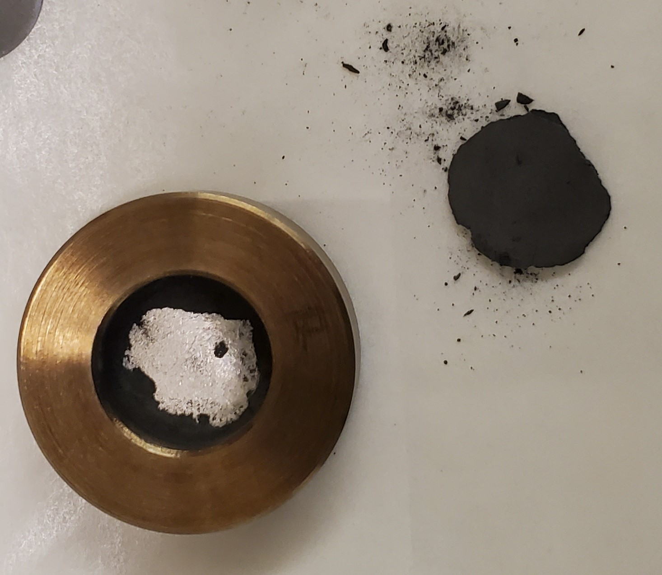
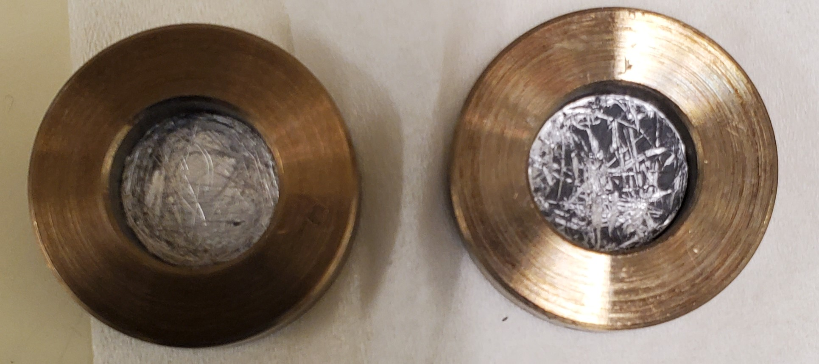
Boron Nitride (BN) Release test
Optimal spray for 3 seconds 6 inches from surface
  Let dry for 3-5 minutes before touching/pressing
Germanium targets prepared w/ & w/o BN on aluminum
  Targets subjected to 250 °C and vacuum
Weight: 64 mg 66 mg
Thickness: 0.2 mm 0.22 mm
w/o BN
w/ BN
w/ BN
w/o BN
13

Slide 14
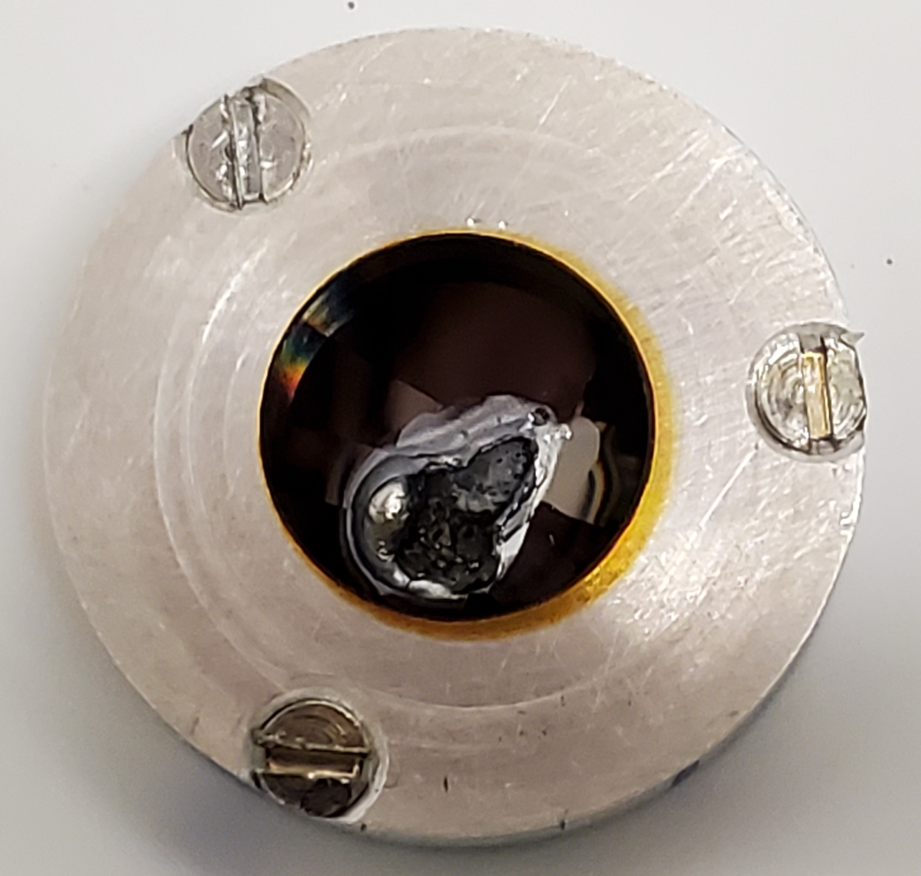
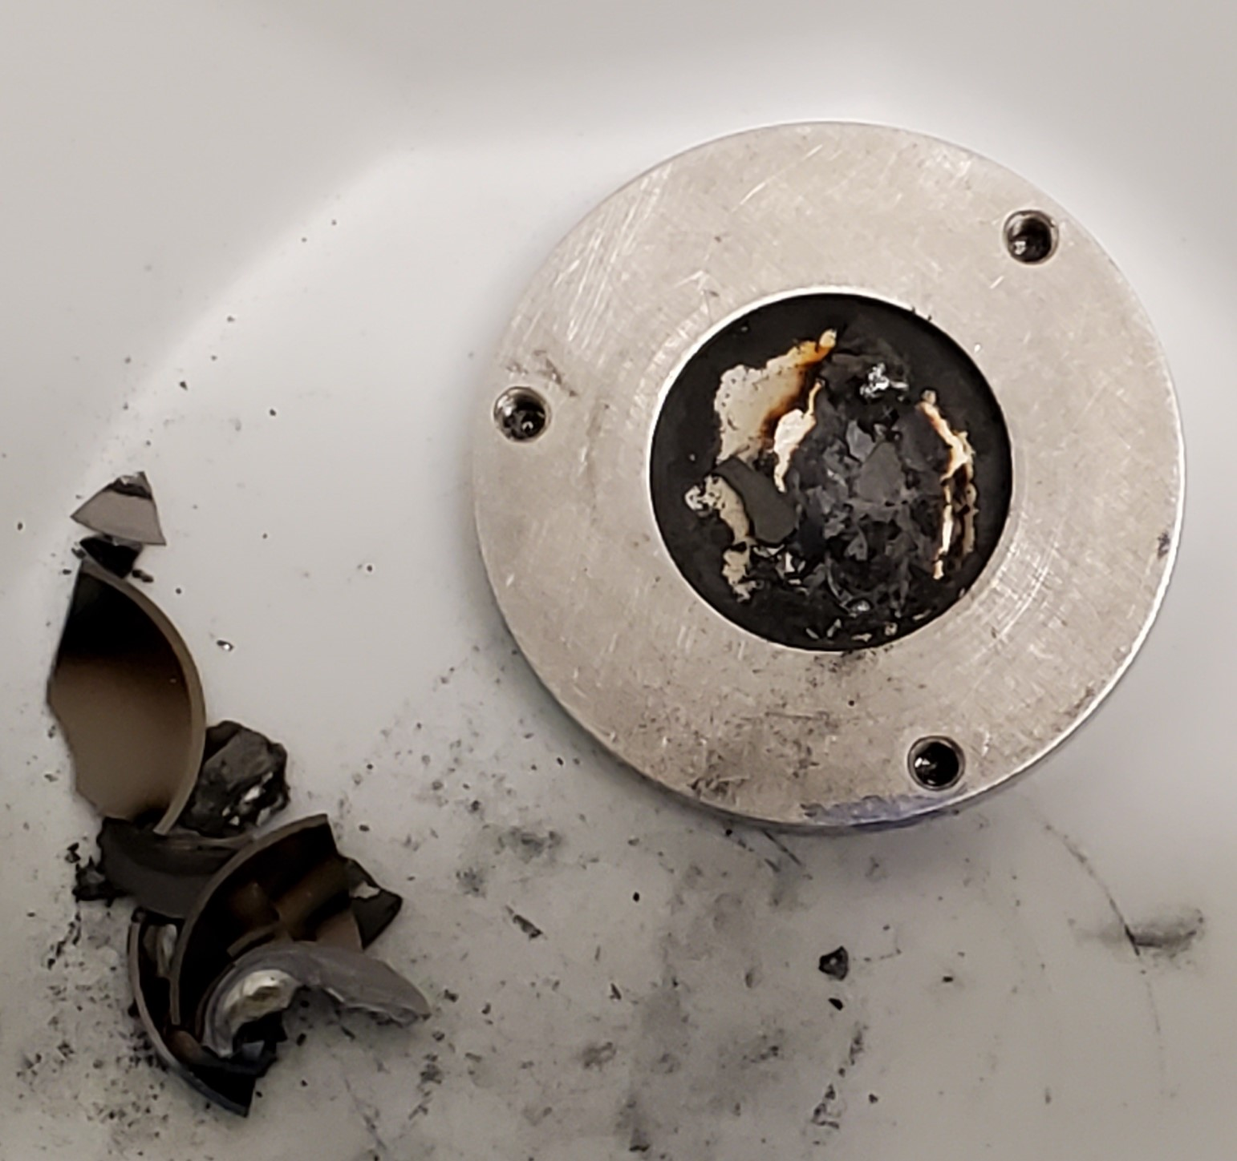
Silicon Window Germanium Target with BN
47.3 MeV α-beam at 10 µA for 15 minutes
Target prepared with BN release agent and preheating Ge (105 °C overnight)
Hole burned through Si, losing 24.5 mg of material (Ge and Si)
Si disc needed to be removed with spatula
  Majority of germanium was bonded to Si when removed
14

Slide 15
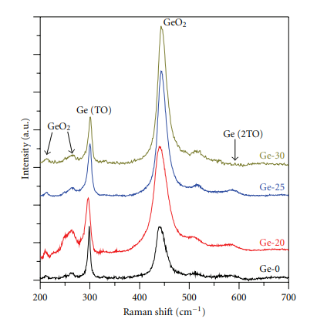
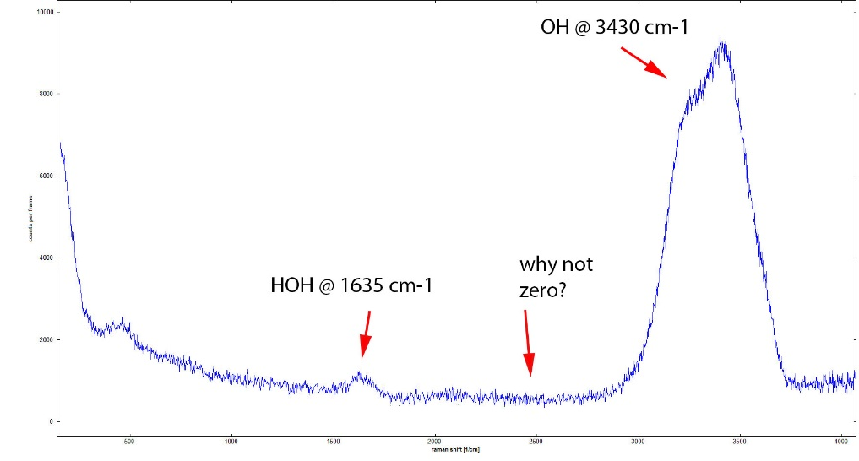
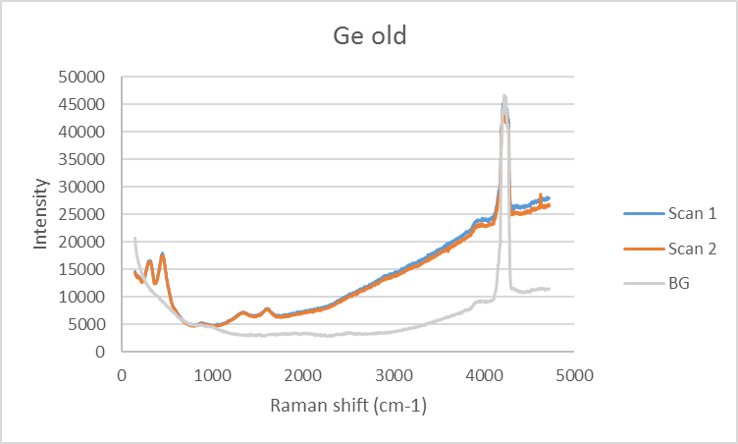
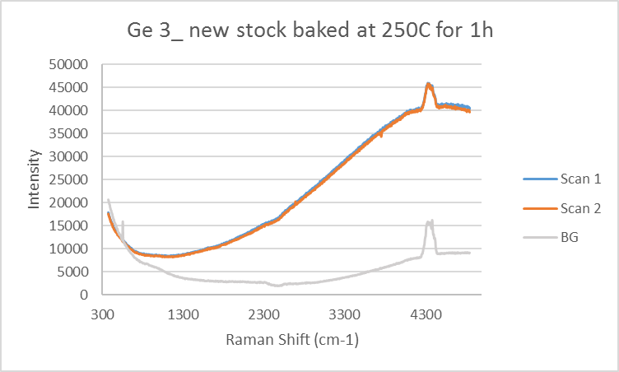
Raman Spectroscopy Analysis
Raman shifts of Ge-O and Ge-water peaks
Measured Raman shifts of germanium samples
P.K. Giri, S.Dara, Journal of Nanomaterials, 2012, 2012, 905178
15

Slide 16
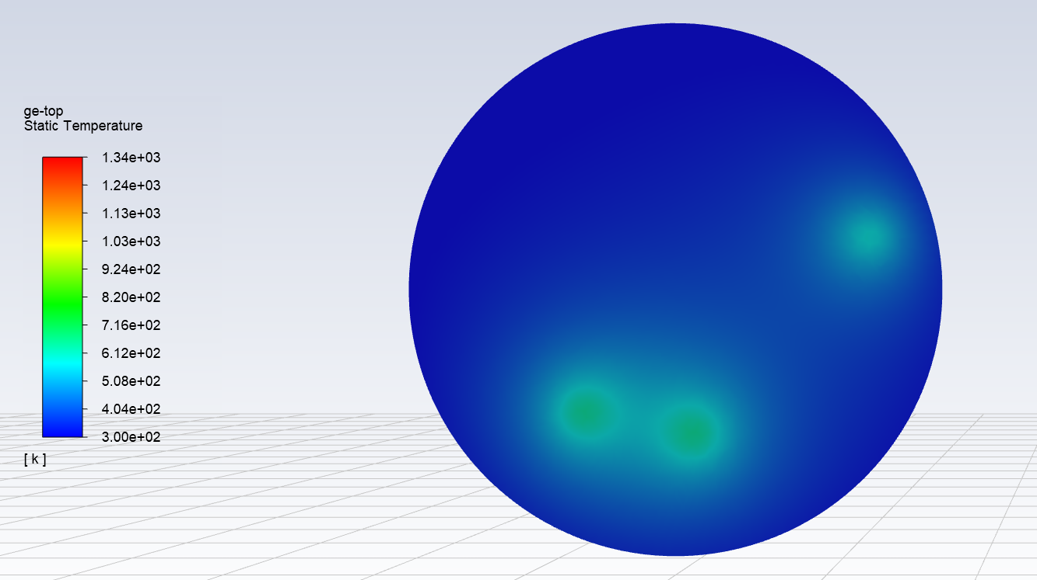
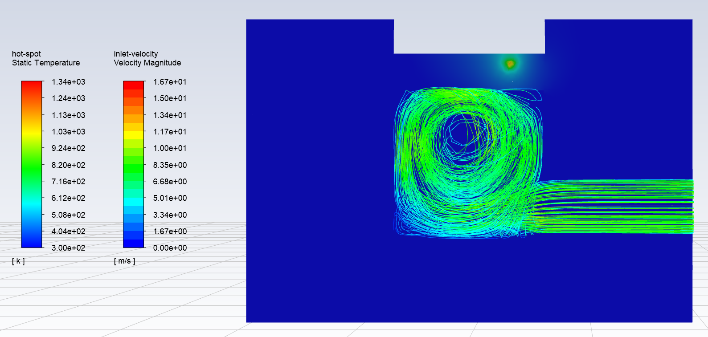
Thermal Modeling
Hot spots in Ge layer match with turbulent flow inside cooling cup
Al: 1734.29 °C Cooling Water: 68.49 °C Ge: 1076.59 °C Si: 668.82 °C
Ge mp = 938 °C
Si
Ge
Al
Inlet
With David Argento, Marissa Kranz, and Rob Emery
16

Slide 17
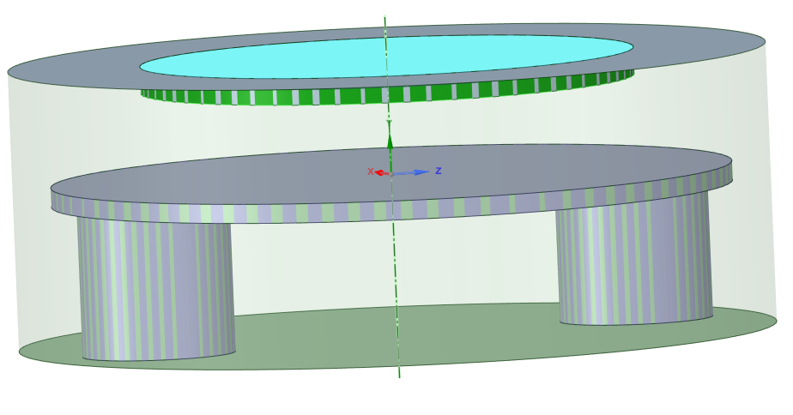
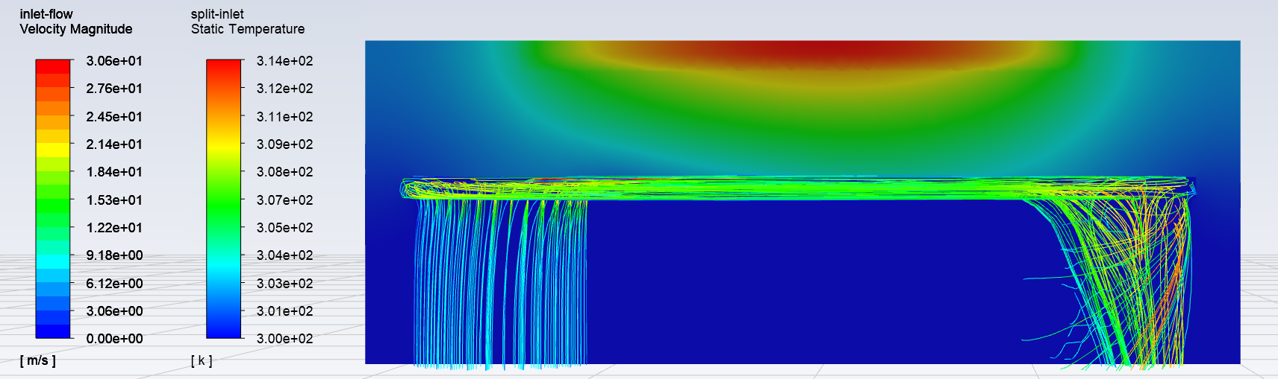
Thermal Modeling
New cooling cup shows a 10x decrease in max temperatures reached in germanium and silicon layers
Al: 107.1 °C Cooling Water: 52.08 °C Ge: 134.65 °C Si: 138.47 °C
Si
Ge
Al
Inlet
outlet
With David Argento, Marissa Kranz, and Rob Emery
17

Slide 18
Summary
Multiple target configurations are susceptible to target failures
  Graphite sandwich
  Aluminum cover
  Silicon cover
Silicon is promising for multiple reasons
  Good thermal properties
  Low production of radioisotopes
  Easily removable
Boron Nitride allows for easy removal of germanium pellet post-irradiation
Thermal Modeling shows sufficient cooling can be achieved with new cooling cup
18

Slide 19

Acknowledgements
Thermal Modeling
  Marissa Kranz
  Rob Emery
  David Argento
Target Preparation and irradiation
  Bob Smith
  Eric Dorman
University of Washington Physics Machine Shop
  Bob Scott (manager)
WTTC18 Committee Travel Bursary
This research is supported by the U.S. Department of Energy Isotope Program, managed by the Office of Science for Isotope R&D and Production
  DE-SC0020159 (8/1/2019 – 7/31/2021)
  DE-SC0018662 (6/1/2018 – 5/31/2020)
18th Workshop on Targetry and Target Chemistry
19

Slide 20

Thank you!

Slide 21
Supplemental

Slide 22
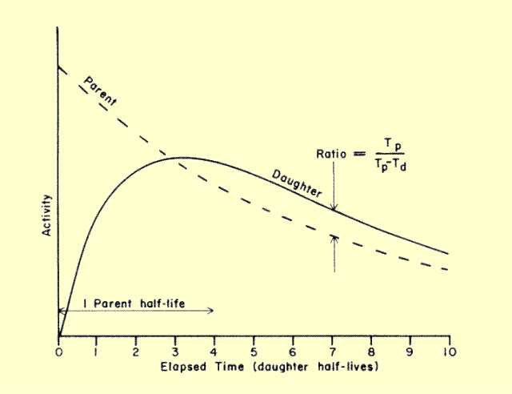
Gamma Analysis
Se-72 emits 45.9 keV gamma in Compton scattering region of HPGe spectra
Se-72 quantity based on transient equilibrium with daughter, As-72
As-72 emits 834 (81% I_{γ}) and 630 (8.1% I_{γ}) keV gamma that can be distinguished

Slide 23
Summary
Predicted production rate using ^{nat}Ge: 28 µCi/µAh
E₀ = 20 MeV
E₁ = 41 MeV
Target | Max beam current (µA) | Total Charge (µAh) | Production Rate (µCi/µAh)
Graphite encased | 20 | 120 | 62.2
Graphite covered | 10 | 15 | 17.8
Aluminum cover | 20 | 22 | 6.7
Si cover 1 | 5 | 4.5 | 37
Si cover 2 | 12 | 6 | 26.4
Si cover 3 | 10 | 2.95 | 16.4

Slide 24
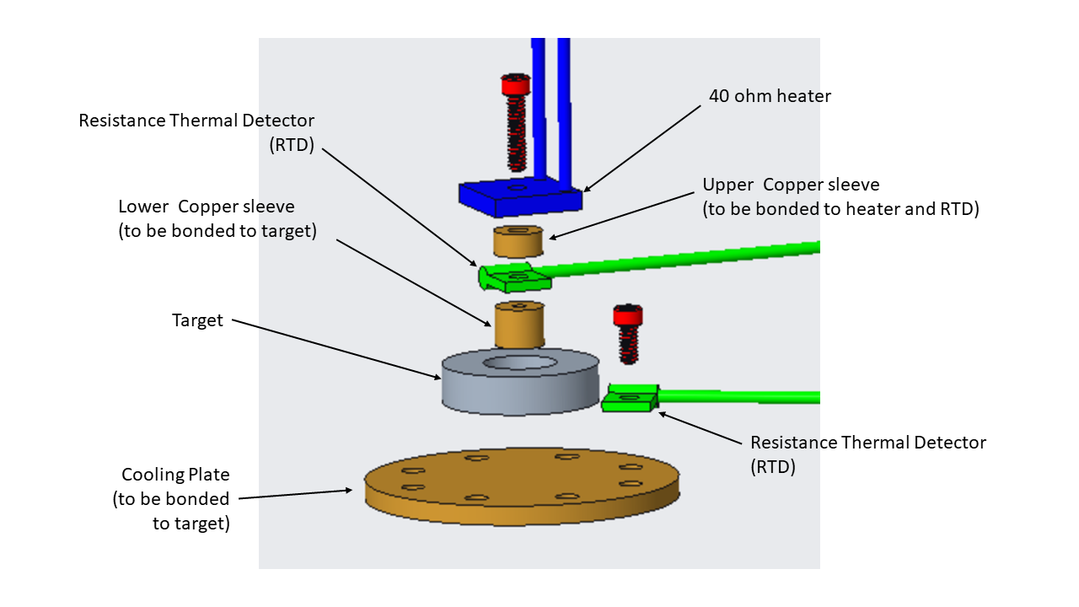
Thermal Contact Testing
Data for thermal contact resistance to be used in Ansys for better thermal modeling
Test different target configurations to see how each layer effects heat transfer
  Fully Assembled Target
  Target without Si cover
  Target without Ge layer
  Target base

Slide 25
Other Radioisotopes Observed
47.3 MeV α-beam at 5 µAh
47.3 MeV α-beam at 6 µAh
 | Yield at EOB (µCi) | Production Rate (µCi/µAh)
As-74 | 67 | 15
As-72 | 3779 | 840
As-71 | 90 | 20
Ge-75 | NA* | NA*
Se-75 | 24 | 5
Ge-69 | 191 | 43
 | Yield at EOB (µCi) | Production Rate (µCi/µAh)
As-74 | 37.2 | 8.3
As-72 | 2206.1 | 490.2
As-71 | 156.0 | 34.7
Ge-75 | NA | NA
Se-75 | 22.7 | 5.1
Ge-69 | 136.3 | 30.3

