Slide 1
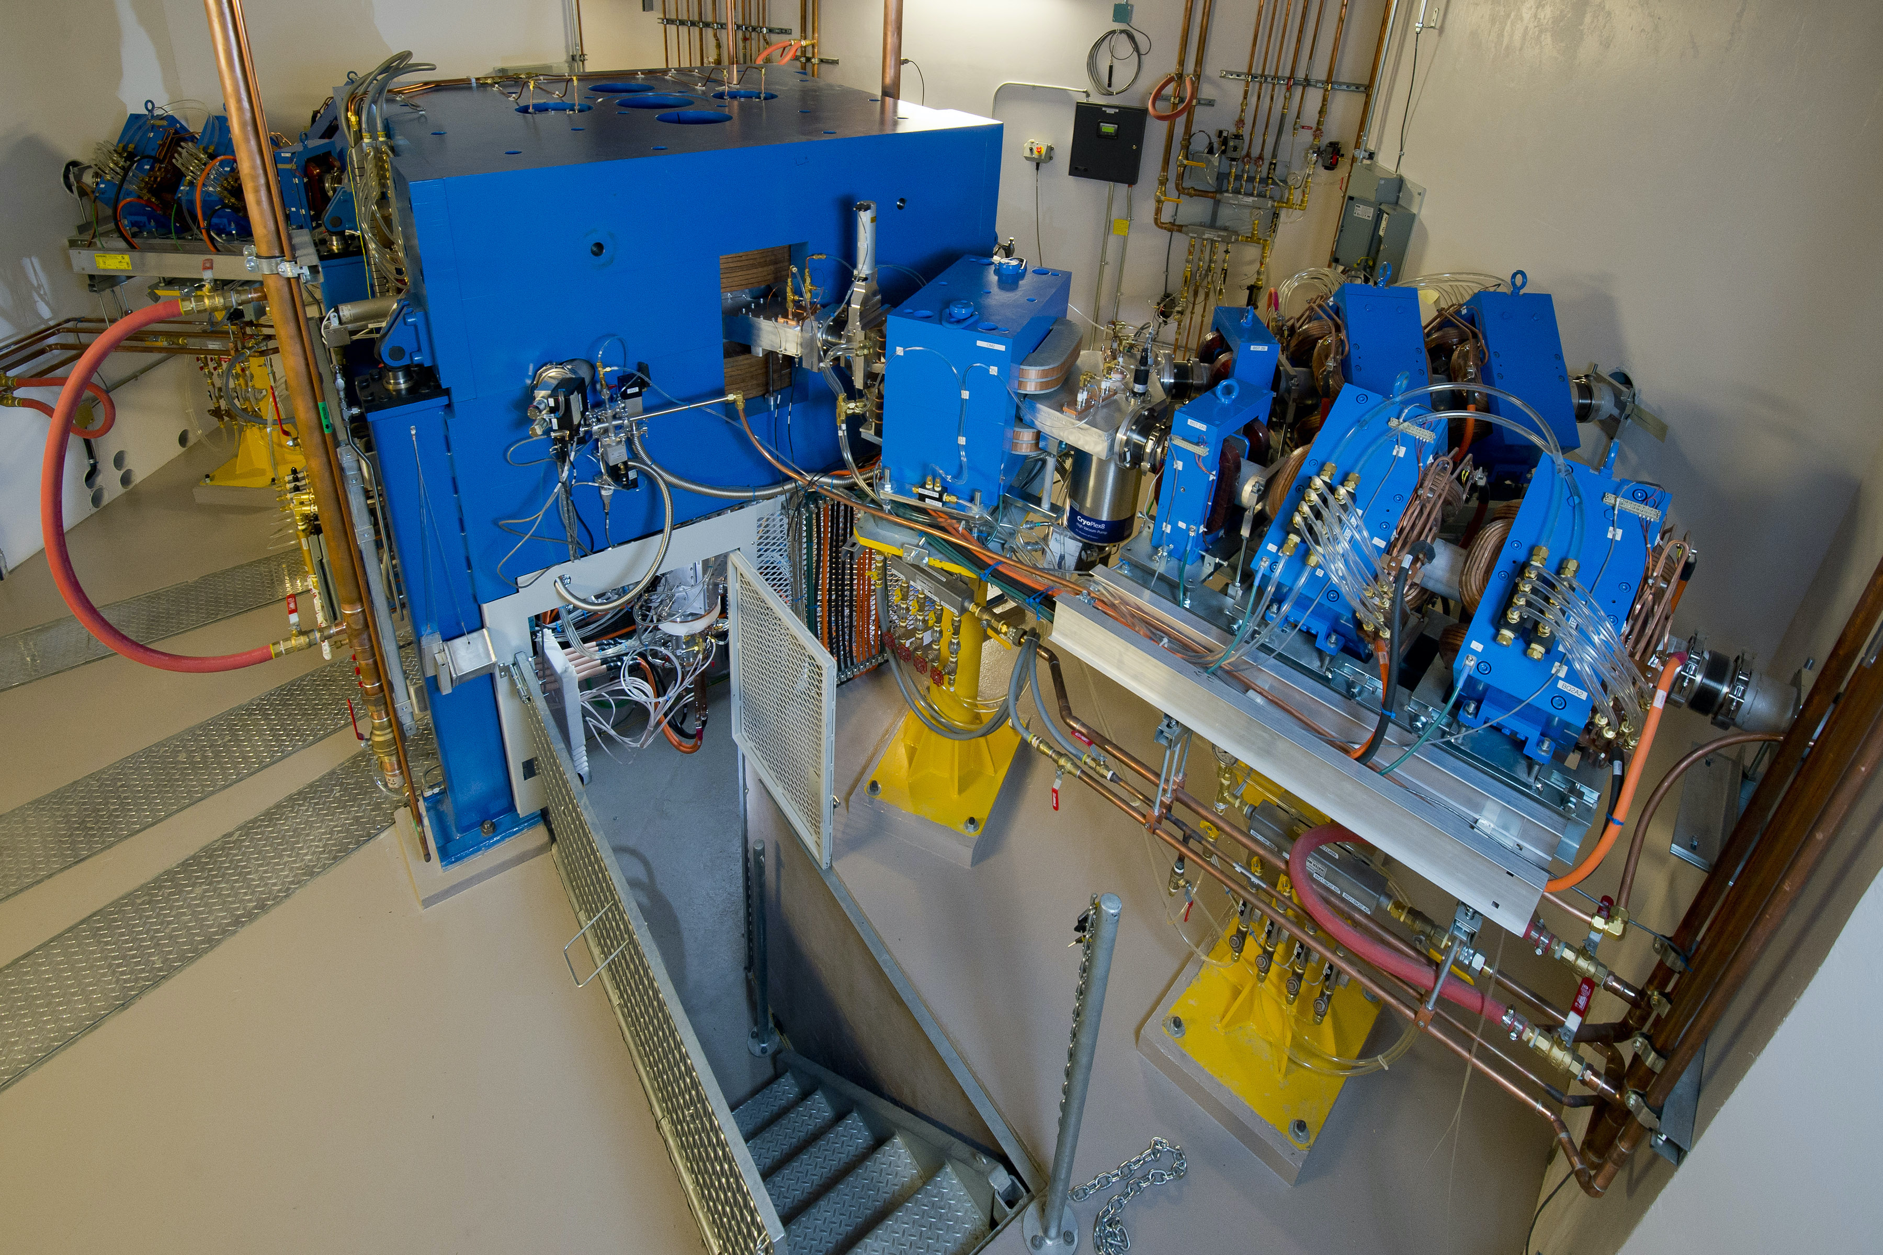
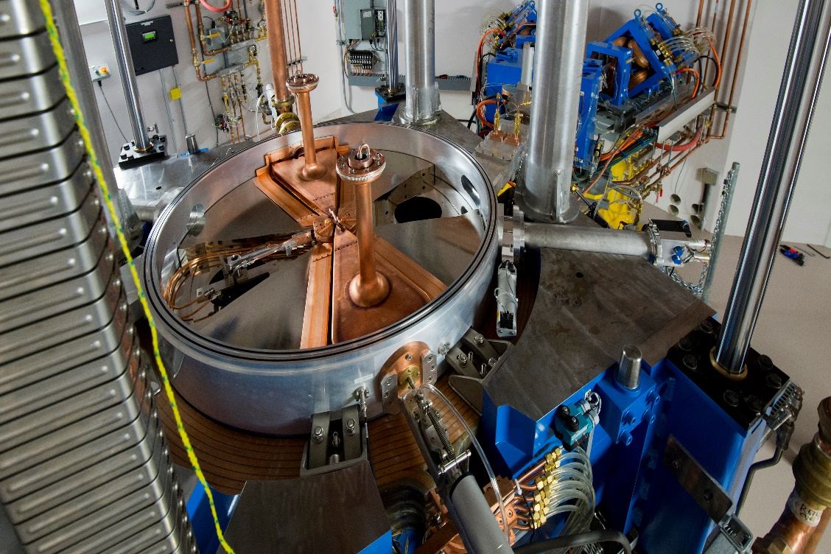

An Aluminum-Indium-Silver Sealed Solid Cyclotron Target for High Yield Radiometal Production
Bryce Nelson, John Wilson, Jan Andersson, Frank Wuest
Department of Oncology
University of Alberta, Edmonton, Alberta, Canada

Slide 2
Disclosures
A patent application has been filed for the described cyclotron target technology
Notes:
Here are my disclosures

Slide 3
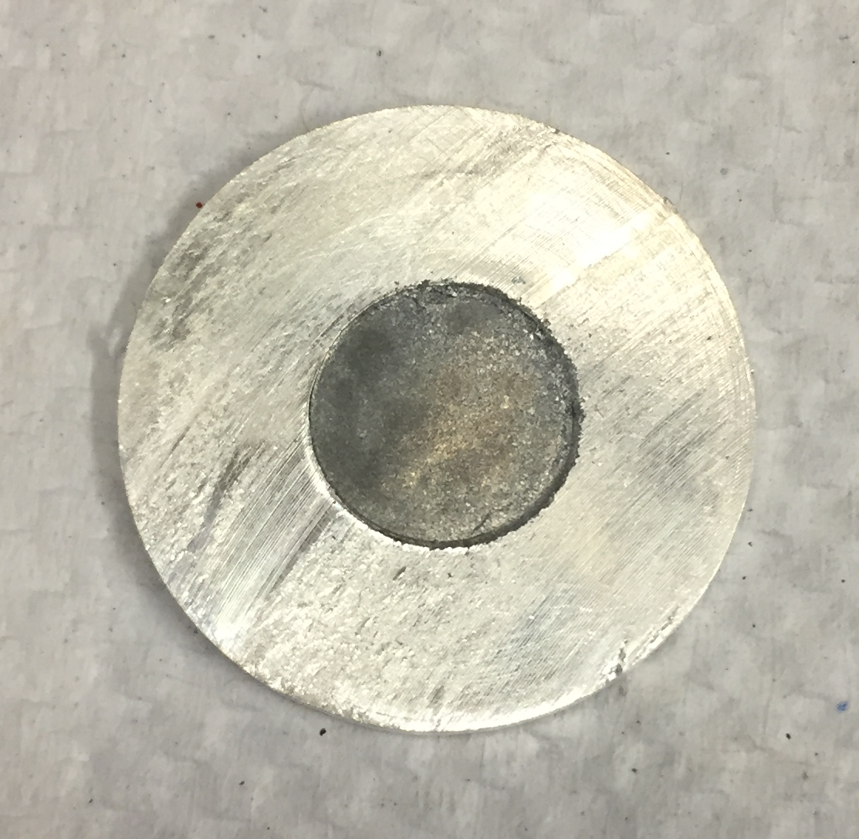
Challenges with Existing Solid Targetry
Existing unsealed solid targets face several challenges
Risk of target material delamination and contamination during irradiation or upon download
Target material limited to compounds that can adhere to the target backing
Need an alternative target that can encapsulate a variety of sensitive or hazardous target materials and is conducive with post-irradiation processing (start with the chemistry, work back to the targetry)
?

Slide 4
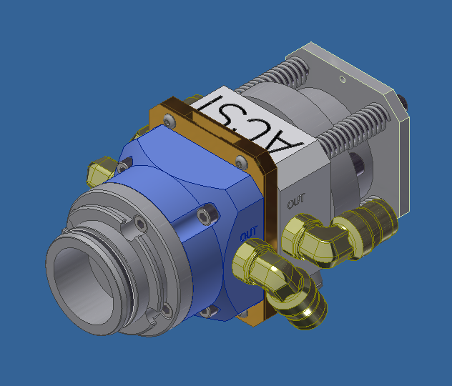
24 MeV TR24 Cyclotron (ACSI)
4 beamlines
TA-1186/TA-2150-B solid target assemblies (ACSI)
Image credit of Advanced Cyclotron Systems Inc. (ACSI)

Slide 5

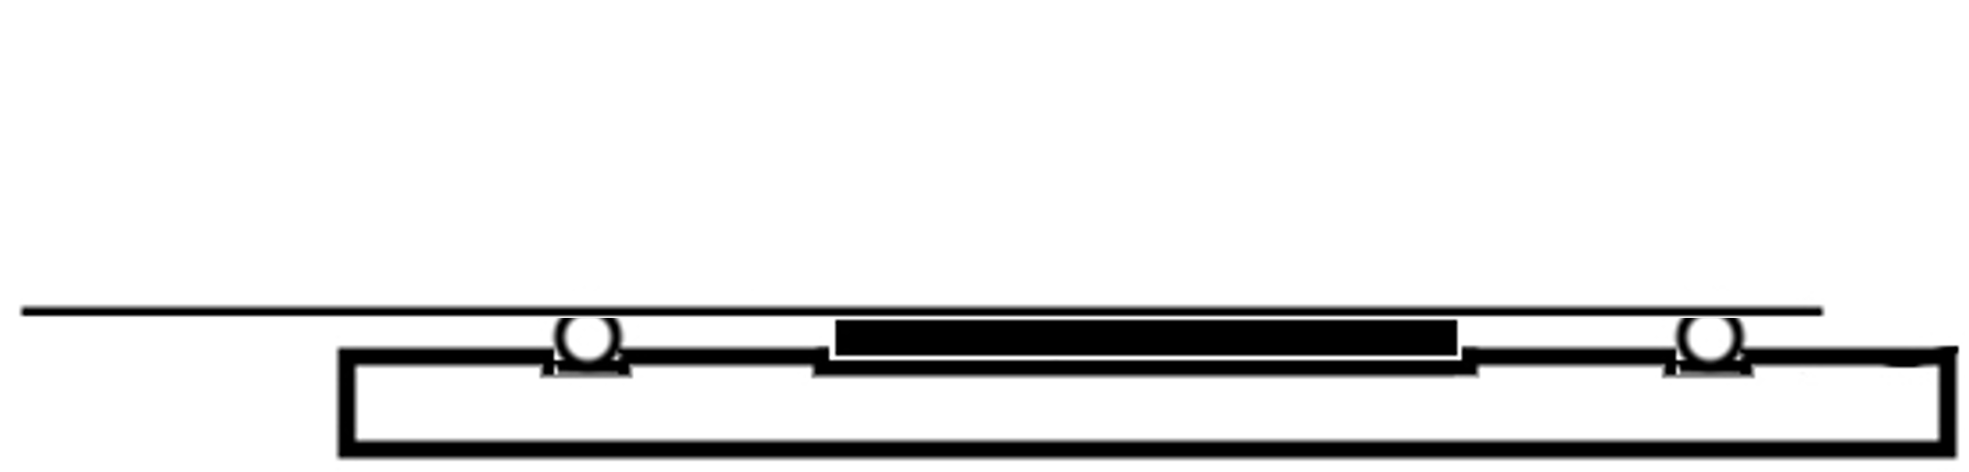
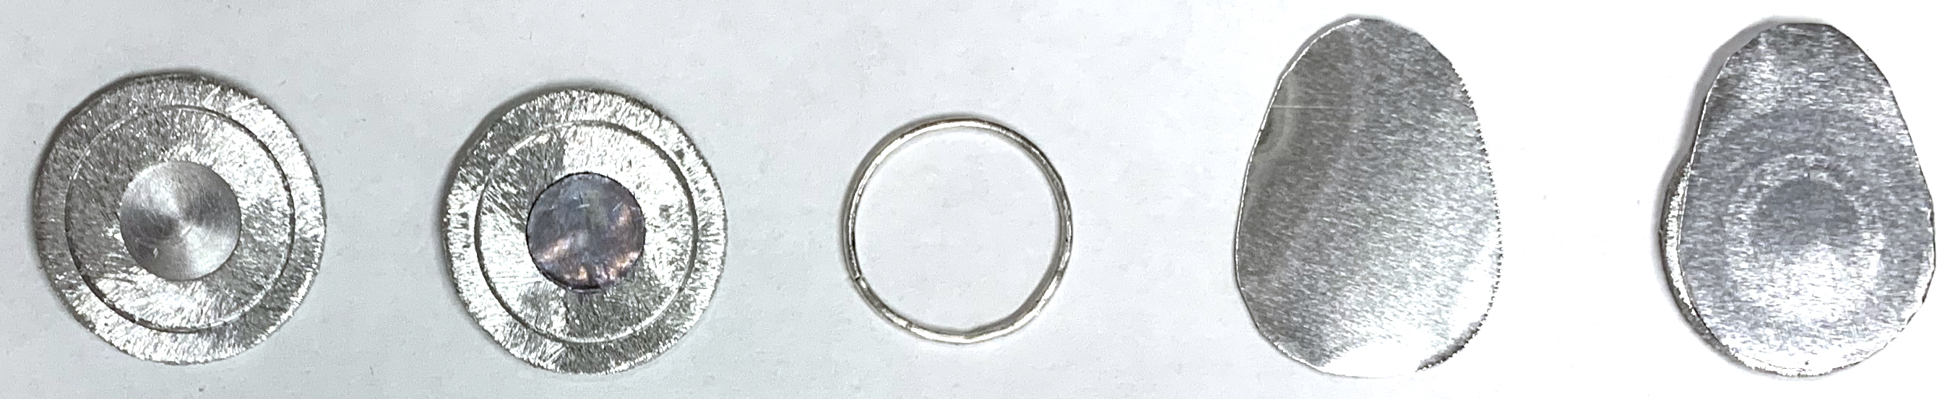
Cyclotron Targetry
Aluminum cover
Target material pellet
Indium wire
Aluminum or silver disc with machined depression
Machined aluminum or silver disc
Aluminum cover
1 cm
Target pellet added to depression
Indium wire
Complete assembly
Pressed target material pellet placed in machined depression
Aluminum cover pressed onto indium wire encapsulates target material for bombardment, tab facilitates easy peeling removal
Improved heat transfer via target material contact with both Al cover and backing

Slide 6
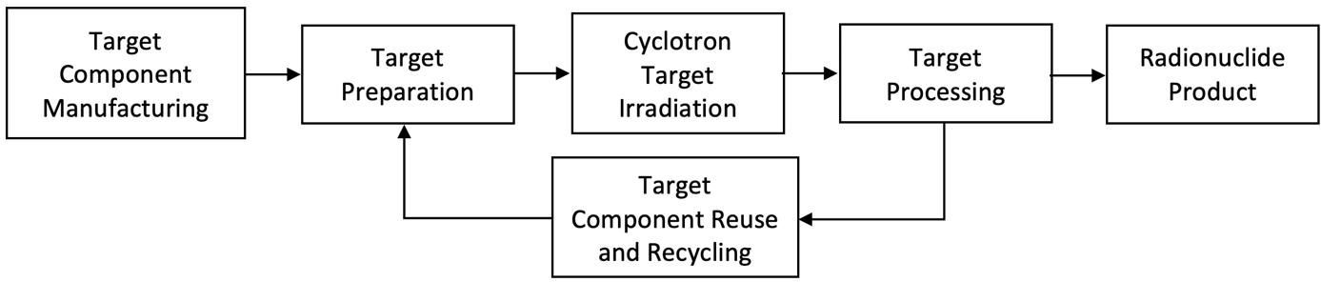
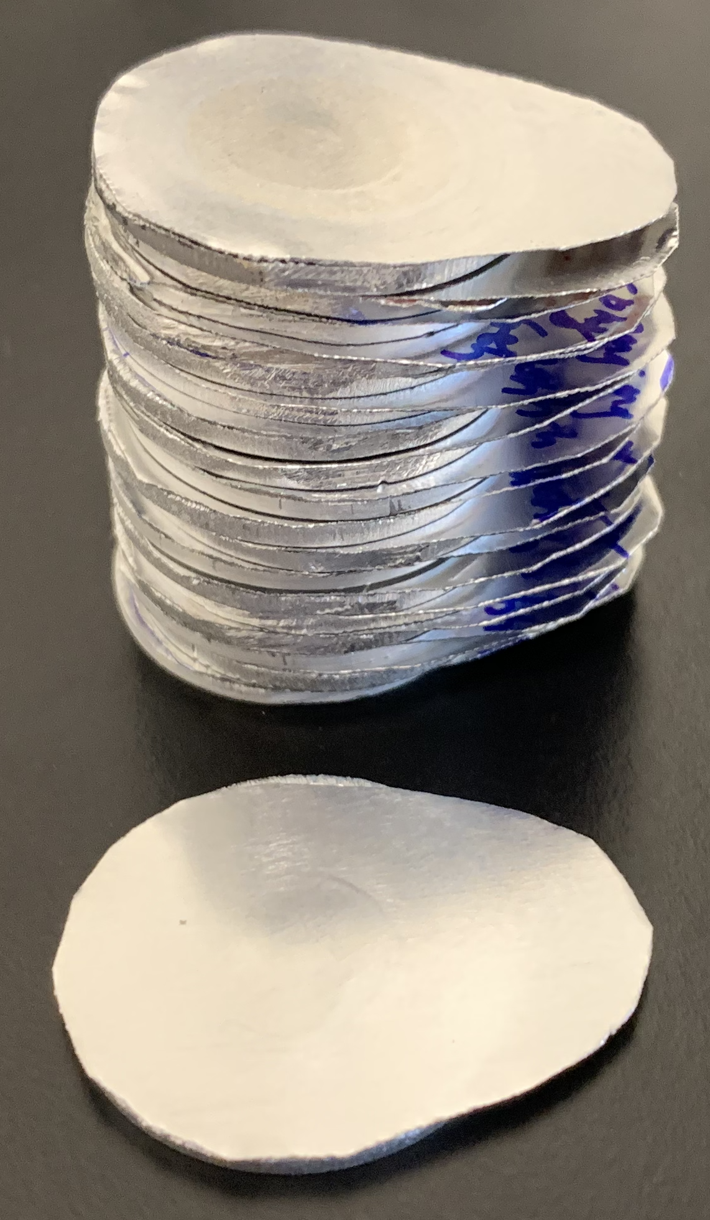
Cyclotron Targetry
Fast to assemble, easy to handle, storable, contains reusable Al/In components
Flexible processing: Al disc resistant to HNO₃, Ag disc resistant to HCl
Minimal activation with high purity Al disc (99.999%) permitting rapid reuse
Adaptable with a variety of target materials to produce other radionuclides

Slide 7
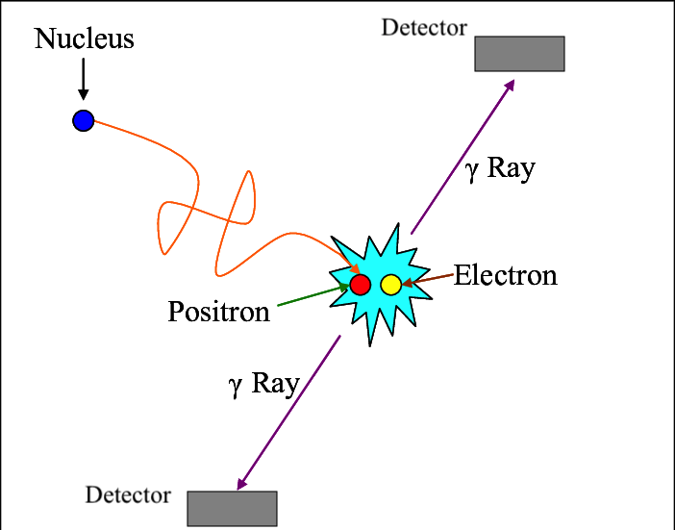
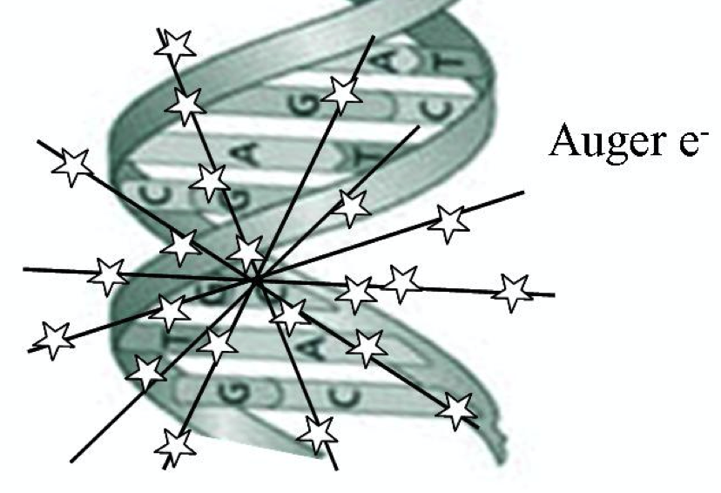
^{133/135}La Theranostics
¹³³La: PET imaging
¹³⁵La: Auger-Meitner electron therapy
Modified from Darryl J Bornhop
Image from Helge Thisgaard
^{133/135}La theranostic pair
Nelson et al., Sci Rep. 2020; 10(1)
Nelson et al., J Nucl Med. 2022;63(4):584-590

Slide 8
Cross Sections Weighted for ^{nat}Ba Isotopic Abundance
22 MeV
11.9 MeV
Cross Section simulation data from TENDL 2019 (Koning et al.)

Slide 9
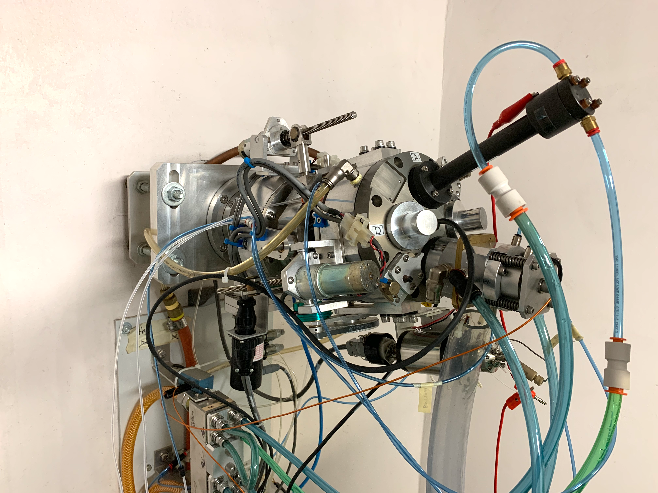
Cyclotron Irradiation – ^{nat}Ba metal Target Material
200 mg ^{nat}Ba metal target material
Ag target backing
22 MeV for ^{133/135}La production
11.9 MeV for ^{132/135}La production
250 μm Ag foil degrader for 11.9 MeV
20 μA, 25 min (500 μA·min)
Beam energy (MeV) | ¹³²La EOB yield (MBq) | ¹³³La EOB yield (MBq) | ¹³⁵La EOB yield (MBq)
11.9 | 0.82 | - | 17.9
22 | 0.38 | 231 | 166

Slide 10
Cross Sections of Interest – Enriched ¹³⁵BaCO₃ Target Material
Cross section simulation data from TENDL 2019 (Koning et al.)

Slide 11
Cyclotron Irradiation – BaCO₃ Target Material
¹³⁵BaCO₃ (92.7%) and ^{nat}BaCO₃ target materials
Al target backing
23.3 MeV to maximize ¹³³La production
11.9 MeV for ¹³⁵La production, target installed in reverse with 1 mm Al disc acting as degrader
Direct water cooling on target back
10 μA, 10 min (100 μA·min)
Al cover
Proton beam
Al disc
23.3 MeV energy irradiation
Beam Energy (MeV) | ¹³⁵BaCO₃ target activity of La isotopes (MBq) |  | ^{nat}BaCO₃ target activity of La isotopes (MBq)
 | ¹³⁵La | ¹³³La | ¹³⁵La | ¹³³La
11.9 | 81 ± 2 | 0 | 6.8 ± 0.4 | 0
23.3 | 28 ± 1 | 214 ± 7 | 35 ± 1 | 59 ± 2
11.9 MeV energy irradiation

Slide 12
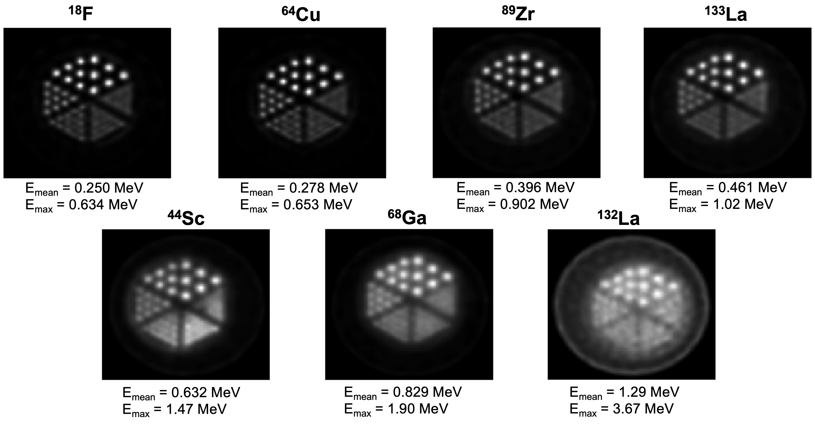
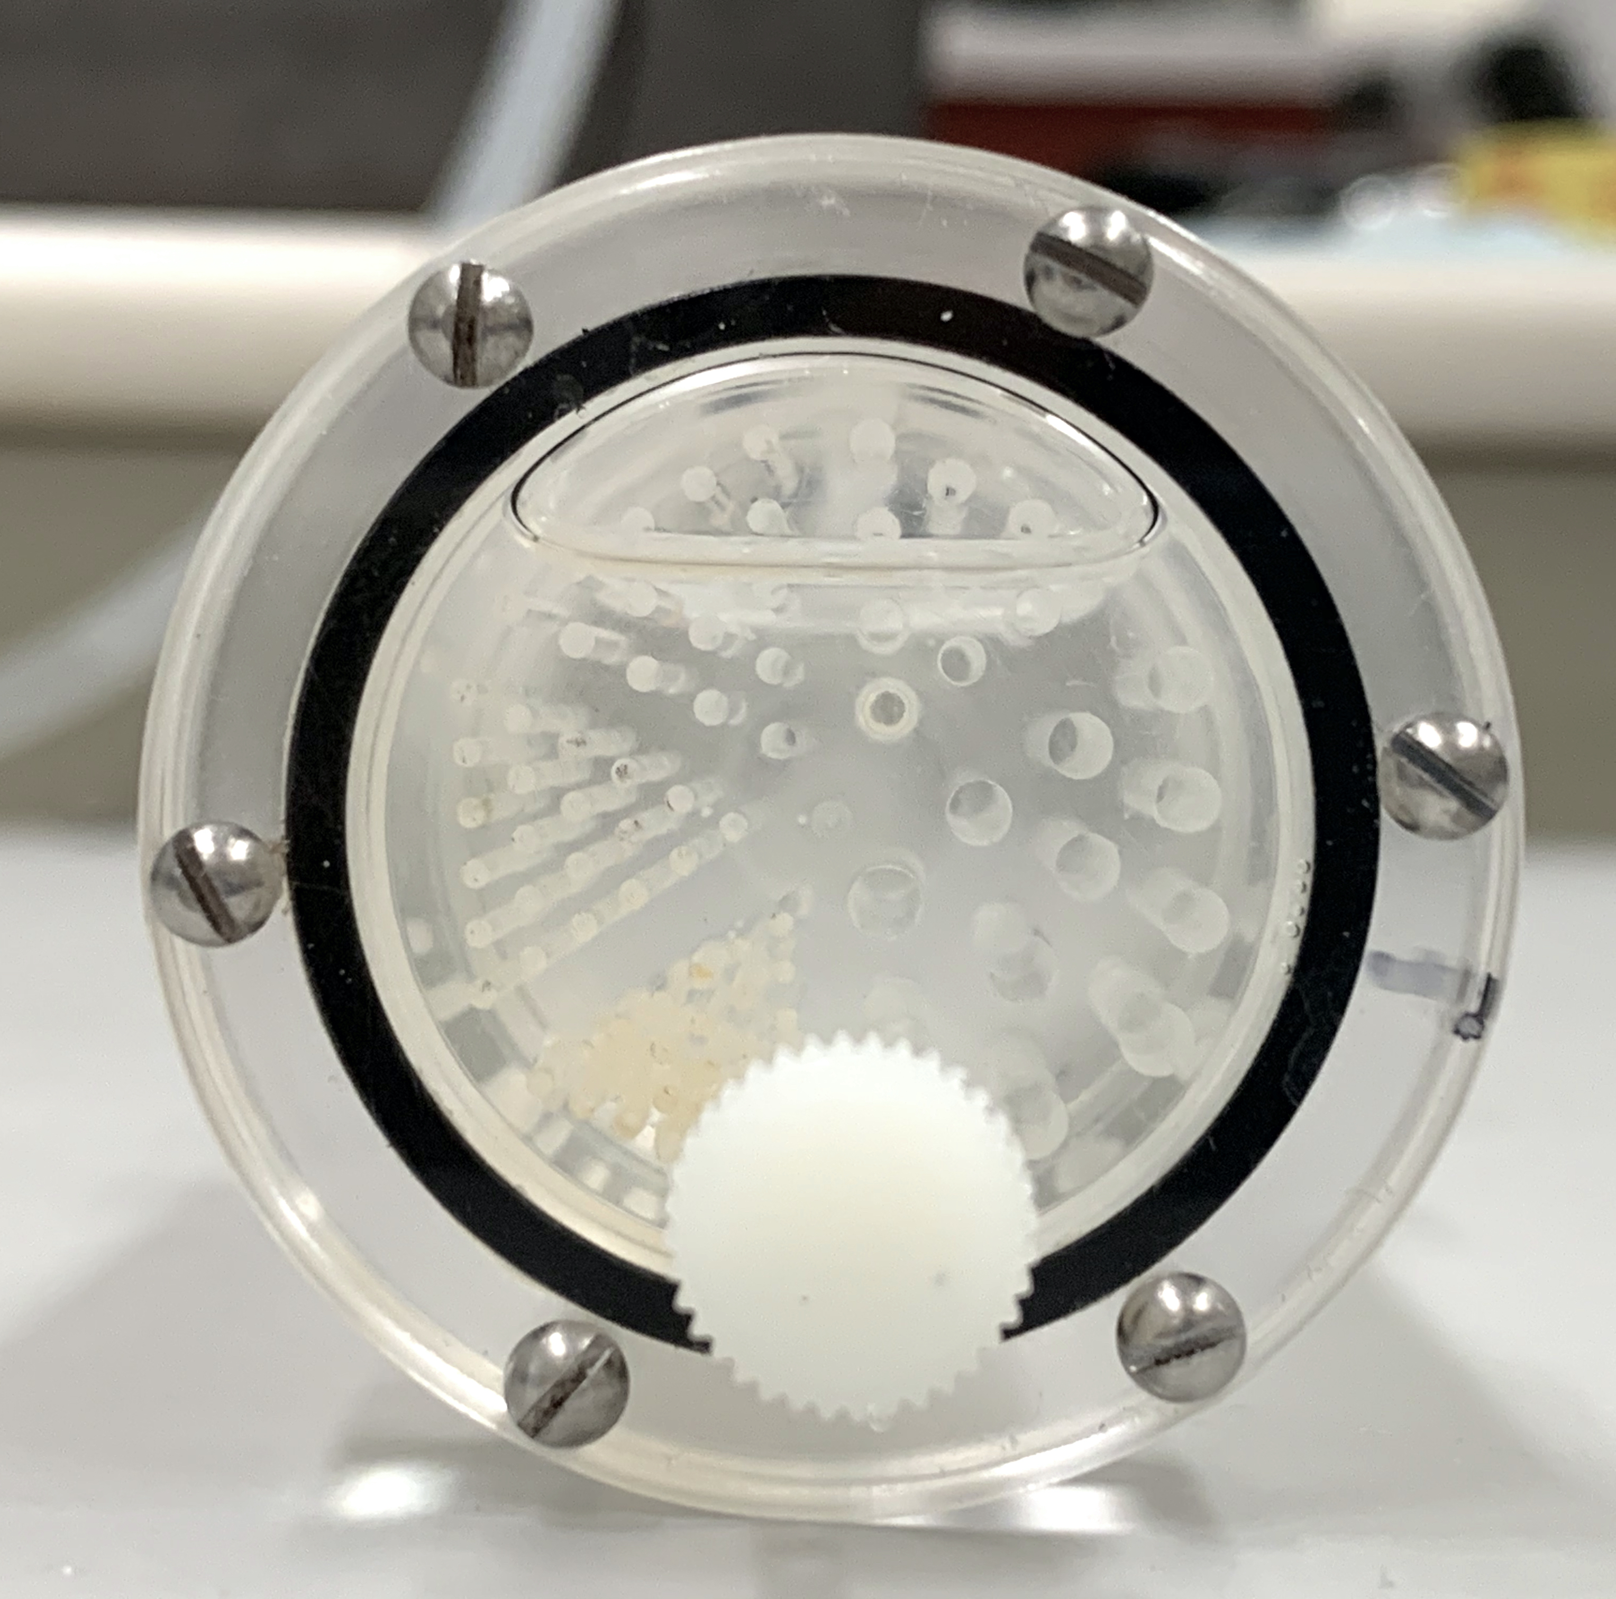
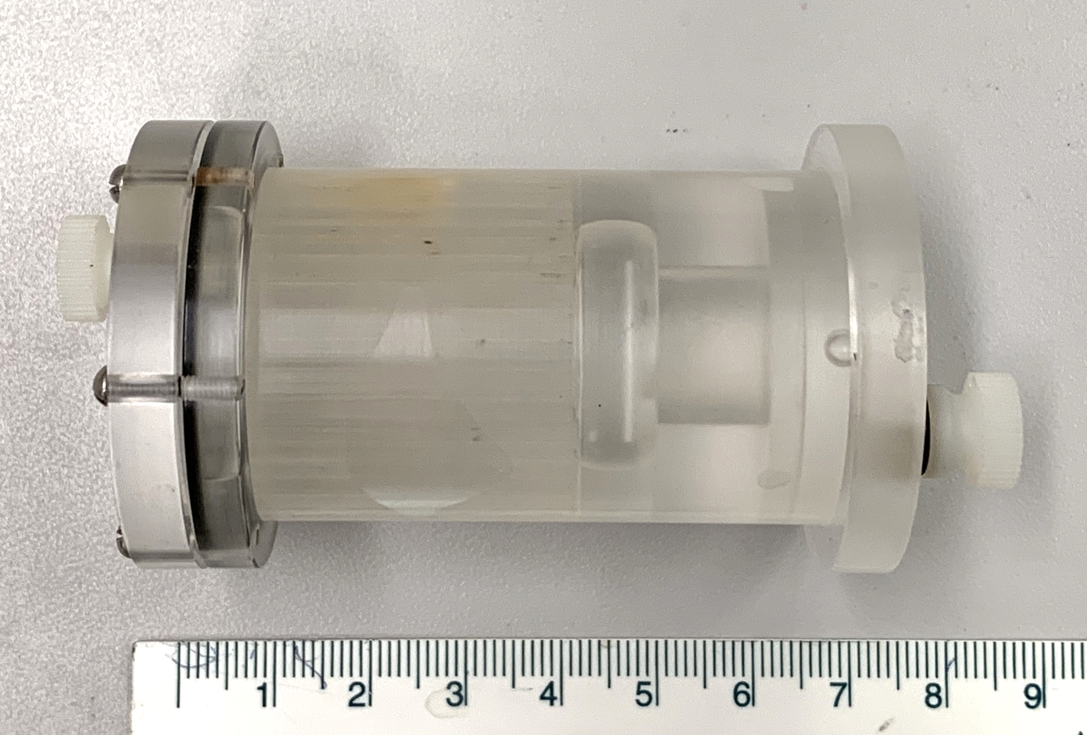
Derenzo Phantom PET Imaging - Spatial Resolution
Derenzo phantom assembly for investigating PET spatial resolution
PET radionuclides in order of increasing positron E_{mean} and E_{max}
Nelson et al., J Nucl Med. 2022;63(4):584-590
¹⁸F, ⁶⁴Cu, ⁴⁴Sc and ⁶⁸Ga from Ferguson et al., EJNMMI Phys. 2019; 6(1)
Notes:
And there is a strong correlation between the radionuclide positron energy and spatial resolution. Comparing to PET phantom data for fluorine, copper, scandium, and gallium from a recent paper by Ferguson et al, Lanthanum 133 clearly exhibits superior spatial resolution to scandium 44, the widely used radiometal gallium 68, and another radiolanthanum PET candidate, lanthanum 132, and looks decent even compared to the PET imaging spatial resolution gold standards F-18 and Cu-64. This highlights the excellent image quality obtainable from lanthanum 133.

Slide 13
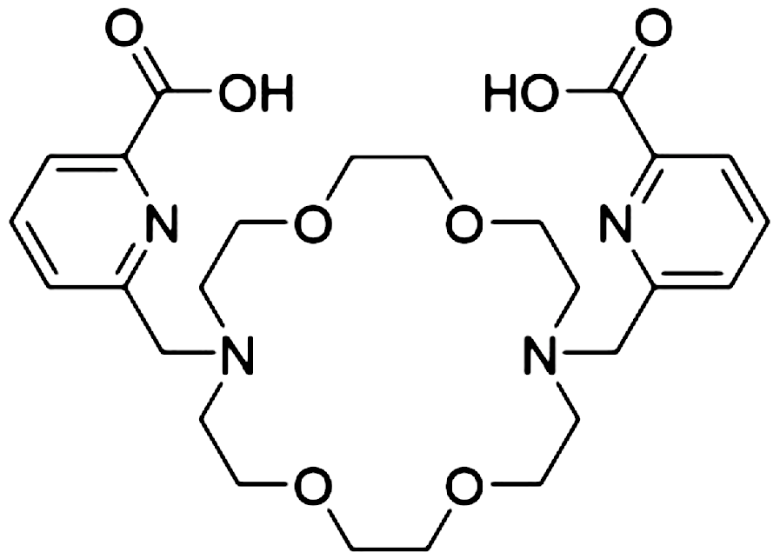
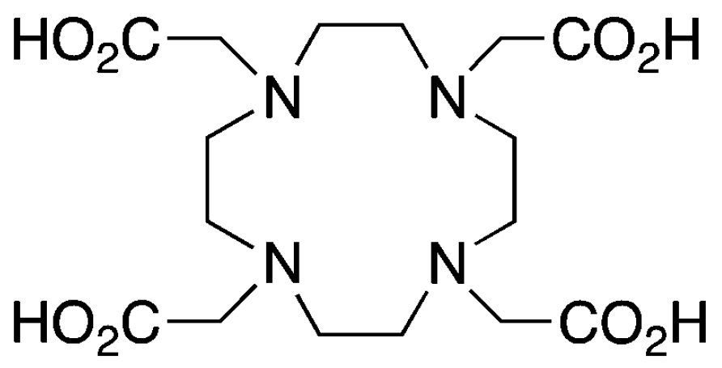
Radiolabeling
Radiolabeling performed with DOTA and Macropa
Use [¹³³La]LaCl₃ produced with isotopically enriched ¹³⁵BaCO₃ target material, Ba/La separation performed using branched DGA resin
Adjust [¹³³La]LaCl₃ to pH 4.5 with NaOAc buffer
DOTA: React at 90°C for 30 min
130 ± 15 GBq/μmol (¹³³La)
Macropa: React at 22°C for 10 min
206 ± 31 GBq/μmol (¹³³La)
¹³³La
Macropa
¹³³La
DOTA
Nelson et al., J Nucl Med. 2022;63(4):584-590
Separation modified from Aluicio-Sarduy et al., Sci Rep. 2019; 9(1)
Notes:
After separation is complete, we used 100 microliter aliquots our lanthanum-133 to radiolabel the chelators DOTA and macropa.
To radiolabel DOTA and macropa, we first adjust to pH 4.5 with sodium acetate buffer.
Then, we react at 90oC for 30 mins for DOTA, and room temperature for 10 min with macropa.
We achieved full incorporation, and 130 GBq/umol with DOTA, and 206 GBq/umol with macropa.

Slide 14
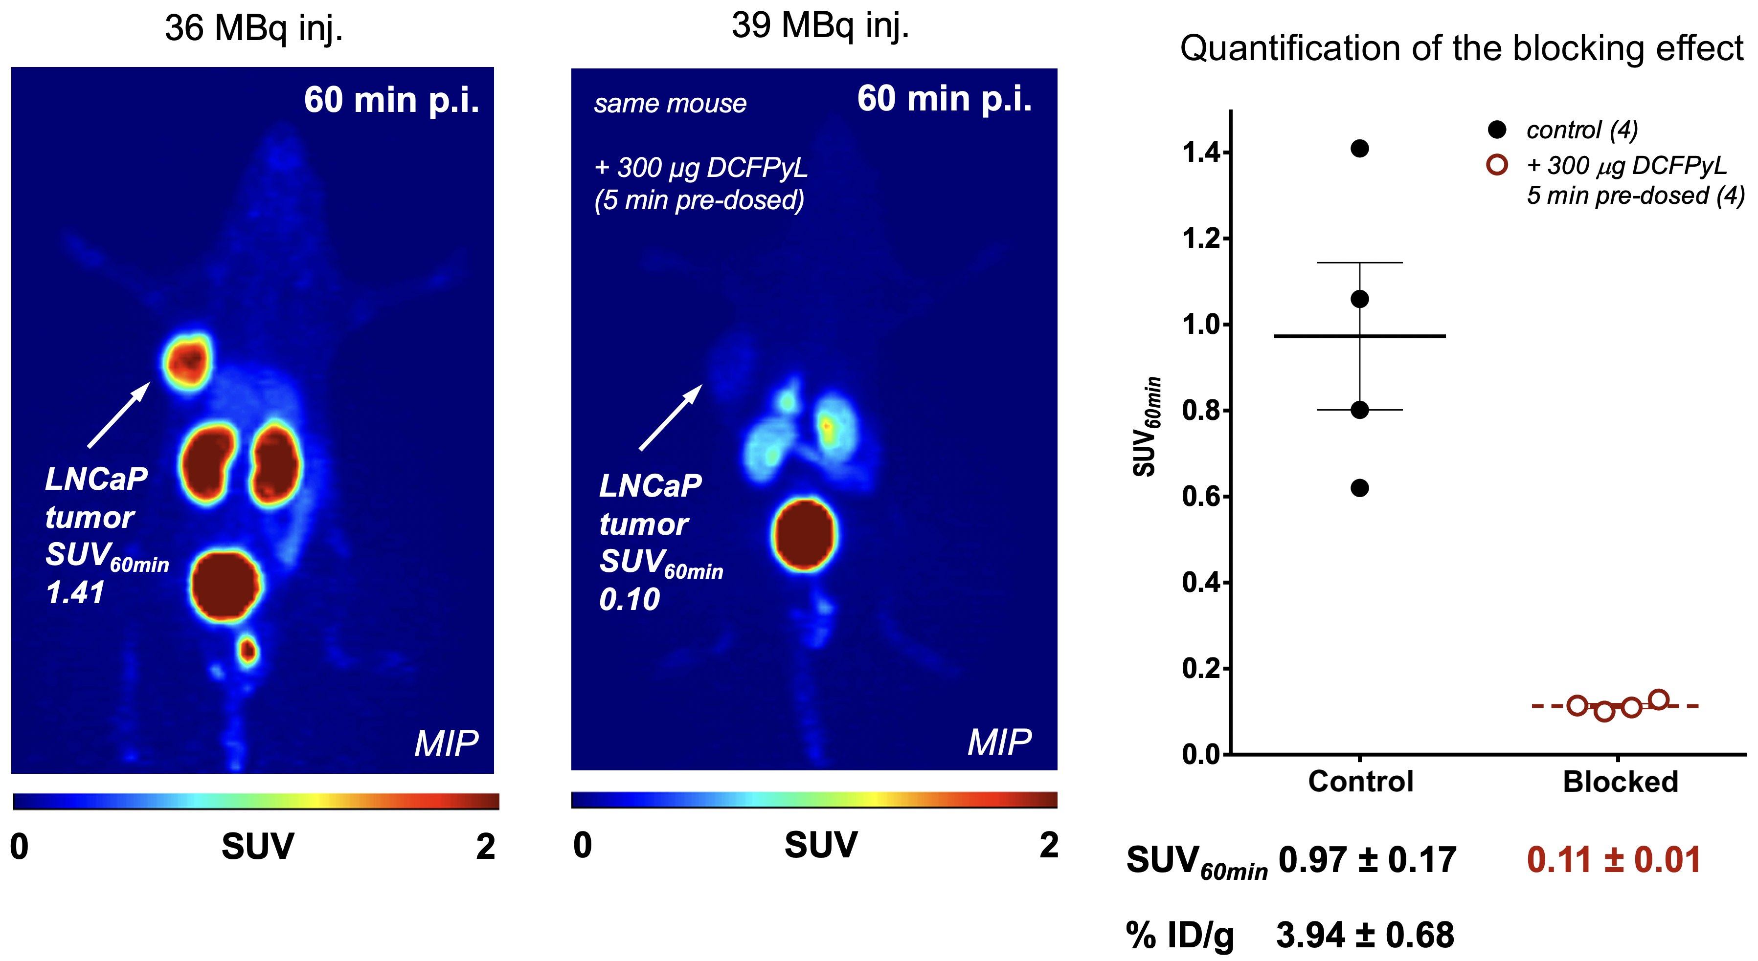
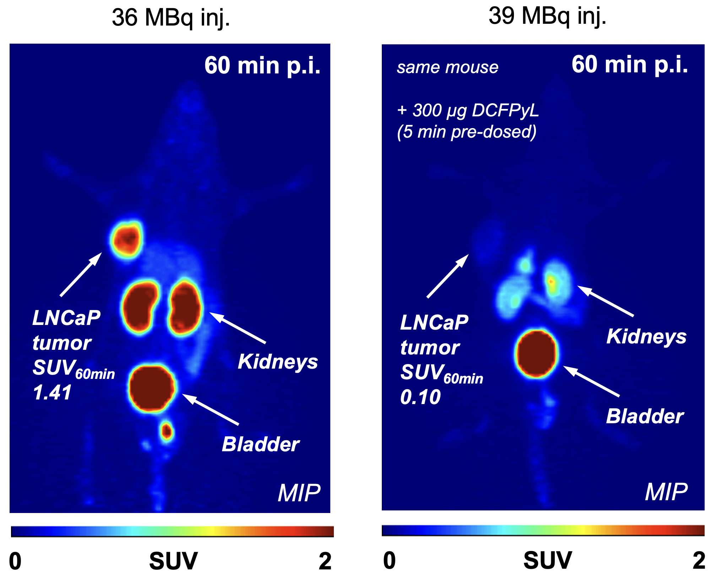
Preclinical PET Prostate Cancer Imaging
PET imaging of LNCaP tumor-bearing male NU/NU mice injected with [¹³³La]La-PSMA I&T and DCFPyL
Nelson et al., J Nucl Med. 2022;63(4):584-590
Notes:
Upon injection in the mouse, the lanthanum-133 radiopharmaceutical was allowed to accumulate for 60 min prior to PET imaging, and as you can see in the left image, the LNCaP tumor is clearly visualized with high spatial resolution, with a high SUV value, which measures radiotracer uptake.
Next, for a blocking experiment, we used the PSMA targeting agent DCFPyL. As PSMA I&T and DCFPyL contain the same PSMA targeting motifs and have similar IC50 values with LNCaP cells, DCFPyL should serve as an effective competitive inhibitor to try to prevent our lanthanum-133 PSMA I&T from binding to the tumor. And as you can see in the right image, mice predosed with DCFPyL exhibited significant tumor blocking of lanthanum-133PSMA I&T, with the tumor PET signal vanishing. The graph on the right shows the quantification of this consistent blocking effect. This demonstrated the high affinity of the lanthanum-133 PSMA I&T for the LNCaP cells.
All of this data for our improved targetry, chemical separation, phantom and animal imaging was published in a recent article in the Journal of Nuclear Medicine.

Slide 15
⁶⁴Cu Production Cross Sections of Interest – Enriched ⁶⁸Zn Target Material
Cross section simulation data from TENDL 2019 (Koning et al.)

Slide 16
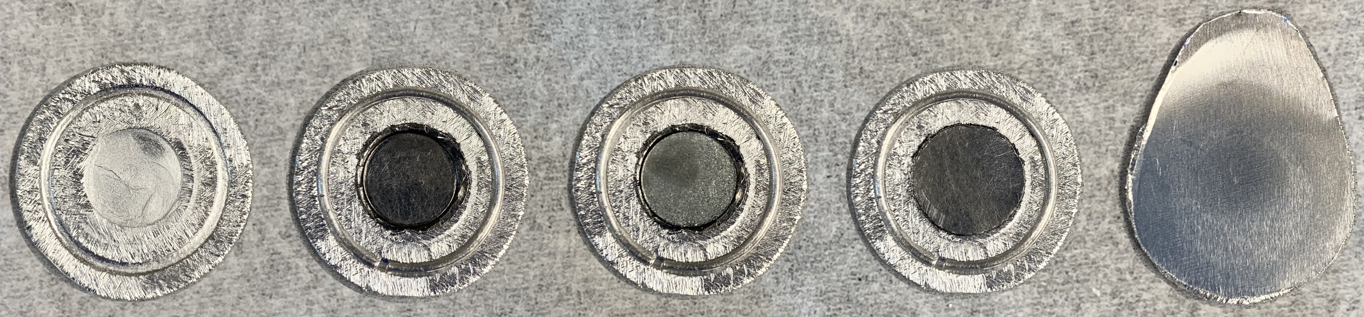
Cyclotron Irradiation
Machined aluminum disc
Base graphite foil in depression
⁶⁸Zn pellet on graphite foil
Top graphite foil
Complete assembly
100 mg ⁶⁸Zn (98.3%) sandwiched between two 0.075 mm graphite foils
24 MeV (extracted), 23 MeV incident on ⁶⁸Zn at currents up to 70 μA
Ag foil behind target disc backing with direct water cooling in TA-1186 (exit beam energy <7 MeV to stop water activation), helium cooling on target front
⁶⁴Cu saturated yield of 348 ± 6 MBq/μA (n=3)

Slide 17
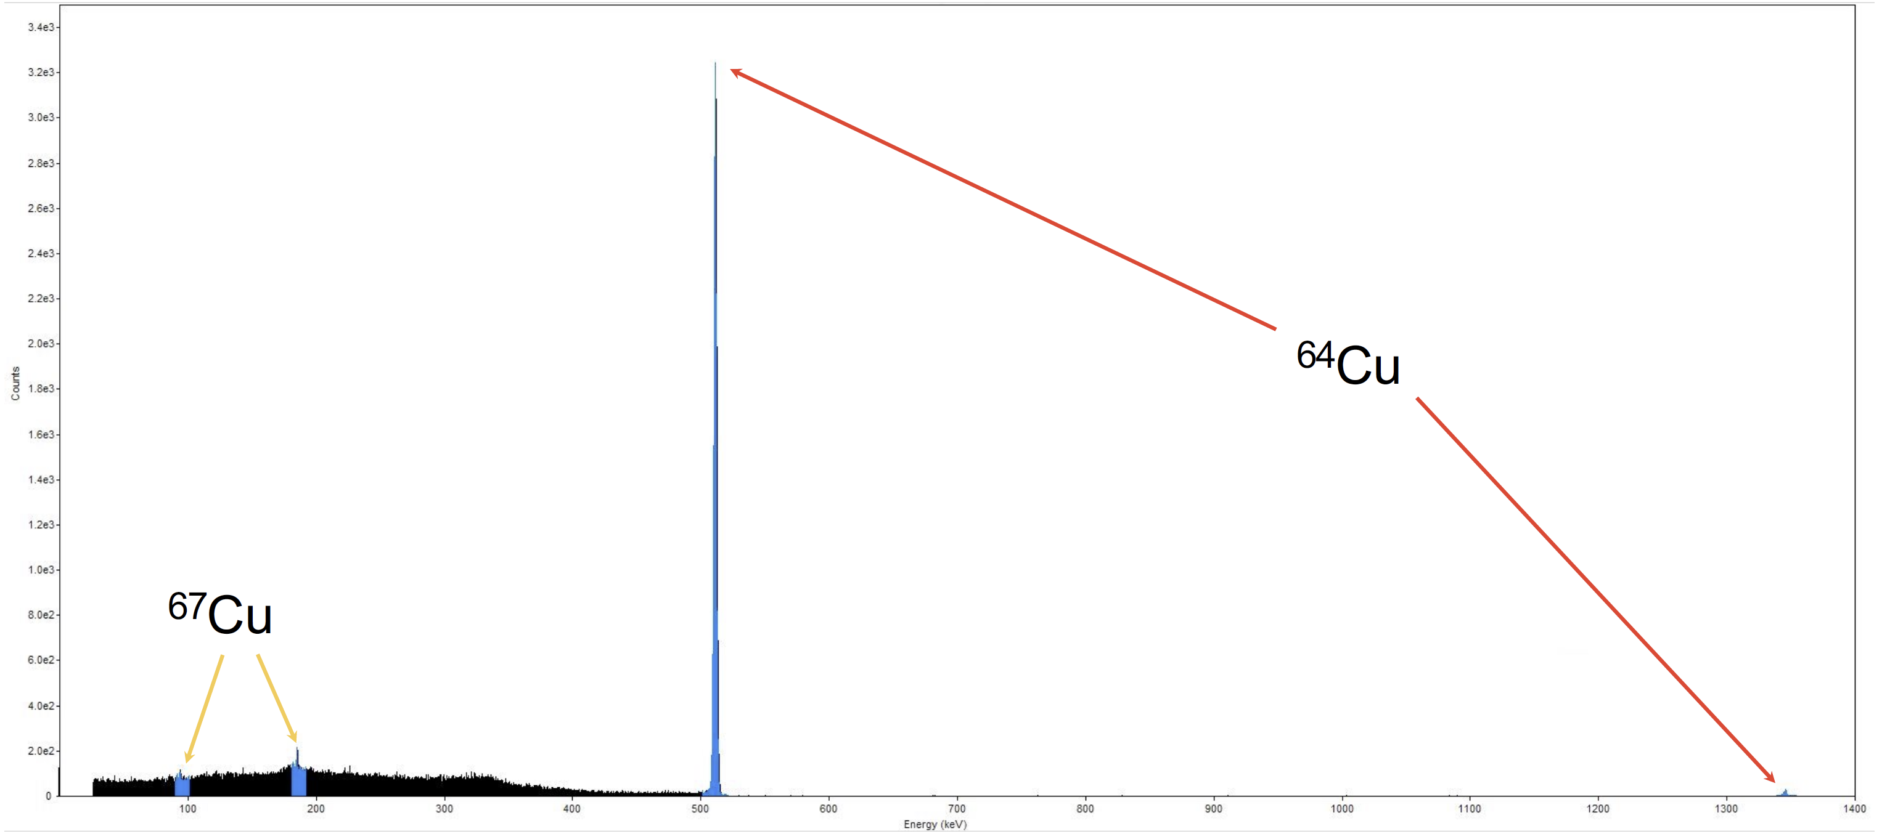
⁶⁴Cu Purification and Radiolabeling
Co-produced ⁶⁷Cu (<0.3% at EOB), large ^{67/68}Ga activities
⁶⁴Cu purified using a CU/TBP/TK201 resin combination
>94% ⁶⁴Cu decay-corrected yield in <2 mL [⁶⁴Cu]CuCl₂
Besides ⁶⁷Cu, no detectable radionuclidic impurities
Full radiolabeling incorporation down to 1 μg with DOTA, NOTA, TETA chelators
HPGe gamma emission spectrum of [⁶⁴Cu]CuCl₂ product

Slide 18
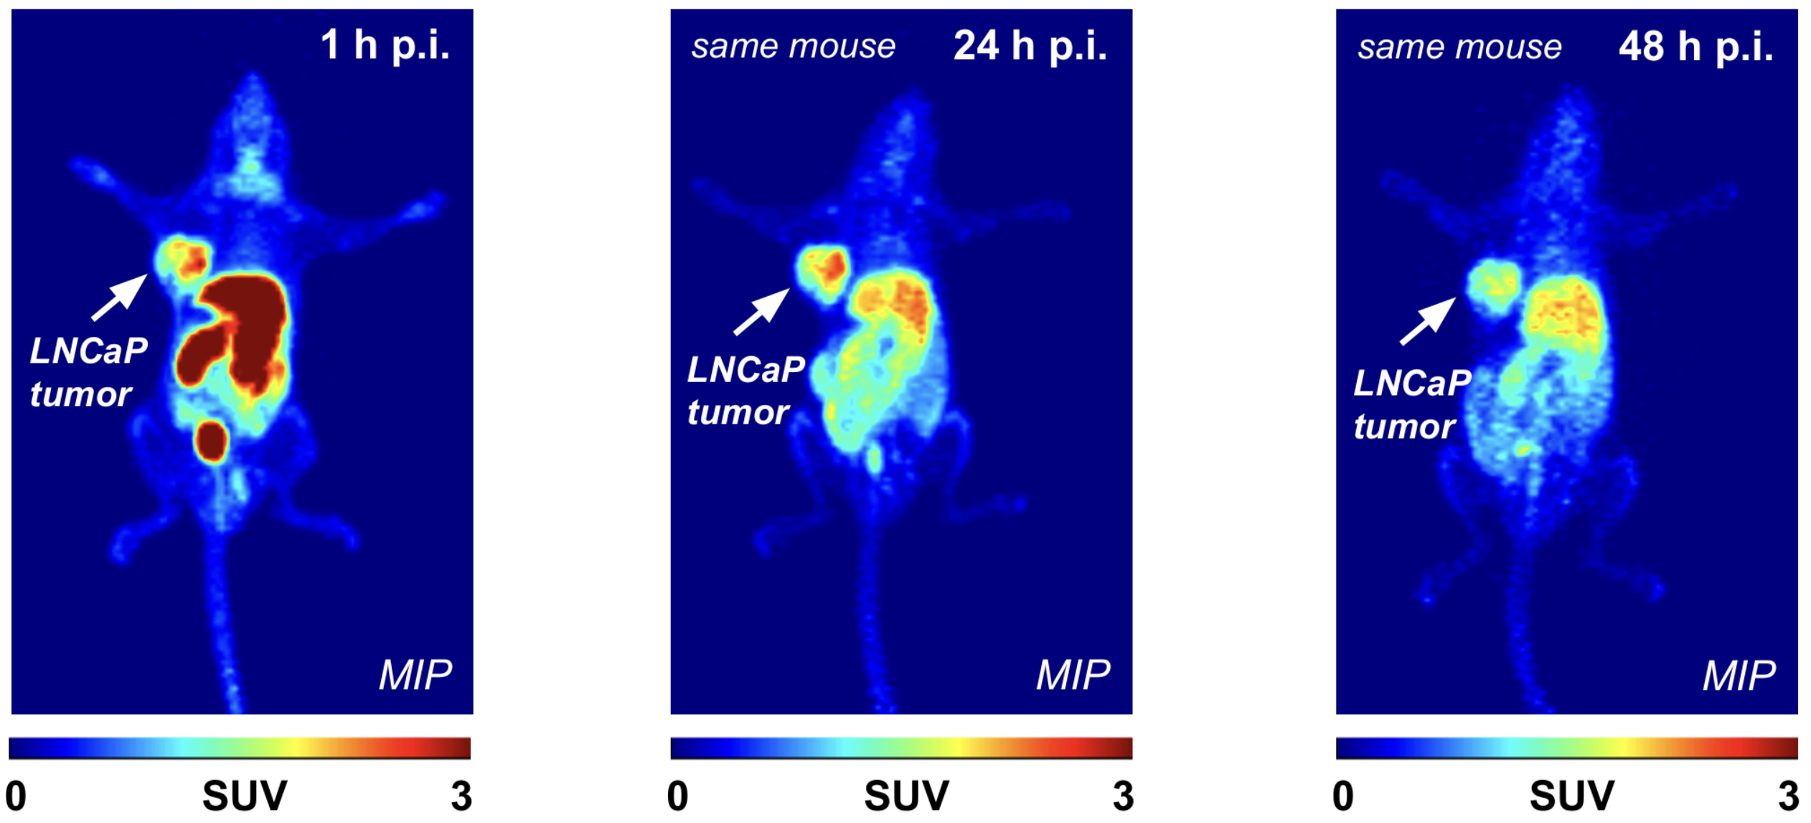
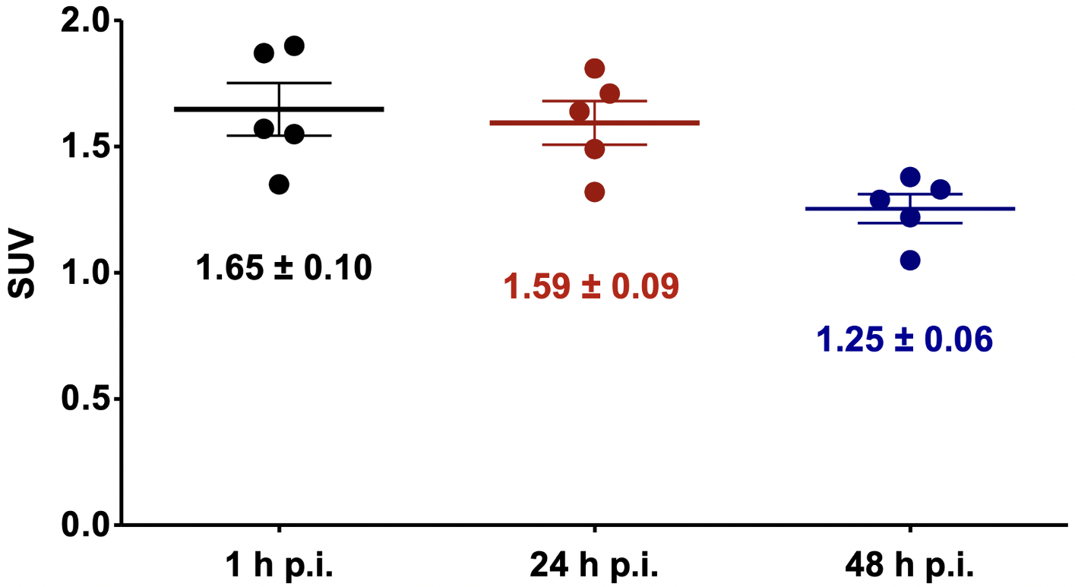
Preclinical PET Prostate Cancer Imaging
Preclinical PET imaging of LNCaP tumor-bearing male NU/NU mice injected with [⁶⁴Cu]Cu-PSMA I&T
Notes:
Upon injection in the mouse, the lanthanum-133 radiopharmaceutical was allowed to accumulate for 60 min prior to PET imaging, and as you can see in the left image, the LNCaP tumor is clearly visualized with high spatial resolution, with a high SUV value, which measures radiotracer uptake.
Next, for a blocking experiment, we used the PSMA targeting agent DCFPyL. As PSMA I&T and DCFPyL contain the same PSMA targeting motifs and have similar IC50 values with LNCaP cells, DCFPyL should serve as an effective competitive inhibitor to try to prevent our lanthanum-133 PSMA I&T from binding to the tumor. And as you can see in the right image, mice predosed with DCFPyL exhibited significant tumor blocking of lanthanum-133PSMA I&T, with the tumor PET signal vanishing. The graph on the right shows the quantification of this consistent blocking effect. This demonstrated the high affinity of the lanthanum-133 PSMA I&T for the LNCaP cells.
All of this data for our improved targetry, chemical separation, phantom and animal imaging was published in a recent article in the Journal of Nuclear Medicine.

Slide 19
²⁰³Pb Production Cross Sections of Interest
Cross section simulation data from TENDL 2019 (Koning et al.)

Slide 20
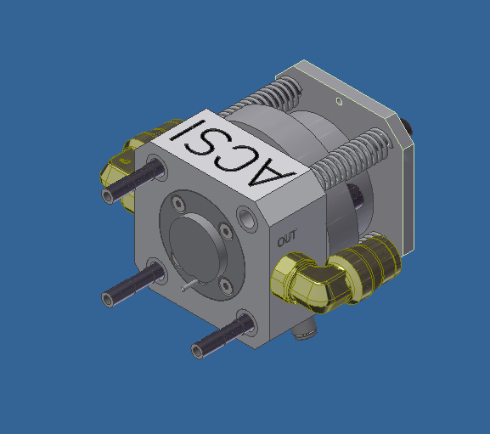
New Target Assembly
Slot for target loading
Cu cold finger
Switch from TA-1186 target assembly with direct water cooling to TA-2150-B target assembly with copper cold finger
Disc installed in target assembly, pressed onto copper cold finger with springs and air pressure
No cooling water activation with TA-2150-B
Images credit of Advanced Cyclotron Systems Inc.
Notes:
Adjusting the nuclear cross sections for this enriched isotopic abundance, we get two distinct reactions. Irradiating at a lower energy of 11.9 MeV allows high yield production of highly pure lanthanum-135 via the barium-135 p,n reaction, while irradiating at higher energies allows significant production of lanthanum-133 via the barium-135 p,3n reaction with lower amounts of co-produced La-135.

Slide 21
Lead-203 Production
²⁰³Pb (t_{1/2} = 51.9 h, 279 keV (81%)) attractive radionuclide to provide theranostic SPECT imaging alongside ²¹²Pb targeted radionuclide therapy
Thallium metal highly toxic and poor thermal conductivity (46 W⋅m⁻¹⋅K⁻¹)
Utilize sealed solid target assembly to encapsulate thallium metal target material
Bombard at 24 MeV (extracted), 23.3 MeV incident on ²⁰⁵Tl metal (99.9% enrichment) at 60 μA proton beam current
Water cooled by TA-2150-B copper cold finger on back, helium cooling on front

Slide 22
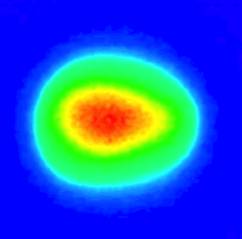
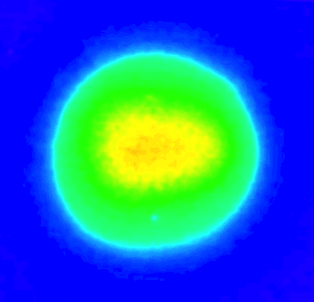
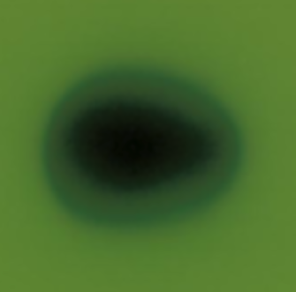
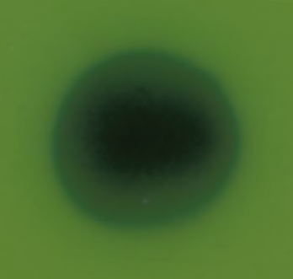
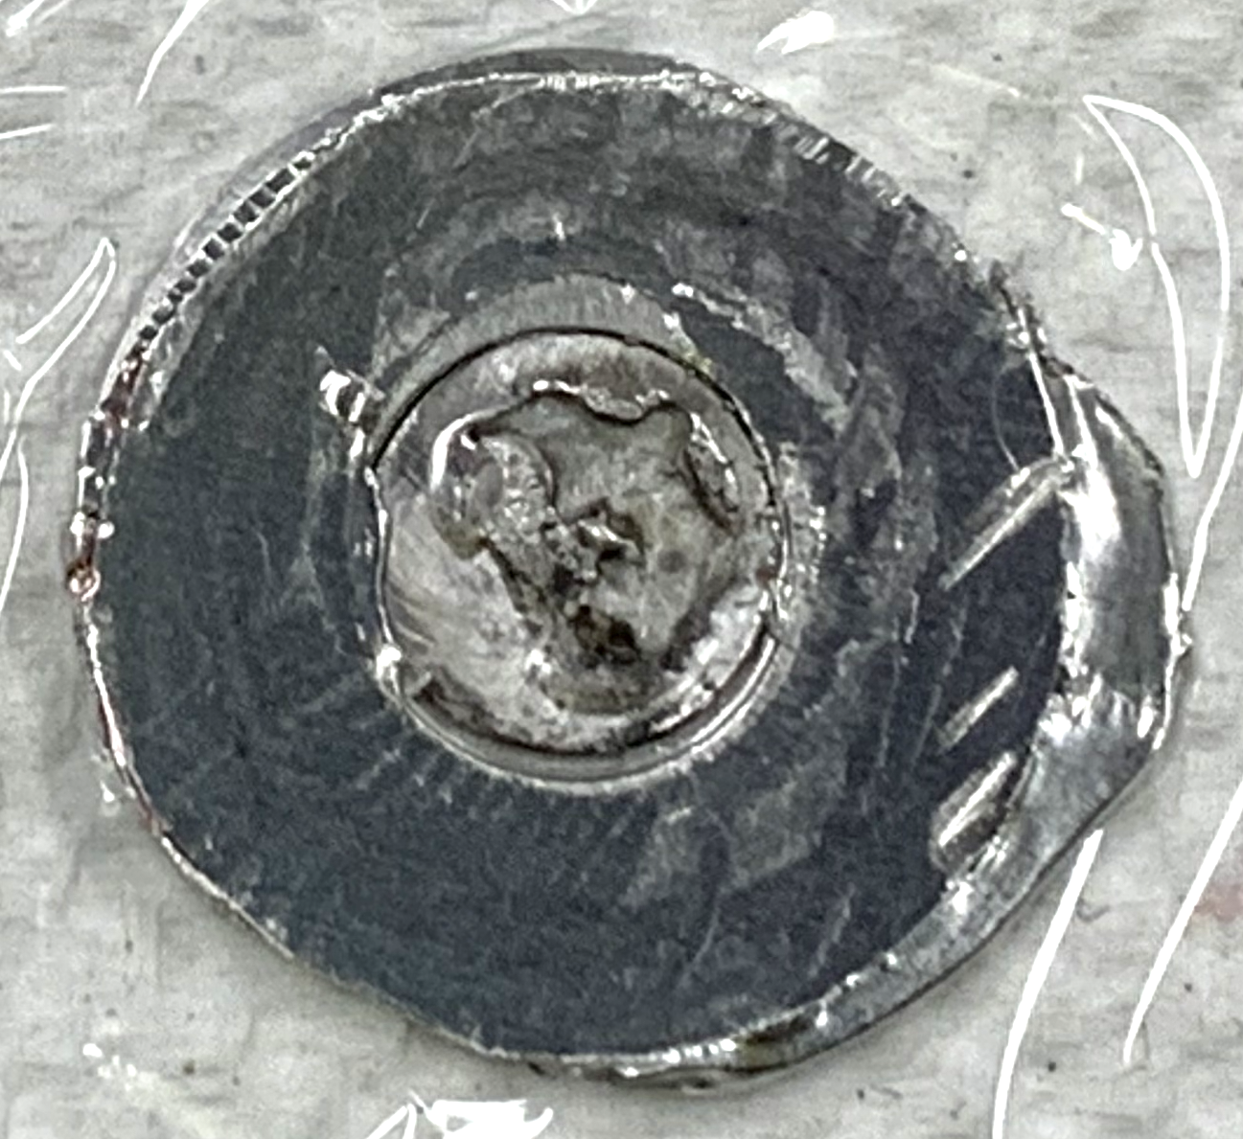
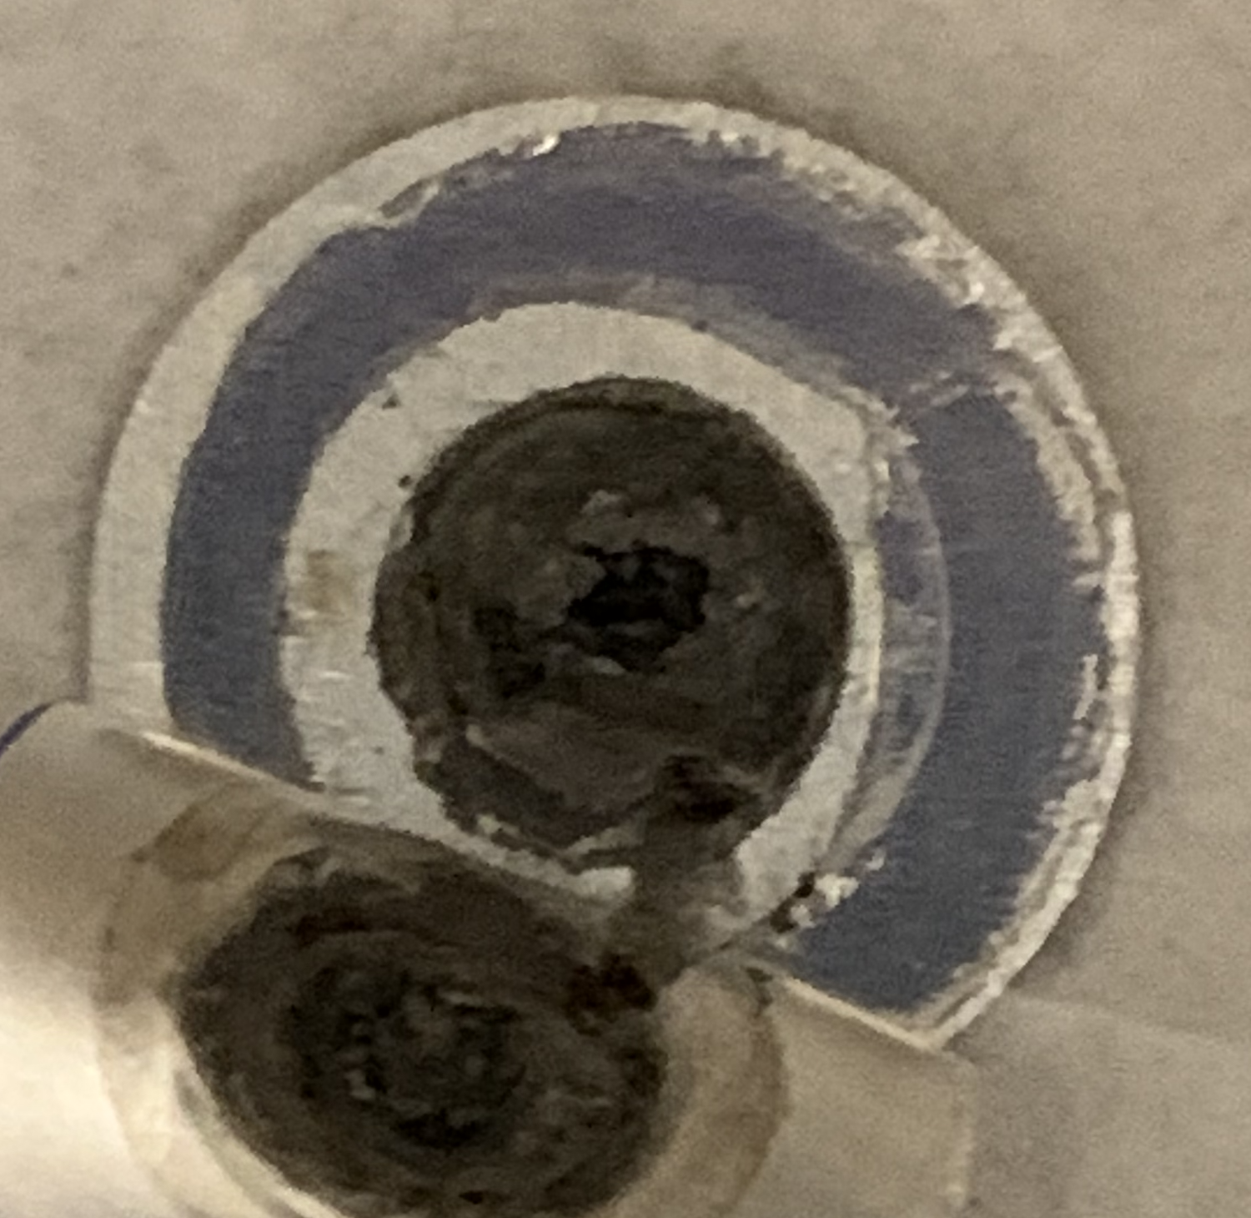
Beam Distribution Optimization and Analysis
Investigate target thermal performance
Irradiate Cu discs at 60 μA for 1 min with beam tune for ¹⁸F liquid target (80% beam transmission) and beam tune optimized for ²⁰⁵Tl sealed solid target (55% beam transmission)
Expose irradiated targets to Gafchromic EBT film to investigate beam spread, digitize with a scanner for analysis
Max beam intensity
1 cm
1 cm
Min beam intensity
80% current transmission
55% current transmission
1 cm
1 cm
Melted thallium, Reduced ²⁰³Pb yield (<50% theoretical)
²⁰³Pb yield >90% of theoretical
80% current transmission
55% current transmission
Image analysis performed using ImageJ
Notes:
Adjusting the nuclear cross sections for this enriched isotopic abundance, we get two distinct reactions. Irradiating at a lower energy of 11.9 MeV allows high yield production of highly pure lanthanum-135 via the barium-135 p,n reaction, while irradiating at higher energies allows significant production of lanthanum-133 via the barium-135 p,3n reaction with lower amounts of co-produced La-135.

Slide 23
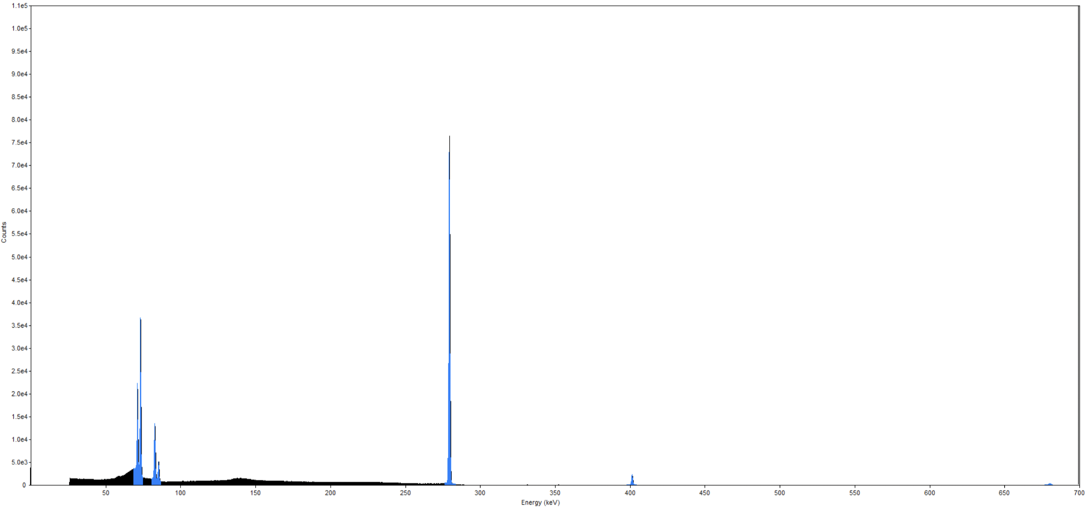
²⁰³Pb Purification and Radiolabeling
²⁰³Pb saturated yield of 3.9 ± 0.3 GBq/μA
Tl/Pb chemical separation performed with Pb resin >12 hours after EOB (allows ^{204m}Pb decay)
Elute with 8M HCl, >85% decay-corrected [²⁰³Pb]PbCl₂ yield in 4 mL
Can convert to [²⁰³Pb]Pb(OAc)₂ with 1M NH₄OAc elution using a second Pb resin
Maximum purified yield of 12 GBq [²⁰³Pb]PbCl₂ (15.8 GBq at EOB) with 8.6 h irradiation, radionuclidic purity >99.9%
Radiolabeling [²⁰³Pb]Pb(OAc)₂ with bifunctional chelators: 461 ± 30 GBq/μmol with PSC-Bn-NCS, 195 ± 37 GBq/μmol with TCMC-NCS, 83 ± 16 GBq/μmol with DOTA-NCS
²⁰³Pb
HPGe gamma emission spectrum of [²⁰³Pb]PbCl₂ product
PSC-Bn-NCS provided by Viewpoint Molecular Targeting
Separation modified from McNeil et al., EJNMMI Radiopharm Chem. 2021;6(1):6
Notes:
Adjusting the nuclear cross sections for this enriched isotopic abundance, we get two distinct reactions. Irradiating at a lower energy of 11.9 MeV allows high yield production of highly pure lanthanum-135 via the barium-135 p,n reaction, while irradiating at higher energies allows significant production of lanthanum-133 via the barium-135 p,3n reaction with lower amounts of co-produced La-135.

Slide 24
Summary
Nuclear reaction | Target material and mass | Target pellet incident energy (MeV) | Proton beam current (μA) | Saturated yield
¹³⁵Ba(p,3n)¹³³La | ^{nat}Ba metal, 200 mg | 23.3 | 10 | 277 MBq/μA
¹³⁵Ba(p,n)¹³⁵La | ^{nat}Ba metal, 150 mg | 11.9 | 10 | 167 MBq/μA
¹³⁵Ba(p,3n)¹³³La | ^{nat}BaCO₃, 200 mg | 23.3 | 10 | 204 MBq/μA
¹³⁵Ba(p,n)¹³⁵La | ^{nat}BaCO₃, 150 mg | 11.9 | 10 | 115 MBq/μA
¹³⁵Ba(p,3n)¹³³La | ¹³⁵BaCO₃ (92.7%), 200 mg | 23.3 | 10 | 736 MBq/μA
¹³⁵Ba(p,n)¹³⁵La | ¹³⁵BaCO₃ (92.7%), 150 mg | 11.9 | 10 | 1377 MBq/μA
⁶⁸Zn(p,αn)⁶⁴Cu | ⁶⁸Zn metal (98.3%), 100 mg | 23 | 70 | 348 MBq/μA
⁶⁸Zn(p,n)⁶⁸Ga | ⁶⁸Zn metal (98.3%), 100 mg | 12.5 | 10 | 5.6 GBq/μA
²⁰⁵Tl(p,3n)²⁰³Pb | ²⁰⁵Tl metal (99.9%), 250 mg | 23.3 | 60 | 3.9 GBq/μA
⁸⁹Y(p,n)⁸⁹Zr | ^{nat}Y metal, 150 mg | 13 | 10 | 4.6 GBq/µA

Slide 25
Conclusions
Novel indium-aluminum sealed cyclotron target is robust, simple to manufacture, contains reusable components
Target assembly can be irradiated at beam currents up to 70 μA with no signs of degradation and minimal component activation
Target backing can be used as an intrinsic degrader
Easily adaptable to produce clinically relevant activities of various diagnostic or therapeutic radiometals with sensitive or hazardous target materials
Chemically compatible with multiple separation processes demanding high radiochemical purity

Slide 26





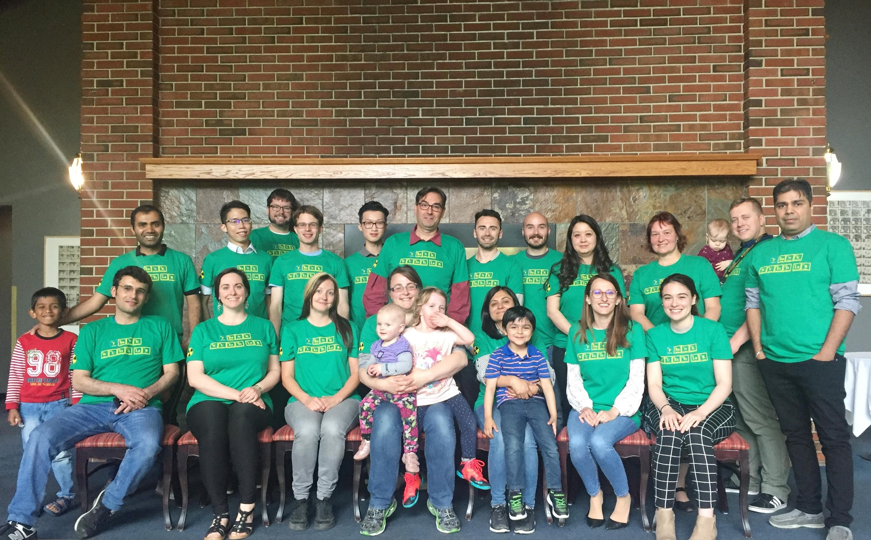

Acknowledgments
Cross Cancer Institute
Medical Isotope and Cyclotron Facility
Dr. Frank Wuest
Dr. Jan Andersson
Dr. John Wilson
Dr. Melinda Wuest
Dr. John Duke
Dr. Hans-Sönke Jans
Dr. Susan Pike
Dr. Simon Ferguson
Dr. Jonathan Doupe
Cody Bergman
Blake Lazurko
Curtis Osinchuk
Steffen Happel (Triskem)
Jayden Sader (ACSI)
Notes:
Finally, I’d like to thank my supervisors Dr. Frank Wuest and Dr. Jan Andersson and members of my supervisory committee for their support and guidance, the entire Wuest lab, and others from the University of Alberta and Alberta Health services working at the Cross Cancer and Medical Isotope and Cyclotron Facility whose expertise were invaluable for this project.

