Slide 1


Characterization of a cyclotron liquid target using thick niobium target windows with thermal simulation studies
Sergio do Carmo, Pedro Oliveira and Francisco Alves

Slide 2
Motivation
Need to increase current on targets with reliability
Interest in studying the influence of the cooling systems
R&D PROGRAM: production of radiometals in liquid targets
  Representing more critical situations as:
  i) use of less mechanically resistant Niobium target windows instead of Havar;
  ii) thicker windows to decrease the initial energy on target, i.e. greatly enhanced heat on foils;
  iii) lower energies mean higher stopping powers, i.e. even more heat deposited per MeV;
  iv) desire to use larger target currents, due to lower amount of target material

Slide 3
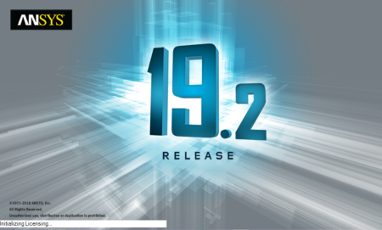
Simulations
FEM simulations with Ansys® software
Characterization of a commercial IBA C8 liquid target system
Beam power in the target windows and the liquid target
Water cooling of the Niobium insert
Helium cooling for target windows
Definition of standard initial conditions (flows, temperatures, power…)
Thermal conductivity and heat capacity as a function of the temperature

Slide 4
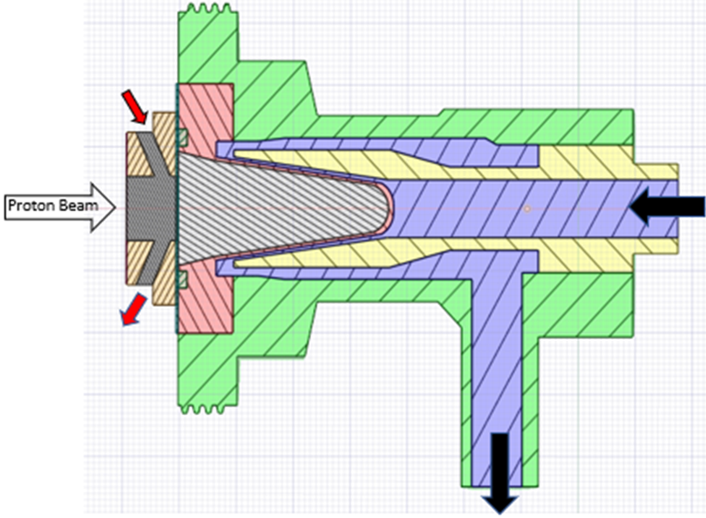
Simulations
FEM simulations with the Ansys software
          Distinct target windows, particular interest in niobium thick foils
Study of the influence of relevant parameters:
          Temperature of the cooling helium
          Flux of the cooling helium
          Temperature of the cooling water
          Flux of the cooling water
          Different beam currents
          Different materials
          …
Helium flow
Water
flow

Slide 5
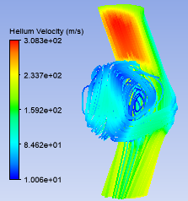
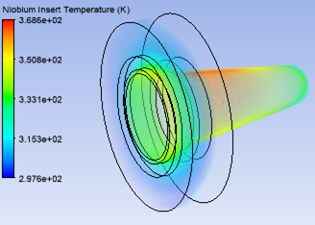
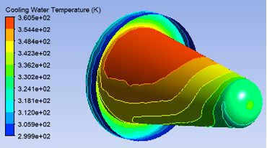
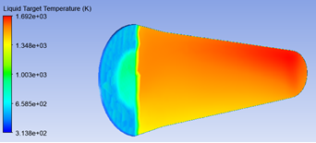
Simulations

Slide 6
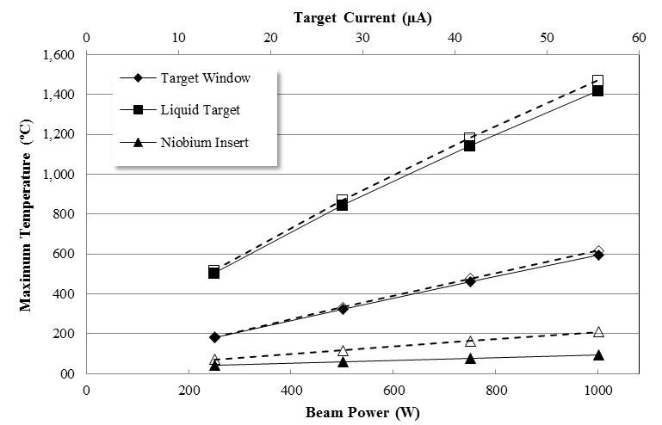
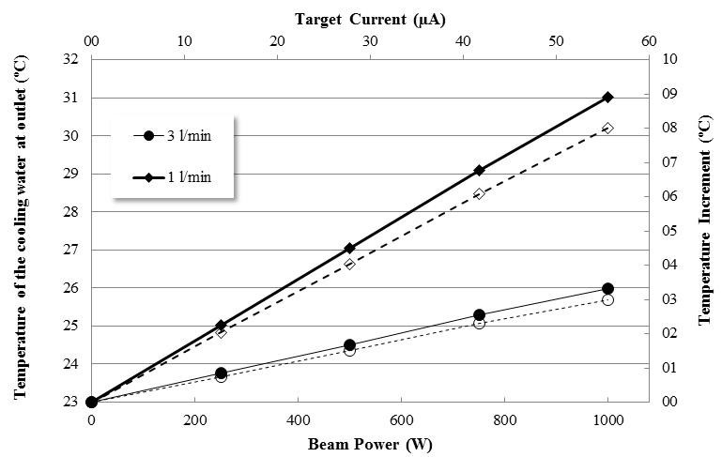
Simulations – Havar (influence of beam current)
Firstly, standard conditions were implemented with the standard Havar target window

Slide 7
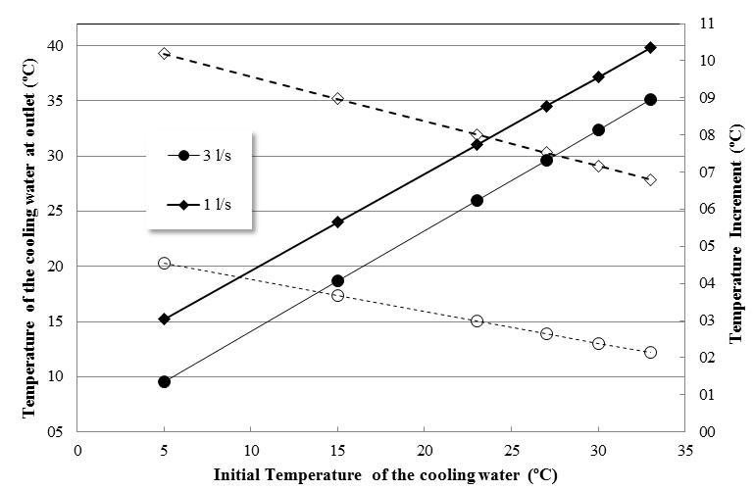
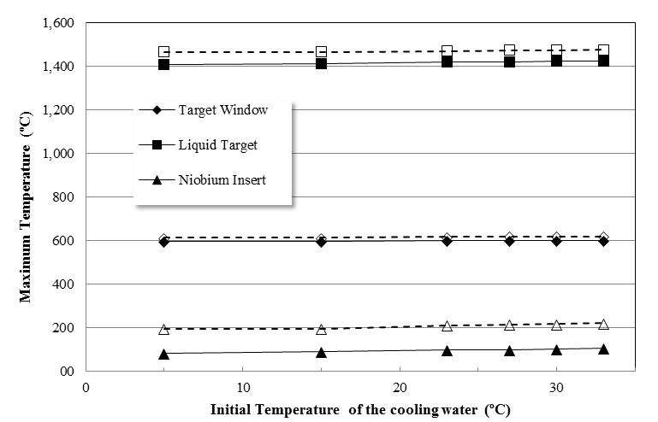
Simulations – Havar (influence of cooling water conditions)

Slide 8
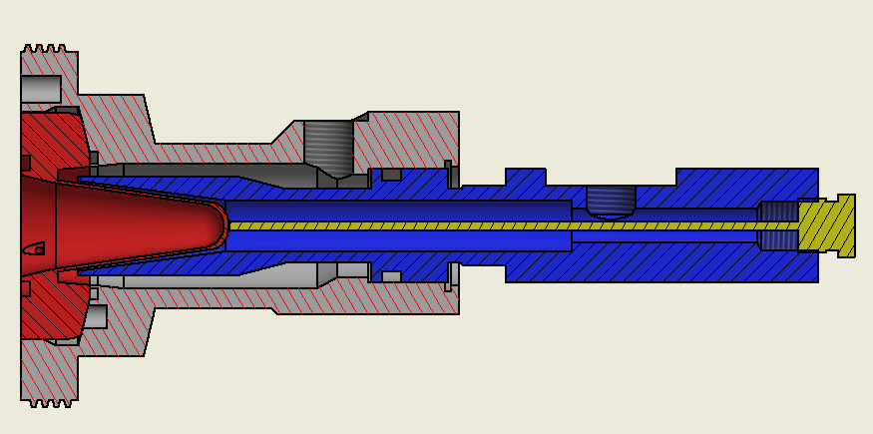
Experimental validation
Experimental measurement of the temperature of the cooling water at 3 locations
3 thermistors connected to an Arduino used as a datalogger
Adapted diffuser to allocate temperature measurement at the vicinity of the insert
Measurements of temperature increments
Distinct heat conditions during irradiations (water temperature, beam current…)
2- WATER OUT FROM TARGET TO THE COLIMATOR
3- WATER OUT FROM COLIMATOR
1 - WATER IN

Slide 9
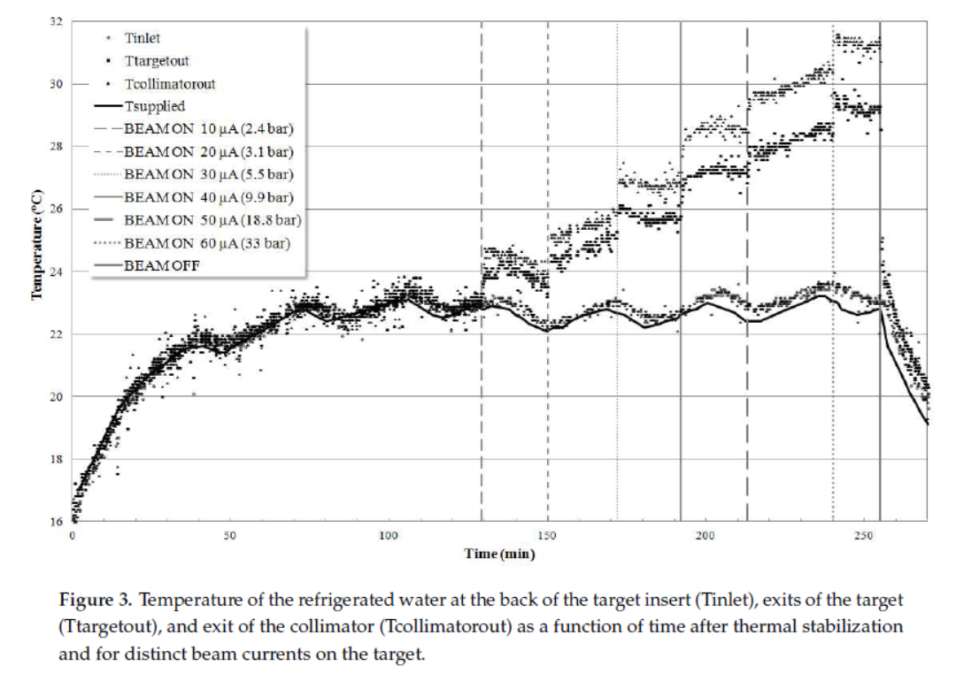
Experimental validation

Slide 10
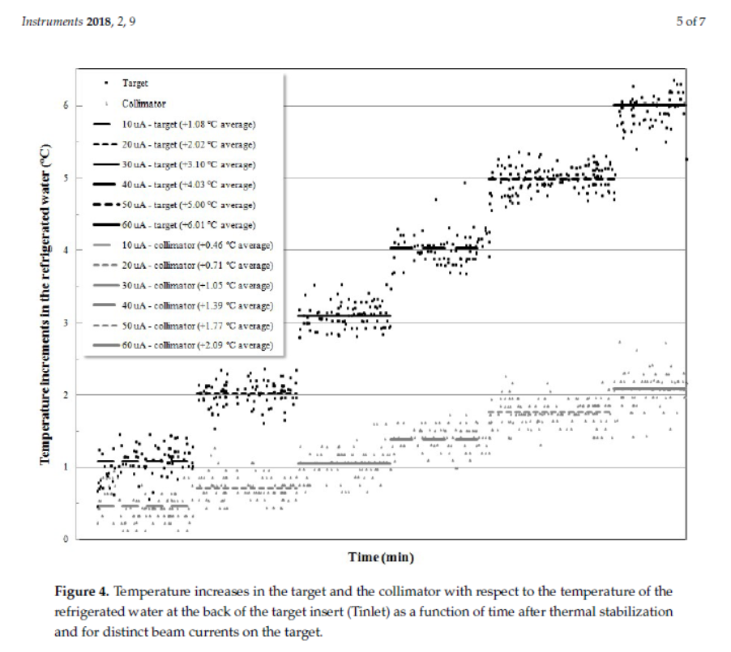
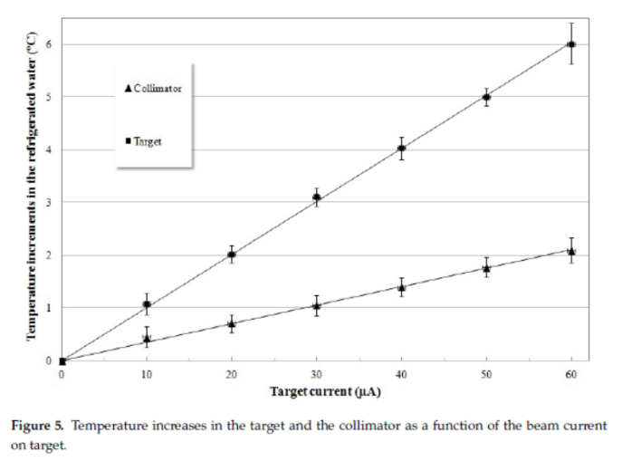
Experimental validation

Slide 11
Experimental validation - Comparison
Experimental result:
Temperature increment of 5 ºC @ 50 µA with cooling water flow ~ 2 l/min
Simulation results:
- Temperature increment of 7.5 ºC @ 50 µA with cooling water flow of 1 l/min
- Temperature increment of 3 ºC @ 50 µA with cooling water flow of 3 l/min

Slide 12
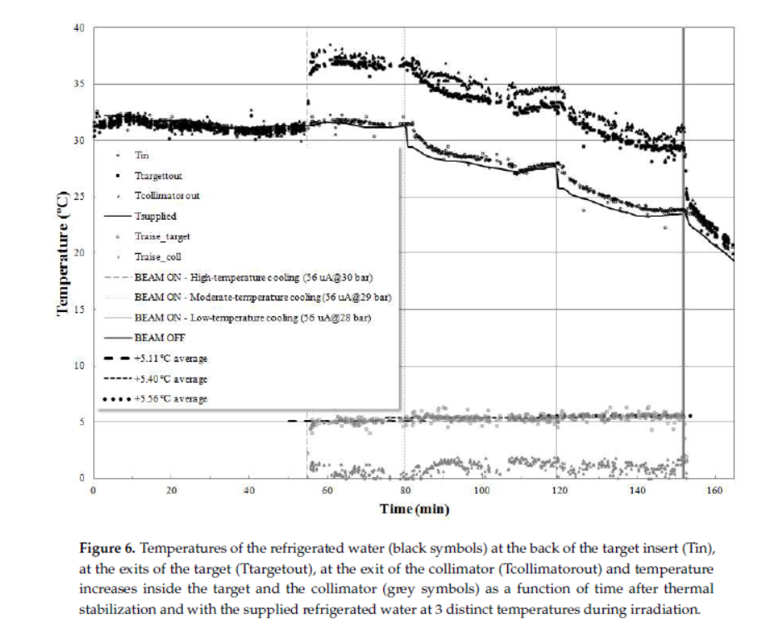
Experimental validation

Slide 13
Experimental validation - Comparison
Simulation results, within the temperature range considered:
the temperature increment varies by ~0.8 ºC with cooling water flow of 1 l/min
the temperature increment varies by ~0.5 ºC with cooling water flow of 3 l/min
Experimental results, within the temperature range considered:
the temperature increment varies by 0.5 ºC with cooling water flow of ~2 l/min

Slide 14
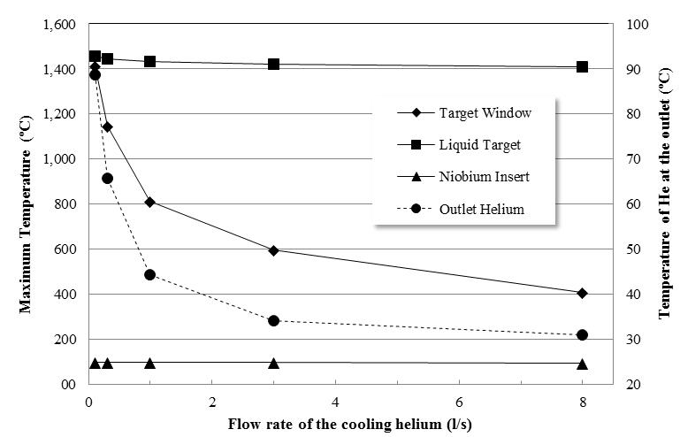
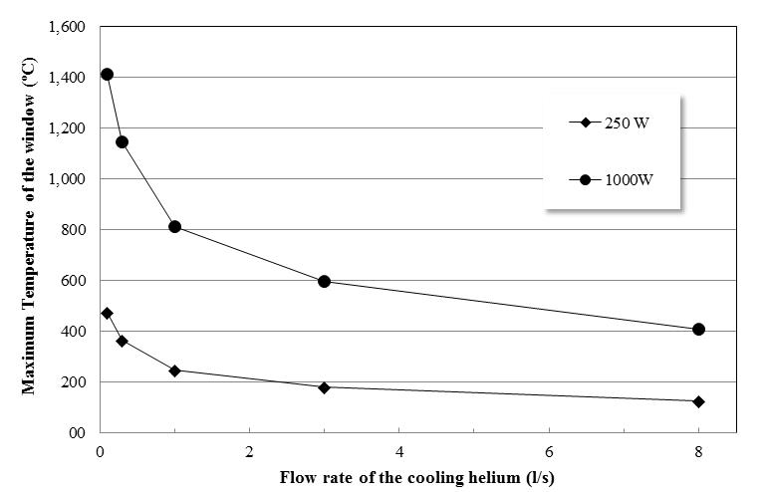
Simulations – Havar (influence of He cooling conditions)

Slide 15
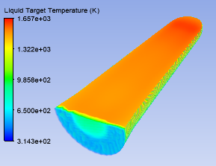
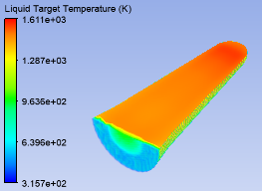
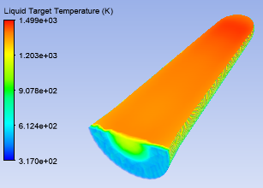
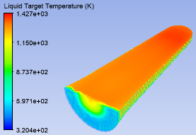
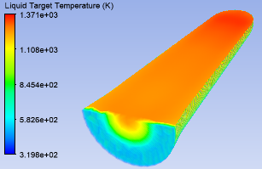
Simulations – niobium windows (several thicknesses)
75 µm Nb
125 µm Nb
250 µm Nb
325 µm Nb
375 µm Nb

Slide 16
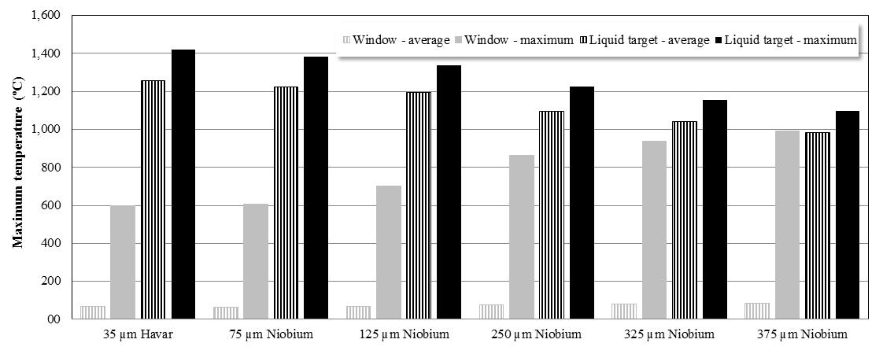
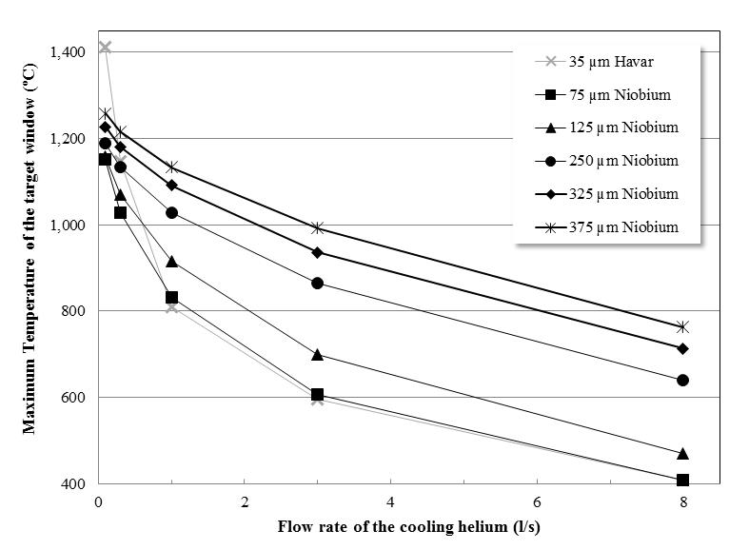
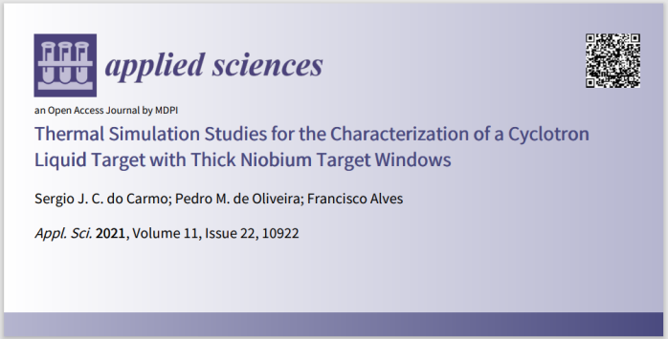
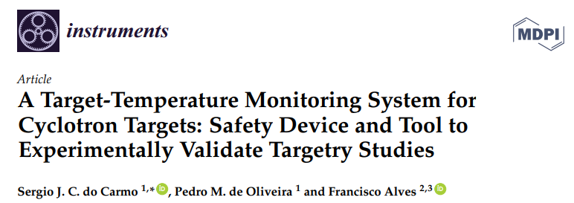

Simulations – niobium windows (several thicknesses)

Slide 17
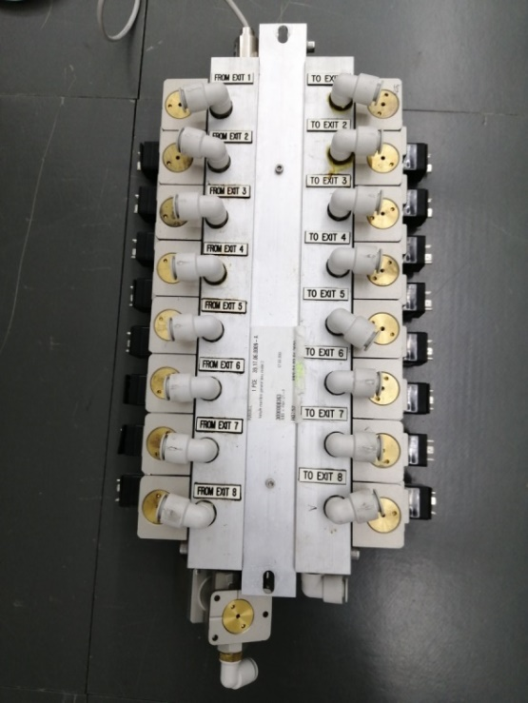
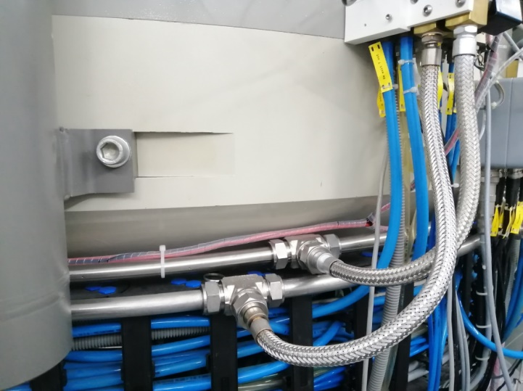

Improvement of the helium cooling system
Taking into account the results of the simulations…..
several modifications in the Helium cooling system were implemented to increase and maintain improved helium fluxes
Average Helium fluxes on target
from 0.38 to 1.53 l/s

Slide 18
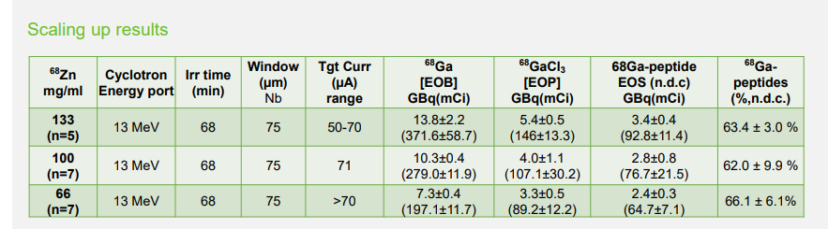
Ultimate improvements: ⁶⁸Ga example
Initially, for R&D for the production of Ga68 in liquid targets
Nowadays, the same target is irradiated everyday at up to 70 µA
or even up to 90 µA @ 13 MeV with the new IBA Kiube VE
F. Alves, “Cyclotron production of Ga-68 for human use from liquid targets: From theory to practice”, AIP Conference Proceedings 1845, 020001 (2017)
C. Gameiro et al. “Securing Gallium-68 availability with liquid target production on mid-energy cyclotrons: Users' experience and scaling up”, EANM 2021 Poster #612

Slide 19
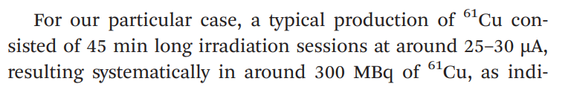
Ultimate improvements: ⁶¹Cu example
S.J.C. do Carmo et al., “Fast and cost-effective cyclotron production of ⁶¹Cu using a ^{nat}Zn liquid target: An opportunity for radiopharmaceutical production and R&D”, Dalton Transactions 46(42), (2017)
S.J.C. do Carmo et al., “The production of radiometals in liquid targets”, EJNMMI Radiopharmacy and Chemistry 5(1), (2020)

Slide 20
Conclusions
Simulation platform developed
Validation by complementary experiment
Study of the influence of several parameters (e.g. temperature and fluxes of the coolants)
Simulations confirmed the vital importance of Helium cooling
Helium cooling even more relevant when using thick and/or niobium target foils
Useful tool that potentiated decision making to intervene on the Helium cooling system:
Constant fluxes over time
Massive reduction of Helium consumption $$$
More reliable
Larger current targets
Larger activities produced

Slide 21
THANK YOU

