Slide 1
Electroplating and recycling chromium targets for ⁵²Mn production
Margarita Chernysheva, Kendall Barrett, Todd Barnhart, Jonathan Engle

Slide 2
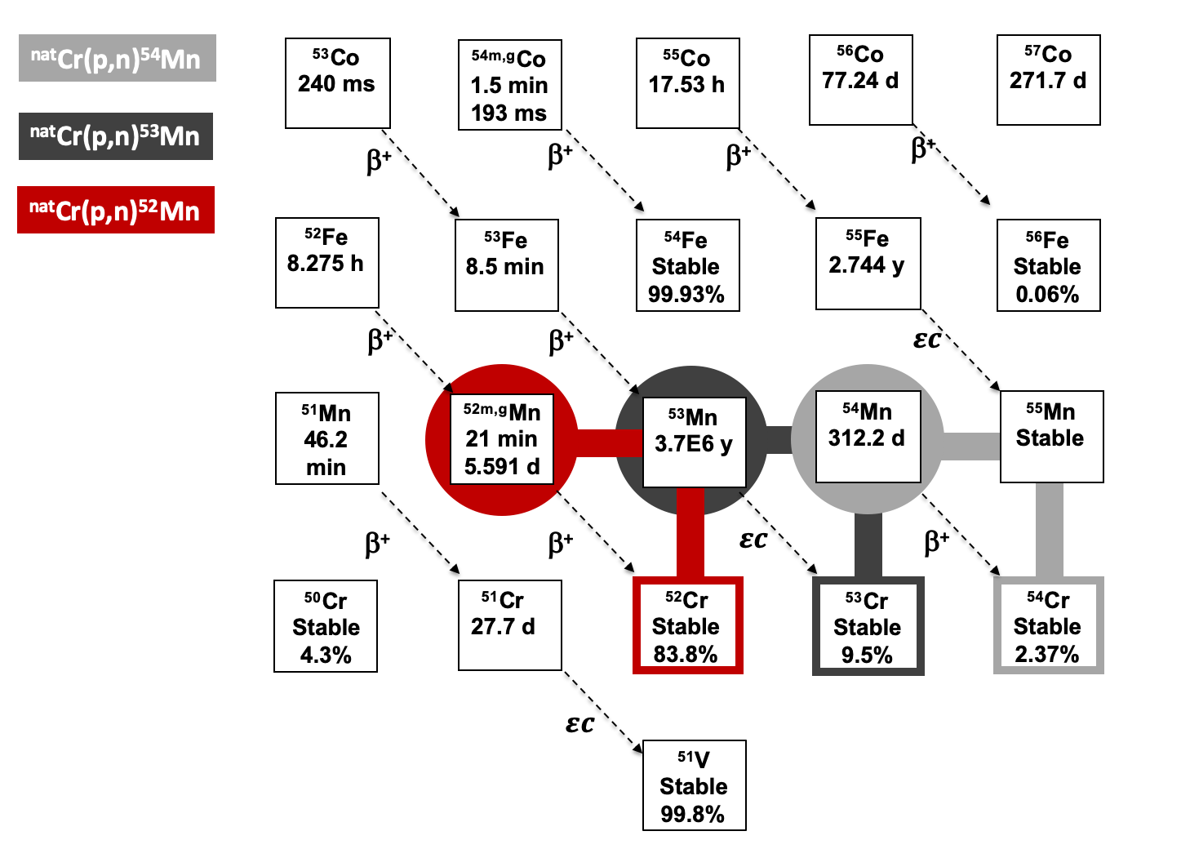
Production of ^{52g}Mn from ^{nat}Cr targets
2

Slide 3
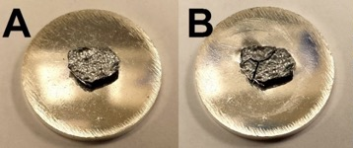
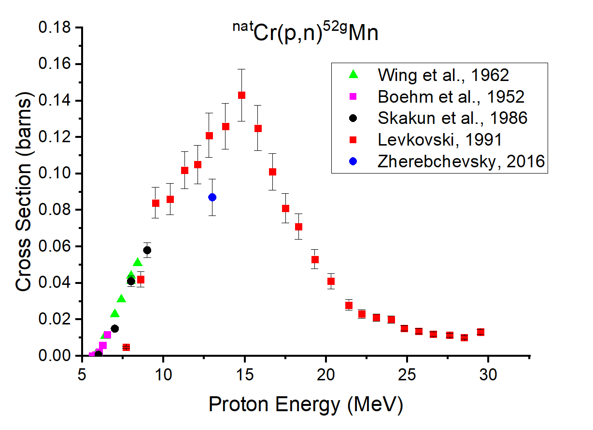
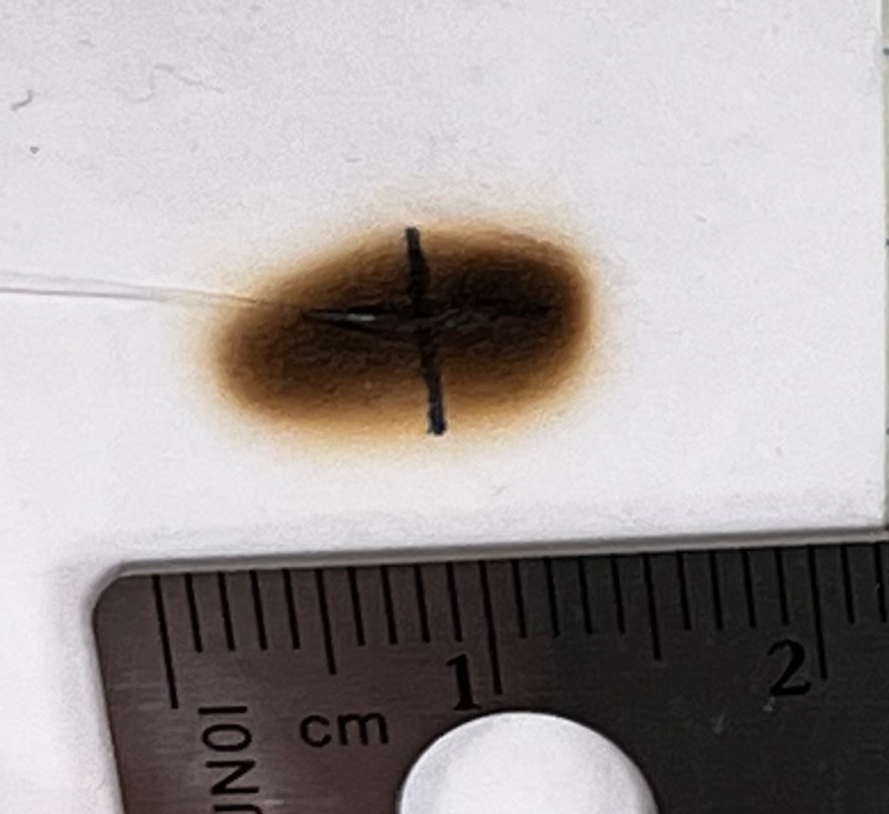
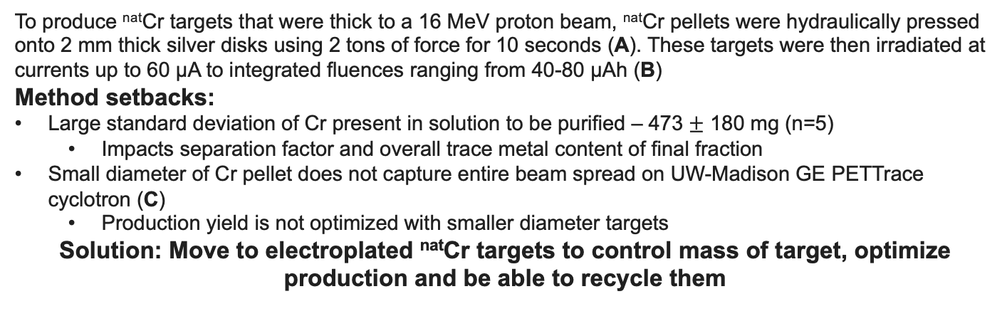
Previously used hydraulically pressed ^{nat}Cr targets at UW-Madison
C
To produce ^{nat}Cr targets that were thick to a 16 MeV proton beam, ^{nat}Cr pellets were hydraulically pressed onto 2 mm thick silver disks using 2 tons of force for 10 seconds (A). These targets were then irradiated at currents up to 60 µA to integrated fluences ranging from 40-80 µAh (B)
Method setbacks:
Large standard deviation of Cr present in solution to be purified – 473 $±$ 180 mg (n=5)
  Impacts separation factor and overall trace metal content of final fraction
Small diameter of Cr pellet does not capture entire beam spread on UW-Madison GE PETTrace cyclotron (C)
  Production yield is not optimized with smaller diameter targets
Solution: Move to electroplated ^{nat}Cr targets to control mass of target, optimize production and be able to recycle them
3
Graves, S. A (2017) Doctoral Thesis for University of Wisconsin- Madison

Slide 4
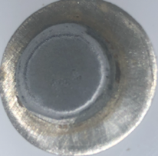
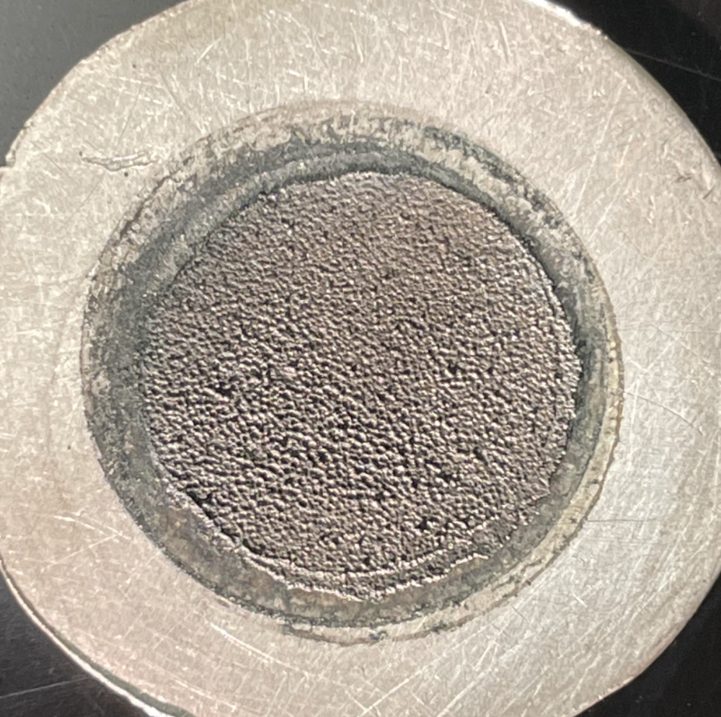
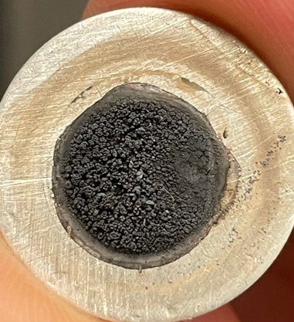
^{nat}Cr electrodeposition from electrolyte based on oxidation state:
Hexavalent Chromium Cr(VI) | Trivalent Chromium Cr(III)
Electrodeposits in thick layer | Possible to recycle
Control over target mass | Non-toxic
Good adhesion to target backing | Limited mass can be electroplated – but targets produced are thick to 12 MeV
Difficult to recycle | Degassing observed during irradiate due to adhesion difficulties
Toxic | Mix of Cr and Cr₂O₃ after dissolution of target
CrO₃ + H₂SO₄
CrCl₃ + ChCl
CrCl₃ + HCOOH
+ H₂SO₄
4

Slide 5
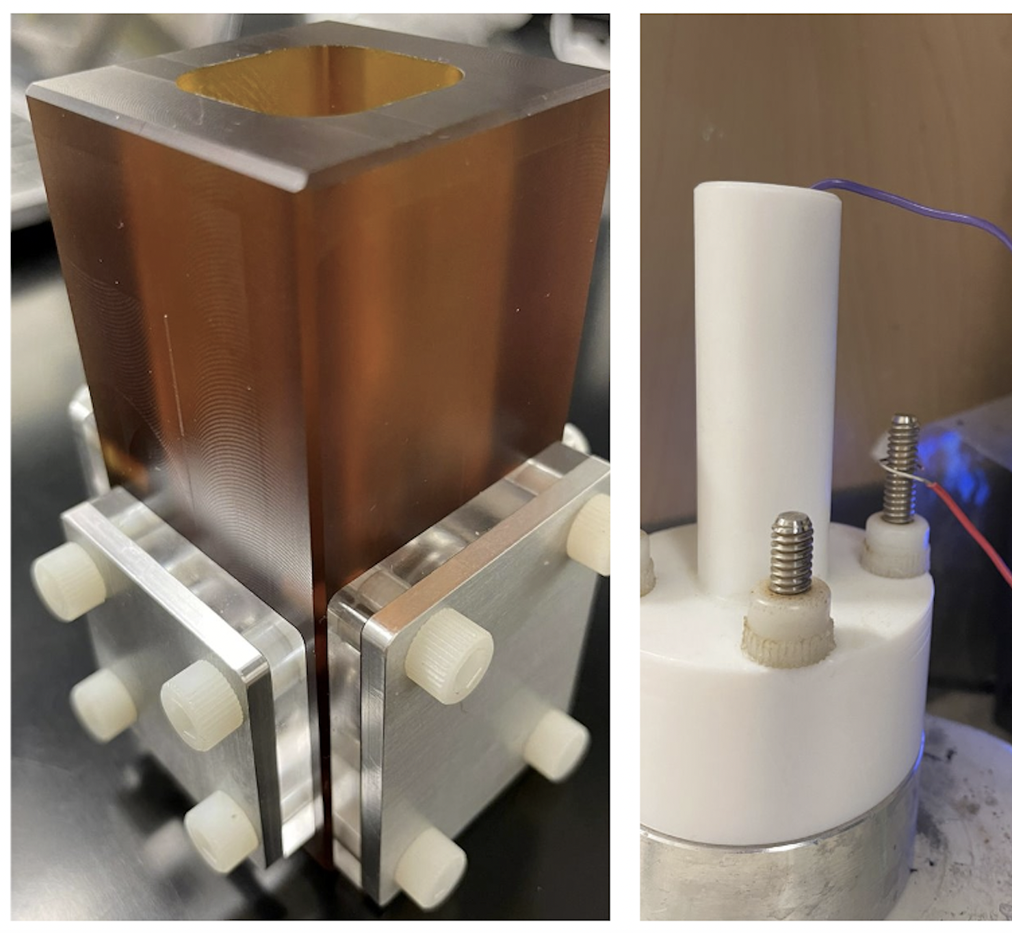
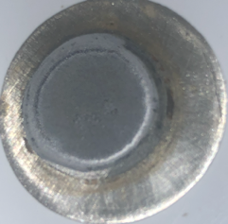
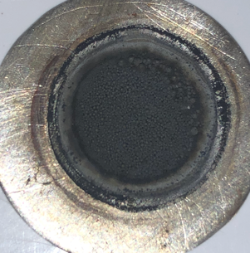
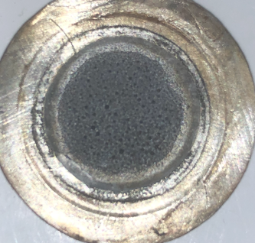
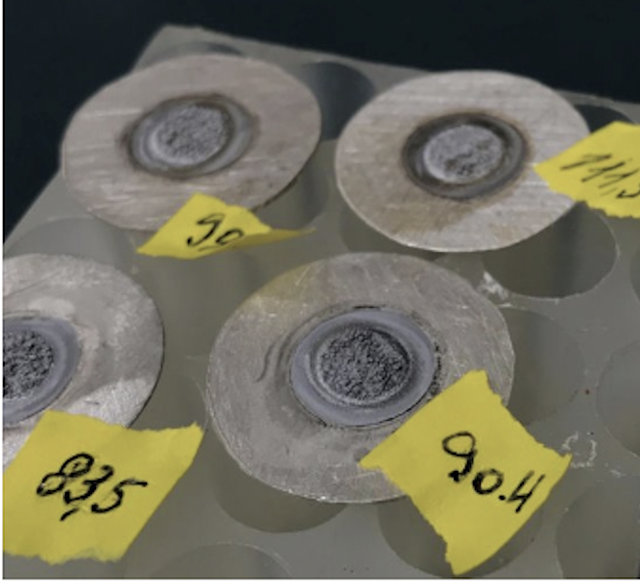
Targets from Cr(VI) electrolyte
CrO₃ + H₂SO₄ = 100:1
m_{Cr} electrolyte [g] | m_{Cr} plated [mg] | efficiency [%]
1.77 | 162 | 9.2
1.77 | 262 | 14.8
1.77 | 154 | 8.7
Working electrode: Silver disk
Counter electrode: Pt wire/Ti mesh covered with Pt
Current density: 0.2-0.3 A/cm²
5

Slide 6
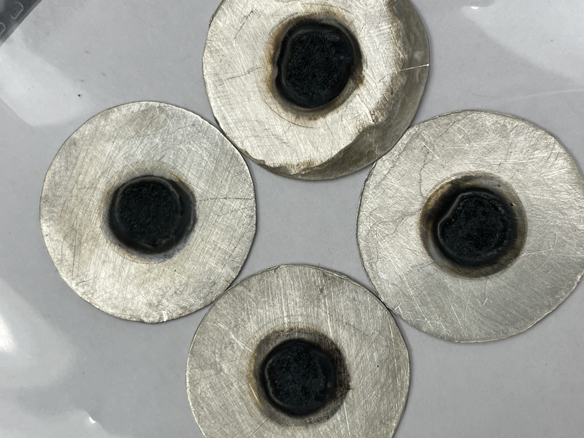
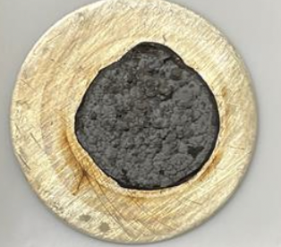
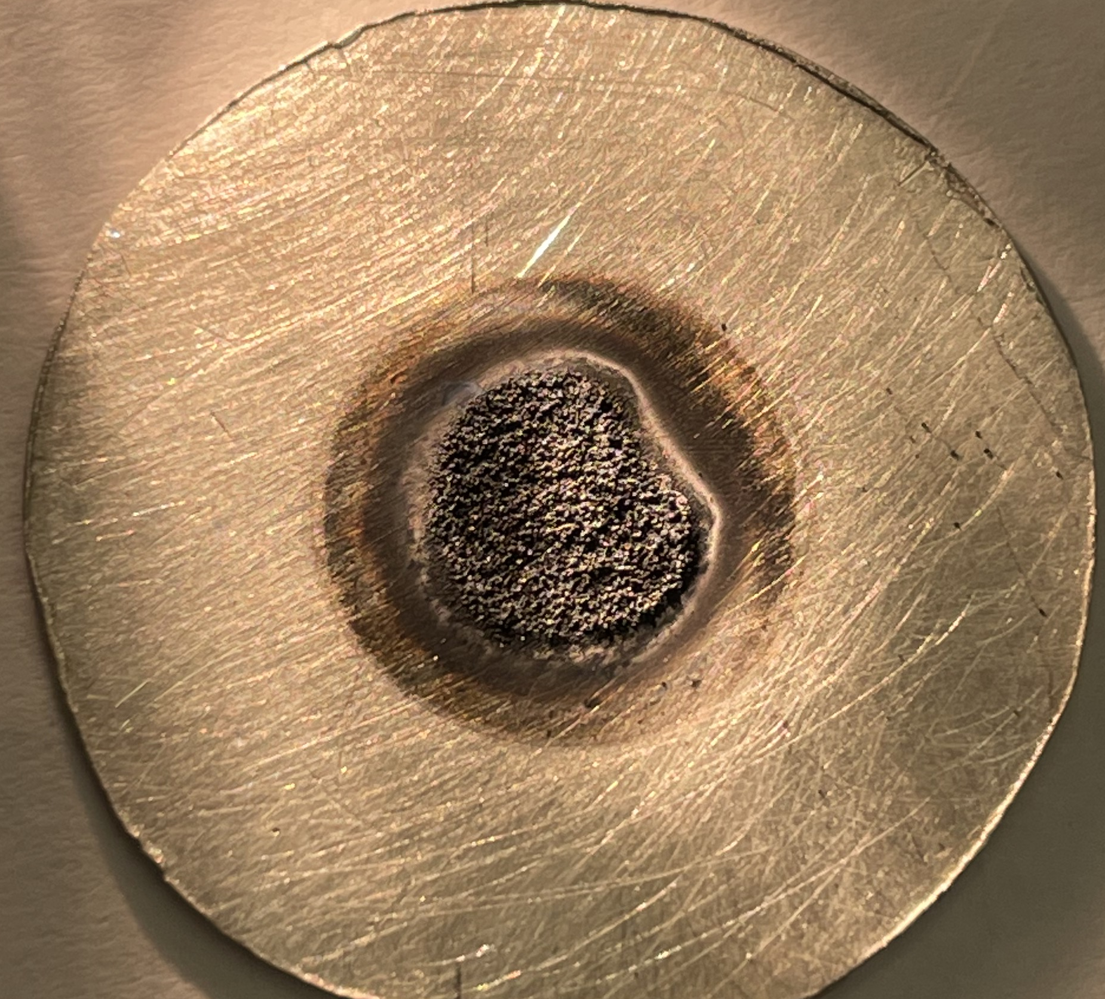
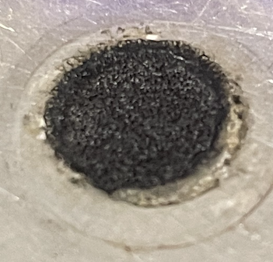
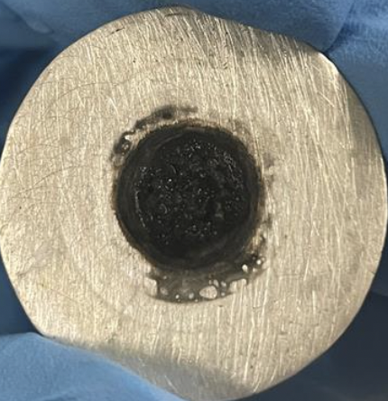
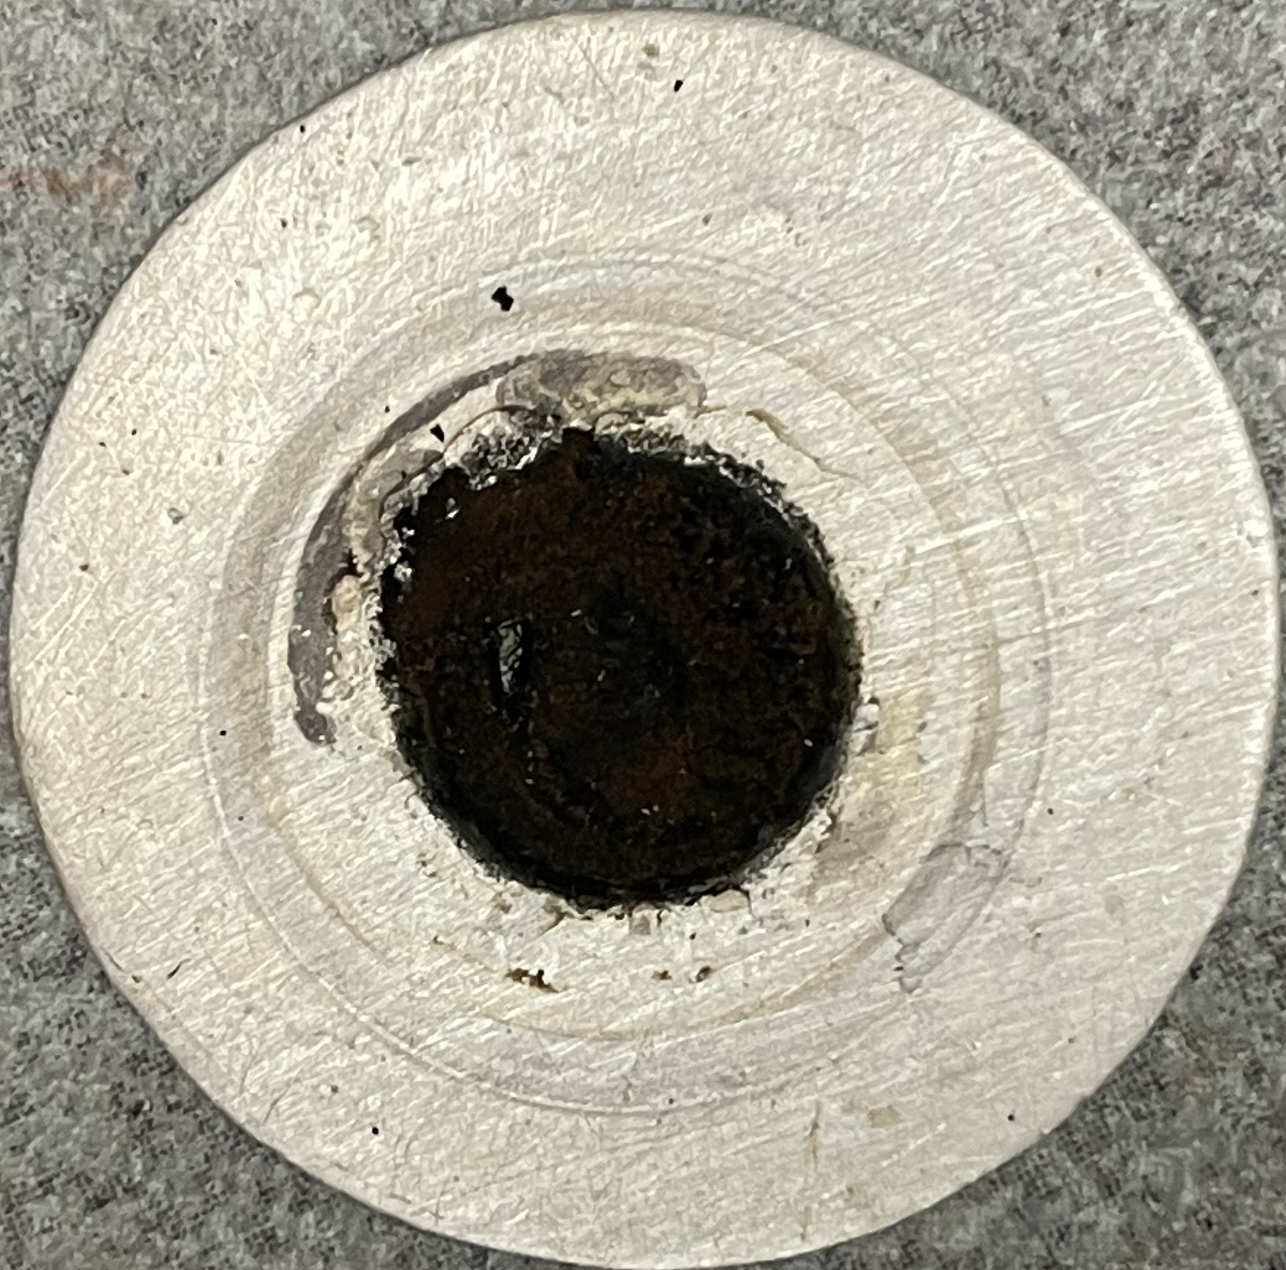
Targets from Cr(III) electrolyte
6HCl {H₂O} + 2Cr → 2CrCl₃ {6H₂O} + 3H₂
Component | Concentration [mg/mL]
Cr metal powder | 0.75-0.85
HCl | 0.4
HCOOH | 40
H₂SO₄ | 2
current density 0.23 A/cm²
Masses and efficiencies of electroplated recycled targets
 | N=1 | N=2 | N=3 | N=4 | N=5 | N=6 | N=7
m_{(added Cr to electrolyte)} [mg] |  | 16.4 | 20.5 | 31.4 | 27.1 | 17.1 | 43.9
m_{(Сr in electrolyte)} [mg] | 84.1 | 82.8 | 86.8 | 77.5 | 83.5 | 80.0 | 85.6
m_{(Сr on substrate)} [mg] | 66.4 | 66.3 | 46.1 | 56.4 | 62.9 | 41.7 | 66.8
Efficiency [%] | 78.9 | 80.0 | 53.1 | 72.8 | 75.3 | 52.1 | 78.0
6

Slide 7
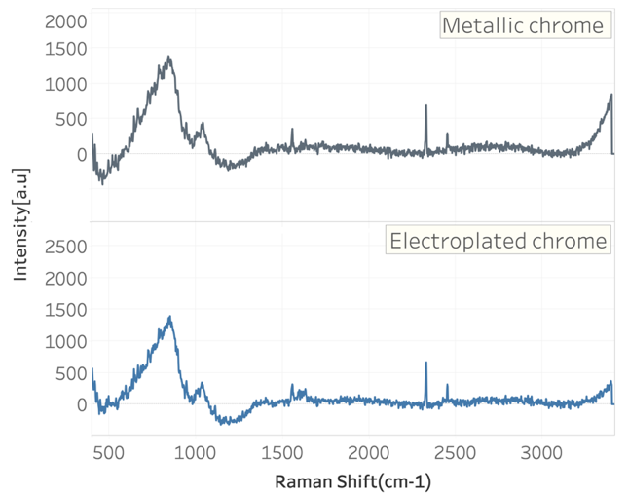
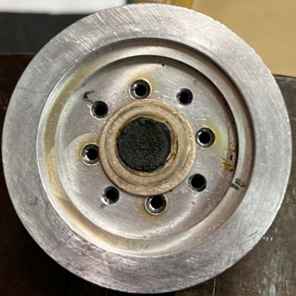
^{nat}Cr targets from Cr(III) electrolyte
^{nat}Cr electroplated target before (up) and after (down) irradiation
Raman spectroscopy of the Cr targets
7

Slide 8
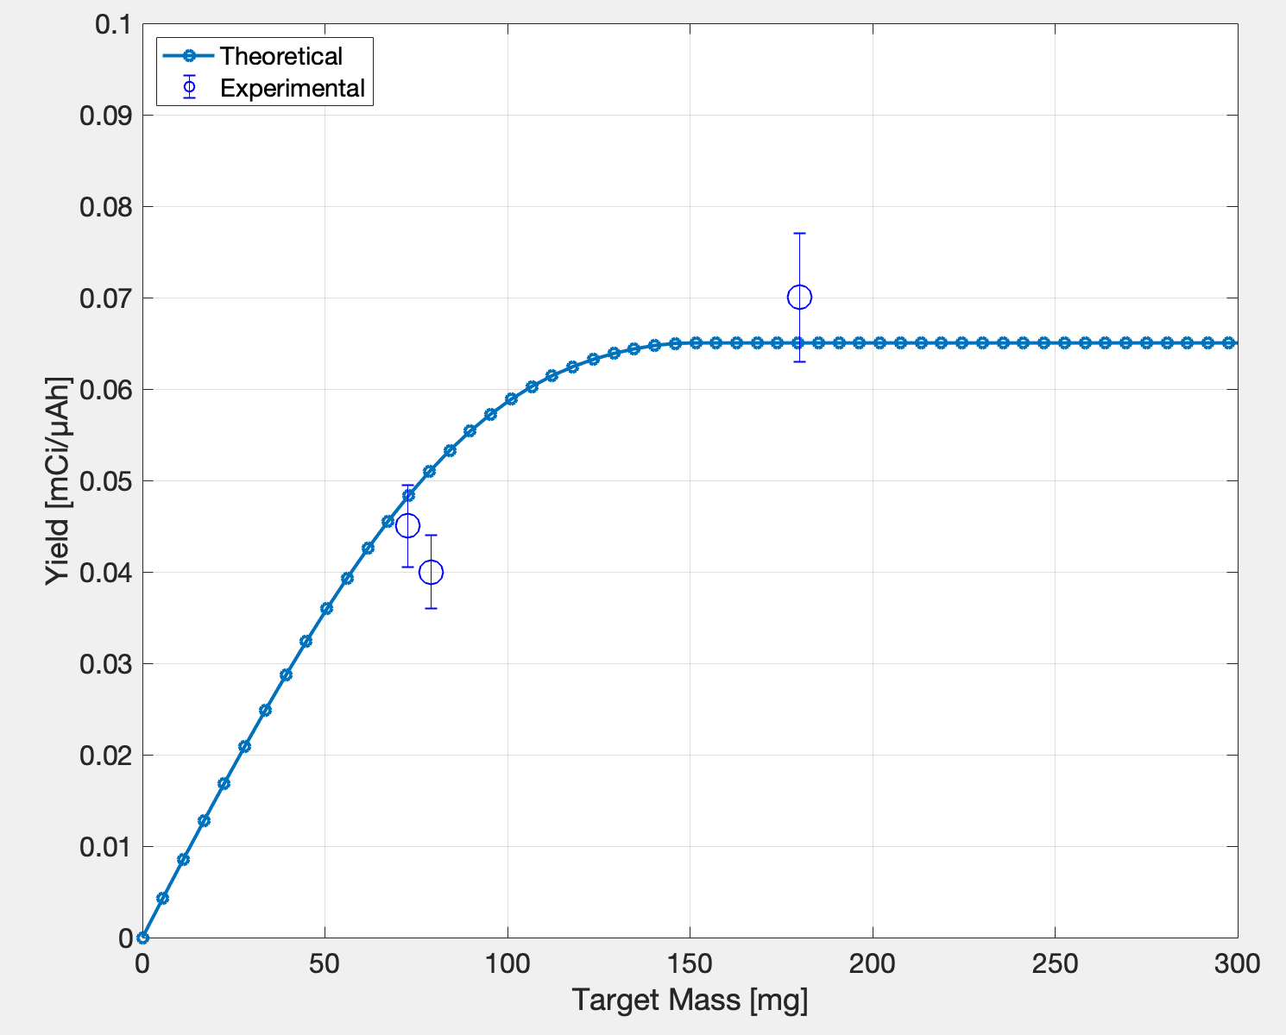
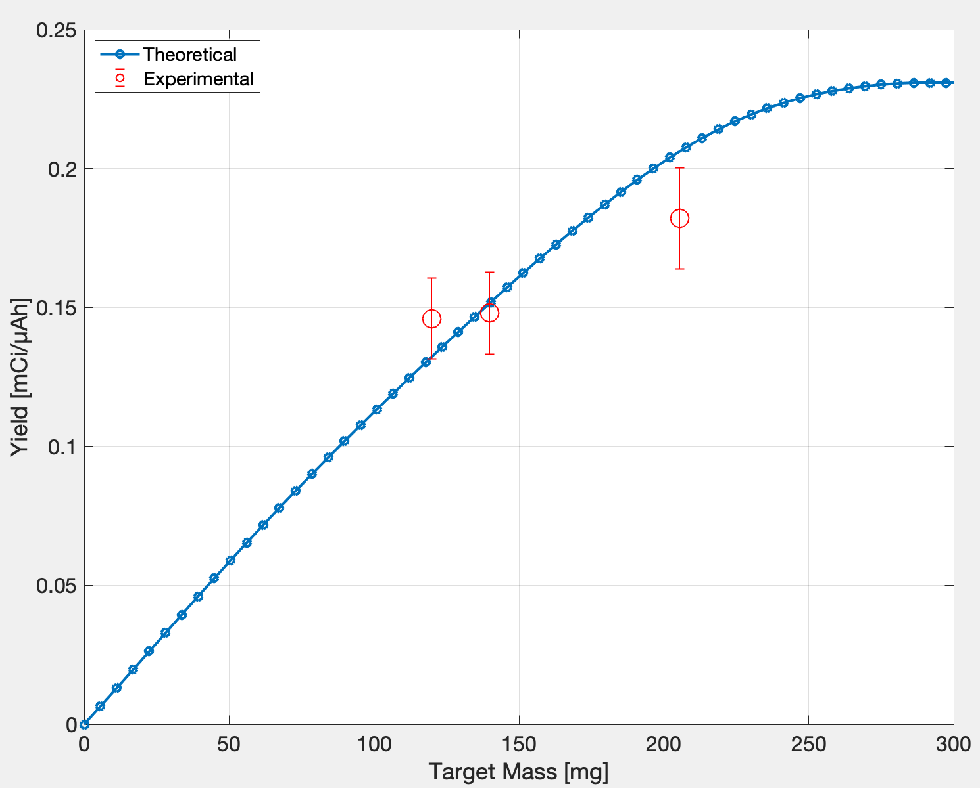

Production yield using electroplated ^{nat}Cr targets
^{nat}Cr³⁺ Targets irradiated at 12 MeV
^{nat}Cr⁶⁺ Targets irradiated at 16 MeV
Mass [mg] | Yield [mCi/µAh] | Integrated Current [µAh]
79 | 0.04 | 23
72.7 | 0.05 | 30
180 | 0.07 | 30
Mass [mg] | Yield [mCi/µAh] | Integrated Current [µAh]
205.5 | 0.18 | 73
120 | 0.15 | 80
140 | 0.15 | 84.7
*Assuming $±$ 10% error for yield
8
D. Thor, J. Siikanen (2022) Matlab Theoretical Yield Tool – Beta Version, Karolinska University

Slide 9
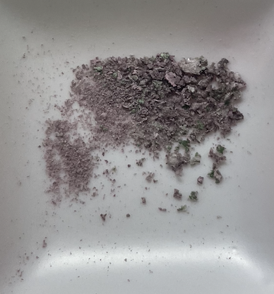
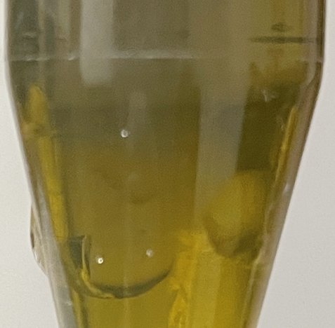
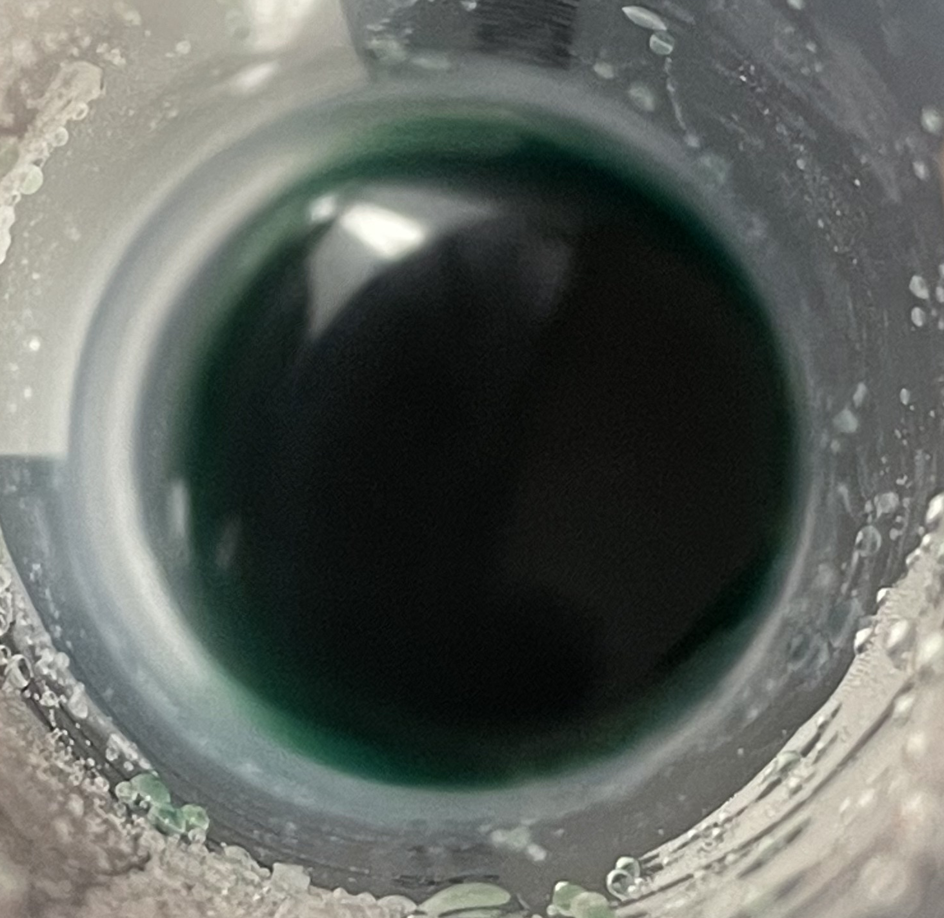
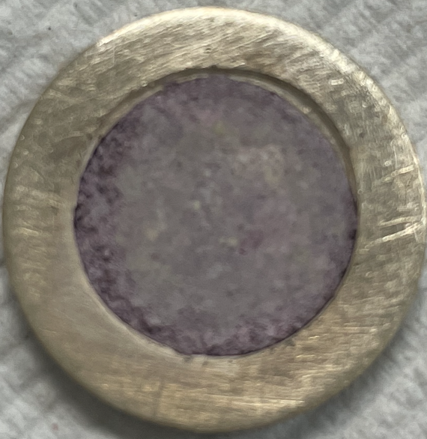
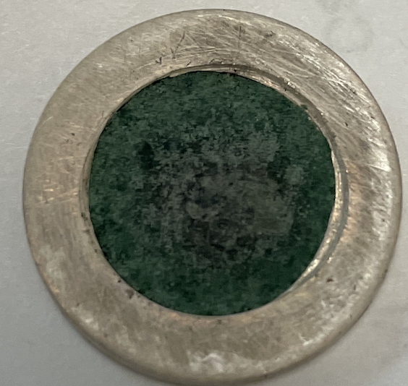
What can be done with the rest of electrolyte?
Cr₂O₇²⁻
H₂O₂
drying
HCl
20.0%
CrCl₃
CrCl₃ targets
100%
1 week later
80.0%
9

Slide 10
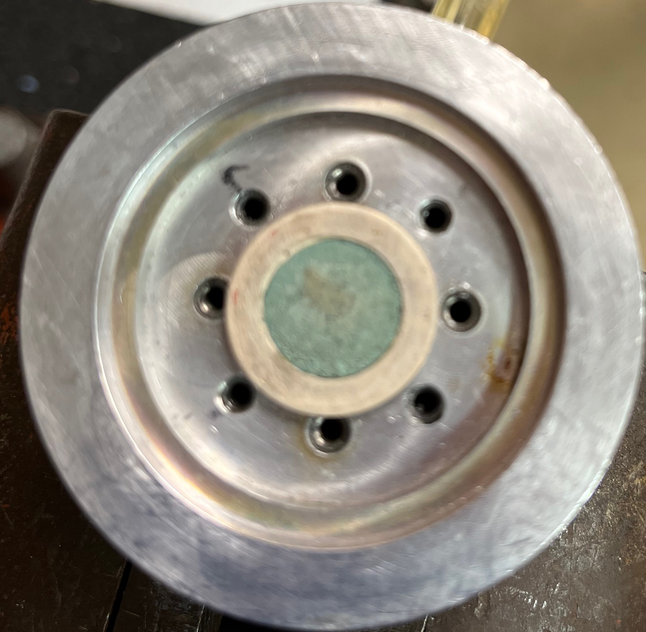
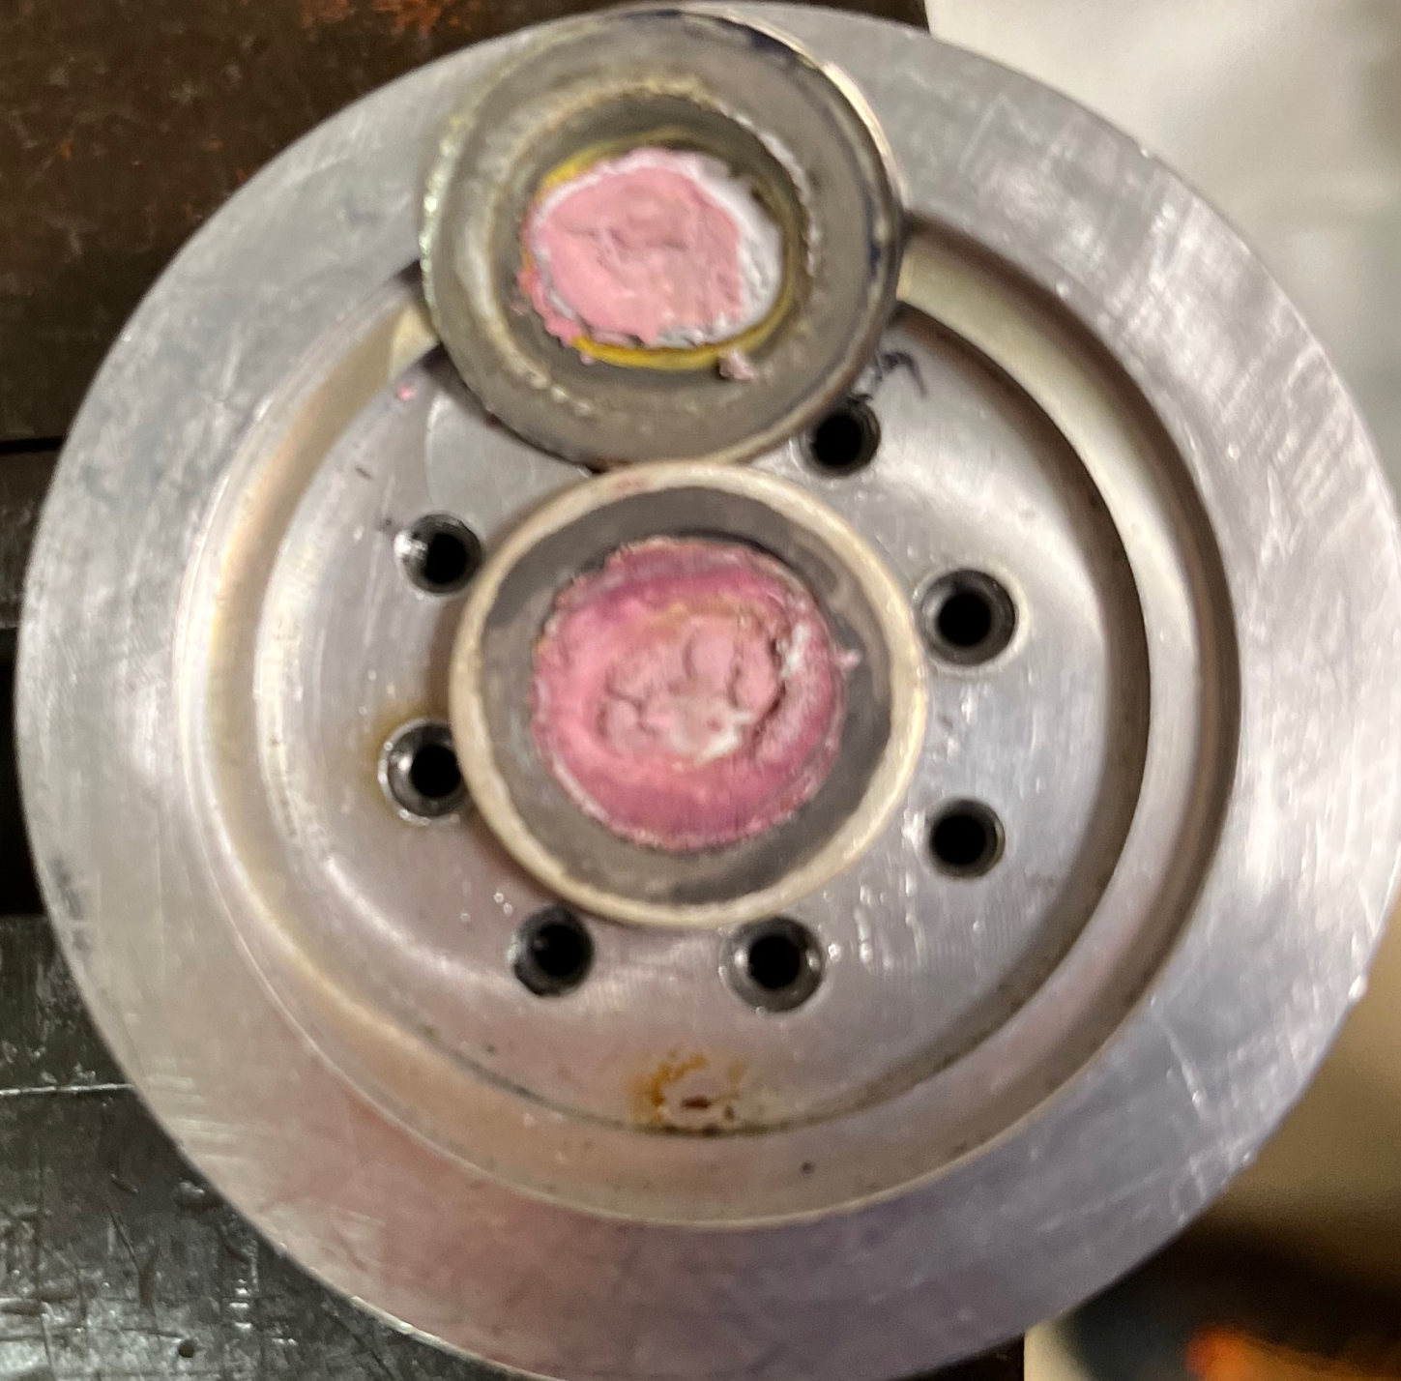
CrCl₃ irradiation
158.36 mg CrCl₃ x 6H₂O​
Density: 1.76 g/cc​
Degrader: 10 µm Nb foil​
Energy: ˜12 MeV​
Integrated current: 6.7 µAh​
61 µCi on target​
471 µCi on Nb foil​
Yield ˜0.01 mCi/µAh​
10

Slide 11
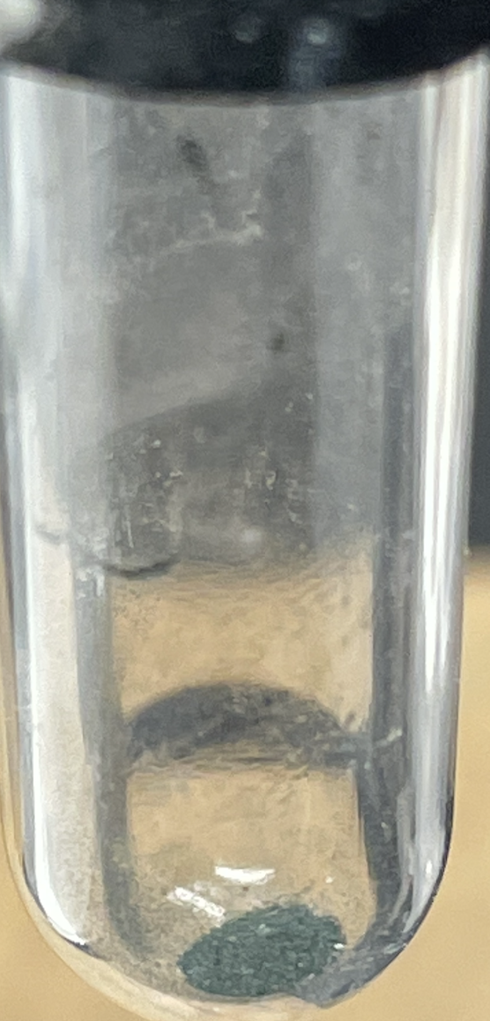
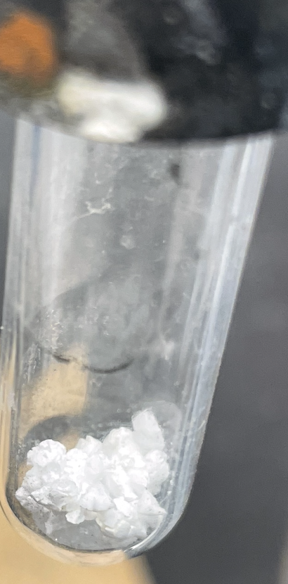
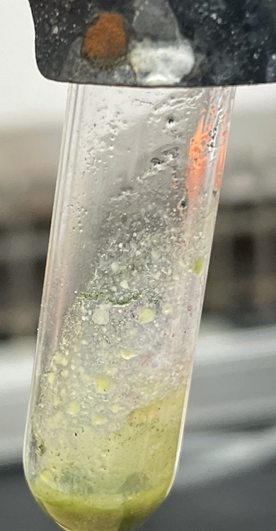
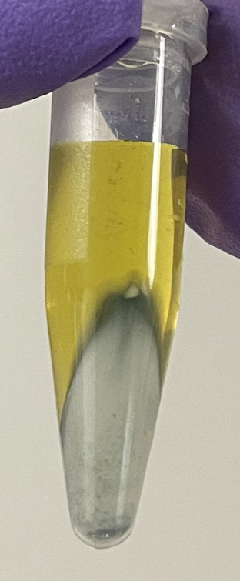

^{nat}Cr recycling from dissolved electroplated target and reduced electrolyte
 | Initial | 1st loop | 2d loop | 3d loop
m _{(plated Cr)}, mg | 104.1 | 110.3 | 45.0 | 13.7
Efficiency, % | 71.0 | 75.3 | 30.7 | 9.4
Na₂O₂
NaOH
centrifugation
torch
11

Slide 12
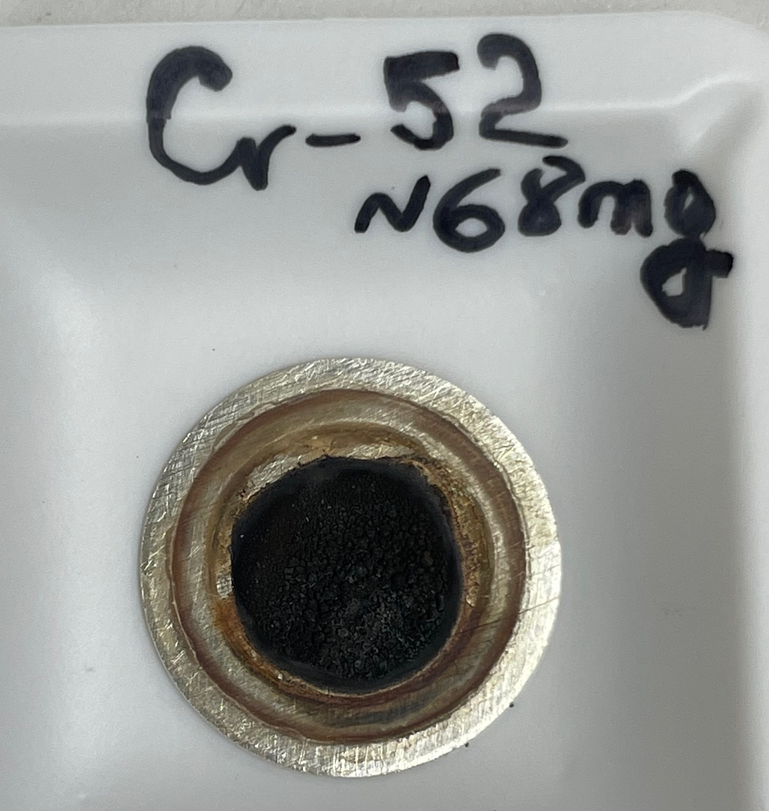
Conclusions and future studies
We successfully electroplated enriched ⁵²Cr
  65 mg irradiated at 12 MeV for 30 µAh
  Yield: 0.052 mCi/µAh
Presented results indicate that the production of targets from electroplated ^{nat}Cr gives multiple opportunities to recycle enriched ⁵²Cr to produce pure ^{52g}Mn
Investigation of opportunities to decrease Cr₂O₃ formation
Try to plate thicker targets with better adhesion from Cr(III) electrolyte
12

Slide 13
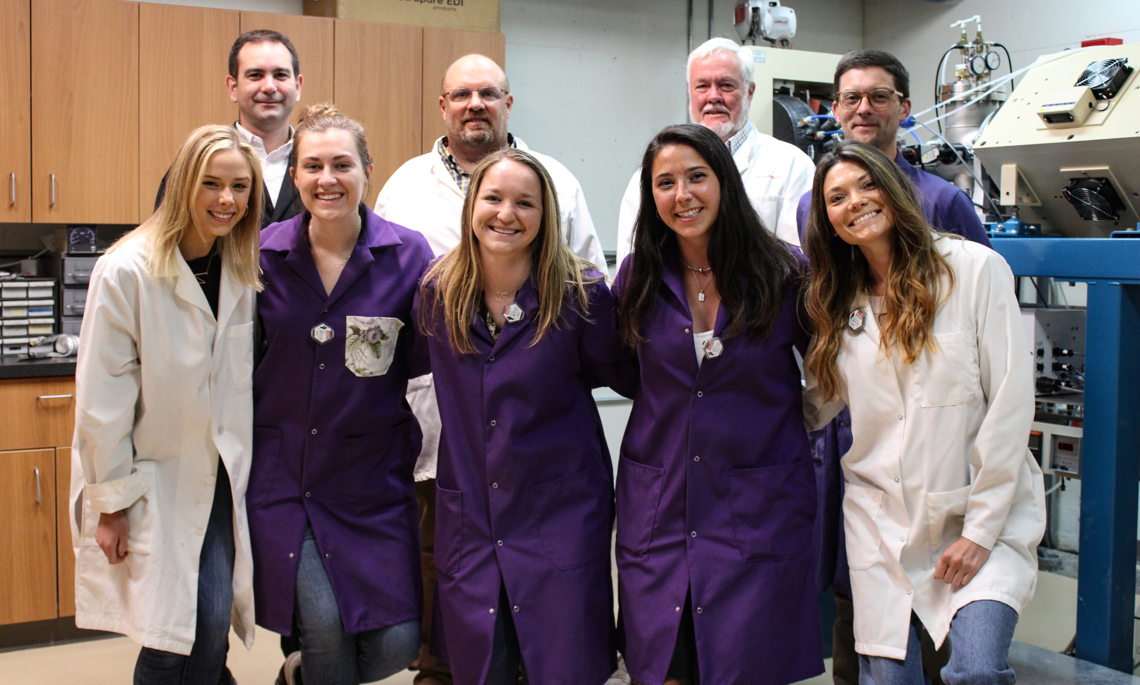


Acknowledgement
Prof. Dr. Jonathan Engle
Prof. Dr. Robert Nickles
Prof. Dr. Paul Ellison
Dr. Todd Barnhart
Dr. Eduardo Aluicio-Sarduy
Aeli Olson
Kaelyn Becker
Kendall Barrett
Wilson Lin
Molly DeLuca
Thank you to the DOE Isotope Program, managed by the Office of Science for Isotope R&D and Production for funding support and the WTTC18 travel bursary.

Slide 14
THANK YOU!

