Slide 1
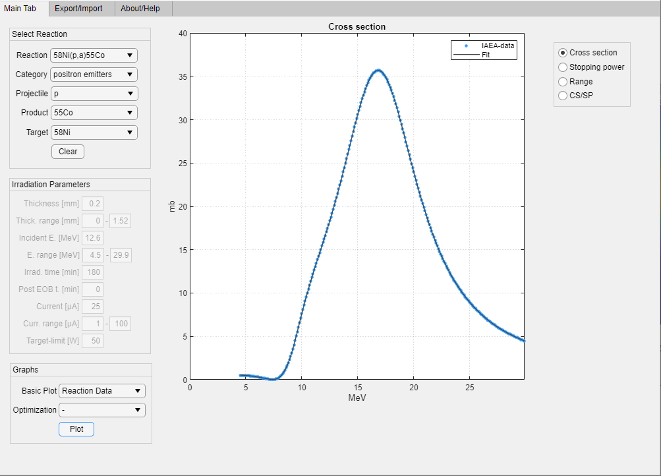
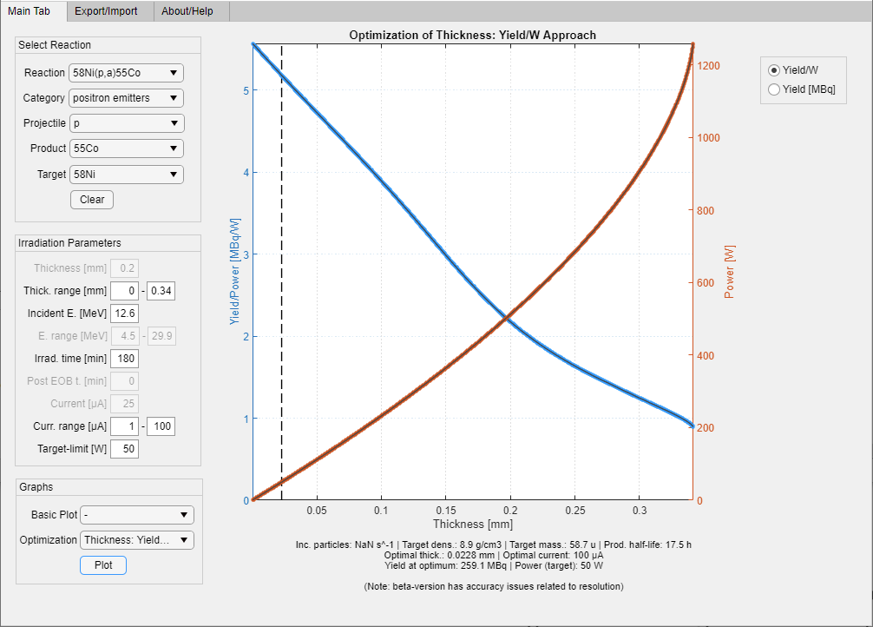
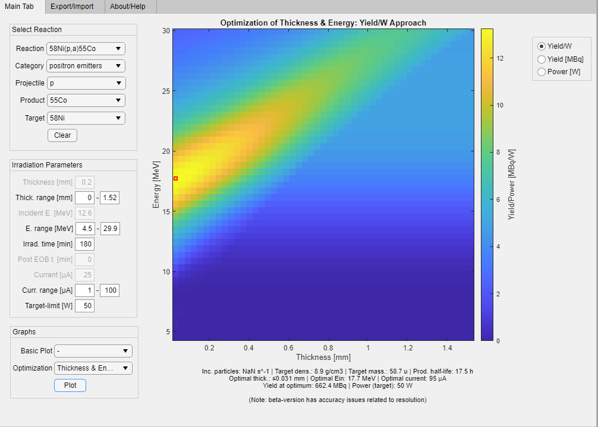

Software For Yield and Target Power Optimization
Daniel Thor^{1,2}, Gavin Poludniowski^{1,3}, Jonathan Siikanen^{1,2}
¹Department of Medical Radiation Physics and Nuclear Medicine, Karolinska University Hospital, Stockholm, Sweden
²Department of Oncology and Pathology, Karolinska Institutet, Stockholm, Sweden
³CLINTEC, Karolinska Institutet, Stockholm, Sweden

Slide 2
Overview
Activation formula and beam power
Software
  Why?
  Main Tabs
  Basic plots
  Optimization plots
Acknowledgements
Availability, improvement and future plans

Slide 3
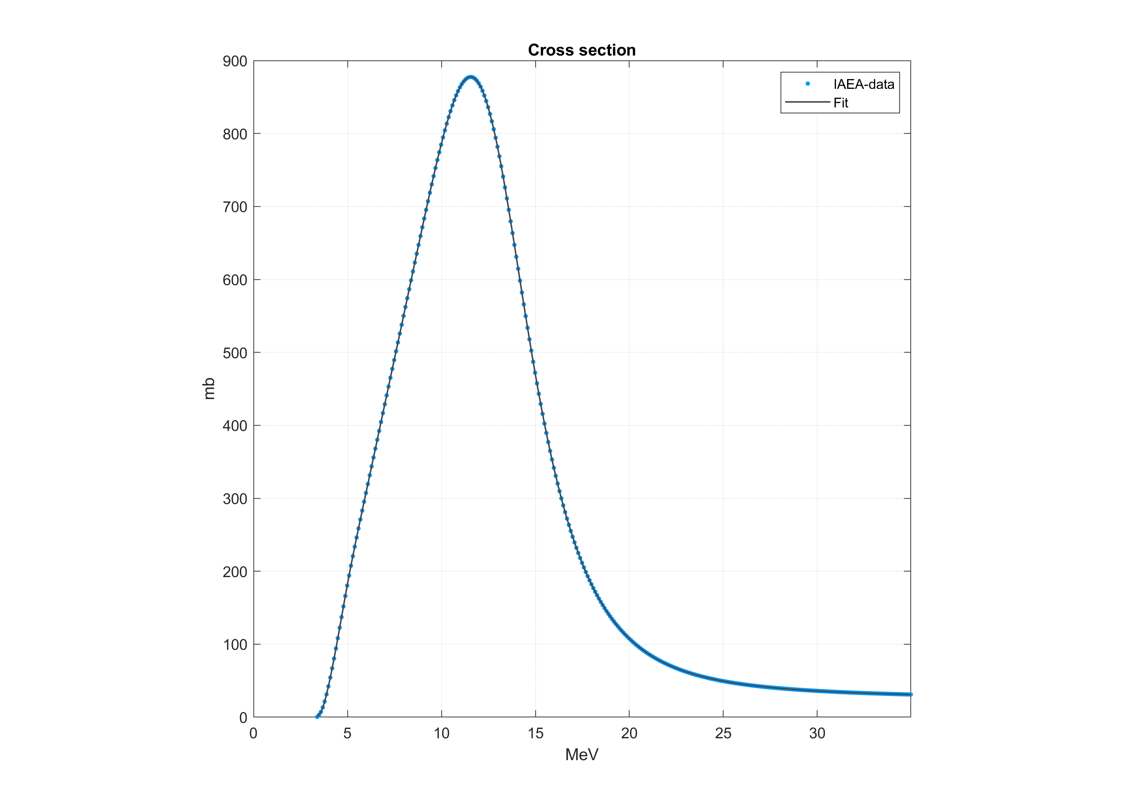
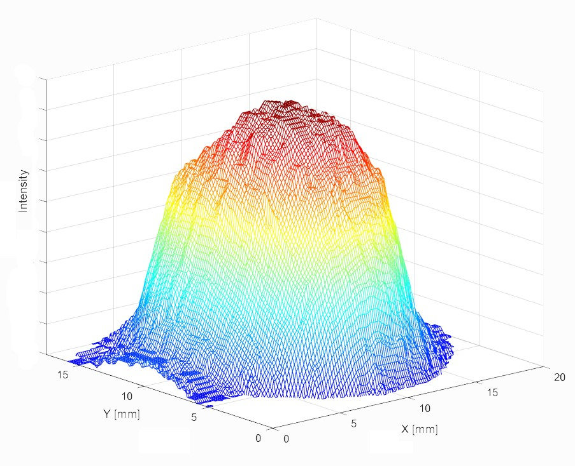
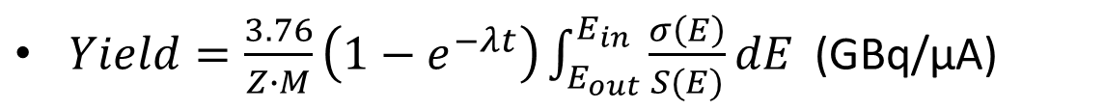
Activation formula and Beam Power
$Yield=\frac{3.76}{Z∙M}\left(1−e^{−λt}\right)\int_{E_{out}}^{E_{in}}{\frac{σ\left(E\right)}{S(E)}dE}$ (GBq/µA)
P=U x I (W)
  Example: 15 MeV x 100 µA= 1500 W
σ(E)
E_{out}
E_{in}
Notes:
as we put more power(energy) into the target the temperature will rise since our cooling is limited
The temp rise depends on beam area…
Q: how do I decide my target limit (in reality) in the units of W? assume a fixed bam size, escalation study, fine the point when you melt you target or do modelling.
A: our model assumes
Från Daniel på mailen efter vårt mote:
Q: Why do you need the uA-lim and W-lim for your method? Why cant you just optimize the Y/W and take the thickness with highest Y/W as optimum?
A: Because for energies at (or below) the CS/SP-peak the Y/W-curve will have it’s peak at 0 thickness and decrease with increasing thickness (since any degradation in energy will move us to lower CS/SP-values; and hence lower Y/W). So the algorithm will answer that 0 thickness (or lowest value in your vector) will be the “optimum”. But this means the yield will be very low, unless you have “infinite” µA. So this naturally raises the question “how much can we increase µA?”. Also, we may need to consider energy deposited both to the target material, but to the system as a whole. Therefor both target limit and total limit needs to be set.

Slide 4
Target and Yield Optimization tool (TYtool)
TYtool provides automated calcs of yield optimum for different:
  target thicknesses, particle energies and currents
Also
Basic plots (Cross Section, Yield vs Time, Proj R, etc.)
Various reactions via import function of CS, SP or default data base
TYtool is coded in Matlab
Notes:
Why did we develop this? It’s a tool for you to optimize your production without destroying your target…..
Fast computer aided calcs of various optimal target thicknesses, particle energies and currents
user input: particle energy, current and power limit of target/holder
Also
Facilitates graphical representation of many basic plots (CS, SP, CS/SP, Yield vs Time, Proj R, etc)
Useful for many particles/reactions/radionuclides via import function of CS, SP
Its for free!

Slide 5
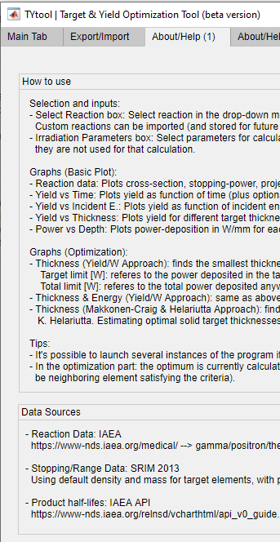
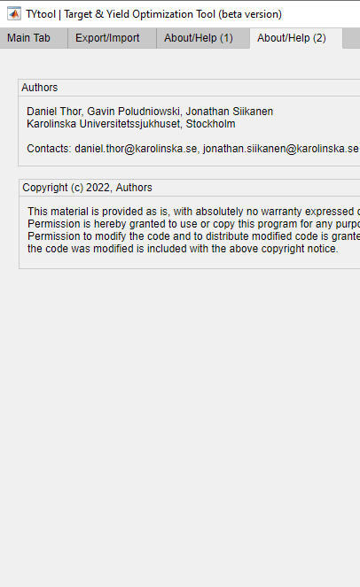
About/Help-tabs
How to use
  Selection and Inputs
  Basic Plots
  Optimization Plots
  Data Sources
    SRIM, IAEA, etc
  Author Information

Slide 6
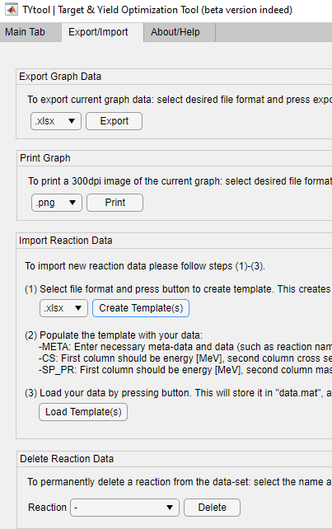
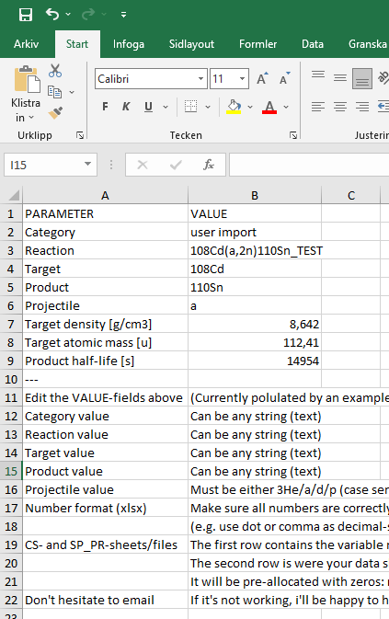
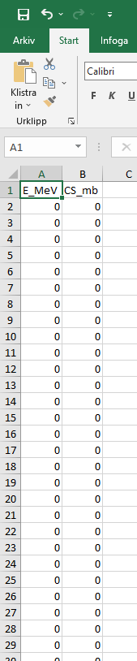
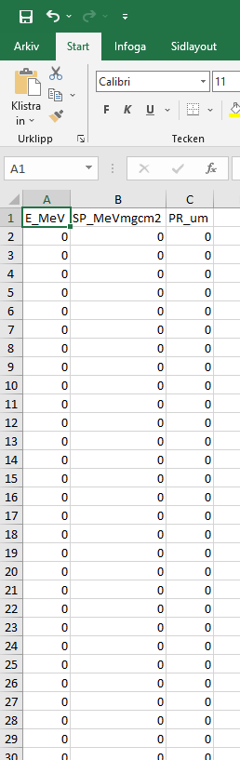
Export/Import-tab
Export Graph Data
Print Graph
Import/Delete Reaction Data
138 CS from IAEA NDS included
Notes:
By using template either in excel or csv formats

Slide 7
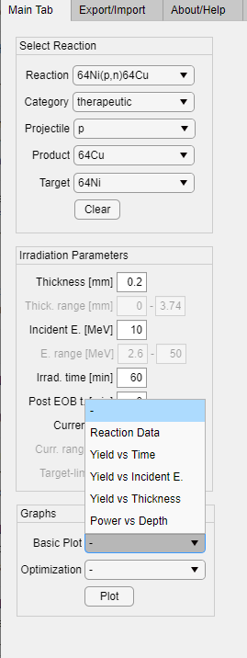
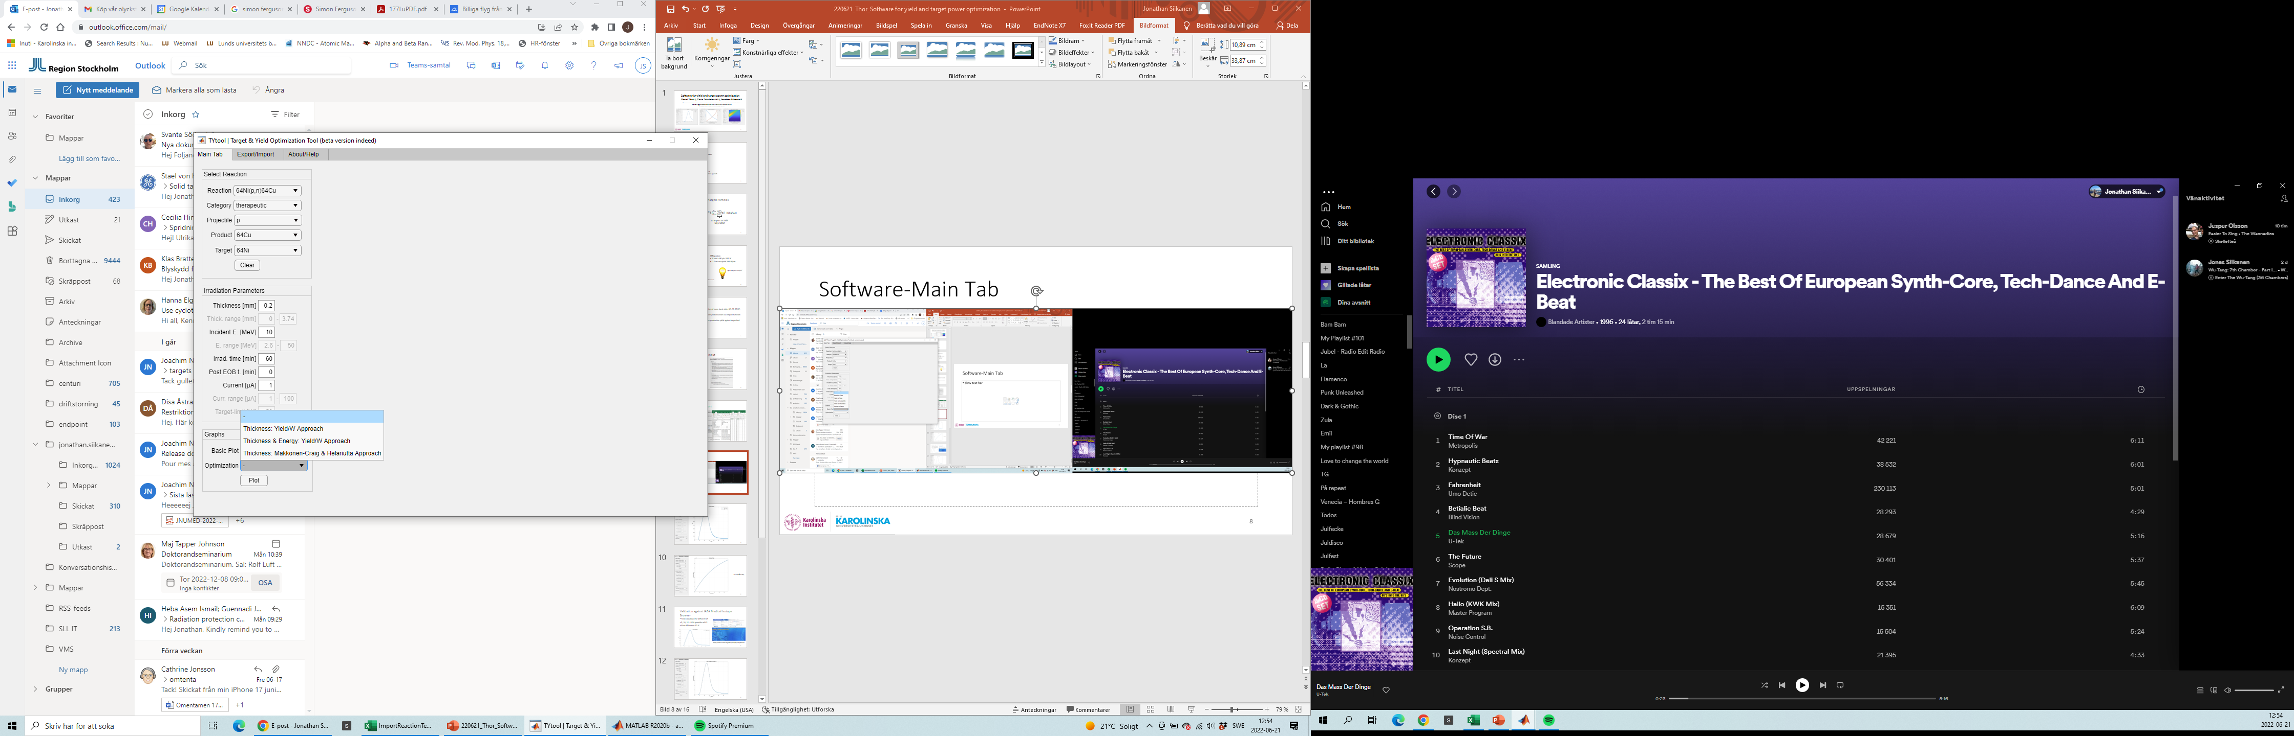
Main-Tab
Basic plots
  Reaction Data
  Yield vs Time
  Yield vs Incident E
  Yield vs Thickness
  Power vs Depth
Optimization plots
  3 different

Slide 8
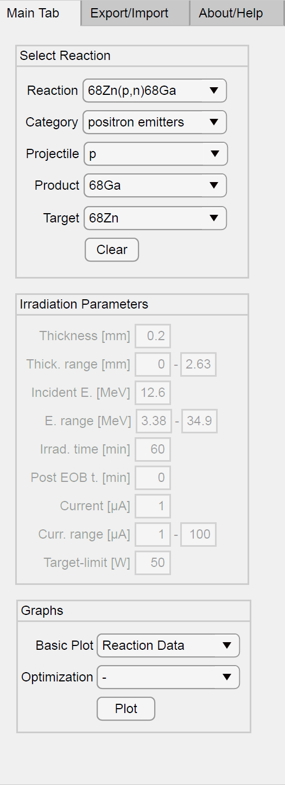
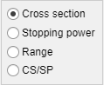
Basic plots

Slide 9
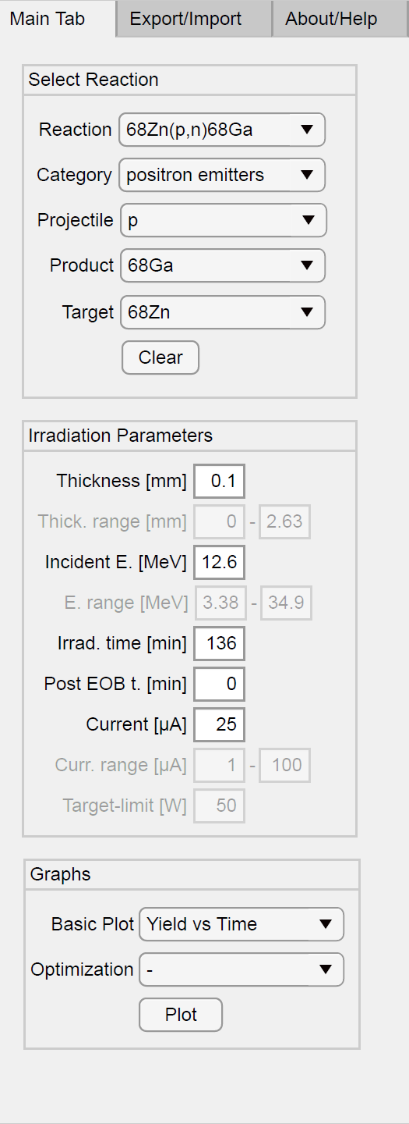
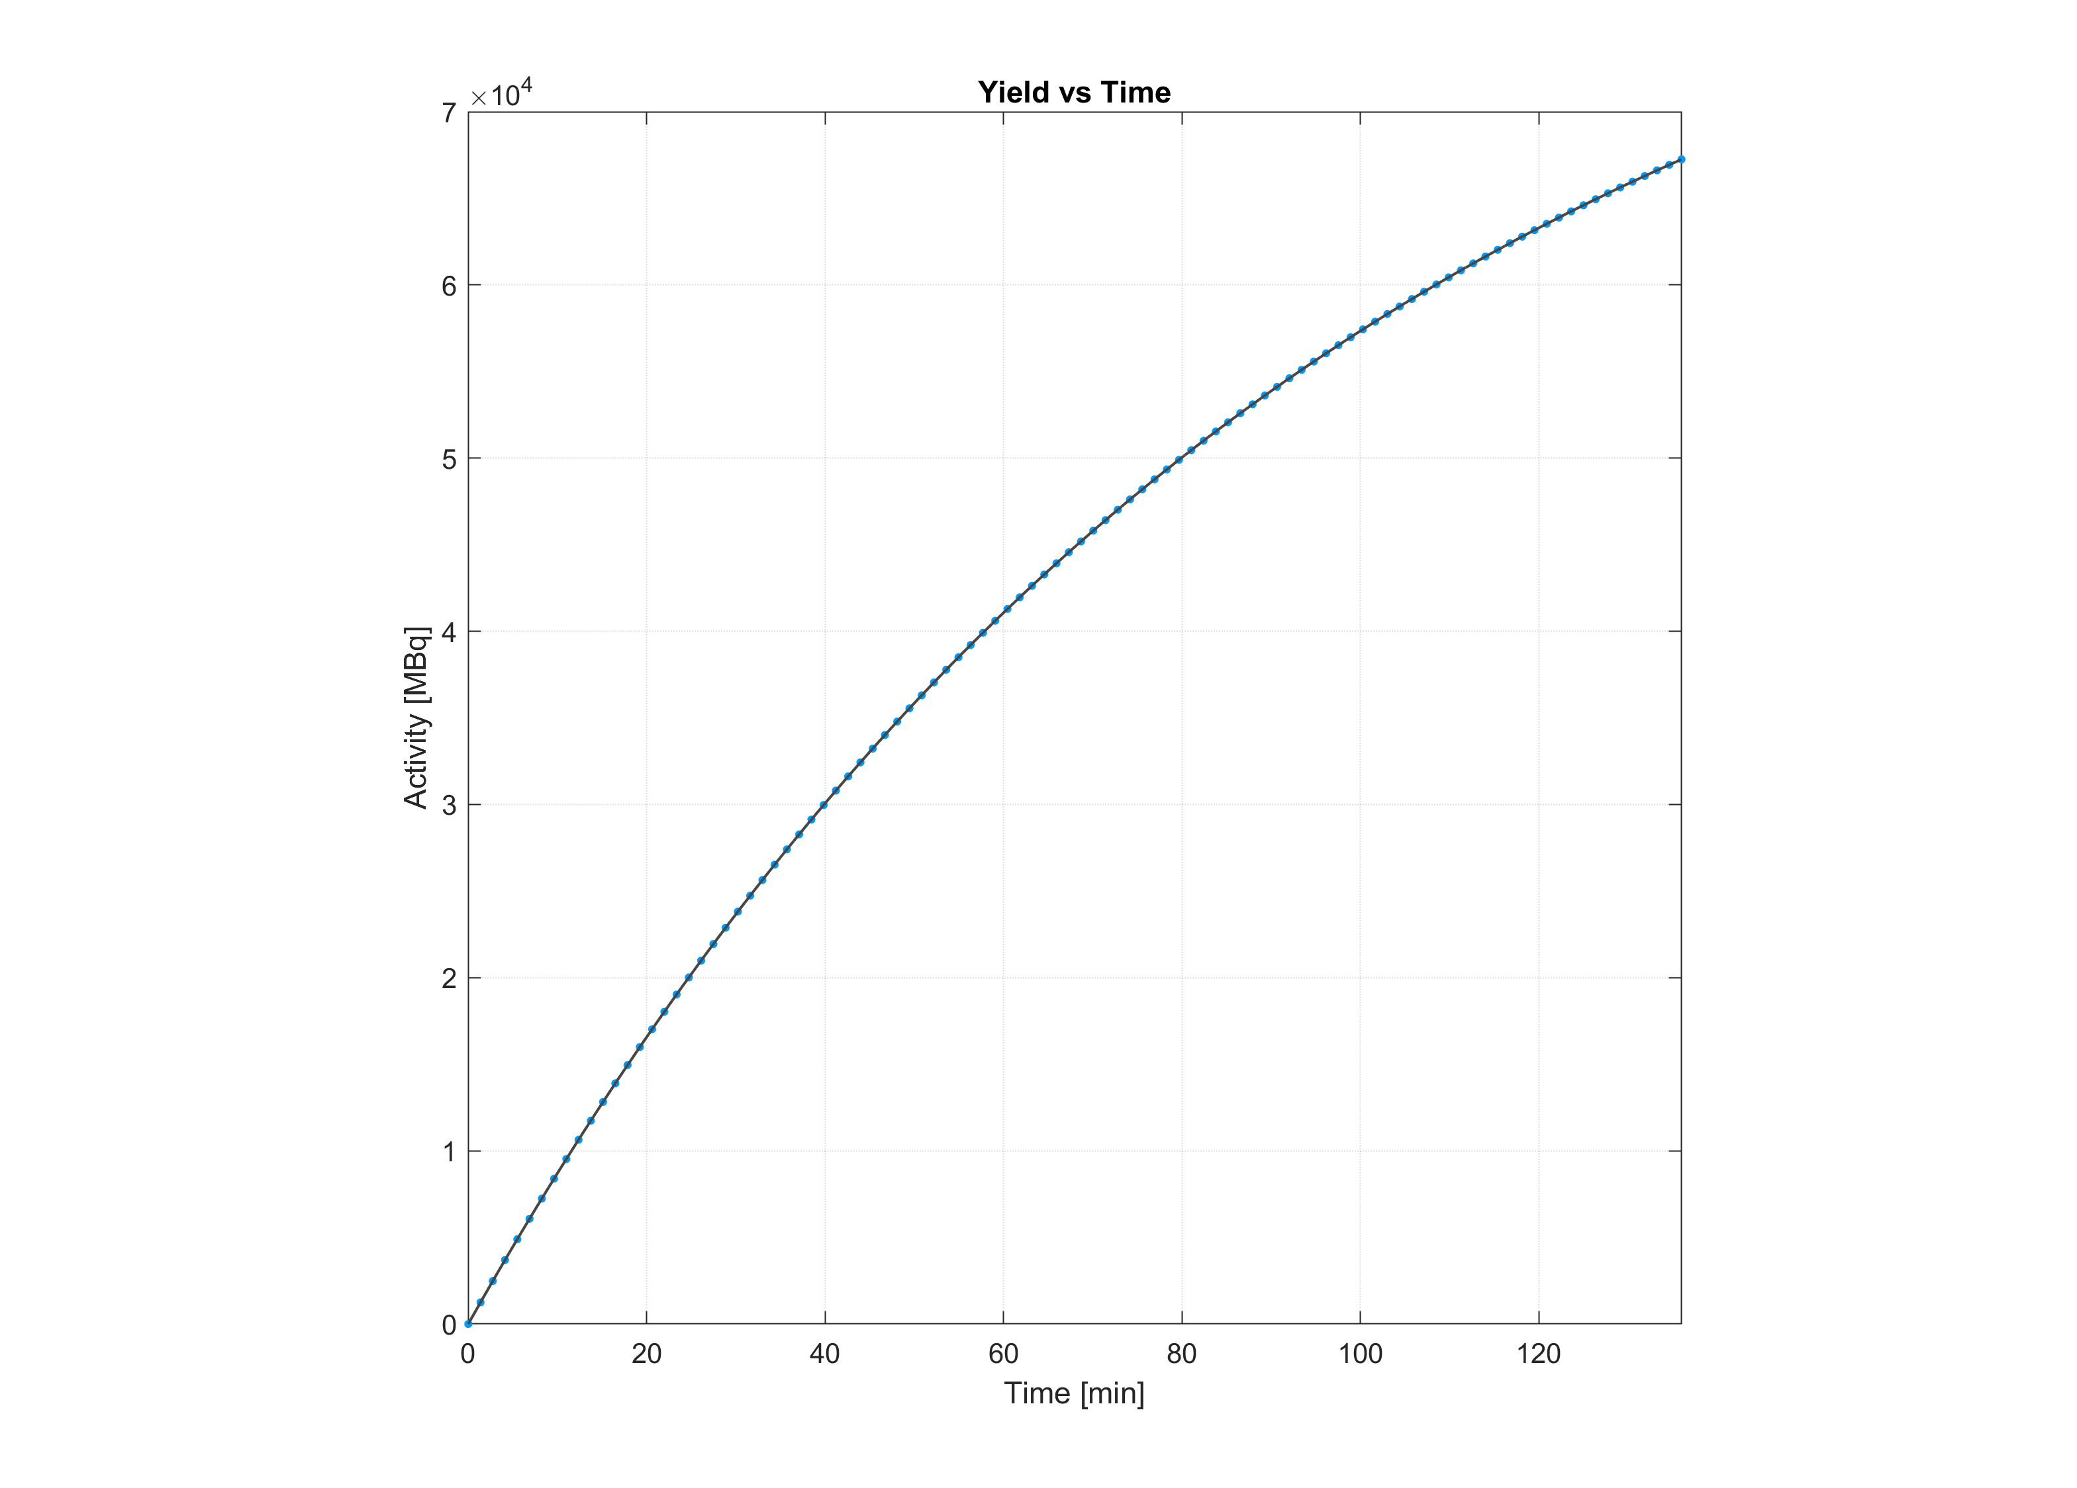
Basic plots

Slide 10
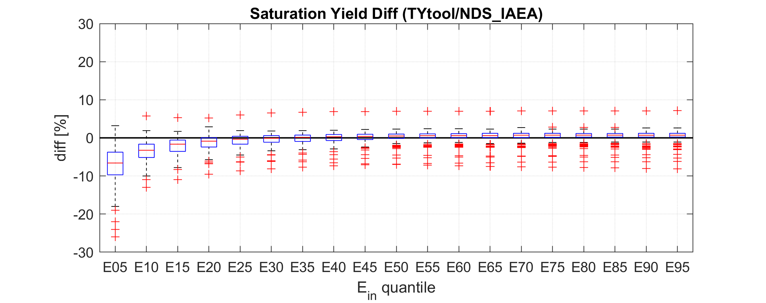
Validation
Basic plots
Notes:
We did this validation across different 19 different Ein across the entire CS-curve for 138 reaction,
mostly within 10 %

Slide 11
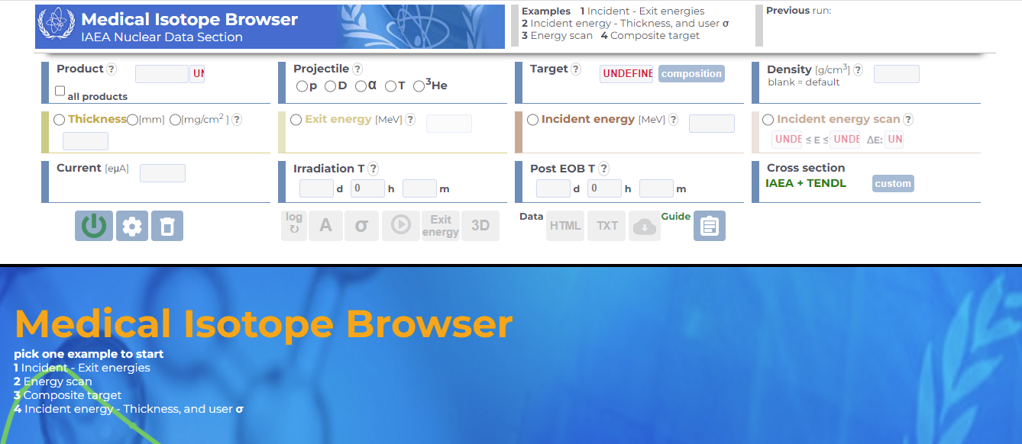
1. https://www-nds.iaea.org/relnsd/isotopia/isotopia.html
2. S. Ferguson, T. Riauka, H. Jans, and K. Gagnon, "Radionuclide production calculations:
A GUI to determine irradiation conditions", AIP Conference Proceedings 1845, 020008 (2017)
Notes:
Medical isotope browser – yield vs time
GIU they can do RNP we cannot but we can optimize y vs E

Slide 12
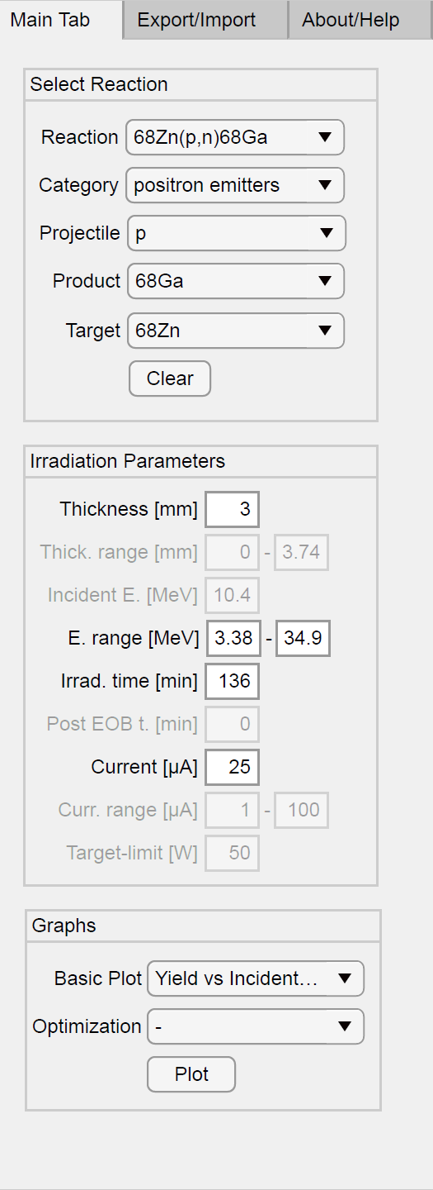
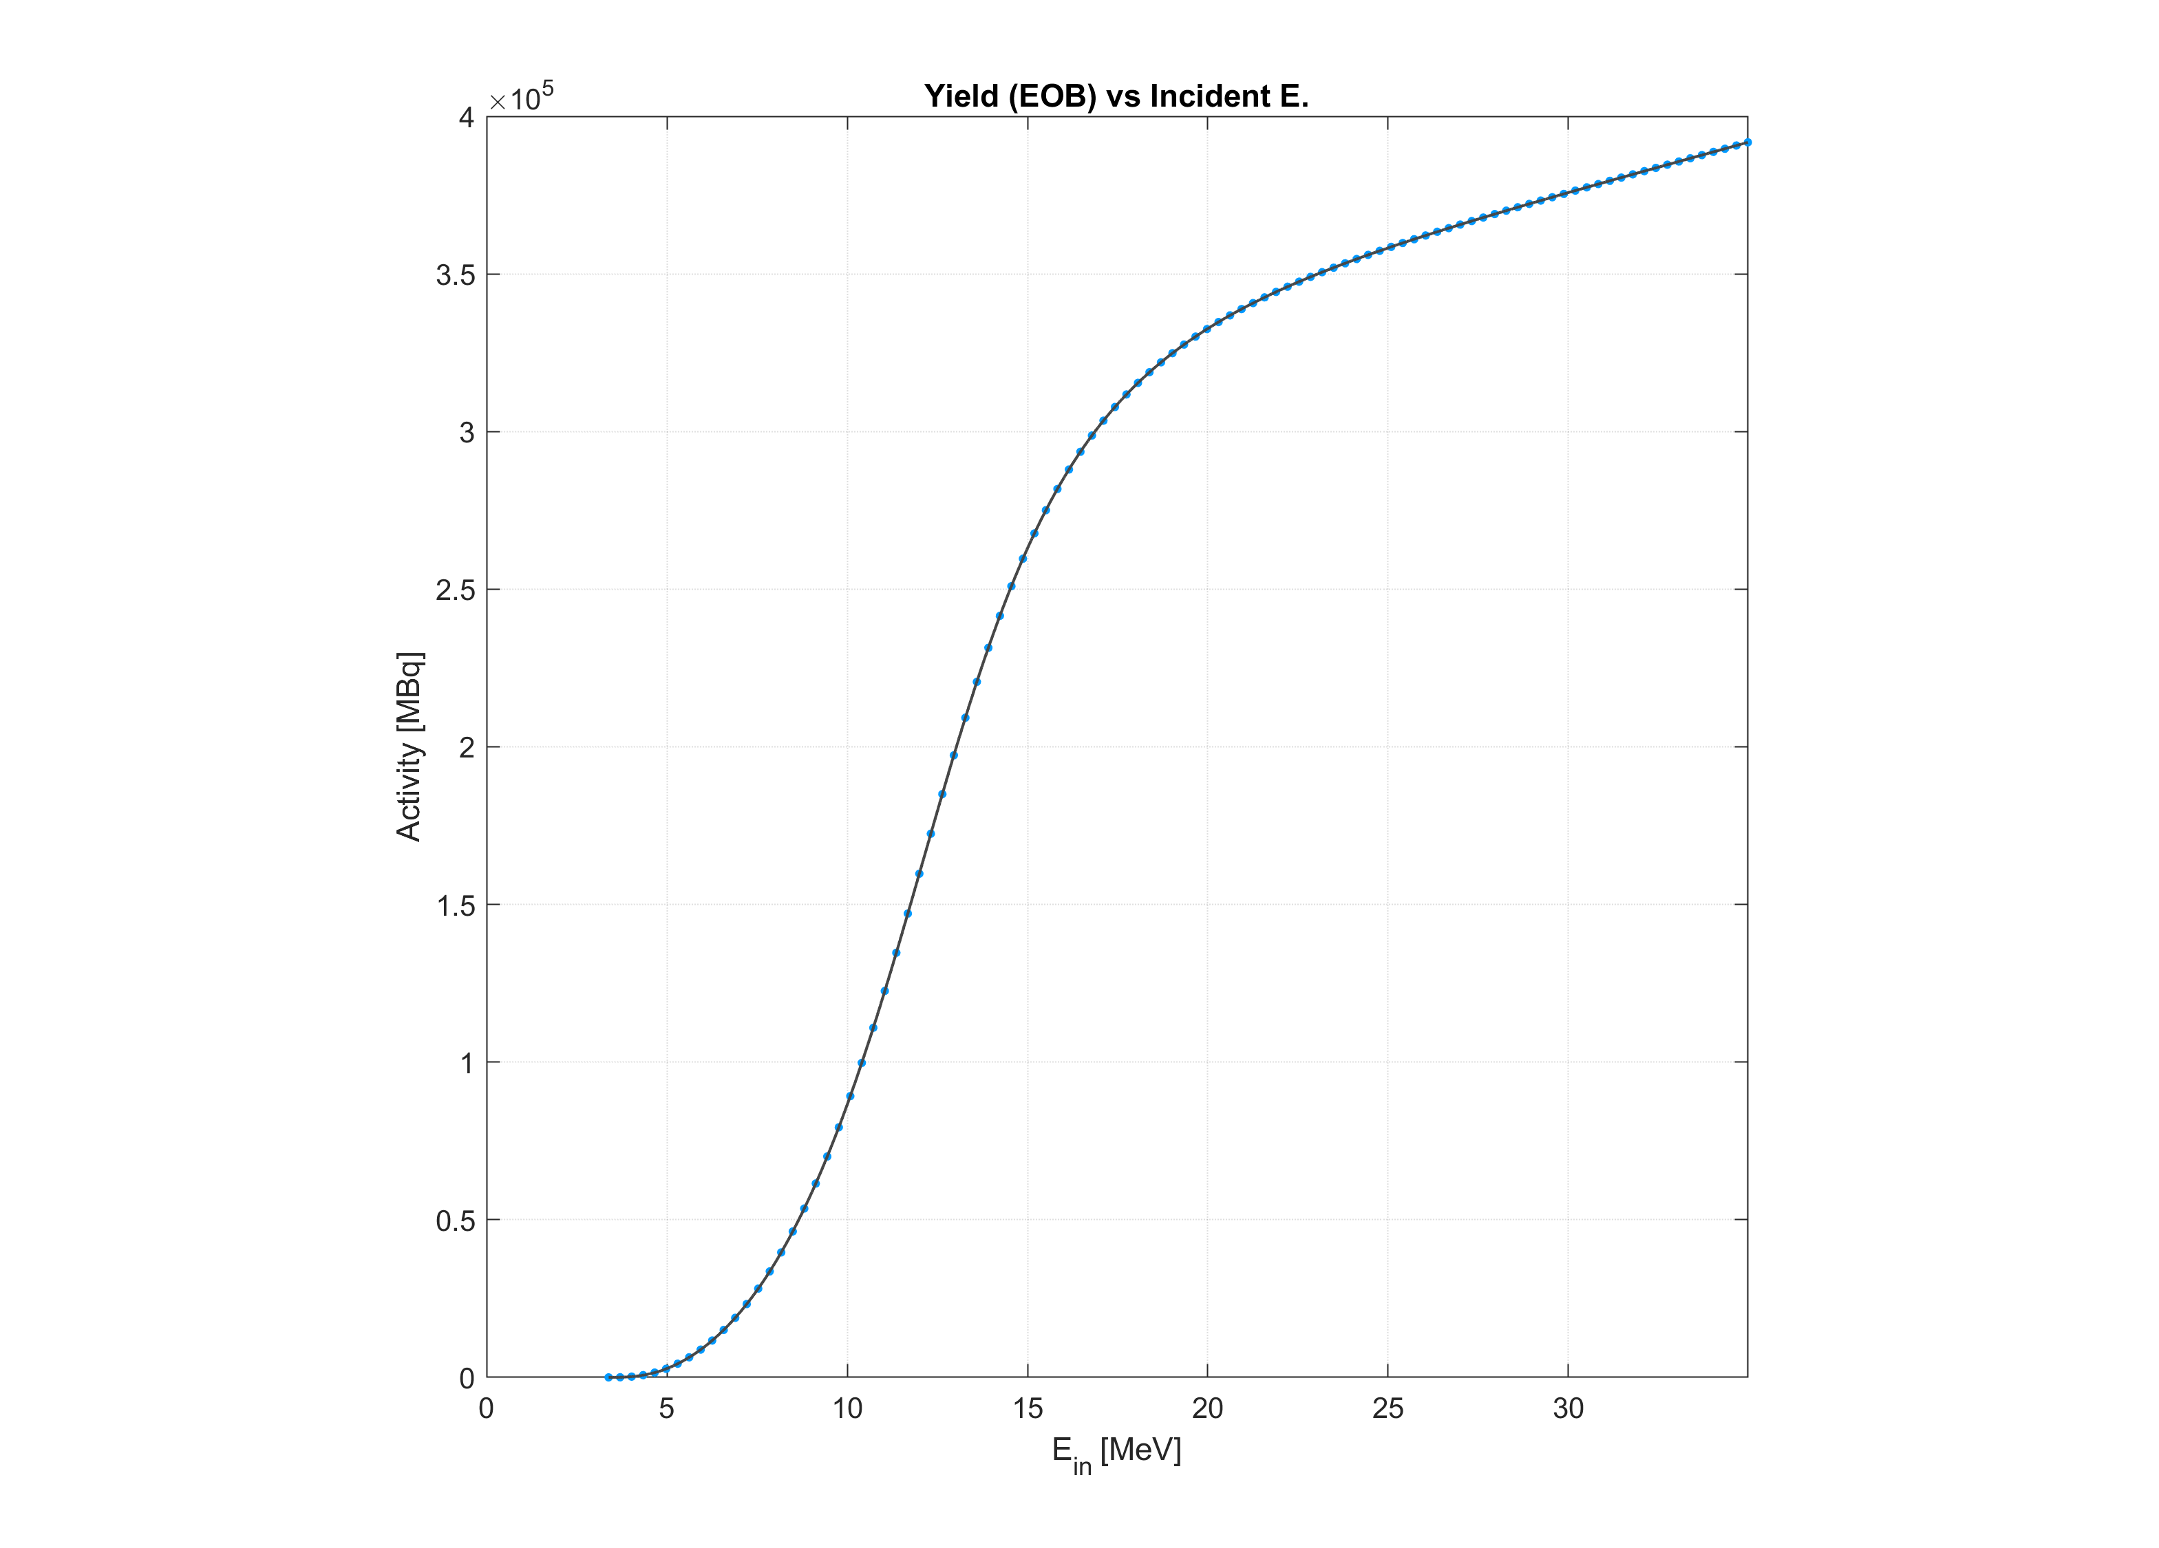
Basic plots
Notes:
Påminn om yield per time är samma som medical isotope browser ….In addition to the yield vs time plot we added bla bla we

Slide 13
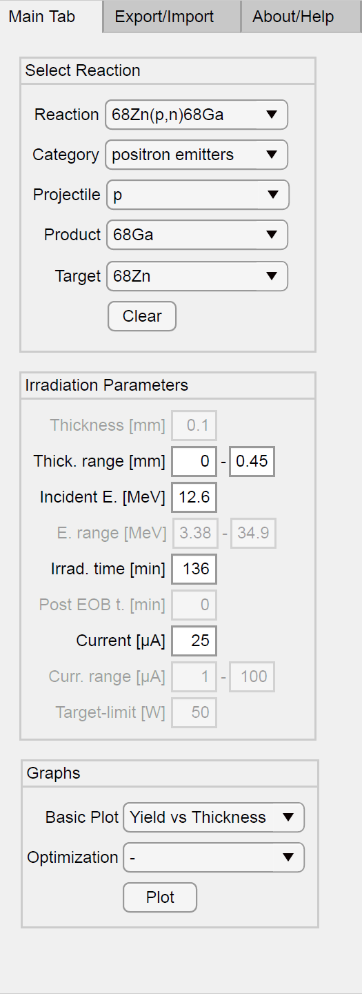
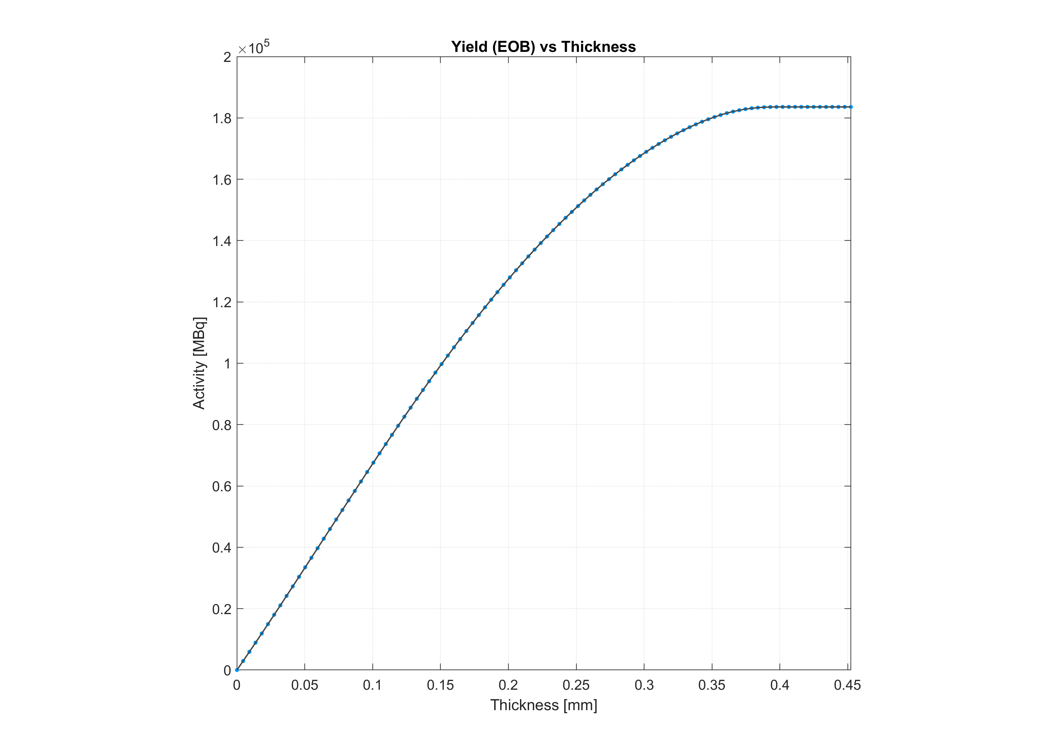
Basic plots

Slide 14
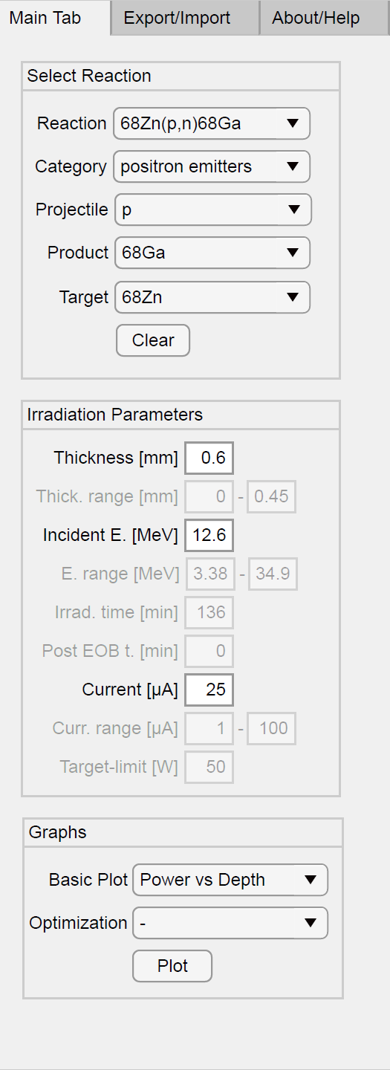
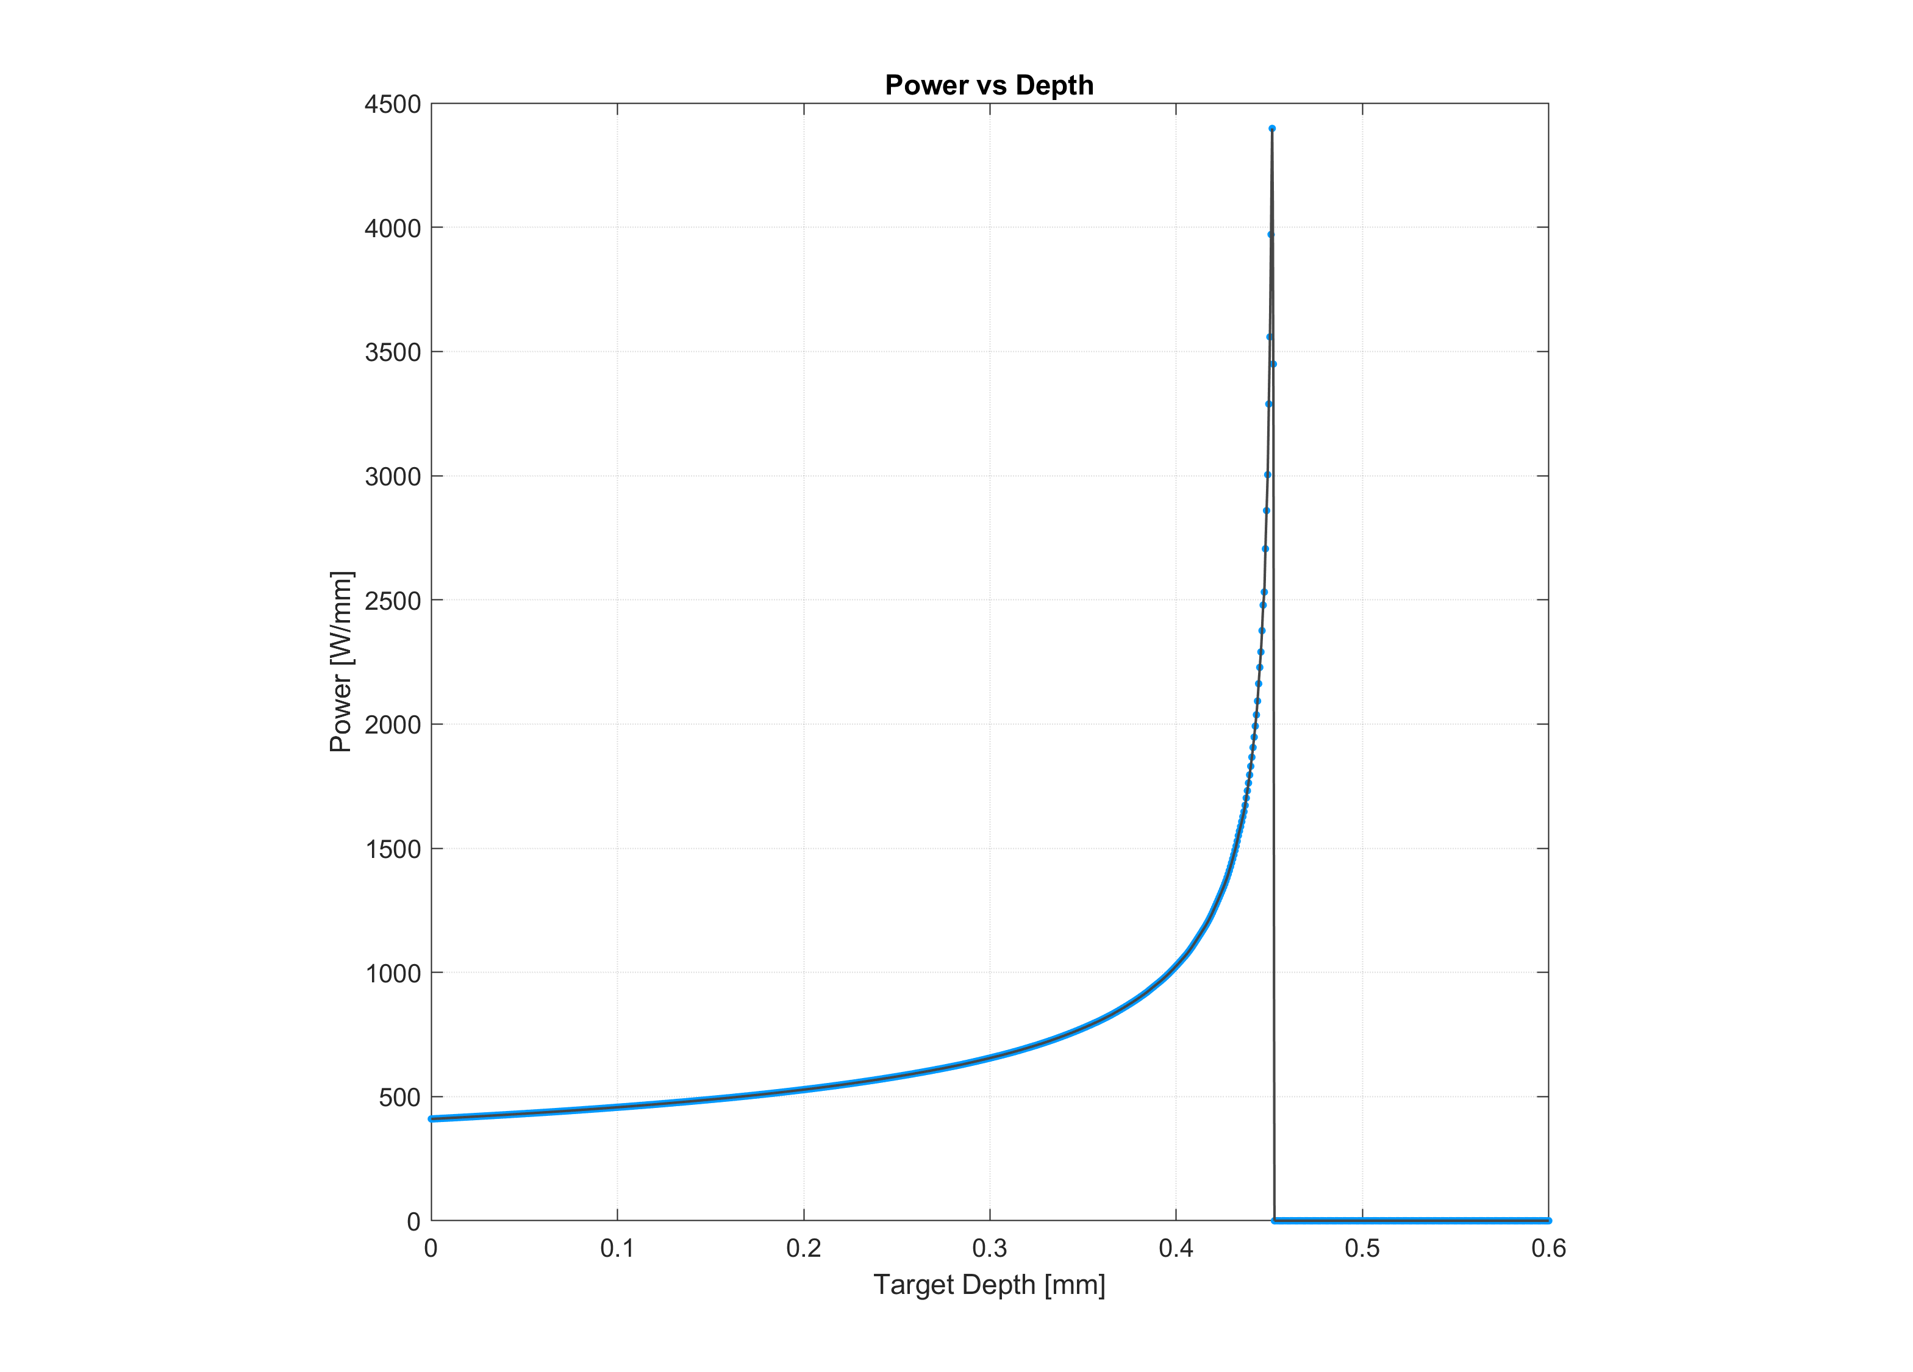
Basic plots
Notes:
Beskriv inte bragg bara säg att den finns där
Change y-axel to power density,

Slide 15
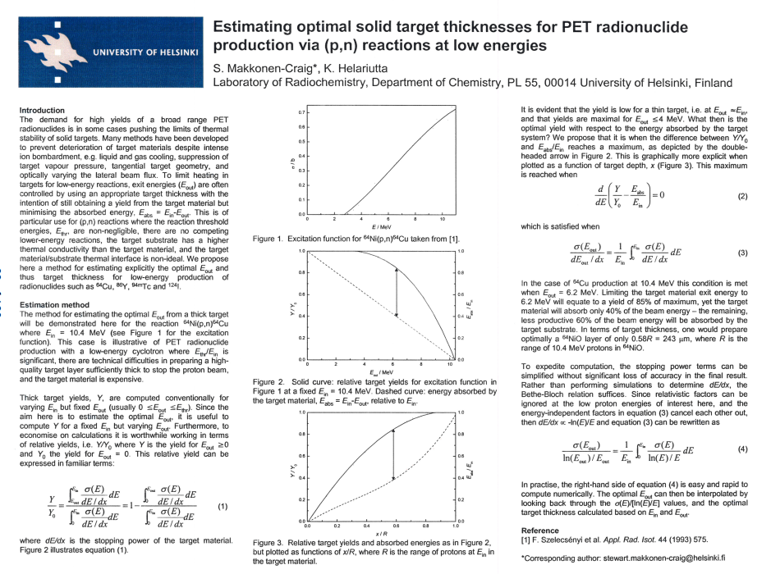
Optimization plots
Optimizes
  Makkonen-Craig & Helariutta-approach with fixed E_{in} (Thick.)
  Yield/W-approach fixed E_{in} (Thick., µA)
  Yield/W-approach with variable E_{in}/E_{out} -range (Thick., µA, E_{in}/E_{out})
S. Makkonen-Craig, K. Helariutta. Estimating optimal solid target thicknesses for PET radionuclide production via (p,n) reactions at low energies. WTTC, Cambridge, 2006
Notes:
Dela upp I 3 olika och besrkiv vad de optimerar på. Eventuellt en tabell
Betona att det gäller optimering av targettjocklek och current I de 2 första metoderna givet en fix inkomande E.
3:an är optimering av targettjocklek, plus Energi givet en E-range

Slide 16
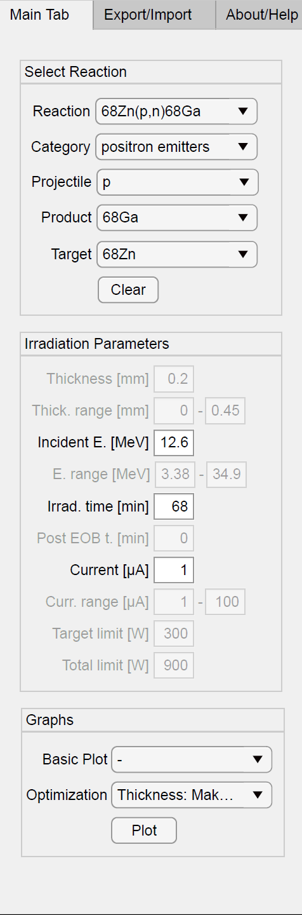
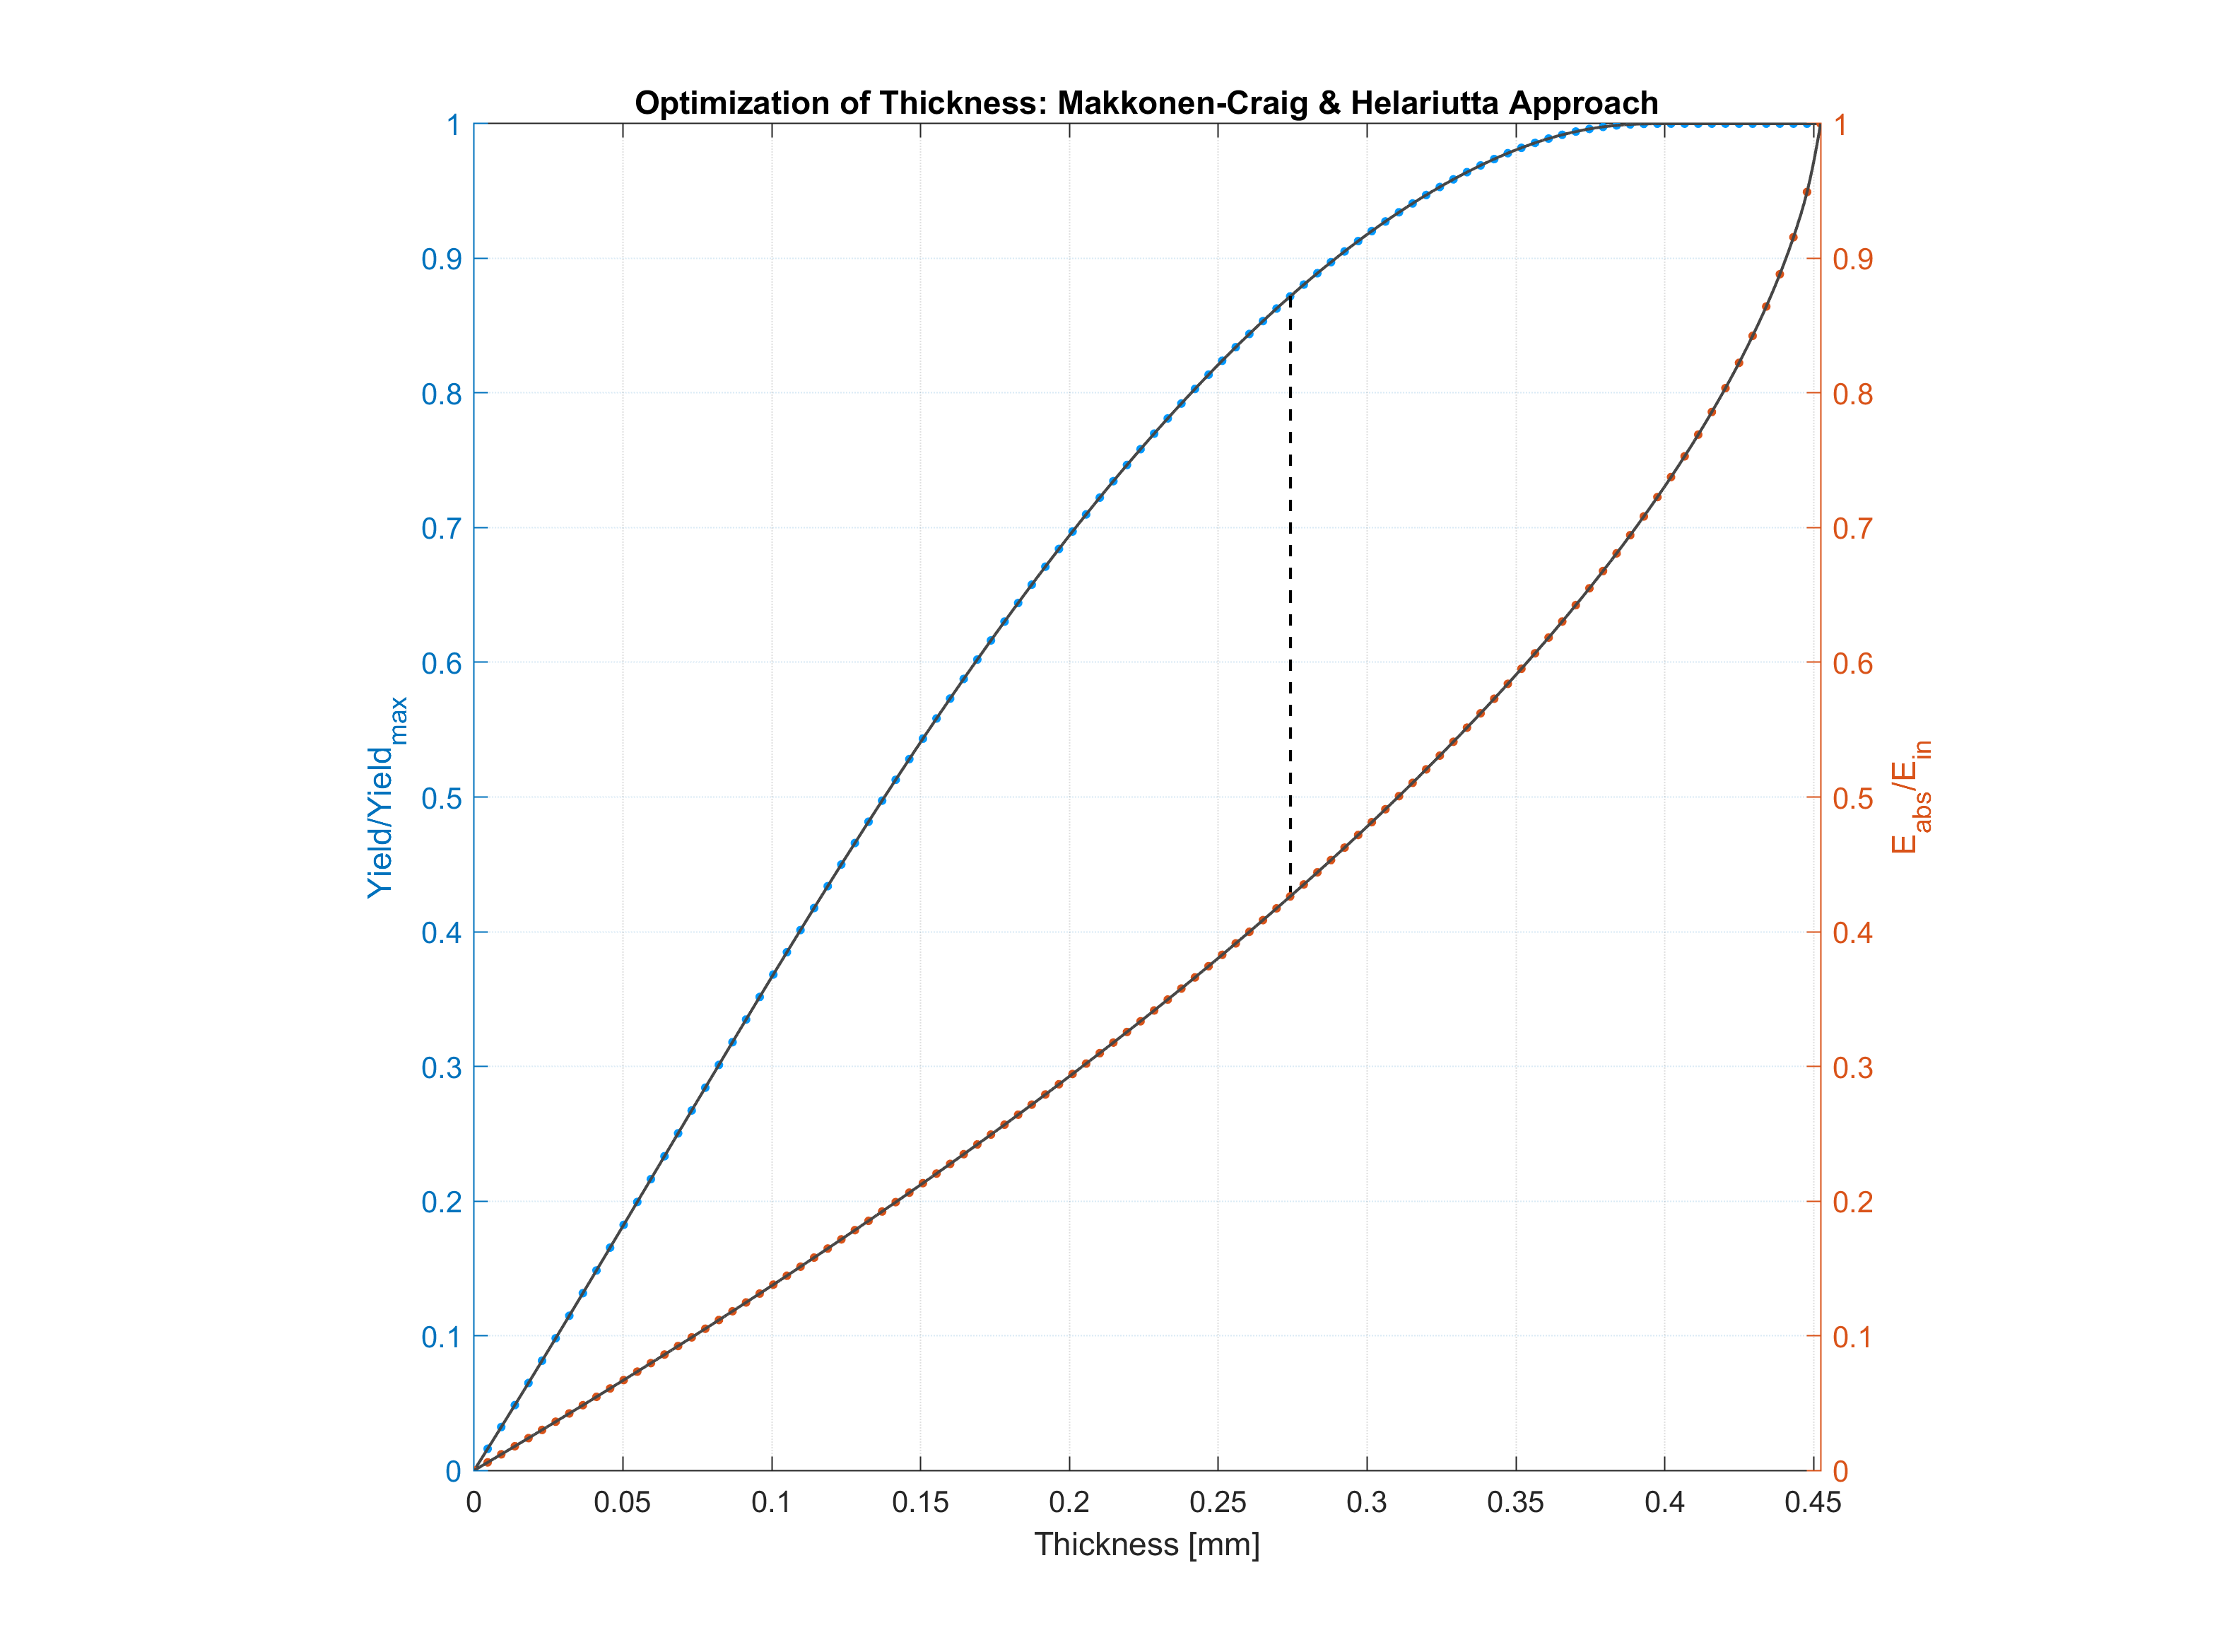
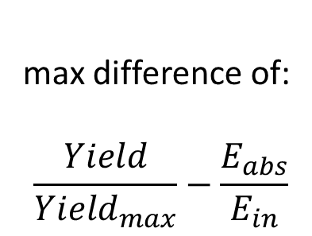
Optimization plots
max difference of:
$$\frac{Yield}{{Yield}_{max}}−\frac{E_{abs}}{E_{in}}$$
Notes:
Here the authors compared relative target yields with relative absorbed energies, proposing that the point where the distance between these two functions are maximized can be used as an optimal thickness.
They derived a mathematical expressions useful for manual calculations. We have included and automated their method to be used for any reaction in the software’s database.
The reasoning, as we understand it, that at the point were we start to get decreasing returns on yield, while the Eabs is increasing at a faster rate seems to be a reasonable point to choose as your optimum.
This is a general method that gives reasonable results for any given situation for a fixed Ein.
However if you know the specific power limit of your target and the available µA-range and E-range it will be possible to find a higher yield.

Slide 17
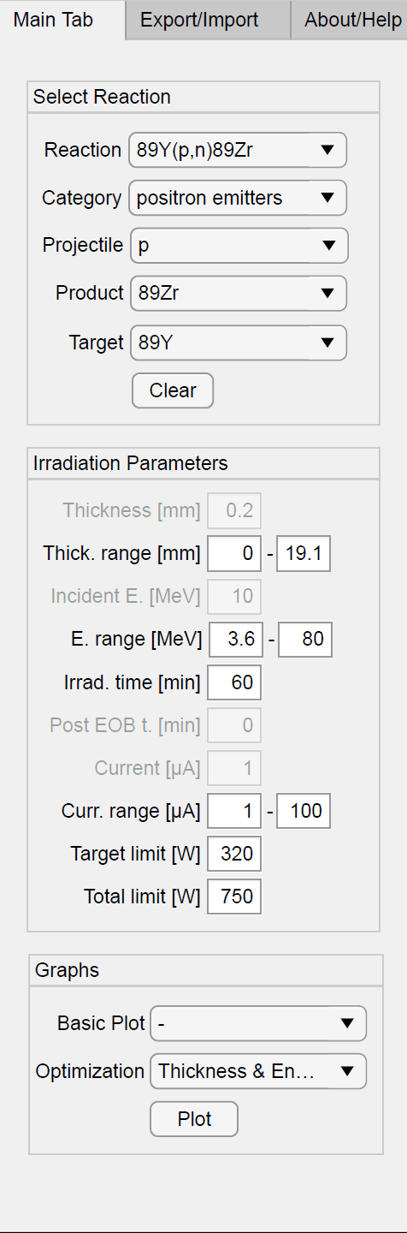
Target limit (320 W)
The material
Water cooling
Total limit (750 W)
Includes the holder/backing

Slide 18
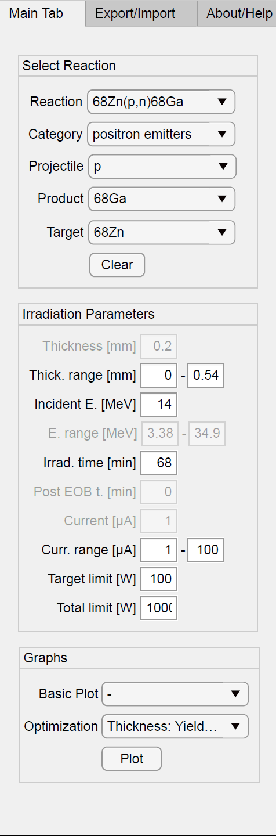
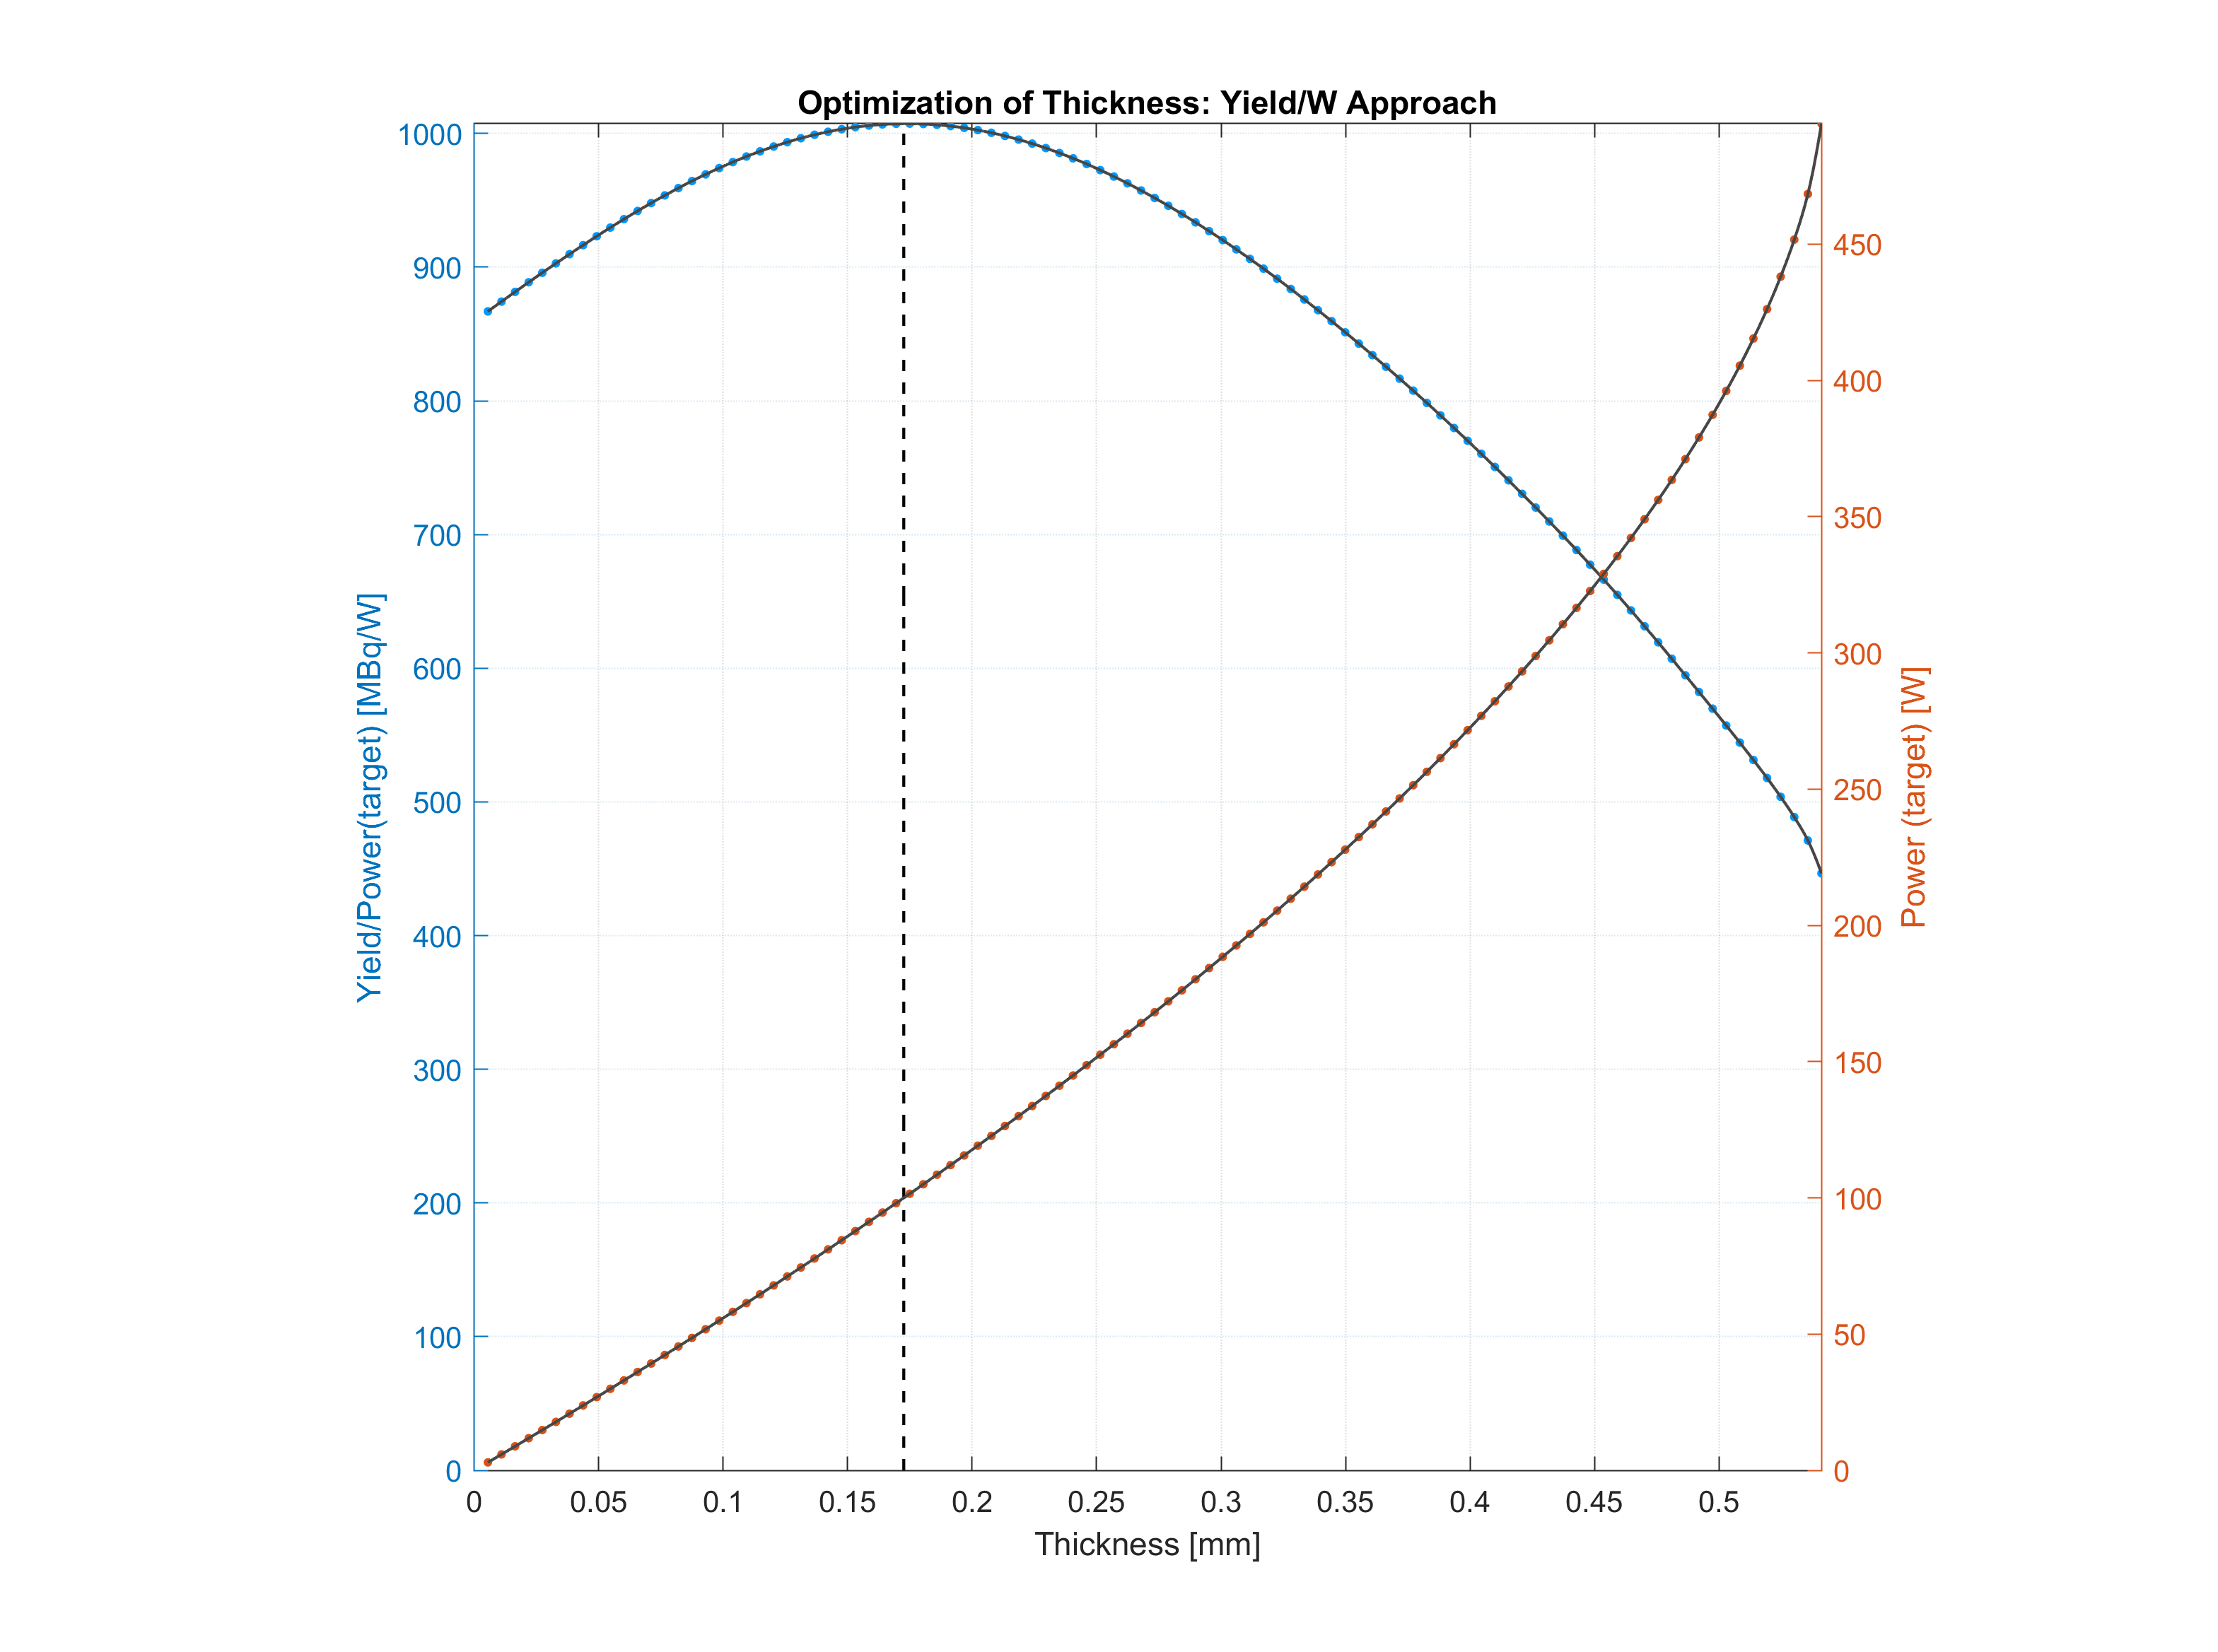
Yield/W-approach
(fixed E_{in})

Slide 19

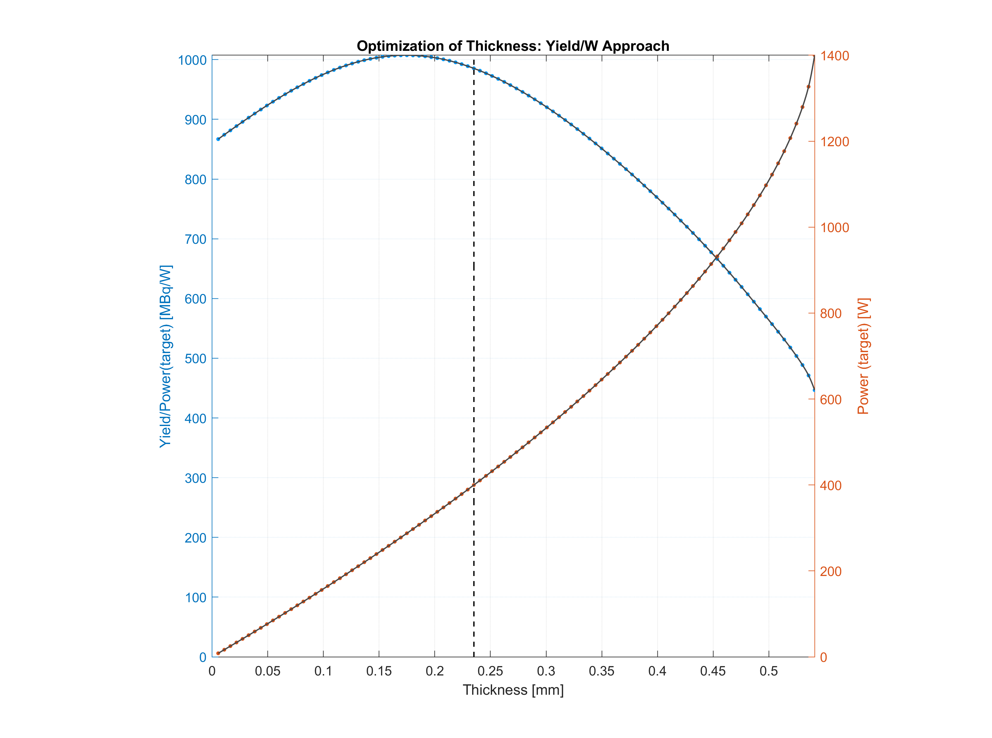
Yield/W-approach
(fixed E_{in})

Slide 20
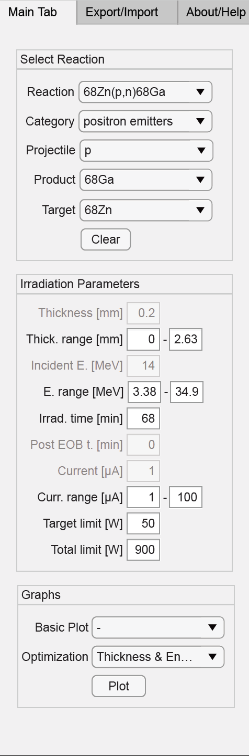
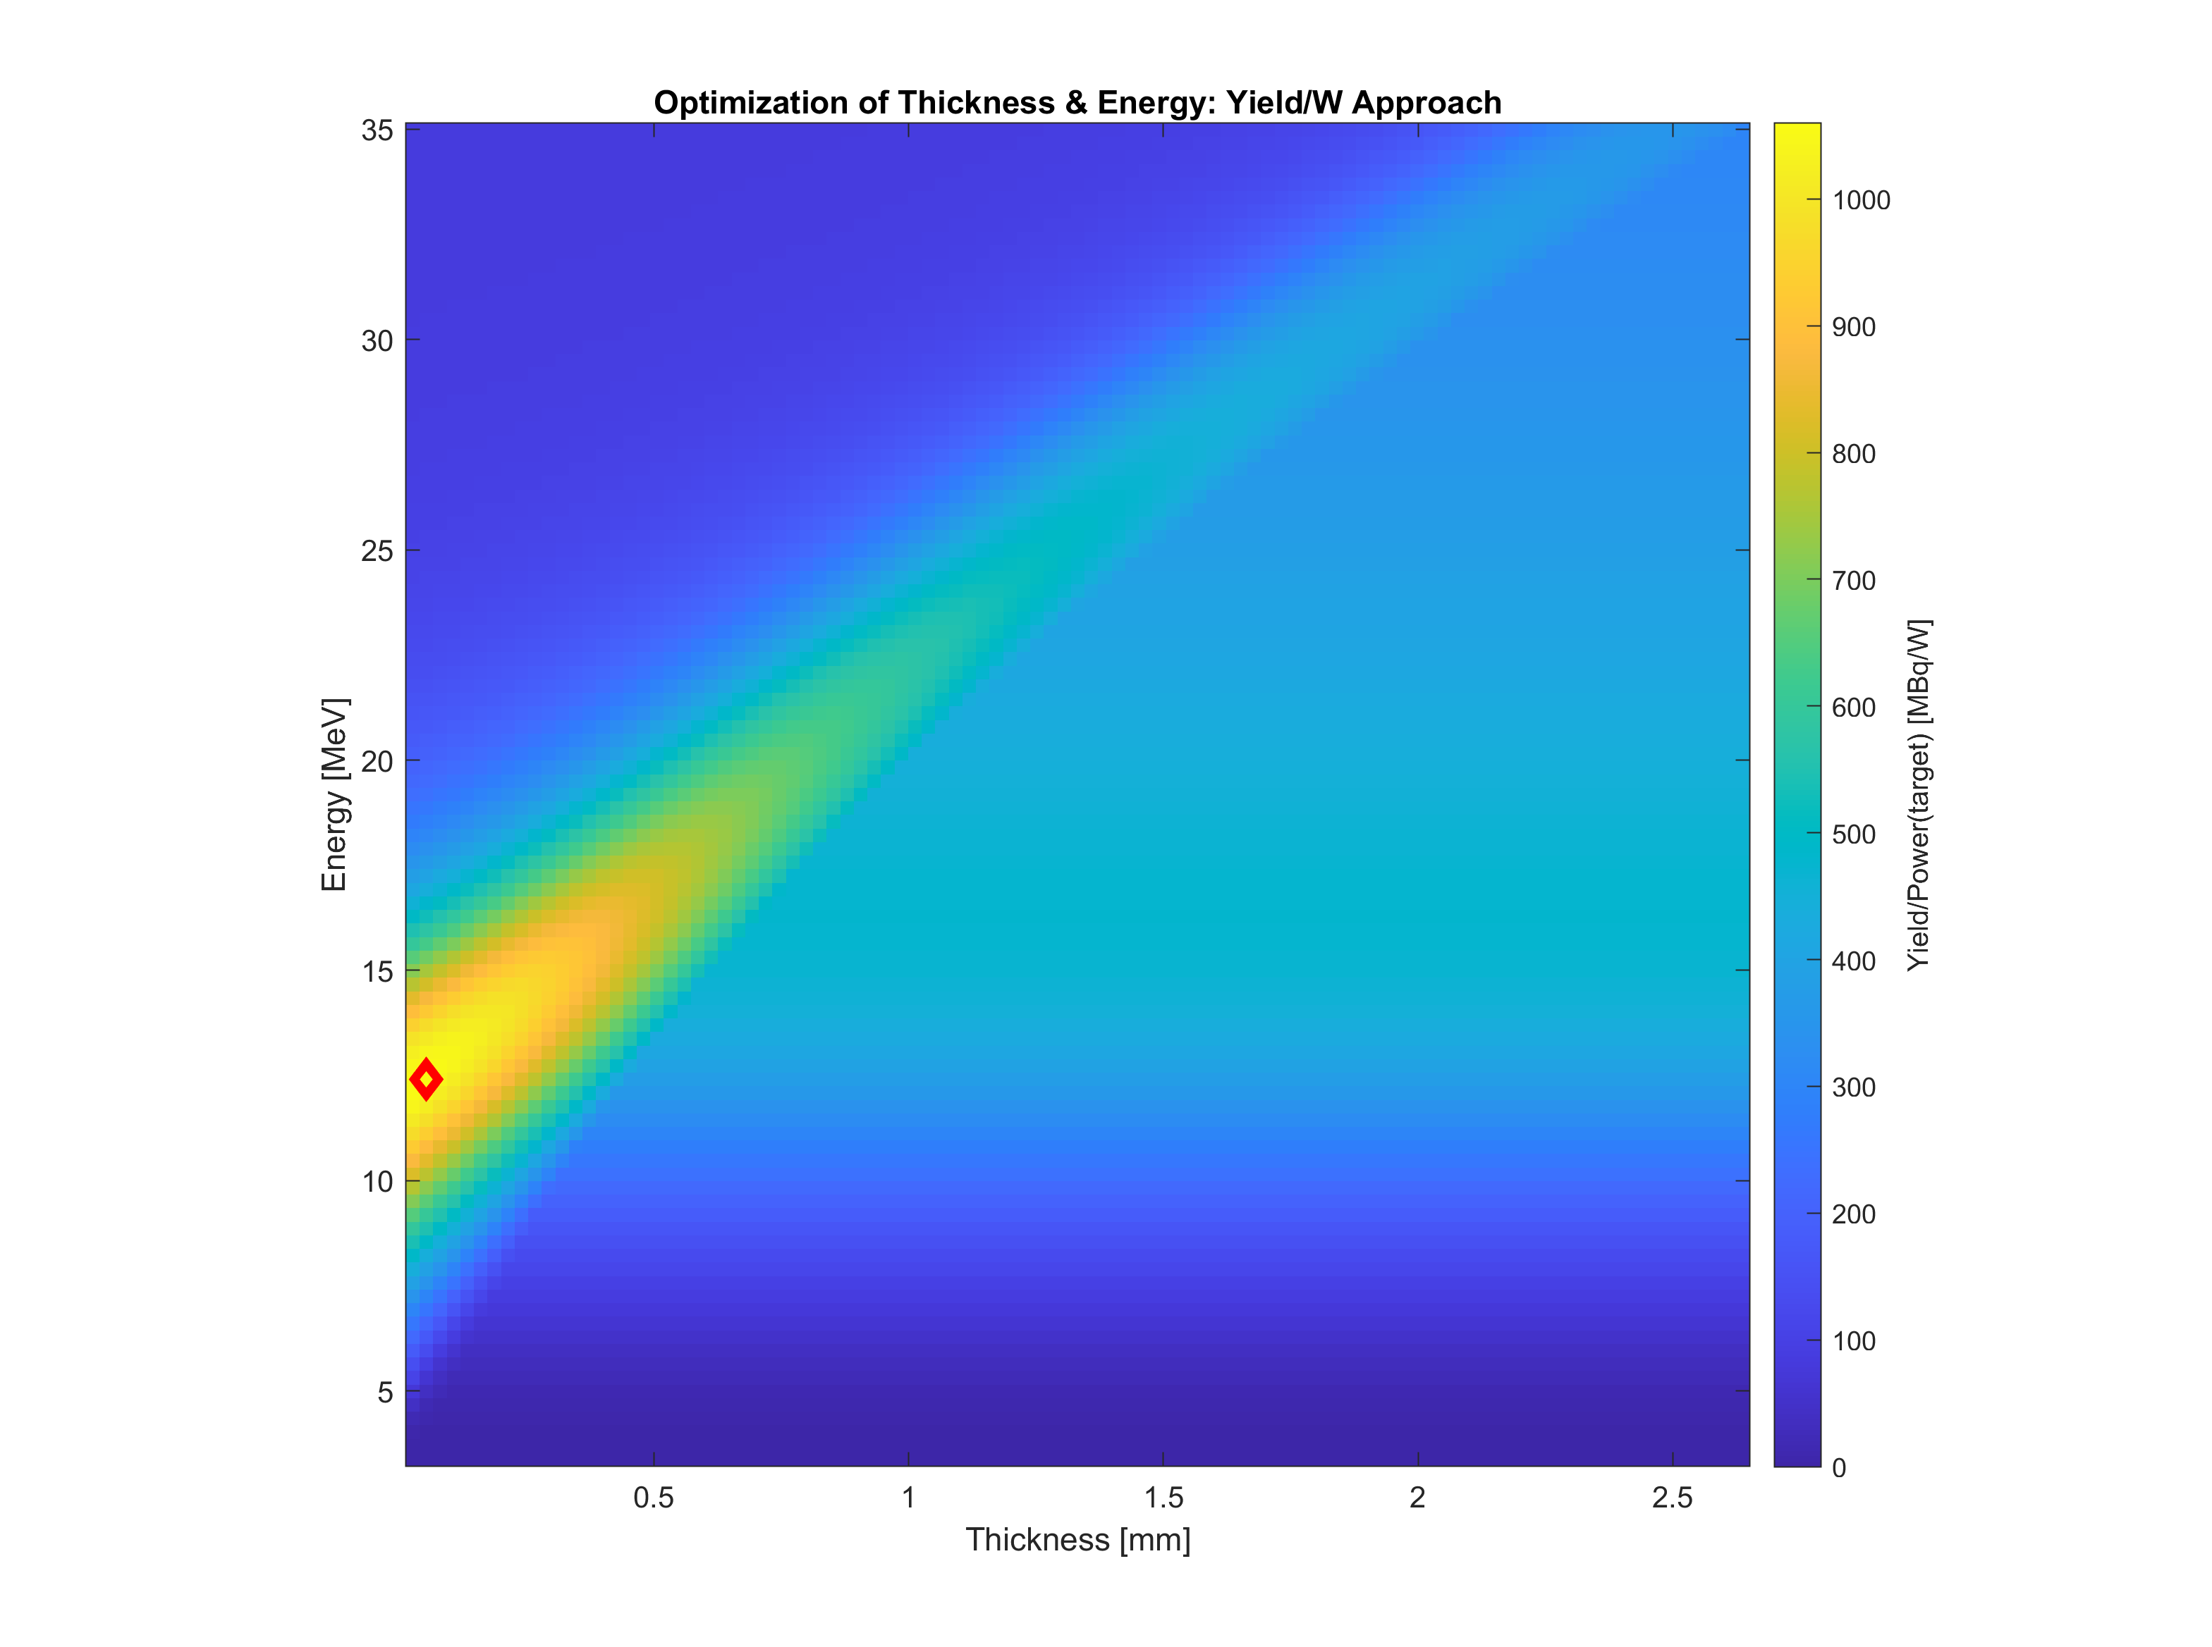
Optimization plots
Yield/W-approach
(variable E)

Slide 21
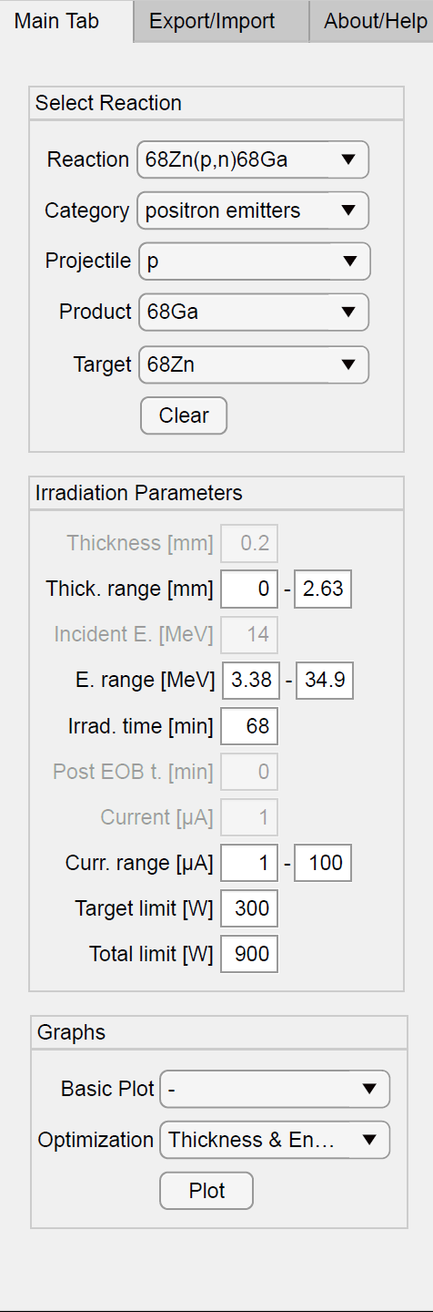
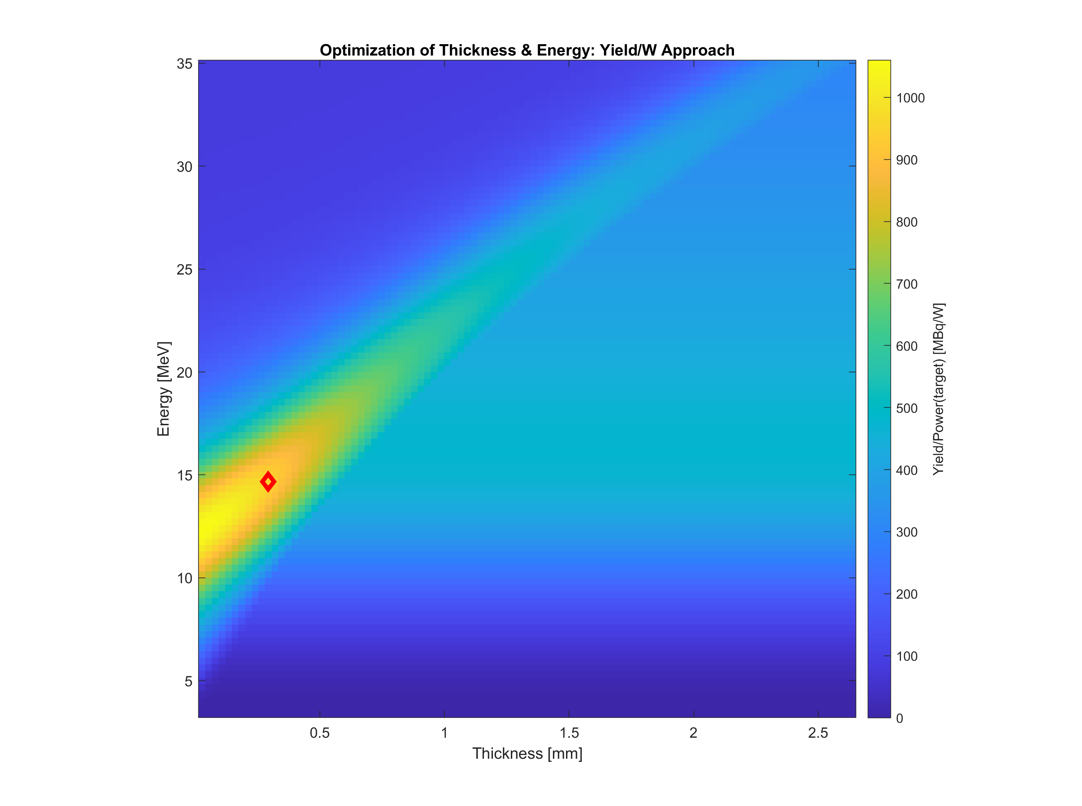
Optimization plots
Yield/W-approach
(variable E)

Slide 22
Many different combinations
And only 15 min presentation

Slide 23


Acknowledgements to UW-Madison Cyclotron Gang for Beta Testing
PROFESSORS
Jonathan W Engle, Associate Professor
Paul A Ellison, Assistant Professor
Robert J Nickles, Emeritus Professor
SCIENTISTS
Todd E Barnhart, Distinguished Scientist
Eduardo Aluicio-Sarduy, Assistant Scientist
POSTDOCS AND STUDENTS
Margarita N Chernysheva, PhD
Aeli P Olson
Kaelyn V Becker
Kendall E Barrett
Wilson Lin
Molly DeLuca

Slide 24
Availability, improvement and future plans
To get TYtool, (it’s for free) download from:
  https://gitlab.com/NM_Karolinska_Solna/TYtool/
  &
  Send an email to:
  daniel.thor@regionstockholm.se
  jonathan.siikanen@regionstockholm.se
Potential future upgrades:
  Including more CS by default, Energy spread/straggling correction, Beam Profile optimization/minimization of target material, RNP etc.
We are open for your input
  anything from bugs/design-suggestion/usability to theoretical issue

Slide 25
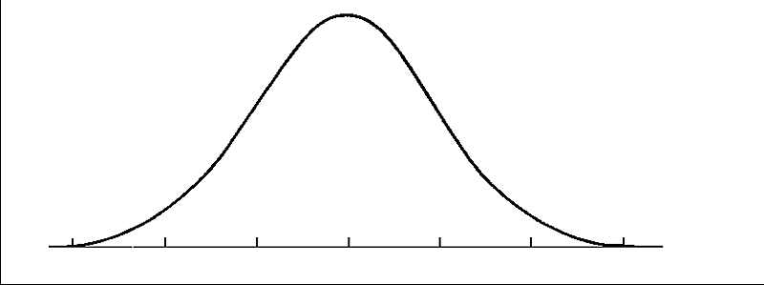
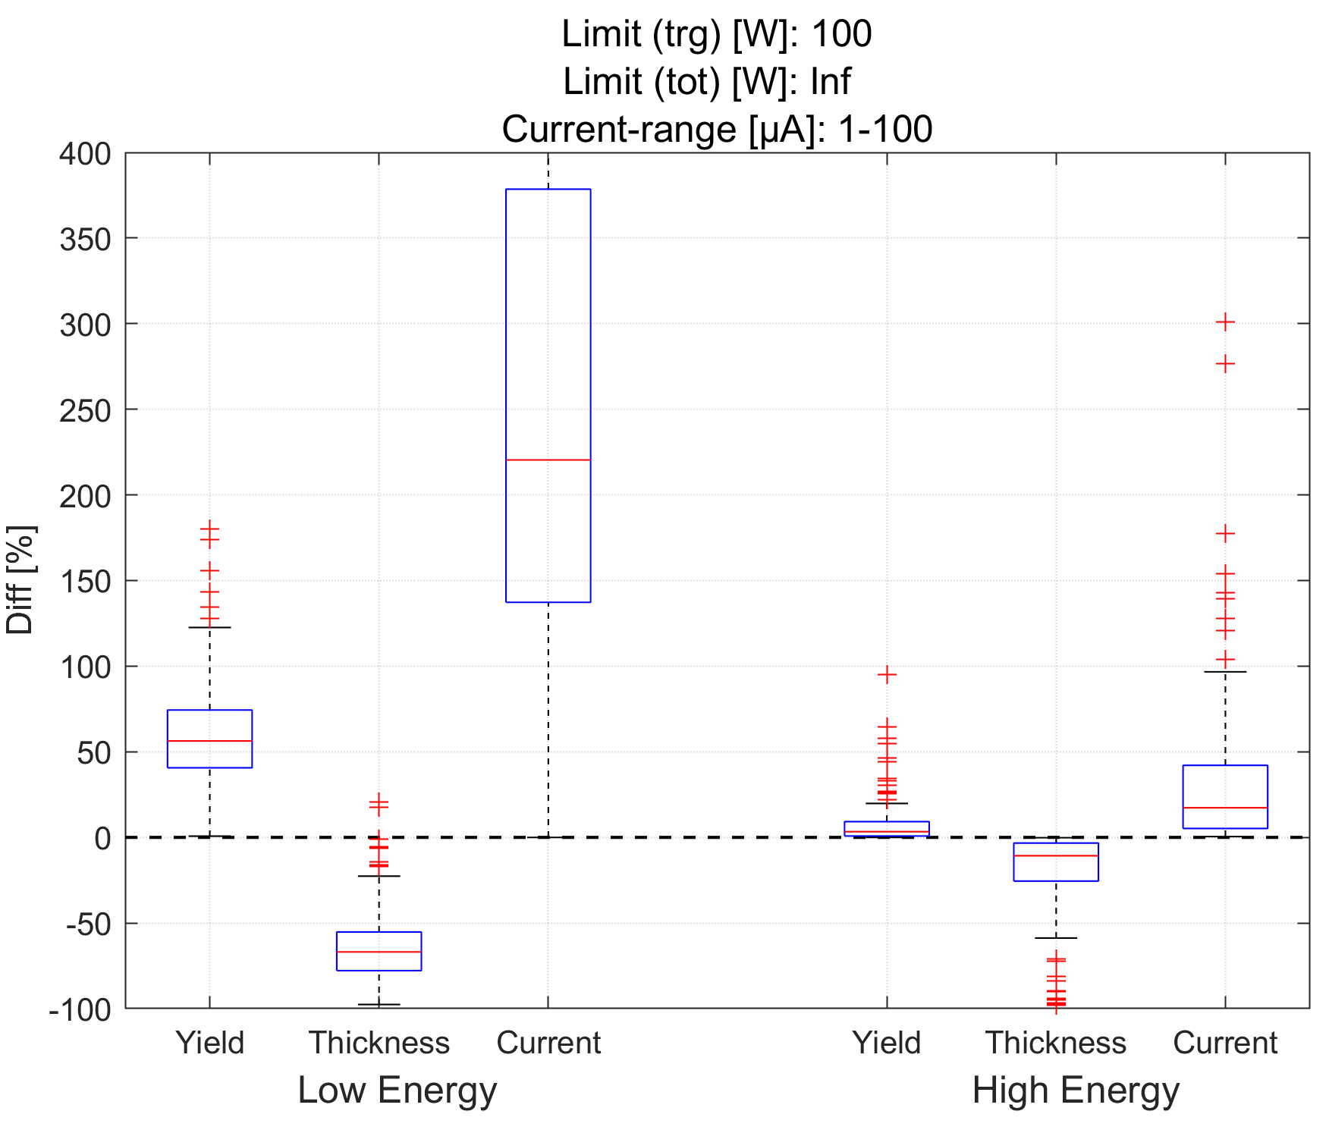
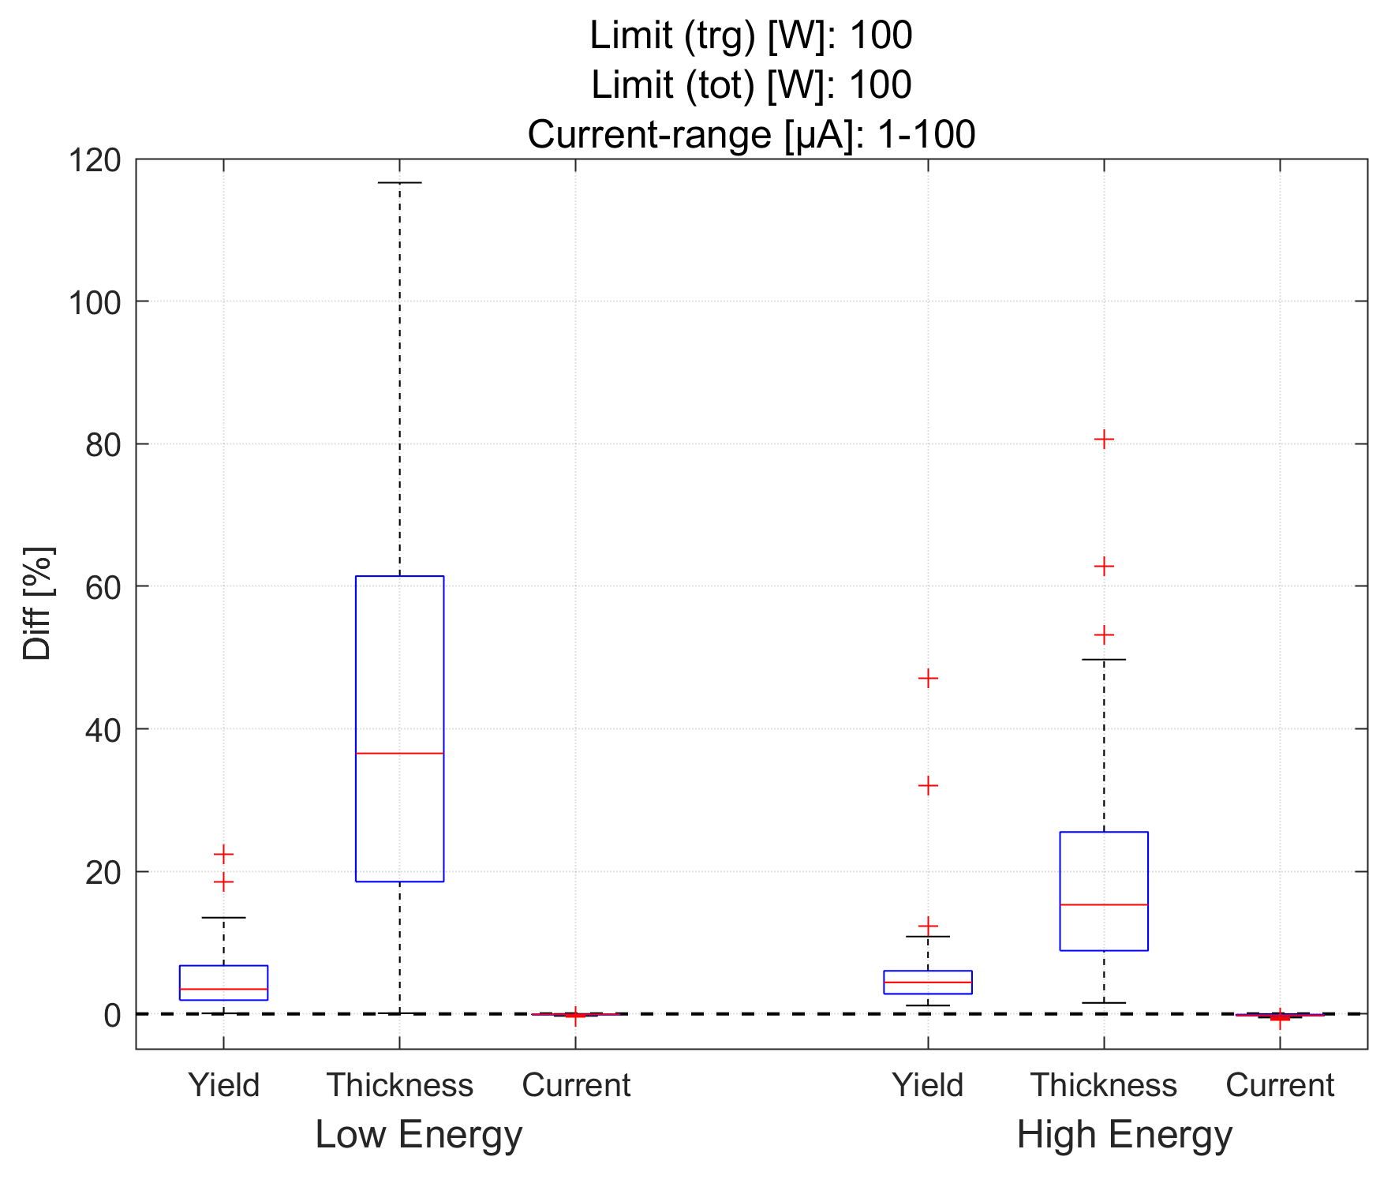
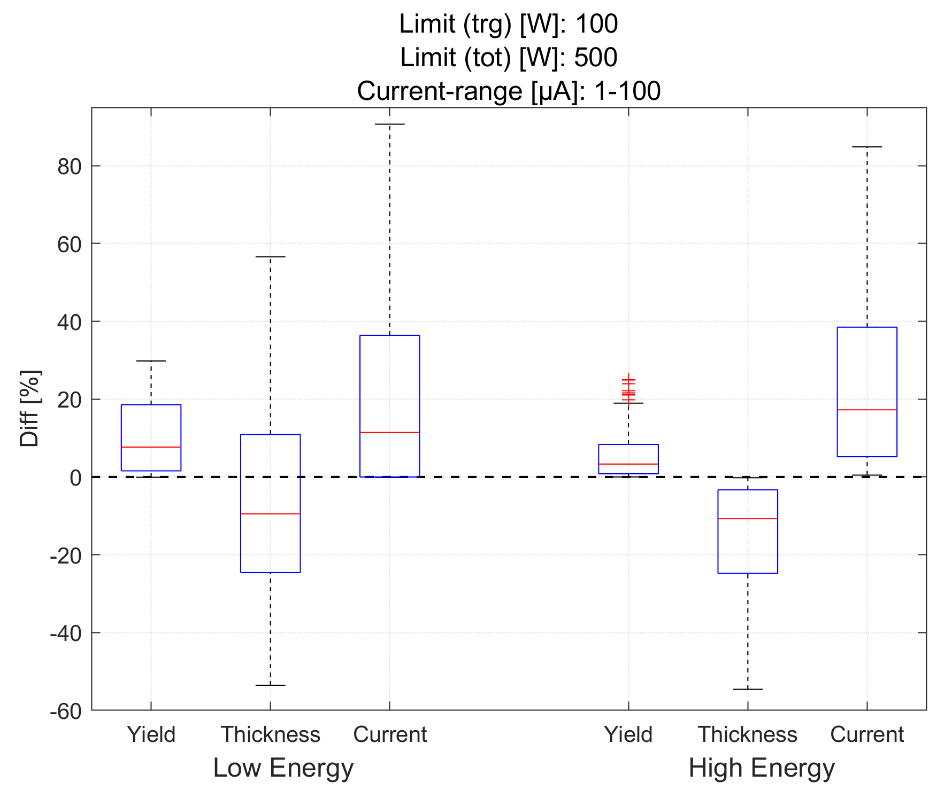
Yield/W-approach fixed E_{in} vs
Makkonen-Craig & Helariutta-approach
Comparison for 138 reactions
Low Energy
High Energy
CS/SP
E (MeV)
Notes:
Jag har gjort 3 separata figurer
1) Lim(trg)=100, Lim(tot)=inf (dvs ena extremfallet) ingen hänsyn till totala
2) Lim(trg)=100, Lim(tot)=100 (dvs andra extremfallet) ger en liten skillnad i yield
3) Lim(trg)=100, Lim(tot)=500 (mitt emellan)Jag har grupperat boxarna enl:
"low energy"=vänster om CS-peak
"high energy"=höger om CS-peakKommentarer till resultaten:
1) Lim(trg)=100, Lim(tot)=inf
Här gynnas YW-metoden särskilt mkt av tunna targets med hög ström, särskilt till vänster om CS/SP-peak där den inte vinner ngt på att degradera energin. Till höger om peak väljer den tjockare target för att få med peak. Notera att grafens y-axel är beskuren så att outliers inte syns på µA (blev så trunkerat annars).
2) Lim(trg)=100, Lim(tot)=100
Här tjänar man ingenting på att dumpa energi bakom target. Därför har YW ökat sin yield jmf med Makkonen genom att göra öka targettjocklek tills tröskeln nåtts, dvs mer energi dumpas i target (+60% i snitt), men Wtot är samma som Makkonen. det är också därför som µA är samma för båda.
3) Lim(trg)=100, Lim(tot)=500
Ett mellanting mellan dom övre fallen. vi får oftast tunnare target och högre ström.*Generellt kan man säga att vår metod ger högst yield vs Makkonen när lim(tot) är betydligt högre än lim(trg).
*När lim(tot)=lim(trg) är vår metod (o-guidad) sämre än Makkonen eftersom vi oftast vinner lite yield men till en stor ökning i target-material. I vissa outlier-fall är yield-vinsten stor dock. MEN: det är väldigt lätt att manuellt optimera våran metod. Just nu så ökar den ju tjockleken ända fram tills yield-kurvan inte ökar numeriskt längre. Och då har det ju redan varit platt ganska länge så rimligen väljer man ett tunnare target. och då tror jag att resultatet kommer närma sig Makkonen, eftersom det är en rimlig punkt att stanna på.

Slide 26
