Slide 1



18th Workshop on Targetry and Target Chemistry
New metallic germanium target fabrication and dissolution techniques for the cyclotron production of positron-emitting ⁷¹As and ⁷²As
Yi-Hsuan Lo¹, Todd E. Barnhart¹ Jonathan W. Engle¹, Silvia S. Jurisson^{2,3}, Heather M. Hennkens^{2,3}, Paul A. Ellison¹
¹Department of Medical Physics and 2Department of Radiology, University of Wisconsin School of Medicine and Public Health, Madison, WI 53705, USA
²Department of Chemistry, University of Missouri and ³University of Missouri Research Reactor Center, Columbia, MO 65211, USA
7/18/2022

Slide 2
Research topic
⁷⁷As beta emitter and ^{71/72}As positron emitter
⁷²Se 8.4 d Ec only | ⁷³Se |  | ⁷²Se 0.89% | ⁷⁵Se 119.8 d EC only |  | ⁷⁶Se 9.4 % | ⁷⁷Se 7.6 % |  | ⁷⁸Se 23.8 % | ⁷⁹Se
 | 7.2 h | 40 m |  |  |  |  |  |  |  | 4 m | 3×10⁵y
⁷¹As 65.3 h β⁺: 816 keV... | ⁷²As 26 h β⁺: 1117 keV. |  | ⁷³As 80.3 h Ec only | ⁷⁴As 17.8 d |  | ⁷⁵As 100 % | ⁷⁶As 26.4 h β⁻: 2962 keV |  | ⁷⁷As 38.8 h β⁻: 683 keV | ⁷⁸As 90.7 m β⁻: 4209 keV
 |  |  |  | β⁺ | β⁻
⁷⁰Ge 20.57% | ⁷¹Ge 11.43d Ec only |  | ⁷²Ge 27.45% | ⁷³Ge 7.75% |  | ⁷⁴Ge 36.5% | ⁷⁵Ge |  | ⁷⁶Ge 7.73% | ⁷⁷Ge
 |  |  |  |  |  |  | 48 s | 83 m |  | 53 s | 11 h
¹¹⁹Sb MAe⁻ emitter
N
P
As
Sb
Bi
Homologous relationship with ¹¹⁹Sb
[1] P.A. Ellison et al. Bioconjug. Chem. 27 (2016) 179–188.
[2] Y. Feng et al., Appl. Radiat. Isot. 143 (2019) 113–122.
[3] Matthew D.Gott et al., Journal of Chromatography A, 1441(2016) 68-74
Notes:
As77 could be produced by Ge77 and be used as beta emitters to treat cancer cells.
There are very limited number of places that have an accelerator capable of the 72Se production and so it only has very limited availabilityPut reference As-72 Ellison biocol chem 2015
Put reference Se-72 Y. Feng et al., Appl. Radiat. Isot. 143 (2019) 113–122.
Gott et al. J Chromatogr A for (n,r)
Having a slide after it about .
76Ge(n, γ)77Ge reaction in a reactor, and then β− decays to 77As

Slide 3
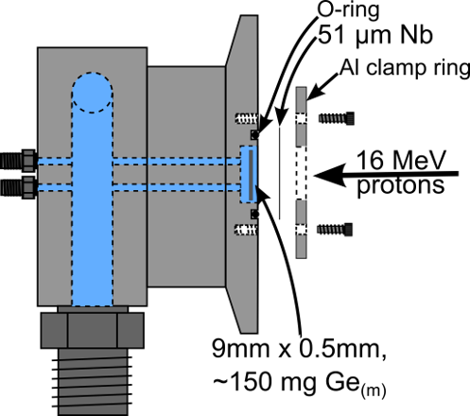
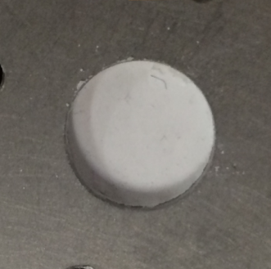
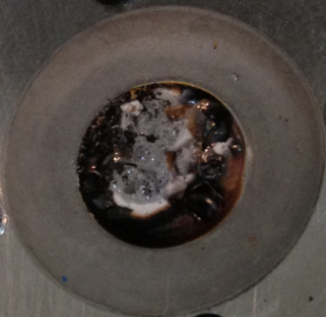
Research topic
GeO₂ target
4π-water-cooled target
Pre irradiation:
After 4 μA*
GeO₂
Difficult to dissolve it and As isolation yield deceased.
Problem…
Only tolerant to low beam.
Problem…
it is incompatible with deuterons and commercial solid target irradiation systems.
[4] P.A. Ellison et al., AIP Conf. Proc. 1509 (2012) 135-140.
[1] P.A. Ellison et al. Bioconjug. Chem. 27 (2016) 179–188.
Notes:
GeO2 pressed at 225 MPa into H2O-jet-cooled stainless steel or Nb holde
Significantly diminished dissolution and As isolation yields.

Slide 4


Research topic
Bombardment
Target making
Isolation
Radiopharmaceuticals
Reclamation
Radiolabeling

Slide 5
Research topic
Bombardment
Target making
Isolation
Radiopharmaceuticals
Reclamation
Radiolabeling

Slide 6
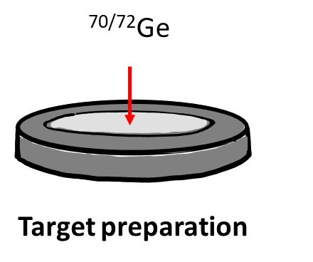
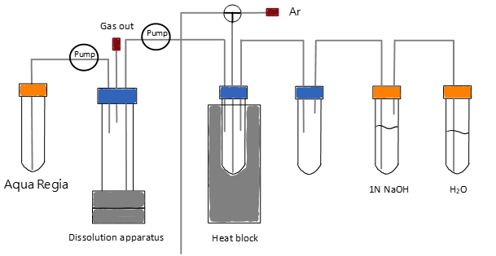

Research topic
Target making
Bombardment
Isolation
(non-radioactive )
Reclamation
⁷²Ge (p,n) ⁷²As
⁷⁰Ge (d,n) ⁷¹As
Bombardment
Dissolution and Separation
Ta coin
(⌀=10 mm, 1 mm deep)

Slide 7
Target making
Target making
Bombardment
Isolation
Reclamation
Ge bb making
Hot pressing
Ge Target
Ta coin
(⌀=10 mm, 1 mm deep)

Slide 8


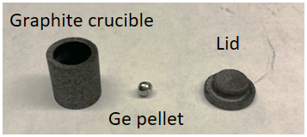
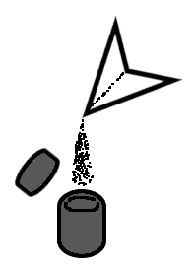


Target making: Germanium bb making
Method
Ar infilled
Heated in furnace for 30 min (1045° C)
^{Nat}Ge bb
≈
Prepare ^{Nat}Ge (~70 mg) powder in carbon crucible.
Use furnace to heat Ge to form Ge bb.

Slide 9

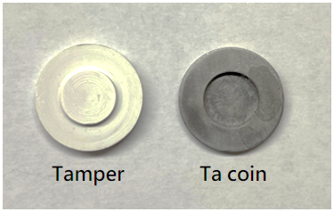

Target making: Ge target production
Method
Ar infilled
^{Nat}Ge
Ta coin
Tamper (Boron nitride)
Heated in furnace for 10 min (1000° C)
Ta coin
(⌀=10 mm, 1 mm deep)
≈
Prepare ^{Nat}Ge bb (~70mg) on Ta coin.
Heated in furnace at 1000 ° C for 5 min
Hot pressing in furnace

Slide 10
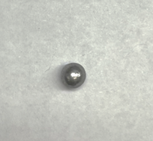
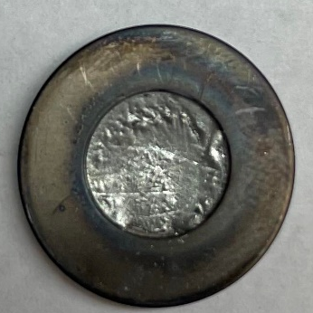
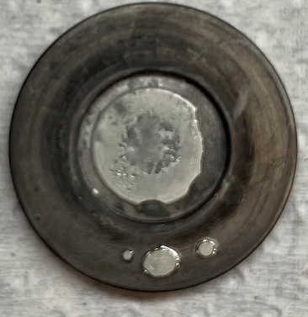
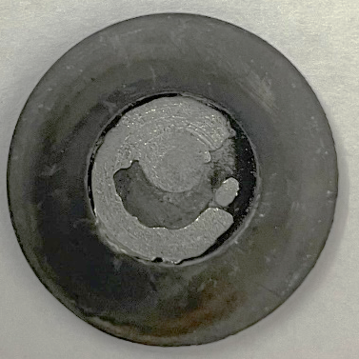
Target making: Germanium bb making and Ge target production
Result
Ge bb making | Initial Ge powder mass (mg) | Ge Loss (mg) | Ge % Loss
Natural | ~70 | 0.3 ± 0.27 | 0.5 ± 0.35 | -
Ge-Ta target making | Initial Ge bb mass (mg) | Ge loss on target (mg) | Ge % Loss | Ge thickness (μm)
 | ~70 | 0.7 ± 0.73 | 0.9 ± 1.0 | 325 ± 44
Notes:
However, we still can not always make a perfect target like the fully covered Ge target. So we keep trying to improve the procedure to get much better target.

Slide 11
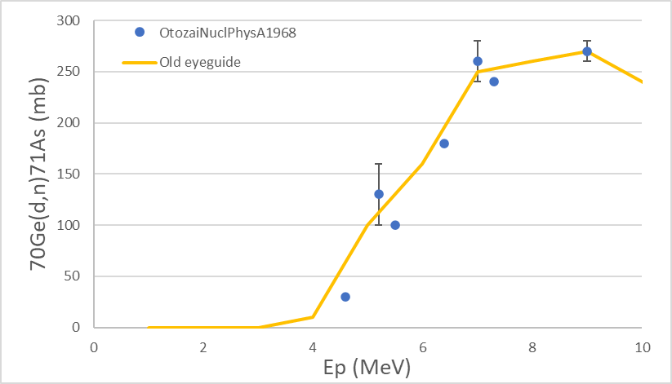

Target making: Germanium bb making and Ge target production
Result
Ge bb making | Initial Ge powder mass (mg) | Ge Loss (mg) | Ge % Loss
Natural | ~70 | 0.3 ± 0.27 | 0.5 ± 0.35 | -
Ge-Ta target making | Initial Ge bb mass (mg) | Ge loss on target (mg) | Ge % Loss | Ge thickness (μm)
 | ~70 | 0.7 ± 0.73 | 0.9 ± 1.0 | 325 ± 44
Theoretical thickness: 166 μm
$$Thickness=\frac{mass}{ρ×area }=\frac{0.07 g}{5.35\frac{g}{{cm}^{3}}×0.25π{cm}^{2}}$$
[5] K. Otozai, et al., Nucl. Phys. A. 107 (1968) 427–435.
[6] J.F. Ziegler et al., Nucl. Phys. B. 268 (2010) 1818–1823.

Slide 12
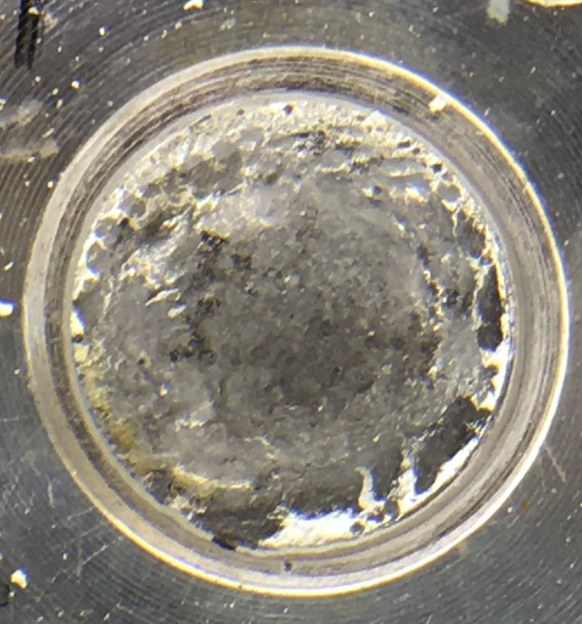
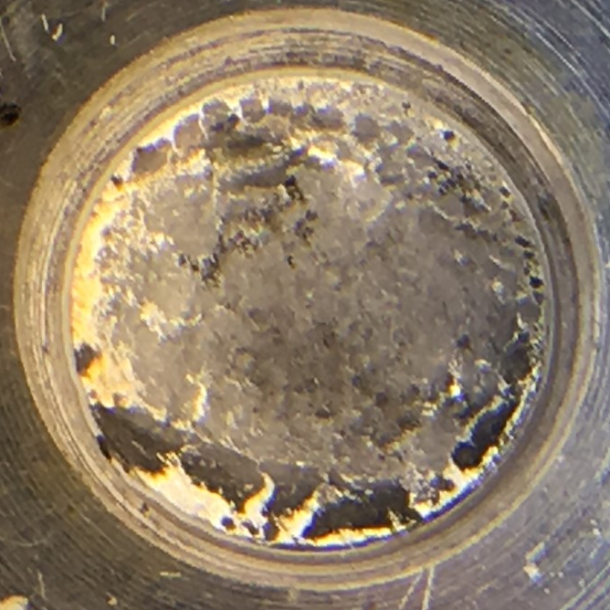
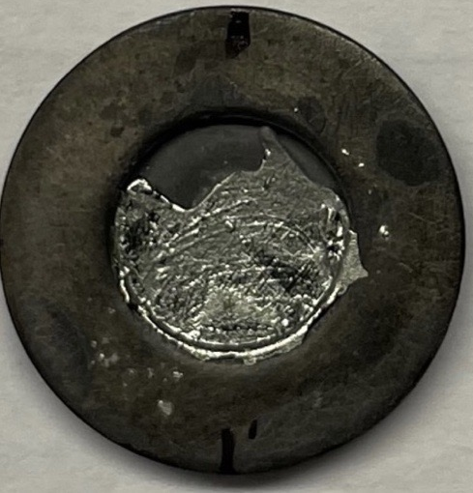
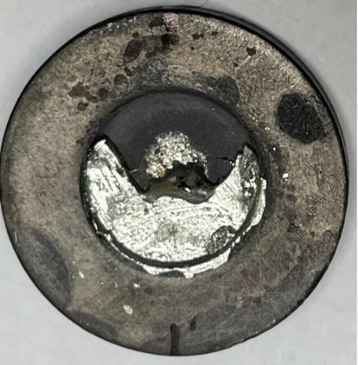
Bombardment: Irradiation study
Method & Result
Irradiation condition
Projectile | Proton | Deuteron
Energy | 12 MeV | 8 MeV
Current | 30μA | 18.5 μA
Target | ^{nat}Ge | ^{Nat}Ge
Targetry | Reaction | Energy (MeV) | Experiment (mCi/μAh) | Theory (mCi/μAh) [5,7]
Prototype coin-type target | ⁷²Ge(p,n)⁷²As | 12 | 2.5 | 5.7
Prototype coin-type target | ⁷⁰Ge(d,n)⁷¹As | 8 | 0.17 | 0.17
*Enriched target yields extrapolated from experimental proton and deuteron irradiations of a ^{nat}Ge target
Before irradiation
(proton)
After irradiation
(proton)
Before irradiation
(deuteron)
After irradiation
(deuteron)
[5] K. Otozai, et al., Nucl. Phys. A. 107 (1968) 427–435. [7] I. Spahn, et al., Appl. Radiat. Isot. 65 (2007) 1057–1064
Notes:
Why we choose 12 MeV??
Reference
beam spot is larger than coin

Slide 13
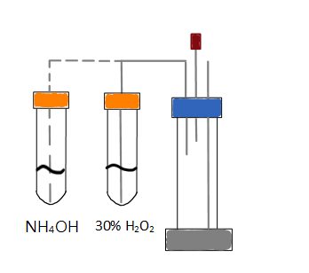



Isolation: Dissolution of Ge
Method
NH₄OH method
HCl method
Aqua Regia method
Add 2 mL 0.48M NH₄OH in 30% H₂O₂
Heated at 100 °C for 15 min.
Add 2 mL 37% HCl
Heated at 100 °C for 15 min.
Dropwise addition of 2 ml of 30% H₂O₂
Add 2.5 mL aqua regia
Heated at 100 °C for 30 min.

Slide 14
Isolation: Dissolution of Ge
Result
Condition | Ge-coated Ta coin
Dissolution solution | 0.48M NH₄OH [M] in 30% H₂O_{2 [7]} | 37% HCl with 30% H₂O₂ _{[8]} | Aqua regia [1]
Solution volume (mL) | 2 | 2 | 2.5
Total reaction time (min) | 15 | 15 | 30
Reaction Temp. (°C) | 100 | 100 | 100
Ge mass dissolved (mg) | 6.9 ± 0.7 (14±2%) n=20 | 20.7 ± 7.4 (25±10%) n=5 | 153± 12 (100%) n-=6
Ta coin mass dissolved (mg) | 1.1 ± 0.2 n=4 | 0.1± 0.1 n=3 | 0.0±0.1 n=3
Conclusion
Aqua regia condition dissolved more mass of Ge than others under the same reaction time.
No significant mass lost for Ta coin under aqua regia condition.
[8] Y. Feng et al., Appl. Radiat. Isot. 143 (2019) 113–122. [9] J. W. Irvine, Jr., J. Phys. Chem. 46, 910 (1942) 910-914
Notes:
Why did you try these methods? Why Ta coins? These reagents? Justify with reasoning/citations.

Slide 15





Reclamation: Dissolution and Distillation
Method
Dissolution:
Distillation and Hydrolysis:
Ge+4HNO₃ GeO₂+4NO₂+2H₂O
GeO₂+4HCl GeCl₄+2H₂O
GeO₂+4HCl GeCl₄+2H₂O
GeCl₄+2H₂O GeO₂+4HCl
^{71/72}AsCl₅ would remain in heating tube during distillation
2ml HCl
^{Nat}Ge pieces mass ~150 mg
^{71/72}AsCl₅

Slide 16
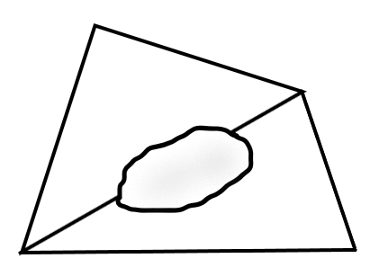
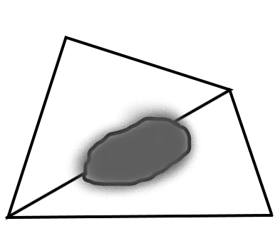
Reclamation: Dissolution and Distillation
Method
Dissolution:
Distillation and Hydrolysis:
Ge+4HNO₃ GeO₂+4NO₂+2H₂O
GeO₂+4HCl GeCl₄+2H₂O
GeO₂+4HCl GeCl₄+2H₂O
GeCl₄+2H₂O GeO₂+4HCl
Reclamation:
Reduction under H₂ at 600°C
for 1.5 h
Heated at 1045°C for 30 min
GeO₂
^{Nat}Ge powder
^{Nat}Ge bb

Slide 17
Reclamation: Dissolution and Distillation
Method
Dissolution:
Distillation:
Ge+4HNO₃ GeO₂+4NO₂+2H₂O
GeO₂+4HCl GeCl₄+2H₂O
GeO₂+4HCl GeCl₄+2H₂O
Reclamation:
HCl capture method
NH₄OH neutralization method
NaOH neutralization method

Slide 18
Reclamation: Distillation and Reclamation
Method
HCl capture method
2ml HCl
Dry out the precipitate with Ar
and
Heated at 150°C to remove residual HCl
^{Nat}Ge pieces mass ~150 mg
GeO₂

Slide 19


Reclamation: Distillation and Reclamation
Method
NH₄OH neutralization method
Dry out the precipitate
and
Heated at 350°C to remove salt
Condense tube
NH₄OH
H₂O
NH₄OH
GeO₂
Neutralization

Slide 20


Reclamation: Distillation and Reclamation
Method
NaOH neutralization method
Wash with H₂O
and
Dry out the precipitate
Condense tube
1N NaOH
H₂O
GeO₂
NaOH pellet (~2 g)
Neutralization

Slide 21

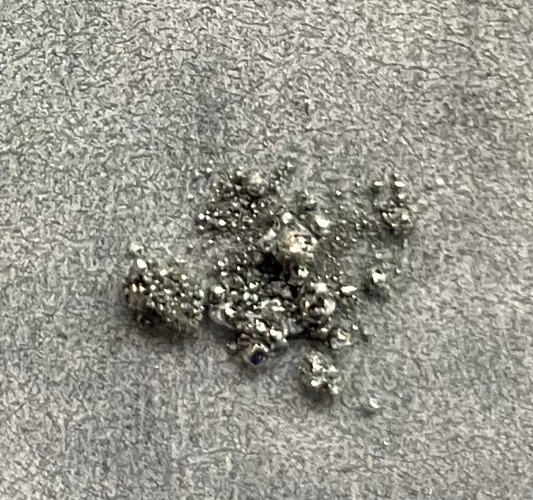
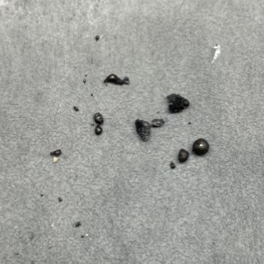
Reclamation
Result
Condition | HCl capture | NH₄OH neutralization | NaOH neutralization
Ge piece mass (mg) | 142.2 | 153.6 | 151.7
 | After removing residual HCl or salt
^{Nat}GeO₂ mass (mg) | 103.5 | 86.4 | 53.8
 | After reduction by H₂
Ge mass | 67.5 | 55.3 | 19.6
 | After bb making
Ge bb mass | 68.7 | 58.6 | 14.8
Reclamation efficiency % | 48.3% | 38.2% | 9.8%
Notes:
Some impurity

Slide 22
Conclusion
Target making
Bombardment
Isolation
Reclamation
Target production:
Improve the target production procedure to get fully covered Ge target.
Reclamation:
HCl capture method.
Optimization for the procedure to increase the efficiency is needed.
Target cooling problem:
The Ge is melted during irradiation. We will use thinner Ta coin and try to make the thickness of Ge thinner.
Separation of As from Ge:
Aqua regia method displayed higher Ge mass dissolved and shorter dissolving time.

Slide 23
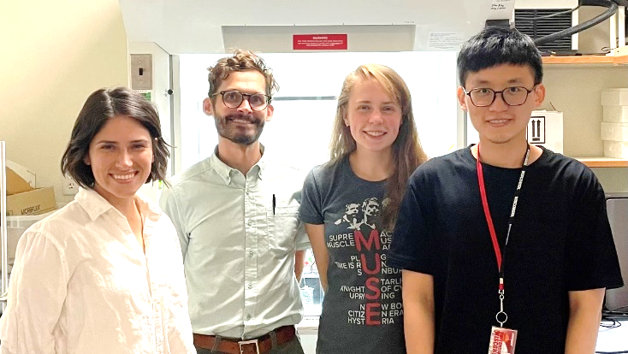




Acknowledgement
Thanks to
Department of Energy Isotope Program, managed by the Office of Science for Isotope R&D and Production grant DE-SC0022032.
Paul Ellison’s Group
University of Missouri
Cyclotron Group
Professor Heather M. Hennkens
Professor Silvia S. Jurisson
Professor Jonathan W. Engle
Todd E. Barnhart, PhD

Slide 24
Thanks for your attention

Slide 25
Reference
P.A. Ellison et al. Bioconjug. Chem. 27 (2016) 179–188.
Y. Feng et al., Appl. Radiat. Isot. 143 (2019) 113–122.
Matthew D.Gott et al., Journal of Chromatography A, 1441(2016) 68-74
P.A. Ellison et al., AIP Conf. Proc. 1509 (2012) 135-140.
K. Otozai, et al., Nucl. Phys. A. 107 (1968) 427–435.
J.F. Ziegler et al., Nucl. Phys. B. 268 (2010) 1818–1823.
I. Spahn, et al., Appl. Radiat. Isot. 65 (2007) 1057–1064
Y. Feng et al., Appl. Radiat. Isot. 143 (2019) 113–122. [
J. W. Irvine, Jr., J. Phys. Chem. 46, 910 (1942) 910-914

Slide 26
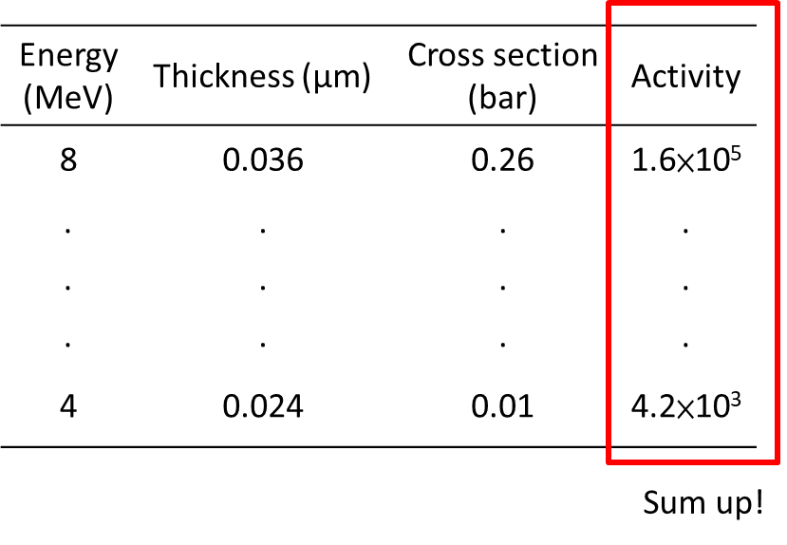
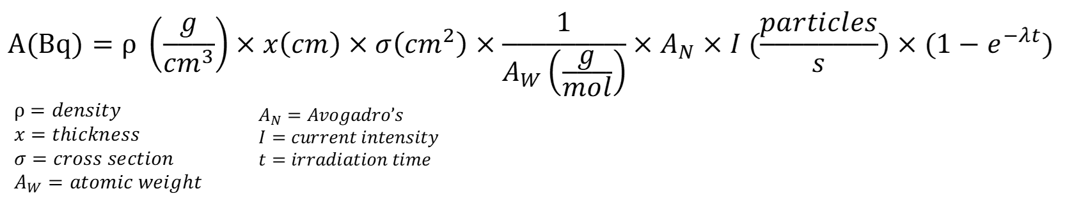
Bombardment: Irradiation study
Method & Result
Irradiation condition
Projectile | Proton | Deuteron
Energy | 12 MeV | 8 MeV
Current | 30μA | 18.5 μA
Target | ^{nat}Ge | ^{Nat}Ge
Targetry | Reaction | Energy (MeV) | Experiment (mCi/μAh) | Theory (mCi/μAh) [1,4]
Prototype coin-type target | ⁷²Ge(p,n)⁷²As | 12 | 2.5 | 5.7
Prototype coin-type target | ⁷⁰Ge(d,n)⁷¹As | 8 | 0.17 | 0.17
*Enriched target yields extrapolated from experimental proton and deuteron irradiations of a ^{nat}Ge target
Notes:
reference

Slide 27
Research topic
⁷⁷Ge(n,γ)⁷⁷As
⁷⁷As beta emitter
End point energy ≈683 keV
T_{1/2}=38.8 h
Problem…
The lack of imaging property which can provide in patient selection, target verification and dosimetry.
^{71/72}As positron emitter
⁷²Ge(p,n)⁷²As--UWisc PETtrace cyclotron
T_{1/2}: ⁷¹As=65.3 h and ⁷²As=26 h
End point energy: ⁷¹As=816 keV and ⁷²As=2500 keV
¹¹⁹Sb MAe⁻ emitter
N
P
As
Sb
Bi
Homologous relationship with ¹¹⁹Sb
Notes:
Put reference As-72 Ellison biocol chem 2015
Put reference Se-72 Y. Feng et al., Appl. Radiat. Isot. 143 (2019) 113–122.
Gott et al. J Chromatogr A for (n,r)
Having a slide after it about .

Slide 28
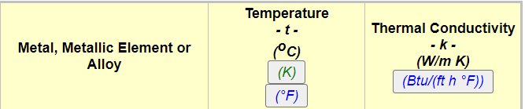
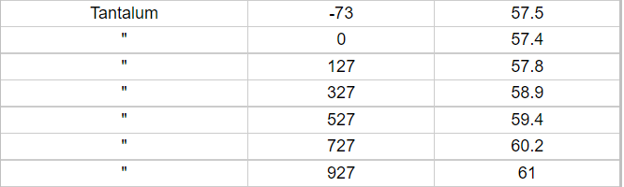
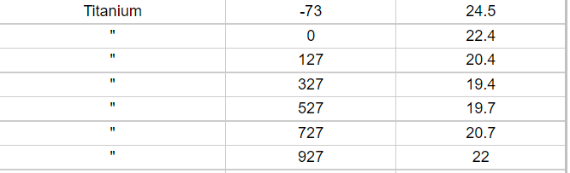
Conclusion
Target making
Bombardment
Isolation
Reclamation
Target production
Improve the target production procedure to get fully covered Ge target.
Reclamation
HCl capture method.
Optimization for the procedure to increase the efficiency is needed.

