Slide 1
Purifying Radioantimony for Targeted Radionuclide Therapy: Developments in Separating Antimony from Bulk Tin Target
Aivija Grundmane,
TRIUMF/Simon Fraser University
August 25, 2022

Slide 2
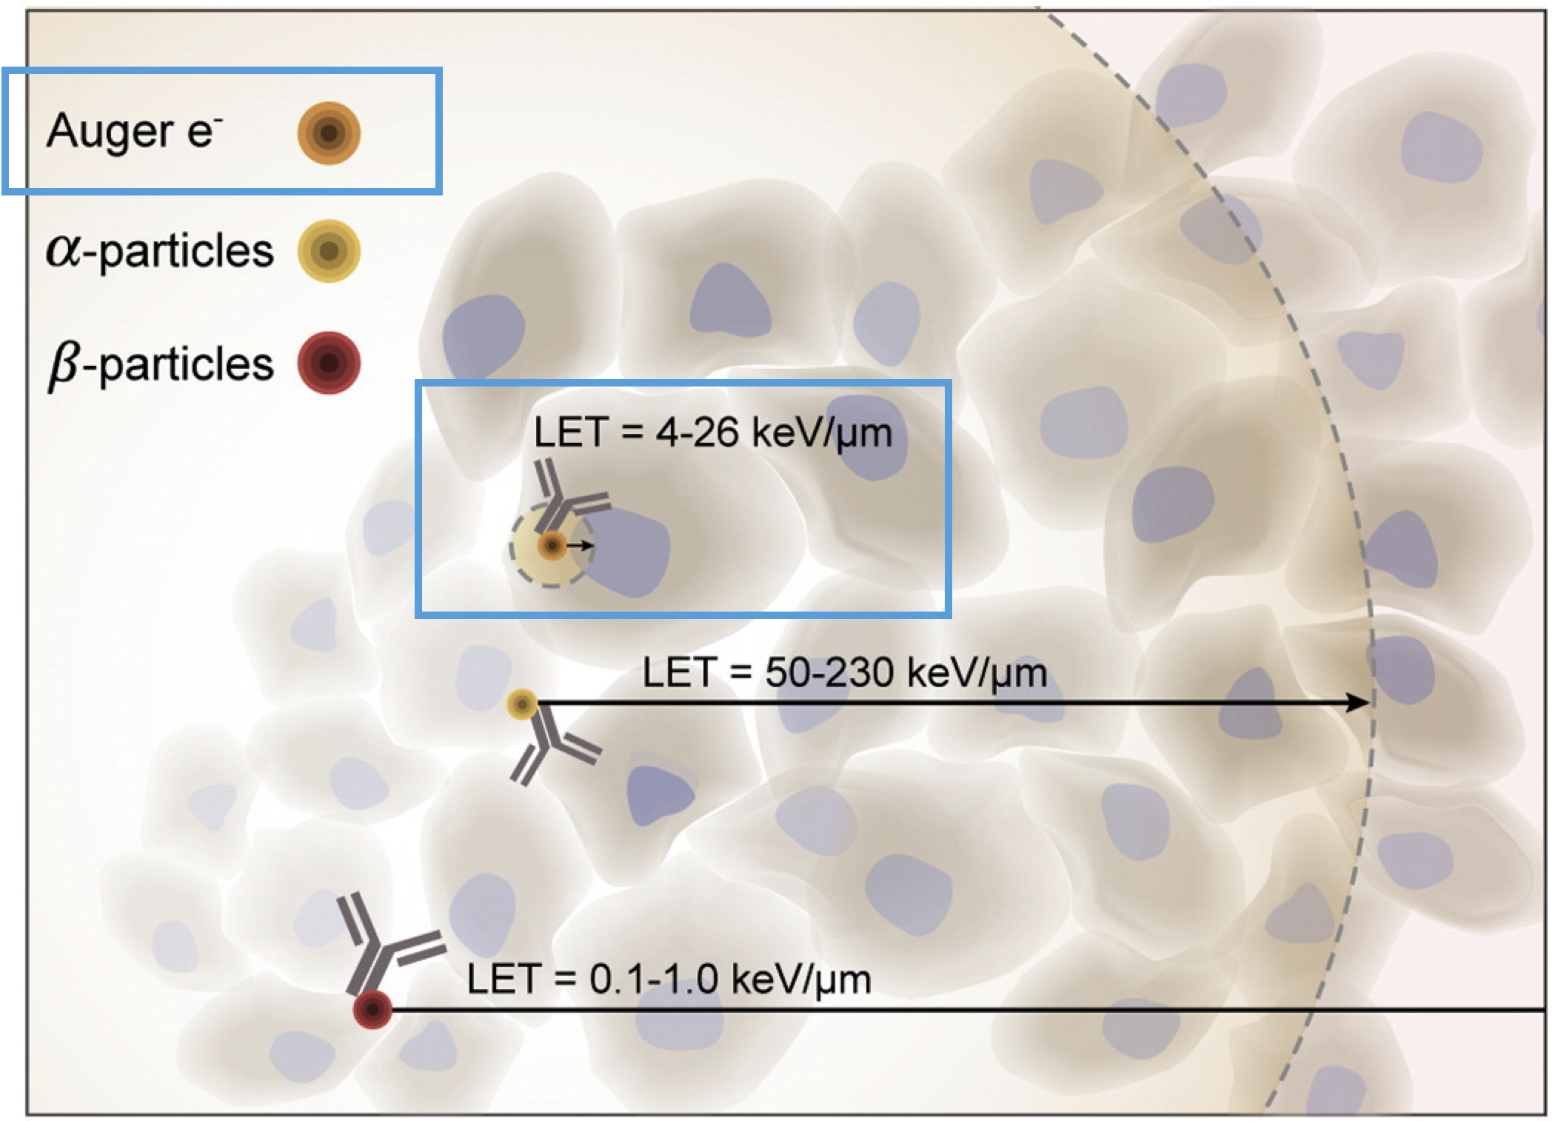
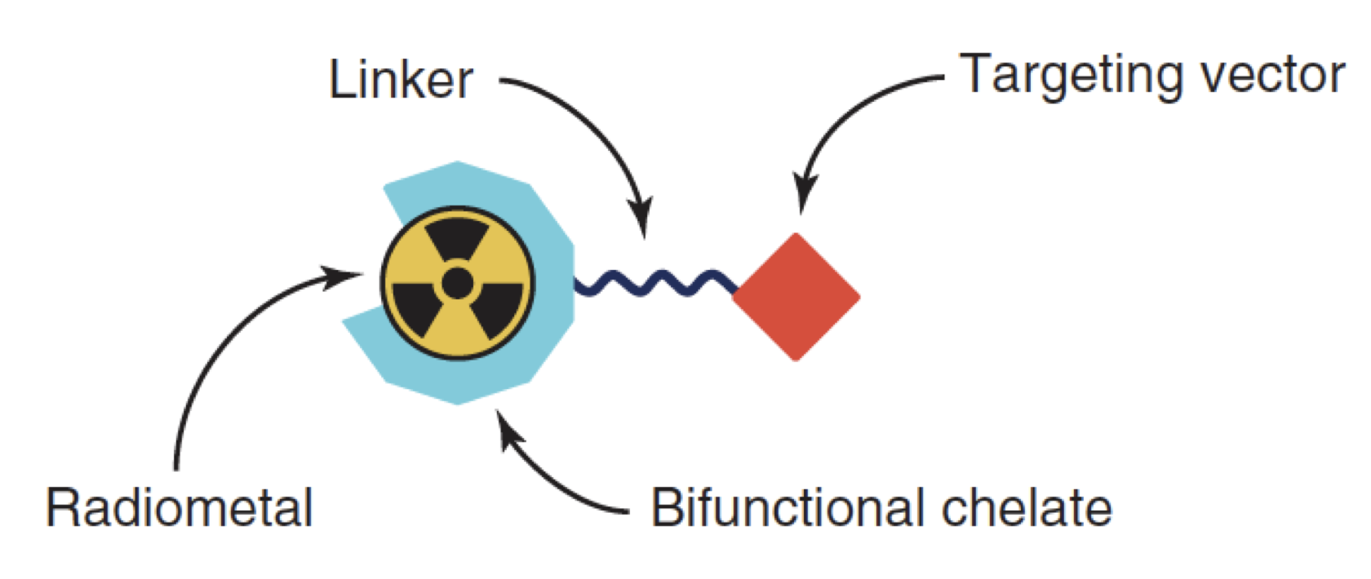
Meitner-Auger Emitters for Targeted Radionuclide Therapy
Carbo-Bague et al, Encyclopedia of Inorganic and Bioinorganic Chemistry, 2021.
S. Aghevlian et al, Adv. Drug Deliv. Rev. 2017, 109, 102–128.
2
Notes:
So first a bit of a background on why we are interested in antimony-119 is that it is a potential candidate for TRT.
Targeted Radionuclide Therapy is a type of cancer treatment based on selectively delivering a radionuclide to the tumour.
There are several mechanisms of doing this, most commonly the bifunctional chelator model you can see on the left here, where you produce a radiometal of your choice, in my case antimony-119, you purify it and chelate it to a bifunctional chelator, which is then in turn linked to a targeting vector, which then selectively binds to cancer cells, depositing the dose there and killing the cells.
As there are many isotopes, there are different types of radioactive decay that can be utilized for this purpose and so on the right here you can see a comparison between three types of radioactive decay and their typical LET values as well as distance travelled in tissue. And you can see that Meitner-Auger electrons travel very short distances while depositing high LET in the area, therefore offering highest selectivity of treatment achievable by TRT, which brings me to antimony-119.

Slide 3
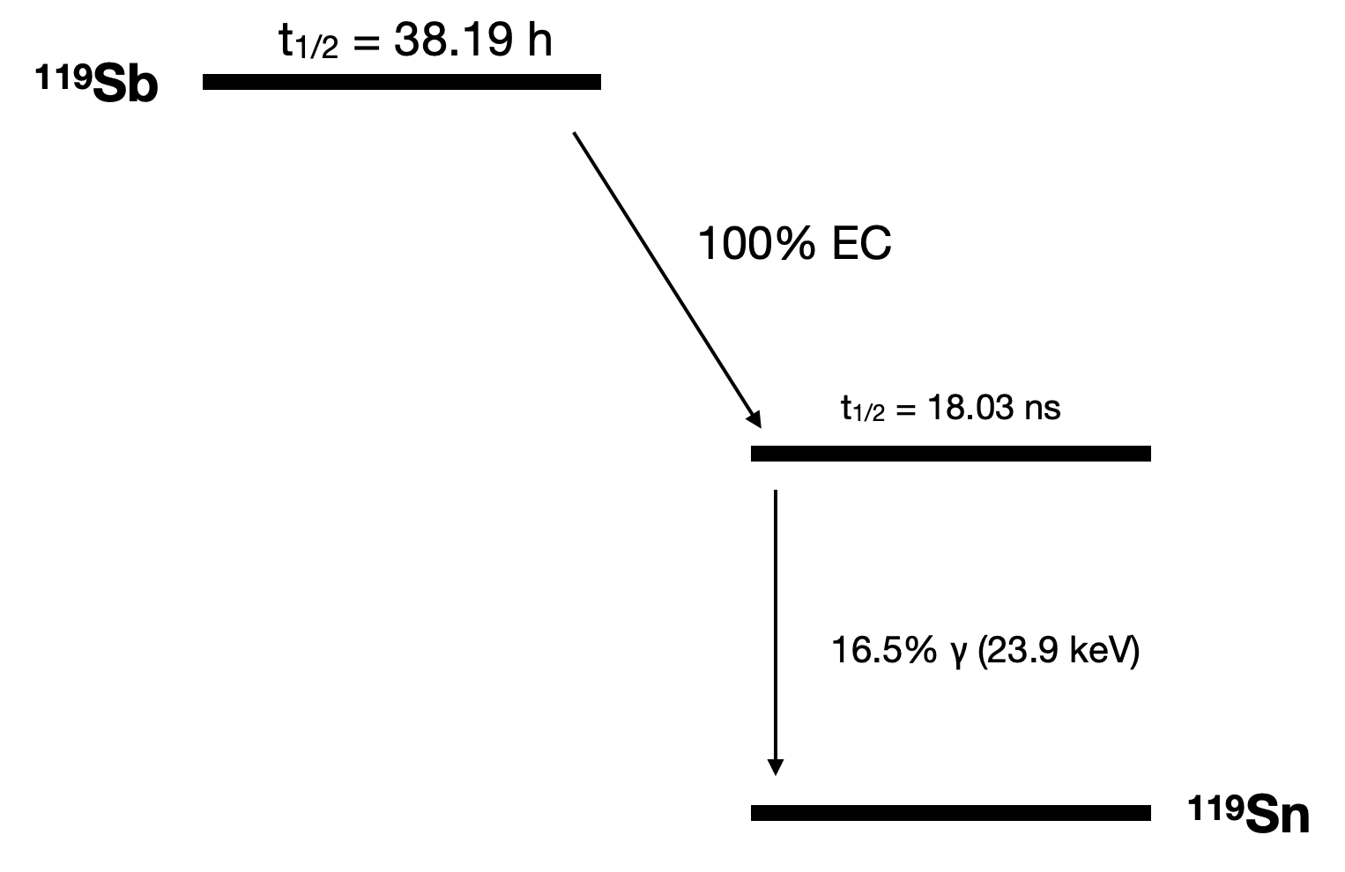
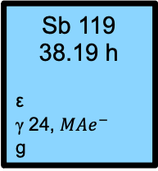

Sb 119
38.19 h
ε
γ 24, ${MAe}^{−}$
g
Appropriate half-life for TRT
Absence of other accompanying emissions
Good number and energy of Meitner-Auger electrons
Isotope | Half-life | MAE/decay | E_{avg} (keV/decay) | High E γ
¹¹⁹Sb | 38.2 h | 23.7 | 8.9 | No
^{197g}Hg | 2.67 d | 23.2 | 7.4 | No
^{197m}Hg | 23.8 h | 19.4 | 7.6 | Yes
¹¹¹In | 2.81 d | 14.7 | 6.75 | Yes
¹²⁵I | 60.1 d | 24.9 | 12.24 | No
Symochko et al, 2009, 110(11), 2945 - 3105
Randhawa et al, Curr. Radiopharm., 2021, 14, 394 - 419
Notes:
Decay scheme – 100% EC, pure MA e- emitter, decays to stable tin directly.
Several MA e- emitters of interest (table), explain why 119sb is better (125I has a half life too long, 111In has problems with the high energy gammas, 119sb has the best MAE/decay). Only problem is detecting it.

Slide 4
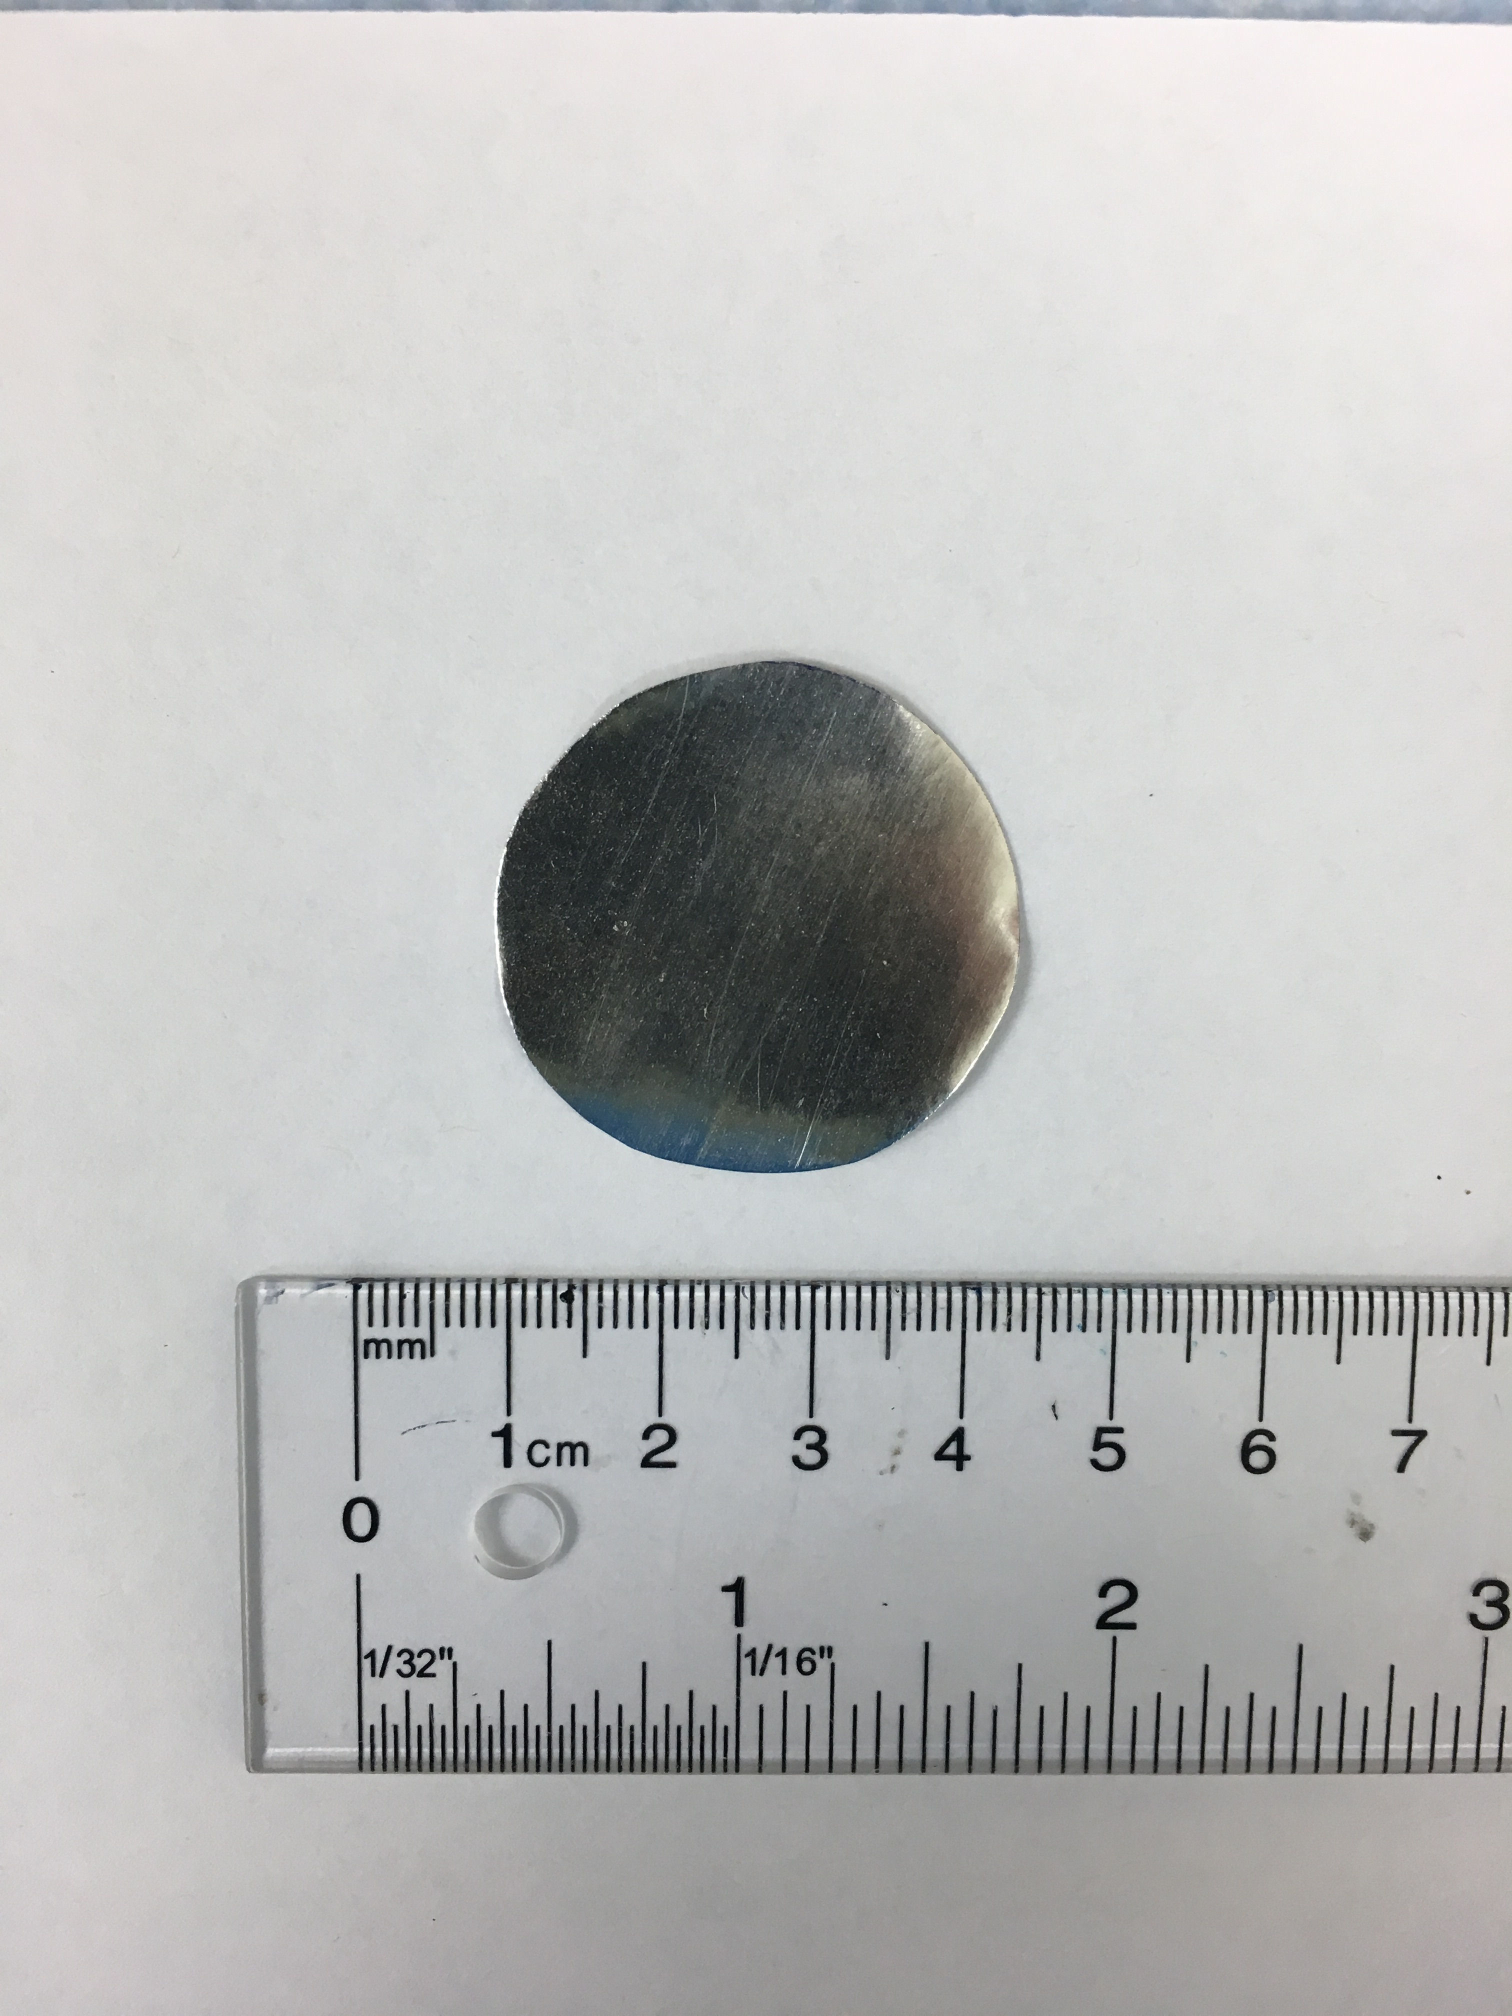
Irradiation of ^{nat}Sn at TRIUMF
^{nat}Sn target irradiated with 12.8 MeV protons (TR13) at 5 μA for 60 min
50 MBq of ¹¹⁹Sb (t_{1/2} = 38.19 h)
1.5 MBq of ^{120m}Sb (t_{1/2} = 5.76 d) and 28 kBq of ^{117m}Sn (t_{1/2} = 14.0 d)
^{nat}Sn target
Isotope | Natural abundance (%)
Sn-117g | 7.68
Sn-118 | 24.22
Sn-119 | 8.59
Sn-120 | 32.58
Sn-122 Sn-124 | 4.63 5.79
Notes:
Currently using natural Sn target for research and development purposes. This allows us to track where the activity is going.
Plans to move to an enriched tin target.

Slide 5
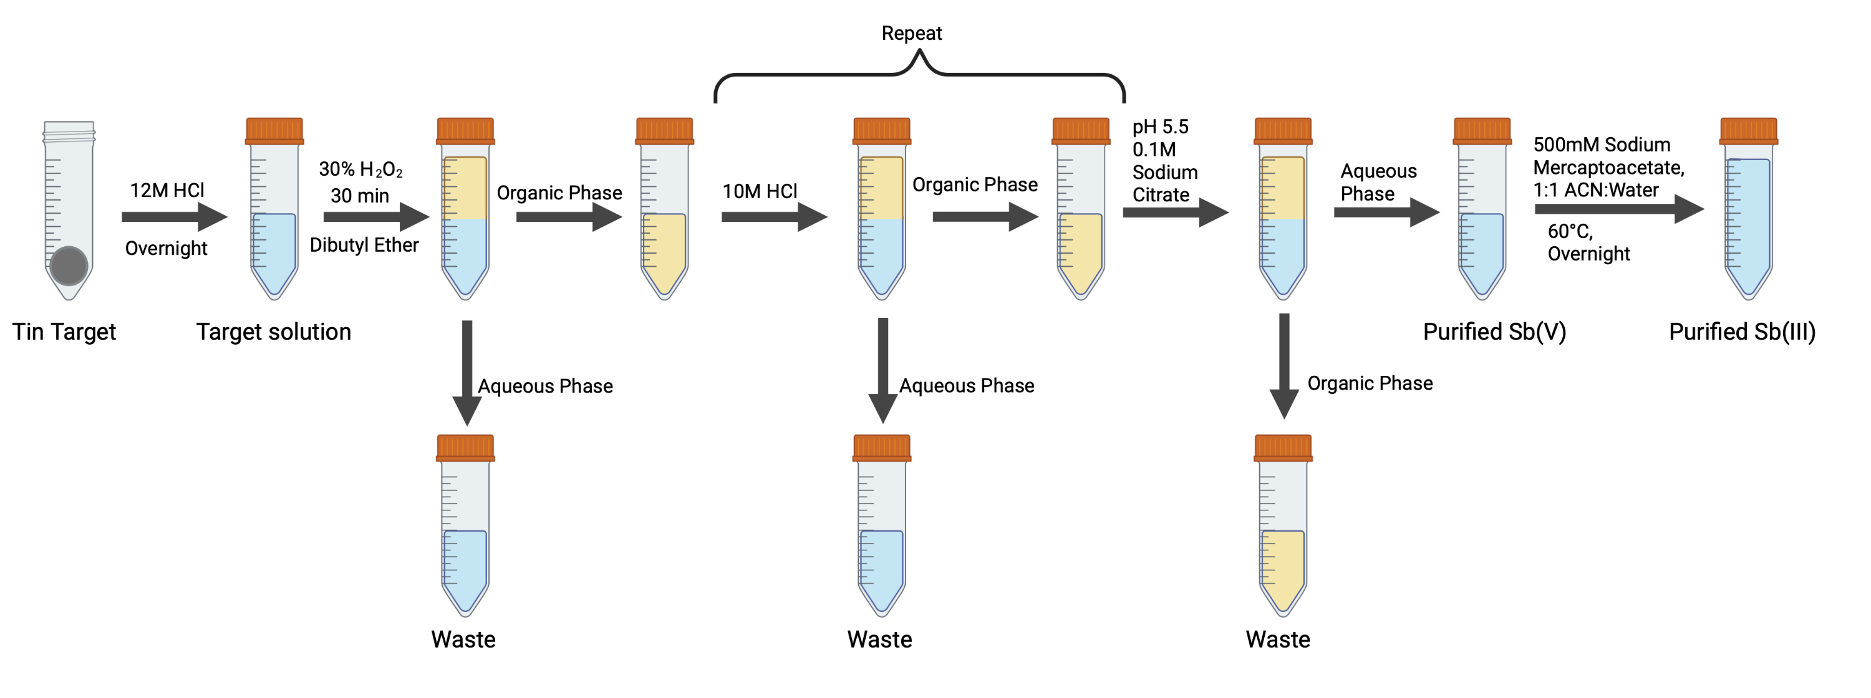
Radiochemical Separation – Liquid-Liquid Extraction
Removes > 99.95% of the tin target
> 75% recovery of radioantimony
Limitations inherent to the methodology (dilute Sb, high hand dose, large volume of waste)
~400 mg Sn
< 200 μg Sn
Sb
Sb
Sb
Sb
Sb
Sb
Sb
Sb
Notes:
After irradiation, conc. HCl.
limitations, some that affect the subsequent radiolabeling process, some that prevent automation and are of practical consideration

Slide 6
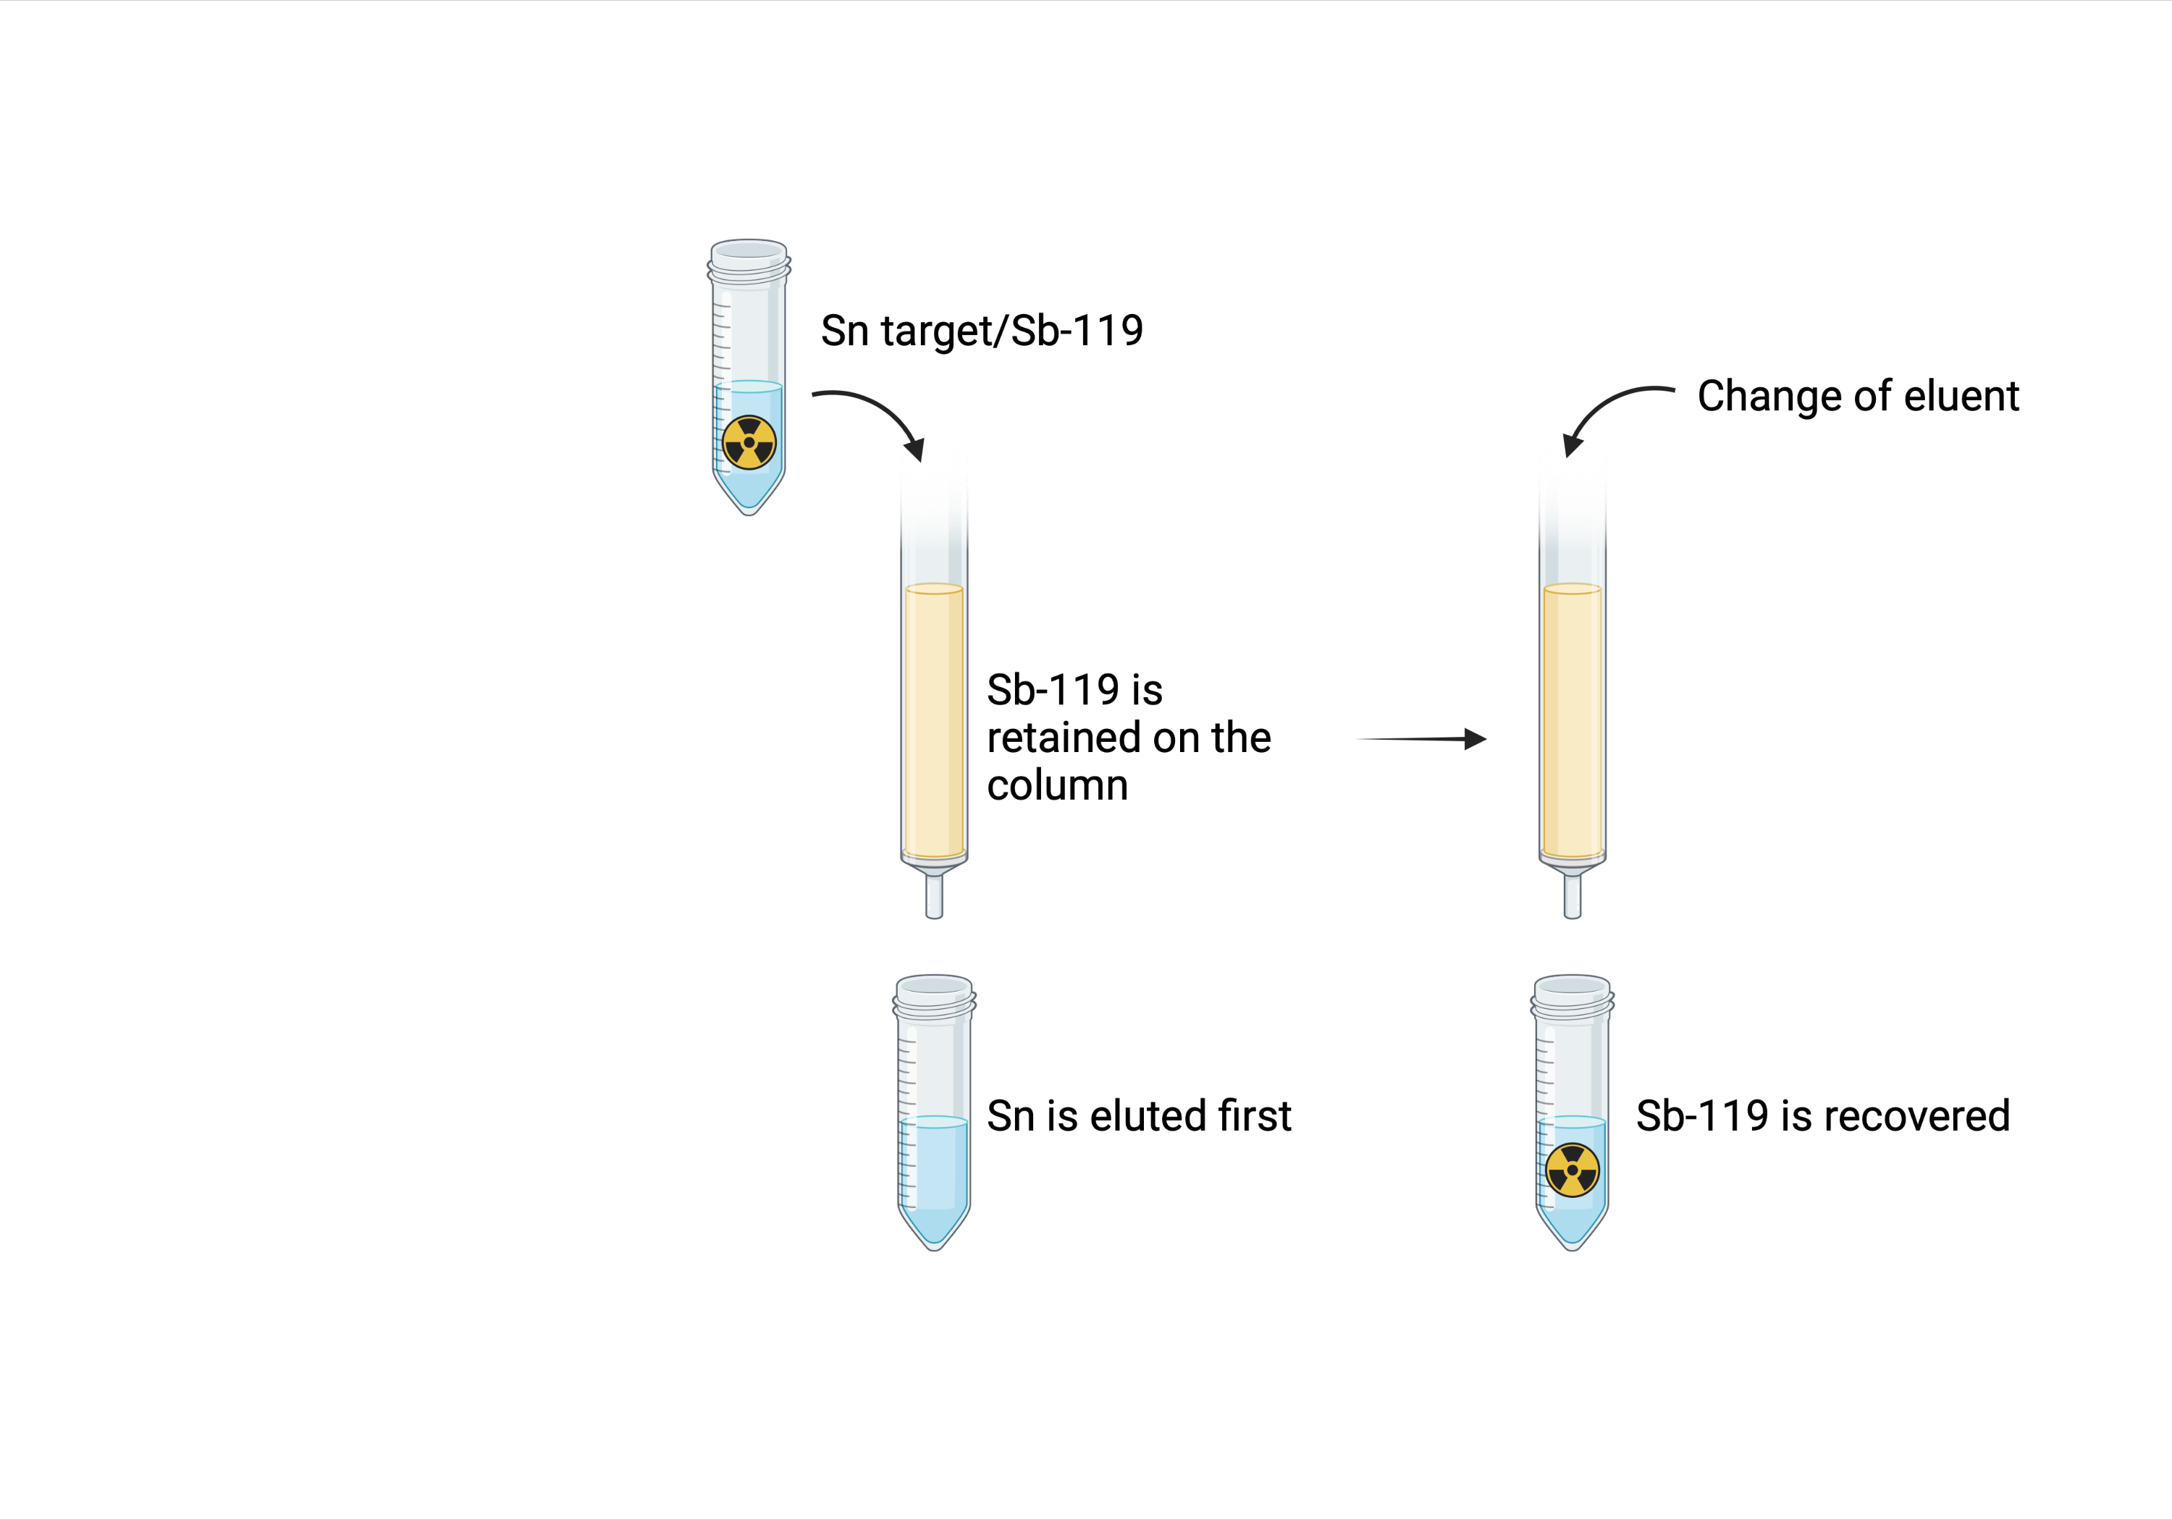
Radiochemical Separation – Column Chromatography
Ideal separation:
  Concentrated Sb-119
  No oxidation/reduction required
  High separation factor
  Easy to automate
Notes:
This would enable potential automation down the line, increase the concentration of radioantimony for labeling as well as improve purity (e.g. multi-column set ups)
Burns et al, Sep. Purif. Technol., 2021, 256, 117794. Texas AM University. Sherry Yenello

Slide 7
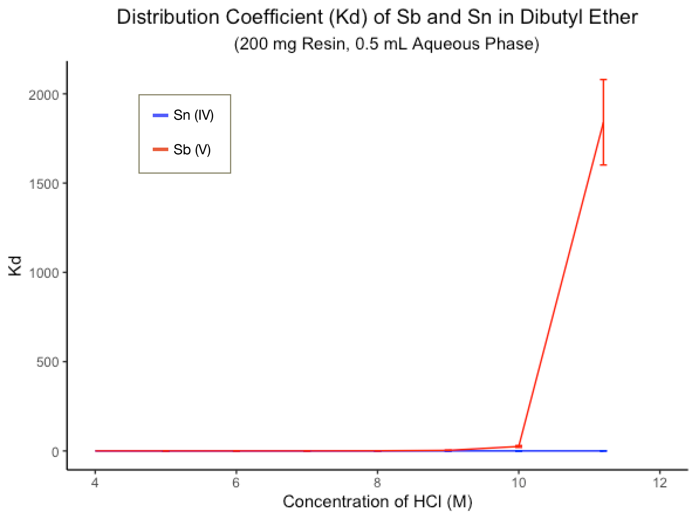
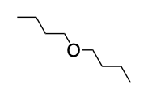
Dibutyl Ether Resin in Development
Resin Beads
+
Dibutyl Ether Resin
Irradiated Sn target (400 mg), γ spectroscopy, n = 3.
Notes:
8 different concentrations

Slide 8
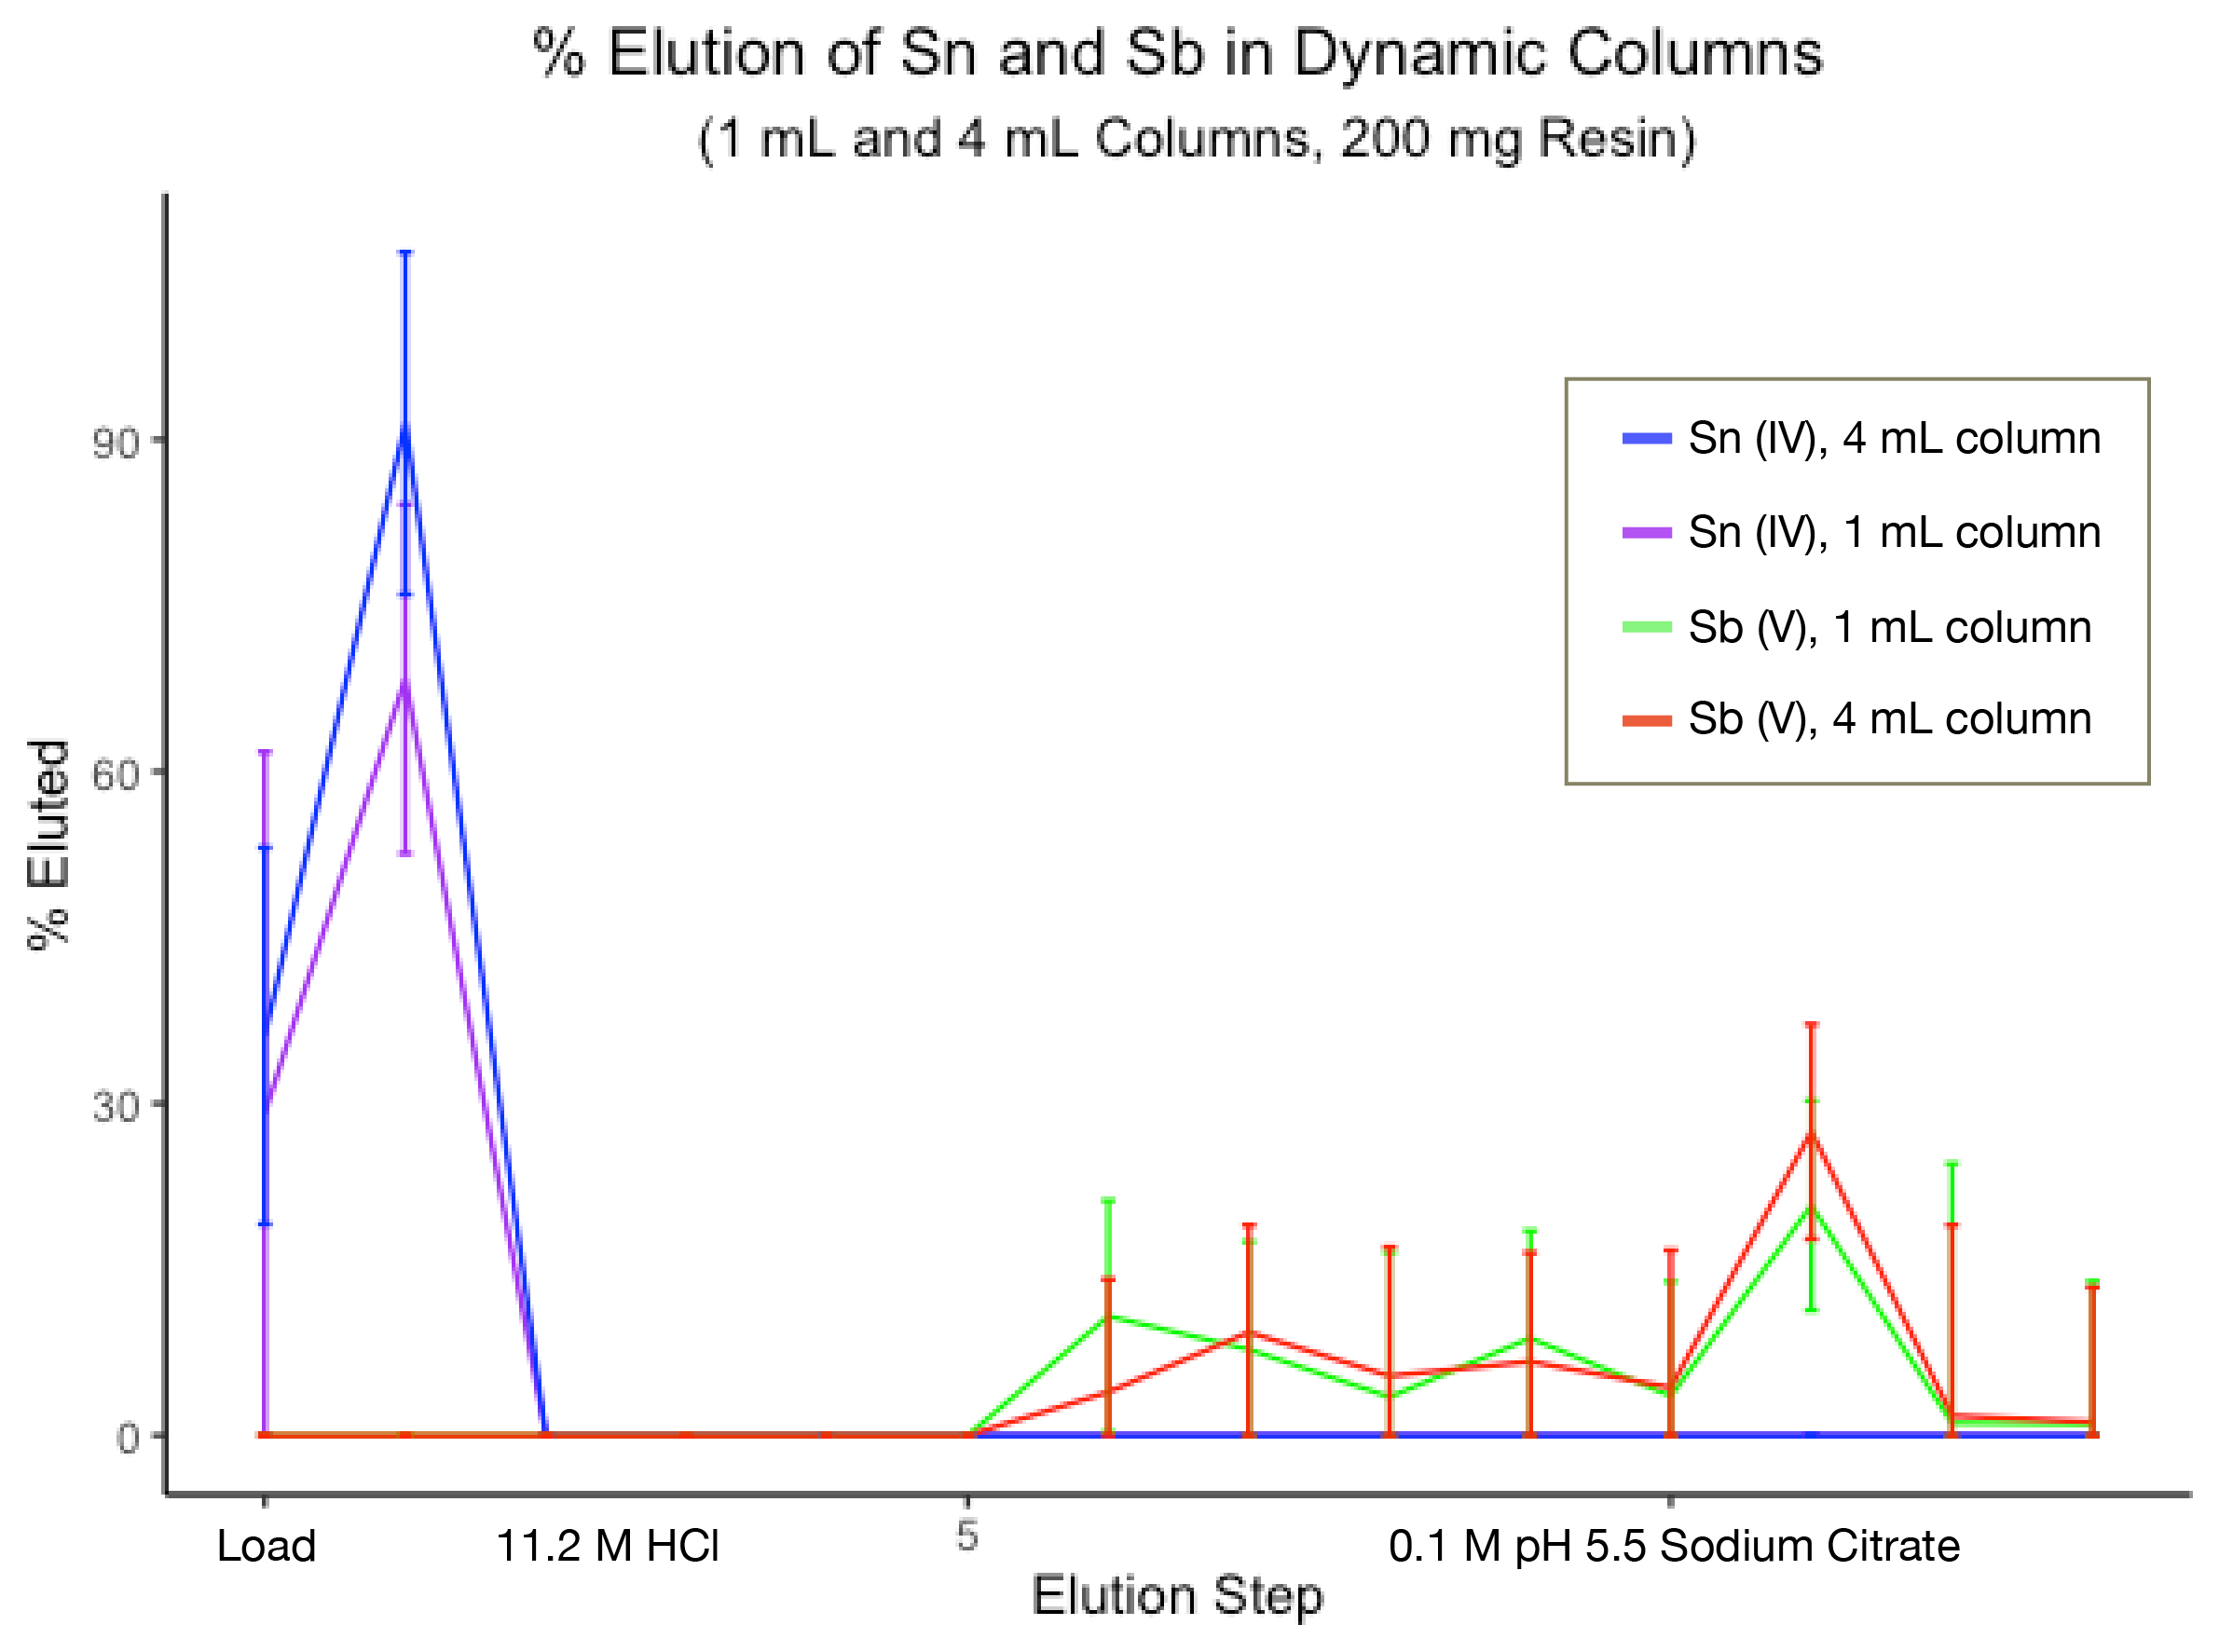
Dibutyl Ether Resin in Development
Resin Beads
+
Dibutyl Ether Resin
Irradiated Sn target (400 mg), 0.5 mL elution steps, γ spectroscopy.
Notes:
Tested out two dynamic columns, using the same back extraction as the LLE method to draw direct comparison.
13 elution steps – Load in 11.2M HCl, steps 1-5 washes with 11.2 M HCl, 6 – 13 citrate. Tin eluted fully in first two fractions, which is also observed via ICPMS when eluting a cold tin target.
Elution step number 11 is higher because I pushed onto the column and let it sit for half an hour.

Slide 9

Future Direction
Optimizing antimony elution conditions
Resin characterisation
Radiolabeling studies
Notes:
Tin elution profiles are in agreement with ICPMS data for cold tin.
Bulk tin is removed in two elution steps, while all of the antimony is retained.
The antimony elution needs to be optimized and resin characterized to ensure reproducible consistent separation for subsequent radiolabeling studies, which is heavily affected by a suboptimal purification.

Slide 10
Thanks to
Dr Valery Radchenko
Dr Caterina Ramogida
The Ramogida Group
TR13 Team
Scott McNeil
Aeli Olson
Dr Tom Kostelnik

