Slide 1

Production of ¹⁶⁵Er by deuteron
I. Da Silva¹, D. Baux¹, P. Ellison²
(1) CEMHTI CNRS UPR 3079 University of Orléans (France)
(2) University of Wisconsin School of Medicine and Public Health (United States)
WTTC 18 , August 21-26th, 2022
(Whistler, Canada)

Slide 2
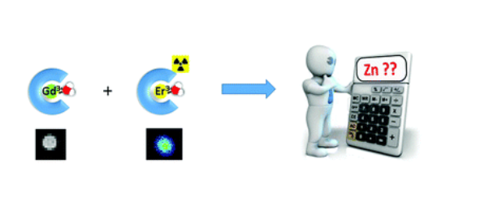
Radiolanthanide for bimodality imaging
Goal : Development of bimodal probes for MRI PET/SPECT imaging to detect Zn (II)
  ➔ Correlation between [*Gd] / [Gd] and [Zn] :
      [*Gd] ➔ [Gd] : SPECT/PET
      Relaxation Gd / [Zn] : MRI
But no radioactive Gd easy available at Orleans’Cyclotron
-
O
C
N
2
2
Z
n
+
C
O
-
N
2
Ln
3+
= Gd
3+
MRI, quantitative technique
N
Ln
=
Er
SPECT, responsive technique
N
3+
165
3+
N
3
N
L
+
n
C
O
-
C
O
-
C
O
-
C
O
-
2
2
2
2
Linker
Zn
Ln
-
2+
3+
complexing
complexing
part
unit
Notes:
Zn(II) is a very interesting biomarker, its homeostasis misregulation is linked to various diseases such as cancers, neurodegenerative diseases and diabetes. Therefore, imaging Zn(II) by MRI is of the highest interest for the early detection of these diseases as changes in Zn(II) are thought to occur well before the onset of the pathologies. However, MRI is not a quantitative technique and to be sure that the changes observed on MRI images are linked to Zn(II) changes and not a change in the biodistribution of the agent, the addition of a quantitative technique such as SPECT/ PET is compulsory. Access to radioactive Gd will be helpful but such radionuclide is not really available in easy way at Orleans’ cyclotron,

Slide 3

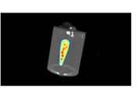
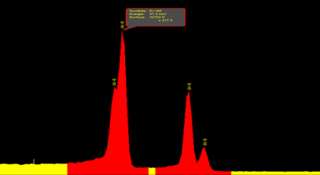
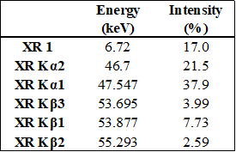
Why ¹⁶⁵Er ?
La
Ce
Pr
Nd
Pm
Sm
Eu
Gd
Tb
Dy
Ho
Er
Tm
Yb
Lu
Radiolanthanide needs :
  β⁺ emitter or ɣ emitter with E < 300 keV (PET or SPECT)
  Half-life compatible radiolabelling and imaging time
  Production yield to perform images with good statistics
  Commercially target no enriched
  2 candidates : ¹⁴¹Nd (from ¹⁴¹Pr) and ¹⁶⁵Er (¹⁶⁵Ho)
  But T_{1/2} ¹⁴¹Nd (2,49h) lower than ¹⁶⁵Er (10,36h)
    ➔ Er ³⁺ : Production from natural Ho target
        imaging with X ray ➔ SPECT/MRI
Notes:
Considering all radiolanthanide has a similar biodistribution, it will serve as surrogate for Gd(III). But physical and chemical specifications we need to select the right radiolanthanides ? After evaluate some criteria as a half life and radiation emission, 2 candidates seems acceptable. Nevertheless 141Nd has been excluded considering its half life.
¹⁶⁵Er was chosen for these reasons,
165Er is easily produce from a natural Ho target. its X ray emission (50KeV average) permits its use in imaging SPECT application.

Slide 4
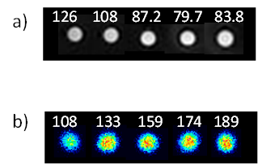
Results of in vitro experiments with ¹⁶⁵Er
* Determination of [Zn] in vivo
(a) T1-weigthed images (values in ms)
(b) images from ɣ-camera (activities in kBq)
Proof of concept validated in vitro
But high ratio between ligand and ¹⁶⁵Er :
  low AMA (SF = 1000)
  insuficient for specific applications (in vivo or Auger therapy dosimetry studies)
Notes:
Using this concept of bimodality Gd for MRI and 165Er for SPECT, we explore this quantification method of Zn in vitro with very promising results, both for Zn(II) detection in model cancers demonstrate correlation of Zn this quantification method and results from ICP MS Zn determination.
But 165Er with lower AMA didn’t impact in vitro results but translation to in vivo application turn to its use difficult.
For that improve AMA of 165Er for specific applications is compulsory,

Slide 5
AMA : Apparent Molar Activity
Unit : Activity of ¹⁶⁵Er by µmole of chelator (MBq/nmol or GBq/µmol)
Theoretical AMA :
Notes:
What parameter we need to consider in case of production of 165Er by irradiation of Ho target ?
If we look for a simplified expression of AMA, 3 major parameters appear essential on AMA value :
Targetry associated with used beam and/or accelerator, target (material and quality, mass) and at least of course radiochemistry separation and in case of Ho/Er separation SF which needs more than 10⁵

Slide 6
AMA : Apparent Molar Activity
Unit : Activity of ¹⁶⁵Er by µmole of chelator (MBq/nmol or GBq/µmol)
Theoretical AMA :
Notes:
What parameter we need to consider in case of production of 165Er by irradiation of Ho target ?
If we look for a simplified expression of AMA, 3 major parameters appear essential on AMA value :
Targetry associated with used beam and/or accelerator, target (material and quality, mass) and at least of course radiochemistry separation and in case of Ho/Er separation SF which needs more than 10⁵

Slide 7
AMA : Apparent Molar Activity
Unit : Activity of ¹⁶⁵Er by µmole of chelator (MBq/nmol or GBq/µmol)
Theoretical AMA :
Notes:
What parameter we need to consider in case of production of 165Er by irradiation of Ho target ?
If we look for a simplified expression of AMA, 3 major parameters appear essential on AMA value :
Targetry associated with used beam and/or accelerator, target (material and quality, mass) and at least of course radiochemistry separation and in case of Ho/Er separation SF which needs more than 10⁵

Slide 8
AMA : Apparent Molar Activity
Unit : Activity of ¹⁶⁵Er by µmole of chelator (MBq/nmol or GBq/µmol)
Theoretical AMA :
Notes:
What parameter we need to consider in case of production of 165Er by irradiation of Ho target ?
If we look for a simplified expression of AMA, 3 major parameters appear essential on AMA value :
Targetry associated with used beam and/or accelerator, target (material and quality, mass) and at least of course radiochemistry separation and in case of Ho/Er separation SF which needs more than 10⁵

Slide 9
AMA : Apparent Molar Activity
Unit : Activity of ¹⁶⁵Er by µmole of chelator (MBq/nmol or GBq/µmol)
Theoretical AMA :
Parameters :
        1 : Targetry : yield (MBq/µA/h), beam (Energy and particle)
        2 : Target : mass (ng), Er impurities (ppm)
        3 : Radiochemistry : SF (Separation factor Ho/Er), yield
Notes:
What parameter we need to consider in case of production of 165Er by irradiation of Ho target ?
If we look for a simplified expression of AMA, 3 major parameters appear essential on AMA value :
Targetry associated with used beam and/or accelerator, target (material and quality, mass) and at least of course radiochemistry separation and in case of Ho/Er separation SF which needs more than 10⁵

Slide 10
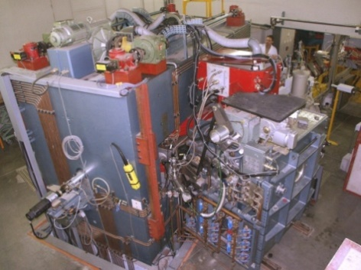
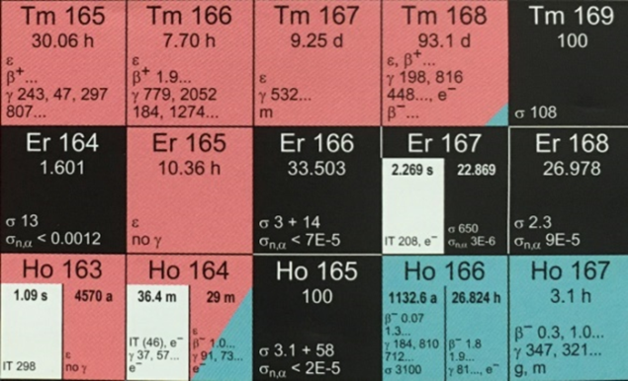
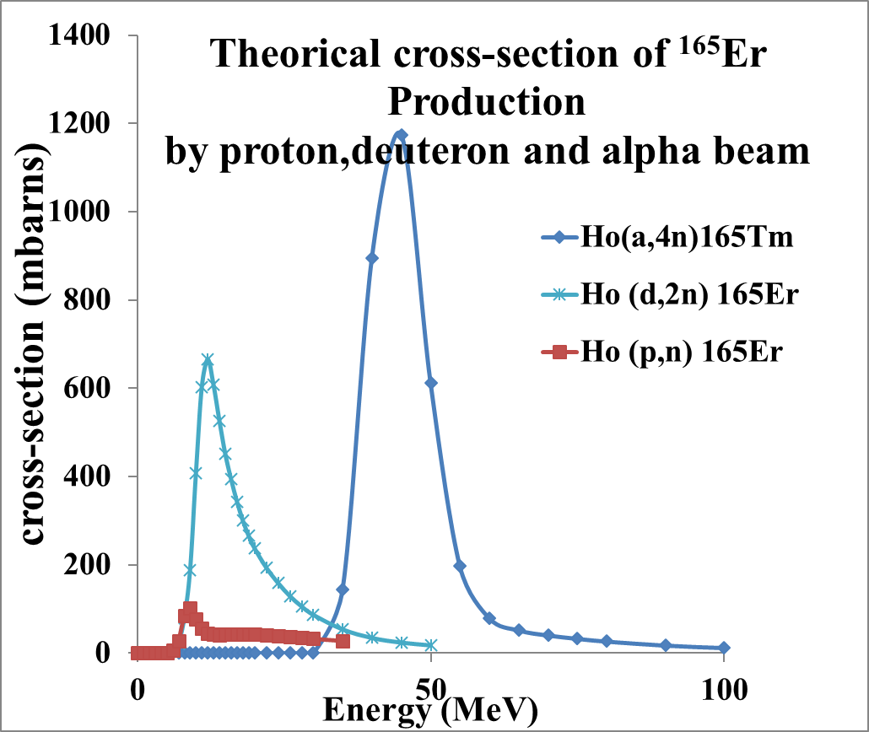
¹⁶⁵Er Production from a Ho target at Orleans’ Cyclotron
Energy (MeV) :
  Proton 10 – 35
  Alpha 10 - 45
  Deuteron 7 – 17,5
    One target, 3 nuclear reactions :
        ¹⁶⁵Ho (p, n) ¹⁶⁵Er ⁽¹⁾
        ¹⁶⁵Ho (a, 2n) ¹⁶⁵Tm (30,1 h)
        ¹⁶⁵Ho (d, 2n) ¹⁶⁵Er
1- L. Frealle, J. Vaudon , G. Audiger , E. Dutillly, M. Gervais, E. Sursin, C. Ruggeri, F. Duval, M.-L. Bouchetou, A. Bombard, I. Da Silva, “First steps at the Cyclotron of Orleans in the radiochemistry of radiometals : 52Mn and 165Er, Instruments, 2018, 2(3) 15.
Notes:
Point 1 : accelerator, in Orleans we have access to research cyclotron and possibility to produce 165Er using 3 beam :
alpha that we don’t talk here more today,
proton (used for proof of concept for in vitro application and extend to dosimetry studies using Madison biomedical cyclotron with high intensity (30 -40µA)
Deuton purpose of our work : Physical yield (MBq.µA.h) of deuton on TENDL 2017 calculations appears 7 times higher than in case of proton,

Slide 11
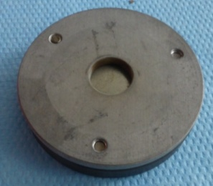
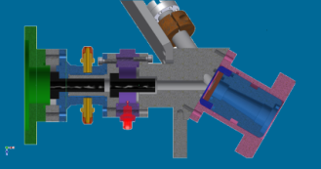
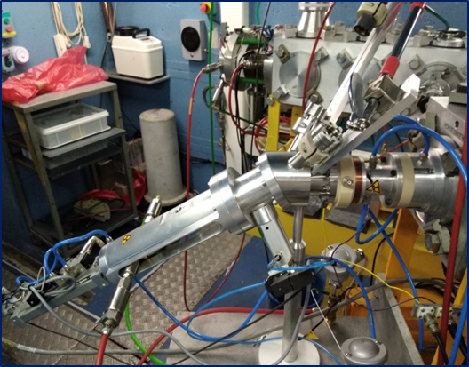
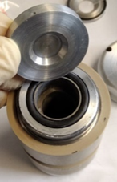
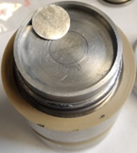
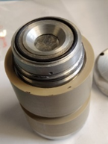
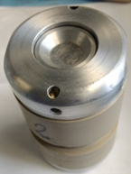
CISCoTe targetry
Irradiation with CISCoTe targetry with shuttle system :
beam
CISCoTe drawn of beam line
Notes:
About the parameter 1 on AMA expression, we will consider used CISCOTe targetry (developped to irradiate target on a shuttle at higher intensity current than 3µA,(limit of old targetry system) : the CISCoTe is a 30° sloped targetry design for irradiation ( until 20µA) a target on a shuttle

Slide 12
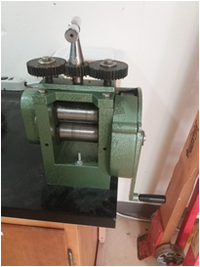
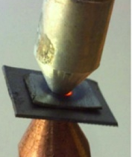
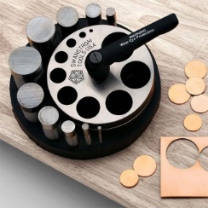
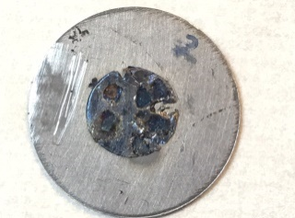
Ho Target preparation
Spot welding method² :
  increase efficiency cooling
  modulation of target Ho size (∅, thickness ➔ mass)
2 - Ellison PA, Valdovinos HF, Graves SA, Barnhart TE, Nickles RJ. Spot-welding solid targets for high current cyclotron irradiation. Appl Radiat Isot 2016;118:350–3. https://doi.org/https://doi.org/10.1016/j.apradiso.2016.10.010.
Notes:
By fact of using a 30° sloped targetry, spot beam has a ellipsoidal shape (yellow spot) with theorical dimension 10 by 11.6mm (we will back to talk it later)
In a CISCO Targetry, a shuttle was used to irradiate Ho foil but the system demonstrate some drawbacks in terms of cooling above I> 10-12µA, Reduce thickness of Al holder target wasn’t possible for a more efficient cooling target,
Nevertheless, we use an other option to refresh target : the spot welding method developped in Madison University by Paul Ellison ,
This method has another advantage in case of 165Er production , modulation of Ho size that significantly affect parameter 2 of AMA expression,

Slide 13
Energy versus thickness
Notes:
By fact of using a 30° sloped targetry, spot beam has a ellipsoidal shape (yellow spot) with theorical dimension 10 by 11.6mm (we will back to talk it later)
In a CISCO Targetry, a shuttle was used to irradiate Ho foil but the system demonstrate some drawbacks in terms of cooling above I> 10-12µA, Reduce thickness of Al holder target wasn’t possible for a more efficient cooling target,
Nevertheless, we use an other option to refresh target : the spot welding method developped in Madison University by Paul Ellison ,
This method has another advantage in case of 165Er production , modulation of Ho size that significantly affect parameter 2 of AMA expression,

Slide 14
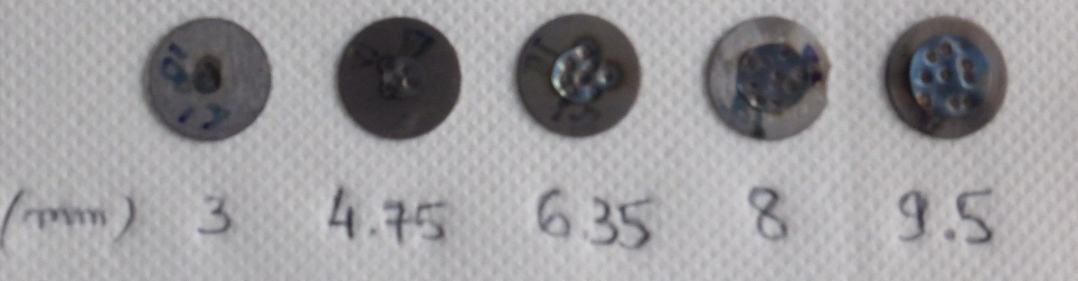
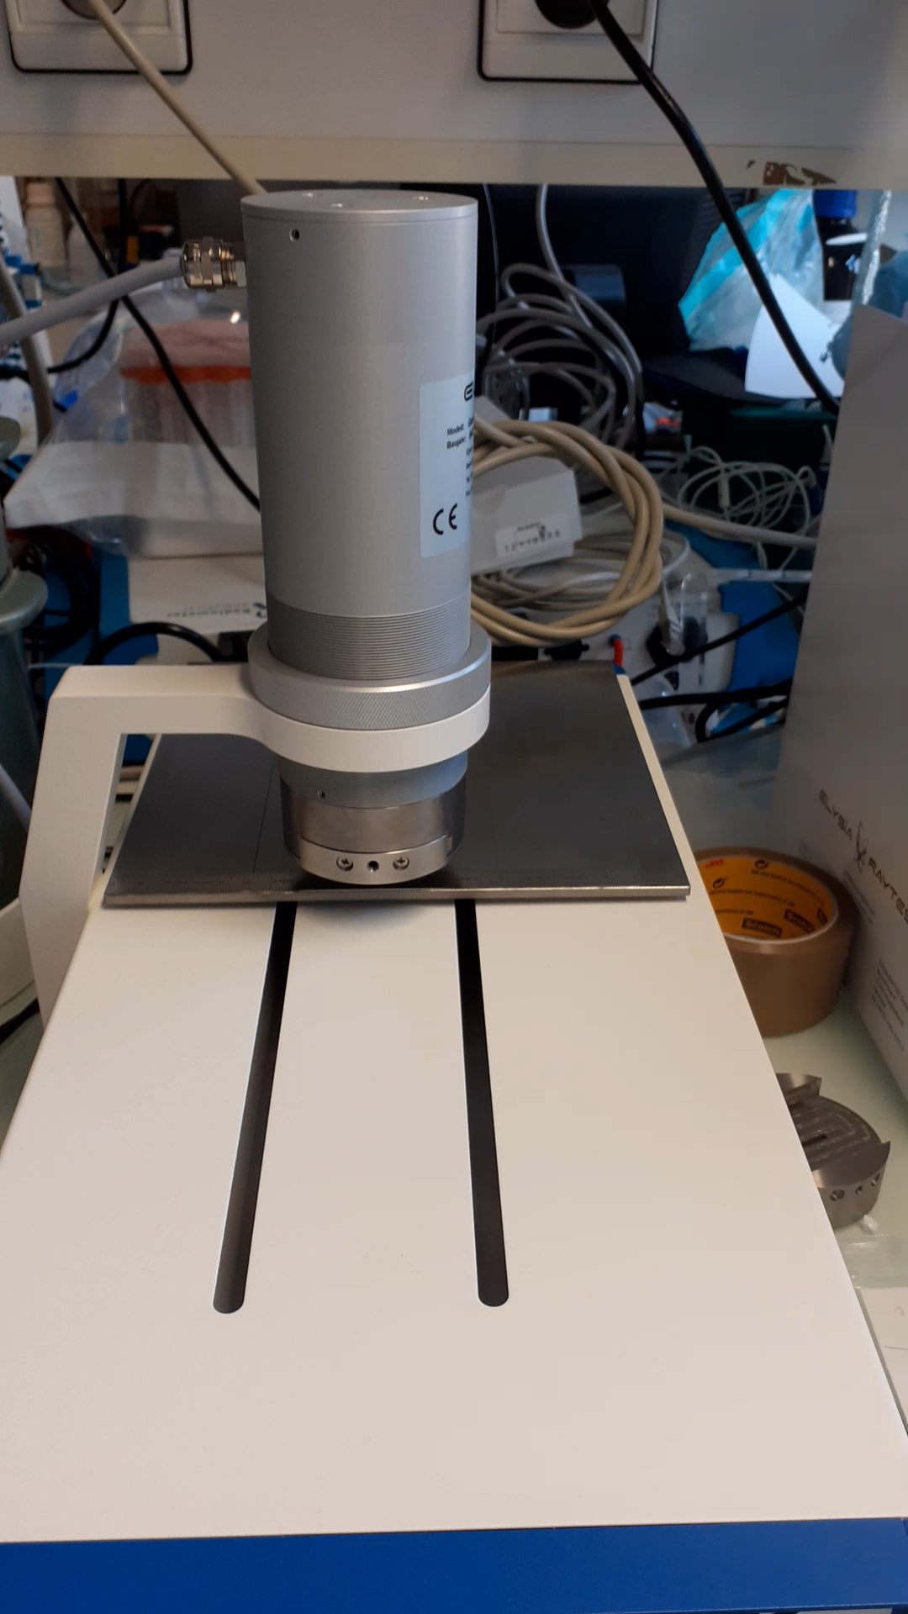
Yield and position of spot beam
Ho foil centered (thickness 127µm at 30° on Ta support (∅ 14,7mm, 500µm thick)
Irradiation at low current : 30min 2µA 17,5MeV
=> beam off center for all irradiation (confirmed by radioTLC)
  ➔ Choice : irradiation of unc. Ho foil ∅ 8 mm thick 300µm for 6-10µA
Notes:
Considering Parameter 1 (targetry : deuton beam on CISCoTe targetry) and 2 (spot welding preparation of target , we evaluate Physical yield of 17,5MeV deuton beam with irradiation of 30min at 2µA on a centered target with various diameter,, Ever it seems obvious of error value on 8mm ∅, this diameter appear a good compromise between yield and target mass,
Well, during this irradiation we check the shape and position of spot beam on target with TLC system : compare to the evaluation, the spot was drift that why for high intensityat 17,5Mev deuton of current we prepare an uncetered 8mm diameter target,

Slide 15
Results deuteron irradiation at « high current »
17,5MeV :
uncentered Ho foil ∅ 8mm thick 300µm (manual clamping)
centered Ho foil ∅ 9,5mm thick 300µm (manual clamping)
13MeV :
centered Ho foil ∅ 9,5mm thick 127µm (clamping with a wrench)
Manual clamping not sufficient to reproductible contact between Ta disc, Al support and cooling system : loss part or complete target with high heating
Notes:
Here results from deuton irradiations on 8mm uncentered target with no reproductibility if we consider all experiments but excluding melted taget (3) and intensity measurement troubles (2) we can express a physical yield of 117± 24 , to be compared to 136±48 of centered Ho foil ∅ 9,5mm thick . In all these irradiations clamping was done manually perhaps it’s explain no reproductibility of irradiation and more and less efficiency in cooling target.
In order to ensure access to 165Er activity sufficient for bimodality experiments, we irradiate target at E=13MeV and reduce intensity current to 6µA. We clamp the target with a wrench and A physical yield , very reproductible of 77± 5 has been obtained.

Slide 16
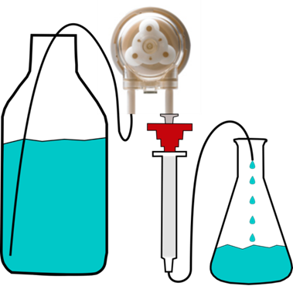
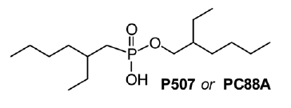
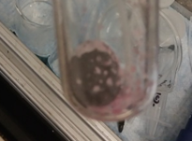
Radiochemical separation ¹⁶⁵Er from Ho target
Protocol separation :
S1 : 4g of LN 2 20-50µm resin
  Loading target (2ml of solution 0,1M HNO3)
  130ml 0,4M HNO3 : Ho eluted
  Elution: 165Er > 30ml 1M HNO3
S2 : 500mg of LN2 20-50µm resin
  Loading 165Er diluted to 0,1M HNO3
  50ml [HNO3] 0,4M ➔ > 90% Ho eluted
  9-14ml [HNO3] 1M➔ Ho + 20% 165Er
  10ml [HNO3] 1M➔ ¹⁶⁵Er
S3 : 100mg of DGA-b 50-10µm
  Loading 165Er adidified to 5M HNO3
  Rinsing with 3M HNO3 (metal trace) and 2ml of 0,5M HNO3
  ¹⁶⁵Er recovered in 2ml 0,01M HCl
Extractant derivated from orthophosphonic acid
I. Da Silva, T. R. Johnson, J. C. Mixdorf, E. Aluicio-Sarduy, T. E. Barnhart, R. J. Nickles, J. W. Engle,, P. A. Ellison, A high separation factor for ¹⁶⁵Er from Ho for Auger electron therapy, Molecules, 2021
Notes:
On these experiments (8mm ???) and 9,5mm centered 127µm, separation between ^{165-nat}Er and ^{166-nat}Ho was done in a published protocol (ref of our article) except using here in firt step as in 2nd extraction resin LN2

Slide 17
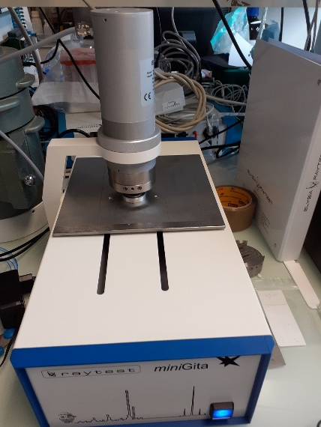
Determination AMA : radiolabeling
Irradiation :
  13MeV 9,5mm centered Ho target 127µm thick
Protocol : 10 - 30µl ¹⁶⁵Er in 0.01M HCl
50-200µl Buffer pH = 4.5-5.5
100µl chelator (DOTA, DTPA) at various [ ]
Heat 1h stirring at 85°C (DOTA) / RT (DTPA)
* Kinetic of reaction : Ln (+3) / transition metals (+2) :

Slide 18
Conclusions
Deuteron irradiation :
  Physical yield (MBq/µA/h) : 9,5mm centered thick 300µm
    Deuteron (17,5 MeV): 136 ± 48 MBq/μA/h (Orleans n=4)
    Proton (12,5 MeV): 24 ± 1 MBq/μA/h (PETrace n=5)
  AMA reproductible at 13 MeV :
    Deuteron 17,5 MeV : 4 ± 2 GBq/µmol (DOTA) and 34 ± 25 GBq/µmol (DTPA) (n=4)
    Proton 12,5 MeV : 10 ± 4 GBq/µmol max (DOTA/DTPA) (n=5)
Future works :
  Radiolabeling with L6 for in vivo studies (in progress) with cocktail method (ratio of Gd/¹⁶⁵Er known)

Slide 19





Acknowledgements
Financial support :
Ligue Cancer 2021 / 2022
AVIESCAN project (INSERM)
CEMHTI Laboratory
Dominique Baux
Célia Bonnet
Paul Ellison
And Spirit of Gang’s cyclotron …

Slide 20

Thank you for your attention

