Slide 1
Zinc Electrodeposition at Constant Current for Cyclotron Production of Gallium Radioisotopes Isaac Velázquez Carreón Miguel Ángel Ávila Rodríguez Unidad de Radiofarmacia-Ciclotrón, División de Investigación, Facultad de Medicina, Universidad Nacional Autónoma de México, Ciudad de México 04510, MEXICO
Notes:
I have to apologize because this is the first time I have spoken in front of a large group of experts on the subject.
It is part of the efforts of the International Atomic Energy Organization to search for alternatives to obtain gallium 68.
My name is Isaac Velazquez, from the Radiopharmacy-Cyclotron Unit at National Autonomous University of Mexico

Slide 2
Introduction
The growing demand for ⁶⁸Ge/⁶⁸Ga generators and their limited output has prompted the search for alternatives to obtain ⁶⁸Ga (cyclotron irradiation)
A high yield production method of gallium radioisotopes comprises the irradiation of solid targets of isotopically enriched ⁶⁸Zn on a suitable substrate.
Electrodeposition of Zn is a commonly used method for solid target preparation to produce gallium radioisotopes via proton irradiation.
Electrodeposition of Zn can be efficiently accomplished at room temperature using acidic baths of zinc chloride (ZnCl₂) solutions.
Notes:
As you know, there is currently a decrease in the production of generators
[Read]

Slide 3
Background
Electrodeposition of ⁶⁸Zn from acidic baths of ZnCl₂
Author | Solution | Zn mass [mg] | Electrodeposition time (hours) | Current density (mA/cm²) | Substrate
Engle (2012) | ZnCl₂:HCl | 109-131 | 20 | 37.5-75 | Silver or gold
Lin (2018) | ZnCl₂:HCl | 60-120 | - | 25 | Platinum
Tieu (2019) | ZnCl₂:HCl | 40-50 | 3 | 18-35 | Silver
Svedjehed (2021) | ZnO:HCl | 137-263 | 20 | 6-40 | Silver
Appearance of a solid target of ⁶⁸Zn on a silver substrate Svedjehed (2021)
Time consuming procedure
Notes:
In this first article our research group collaborated in the production of gallium 66 and 68
I'm not sure I can say "our group" because I was in high school back then.
the technique is the same for almost all authors, using acid solutions with zinc chloride or zinc oxide
>I have to remark that
>electrodeposition is a time consumig procedure
If you have any experience with the preparation of solid targets by electrodeposition, you will know that sometimes it can be very complicated and you will wait almost a full day for a target that will not be useful.
and it makes sense because you want to use all the enriched material because it is usually expensive, but in a few moments I will show you a viable alternative for solid target whose price is not high

Slide 4
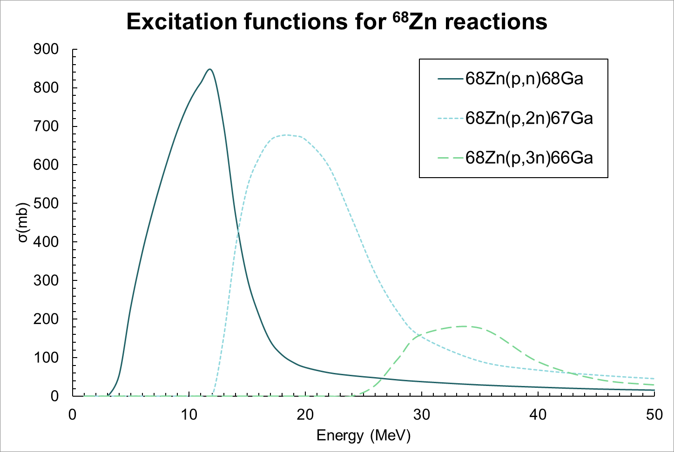
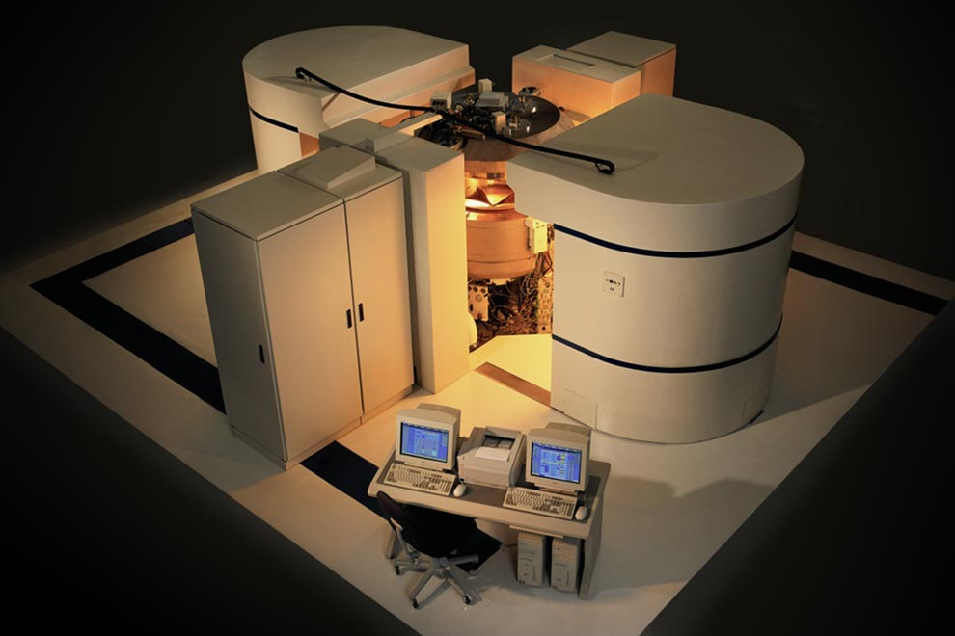
Target optimization
Reaction | Q (MeV) | E_{th} (MeV)
⁶⁸Zn(p,n) ⁶⁸Ga | -3.7 | 3.93
⁶⁸Zn(p,2n) ⁶⁷Ga | -11.98 | 12.15
Q value an threeshold energy of relevant reactions
Eclipse HP Siemens Cyclotron
Entry energy: 11 MeV
Exit energy (E_{th}): 4 MeV
Required thick target ～300μm of Zn (aproximately 100 mg)
Notes:
I have to say that the cyclotron that is in our facilities is not designed to irradiate solid targets. Years ago an adaptation was made that allows solid targets to be irradiated, but the energy of this baby cyclotron is not very high and it does not have a helium cooling system
>We start with an eleven MeV proton beam>
and to make the most of our useful beam it is required that the target absorbs the energy of the beam up to 4 meV which is the threshold energy of the reaction
the only advantage of this cyclotron is that, in this case we arent worried about the 66/67 isotopes

Slide 5
Objetives
Optimization of Gallium-68 Production via Cyclotron Irradiation (p,n) of Solid Targets
Optimize the Zn electrodeposition process
1) Evaluate galvanostatic vs potentiostatic methods
2) Feasibility of reusing the electrolytic solutions
3) Produce viable targets for proton irradiation
4) Keep the process as simple as possible
Notes:
this is a very early and very simple stage of a complete project involving…
[Read]
it is possible to add organic compounds or other materials to improve the quality of the deposit and of course theres a lot of research about zinc electrodeposition

Slide 6
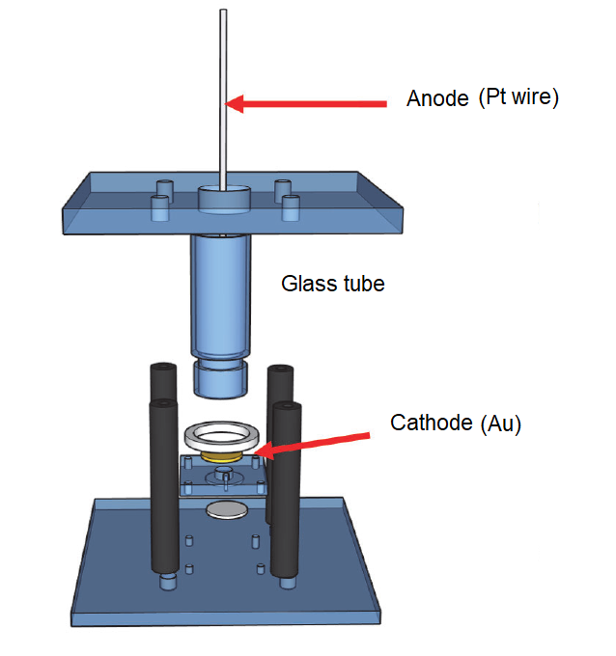
Materials
Electrolytic solution
Natural abundance ZnCl₂ as solute
0.05M HCl as solvent
Gold target substrate as cathode (φ2.5 cm).
Platinum wire as anode (φ1.0 mm)
Electrolytic cell consisted of a glass tube with a PTFE plug in with an exposed area of 0.5 cm²
Agilent Technologies A3640A Power supply
Scheme of the electrolytic cell used
Notes:
[Read]
This power supply allows the constant current/voltaje mode, so the voltaje will be adjusted automatically every time to maintain the same current

Slide 7
Methods
Electrolytic solutions comprised of varying concentrations of ^{nat}ZnCl₂ in 2 ml 0.05M HCl.
ZnCl₂ concentration and applied current were adjusted to find optimal electrodeposition conditions, also evaluating the finished appearance of deposits
The weight of the gold substrate were measured after and before the electrodeposition to quantify the current efficiency (ε)
Comparison between the galvanostatic and potentiostatic methods.
Alternatives are explored to obtain more homogeneous deposits
Notes:
Those that increase the current eficiency
but beyond obtaining more uniform deposits, we looked for alternatives to fix the problems that we ourselves were creating

Slide 8
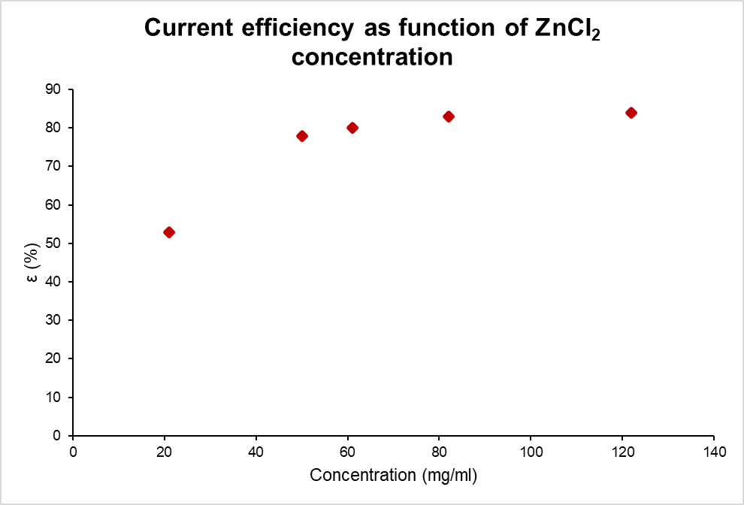
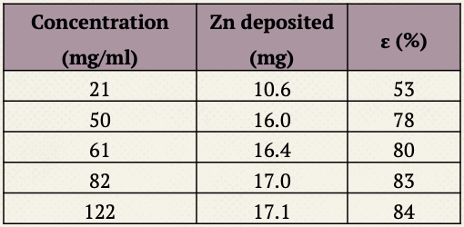
Results
Galvanostatic method (20 min, 50 mA)
Notes:
we observe that increasing the amount of zinc chloride increases the current efficiency, which makes a lot of sense, but that implies a problem
because in most cases the amount of zinc in the solution is greater than the amount of zinc required in the solid target
So you might want to make a target with about 20 mg but there’s about 40mg of zinc in the solution, so youre wasting the extra zinc in the solution just to improve the current eficiency

Slide 9
Results
Potentiostatic: Using the fixed voltage method does not produce a uniform deposit
Galvanostatic: Large amounts of Zn produces targets with irregular thickness
10X
6X
92 Mg of Zn, 30 mg/ml of ZnCl₂ , 20 h, 6 V
86 mg of Zn, 40 mg/ml of ZnCl₂ , 20 h, 8 mA
Notes:
In addition, if we use a potentiostatic method to try to deposit all the available material, very good results are not obtained., that produces:
Irregular area
Spiky pattern
on the other hand, using a constant current produces targets with irregular thicknesses when attempting to deposit large amounts of Zn. (Above 70 mg)

Slide 10
Results
Potentiostatic vs Galvanostatic method (200mg/ml of ZnCl₂ , 20 min, n=3)
10X
Mass and current efficiency (n=3)
 | Potentiostatic | Galvanostatic
Mass (mg) | 30.3±1.8 | 30.7±0.4
ε (%) | 75±3 | 84±1
Potentiostatic method (6V)
Appearance of the targets is very similar in both methods
Better current efficiency is observed by using constant current
10X
Galvanostatic method (90 mA)
Notes:
[Read bullets}
[Show images]
[Remark Higher eficiency]

Slide 11
Results
(Re)using same electrolytic solution (Galvanostatic method, 20 min, 50 mA)
Zn in solution (mg) | pH_{i} | pH_{f} | Zn on target (mg) | ε (%)
101.3 | 1.4 | 1.4 | 17.2 | 86
84.1 | 1.4 | 1.4 | 17.4 | 87
66.7 | 1.4 | 1.5 | 16.2 | 81
50.5 | 1.4 | 1.5 | 14.4 | 72
*100.2 | 1.3 | 1.4 | 17.0 | 85
Same electrolytic solution can be used multiple times to produce new targets
*ZnCl₂ added
10X
Notes:
One way to reduce the amount of wasted zinc while maintaining high current efficiency is to reuse the solution.
since the pH of the solution does not change, we thought it possible to reuse the solution to take advantage of the remaining zinc, so
once the concentration of zinc in the solution is reduced, it is only necessary to add more zinc chloride
The importat message of this slide is that (bullet)
And the targets looks almost the same
Ph doesnt change, tends to increase when the amount of zn decreases, but once you add more Zn it backs to its first value
Targets looks almost the same and has an aceptable finish
Of course, the efficiency is reduced but once more zinc chloride is added it increases again, as expected

Slide 12
Can we improve the finishing?
6X
10X
Zn electroplated (94.3 mg) during 1 hour at 60 mA with a concentration of 100 mg/ml of ZnCl₂
Notes:
So, almost donde, we can reduce the amount of wasted zinc, but we still having a problem, and its because the finish on the targets still has a spiky appearance and the thickness is not uniform along the surface

Slide 13
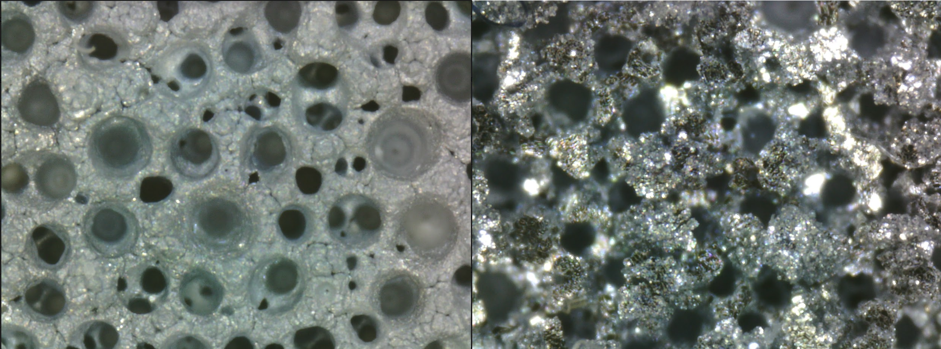
Results
Electrodeposition by layers (Galvanostatic method, 100 mg/ml of ZnCl2, 30 min, 60 mA)
New solution for each layer
Same solution adding ZnCl₂ for each layer
Layer | Mass of Zn (mg) | ε (%)
1 | 30.9 | 84
2 | 32.7 | 89
3 | 32.9 | 90
 | Total mass | Average ε
 | 96.5 | 88
Layer | Mass of Zn (mg) | ε (%)
1 | 31.9 | 87
2 | 31.9 | 87
3 | 32.0 | 87
 | Total mass | Average ε
 | 95.8 | 87
More homogeneous deposits
10X
10X
^{1st layer}
^{2nd layer}
^{3rd layer}
^{Galvanostatic (3 layers)}
^{Galvanostatic (1 layer)}
Notes:
To overcome this problem, we tried a method that i call electrodeposition by layers
We proposed electroplating the zinc by layers, in such a way that a first layer is deposited on the gold substrate, and a second layer is deposited on the first layer`, and then you can go on and keep adding layers
Explain tab 1
The whole process takes about 2 hours
but following the idea of ​​reducing wasted zinc and keeping efficiency high, it is possible to do the same as we did before in the past two slides and add more zinc chloride to the solution.
Explain tab 2
In this case we just used three layers
The electrodeposition by layers can produce more uniform deposits

Slide 14
Conclusions
Better current efficiency was observed for galvanostatic vs potentiostatic electrodepositions.
Thin targets (20 mg Zn) with acceptable finishing can be obtained in 20-30 min using a constant current that implies a faster electrodeposition.
It is recommended to always use an excess of Zn in the electrolytic solution as the same bath solution can be recovered and used in several electrodepositions without affecting the performance.
More uniform deposits can be obtained by electroplating multiple layers to produce thicker deposits.
Notes:
[Read bullets but add some of the folowing information at the end of each bullet]
[Nothing]
Thin targets is what we need
And if we use hydrochloric acid to dissolve the target once it's been irradiated, there's a good chance we can recycle the target material in the future
Thick target allows a high yield production
we use only three layers because we are trying to optimize the targets and 100mg of Zn is enough, but I think it is possible to keep adding layers to produce thicker targets

Slide 15
THANKS!
Any questions?
isaac_velazquez@ciencias.unam.mx
avilarod@uwalumni.com
Acknowledgment. This research was supported by International Atomic Energy Agency (IAEA) and CRP F22073-RC24380 and Universidad Nacional Autónoma de México (UNAM) DGAPA-PAPIIT Grant IT200221.

