Slide 1
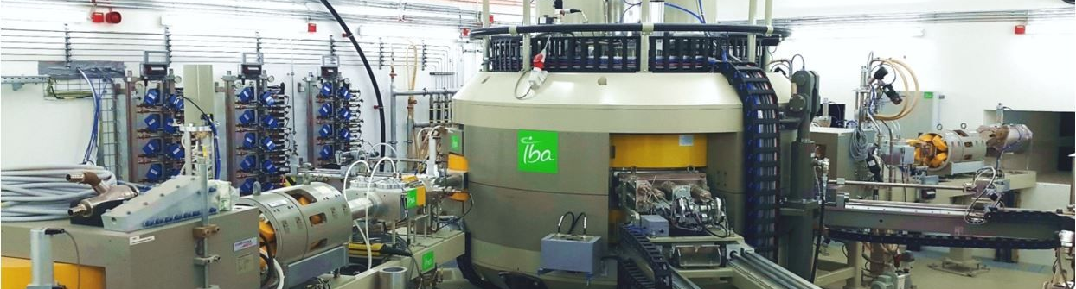
The interlocksystem of the Jülich IBA C30 XP
Presented at the 18th International Workshop on Targetry and Target Chemistry,
21. - 26. August 2022, Whistler, Canada
August 2022 I s. spellerberg, P. Frech, I. Spahn, B. Mayer, B. Neumaier
Notes:
Ladies and Gentlemen i want to show you our interlock safety system at our cyclotron in the pet-centre of the Forschungszentrum Jülich

Slide 2
introduction
What is connected and what is the INTERLOCK SYSTEM doing?
Short Overview – The Jülich PET-Centre
Why do we need such a comprehensive interlock system?
Connected buildings, labs, hot cells and sub-systems
Processed signals
Structure and design of the interlock cabinet
Notes:
First I want to give a short overview about the PET-centre
After that I want to explain, why we need such a system
Than I will show what buildings, labs, hot cells, and other sub-systems are integrated
Furthermore, the processed signals and the structure and design of the cabinet

Slide 3
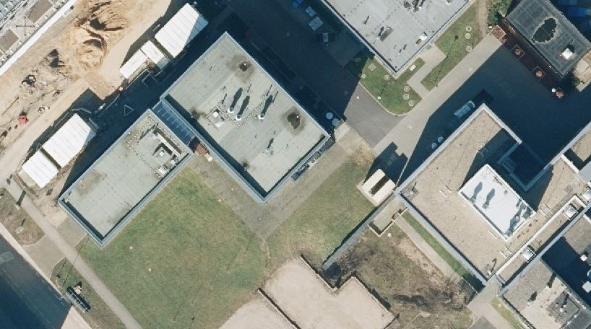
The Jülich Pet centre
Overview
Research Hot Cells
PET-Nuclide
Target Station
Research building
Alpha Lab
Cyclotron
Shuttle Receiving Lab
PET centre
GMP-Labs
Connecting Corridor
High Current
Target Station
Experimental
Beamline
9.4T PET-MR
Notes:
This is a bird eye view of the area - This is the PET-centre
This the Research building - Here is the cyclotron under the lawn with a connecting underground corridor to the research building - The Standard-PET-nuclide-target station is located under the street - This is the position of the target vault, where the high current target station with connected solid target shuttle system and the experimental beamline are installed - The shuttle tube ends here in the research building in a hot cell with receiving station - Here are the GMP-Labs located, for example the production cleanroom lab, where we installed the target capillaries for O-15, C-11 and F-18 from the Standard-PET-nuclide targets to the production hot cells
Here in the research building are the development hot cells housed - In the research building we are establishing now an Alpha-Lab next to the lab, where the shuttle is received - We also have laid an O-15 capillary direct to the 9.4T-PET-MR-Room which is located in another connected building of the medical campus

Slide 4
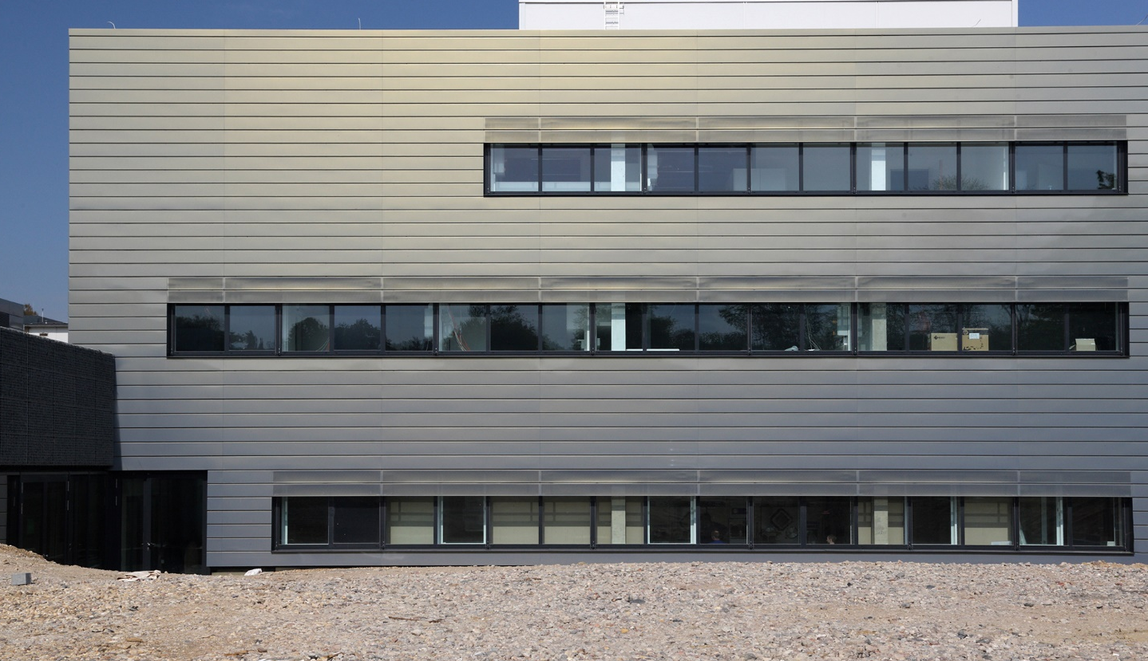
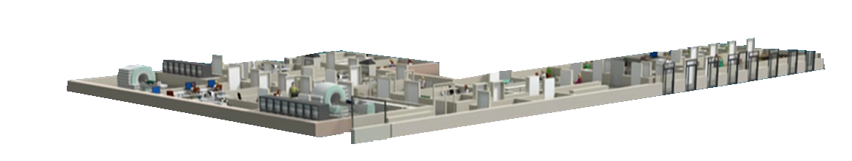

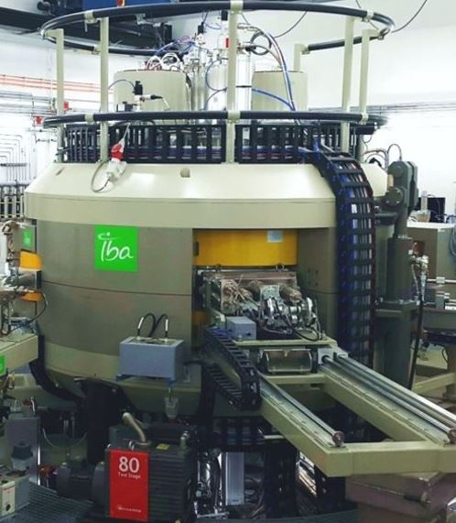
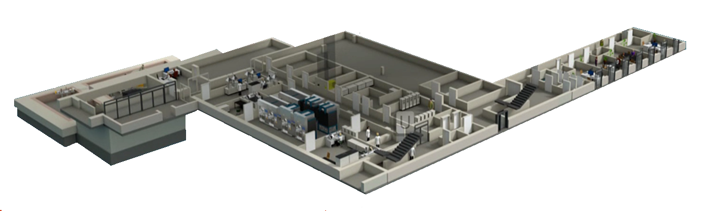
The Jülich Pet centre
Building
CLINICAL LEVEL
PRECLINICAL LEVEL
CYCLOTRON
RADIOCHEMISTRY
Notes:
The Jülich PET-centre is subdivided in 4 parts of one building
at the lowest level the cyclotron is located where the isotope production and the basic research take place
At the basement our institute is busy with the radiopharmaceutical production
At the ground floor is the preclinical area for cell and animal experiments
At the upper level is the clinical level, where examinations of patients and test persons take place

Slide 5
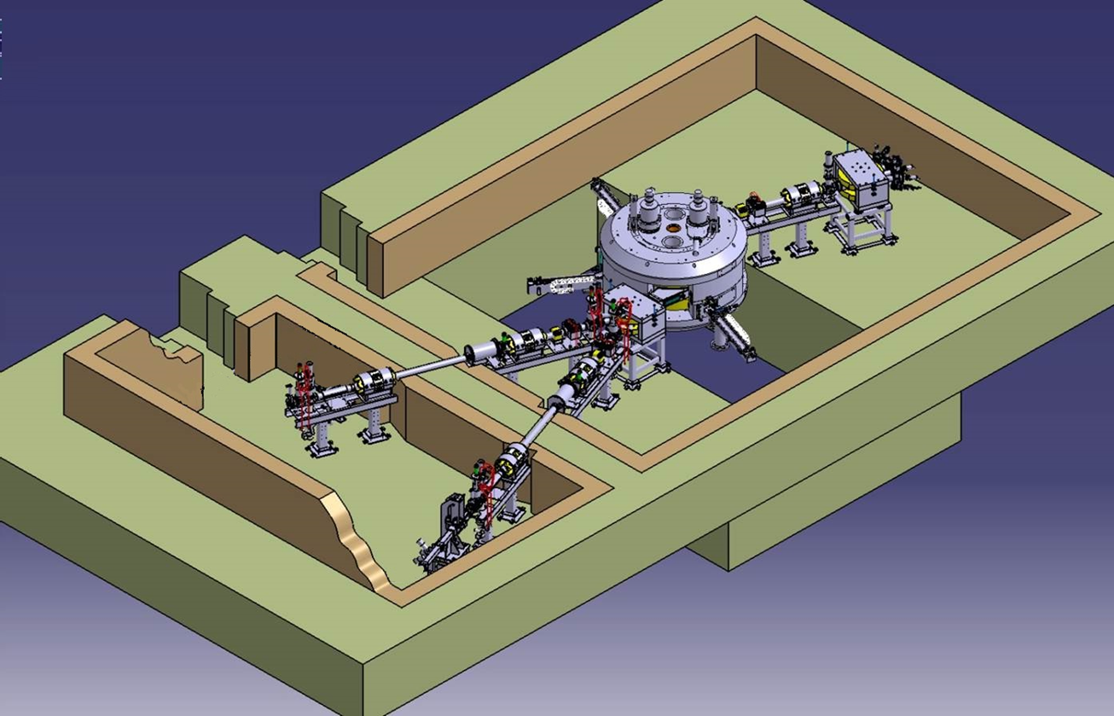
Interlock system
Why do we need such a complex system
Cyclotron facility is build for
Radiochemical research and activation studies
Radionuclide production for radiopharmaceutical application
Reliable operation during large amount of beam hours
Protection of environment and population
Safety of all staff
Obligations due to law and official regulations
- Save and emission free cyclotron operation and radionuclide production
Prevention of accidental exposure
Prevention of damages to technical equipment.
Save transfer of radioactivity to hot cells and labs
No exposure to “by-standers”, no emission or contamination
The sum of requirements spread over different buildings and floors make use of a conventional check-list inadequate.
Notes:
The cyclotron facility is build to do radiochemical research and to produce radionuclides for radiopharmaceuticals
We have to guaranty the reliable operation for a large amount of beam hours, the protection of the environment and the population, and also the safety of the employees
There are obligations due to law and official regulations that technical solutions are to be preferred to personal responsibility, that means
Safe and emission free cyclotron operation and radionuclide production
Prevent of accidental exposure and minimum activity in the vaults
Prevention of damages to the technical equipment
Save transfer of the radioactive products to the hot cells and labs
No exposure to “by-standers”, no emission or contamination
Before a short check-list handled by the personnel was sufficient, but here we connect 3 buildings and labs on 4 levels. So a check-list is not enough, we need the big technical solution with fail-safe connections.

Slide 6
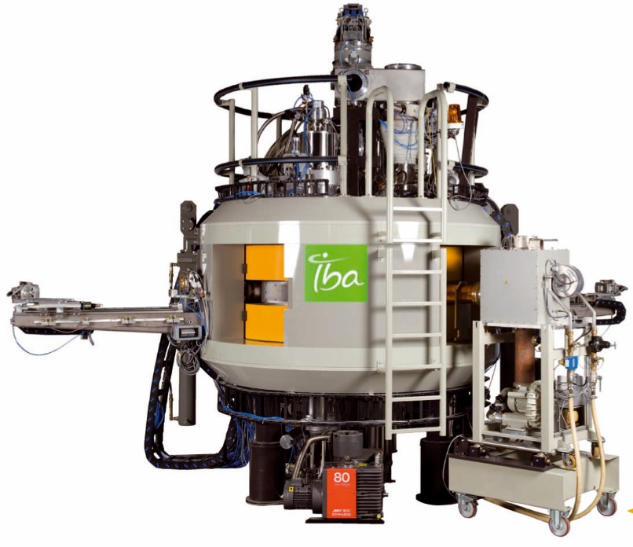
Systems controlled by the Interlock System
General information from the buildings
Cyclotron
Ventilation
Exhaust
Detector
GMP-Room
Ventilation
Exhaust
Detector
Fire Alarm System
Ventilation Cyclotron
Ventilation GMP-Area
Notes:
In this regard, let me start with the fundamental connections from the building to the IBA cyclotron.
To start the machine of course the ventilation has to run in the right level
the exhaust measuring system does not detect any contamination in the outgoing air
No fire alarm is running
To send activity from the PET-Nuclide target station to the GMP-area
The ventilation in the room must be in the correct control range
No radioactivity is detected in the exhaust detection system of the GMP-area ventilation

Slide 7
Hot cells
in labs in
the GMP-clean room
9.4T PET/MR
in medical Research building
Hot cells
in labs in
Research building
Cyclotron
Ventilation
Exhaust
Detector
GMP-Room
Ventilation
Exhaust
Detector
IBA30XP
Cyclotron vault
Target vault
Fire Alarm System
Ventilation Cyclotron
Ventilation GMP-Area
Notes:
This sketch is a little bit easier to overview the connected parts.
The cyclotron, the vaults, the research labs, the hot cells in the GMP-area, the PET/MR and the building signals.

Slide 8
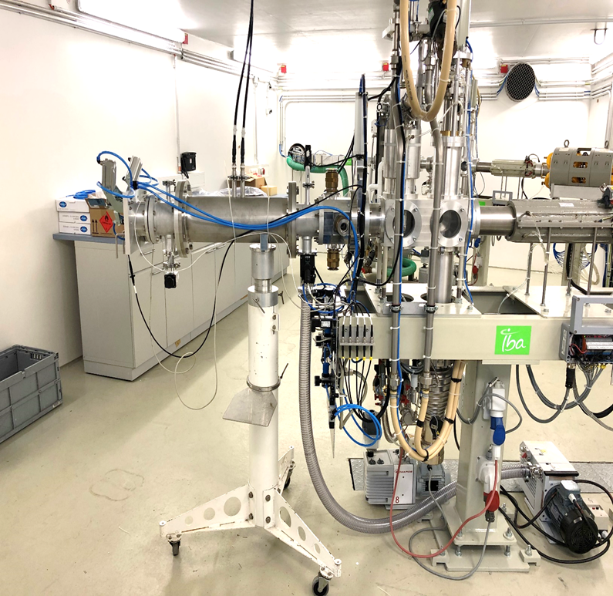
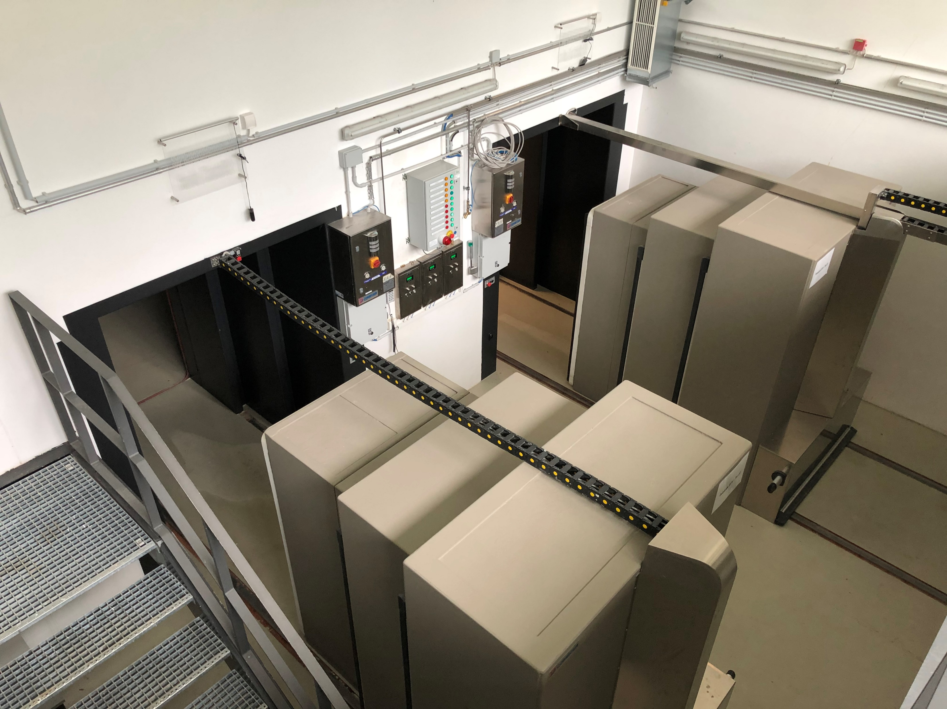
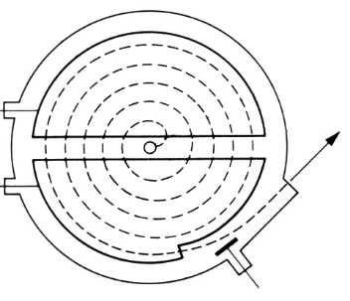
Systems controlled by the Interlock System
Information on beamline, targets and doors
“PET”
Target-station
Door
IBA
Vault
Shuttle-
System
Solid-target
Beamline
Door Target-
room
Cyclotron
Experi-mental
Beamline
Notes:
The signals between the commercial target systems, the pneumatic solid target shuttle system and the cyclotron is handled internal in the IBA software, but our own build target system does not give a signal to the internal system of the cyclotron electronic.
So the experimenter who connect the target to the beamline has to check that the cooling water is running and the tightness of the cooling water connection, that the vacuum level is okay and the connection of the beam current measuring cable is given
He has to press than a ready button outside the vault and has to close the vault door
The contacts of the vault doors are handled by the interlock system, as well as the dose rate detectors.
During the irradiation the detector is shut off, after the irradiation the interlock system switch it on, and if the dose rate level and the air exchange rate is within the limits, the door can be open.

Slide 9
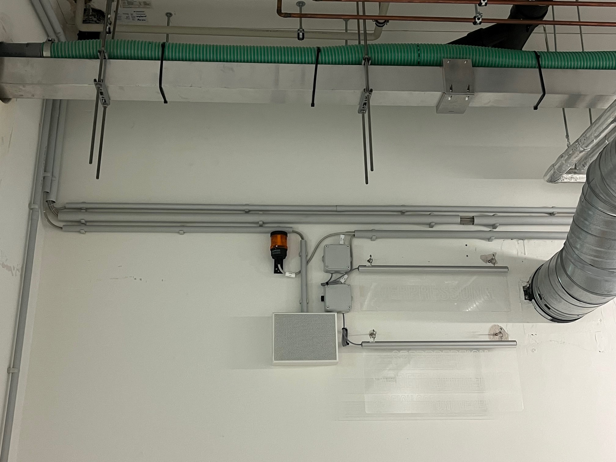
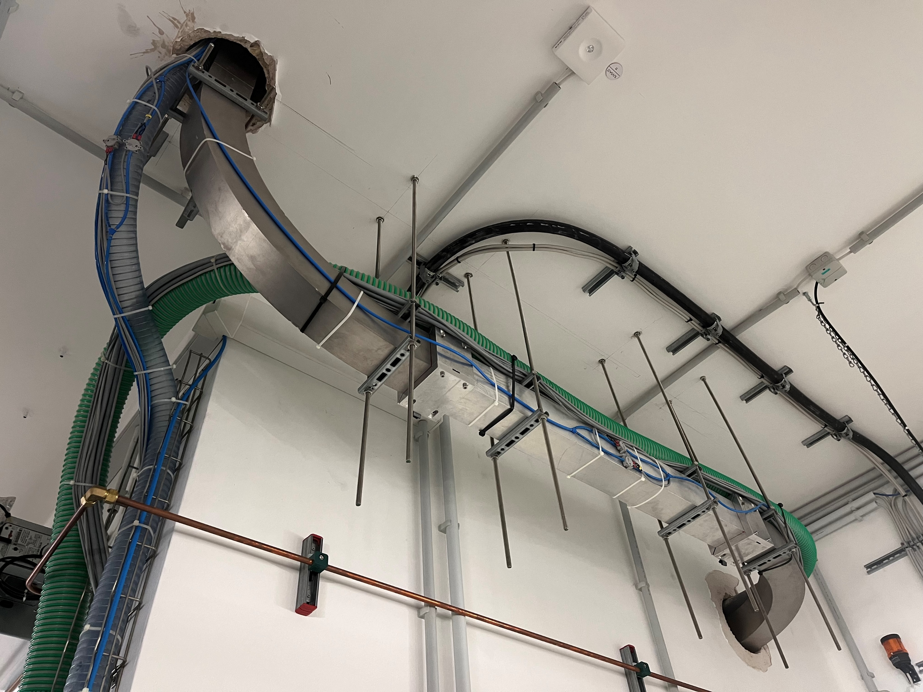
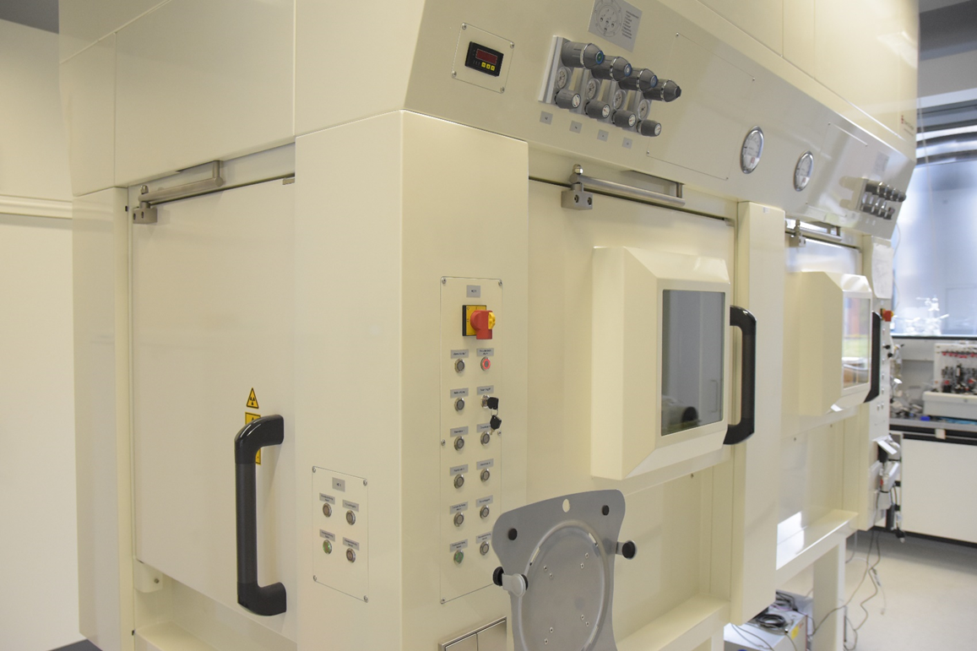
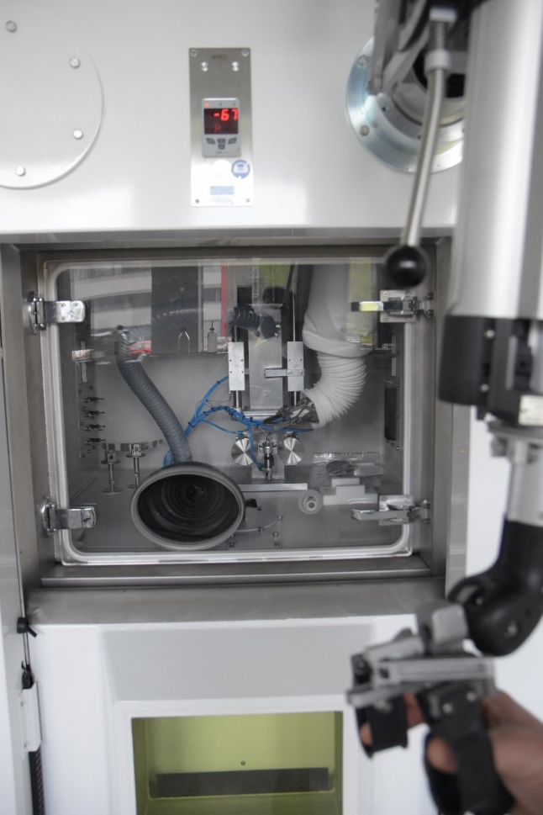
Systems controlled by the Interlock System
Information on the hot cells in the research labs
Receiving cell
of the shuttle transfer system
Hotcell A
(¹⁸F & ¹¹C)
Hotcell B
(¹⁸F & ¹¹C)
Notes:
The hot cells in the research building has also a ready button system.
So the operator at the hot cell has to control that the hot cell doors are closed and that the pressure inside the hot cell is right.
He starts the air compression system that compresses the air of the hot cell during the hole synthesis. We have in a room in the basement a system of a compressor with 2 lines of 5 gas bottles with 50 litres each and 250 bar filling pressure.
After that he press a button next to the hot cell and the interlock give a ready signal to the visualisation monitor.
The cyclotron operator send after that the activity through the capillary to the hot cell.
For the solid target shuttle transfer to the receiving there it is a bit different.
Before sending the shuttle there will be an acoustic warning and an optical warning sign shining. The warning starts 1 min before sending the shuttle, because all people has to leave the area nearby the shuttle tube. The tube is mounted unshielded under the ceiling of the corridor and one lab in the basement of the research building. After receiving the hot cell, the operator in the lab press an other button to reset the warning. The area is released again.
All this is only possible, if there is no fire alarm in the research building and the ventilation is inside the working limits.

Slide 10
Systems controlled by the Interlock System
Information from the GMP- and patient area
9.4T PET/MR
MIP #8
MIP #7
MIP #6
MIP #5
Dis-
pensing No. 1
QC
MIP #4
MIP #3
MIP #2
Dispensing
cell No.2
Notes:
To send F-18, C-11 or O-15 to the GMP-area the system is in connected to the hot cells, the quality lab and the PET/MR area.
To send activity the system gets a ready signal from the selected hot cell if the pressure is right, the air exchange rate is right, the hot cell doors are closed and the air compressing system is running.
To send to the quality lab and the PET/MR area the system is like the one at the research area. The person on site presses a button if the lab or the PET/MR is ready to receive.
All this is only possible, if there is no fire alarm in the building and the ventilation is inside the working limits and the exhaust measuring system is running and doesn´t register any activity.

Slide 11
Receiving Cell
Hotcell A
Hotcell B
MIP #8
MIP #7
MIP #6
MIP #5
Dispenser No. 1
Description:
Blue: Building 1
Green: Building 2
Brown: Building 3
Red: building automation
QC
9.4T PET/MR
MIP #4
MIP #3
MIP #2
Dispenser No.2
“PET”
Target-station
Cyclotron
Ventilation
Exhaust
Detector
GMP-Room
Ventilation
Exhaust
Detector
Door
IBA
Vault
Shuttle-
System
Solid-target
Beamline
IBA30XP
Door Target-
room
Fire Alarm System
Ventilation Cyclotron
Ventilation GMP-Area
Experi-mental
Beamline
Notes:
This is a sketch of all the connections together and how the connections between the systems are.

Slide 12
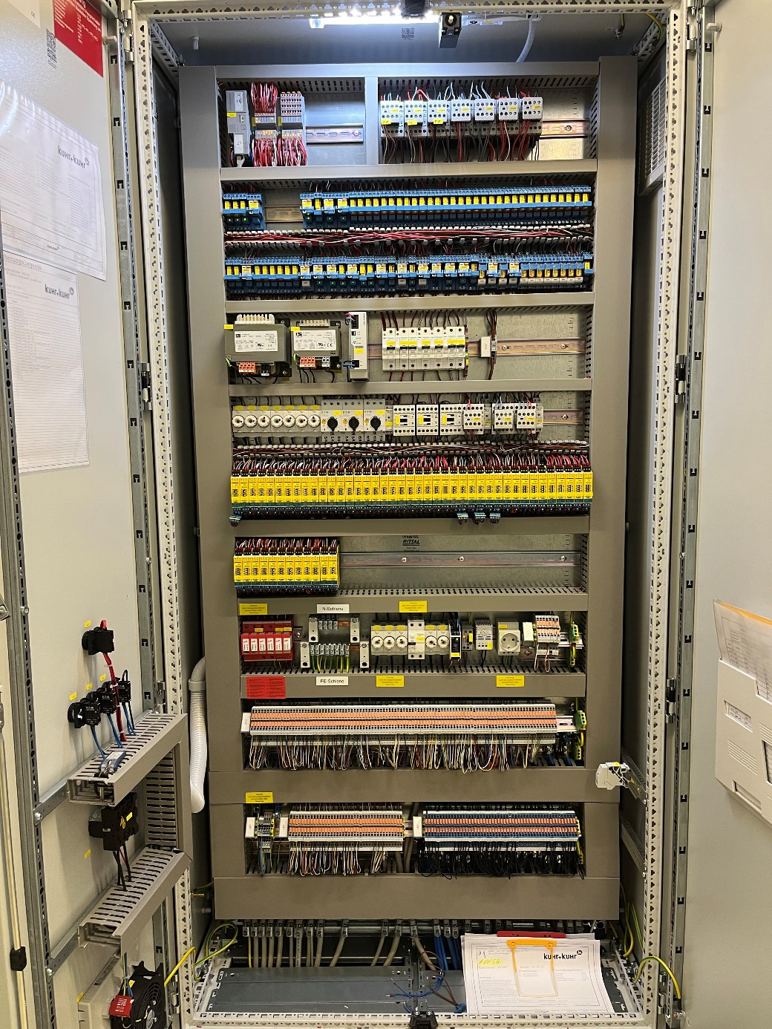
Interlockbox
Structure and design
Signals to be processed
PET-Centre-Building, e.g. ventilation, dose rate in vault
Research-Lab-Building, e.g. no fire alarm detected
GMP-Hot cells, e.g. doors closed, synthesiser is ready
Research Hot cells, e.g. ready to receive ¹⁸F, ¹¹C
Shuttle-Receiving-Hot cell, e.g. door closed
Cyclotron, e.g. beam on target, shuttle ready to send
Interlockbox to IBA, e.g. vault closed, ventilation rate set
Interlockbox to the building, e.g. warning lights on, acoustic warning on for 1 min
QC-lab; e.g. GC ready to receive ¹⁵O
Experimental beamline; e.g. target mounted, water cooling, etc.
Notes:
This photograph shows the open interlock cabinet
The signals to be processed are
From the PET-centre building (for example, is the ventilation running, is the dose rate in the vault inside the limits)
From the research building (are there fire alarms, are the hot cell doors closed)
From the GMP-lab (for example, is the pressure in the receiving hot cell okay, are the doors of the selected hot cell closed, is the ventilation on)
From the research double hot cell (ready to receive C-11 or F-18)
From the receiving hot cell (are the doors closed)
From IBA (beam on target, shuttle ready to send)
Interlock to IBA (vault is closed, ventilation rate is set)
Interlock to the building (warning lights and acoustic warning is on 1 min before the shuttle is send)
From QC-Lab (is the GC ready to receive O-15)
From the imaging facility (ready to receive O-15)
From experimental beamline (target is mounted, vacuum level is sufficient, water cooling is running)

Slide 13
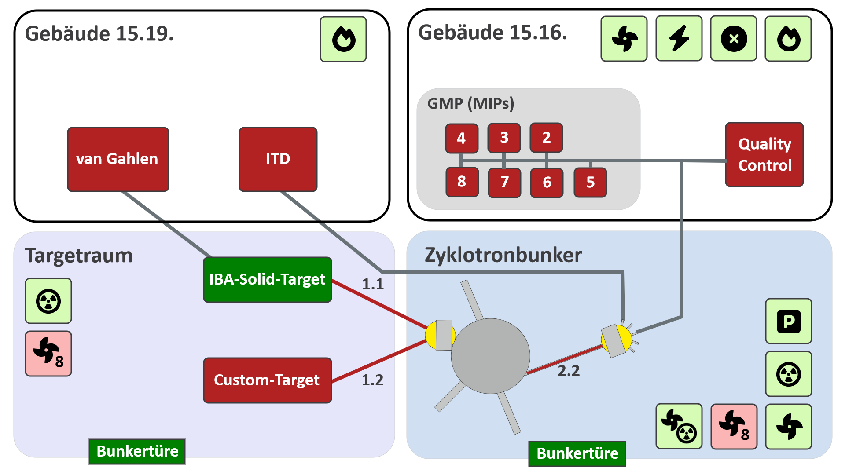
Interlocksystem
Visualisation
Operator get live information about the status of beamlines, targets, building systems, hot cells and dose rates, bunker doors, etc.
Fast reaction time in case of an error
Operator can be outside of the controlled area
No direct contact to the lab necessary
Notes:
The programming is done by our own institute IT-group with the software of Phoenic Contact, the manufacturer of the built-in Interlock-PLC
The Operator get the information visualises on a screen
Fast reaction times
The operator can be outside the active area (second control room)
It is no direct contact to the lab necessary
Here on the right is a screenshot of the visualisation for the cyclotron operators
We have four parts, the building 15.19 is the research building, building 15.16 is the pet-centre
On the left bottom side is the target vault and on the right bottom side the cyclotron vault
This sign represents the fire alarm
This the ventilation
This is the symbol for an electricity failure
This shows if the emergency shut down button pressed
In the vault the ventilation symbol signalize if the air changing rate is 8 time an hour or once an hour if an irradiation is running
This stands for the dose rate monitor, important to open the vault door
This signal here shows, that the crane is the cyclotron vault is in parking position, and if it is allowed to open the cyclotron

Slide 14
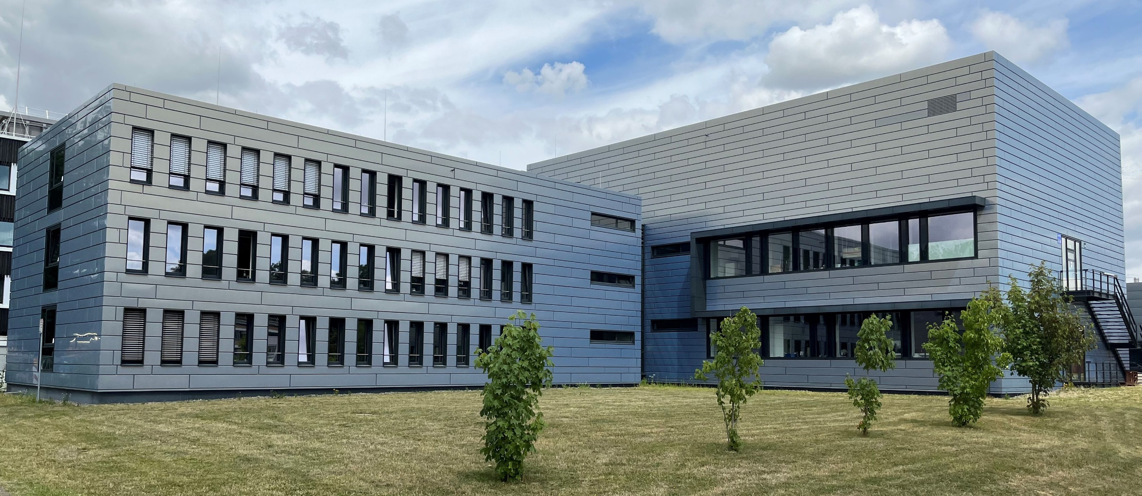
Thank you for your attention!!
Notes:
Ingo Spahn and I want to thank Peter Frech for his help in planning together with Ingo and me the system and transfer it into a form, that the companies can realize our ideas
We would like to thank Björn Mayer for programming the visualisation that we can see all the states of the system and show it on the screen for the cyclotron team
We want to thank the staff off IBA for the very good cooperation in planning and testing the system.
Last but not least I want to thank Bernd Neumaier for the possibility that we could implement our ideas completely
Thank you very much for your attention

