Slide 1
Update from TRIUMF Management on ARIEL Timeline
Reiner Kruecken
Deputy Director
July 14, 2017

Slide 2
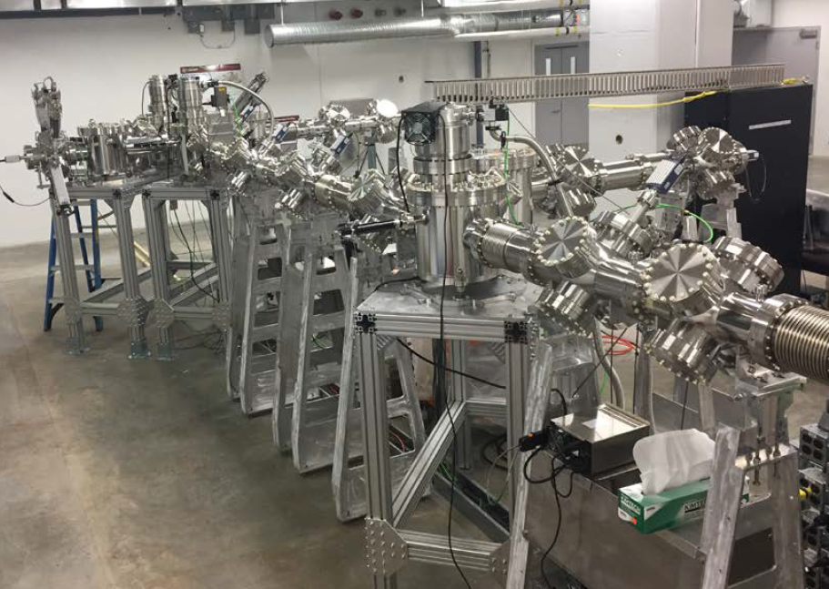
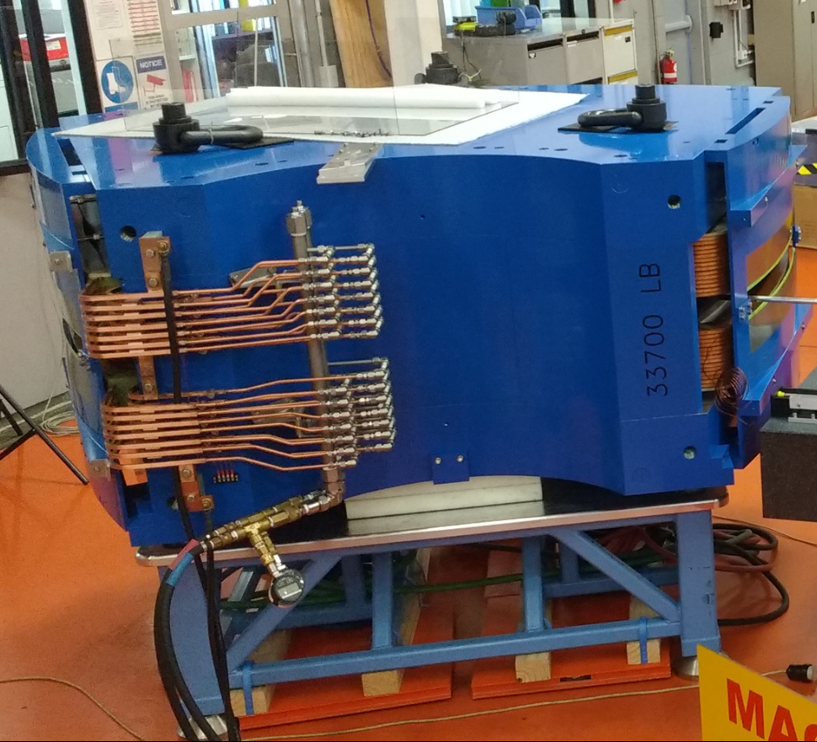
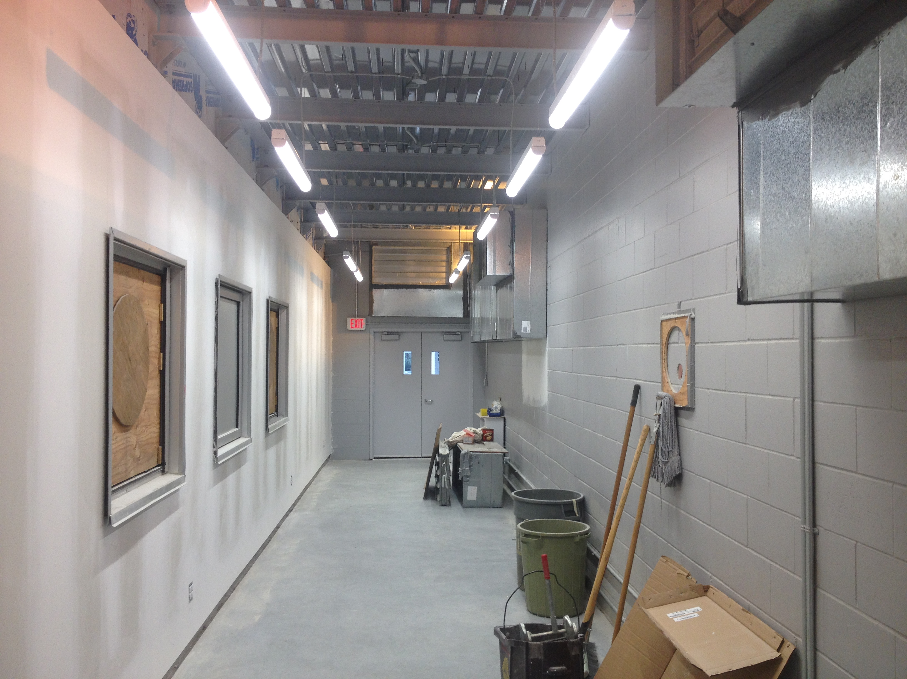
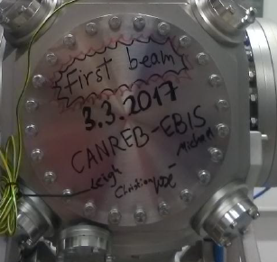

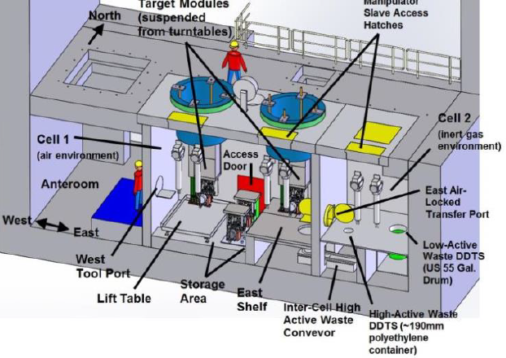
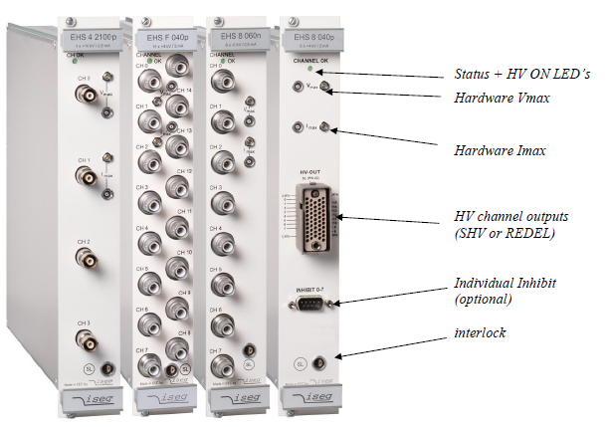
ARIEL-II & CANREB accomplishments in the past 6 months
RIB Transport prototype evaluation complete
ISAC-ARIEL enclosure completed
Contract for Hot Cell signed
EBIS first beam at MPI-K (1A @ 3KeV)
HRS magnets accepted at vendor
Nier spectrometer magnet shipped
Vendor for RIB line optics power supplies selected

Slide 3
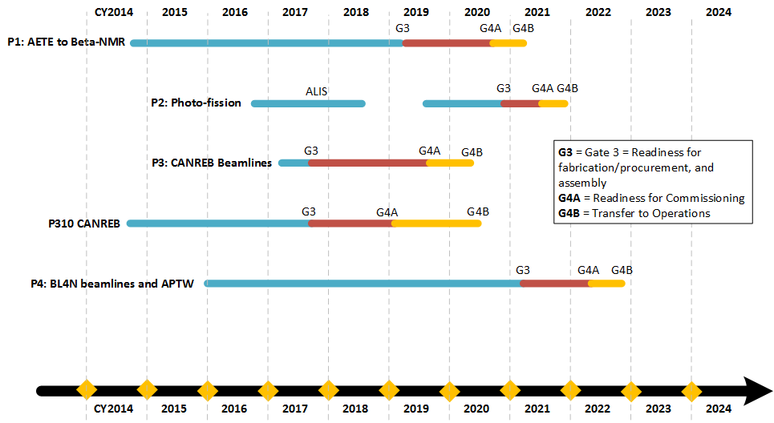
ARIEL-II deterministic schedule
ISAC-ARIEL-ISAC
Aligning Gate 3 for P3 and CANREB
= science enabling milestones

Slide 4
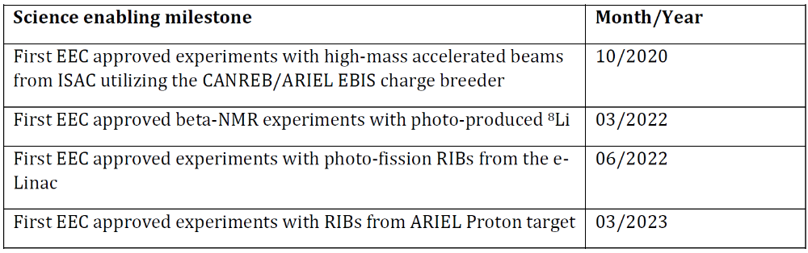
ARIEL: science enabling milestones
As presented during ARIEL Town Hall, January 10, 2017
Higher intensity, cleaner high-mass accelerated beams
PHASE 3
Fall 2019
PHASE 1
More RIB hours, cleaner n-rich RIBs
PHASE 2
PHASE 4
3 parallel RIBs
Dates based on Monte Carlo analysis of schedule
Current best estimates but with high confidence
Only feasible if we focus manpower on key deliverables, such as
RIB beamline installation, CANREB installation, Electron Target Station Design

Slide 5
Pre-Shutdown ISAC Operation Strategy
Strategy
  For Schedule 133 (Oct. 11➔ x-mas):
    utilise simple targets in terms of production, Ta and SiC, simple sources (SIS with limited TRILIS operation and FEBIAD) and
    long runs/ few elements
    no development
Motivation
  Try to free up more personnel to support ISAC refurbishment and ARIEL-II while continuing with Operations
Targeted benefits
  Free up LIS and beam delivery personnel, as well as personnel from Targets and Ion Sources

Slide 6
Strategy for Shutdown 2018
    General shutdown activities will be limited to the absolutely necessary.
      big project: installation of a new main magnet power supply for the cyclotron.
    Up to 8 week ISAC shutdown extension in Spring 2018 in order to achieve:
        the installation of CANREB equipment and CANREB related ARIEL-II RIB transport beamlines in 2018 ➔ CANREB Science in 2019
        major advances in the ISAC refurbishment program, and
        major advances in the ARIEL target design.
    Assess if less than 8-weeks of ISAC shutdown extension is feasible in Fall 2017 with the completion of the detailed shutdown planning (SAS):
      ➔ Communication to users with the call for beam requests.

Slide 7
Analysis and Longer Term
    Implementation of High Level Applications ➔ increase RIB efficiency tuning
      more effective use of the ISAC RIB production hours,
      reduced impact of the extended ISAC shutdown.
    Measure impact of ISAC operation in 2017 & extended ISAC shutdown in 2018 on manpower availability for ARIEL and ISAC refurbishment
      ➔ Results will be presented to the TUG AGM in Summer 2018.
    Any potential impact of the ARIEL project on operations in future years will be discussed in advance with the users.
      It remains a priority for TRIUMF to limit the impact of the ARIEL project execution on beam delivery.
      Planning for 2019 and beyond will be informed by the measured impacts of the 2017/18 actions as well as the efficiency improvements for beam delivery.

Slide 8



Thank you!
Merci!
Follow us at TRIUMFLab

Slide 9
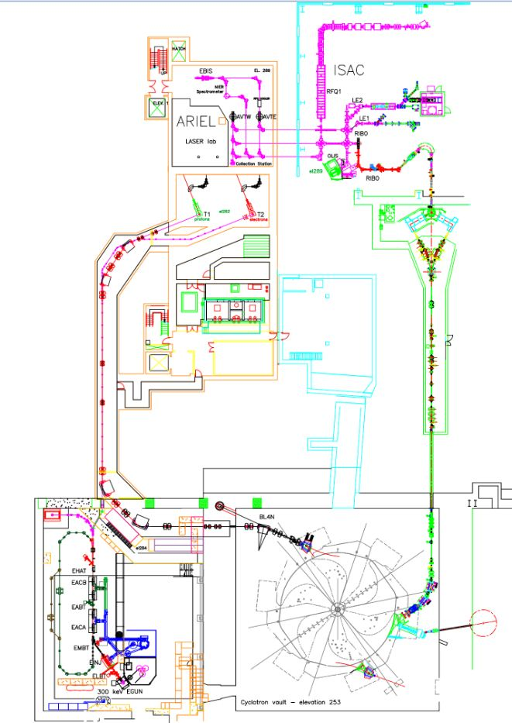
ARIEL is divided geographically
#1 RIB delivery
#2 ARIEL target stations & infrastructure
#3 Driver beam lines
#1
P355 – Laboratories ($1.3M)
P424 – Target Hall Infrastructure ($10.6M)
#2
P310 – CANREB ($3.4M)
#3
P353 – Target Stations ($9M)
P354 – Beamlines ($7M)
P363 – e-linac completion ($0.5M)
P179 – BL4N ($4.5M)
P358 – CFS ($3.3M)
Least risk: complete asap
AETE is new tech: higher risk
Depends on target stations

Slide 10
How to deliver ARIEL-II on schedule
  Identify one major goal for each year and focus effort on it
    2018: Focus on CANREB & RIB Transport installations & advancing ARIEL target design
    2019: Focus on Target Hall installation
    2020: Focus on BL4N installation
  Take advantage of spatial separation of project parts and form dedicated ARIEL-II assembly & installation teams, starting 2H2017, to prevent multi-tasking
    1 team for Target Hall
    1 team for RIB and driver beams
  Make more manpower available for the project by
    Hire more contract labour … only possible within available budget, will be fully utilized
    delaying other projects [big ones: ALPHA-g, UCN, EMMA (completed), M9 reconnect]
    Involvement of university resources
    Reduced beam delivery
    … need to consider graded approach

